Slide 1

Quest for Stones
Unit 1: Knowing Me, Knowing You
Lesson 2
Lesson 3 (Extension)

Slide 2
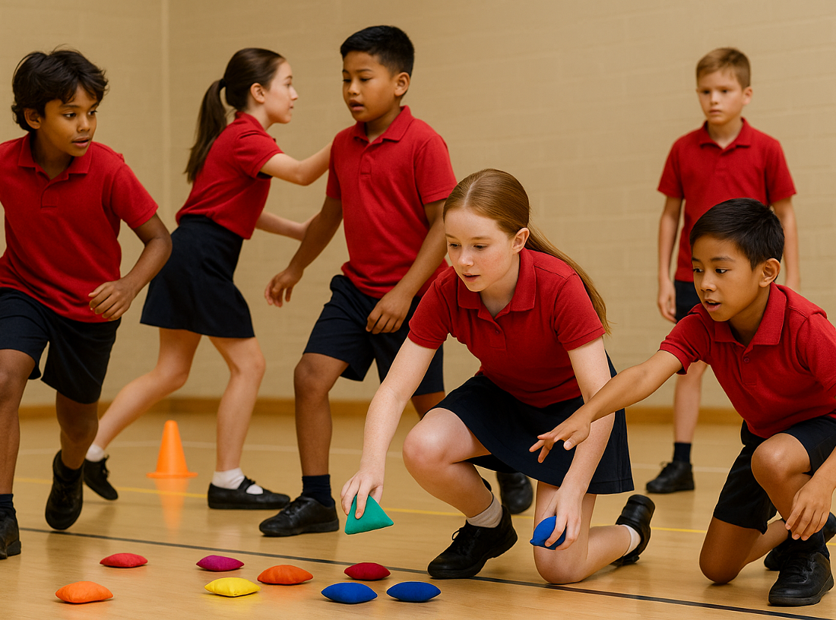
Lesson 2

Slide 3
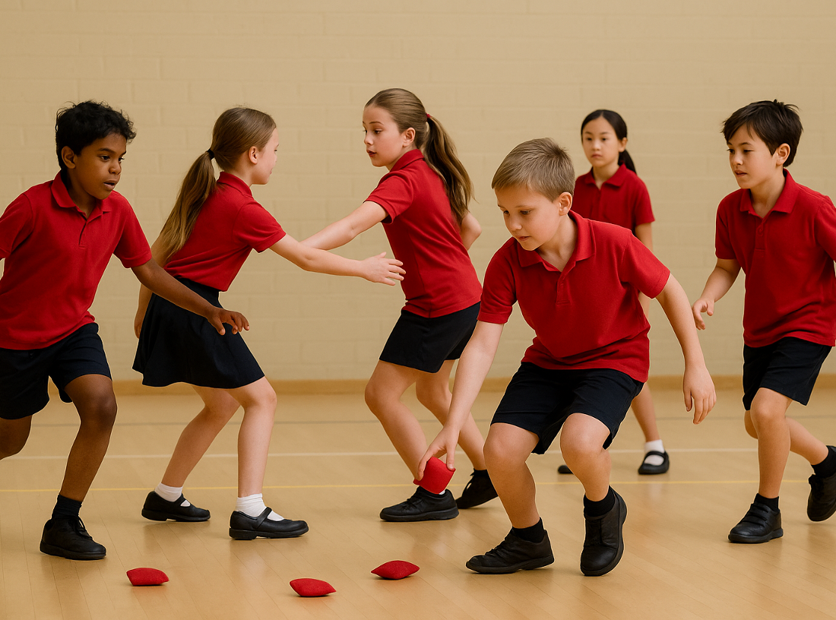
You will explore how our values and goals influence our behaviour.

Slide 4











Slide 6
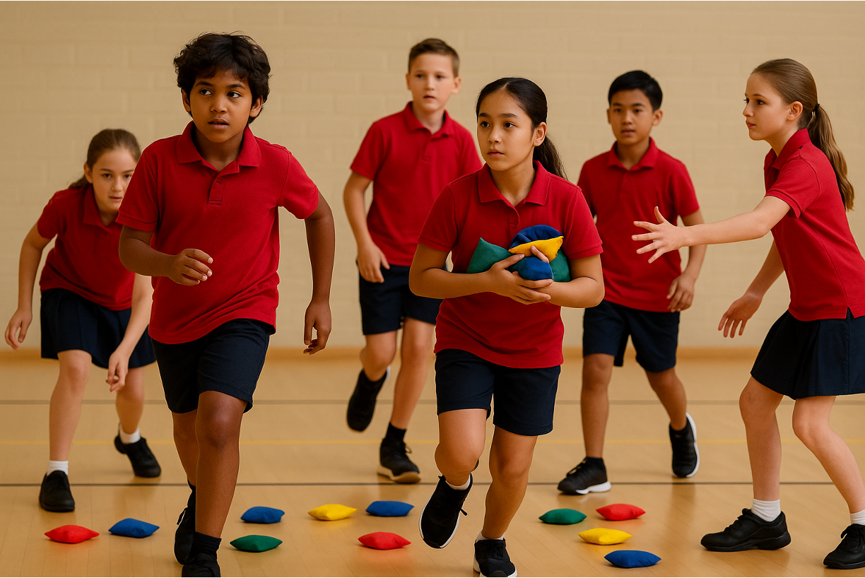
Lesson 3 (Extension)

Slide 7
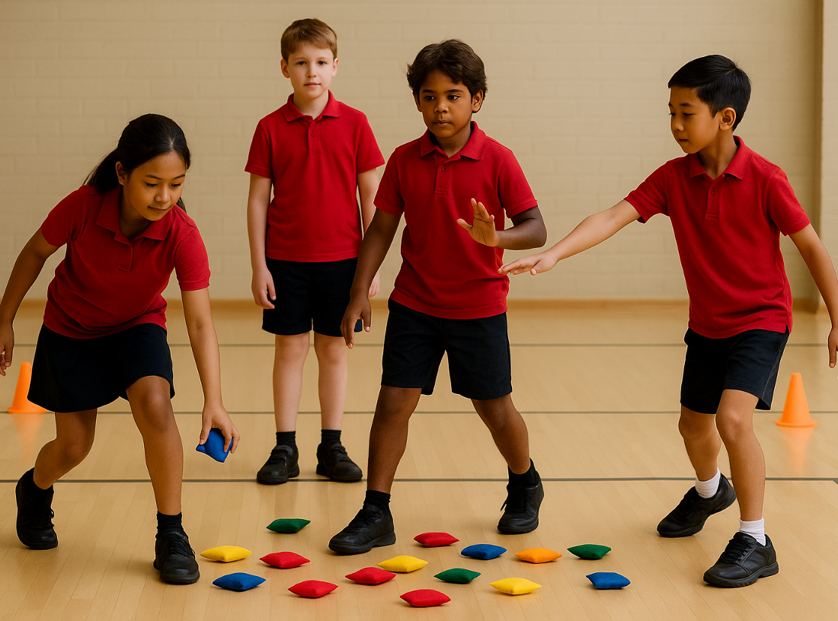
You will work together to create new game rules that reflect an understanding of how each role feels and functions.

Slide 8


