Slide 1

What Makes Me Special?
What Makes You Special?
Unit 1: Knowing Me,
Knowing You
Lesson 2

Slide 2
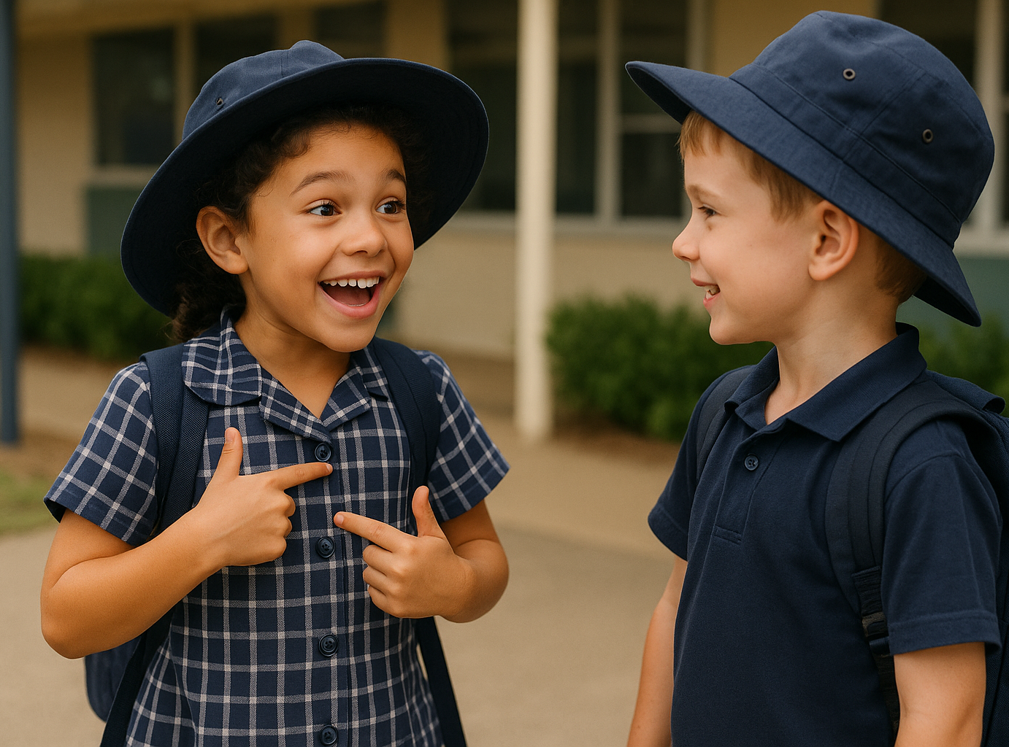
We can use ’I feel’ sentences to share how we are feeling.

Slide 3
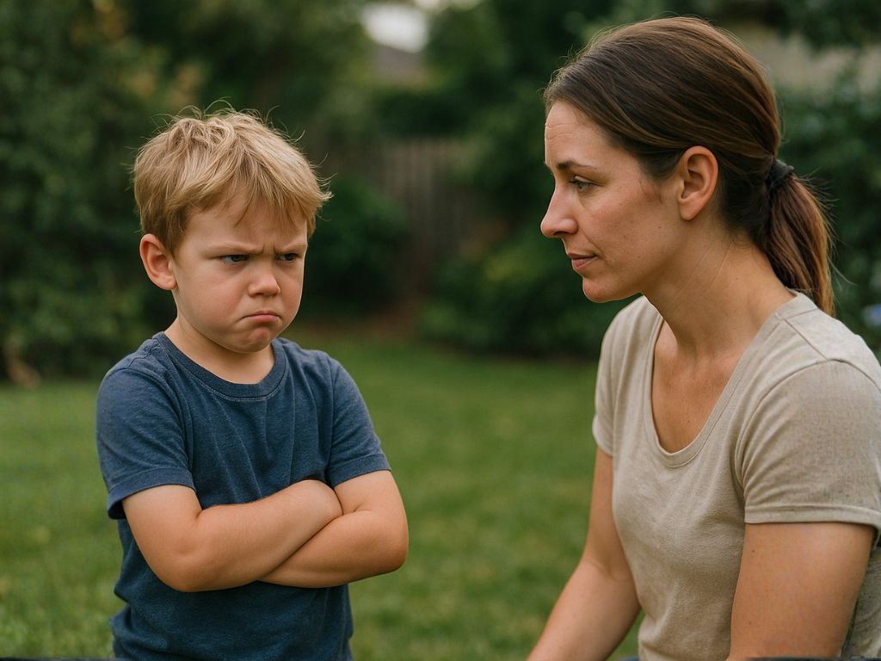
We show how we are feeling with our faces and bodies.

Slide 4
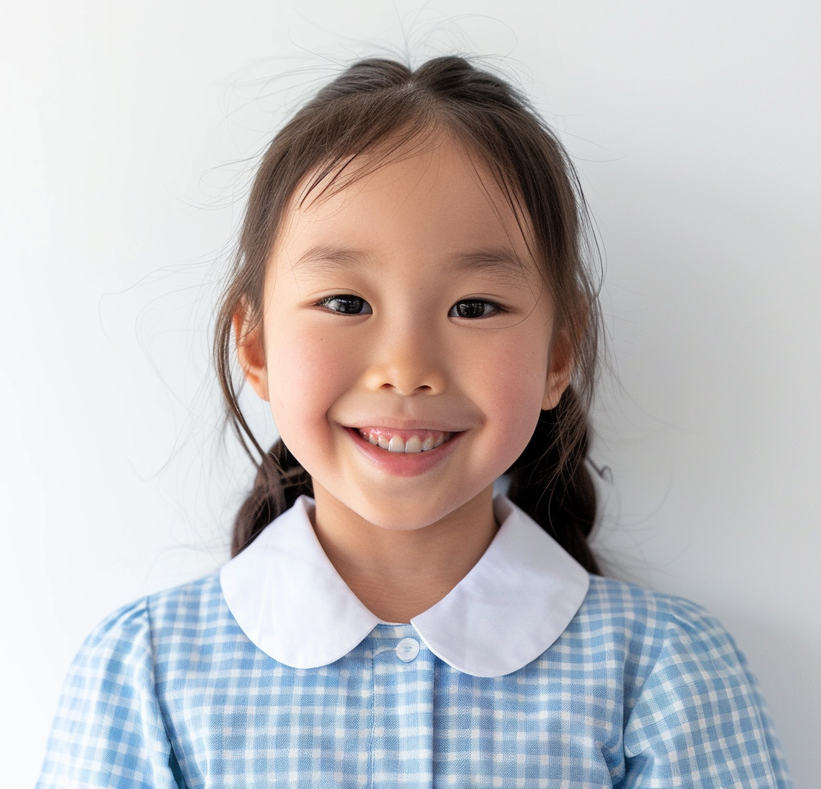
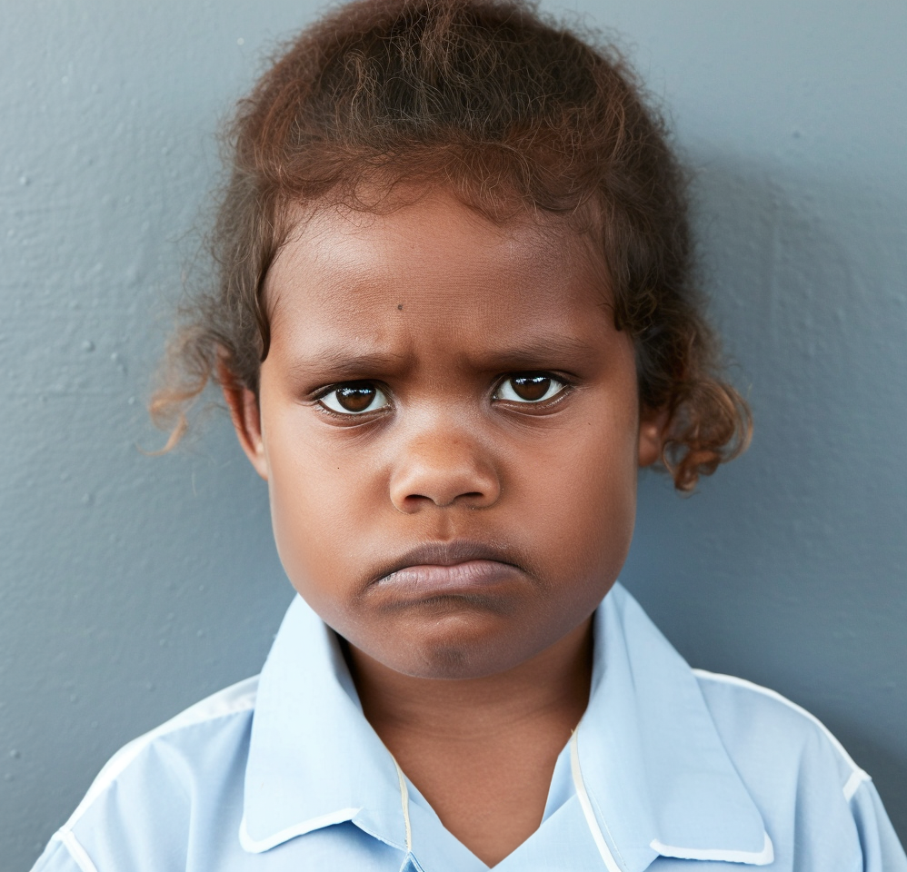
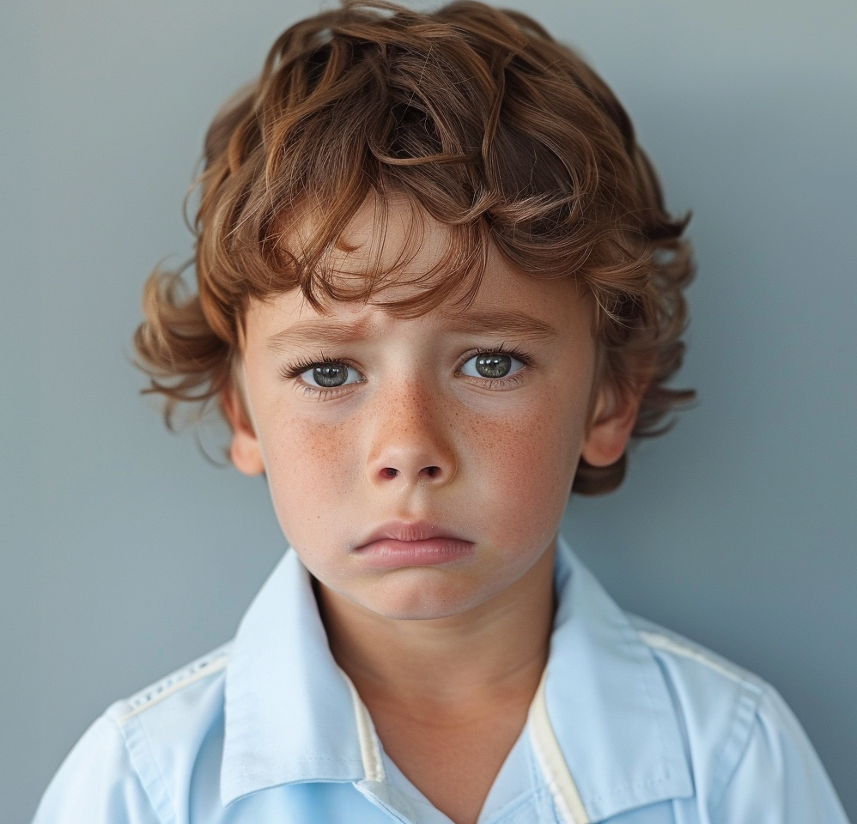
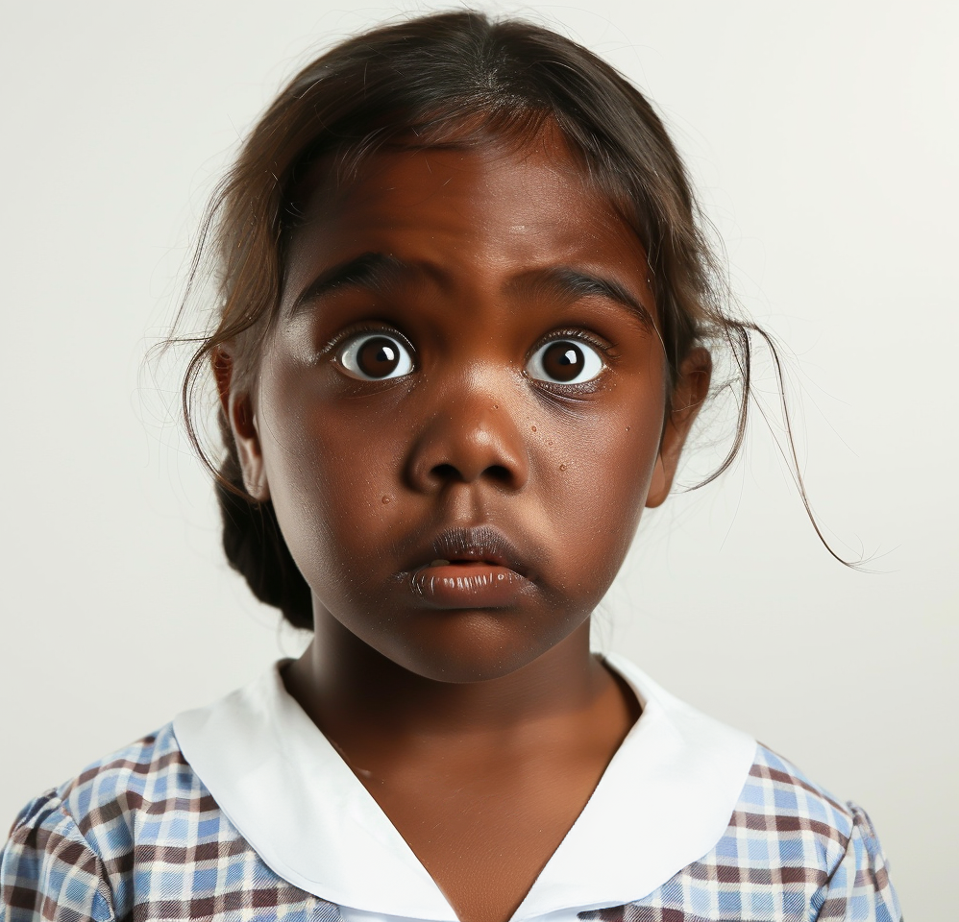
I feel _____.
I feel sad.
I feel _____.
I feel _____.
I feel scared.
I feel mad.
I feel happy.
I feel _____.
I feel
_____.
I feel _____.
I feel
_____.
I feel
_____.

Slide 5
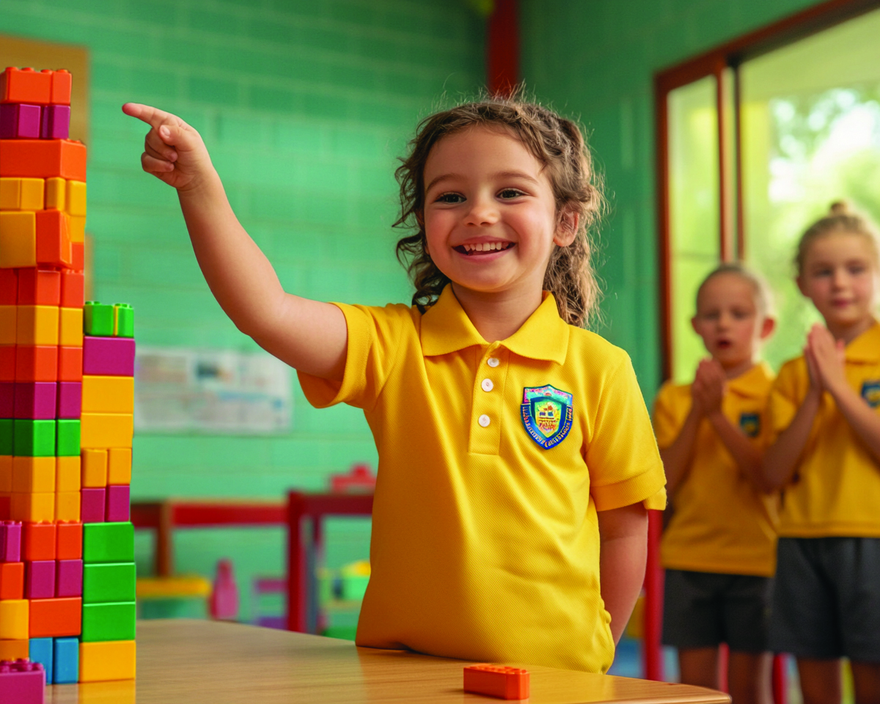
In this lesson, you will share your likes and talents.

Slide 6


You will be successful when you can:
understand it’s okay to like different things
say at least two likes and two talents you have.

Slide 7
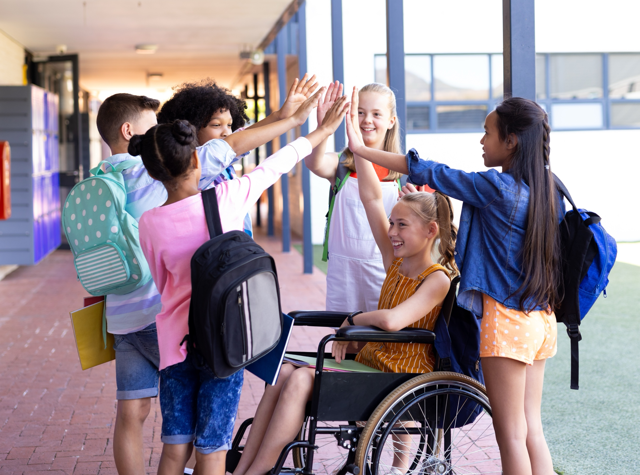
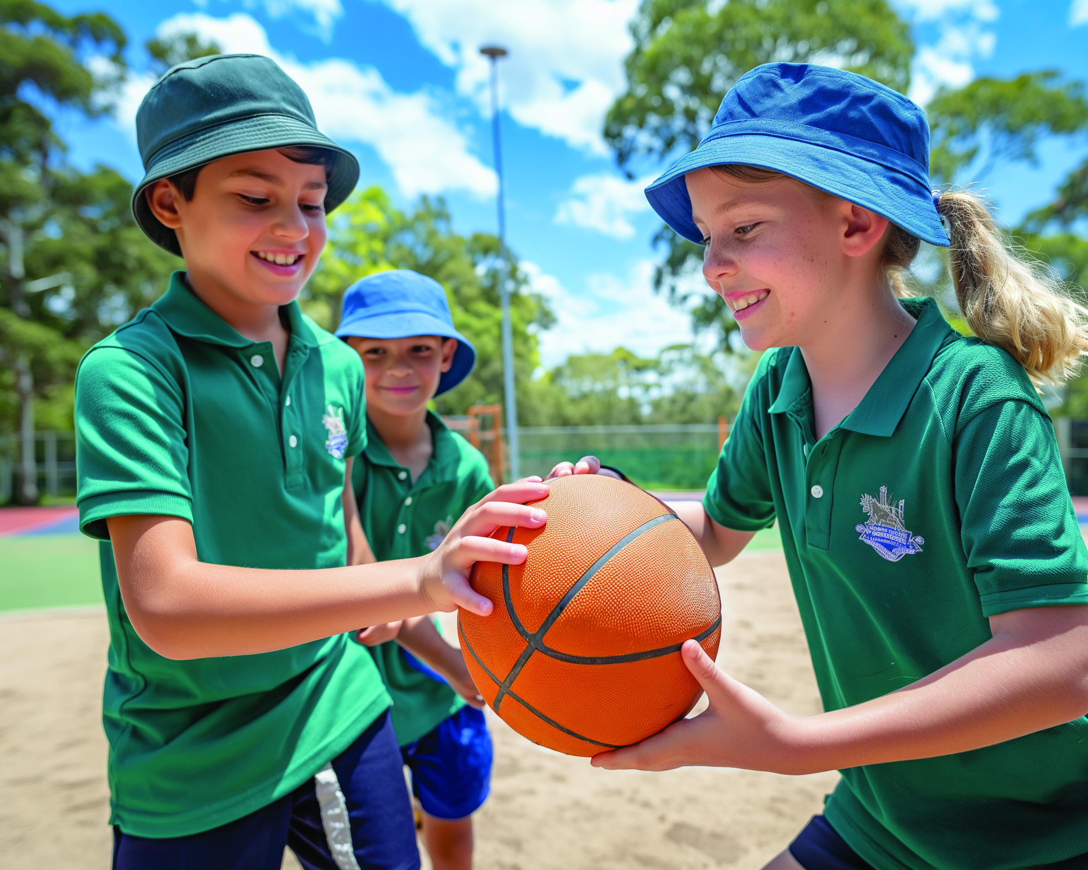
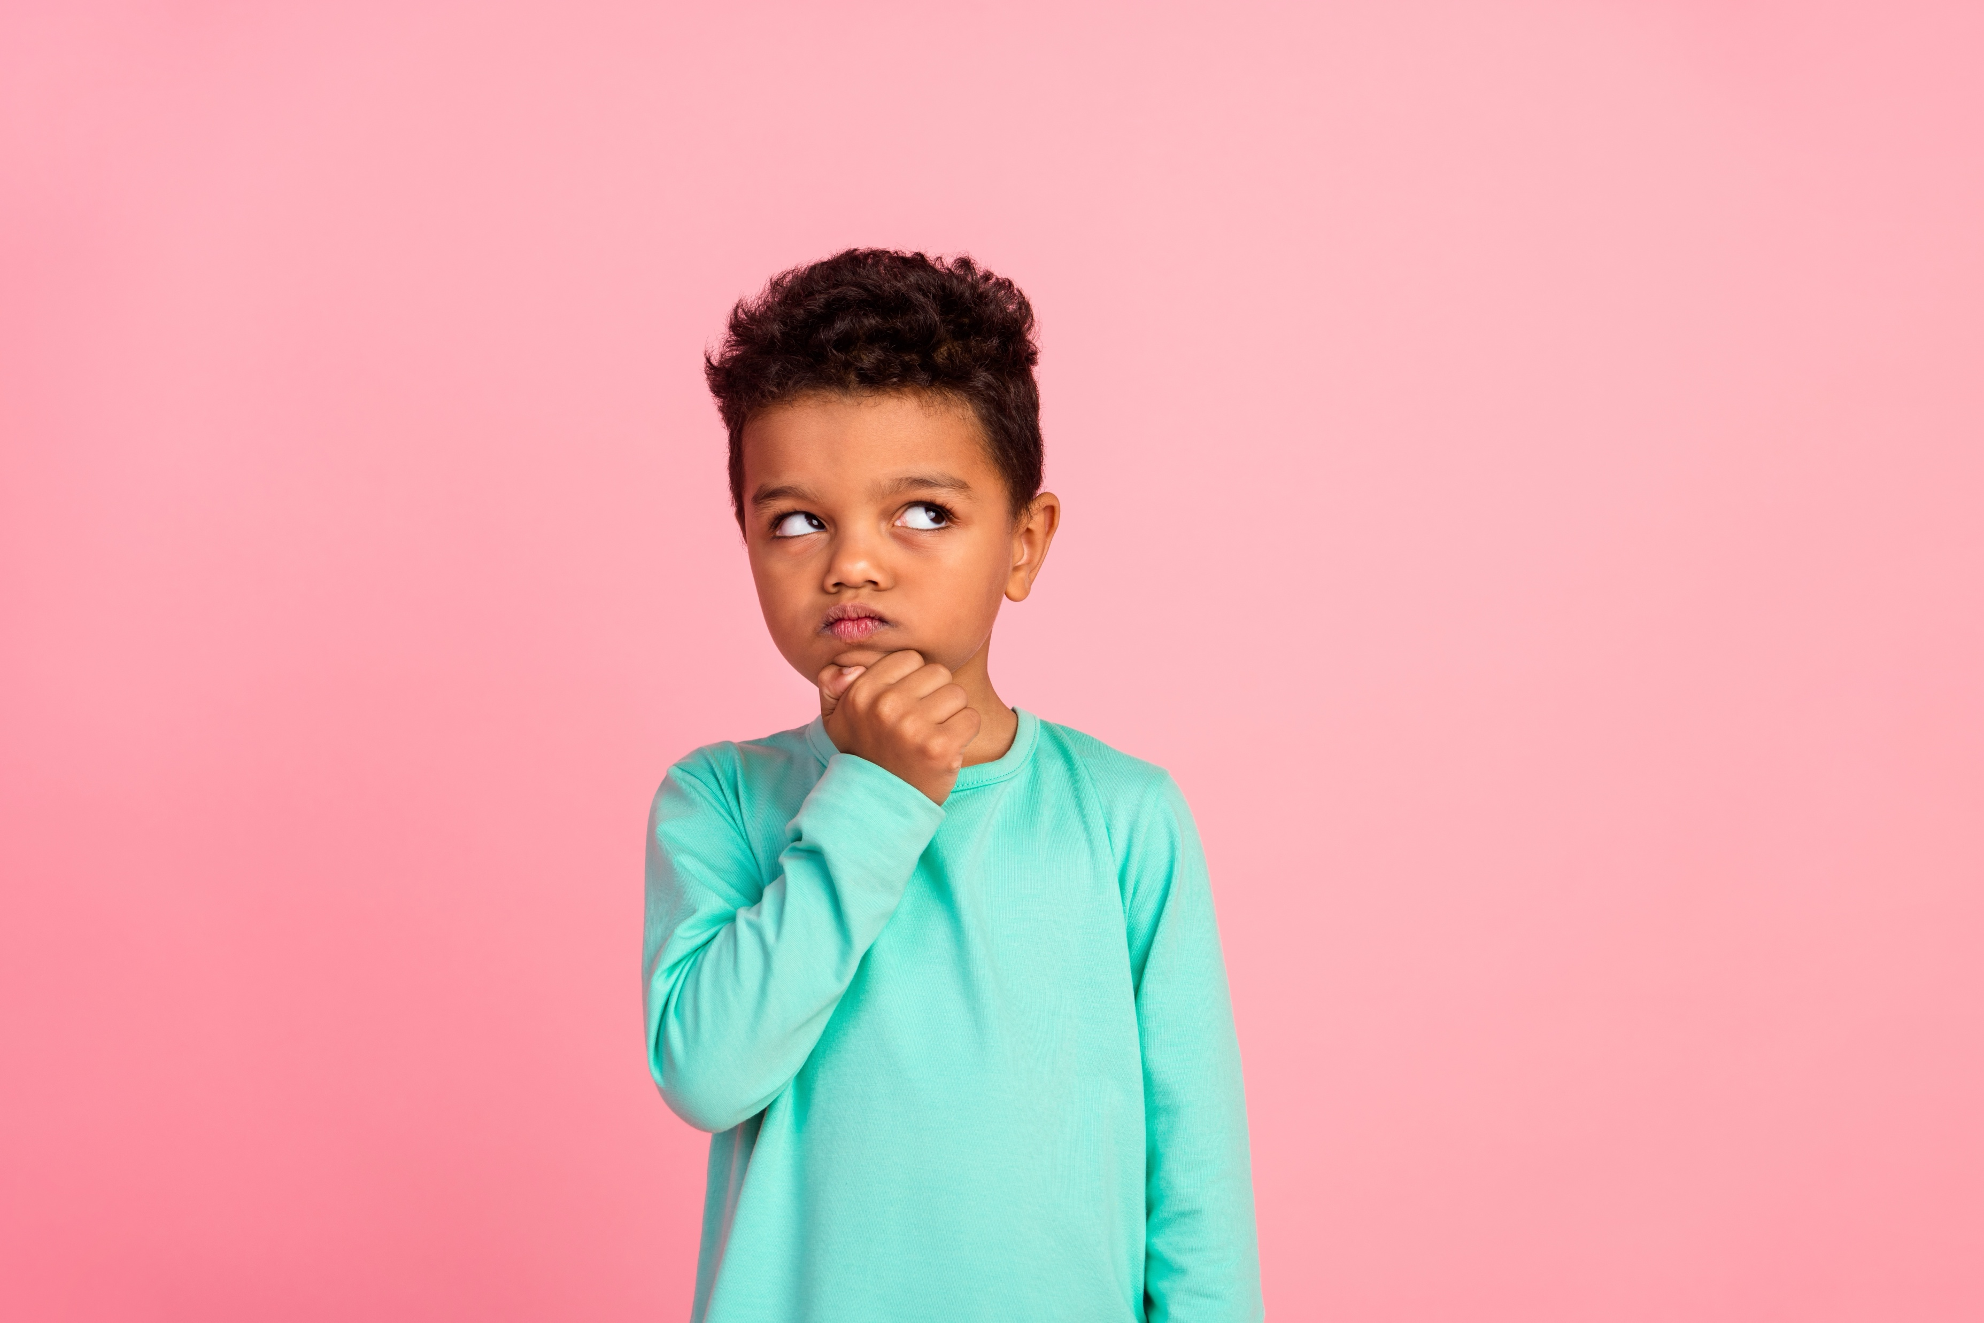

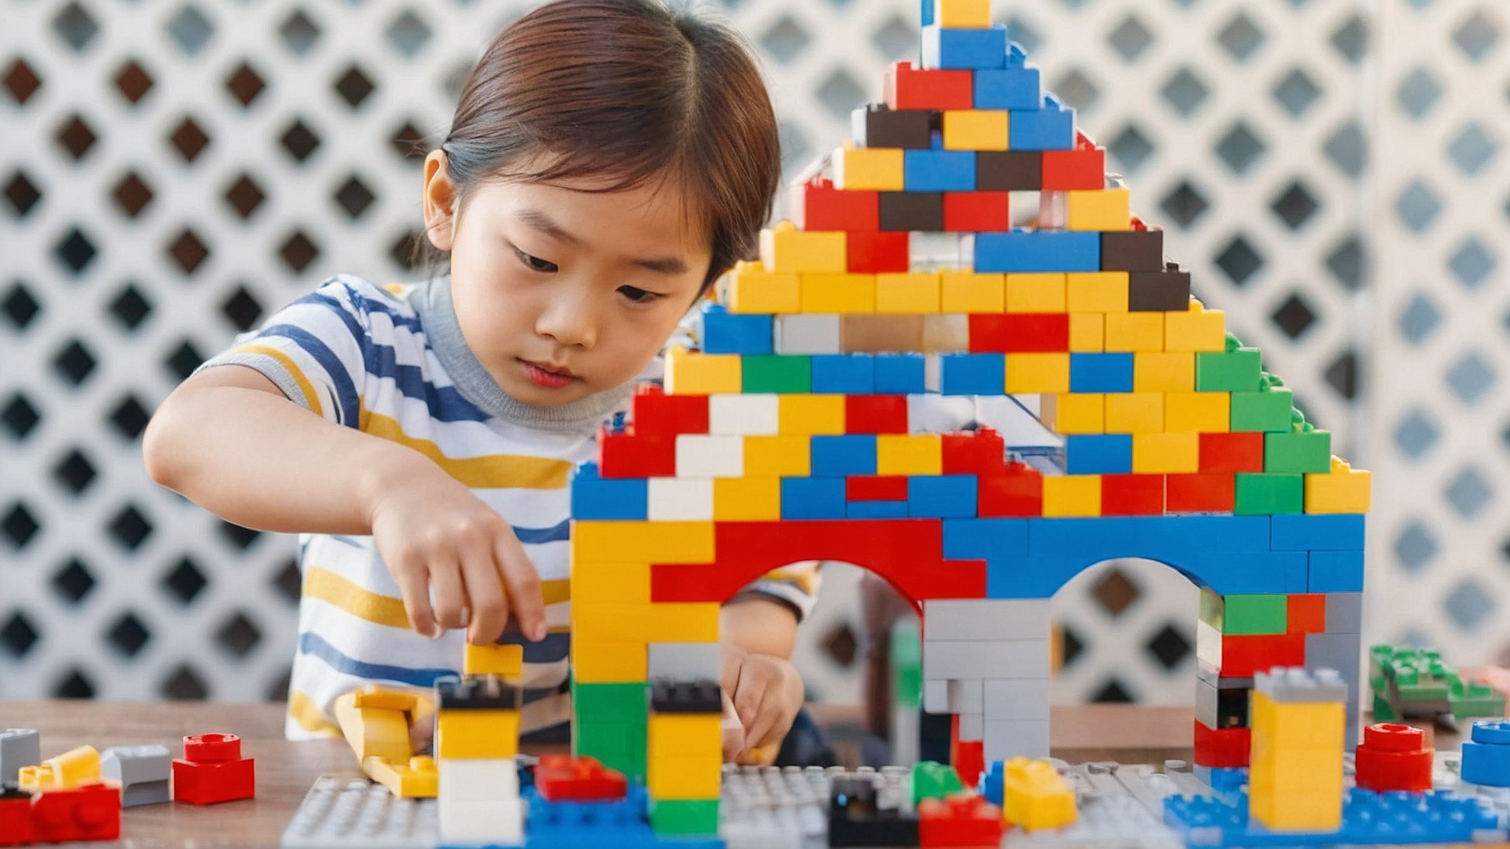
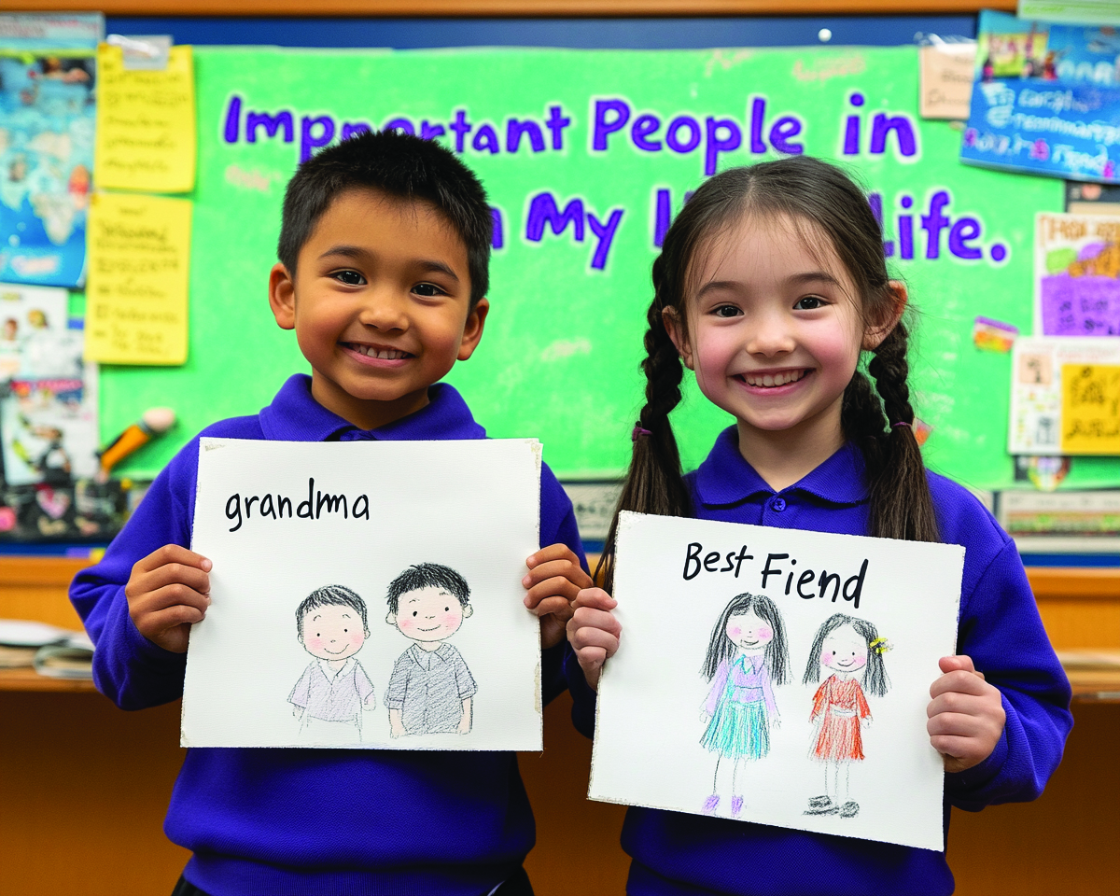
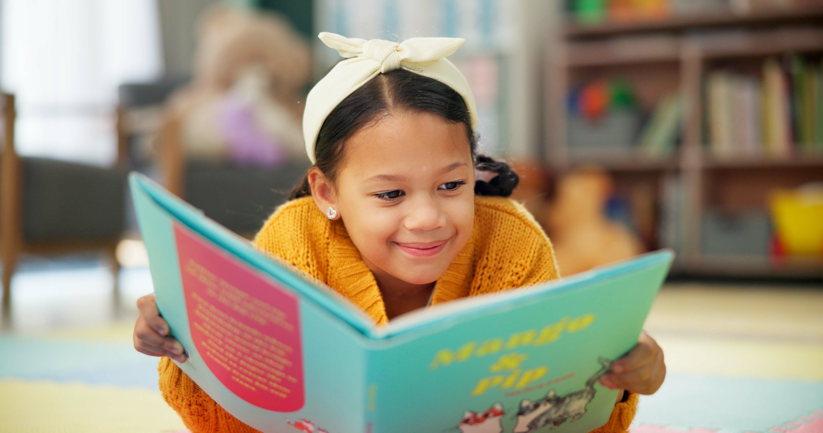

Slide 8
Talents are the things you are good at or can do well.
Likes are things you enjoy doing or that make you happy.

Slide 9

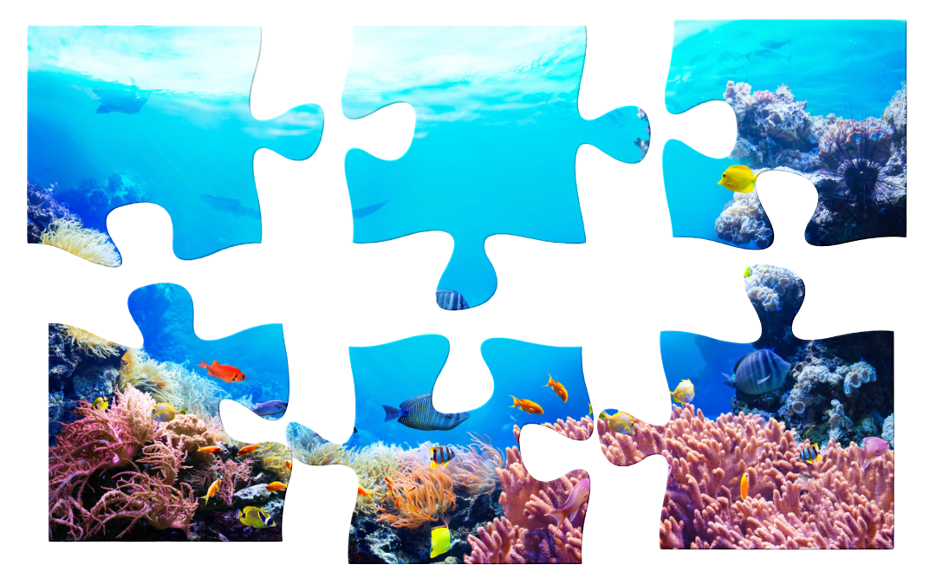
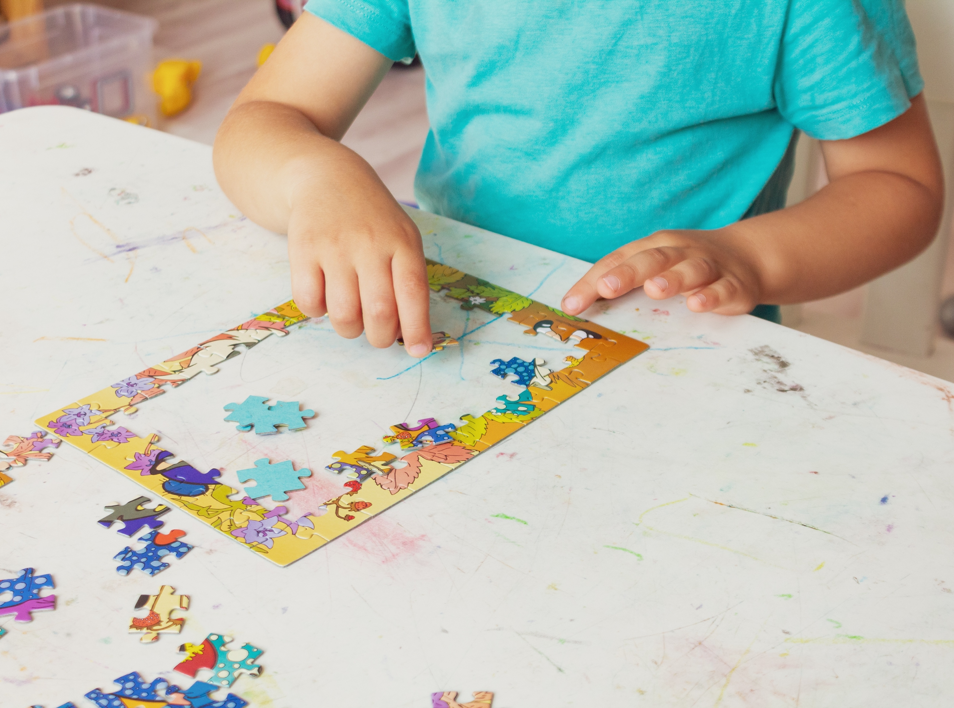
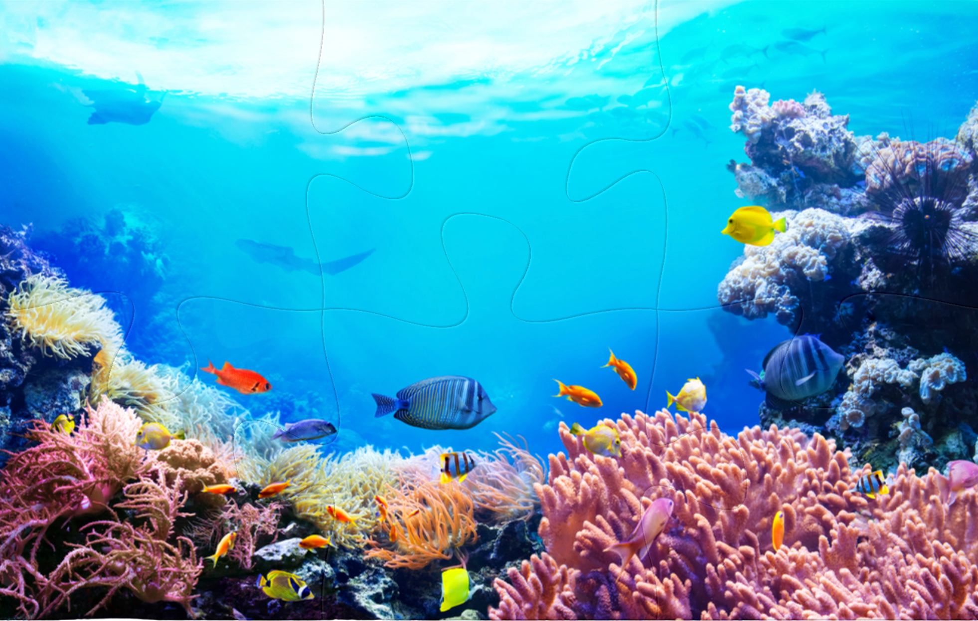
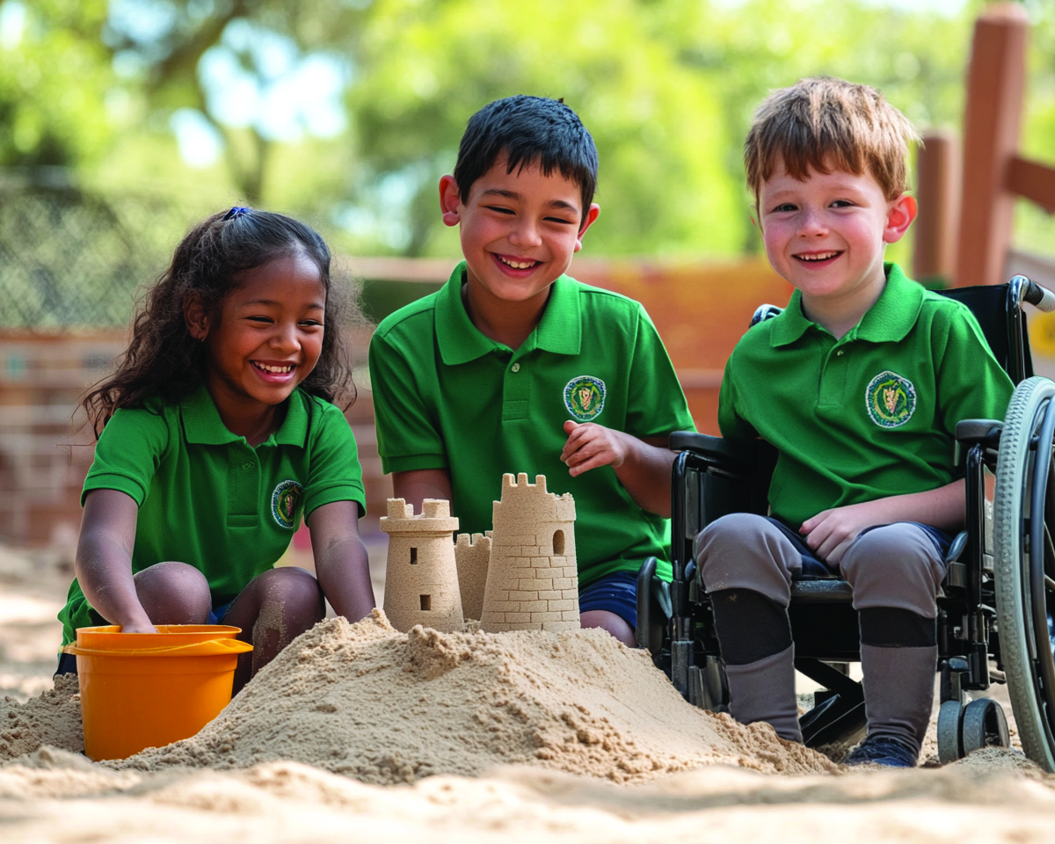
Our Classroom Puzzle

Slide 10
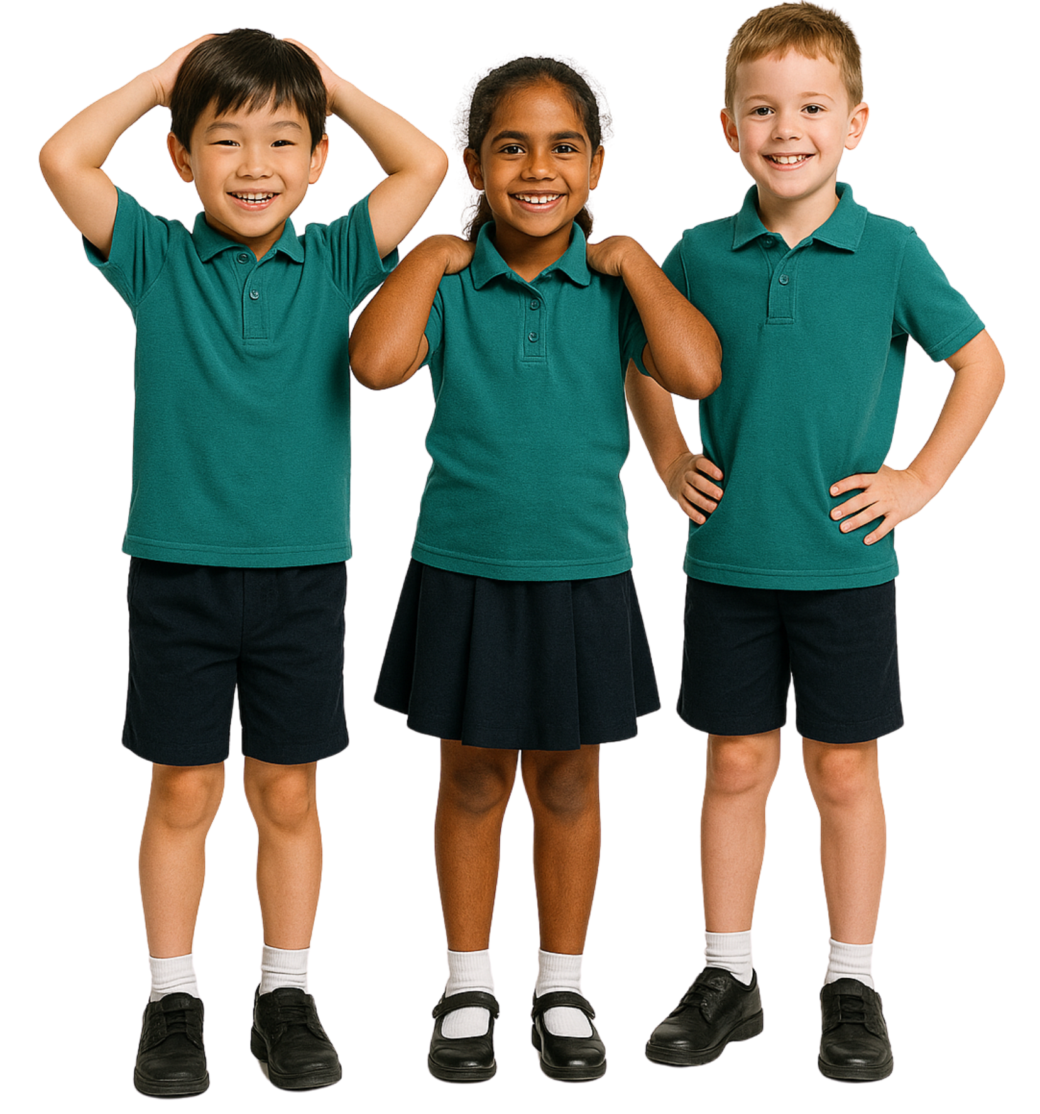
Different Likes and Talents
Having different likes and talents than others makes our classroom…
interesting and fun
boring
smaller

Slide 11
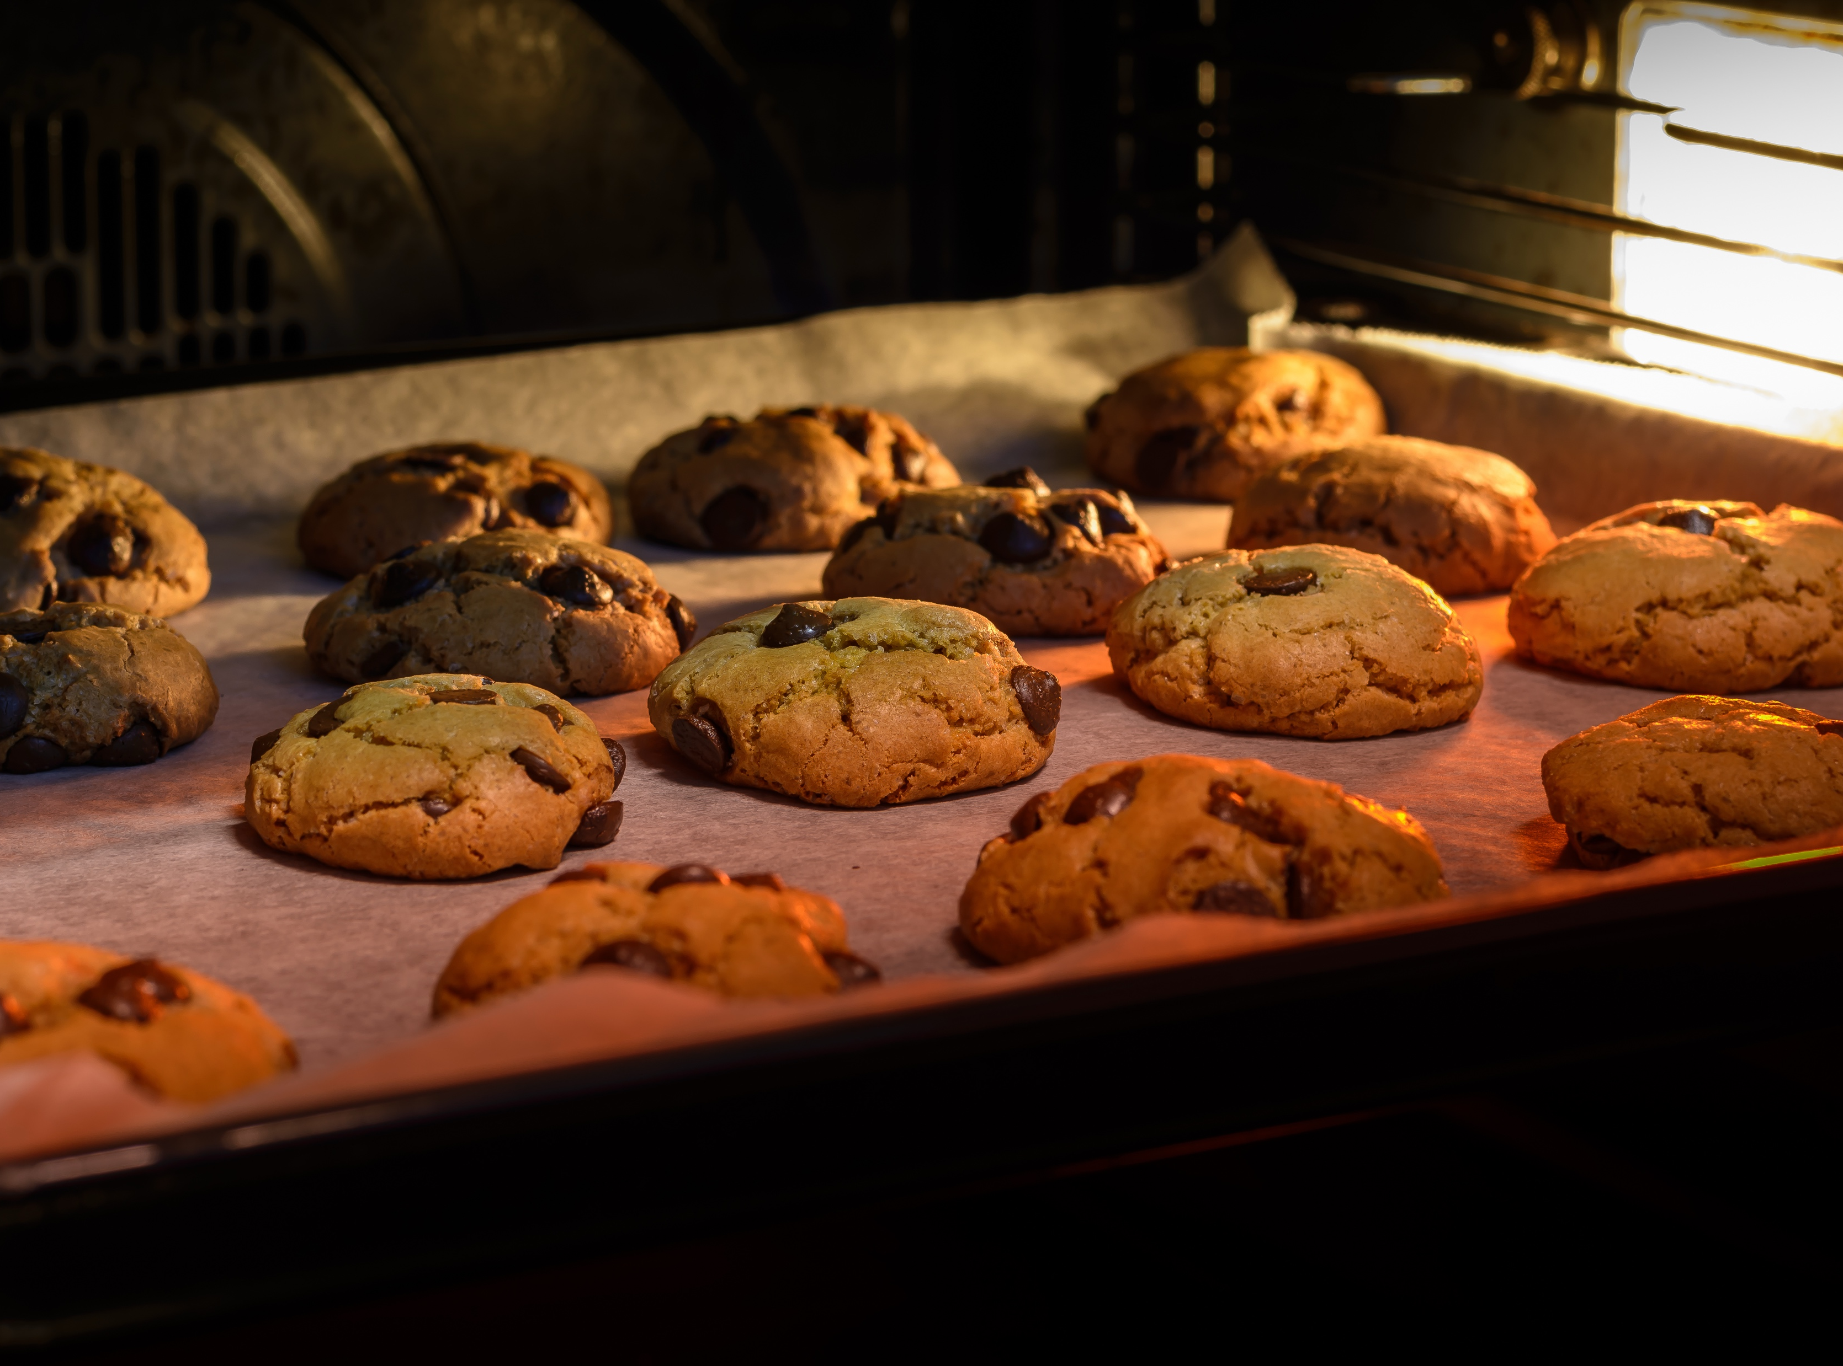
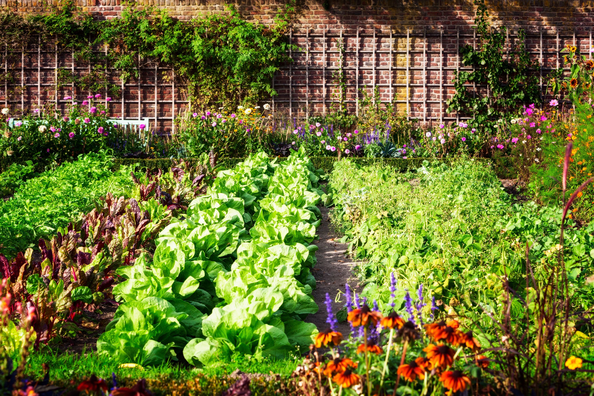
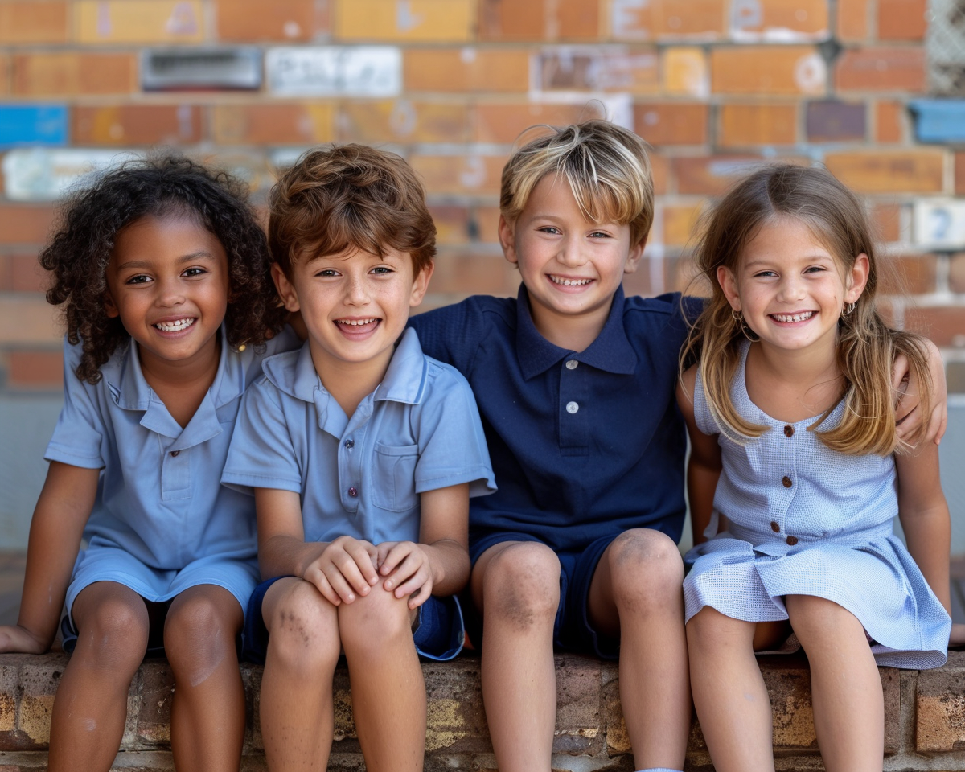
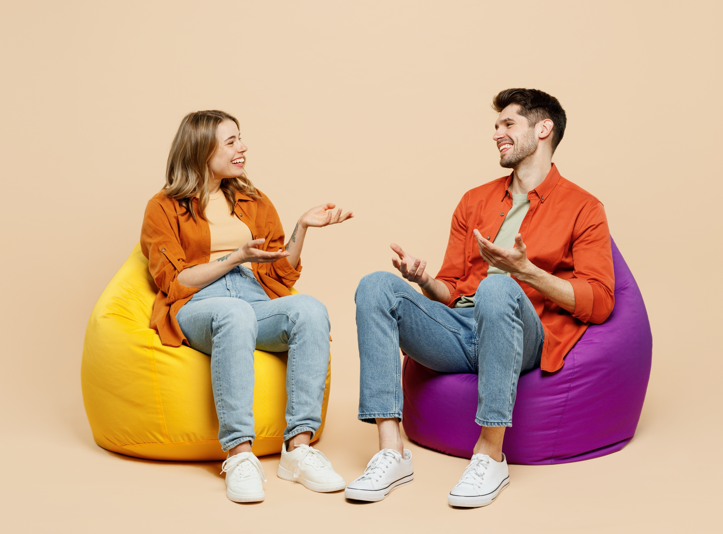
Our Differences Make Us Special

Slide 12




















My Special Puzzle Piece

Slide 13
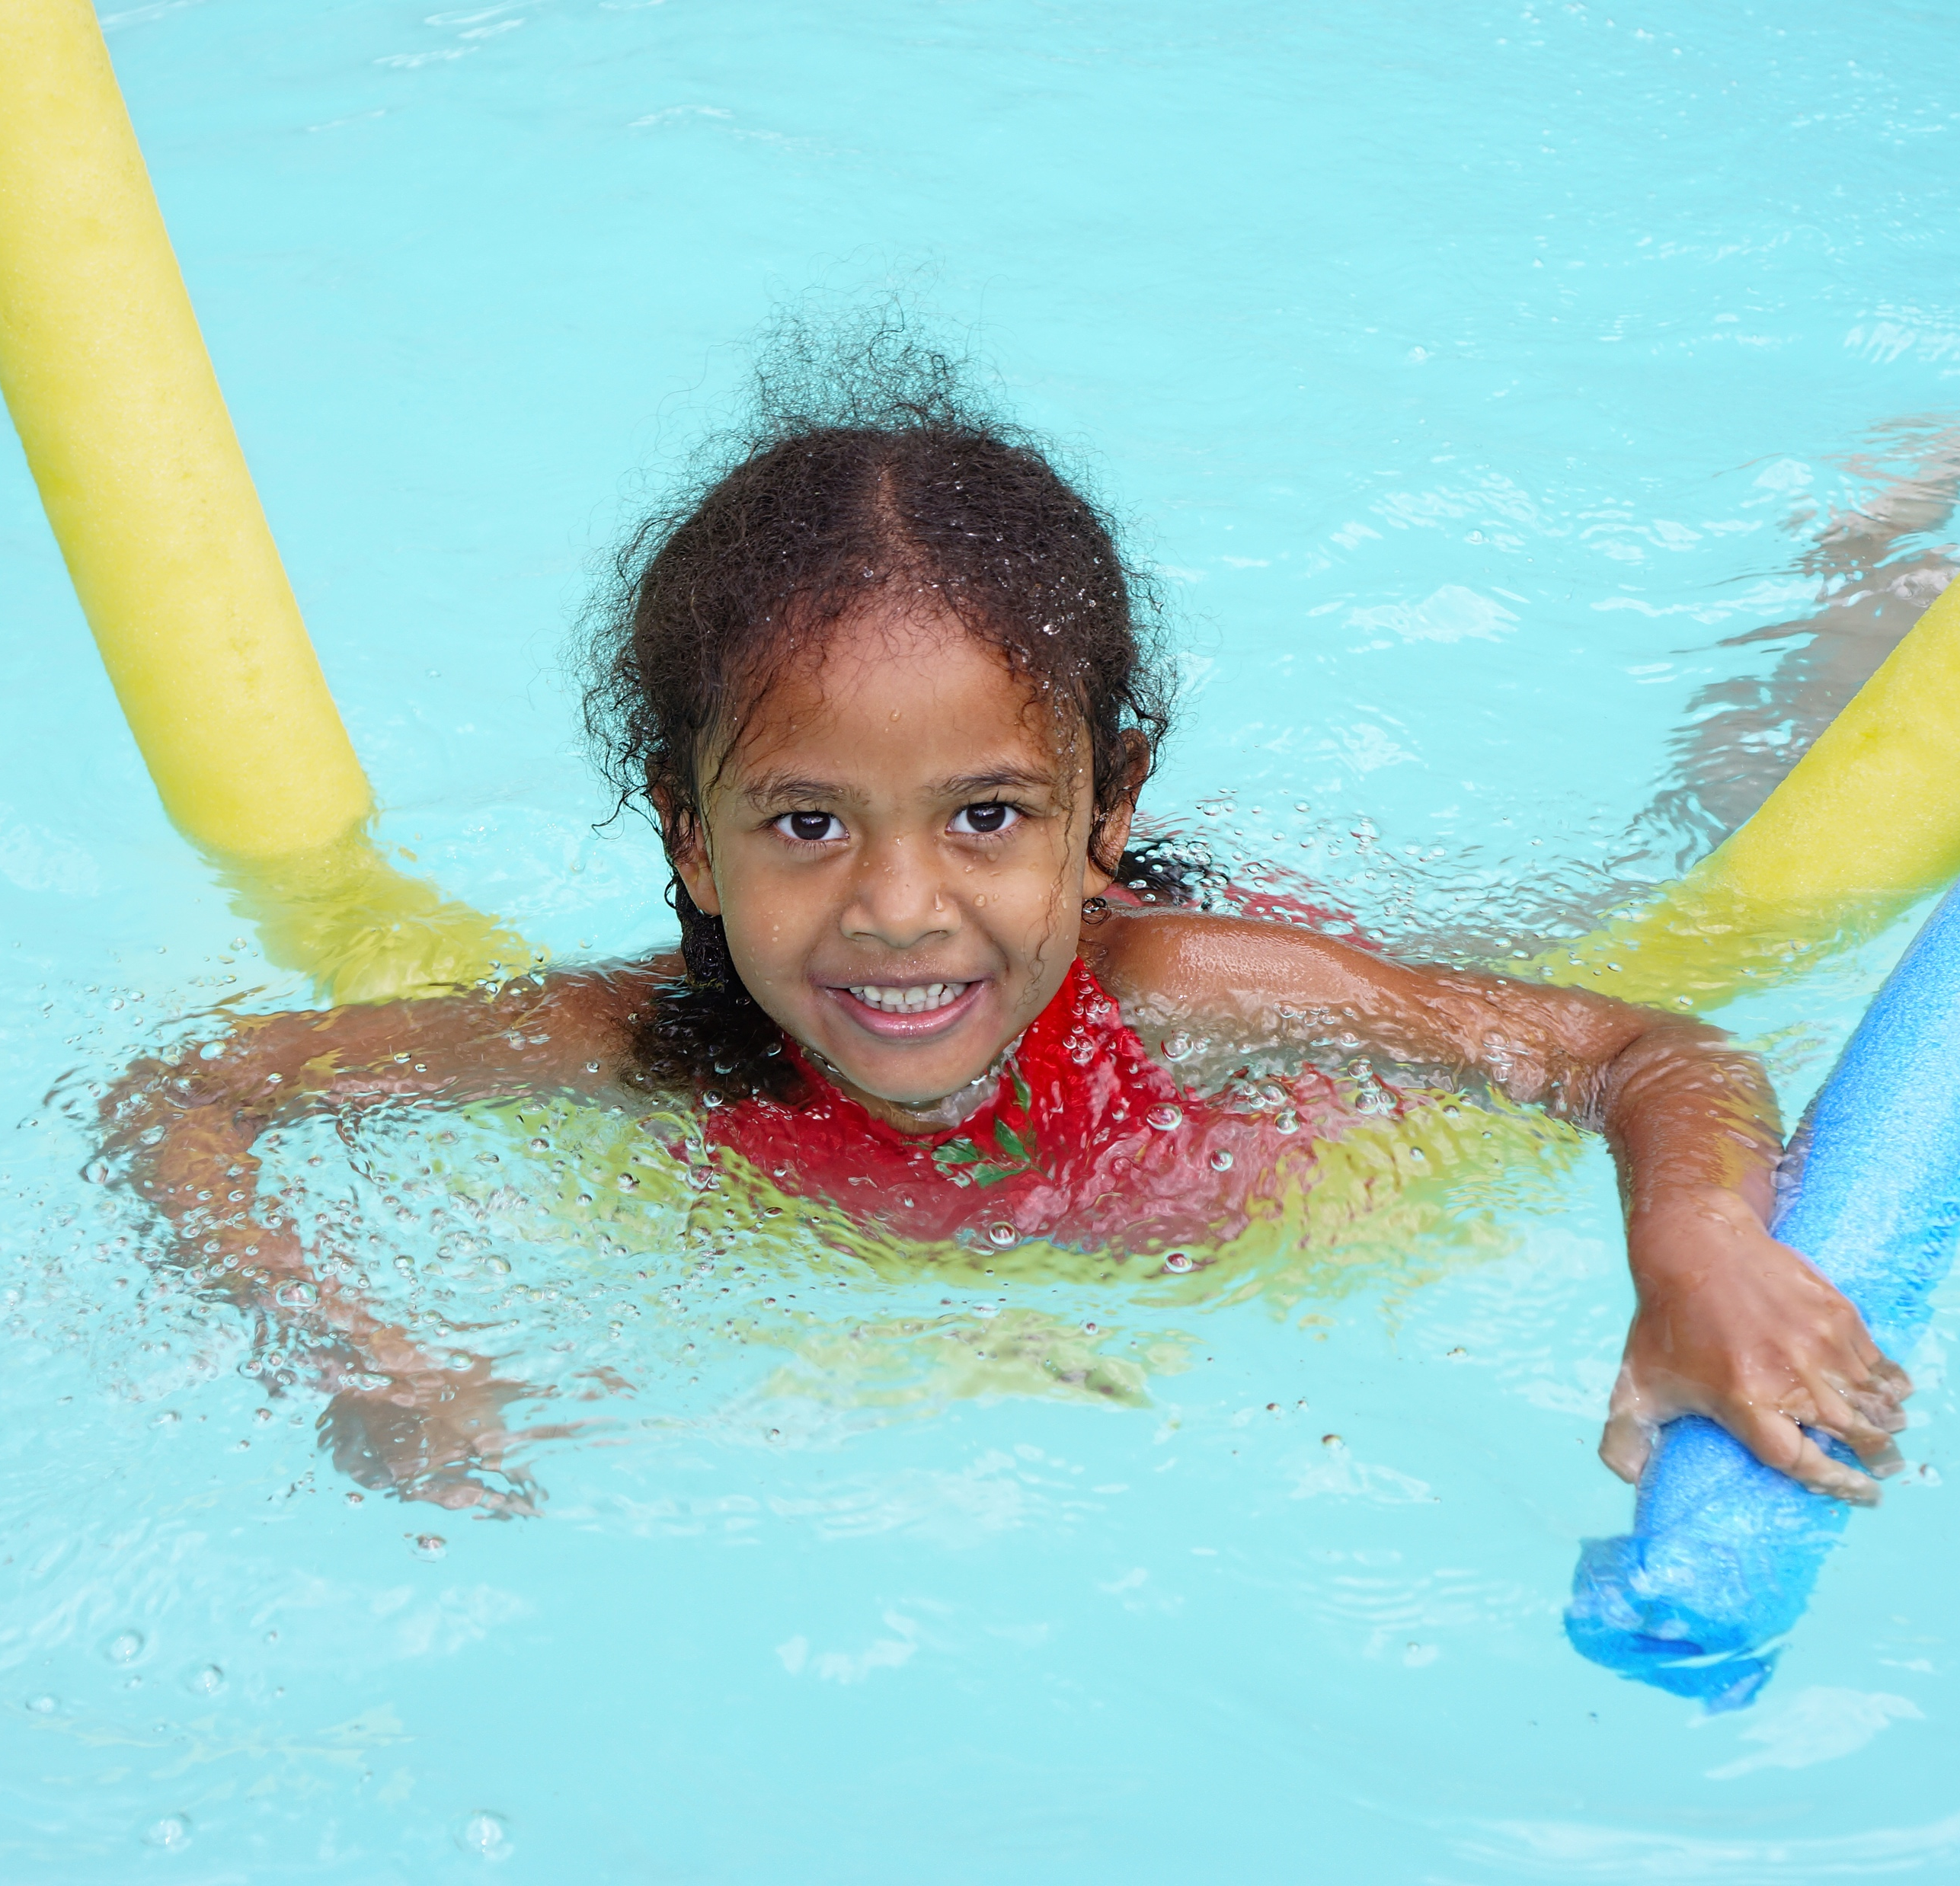
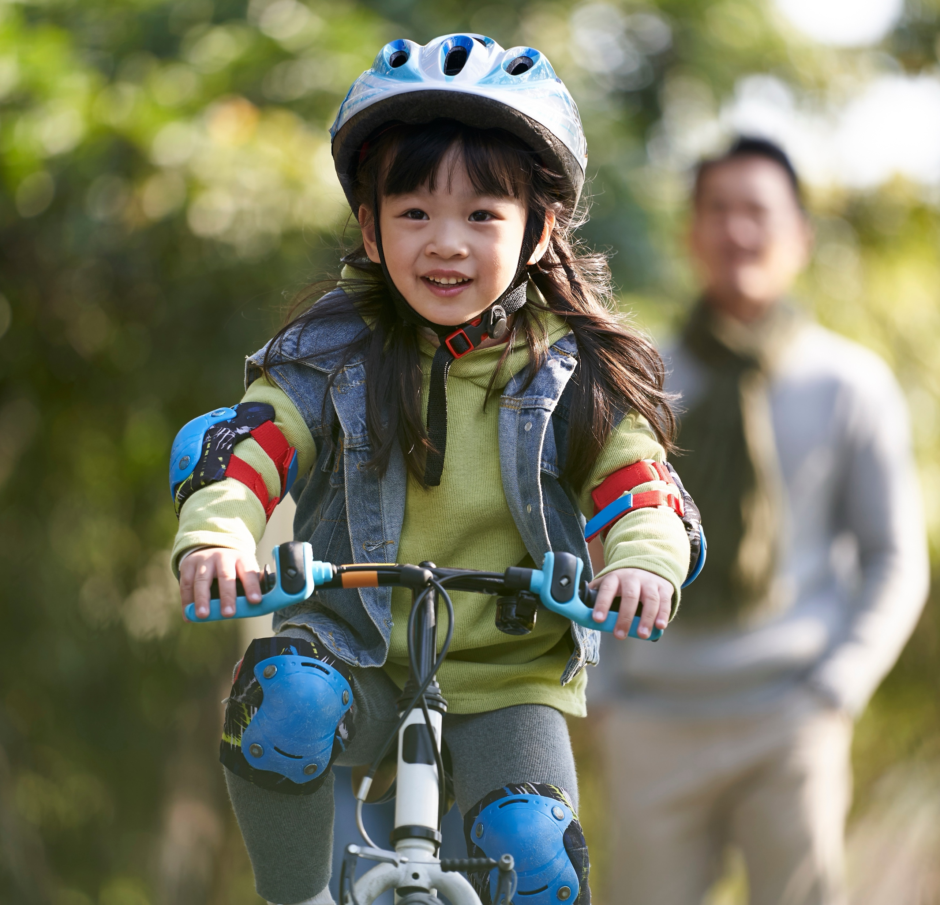
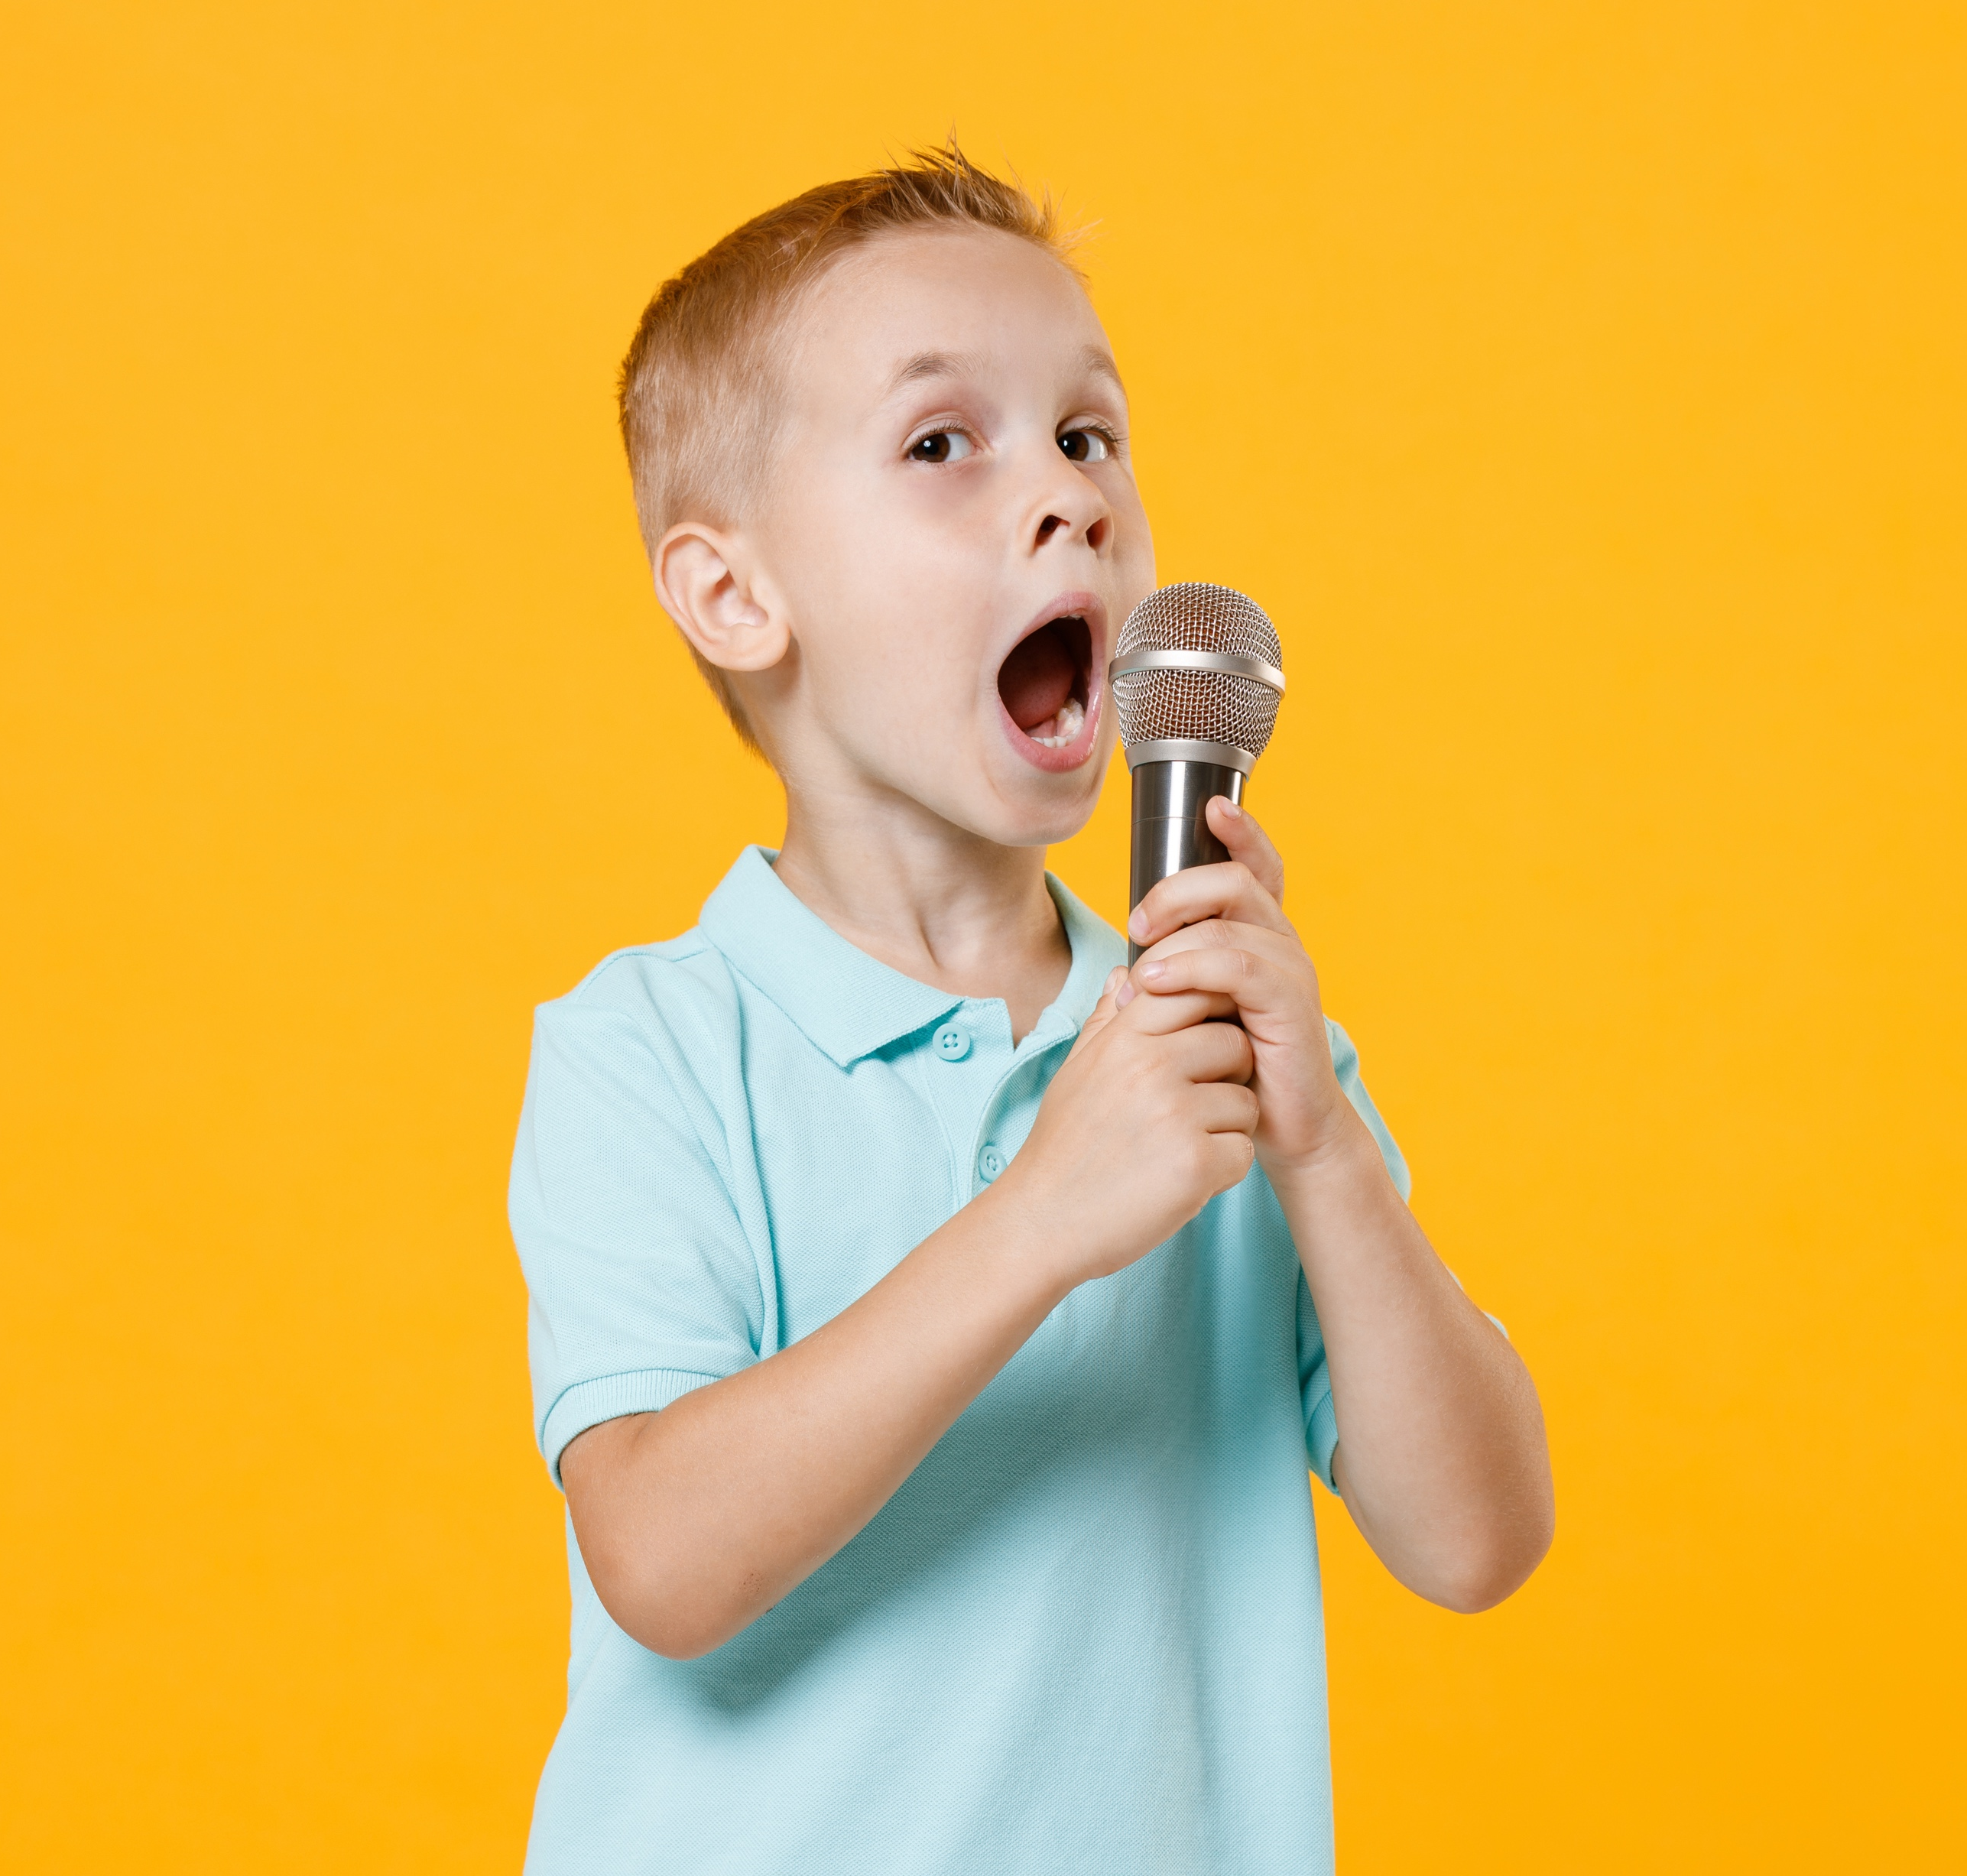
Your Likes and Talents
?

Slide 14
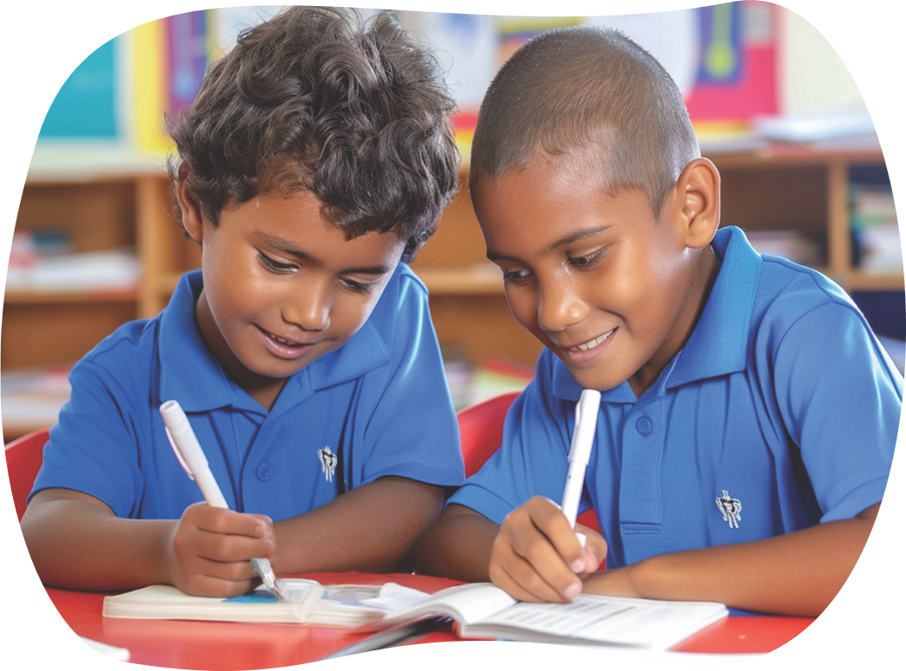
Your Special Puzzle Piece
?

Slide 15
Our different likes and talents make us special, and our classroom interesting and fun.

Slide 16
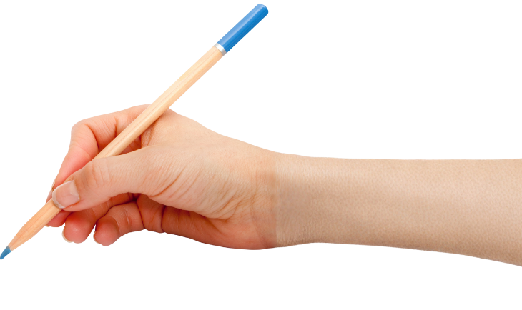

How well did you:
understand it’s okay
to like different things
say at least two likes and two talents?
Notes:
​

Slide 17
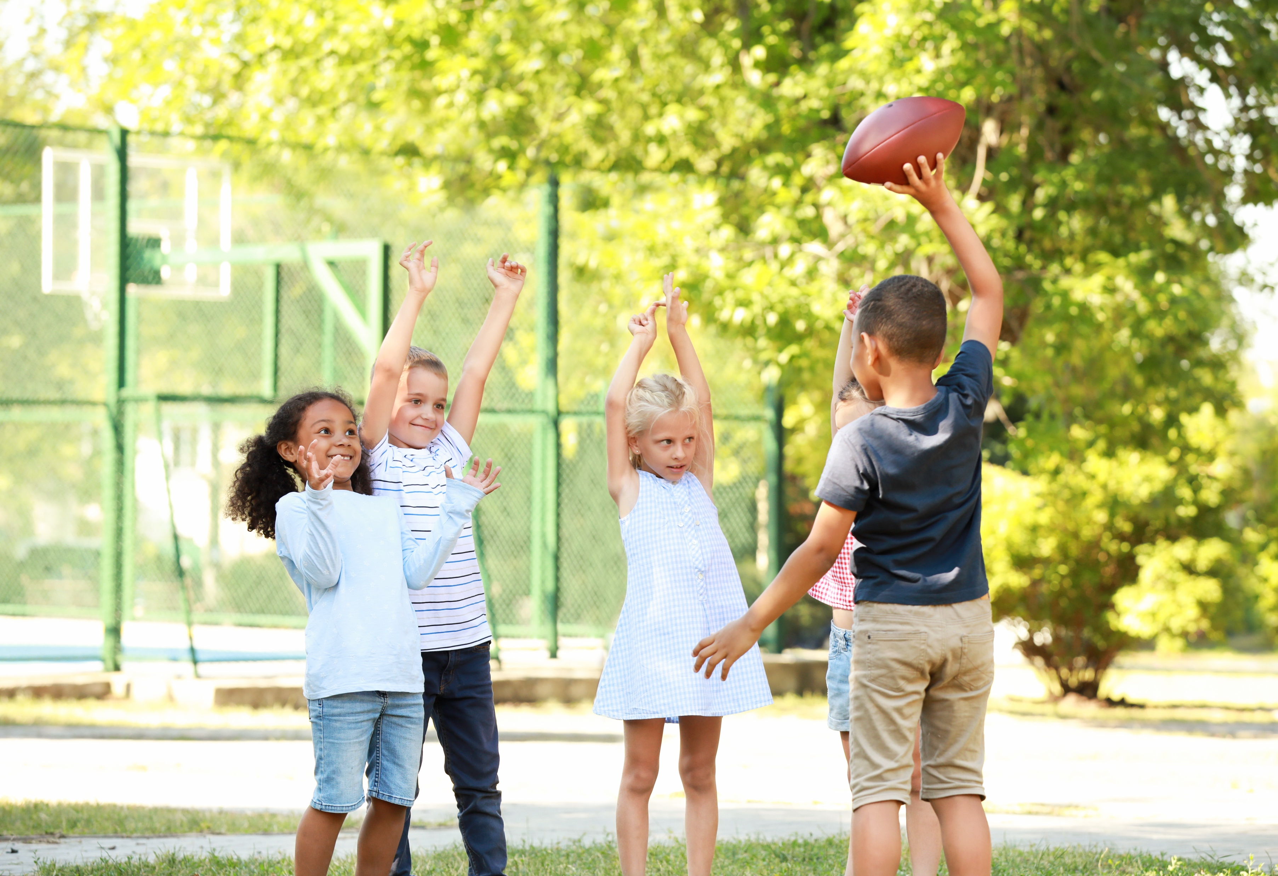
In the next lesson, we will understand what makes someone feel left out and how you can help
them feel included.

