Slide 1
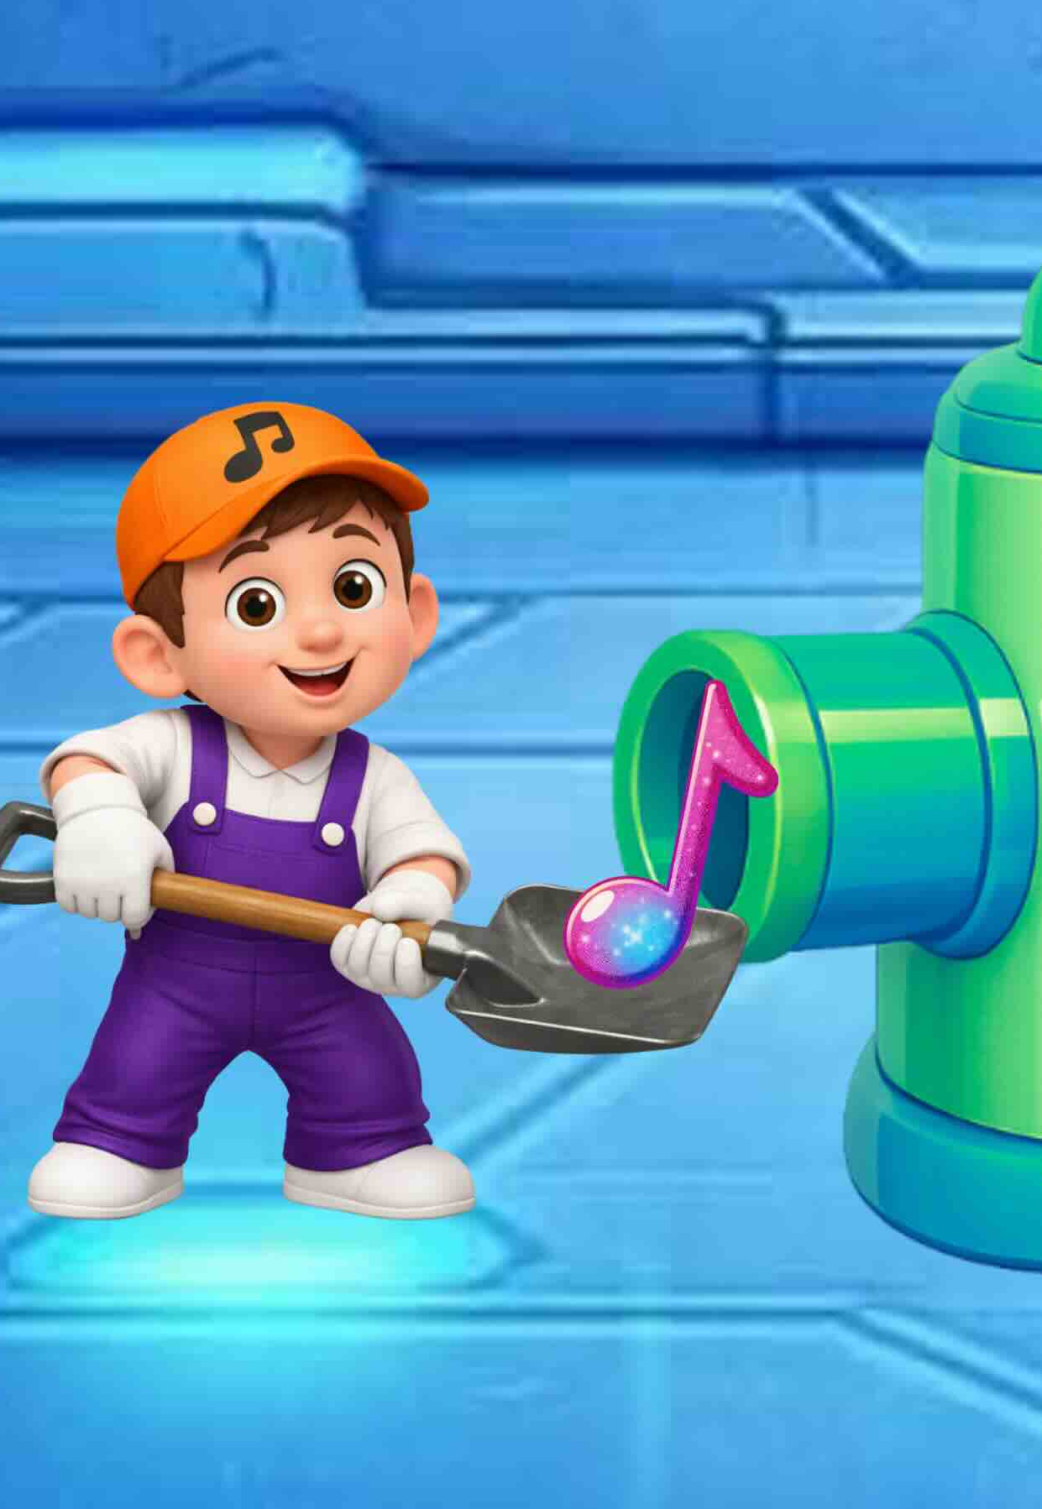
The Song Factory
Lesson 1
High and Low
Unit 1 Version 3

Slide 2

In this lesson, we
will understand
how low and high
sounds are used
in music.

Slide 3
You will be able to: ​
sing high and low sounds
show high and low
sounds using
your body.
Sing means to make music with your voice by using words and a tune.
Show means to let others see or understand what you mean by what you do.

Slide 4


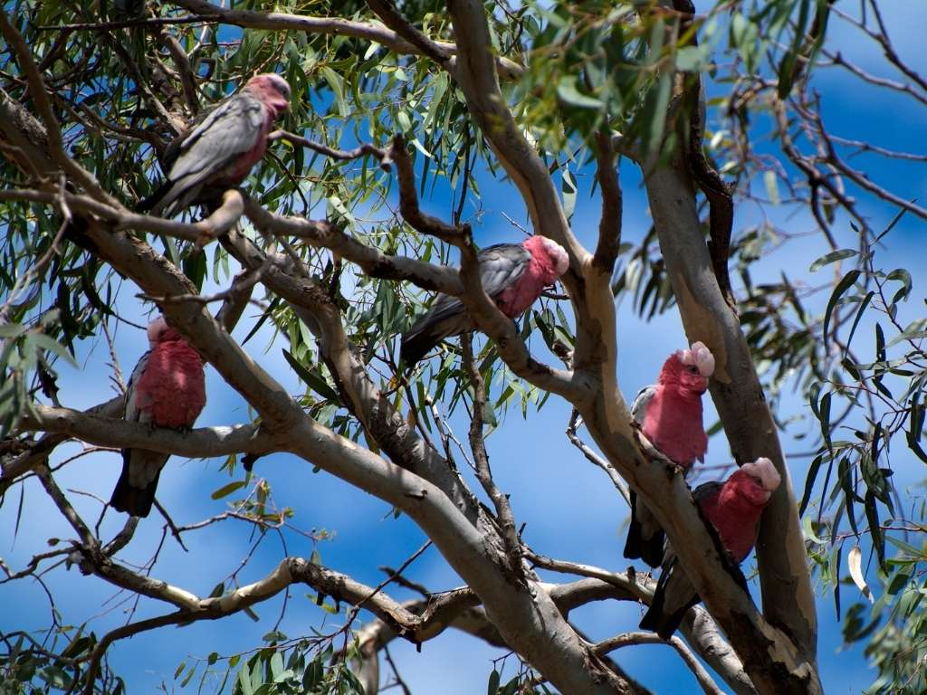

Slide 5

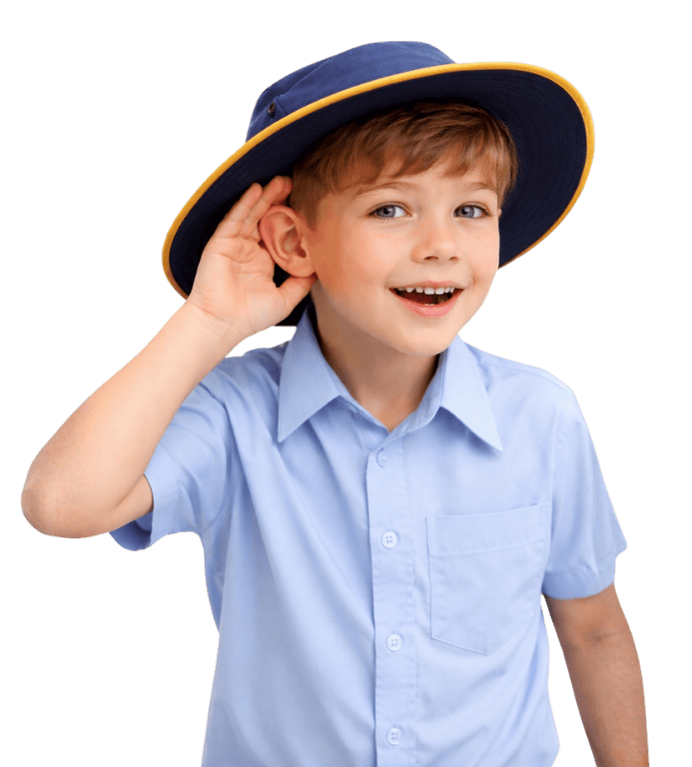
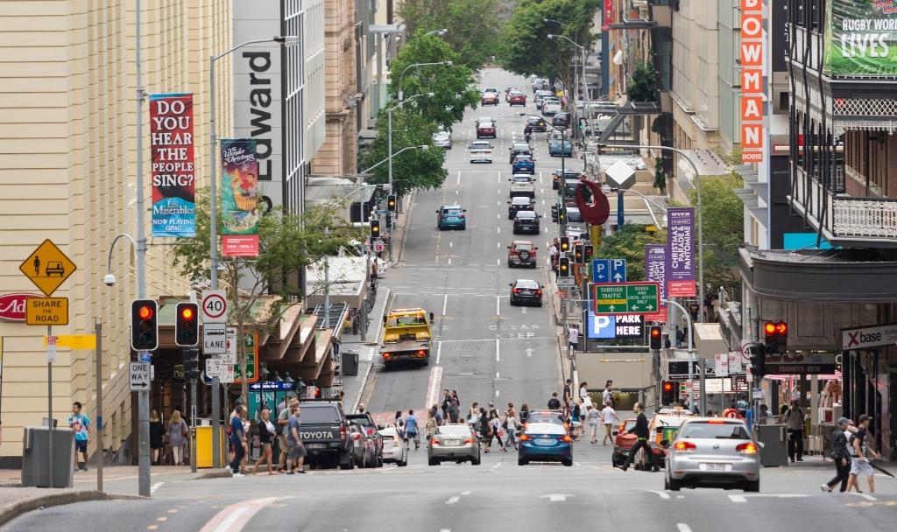



Sound Is All Around Us

Slide 6



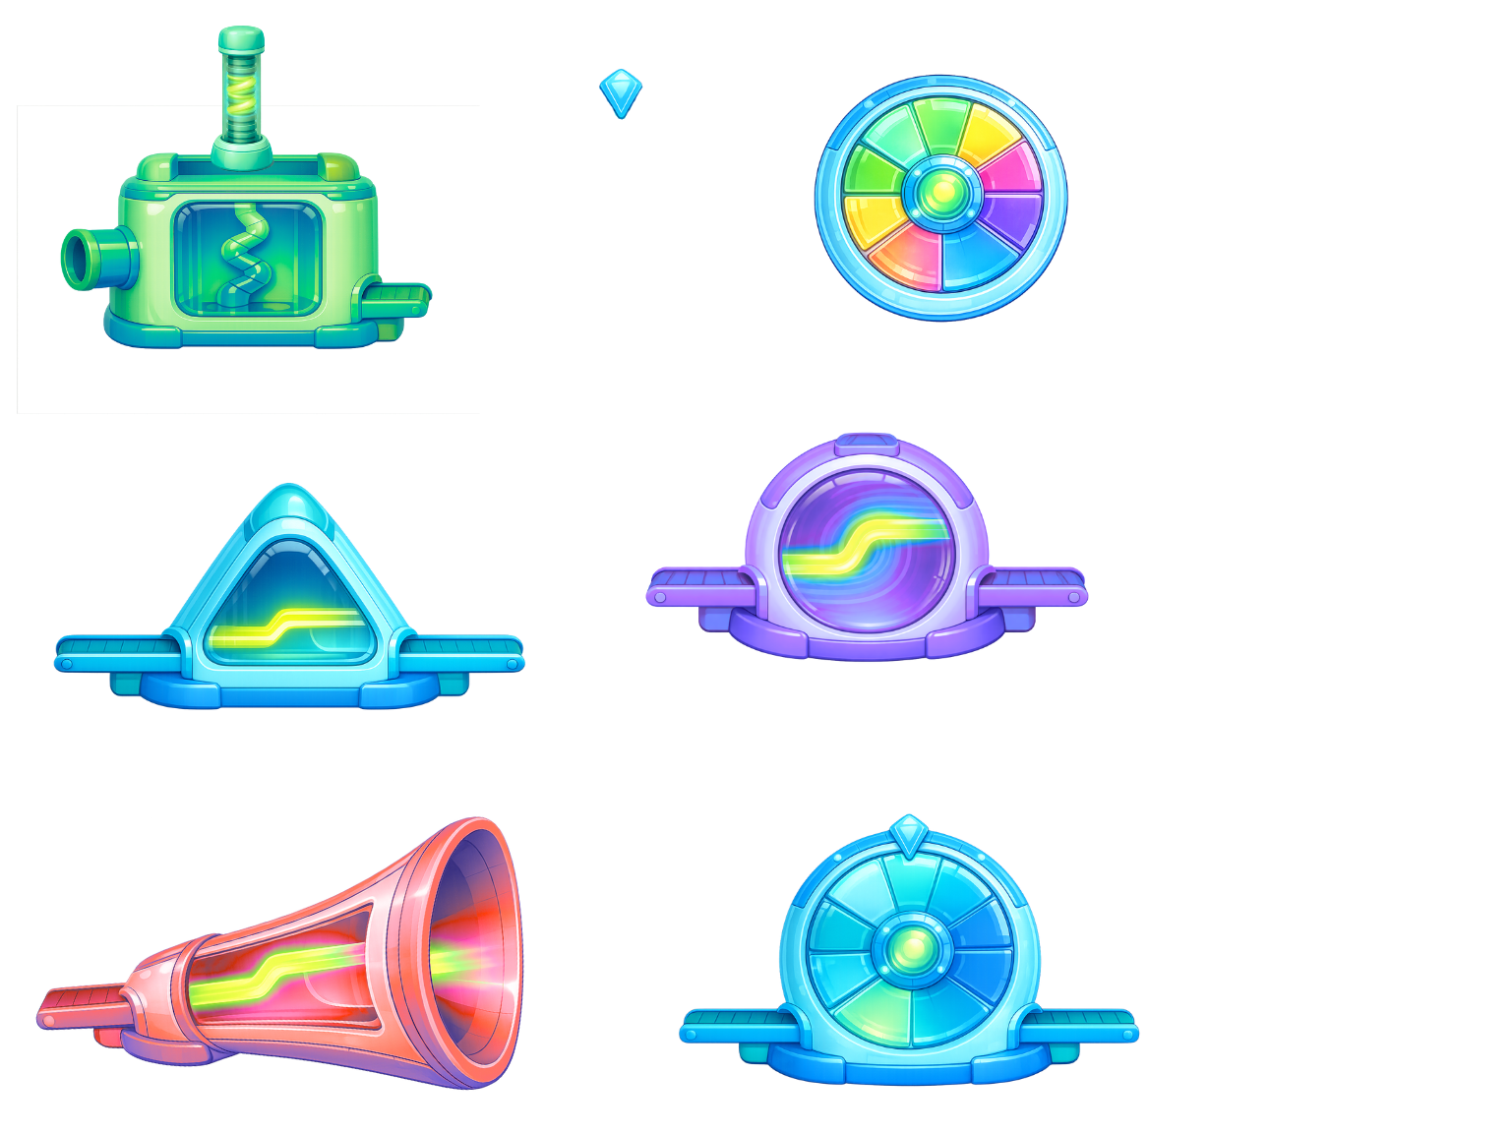


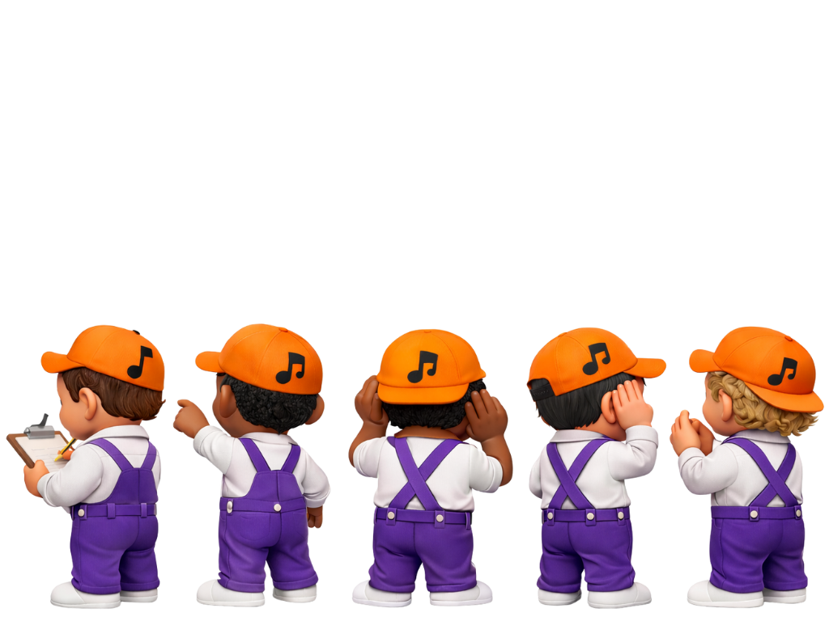

Slide 8
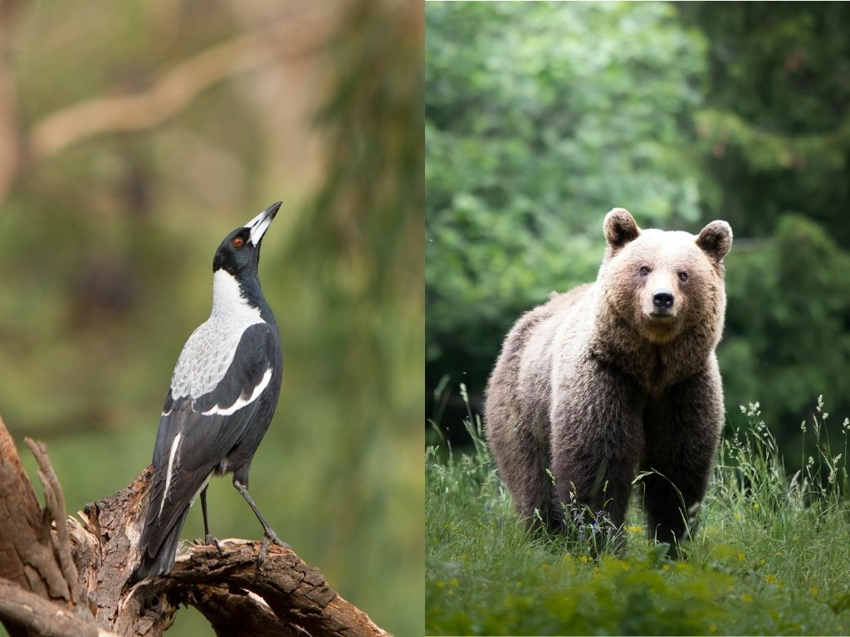

Slide 9
High and Low Sounds in Nature

Slide 10
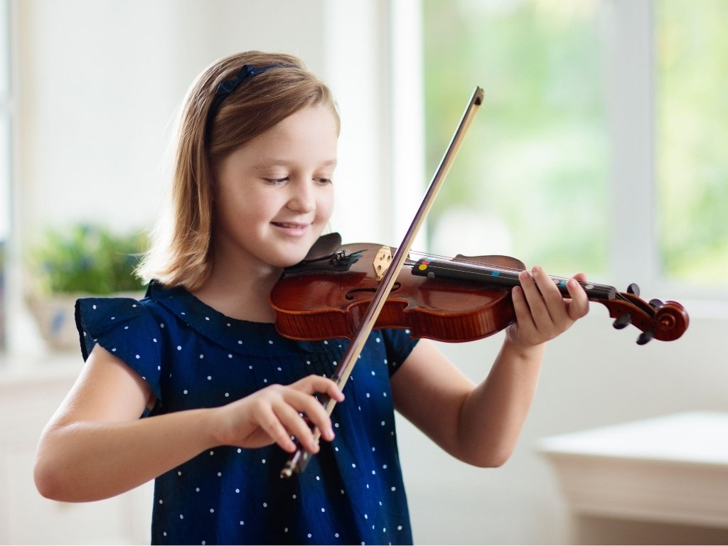
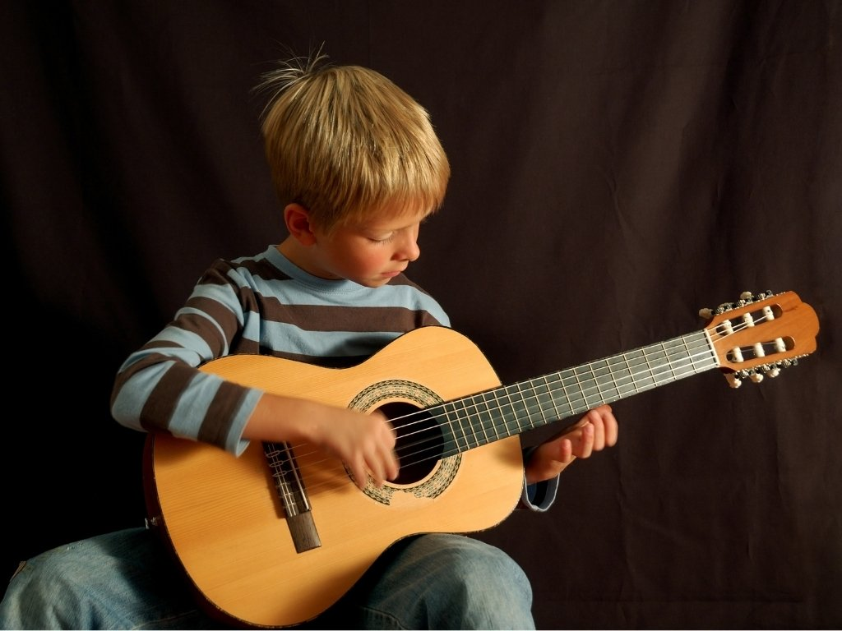
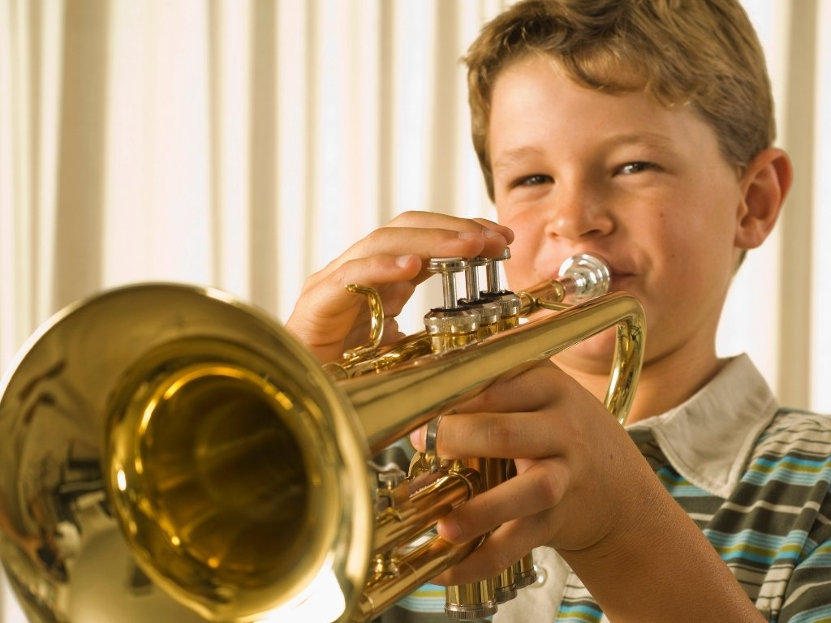
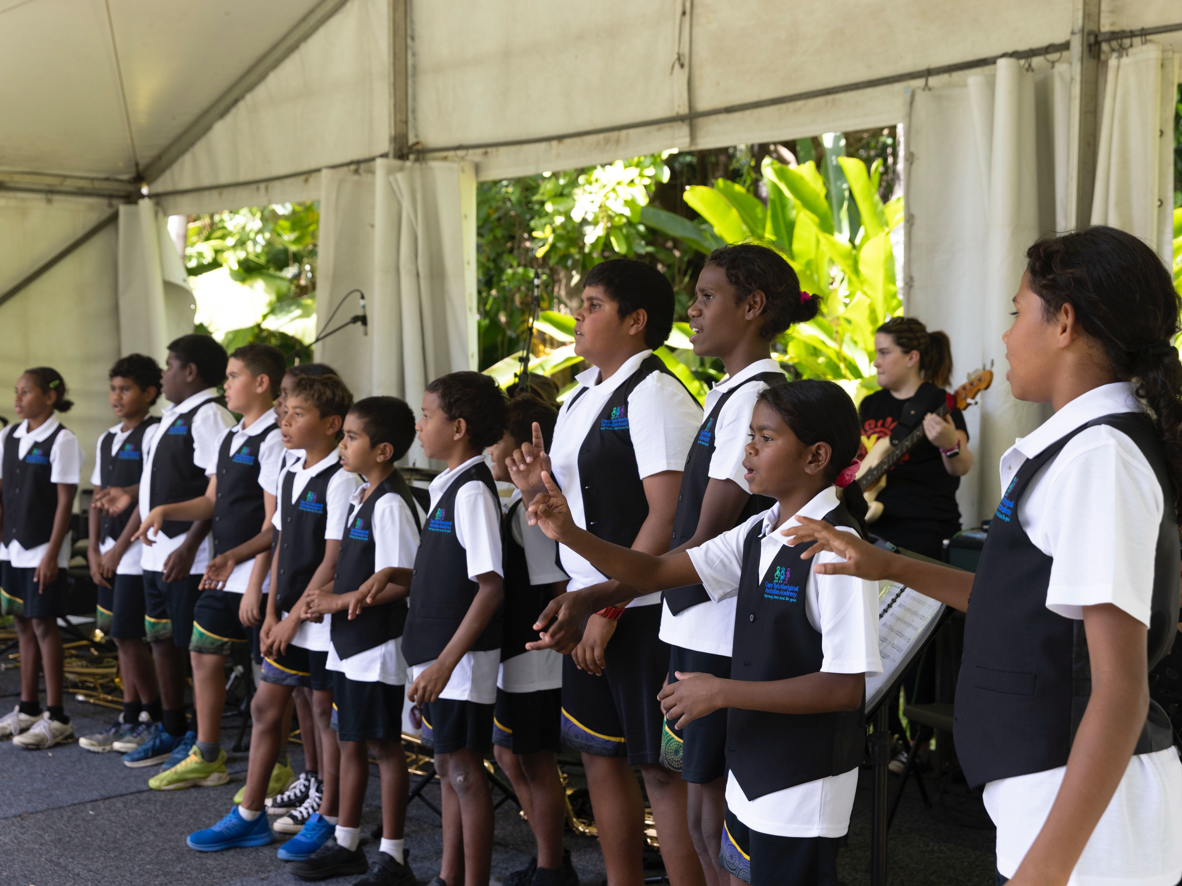
High and Low Sounds in Music

Slide 11
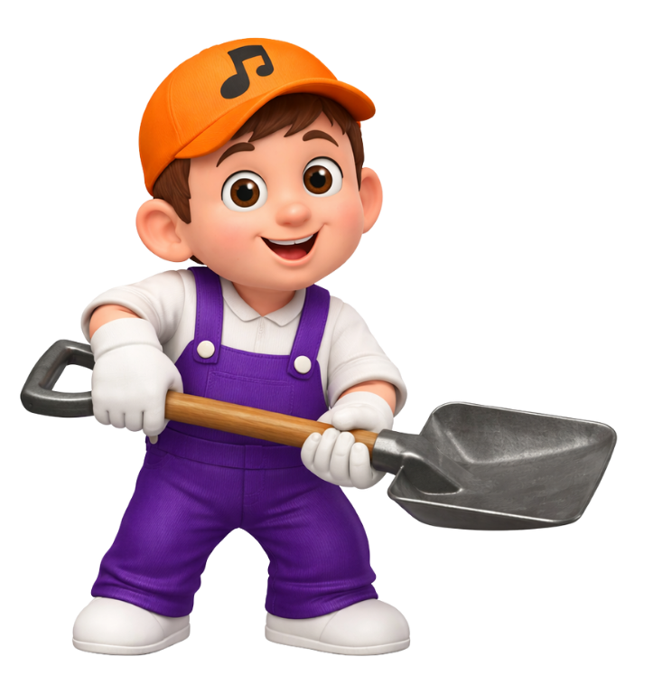



Slide 12
High and Low Sounds
Music can have high and low sounds.
Yes
No

Slide 13
me
me

Slide 14
sun
sun

Slide 15
it’s time
it’s time

Slide 16


Turning Words Into a Song
How are you today?

Slide 17
Turning Words Into a Song
My favourite food is…

Slide 18

Turning Words Into a Song
Good morning,
Good morning,
It’s time to rise
and shine.

Slide 19
Turning Words Into a Song
The sun peeks out
and rises up,
High into the sky.

Slide 20

Turning Words Into a Song
Good evening,
Good evening,
It’s time to
go to bed.

Slide 21
Turning Words Into a Song
The sun is going
down, down, down,
Good night,
you sleepyhead!

Slide 22
Turning Words Into a Song
Good morning, good morning,
It’s time to rise and shine.
The sun peeks out and rises up,
High into the sky.
Good evening, good evening
It’s time to go to bed.
The sun is going down, down, down,
Good night, you sleepyhead.

Slide 23
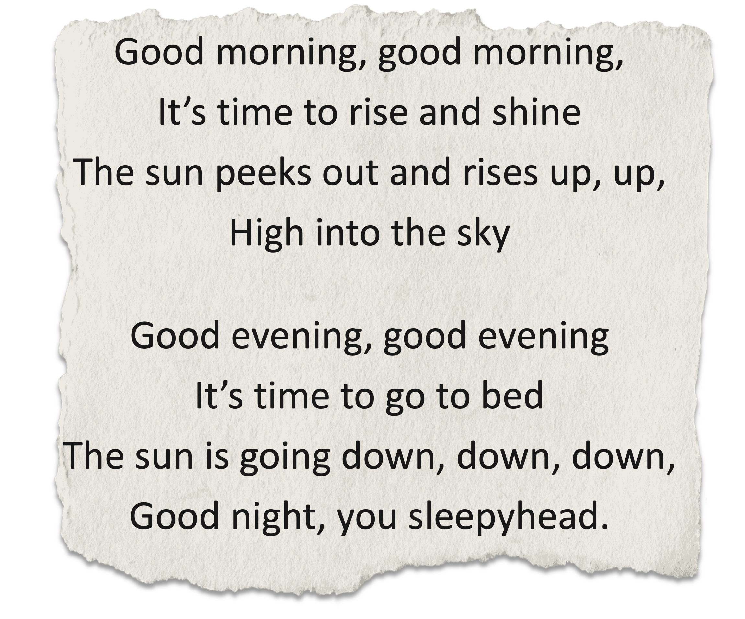

Slide 24

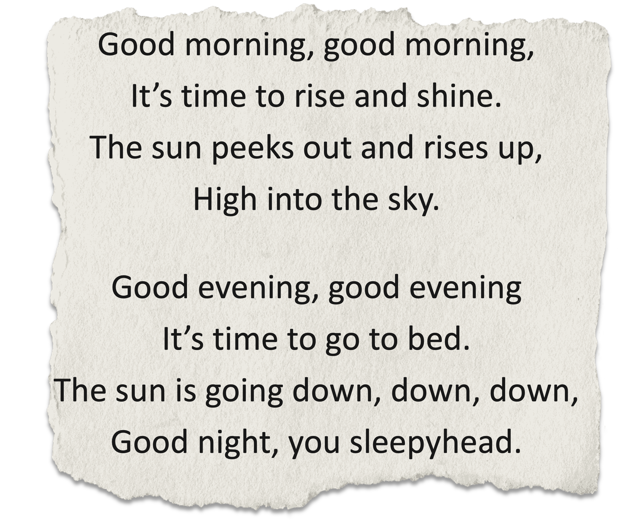
Good morning, good morning,
It’s time to rise and shine.
The sun is going down, down, down,
Good night, you sleepyhead.
The sun peeks out and rises up,
High into the sky.
Good evening, good evening
It’s time to go to bed.

Slide 25
Music is made up of high and low sounds.
We can show high or low
sounds with our bodies.
We can turn words into songs by singing them high and low.

Slide 26



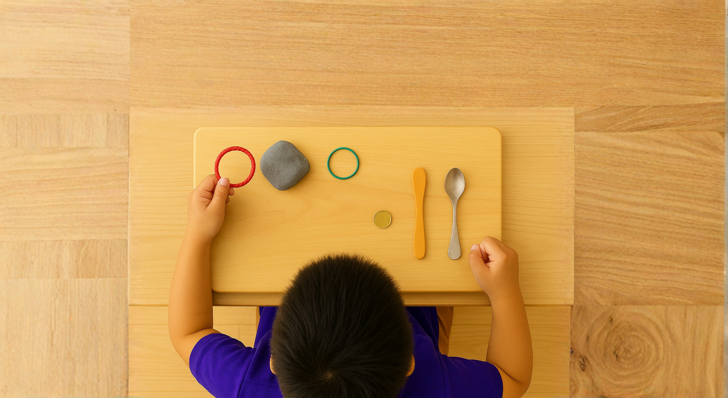
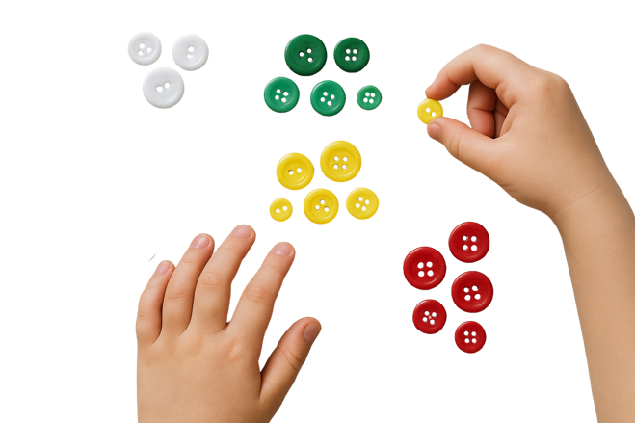
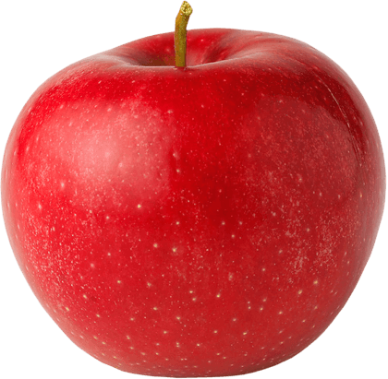




Exit Ticket
Date: _________
Lesson 1A
Lesson 1
You will be successful when you can:
describe properties of objects
sort objects into property groups.
sounds
Music has high and low ________.
We can show high or low sounds with our:
  voices and bodies
  bags and lunchboxes
  pets and siblings.
We put our hands up to show h______ sounds.
bodies
sounds
machines
Describe means to tell what something looks like, sounds like, feels like or what it is.
Sort to put things that are the same together.
red
round
igh
crunchy
3
I know _____ out of 3 answers.

Slide 27
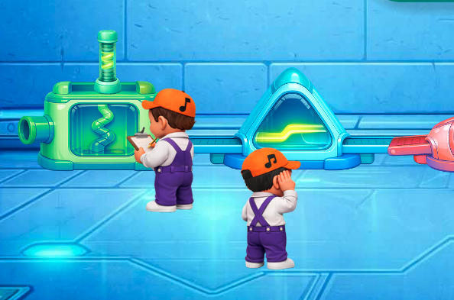
In the next lesson, we will learn that music is made up of short and long sounds.

