Slide 1

The Song Factory
Lesson 2
Short and Long
Unit 1 Version 3

Slide 2





What We Learnt
Exit Ticket
Lesson 1
sounds
Music has high and low ________.
We can show high or low sounds with our:
voices and bodies
bags and lunchboxes
pets and siblings.
We put our hands up to show h____ sounds.
bodies
sounds
machines
igh

Slide 3


Show if this sound is low or high with your body.

Slide 4


In this lesson, we will learn that music is made up of short and long sounds.

Slide 5
You will be able to: ​
sing short and long sounds
show short and long sounds using your body.
Sing means to make music with your voice by using words and a tune.
Show means to let others see or understand what you mean by what you do.

Slide 6
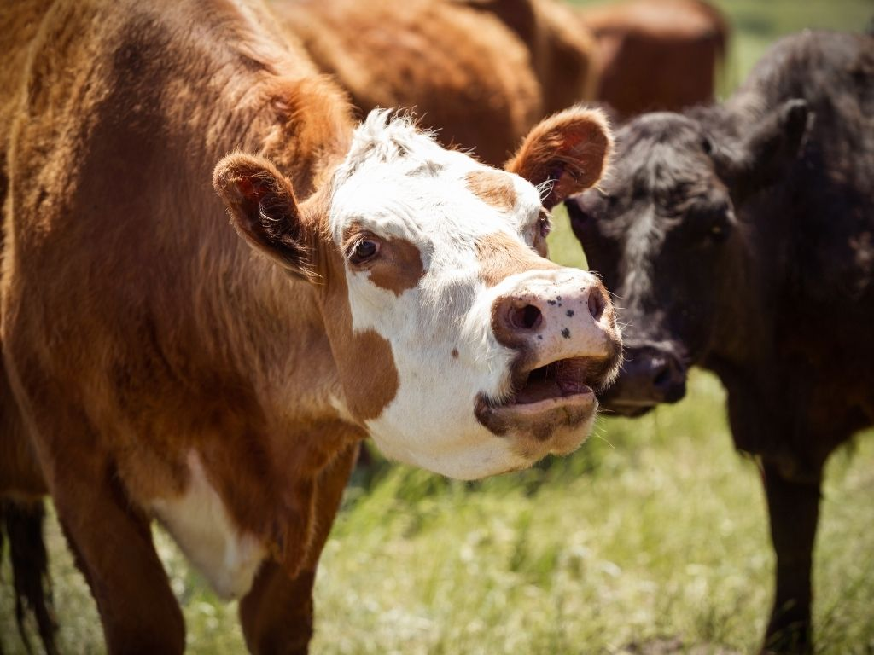
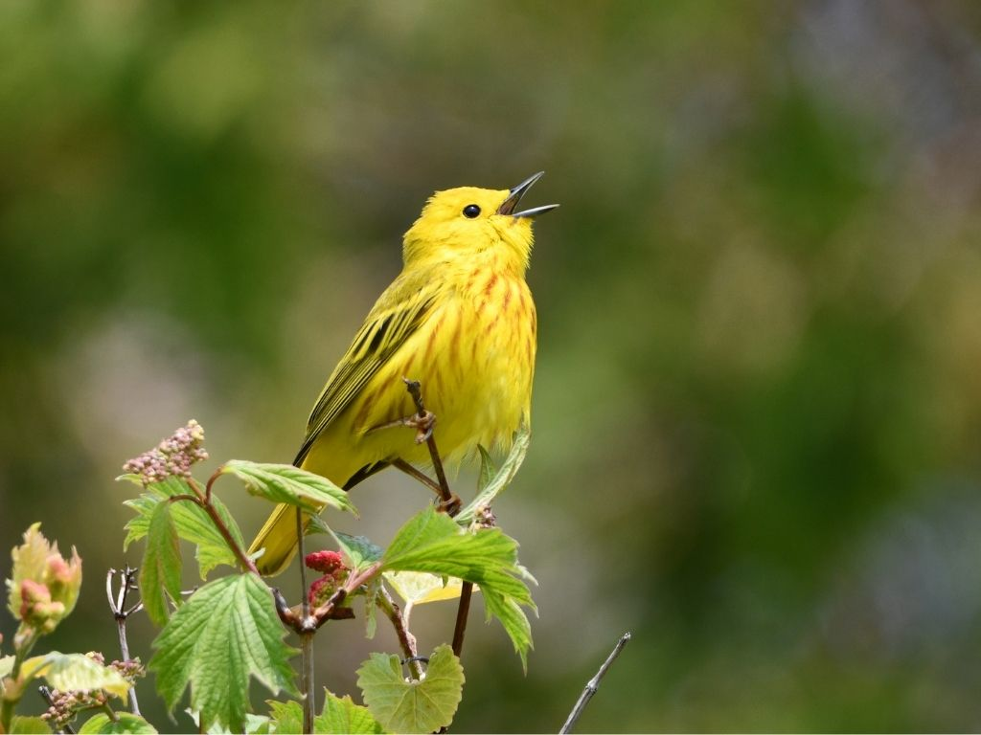

Slide 7




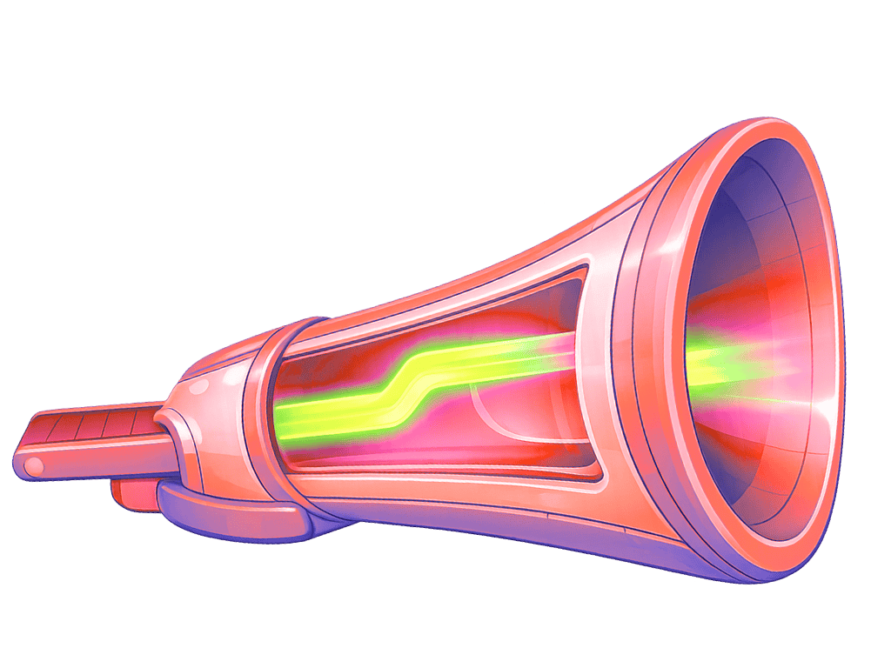


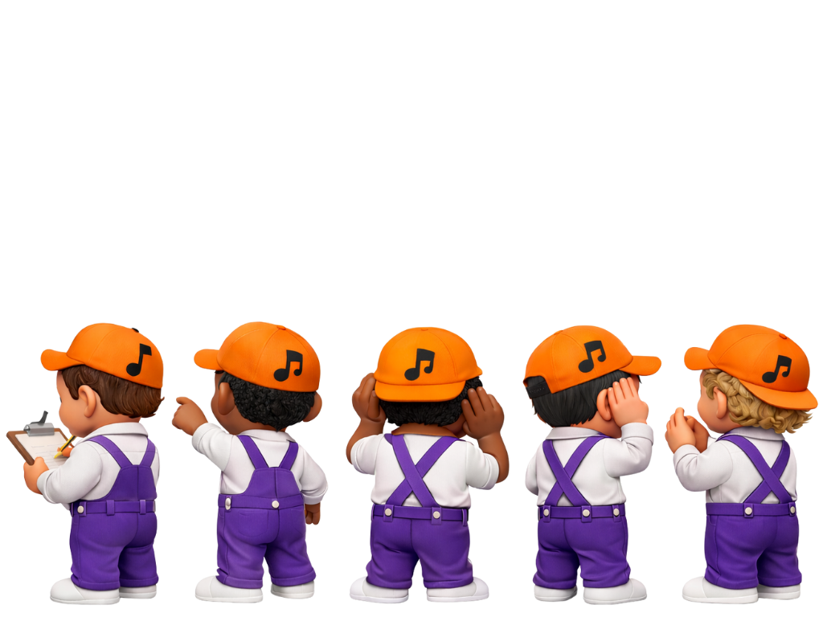

Slide 10
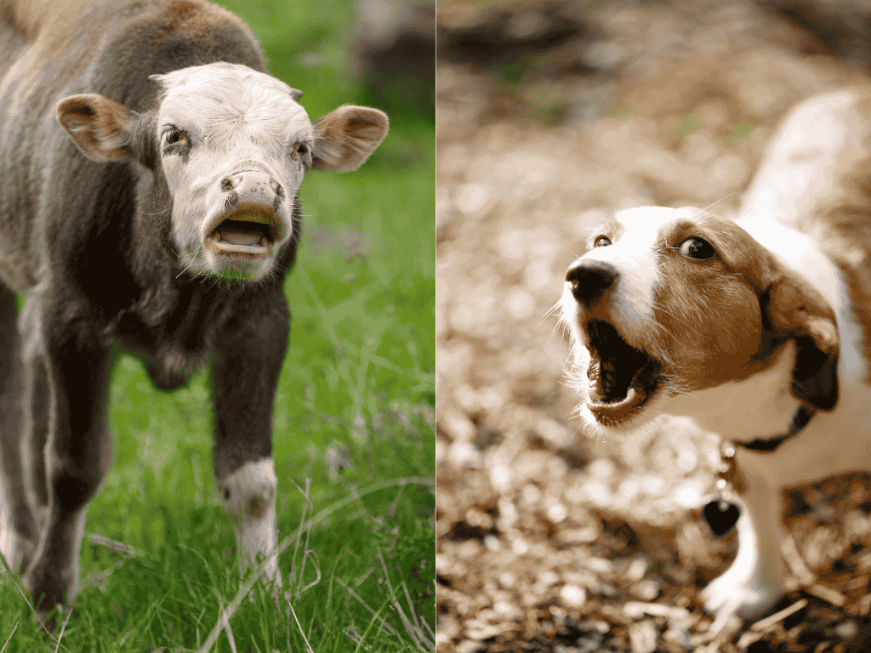




Slide 11
Short and Long Sounds in Nature

Slide 12
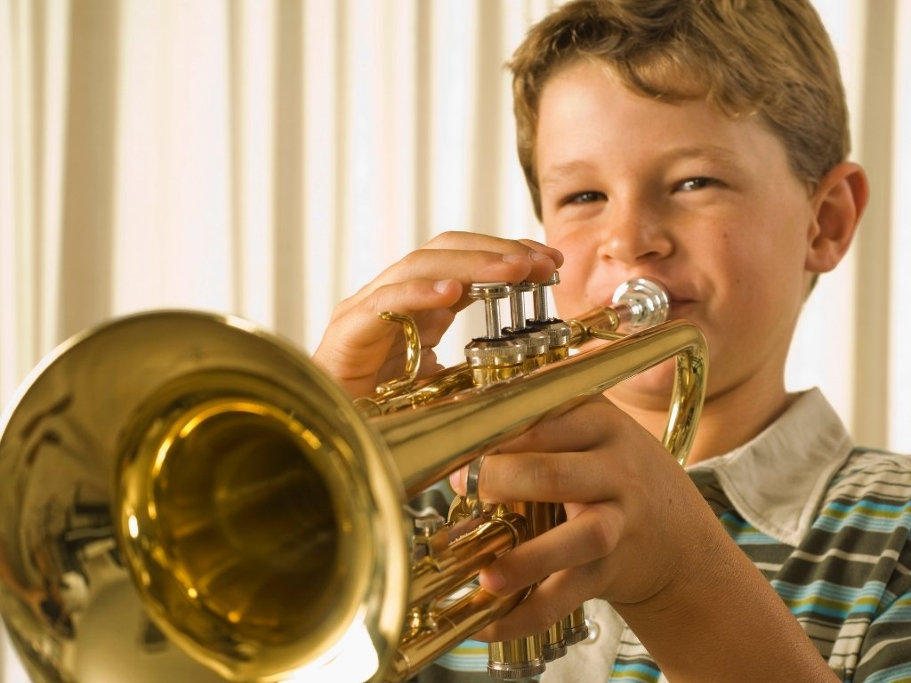
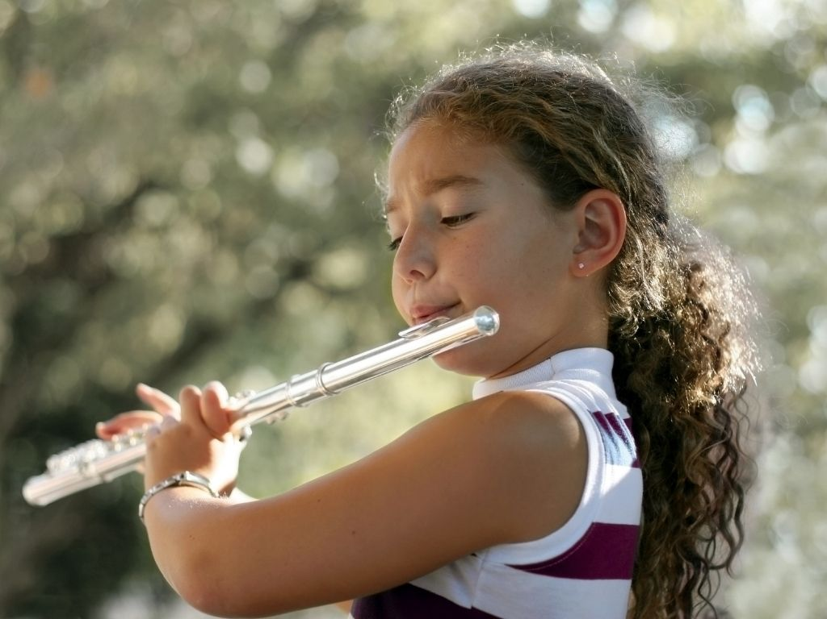

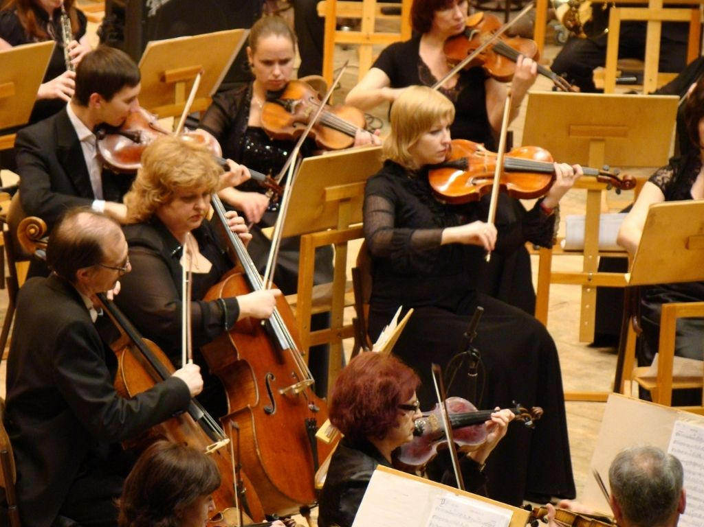
Short and Long Sounds in Music

Slide 13
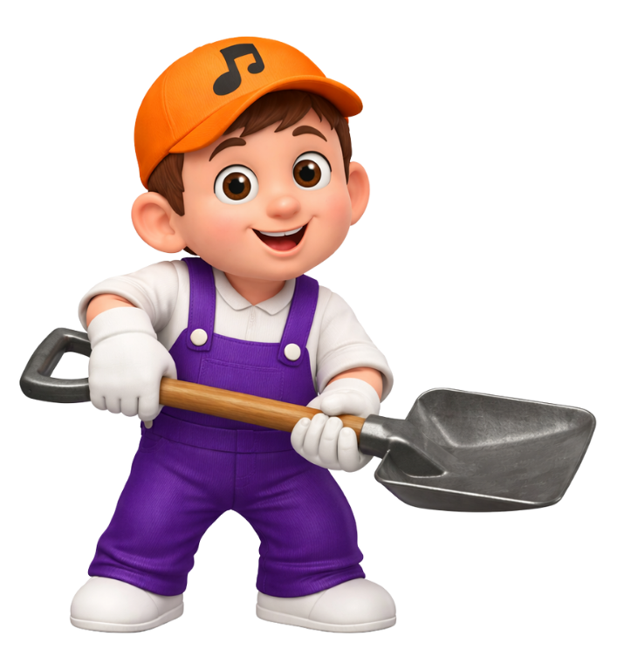



Slide 14
Short and Long Sounds
Music cannot have both short and long sounds.
Yes
No

Slide 15
hi
hi

Slide 16
blow
blow

Slide 17





Making Words Short and Long
Wait for me.

Slide 18
Making Words Short and Long
Look at that.

Slide 20
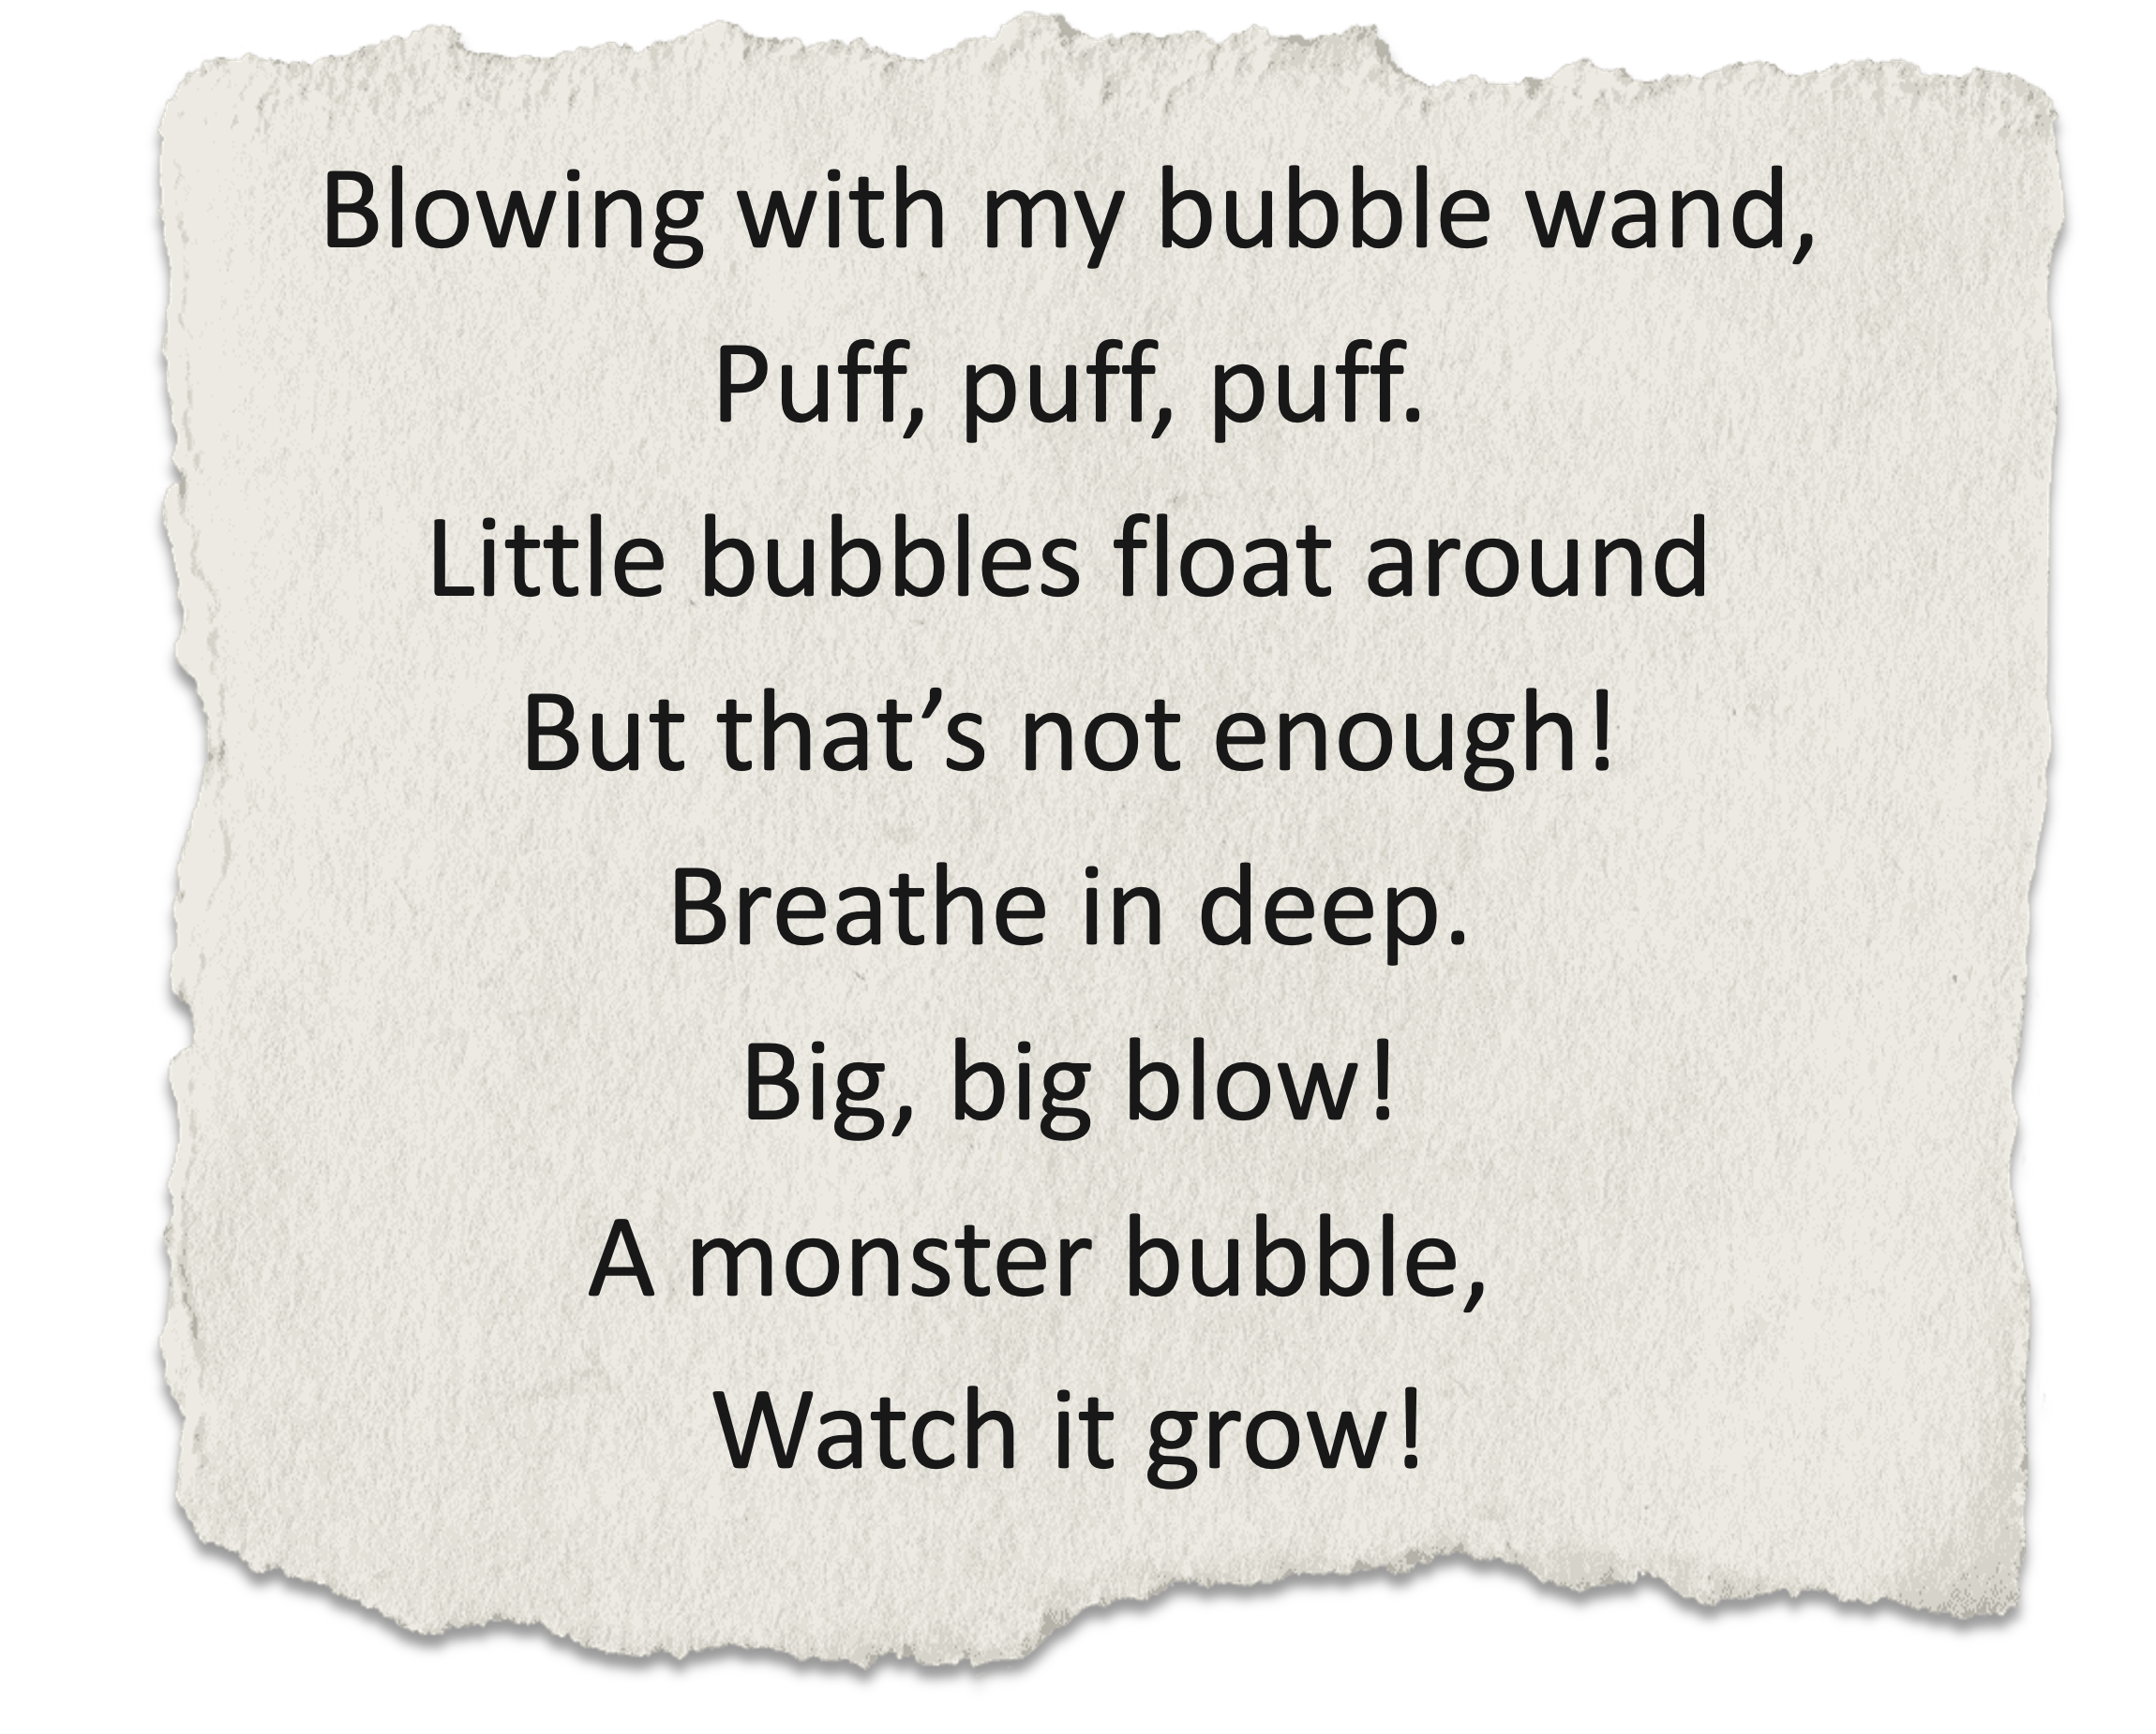

Slide 22

Turning Words Into a Song
Puff, puff, puff.
Big, big blow!

Slide 23

Words of the Song
Blowing with my bubble wand,
Puff, puff, puff.
Little bubbles float around
But that’s not enough!
Breathe in deep.
Big, big blow!
A monster bubble,
Watch it grow!

Slide 24
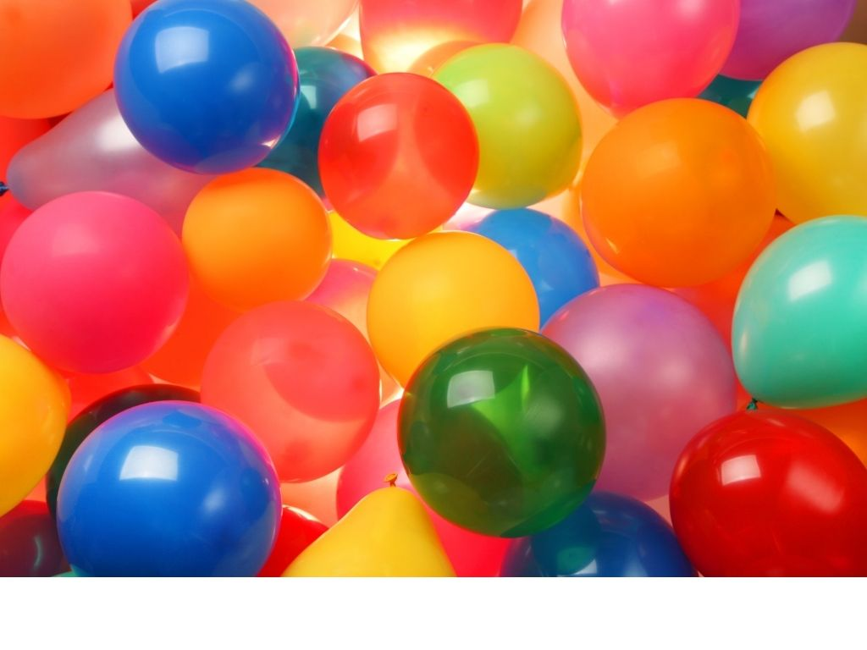
Words of the Song
Blowing lots of small balloons,
Puff, puff, puff.
Bouncy balloons fill the room
But that’s not enough!
Breathe in deep.
Big, big blow!
A monster balloon, Watch it grow!

Slide 25

Words of the Song
Blowing fluff from dandelions,
Puff, puff, puff.
Watch them float and flip and fly
But that’s not enough!
Breathe in deep.
Big, big blow!
A monster dandelion, Monster blow!

Slide 26

Words of the Song
Blowing candles on my cake,
Puff, puff, puff.
Birthday cake my family baked
But that’s not enough!
Breathe in deep.
Big, big blow!
A monster candle, Monster blow!

Slide 28

Blowing with my bubble wand,
Puff, puff, puff.
Little bubbles float around
But that’s not enough!
Breathe in deep.
Big, big blow!
A monster bubble,
Watch it grow!

Slide 29
Blowing lots of small balloons,
Puff, puff, puff.
Bouncy balloons fill the room
But that’s not enough!
Breathe in deep.
Big, big blow!
A monster balloon,
Watch it grow!

Slide 30
Blowing fluff from dandelions,
Puff, puff, puff.
Watch them float and flip and fly
But that’s not enough!
Breathe in deep.
Big, big blow!
A monster dandelion,
Monster blow!

Slide 31
Blowing candles on my cake,
Puff, puff, puff.
Birthday cake my family baked
But that’s not enough!
Breathe in deep.
Big, big blow!
A monster candle,
Monster blow!

Slide 33
Blowing with my bubble wand,
Puff, puff, puff.
Little bubbles float around
But that’s not enough!
Breathe in deep.
Big, big blow!
A monster bubble,
Watch it grow!

Slide 34
Blowing lots of small balloons,
Puff, puff, puff.
Bouncy balloons fill the room
But that’s not enough!
Breathe in deep.
Big, big blow!
A monster balloon,
Watch it grow!

Slide 35
Blowing fluff from dandelions,
Puff, puff, puff.
Watch them float and flip and fly
But that’s not enough!
Breathe in deep.
Big, big blow!
A monster dandelion,
Monster blow!

Slide 36
Blowing candles on my cake,
Puff, puff, puff.
Birthday cake my family baked
But that’s not enough!
Breathe in deep.
Big, big blow!
A monster candle,
Monster blow!

Slide 37
Music is made up of short and long sounds.
We can show short or long sounds with our bodies.
We can sing short and long sounds.

Slide 38

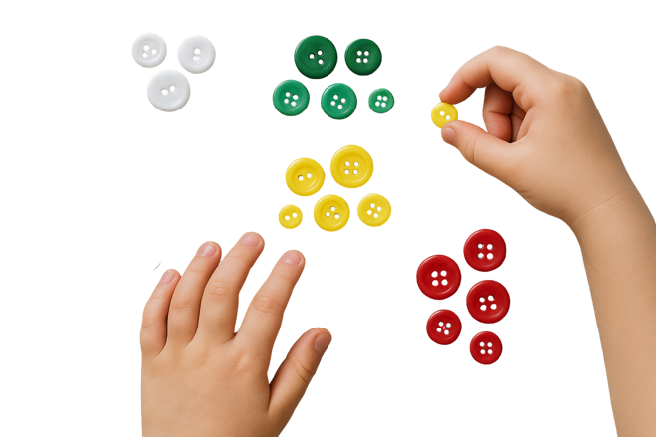
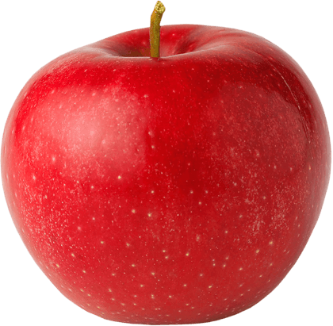




Exit Ticket
Date: _________
Lesson 1A
Lesson 2
You will be successful when you can:
describe properties of objects
sort objects into property groups.
short
Music has long and _______ sounds.
We can show short sounds by:
turning around in circles
clapping our hands
making our hands wide.
We use our voices to s____ long and short sounds.
short
skinny
tall
Describe means to tell what something looks like, sounds like, feels like or what it is.
Sort to put things that are the same together.
red
ing
round
crunchy
3
I know _____ out of 3 answers.

Slide 39
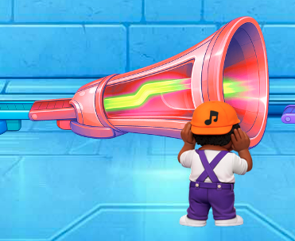
In the next lesson, we will learn that music is made up of soft and loud sounds.

