Slide 1
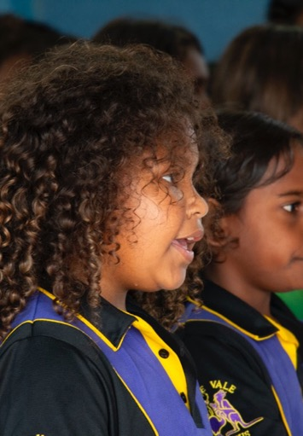
Tell Me a Story
Lesson 1
Sing Me a Story
Unit 1 Version 3

Slide 2
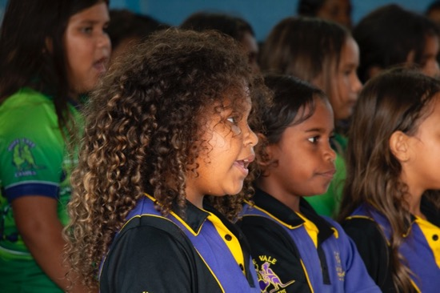
In this lesson, we will sing and move to music.

Slide 3

You will be able to: ​
sing two new songs
act out stories in
the music.
Sing means to make music with your voice by using words and a tune.
Act means to use your body and face to show a story.

Slide 4
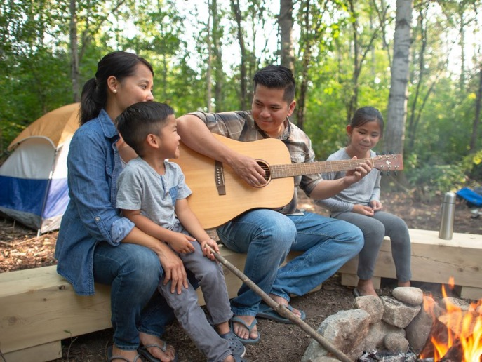
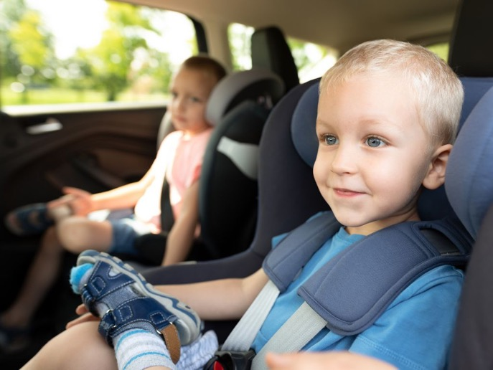


Slide 5


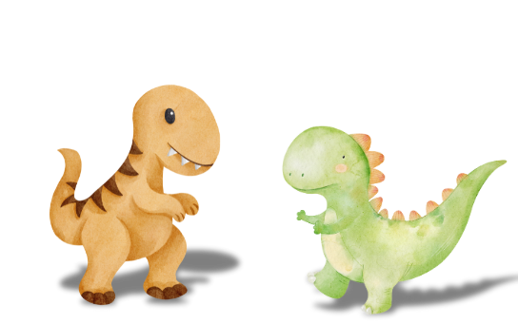


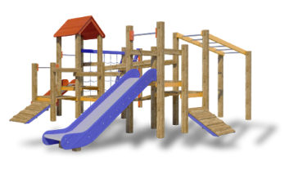
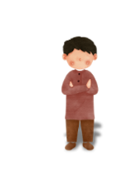
Stories

Slide 6
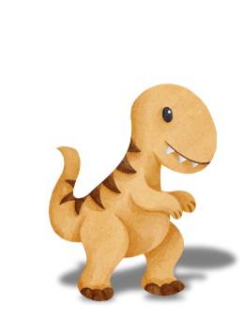
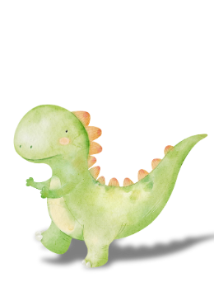

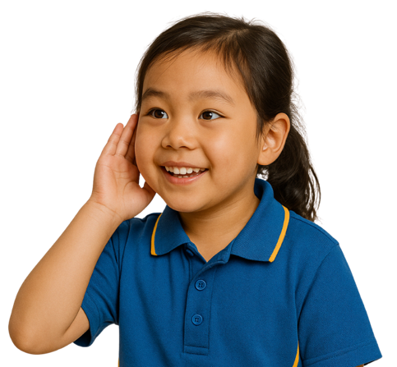
Music Can Tell Stories

Slide 7




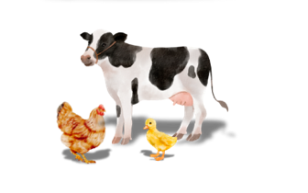
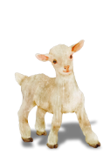
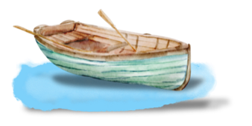
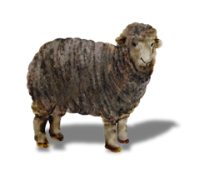
Music Can Tell Stories

Slide 8





Stories
Like books and movies, music can also tell stories.
Yes
No

Slide 9
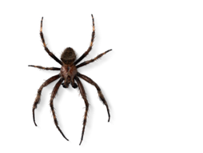
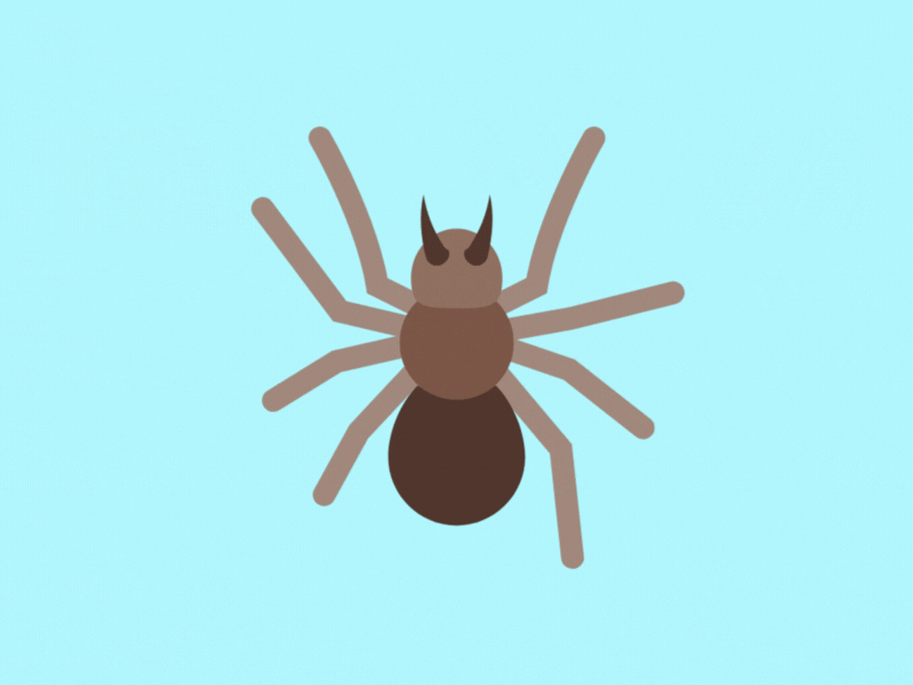


Songs That Tell Stories

Slide 10
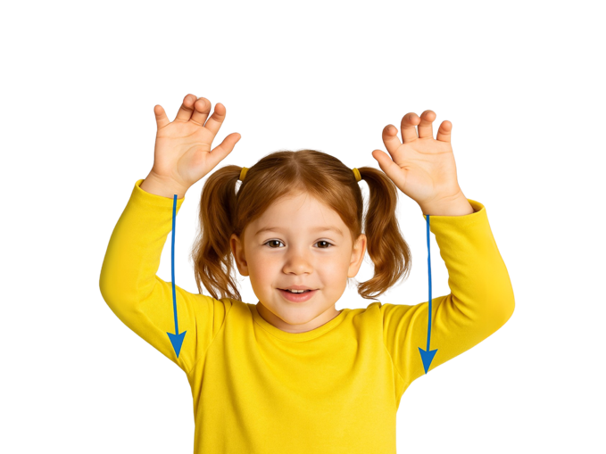


Body Actions As We Sing
And Incy Wincy Spider climbed up the spout again.
Down came the rain and washed poor Incy out
Out came the sunshine and dried up all the rain
Incy Wincy Spider climbed up the waterspout

Slide 11
Body Actions As We Sing
And Incy Wincy Spider climbed up the spout again.
And Incy Wincy Spider climbed up the spout again.
Down came the rain and washed poor Incy out
Out came the sunshine and dried up all the rain
Out came the sunshine and dried up all the rain
Incy Wincy Spider climbed up the waterspout
Down came the rain and washed poor Incy out
Incy Wincy Spider climbed up the waterspout

Slide 12
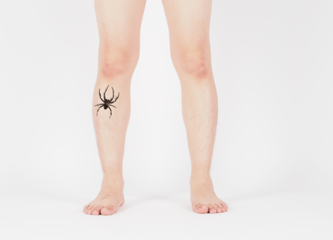

A Scarier Spider Song!

Slide 13
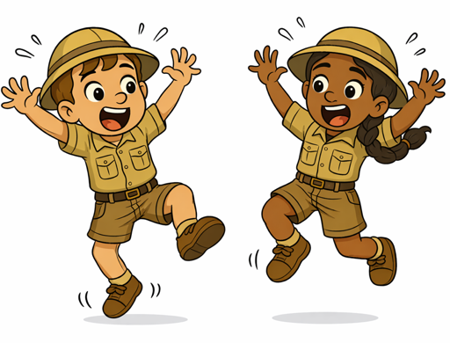
Scary Spider Song Body Actions
Jump up and down – hey, spider, get off me!
Shake my whole body, legs and arms and head
Hairy, scary spider is crawling up my knee
Oh, hairy, scary spider – go climb a tree instead!

Slide 14
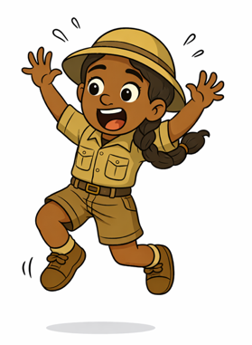
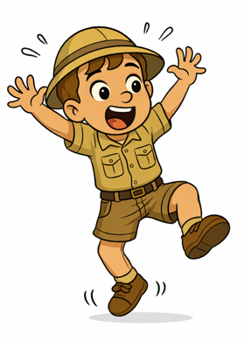
Scary Spider Song Body Actions
Jump up and down – hey, spider, get off me!
Shake my whole body, legs and arms and head
Oh, hairy, scary spider – go climb a tree instead!
Hairy, scary spider is crawling up my knee
Jump up and down – hey, spider, get off me!
Shake my whole body, legs and arms and head
Hairy, scary spider is crawling up my knee
Oh, hairy, scary spider – go climb a tree instead!

Slide 15
Scary Spider Song Body Actions
Jump up and down – hey, spider, get off me!
Shake my whole body, legs and arms and head
Oh, hairy, scary spider – go climb a tree instead!
Hairy, scary spider is crawling up my knee
Jump up and down – hey, spider, get off me!
Shake my whole body, legs and arms and head
Hairy, scary spider is crawling up my knee
Oh, hairy, scary spider – go climb a tree instead!

Slide 16
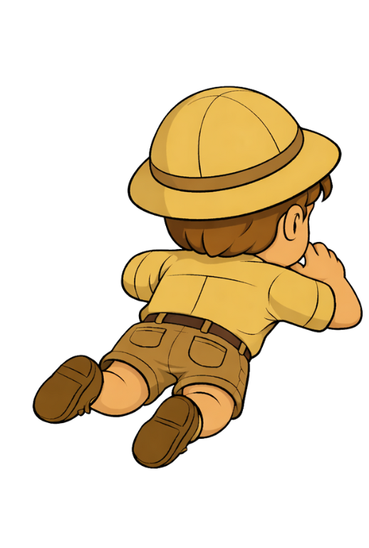
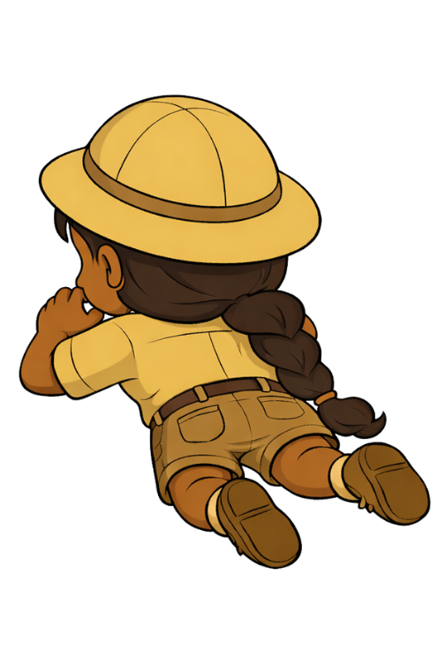


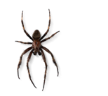



Slide 17




Slide 18
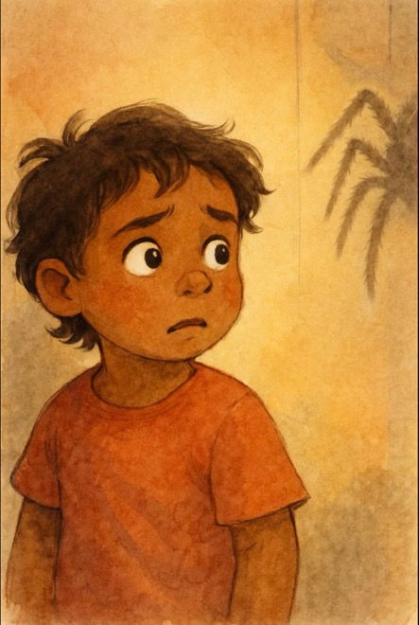
What’s got eight legs?
What’s got eight eyes?
What spins a
sticky web?
And sneaks and scuttles outside?

Slide 19

A hairy, scary spider
Hanging from a tree
Oh, hairy, scary spider,
Please don’t jump on me!

Slide 21

What’s got eight legs?
What’s got eight eyes?
What spins a
sticky web?
And sneaks and scuttles outside?

Slide 22
A hairy, scary spider
Hanging from a tree
Oh, hairy, scary spider,
Please don’t jump on me!

Slide 24
What’s got eight legs?
What’s got eight eyes?
What spins a
sticky web?
And sneaks and scuttles outside?

Slide 25
A hairy, scary spider
Hanging from a tree
Oh, hairy, scary spider,
Please don’t jump on me!

Slide 26
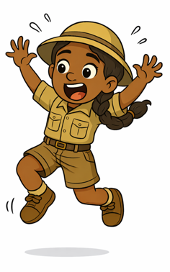
Songs can tell stories about characters and places.
We can make body
actions to music to
help tell its stories.

Slide 27



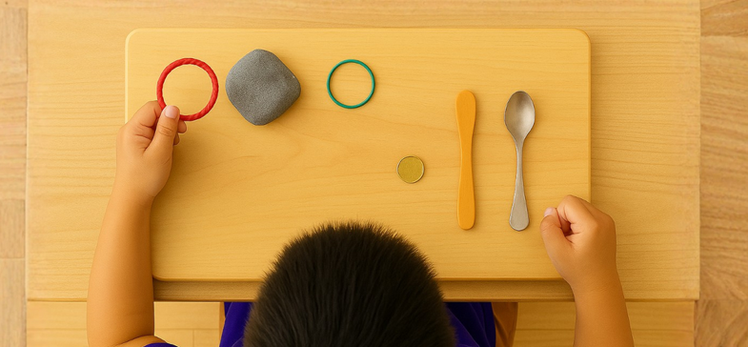
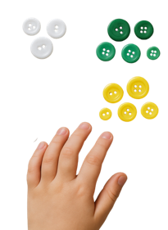






Exit Ticket
Date: _________
Lesson 1A
Lesson 1
You will be successful when you can:
describe properties of objects
sort objects into property groups.
stories
Music can tell __________.
The people or animals in a story are called:
  characters
  places
  events.
We sang songs about a s______.
time
stories
lies
Describe means to tell what something looks like, sounds like, feels like or what it is.
Sort to put things that are the same together.
red
round
pider
crunchy
3
I know _____ out of 3 answers.

Slide 28
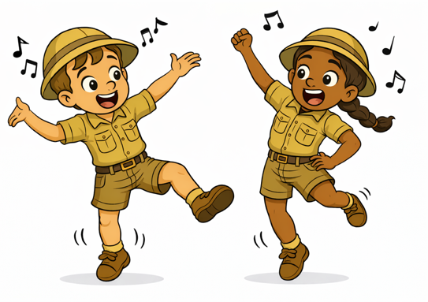
In the next lesson, we will use sounds and actions to tell a story.

