Slide 1
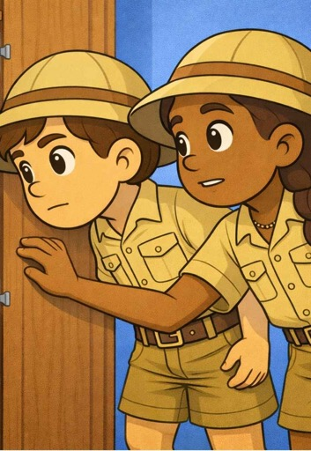
Tell Me a Story
Lesson 2
Bear and Spider Hunts
Unit 1 Version 3

Slide 2





What We Learnt
Exit Ticket
Lesson 1
stories
Music can tell __________.
The people or animals in a story are called:
characters
places
events.
We sang songs about a s______.
time
stories
lies
pider

Slide 3
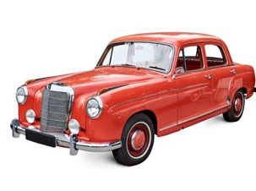
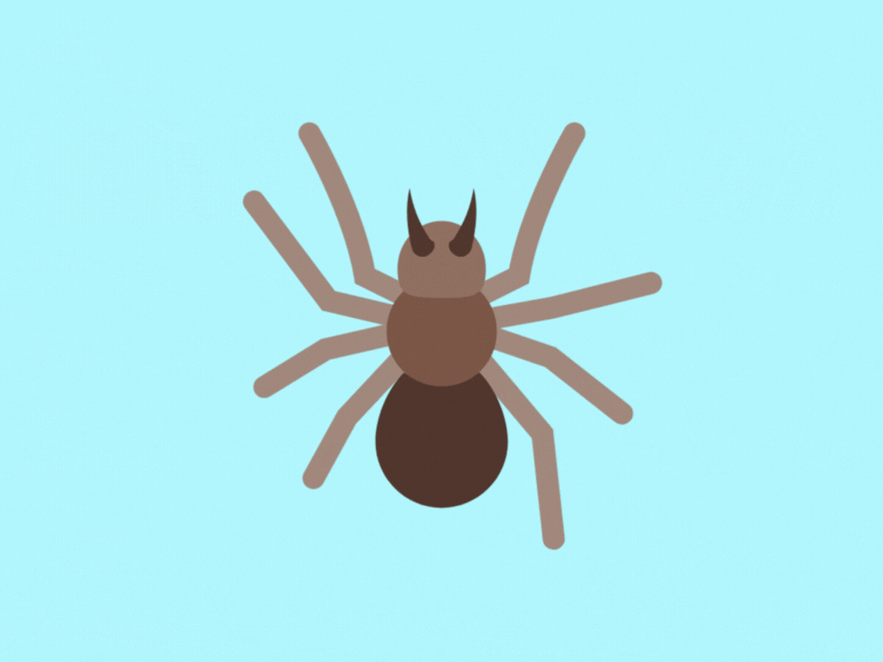


Incy Wincy Spider tells a story about:

Slide 4
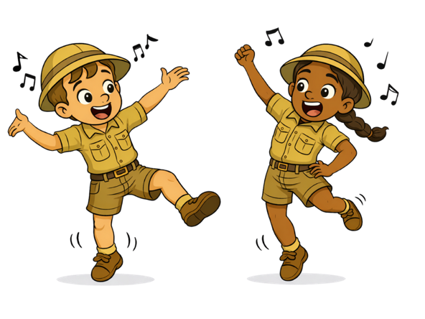
In this lesson, we will use sounds and actions to tell a story.

Slide 5

You will be able to: ​
chant stories together
act out the stories we chant.
Chant means to say a group of words in a special way to make them sound more exciting.
Act means to use your body and face to show a story.

Slide 6
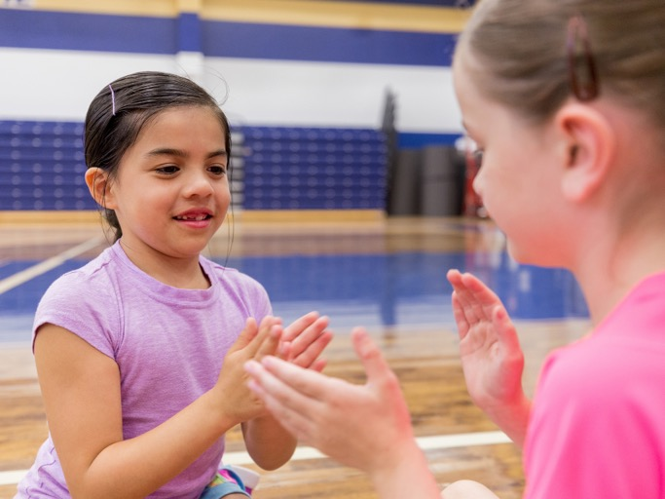
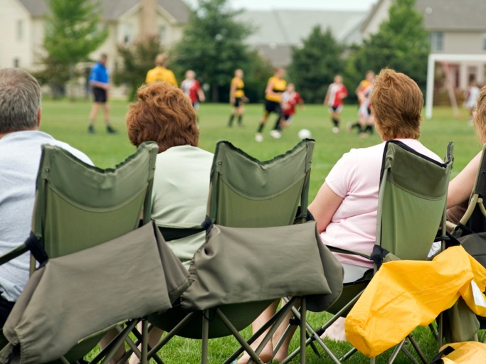
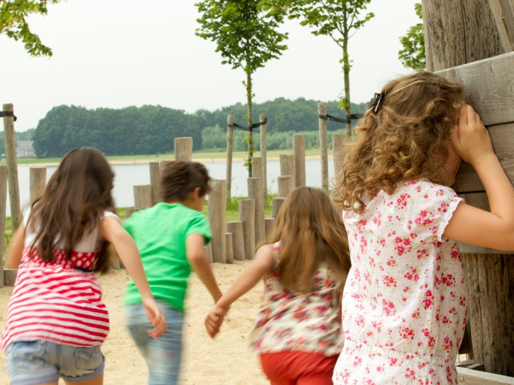

Slide 7
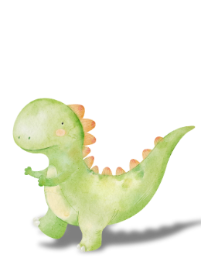
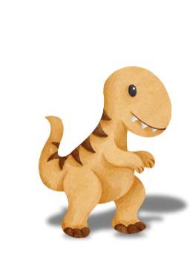
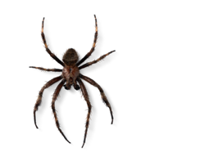

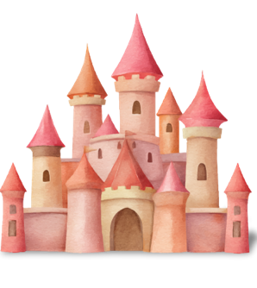
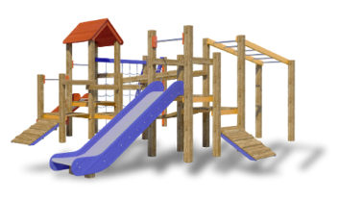
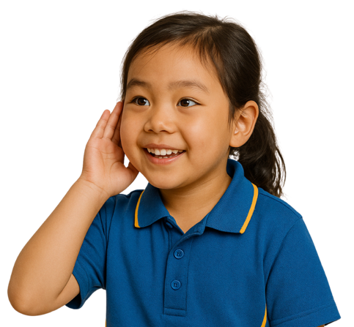
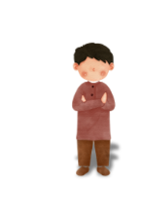

Music Can Tell Stories

Slide 8

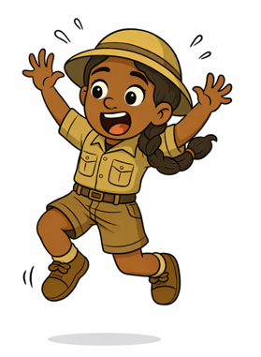
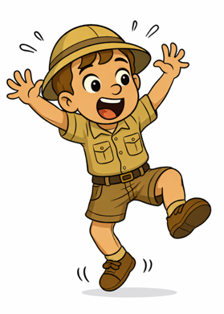
Scary Spider Song Body Actions
Jump up and down – hey, spider, get off me!
Shake my whole body, legs and arms and head
Oh, hairy, scary spider – go climb a tree instead!
Hairy, scary spider is crawling up my knee
Jump up and down – hey, spider, get off me!
Shake my whole body, legs and arms and head
Hairy, scary spider is crawling up my knee
Oh, hairy, scary spider – go climb a tree instead!

Slide 9

We’re Going On a Bear Hunt

Slide 10


Chants
Which one is the chant?

Slide 11
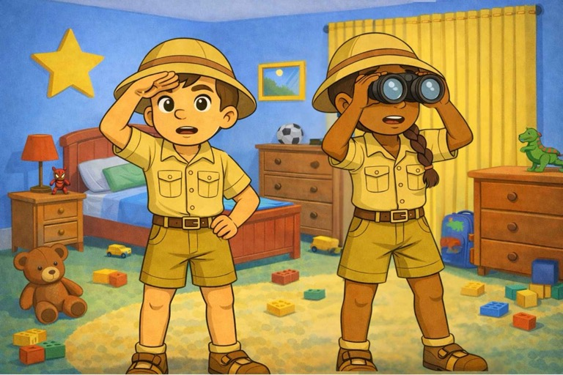
The Spider Is Missing!

Slide 12
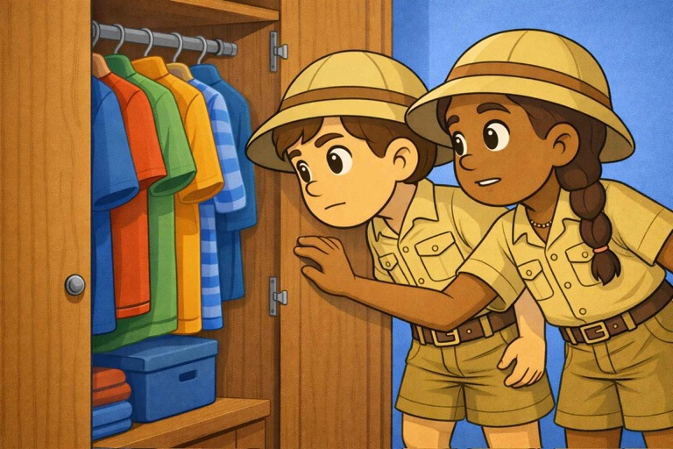
I’m Going On a Spider Hunt

Slide 13
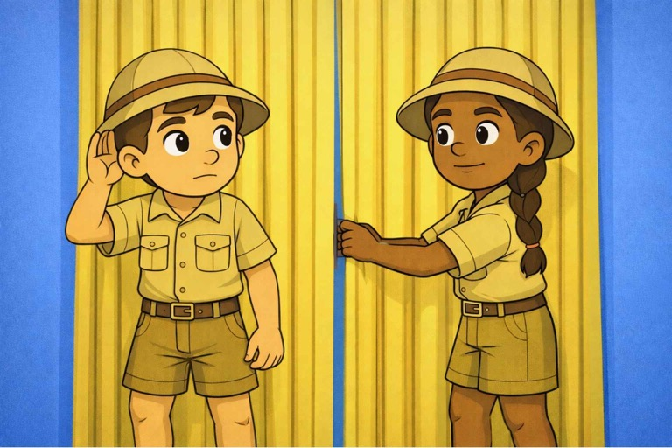
I’m Going On a Spider Hunt

Slide 14

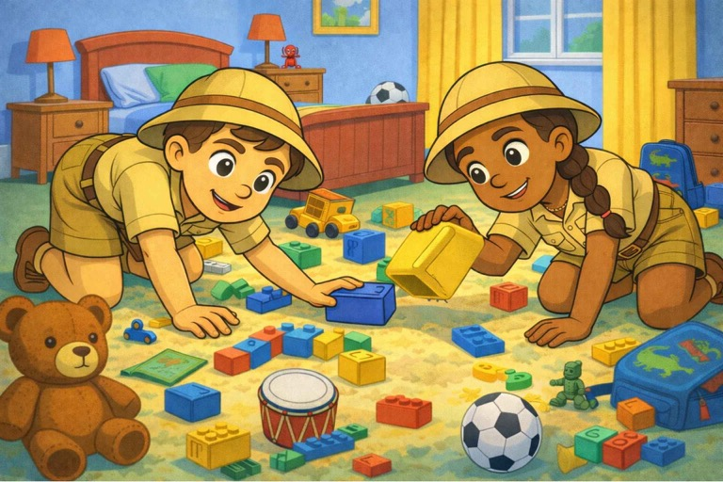
I’m Going On a Spider Hunt

Slide 15
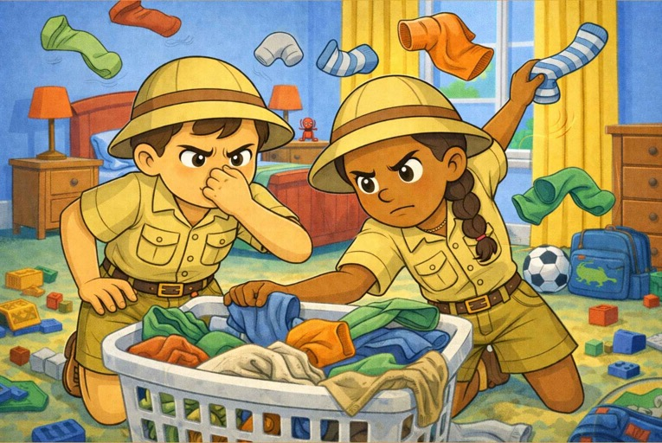
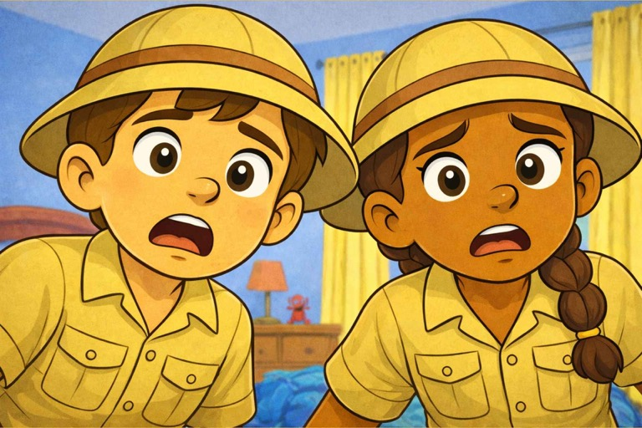
I’m Going On a Spider Hunt

Slide 16
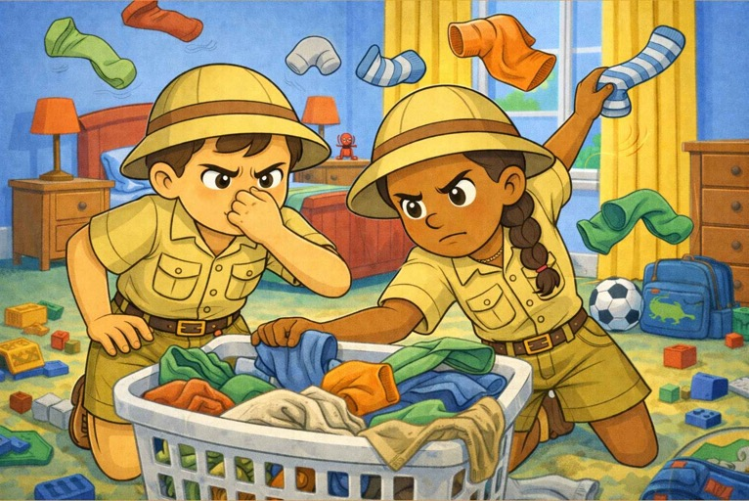
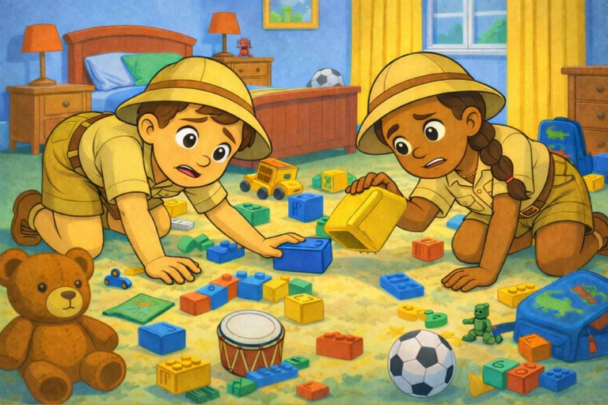
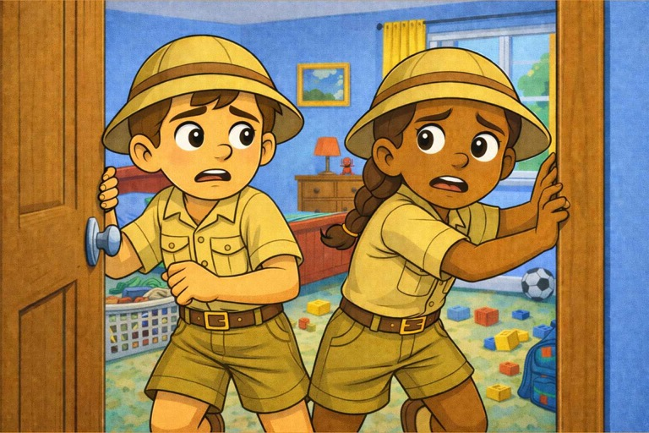
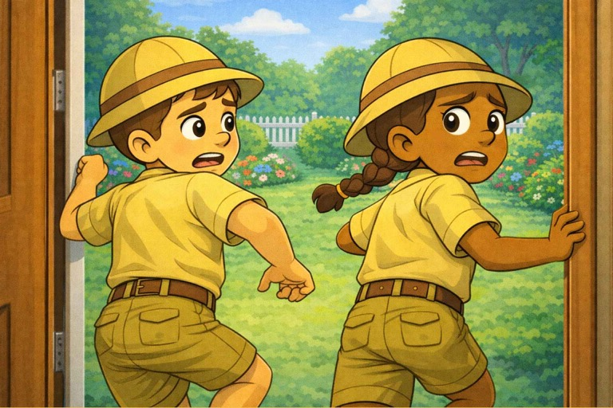
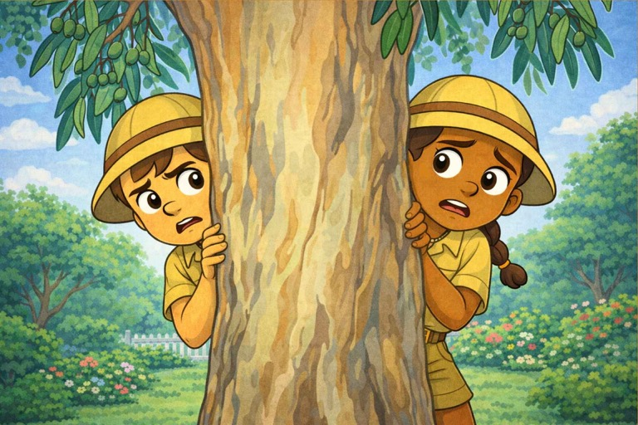
I’m Going On a Spider Hunt

Slide 17

I’m Going On a Spider Hunt

Slide 18
I’m Going on a Spider Hunt

Slide 19
I’m Going on a Spider Hunt

Slide 20
I’m Going on a Spider Hunt

Slide 21
I’m Going on a Spider Hunt

Slide 22
I’m Going on a Spider Hunt

Slide 23
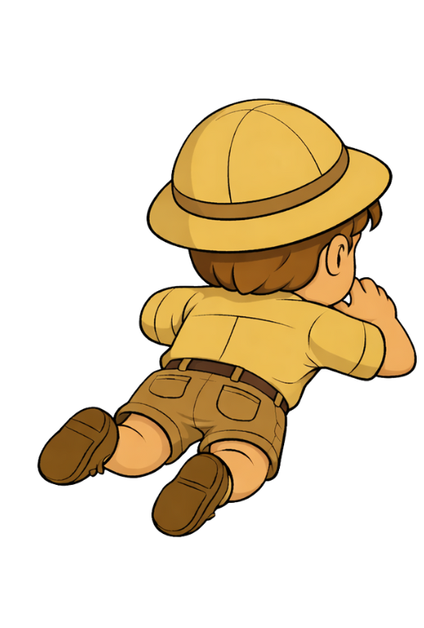
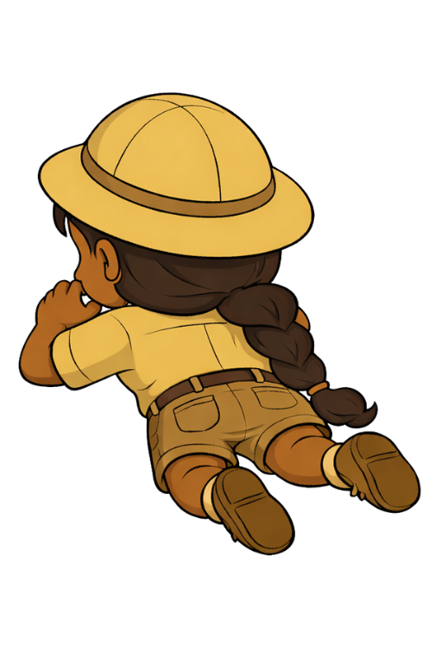

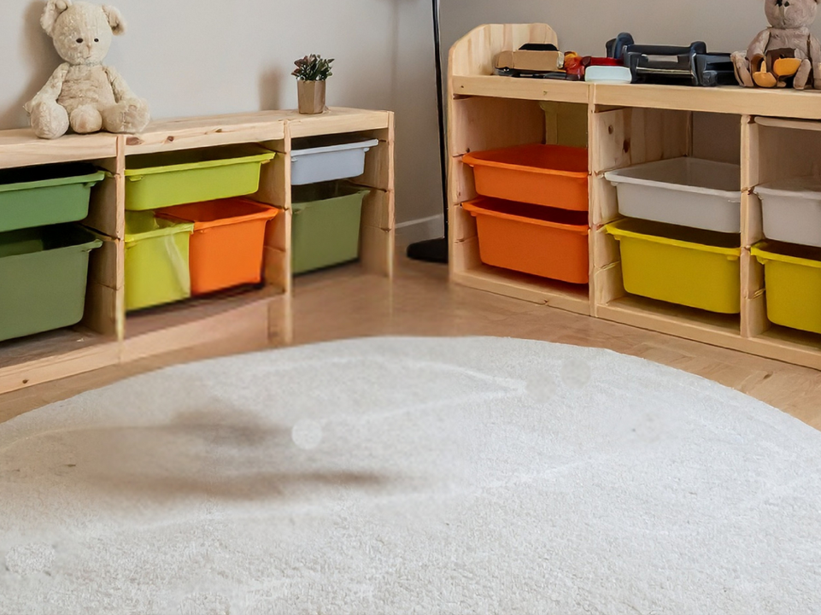
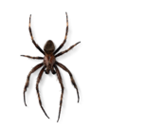




Slide 24




Slide 25
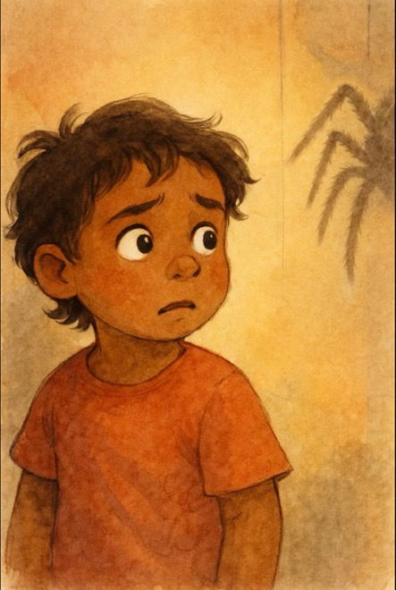
What’s got eight legs?
What’s got eight eyes?
What spins a sticky web?
And sneaks and scuttles outside?

Slide 26
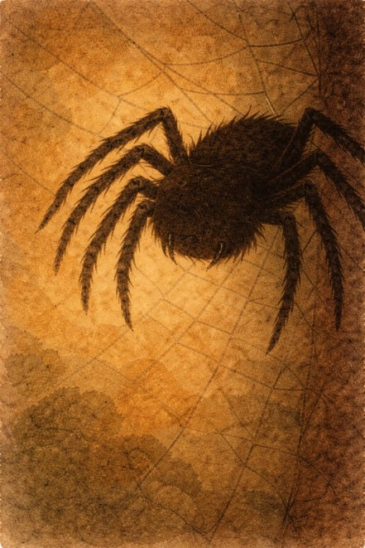
A hairy, scary spider
Hanging from a tree
Oh, hairy, scary spider,
Please don’t jump on me!

Slide 27
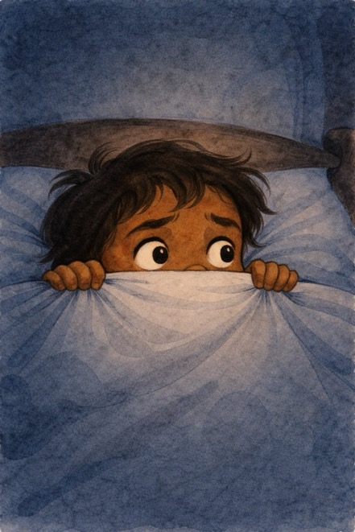
I hear a tap, tap
Has it come inside?
Eight legs go trip, trap
Oh no, I want to run and hide!

Slide 28
A hairy, scary spider
I hear it from my bed
Oh, hairy, scary spider,
Don’t jump on my head!

Slide 30
What’s got eight legs?
What’s got eight eyes?
What spins a sticky web?
And sneaks and scuttles outside?

Slide 31
A hairy, scary spider
Hanging from a tree
Oh, hairy, scary spider,
Please don’t jump on me!

Slide 32
I hear a tap, tap
Has it come inside?
Eight legs go trip, trap
Oh no, I want to run and hide!

Slide 33
A hairy, scary spider
I hear it from my bed
Oh, hairy, scary spider,
Don’t jump on my head!

Slide 35
What’s got eight legs?
What’s got eight eyes?
What spins a sticky web?
And sneaks and scuttles outside?

Slide 36
A hairy, scary spider
Hanging from a tree
Oh, hairy, scary spider,
Please don’t jump on me!

Slide 37
I hear a tap, tap
Has it come inside?
Eight legs go trip, trap
Oh no, I want to run and hide!

Slide 38
A hairy, scary spider
I hear it from my bed
Oh, hairy, scary spider,
Don’t jump on my head!

Slide 39
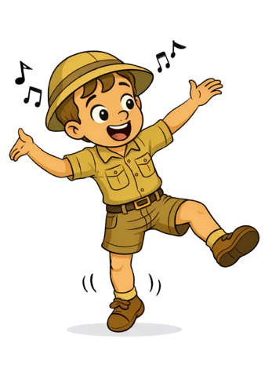
Chants are a special way to say words to make them sound more exciting.
We can make body actions to music to help tell its stories.

Slide 40

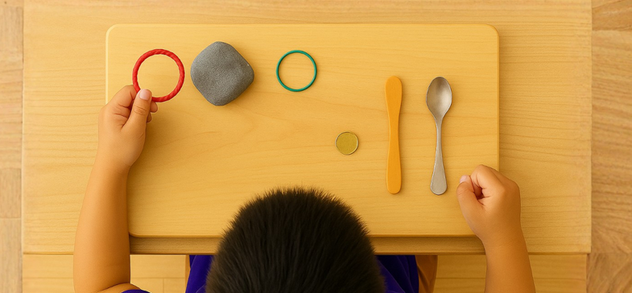
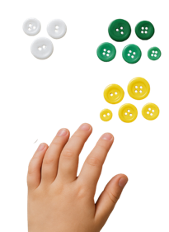
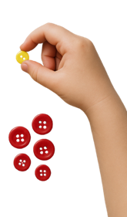





Exit Ticket
Date: _________
Lesson 1A
Lesson 1
You will be successful when you can:
describe properties of objects
sort objects into property groups.
exciting
Chants make words sound ________.
We chant with our:
feet
voices
ears.
We can act out stories with our b______.
exciting
boring
quiet
Describe means to tell what something looks like, sounds like, feels like or what it is.
Sort to put things that are the same together.
red
odies
round
crunchy
3
I know _____ out of 3 answers.

Slide 41
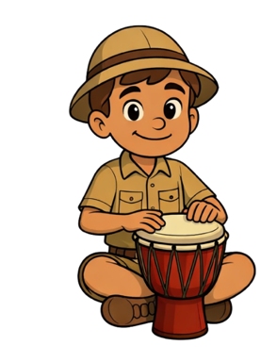
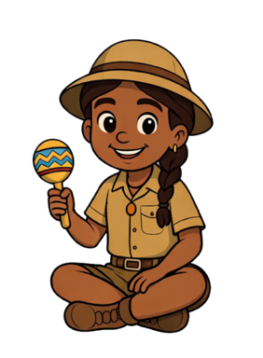
In the next lesson, we will use percussion instruments to tell a story.

