Slide 1

Jazz Music
Lesson 1
What's Jazz?
Version 3

Slide 2

In this lesson, we will learn about the unique characteristics of Jazz music.

Slide 3


You will be able to: ​
identify the unique characteristics of jazz music.
Identify: To pick out or recognise something by noticing its important features.

Slide 4





Slide 5


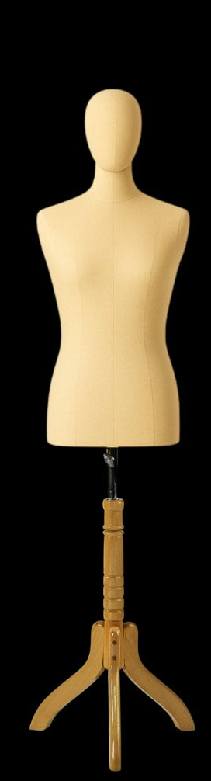


Music Genres

Slide 6


Unique Characteristics of Jazz
instruments
swing rhythms
solos
call and response

Slide 7

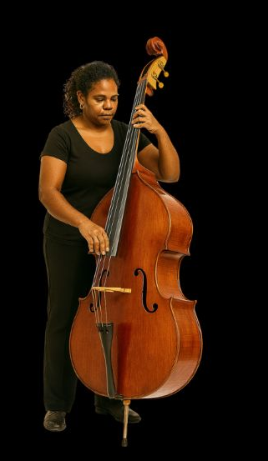
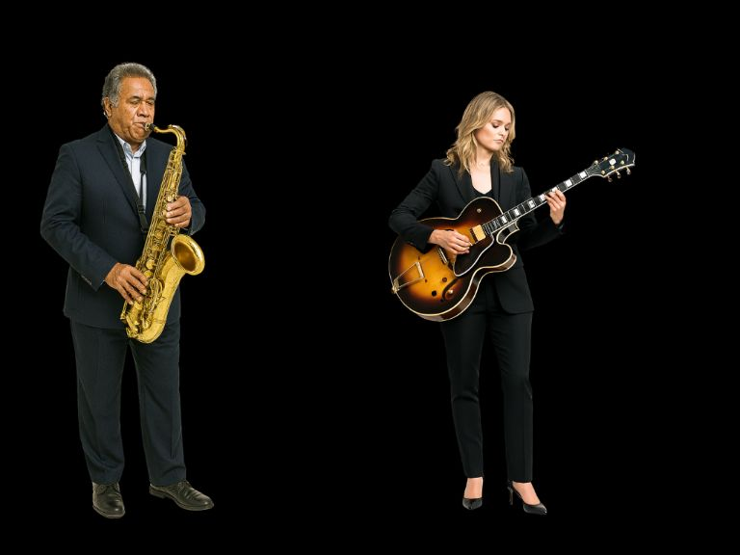
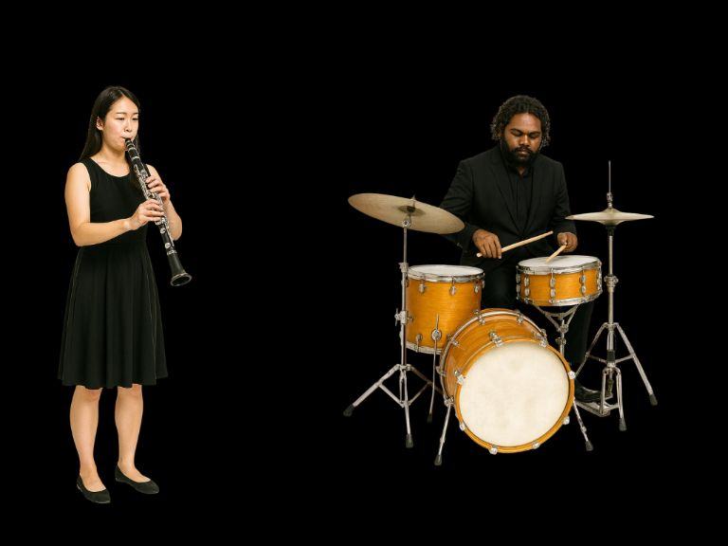
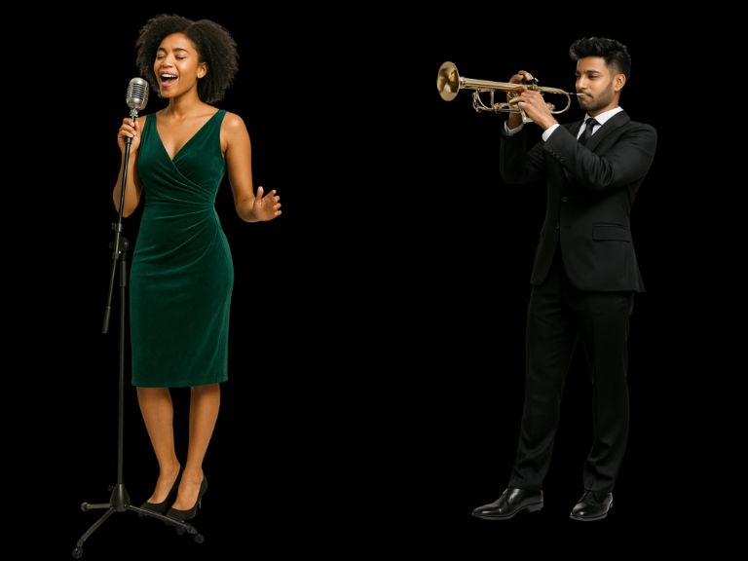
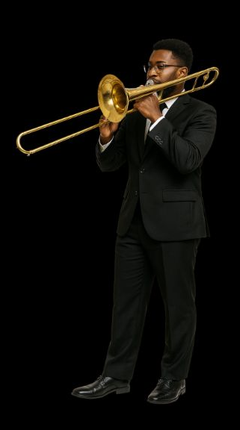
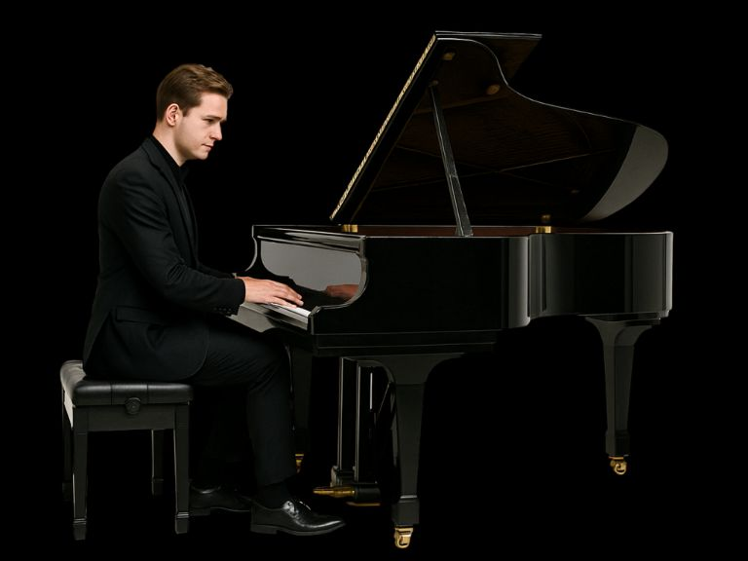

Slide 8
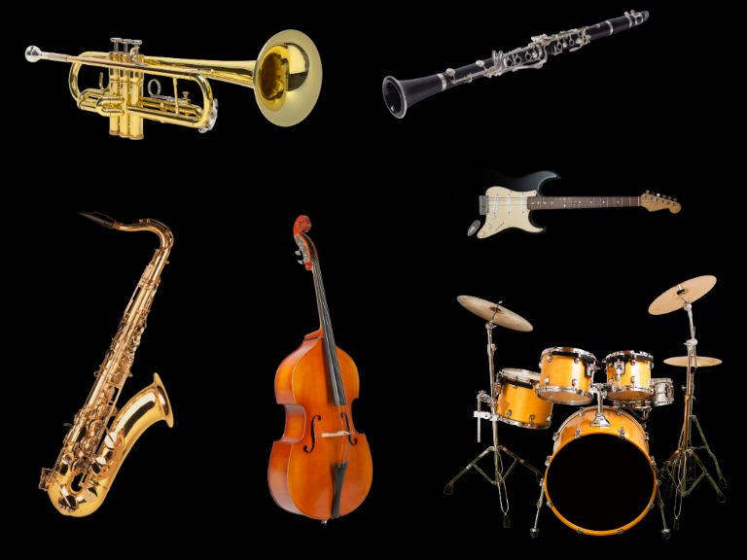
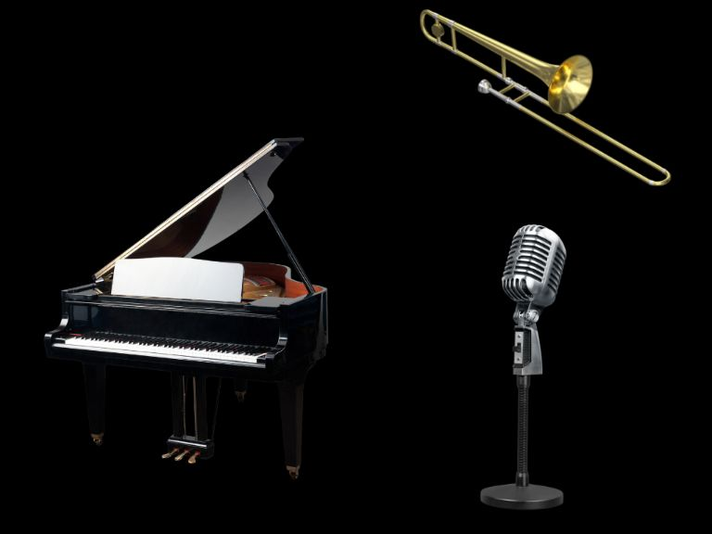

Characteristics #1 - Jazz Instruments

Slide 9



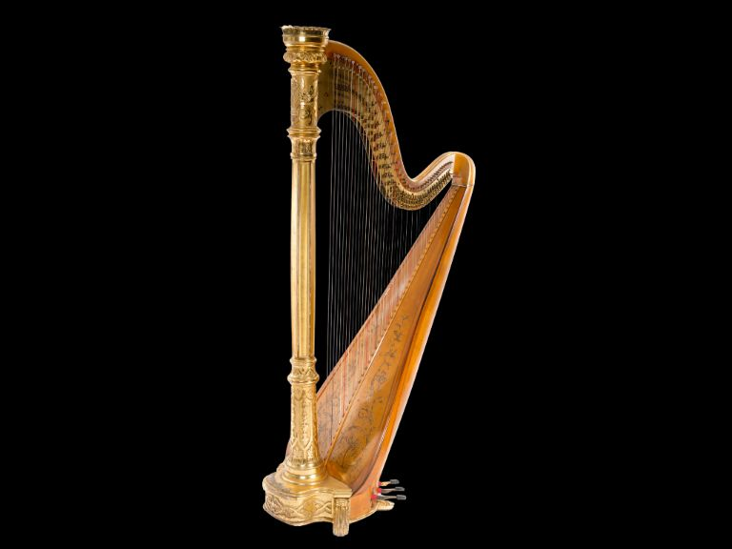
Jazz Instruments
Which of these instruments is not commonly used in jazz music?
harp
trombone
piano

Slide 10
Unique Characteristics of Jazz
instruments
swing rhythms
solos
call and response

Slide 11


Characteristic #2 – Swing Rhythms

Slide 13
Identifying Swing Rhythms

Slide 14
Unique Characteristics of Jazz
instruments
swing rhythms
solos
call and response

Slide 15


Slide 17
Unique Characteristics of Jazz
instruments
swing rhythms
solos
call and response

Slide 18






Slide 19








Slide 20
Jazz music is a genre of music just like pop, rock and classical.

Slide 21
Jazz music uses a unique group of instruments.
Jazz music features a call-and-response, where the instruments play back and forth like a conversation.
Jazz music includes solos, where one musician plays something exciting.
Jazz music has swing rhythms that make you want to dance.

Slide 22




Exit Ticket
Date: _________
Lesson 1
Jazz, Rock, Pop and Classical are all _______ of music.
Jazz music has unique characteristics that can include:
instruments
swing rhythms
solos
call and response
all of the above
Swing rhythms feel b _______ with a mix of long and short rhythms.
genres
genres
ways
sounds
ouncy
3
I know _____ out of 3 answers.

Slide 23
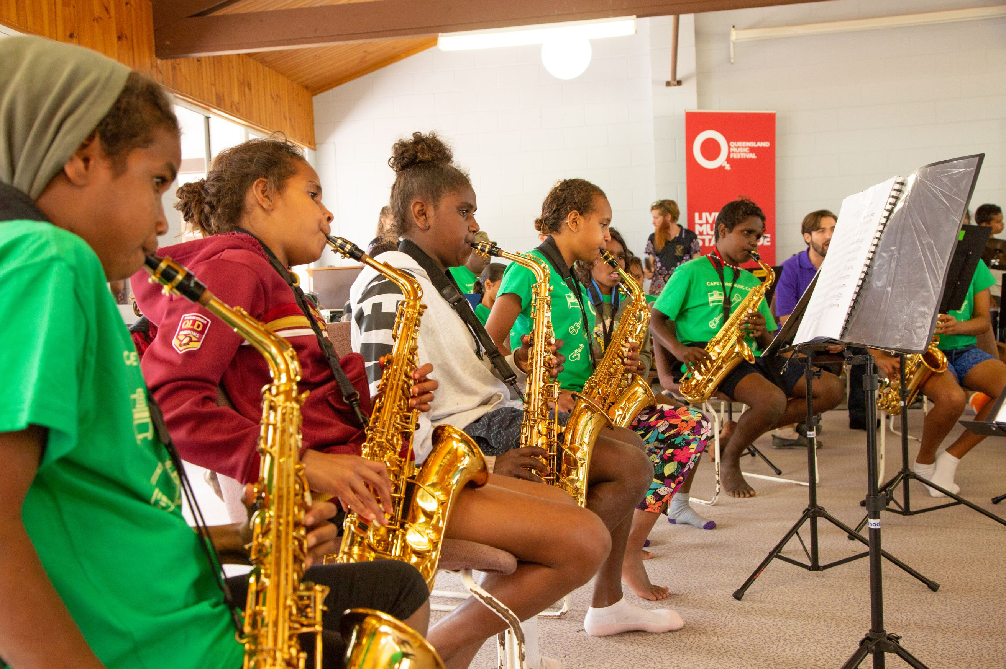
In the next lesson, we will learn how to identify the unique characteristics of jazz music.

