Slide 1
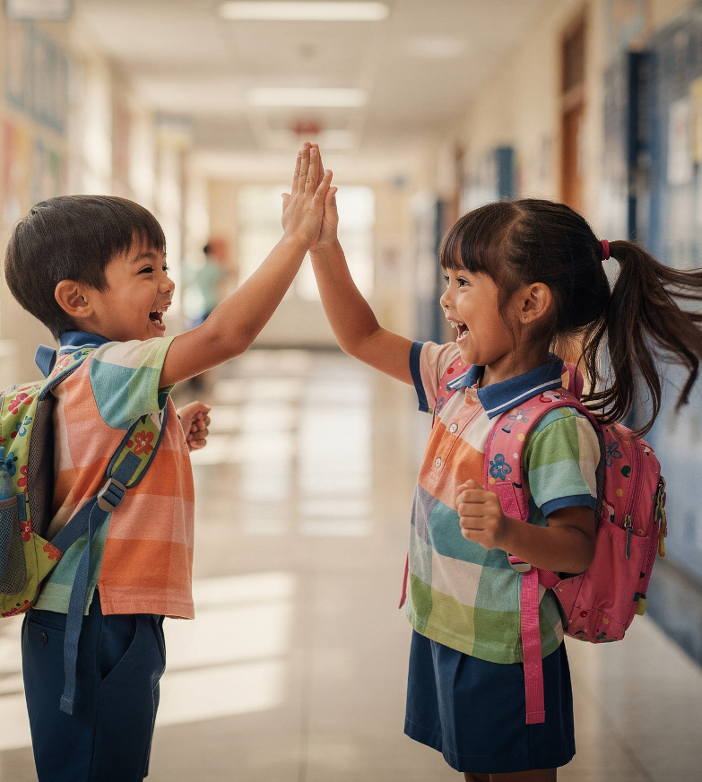
Caring in Shared Spaces
Unit 2: Relating to Others
Lesson 1

Slide 2
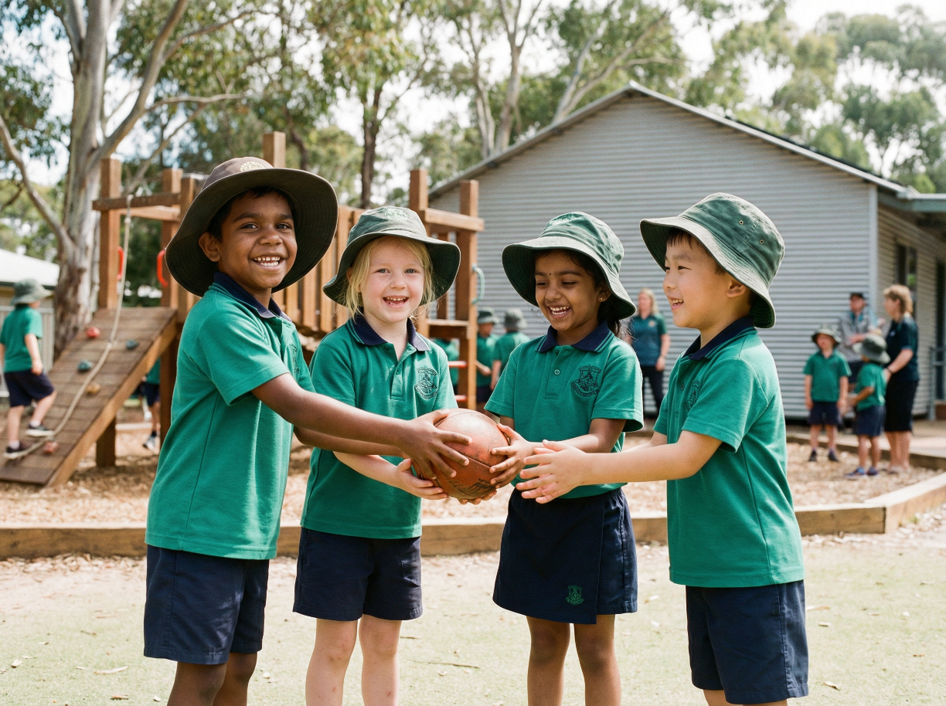
In this lesson, we will learn how to show kindness in shared school spaces.

Slide 3

You will be successful when you can:
notice when someone might need kindness
tell how you can show kindness in a shared space
explain how your action helps others.

Slide 4
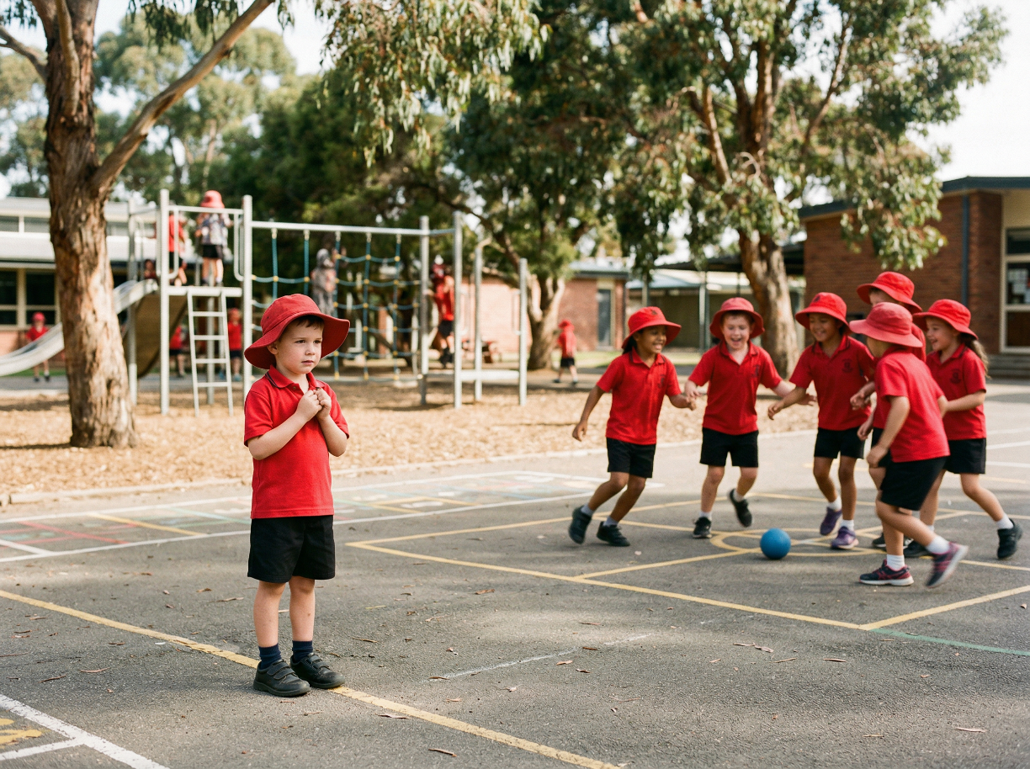
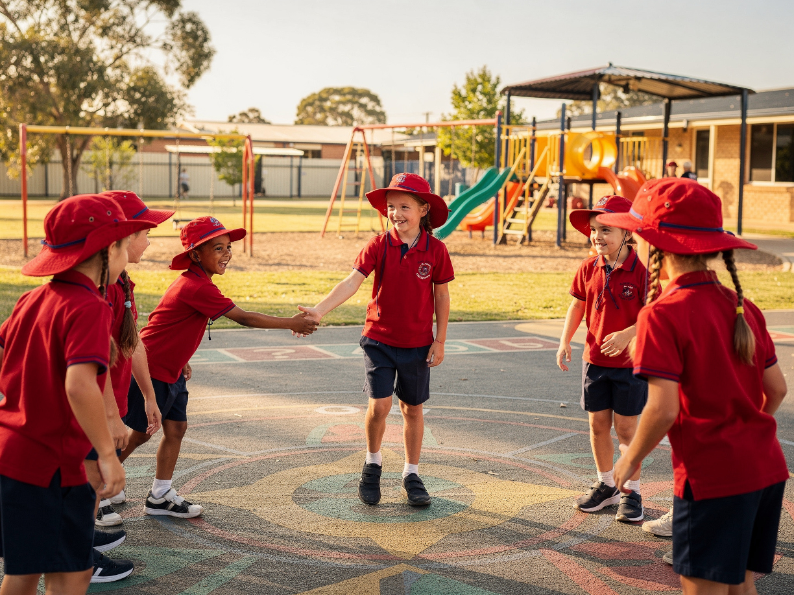
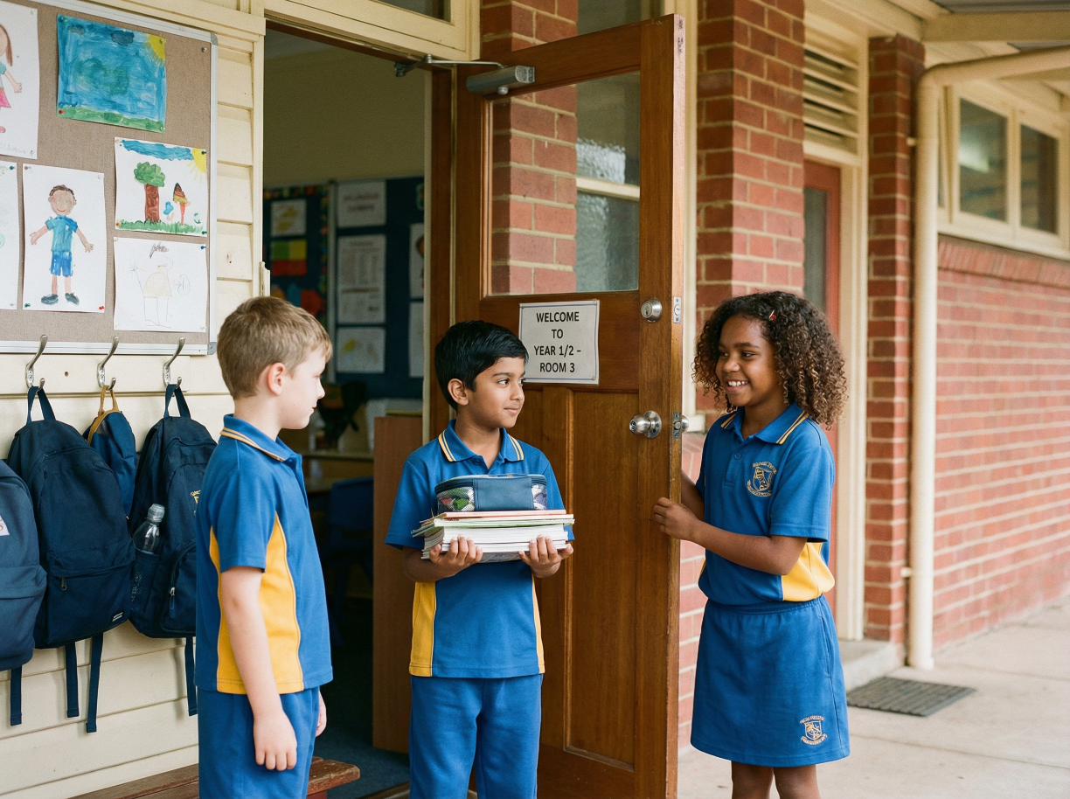

Slide 5
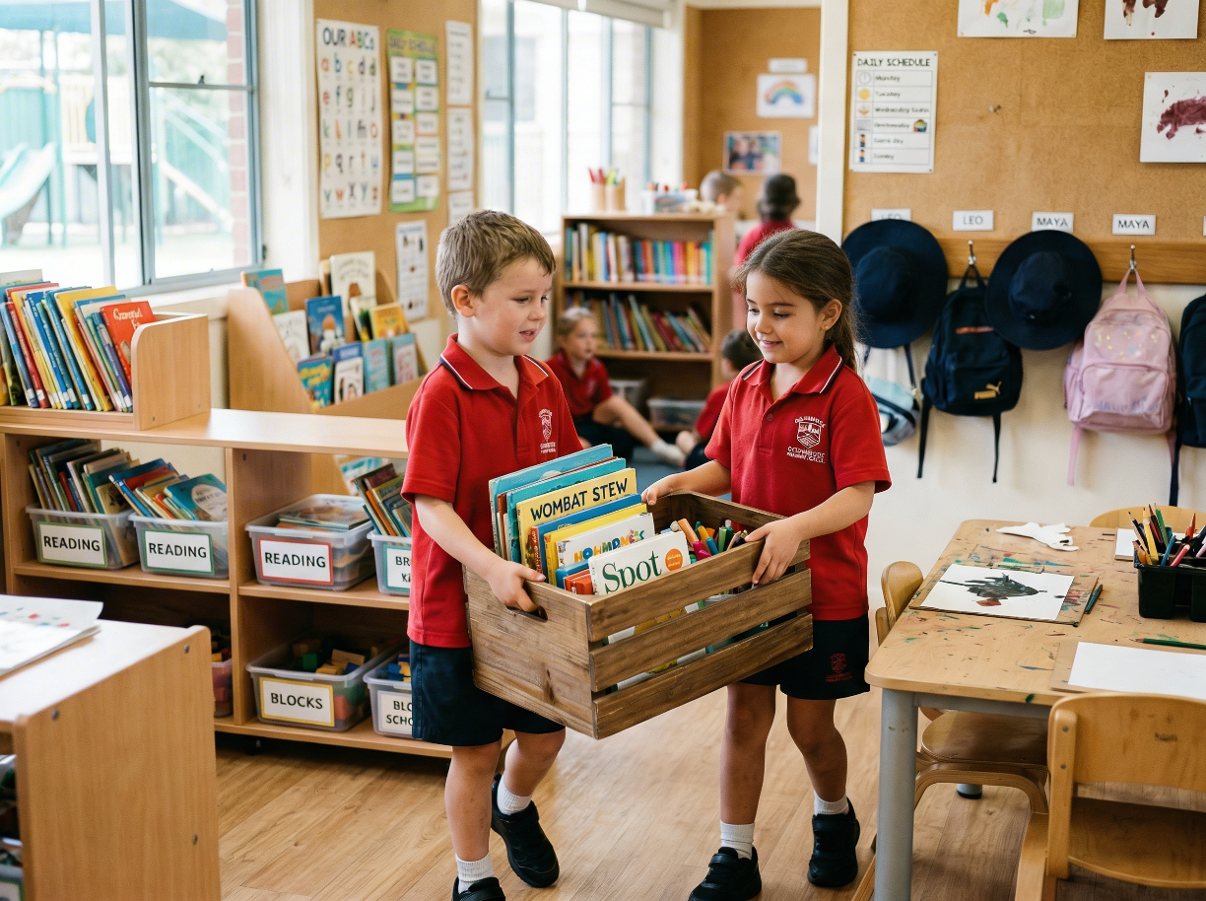
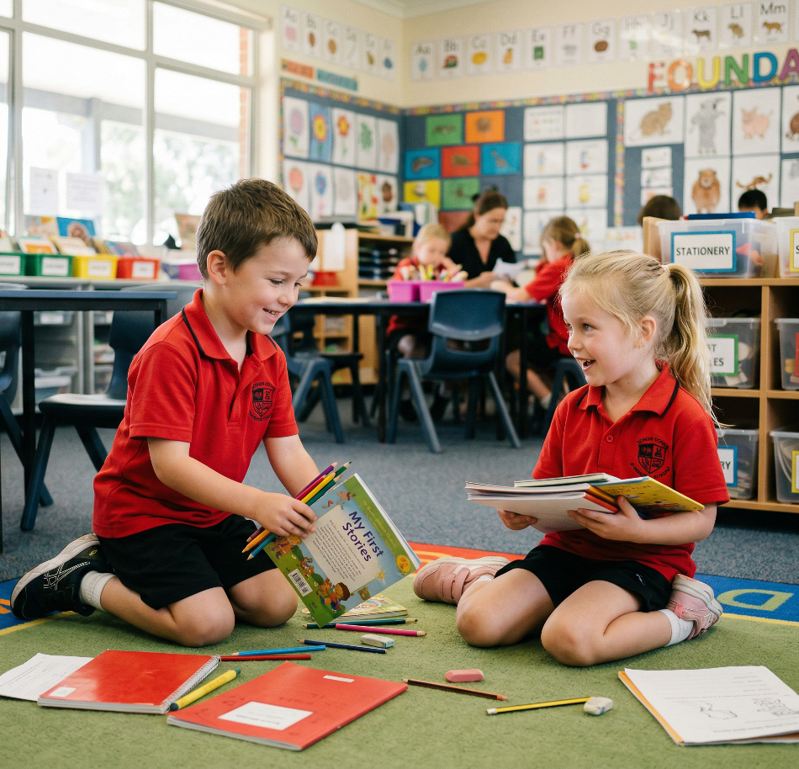
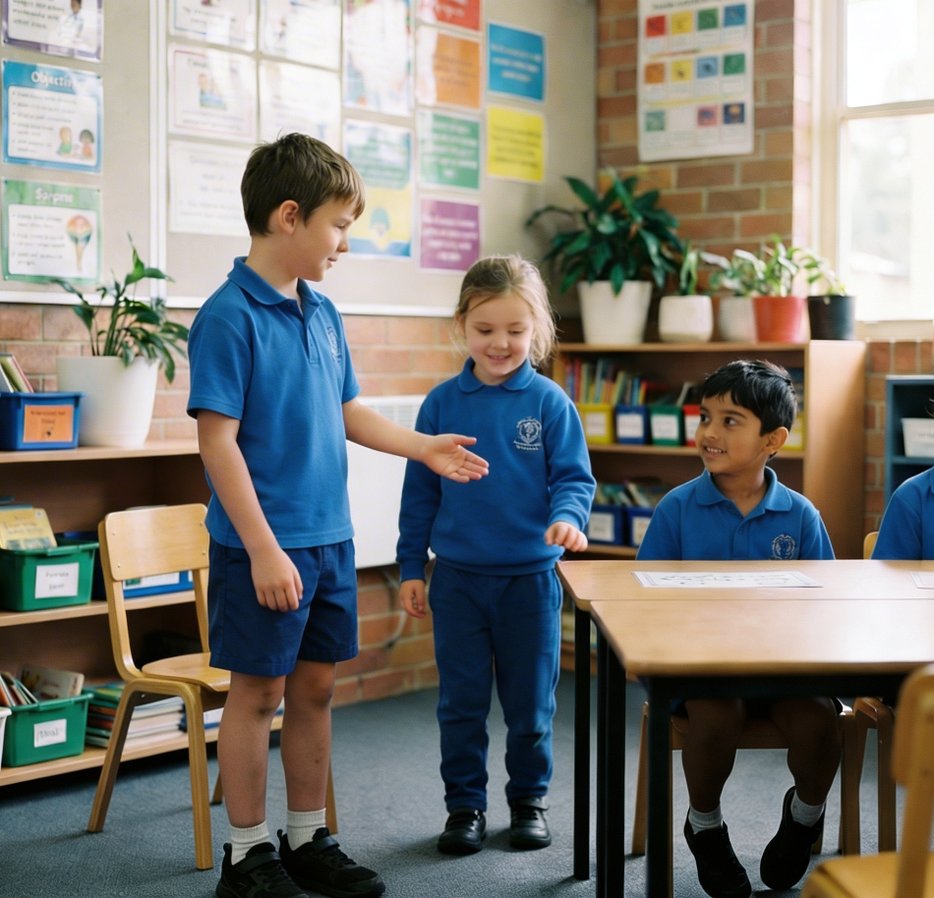
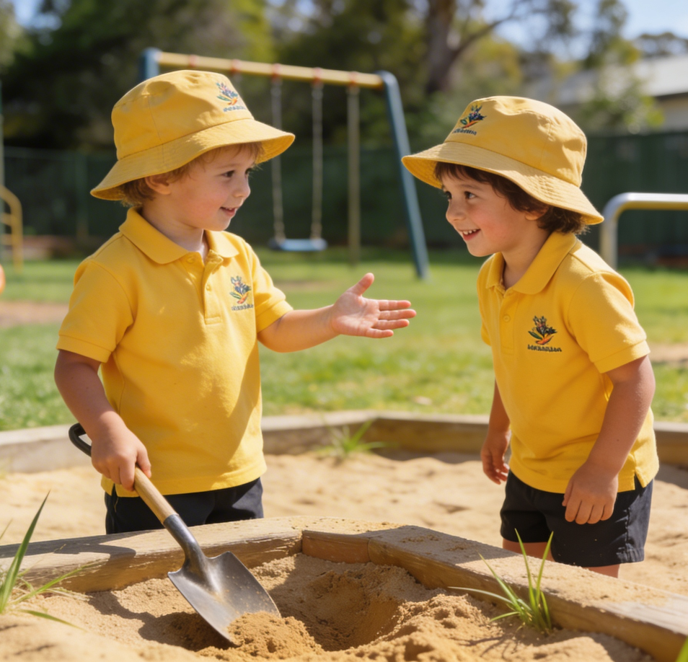
Kindness
We can show kindness when we notice someone needs help and we choose to care.
Kindness is doing something nice to help someone or make them feel happy.

Slide 6
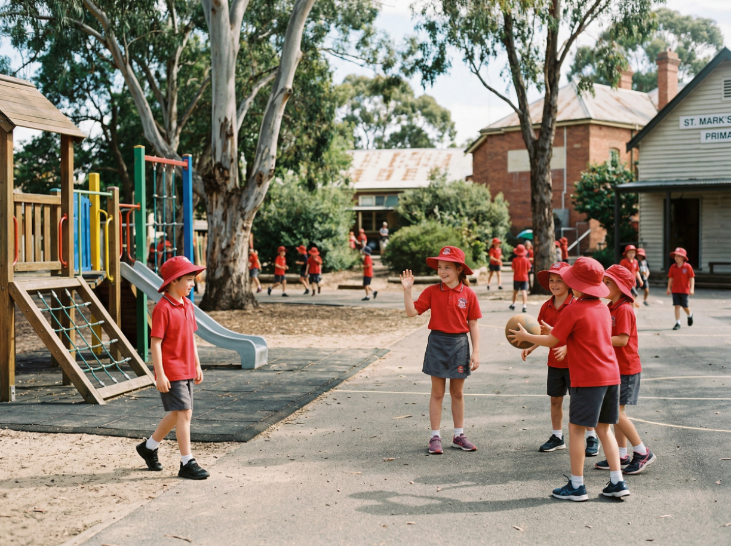
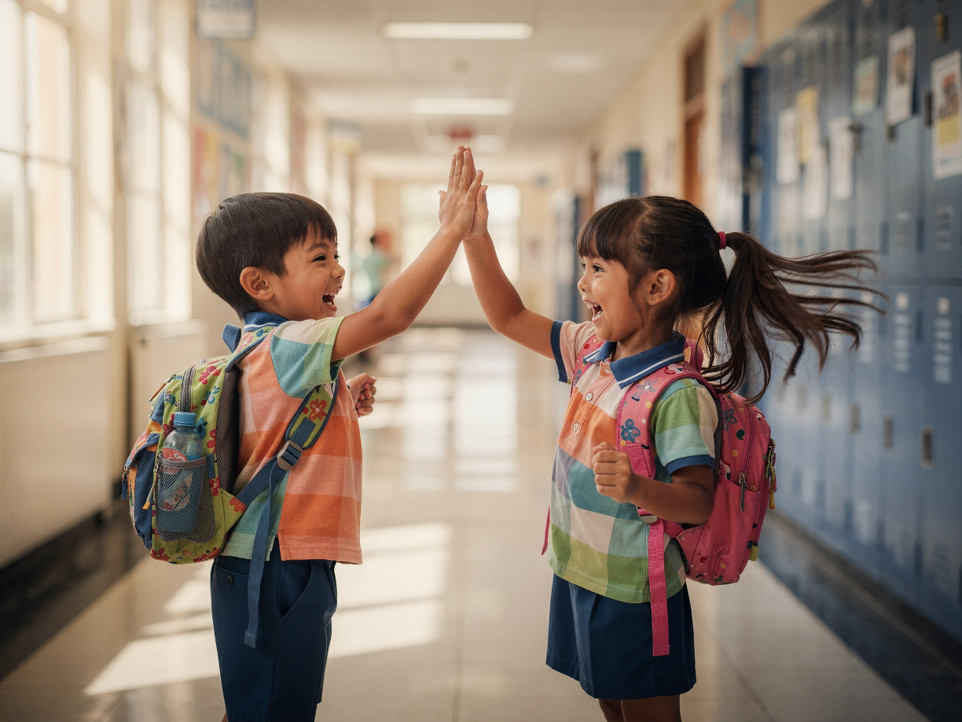
Kind Actions

Slide 7
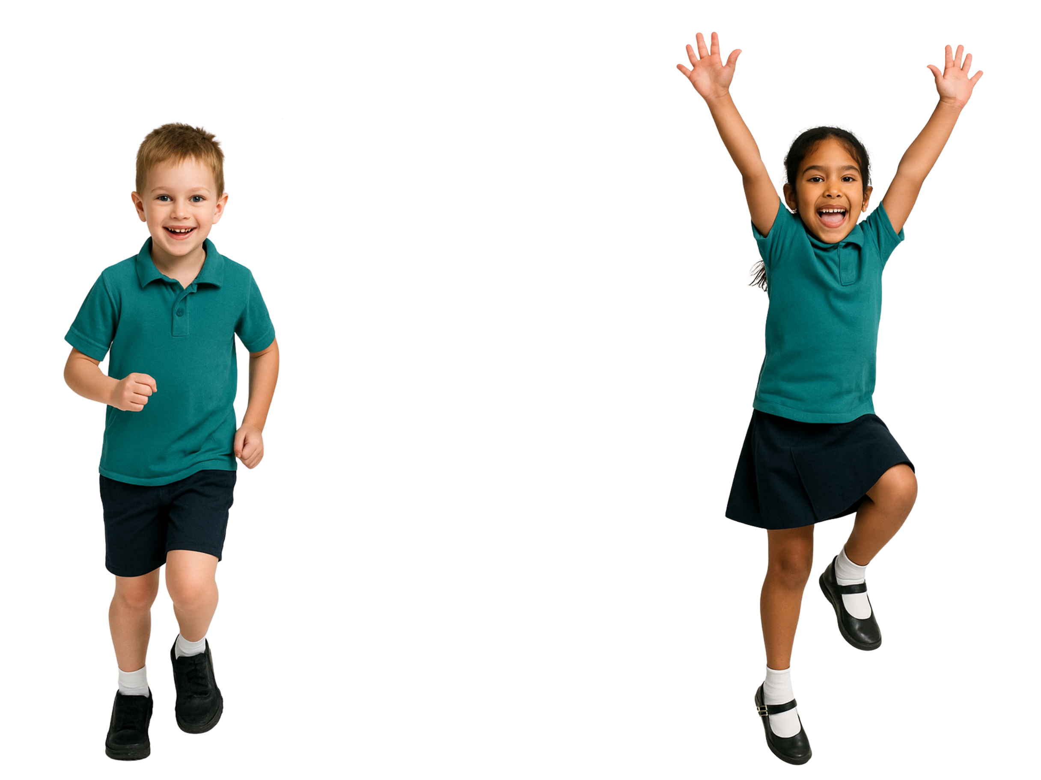
Being Kind
When we notice someone needs help and choose to help, we are being kind.
yes
no

Slide 8



Notice. Think. Act.

Slide 9
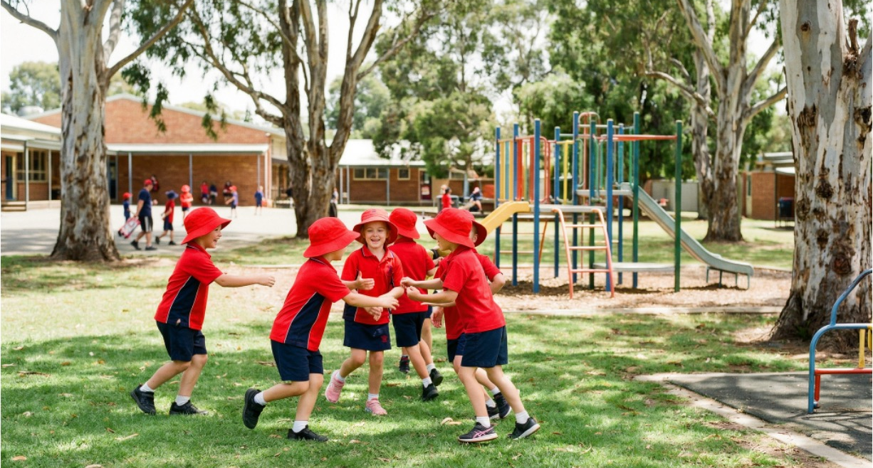
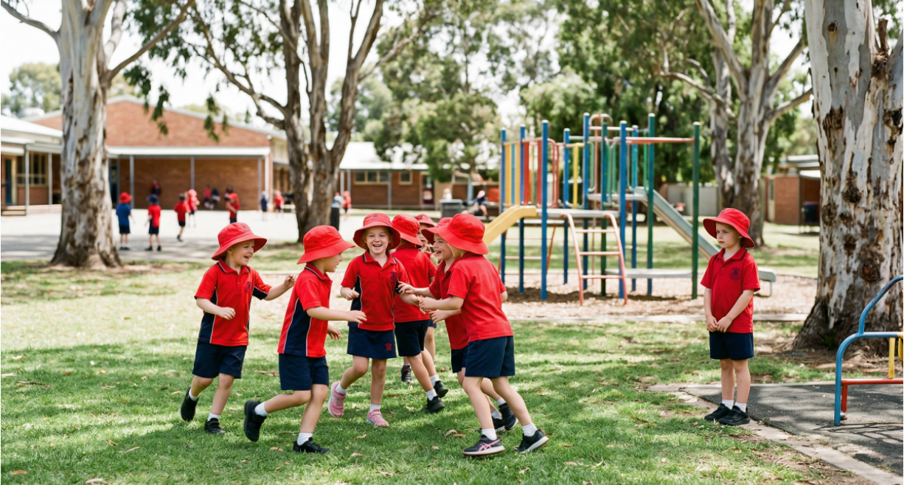
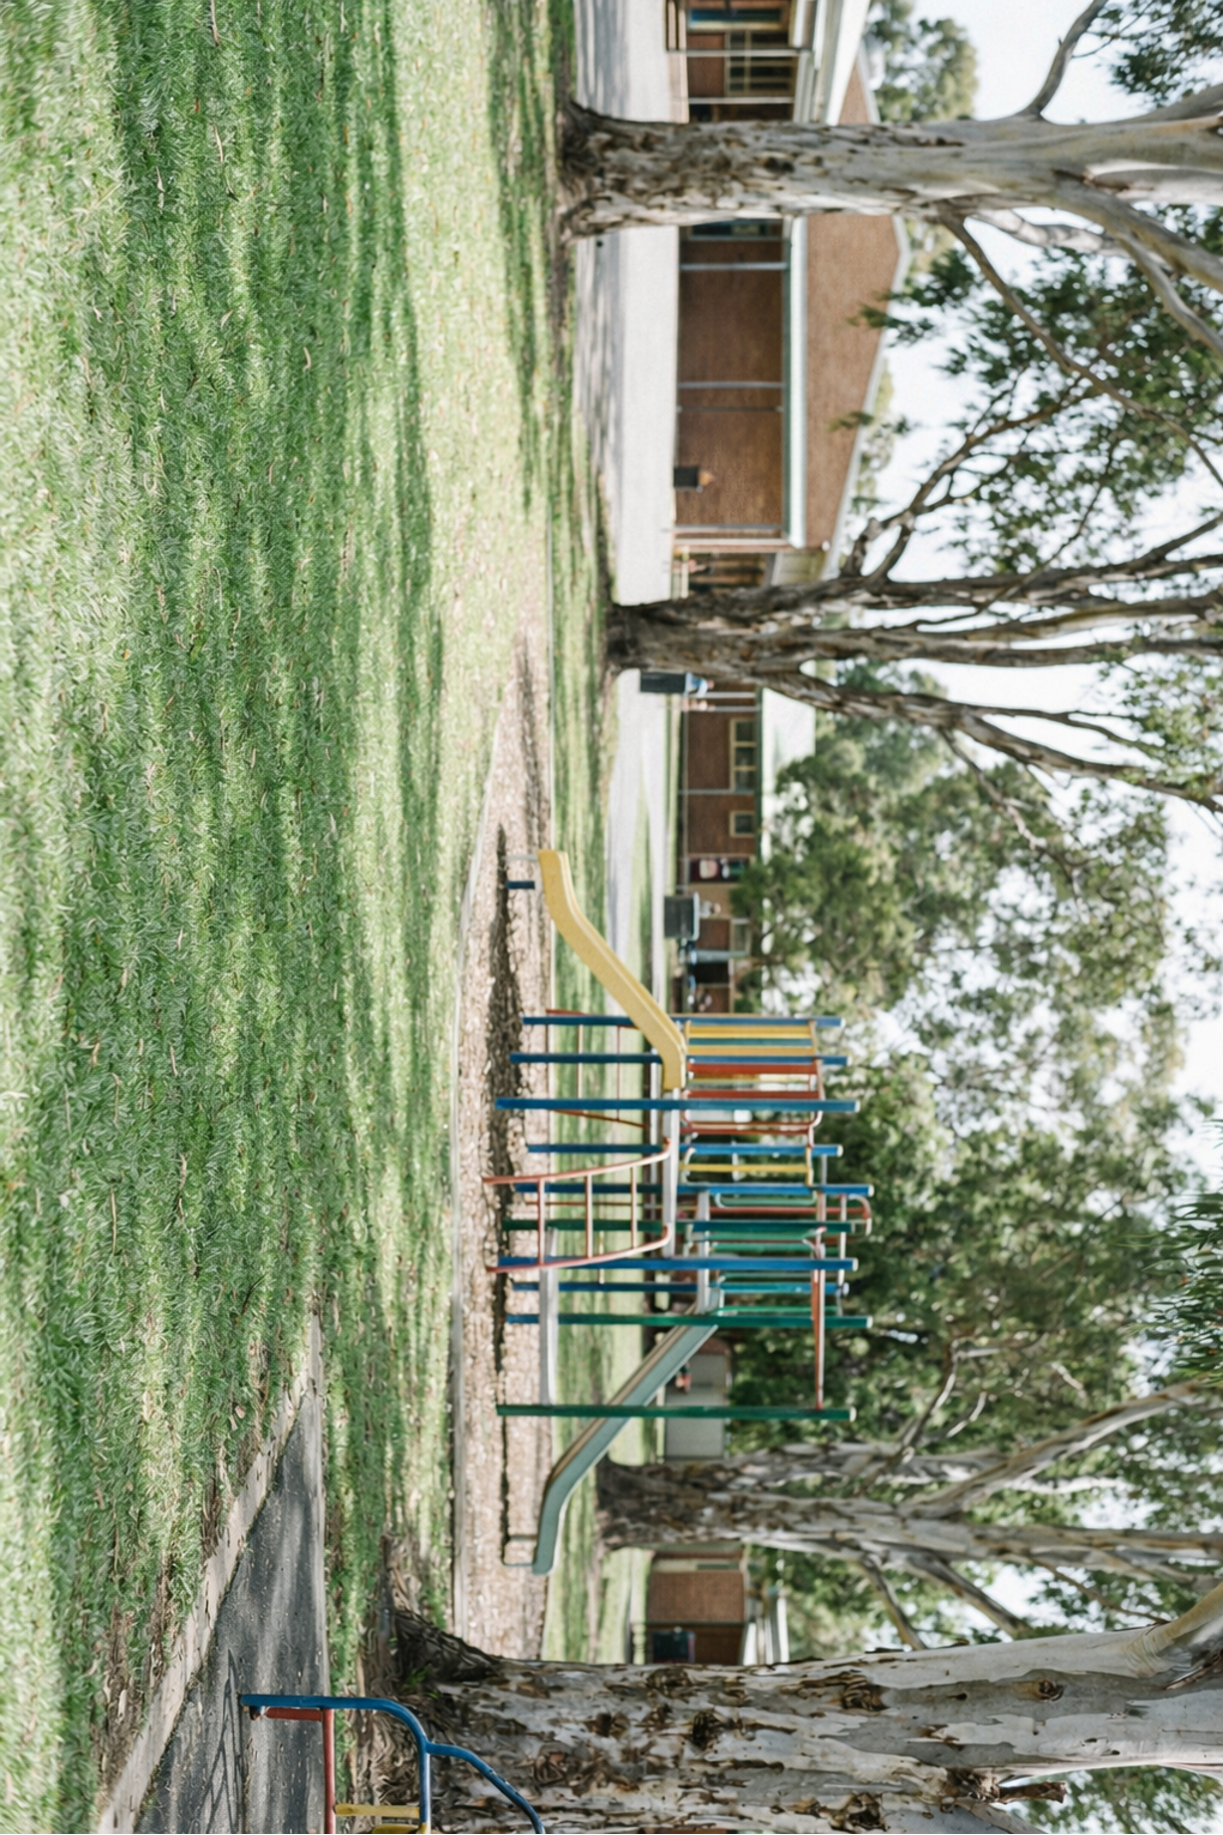




I this student standing alone while others are playing.
I by inviting them to join the game.
I they might want someone to play with.

Slide 10
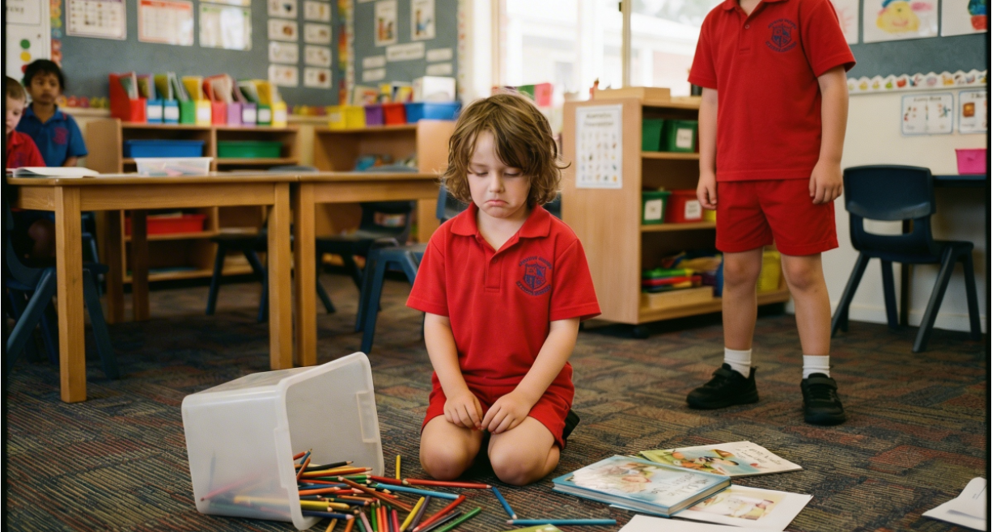
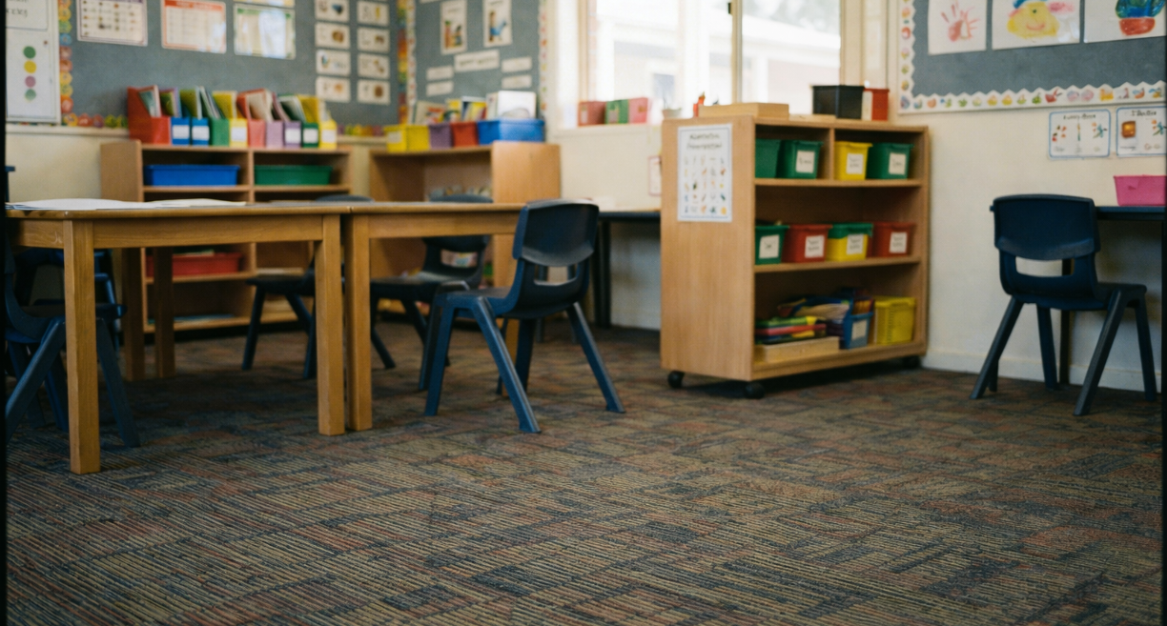
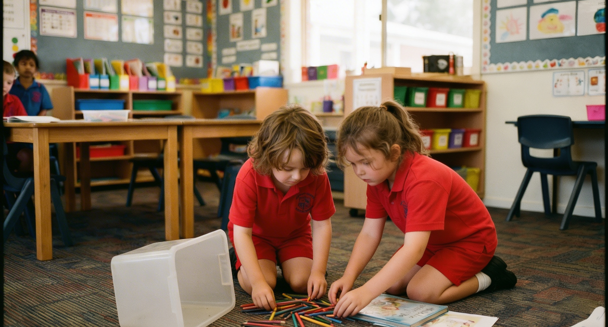

I items dropped on the floor.
I by inviting them to join the game.
I that would be difficult to clean up alone.

Slide 11
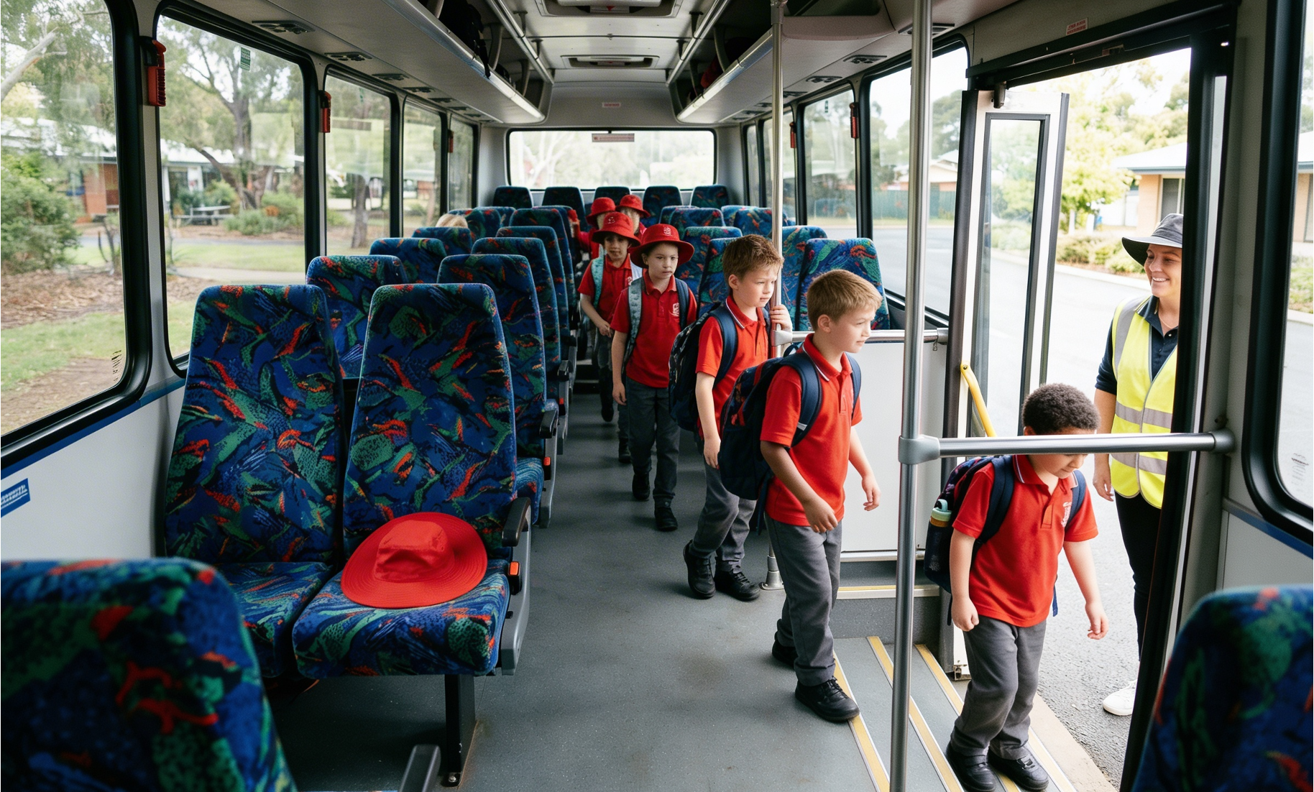
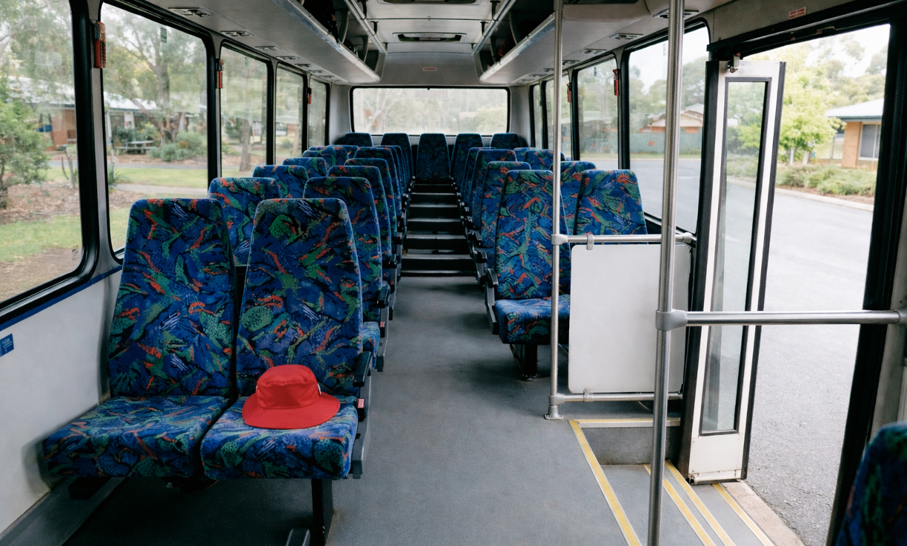

I ________________.
I by __________________.
I ________________.

Slide 12
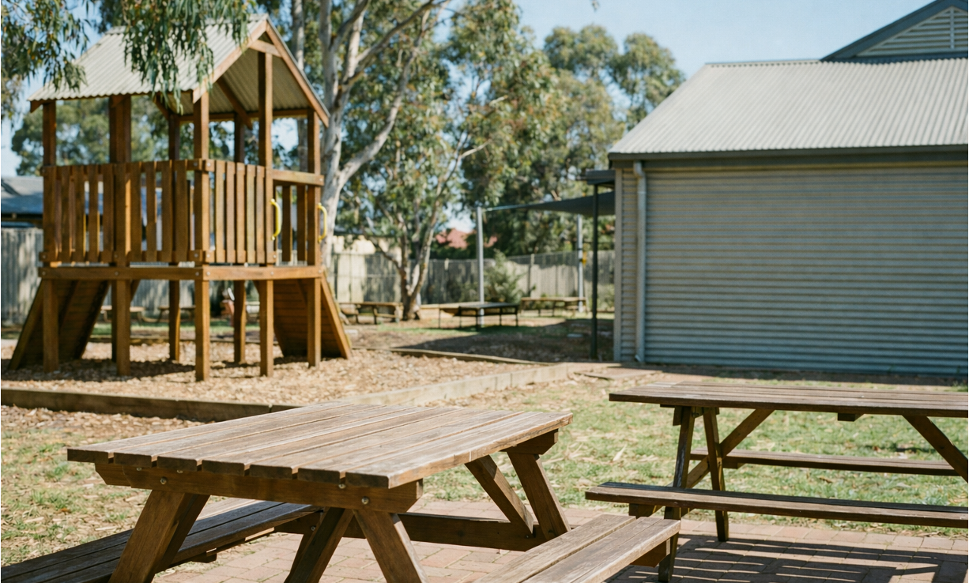
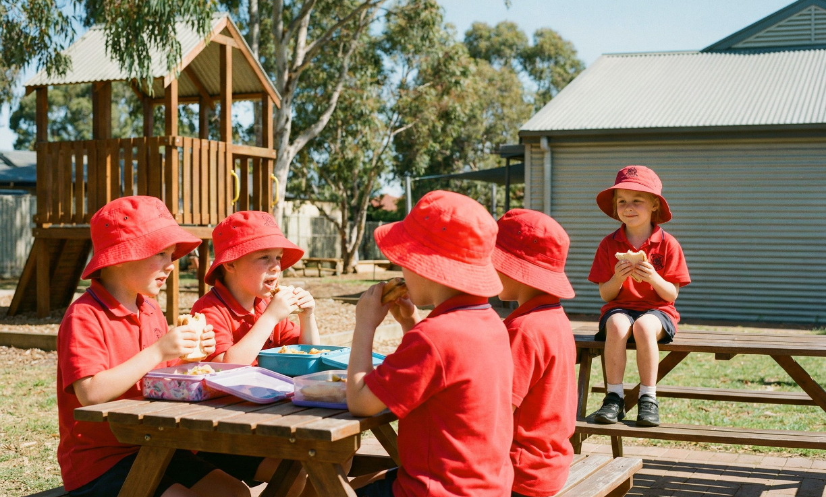

I ________________.
I by __________________.
I ________________.

Slide 13
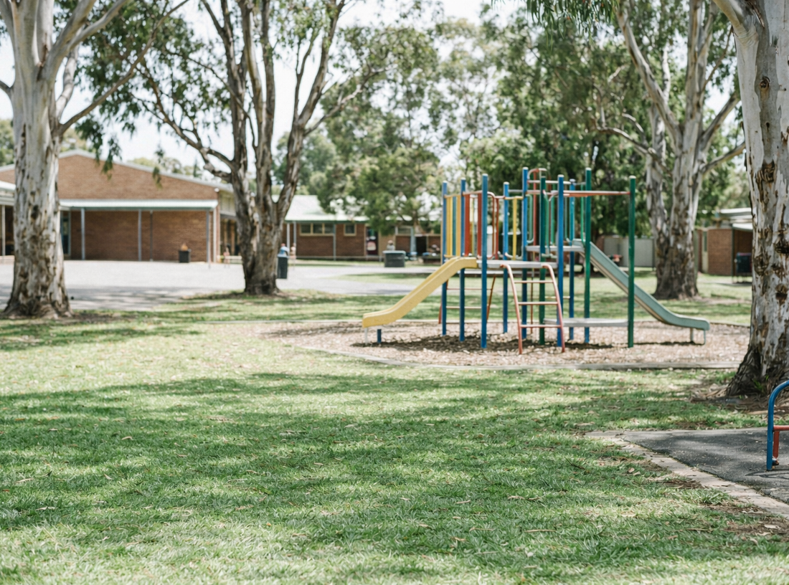
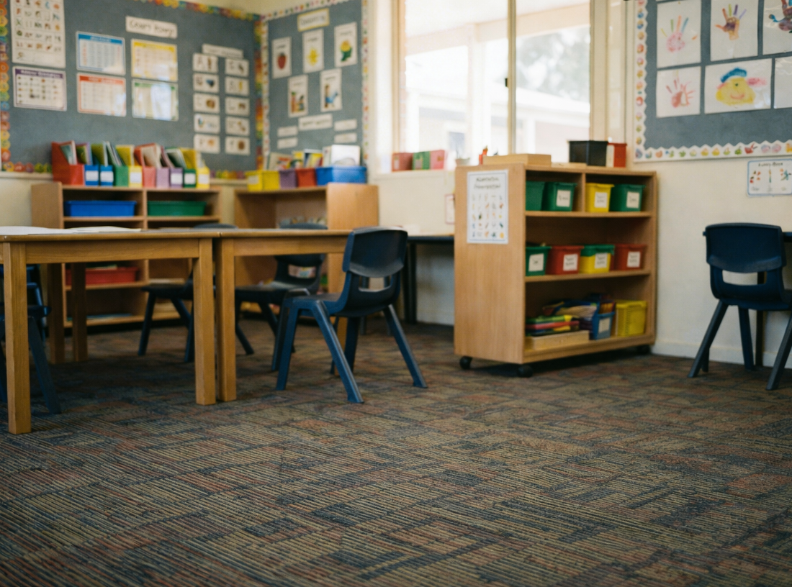
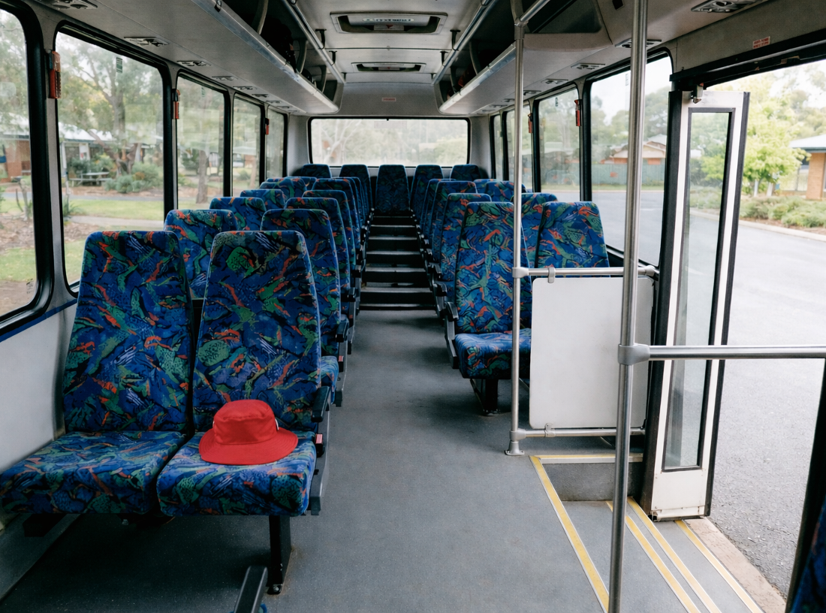
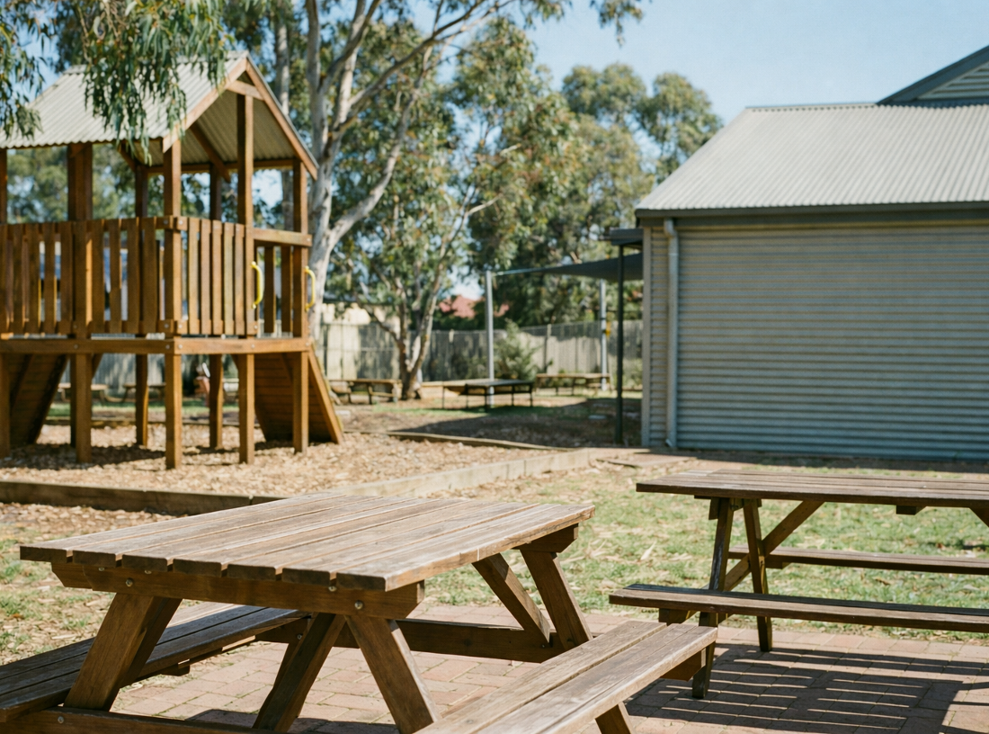

Slide 14
Kindness means noticing when someone needs support and choosing to help.
Kind actions help others feel safe and supported at school.
Kind actions help people feel like they belong.

Slide 15


How well did you:
notice when someone might need kindness
tell how you can show kindness in a shared space
explain how your action helps others?

Slide 16
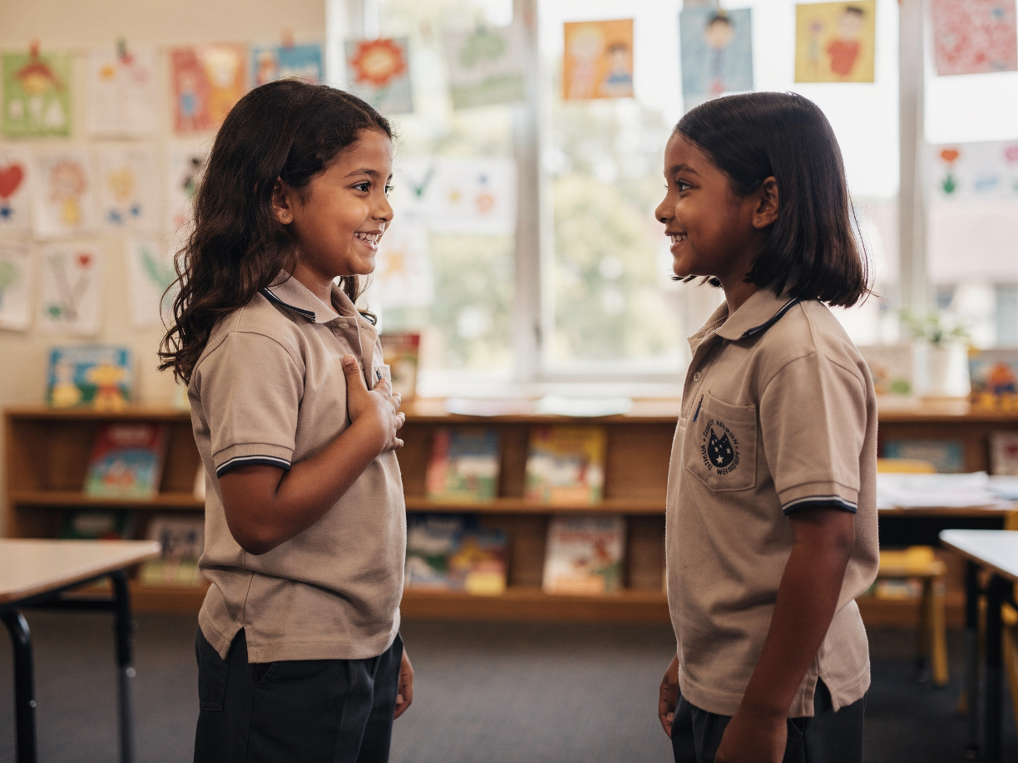
In the next lesson, we will learn how to show gratitude when someone helps us.

