Slide 1
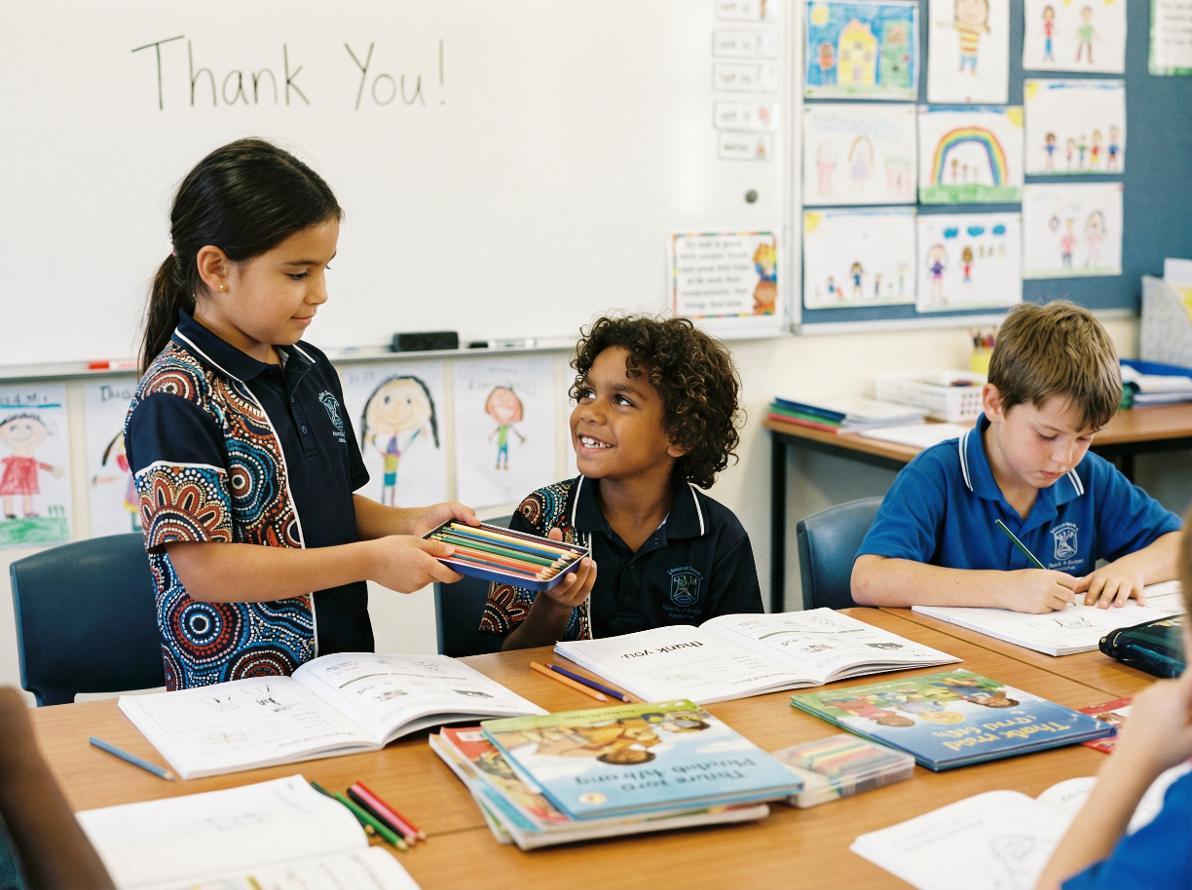
Noticing Helpers at School
Unit 2: Relating to Others
Lesson 2

Slide 2
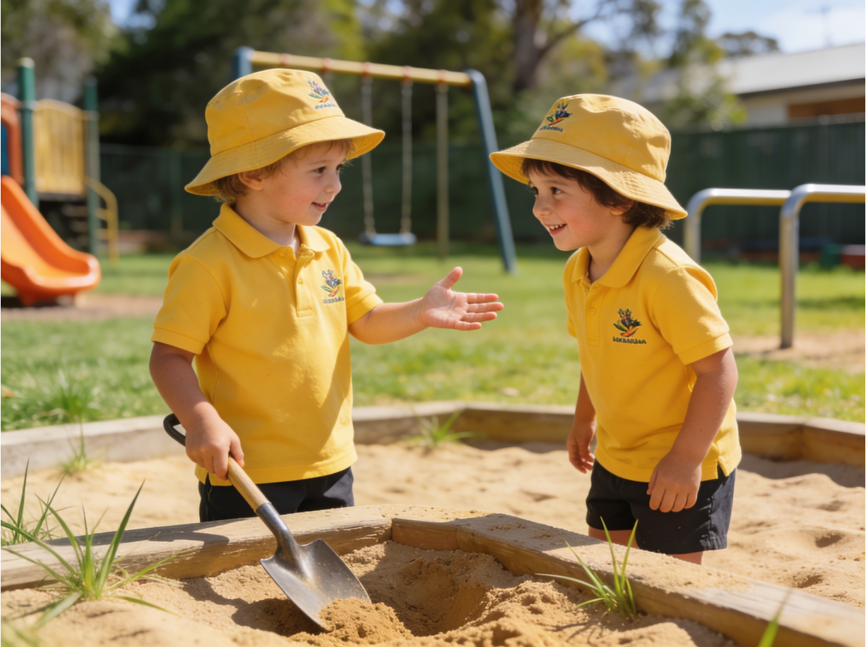
Kindness means noticing when someone needs support and choosing to help.

Slide 3
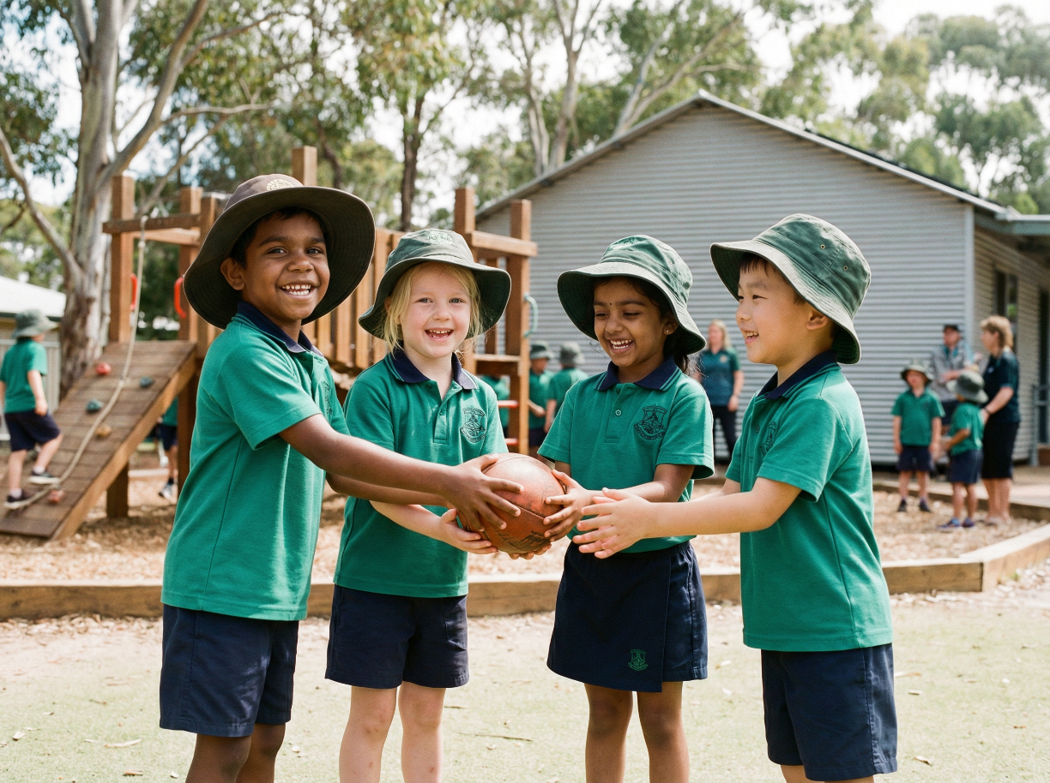
Kind actions help others feel safe and supported at school.

Slide 4
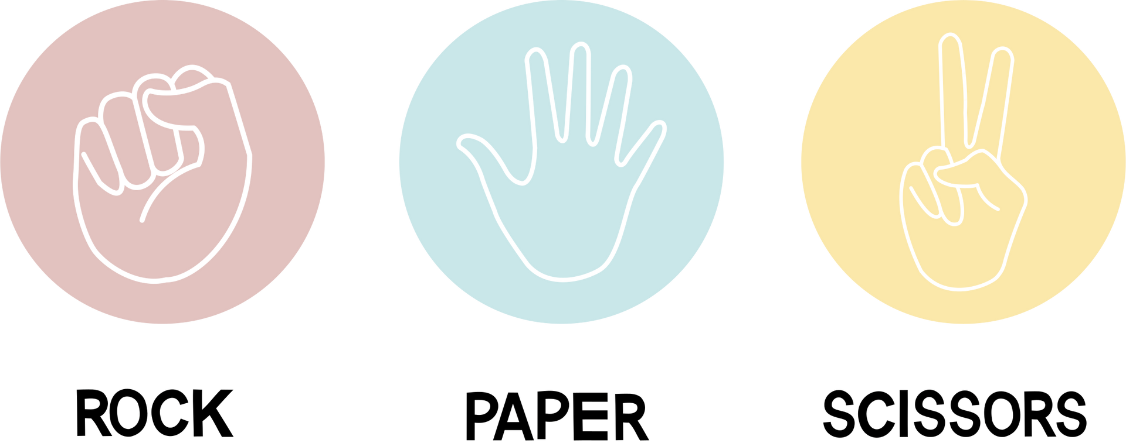
like they
Kind actions help people feel _______ _____.
belong
like they belong
ready to learn
hungry for lunch

Slide 5
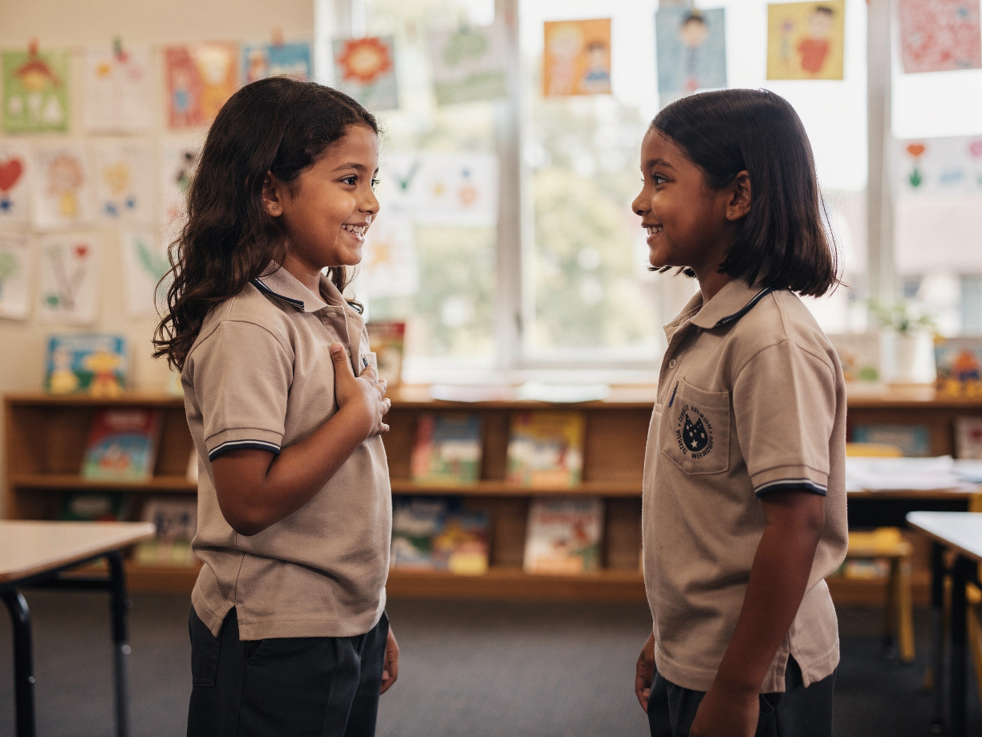
In this lesson, we will learn how to show gratitude when someone helps us.

Slide 6
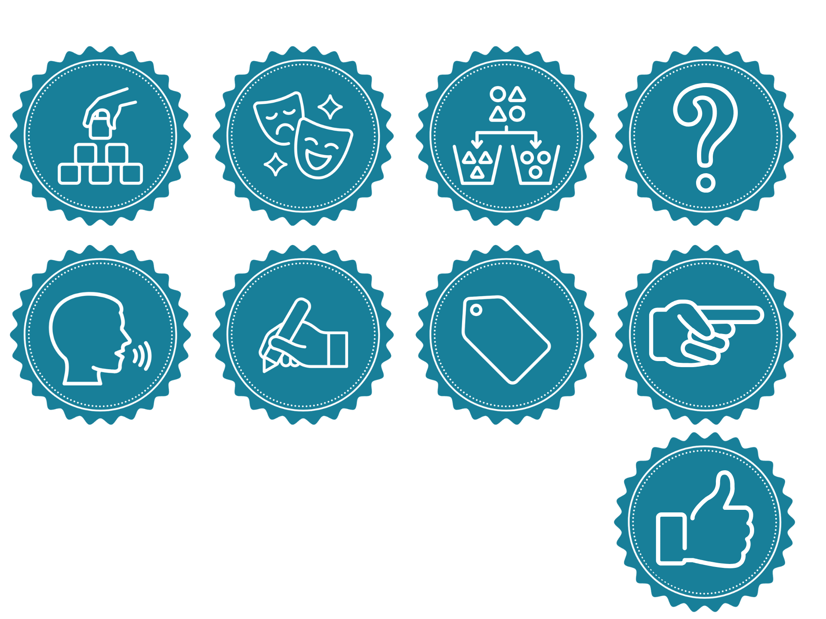
You will be successful when you can:
notice when someone does something kind
say thank you using a gratitude sentence.

Slide 7
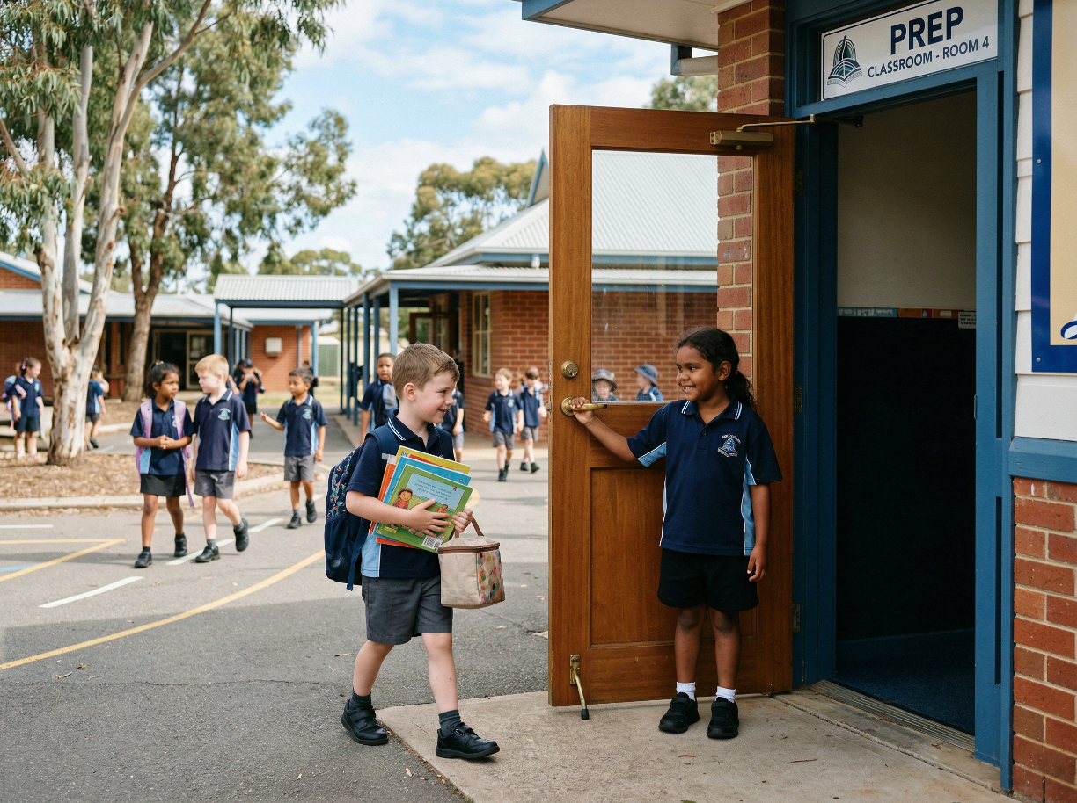
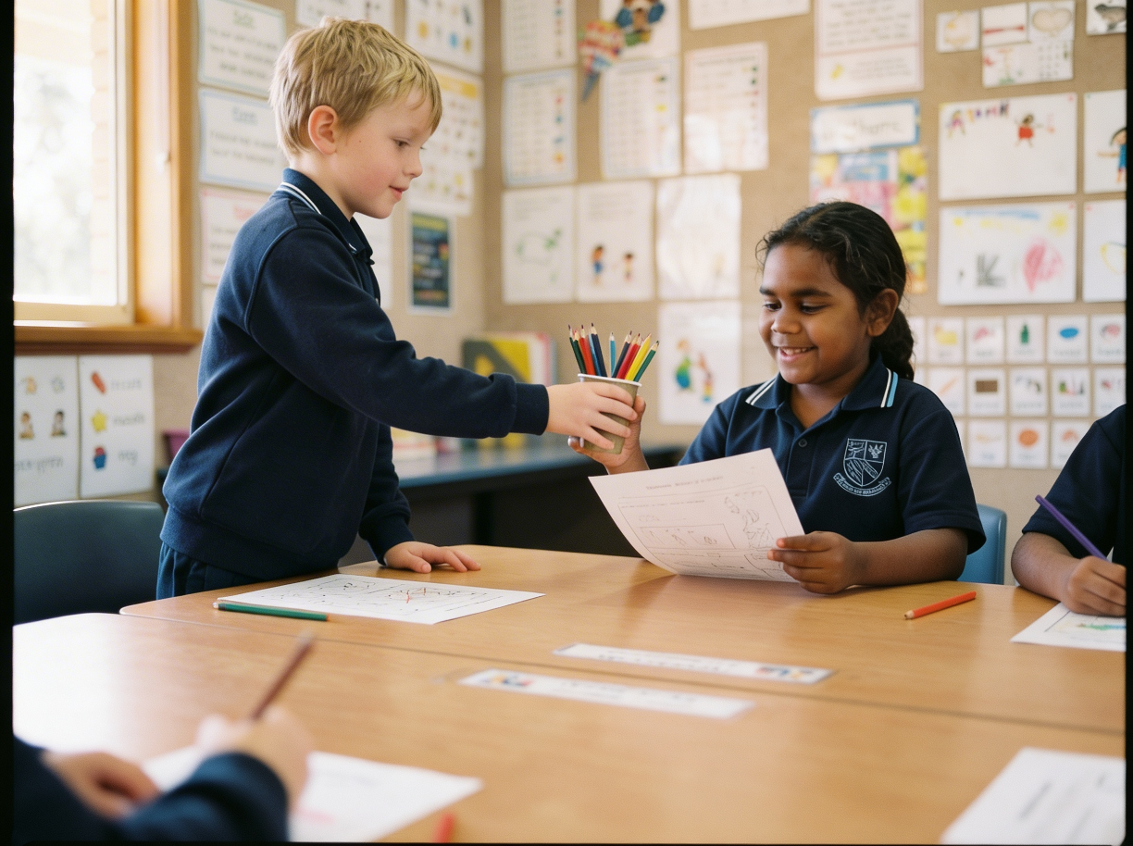
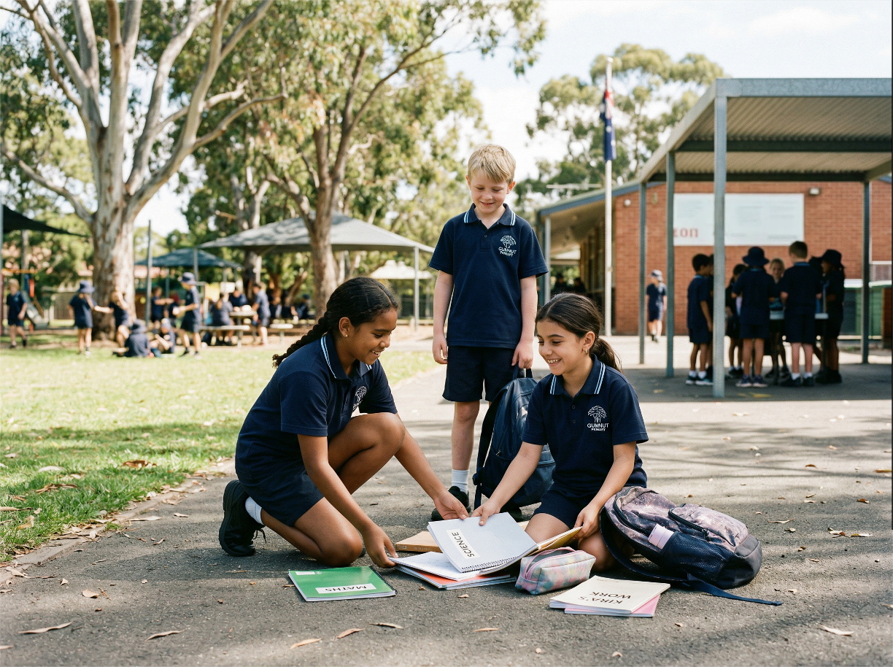

Slide 8
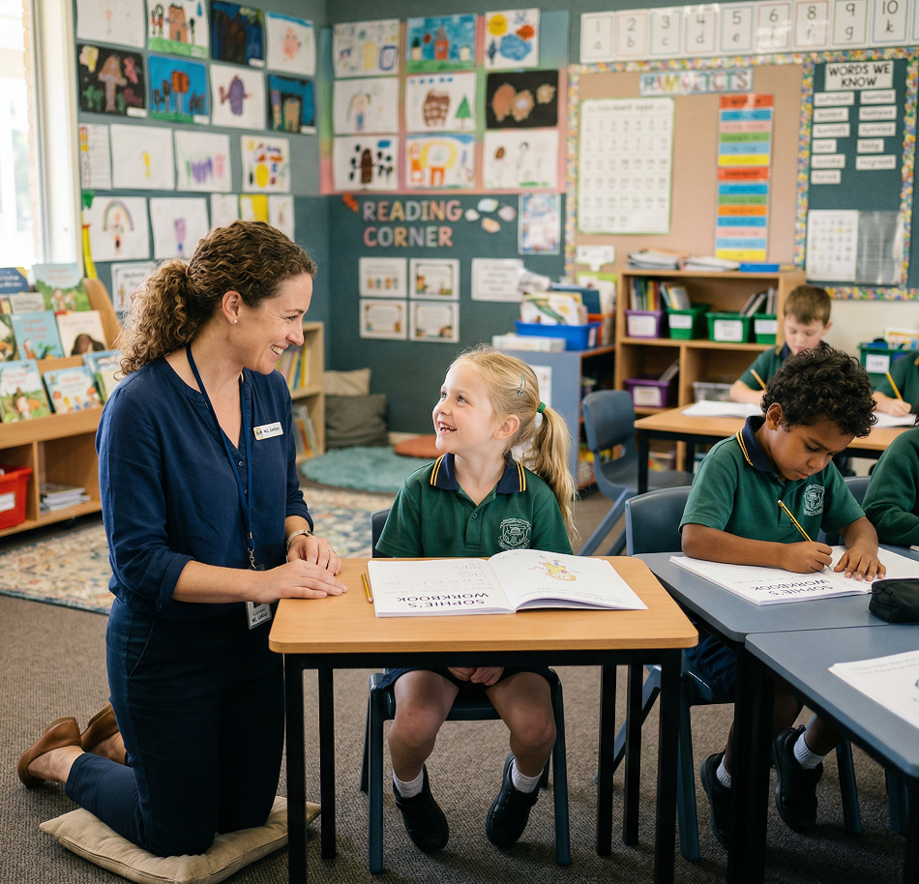
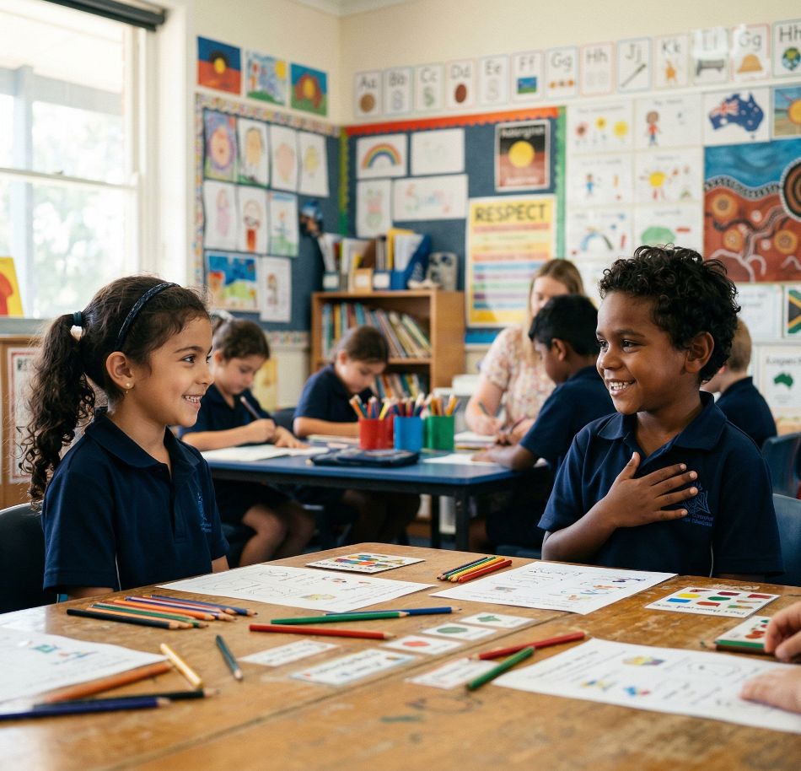
Gratitude
Gratitude is the feeling of being thankful for the good things in your life.

Slide 9
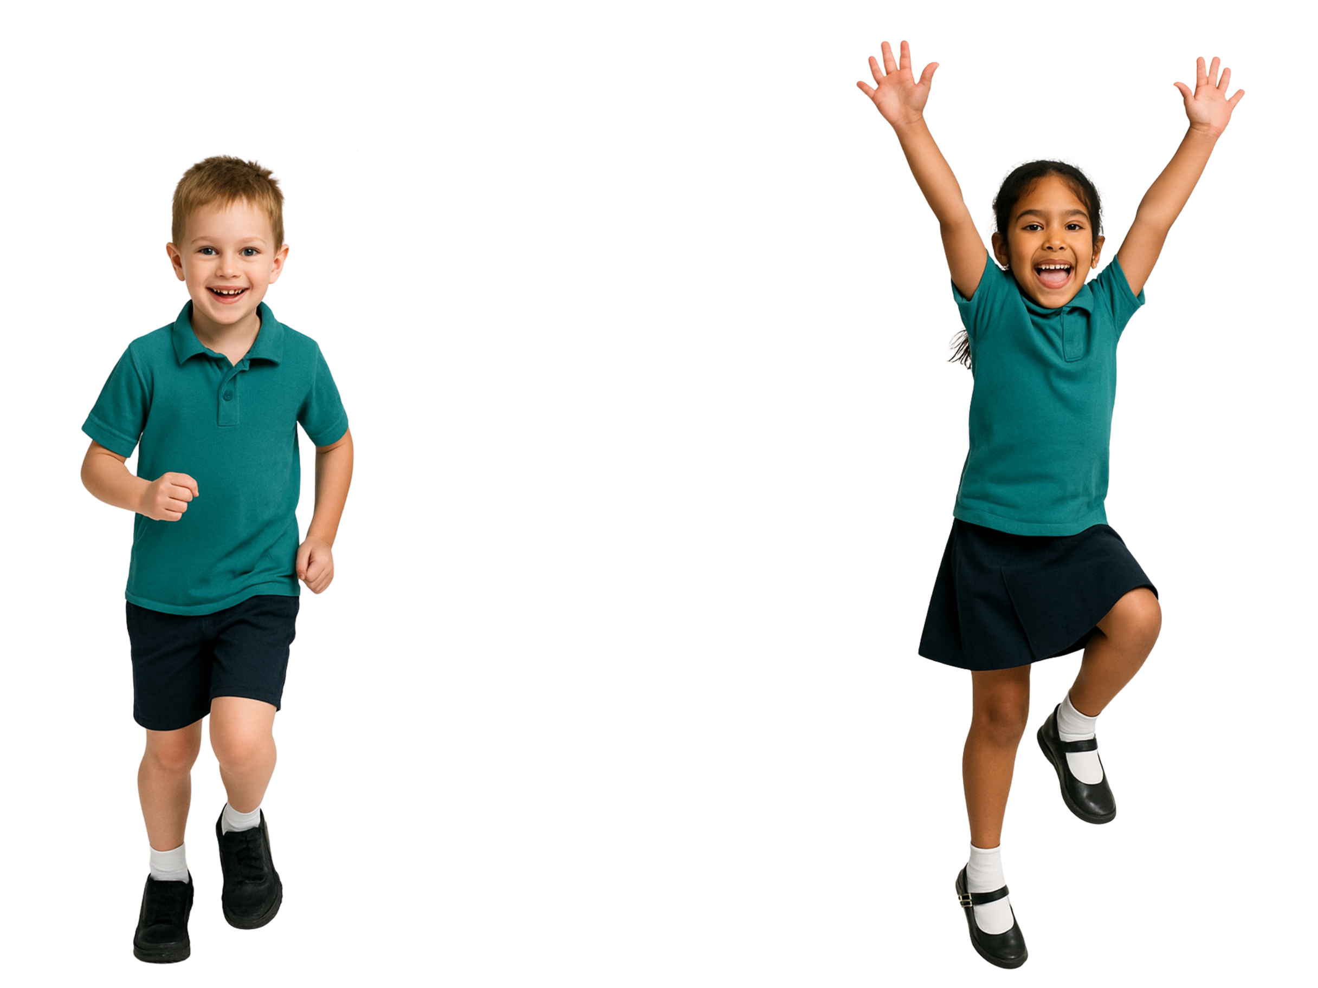
Showing Gratitude
When someone helps us and we say thank you, we are showing gratitude.
yes
no

Slide 10
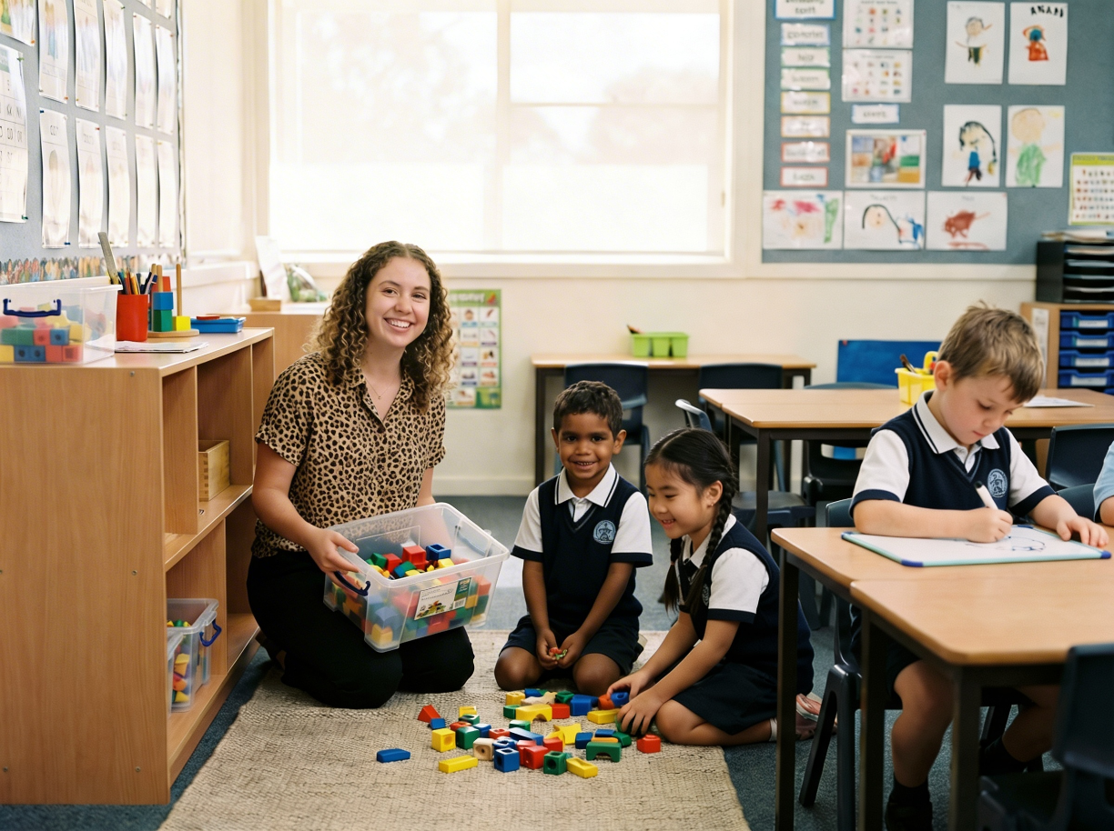

Gratitude Sentence
Thank you for __________________.
helping me clean up
pack up quickly
It helped me ____________.
happy
I feel ______.

Slide 11
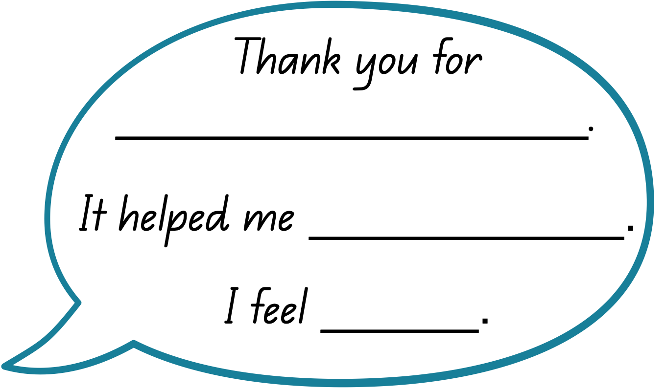
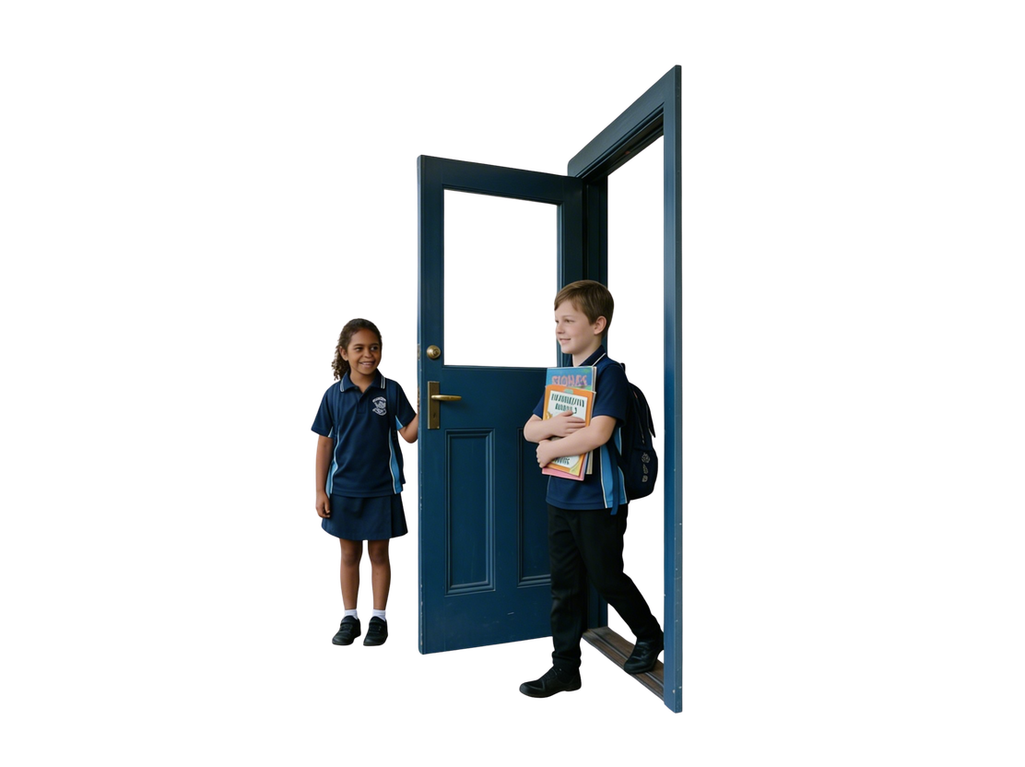
Gratitude Sentence
holding the door
get inside faster
happy

Slide 12
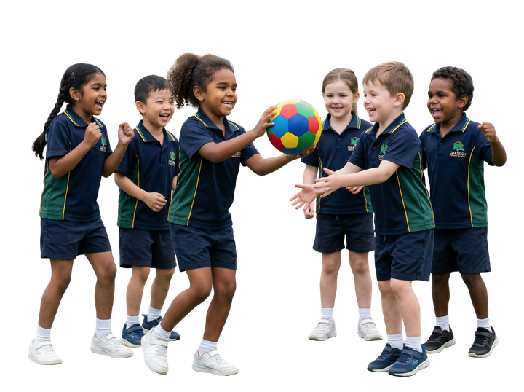
Gratitude Sentence
sharing the ball
join the game
included

Slide 13
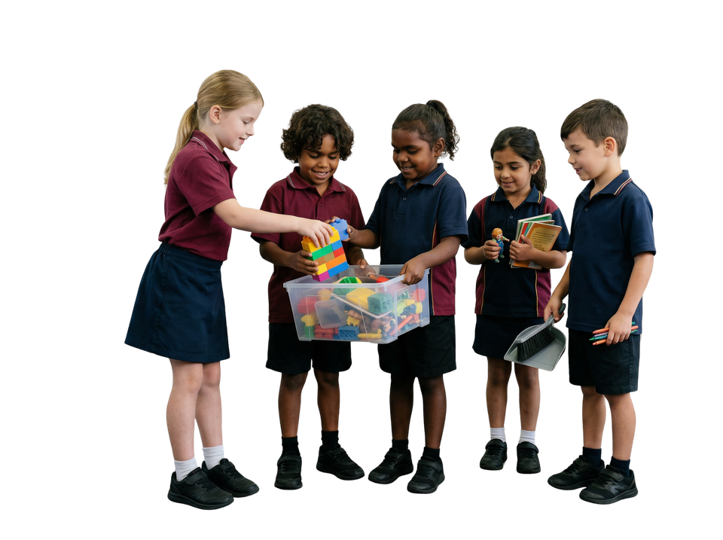
Gratitude Sentence
helping me clean up
finish faster
glad

Slide 14
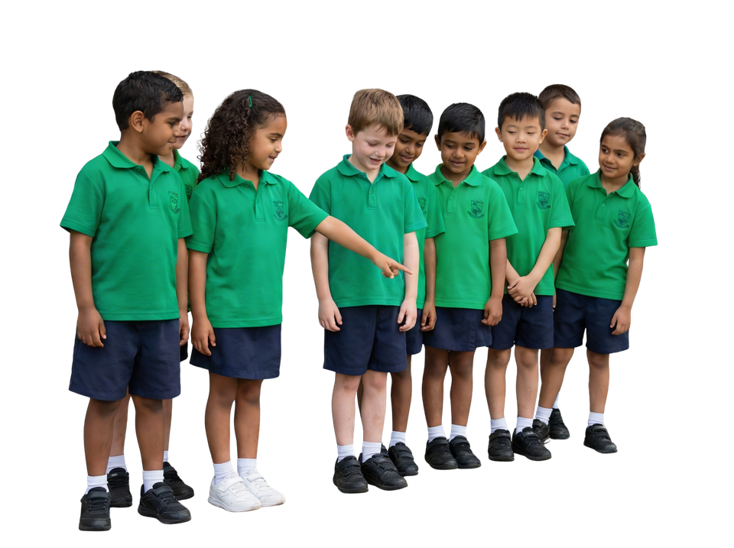
Gratitude Sentence
showing me where to go
line up correctly
included

Slide 15
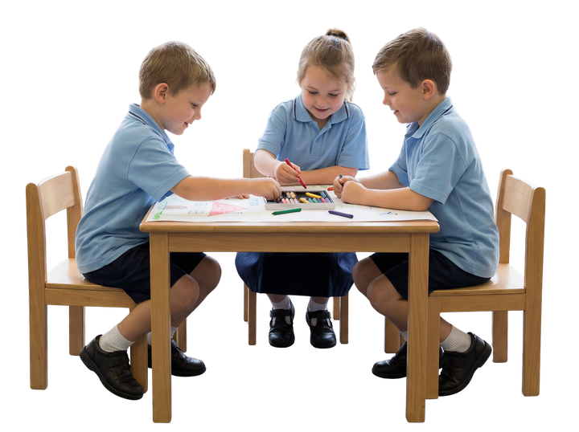
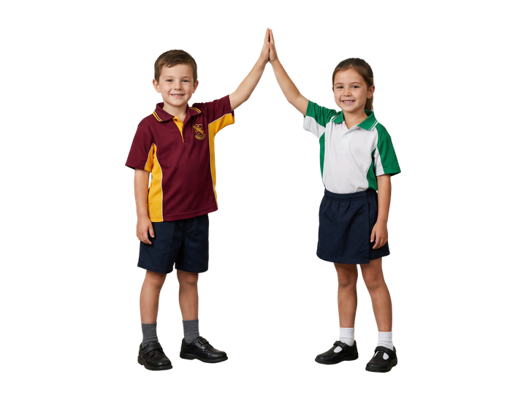
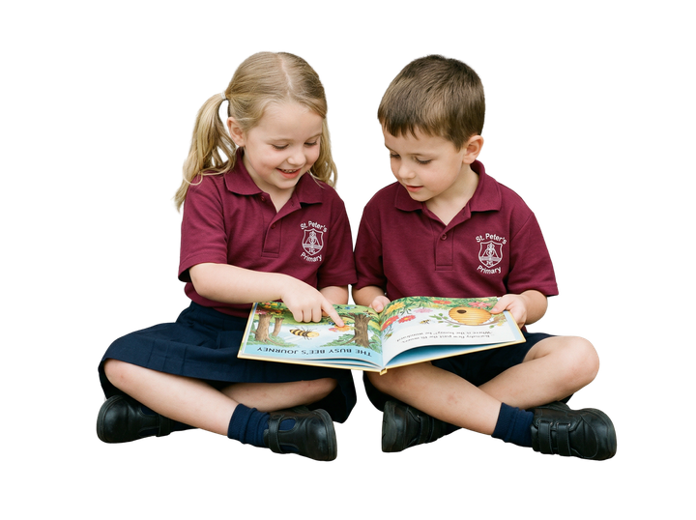
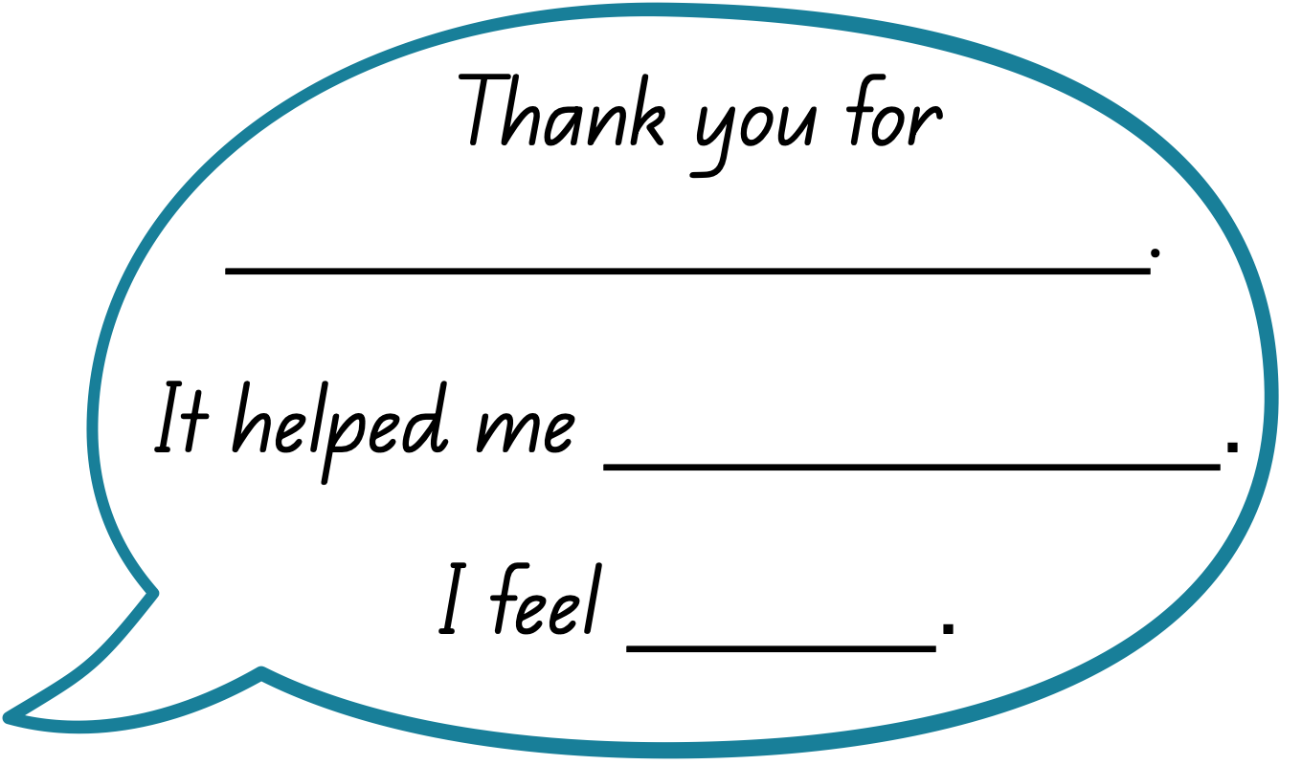
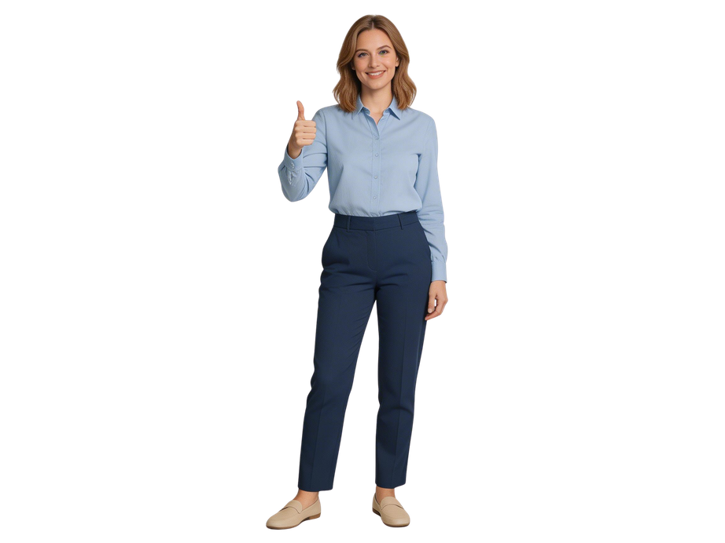
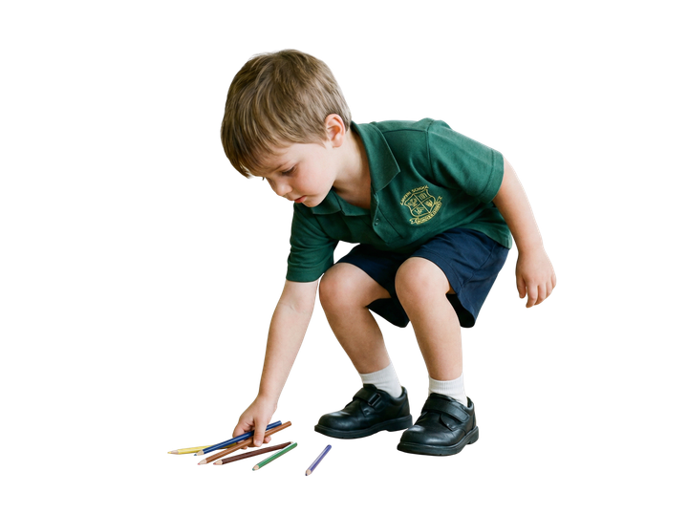
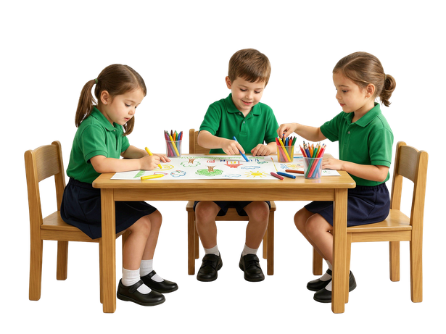

Slide 16
Gratitude is the feeling of being thankful for the good things in your life.
Gratitude helps us recognise kind actions.

Slide 17
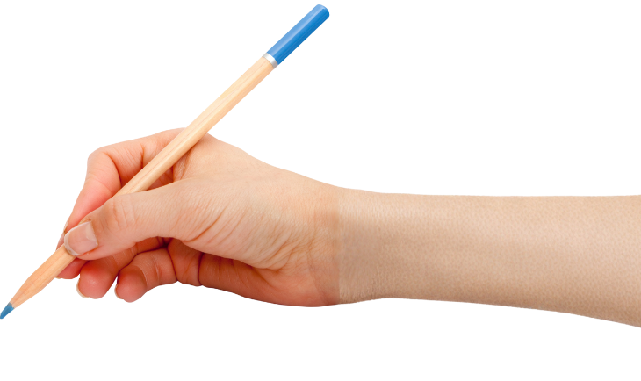

How well did you:
notice when someone does something kind
say thank you using a gratitude sentence?

Slide 18
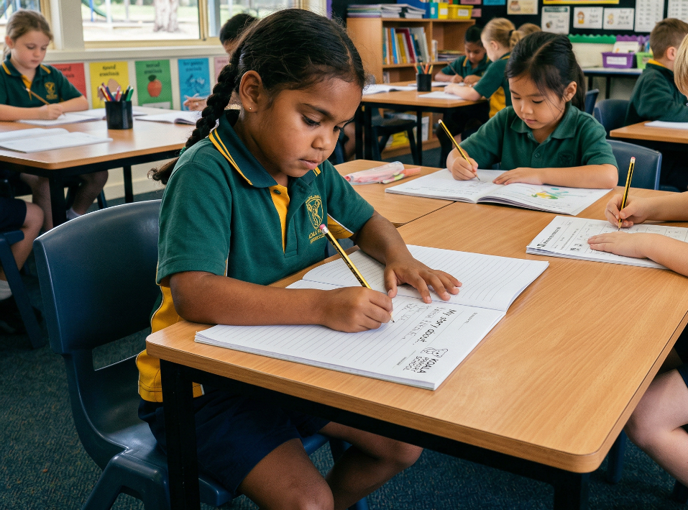
In the next lesson, we will learn how passion helps us keep going during everyday school routines.

