Slide 1
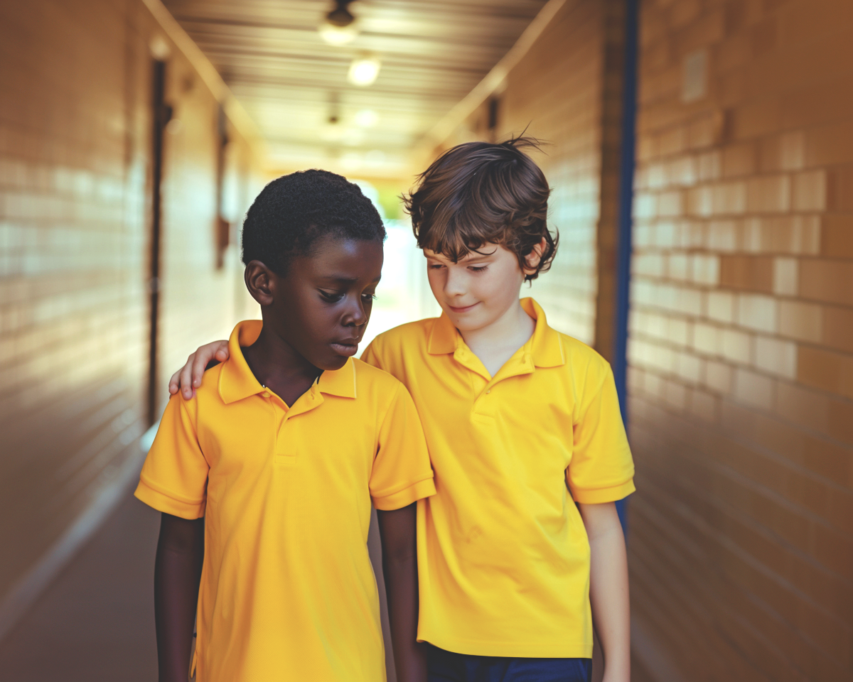
Notice, Ask, Choose
Unit 2: Making Lives Better
Lesson 1

Slide 2
In this lesson, you will learn how kindness helps people notice when others need help and choose actions that support them.

Slide 3

You will be successful when you can:
describe what kindness looks like in different situations
explain how a kind action can help someone feel supported.

Slide 4
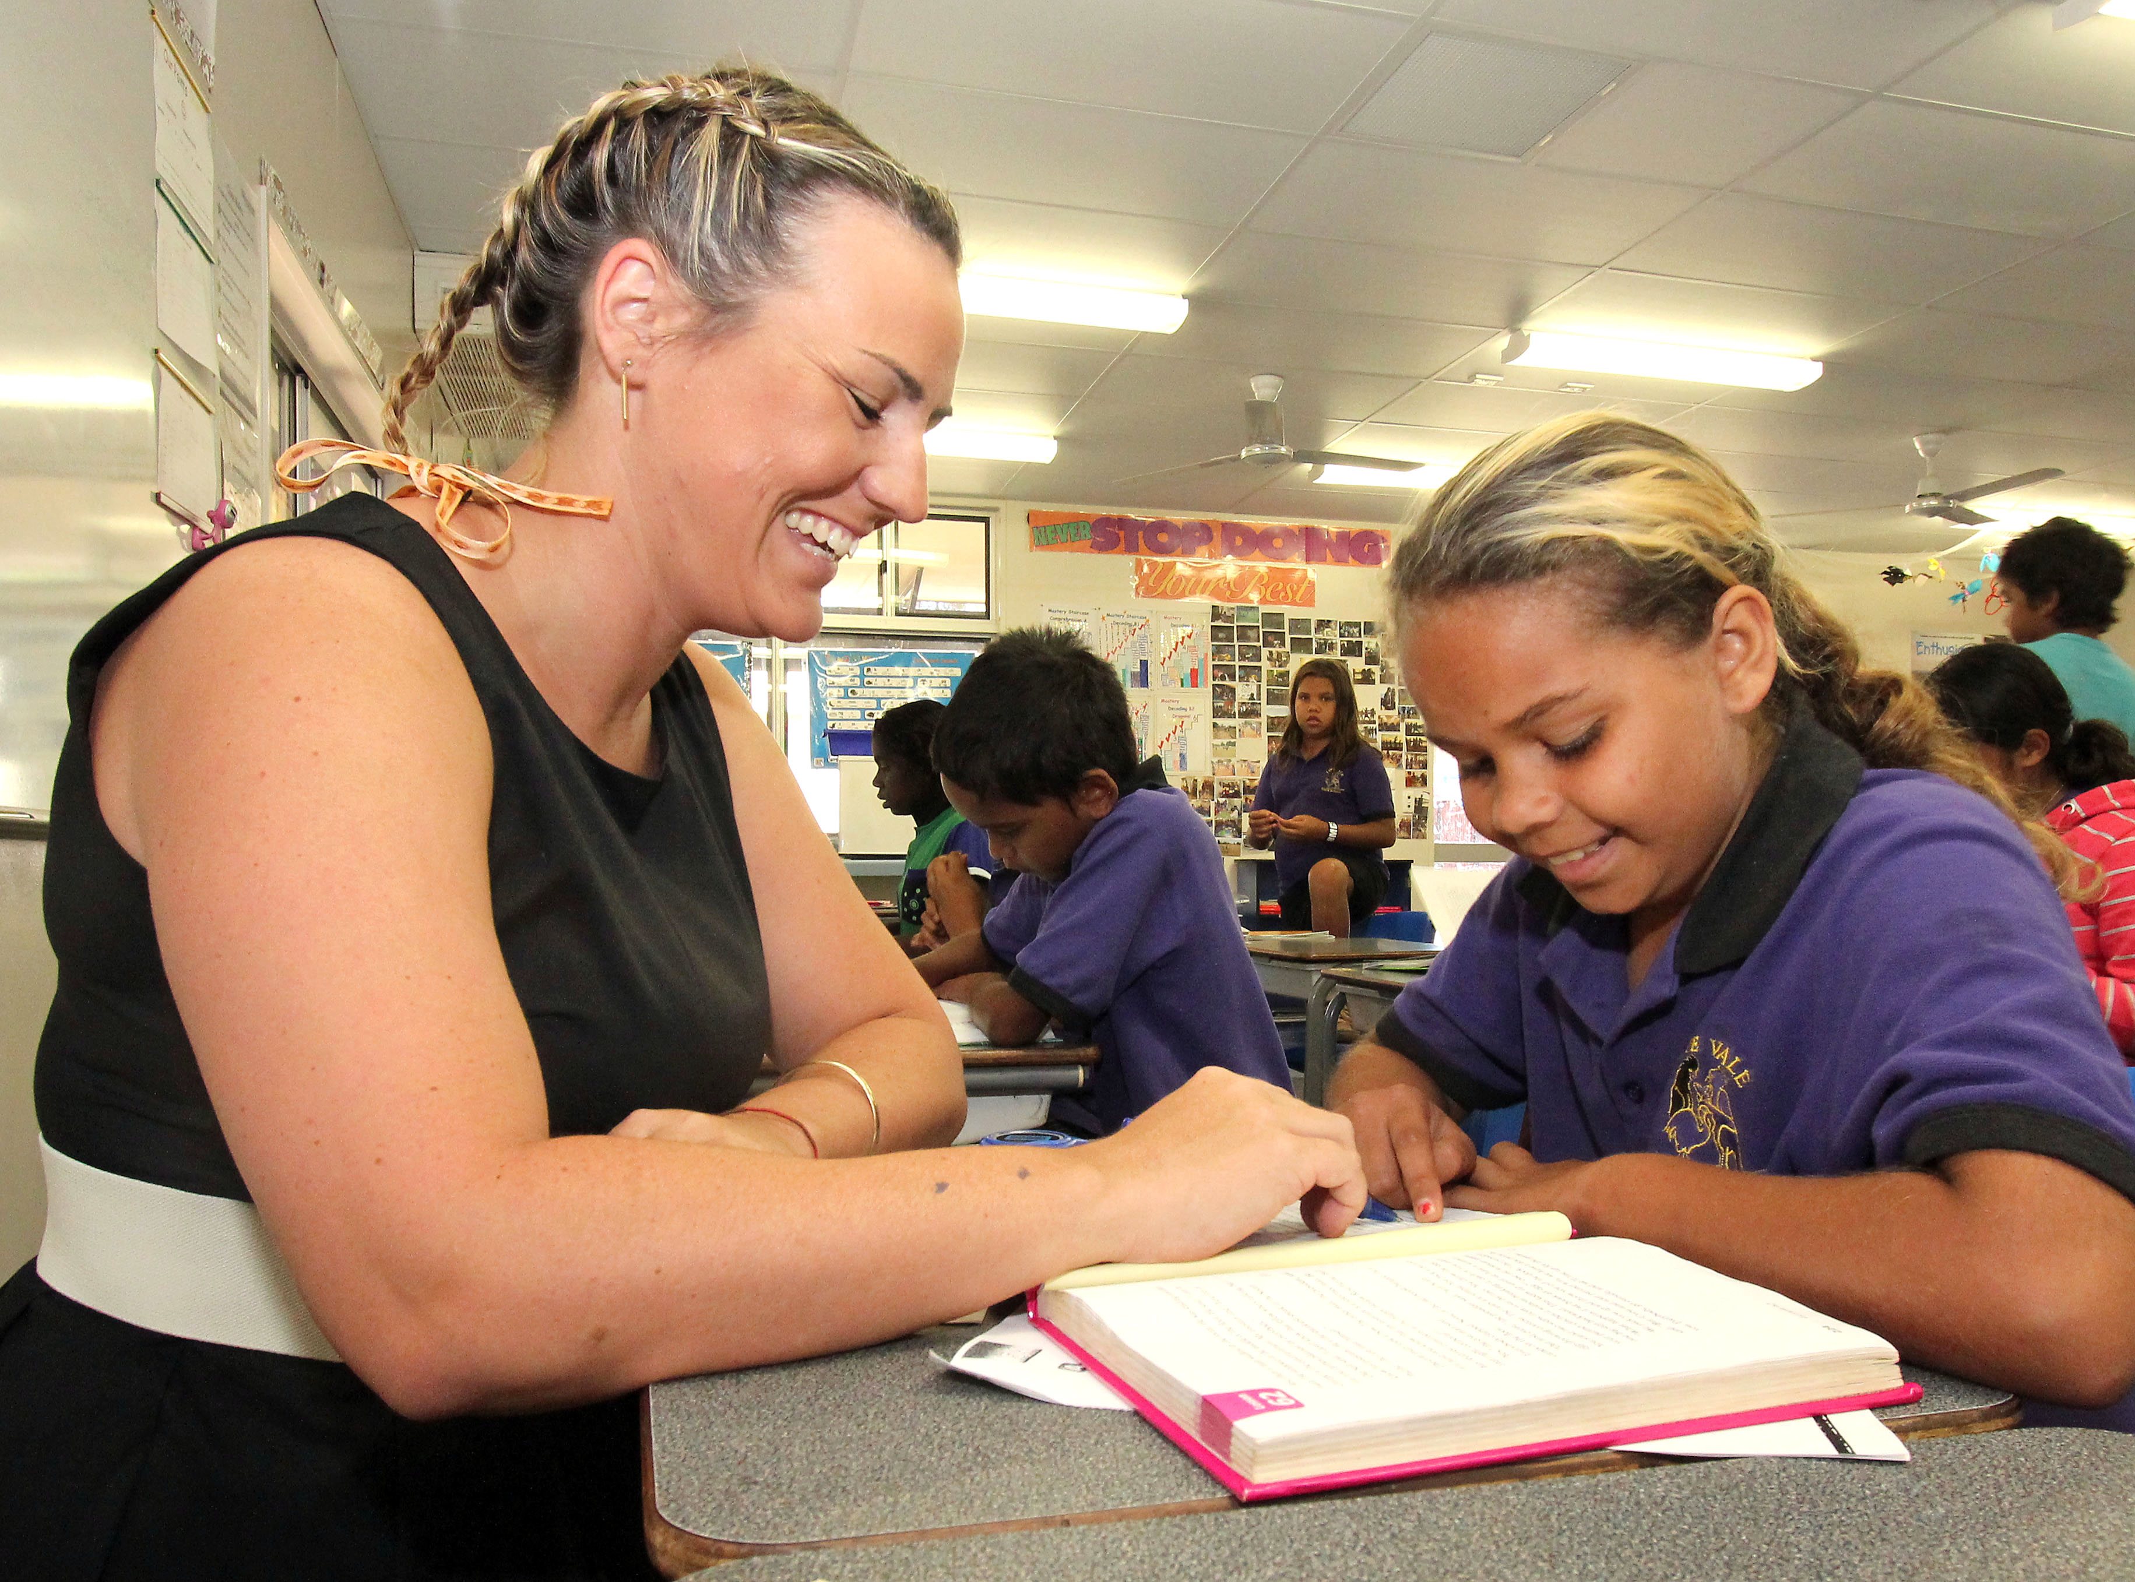
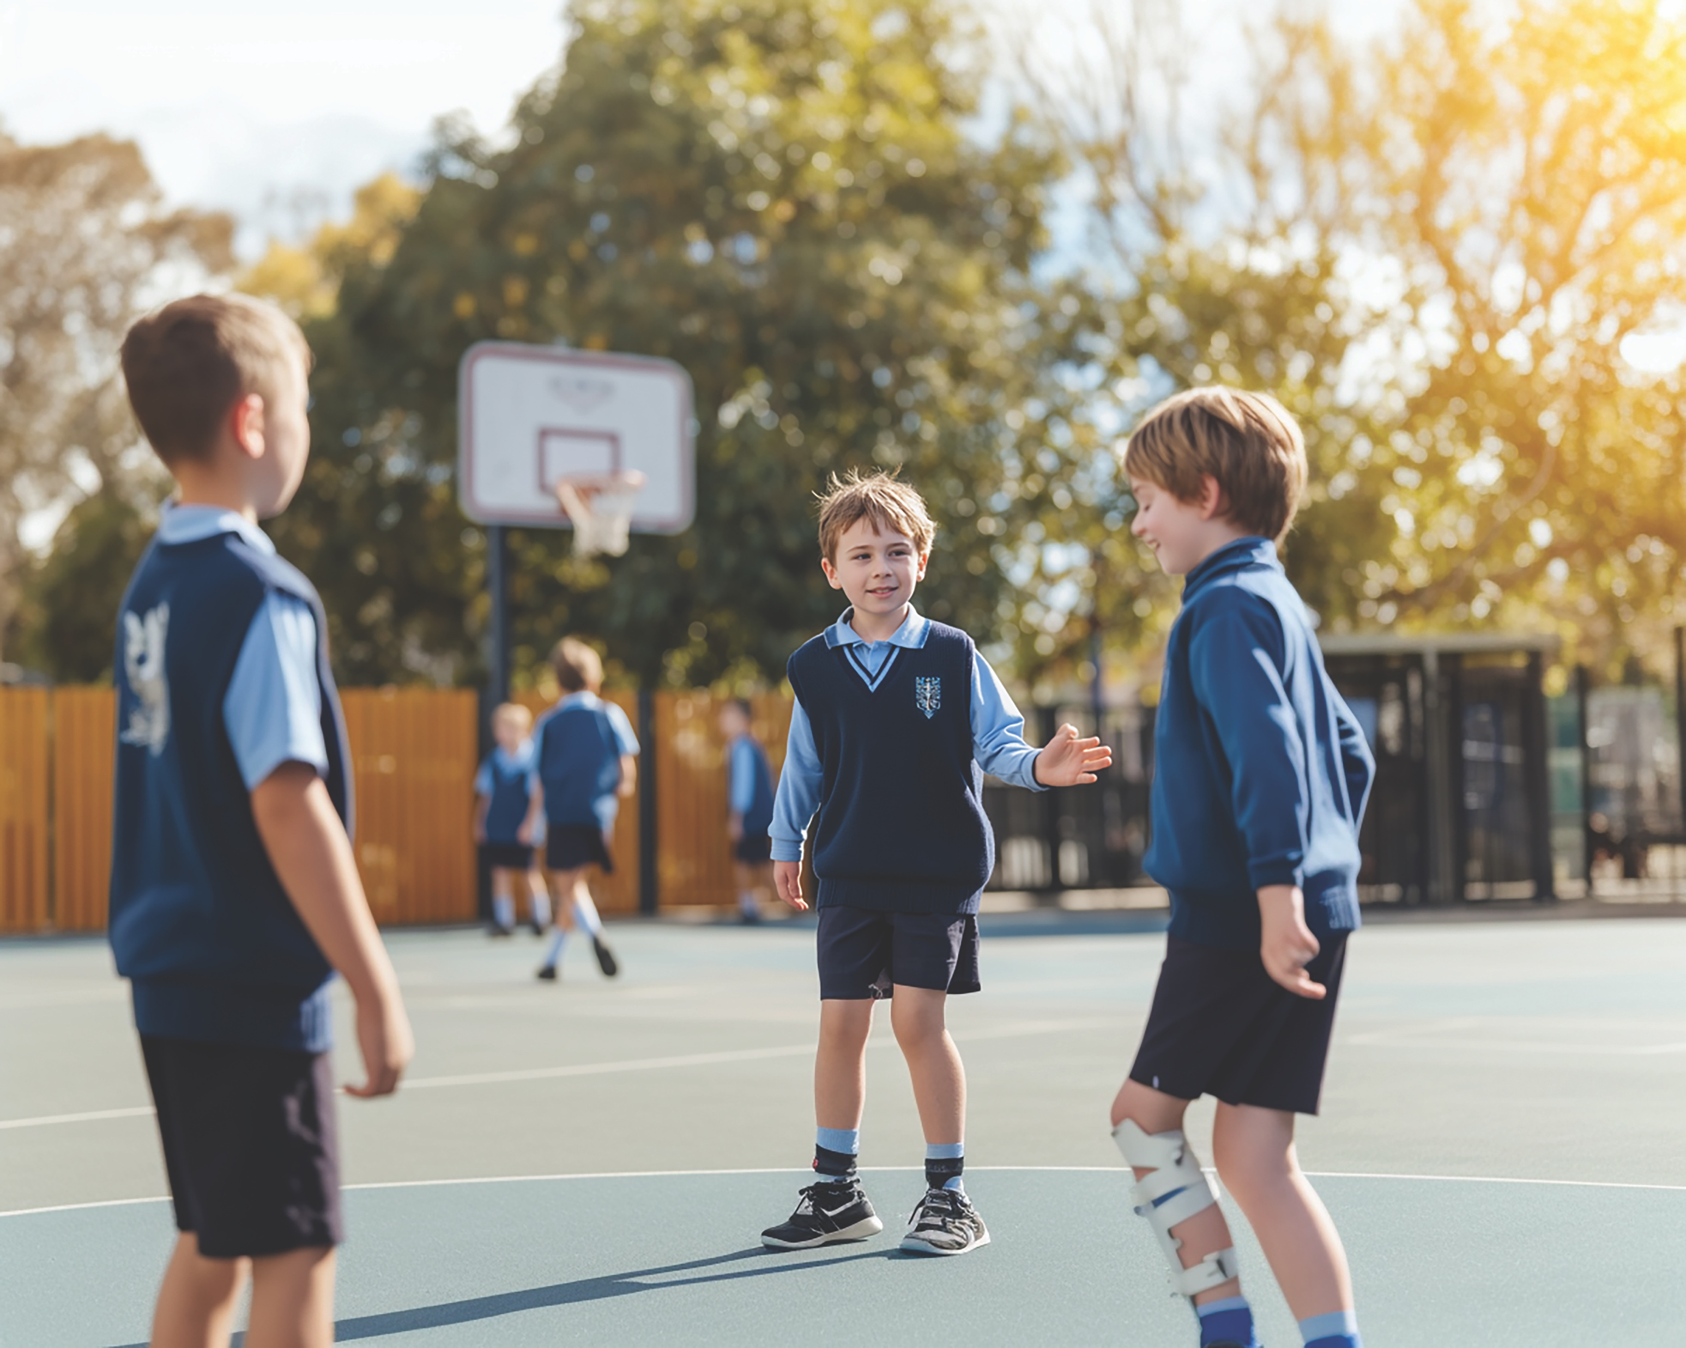
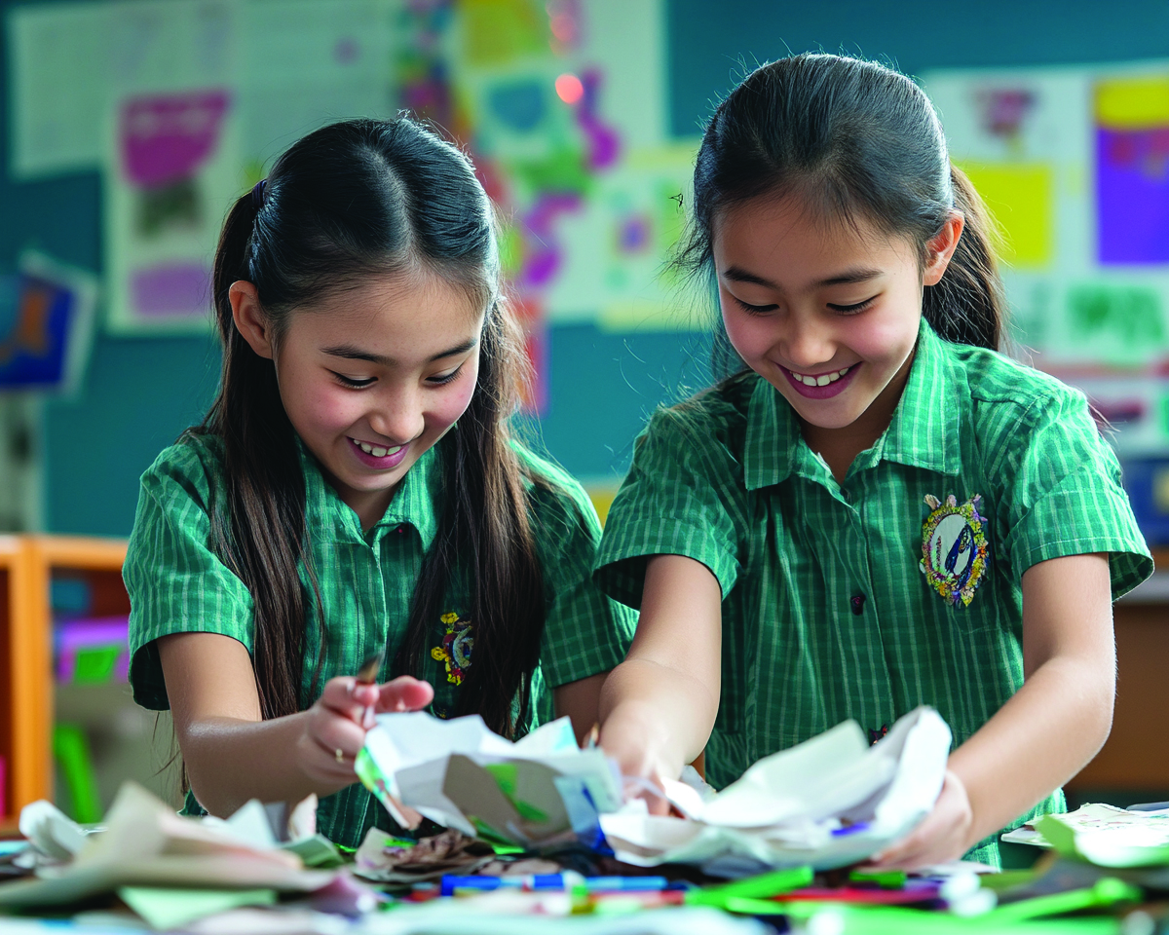
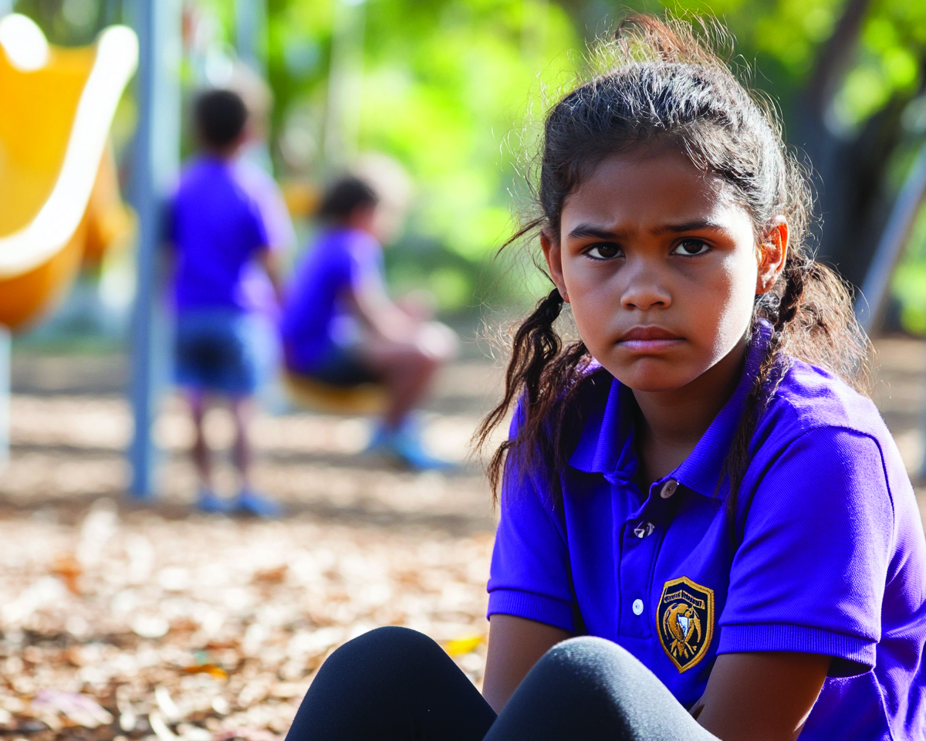

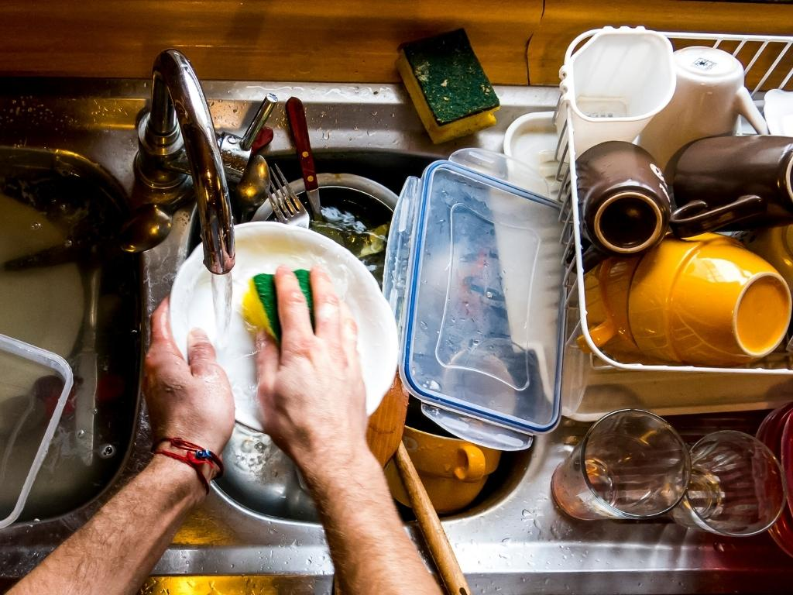

Slide 5
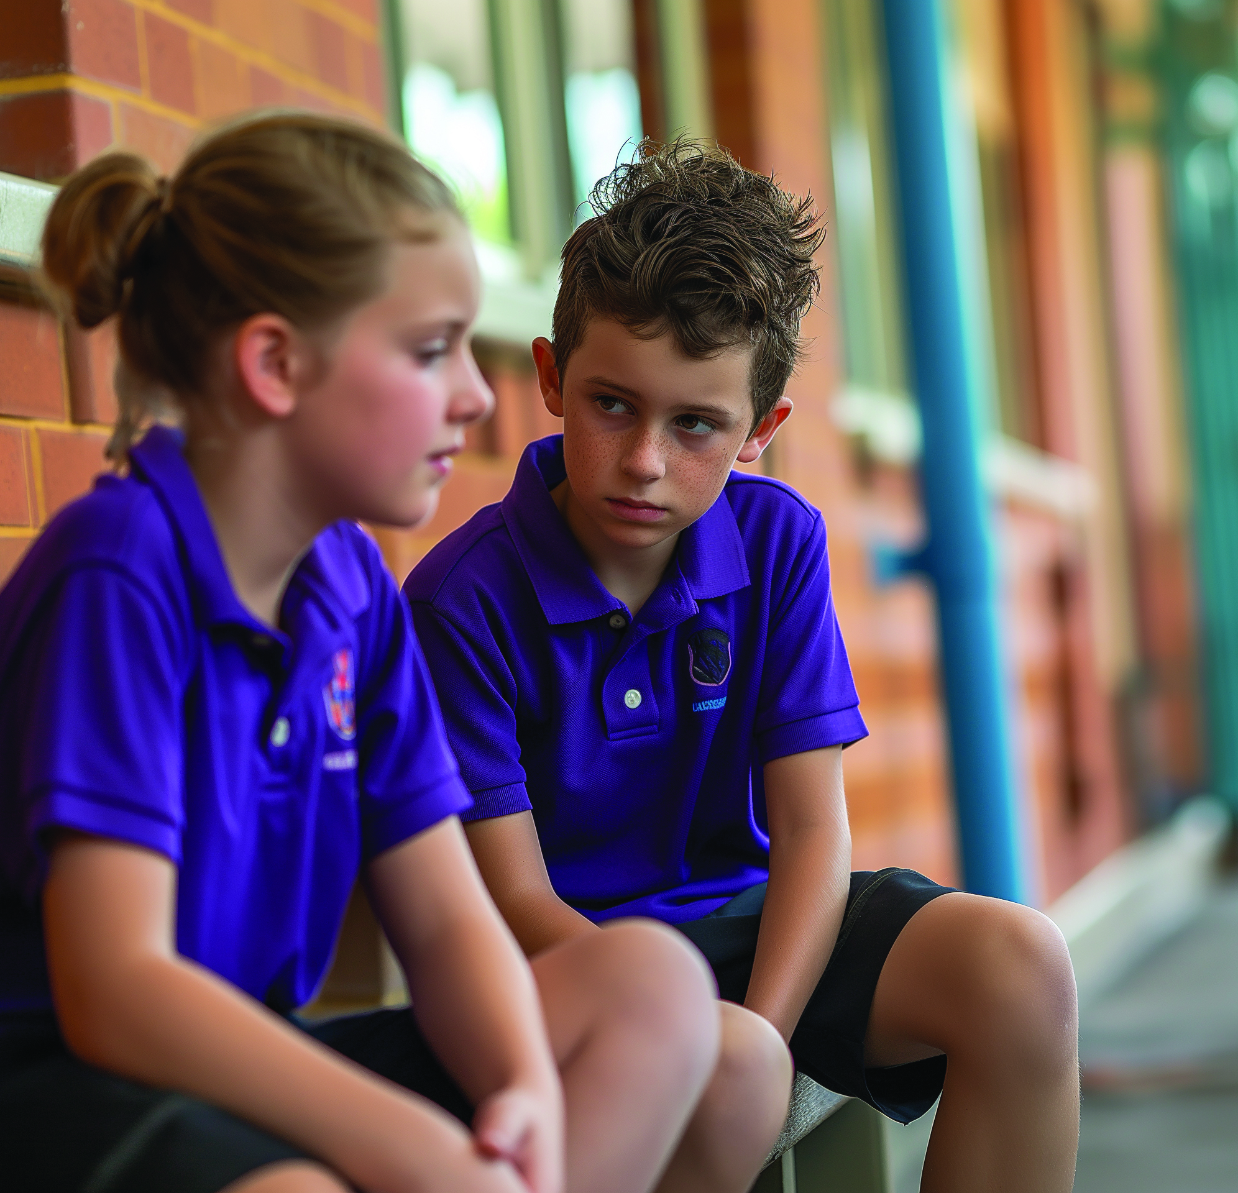
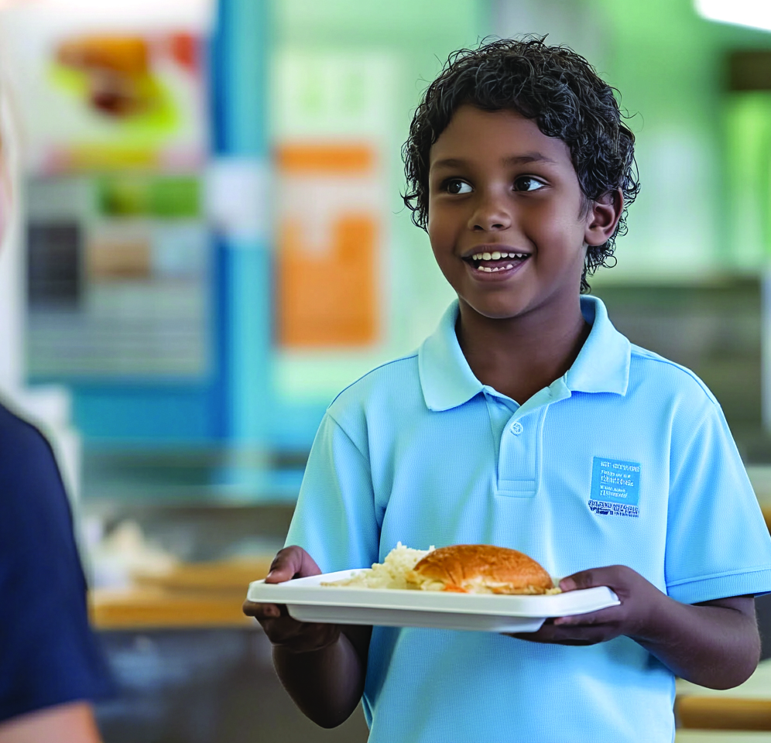
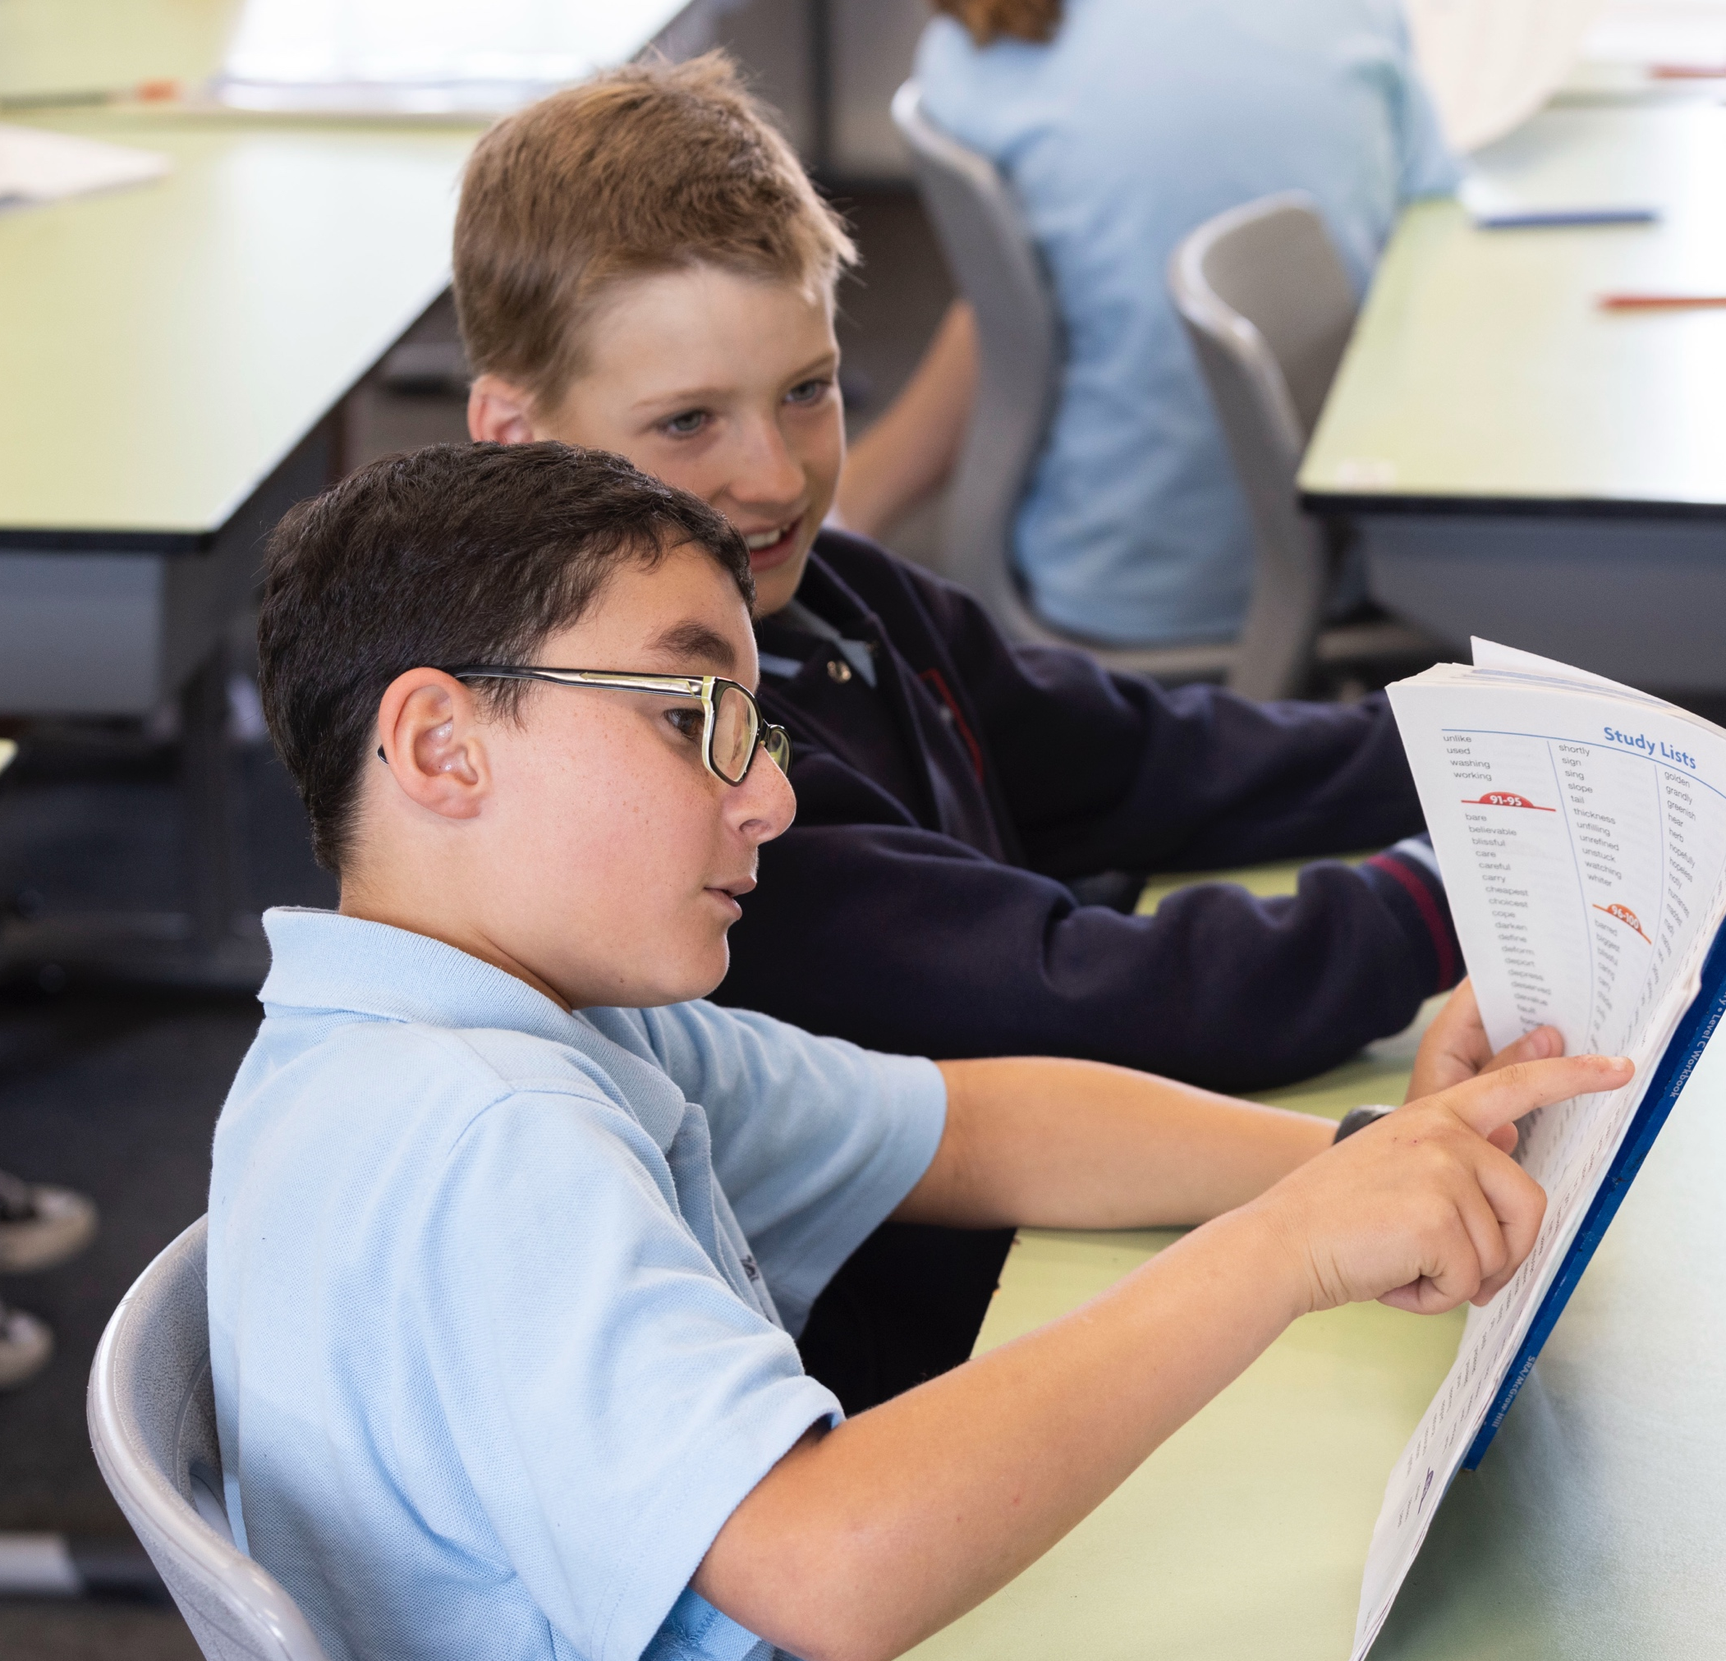
Support is helping someone in a way that makes things easier for them or helps them feel safe, included or able to keep going.

Slide 6
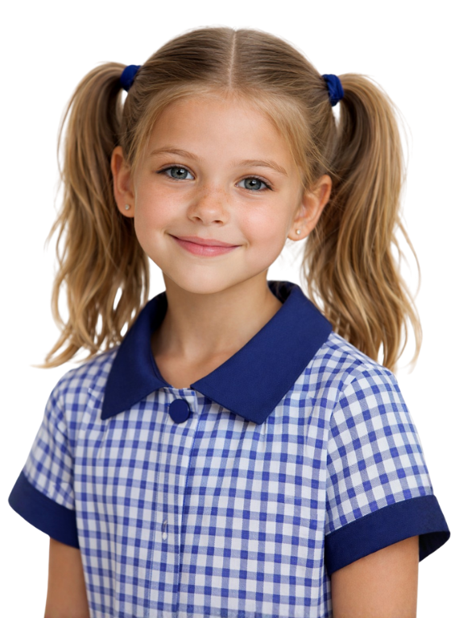
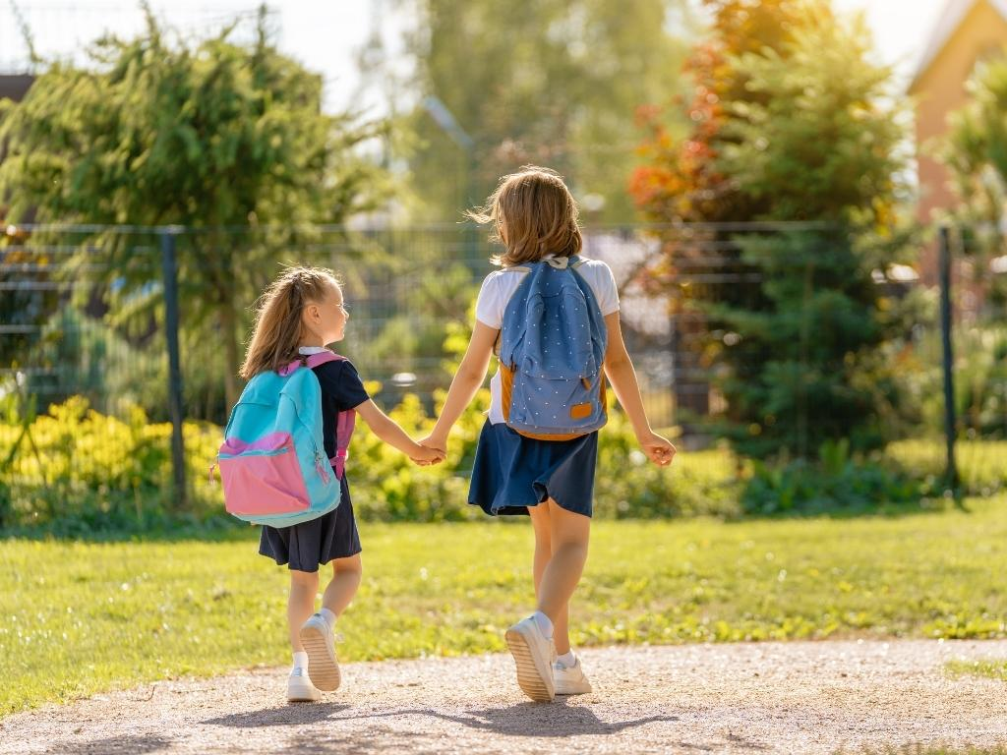
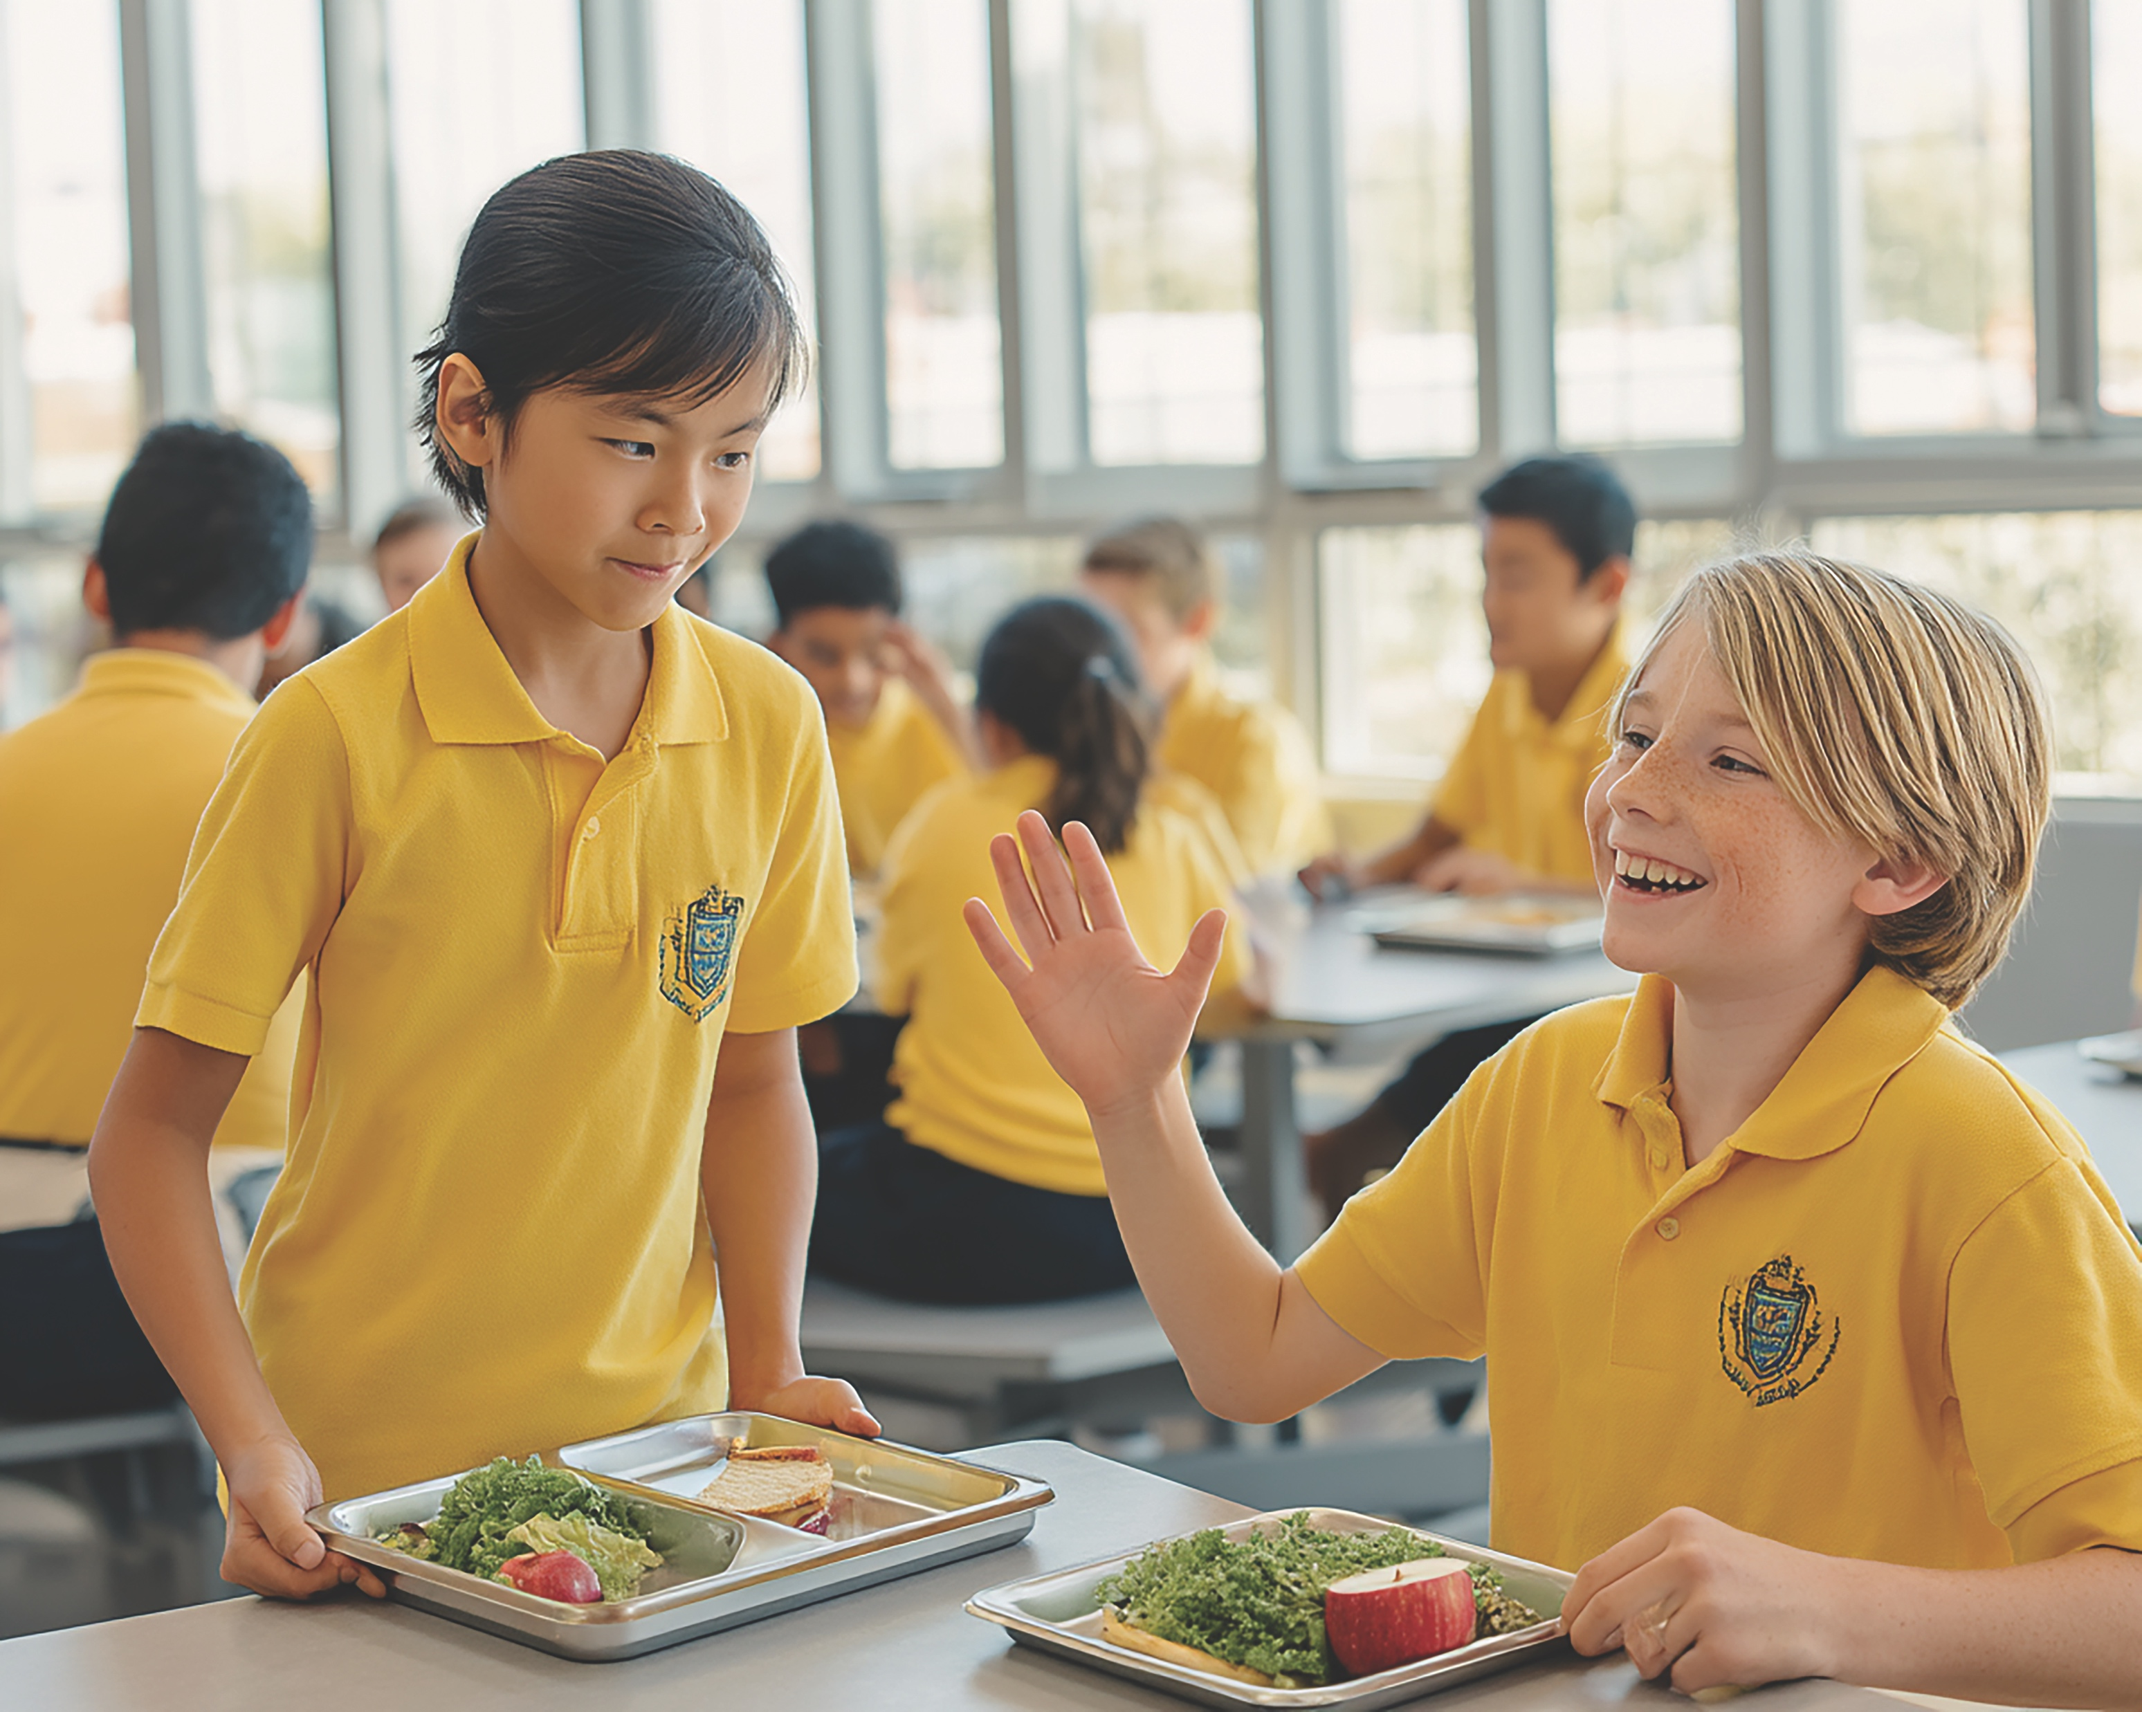

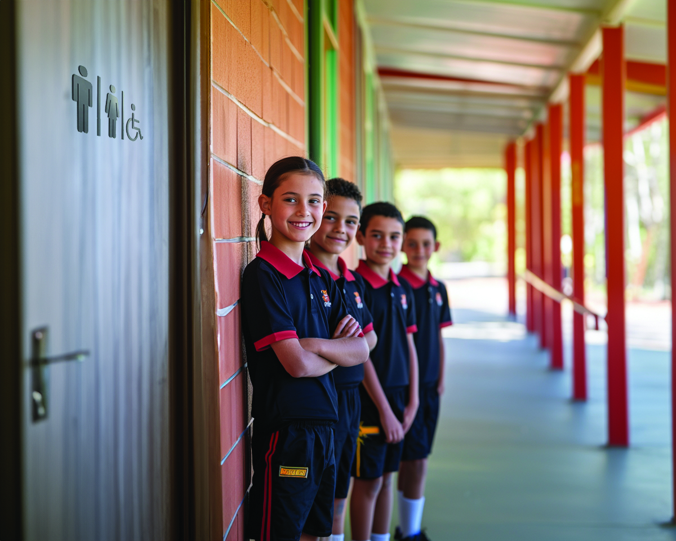
Kindness is choosing to do something to help others, even when you don’t have to.

Slide 7

Kindness Is Not Always Easy
Kindness happens when we notice someone needs help, ask ourselves what we can do and choose to act, even if it’s not the easiest choice.

Slide 8
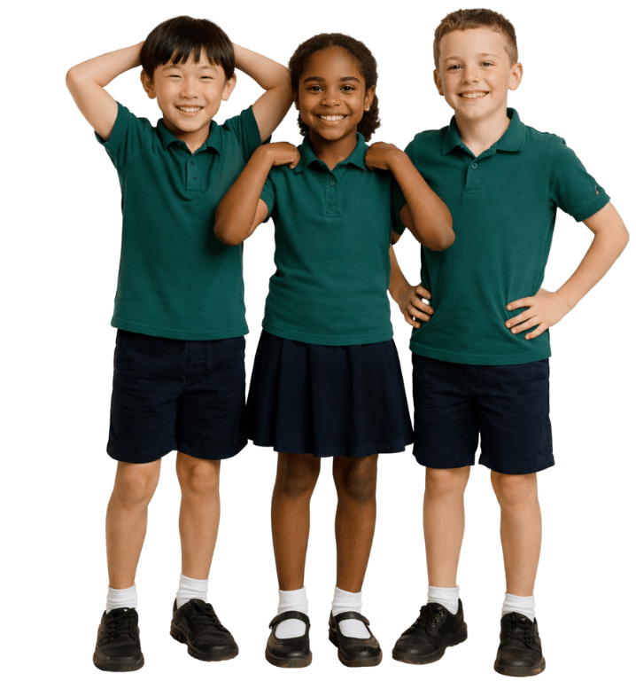
Kindness
Being kind:
is always easy
is something I have to do
is not always easy

Slide 9


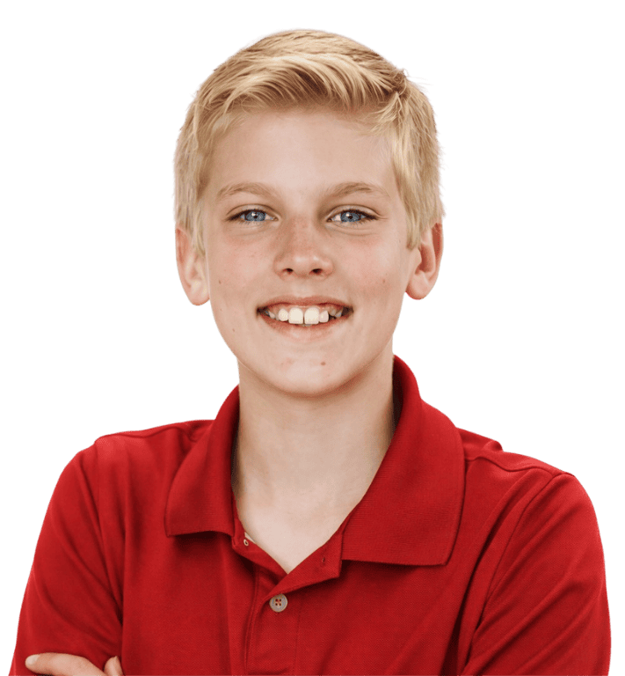
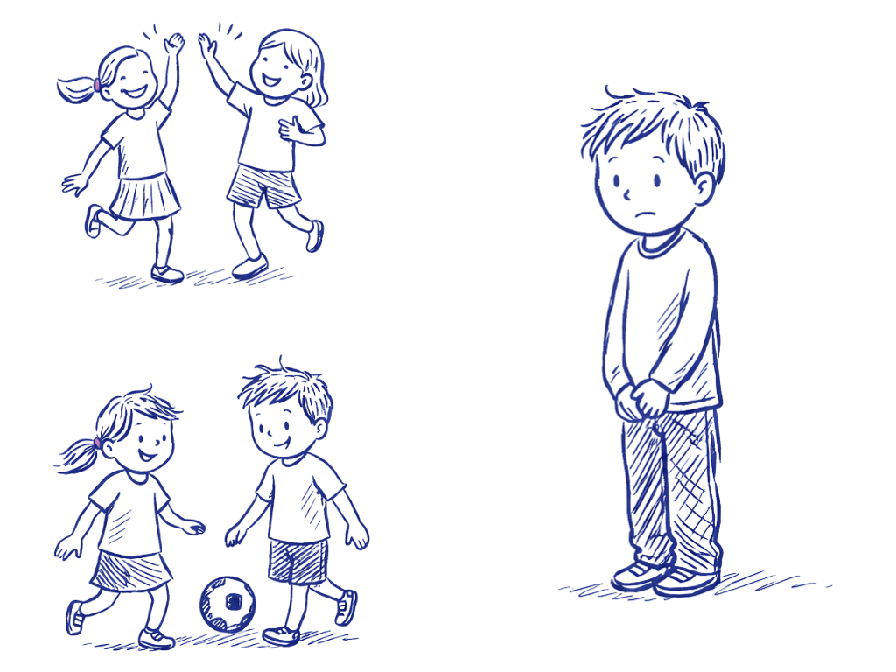
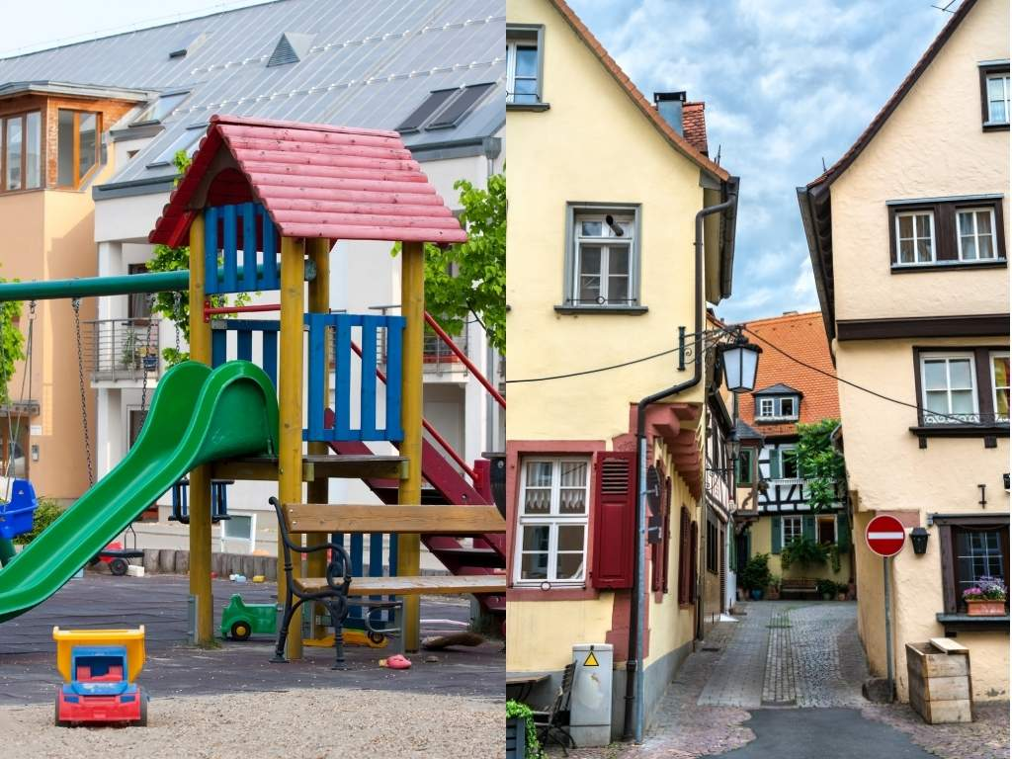

Slide 10
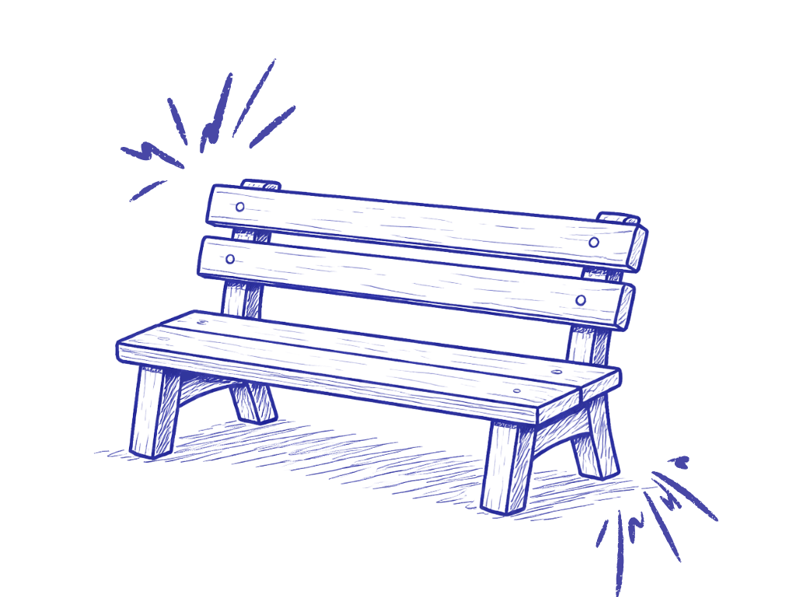

Slide 11
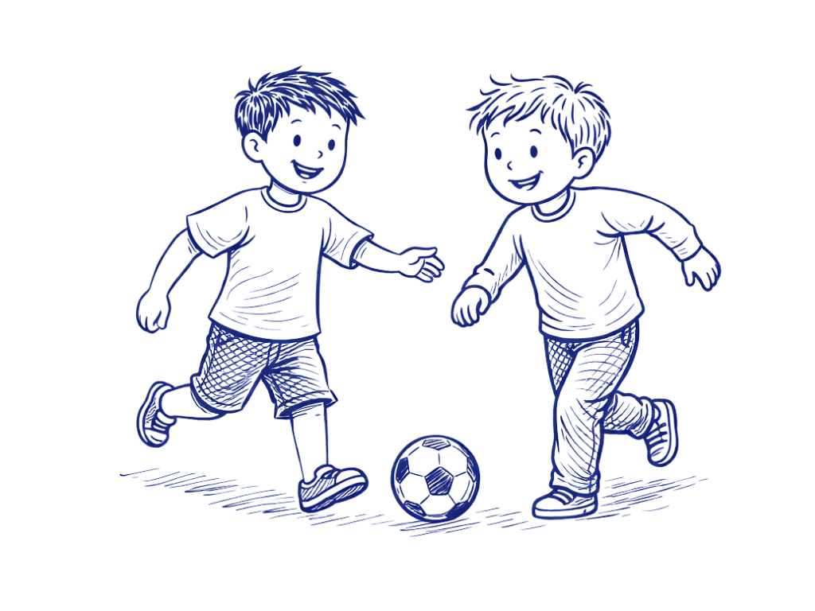
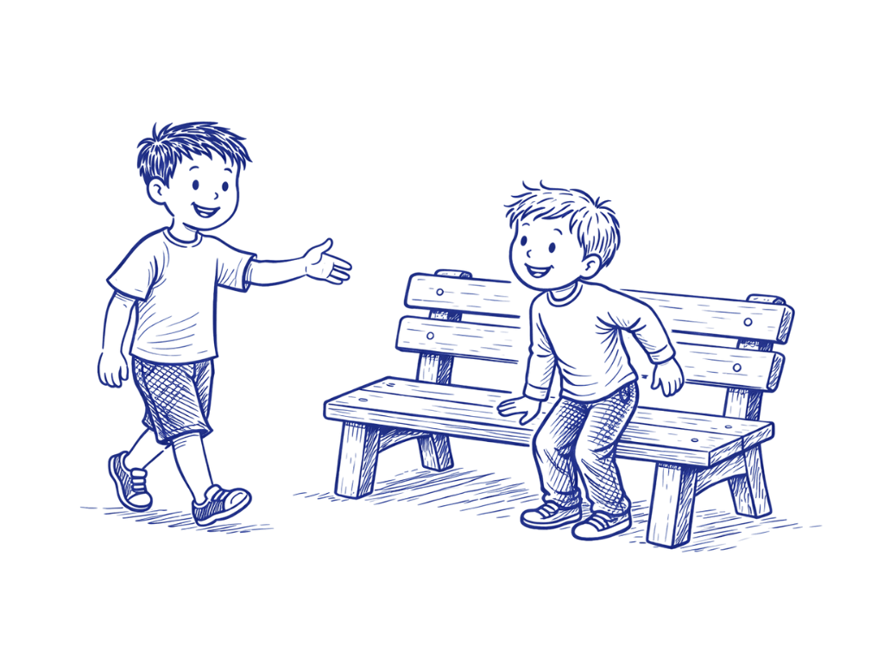
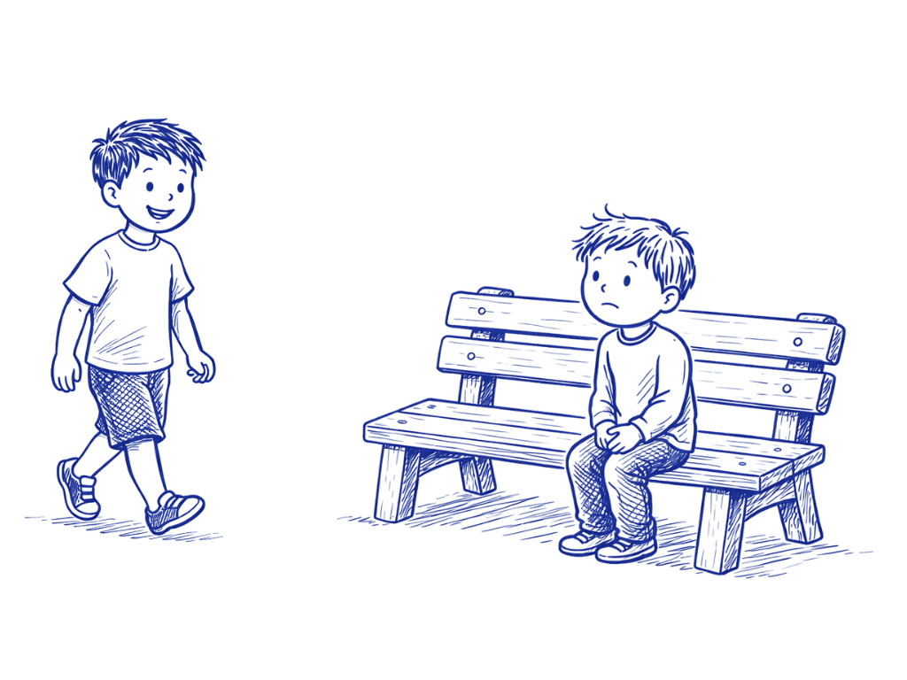
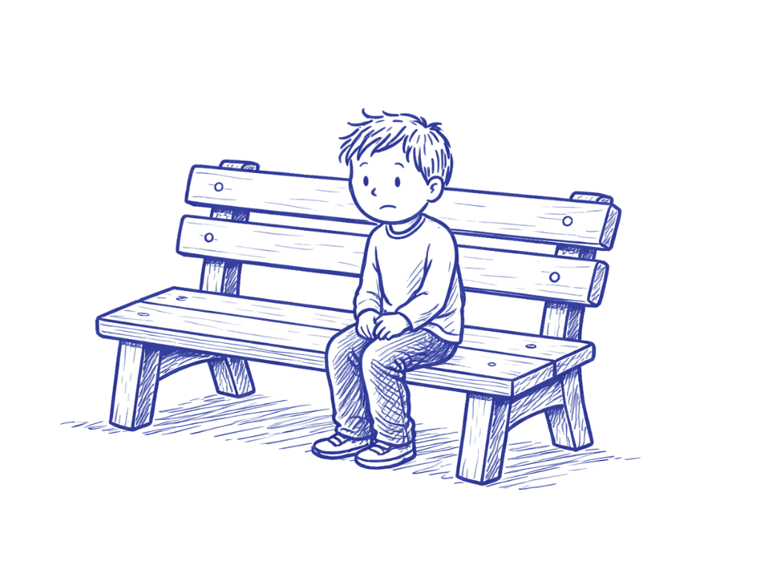

Slide 12
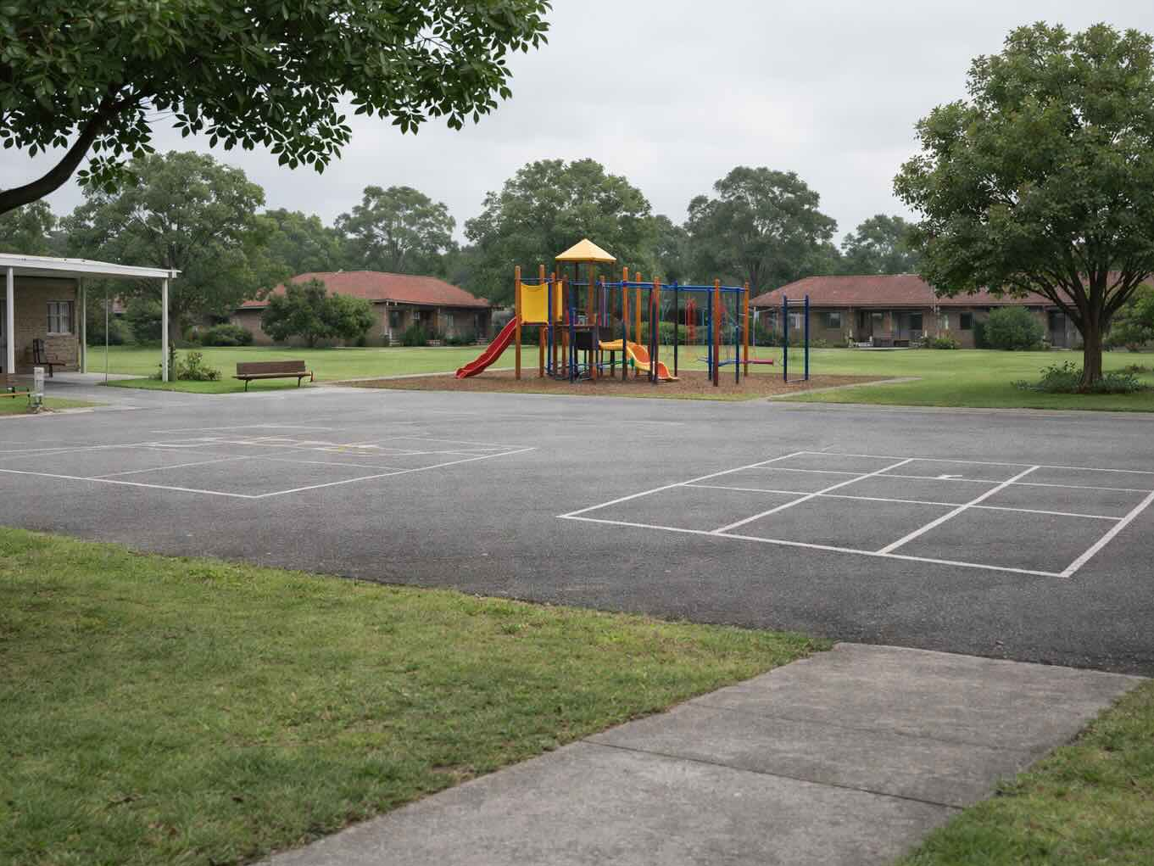

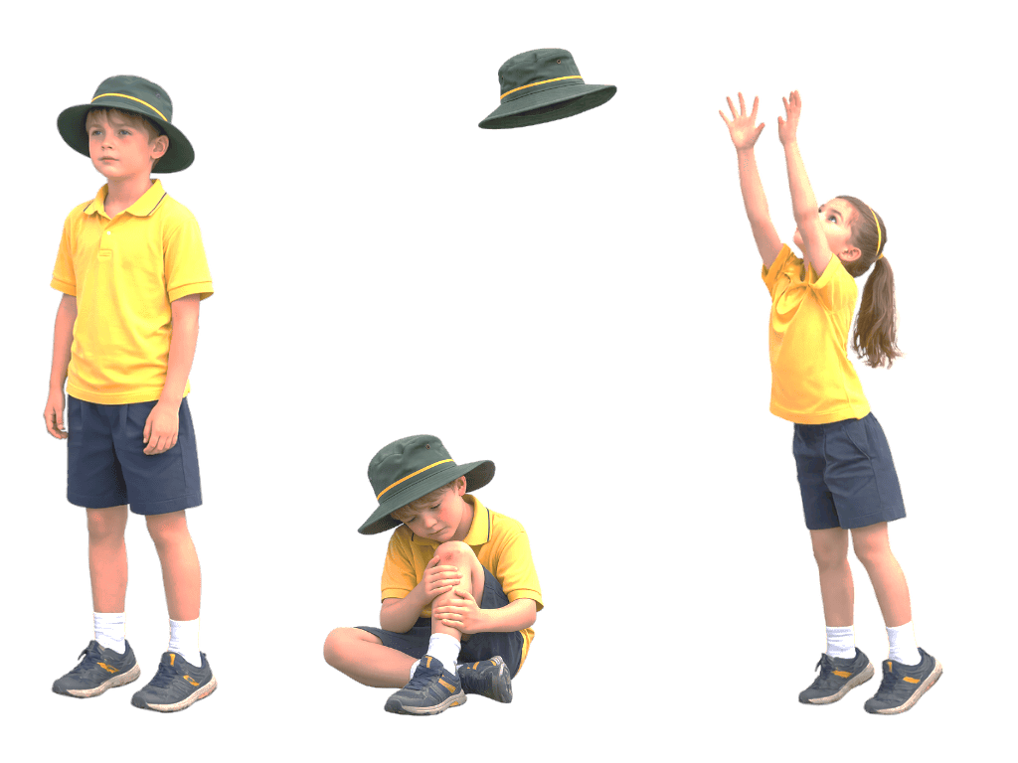
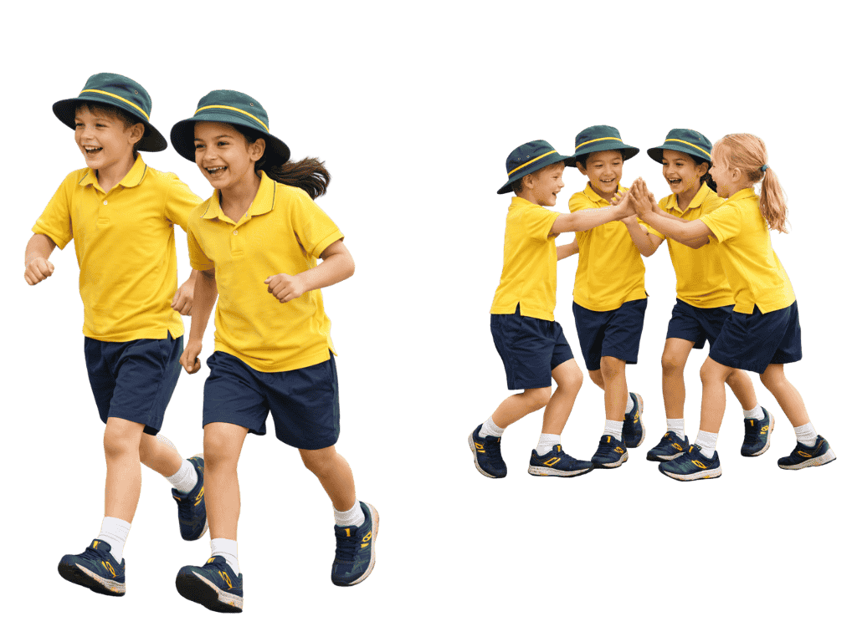
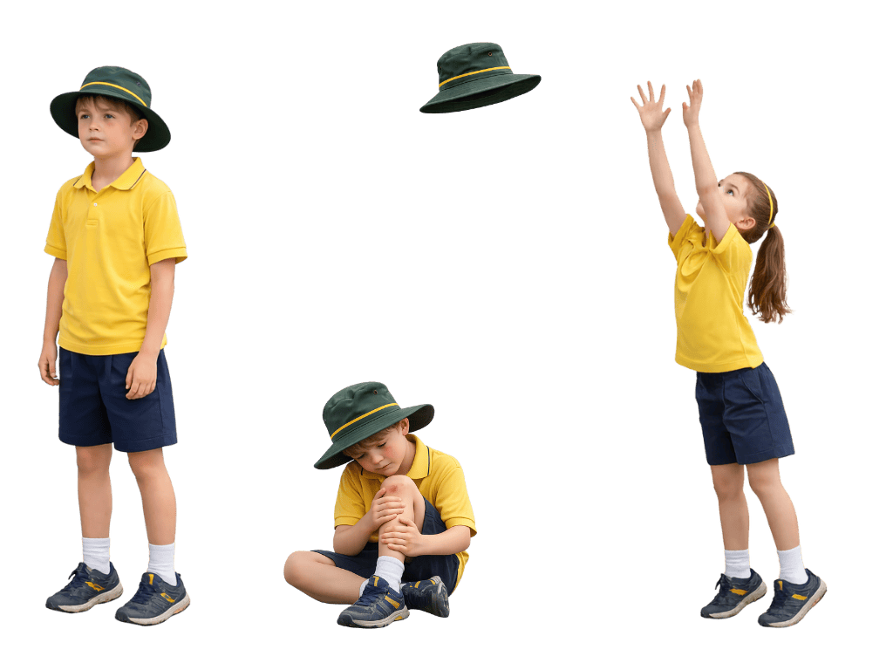
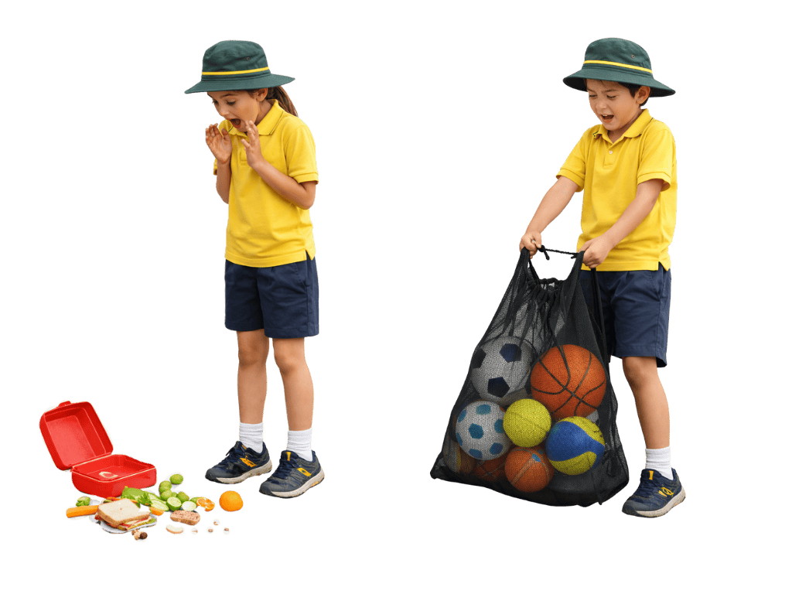
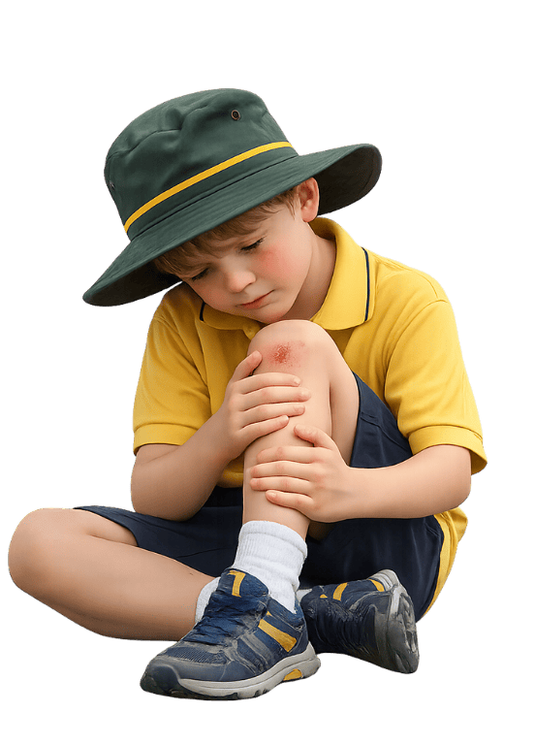

Slide 20
Support is helping someone in a way that makes things easier for them or helps them feel safe, included or able to keep going.
Kindness is choosing to do something to help others, even when you don’t have to.
Kindness happens when we notice someone needs help, ask ourselves what we can do and choose to act, even if it’s not the easiest choice.

Slide 21



How well did you:
describe what kindness looks like in different situations
explain how a kind action can help someone feel supported?

Slide 22
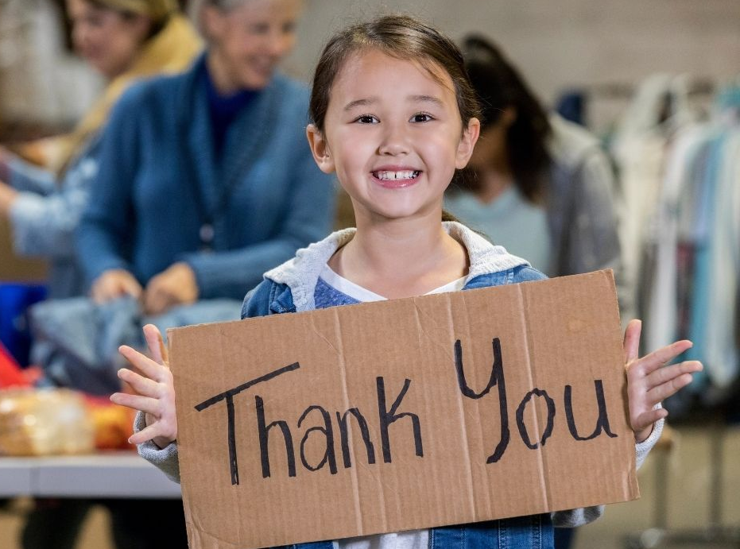
In the next lesson, we will learn how gratitude helps people notice and appreciate the good things in their lives, including everyday experiences and help from others.

