Slide 1
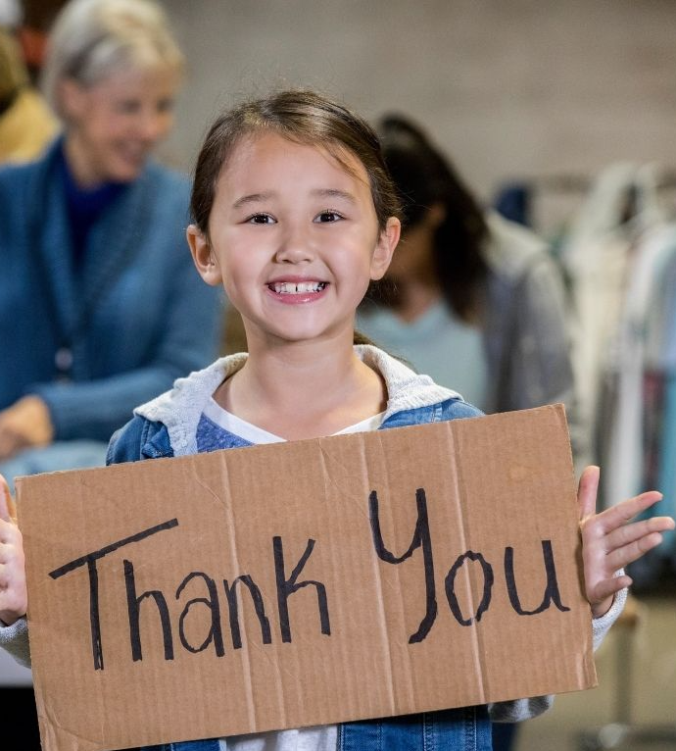
Being Grateful
Unit 2: Making Lives Better
Lesson 2

Slide 2
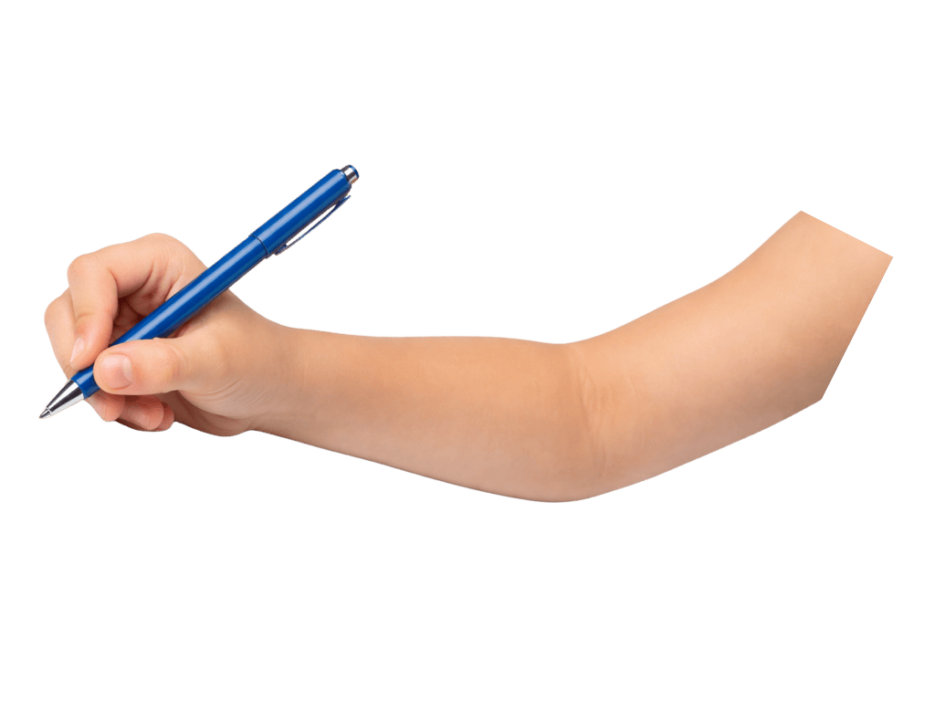
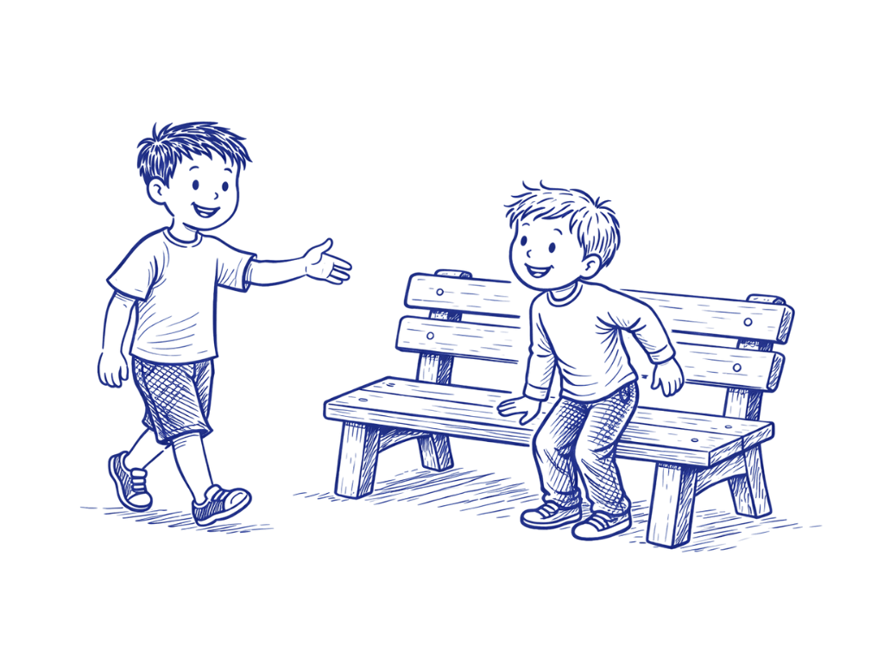
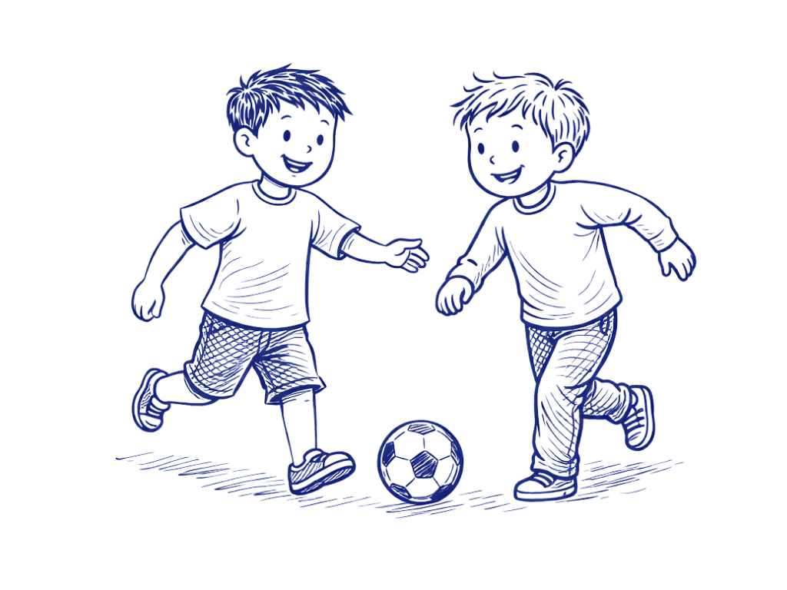
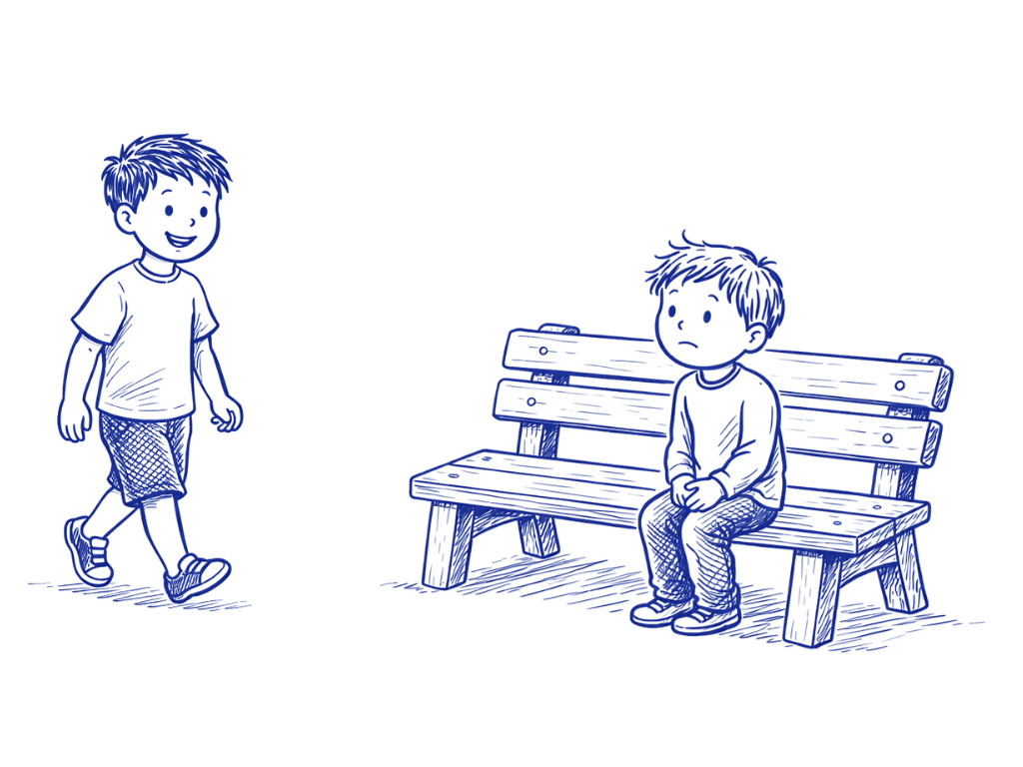
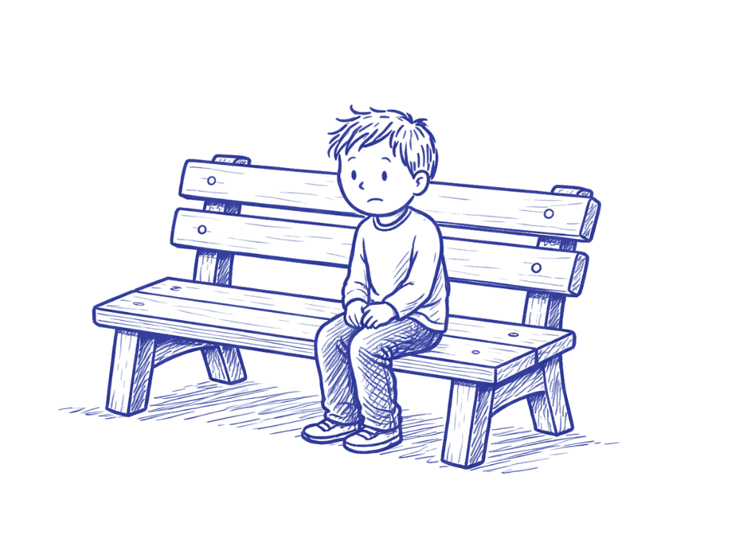
Kindness is choosing to do something to help others, even when you don’t have to.

Slide 3
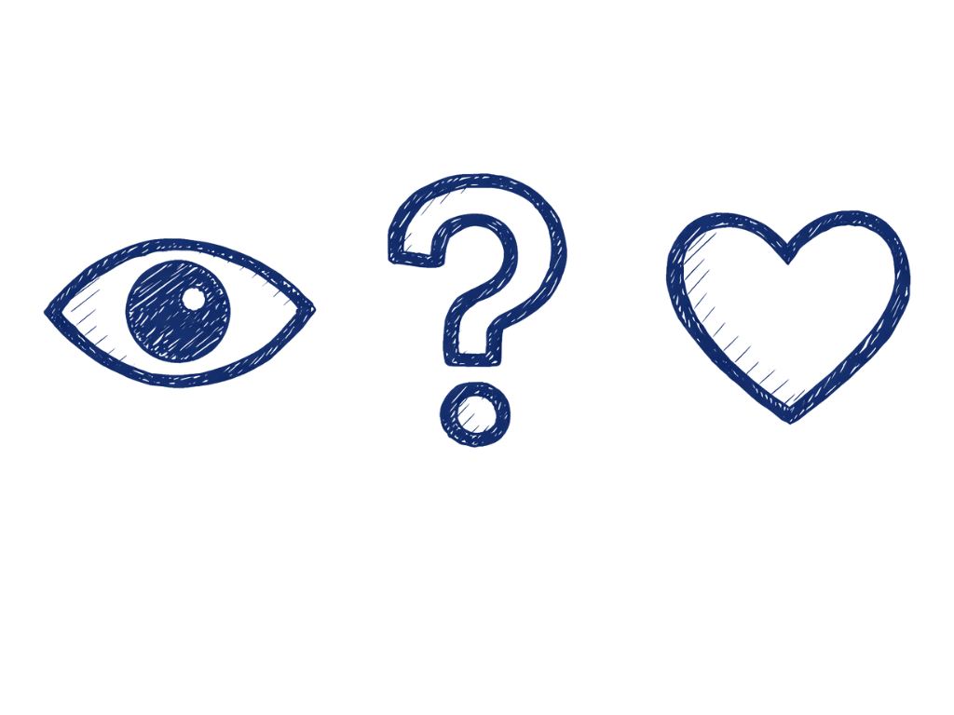
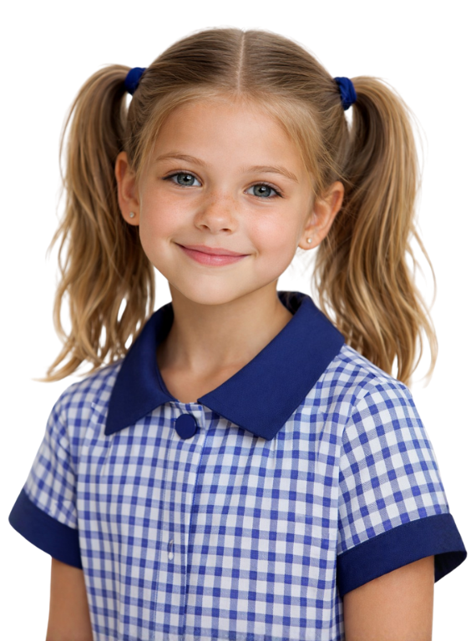
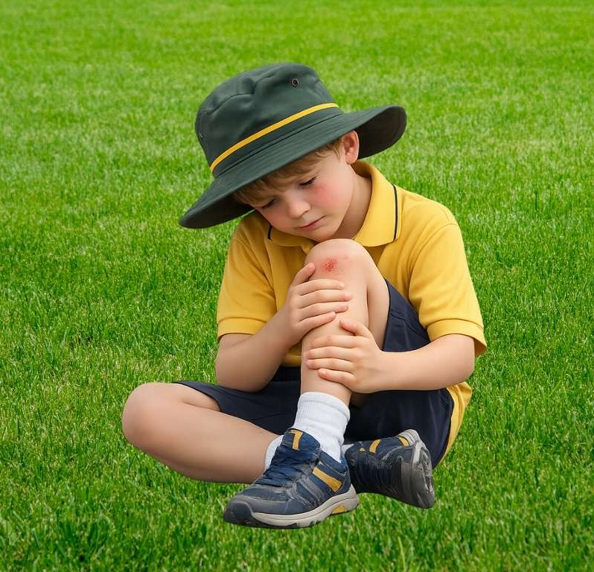
Kindness happens when we notice someone needs help, ask ourselves what we can do and choose to act, even if it’s not the easiest choice.

Slide 4
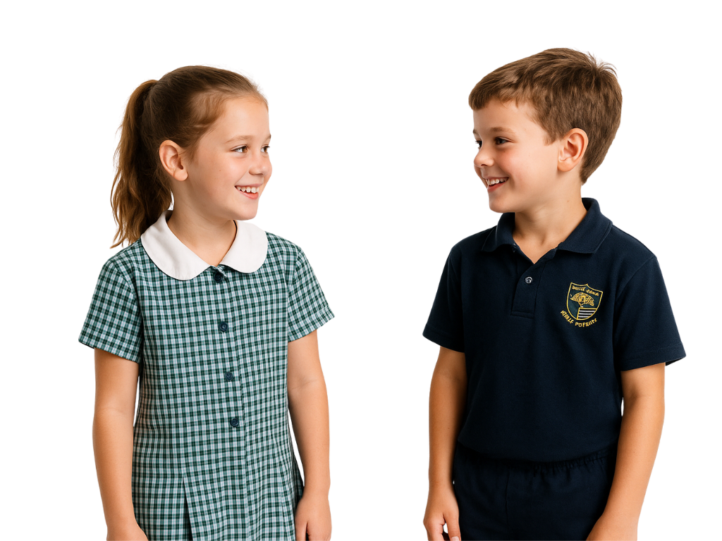
What could you do if you see someone on their own, looking sad in the playground?

Slide 5

In this lesson, we will learn how gratitude helps people notice and appreciate the good things in their lives, including everyday experiences and help from others.

Slide 6
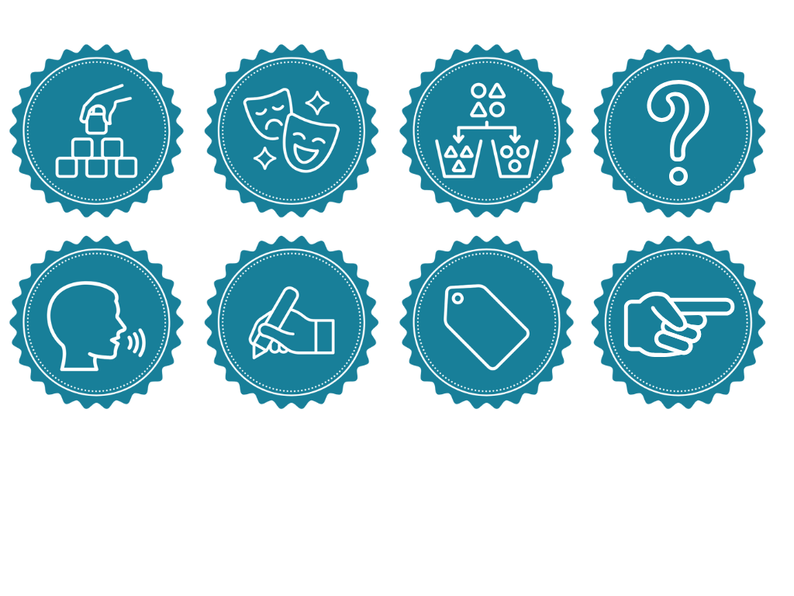
You will be successful when you can:
identify what you feel grateful for
choose a way to show gratitude to someone.

Slide 7
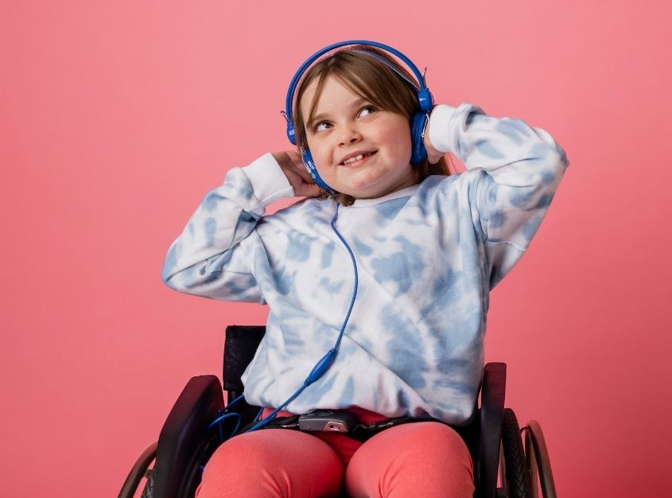
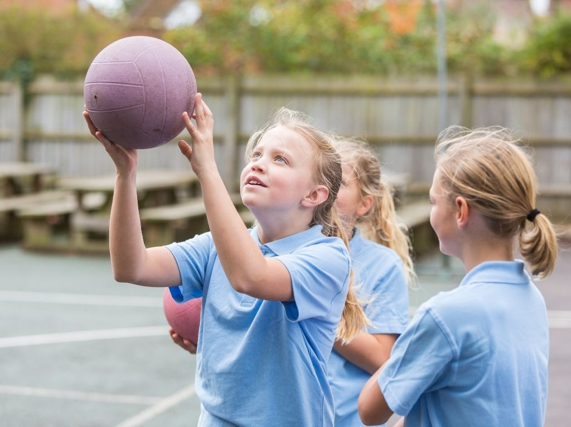
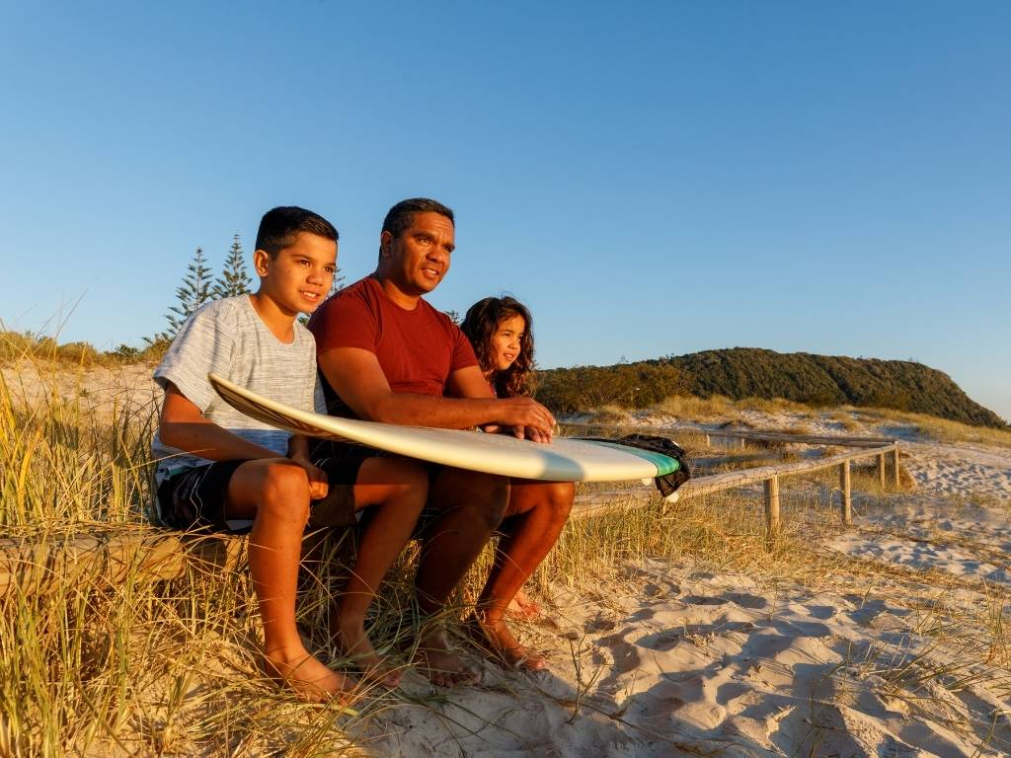

Slide 8
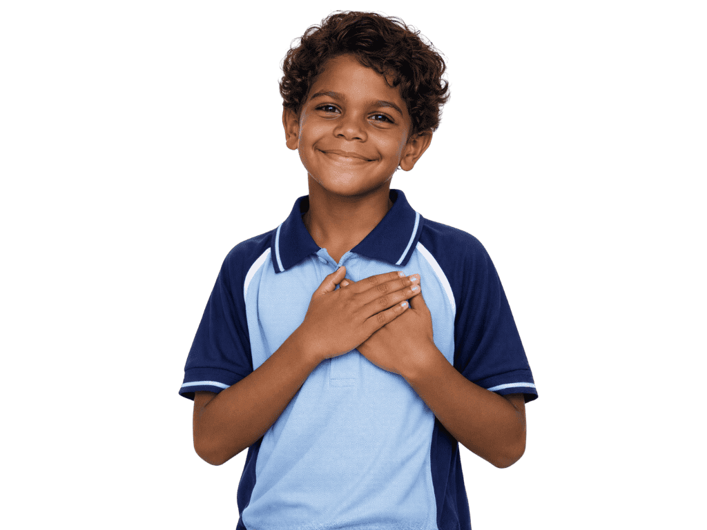
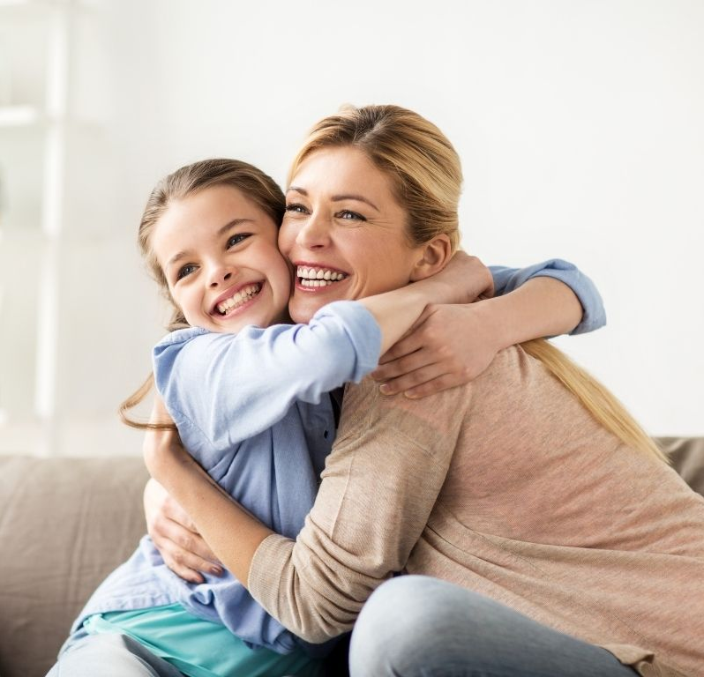
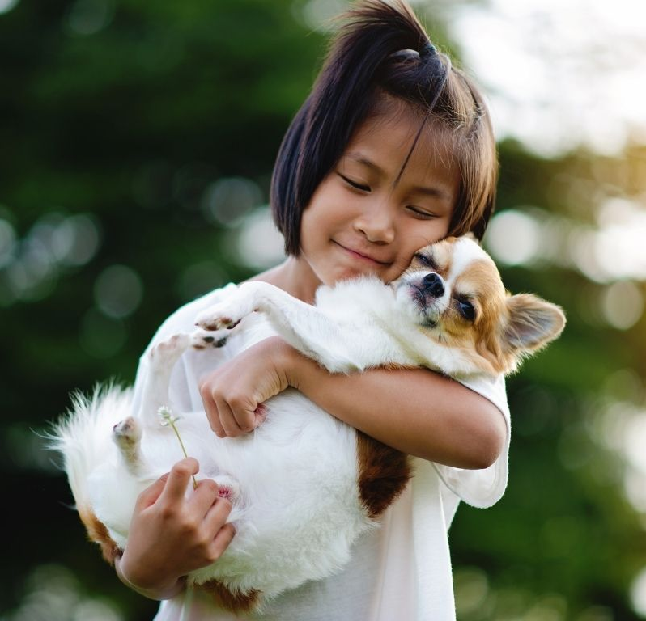
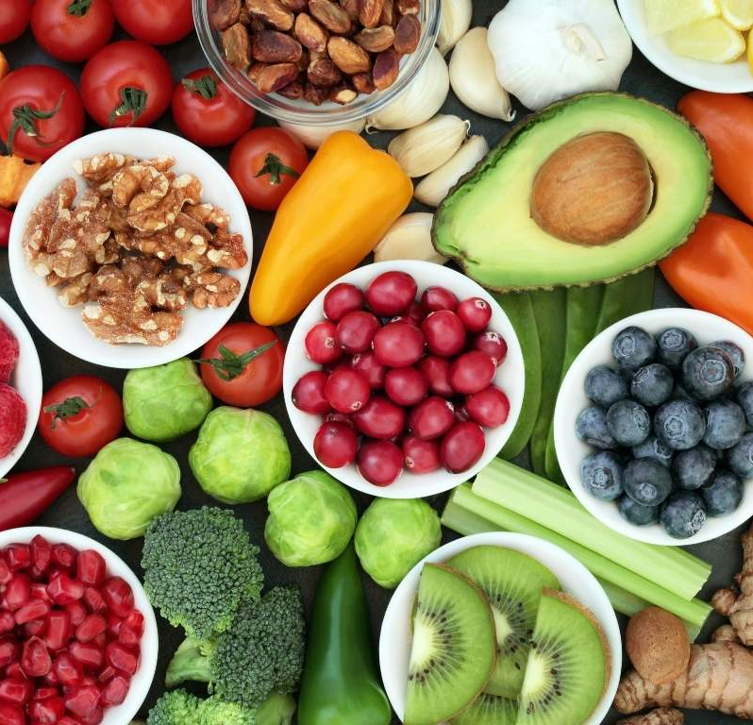
Gratitude is the feeling of being thankful for the good things in your life.
Notes:
.

Slide 9
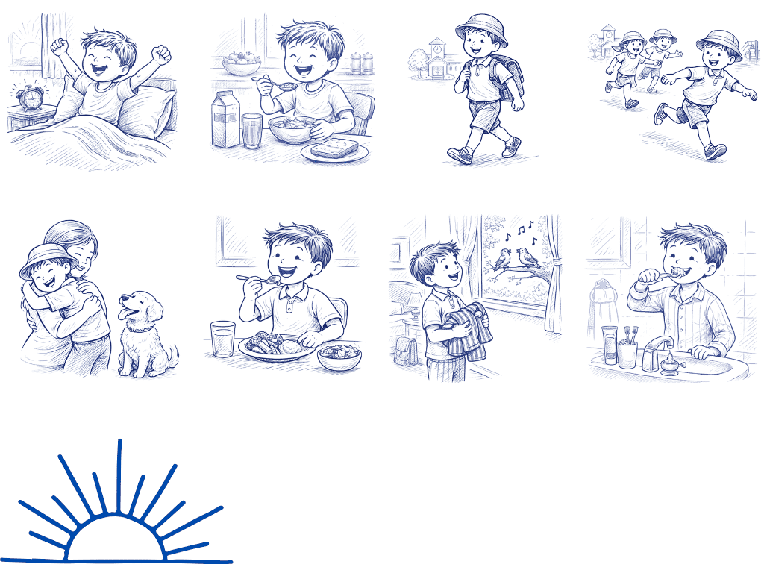
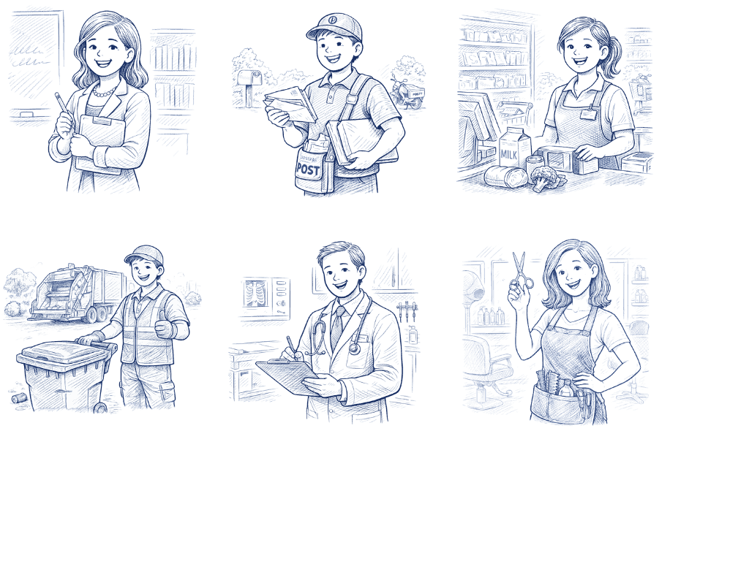
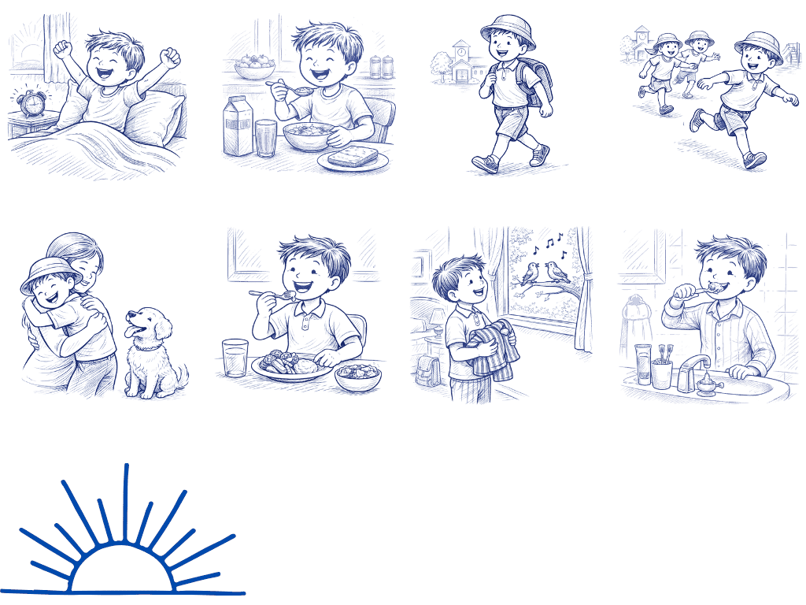
What Am I Grateful For?

Slide 10
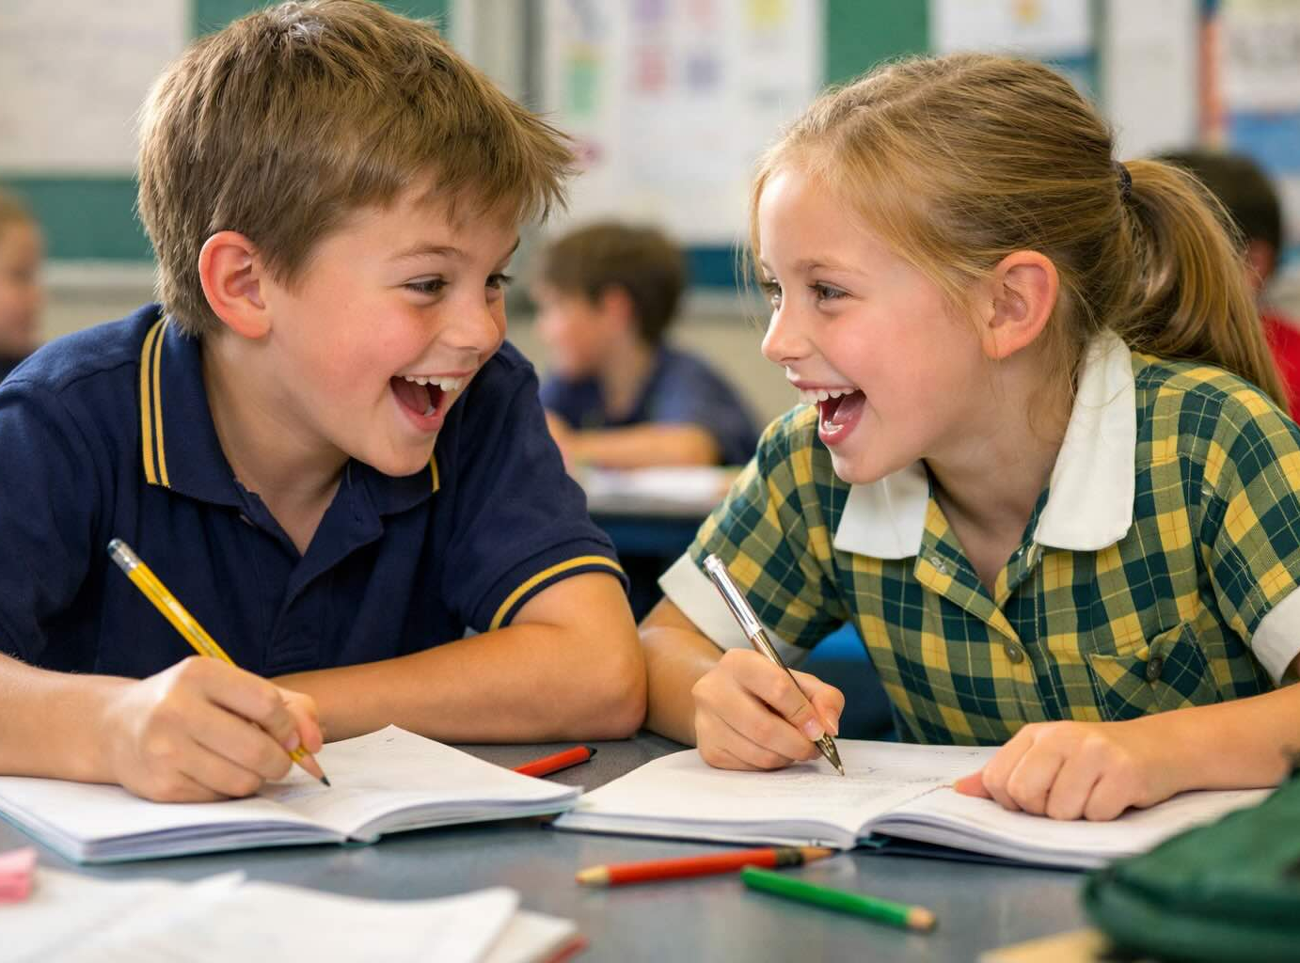
What Are We Grateful For?

Slide 11
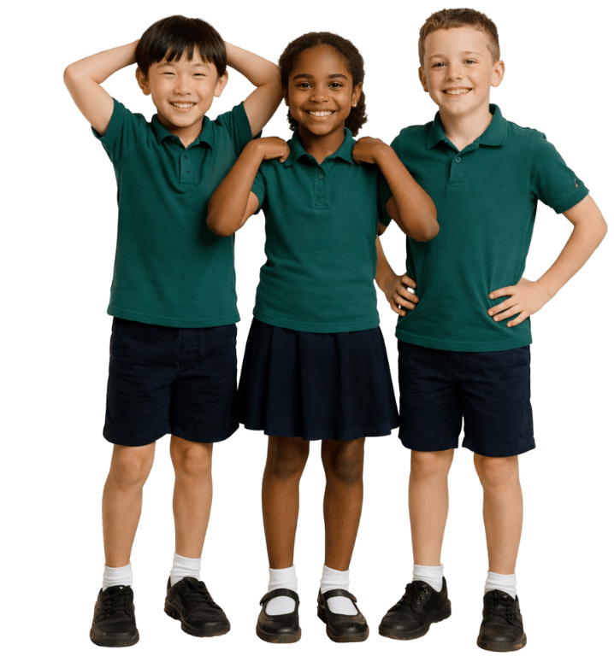
Being Grateful
We can be grateful for:
only people
anything or anyone that makes us happy or makes life better
only those who help us personally

Slide 12
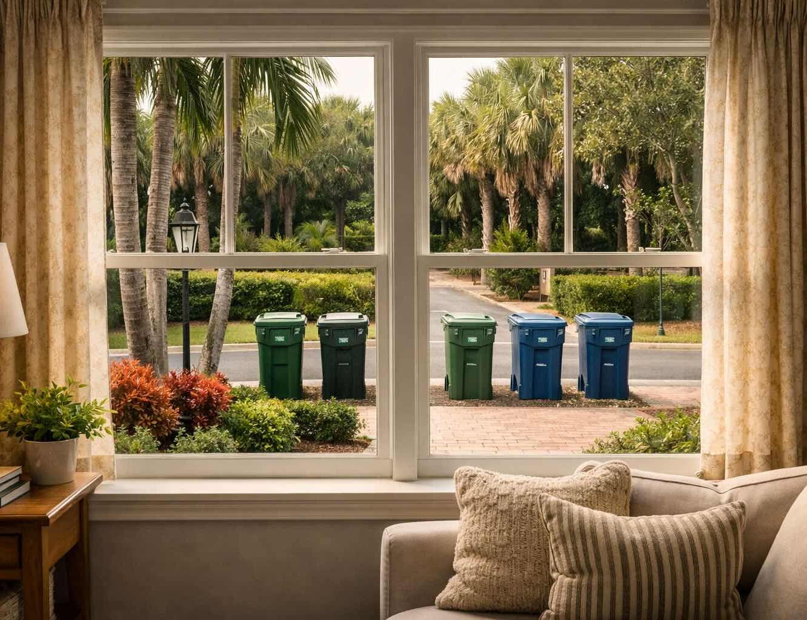
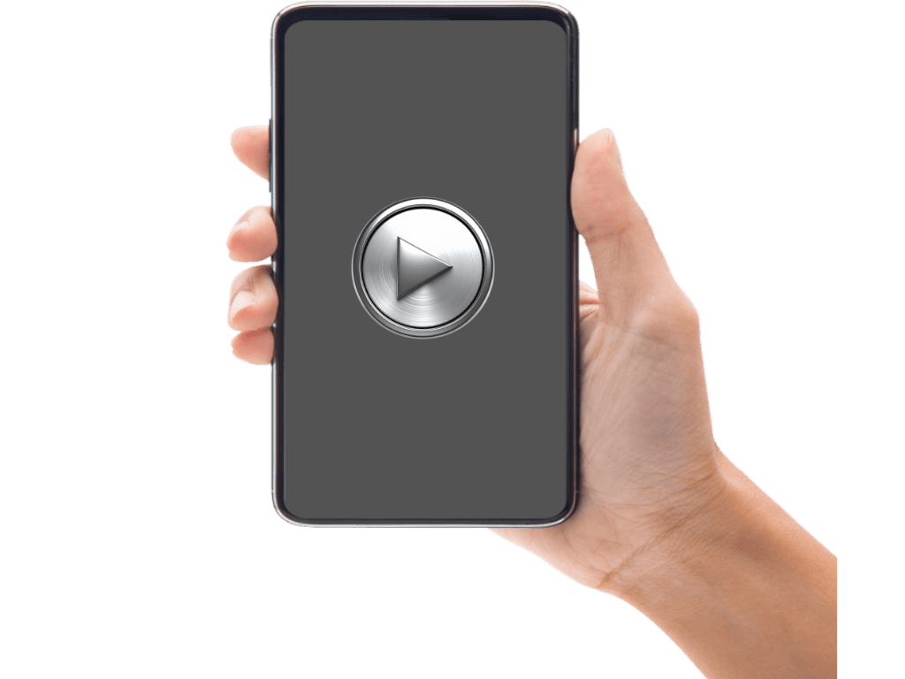
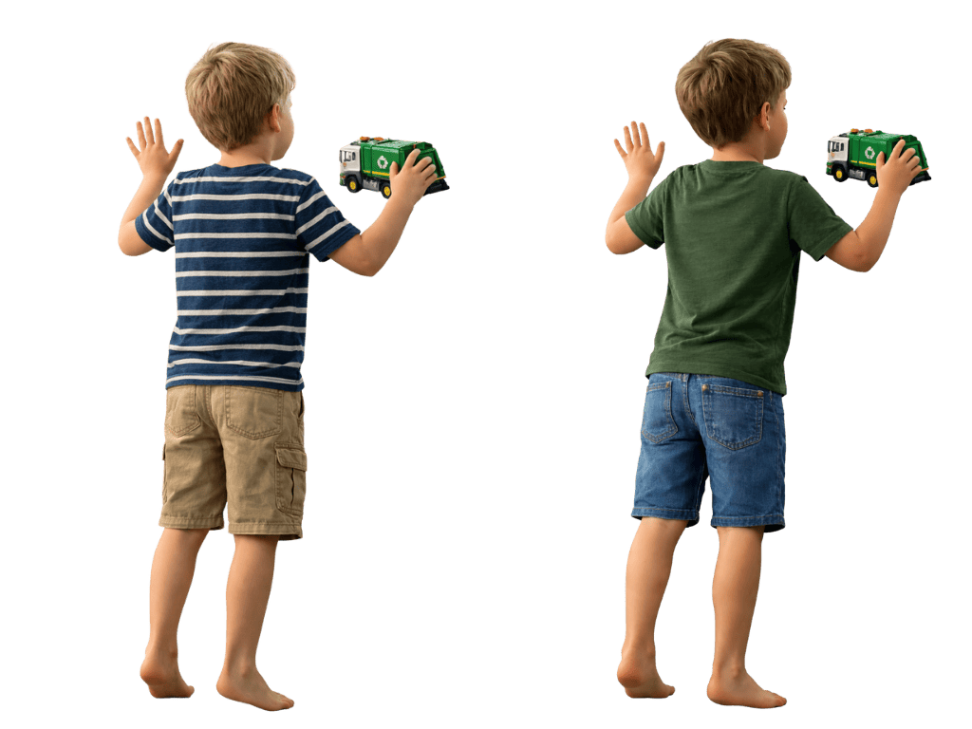
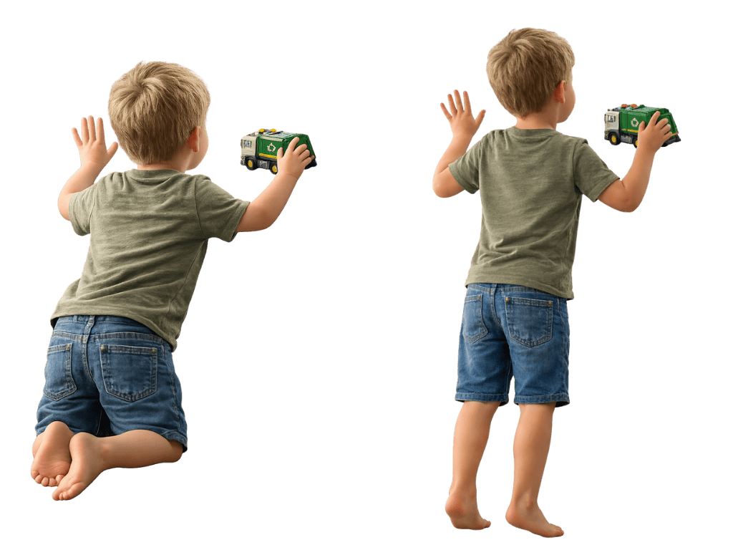

Slide 13
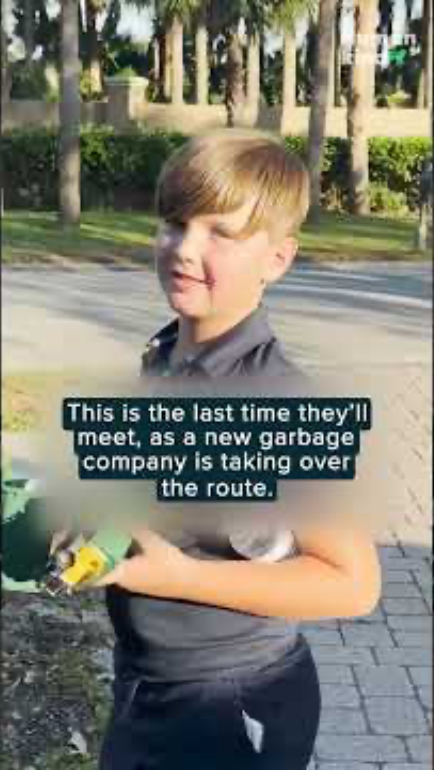

Slide 14
Showing My Gratitude

Slide 15
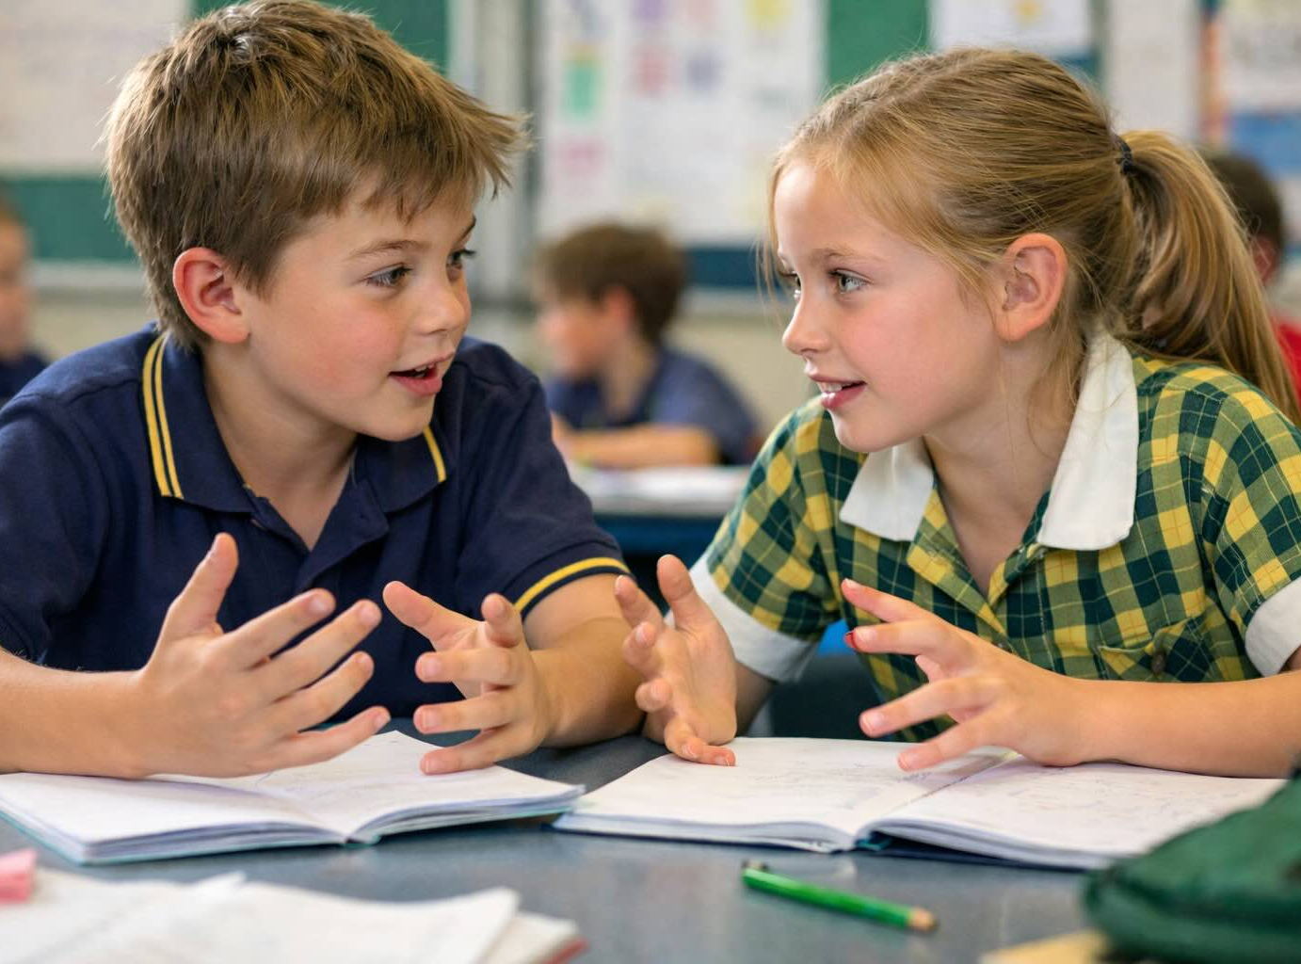
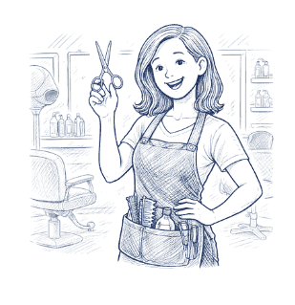
Showing Our Gratitude

Slide 16
Gratitude is the feeling of being thankful for the good things in your life.
We can be grateful for anything or
anyone that makes us happy or
makes life better.
When we show our gratitude to
others, it lets special people know
how special they are. That makes
them feel good too!

Slide 17
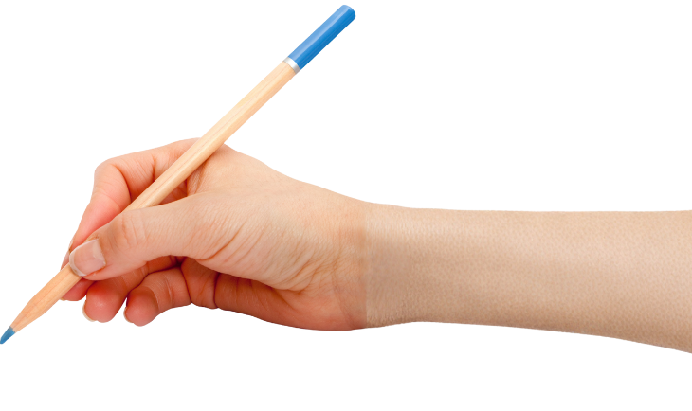
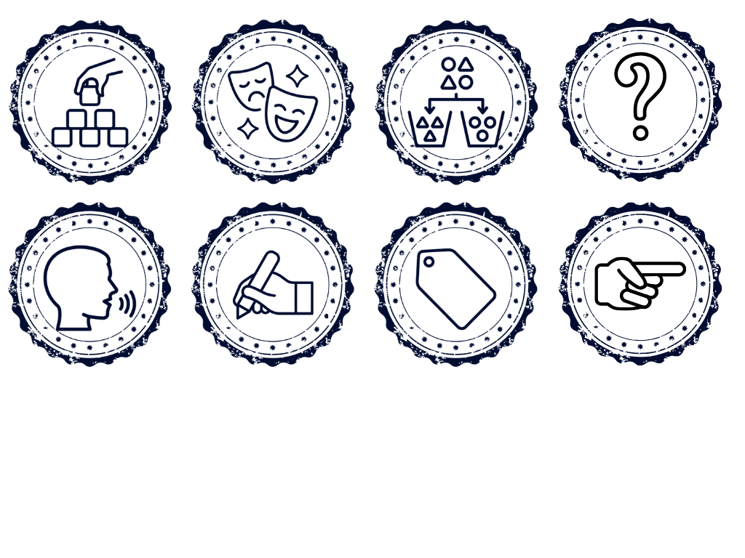

How well did you:
identify what you feel grateful for
choose a way to show gratitude to someone?

Slide 18
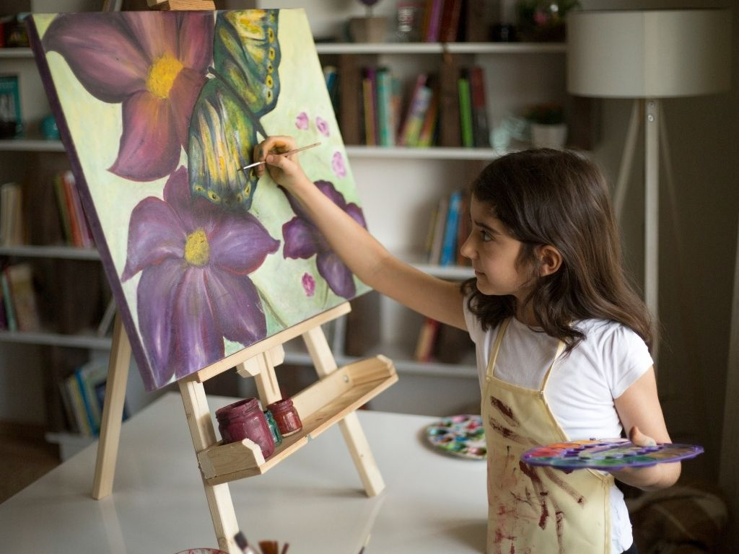
In the next lesson we will learn how passion helps people keep practising and improving because they care.

