Slide 1
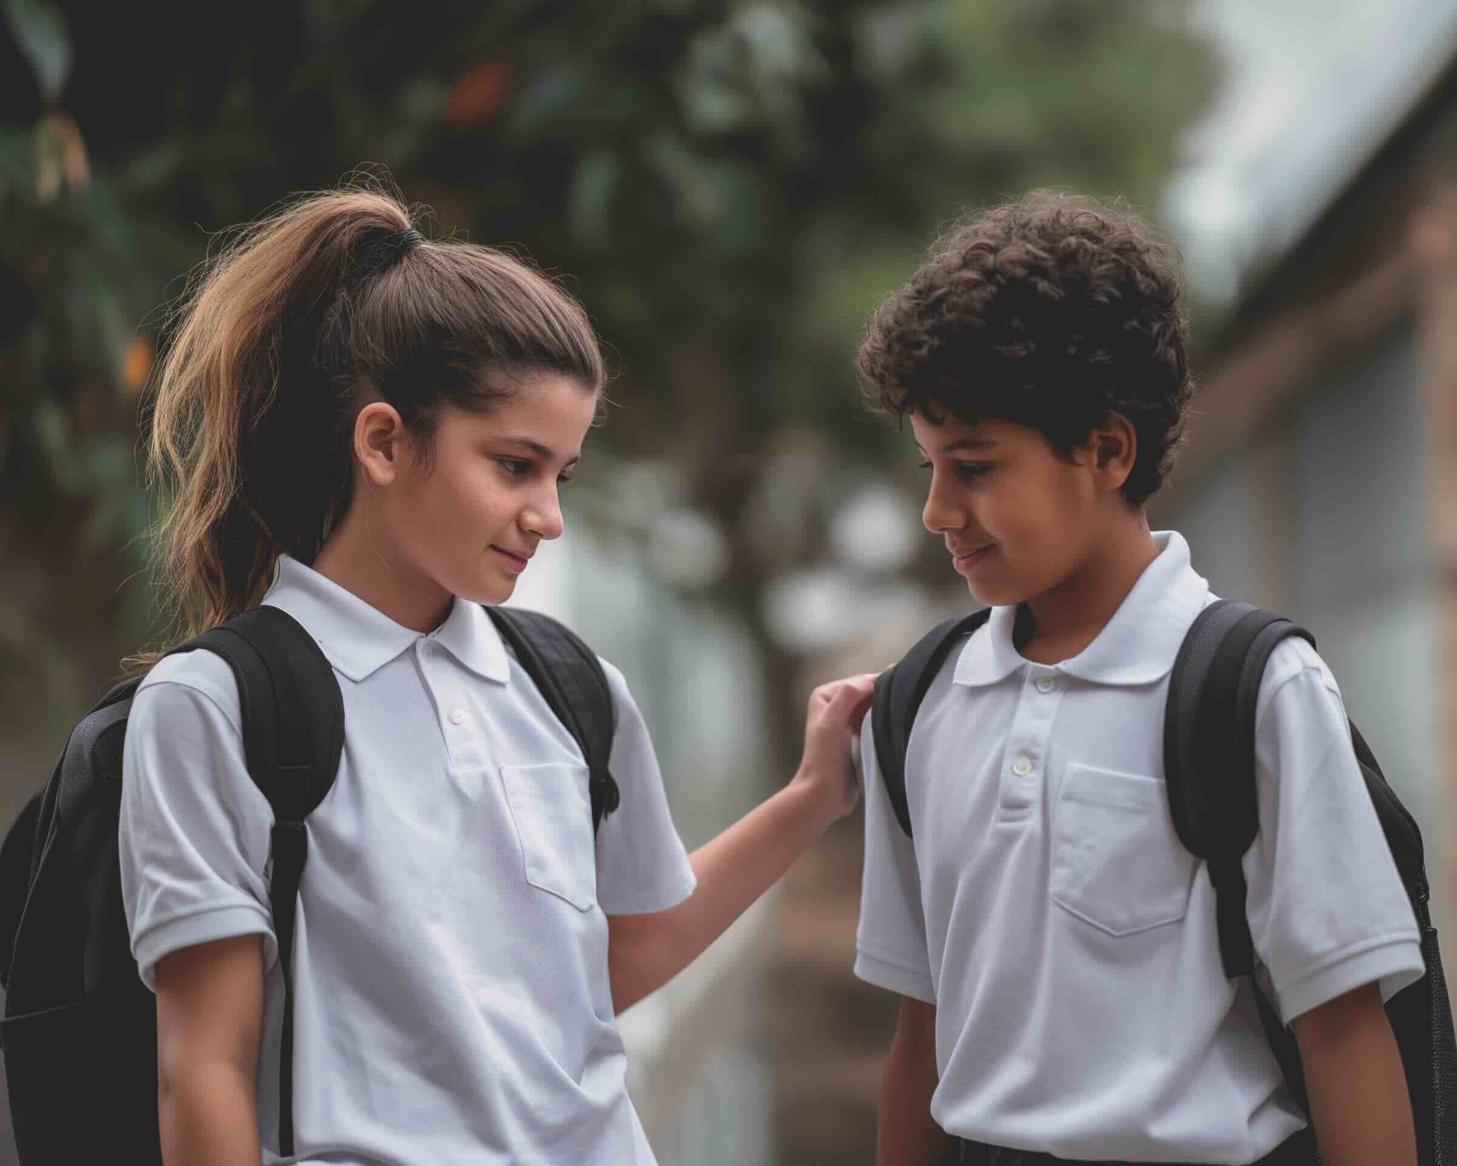
Choosing Kindness
Unit 2: Passion With Purpose
Lesson 1

Slide 2
In this lesson, you will learn how kindness is a choice that can influence what happens next.

Slide 3
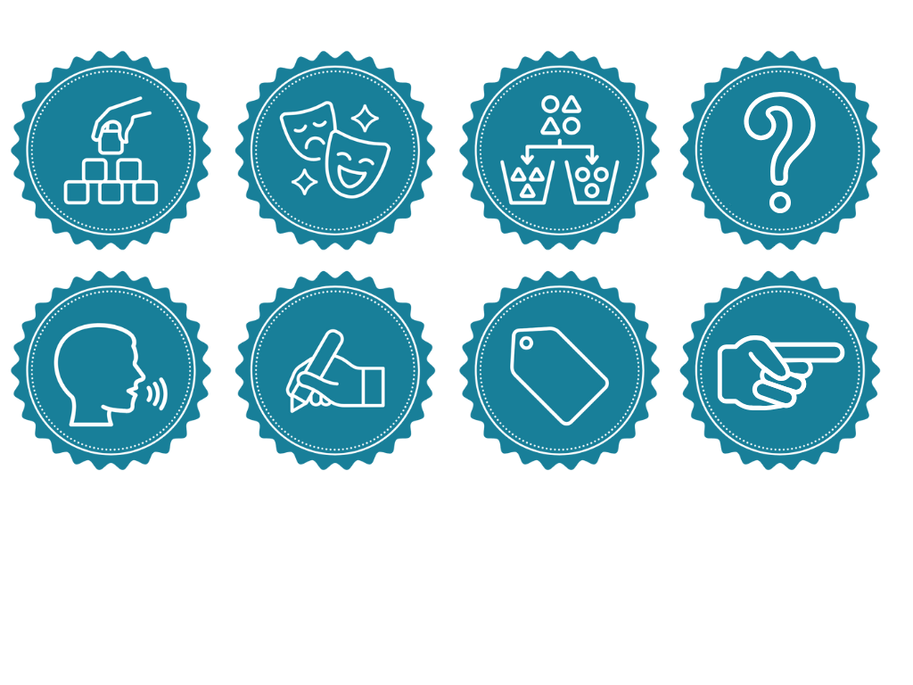
You will be successful when you can:
recognise that kindness is one possible response when a situation is noticed
describe how choosing kindness could affect people or situations.

Slide 4
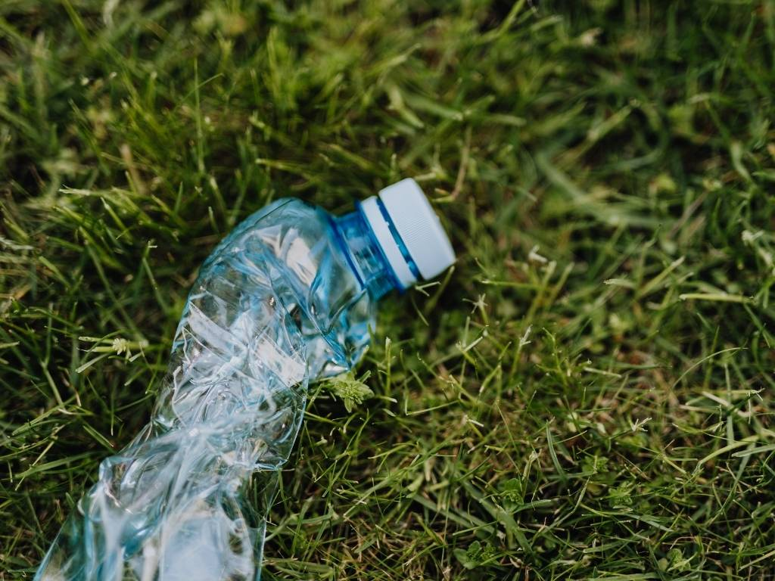

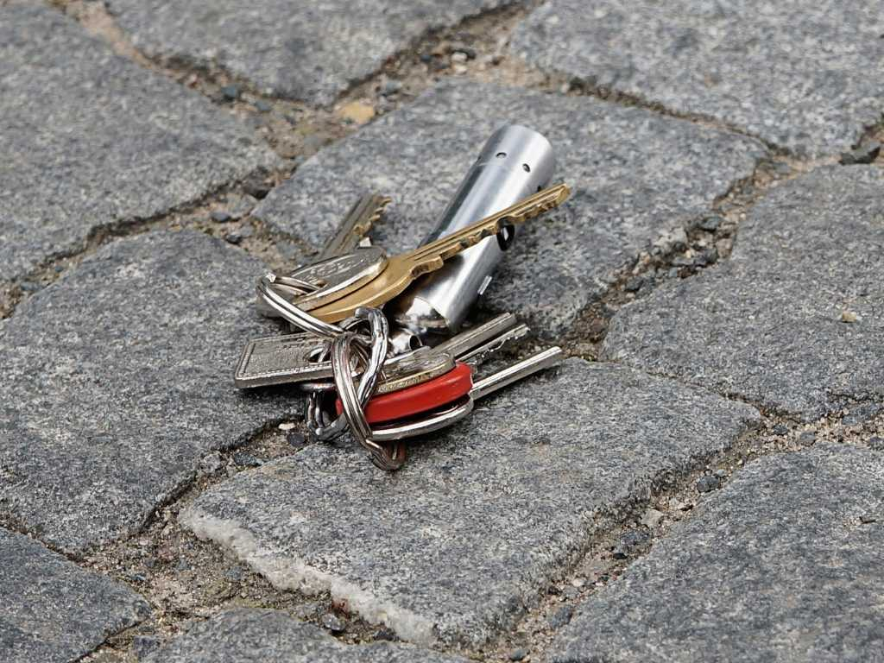

Slide 5
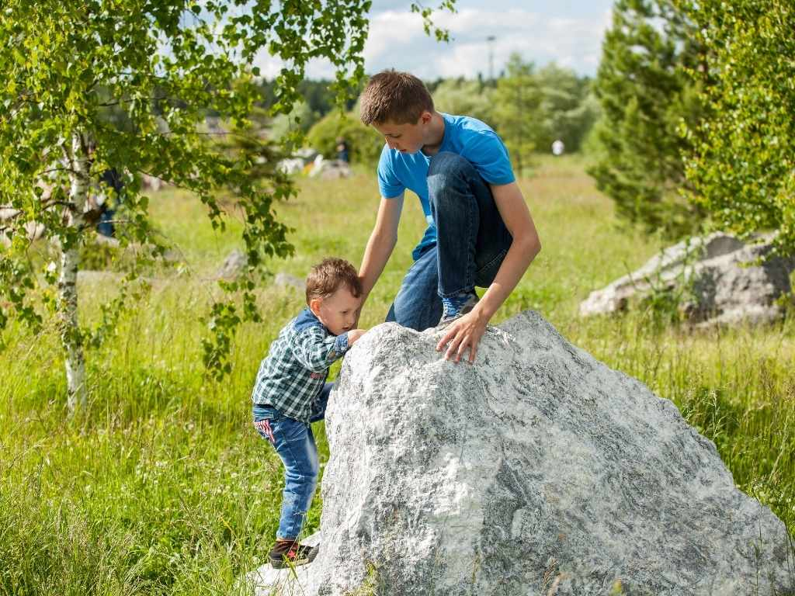
Kindness is choosing to do something to help others, even when you don’t have to.

Slide 6

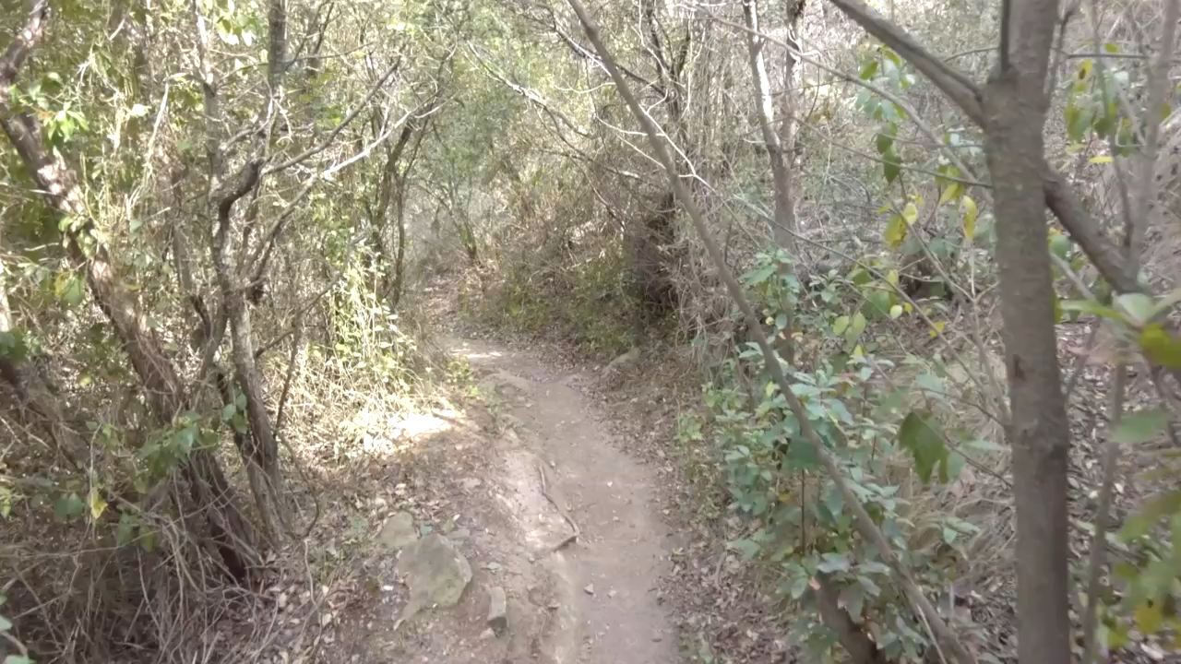
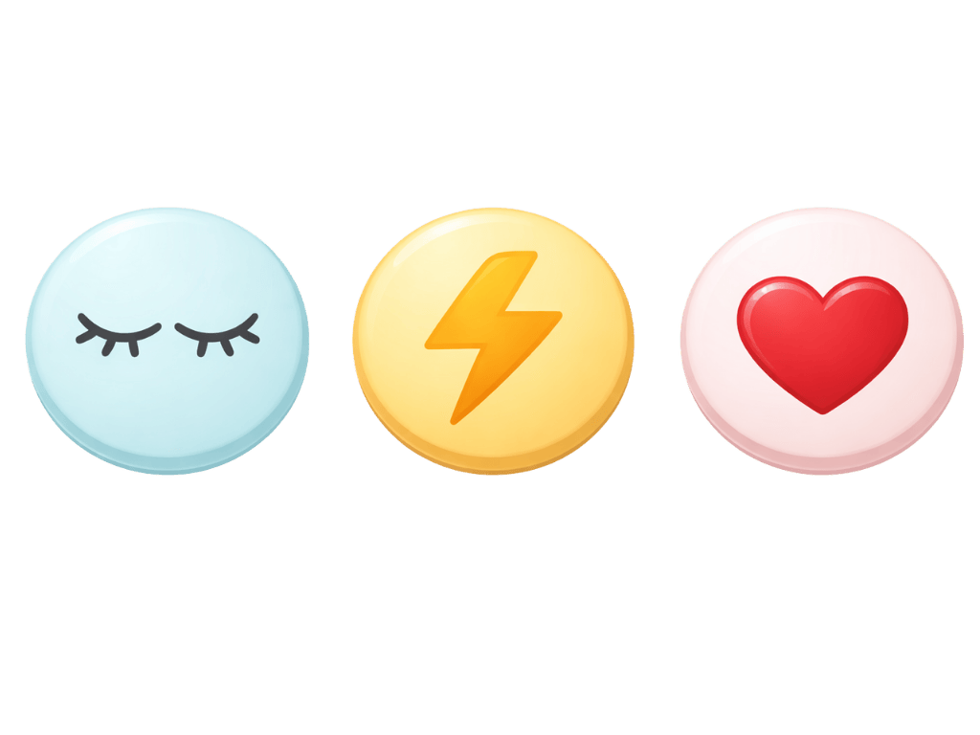
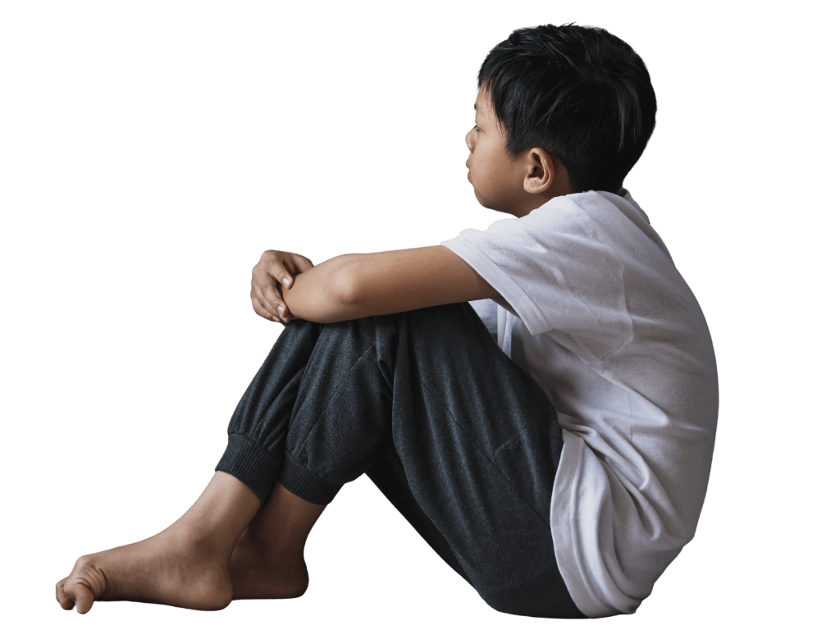

Decision selected: laugh at him.
Decision selected: Just keep walking.
Decision selected: see if he needs help.

Slide 7
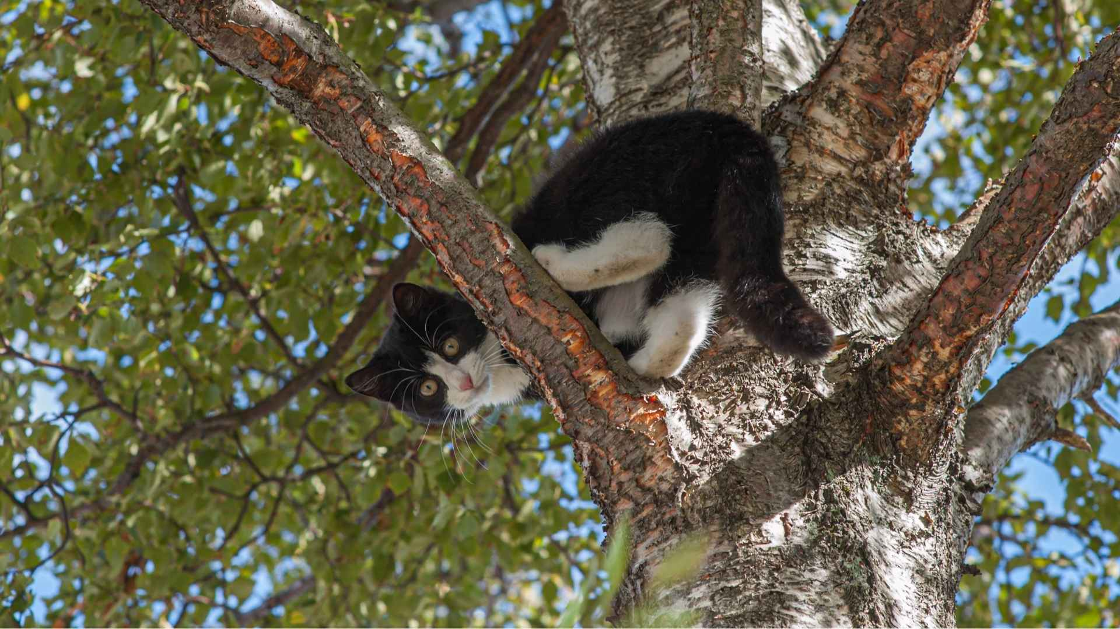
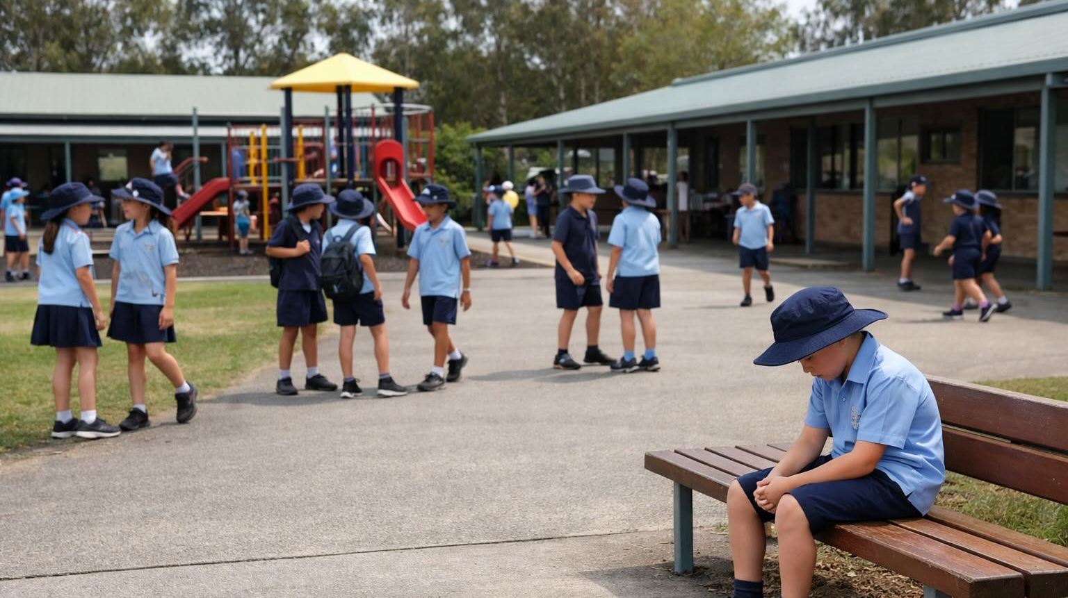


Slide 8

Kindness
Kindness begins when we notice a situation and choose to:
respond in a way that makes it worse
ignore it so we can get on with what we need to do
act in a way that helps others, even if we don’t have to

Slide 9
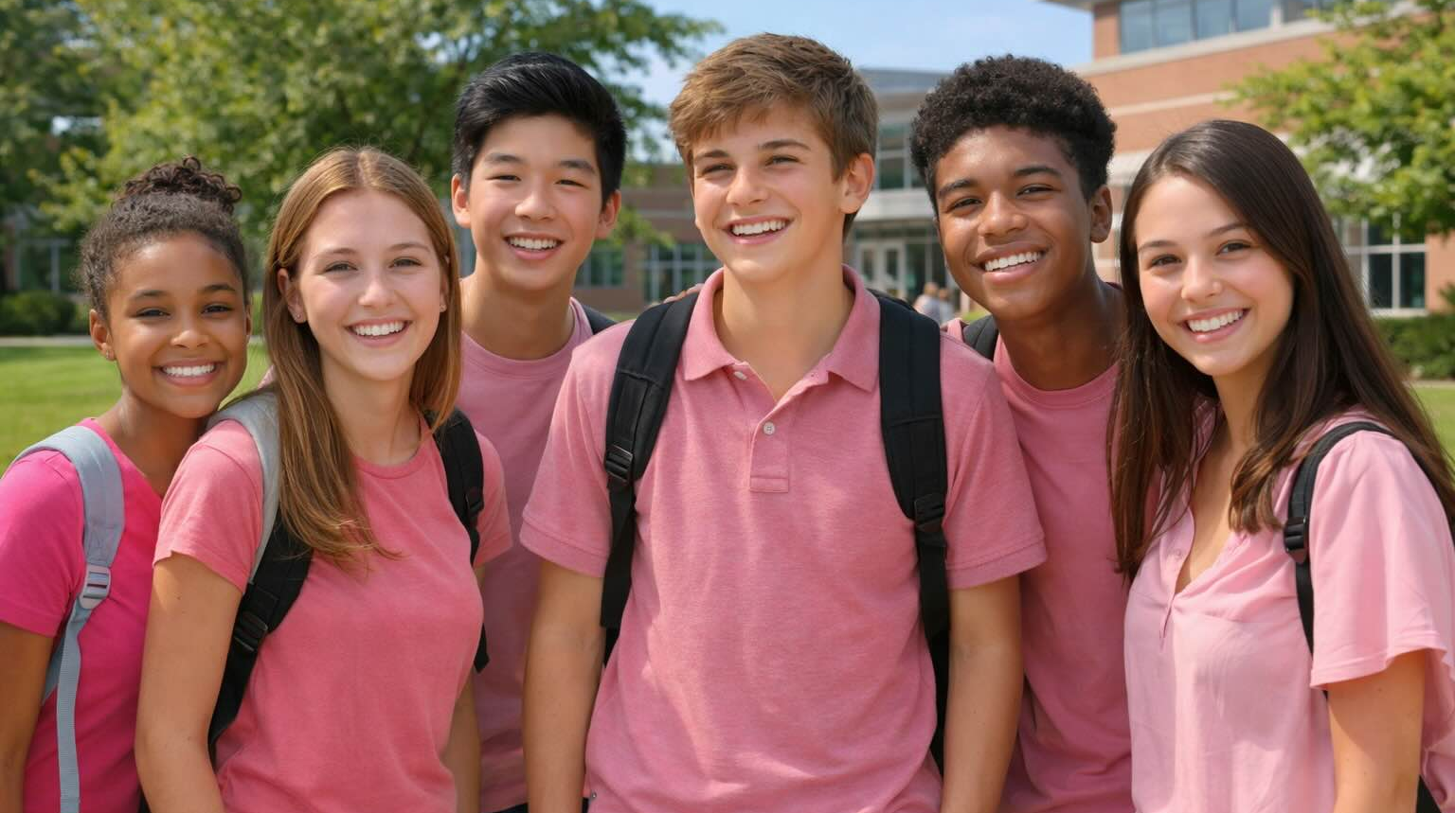
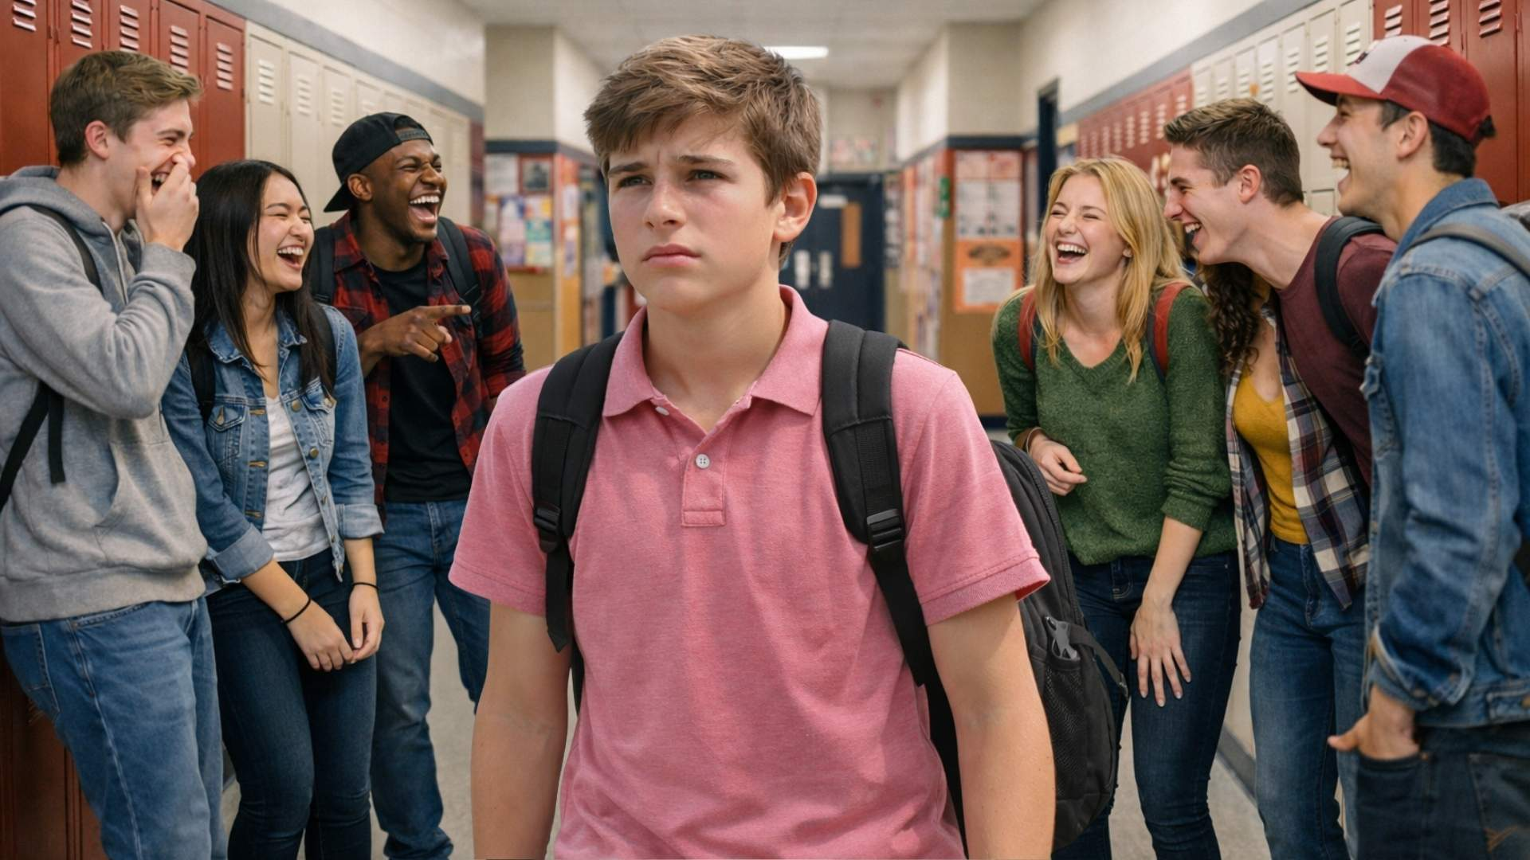
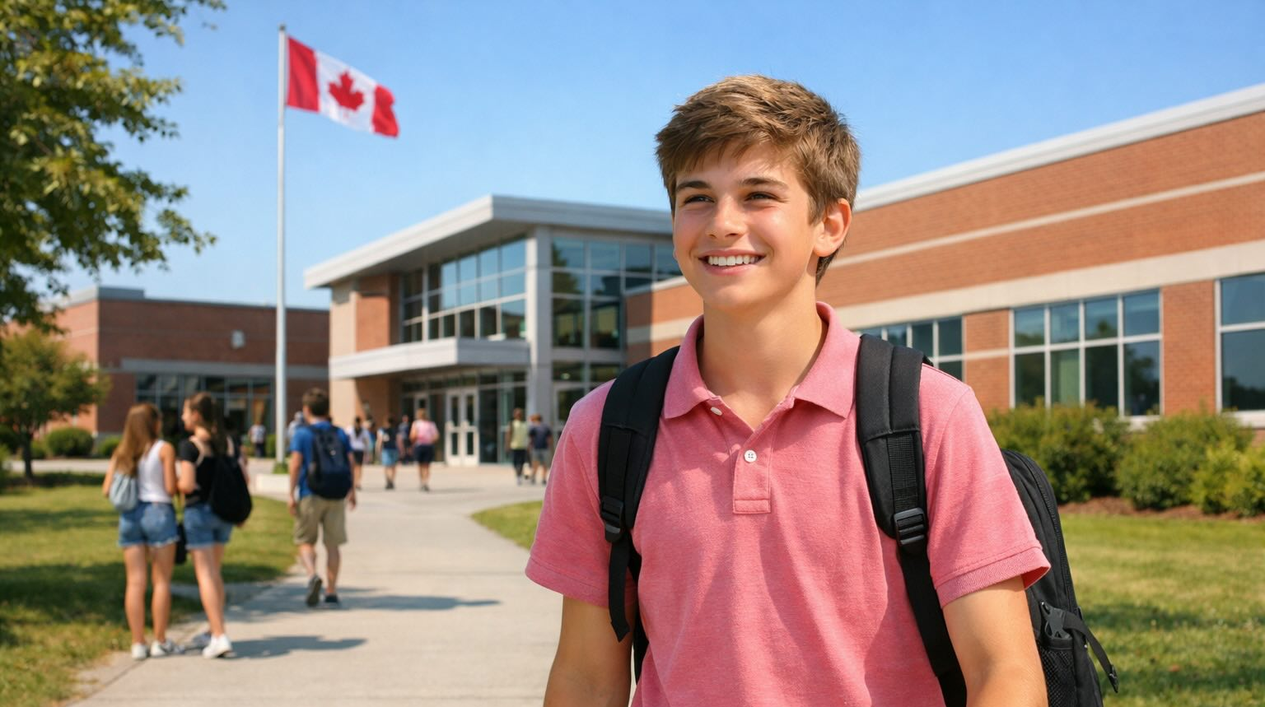

Slide 10
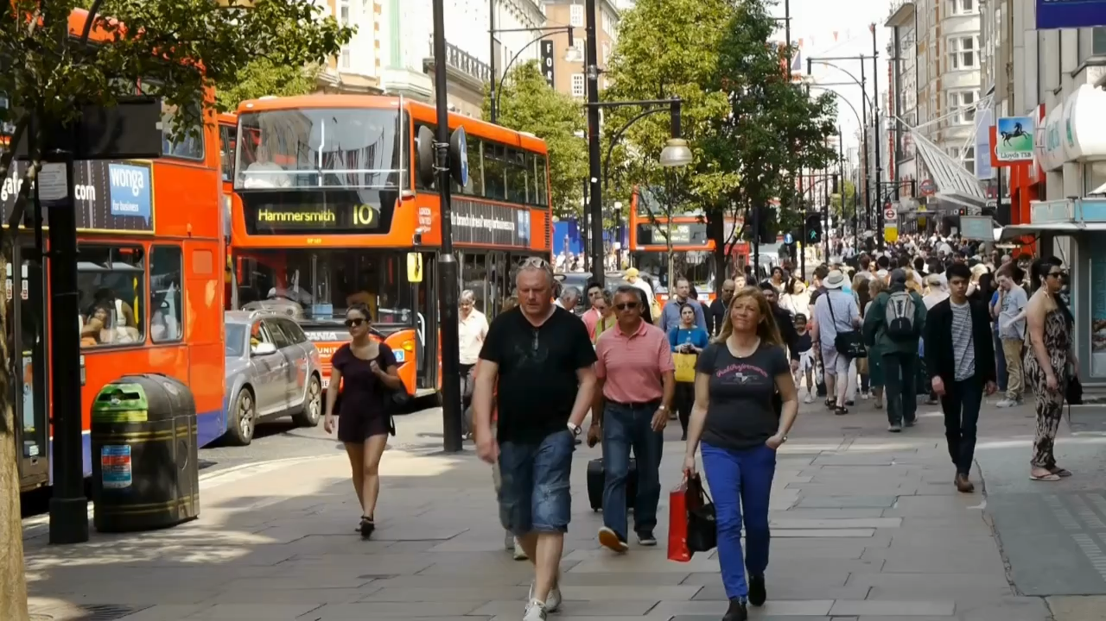
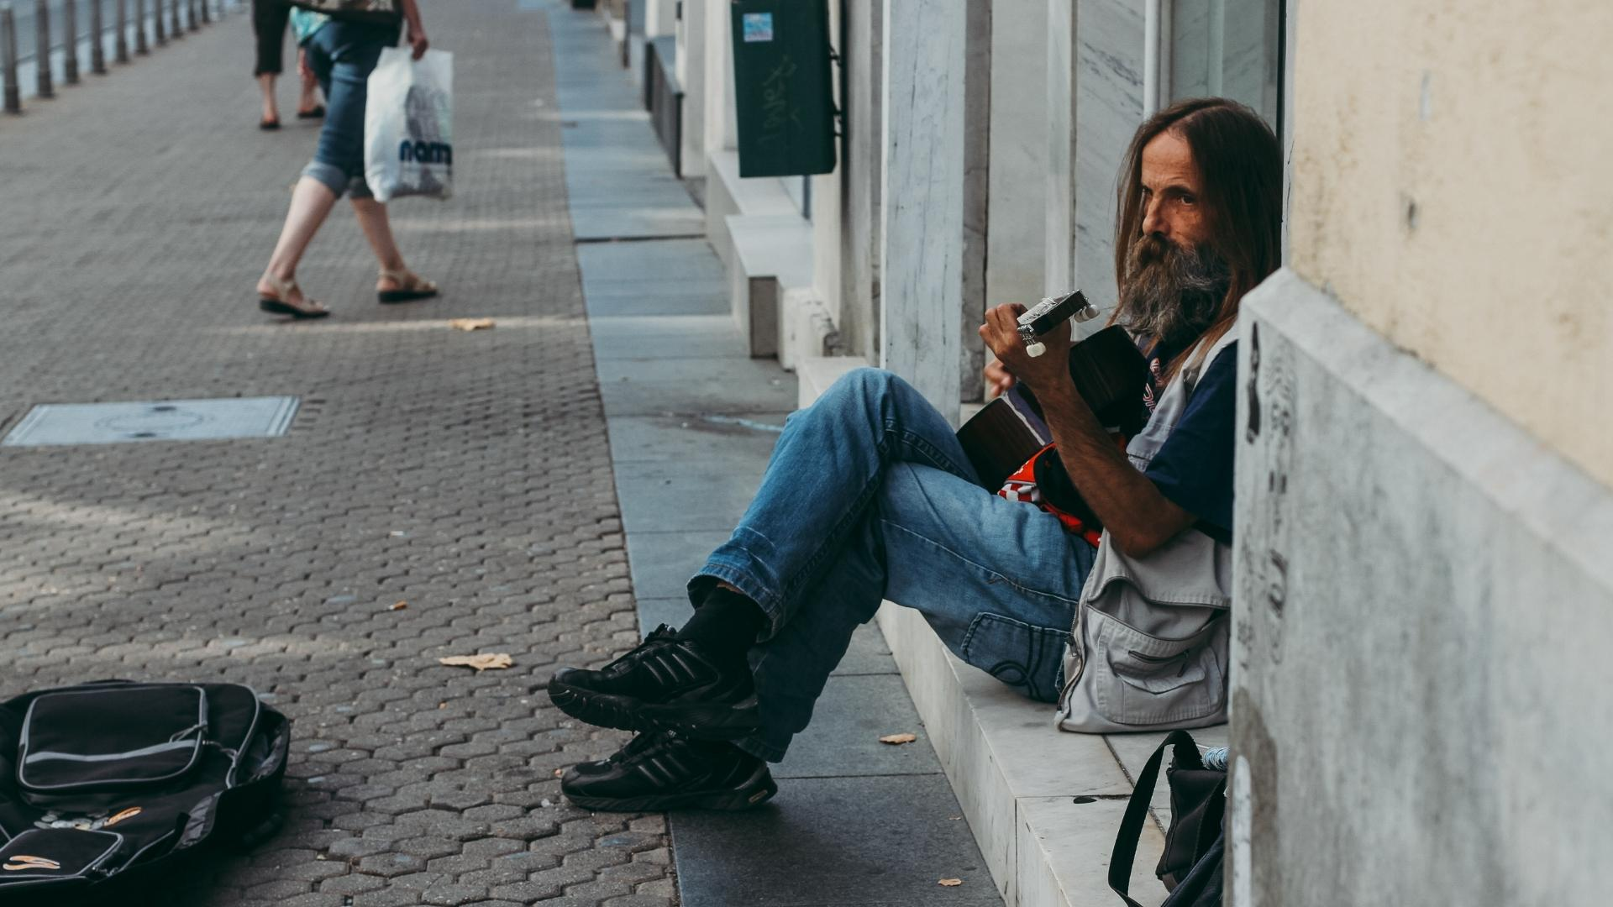

Slide 11
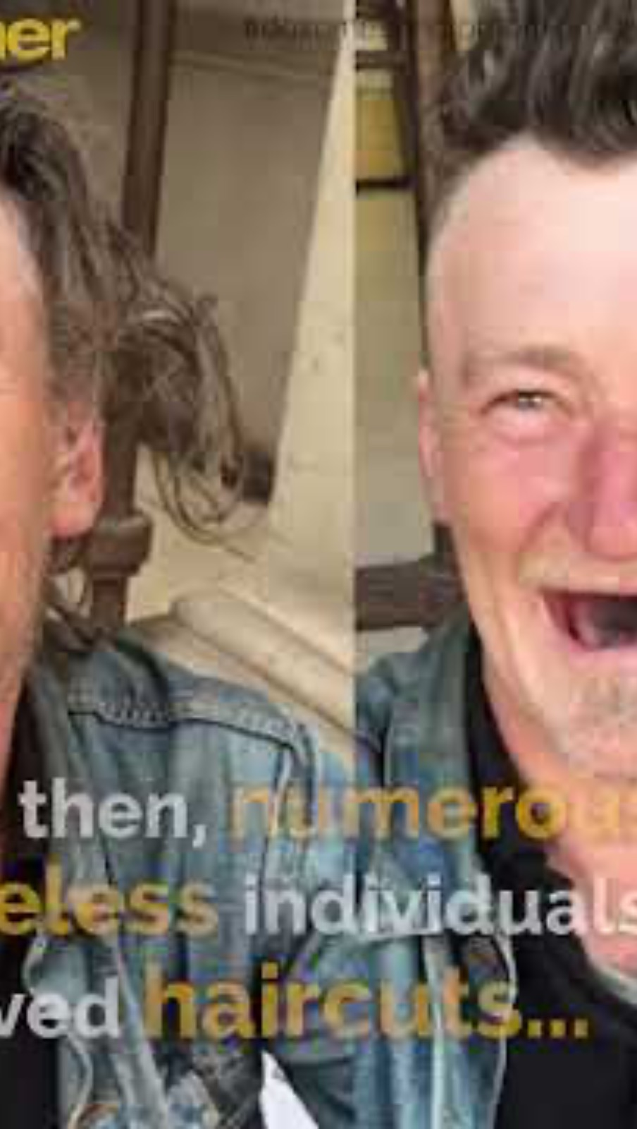

Slide 13
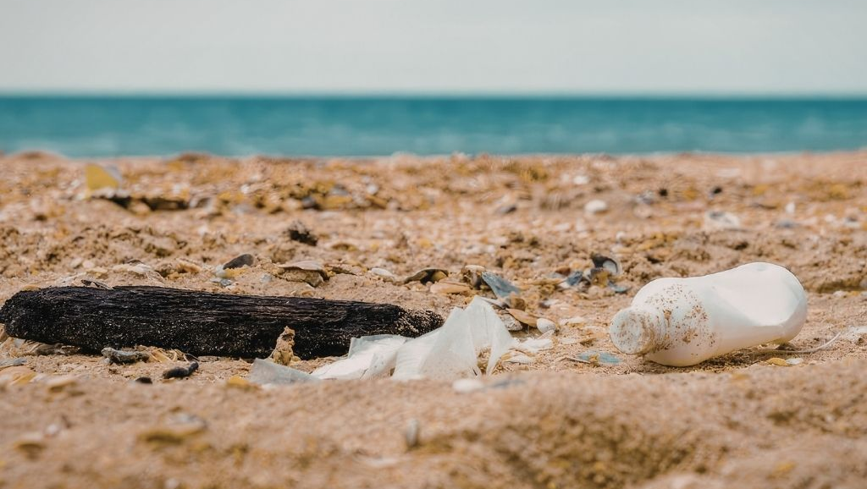
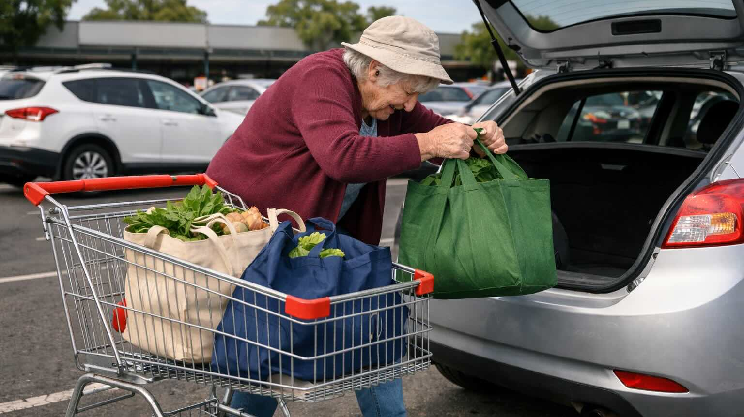


Slide 14
What Could Kindness Do?
Think of one situation you noticed recently and ignored.
Imagine choosing kindness instead.
What might you do?
What might the result of your choice to be kind be?
How might you feel as a result?

Slide 15
Kindness is choosing to do something to help others, even when you don’t have to.
We notice situations where we can ignore them, make them worse, or act with kindness.
Choosing kindness can take time or effort and lead to real, practical changes for others.

Slide 16



How well did you:
recognise that kindness is one possible response when a situation is noticed
describe how choosing kindness could affect people or situations?

Slide 17

In the next lesson, we will learn what gratitude is and how practising it can influence the way we think and feel.

