Slide 1
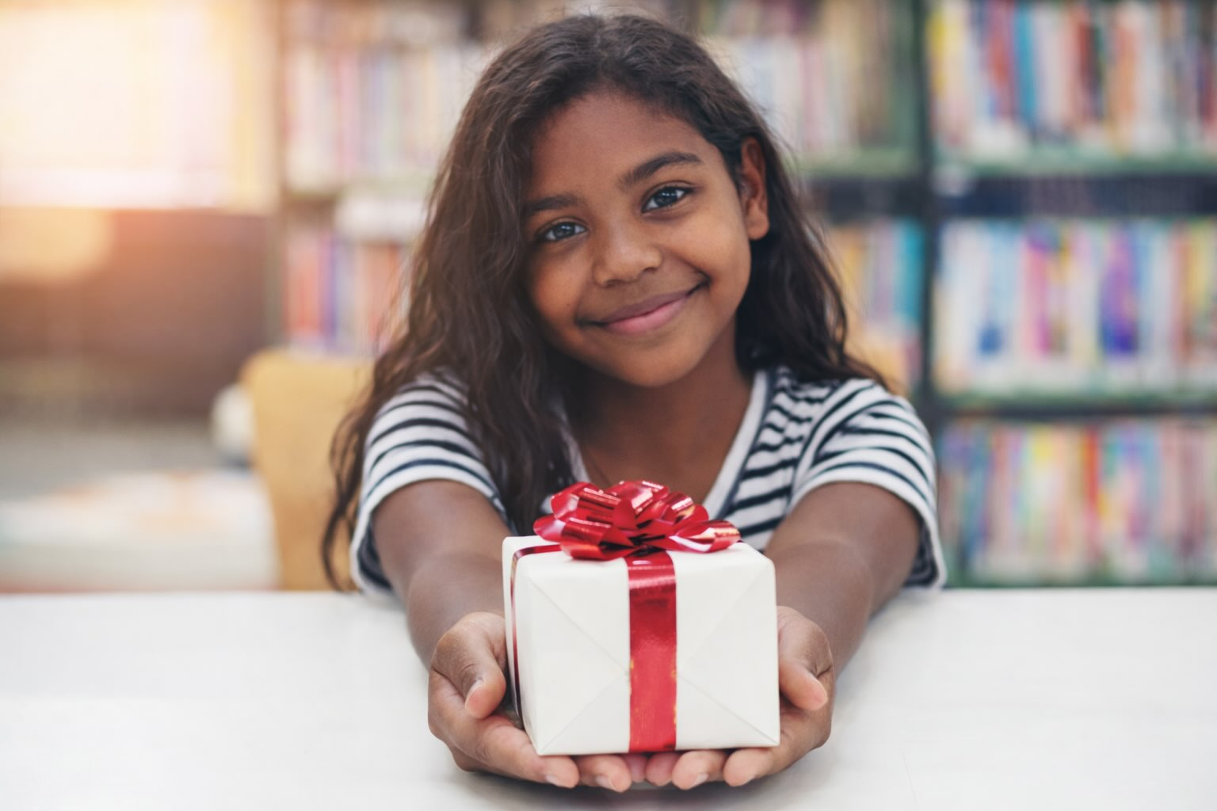
Focus on Gratitude
Unit 2: Passion With Purpose
Lesson 2

Slide 2
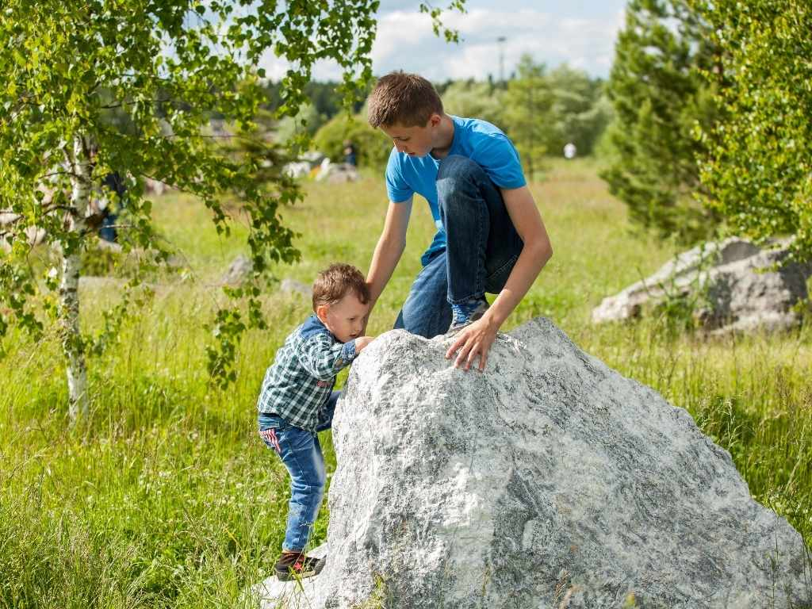
Kindness is choosing to do something to help others, even when you don’t have to.

Slide 3
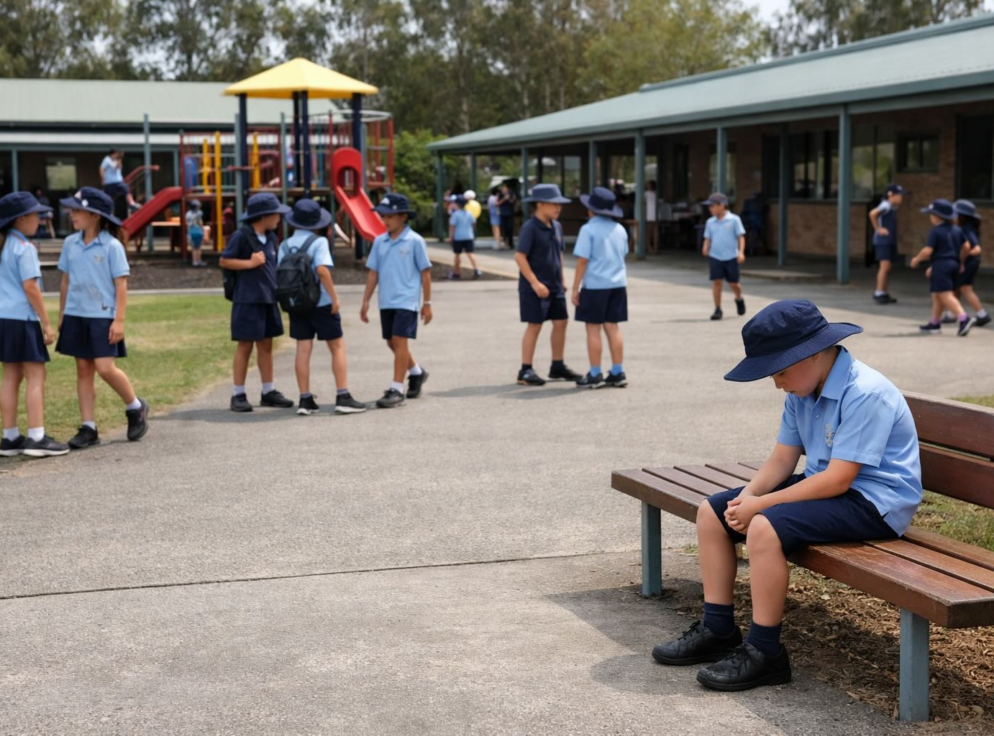

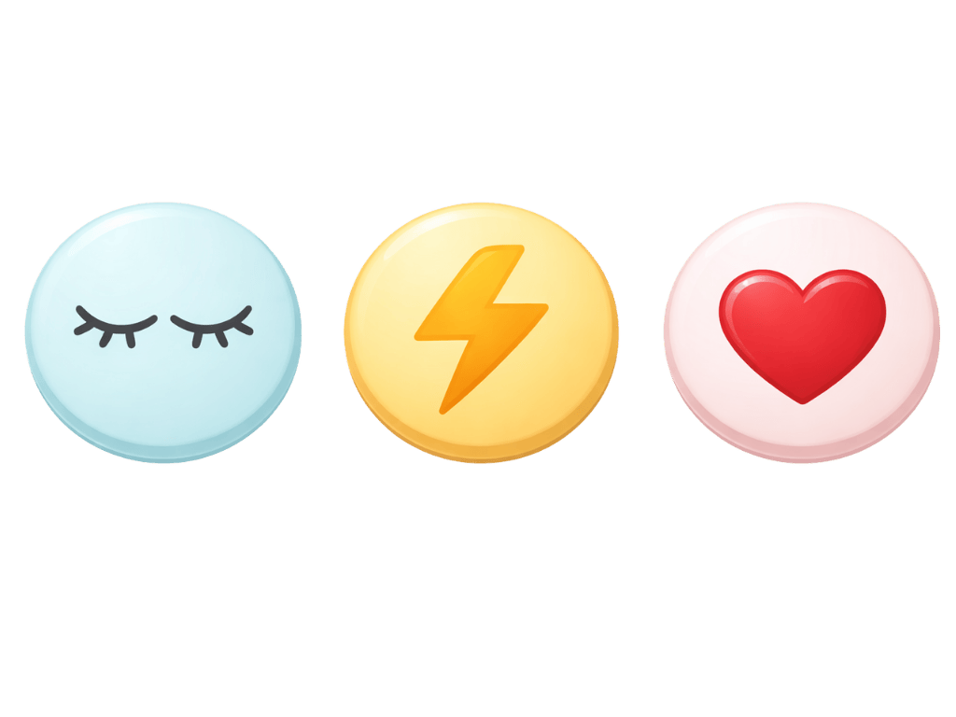
We notice situations where we can ignore them, make them worse, or act with kindness.

Slide 4
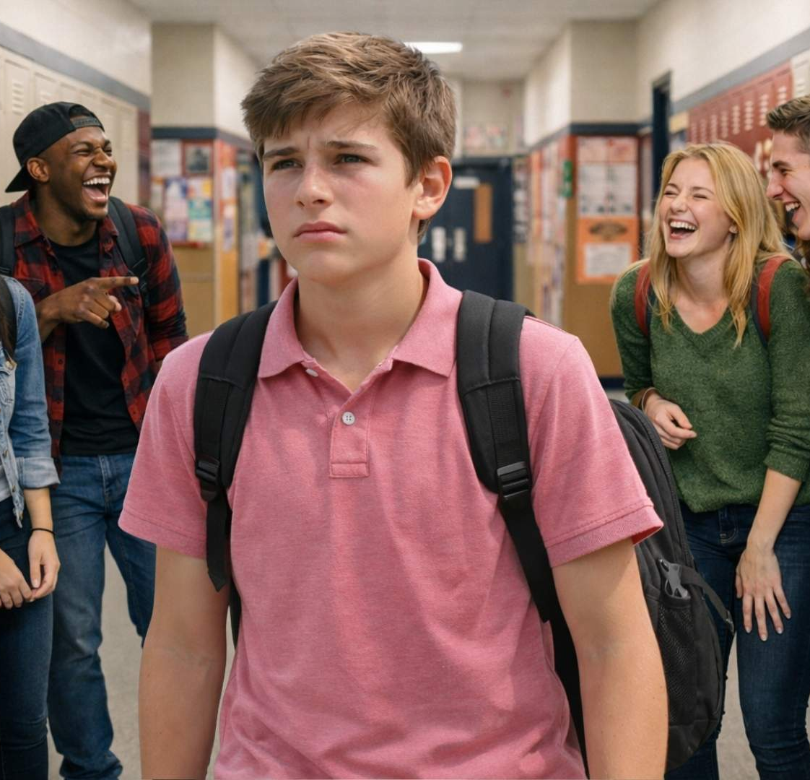
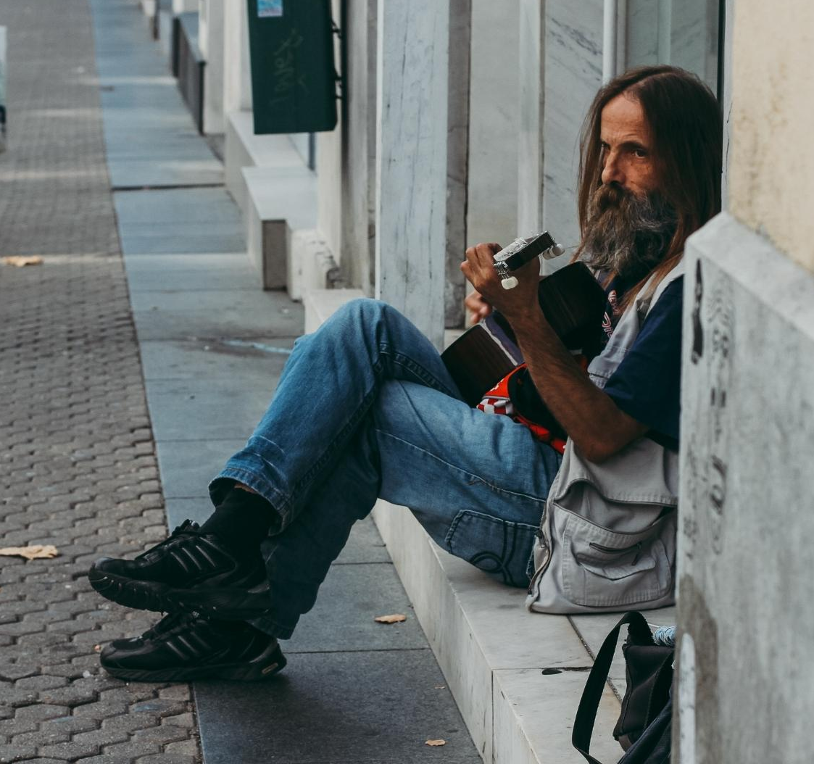
In the last lesson, what was one of the kind things we learnt people had done?

Slide 5
In this lesson, we will learn what gratitude is and how practising it can influence the way we think and feel.

Slide 6
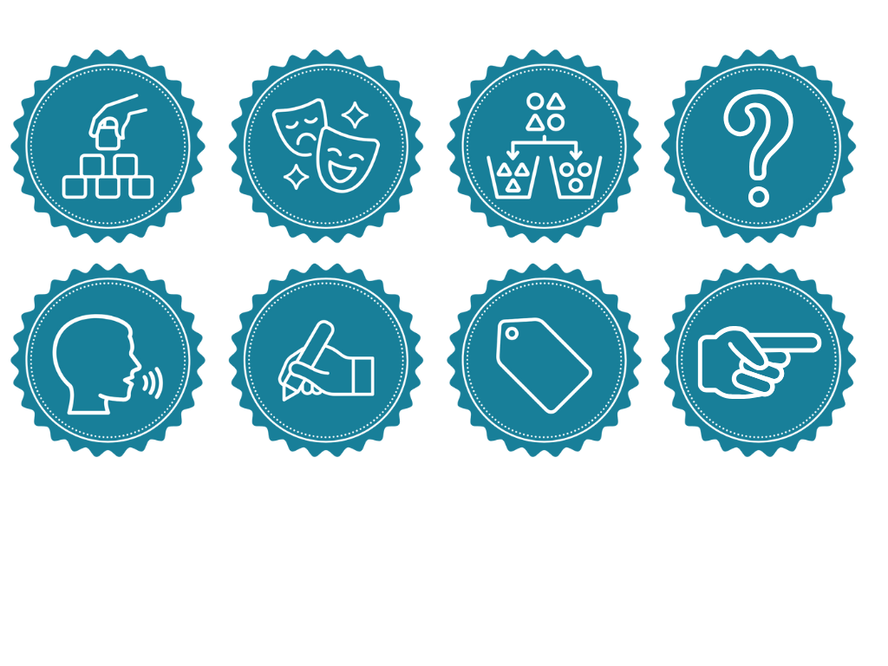
You will be successful when you can:
recognise that gratitude grows when you choose to notice the good things around you
identify things in your life that you can feel grateful for.

Slide 7
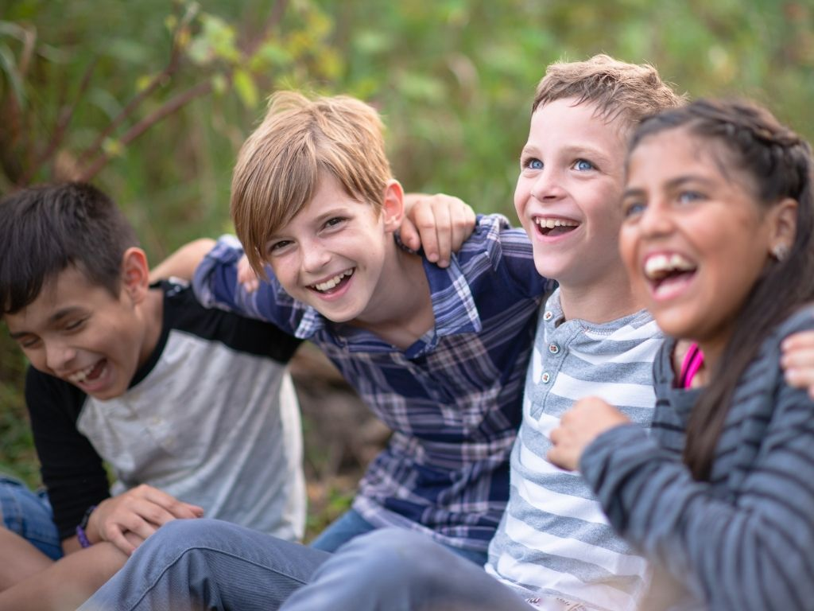
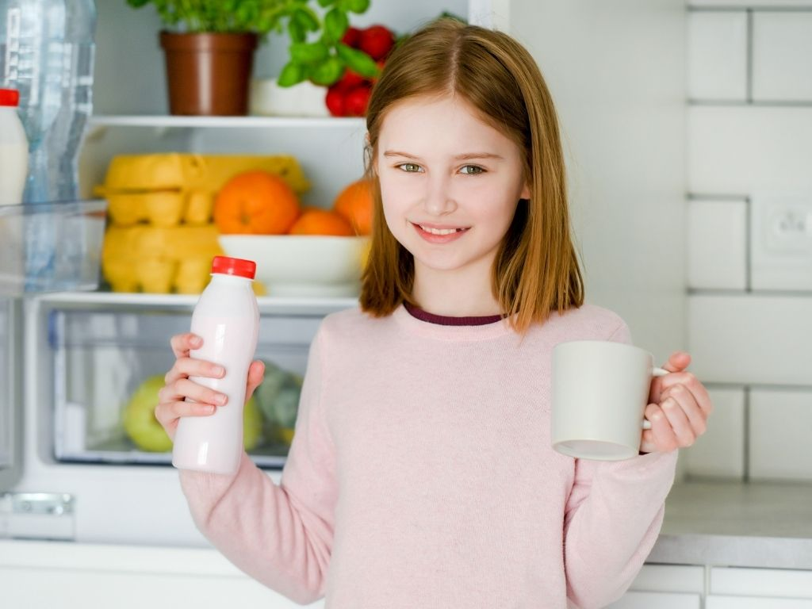
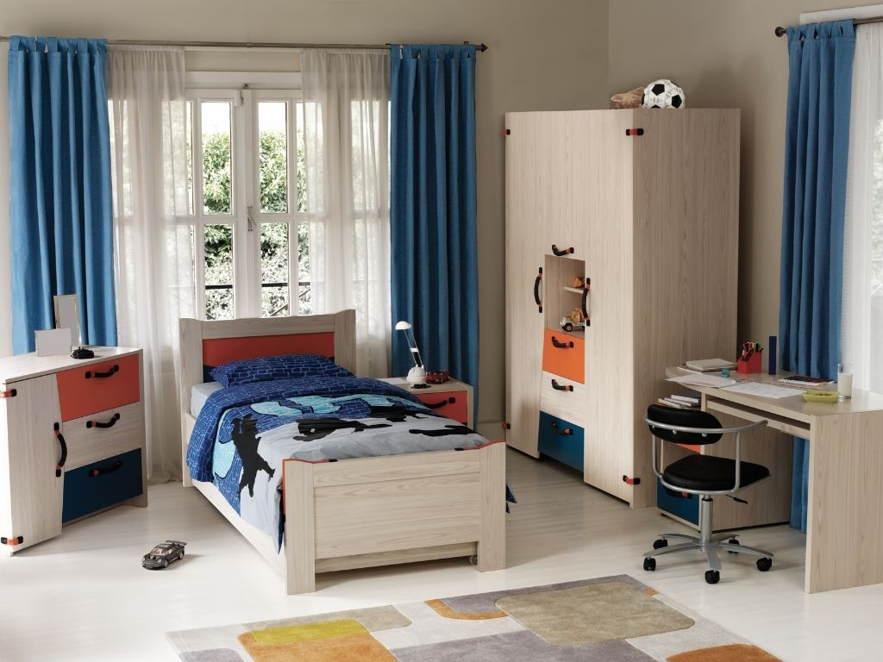

Slide 8
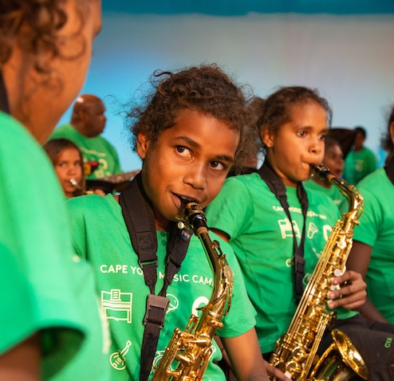
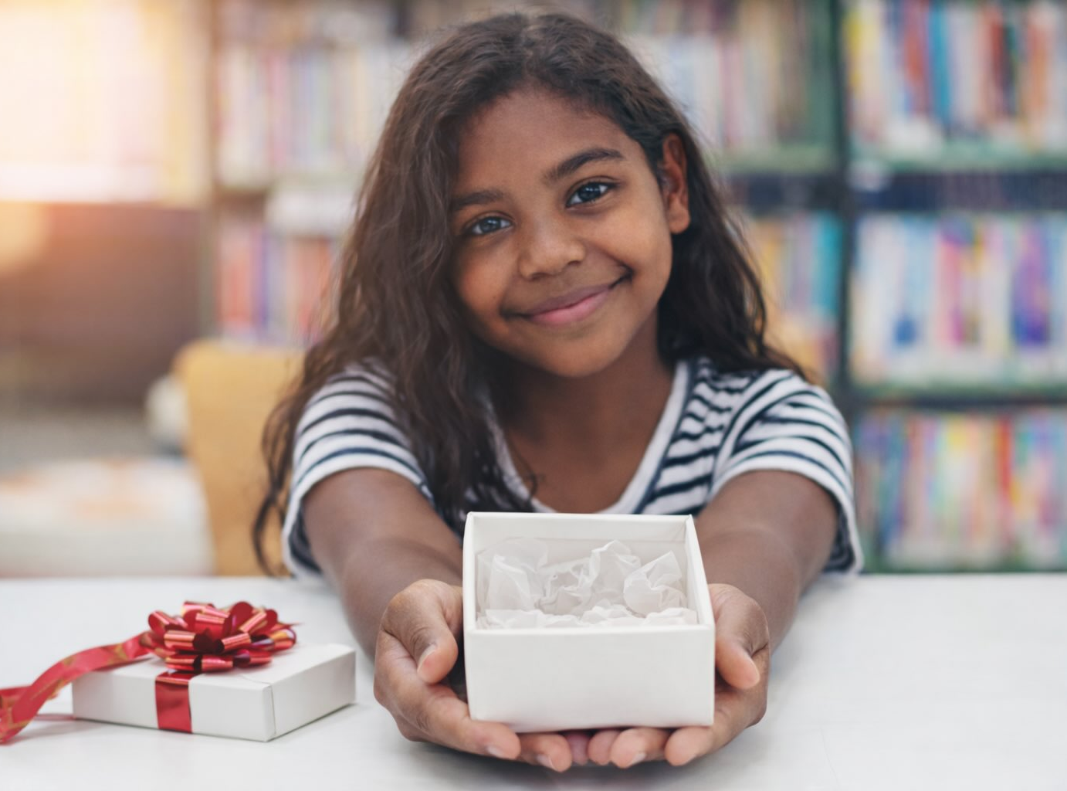
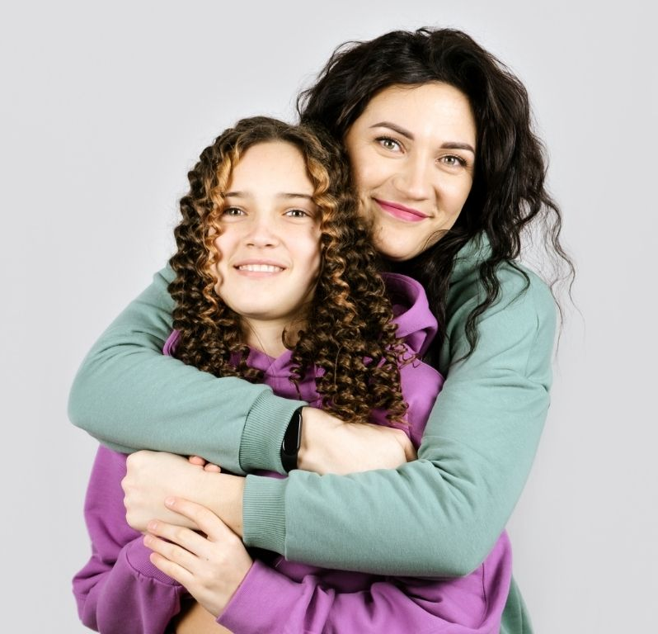
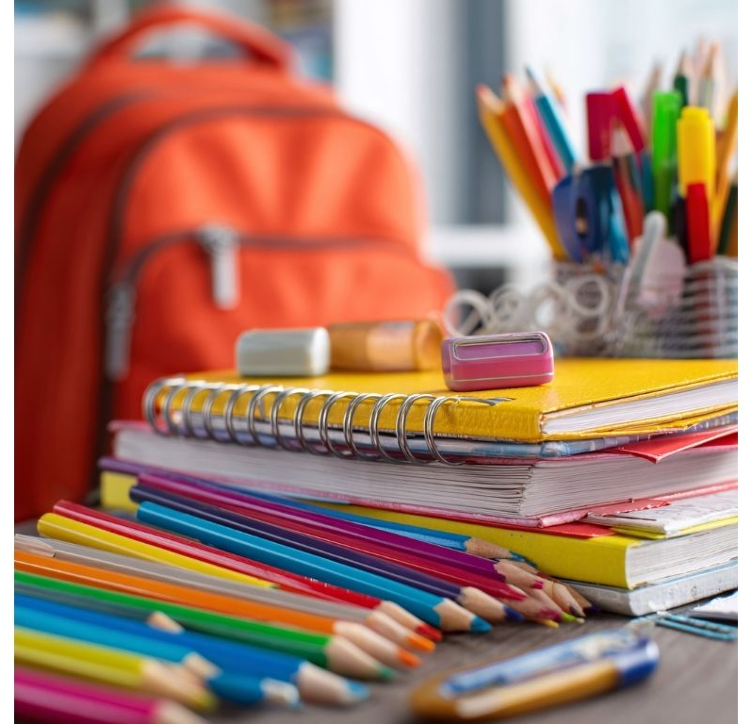
Gratitude is the feeling of being thankful for the good things in your life.

Slide 9
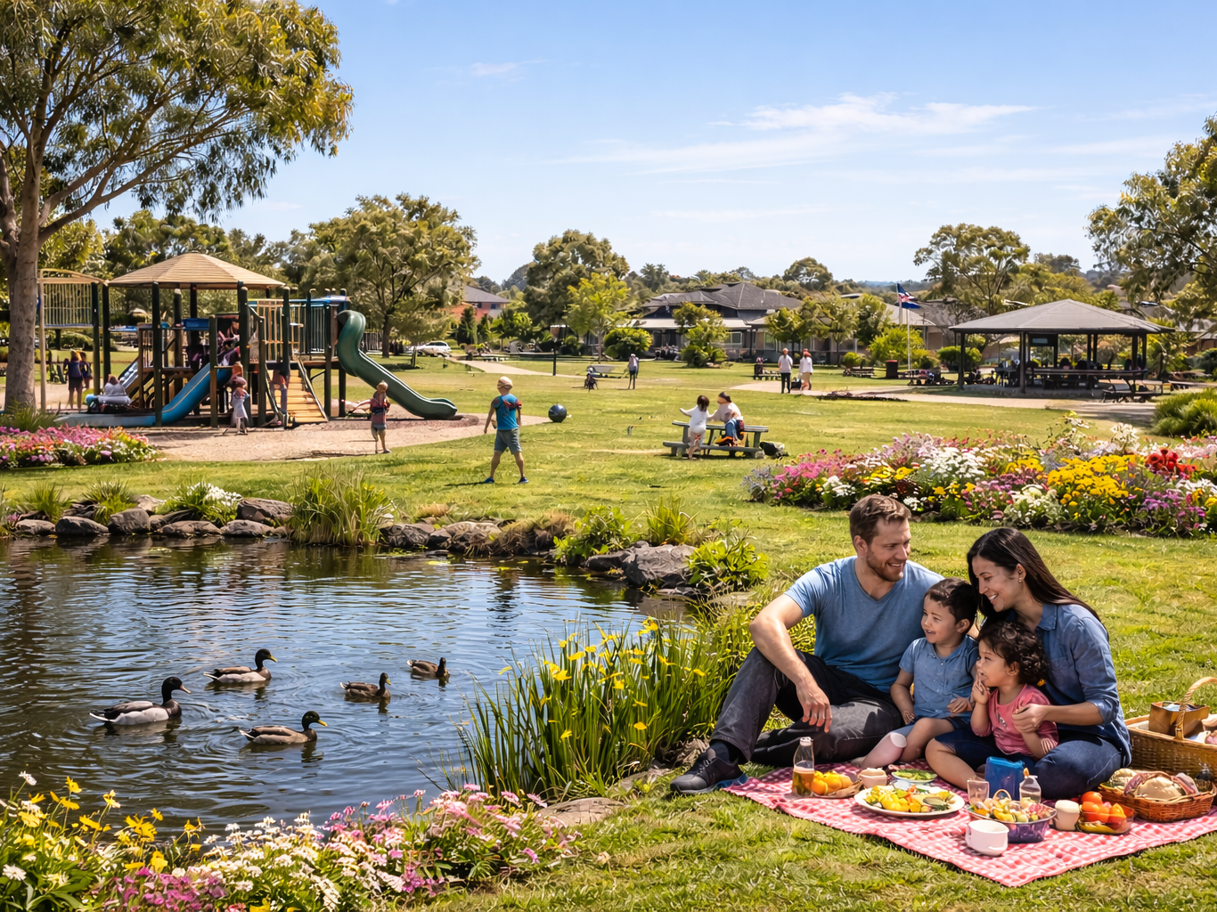
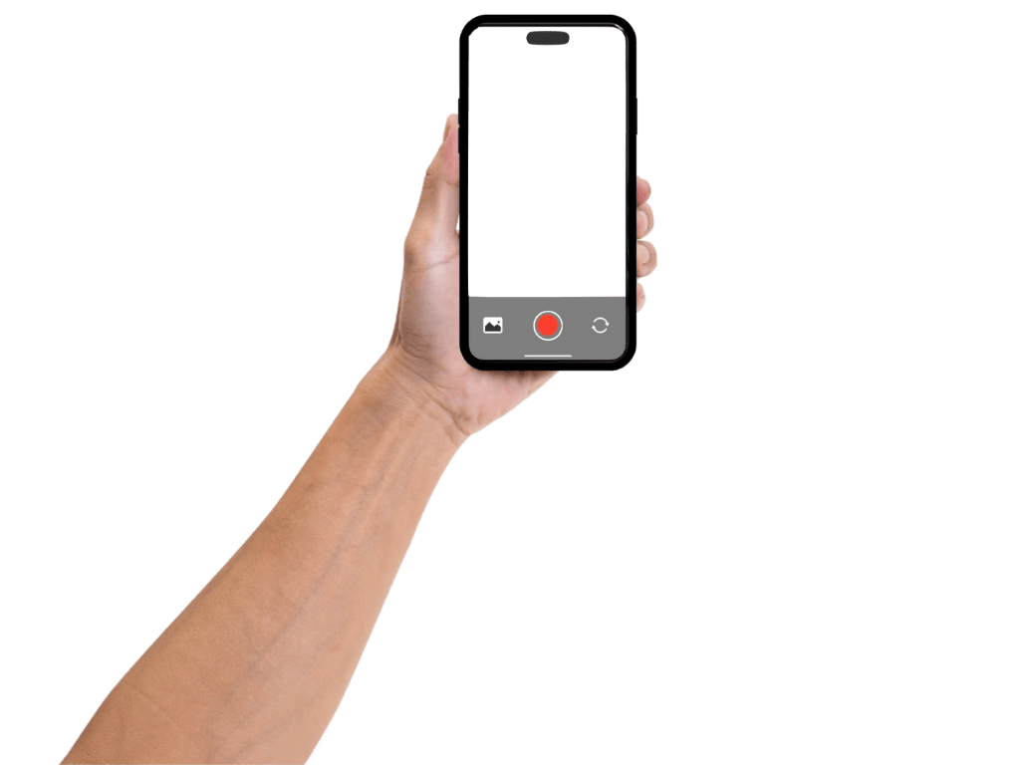

Slide 10
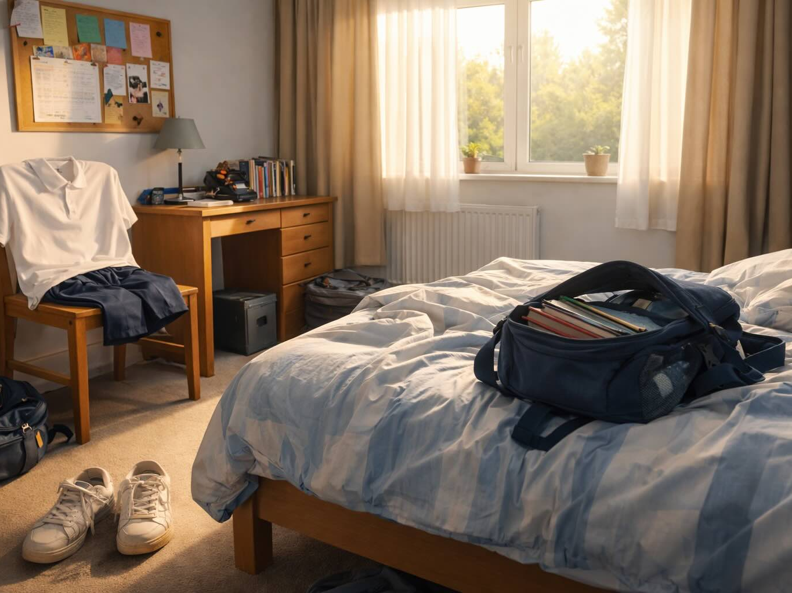

Slide 11
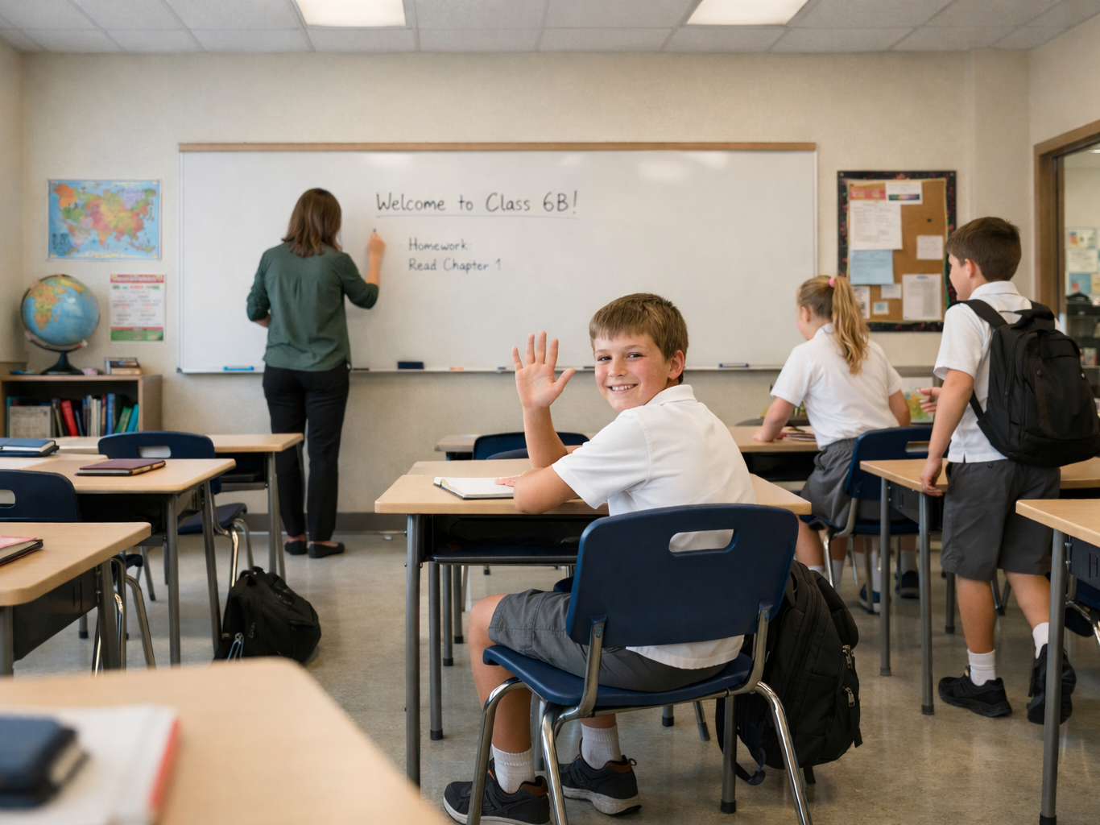

Slide 12
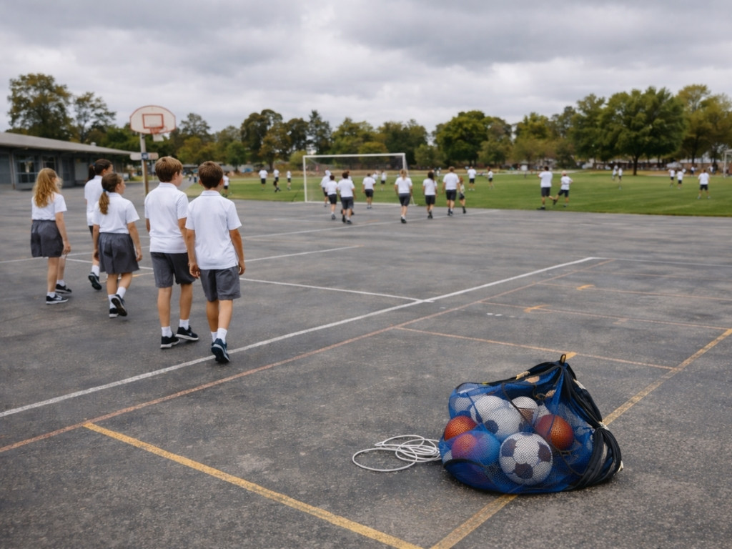

Slide 13
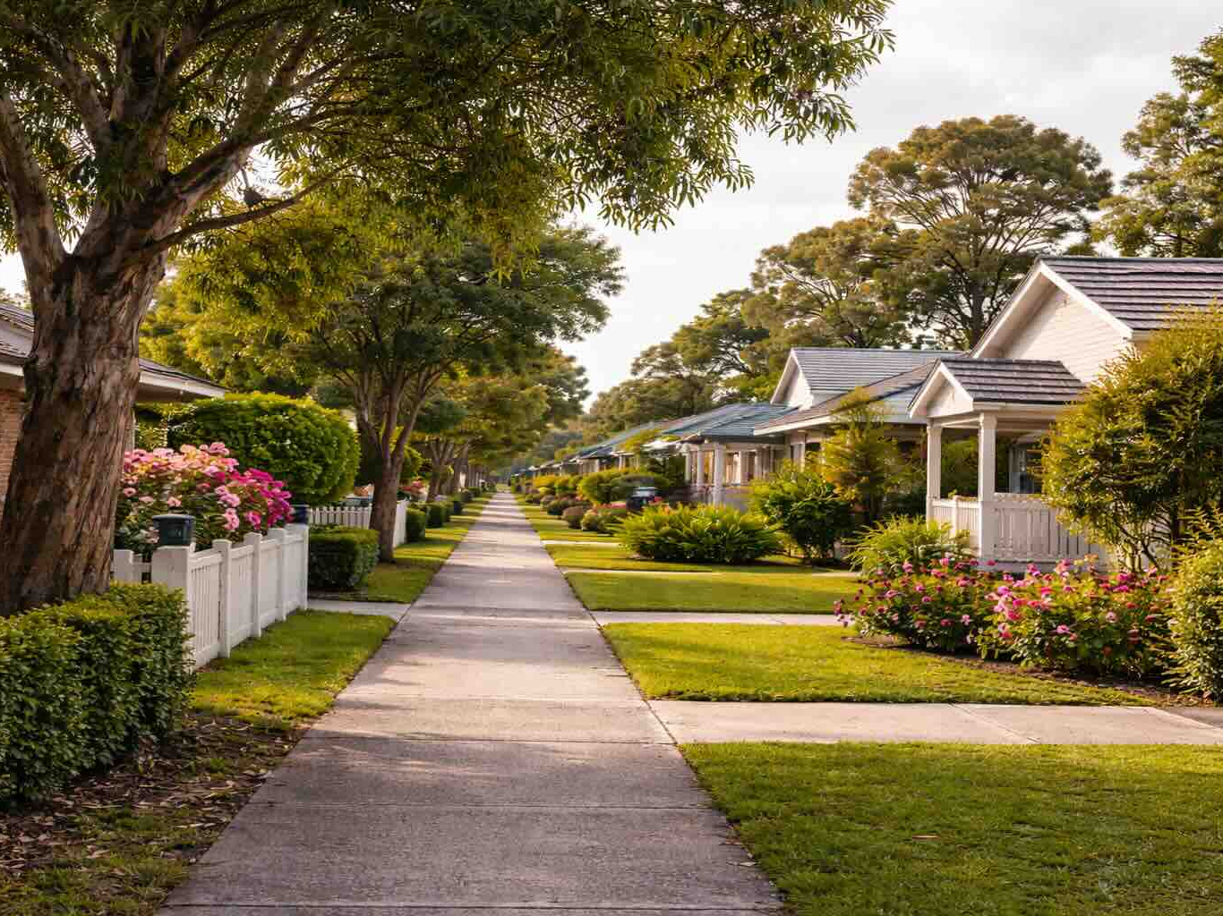

Slide 14
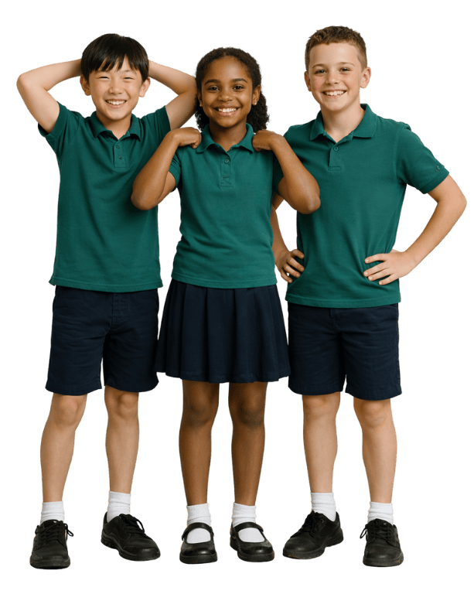
Gratitude
Gratitude grows when we:
wait until good things happen to us
look for and appreciate the many good things in our lives
only focus on the best moments of the day

Slide 15
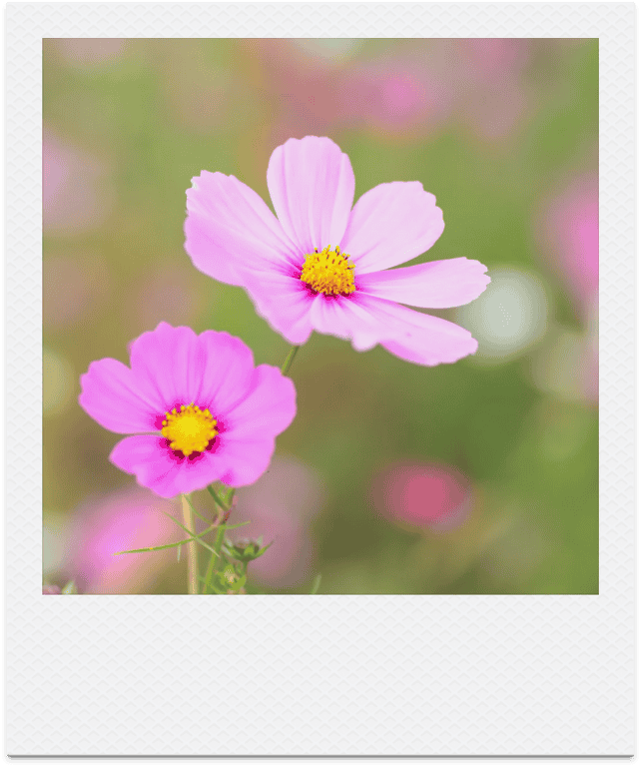
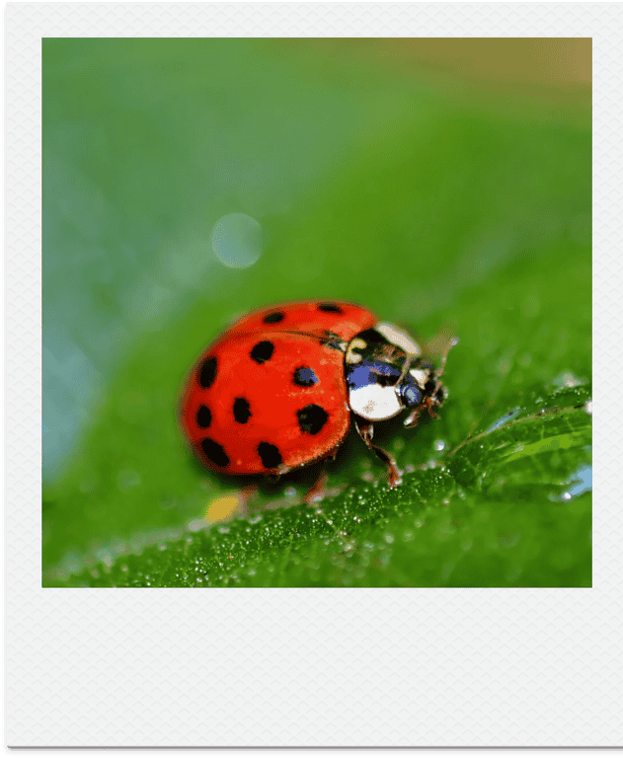
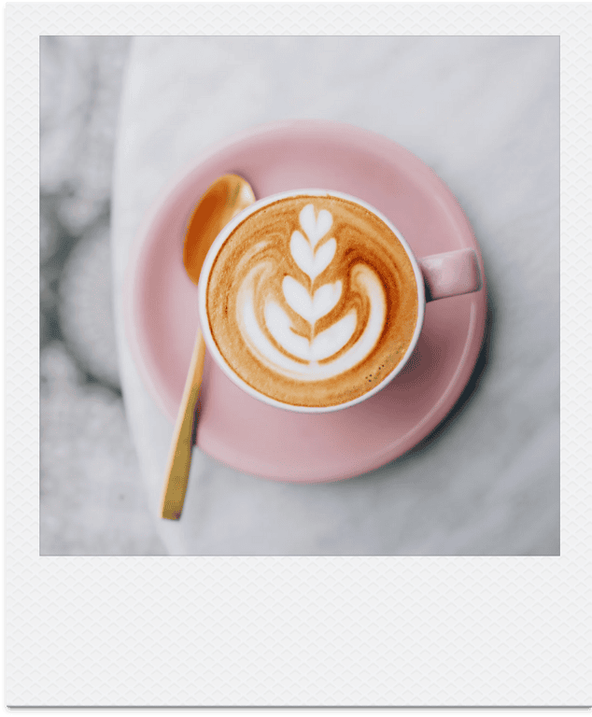
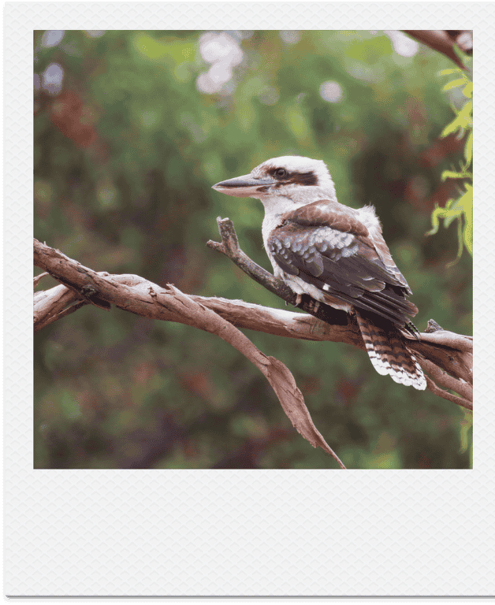
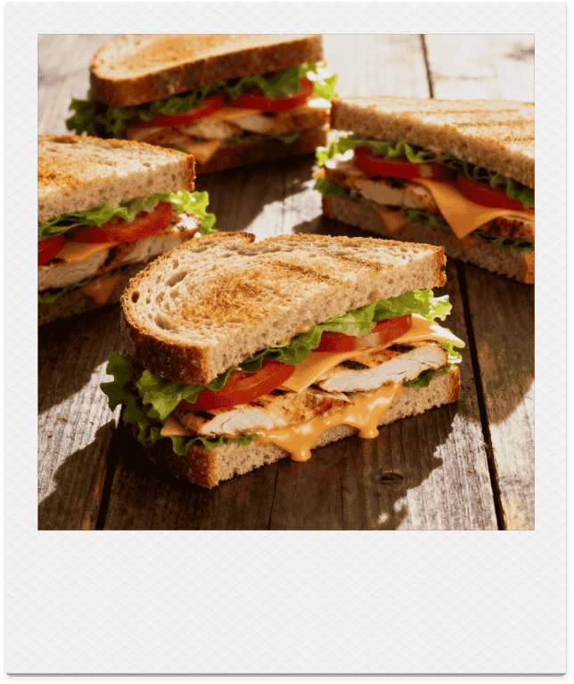
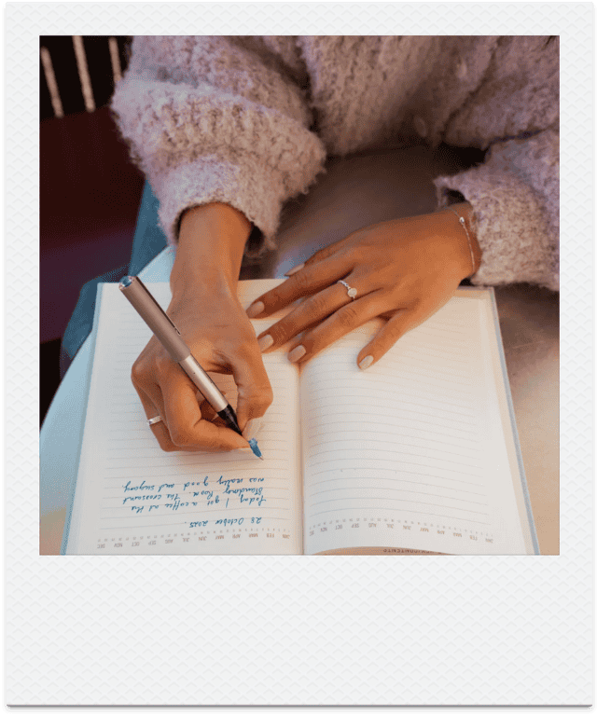
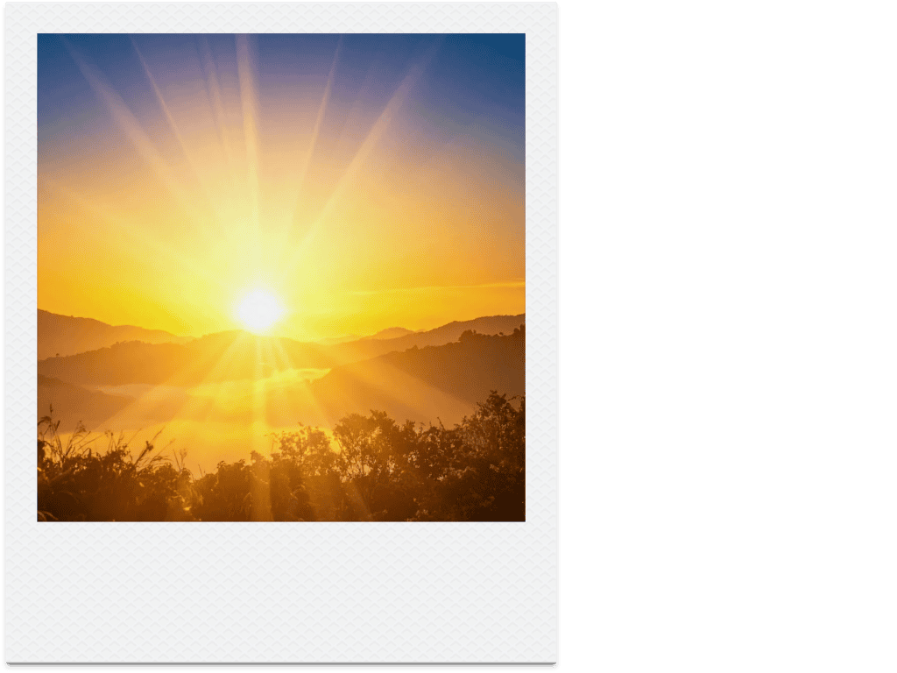
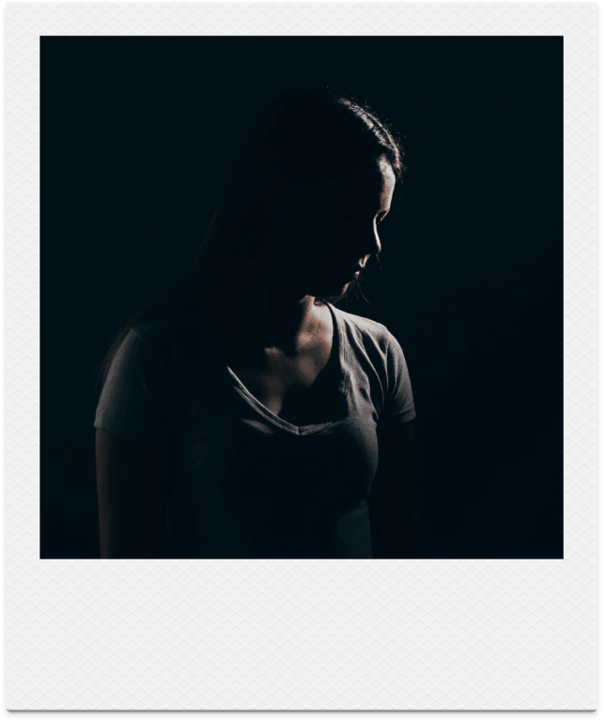
Gratitude Story - Hailey Bartholomew

Slide 16
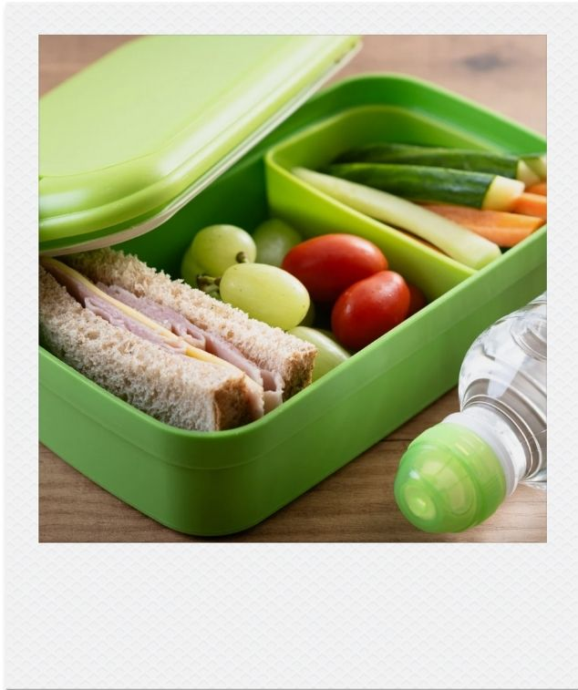
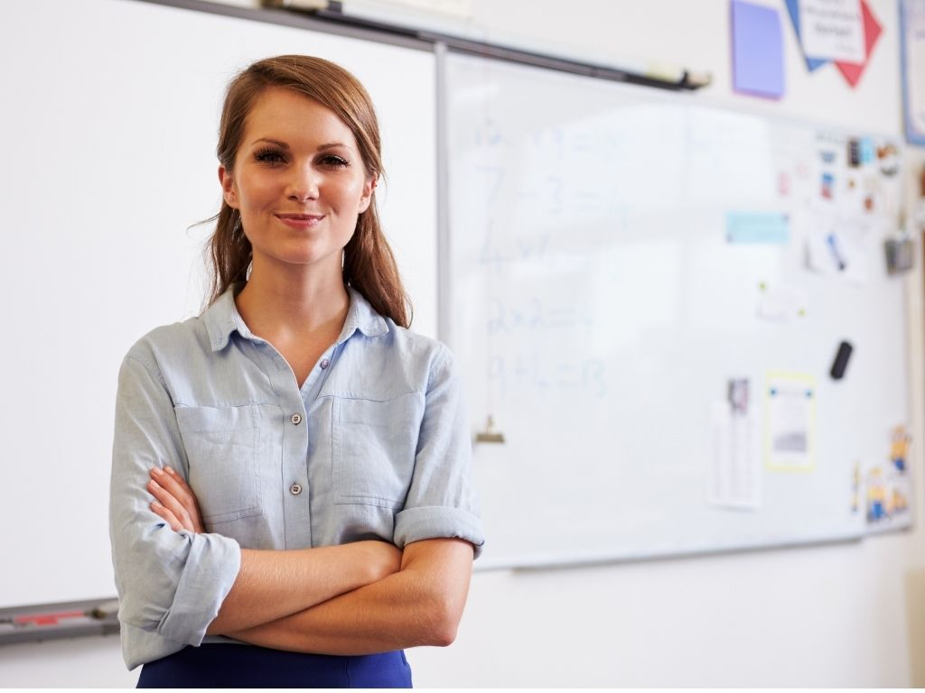
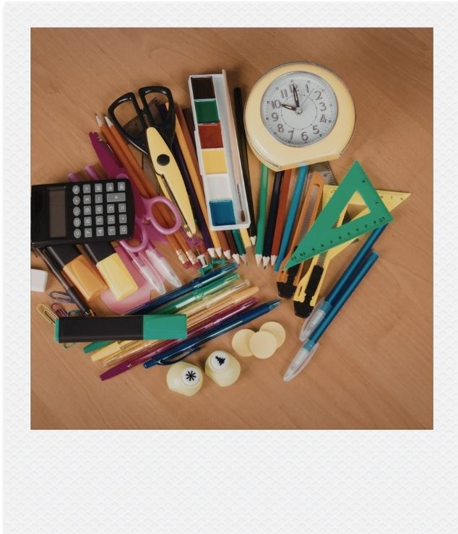
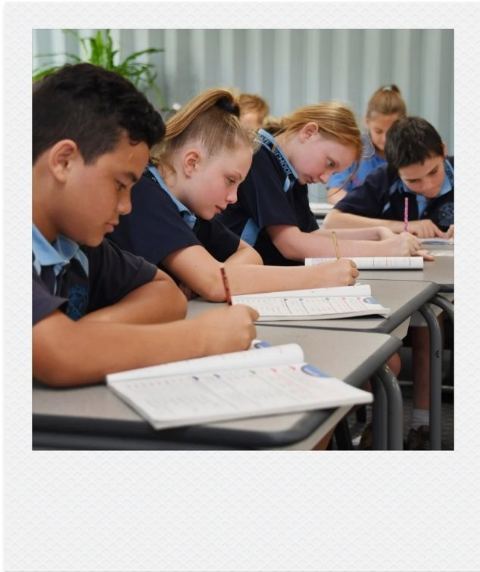
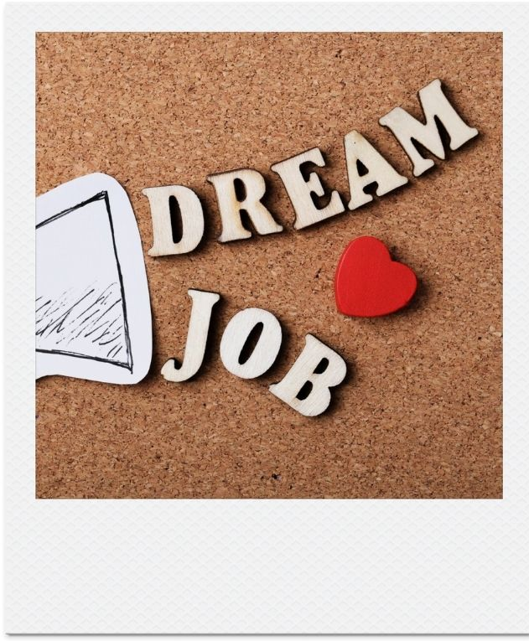
My Gratitude Story

Slide 17
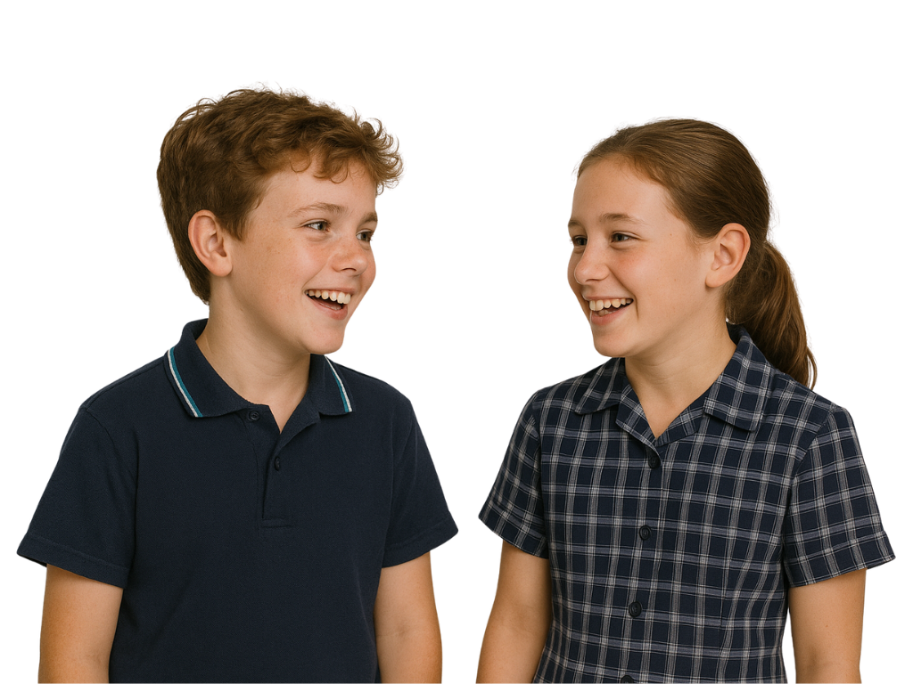
Our Gratitude Stories

Slide 18
My Gratitude Story

Slide 19
Gratitude is the feeling of being thankful for the good things in your life.
Gratitude grows when we choose to notice and appreciate the good things in our lives.
Deliberately focusing on what is good can shape how we think and experience our days.

Slide 20
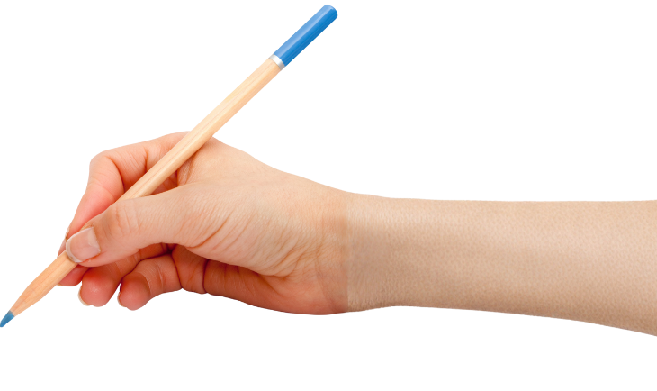


How well did you:
recognise that gratitude grows when you choose to notice the good things around you
identify things in your life that you can feel grateful for?

Slide 21
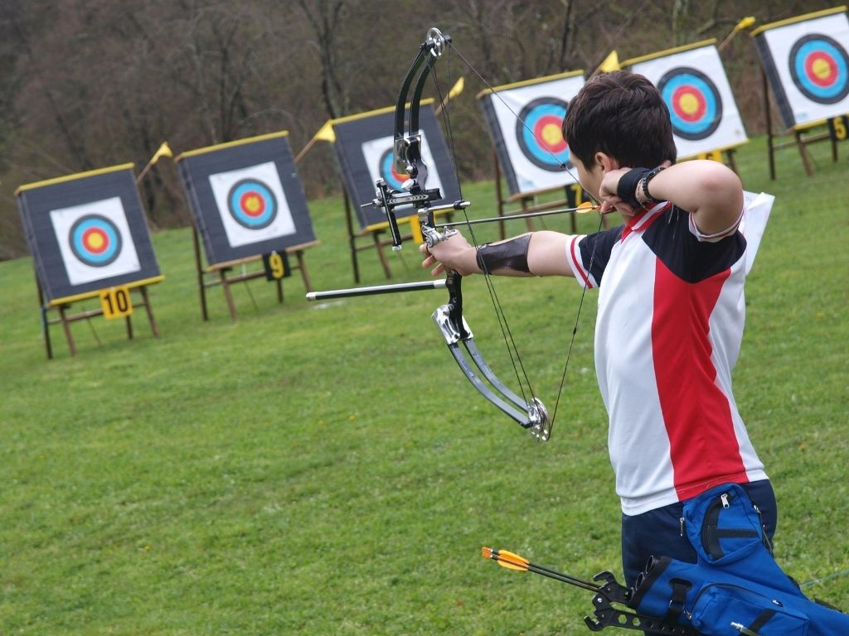
In the next lesson, you will learn how passion can grow from what matters to you and be strengthened through commitment.

