Slide 1
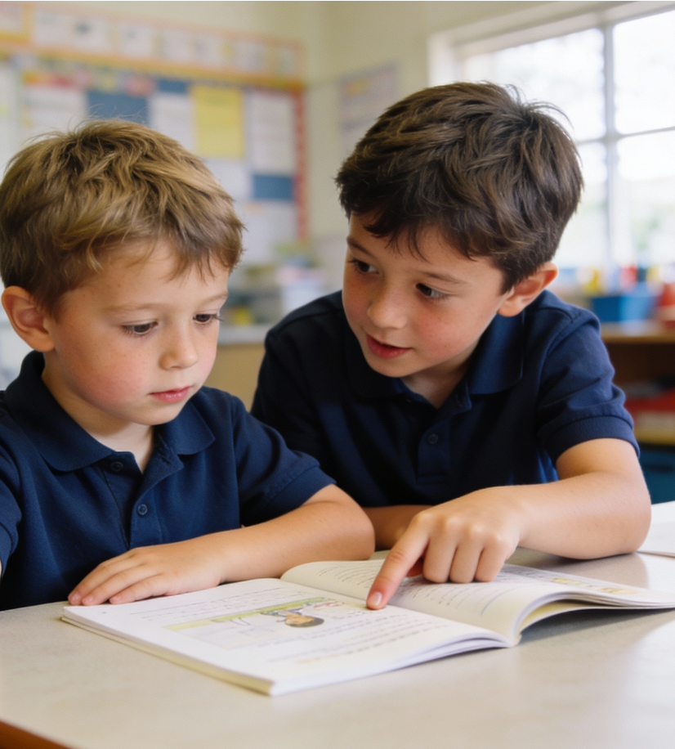
Noticing Kindness Around Us
Unit 2: Relating to Others
Lesson 1

Slide 2
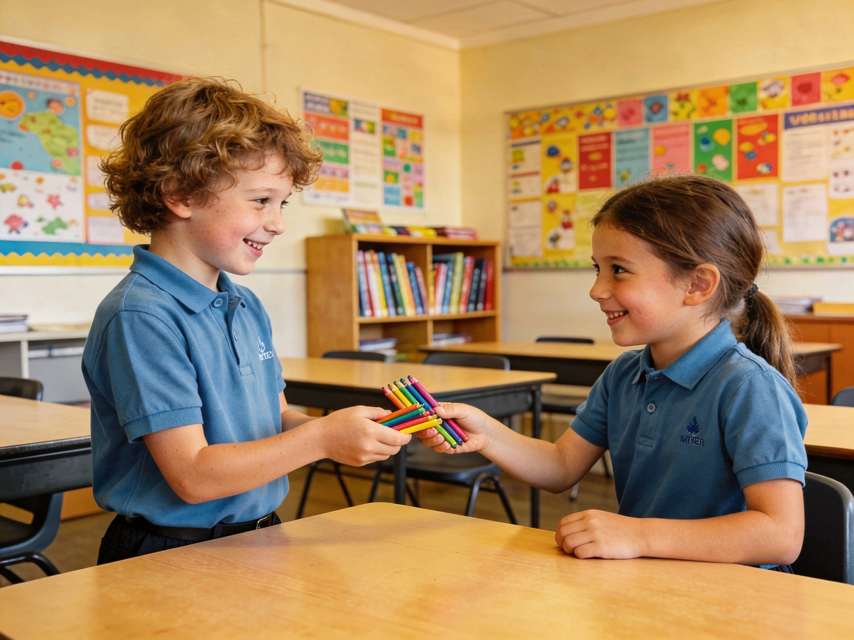
In this lesson, we will learn what kindness looks like.
Notes:
In this lesson, we will learn what kindness looks like.

Slide 3
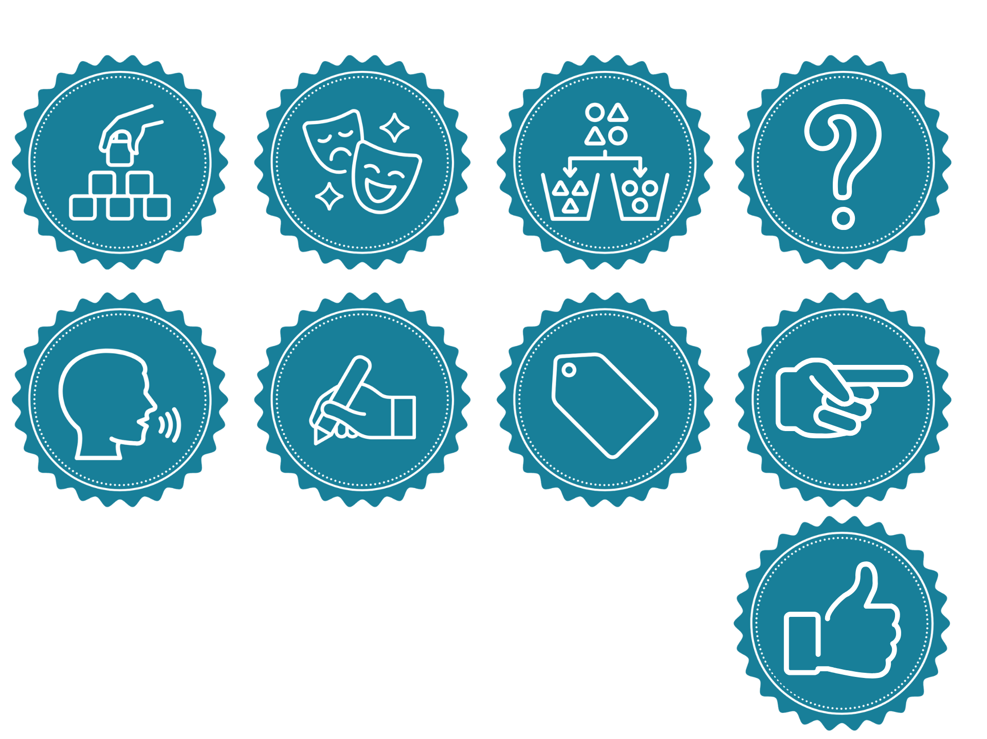
You will be successful when you can:
notice when someone might need kindness
tell how you can show kindness.

Slide 4
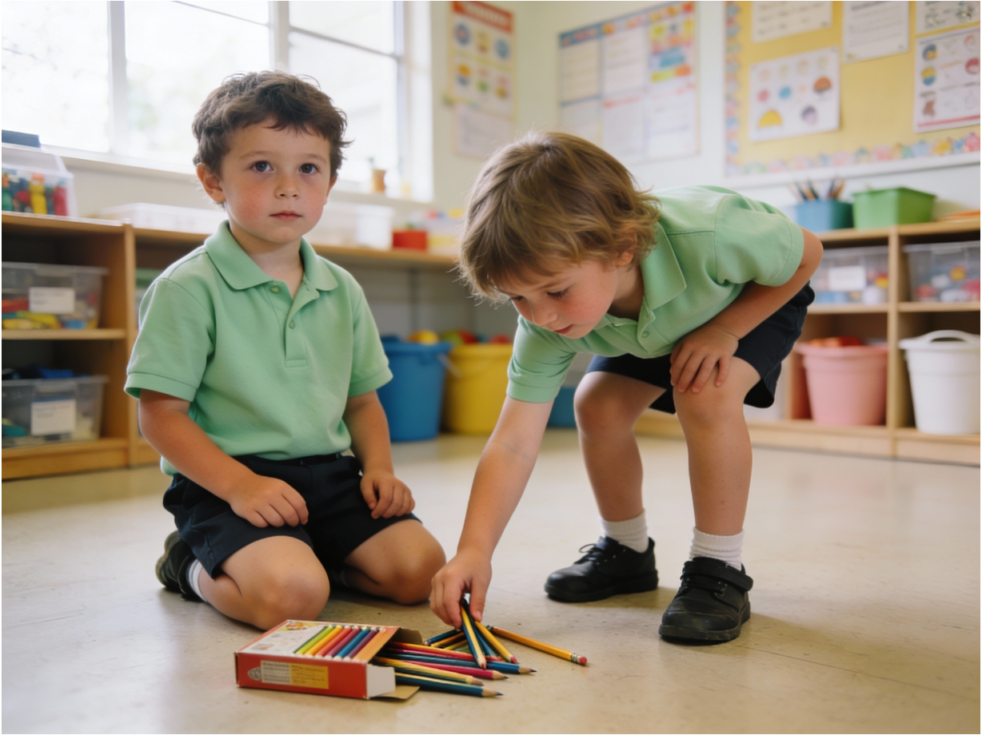
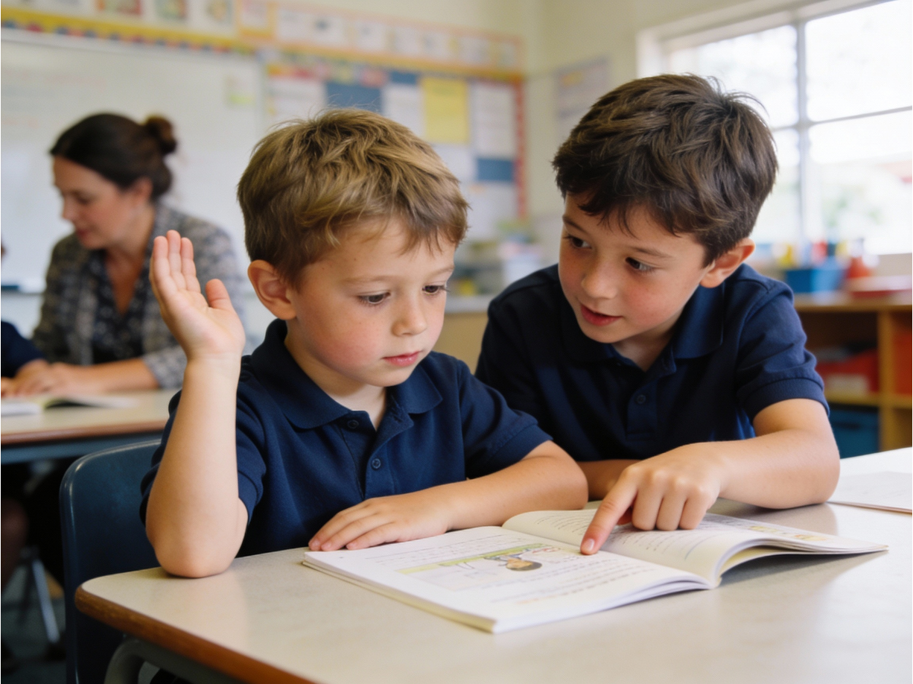

Slide 5
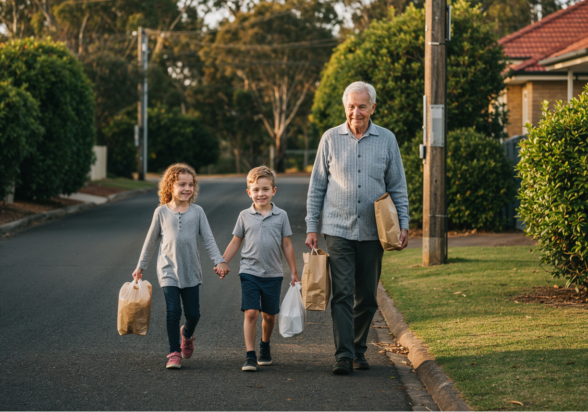
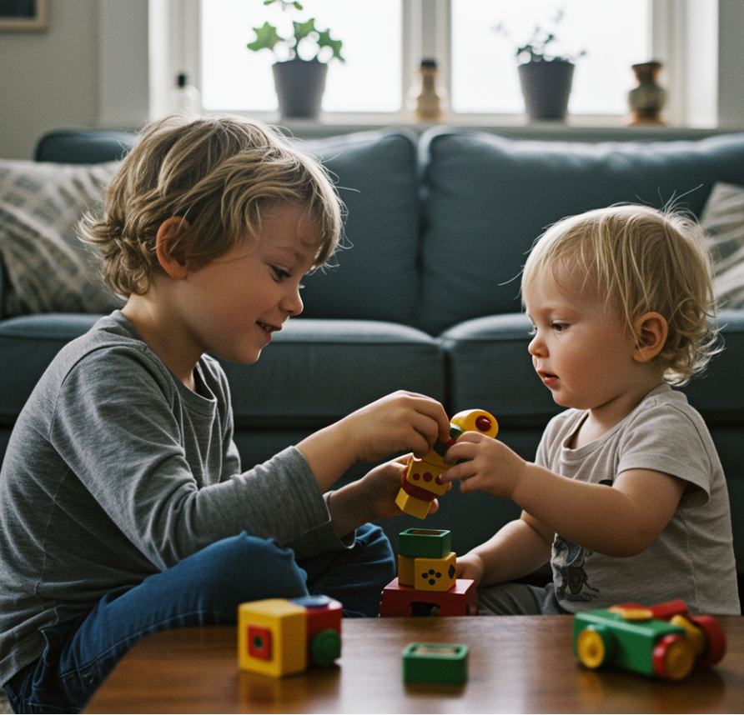
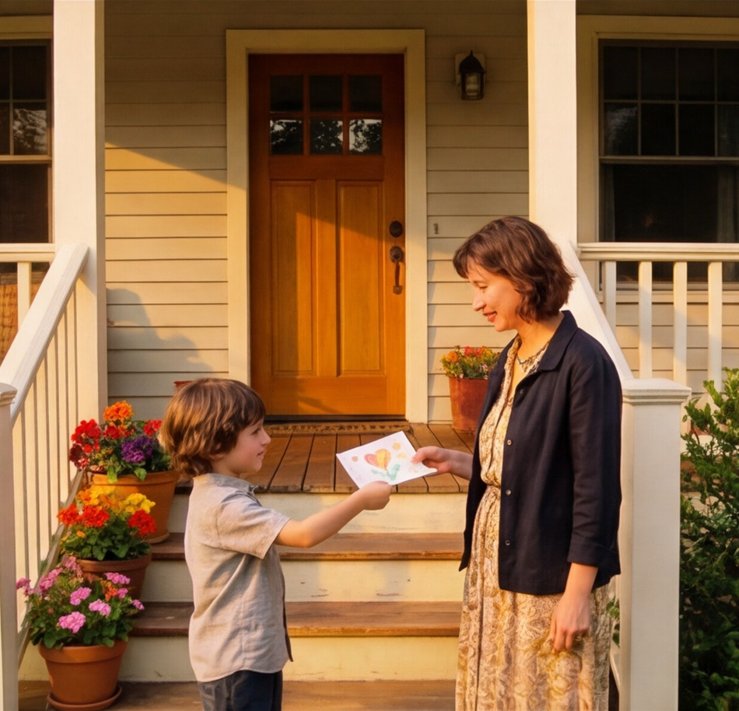
Kindness
We can show kindness when we notice someone needs help and we choose to care.
Kindness is doing something nice to help someone or make them feel happy.

Slide 6
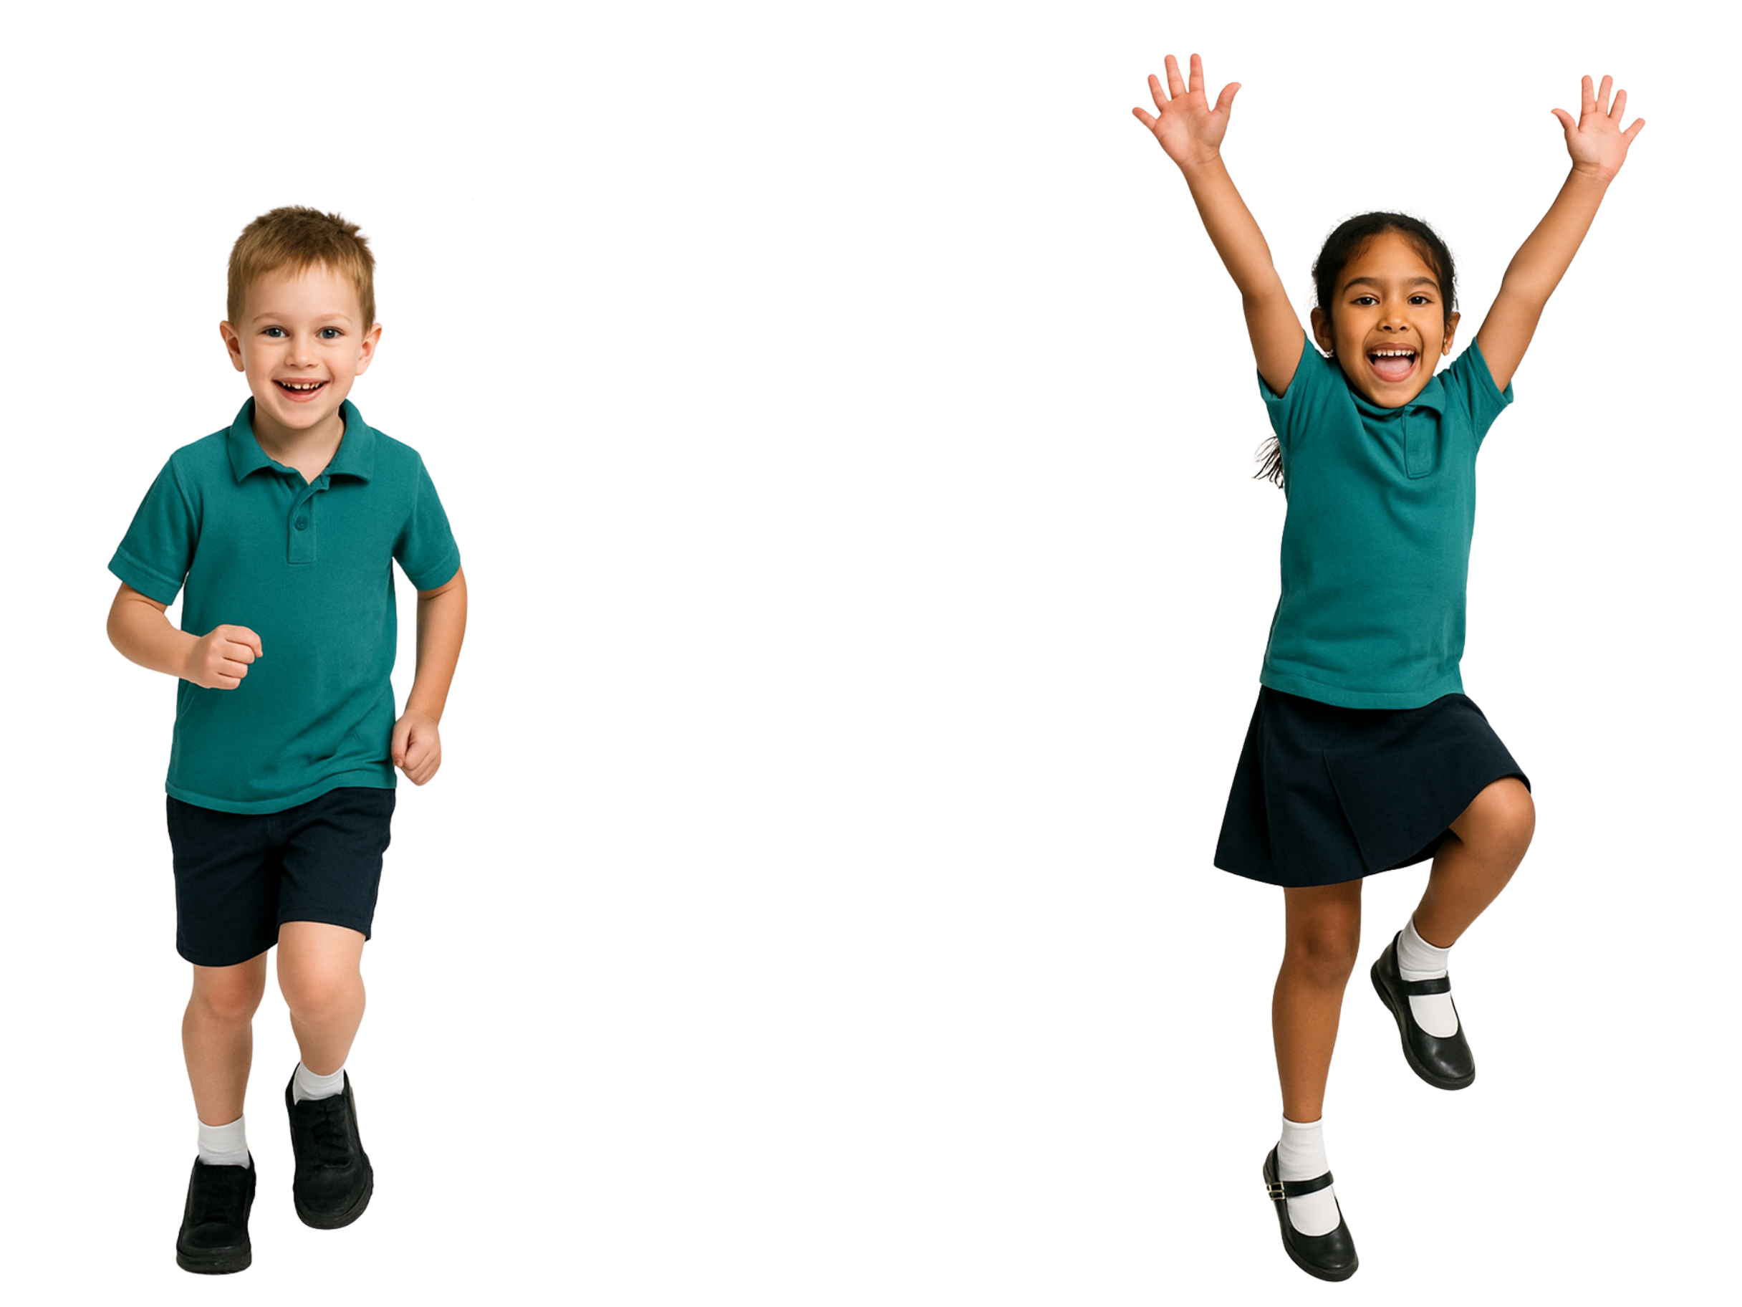
Being Kind
When we notice and choose to help, we are being kind.
yes
no

Slide 7

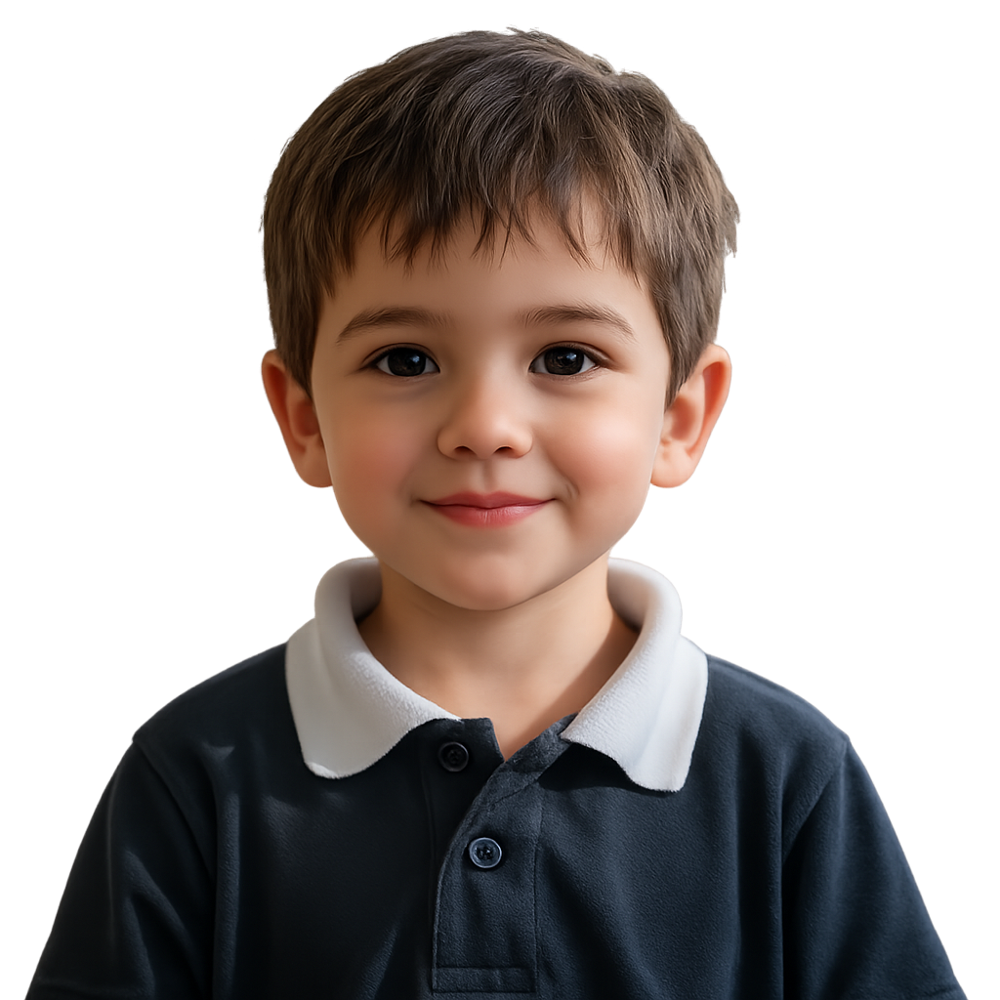


Notice, Think, Act
notice
think
act

Slide 8

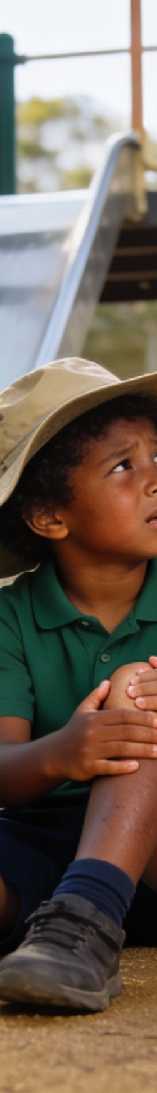
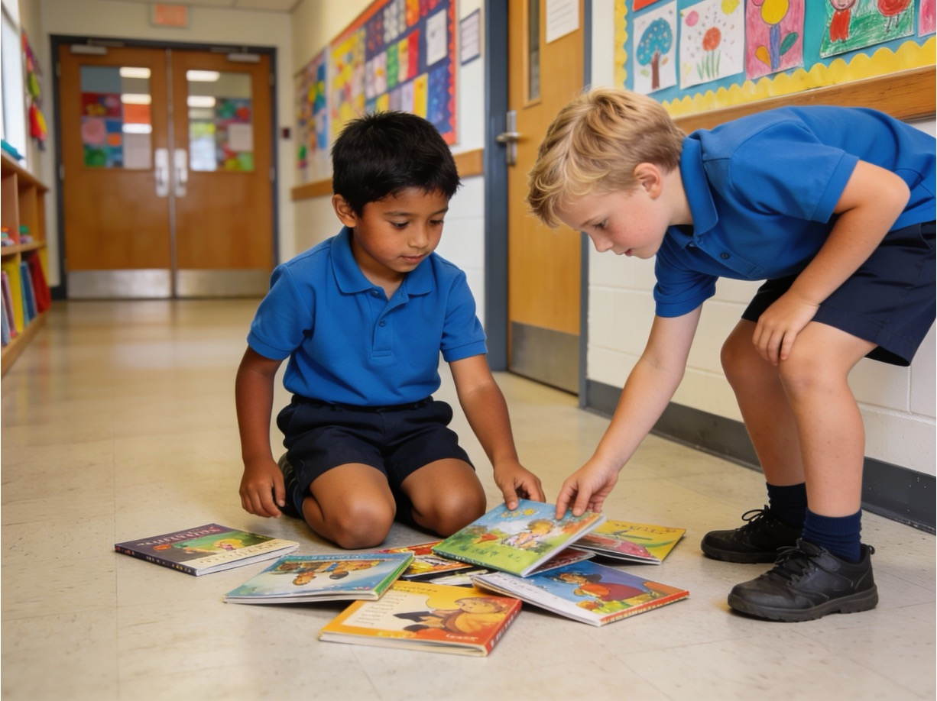
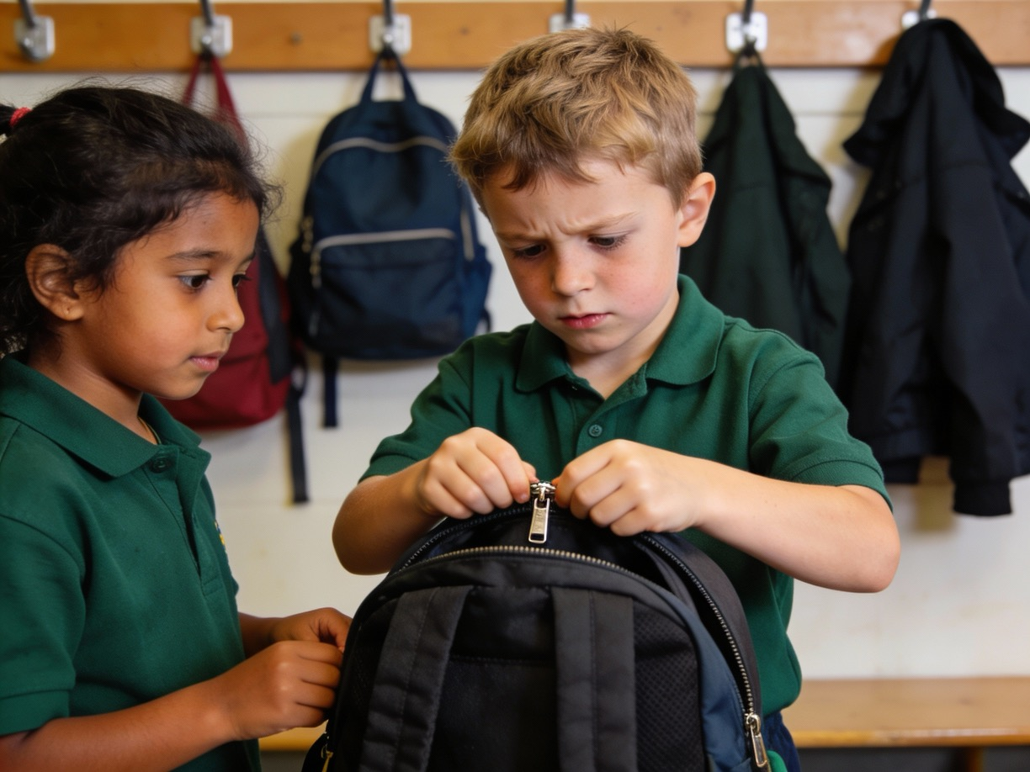
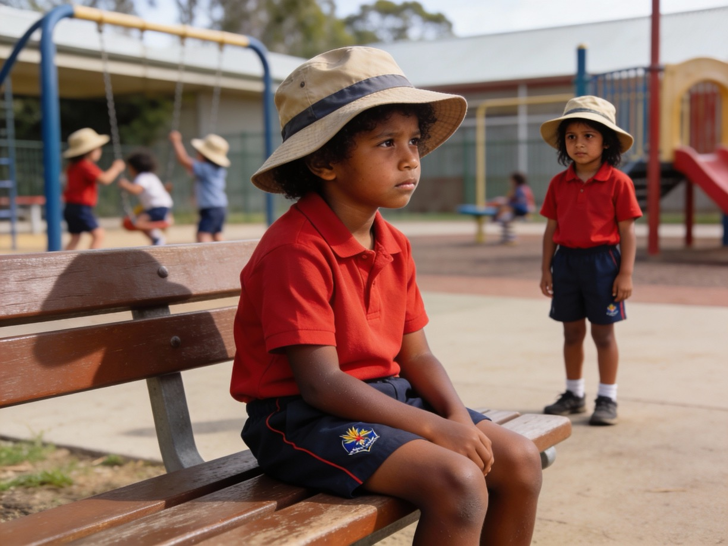
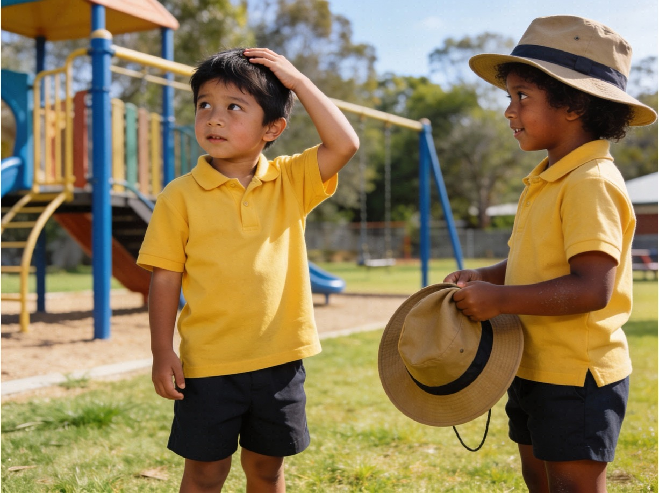



Notice. Think. Act.

Slide 14
Kindness is doing something nice to help someone or make them feel happy.
We show kindness when we notice someone needs help and we choose to care.

Slide 15
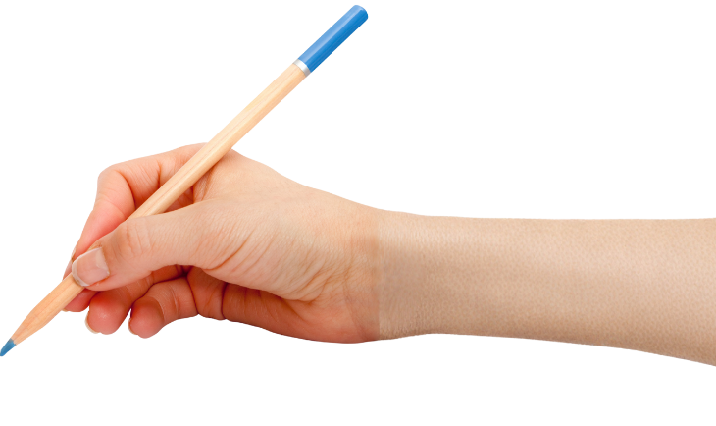

How well did you:
notice when someone might need kindness
tell how you can show kindness?

Slide 16
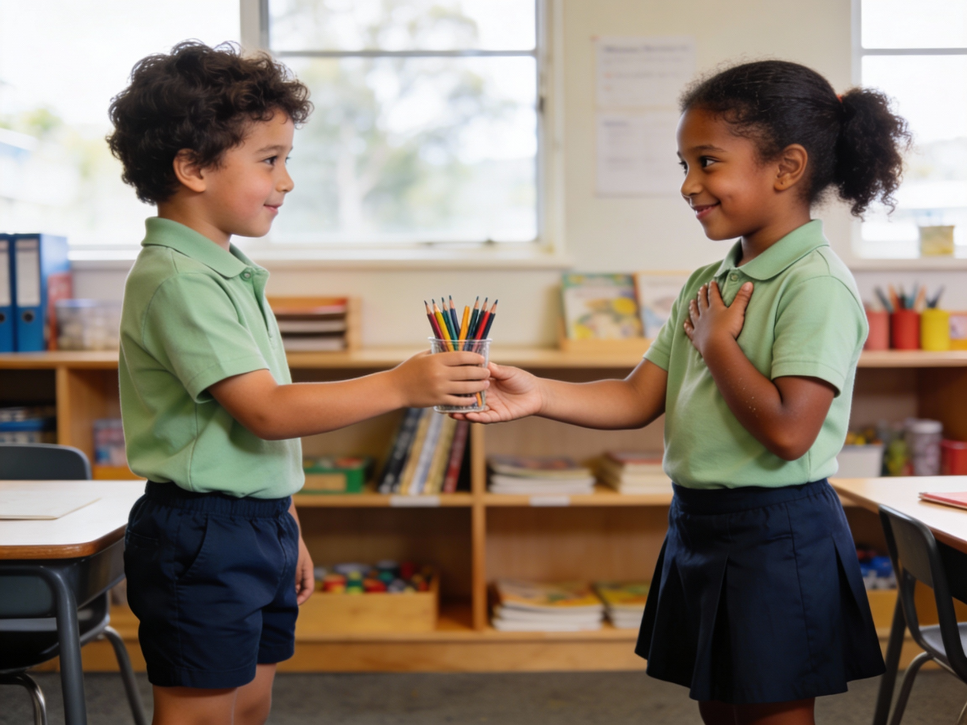
In the next lesson, we will find things in our lives to have gratitude for.

