Slide 1
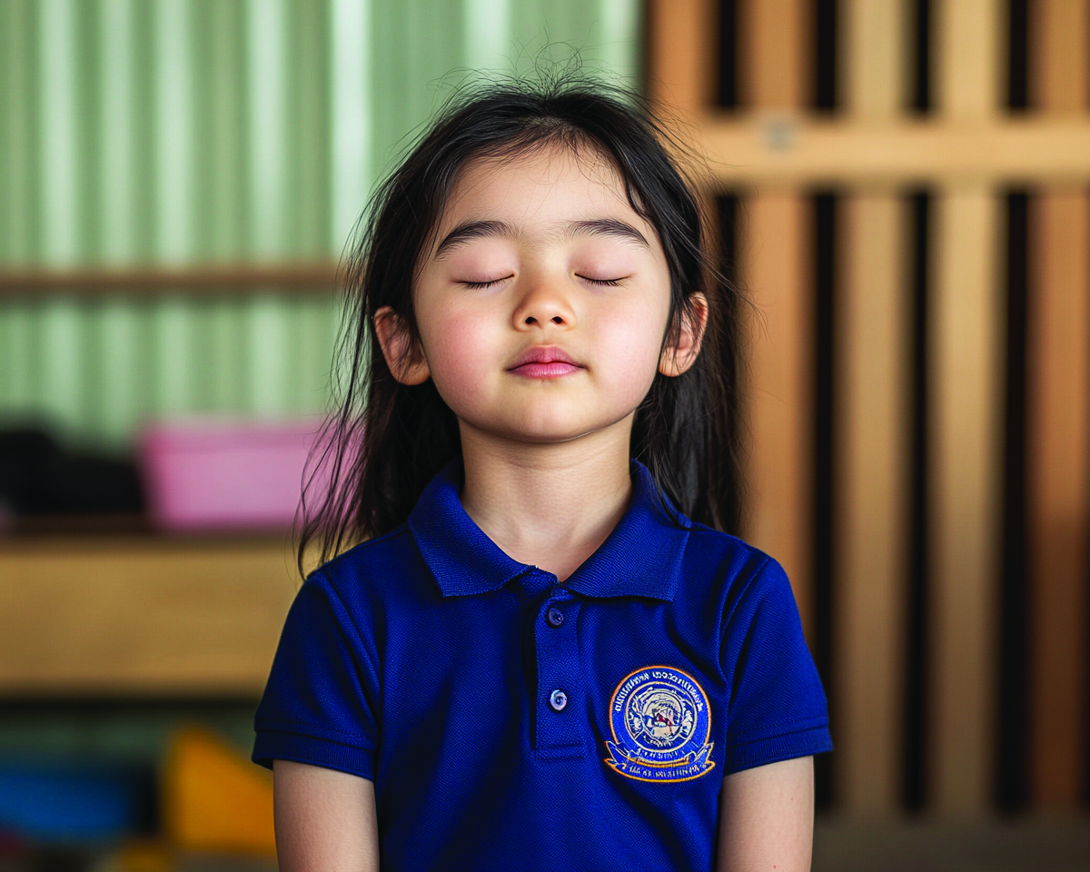
Breathing Helps Me Calm
Unit 2: Big Feelings, Smart Choices
Lesson 2

Slide 2
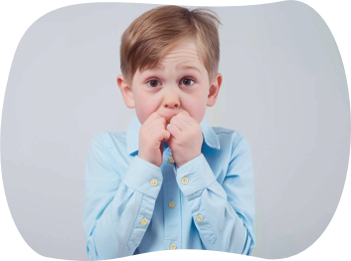
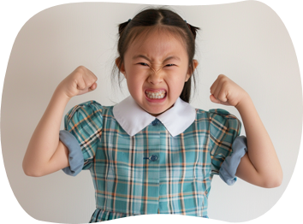
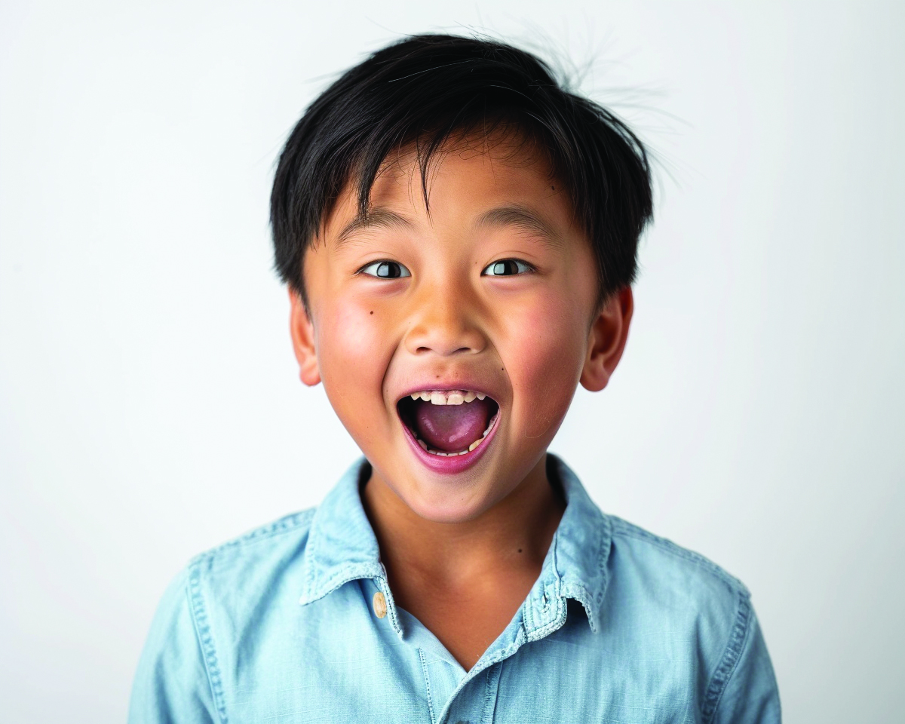
Big feelings are feelings that make us react in big ways, like anger, fear or excitement.

Slide 3
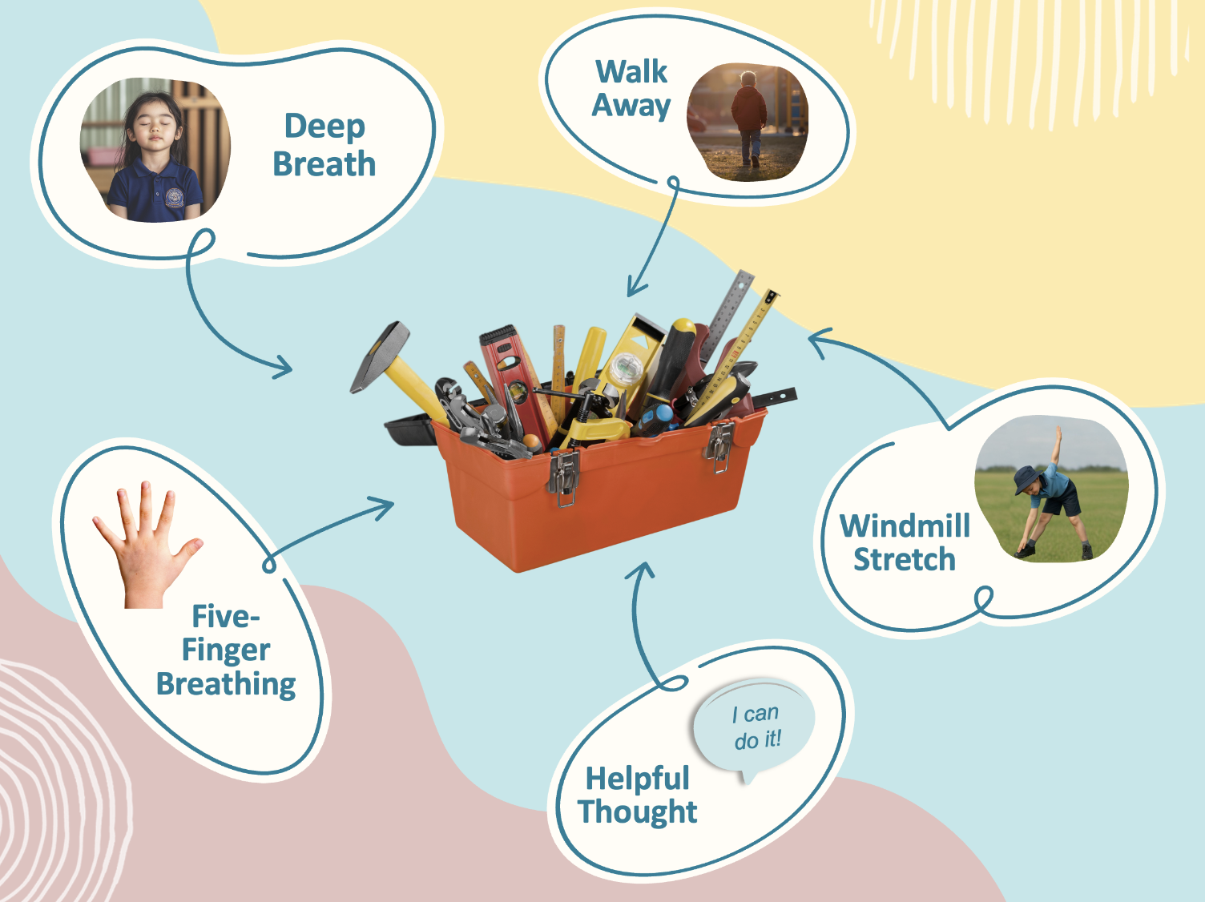
We can use tools to help us feel calmer when we have big feelings.

Slide 4
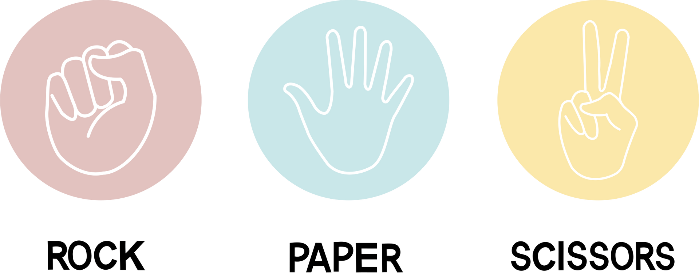
Which is an example of a calming tool you can use when you have a big feeling?
Doing cartwheels
Deep Breathing
Worrying about it

Slide 5
In this lesson, you will practise using your breath to help your body and brain feel calm.

Slide 6
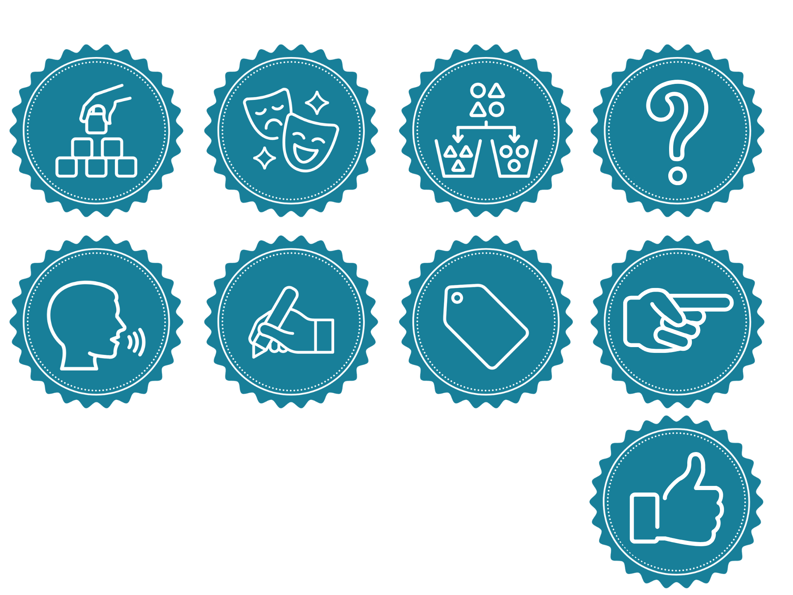
You will be successful when you can:
do a slow, calming Bubble Breath
name a time when you could use the strategy.
You will be successful when you can
Use an ‘I feel’ statement to share your feelings.
Say ‘I feel ____’ using the right feeling word.
Choose a face or gesture that shows how you could feel in different situations.

Slide 7
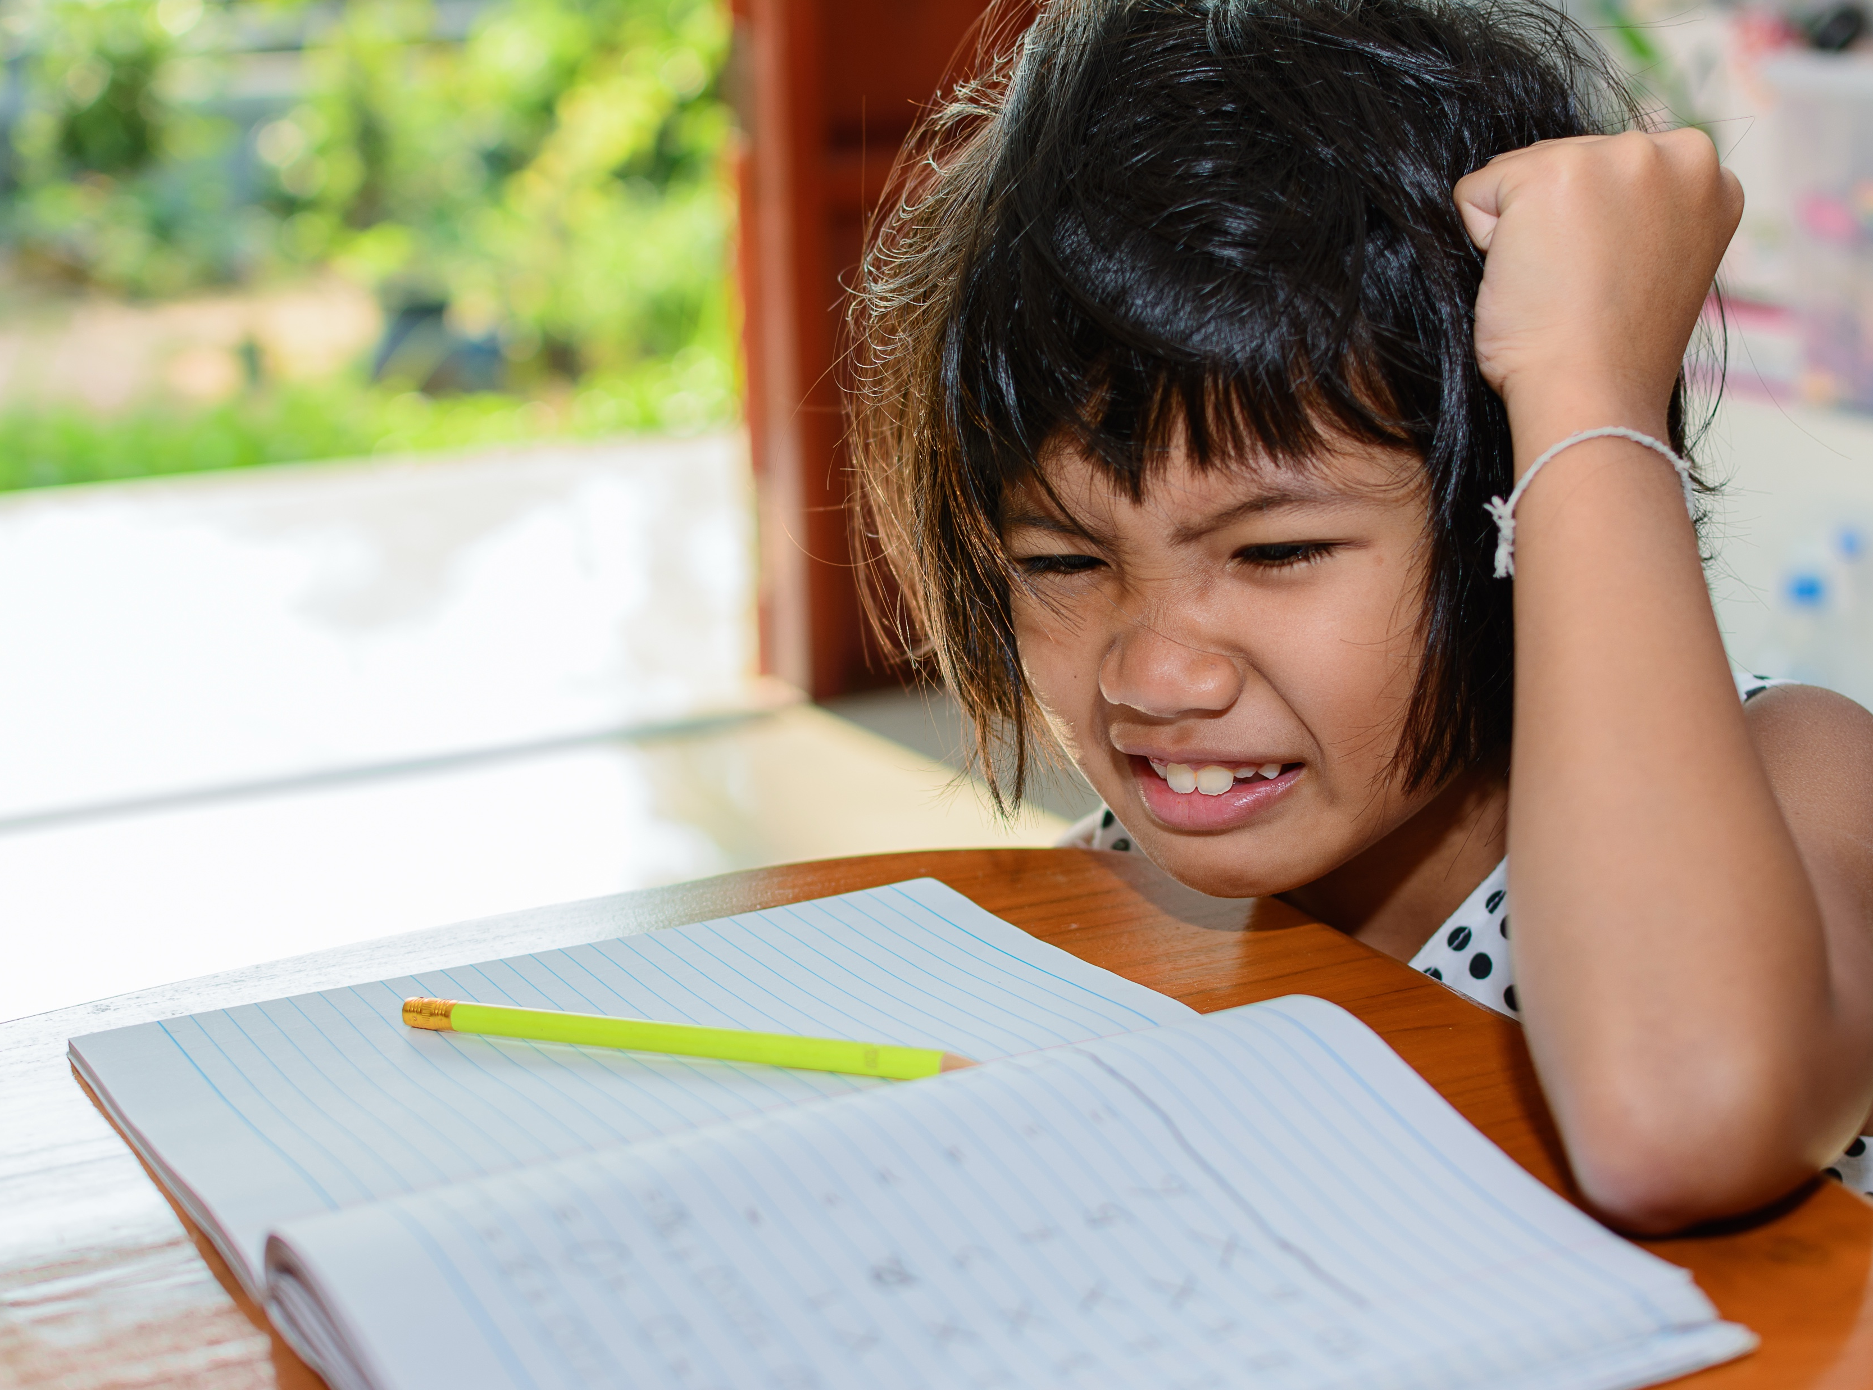
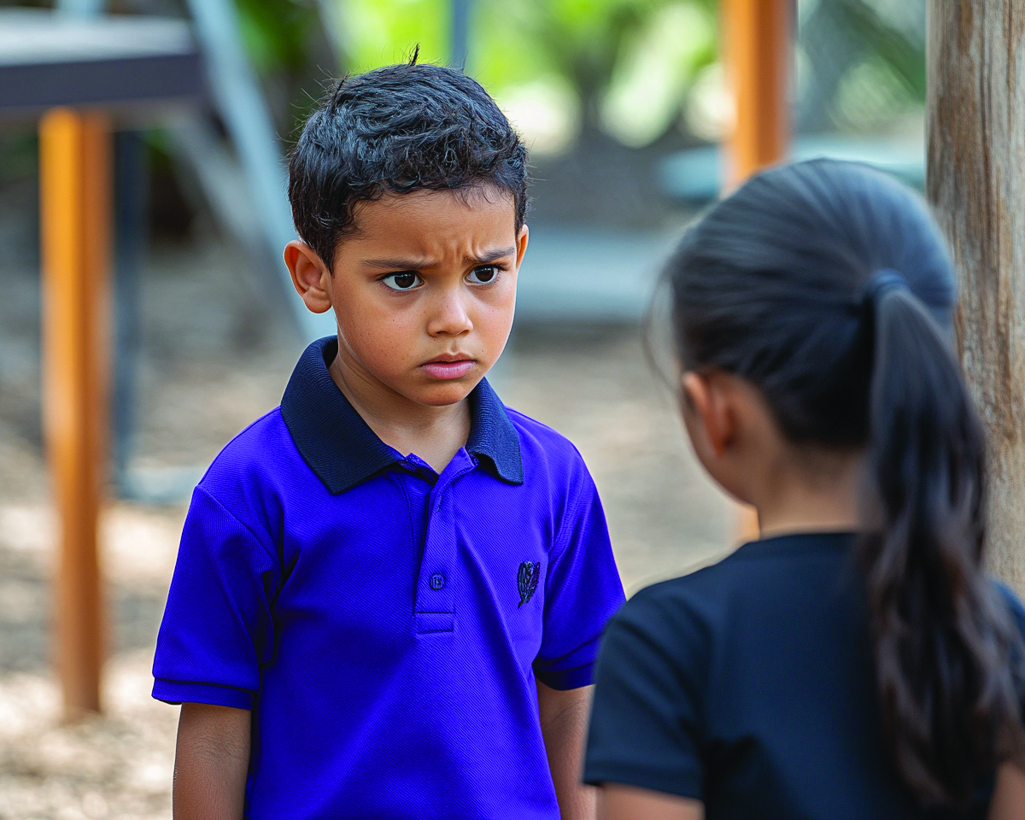

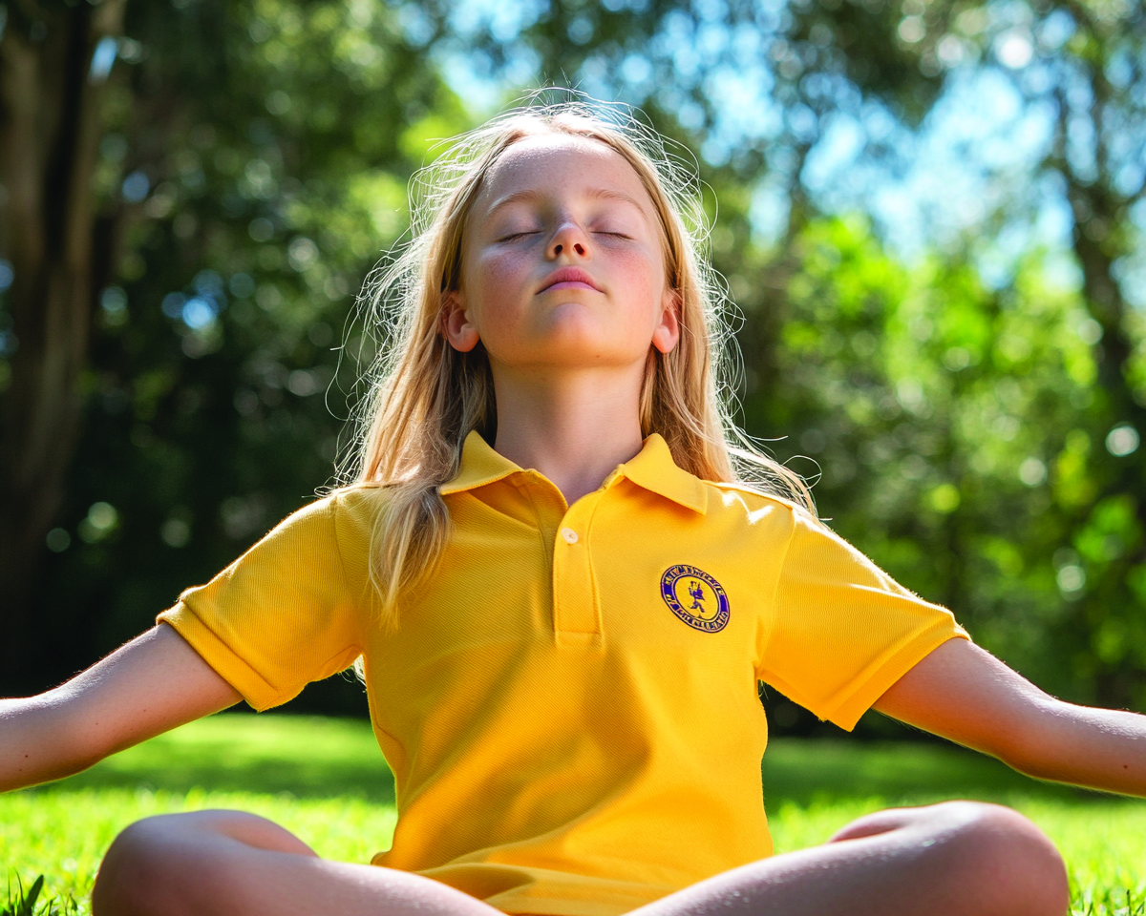

Slide 8
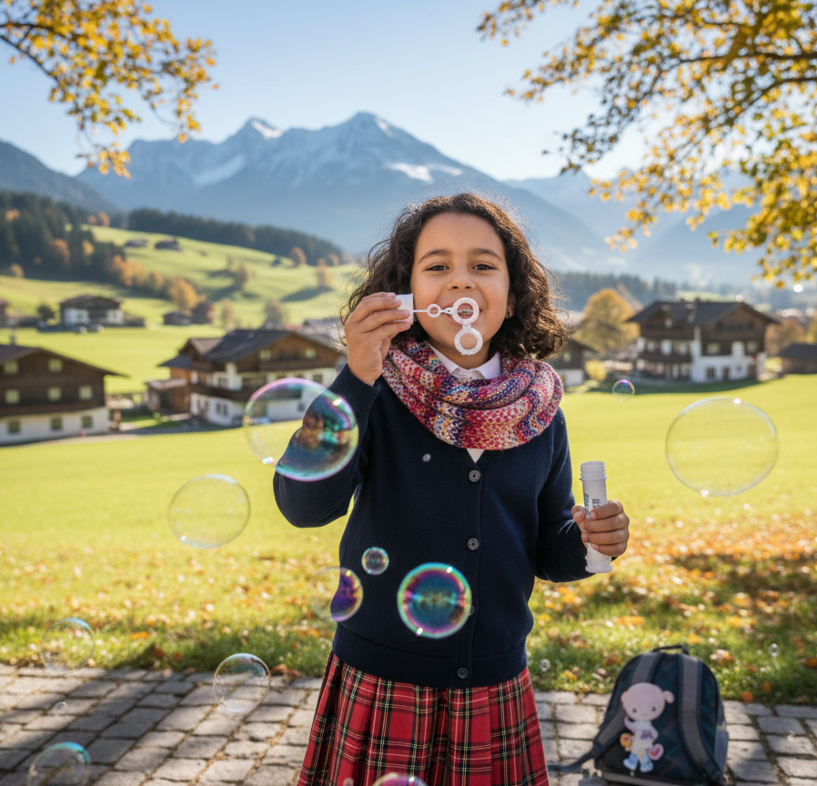
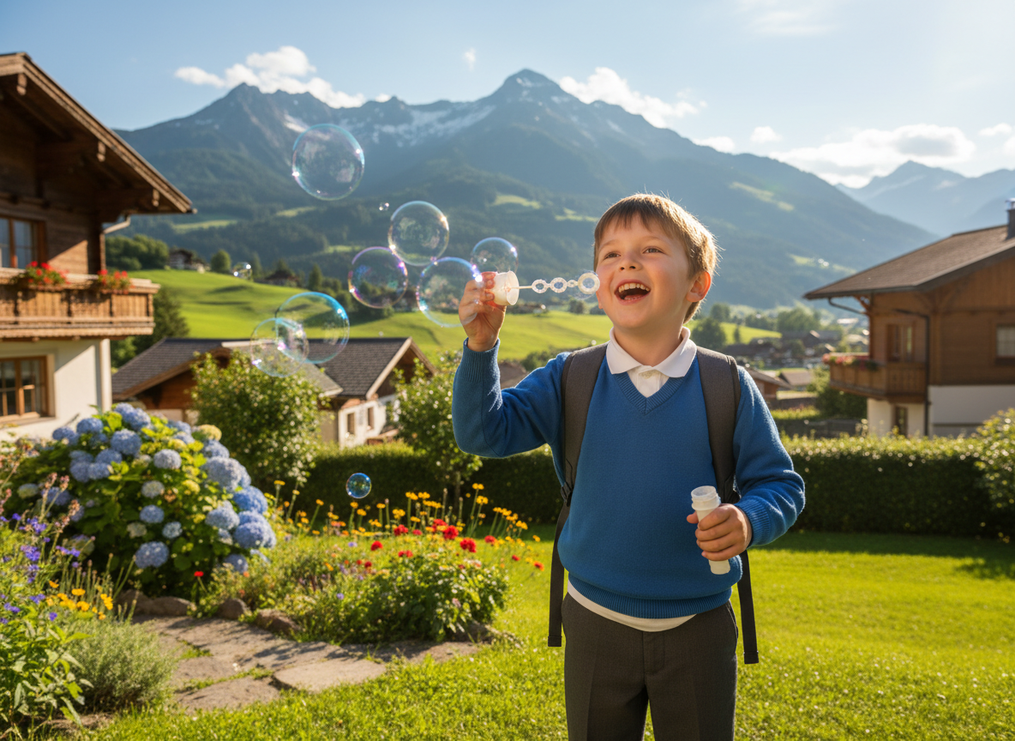
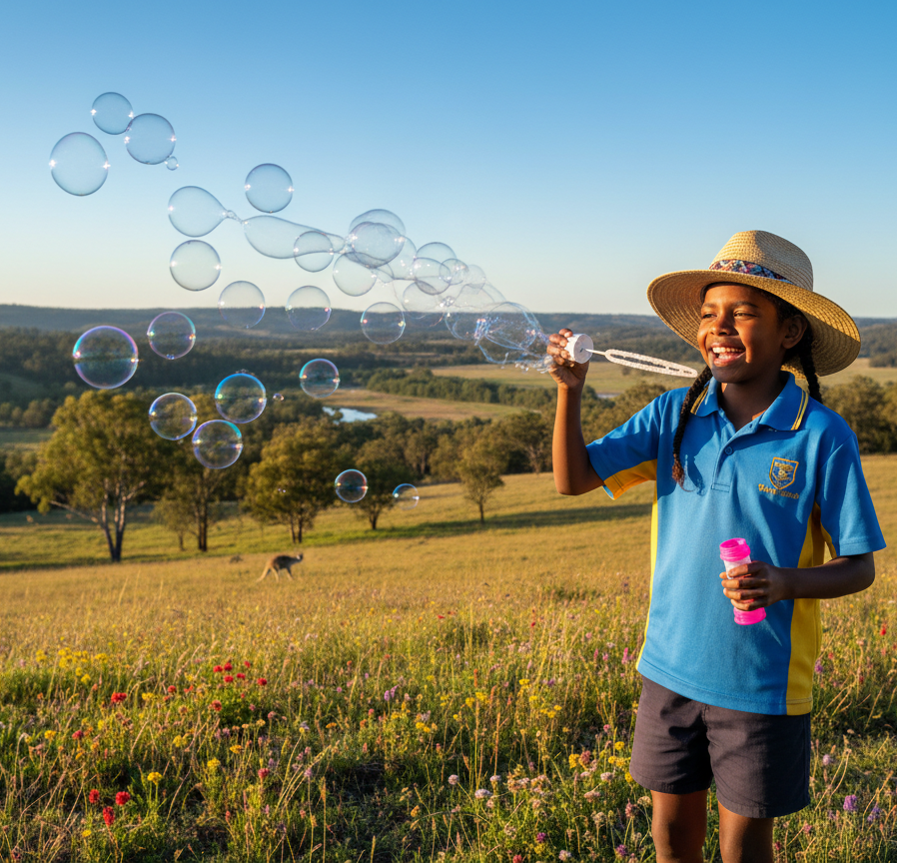
Bubble Breathing

Slide 9
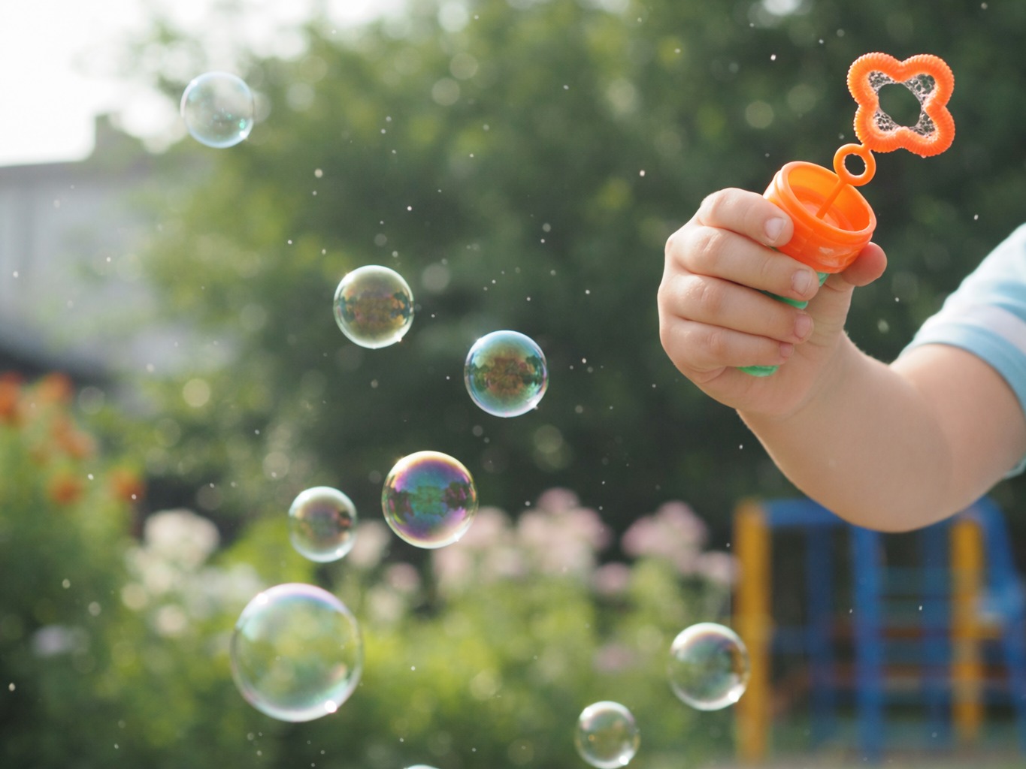




Slide 12
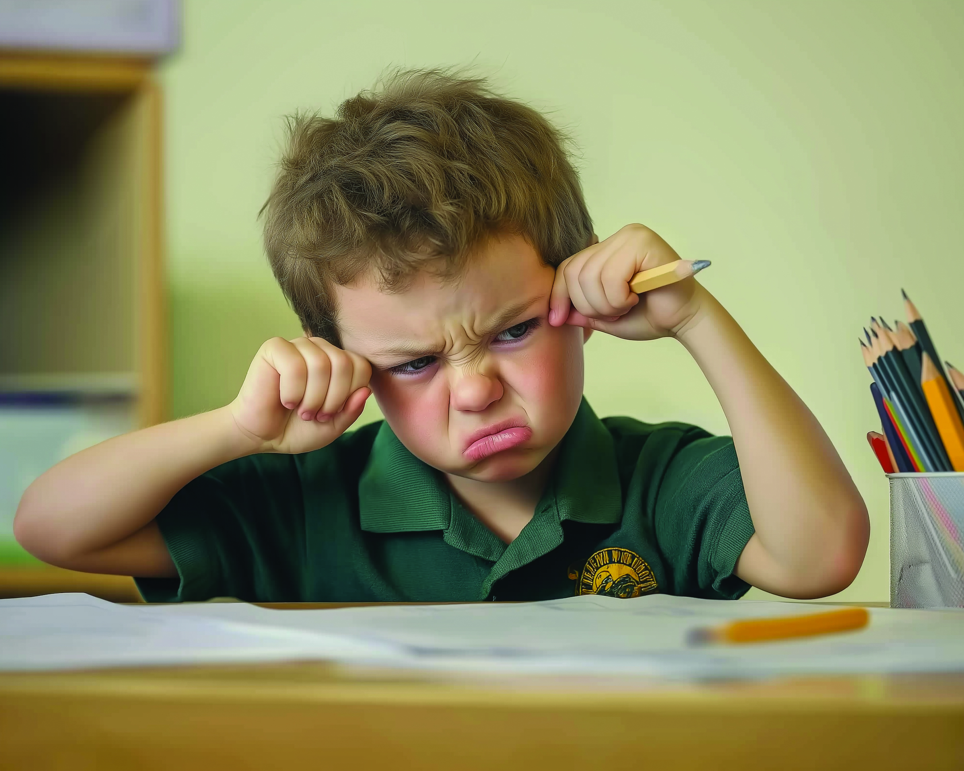
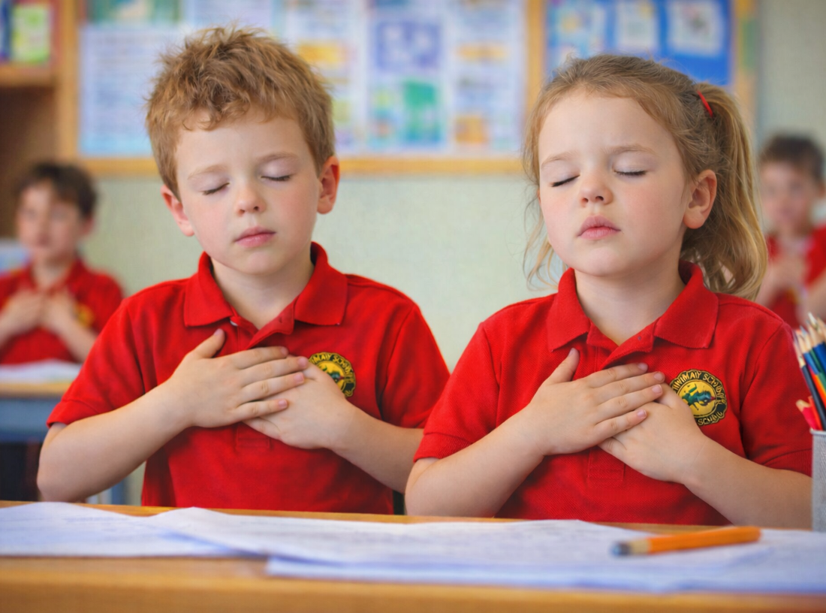
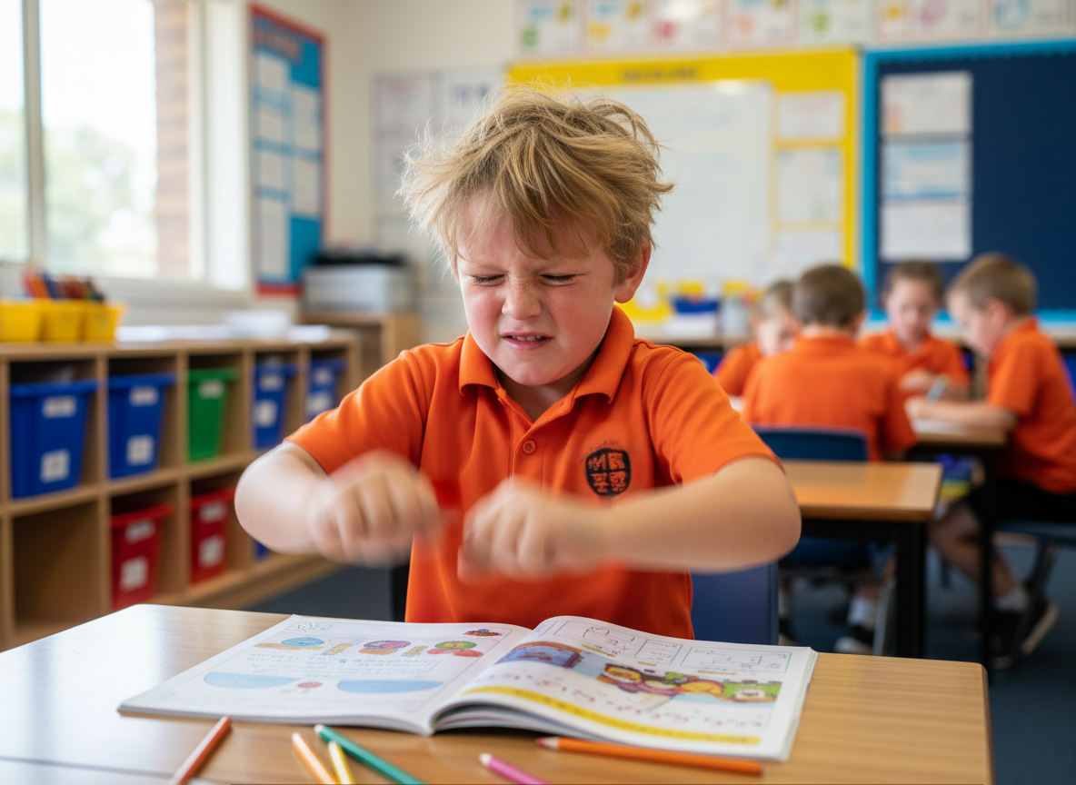



Bubble Breathing
How does blowing a bubble help the person in the poem feel?

Slide 13
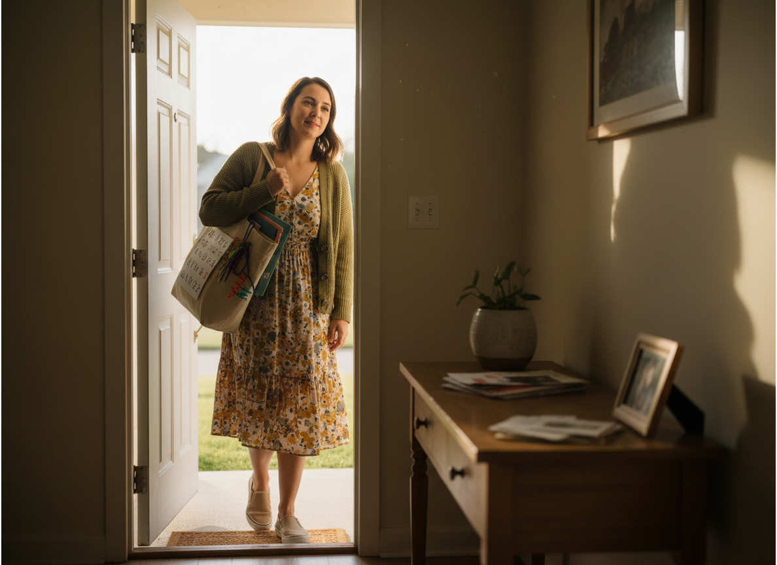
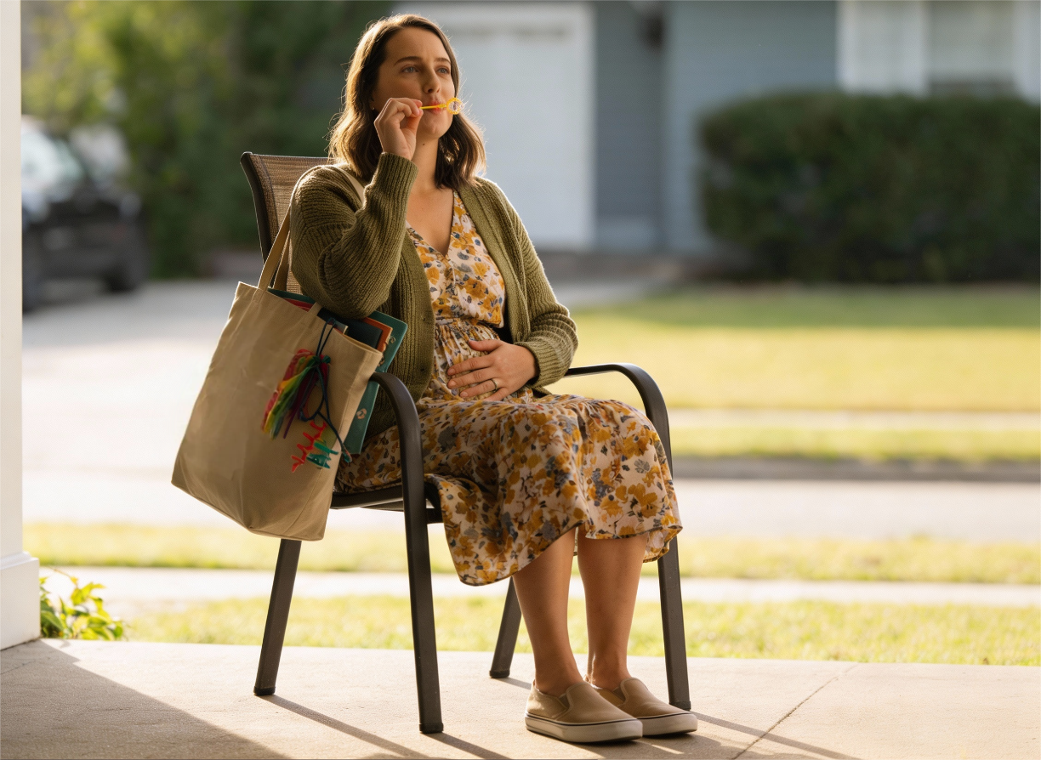
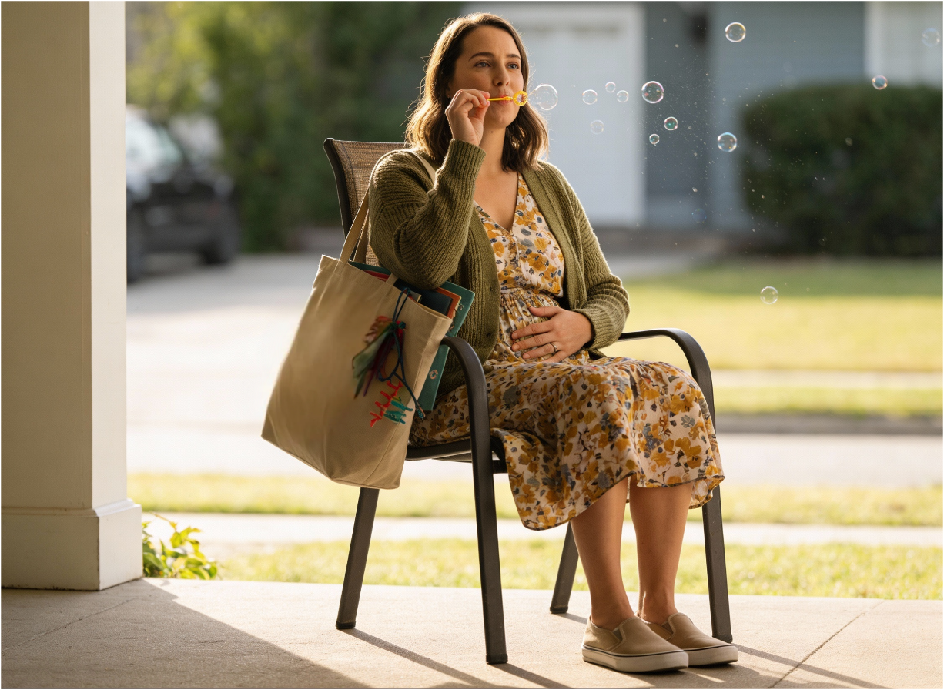
Bubble Breathing

Slide 14
Bubble Breathing

Slide 15
Bubble Breathing

Slide 16
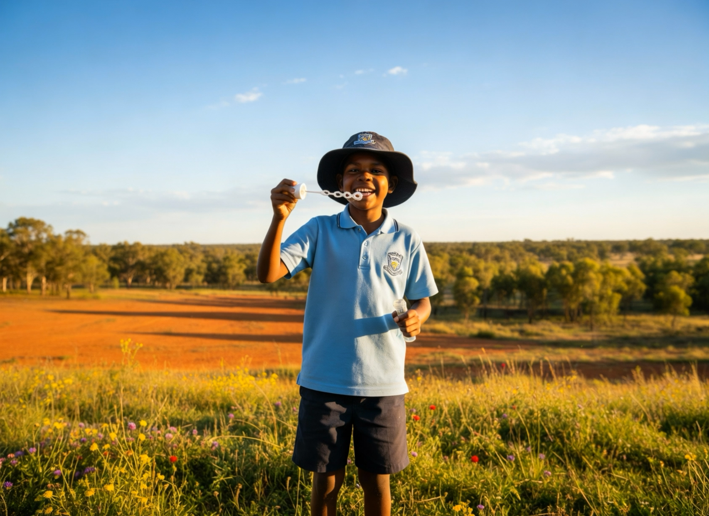
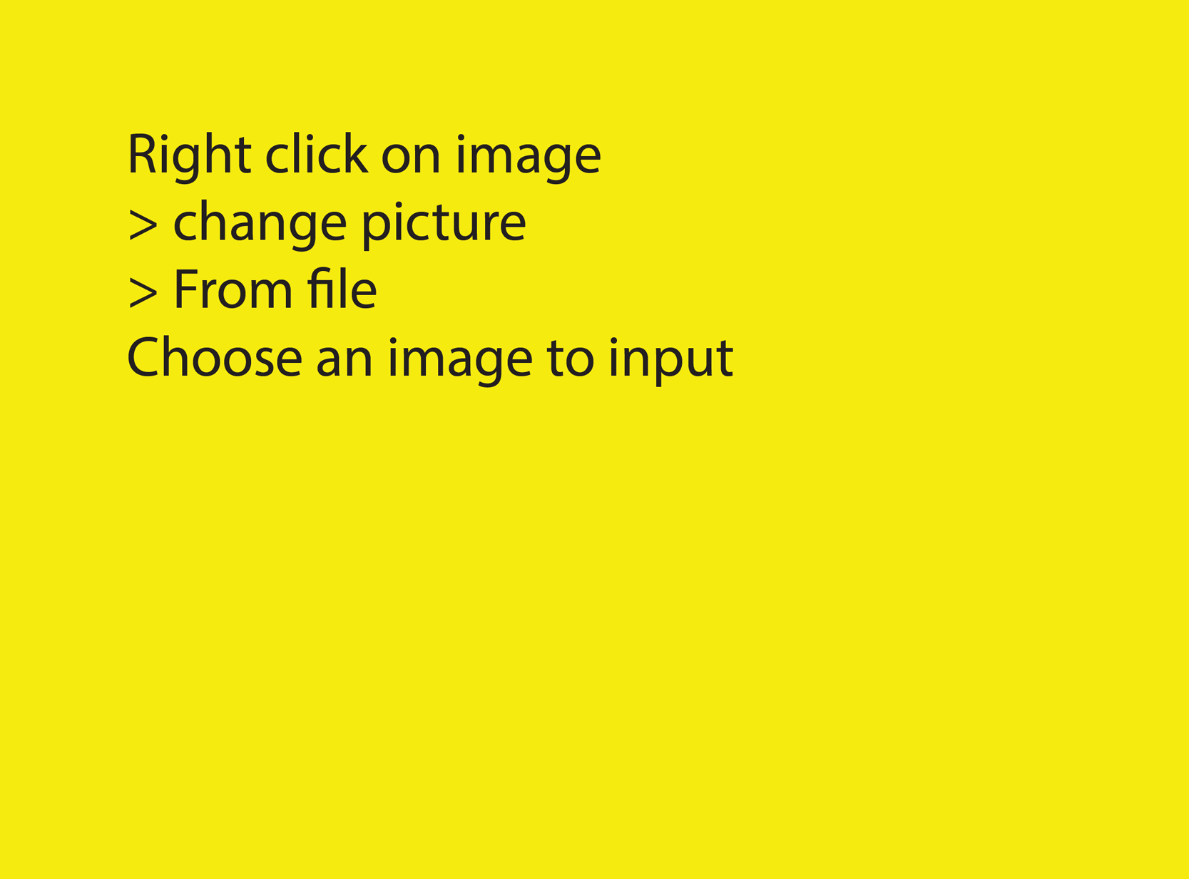
Bubble Breathing

Slide 17
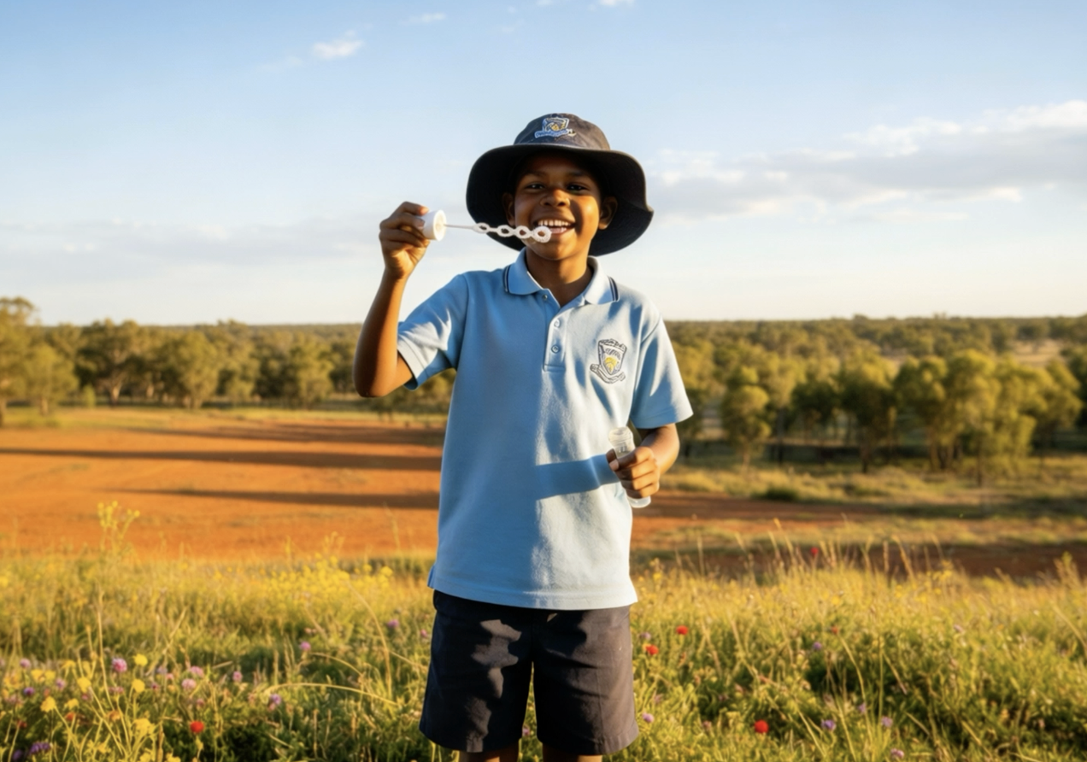
We can use Bubble Breathing to help us feel calmer when we have big feelings.

Slide 18
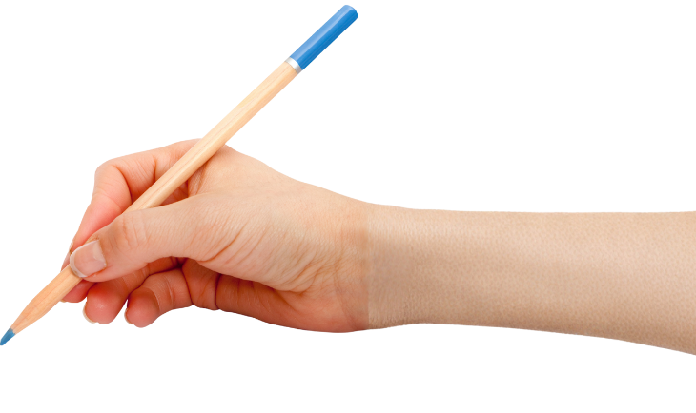

How well did you:
do a slow, calming Bubble Breath
name a time when you could use the strategy?

Slide 19
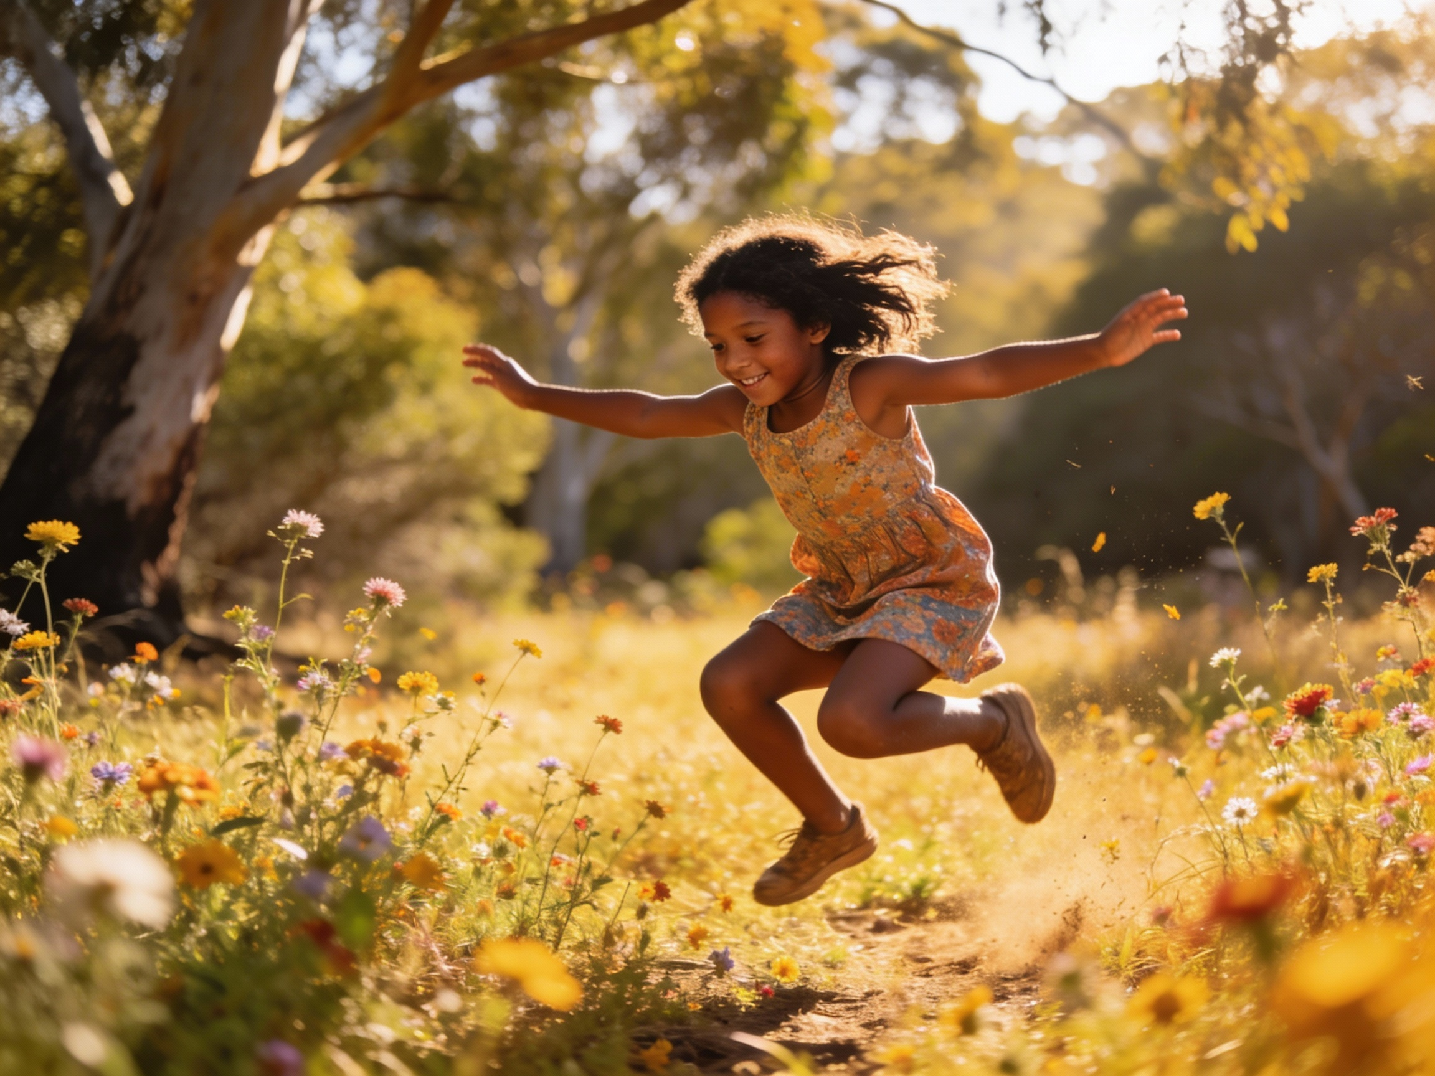
In the next lesson, we will explore how moving our body can help us feel better when we’re upset.

