Slide 1
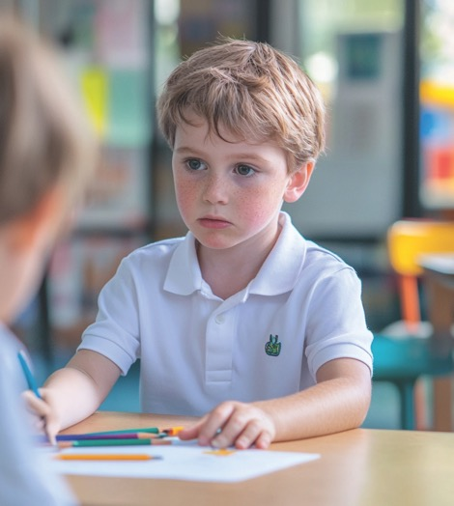
Listening To My Feelings
Unit 2 Big Feelings, Smart Choices
Lesson 1

Slide 2

In this lesson, you will learn to recognise how strong emotions feel in your body and use a feelings scale to help you make smart choices.

Slide 3


You will be successful when you can:
rate your emotions using a scale
use the scale to decide when to use a calming strategy.

Slide 4
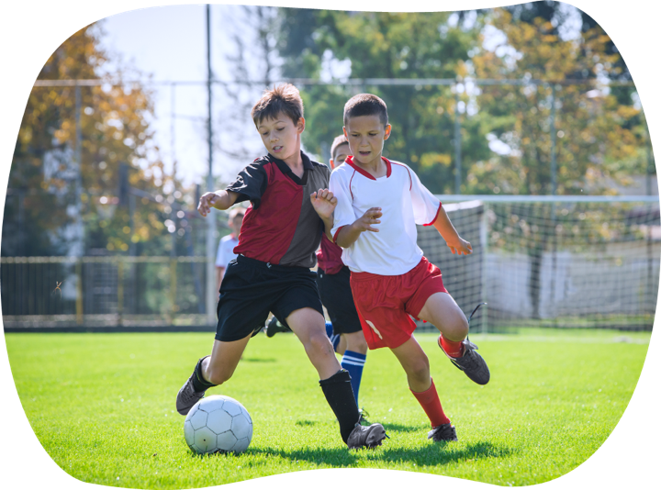

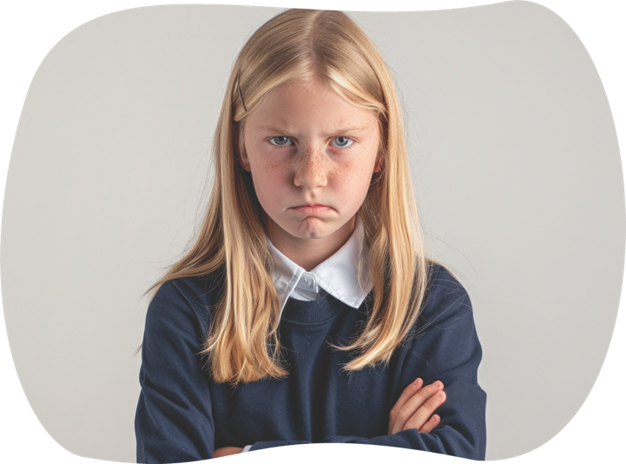

Slide 5
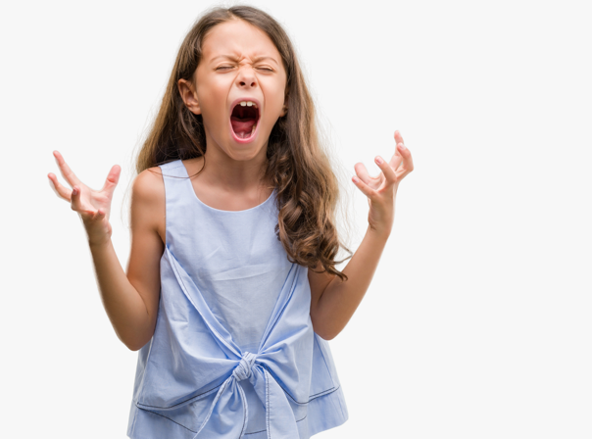

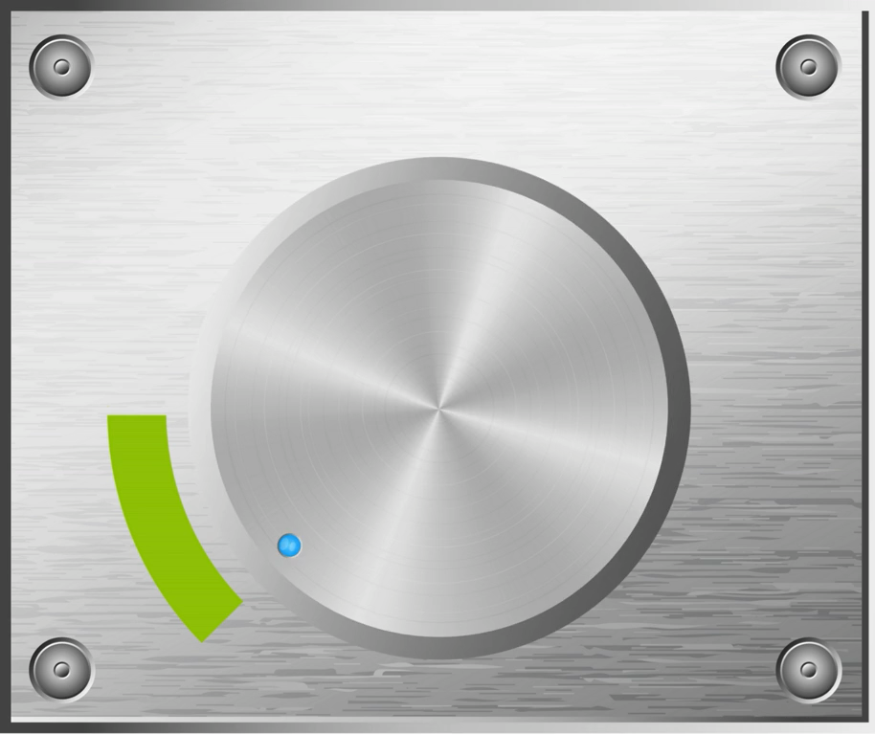
What’s The Volume?
Sometimes, I feel calm and relaxed. At other times, everything inside me feels really loud.

Slide 6



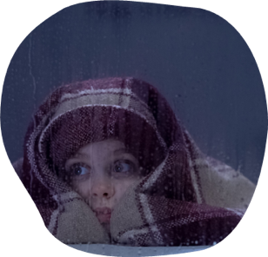
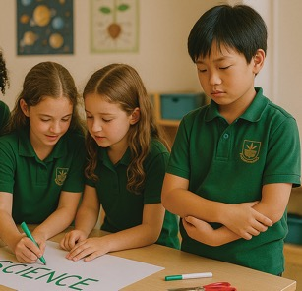
What’s The Volume?
Pay attention!
This matters right now!

Slide 7
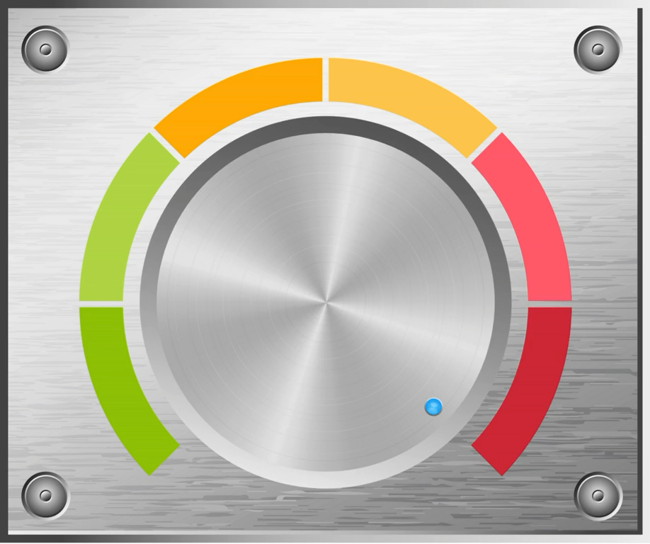
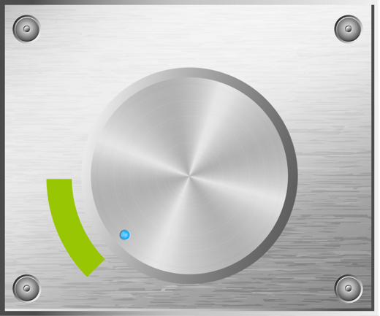

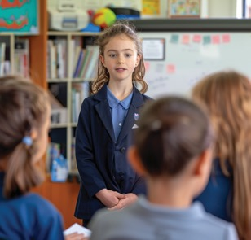
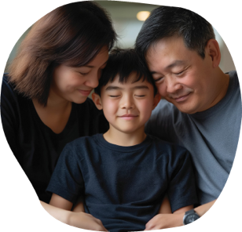

What’s The Volume?
Things feel
okay right now.

Slide 8

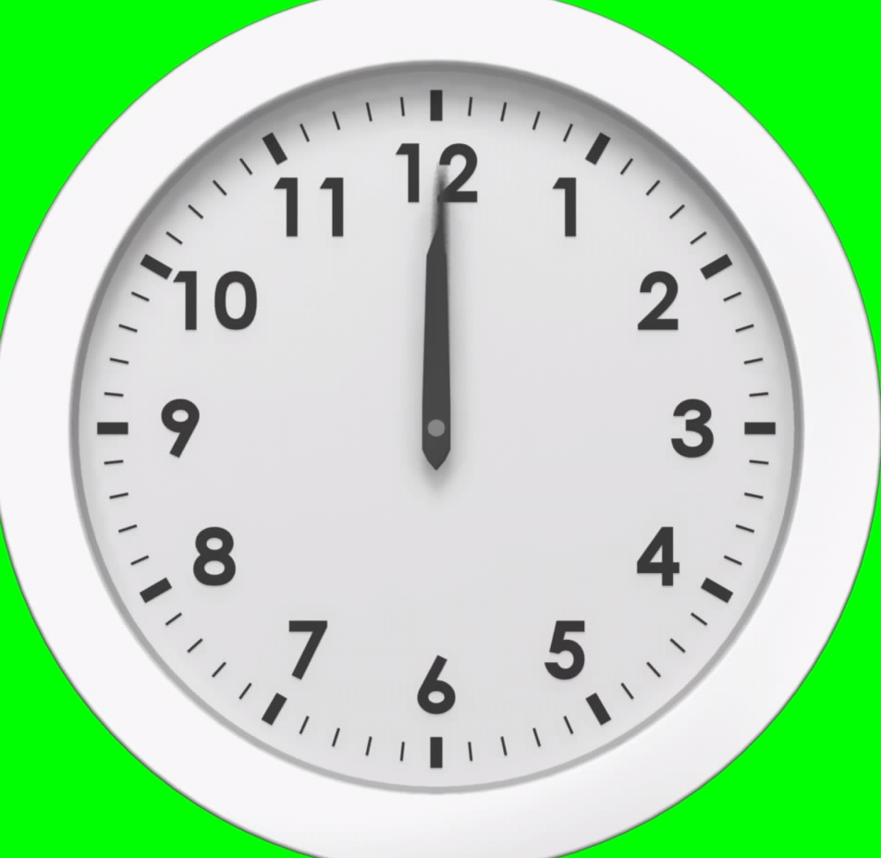

What’s The Volume?

Slide 9

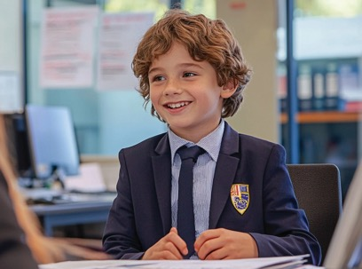
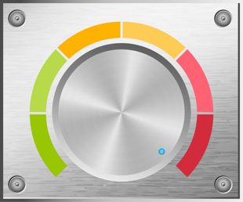
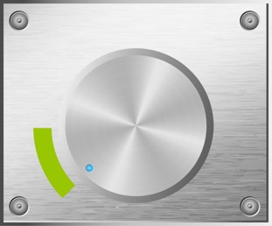
Different People, Different Volumes
The volume in our body isn’t the same for everyone. What feels really loud for me might only turn the volume up a little for someone else.
Same classroom. Same task. Different volume.

Slide 10
Same Place, Time and Situation
Two people can be in the same place, at the same time, experiencing the same situation and still feel very different inside, and so their volumes will be different.
agree
disagree

Slide 11


Slide 12
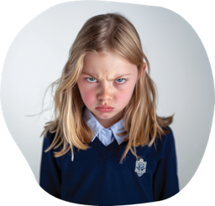
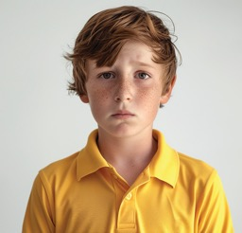
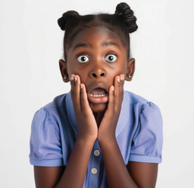
Listen To Your Volume

Slide 13
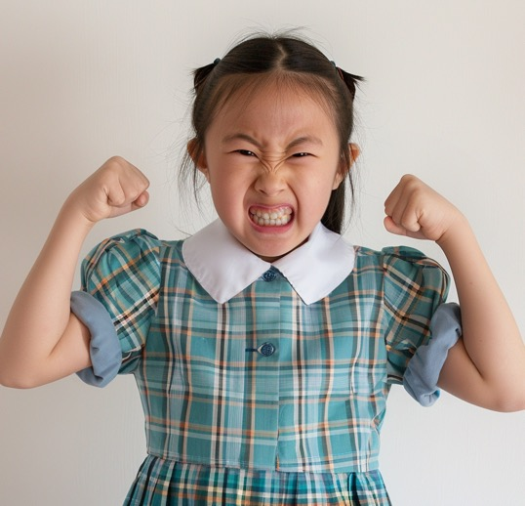
Listen To Your Volume

Slide 14

The Volume Of a Feeling
How does the scenario make me feel?
What is the volume of my feeling?
What are my body clues?
Do I need to lower the volume of my feeling with a calming strategy?
I feel a little nervous.
This feeling is quiet.
I have butterflies in my stomach.
I don’t need to lower the volume of the feeling.
I feel frustrated.
This feeling is quite loud.
My heart is beating fast and my lips are pressed together.
I need to lower the volume of the feeling.

Slide 15



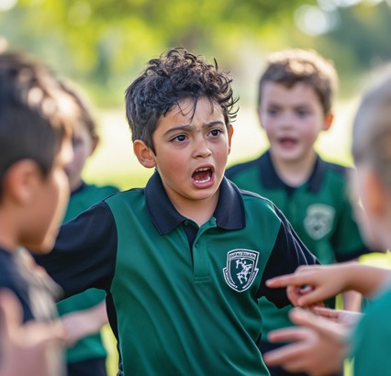

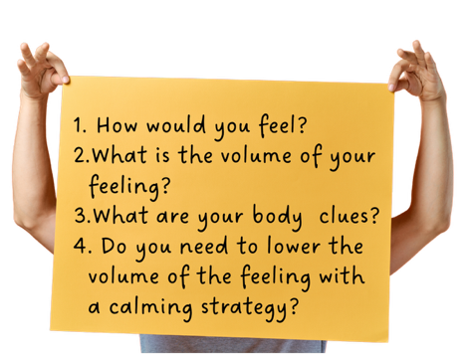
What’s the Volume?
Quiet volume
Middle volume
Loud volume

Slide 16

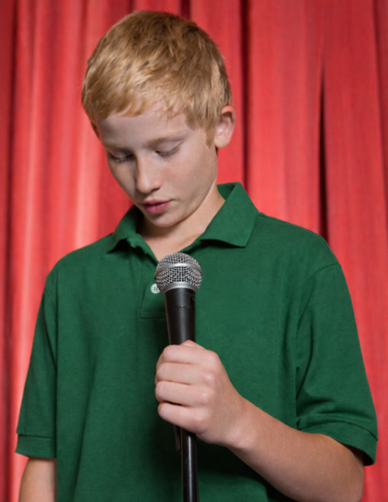
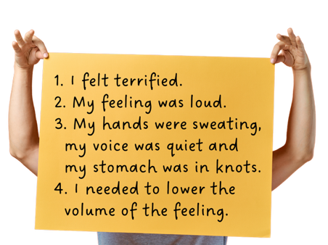
My Feeling Volume

Slide 17

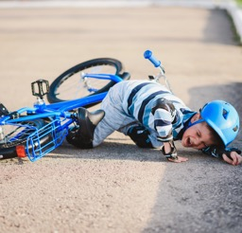
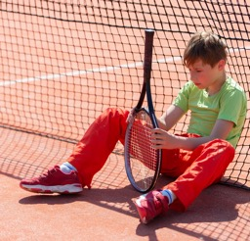
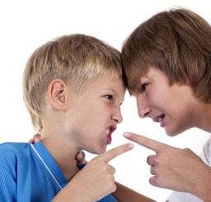


Our Feeling Volume
When was your feeling volume loud?
What happened?
What did you feel?
What were the clues from your body?

Slide 18



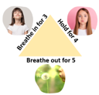


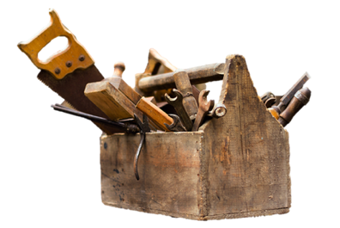

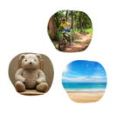


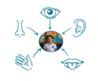
Smell a Flower,
Blow a Candle
Deep
Breathing
Talk to
Trusted
Adult
Visualisation
Stretching
Wall
Pushes
I can do it!
Positive
Self-Talk
5, 4, 3, 2, 1
Grounding

Slide 19
Our body has a sort of volume button like the volume button on a tablet or TV remote.
The volume goes up and down, louder and quieter, depending on what’s happening around us and what we feel inside.
Two people can be in the same place, at the same time, experiencing the same situation and still feel very different inside. Their volumes will be different.

Slide 20
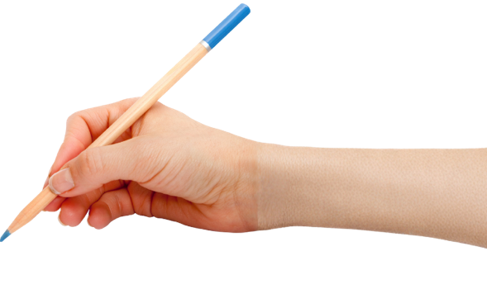



How well did you:
rate your emotions using a scale
use the scale to decide when to use a calming strategy?

Slide 21
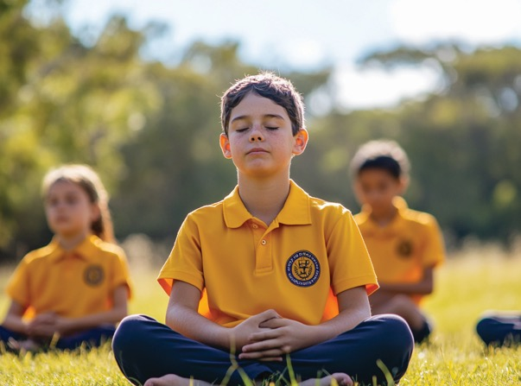
In the next lesson, we will learn how to use visualisation to feel calm and ready before we act.

