Slide 1
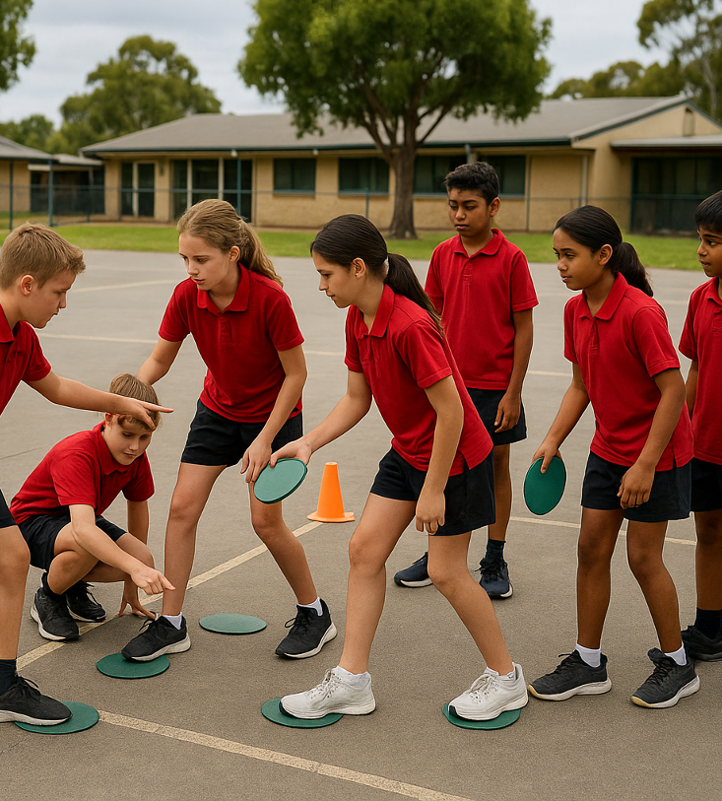
Cross the River
Unit 2: Big Feelings, Smart Choices
Lesson 2,
Lesson 5 (Extension)

Slide 2

Lesson 2

Slide 3
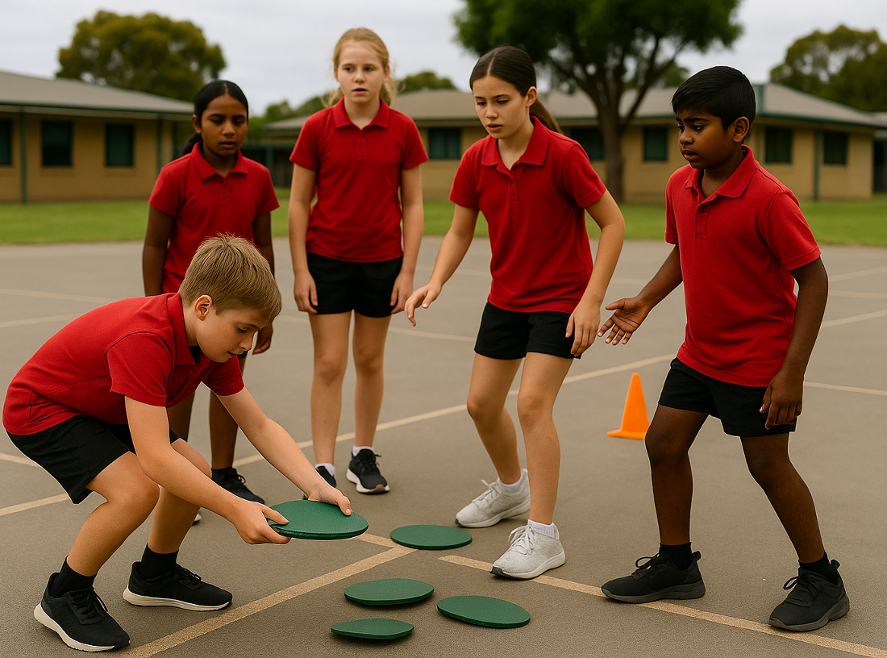
You will understand how to respond when faced with problems outside your control.

Slide 4






Slide 6

Lesson 5

Slide 7
You will learn how to solve problems with others using respectful conversation.

