Slide 1

Line Challenge
Unit 2: Big Feelings, Smart Choices
Lesson 1
Lesson 6 (Extension 1)

Slide 2
Lesson 1

Slide 3
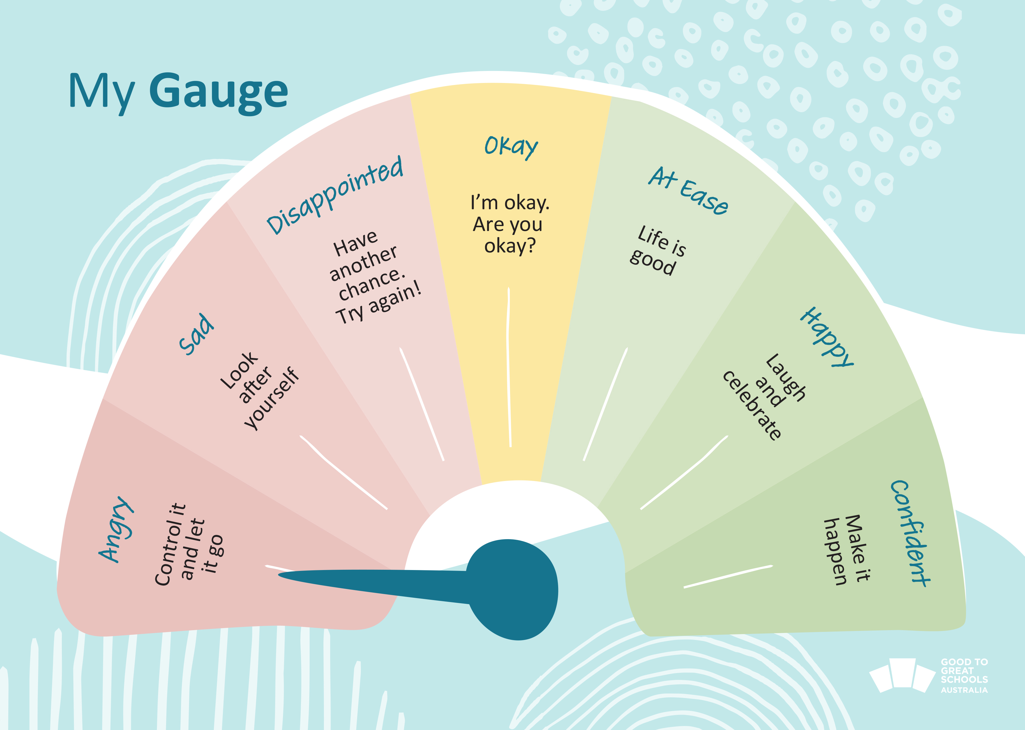
You will use a personal gauge to show how strong your feelings are.

Slide 4







Slide 5
x

Slide 6
x

Slide 7

Lesson 6 (Extension)

Slide 8

You will practise breathing to help your body feel calm and in control during the game.

