Slide 1
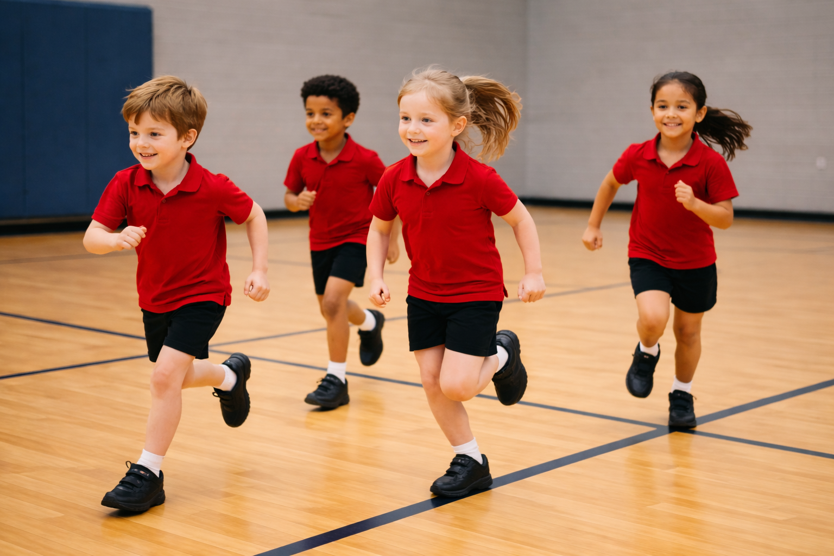
Red Light, Green Light
Unit 2: Big Feelings, Smart Choices
Lesson 2
Lesson 4 (Extension 1)

Slide 2
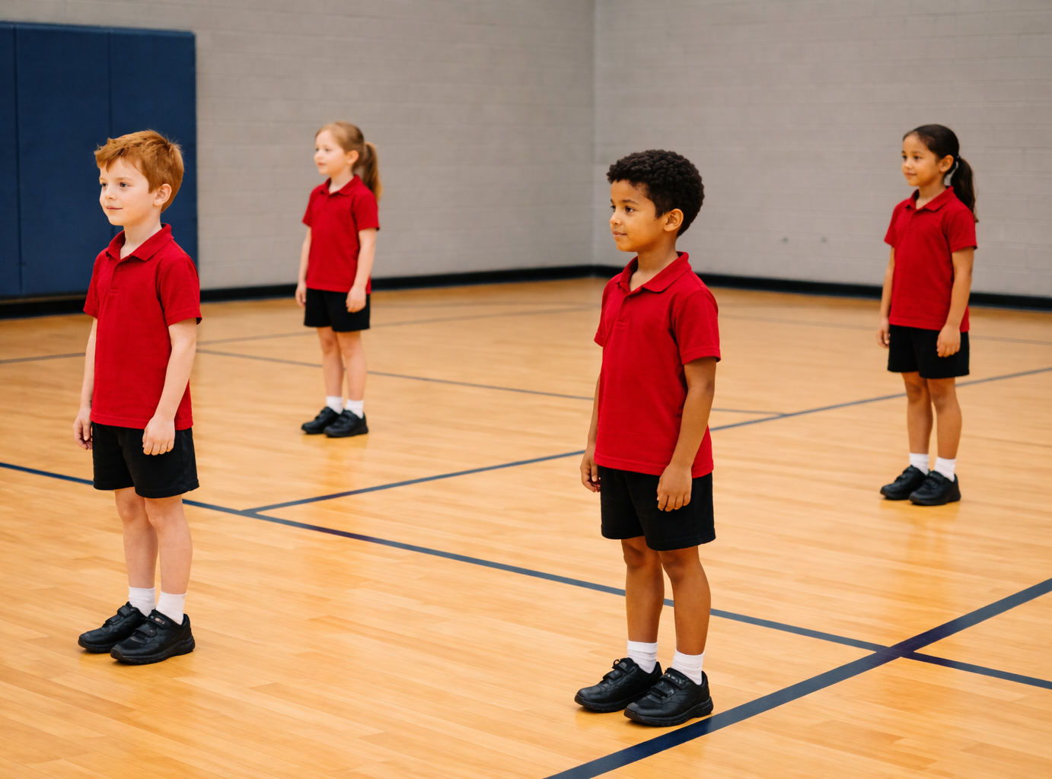
Lesson 2

Slide 3
You will notice what your body does when you feel upset.

Slide 4

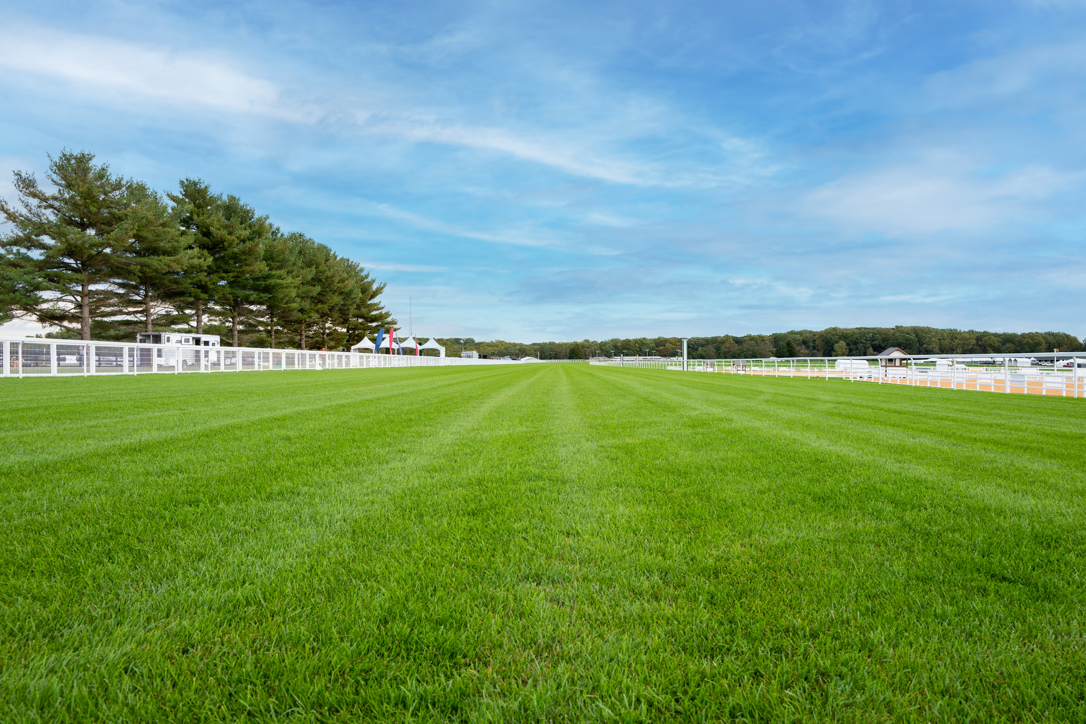







Slide 6
Lesson 4 (Extension)

Slide 7
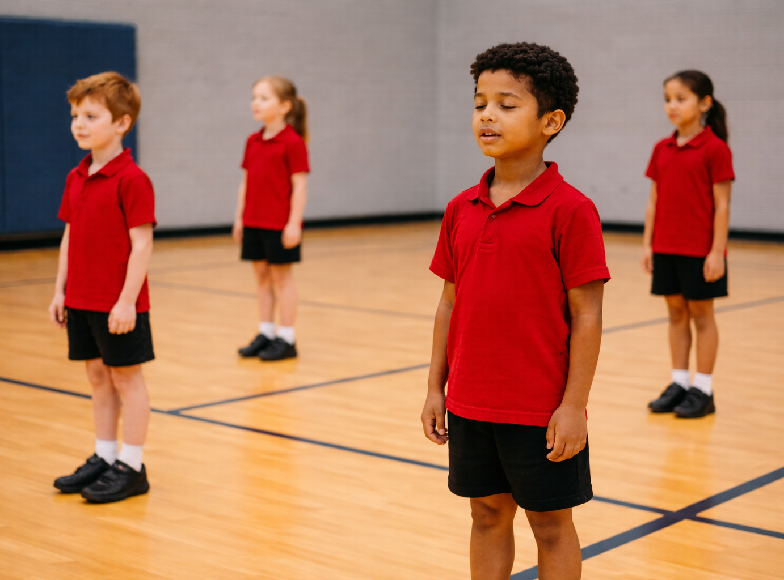
You will try calming strategies to help you feel better when you are upset.

