Slide 1
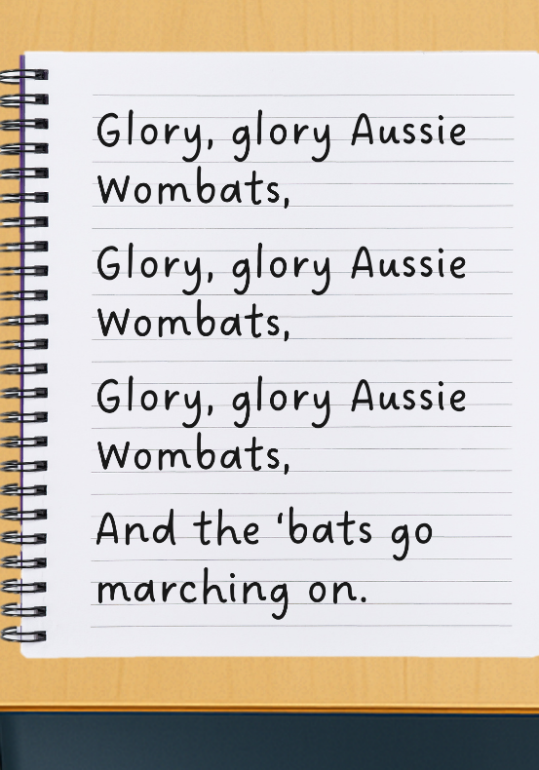
Music in Sport
Lesson 2
Team Anthem Lyrics
Unit 2 Version 3

Slide 2




Revise
Exit Ticket
Lesson 1
Songs that are played to represent different countries are called national ___________.
One purpose of music in sports is to:
hide the sound of the crowds
distract people from the game
motivate the athletes.
Melody is another word for a tune. Music that supports the melody is called an a_________________.
anthems
identity
anthems
parties
ccompaniment

Slide 3
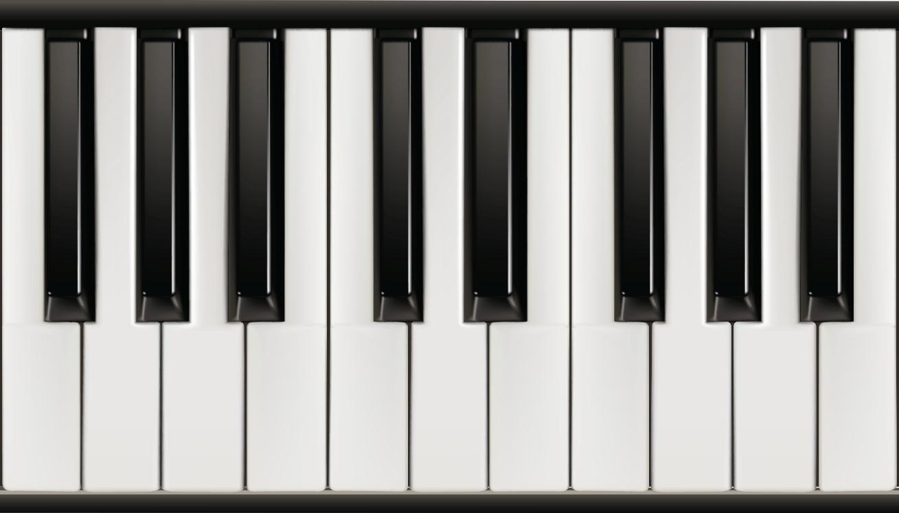

We can play accompaniments on the keyboard.
Label with numbers
MOVE RIGHT
Label with letters
MOVE LEFT
3
C
4
D
B
2
5
E
1
A

Slide 4




In this lesson, we will create lyrics for our own team anthem. ​
Glory, glory Aussie Wombats,
Glory, glory Aussie Wombats,
Glory, glory Aussie Wombats,
And the ‘bats go marching on.

Slide 5
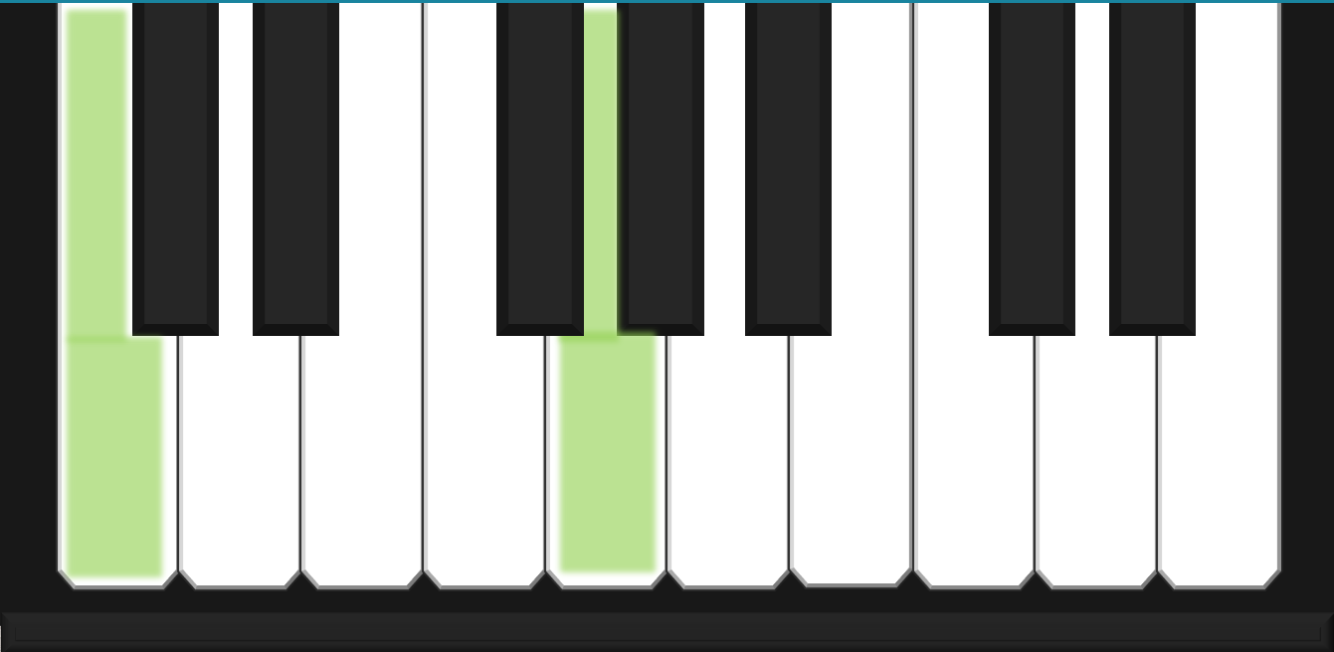
You will be successful when you can:
two-note chords on the keyboard
lyrics for a team anthem.
play
Play: To make a musical sound on your instrument.
create
Create: To make something new using your own ideas.

Slide 6


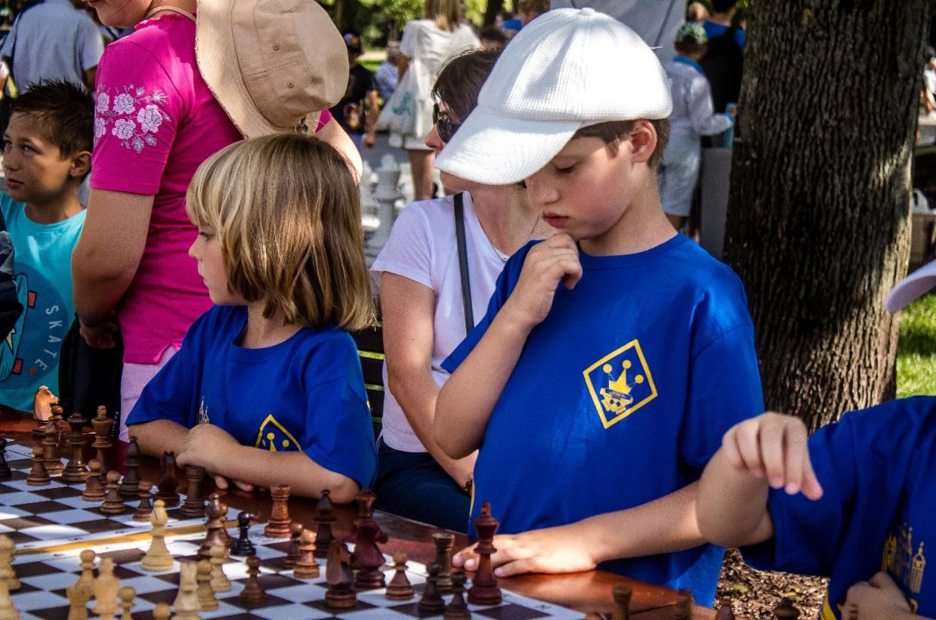


Slide 7








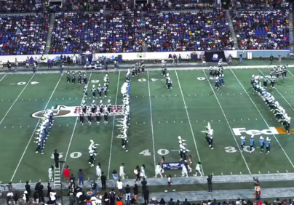





Purpose of Music in Sports

Slide 8


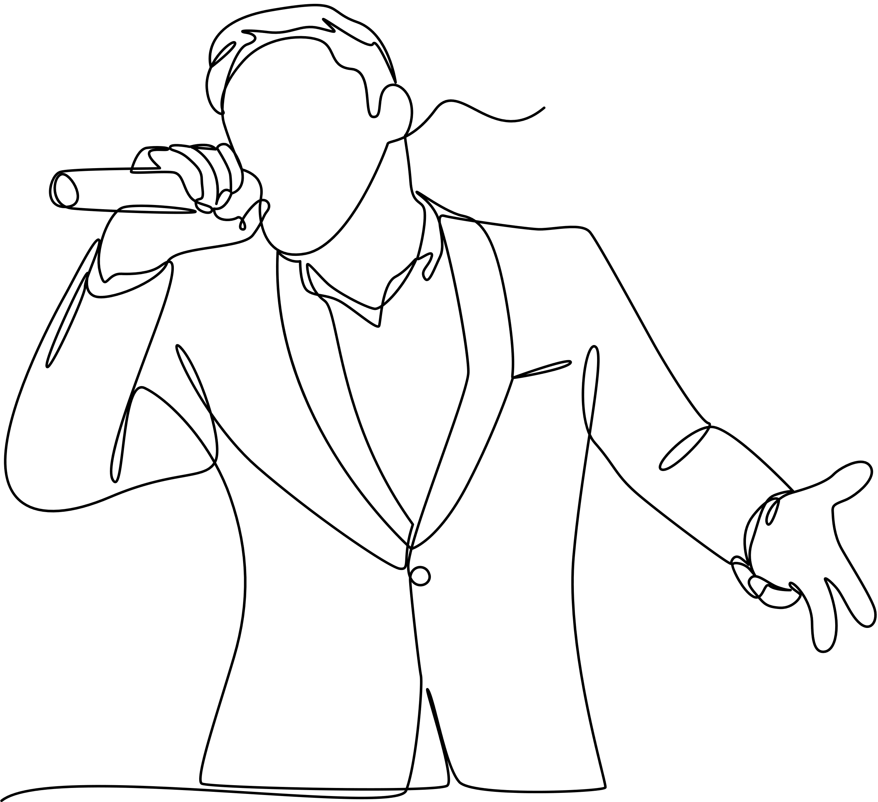

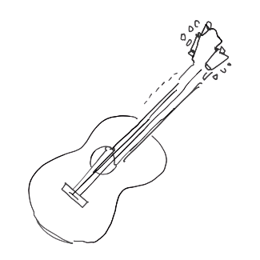
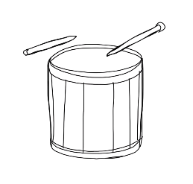
Melody - the part of the music that you sing along to.
Accompaniment - the music that supports the melody.

Slide 9
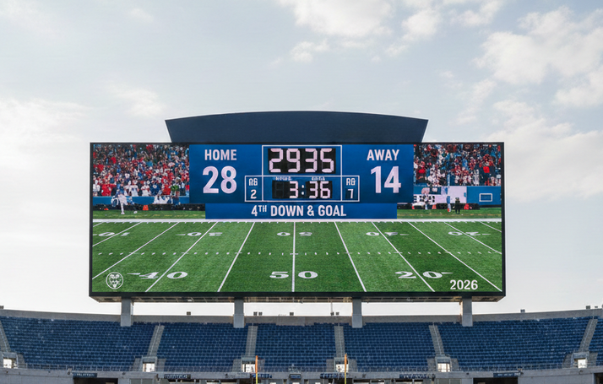

Keyboard Skills: Finding the Notes

Slide 10
Keyboard Skills: Two-Note Chords

Slide 11

I Do/We Do:
Two-Note Chords
VIRTUOSITY
C D E F G
5
1

Slide 12
I Do/We Do:
Two-Note Chords
VIRTUOSITY
3
C D E F G
1

Slide 13

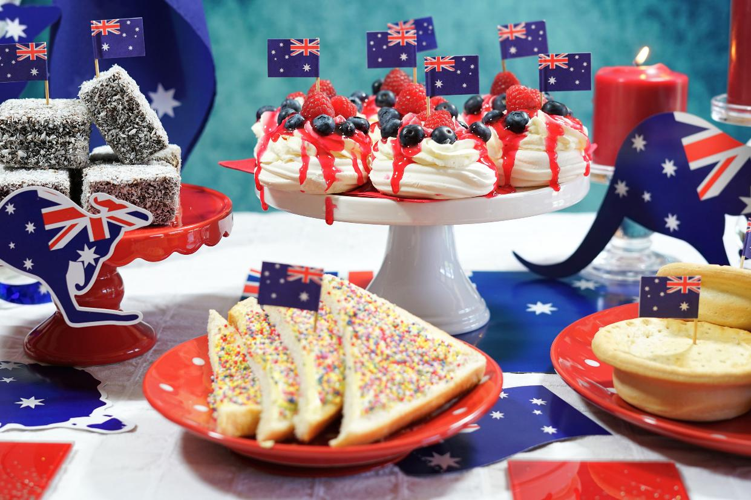
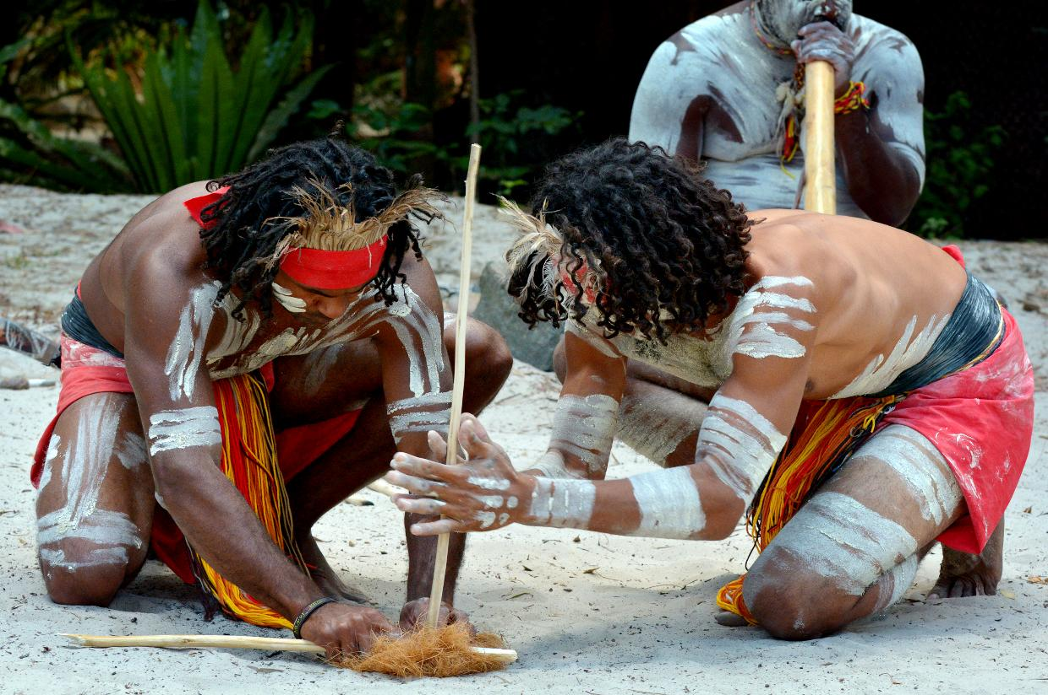
Identity

Slide 14
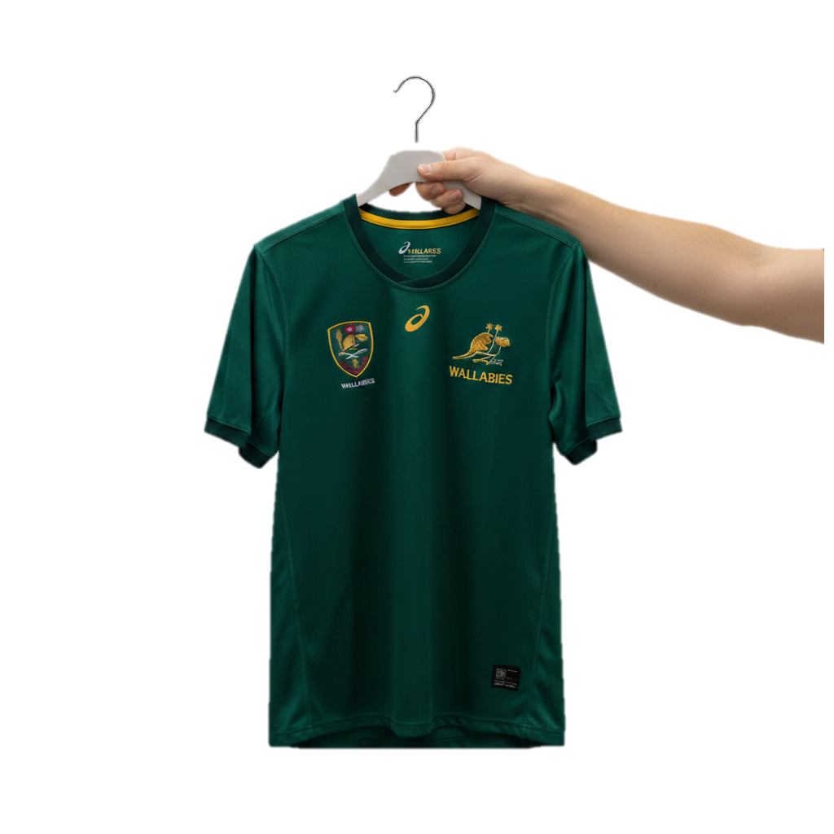

Sports Teams’ Identity

Slide 15

Soccer Anthem Lyrics

Slide 16

Soccer Anthem Lyrics

Slide 17
Soccer Anthem Lyrics

Slide 18

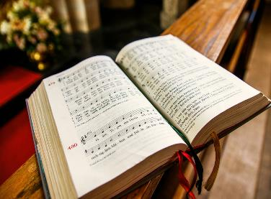

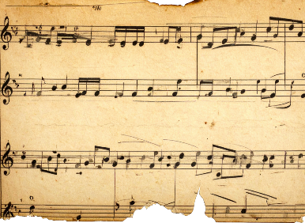
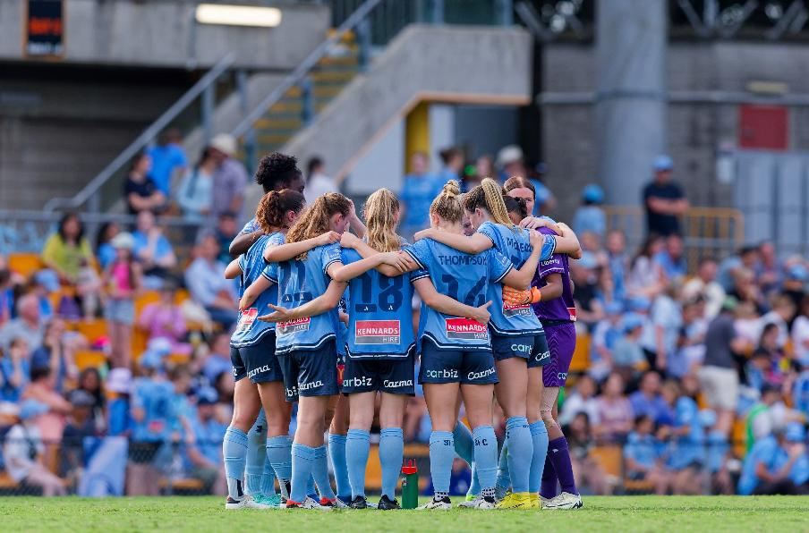
Inspiration For Sports Anthems
Glory, glory Tottenham Hotspurs,
Glory, glory Tottenham Hotspurs,
Glory, glory Tottenham Hotspurs,
And the spurs go marching on.
Glory, glory Man United,
Glory, glory Man United,
Glory, glory Man United,
As the reds go marching on.

Slide 19

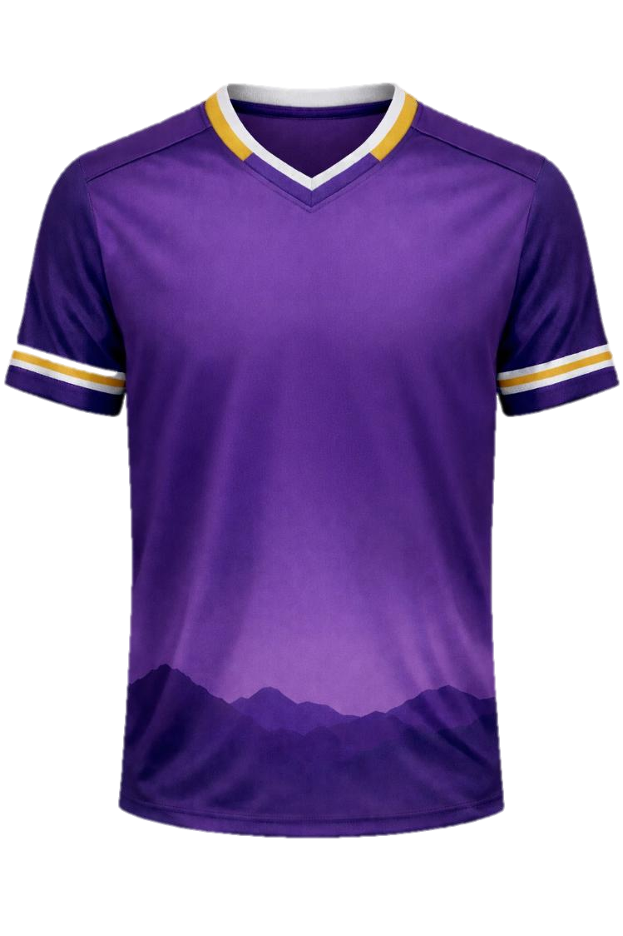
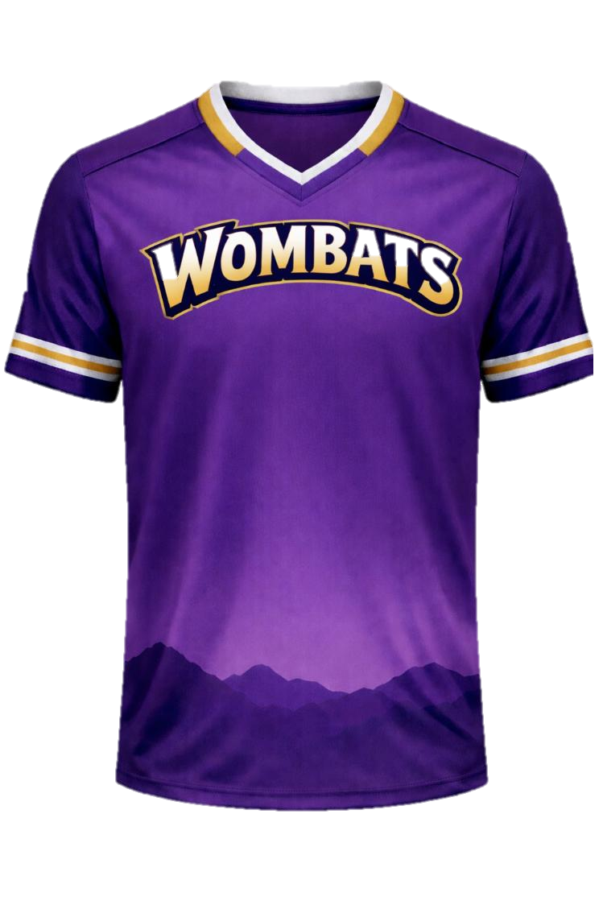

Creating Team Anthem Lyrics

Slide 20
Lesson 2
Date: _________
You Do: Team Identity
Our team’s name is: ______________________
Our team’s colour is: _____________________
Our team’s fact or characteristic is:
______________________________________
______________________________________
Team Anthem Chorus:
Glory, glory _____________________________
Glory, glory _____________________________
Glory, glory _____________________________
And the __________________ go marching on.
You Do: Composition Lyrics

Slide 21

Soccer Anthem Structure
CHORUS:
Glory, glory Tottenham Hotspur,
Glory, glory Tottenham Hotspur,
Glory, glory Tottenham Hotspur,
And the Spurs go marching on.
VERSE:
Tottenham are the greatest team the world has ever seen,
Tottenham are the greatest team the world has ever seen,
Tottenham are the greatest team the world has ever seen,
And the Spurs go marching on.

Slide 22
Glory, glory Aussie Wombats,
Glory, glory Aussie Wombats,
Glory, glory Aussie Wombats,
And the ‘bats go marching on.

Slide 23
Lesson 2
Date: _________
You Do: Team Identity
Our team’s name is: ______________________
Our team’s colour is: _____________________
Our team’s fact or characteristic is:
______________________________________
______________________________________
Team Anthem Chorus:
Glory, glory _____________________________
Glory, glory _____________________________
Glory, glory _____________________________
And the __________________ go marching on.
You Do: Composition Lyrics

Slide 24

I Do:
Writing Lyrics to a Tune
VIRTUOSITY

Slide 25

Glory, glory Aussie Wombats,
Glory, glory Aussie Wombats,
Glory, glory Aussie Wombats,
And the ‘bats go marching on.
The
pur-
ple
Auss-
ie
Wom-
bats
are
de-
ter-
mined
to
suc-
ceed.

Slide 26
Creating Team Anthem Lyrics

Slide 27
Glory, glory Aussie Wombats,
Glory, glory Aussie Wombats,
Glory, glory Aussie Wombats,
And the ‘bats go marching on.
The purple Aussie Wombats
are determined to succeed.
The purple Aussie Wombats
are determined to succeed.
The purple Aussie Wombats
are determined to succeed.
And the ‘bats go marching on.

Slide 28
Lesson 2
Date: _________
You Do: Composition Planner
Team Anthem Verse:
Line 1: _______________________________
Line 2: _______________________________
Line 3: _______________________________
Line 4: _______________________________

Slide 29
When more than one note is played at the same time, it is called a chord.
Two-note chords can be played on the keyboard.
Soccer anthems have positive words or lyrics that tell us about the team.
Soccer anthems have a structure that uses a lot of repetition.
Glory, glory Aussie Wombats,
Glory, glory Aussie Wombats,
Glory, glory Aussie Wombats,
And the ‘bats go marching on.
The purple Aussie Wombats
are determined to succeed.
The purple Aussie Wombats
are determined to succeed.
The purple Aussie Wombats
are determined to succeed.
And the ‘bats go marching on.

Slide 30
Exit Ticket
Date: _________
Lesson 2
When I play more than one note at the same time, I am playing a ________.
The lyrics, or words, to soccer anthems are:
always different
positive and about the team
very complicated.
Soccer anthems have a structure that uses a lot of r___________.
chord
note
song
chord
epetition
3
I know _____ out of 3 answers.

Slide 31

In the next lesson, we will sing in harmony.

