Slide 1

Contemporary Indigenous Music
Lesson 1
What’s Contemporary Indigenous Music?
Version 3

Slide 2

In this lesson, we will learn about the characteristics of contemporary Indigenous music.

Slide 3

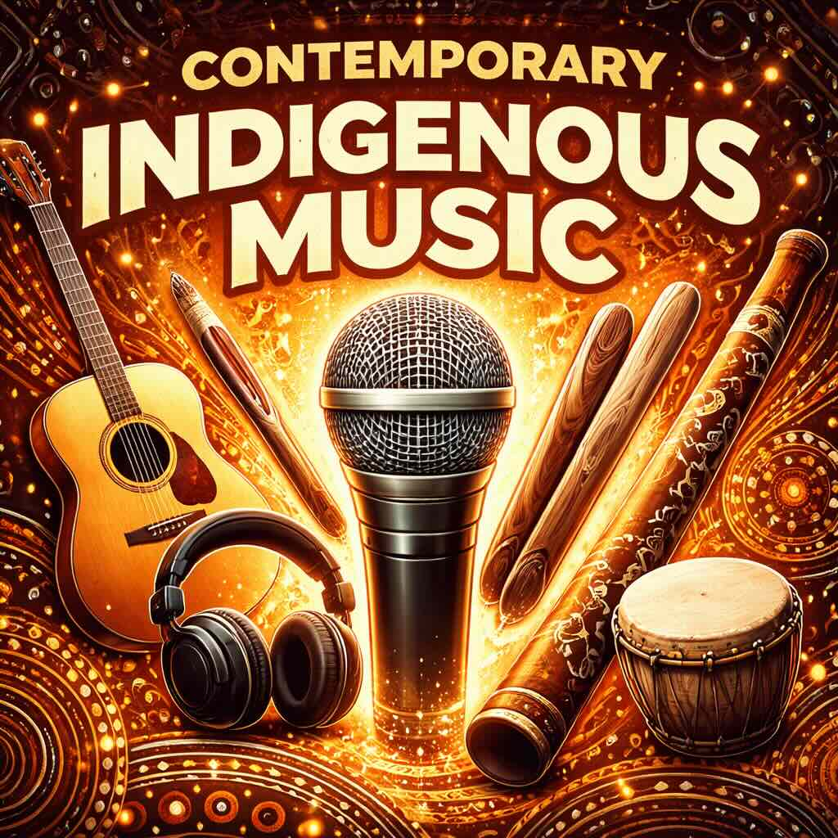
You will be able to: ​
identify the characteristics of contemporary Indigenous music.
Identify: To pick out or recognise something by noticing its important features.

Slide 4

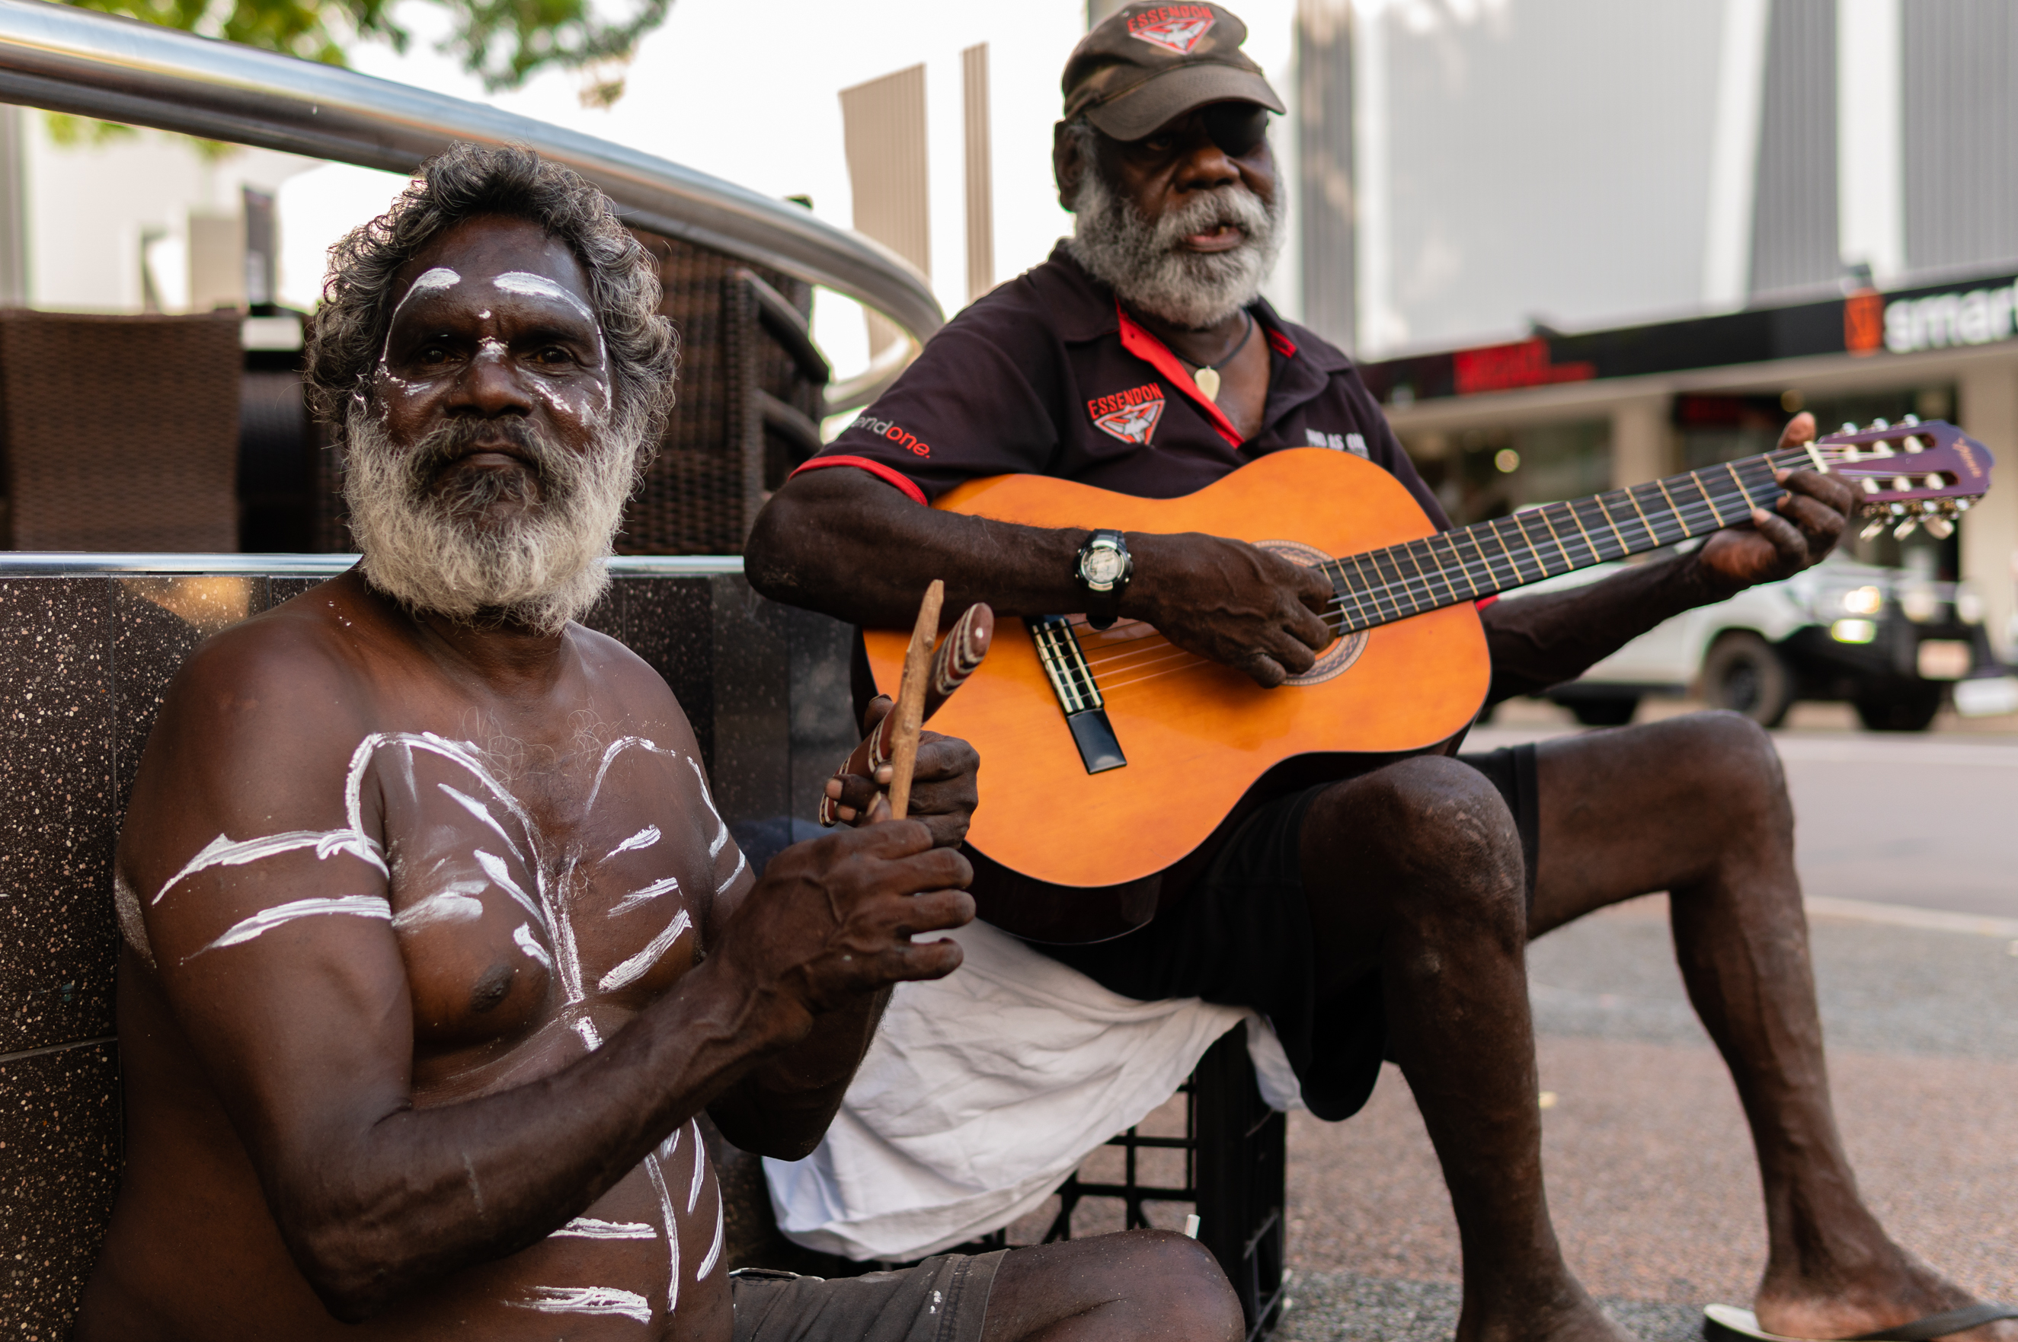
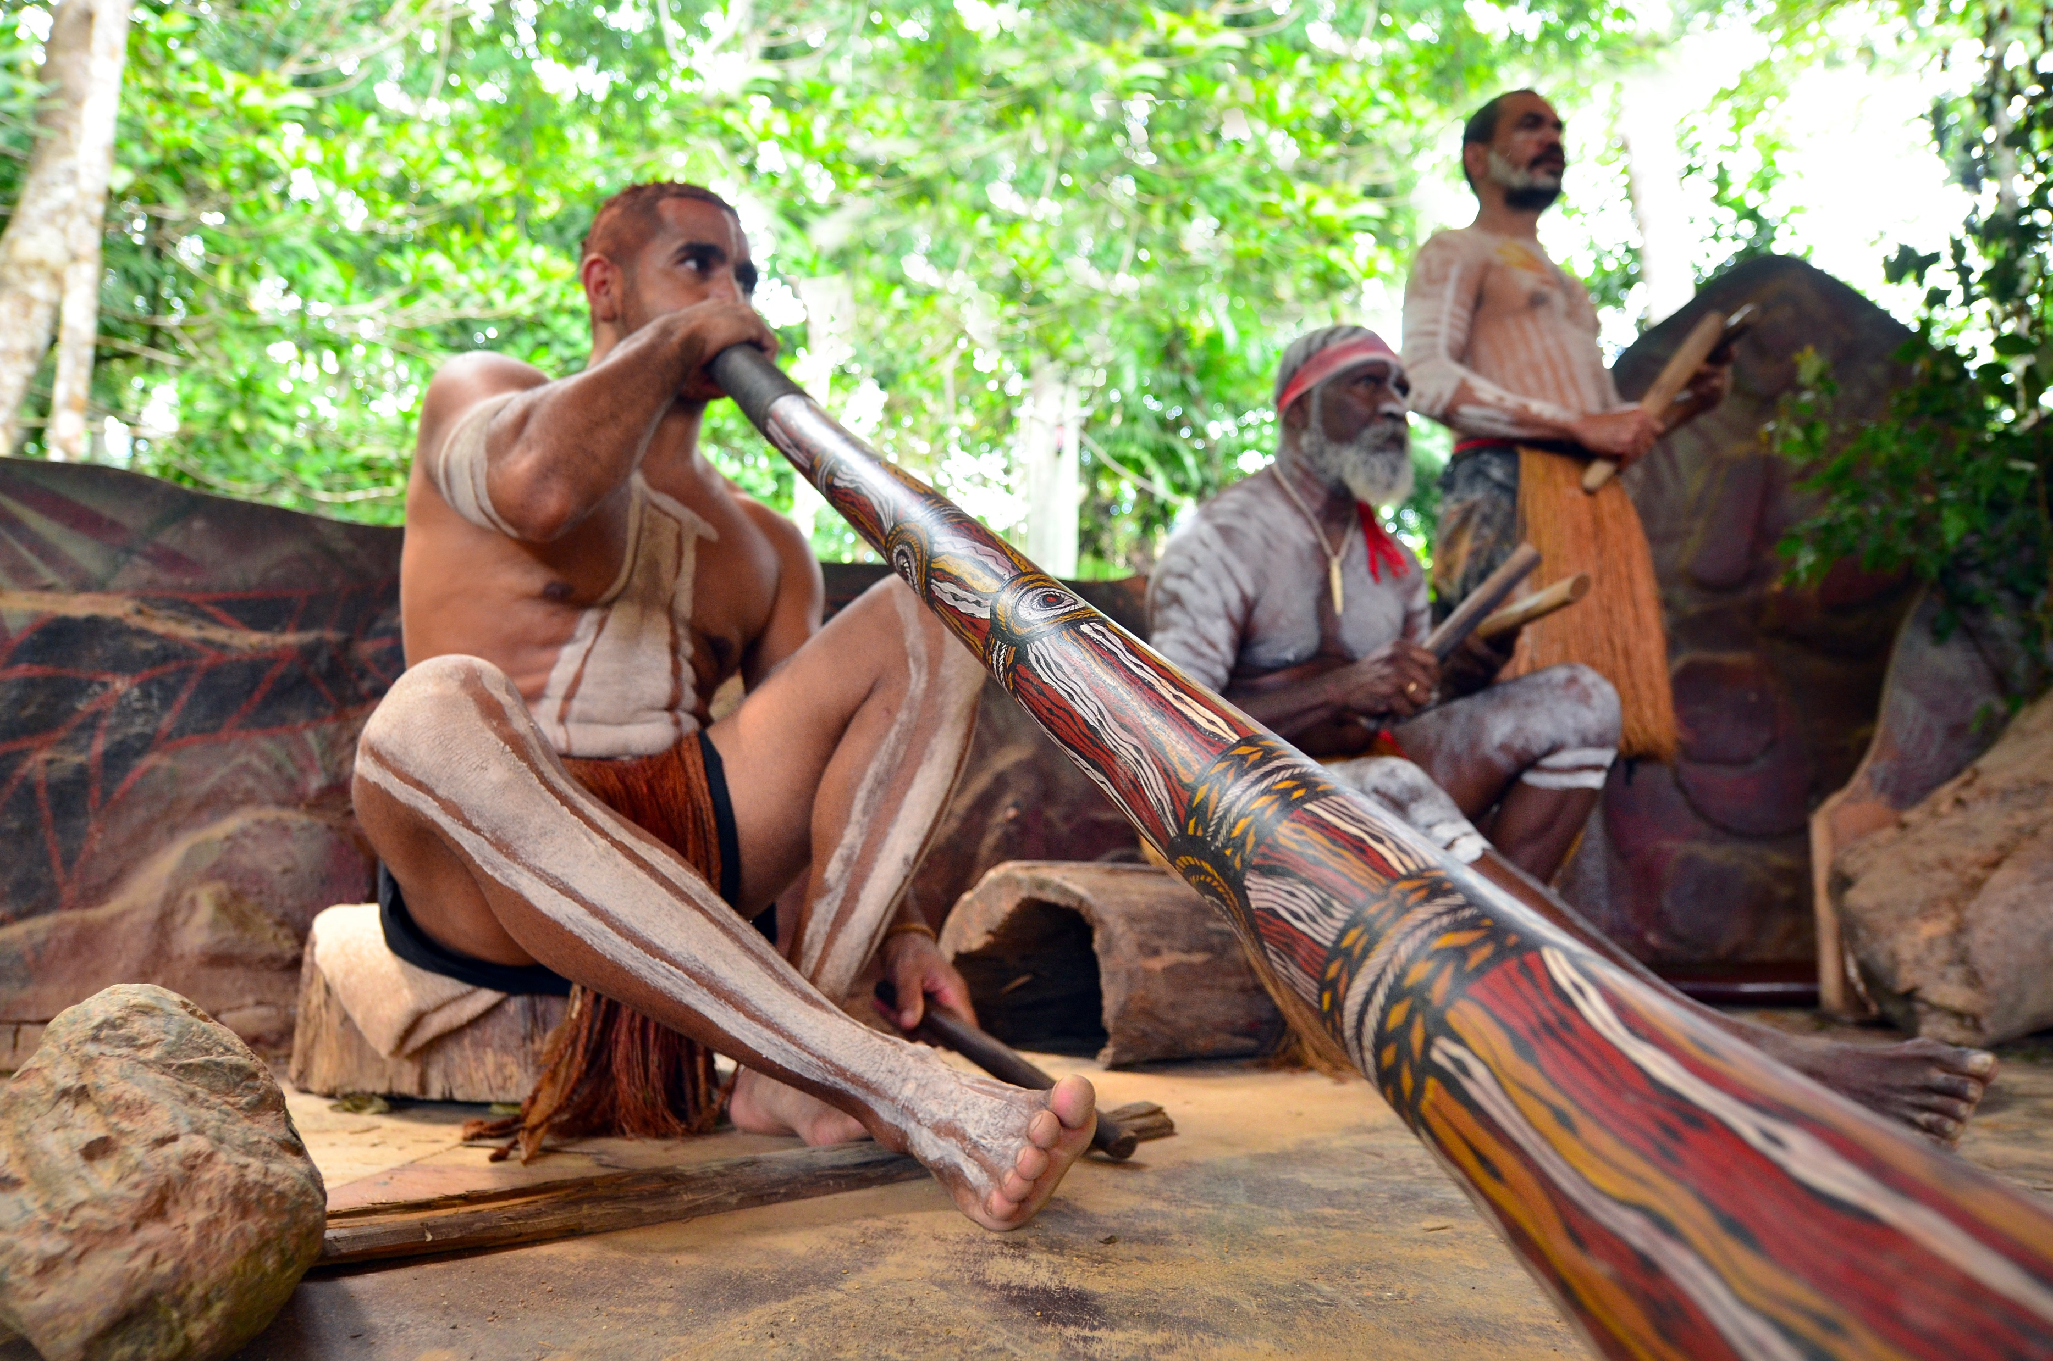

Slide 5


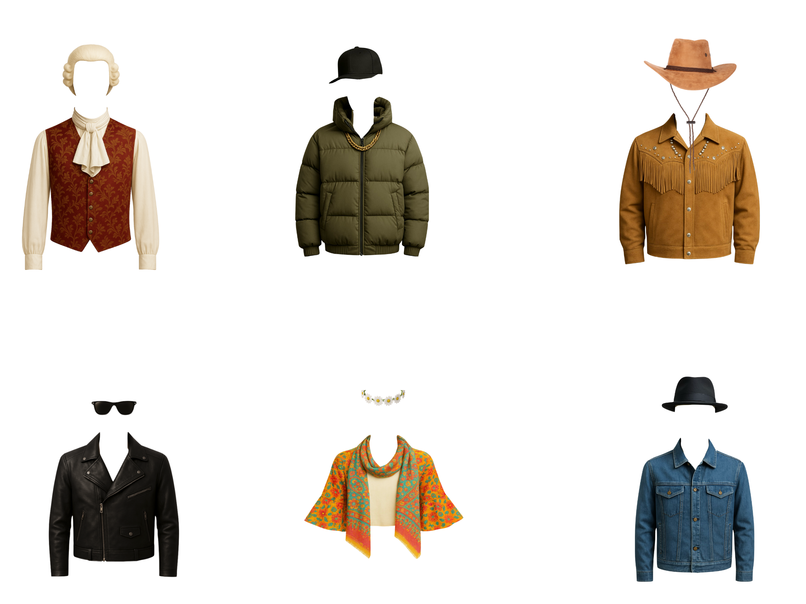

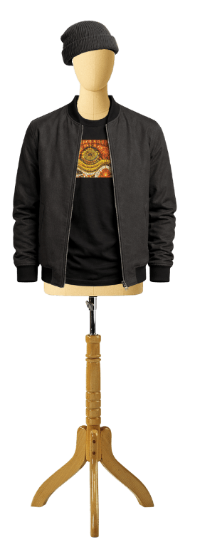

Music Genres

Slide 6

Unique Characteristics
traditional and modern instruments
Indigenous musicians
Indigenous languages and English
deeper meaning or message

Slide 7

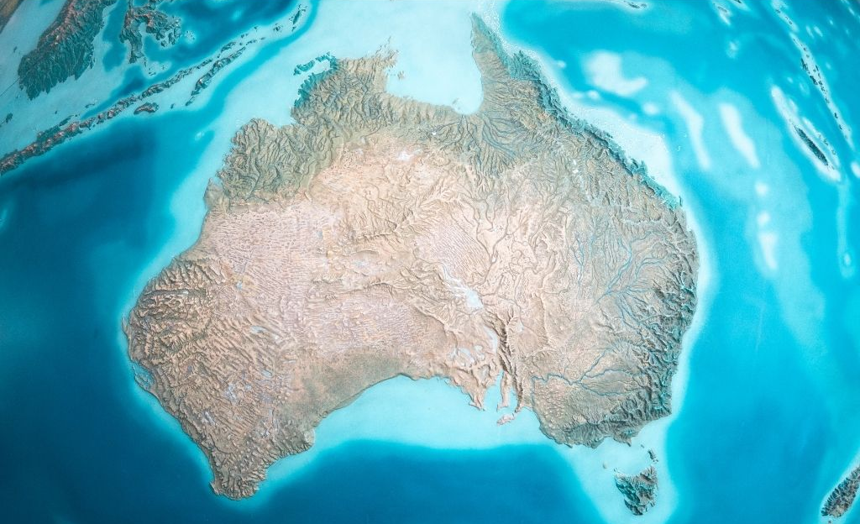


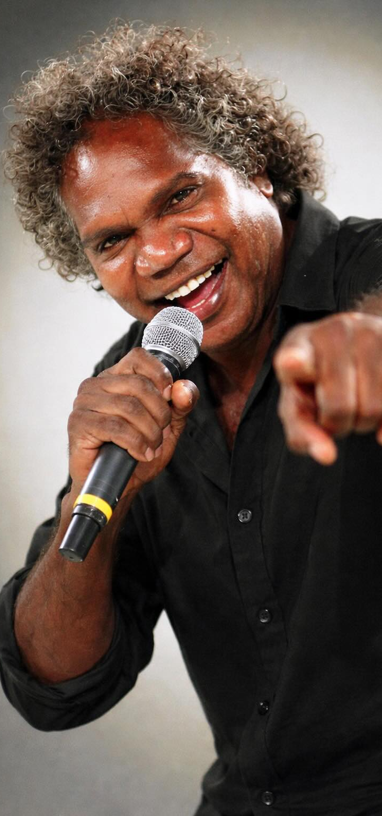
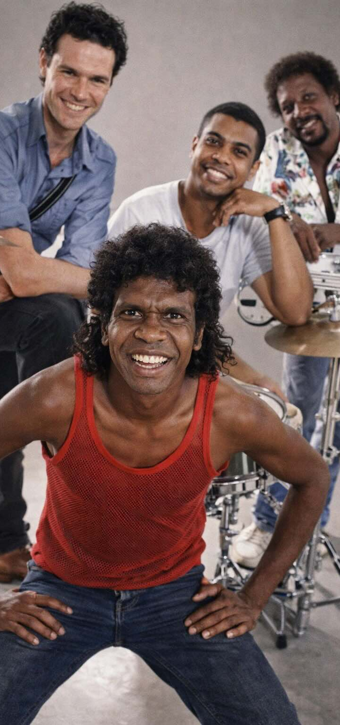

Indigenous Musicians

Slide 8


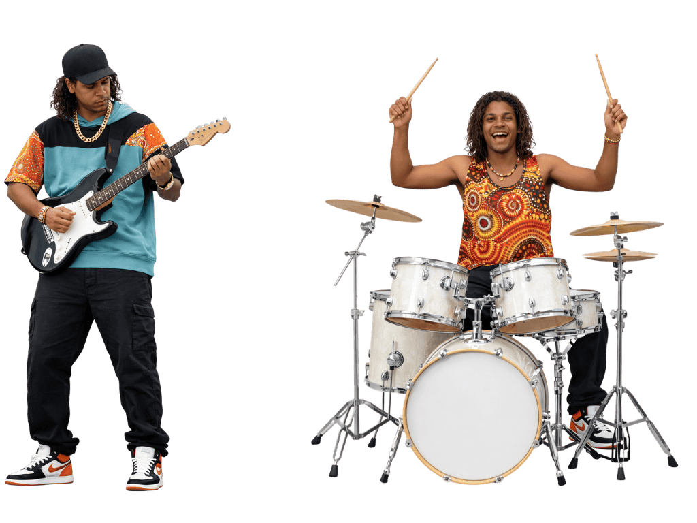
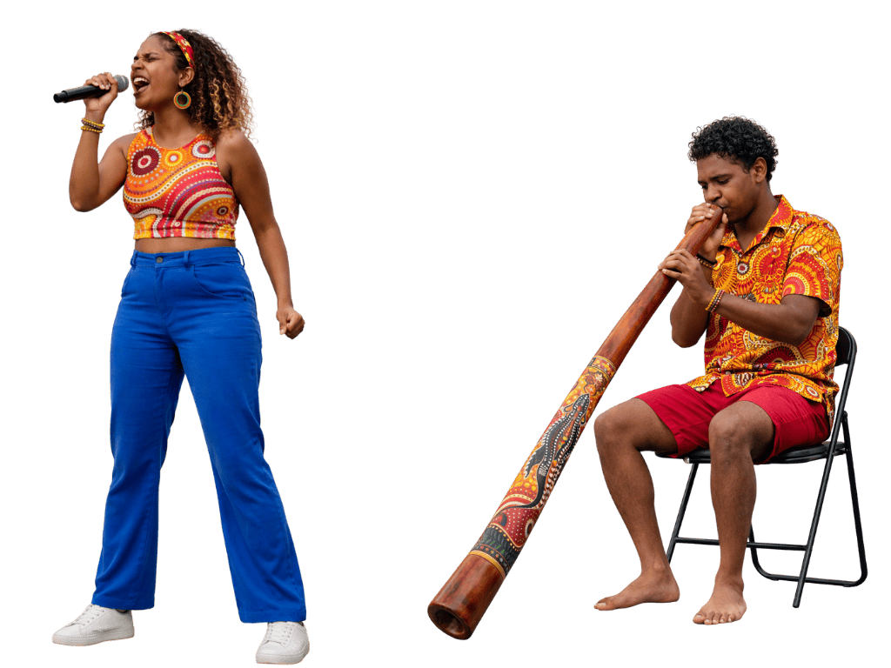
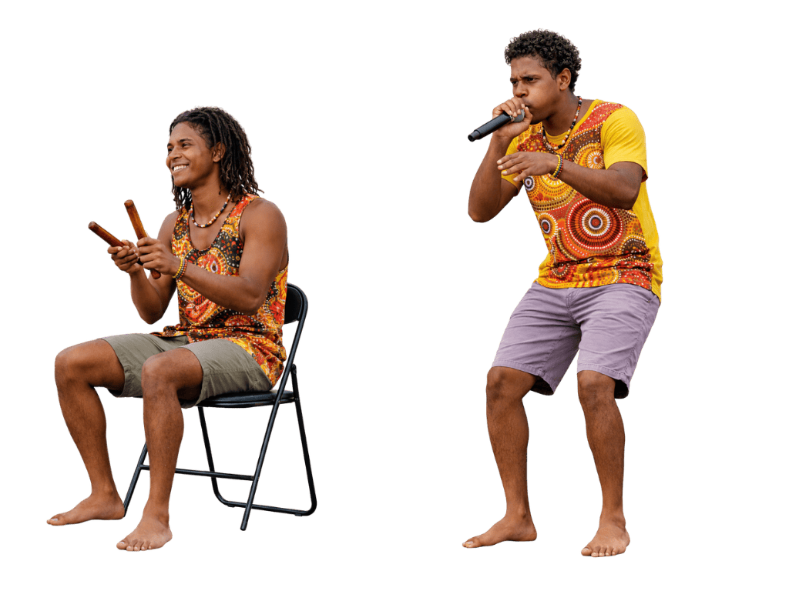

Slide 9
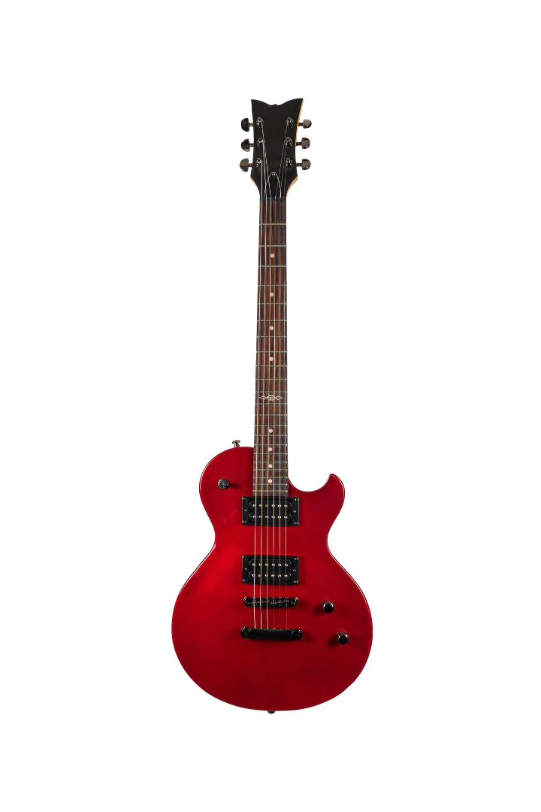
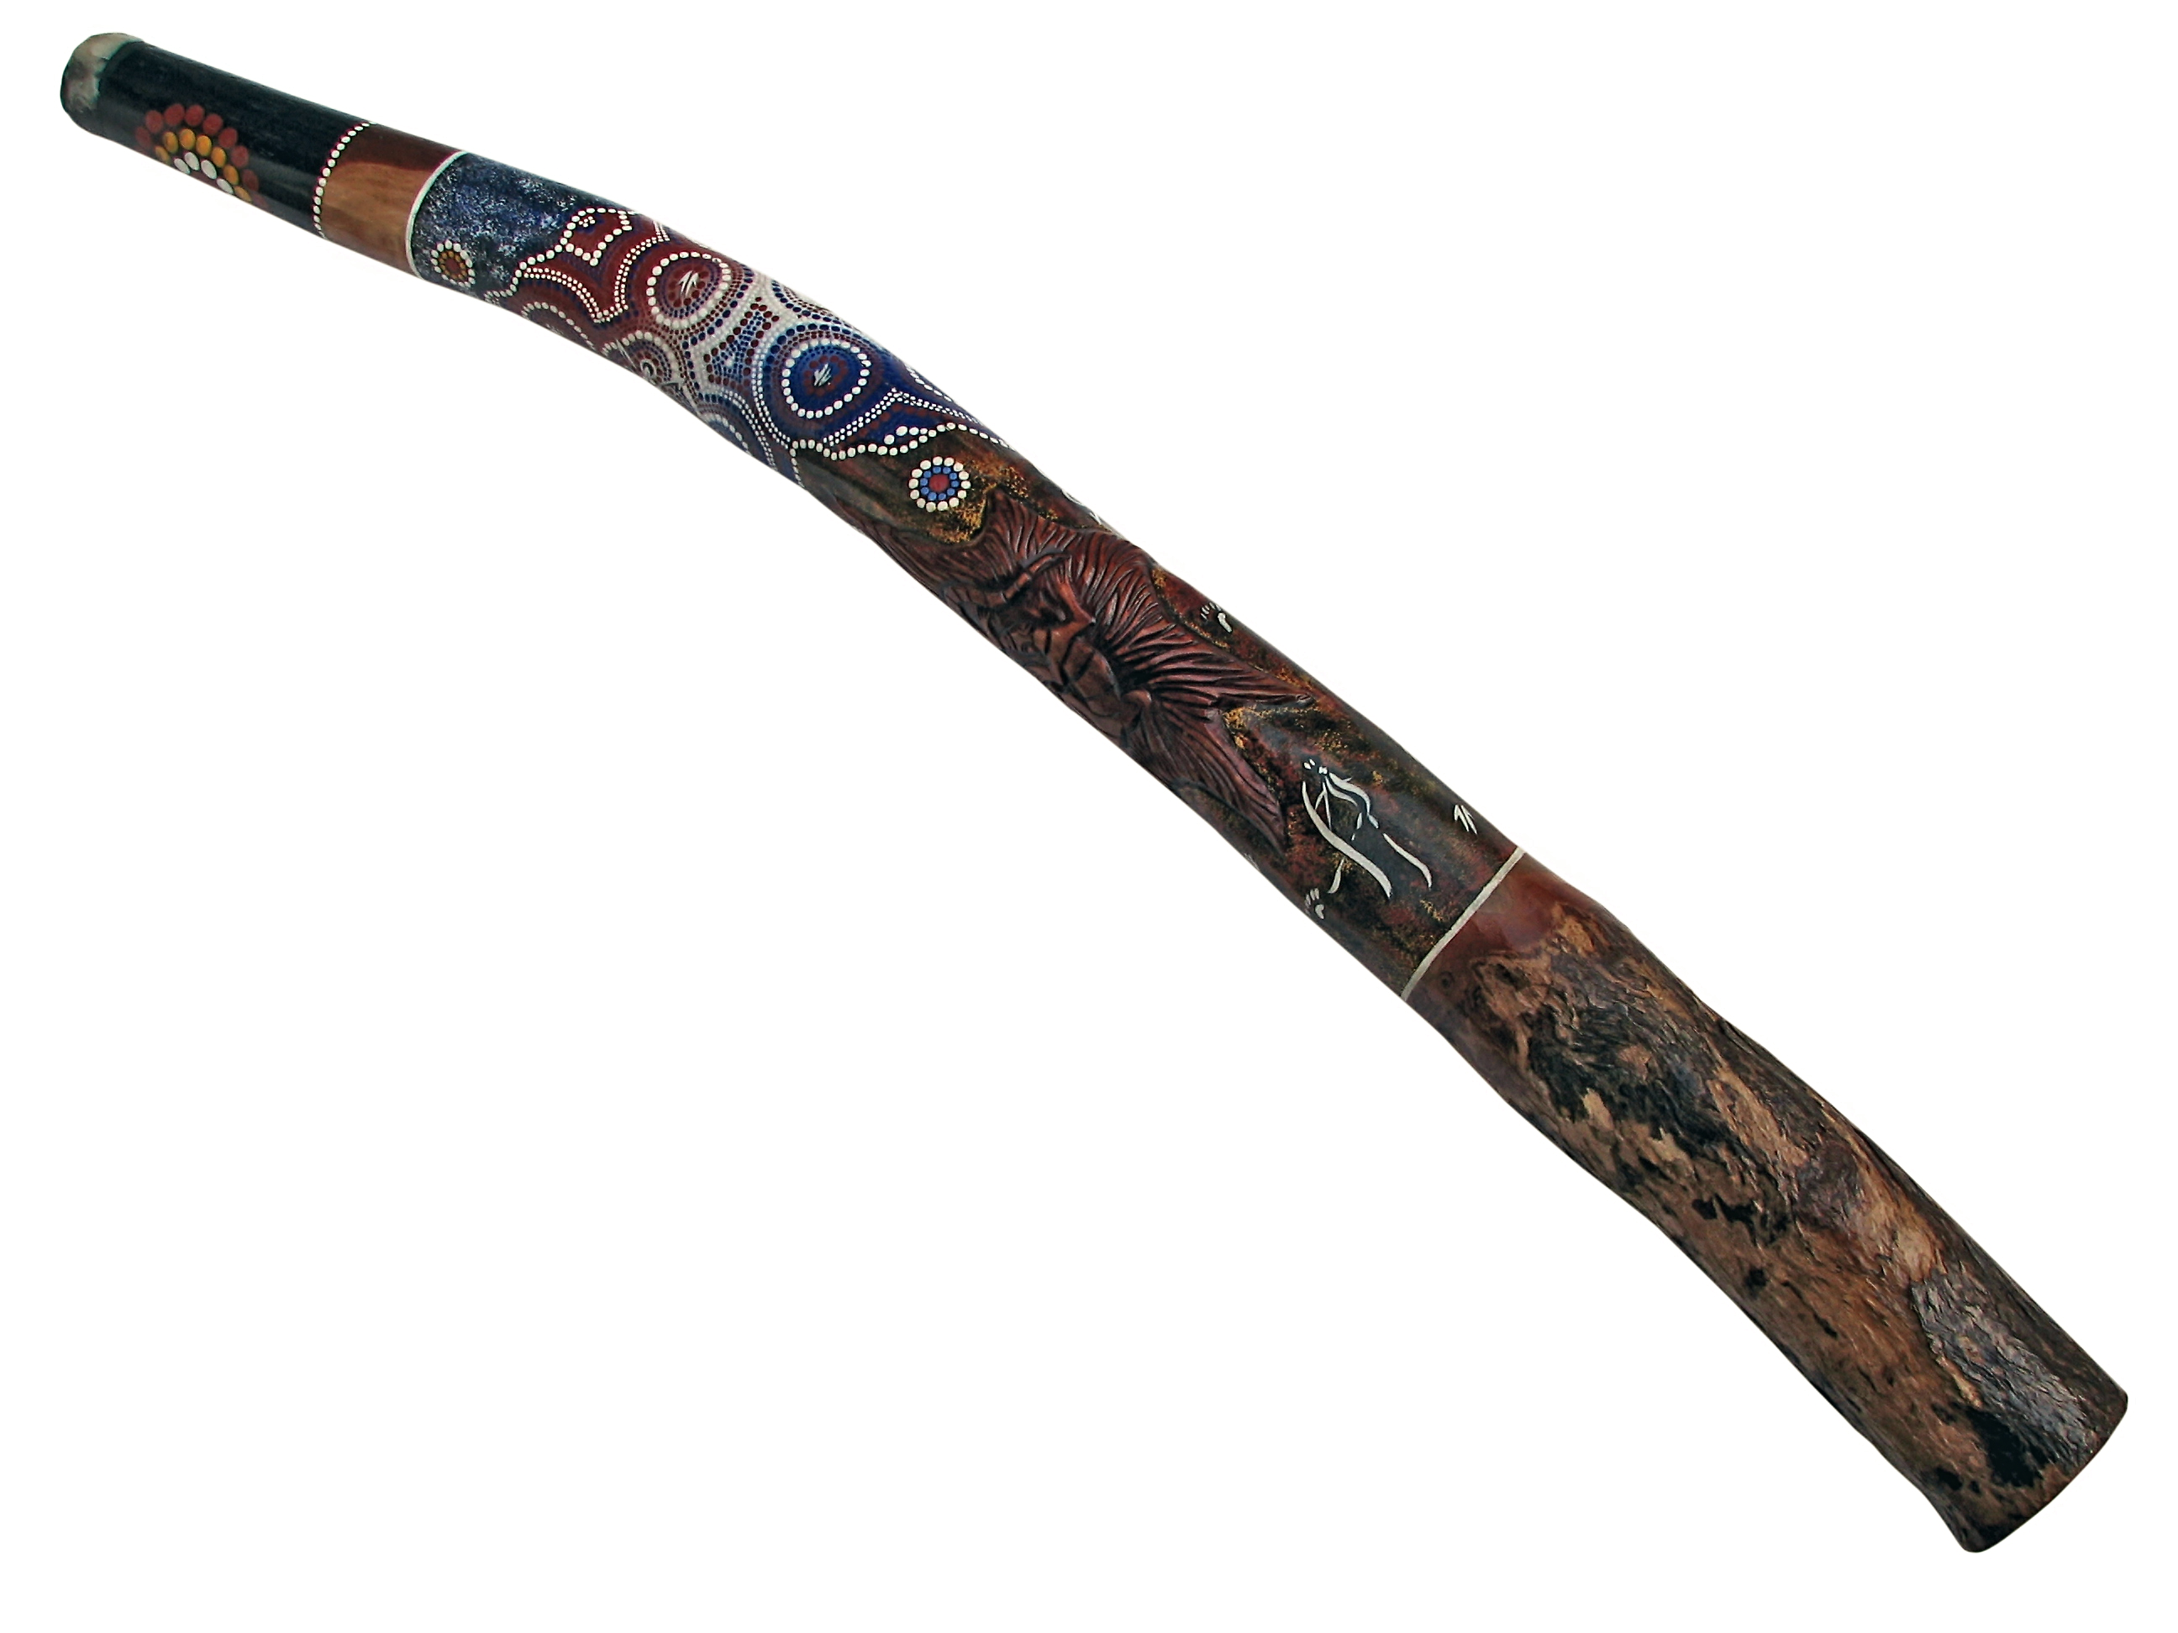
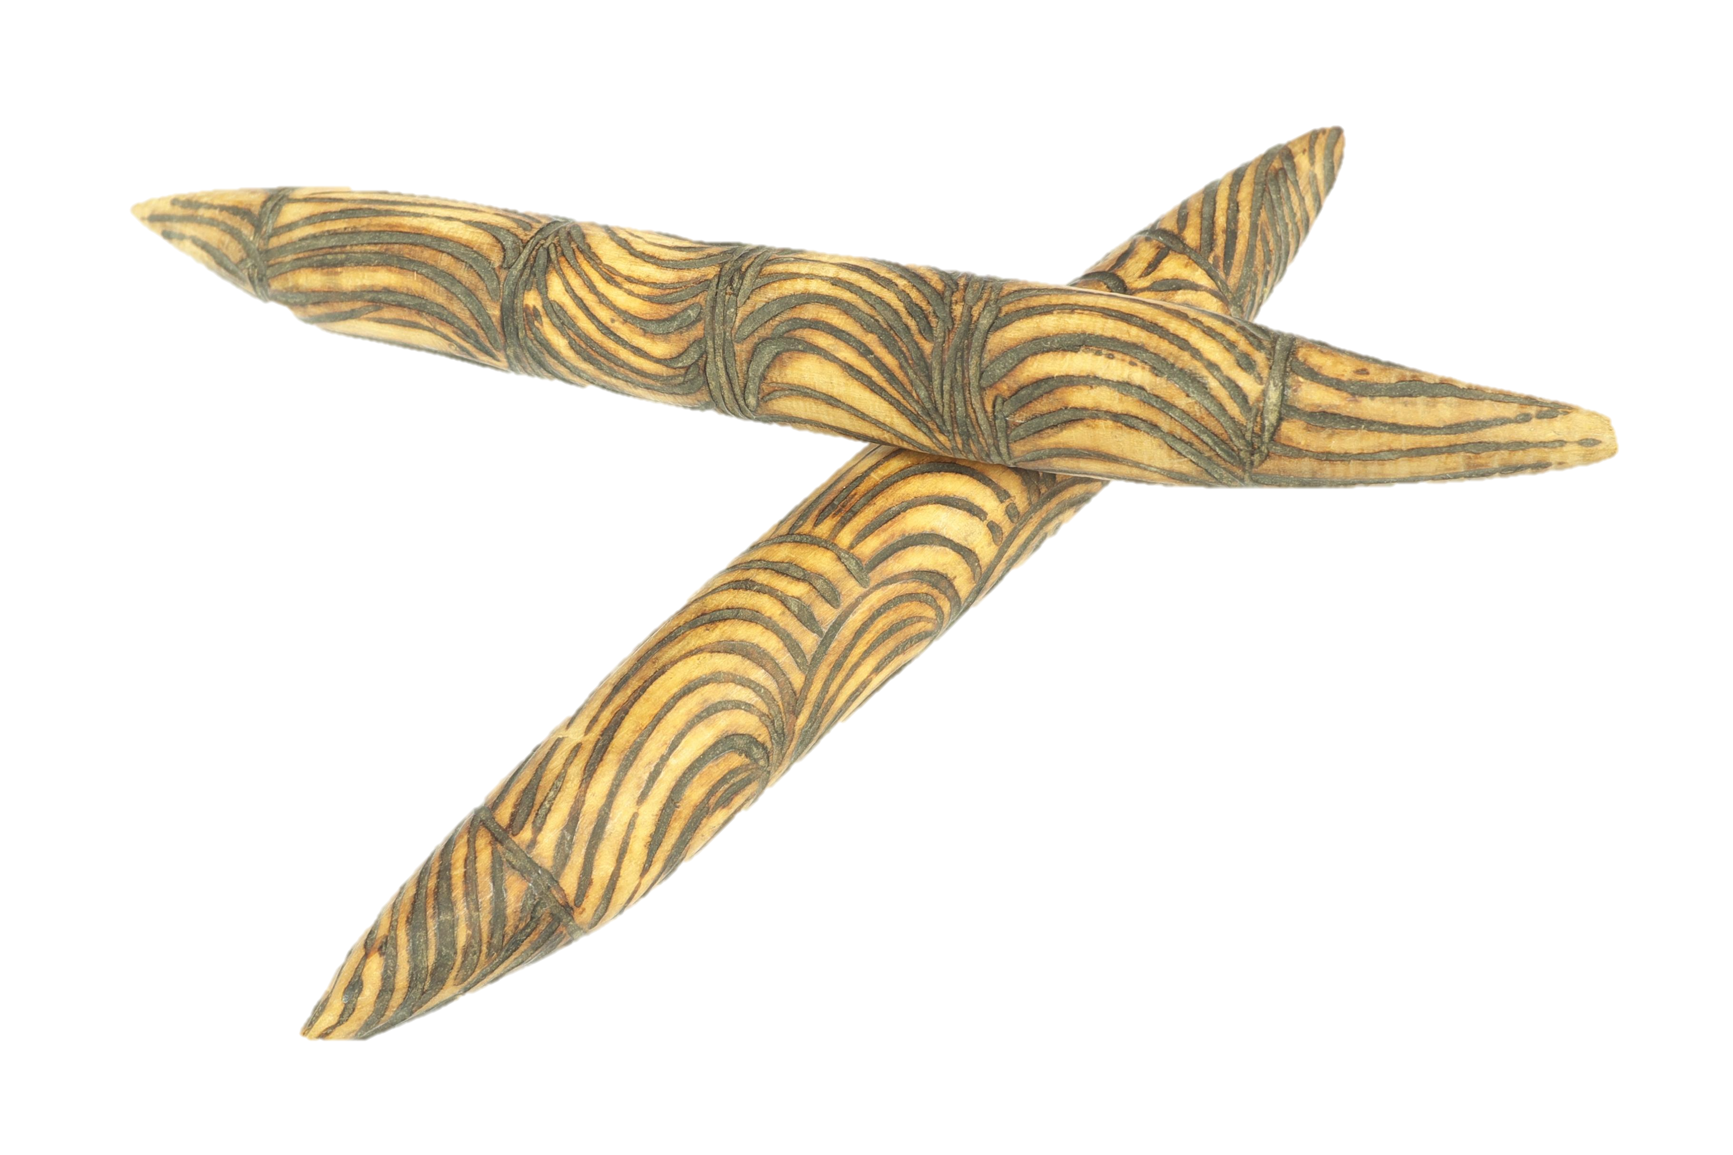

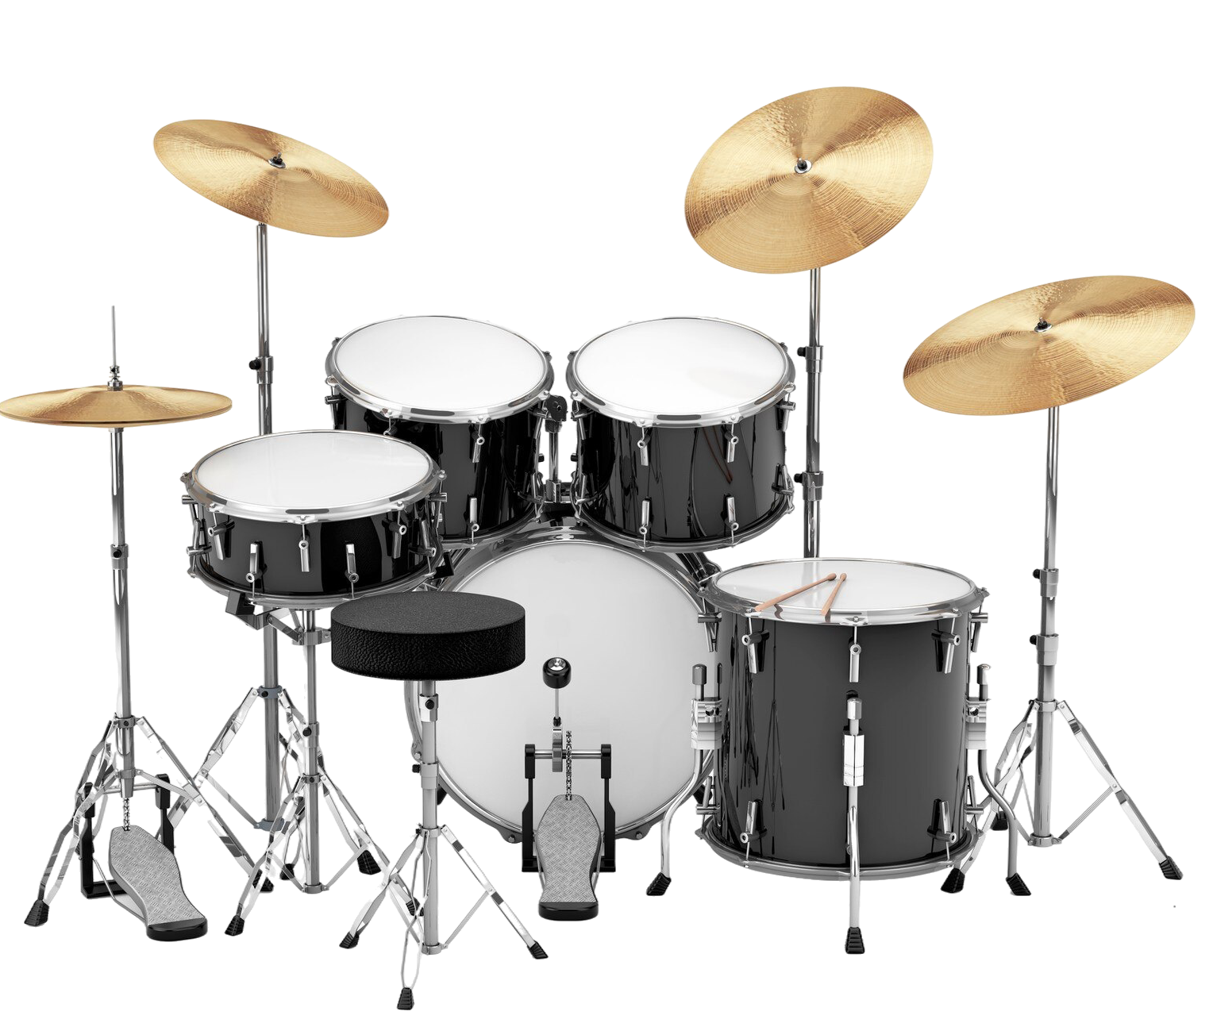


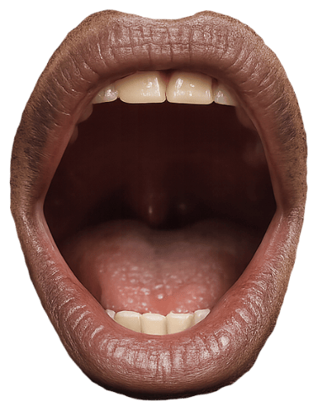
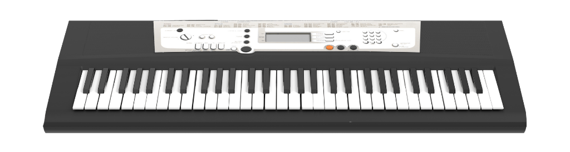


Slide 10



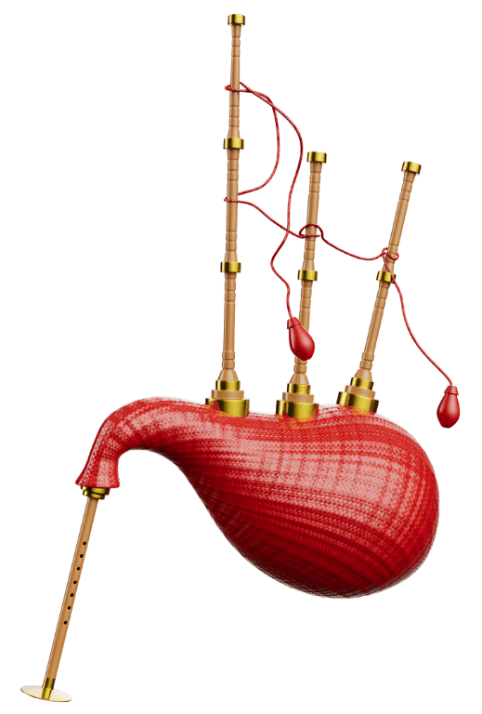
Instruments Used
Which of these instruments is not commonly used in contemporary Indigenous music?
bagpipes
beatboxing
clap sticks

Slide 11
Unique Characteristics
traditional and modern instruments
Indigenous musicians
Indigenous languages and English
deeper meaning or message

Slide 12


Traditional Languages and English
Listen to the yidaki, listen to it blow.

Slide 13

‘Murryuna’ by Baker Boy

Slide 14
Unique Characteristics
traditional and modern instruments
Indigenous musicians
Indigenous languages and English
deeper meaning or message

Slide 15



‘Cape York’ by Black Image Band

Slide 16


‘Treaty’ by Yothu Yindi
traditional and modern instruments
Indigenous musicians
Indigenous languages and English
deeper meaning or message

Slide 17
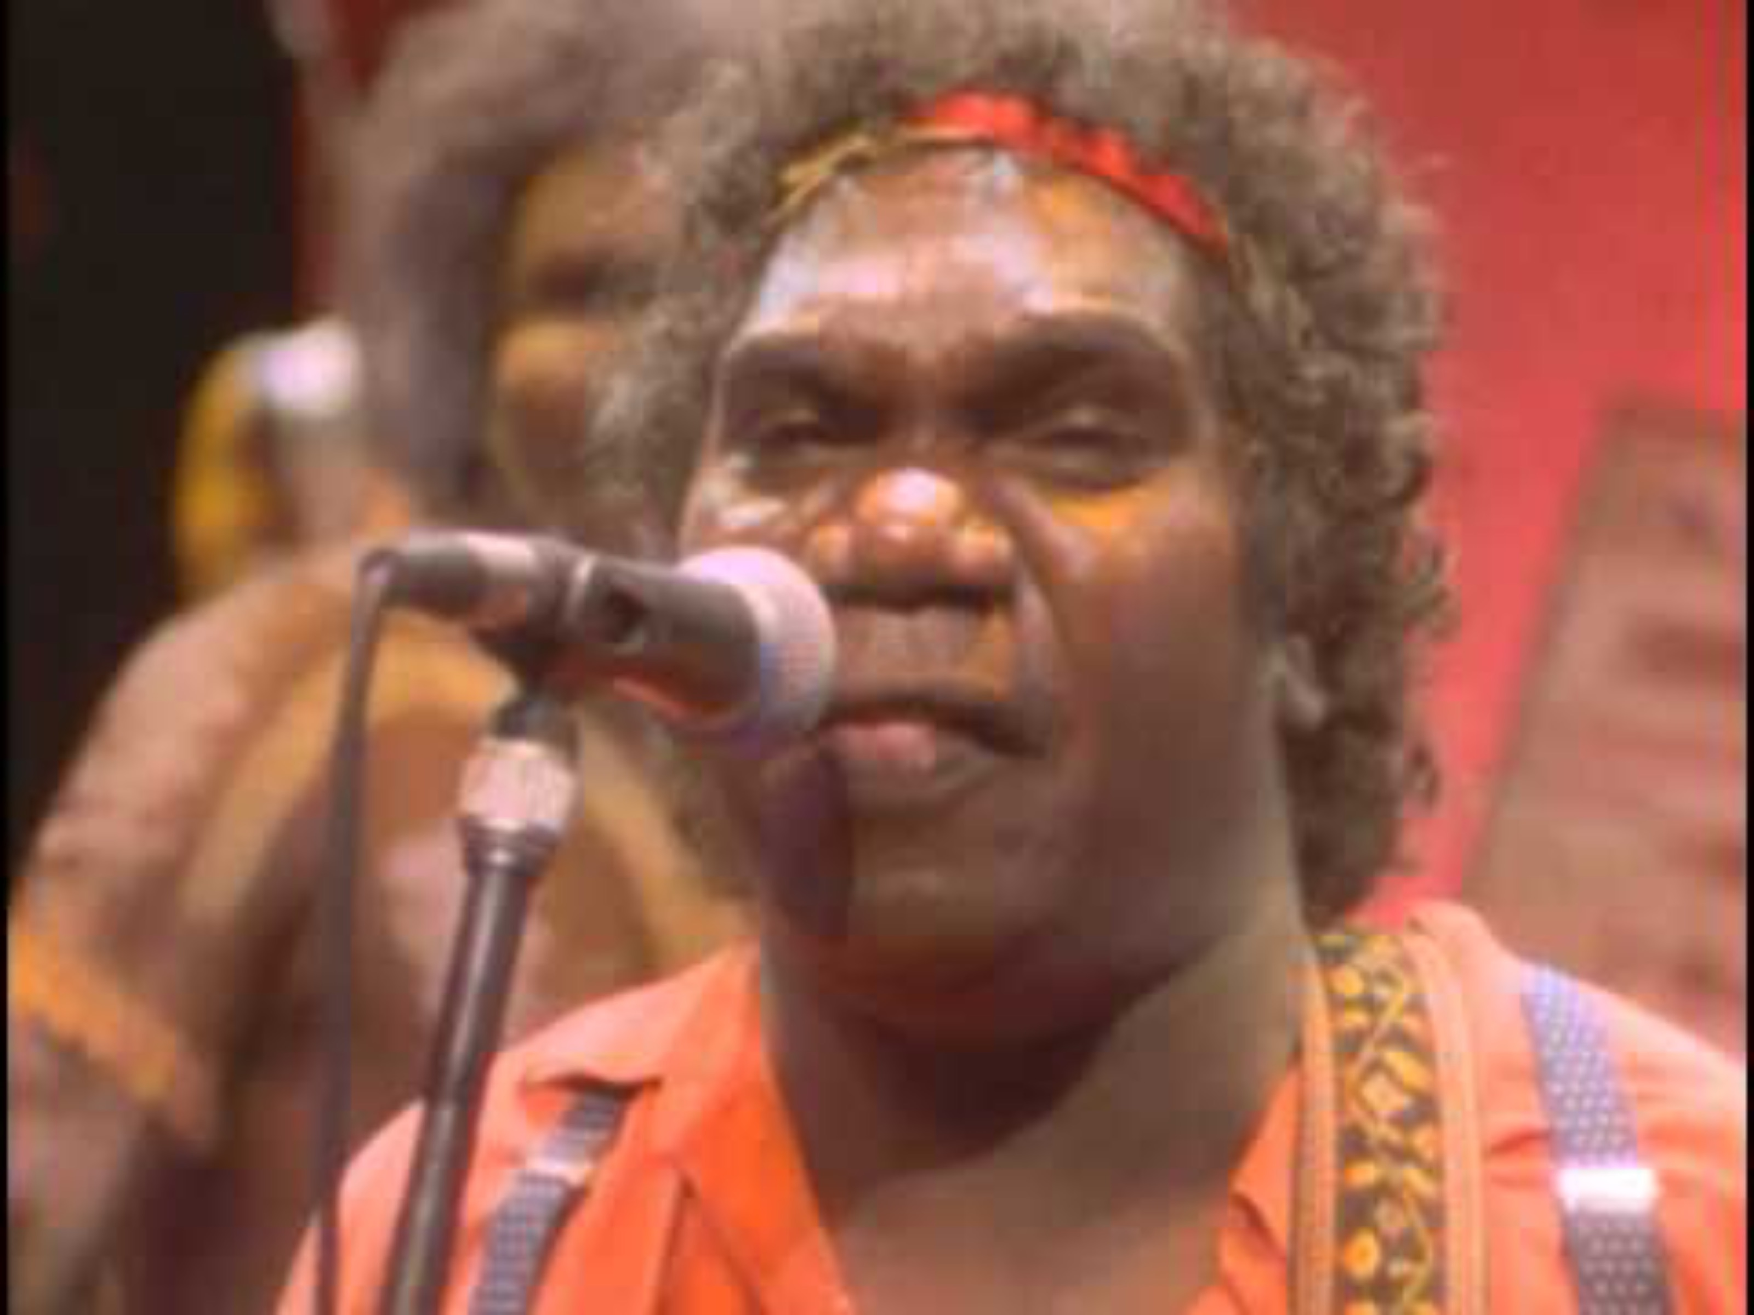
‘Treaty’ by Yothu Yindi
traditional and modern instruments
Indigenous musicians
Indigenous languages and English
deeper meaning or message

Slide 18

Contemporary Indigenous music is a genre of music just like pop, rock, classical and jazz.

Slide 19
Contemporary Indigenous music is made by Indigenous musicians.

Slide 20
Contemporary indigenous music uses both traditional Indigenous languages and English.
Contemporary indigenous music often has a deeper meaning or message in the lyrics.
Contemporary indigenous music uses a mix of traditional and modern instruments.

Slide 21




Exit Ticket
Date: _________
Lesson 1
Contemporary Indigenous music is a _________ of music.
Contemporary Indigenous music has characteristics that can include:
a mix of traditional and modern instruments
a mix of traditional language and English
songs with a deeper meaning or message
all of the above
Contemporary Indigenous music often shares meaning and messages of family, culture, country and i__________.
genre
traditional
piece
genre
dentity
3
I know _____ out of 3 answers.

Slide 22

In the next lesson, we will learn how music can powerfully represent Indigenous pride, identity and culture.

Slide 23
Attributions
Slide 15, Black Image Band joins 2025 Cooktown Discovery Festival, by Cook Shire Council

