Slide 1
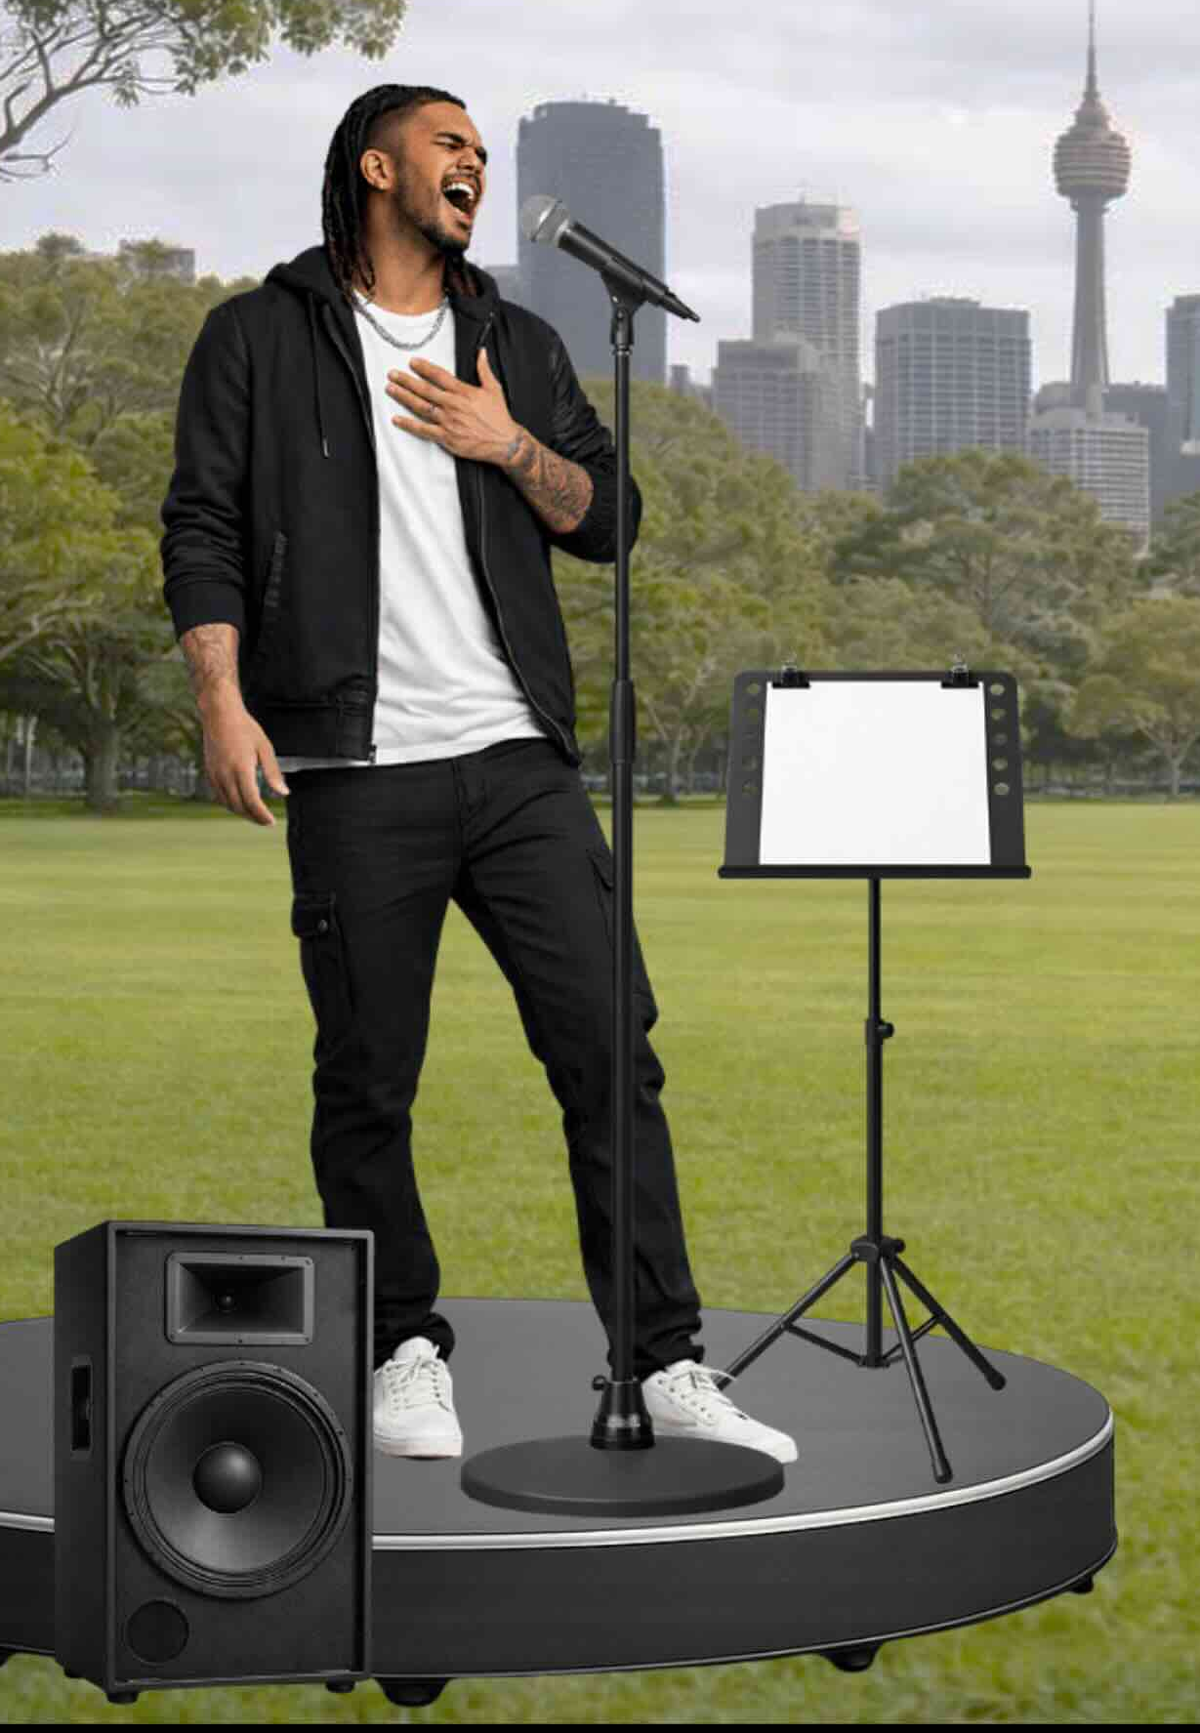
Contemporary Indigenous Music
Lesson 2
Contemporary Indigenous Music and Meaning (Part 1)
Version 3

Slide 2





Revise
Exit Ticket
Lesson 1
Contemporary Indigenous music is a _________ of music.
Contemporary Indigenous music has characteristics that can include:
a mix of traditional and modern instruments
a mix of traditional language and English
songs with a deeper meaning or message
all of the above
Contemporary Indigenous music often shares meaning and messages of family, culture, country and i__________.
genre
traditional
piece
genre
dentity

Slide 3
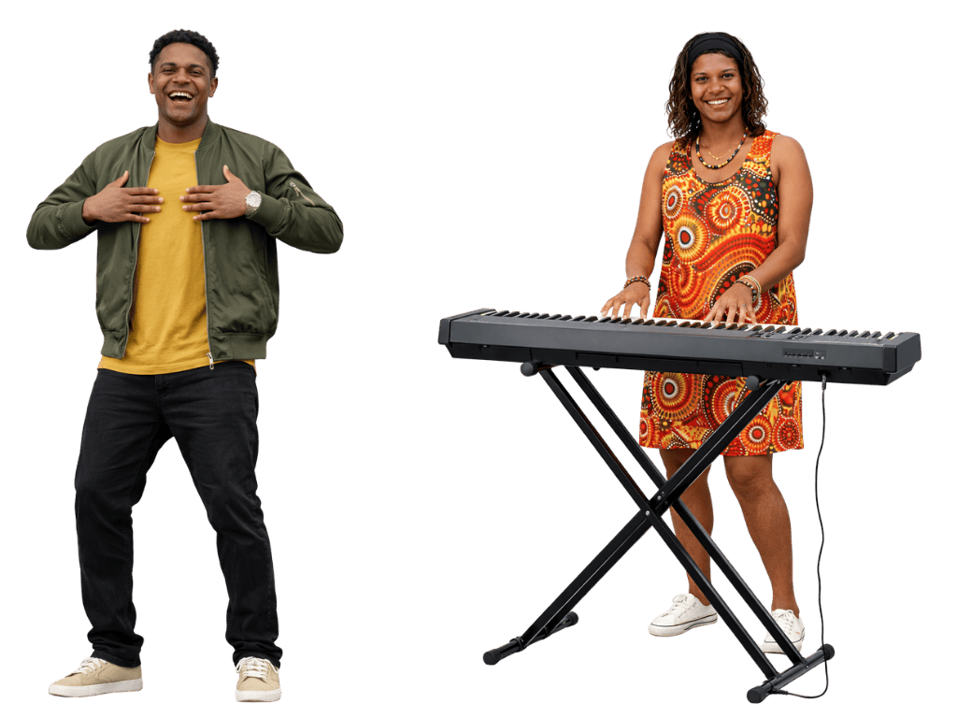
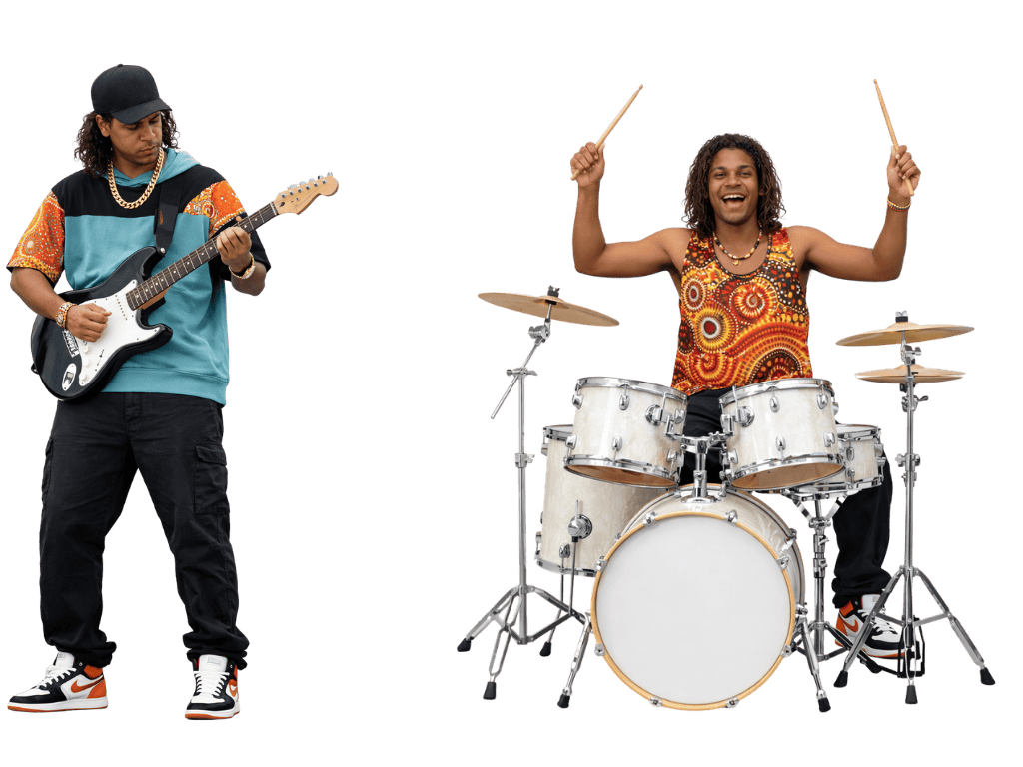
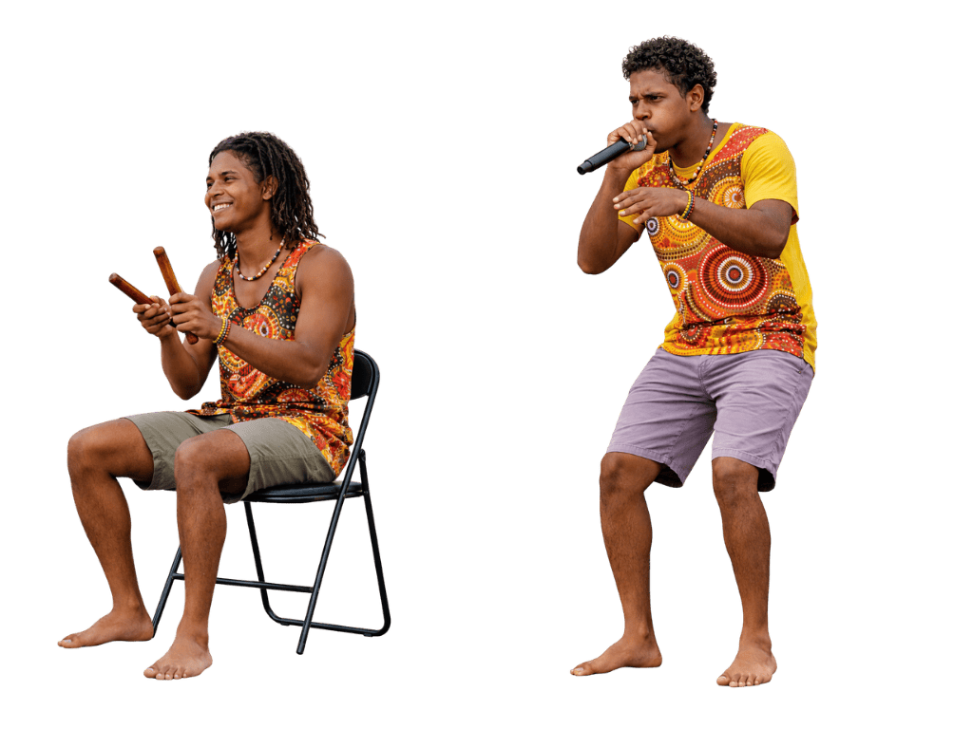
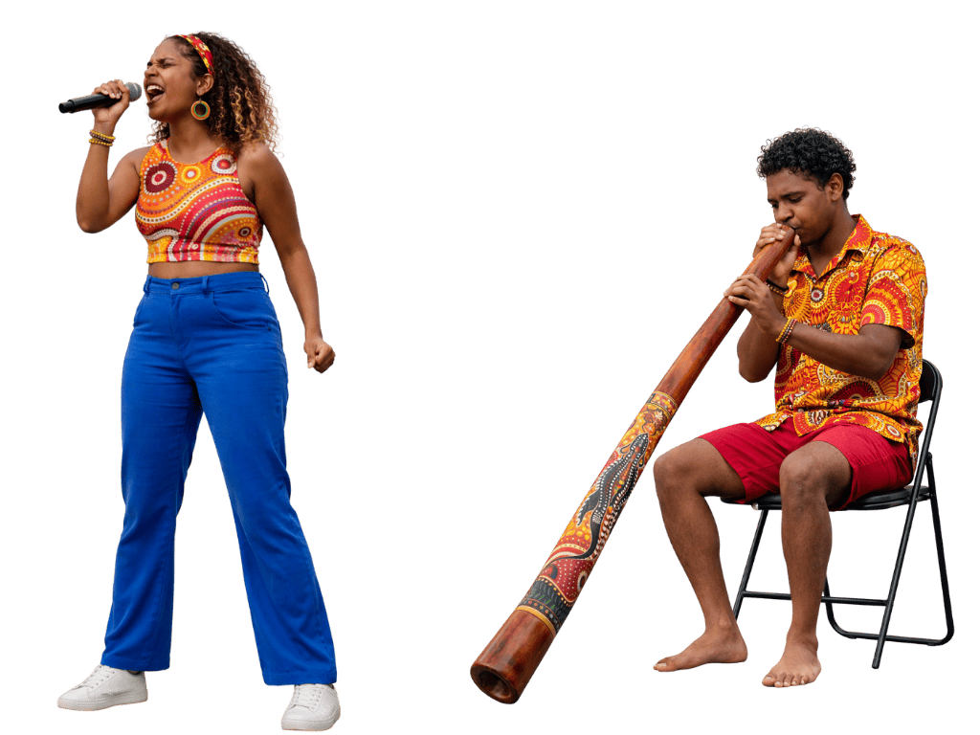
What are traditional and modern instruments often used in contemporary Indigenous music?

Slide 4
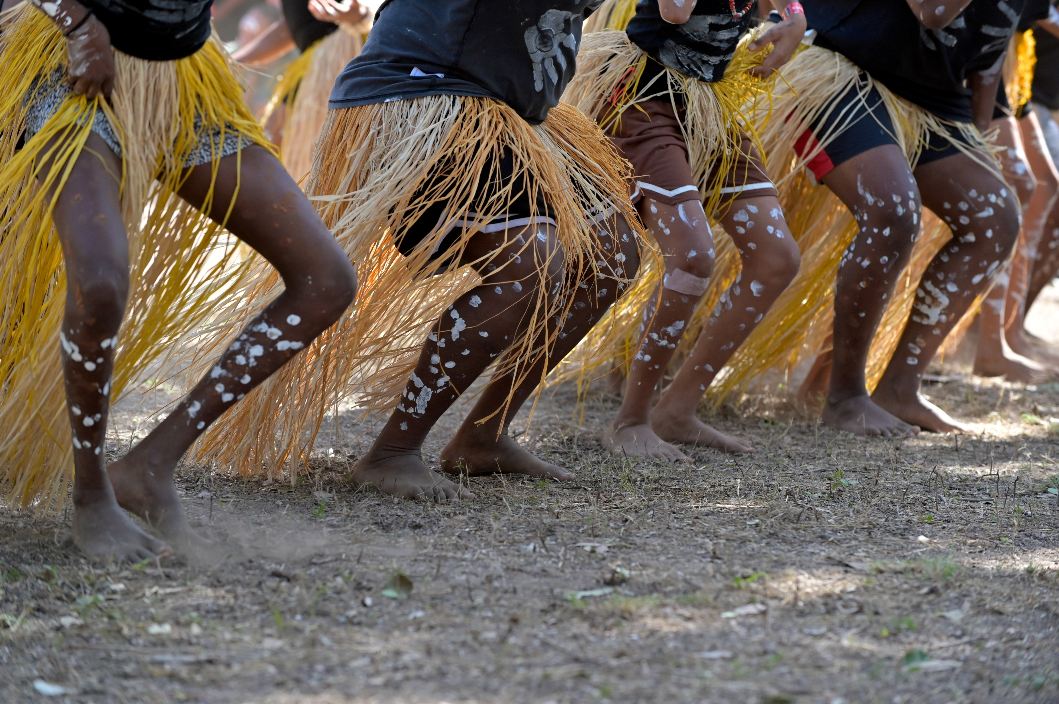
In this lesson, we will learn how music can powerfully represent Indigenous pride, identity and culture.

Slide 5

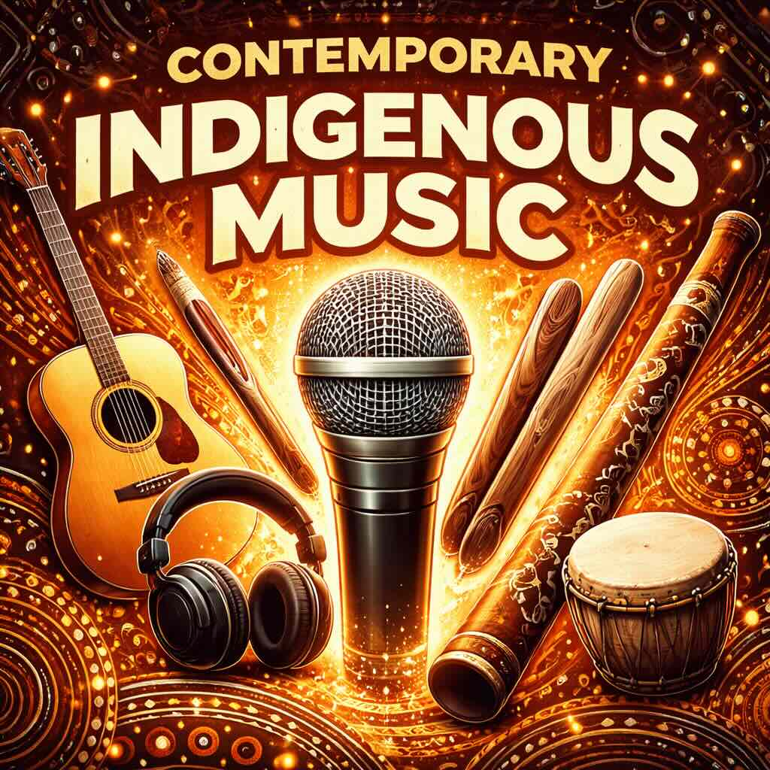
You will be able to: ​
analyse music using the elements of music
explain how music represents Indigenous pride, identity and culture.
Analyse: To look closely at something and think about its parts to understand how it works.
Explain: To tell how or why something happens so others can understand it clearly.

Slide 6


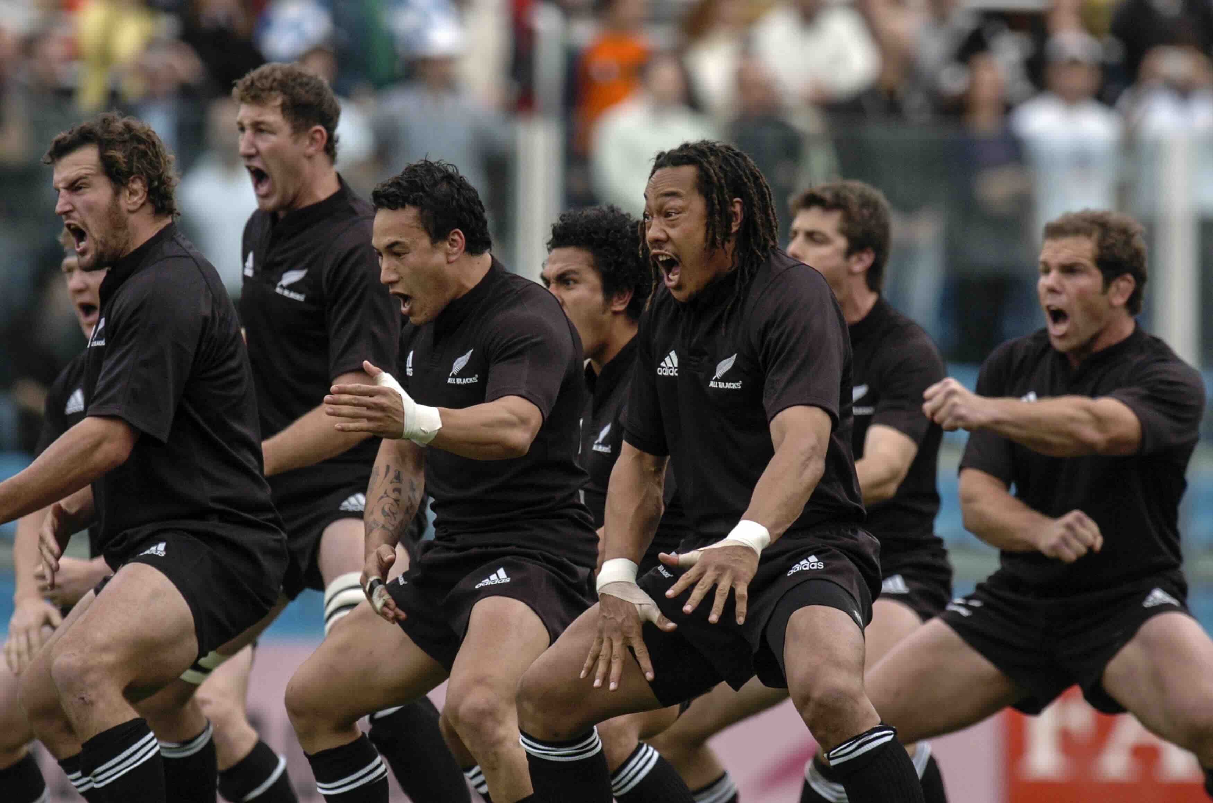
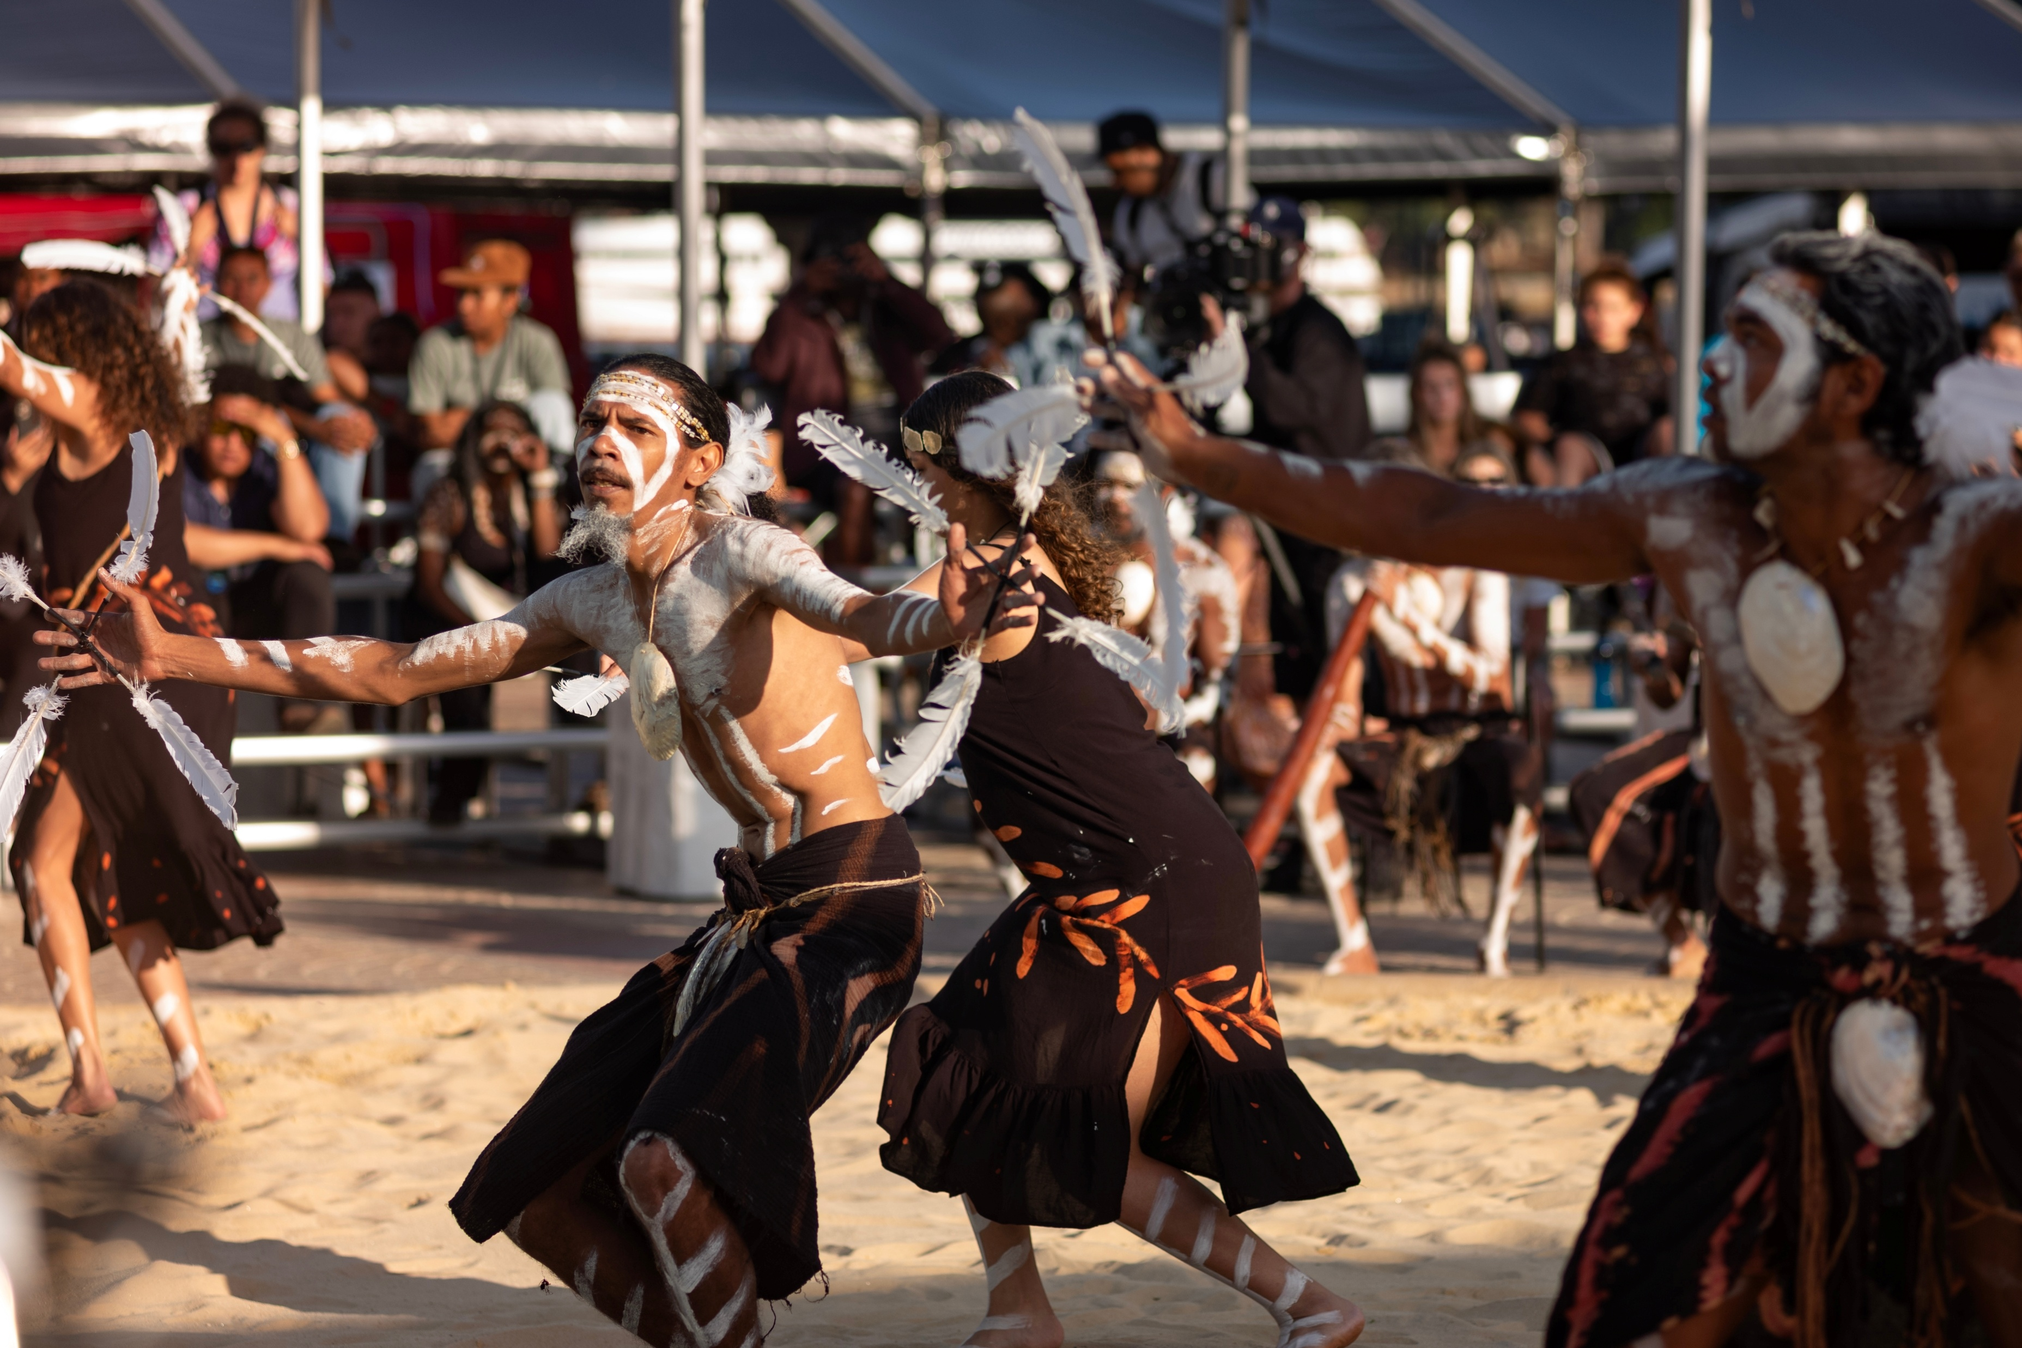

Slide 7


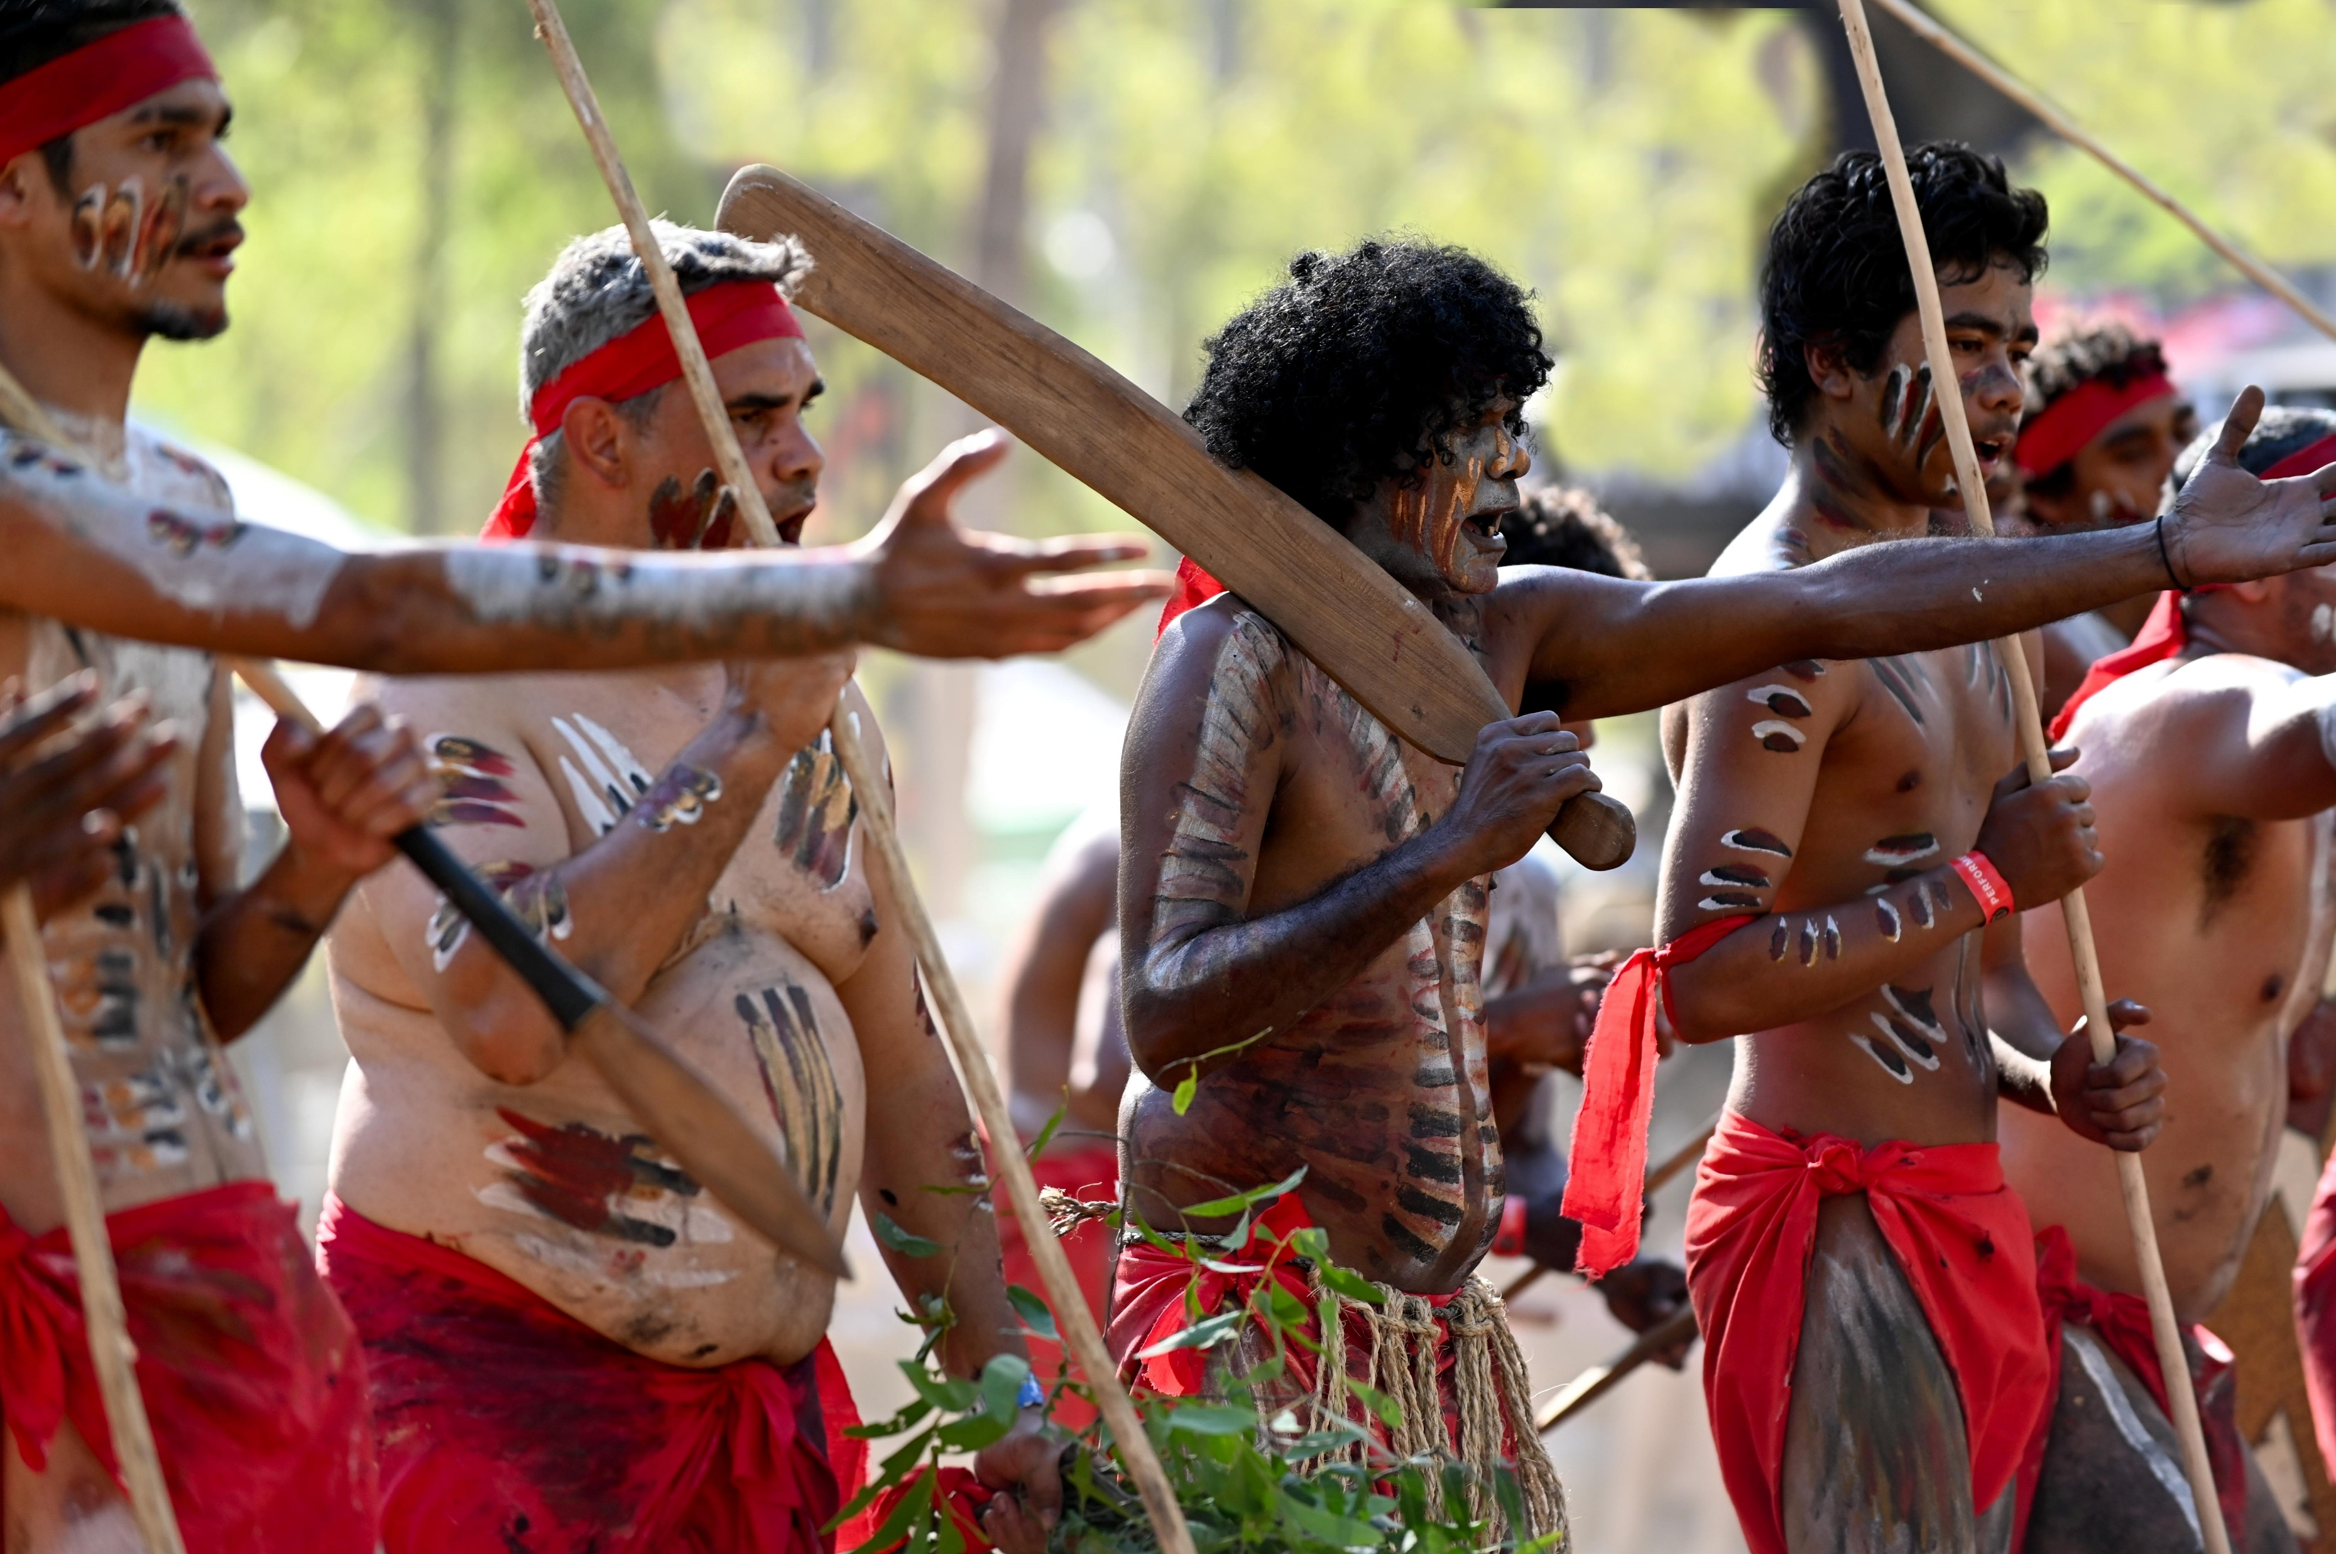
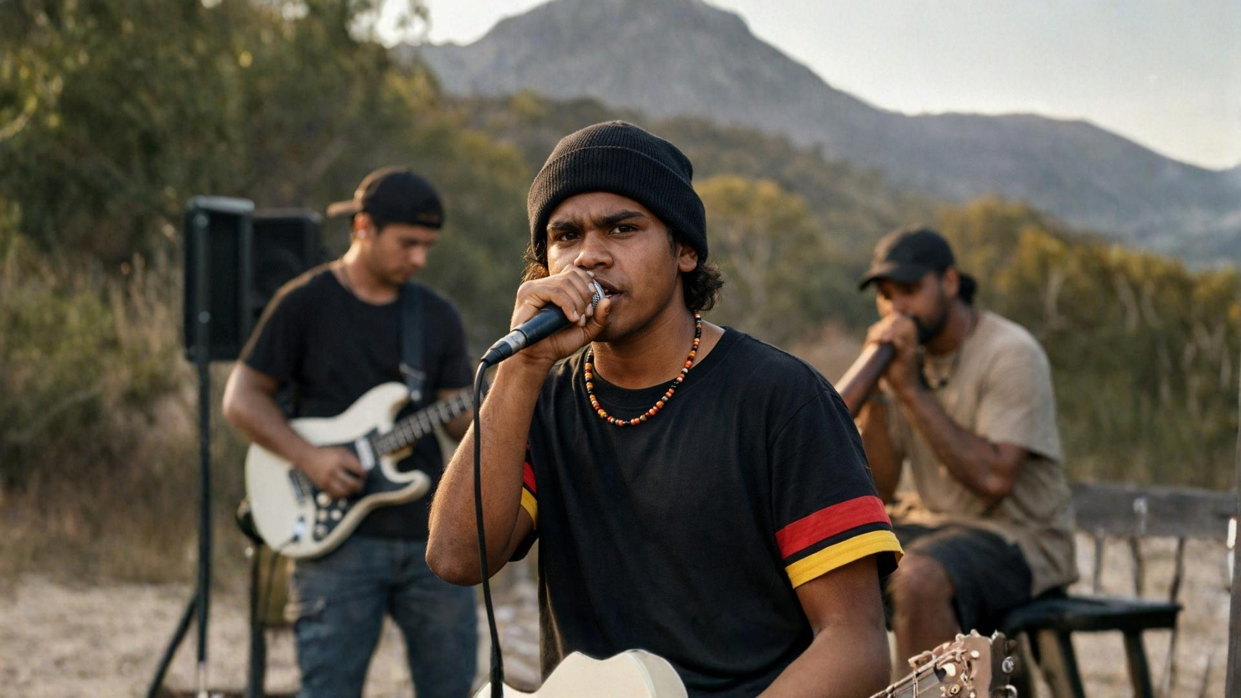
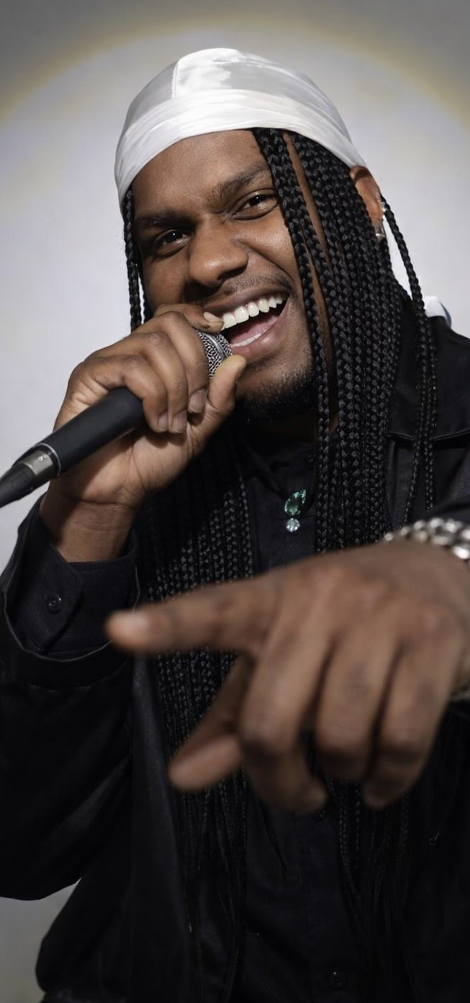
Sharing Through Music

Slide 8


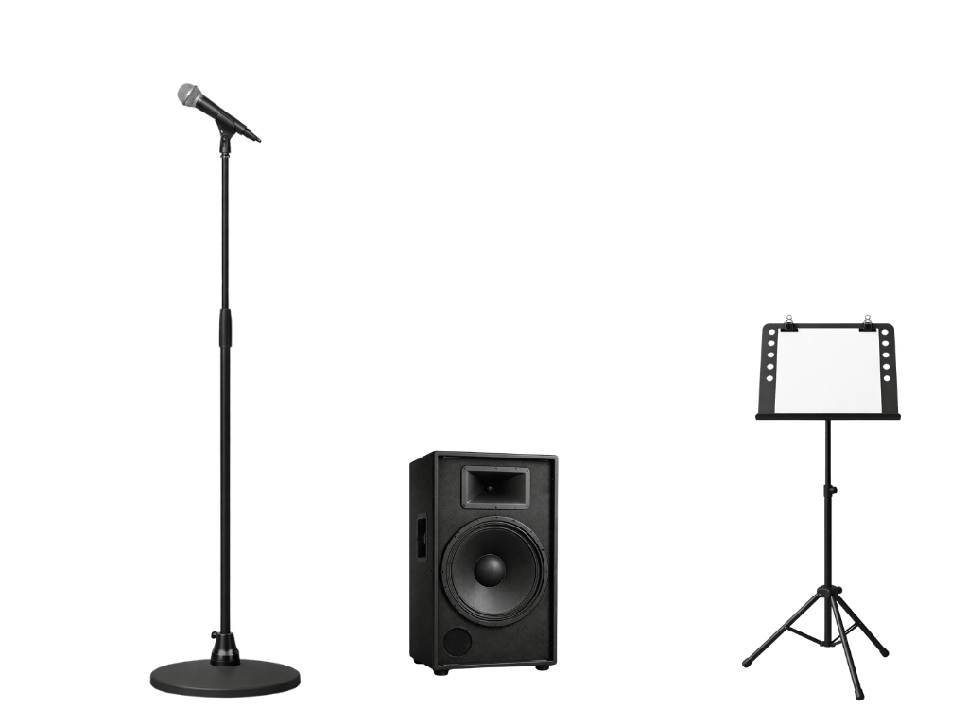


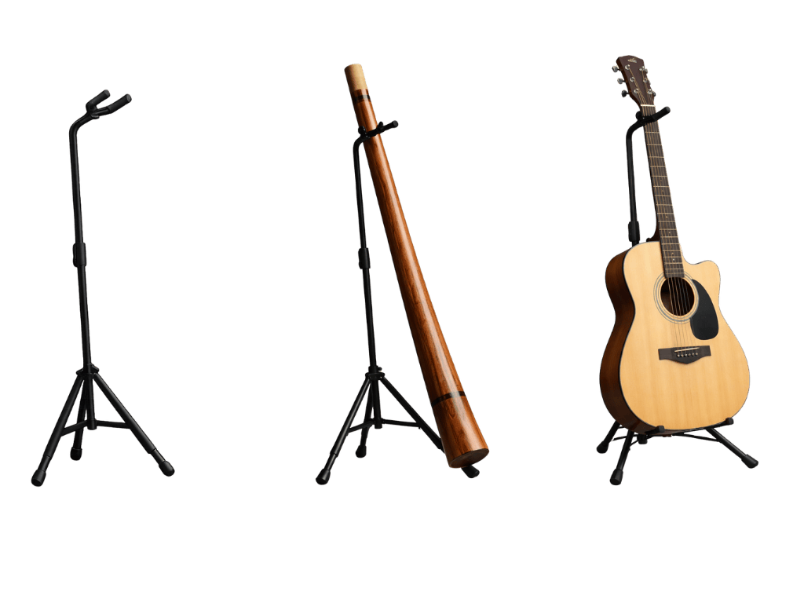
Musical Elements
Pitch
Rhythm
Tempo
Texture
Dynamics
Timbre
Structure

Slide 9

Pitch
Pitch tells us how high or low the notes are.

Slide 10
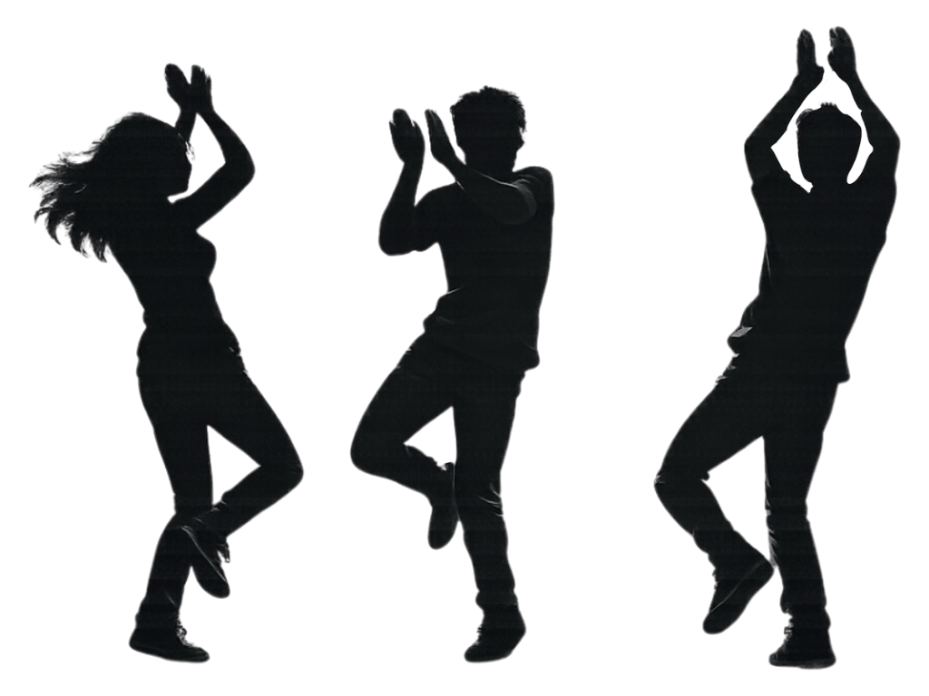
Rhythm and Tempo
Tempo, or speed, tells us how fast or slow the music is.
Rhythms are patterns of longer and shorter sounds or notes.

Slide 11
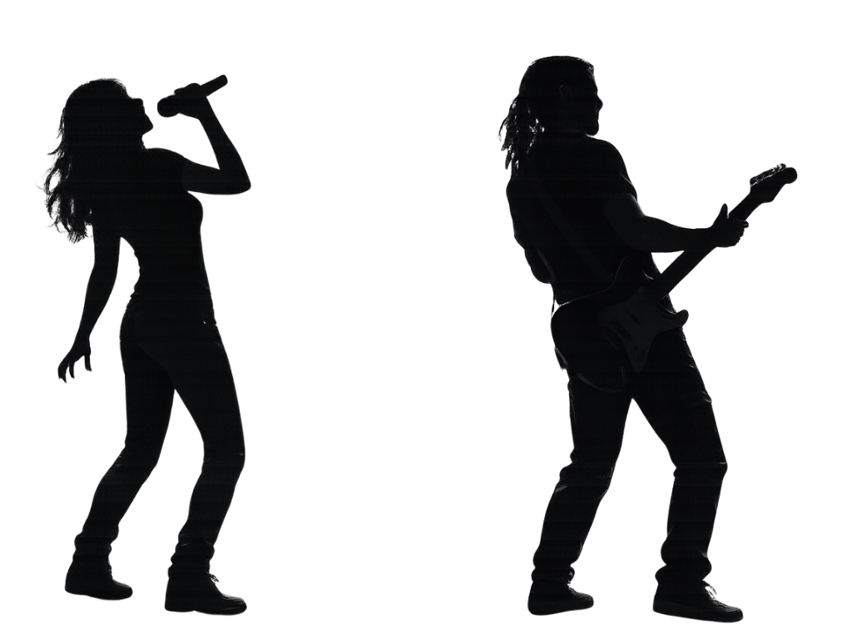
Texture
Texture tells us how many layers there are in the music.

Slide 12

Dynamics
Dynamics tells us how loud or soft the music is. It is another word for volume.

Slide 13
Timbre
Timbre tells us about the quality of the sound, such as bright or dark.

Slide 14
Structure
Structure tells us how the music is built or put together.
Verse
Chorus
Verse
Verse
Chorus

Slide 15



Musical Elements
Which of these musical elements tells us how loud or soft the music is?
pitch
texture
dynamics

Slide 16
Musical Elements
Pitch
Rhythm
Tempo
Texture
Dynamics
Timbre
Structure
high or low?
long or short?
fast or slow?
many or few?
loud or soft?
overall sound?
what repeats?

Slide 17
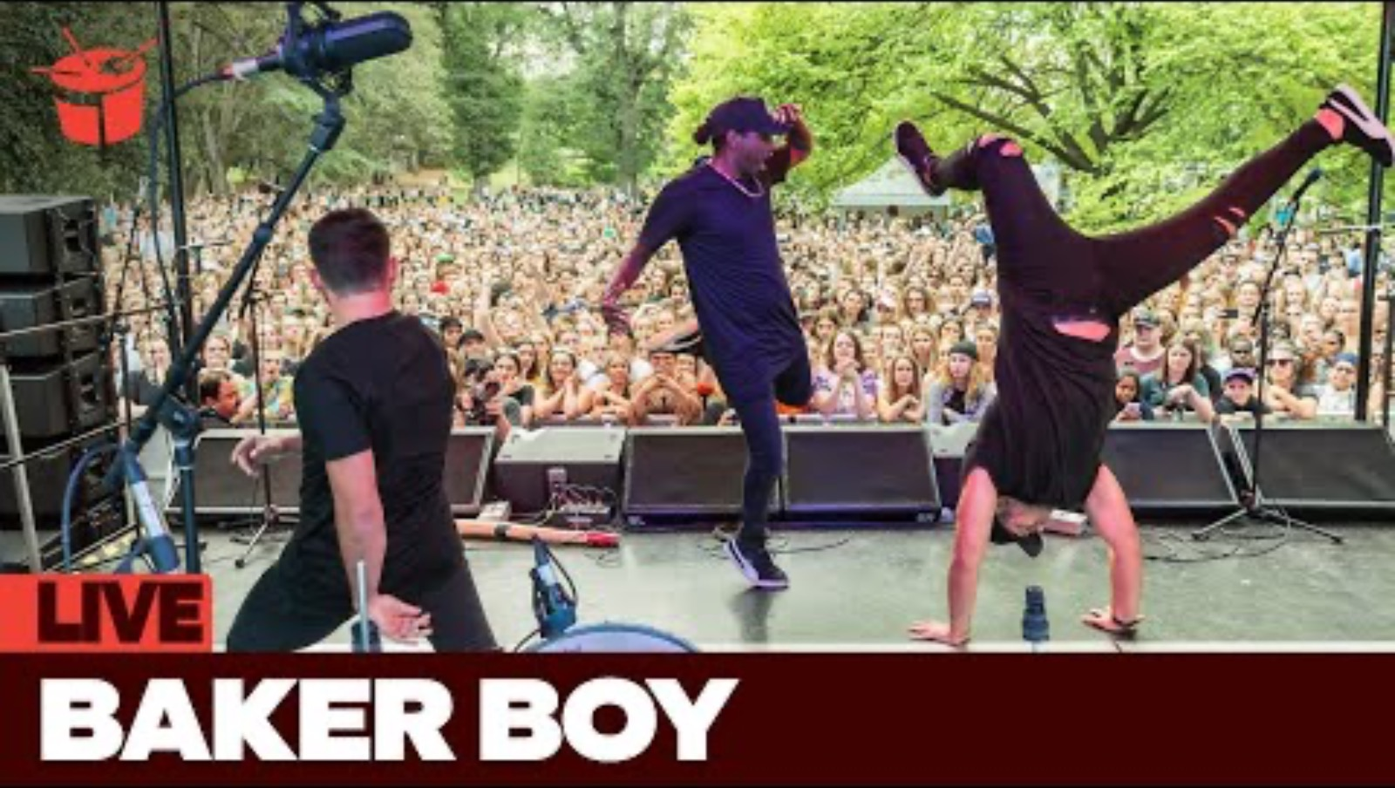
Musical Elements of ‘Marryuna’
Pitch
Rhythm
Tempo
Texture
Dynamics
Timbre
Structure
high or low?
long or short?
fast or slow?
many or few?
loud or soft?
overall sound?
what repeats?

Slide 18
Musical Elements of ‘Marryuna’
Pitch
Rhythm
Tempo
Texture
Dynamics
Timbre
Structure
high or low?
high and low
long or short?
short
fast or slow?
fast
many or few?
many
loud
loud or soft?
powerful
overall sound?
chorus
what repeats?

Slide 19


Musical Elements of ‘Cape York’
Pitch
Rhythm
Tempo
Texture
Dynamics
Timbre
Structure
Pitch
Rhythm
Tempo
Texture
Dynamics
Timbre
Structure
high or low?
long or short?
fast or slow?
many or few?
loud or soft?
overall sound?
what repeats?

Slide 20
Musical Elements of ‘Cape York’
Pitch
Rhythm
Tempo
Texture
Dynamics
Timbre
Structure
high or low?
high and low
long or short?
short and long
fast or slow?
moderate
many or few?
many
softer
loud or soft?
earthy
overall sound?
chorus
what repeats?

Slide 21
Music can be analysed using the elements of music.
The elements of music can help us understand the meaning of a song.
Pitch
Rhythm
Tempo
Texture
Dynamics
Timbre
Structure

Slide 22

Music can be a powerful way to express connection to land, community and history.
Music can represent identity, culture and pride.
Indigenous artists use music to tell stories and share who they are.

Slide 23


Exit Ticket
Date: _________
Lesson 2
We can analyse music using the ___________ of music.
The elements of music include:
sound, words and topic
title, chorus and verse
pitch, rhythm and tempo
singer, instruments and mixer
Contemporary Indigenous music can represent Indigenous pride, identity and c__________.
elements
styles
history
elements
ulture
3
I know _____ out of 3 answers.

Slide 24
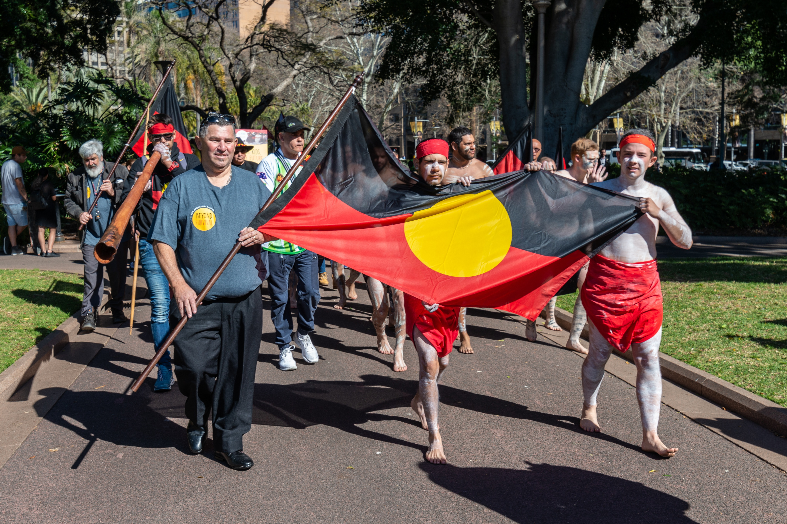
In the next lesson, we will learn how music can be a voice for justice.

Slide 25
Attributions
Slide 11 Audio: ‘violin improv.wav’ by christopherbrooks, https://freesound.org/s/276887/, CC0 1.0
Slide 11 Audio: ‘Samual Arthur Gossner, Brass Quintet No.1’ performed by Joe Ricard, Jason Ford, Kai Sandoval, Nelson Woods and Jeffery Cox, https://imslp.org/wiki/Brass_Quintet_No.1_(Gossner%2C_Samuel_Arthur), CC BY 4.0
Slide 13 Audio: ‘Classical guitar sweet español melody’ by ValentinSosnitskiy, https://freesound.org/s/568316/, CC BY 4.0
Slides 19, 20, Black Image Band joins 2025 Cooktown Discovery Festival, by Cook Shire Council

