Slide 1
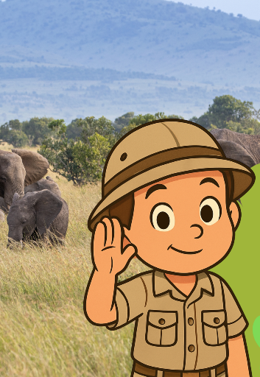
Music and the Animal Kingdom
Lesson 2
What is Music Made Of?
Unit 2 Version 3

Slide 2



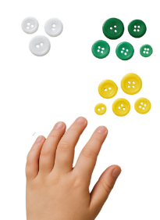
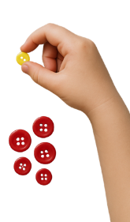


What We Learnt
Exit Ticket
Lesson 1A
Lesson 1
animals
We listened to music about ________.
A song is a kind of music that has:
stories
words
elephants.
We can s____ songs about animals.
animals
parties
teachers
ing

Slide 3

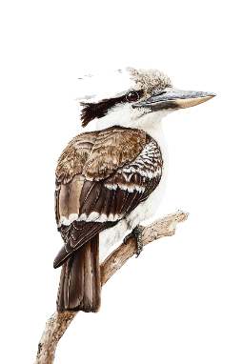
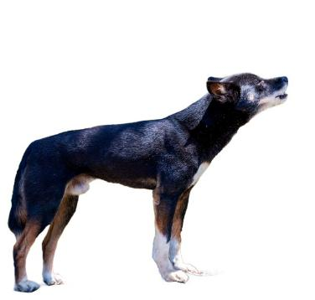
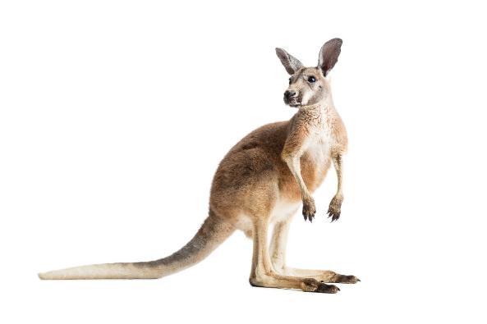
Music can be about animals.

Slide 4
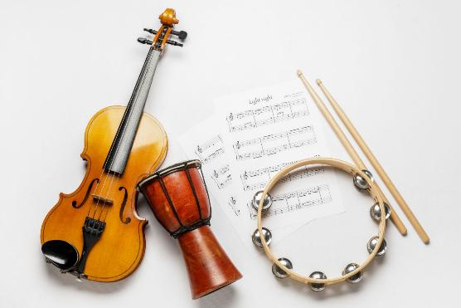
In this lesson, we will learn about different parts of music.

Slide 5

You will be able to: ​
high and low sounds
loud and soft sounds
fast and slow
sounds.​
hear
Hear means to notice sounds using your ears.
hear
hear

Slide 6

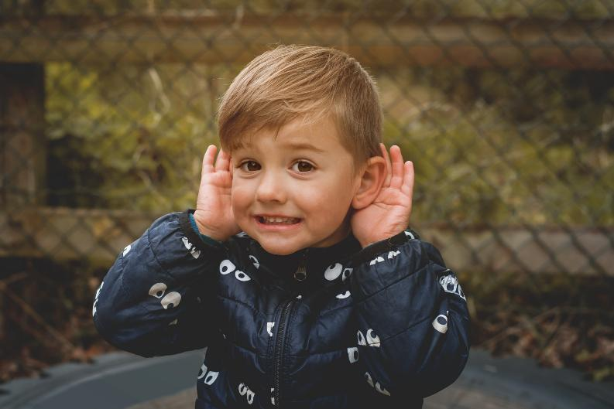
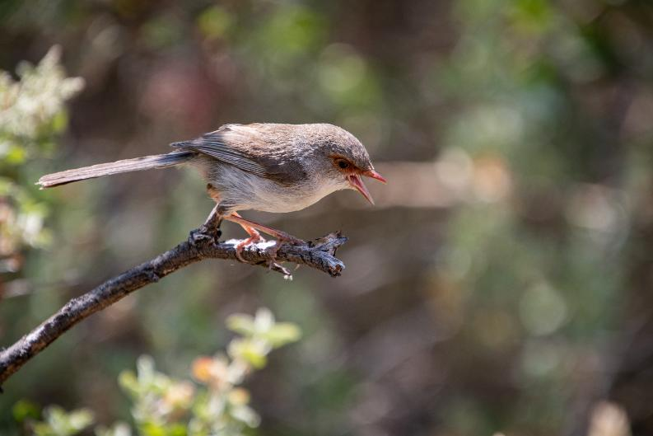
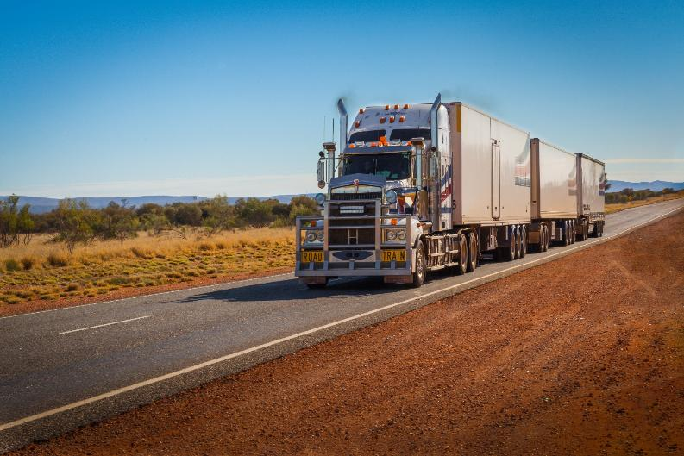

Slide 7
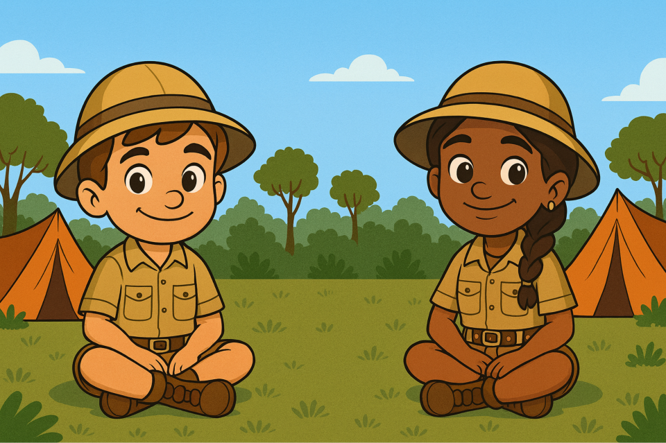





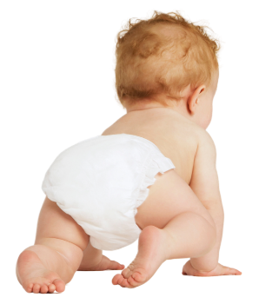
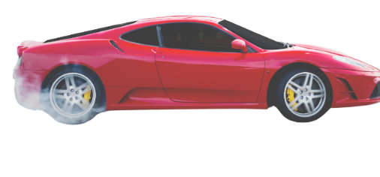

Slide 8




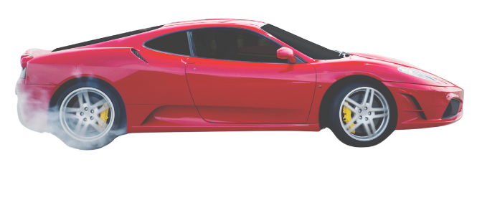
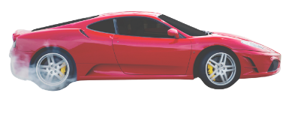
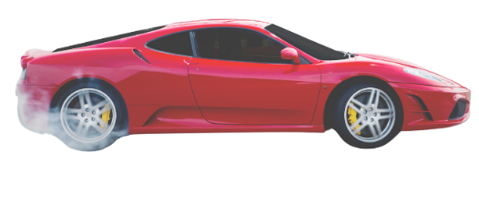
Voice Sounds
We can make different sounds with our voices.

Slide 9
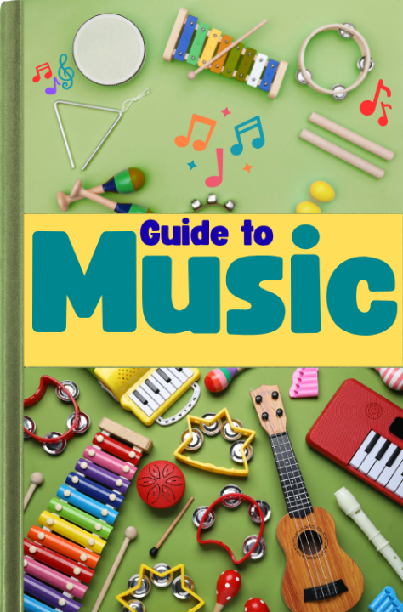

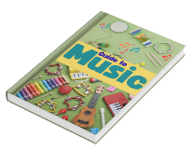

Slide 10

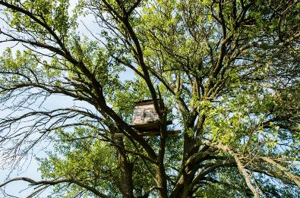
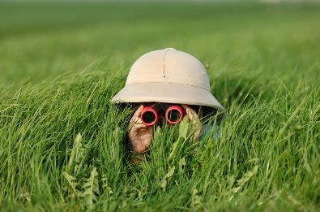
Music is made up of different sounds.
Sounds can be high and low.

Slide 11




High and Low Sounds
Sounds can be high or low.
High
Low

Slide 12
High and Low Sounds
High
Low

Slide 13
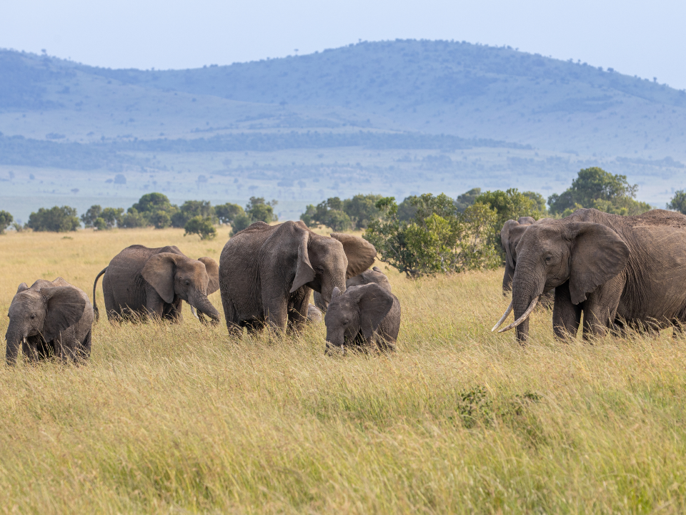




Slide 14
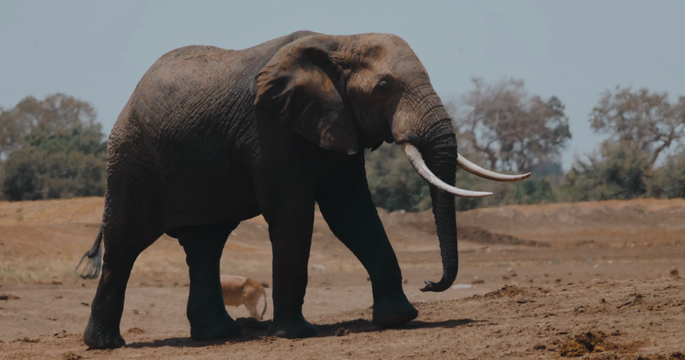
Move Like an Elephant

Slide 15



High and Low Music
Low
Animal music can be high and low.

Slide 16
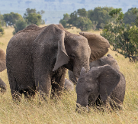


High and Low Sounds
Sounds can be high and _____.
Elephant
Low
Explorers

Slide 17


Music is made up of different sounds.
Sounds can be loud and soft.

Slide 18




Loud and Soft Sounds
Sounds can be loud and soft.
Loud
Soft

Slide 19
Loud and Soft Sounds
Loud
Soft

Slide 20
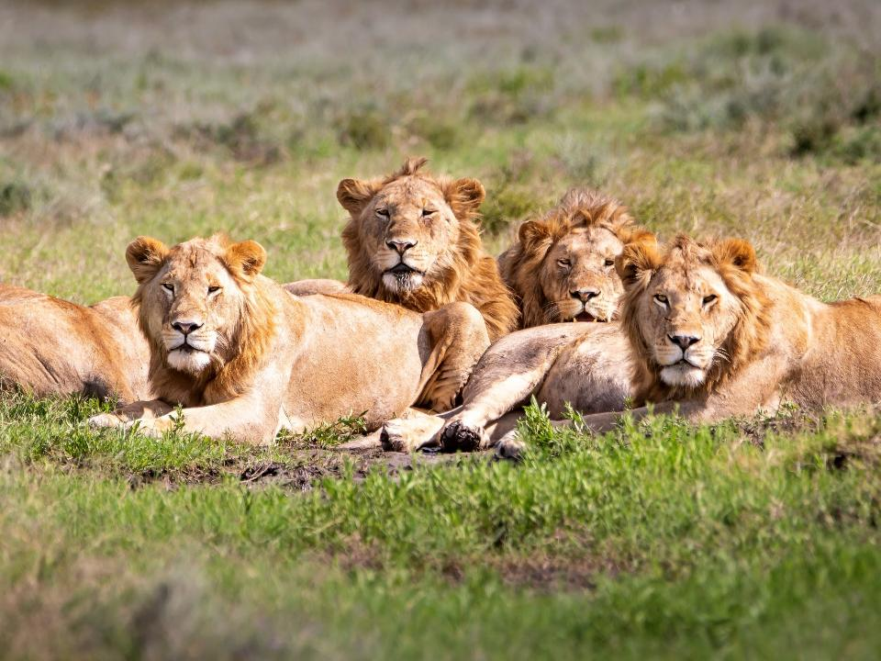





Slide 21
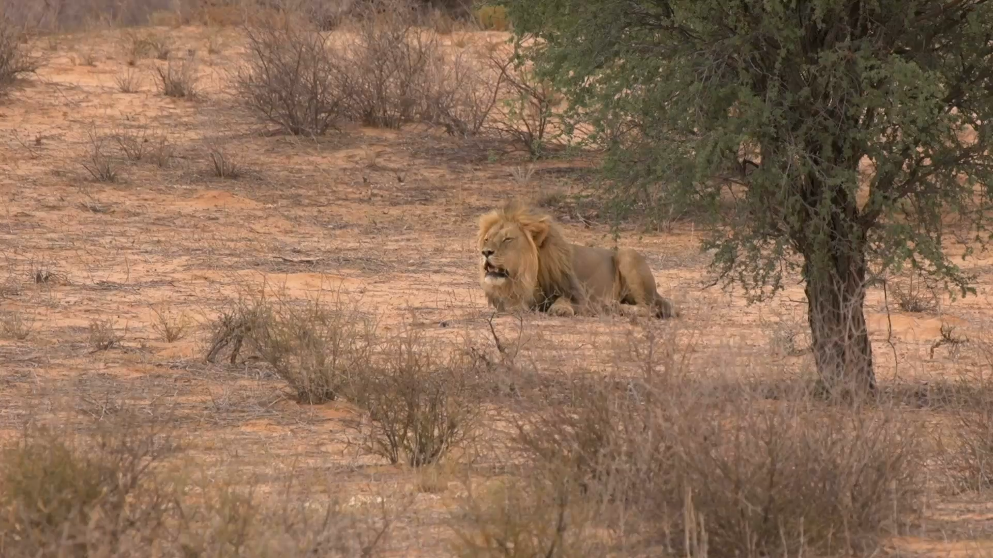
Move Like a Lion

Slide 22


Loud and Soft Music
Loud
Animal music can be loud or soft.

Slide 23
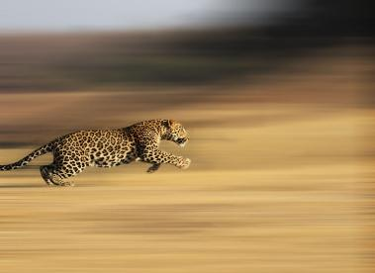

Music is made up of different sounds.
Sounds can be fast and slow.

Slide 24


Fast and Slow Sounds
Sounds can be fast or slow.
Fast
Slow
250
003

Slide 25
Fast and Slow Sounds
Fast
Slow
009
300

Slide 26
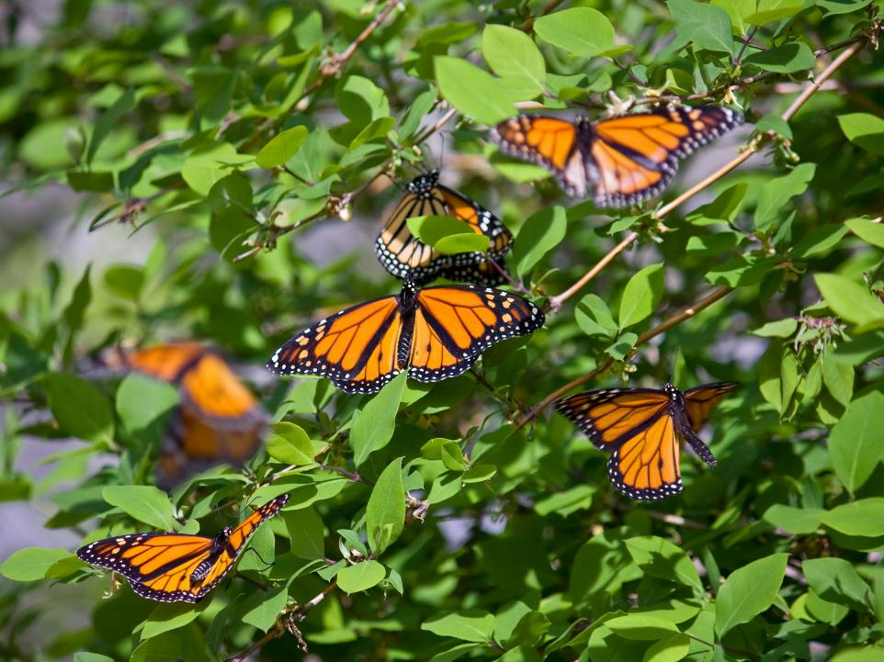


Slide 27
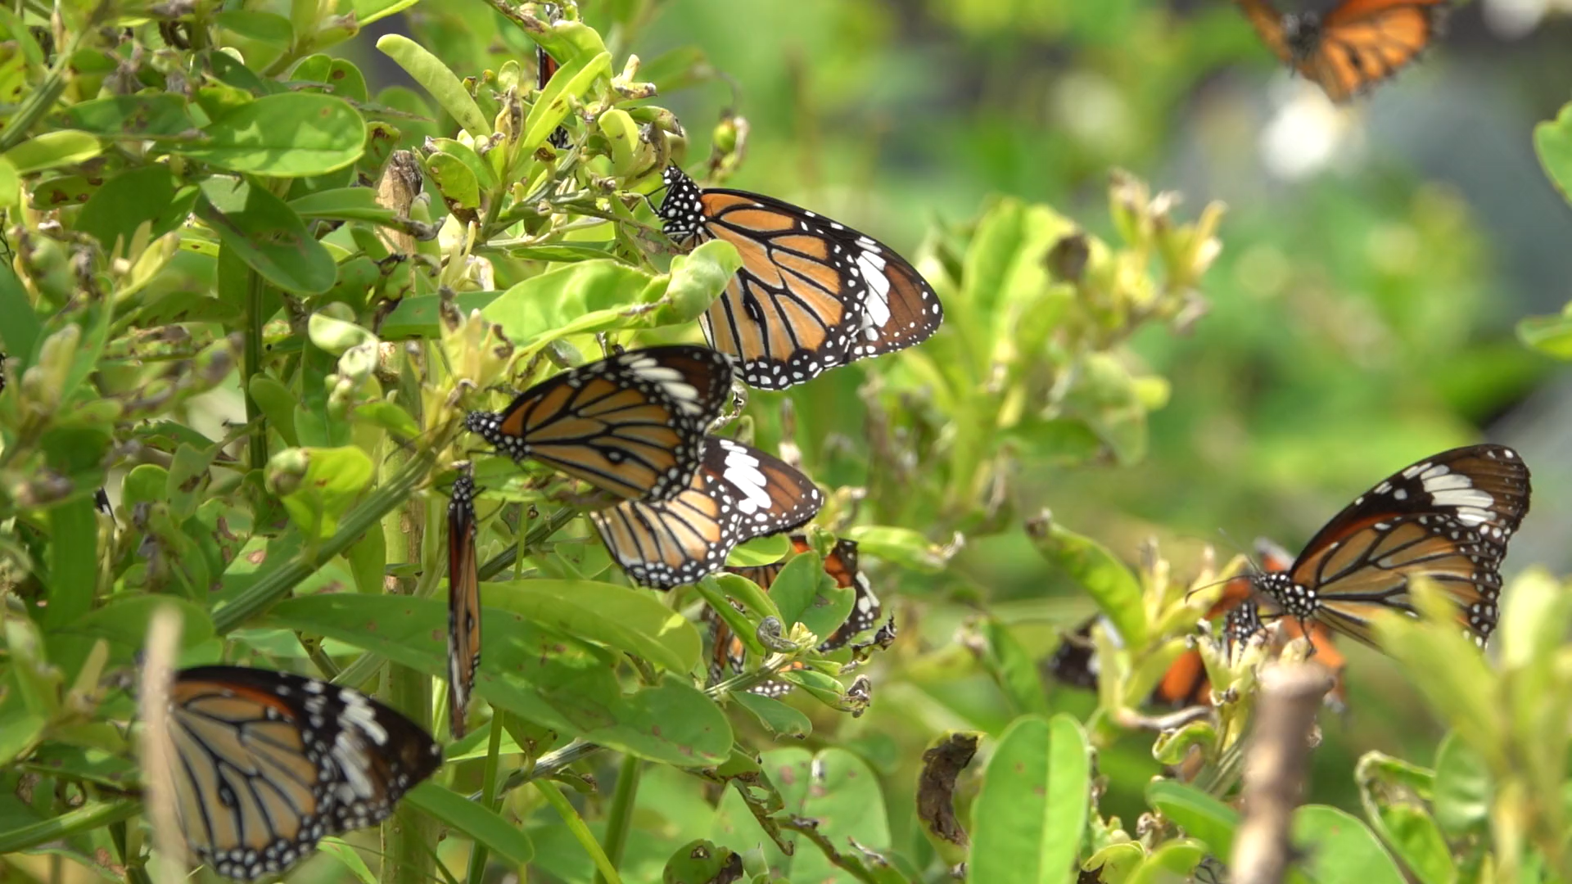
Move Like a Butterfly

Slide 28
Fast and Slow Music
Fast
Animal music can be fast and slow.

Slide 29


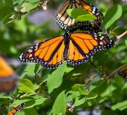
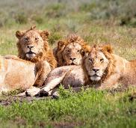
Show of Fingers
Which animal showed fast music?
Which animal showed loud music?
Which animal showed low music?
Elephant
Lion
Butterfly

Slide 30

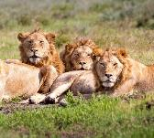
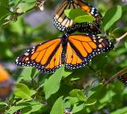
Music can be high or low.
Music can be loud or soft.
Music can be fast or slow.

Slide 31


Exit Ticket
Date: _________
Lesson 1A
Lesson 2
soft
Music can be loud or _____.
Music about butterflies can be:
scary
slow
fast.
Animal music can be h____ and low.
big
soft
small
igh
3
I know _____ out of 3 answers.

Slide 32
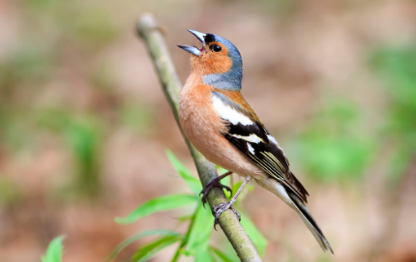
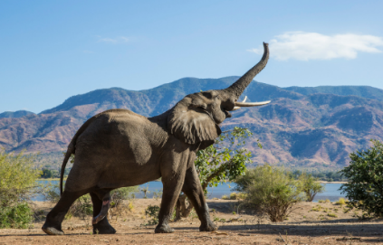
In the next lesson, we will listen to high and low sounds in animal music.

