Slide 1
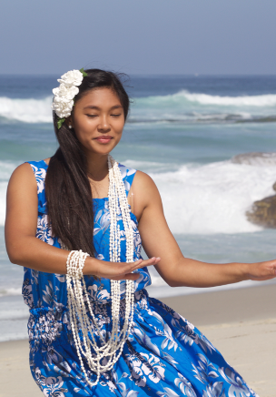
Around the World
Lesson 7
Music Test and Music from the Islands
Unit 2 Version 3

Slide 2
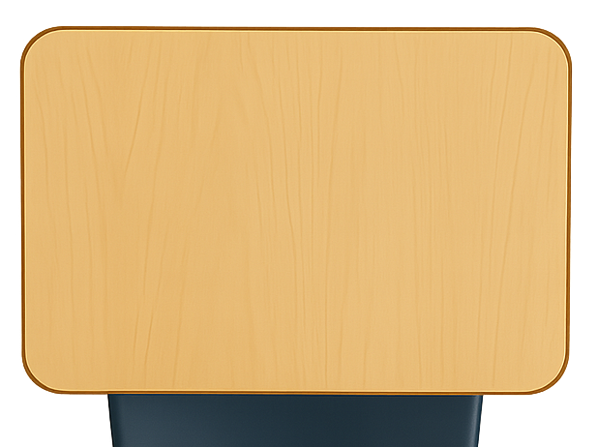
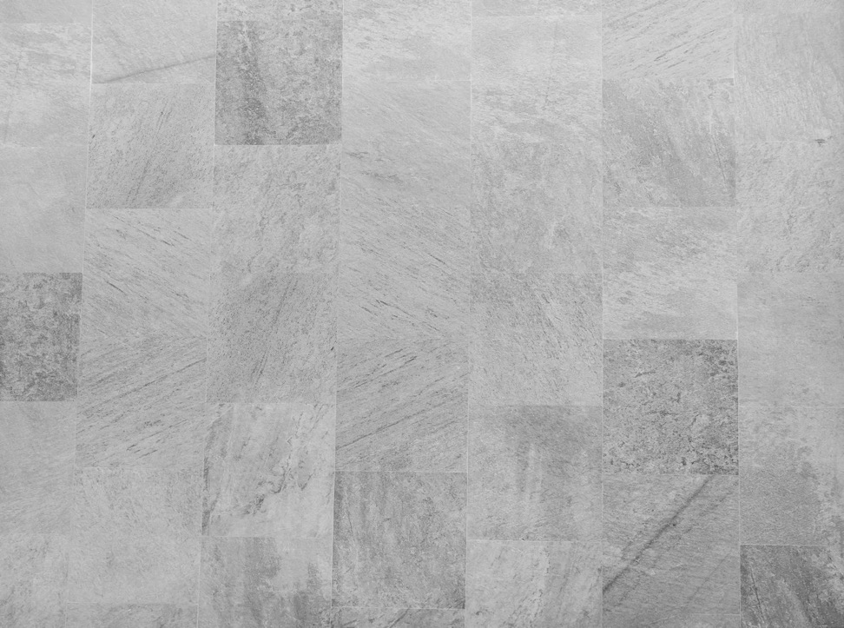
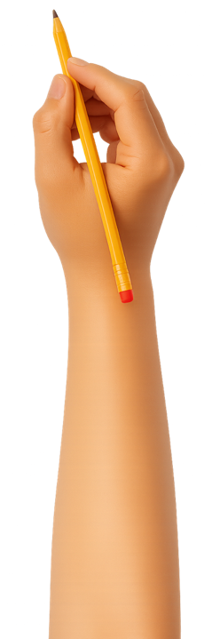
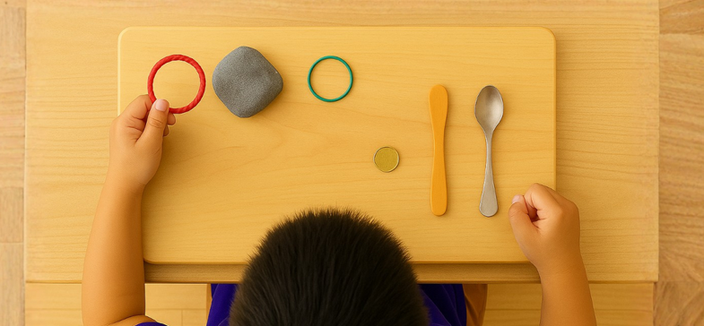
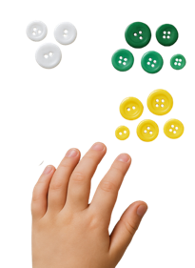
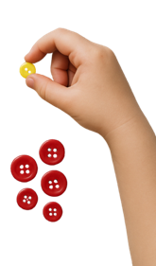
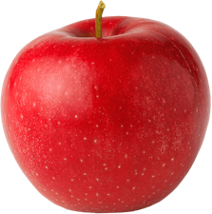




What We Learnt
Exit Ticket
Lesson 6
Lesson 1A
You will be successful when you can:
describe properties of objects
sort objects into property groups.
People in Hawaii make music that tells stories about ________ .
In Hawaii, people play instruments like:
sitar, tanpura and tabla
ukulele, ipu and pahu
koto, shakuhachi and taiko.
Hula is a special d______ from Hawaii.
nature
Describe means to tell what something looks like, sounds like, feels like or what it is.
nature
cities
airplanes
Sort to put things that are the same together.
red
round
ance
crunchy

Slide 3
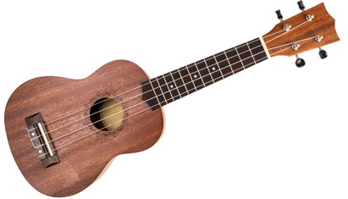


We strum the ukulele with our:
right hand
left hand

Slide 4
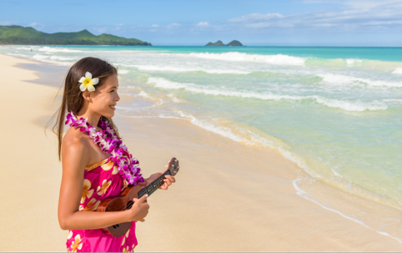
In this lesson, we will complete a music test and sing and play music from Hawaii.

Slide 5
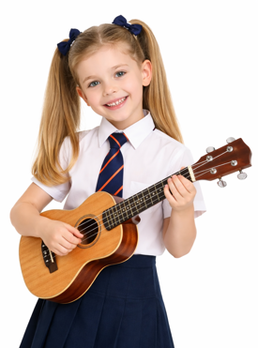
You will be able to:
the music test
a song
from Hawaii.
complete
Complete means to finish all parts of a task so it is fully done.
sing and
play
Sing means to make music with your voice by using words and a tune.
Play means to make a musical sound on your instrument.

Slide 6
Content Test Marking Guide
Content Weeks 1–7 | Questions | Marks
Content | Q1. Circle the correct answer to finish the sentence. | 1
 | Q2. Choose the correct answer. | 1
 | Q3. Choose the correct answer to finish the sentence. | 1
 | Q4. Choose the correct answer to finish the sentence. | 1
 | Q5. Fill in the blank to complete the sentence. | 1
 | Q6. Circle the correct answer to finish the sentence. | 1
 | Q7. Fill in the blank to complete the sentence. | 1
 | Q8. Fill in the blank to complete the sentence. | 1
 | Q9. Circle the correct answer to finish the sentence. | 1
 | Q10. Match the musical instruments to the country they are from. | 4
 | Total Marks _____ /13

Slide 7

Content Test

Slide 8
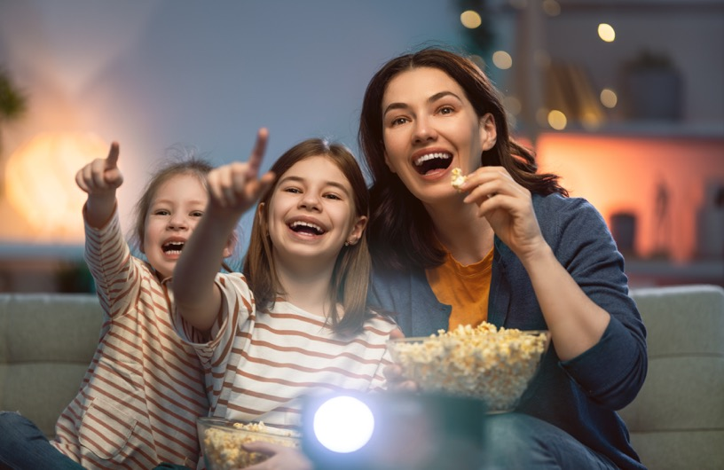
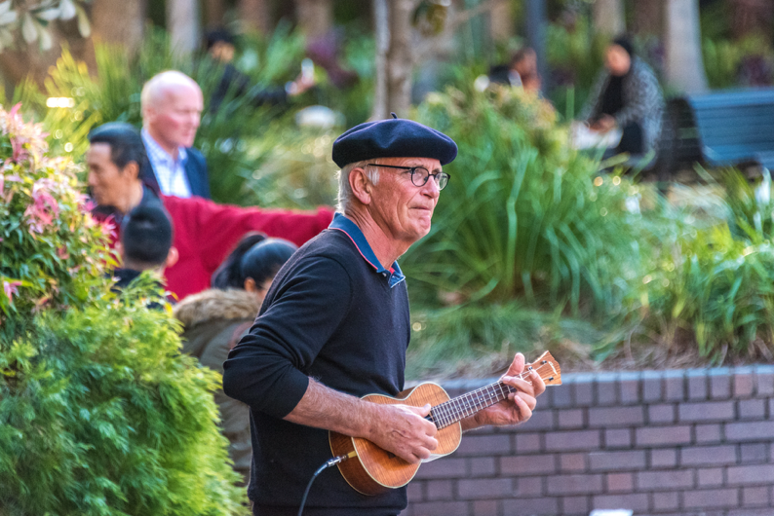
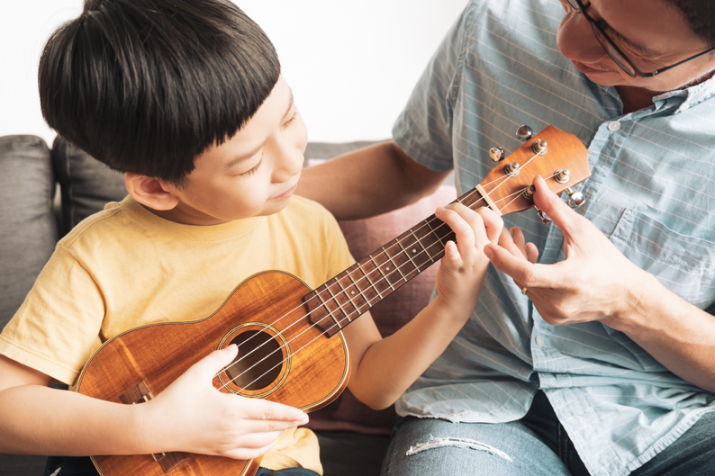
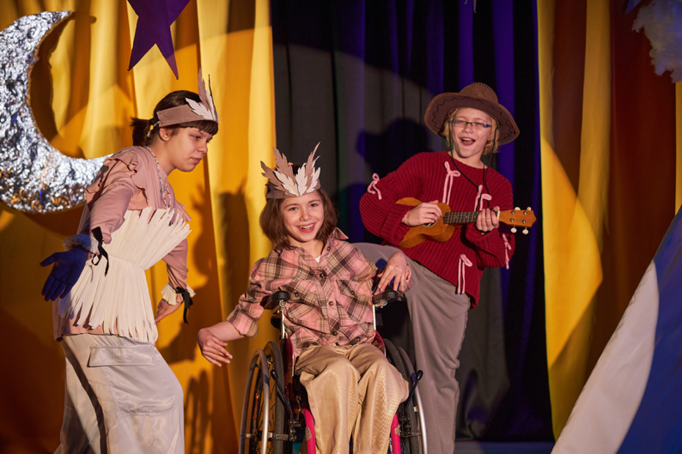

Slide 9

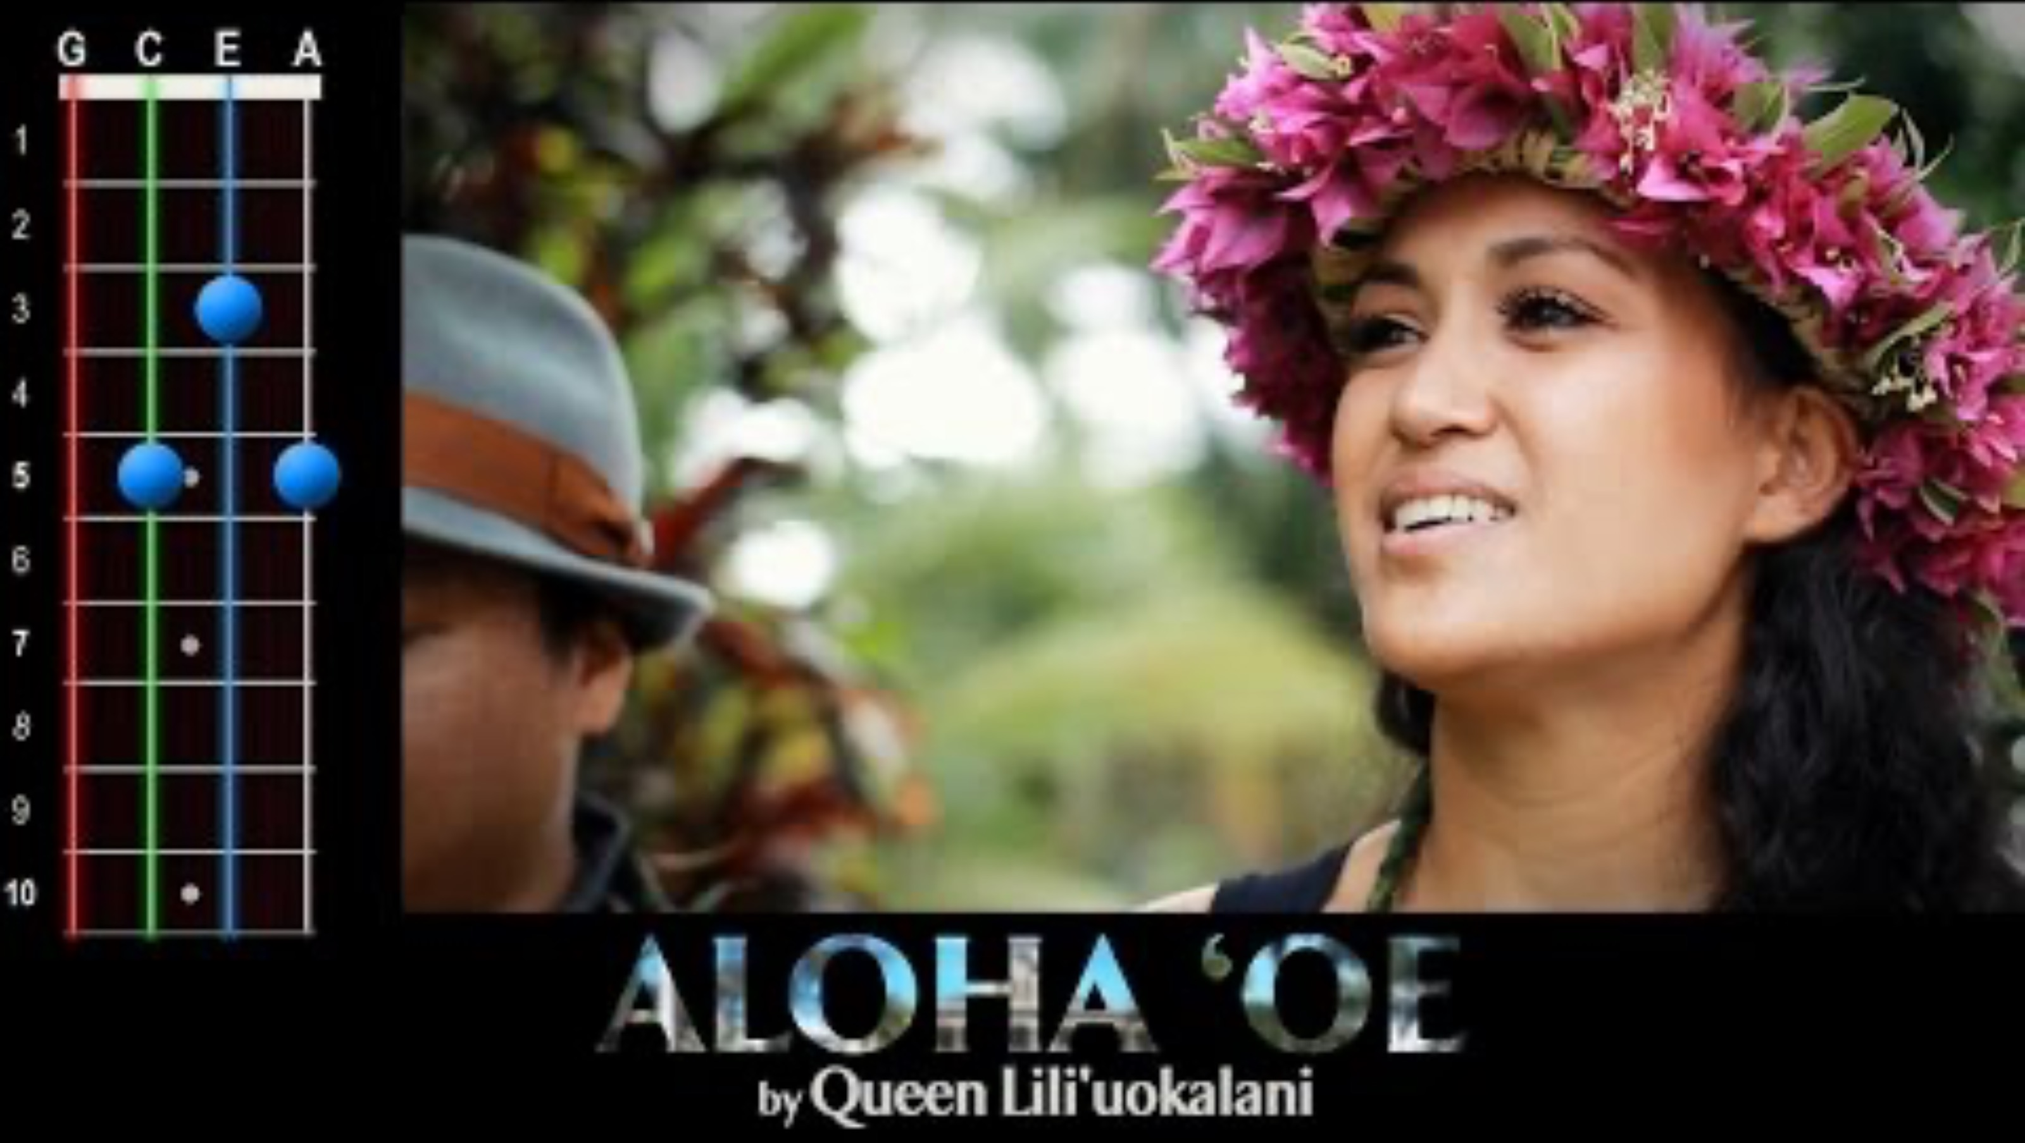
The Dreaming
Music from Hawaii
All
Images
News
Videos
More
Music from Hawaii
Insert Video Here
Music from Hawaii
Play
Videos may be subject to copyright

Slide 10

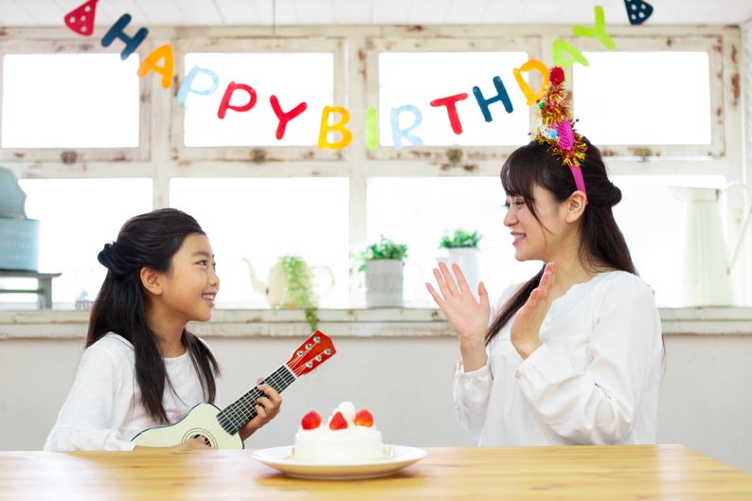
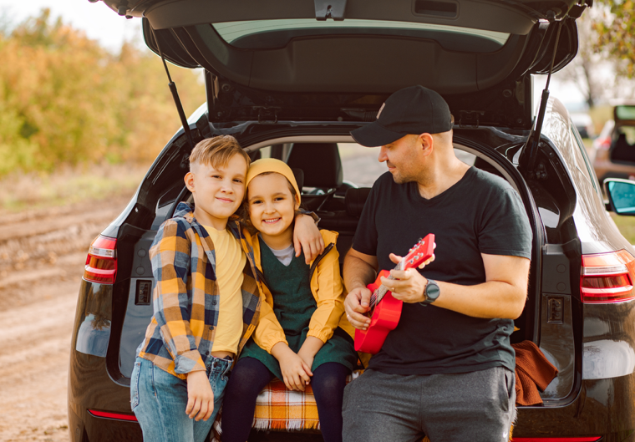
People Play Songs on the Ukulele

Slide 11
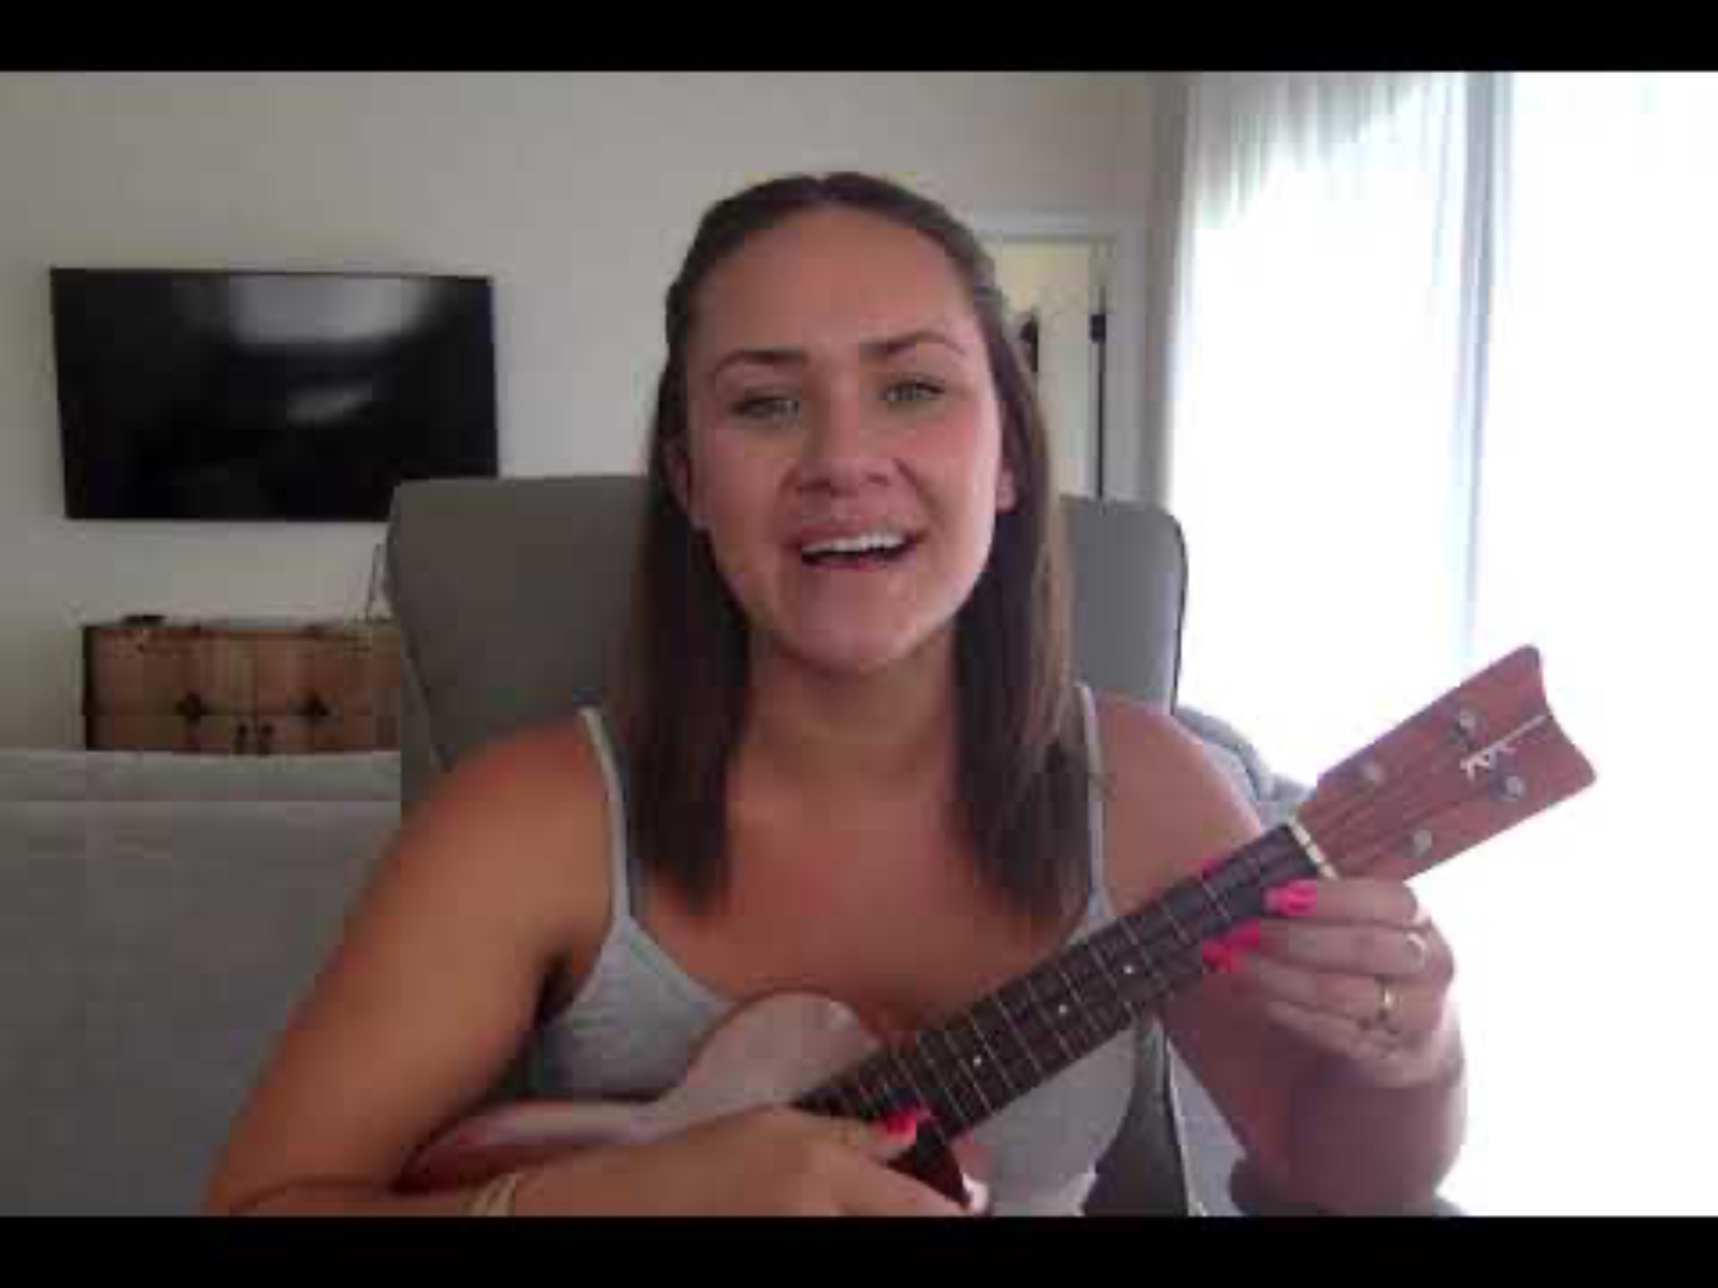
Aloha Kakahiaka

Slide 12

Aloha Kakahiaka
Aloha
kakahiaka
means
good
morning
to you
Aloha
kakahiaka
means
good
morning
to you
Alo---ha,
Alo---ha
Alo---ha

Slide 13
Aloha Kakahiaka
Aloha
kakahiaka
means
good
morning
to you
Aloha
kakahiaka
means
good
morning
to you
Alo---ha,
Alo---ha
Alo---ha

Slide 14
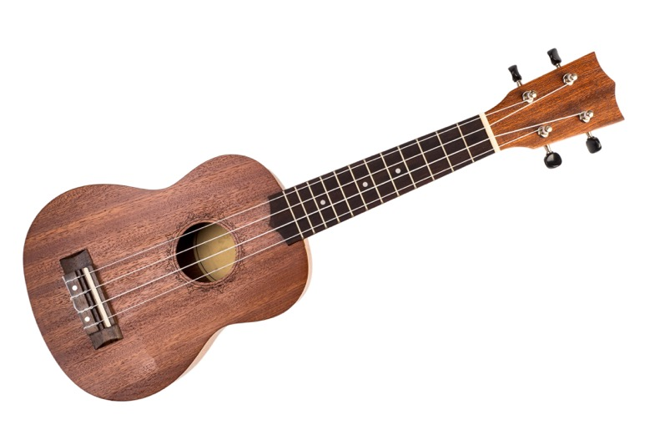
The Ukulele
Head
Neck
Body
Tuners
Frets
G
C
E
A

Slide 15
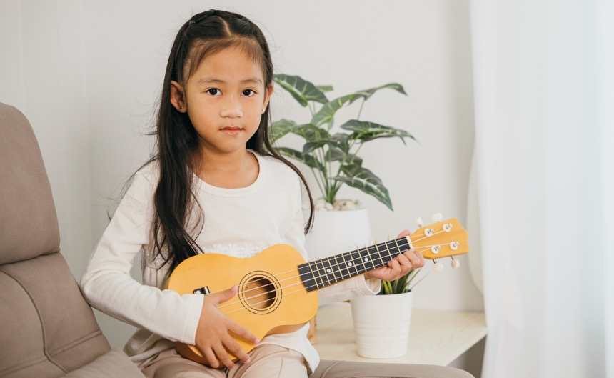
Holding the Ukulele

Slide 16
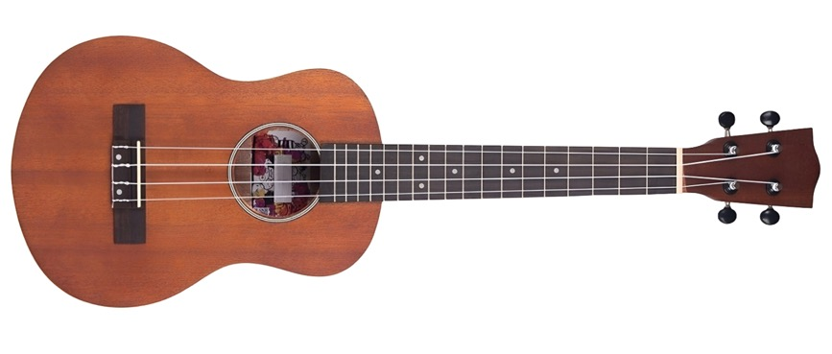

Strumming the Ukulele

Slide 17
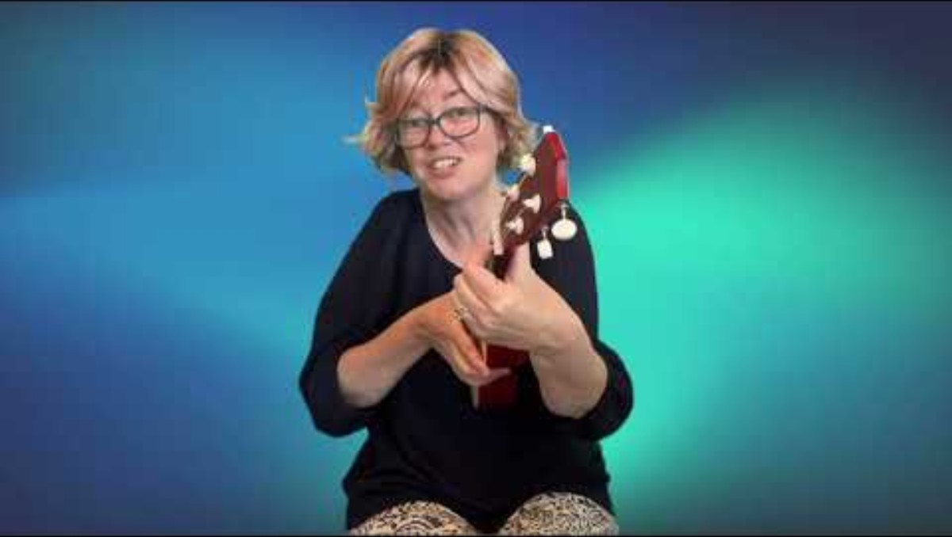
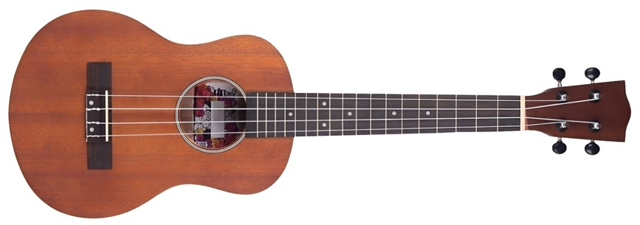

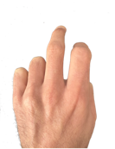
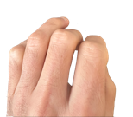
Playing Chord F on the Ukulele
F
3
3
2
2
1
1

Slide 18
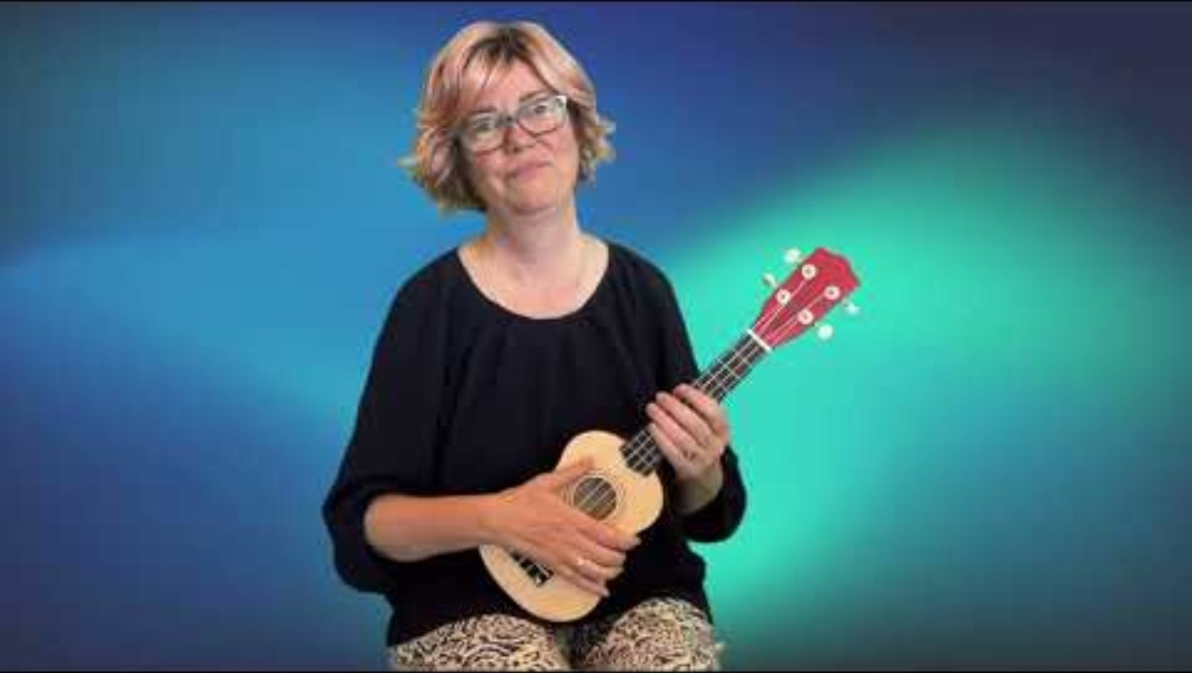
Playing Chord C on the Ukulele
C
3
3
2
2
1
1

Slide 19
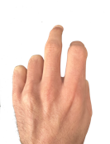
Playing Chords on the Ukulele
C
F
3
3
2
2
1
1

Slide 20
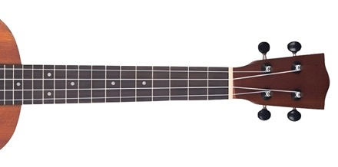

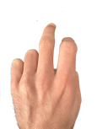

Aloha Kakahiaka
F
F
C
F
Aloha kakahiaka means good morning to you
F
F
C
F
Aloha kakahiaka means good morning to you
F
C

Slide 21
Aloha Kakahiaka
F
F
Alo---ha
Alo---ha
F
Alo---ha
F

Slide 22
Aloha Kakahiaka
F
F
C
F
Aloha kakahiaka means good morning to you
F
F
C
F
Aloha kakahiaka means good morning to you
F
F
Alo---ha
Alo---ha
F
Alo---ha

Slide 23



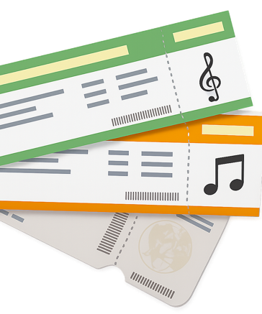



H8

Slide 24
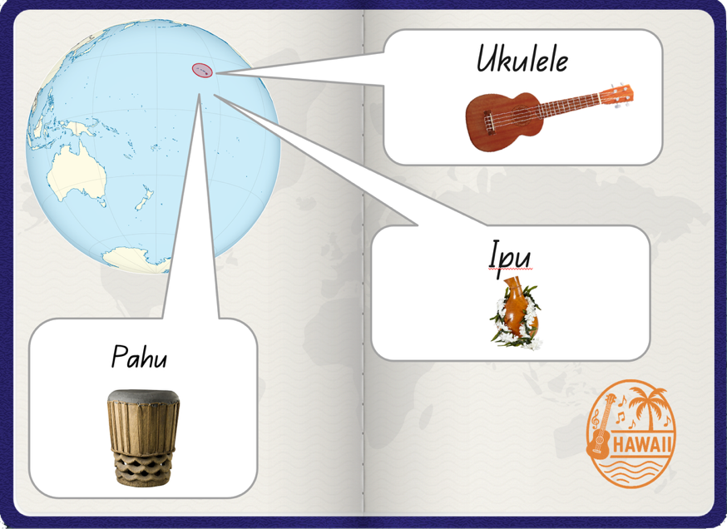
H8

Slide 25
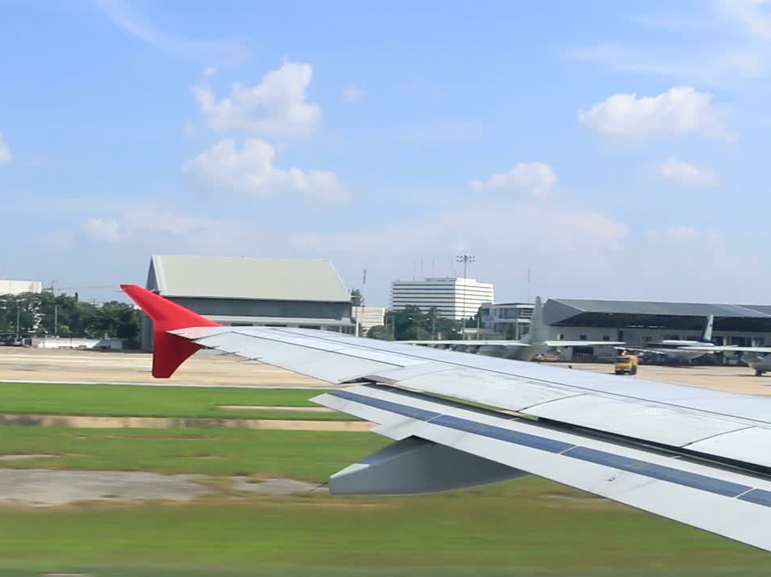

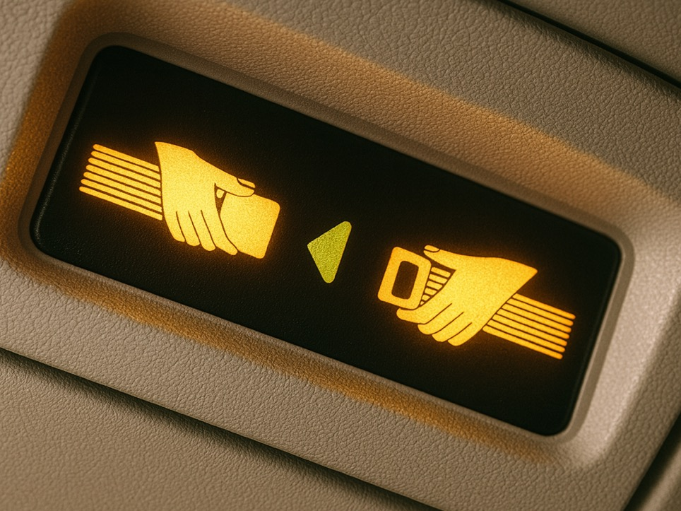

Slide 26
A music test checks what you know.
A music test helps your teacher see what you understand.
A music test shows your teacher what you might need more help with.

Slide 27
People sing and play songs on the ukulele.
Chords are a few sounds played at the same time.

Slide 28


Exit Ticket
Date: _________
Lesson 1A
Lesson 7
You will be successful when you can:
describe properties of objects
sort objects into property groups.
People sing and ______ songs on the ukulele.
Chords are:
names of Hawaiian songs
a few sounds played one after another with pauses
a few sounds played together at the same time.
Aloha Kakahiaka means g_____ m_______.
play
Describe means to tell what something looks like, sounds like, feels like or what it is.
play
write
read
Sort to put things that are the same together.
red
round
crunchy
ood
orning
3
I know _____ out of 3 answers.

Slide 29
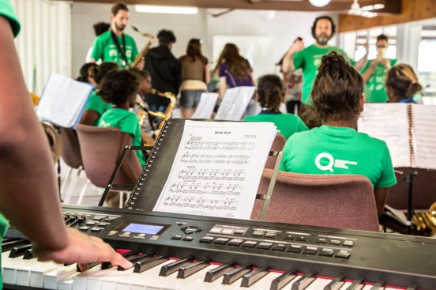
In the next lesson, we will use our knowledge to make music.

