Slide 1
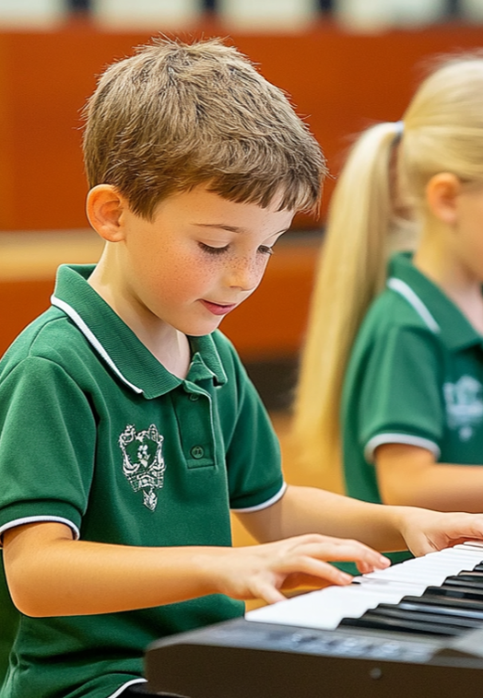
Around the World
Lesson 9
Ready, Set, Play!
Unit 1 Version 3

Slide 2


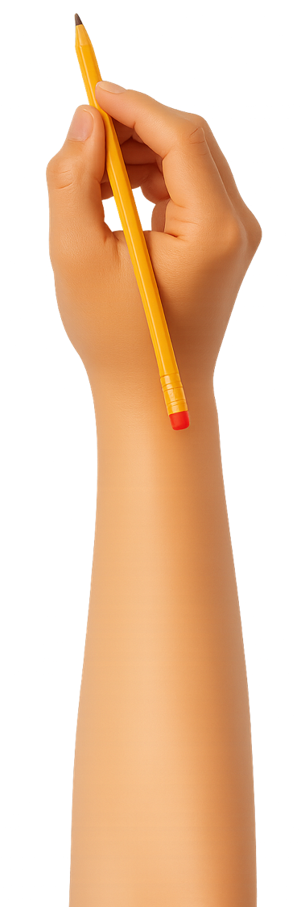
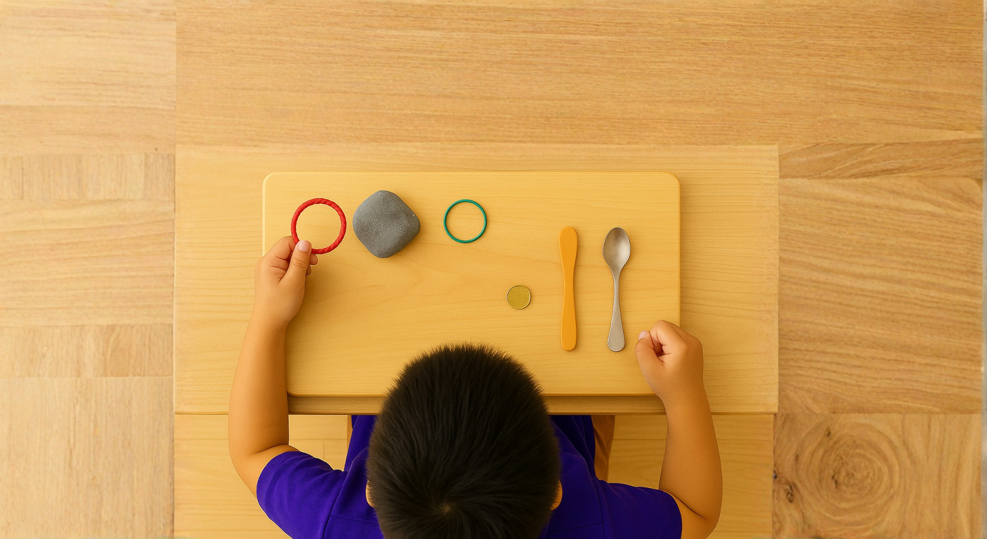
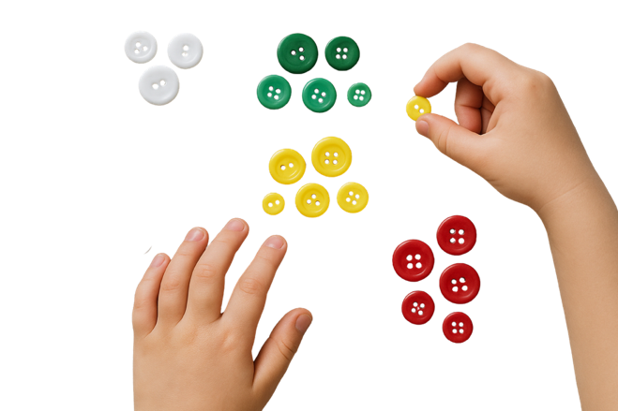
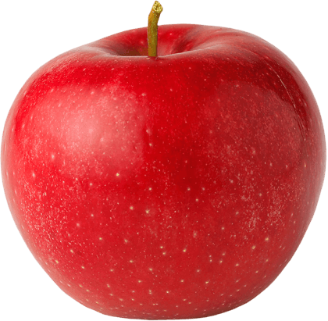




What We Learnt
Exit Ticket
Lesson 1A
Lesson 8
You will be successful when you can:
describe properties of objects
sort objects into property groups.
different
Musicians make __________ music in different countries.
Musicians perform their music to an:
  audience
  interviewer
  teacher.
To have a great performance, it takes p________.
Describe means to tell what something looks like, sounds like, feels like or what it is.
the same
old
different
Sort to put things that are the same together.
red
round
ractise
crunchy

Slide 3



Musicians practice by:
singing and playing slowly, repeating the same section and listening to others
singing and playing the music once

Slide 4
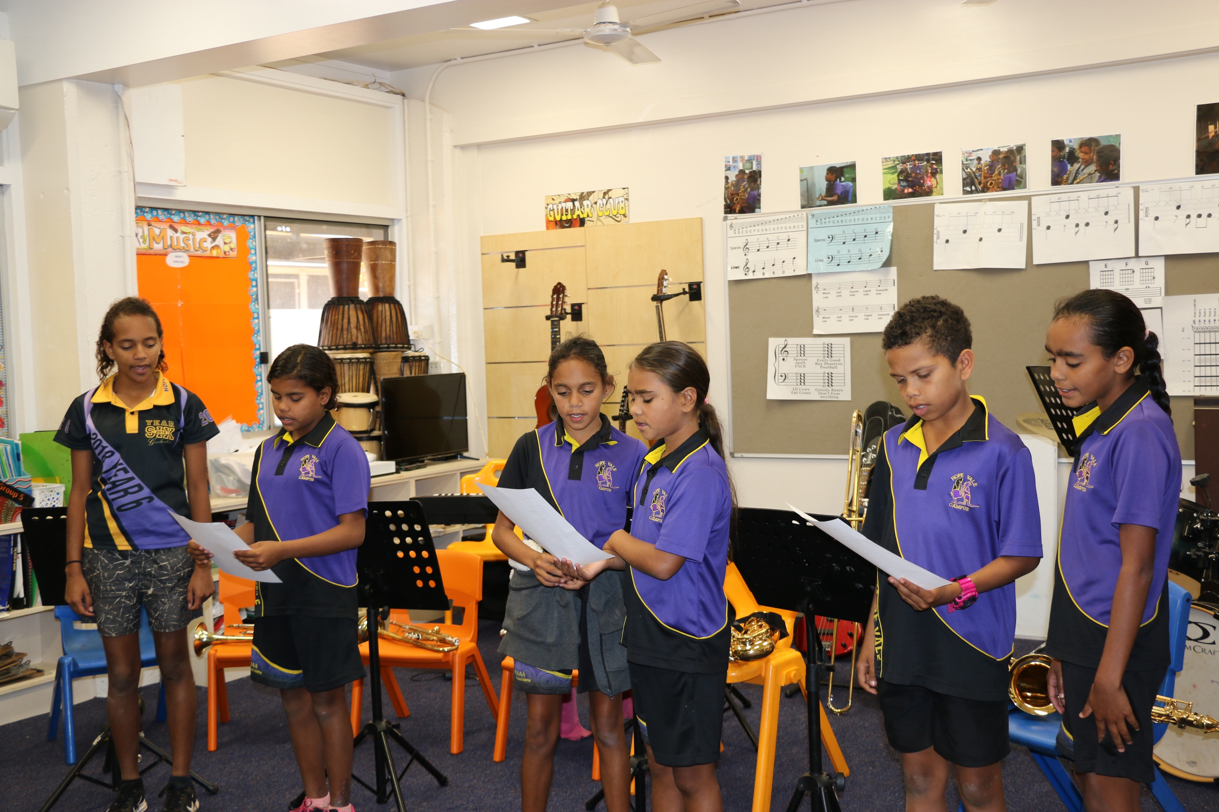
In this lesson, we will perform music as a group for an audience.

Slide 5
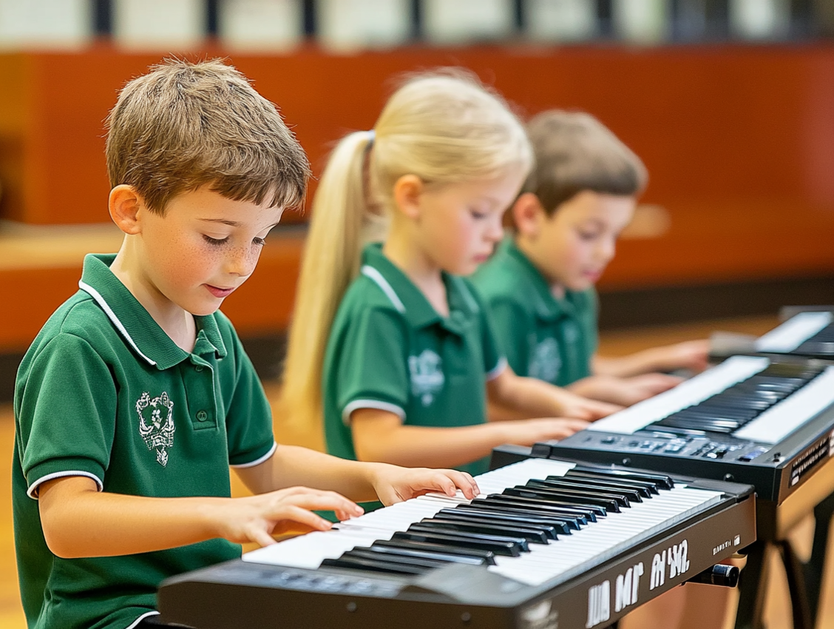
You will be able to: ​
music for an audience
music in a group.
​
perform
Perform means to present something you have practised in front of others.
play
Play means to make a musical sound on your instrument.

Slide 6
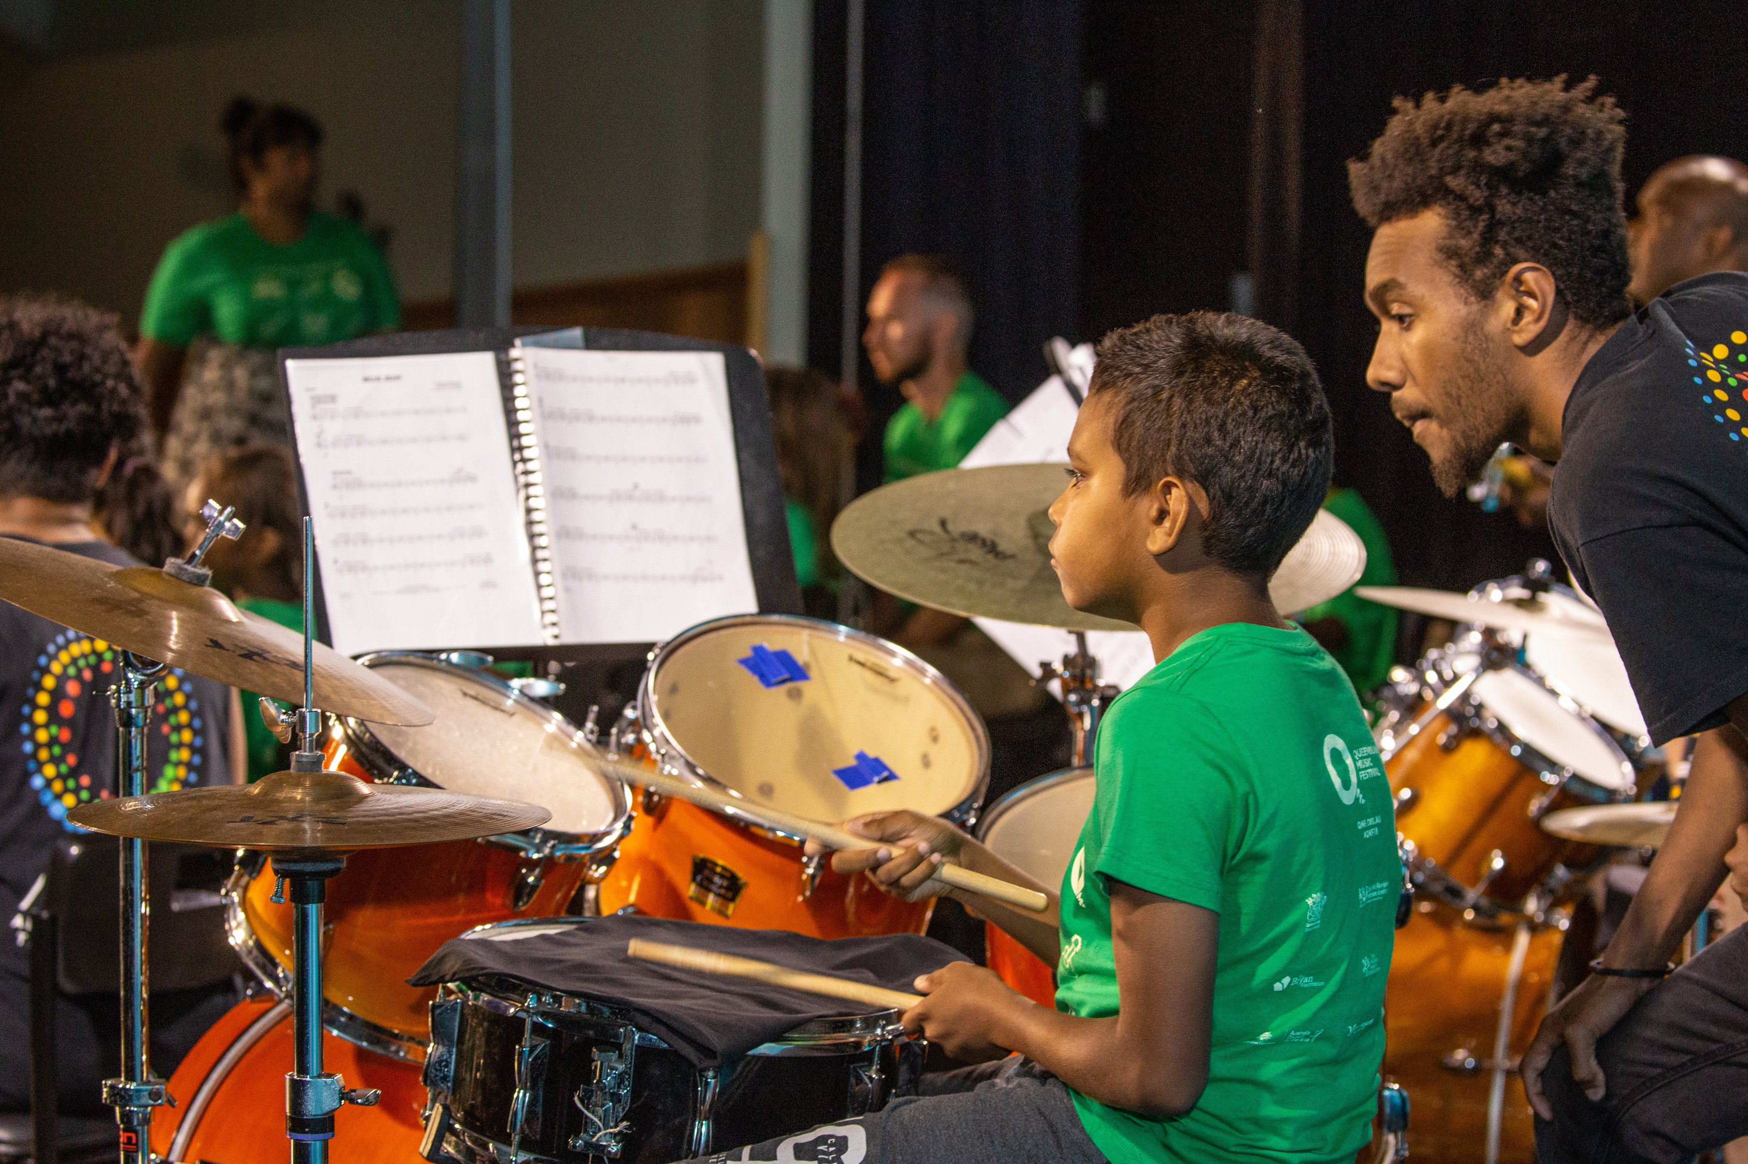
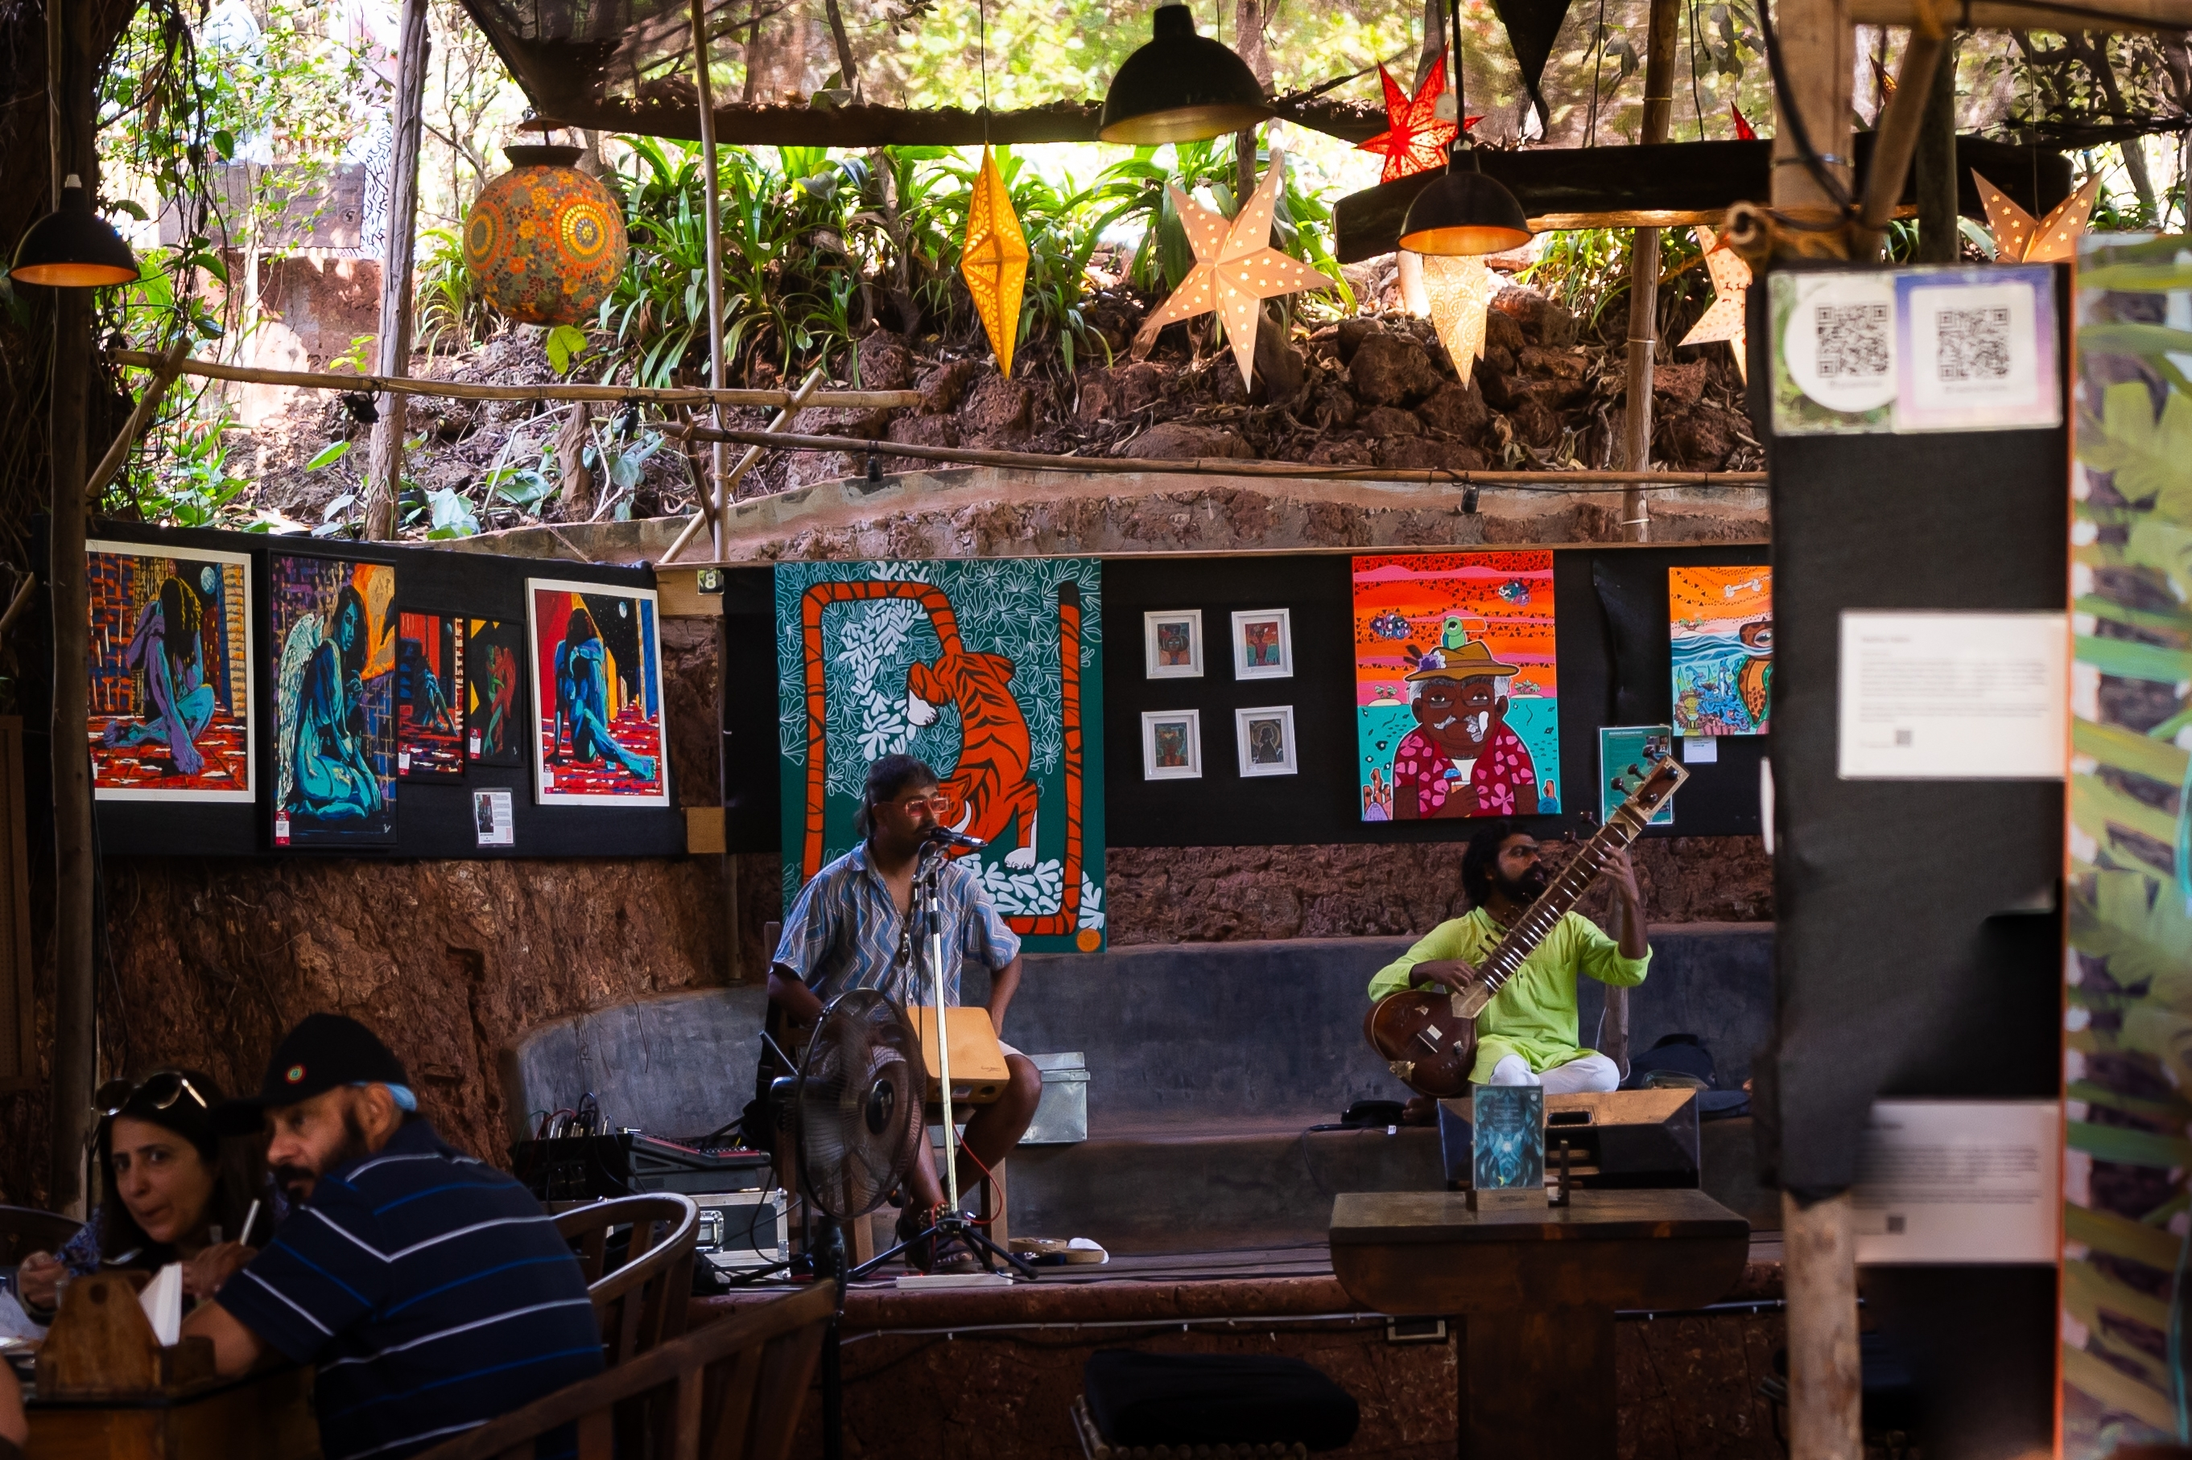
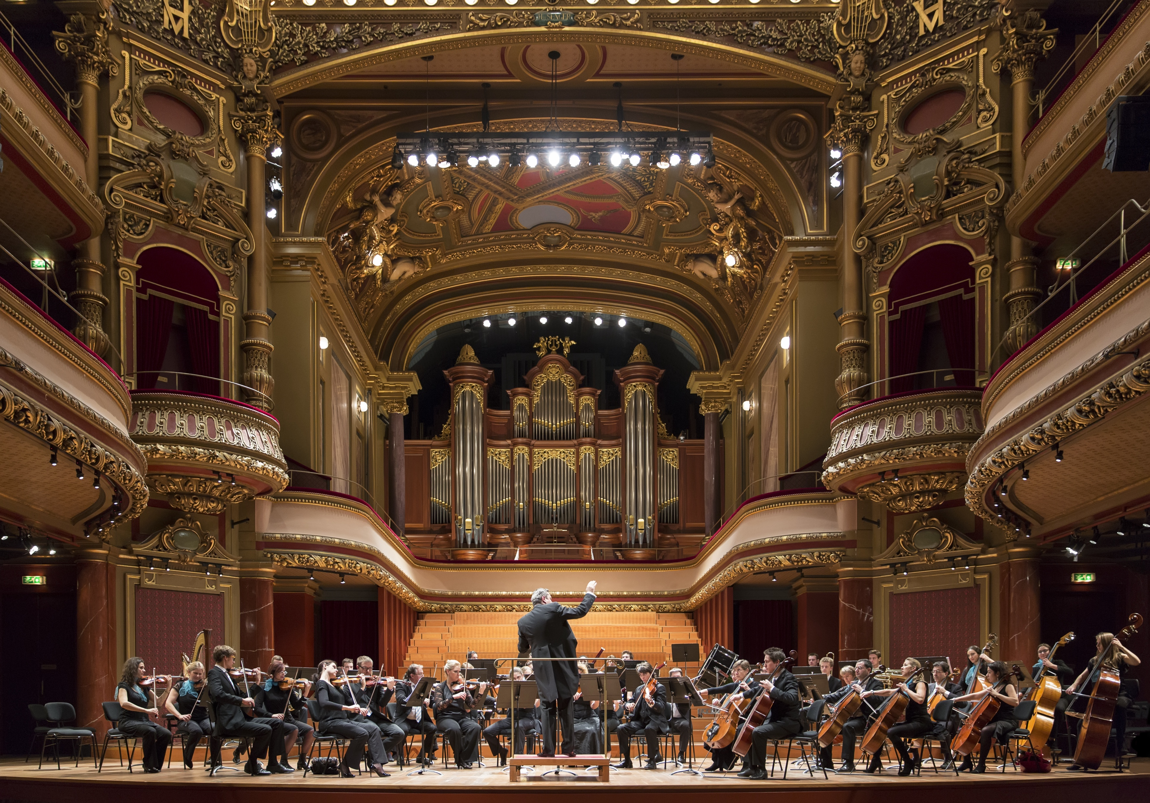
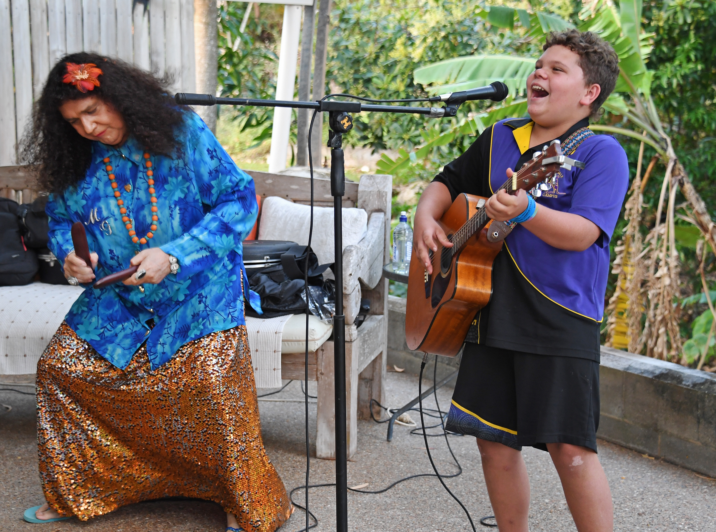

Slide 7




Practicing for a Performance
Practice small sections
Practice slowly
Repeat
Listen to others

Slide 8



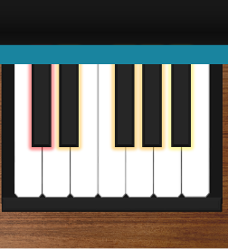

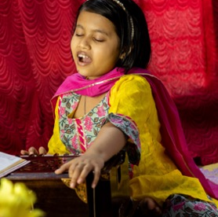



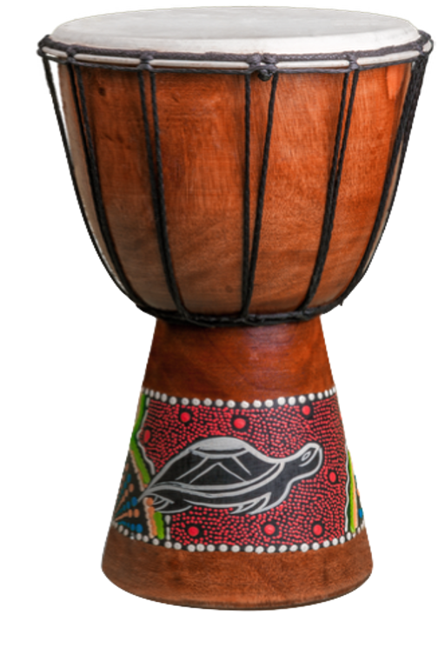
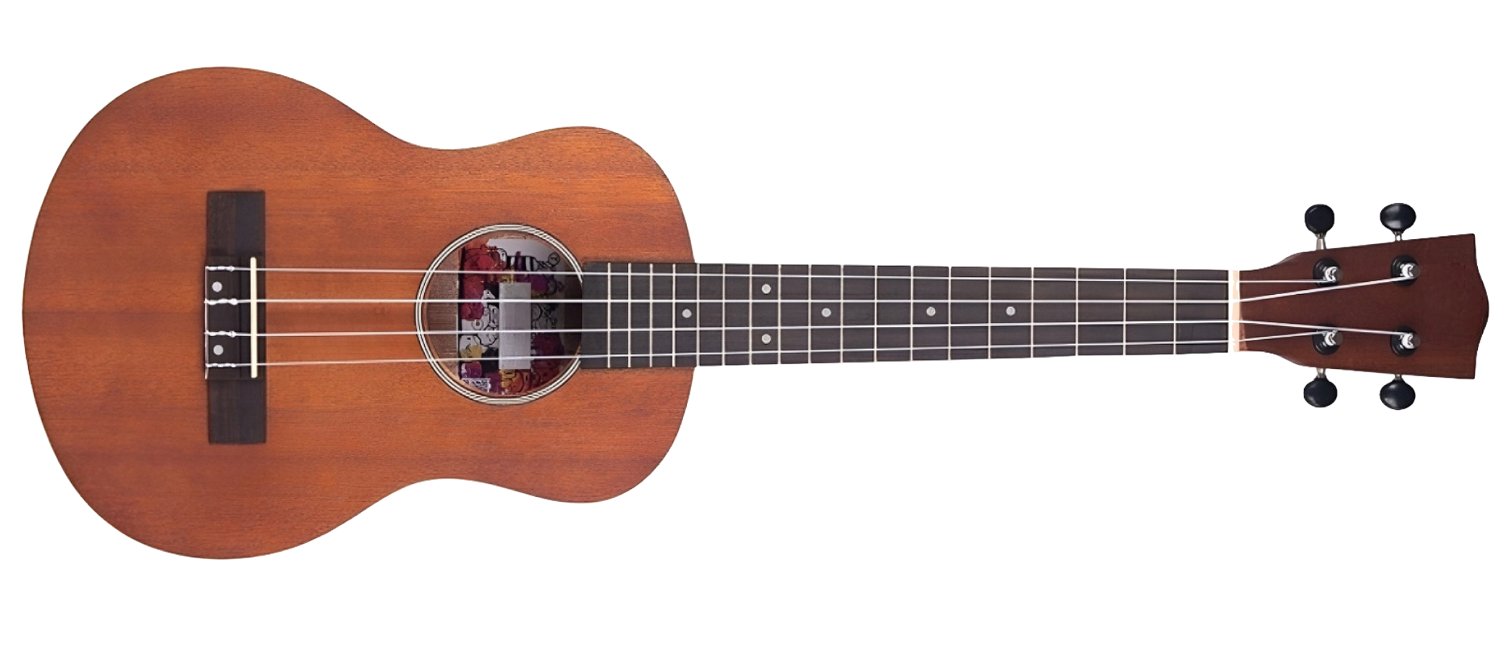
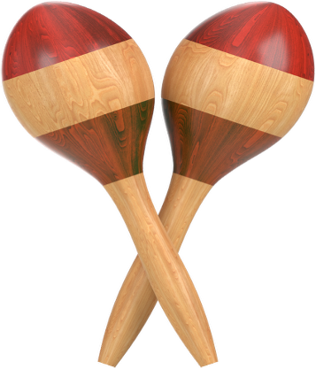
Practice Music in Groups
Group A
Group B
Group D
Group C

Slide 9
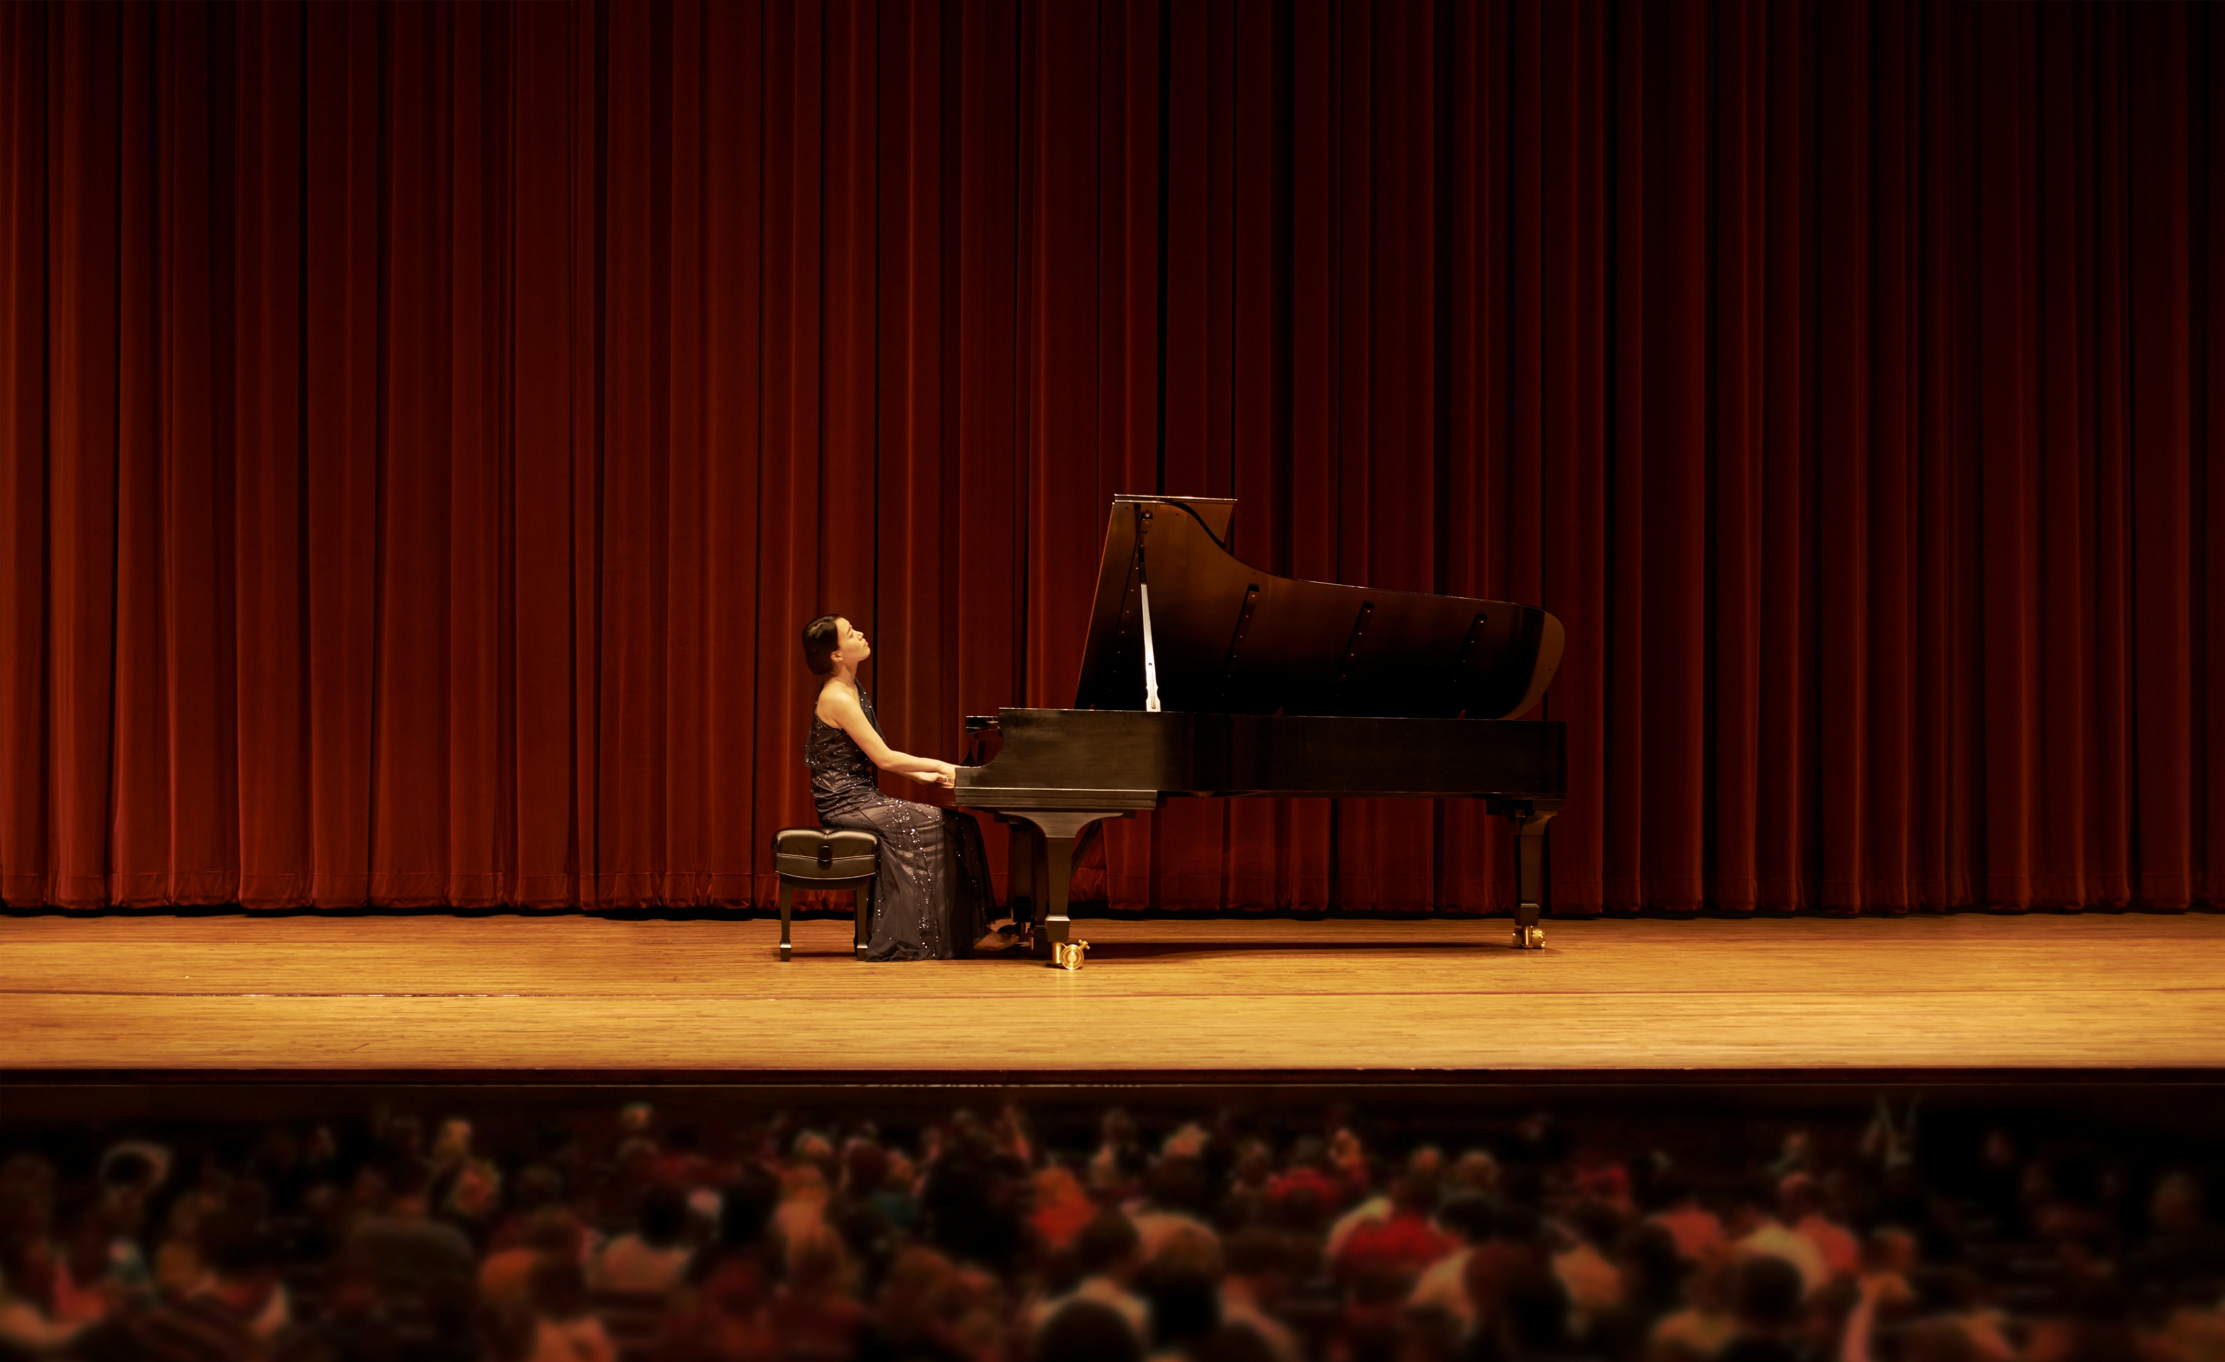
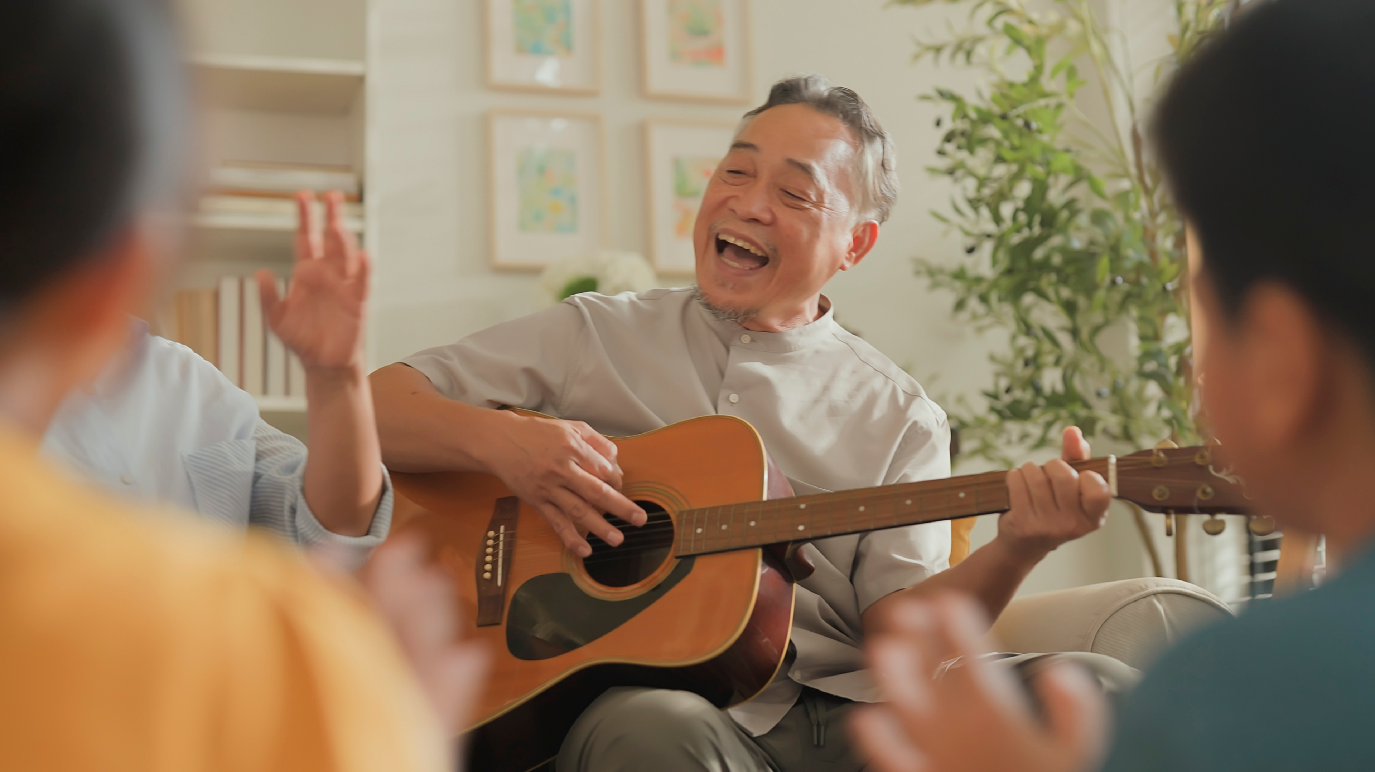
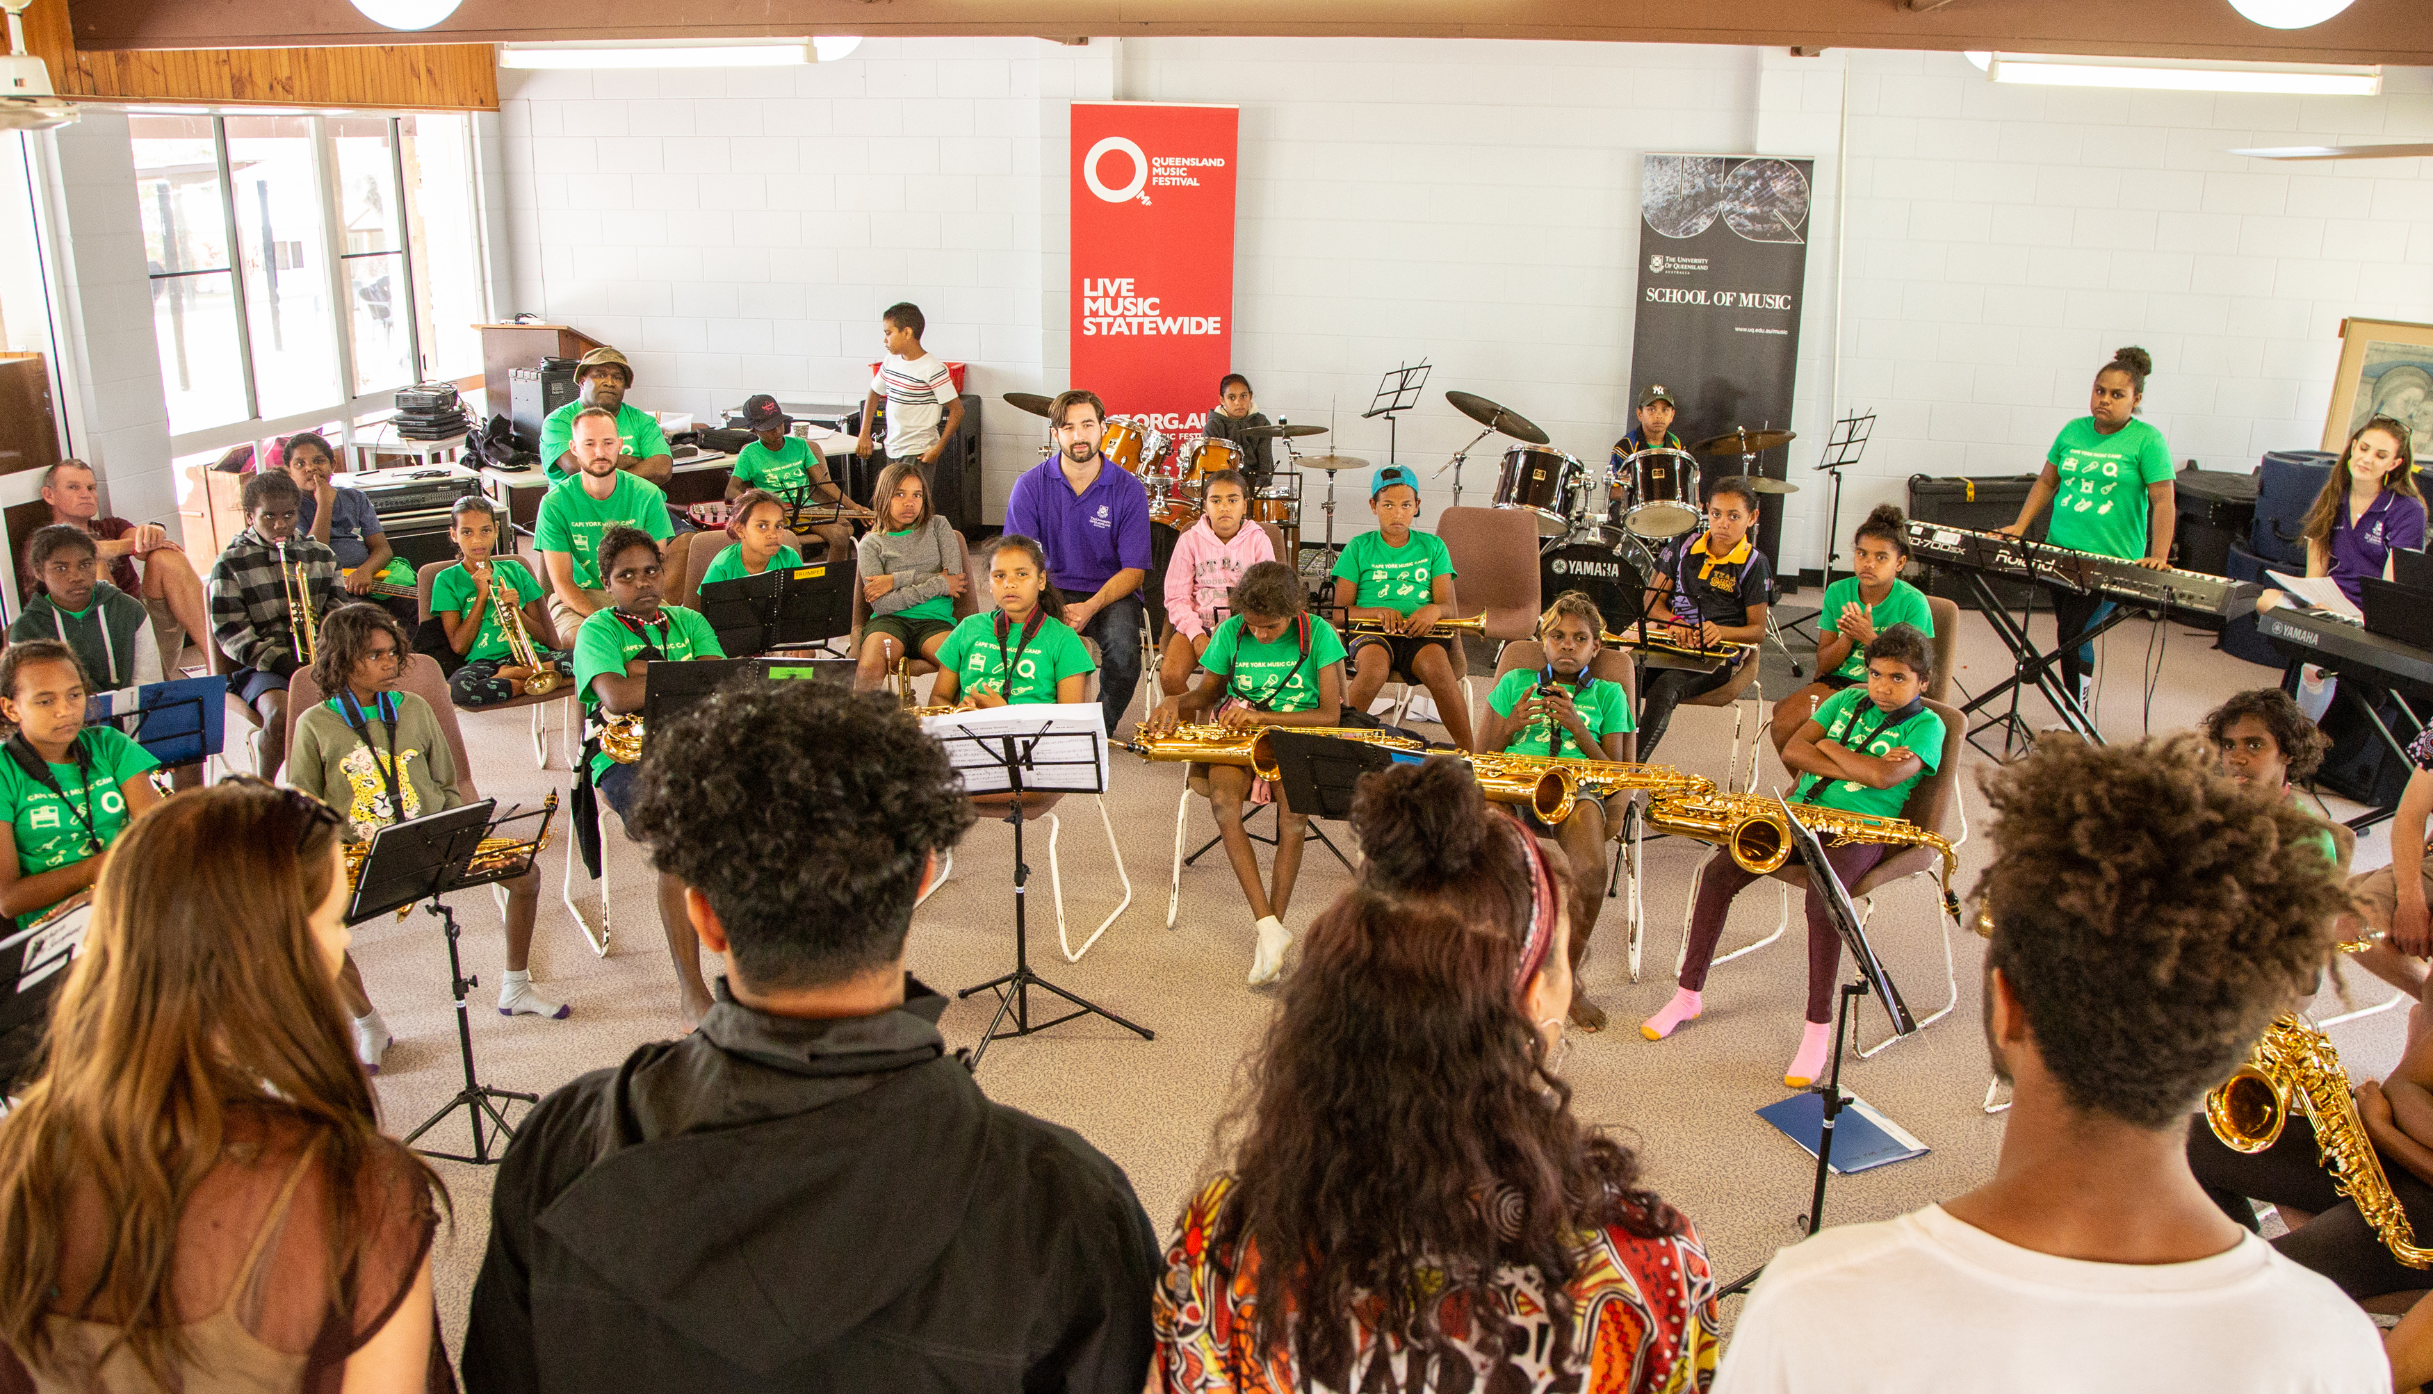
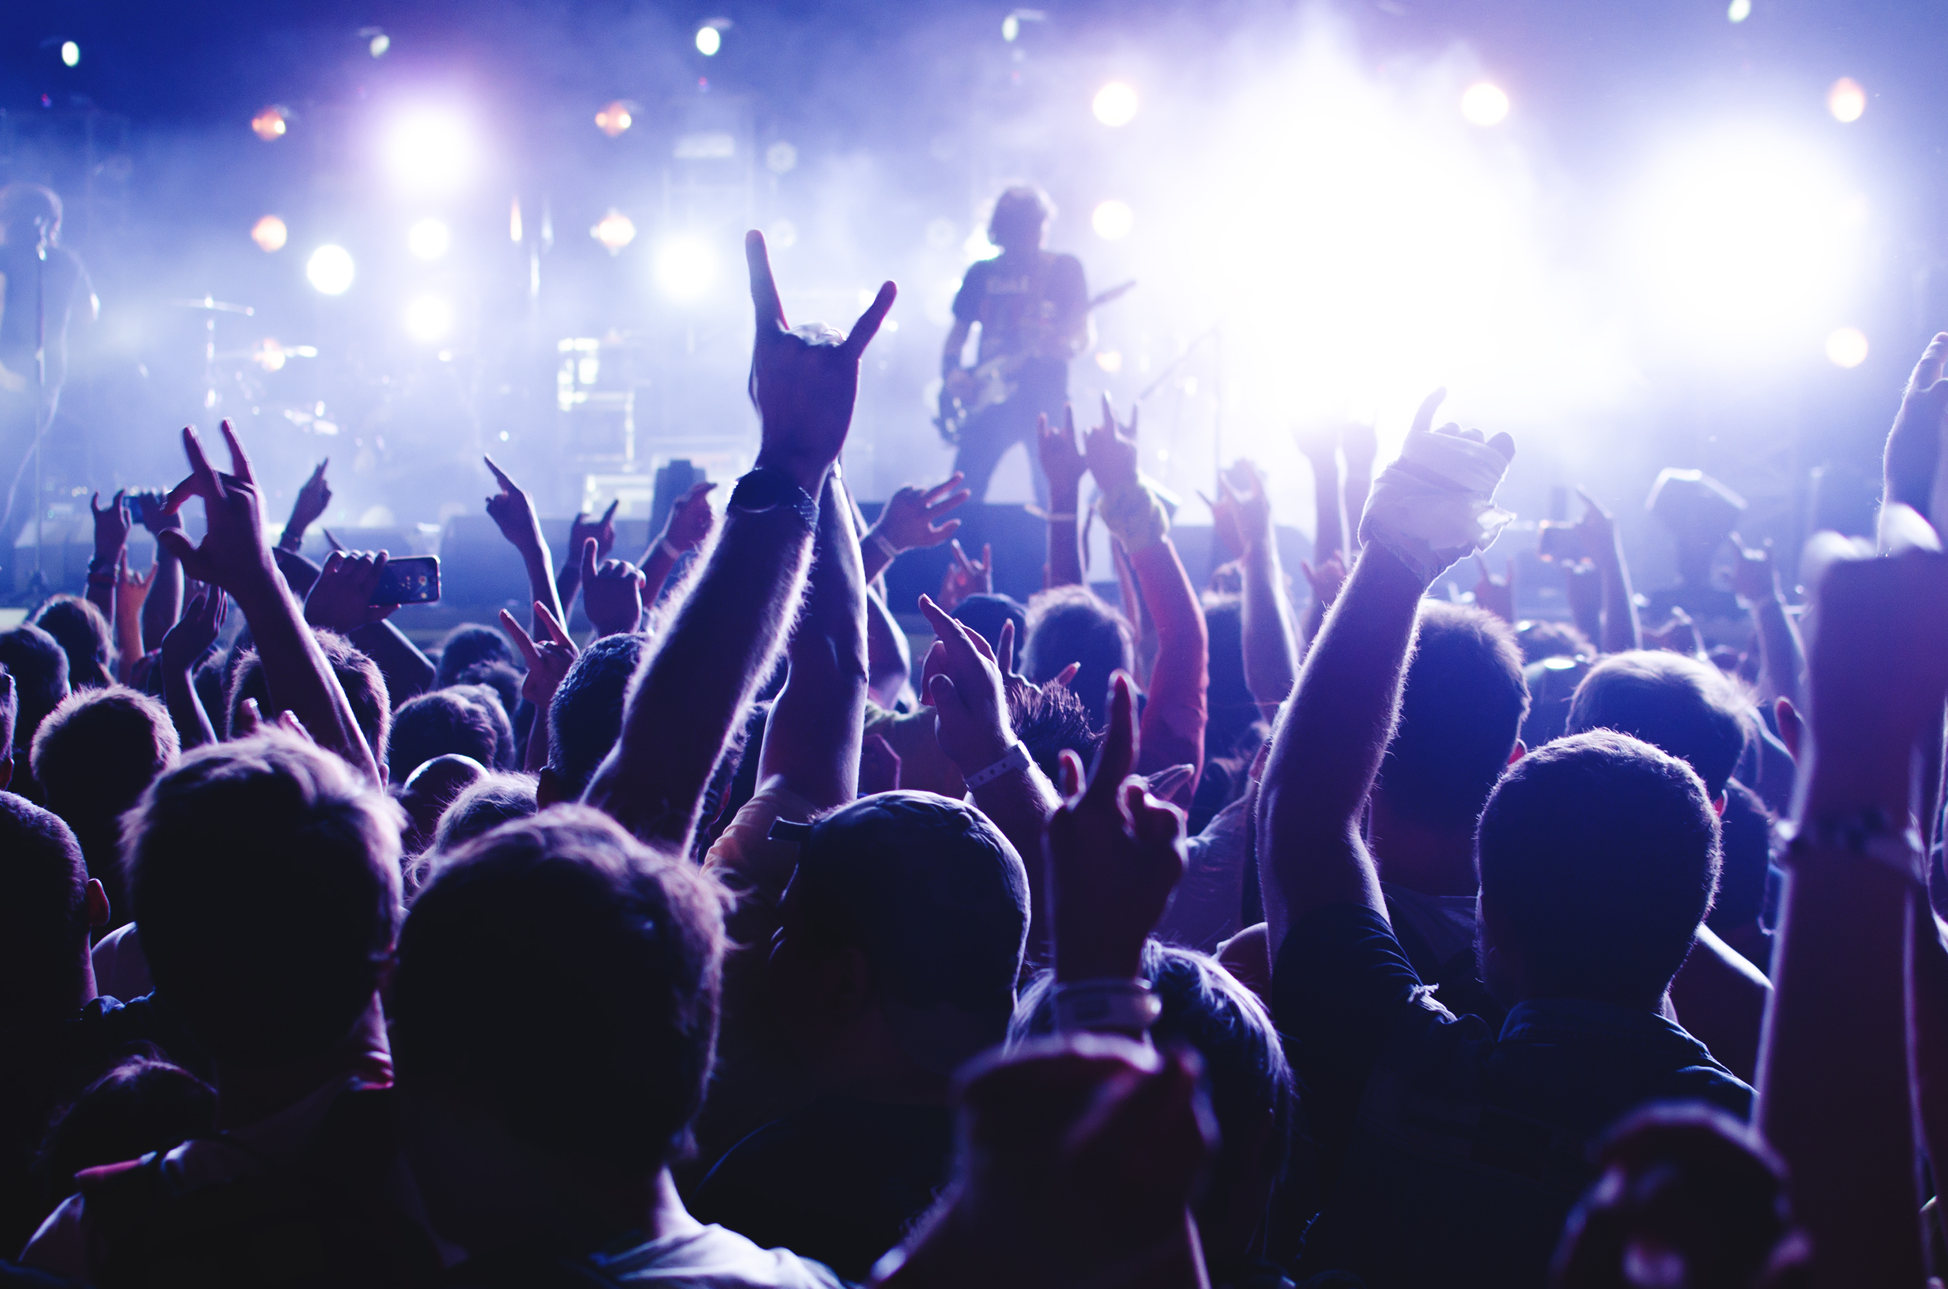
Music Can Be Performed for an Audience

Slide 10
Performing Music
Group A
Group B
Group D
Group C

Slide 11
Music can be performed for an audience.
Musicians practise slowly, repeating small sections and listening to others as they sing and play.

Slide 12


Exit Ticket
Date: _________
Lesson 1A
Lesson 9
You will be successful when you can:
describe properties of objects
sort objects into property groups.
It helps to practise music in small _________.
An audience is:
  the person who writes the music
  the person who plays the music
  the people who listen to the music being performed.
Musicians need to l______ to others as they sing and play.
sections
Describe means to tell what something looks like, sounds like, feels like or what it is.
sections
time
groups
Sort to put things that are the same together.
red
round
isten
crunchy
3
I know _____ out of 3 answers.

