Slide 1

Music in Movies
Lesson 1
We’re Going to the Movies
Unit 3 Version 3

Slide 2
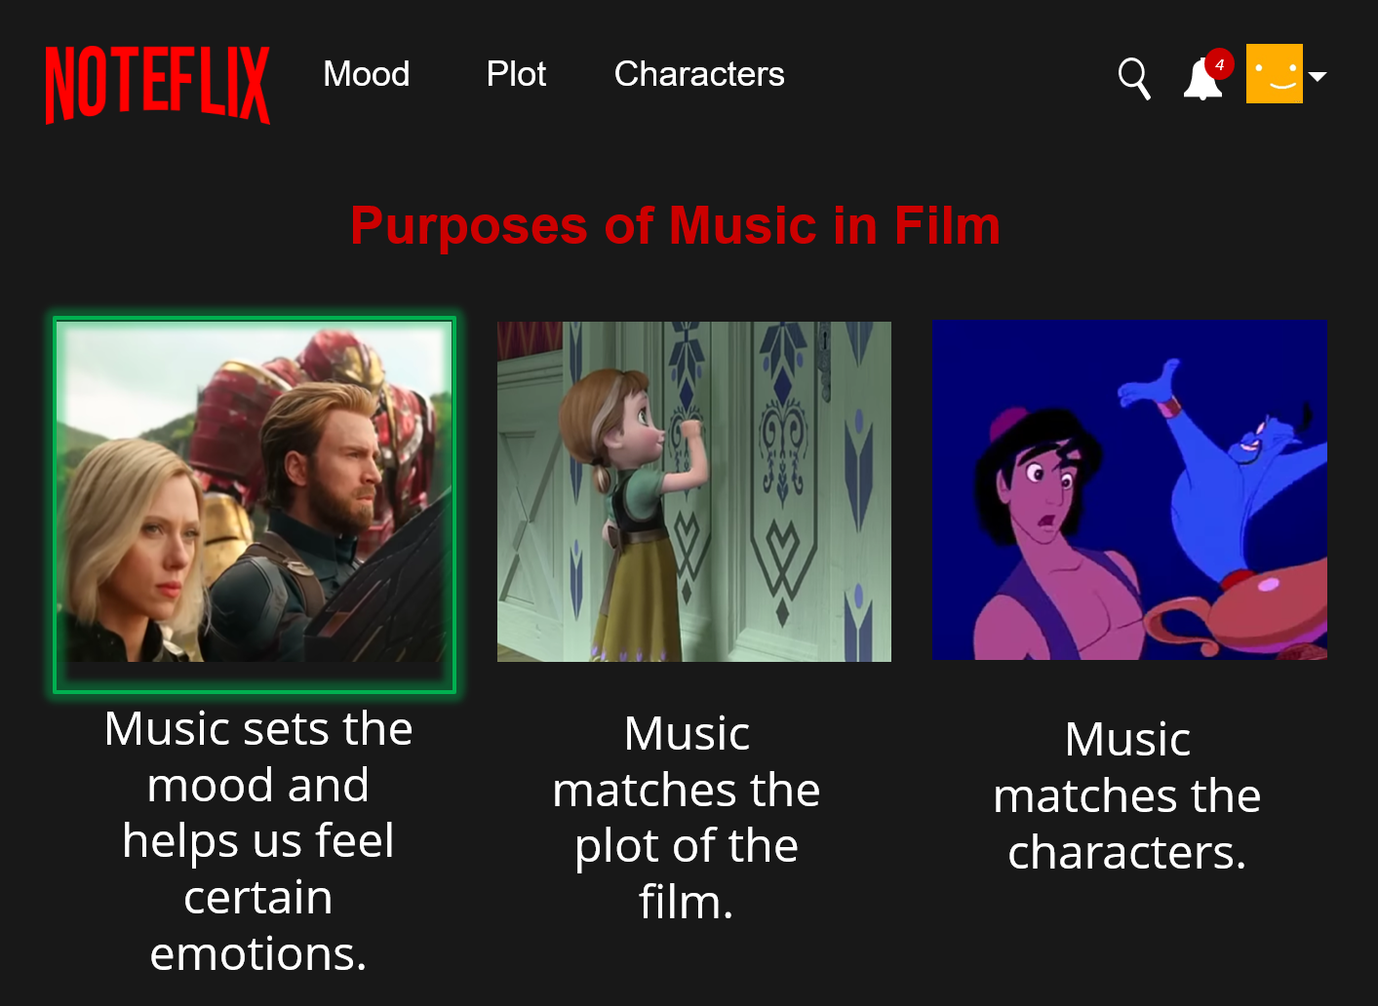
In this lesson, we will explore how music is used in movies. ​

Slide 3
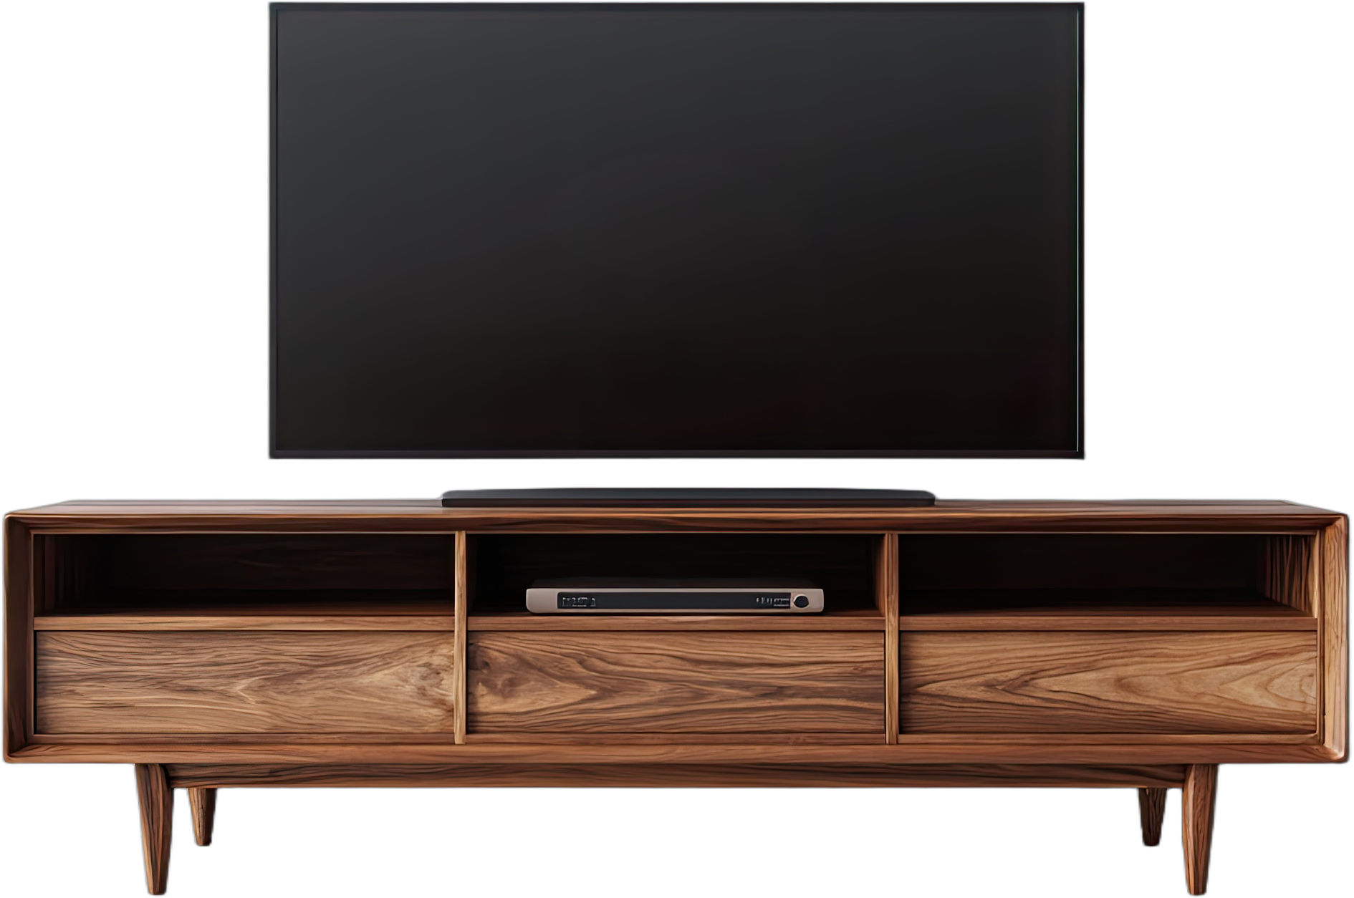
You will be successful when you can:
different genres of film by its music
how music is used in movies.
identify
Identify: To pick out or recognise something by noticing its important features.
explain
Explain: To tell how or why something happens so others can understand it clearly.
Noteflix

Slide 4

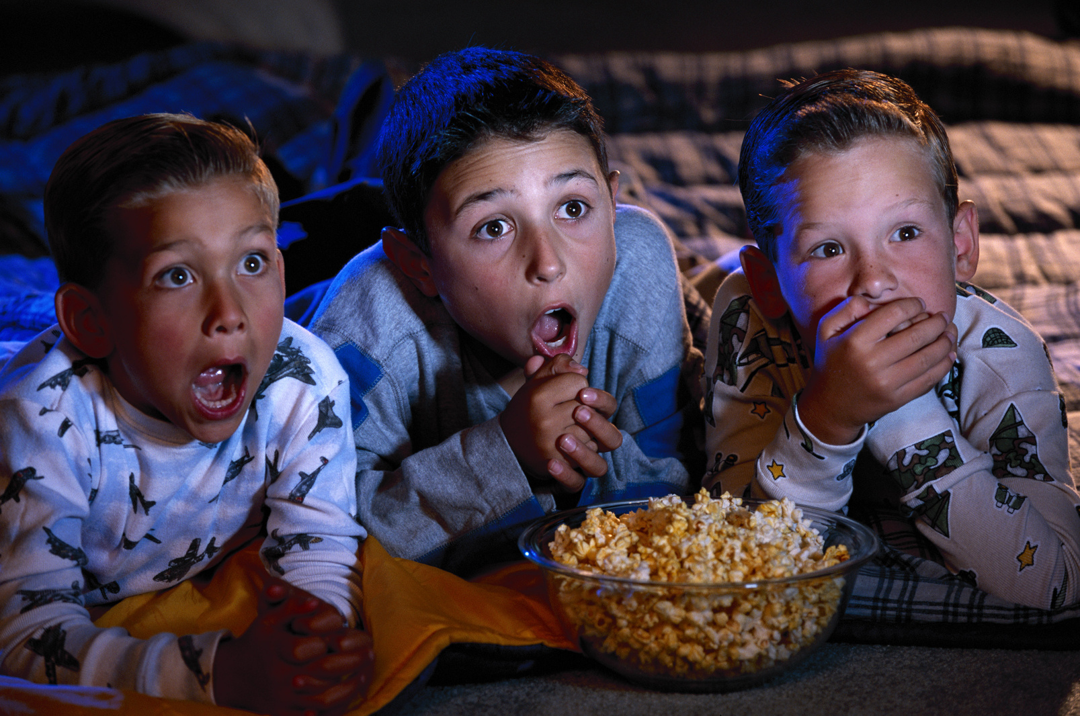

Slide 5


Noteflix

Slide 6


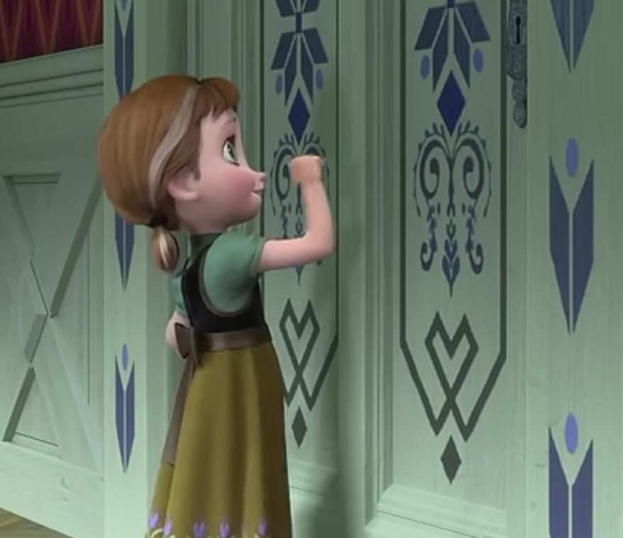
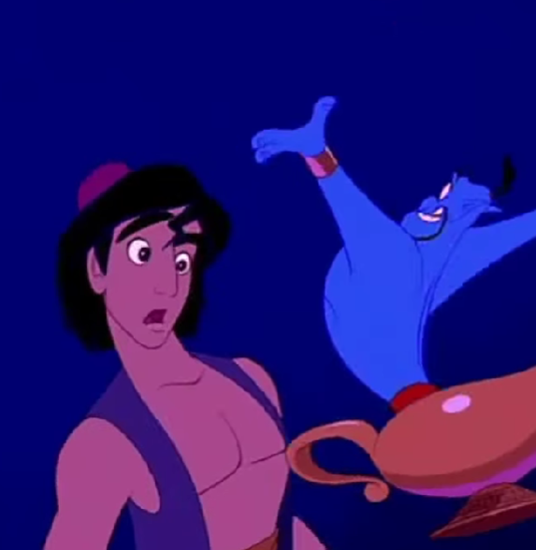
Noteflix
Mood
Plot
Characters
1
4
Purposes of Music in Film
Music sets the mood and helps us feel certain emotions.
Music matches the plot of the film.
Music matches the characters.

Slide 7

Music Creates Mood
‘Portals’| Avengers: End Game
1
4

Slide 8



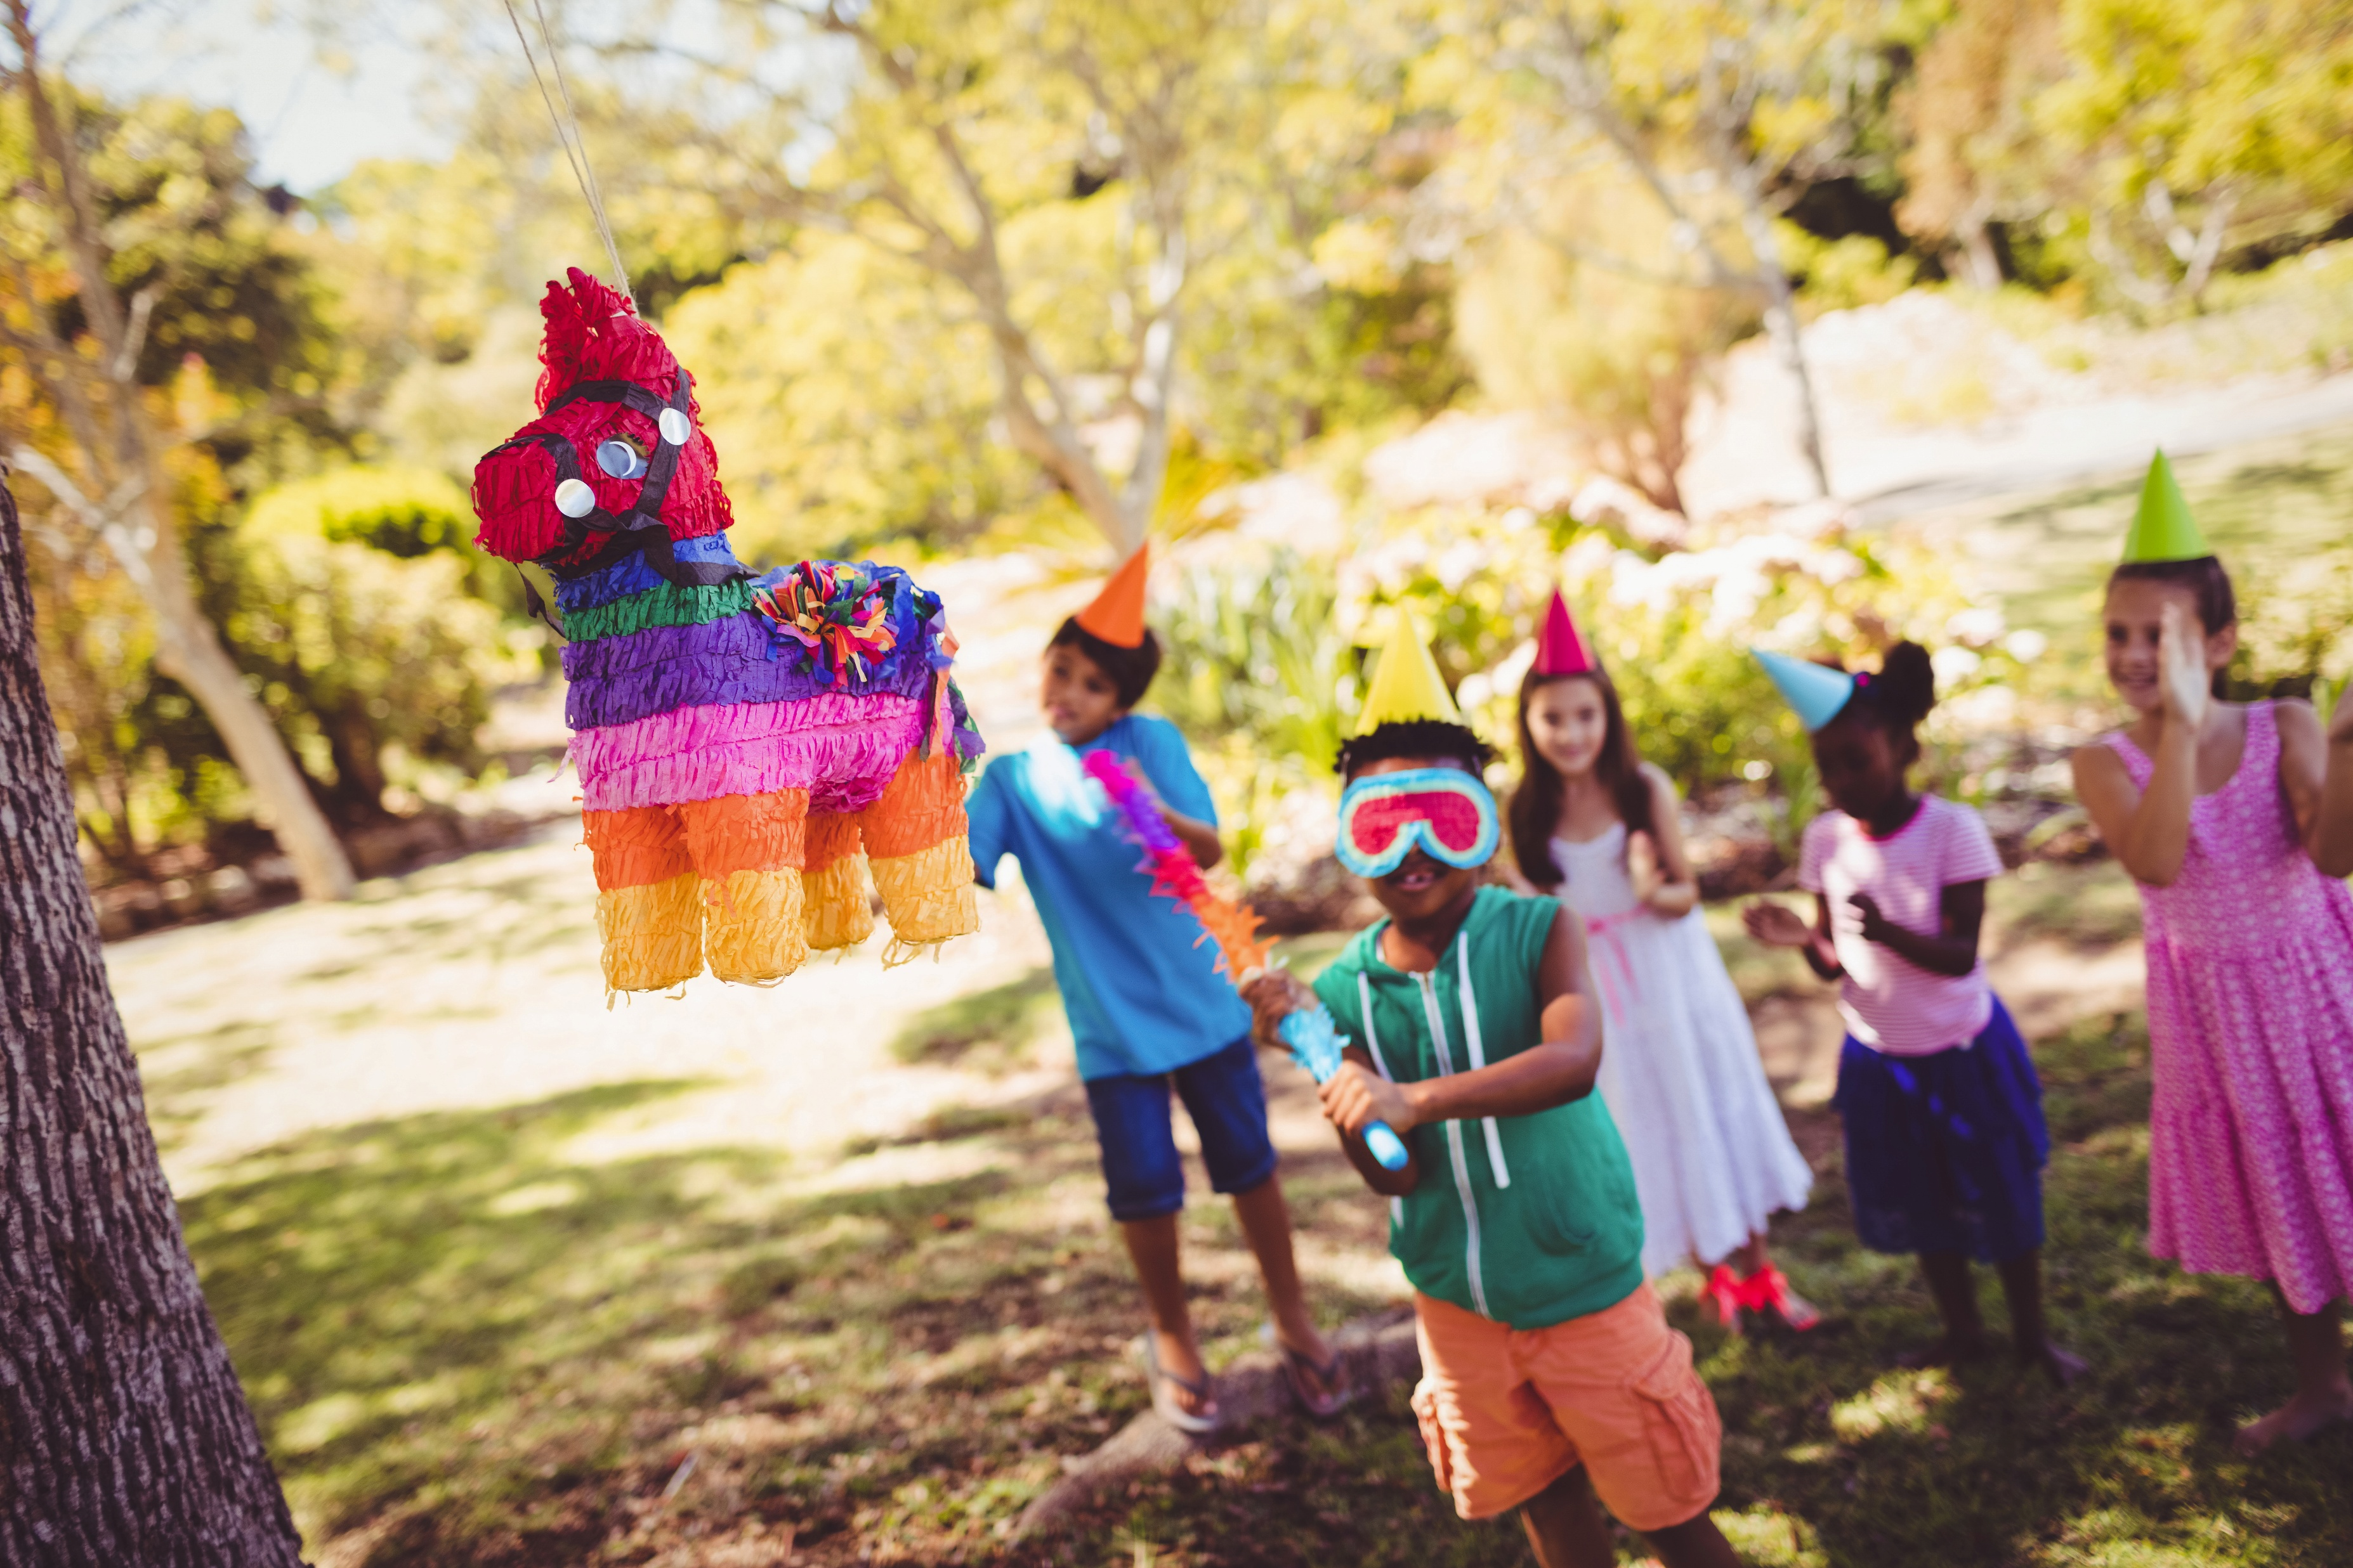

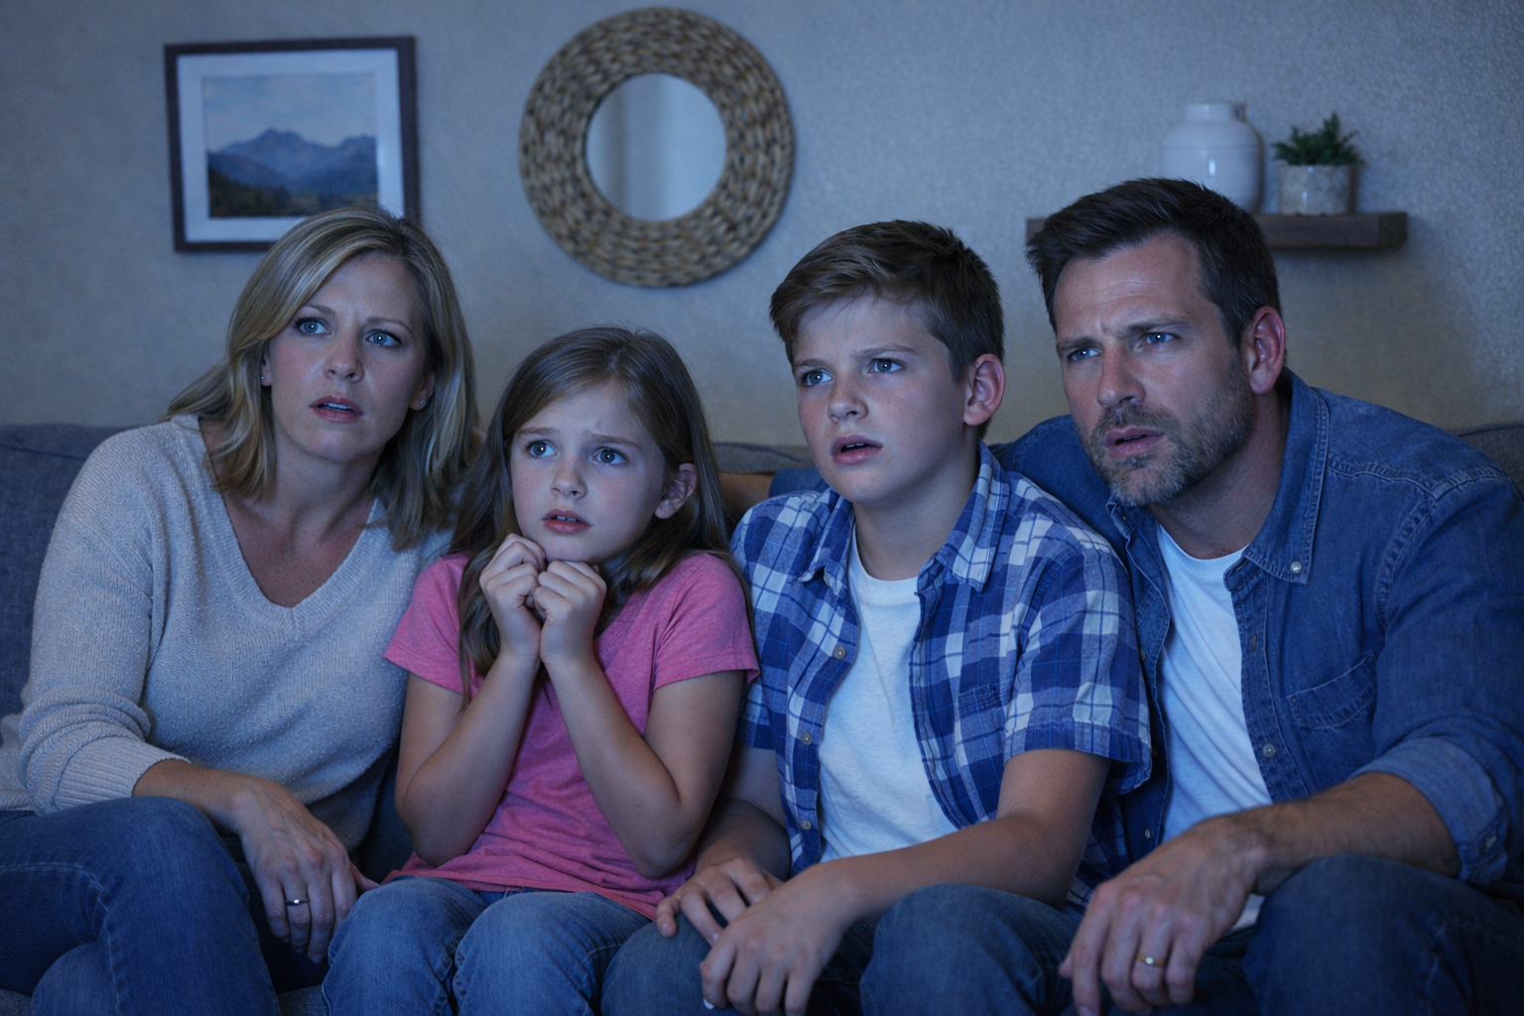
The Meaning of Mood
Mood – the feeling or emotion that a story, movie or piece of music gives you.

Slide 9
Noteflix
Mood
Plot
Characters
1
4
Purposes of Music in Film
Music sets the mood and helps us feel certain emotions.
Music matches the plot of the film.
Music matches the characters.

Slide 10
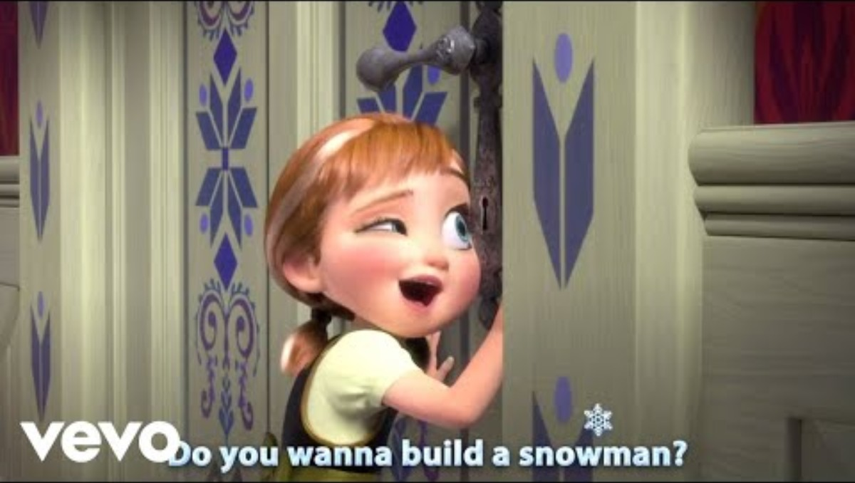
Music Matches the Plot of a Film
‘Do You Want to Build a Snowman?’| Frozen
1
4

Slide 11
Noteflix
Mood
Plot
Characters
1
4
Purposes of Music in Film
Music sets the mood and helps us feel certain emotions.
Music matches the plot of the film.
Music matches the characters.

Slide 12
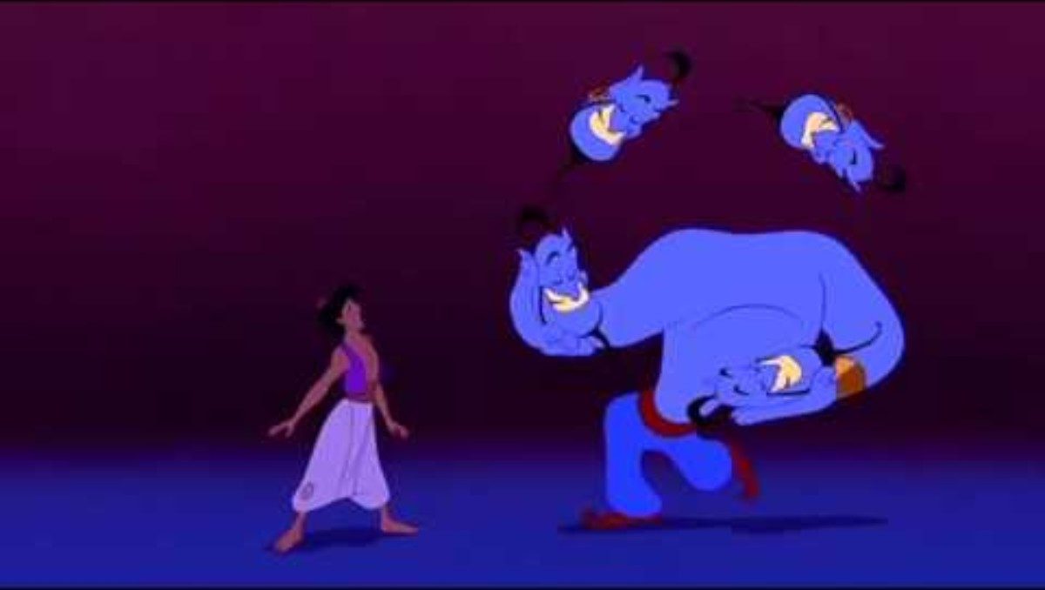
Music Matches Characters
‘Friend Like Me’| Aladdin
1
4

Slide 13



Instruments Used
Which of these is not a purpose of music in film?
The music sets the mood and helps us
feel certain emotions.
The music tells the whole
story of the movie.
The music can match the
characters in the film.

Slide 14


Types of Movies

Slide 15
Types of Movies

Slide 16
Types of Movies

Slide 17
Types of Movies

Slide 18


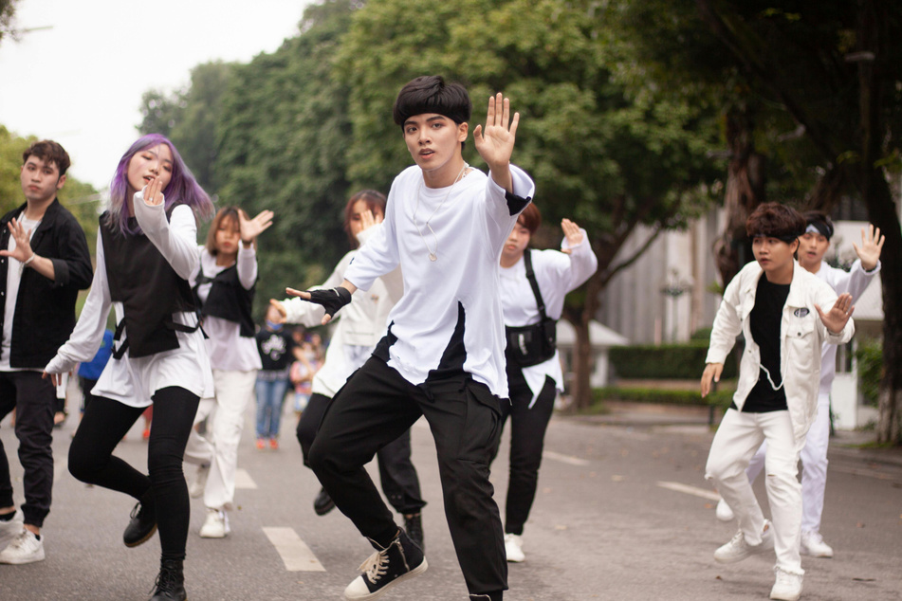

How Different Types of Movies Use Music

Slide 19
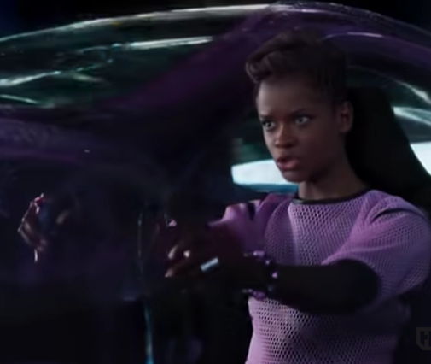
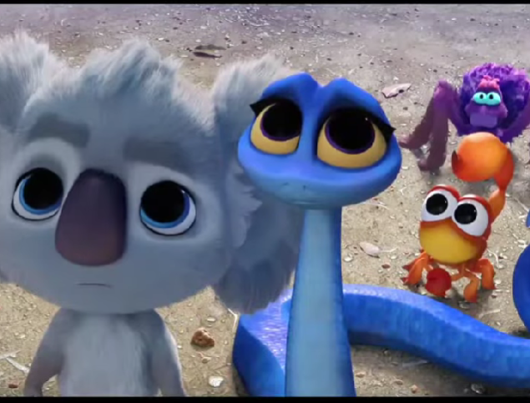
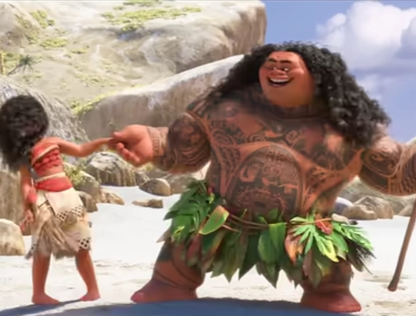
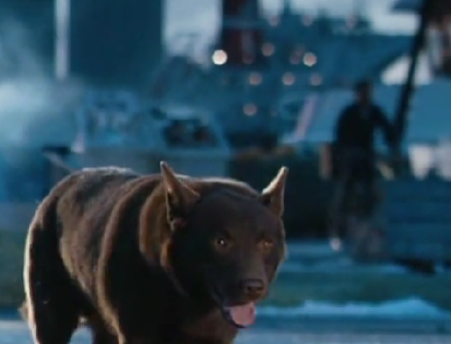
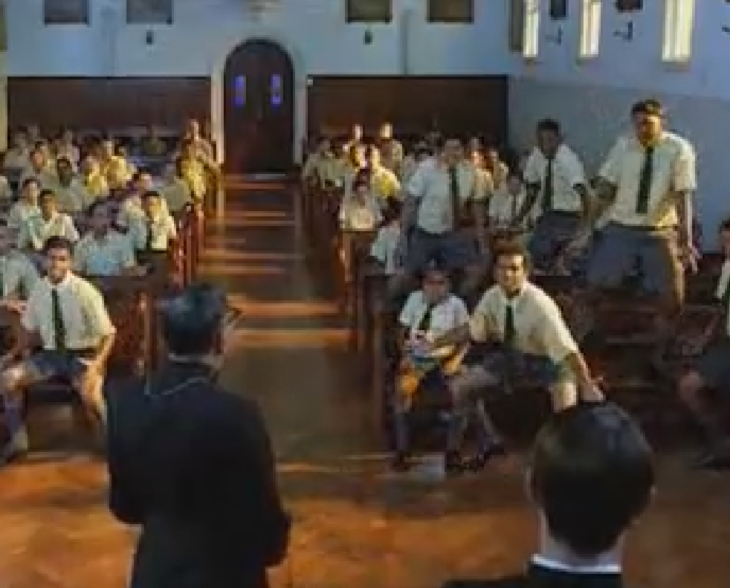
Noteflix
1
4
Identify the
Type of Movie
Comedy
Scary
Action
Musical
Drama
Documentary

Slide 20
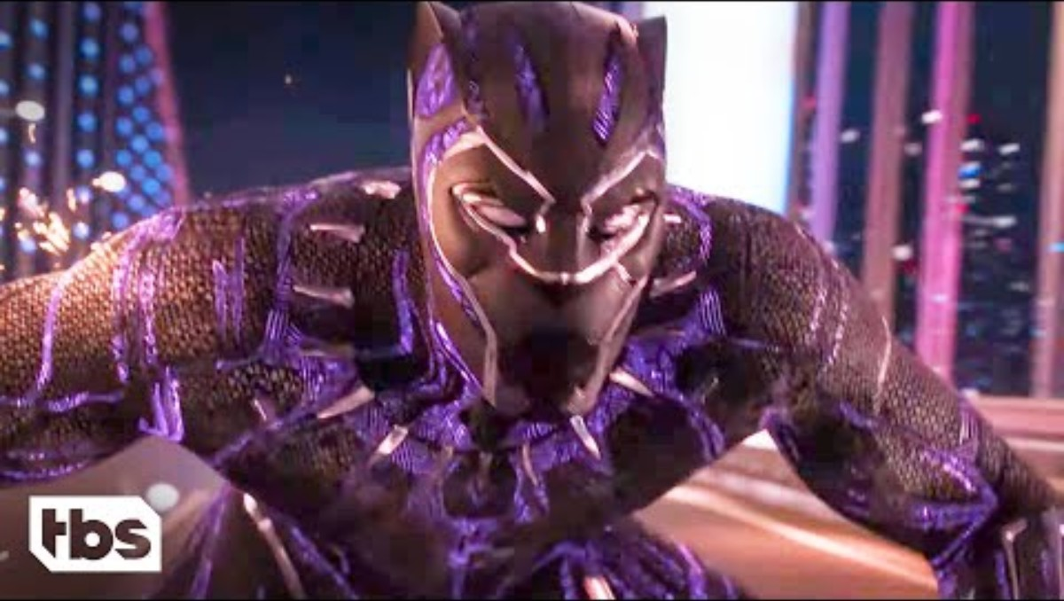
Identify the Type of Movie
Black Panther
1
4

Slide 21
Noteflix
1
4
Identify the
Type of Movie
Comedy
Scary
Action
Musical
Drama
Documentary

Slide 22
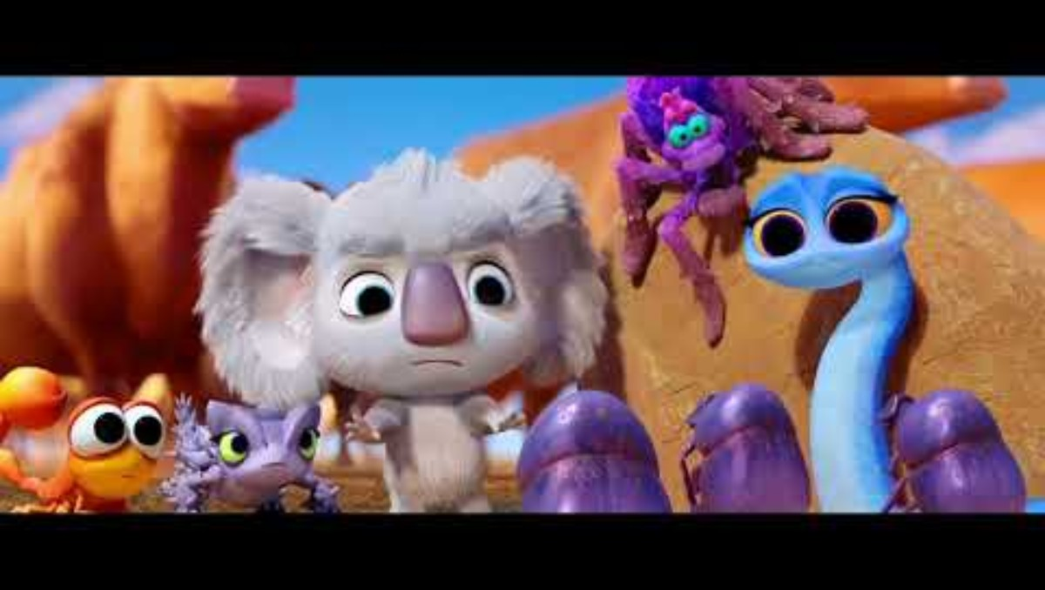
Identify the Type of Movie
Back to the Outback
1
4

Slide 23
Noteflix
1
4
Identify the
Type of Movie
Comedy
Scary
Action
Musical
Drama
Documentary

Slide 24

Identify the Type of Movie
Red Dog
1
4

Slide 25
Noteflix
1
4
Identify the
Type of Movie
Comedy
Scary
Action
Musical
Drama
Documentary

Slide 26
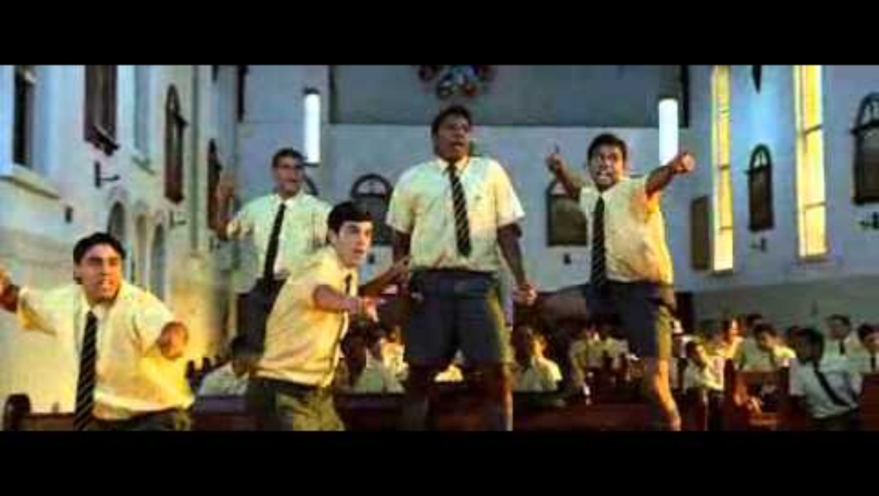
Identify the Type of Movie
Bran Neu Dae
1
4

Slide 27
Noteflix
1
4
Identify the
Type of Movie
Comedy
Scary
Action
Musical
Drama
Documentary

Slide 28
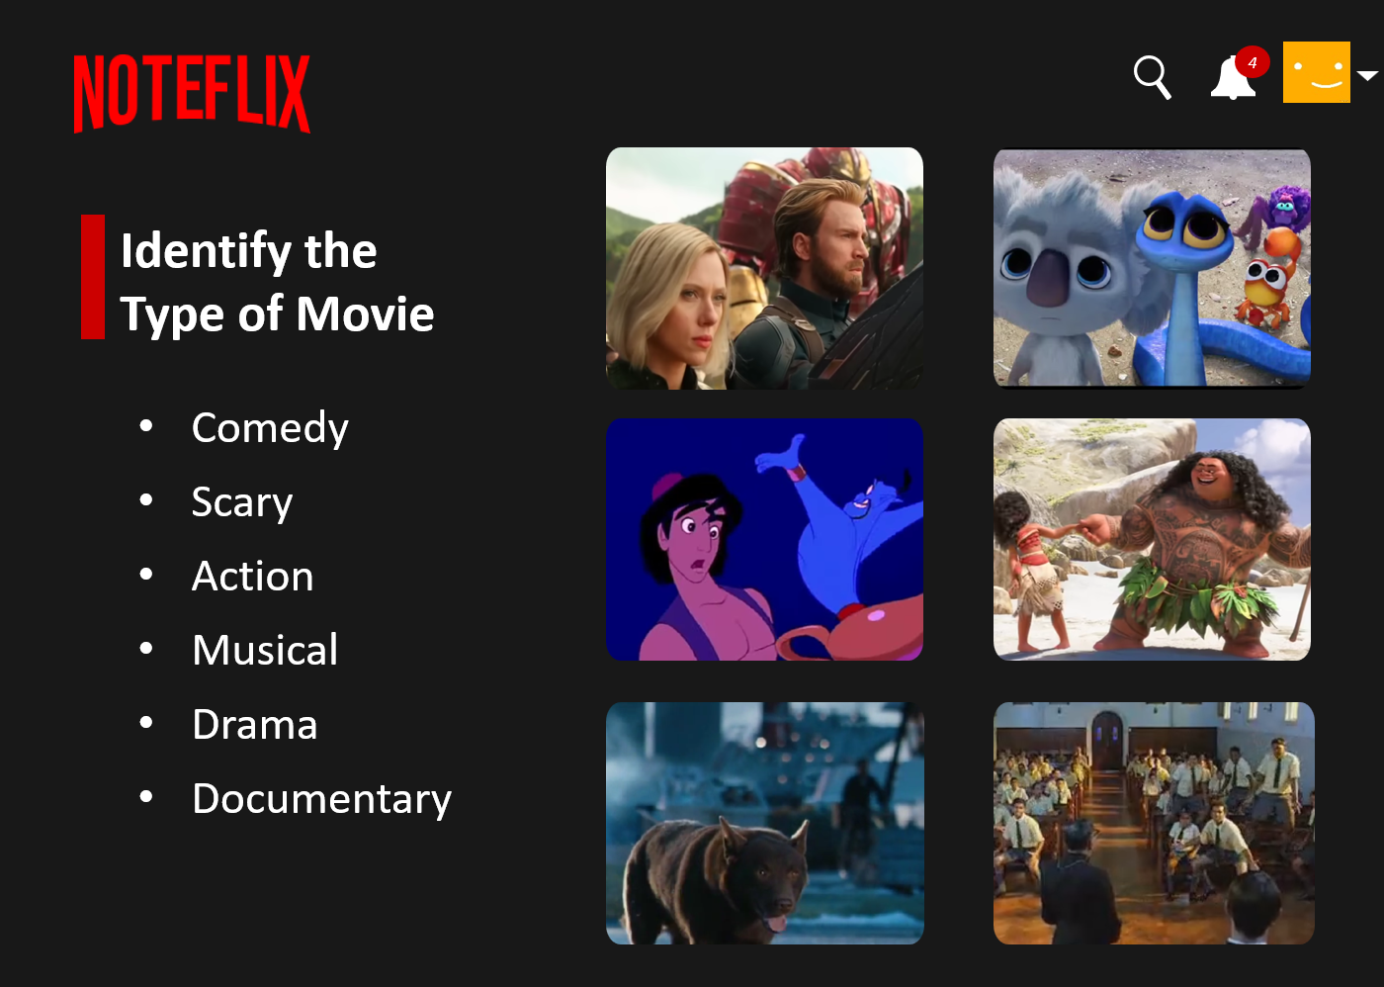
There are different types of movies, including comedy, documentary and musical.
In a musical, the characters sing some of the story.
Music is like the emotional helper of a film.
Music can be used to set the mood or match the plot and characters of a film.

Slide 29





Exit Ticket
Date: _________
Lesson 1
emotional
Music is like the ____________ helper of a movie.
Music in a film can match:
the characters and plot
rhythms
setting
all of the above.
A musical is a type of movie where the characters s_____ some of the words.
word
behaviour
emotional
ing
3
I know _____ out of 3 answers.

Slide 30
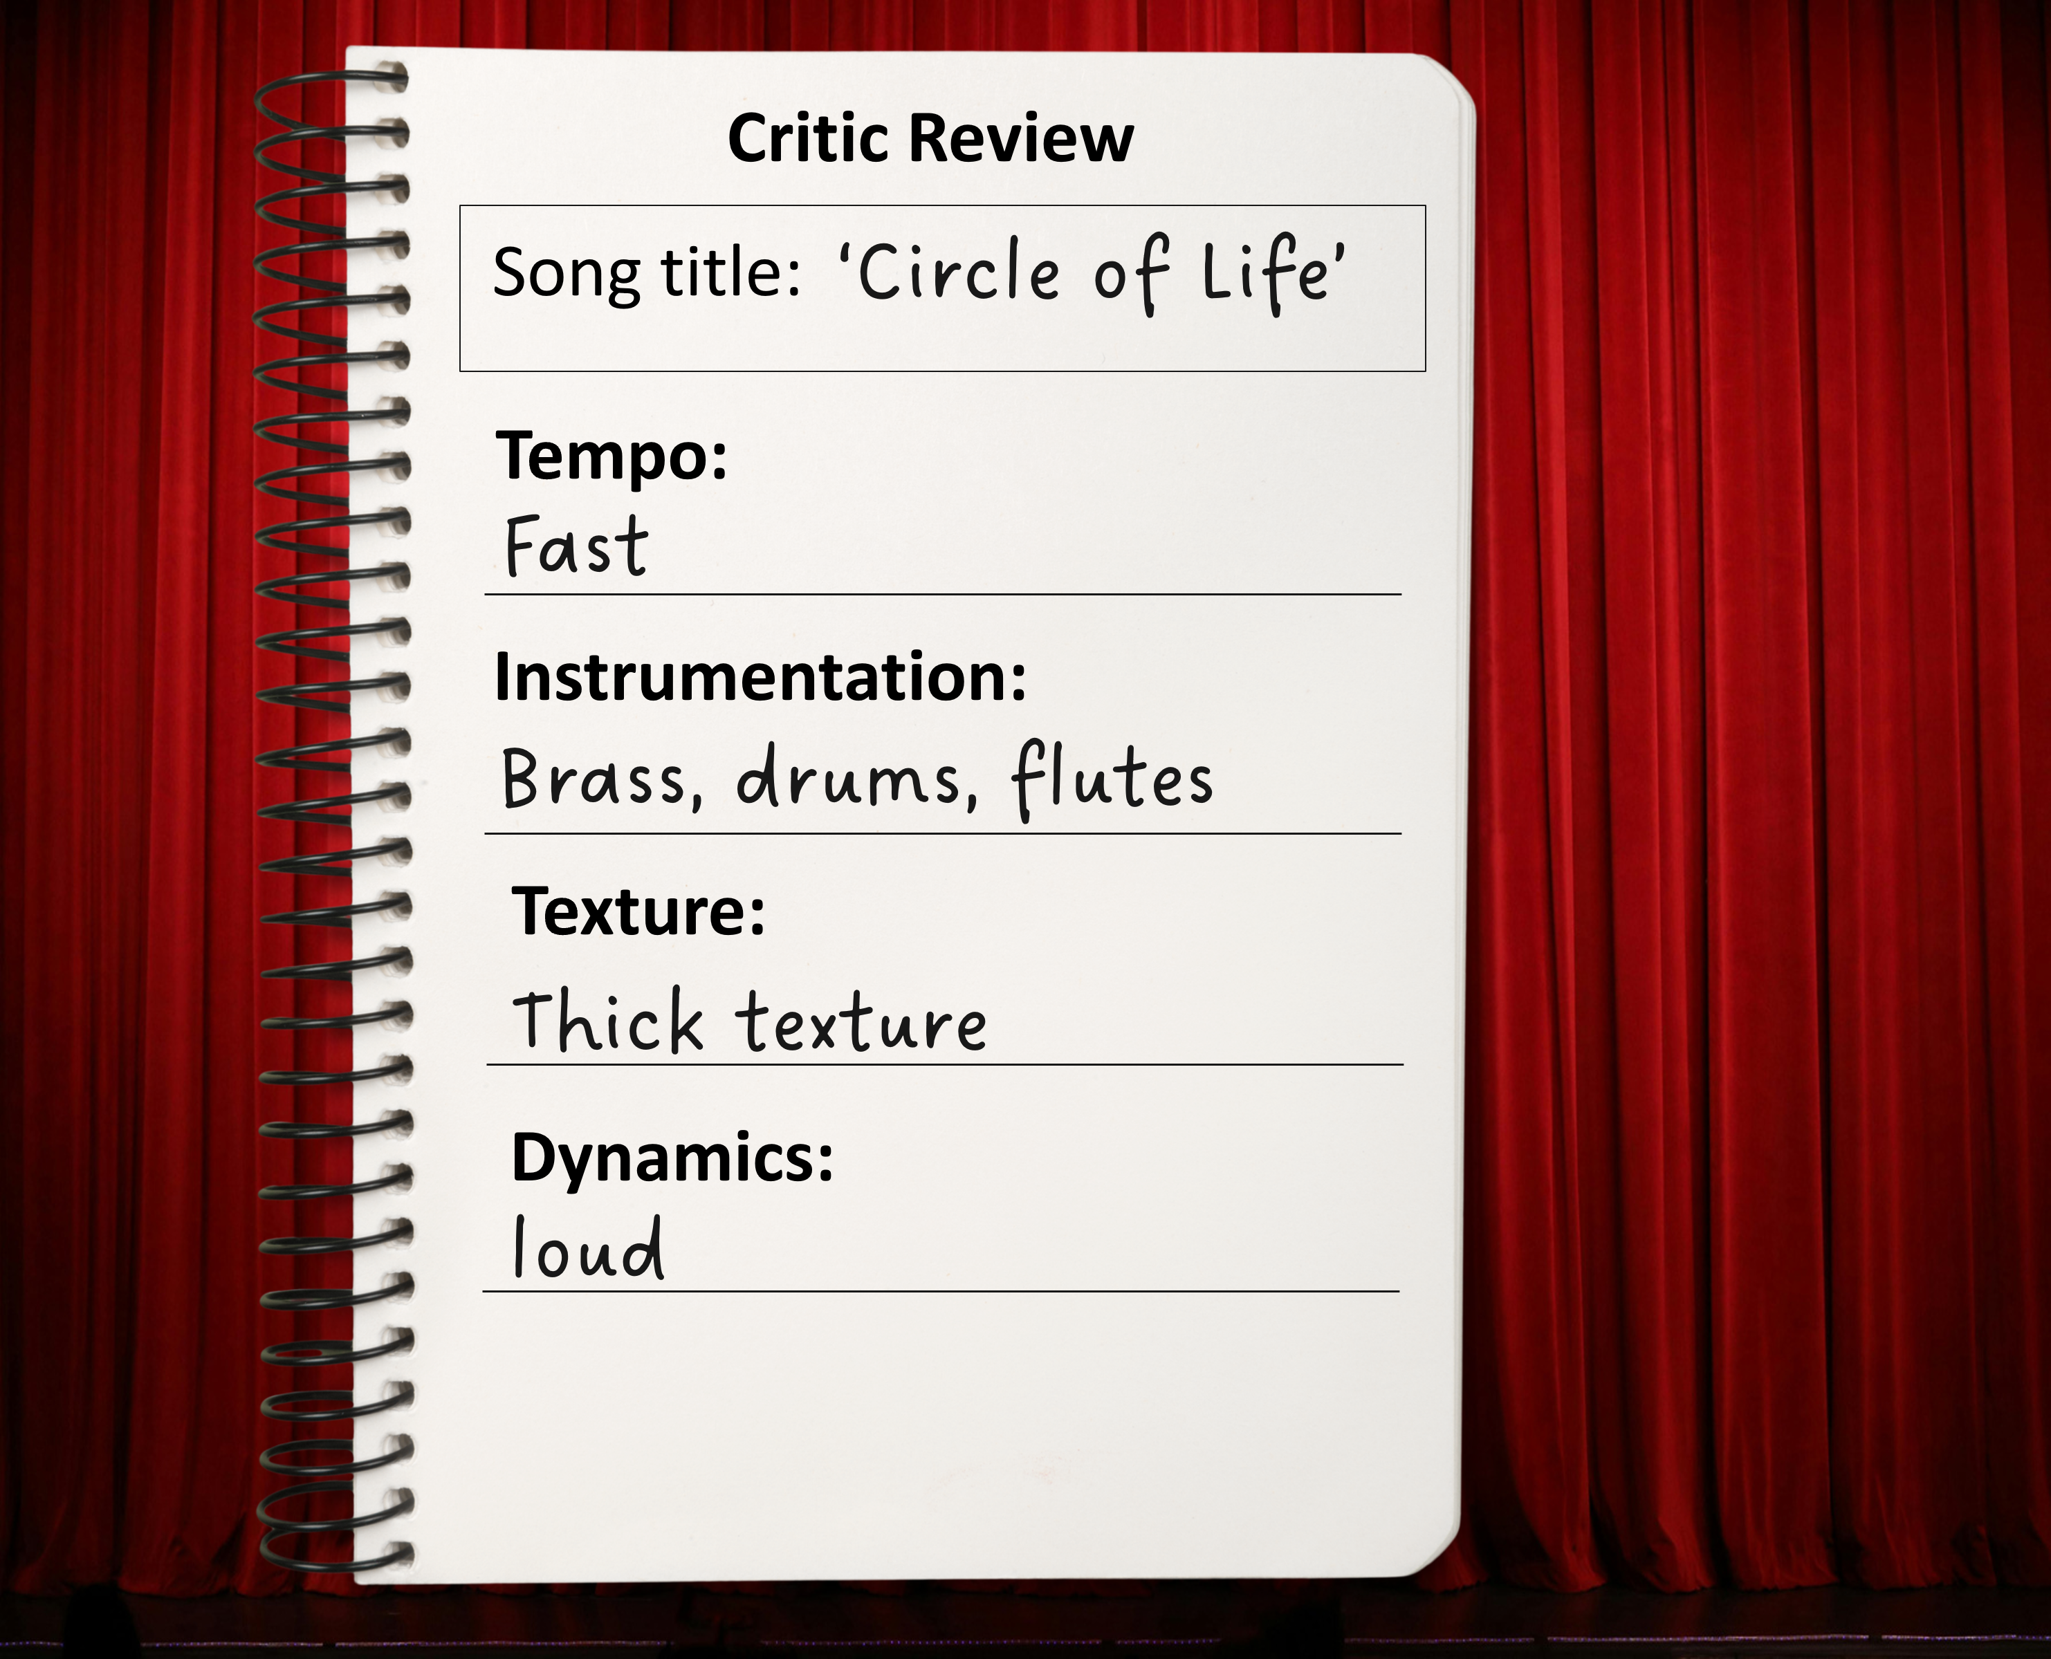
In the next lesson, we will explore how musical elements are used in film.

