Slide 1
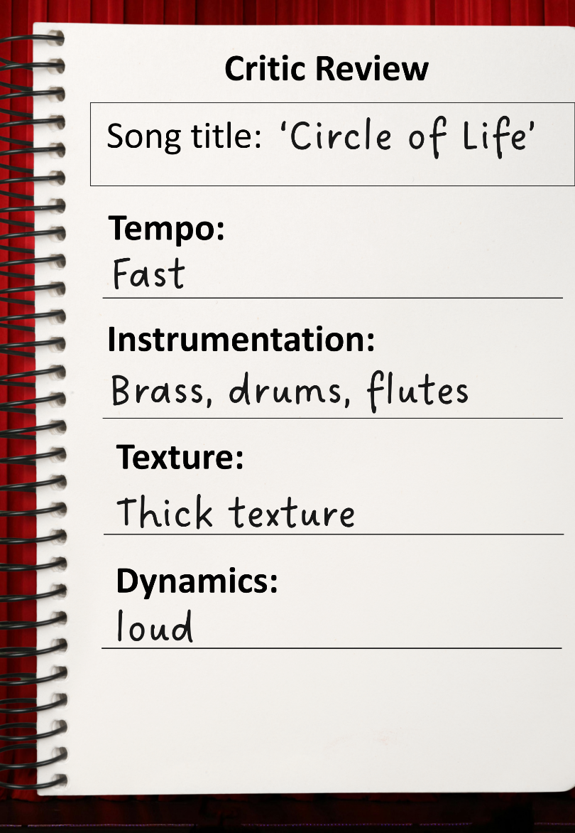
Music in Movies
Lesson 2
Musical Elements in Film Music
Unit 3 Version 3

Slide 2





Revise
Exit Ticket
Lesson 1
emotional
Music is like the ____________ helper of a movie.
Music in a film can match:
the characters and plot
rhythms
setting.
A musical is a type of movie where the characters s_____ some of the words.
word
behaviour
emotional
ing

Slide 3
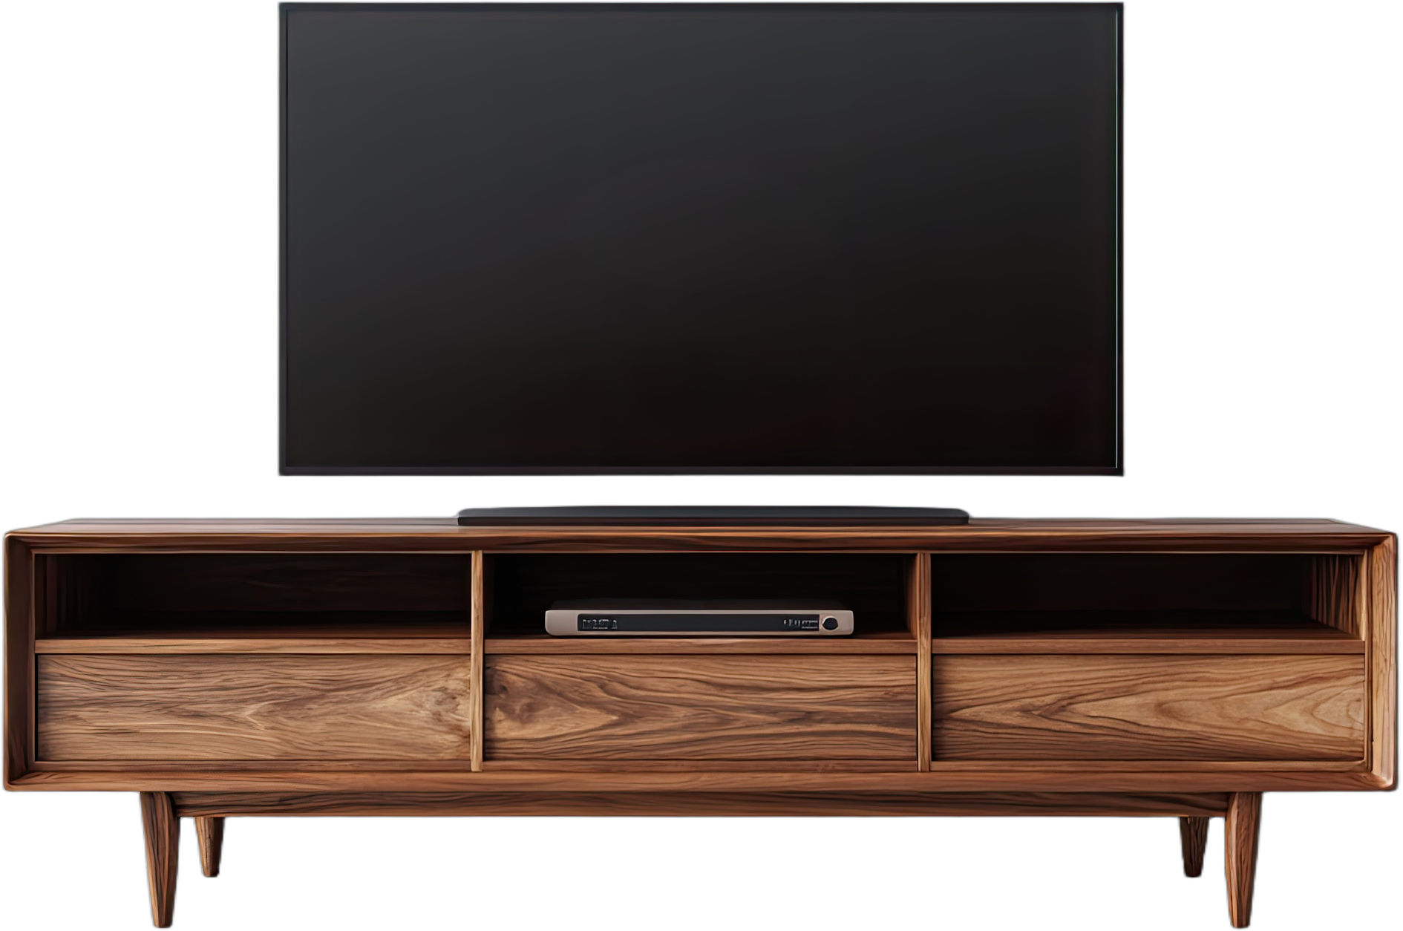
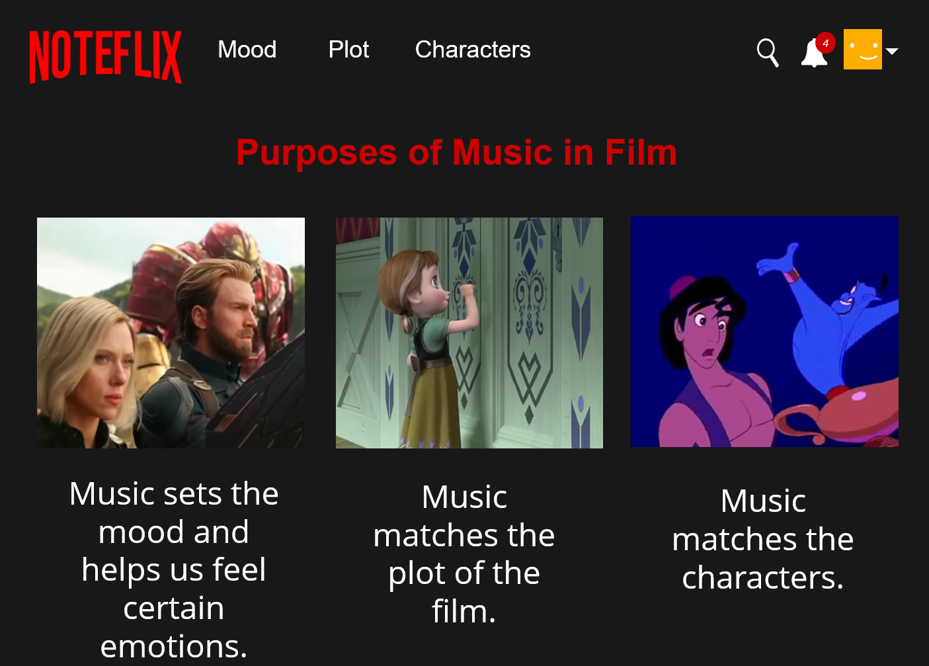



What is the meaning of plot?
The people in the
movie.
The events that
happen in the movie.
How you feel when you watch the movie.

Slide 4

In this lesson, we will explore how musical elements are used in film. ​

Slide 5

You will be successful when you can:
musical elements
musical elements in film music
a basic melody on the keyboard.
define
Define: To tell the exact meaning of a word or idea so others understand what it means.
identify
Identify: To pick out or recognise something by noticing its important features.
play
Play: To make musical sound on your instrument.

Slide 6
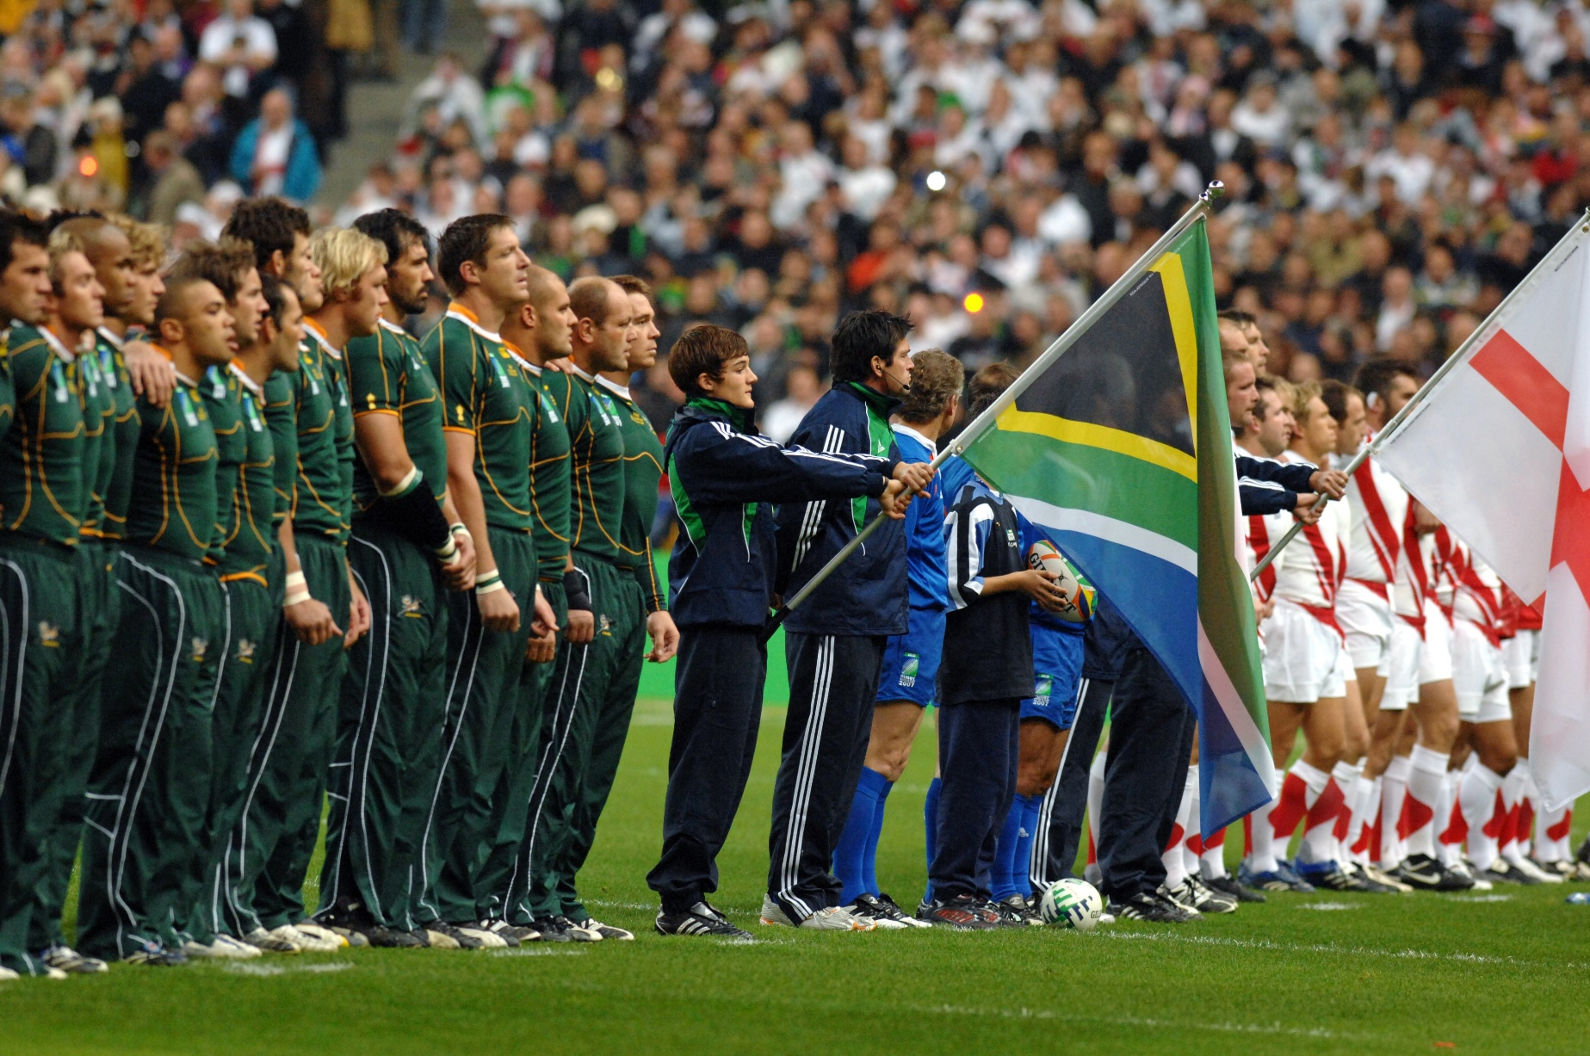
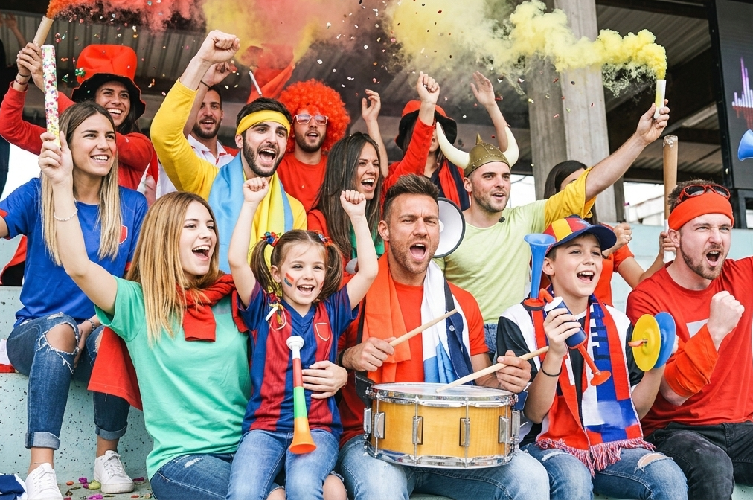

Slide 7

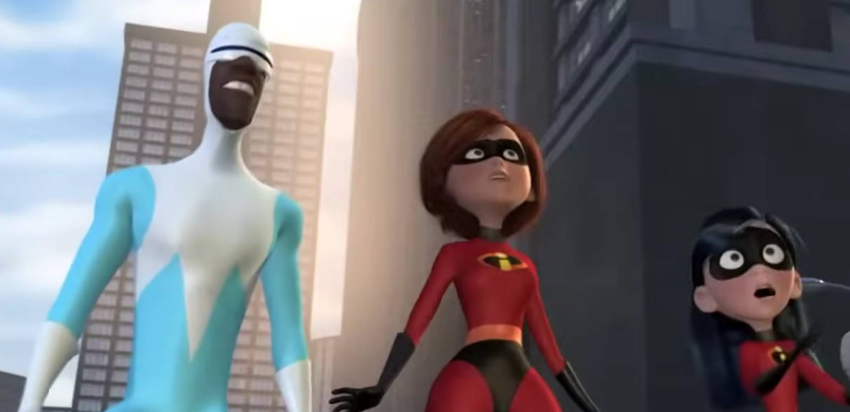


Slide 8

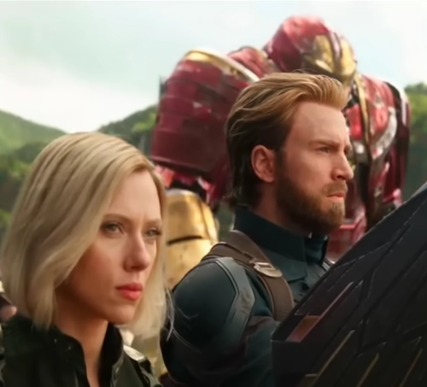
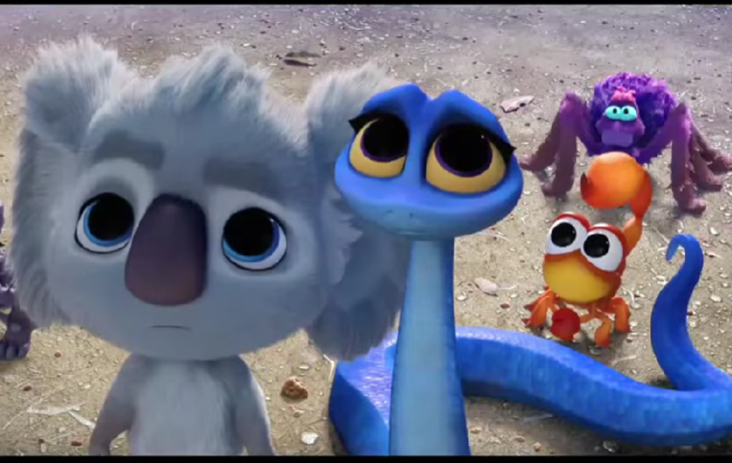
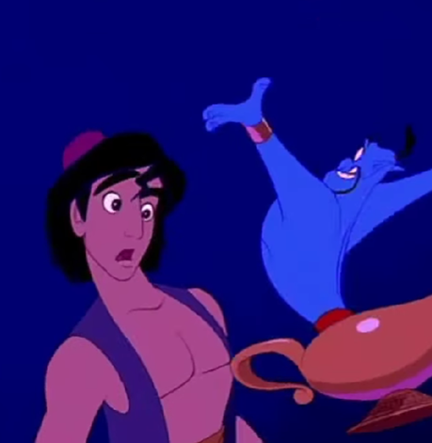
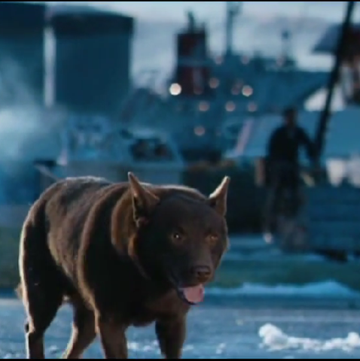
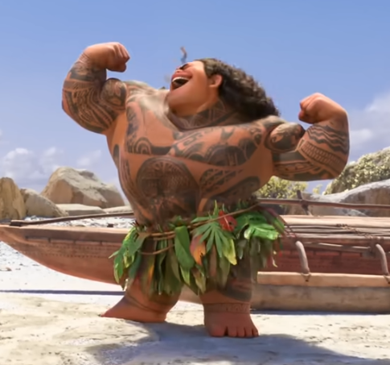
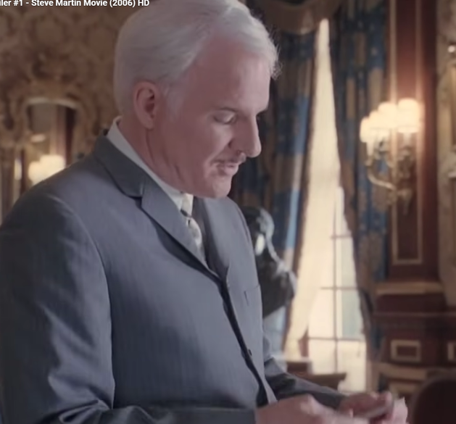
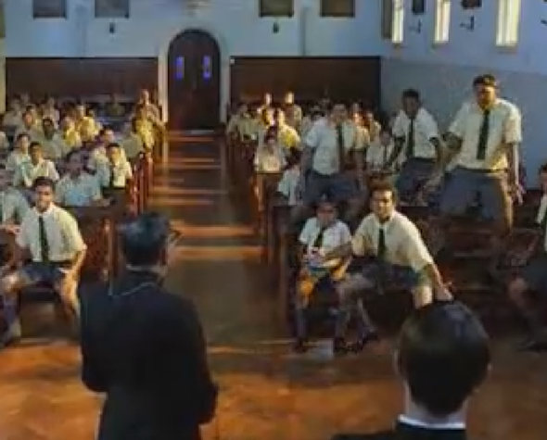
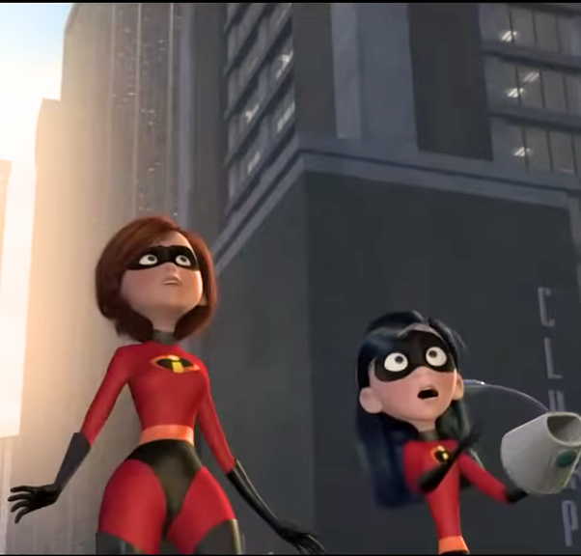
Home Shows Movies Games
1
4
My List
Avengers:
Infinity War
Back to the
Outback
Aladdin
Red Dog
Comedy

Slide 9
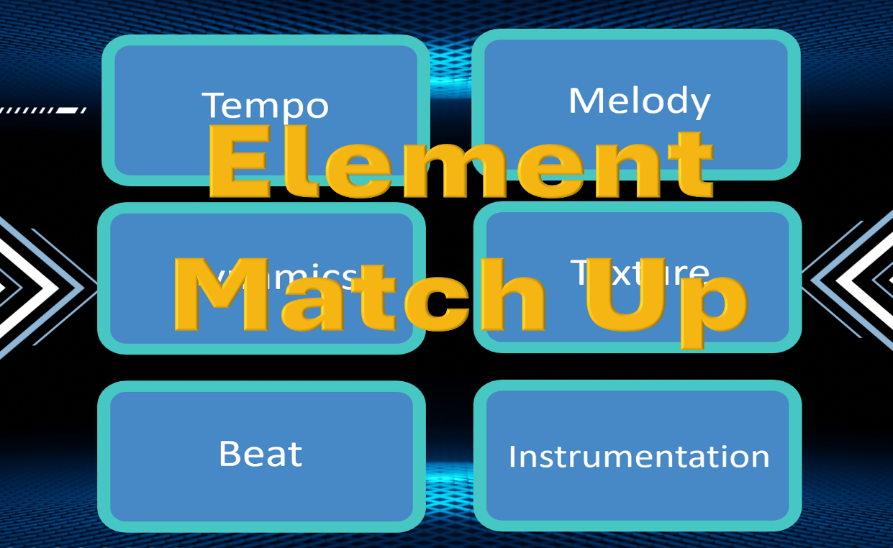

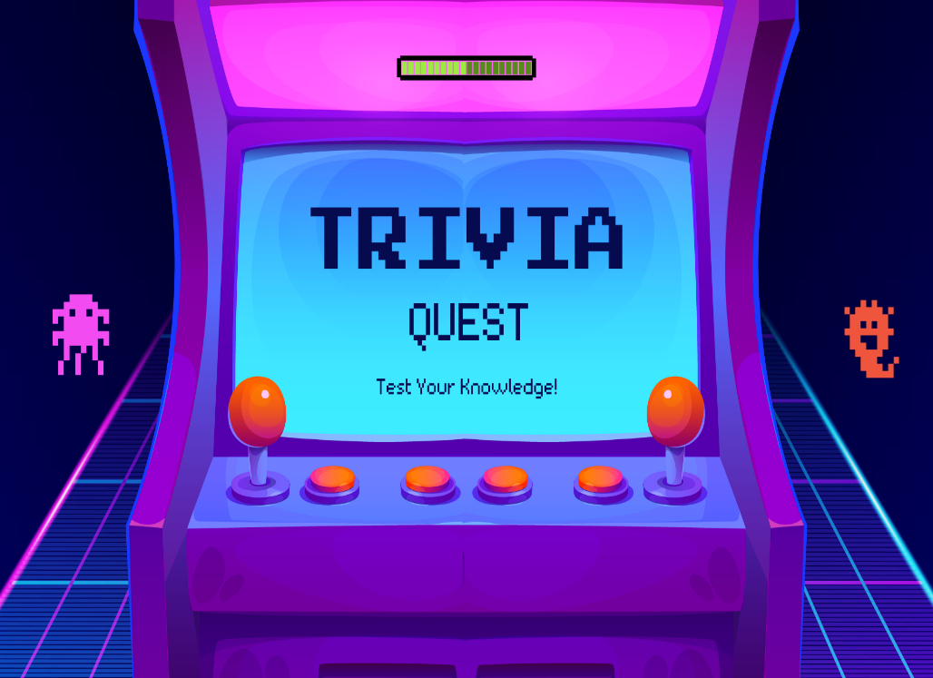


Home Shows Movies Games
1
4
Games

Slide 10


Speed of
the music.
The part of the
music you sing to.
Tempo
Melody
Volume of
the music.
How many layers
are in the music.
Dynamics
Texture
Pulse of
the music.
Which instruments
are being played.
Beat
Instrumentation

Slide 11
Volume of
the music.
Tempo
Pulse of
the music.
Dynamics
Speed of
the music.
Beat

Slide 12
How many layers
are in the music.
Melody
Which instruments
are being played.
Instrumentation
Texture
The part of the
music you sing to.

Slide 13

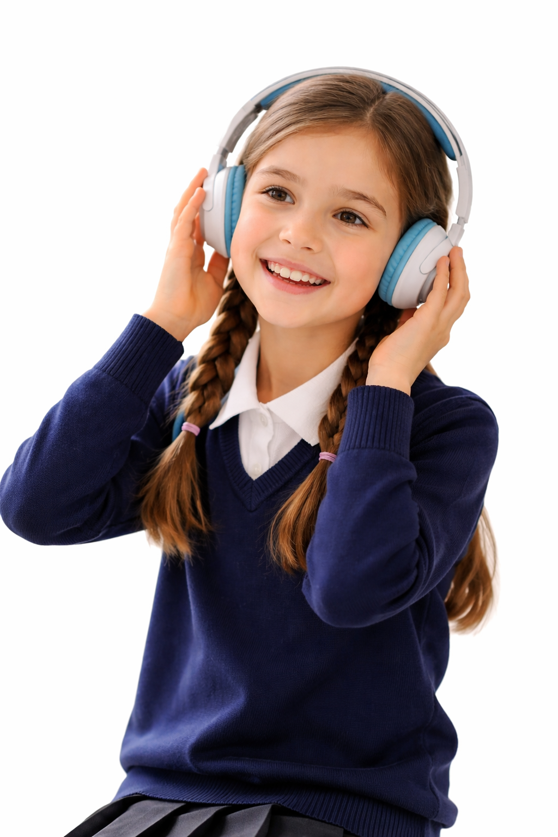
Move Left or Right
Drum
Thick Texture
Flute
Loud Dynamics
Fast Tempo
Slow Tempo
Soft Dynamics
Thin Texture

Slide 14
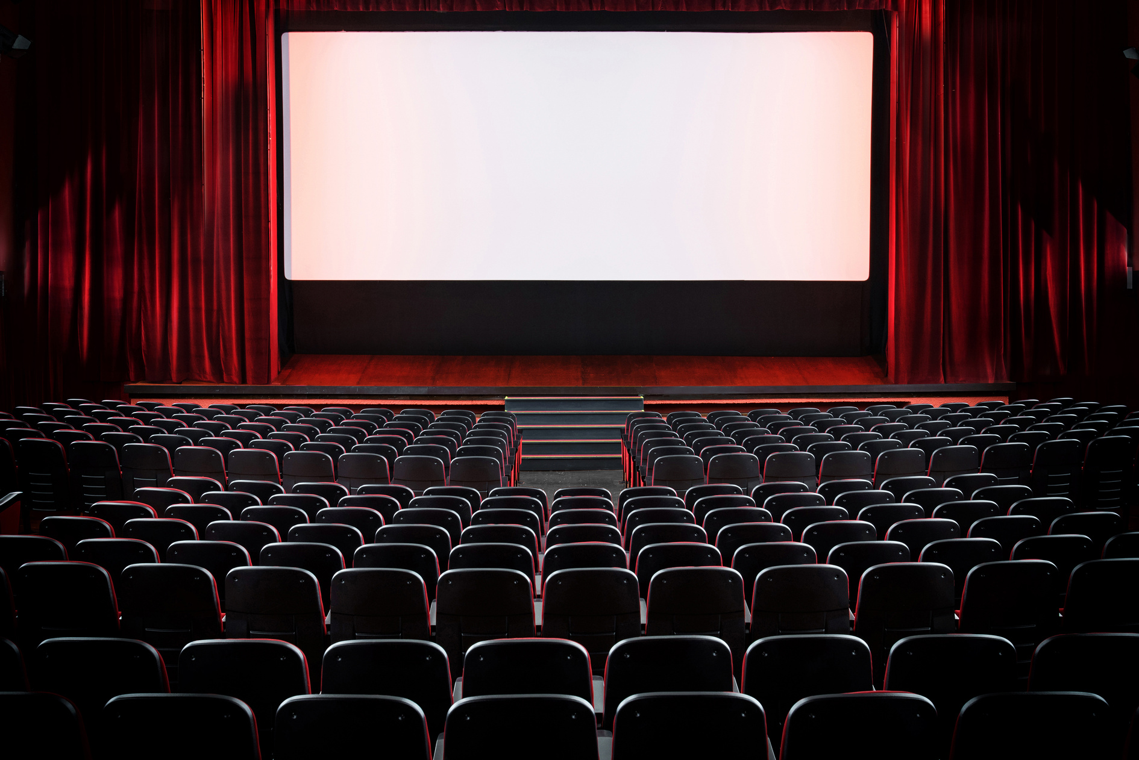

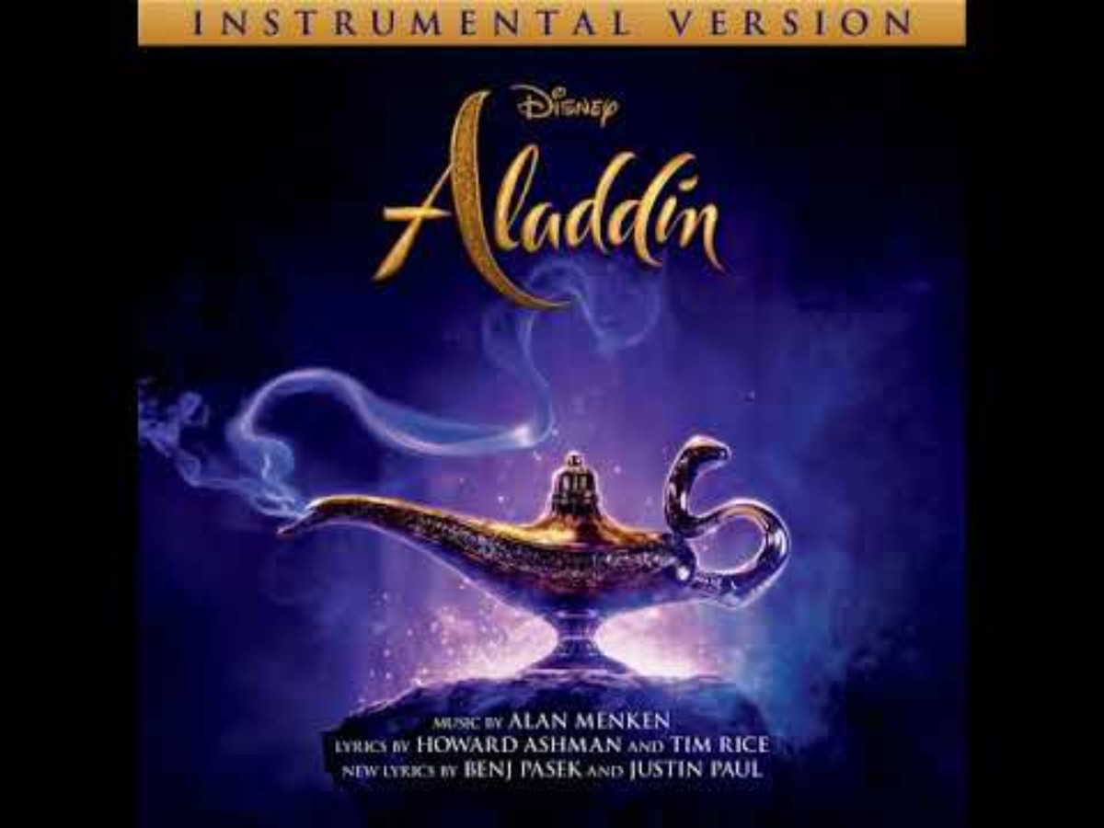

Analysing Musical Elements
Critic Review
Song title:
‘Friend Like Me’
Tempo:
Fast
Instrumentation:
Brass, drums, flutes
Texture:
Thick texture
Dynamics:
loud

Slide 15
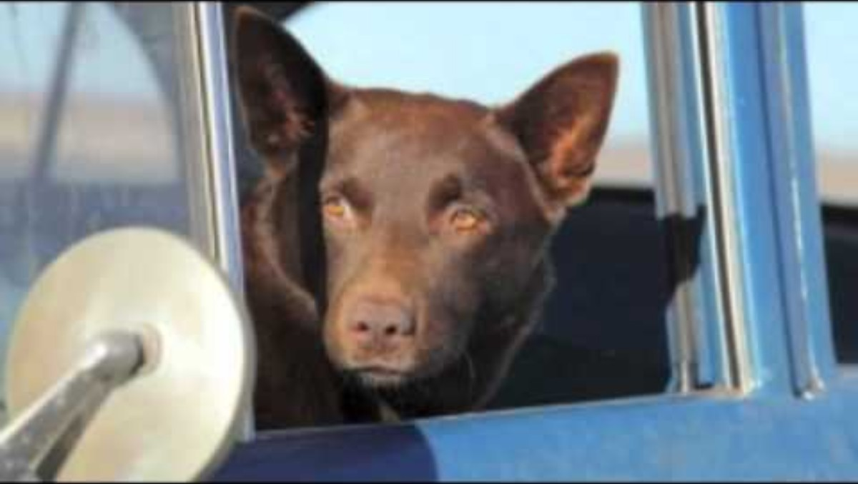
Analysing Musical Elements
Critic Review
Song title:
‘The Search’
Tempo:
Slow
Instrumentation:
Strings, guitar
Texture:
Thin texture
Dynamics:
Soft

Slide 16

Analysing Musical Elements
Critic Review
Song title:
‘Fire Truck Pursuit’
Tempo:
Fast
Instrumentation:
Strings, drum, trombone
Texture:
Thick texture
Dynamics:
Loud

Slide 17

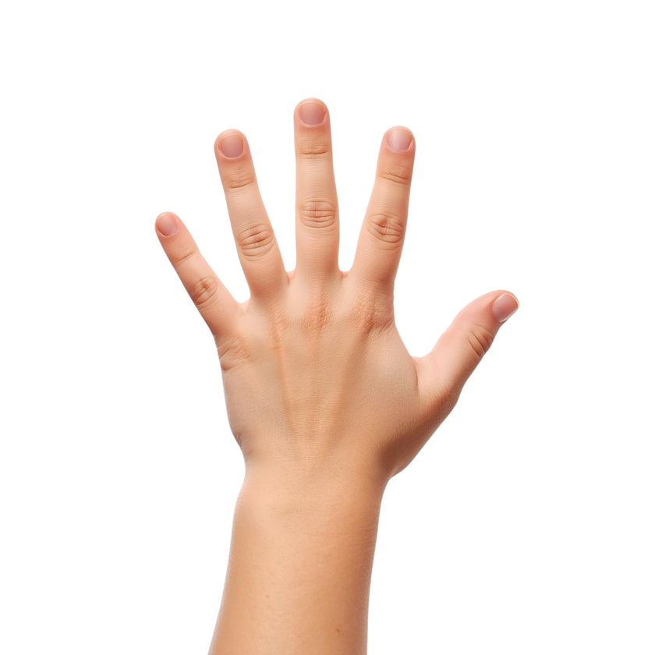
I Do/We Do:
New Hand Position
VIRTUOSITY
C D E F G

Slide 18
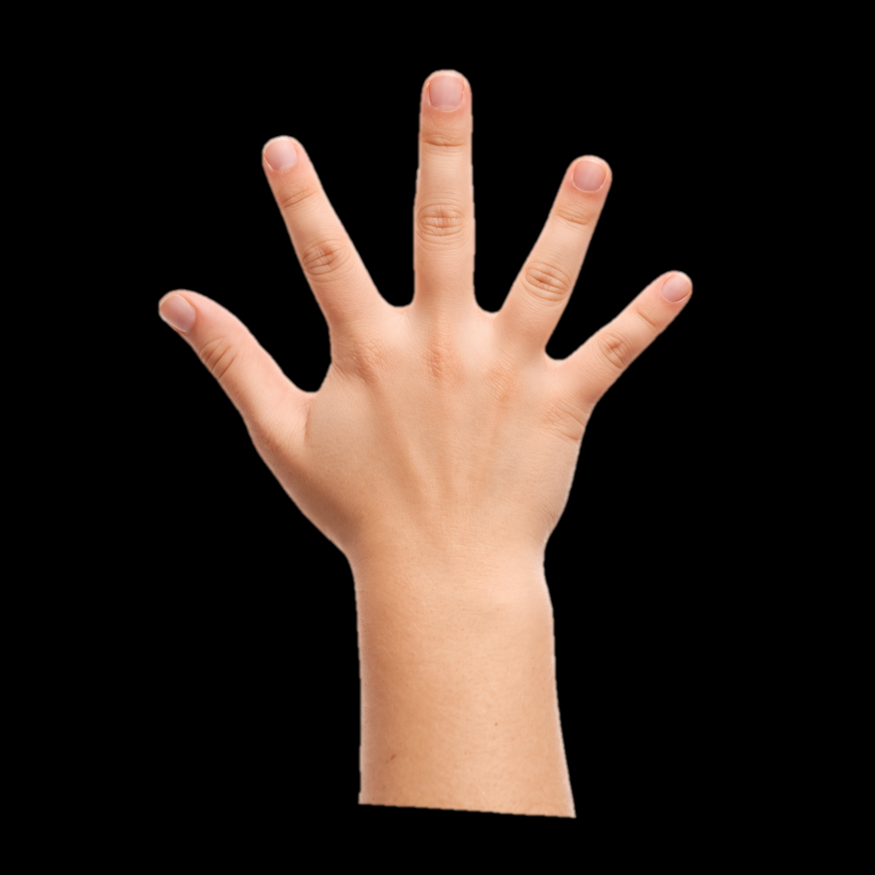
I Do/We Do:
Playing the Black Keys
VIRTUOSITY
C D E F G A B C D

Slide 19
I Do/We Do:
Moving Hand Positions
VIRTUOSITY
C D E F G A B C D

Slide 20
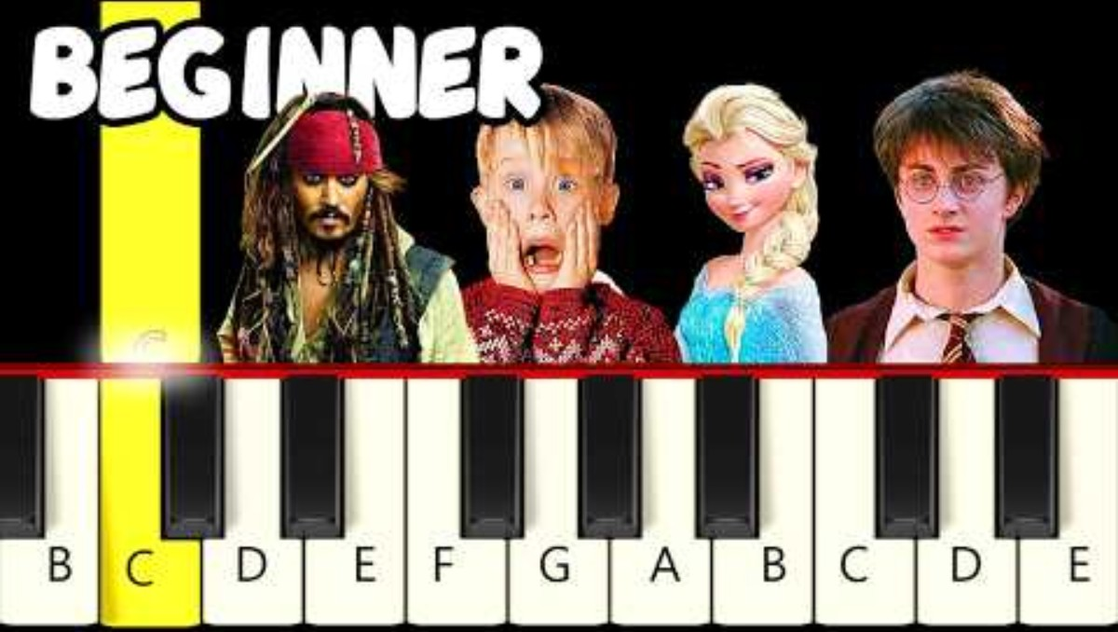
‘Circle of Life’ Melody

Slide 21
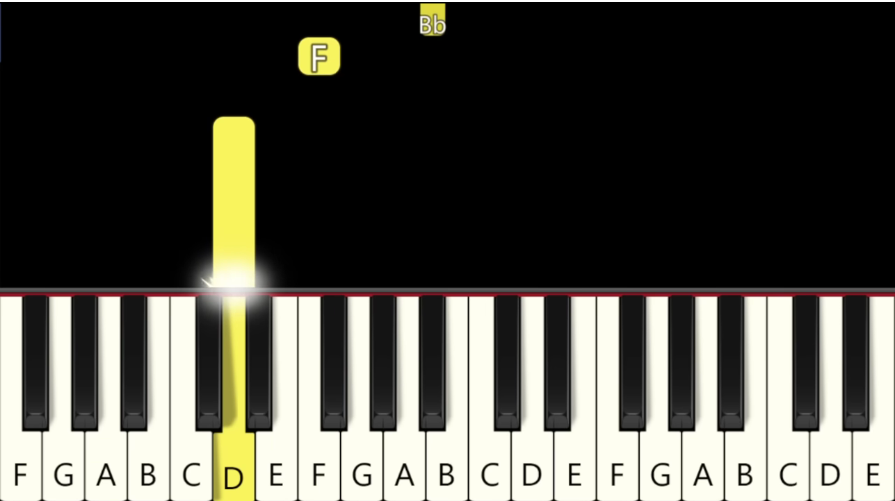
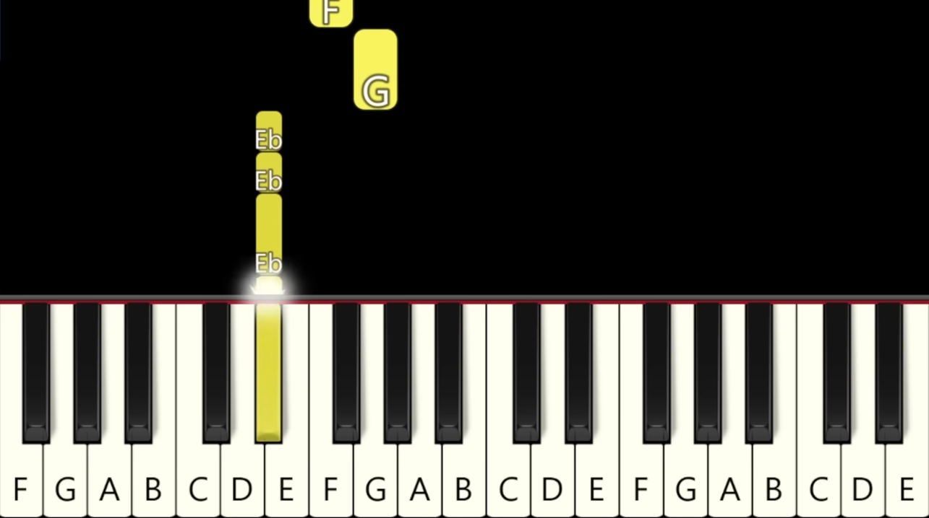
‘Circle of Life’ Screen

Slide 22
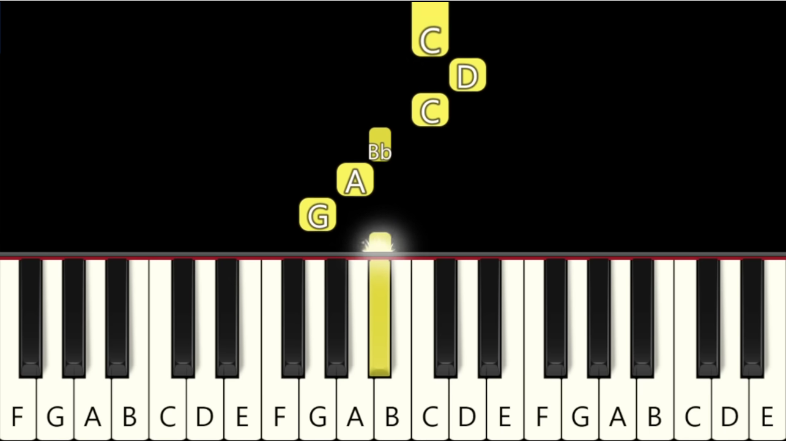
‘Circle of Life’ Screen

Slide 23
‘Circle of Life’ Melody

Slide 24
‘Circle of Life’ Melody

Slide 25
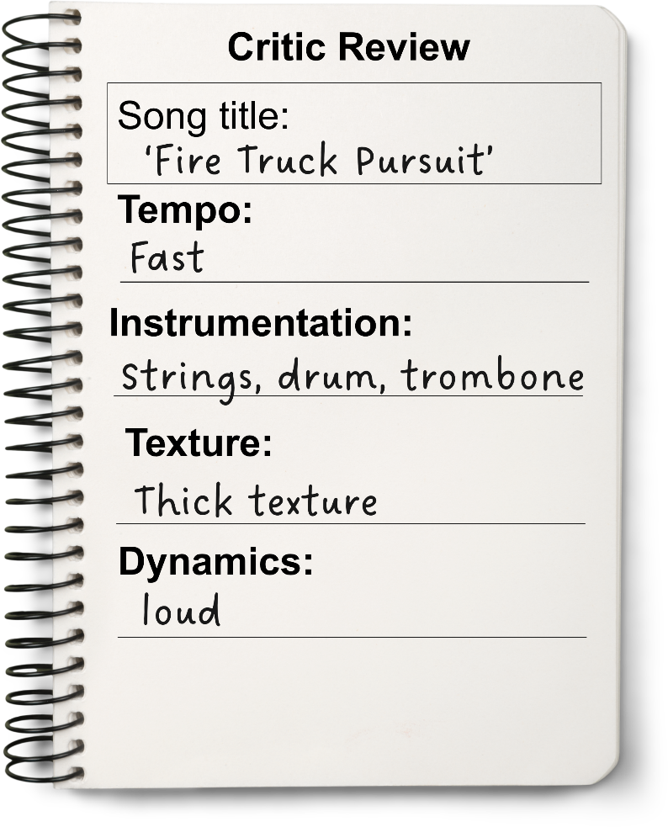
Composers choose musical elements to create different effects.
Tempo is the speed of the music.
Dynamics is the volume of the music.
Texture tells us how many layers there are in the music.

Slide 26

Exit Ticket
Date: _________
Lesson 2
elements
Composers use musical __________ to create different effects.
Tempo means:
the characters and plot
the speed of the music
the part of the music we sing to.
When a song has many layers we say it has t_____ texture.
elements
moods
dynamics
hick
3
I know _____ out of 3 answers.

Slide 27

In the next lesson, we will explore how musical elements create different moods in films.

