Slide 1

Same Song Different Artist
Lesson 1
What is a Cover Version?
Unit 3 Version 3

Slide 2
In this lesson, we will learn what a cover version is and why artists make them.

Slide 3

You will be successful when you can:
hear the difference between a cover version and the original
describe the ways that artists made changes to a song.
Hear: To notice sounds using your ears.
Describe: To tell what something is like using words.

Slide 4
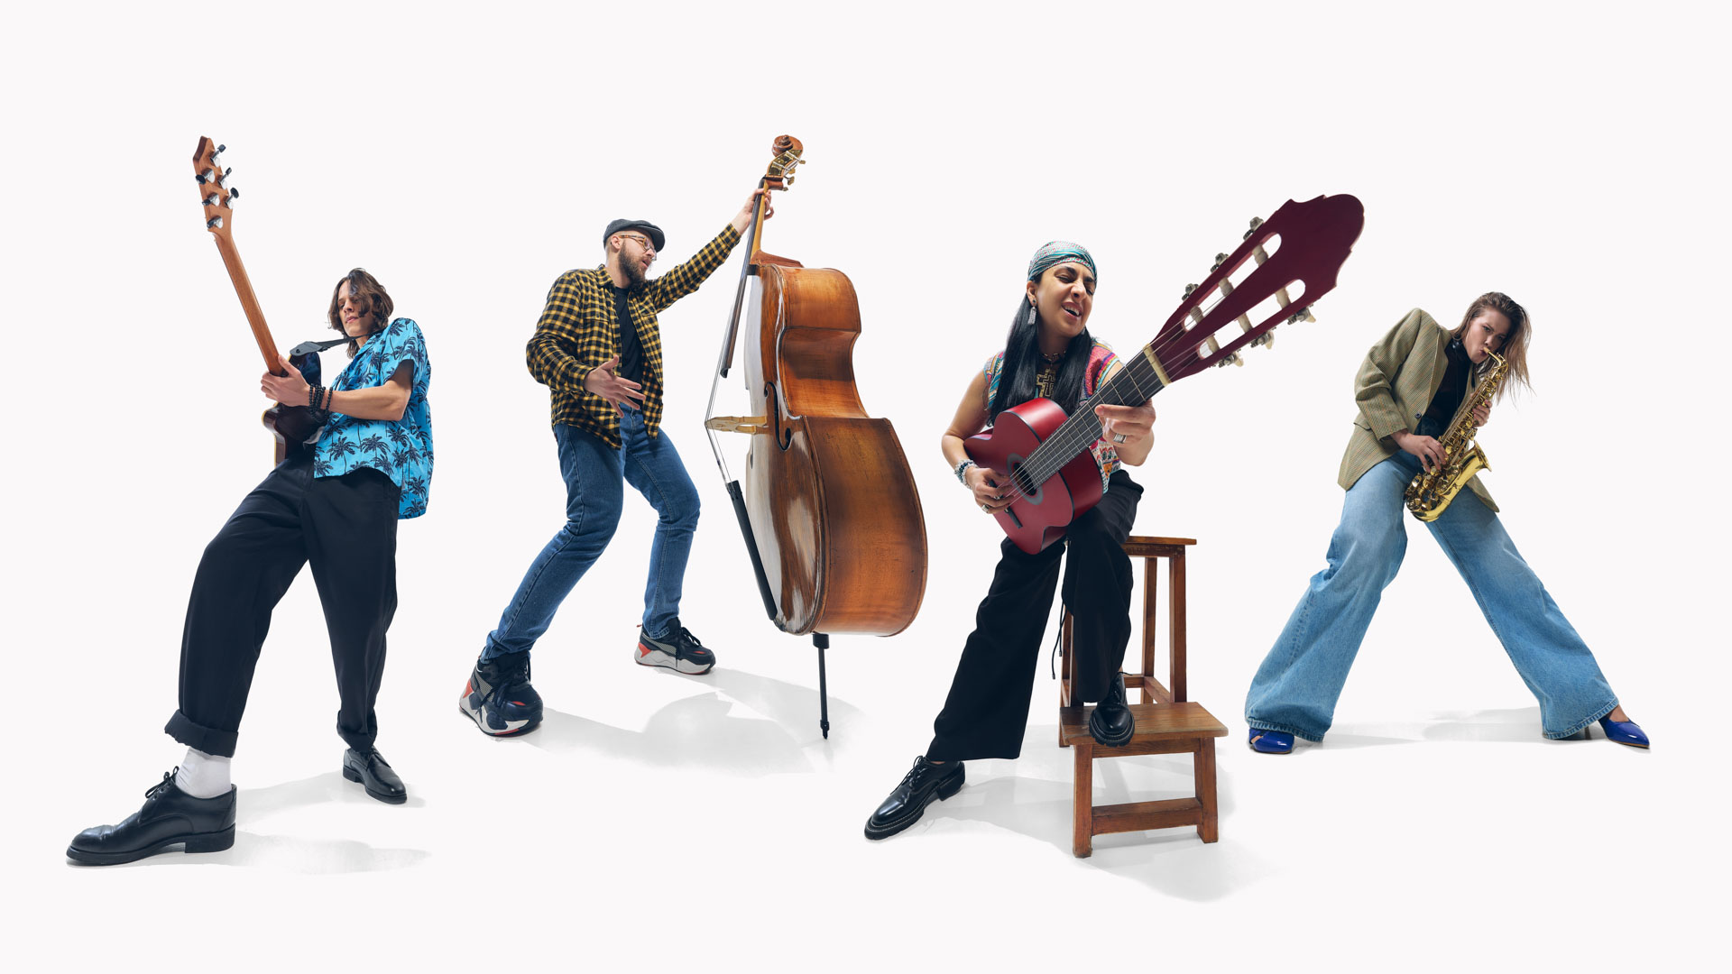




Slide 5
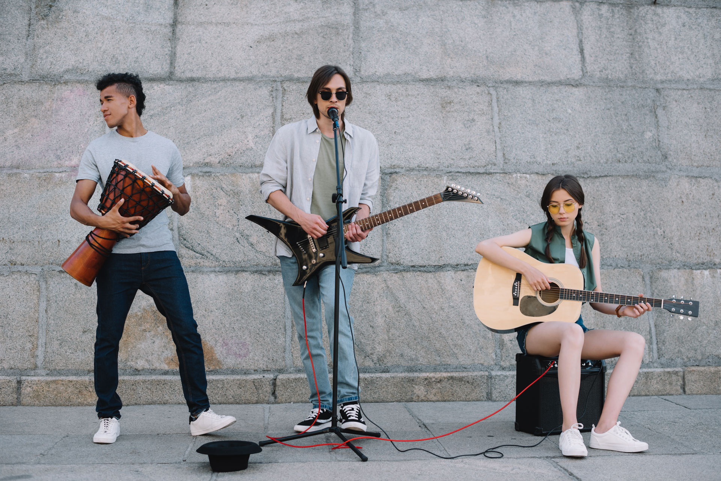
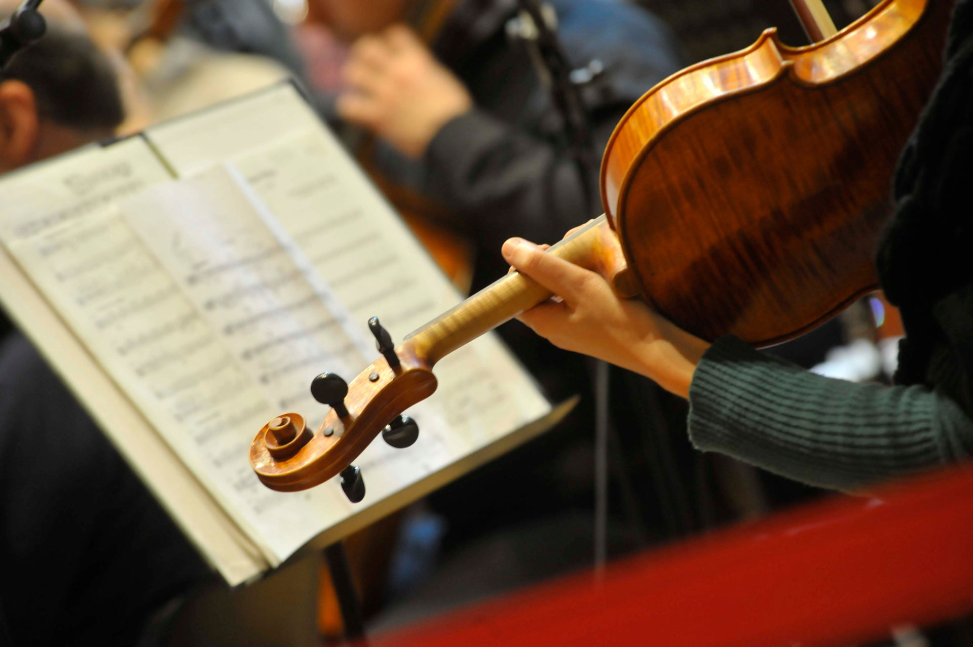

What is a Cover Version?

Slide 6
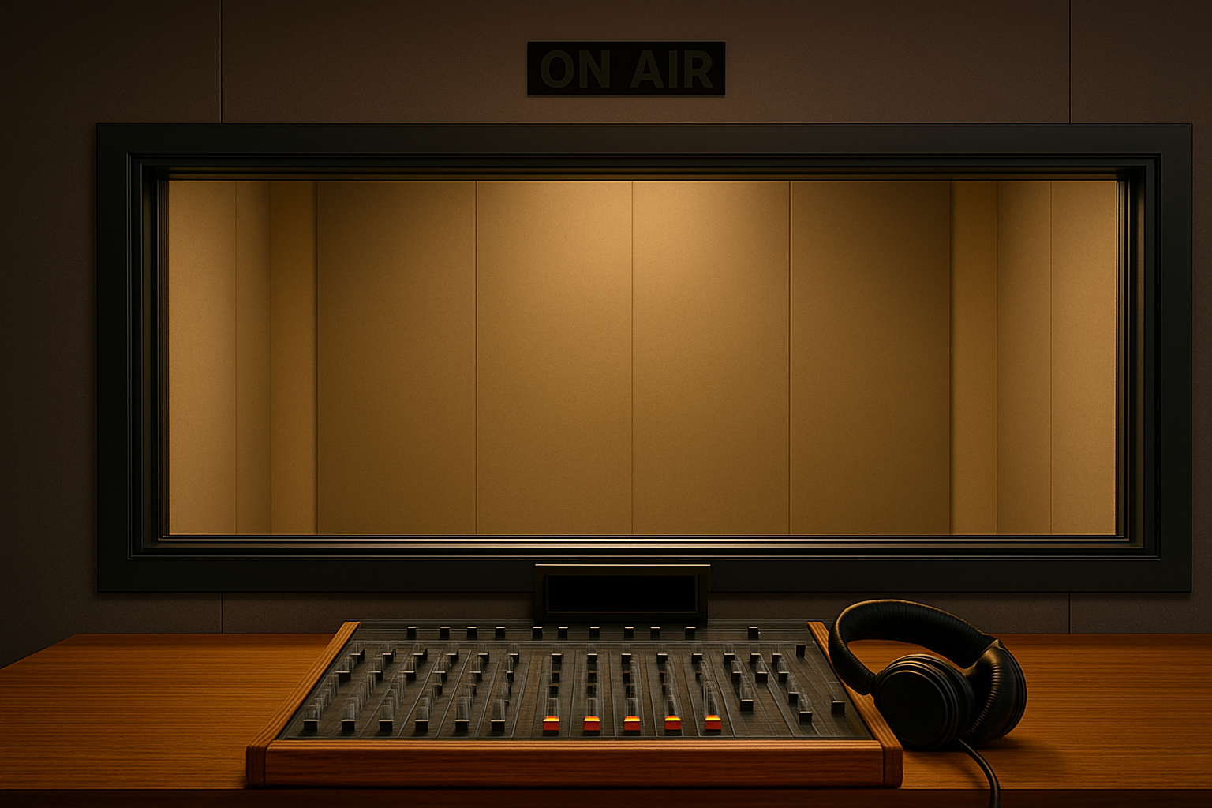
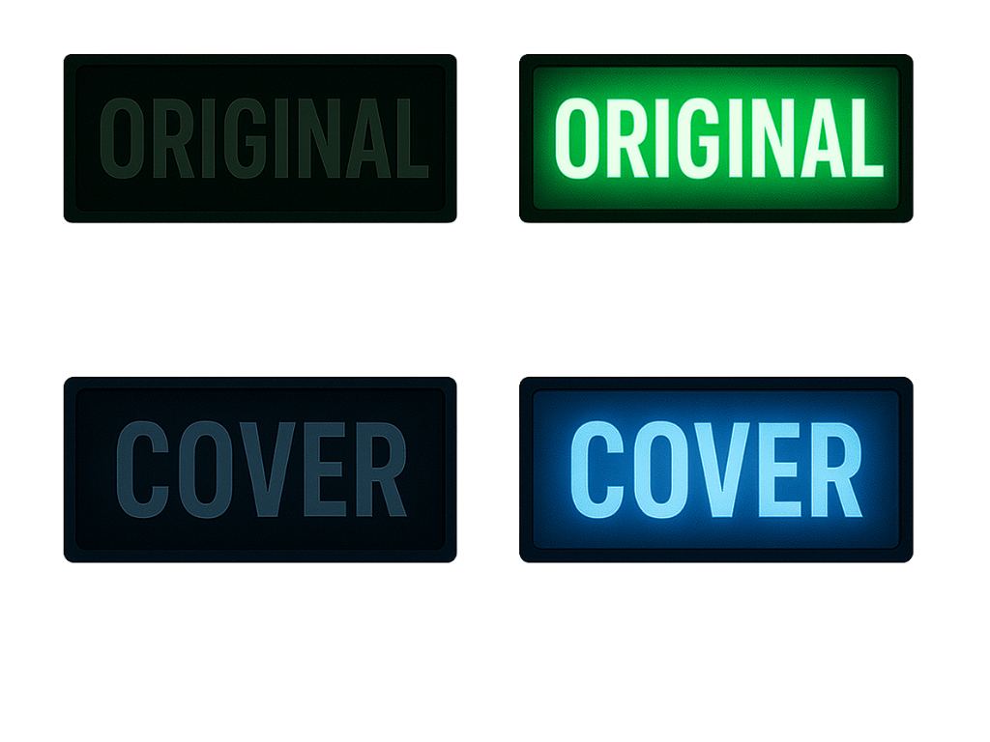


Slide 7



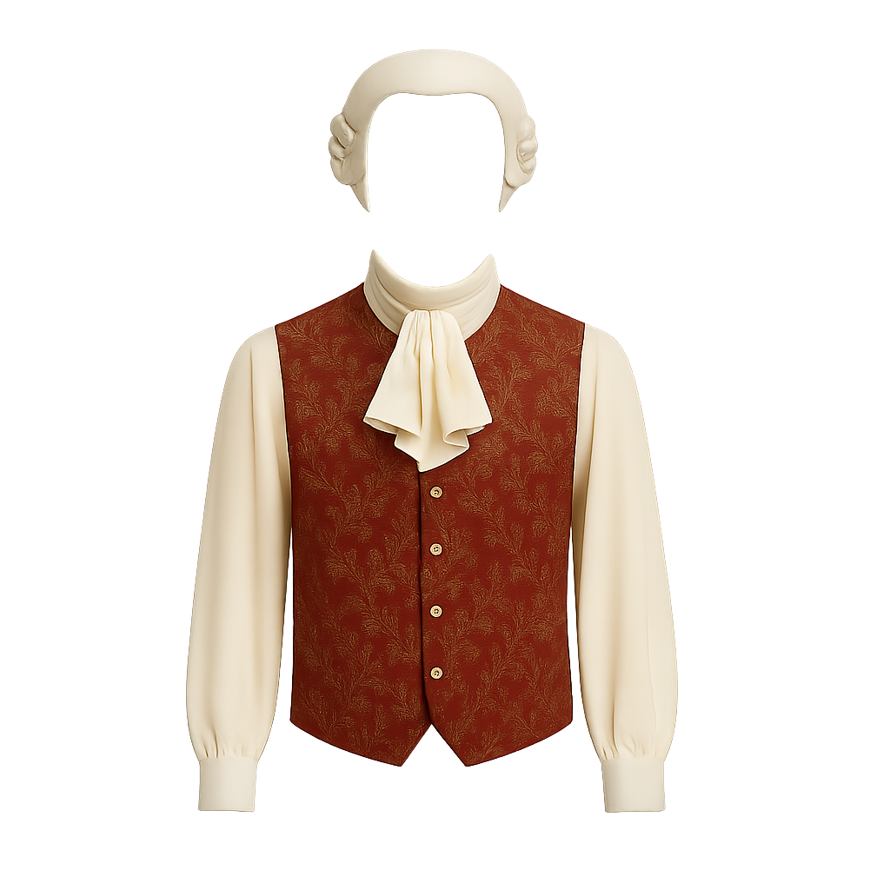
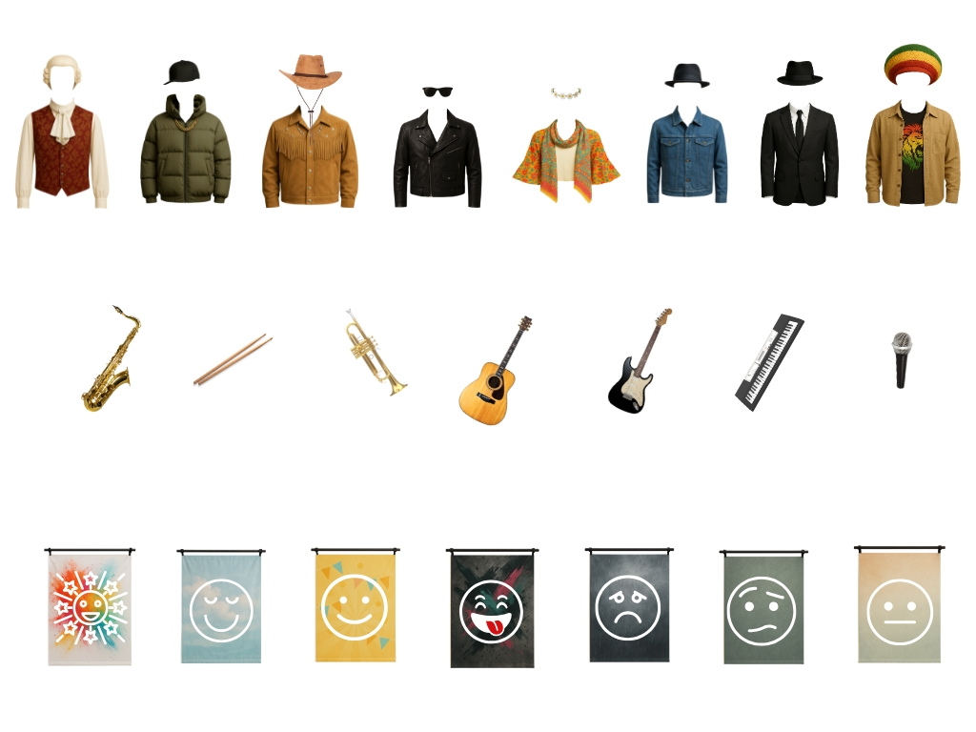

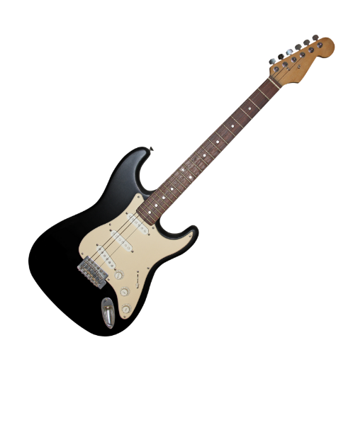

Instrumentation, Style and Mood

Slide 8
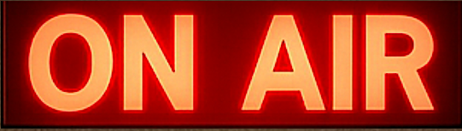
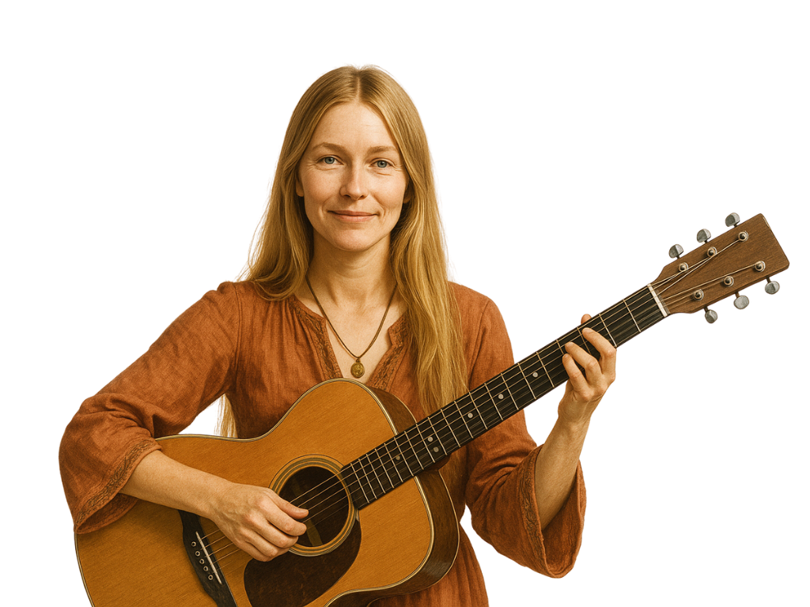



Slide 9

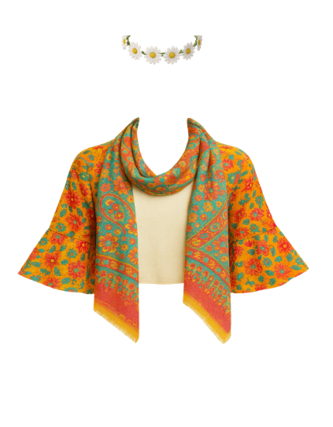
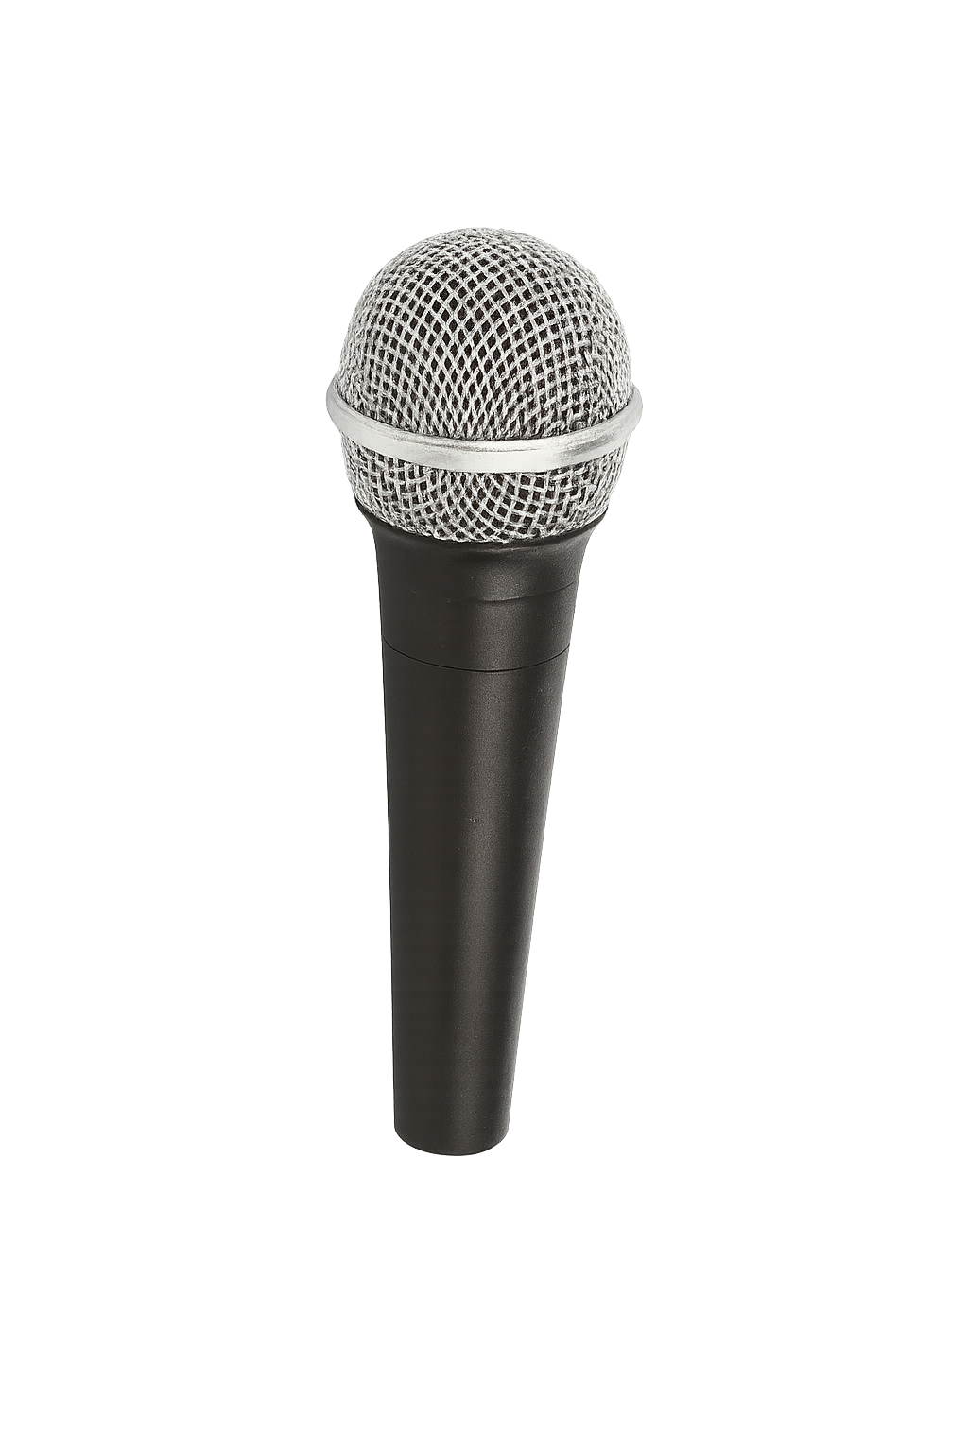
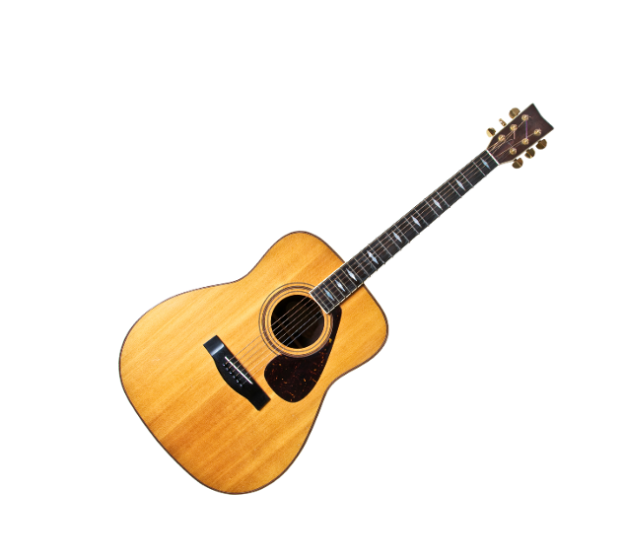
‘Big Yellow Taxi’ Original Version

Slide 10
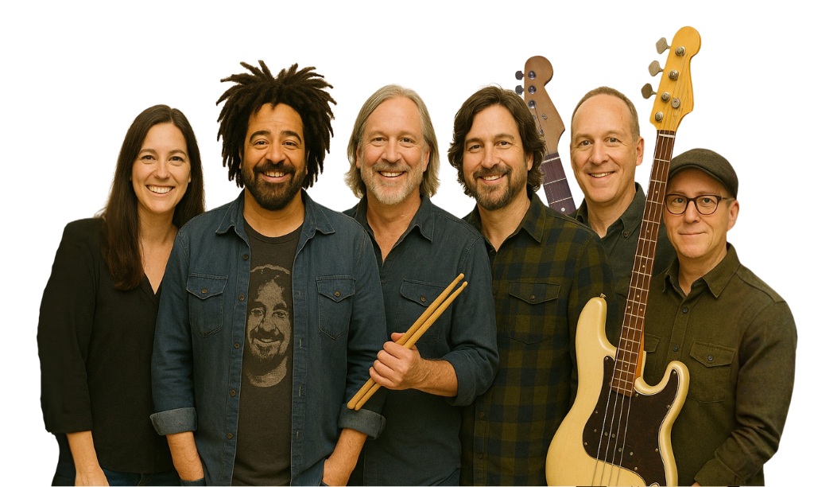
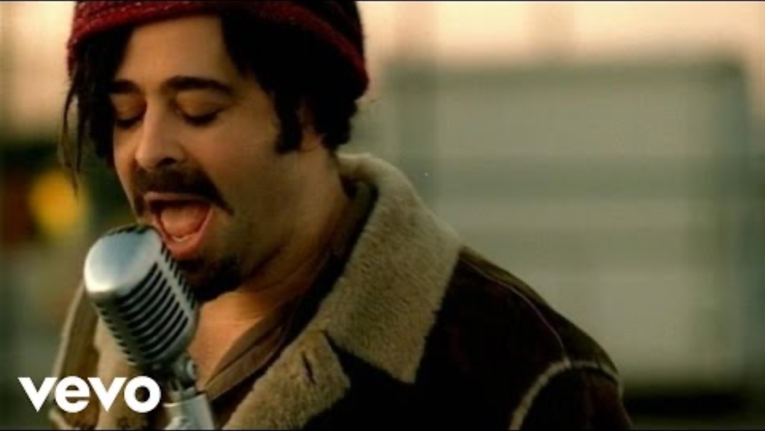

Slide 11

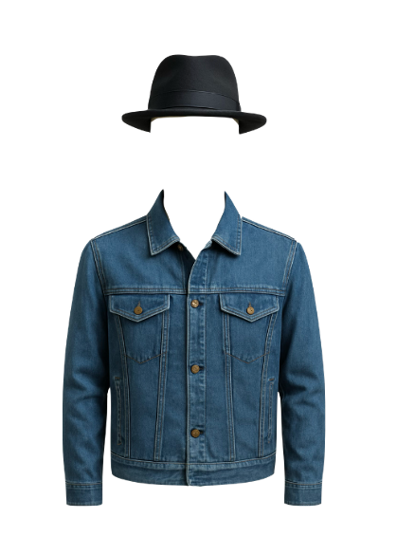
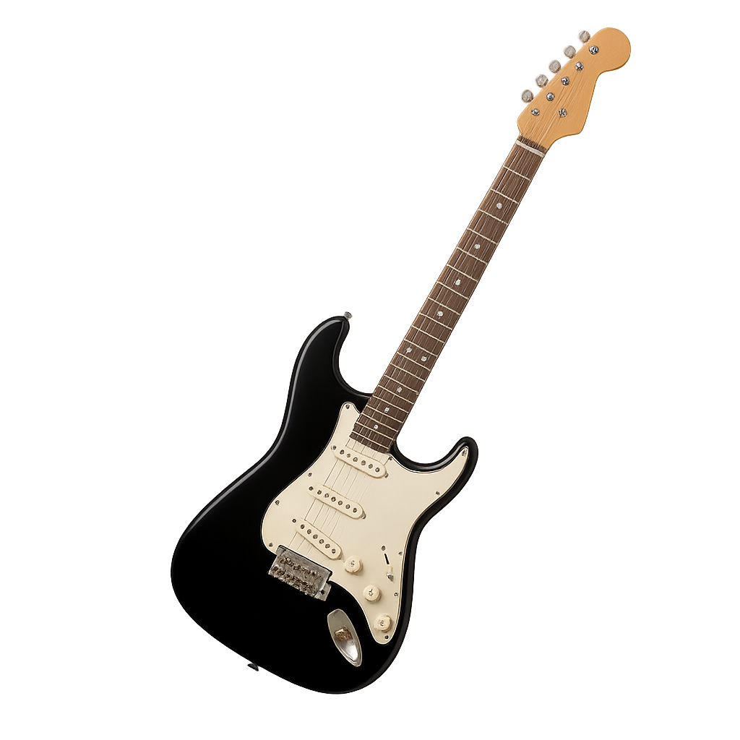
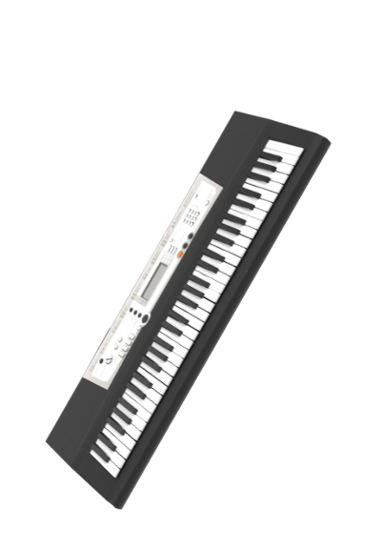

‘Big Yellow Taxi’ Cover Version

Slide 12



Changes in Cover Versions
Which three things could a cover artist change in a song?
Melody, style and instrumentation.
Mood, instrumentation and lyrics.
Instrumentation, style and mood.

Slide 13

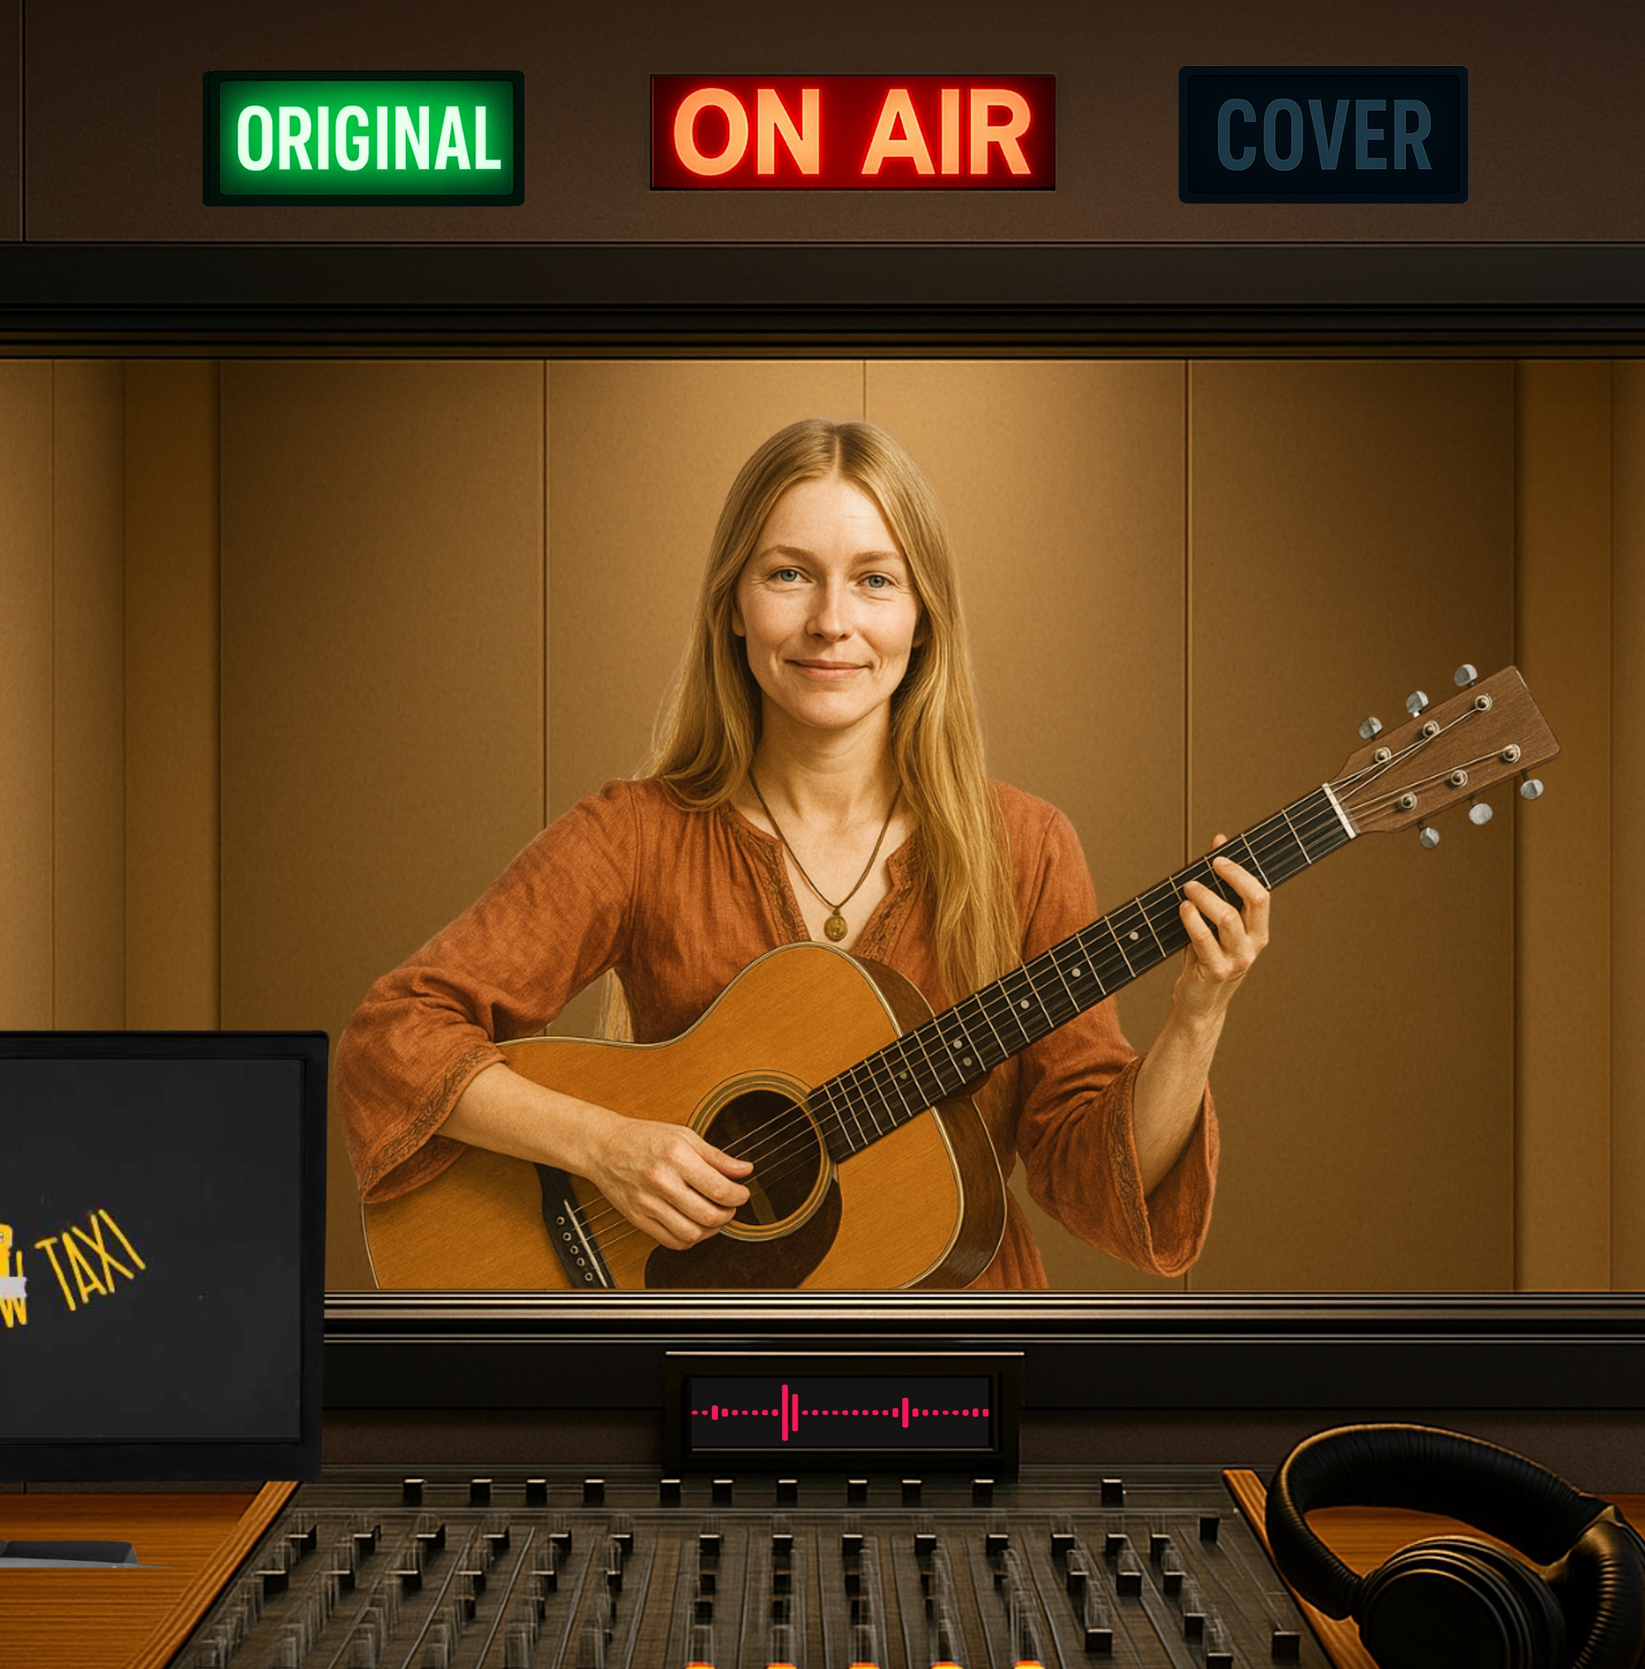
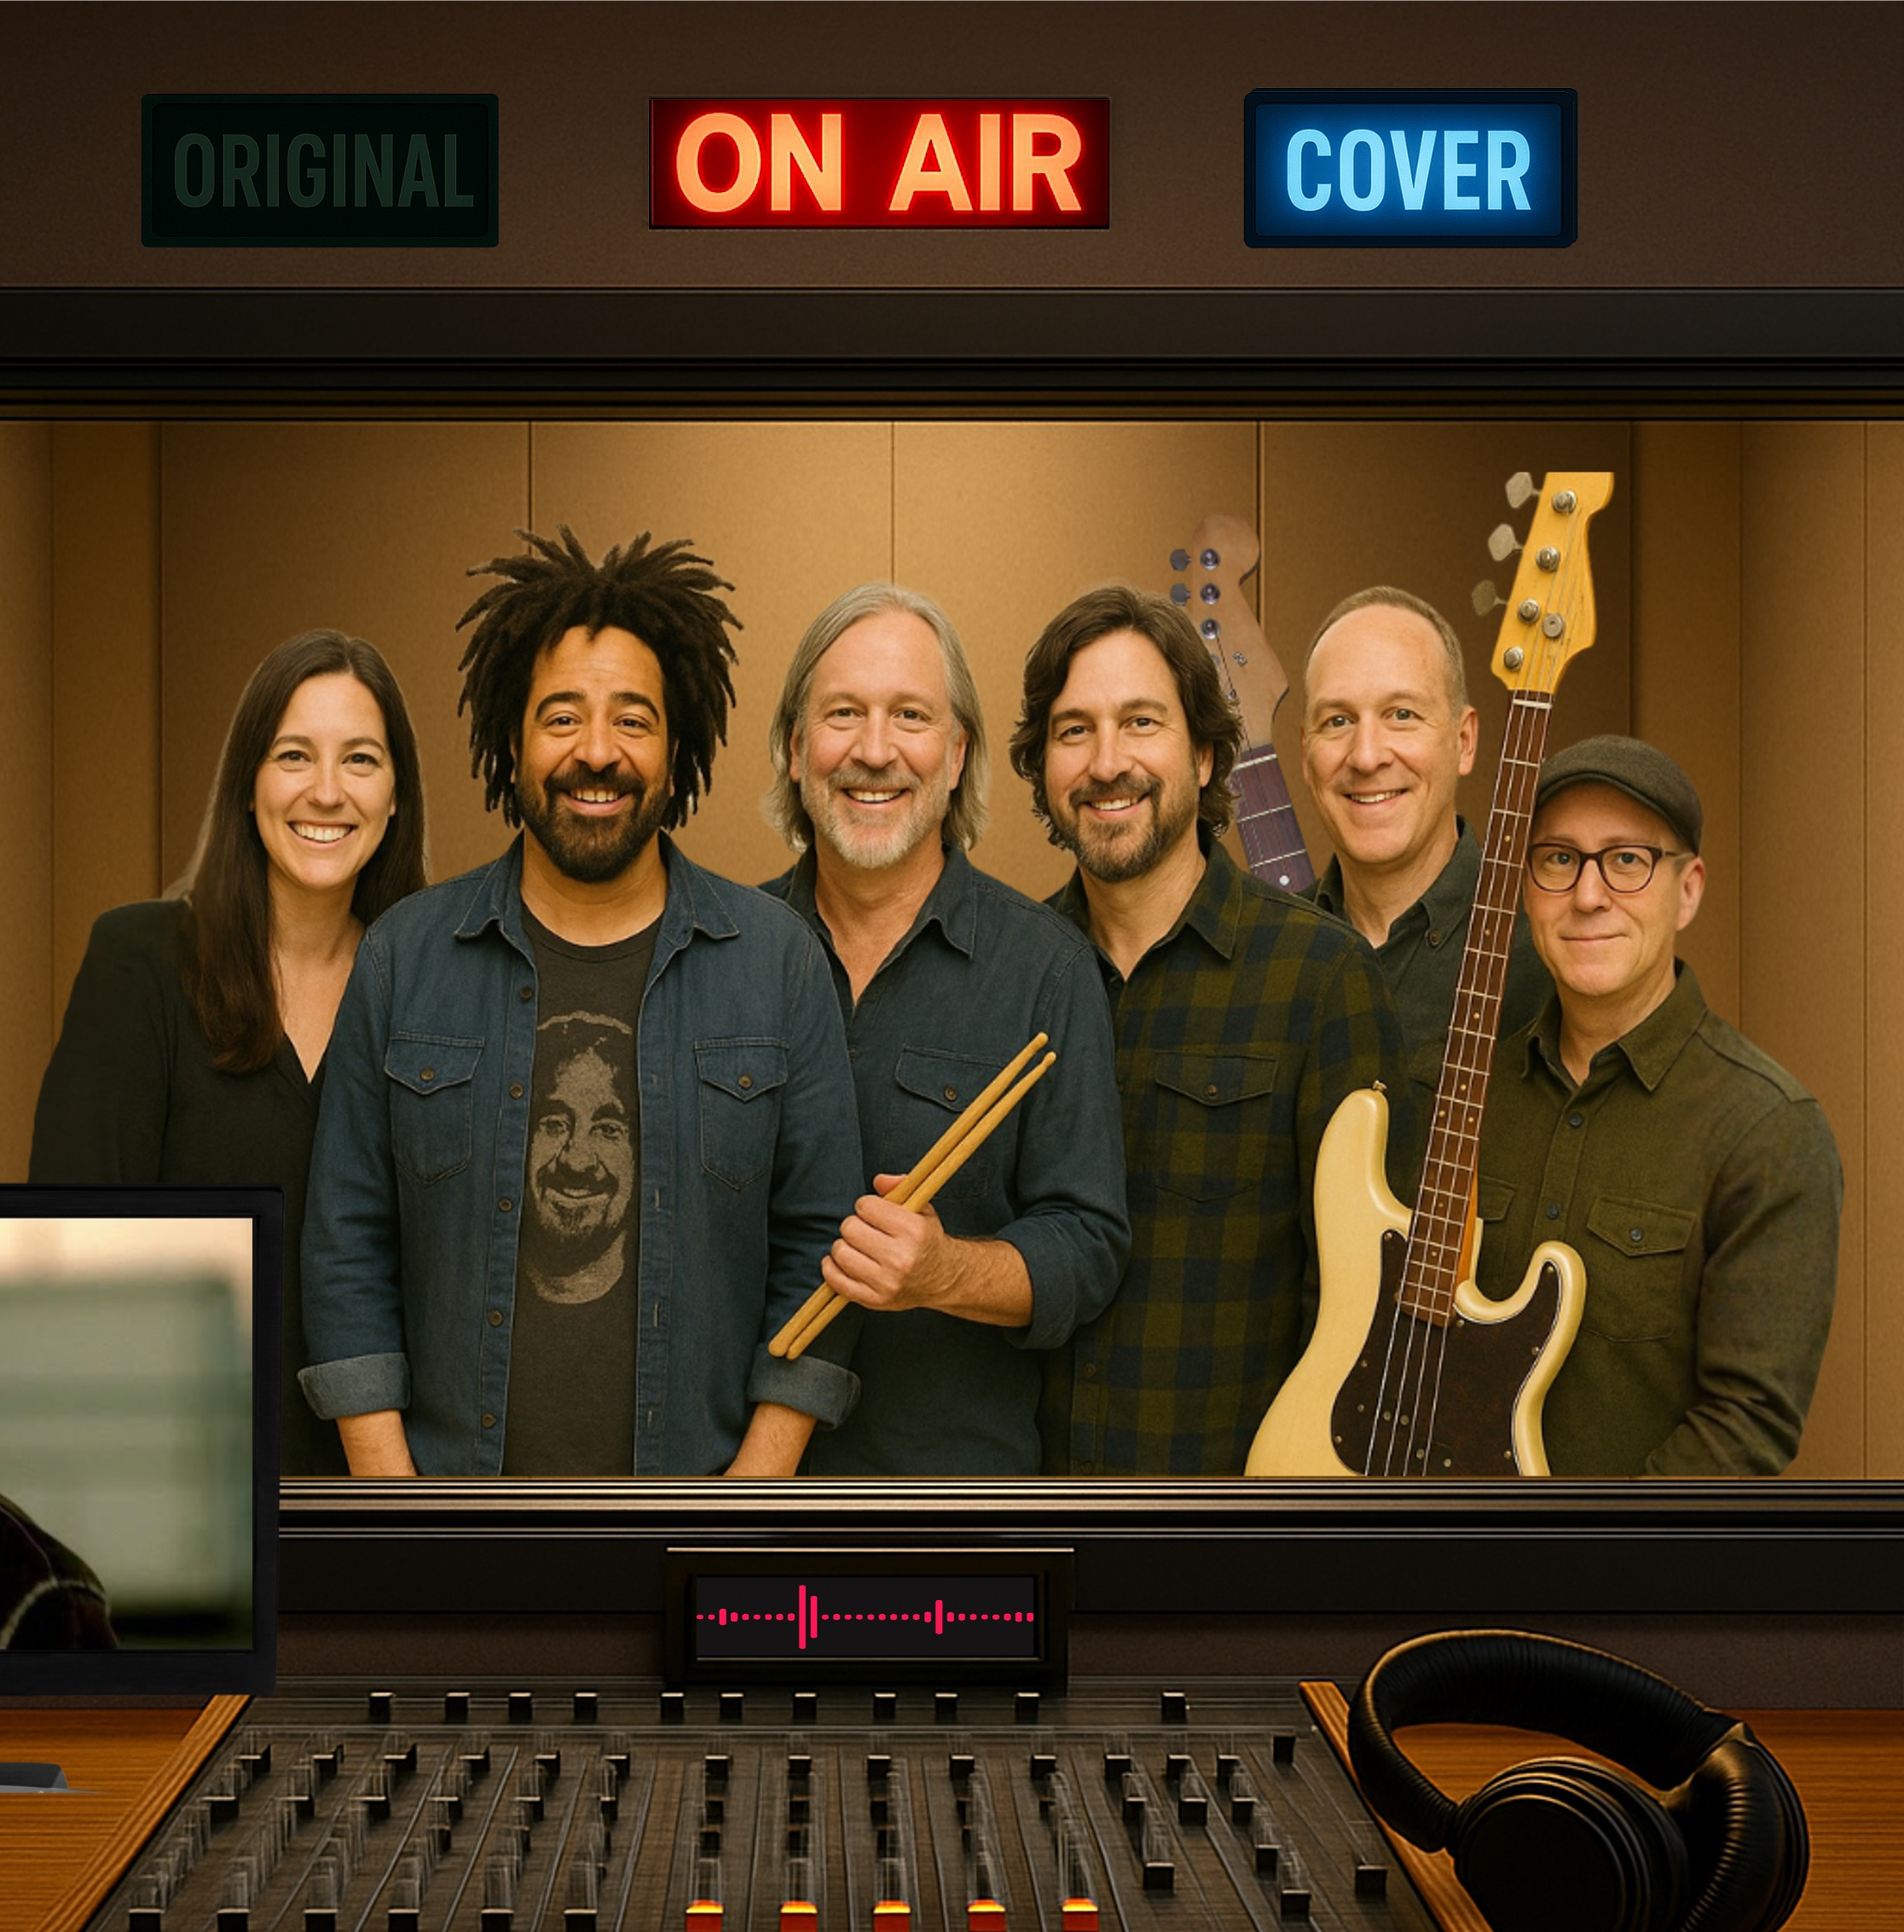
‘Big Yellow Taxi’ Comparison

Slide 14
Comparing Original with Cover
Different instrumentation,
, style
and mood.

Slide 15
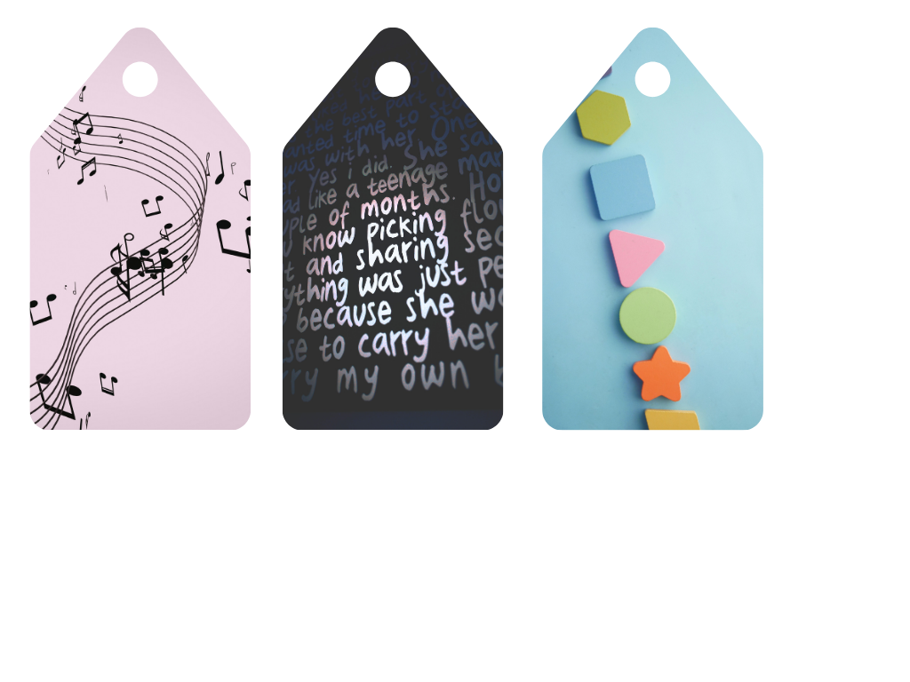
Cover Version Similarities
Same melody,
, lyrics
and structure.

Slide 16
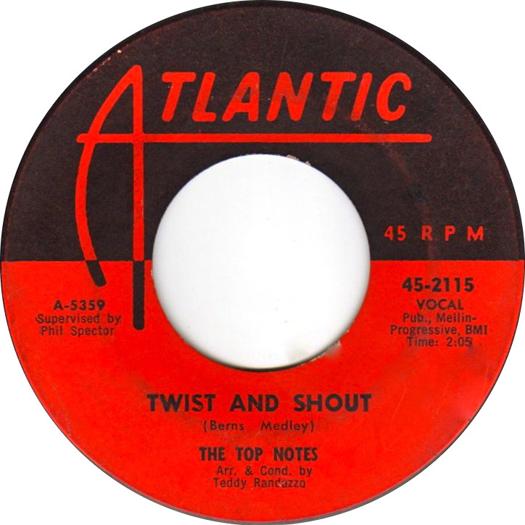
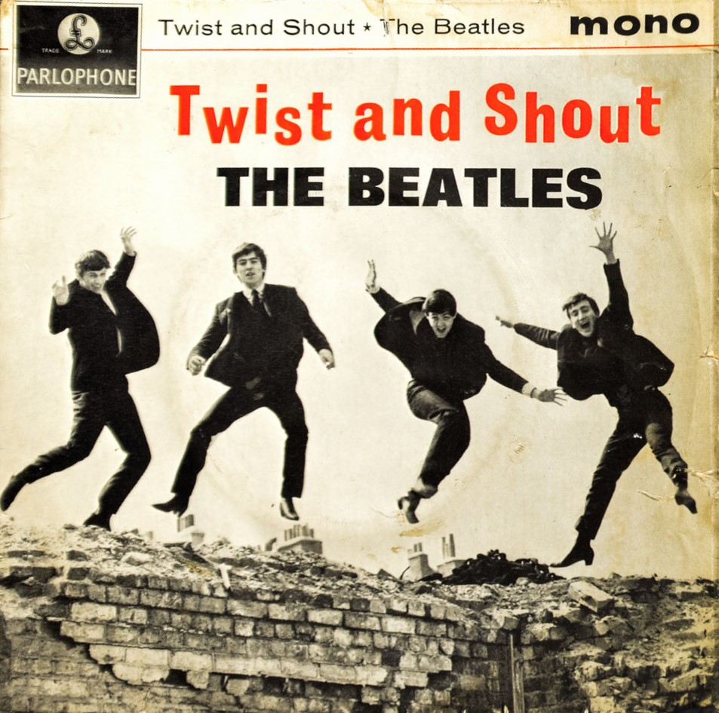

‘Twist and Shout’

Slide 17

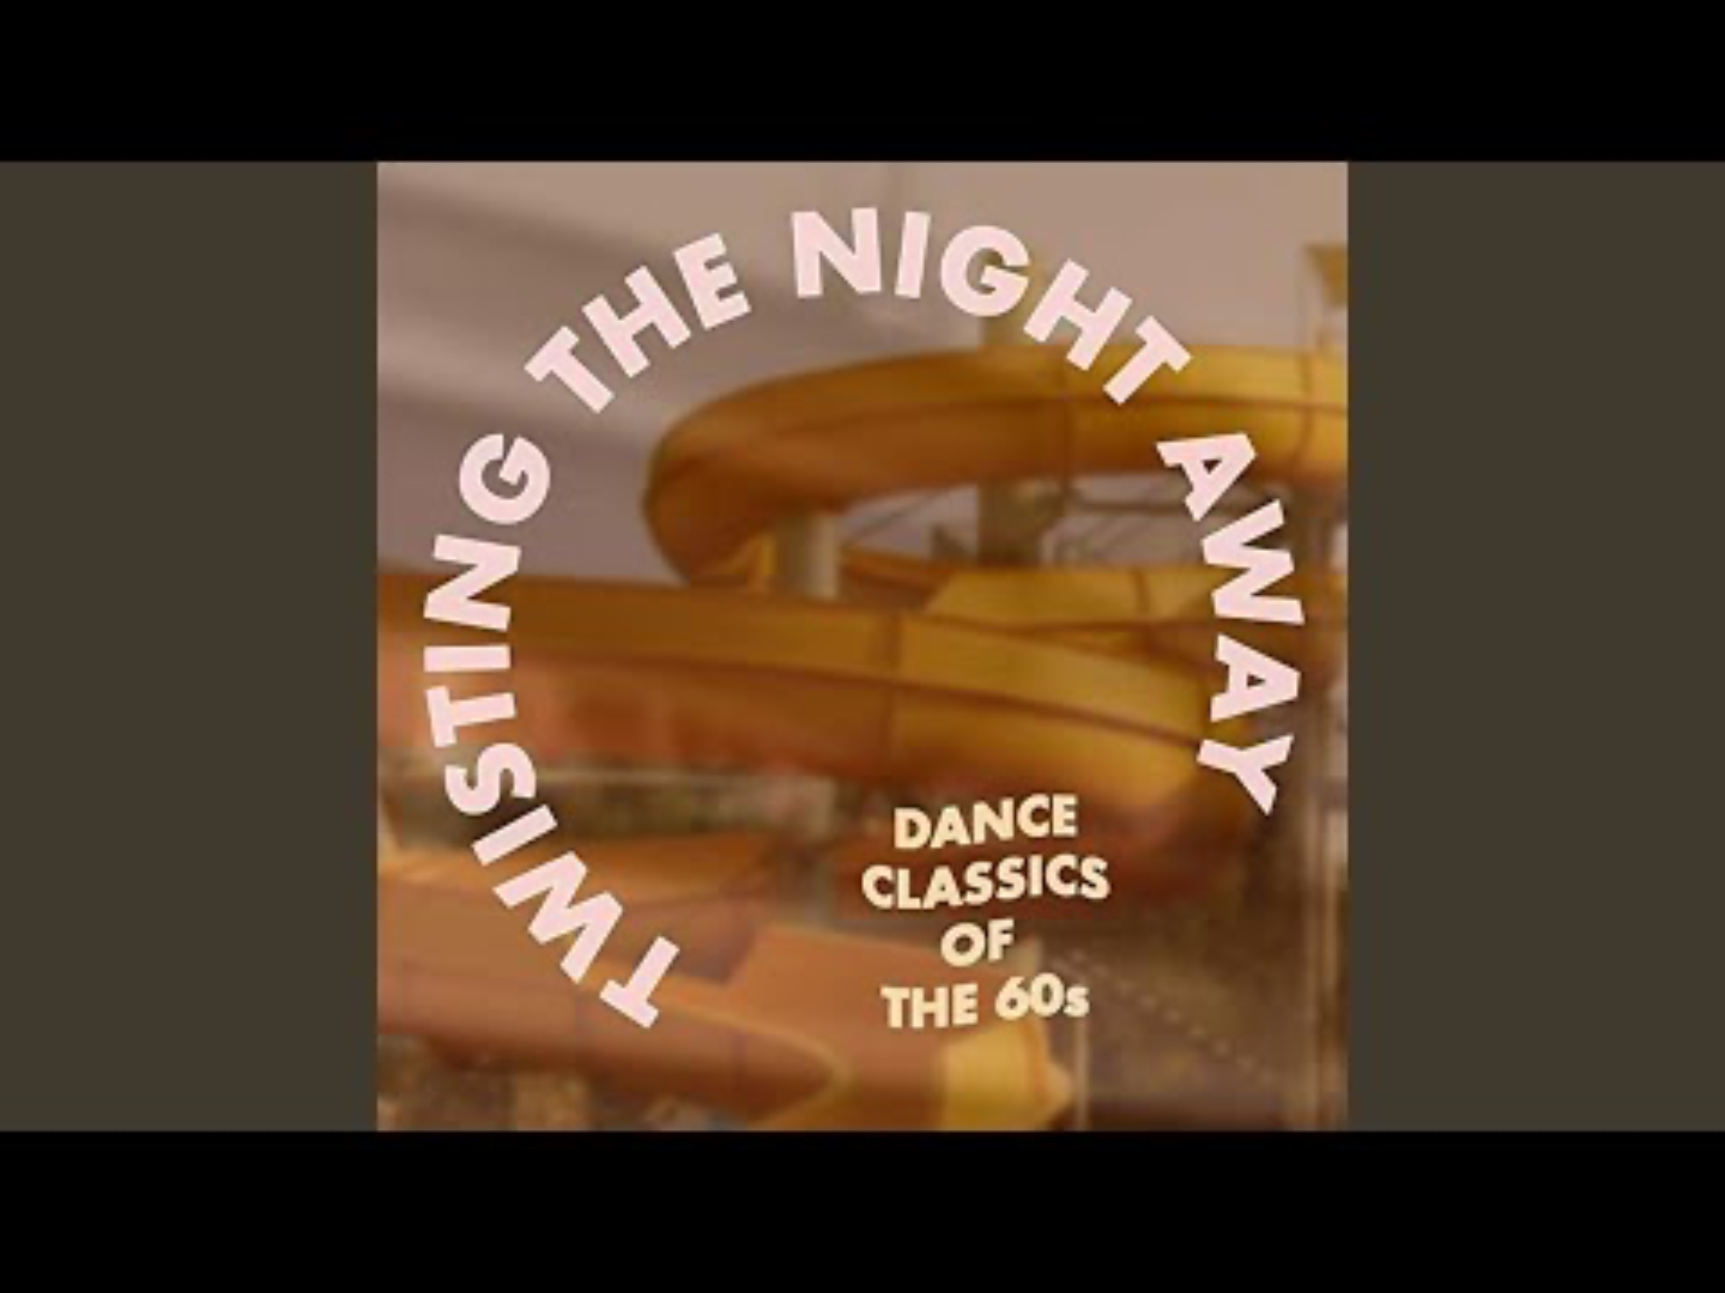

Slide 18
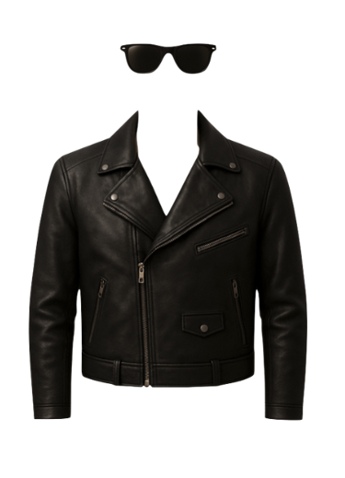
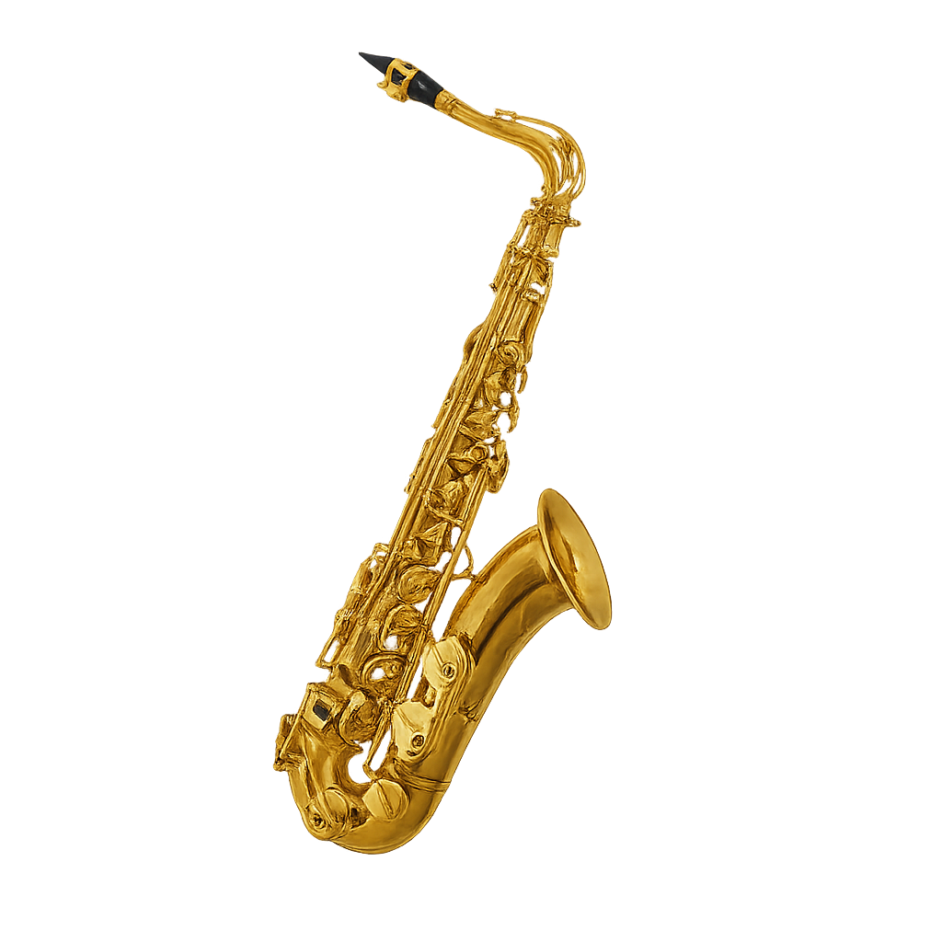
‘Twist and Shout’ by The Top Notes

Slide 19



Slide 20
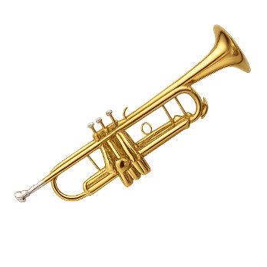
Isley Brothers Cover

Slide 21
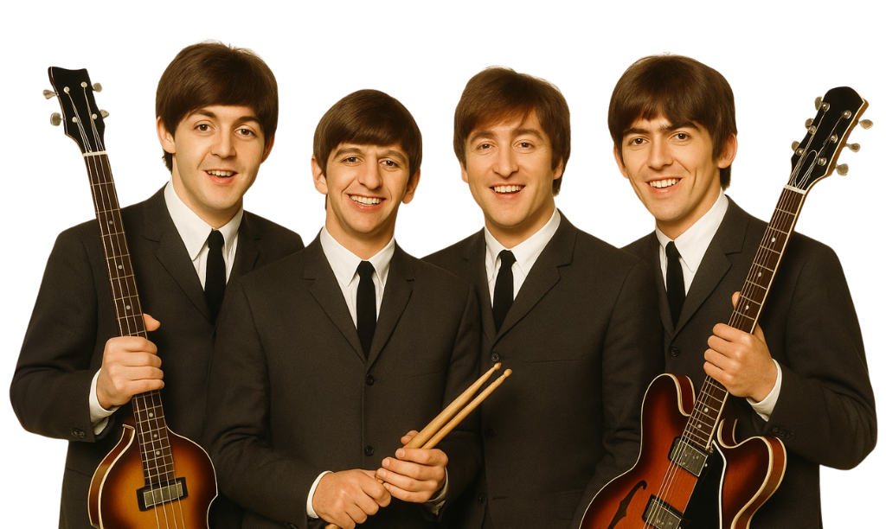


Slide 22
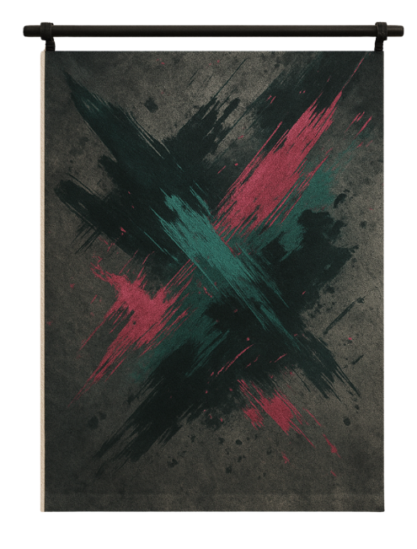
The Beatles Cover

Slide 23

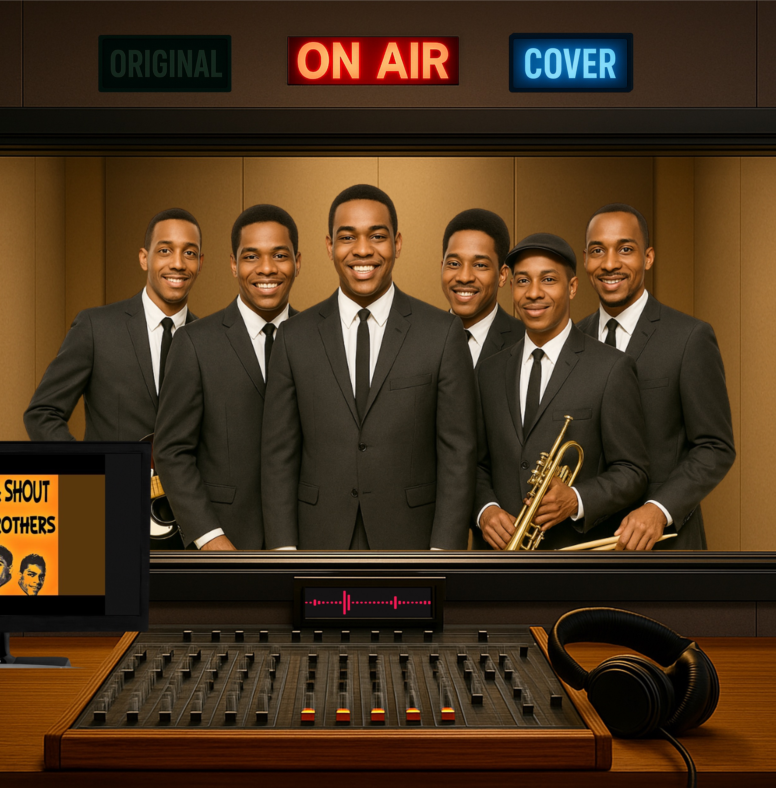
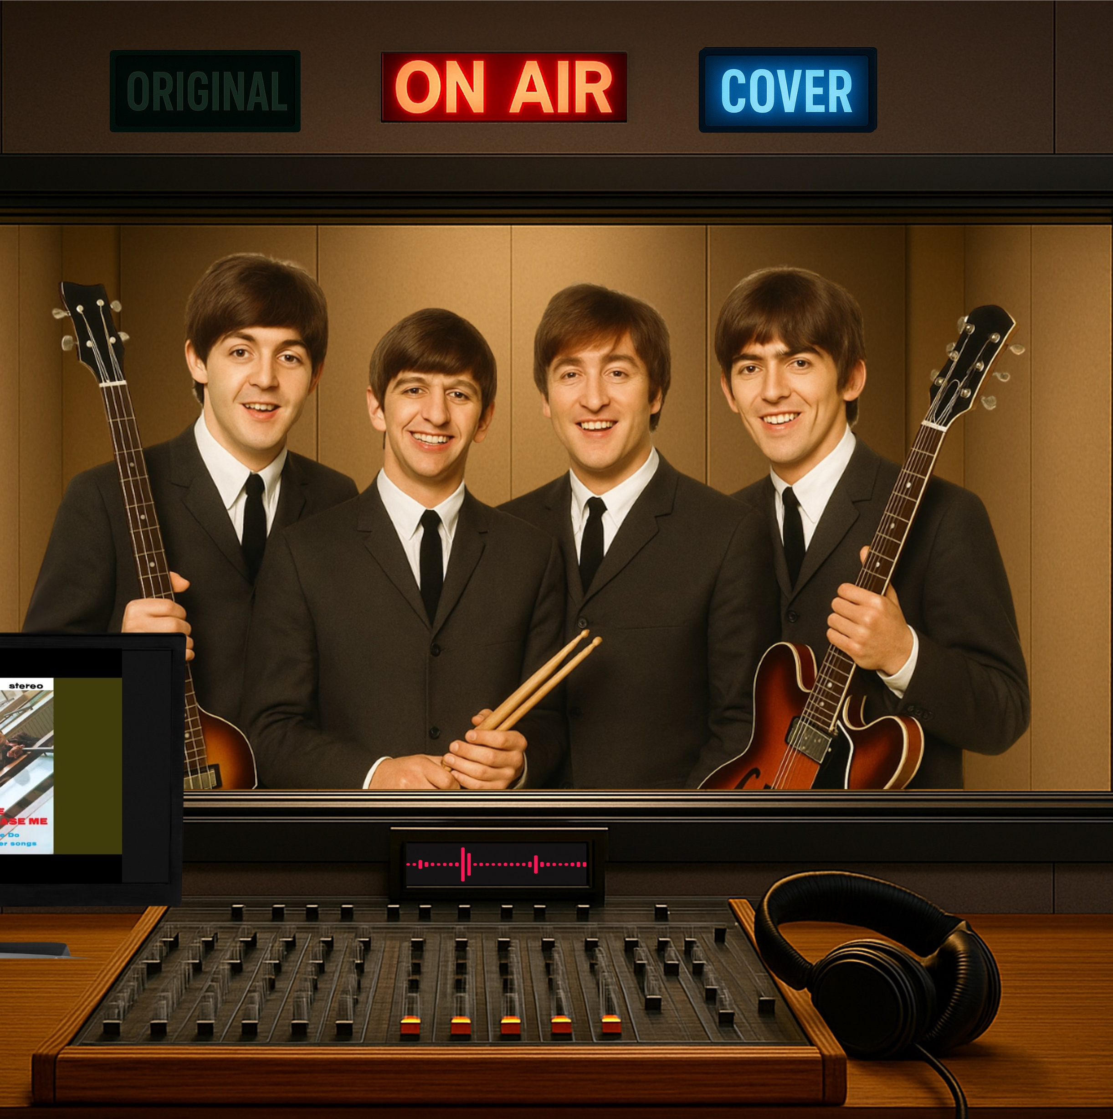
Comparing Original with Covers
Different instrumentation,
, style
and mood.

Slide 24
A cover version is when musicians create their own version of an existing song.

Slide 25

A cover version can use different instruments than the original.
Cover versions can be in a different style or mood than the original.
Cover versions can sound different from the original.

Slide 26
A cover version can use different instruments than the original.
Cover versions also keep some things the same as the original. They might be the melody, lyrics or structure.
Cover versions can sound different from the original.

Slide 27




Exit Ticket
Date: _________
Lesson 1
new version
A cover version is a _____________ of a song.
Cover versions can sound different from the original because the artist might change:
the instruments
the style or genre
the mood or energy
all of the above
A cover version is made when musicians change parts of the o________.
original
new version
copy
riginal
3
I know _____ out of 3 answers.

Slide 28

In the next lesson, we will review the musical elements and explore how they are used to make cover versions sound different from the original.
Musical Elements

Slide 29
Attributions
Slide 20 (lower left) Photo: Twist and Shour Cover Art from Wand Records, from Wikimedia Commons, Used under Fair Use, https://en.wikipedia.org/wiki/File:Twist-and-shout-isleys.jpg
Notes:
(no notes needed.)

