Slide 1

Same Song Different Artist
Lesson 2
Building Blocks Remix
Unit 3 Version 3

Slide 2





Revise
Exit Ticket
Lesson 1
new version
A cover version is a _____________ of a song.
Cover versions can sound different from the original because the artist might change:
the instruments
the style or genre
the mood or energy
all of the above
A cover version is made when musicians change parts of the o________.
original
new version
copy
riginal

Slide 3
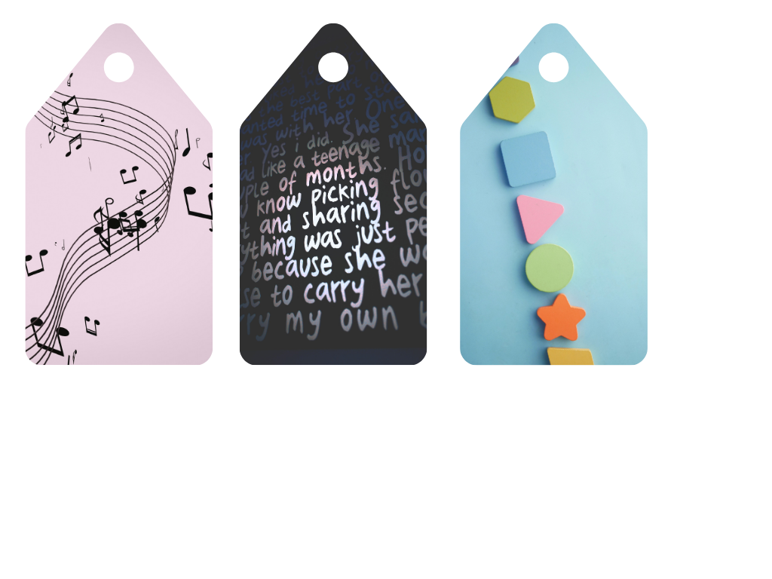
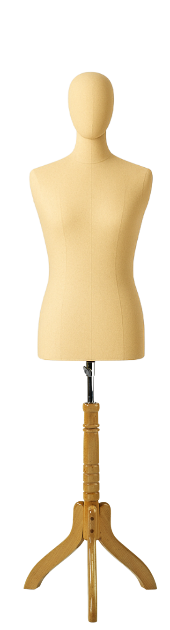
What things might cover versions keep the same as the original?

Slide 4



In this lesson, we will review musical elements and explore how they are used to make cover versions sound different from the original.
Musical Elements

Slide 5

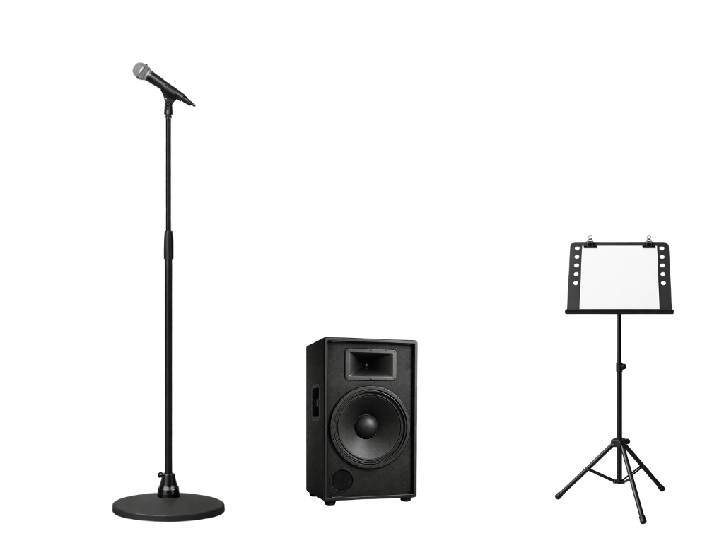

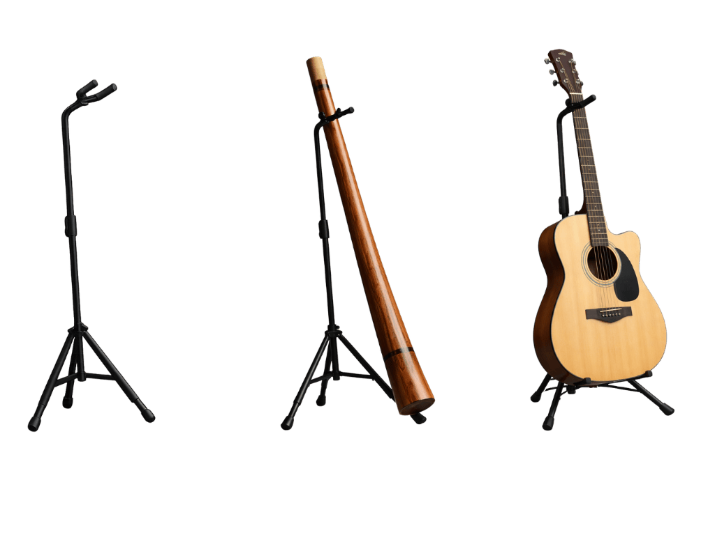
You will be successful when you can:
define the musical elements
identify the musical elements in cover songs.
Define: To tell the exact meaning of a word or idea so others understand what it means.
Identify: To pick out or recognise something by noticing its important features.

Slide 6
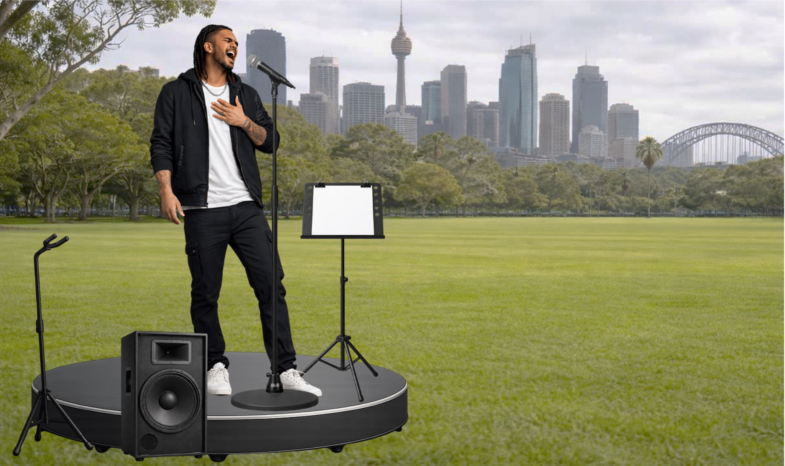


Slide 7
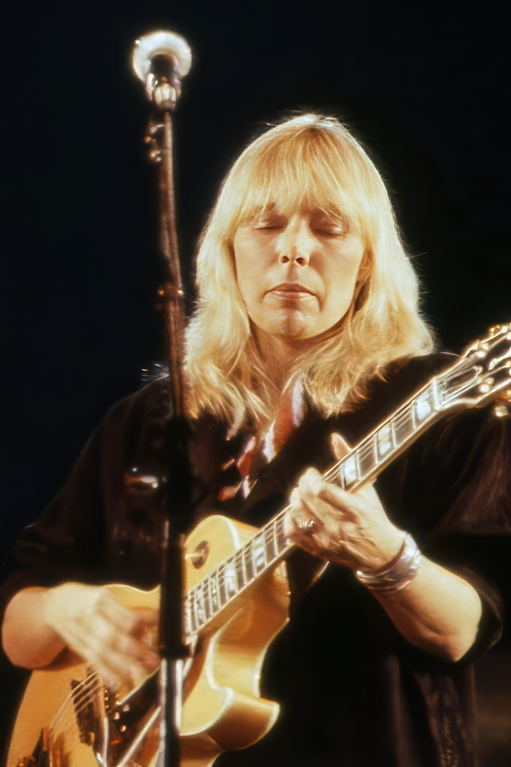
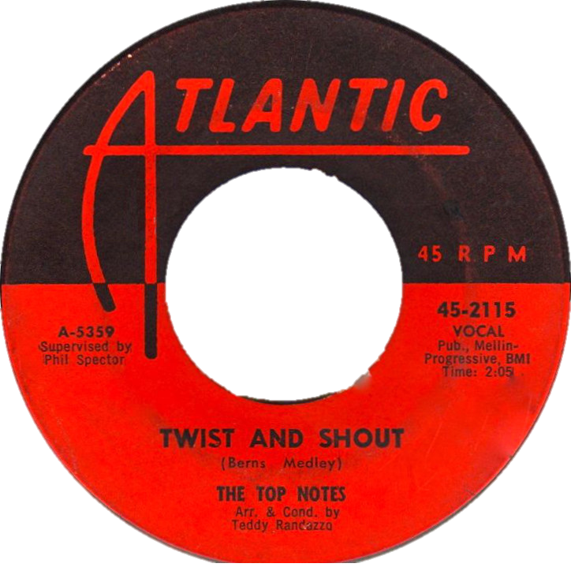

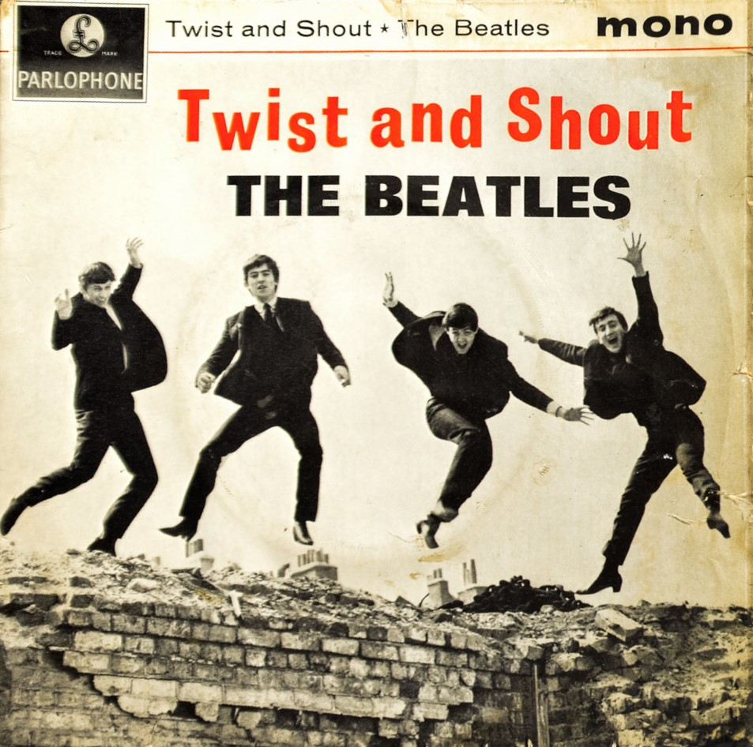

What is a Cover Version?

Slide 8

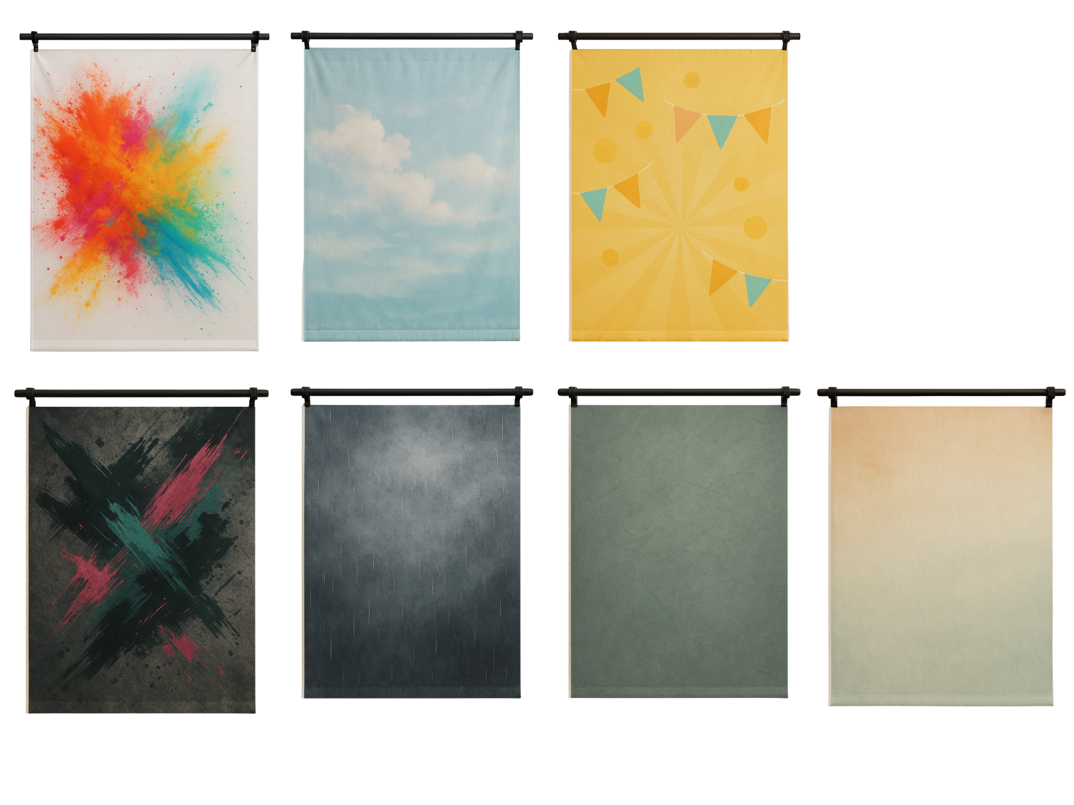
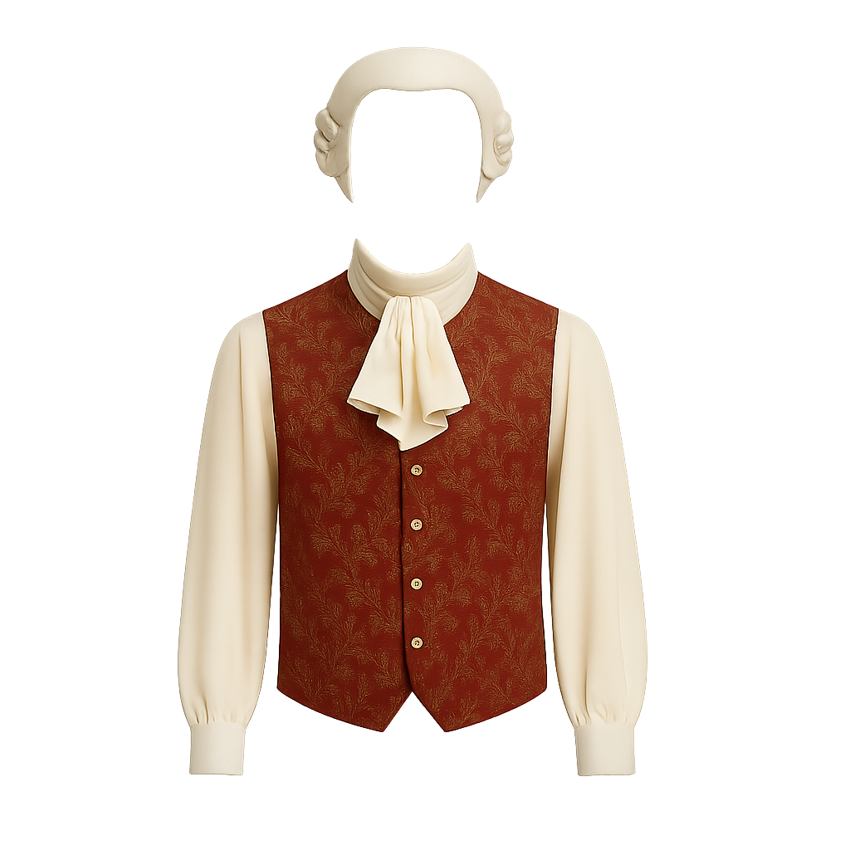
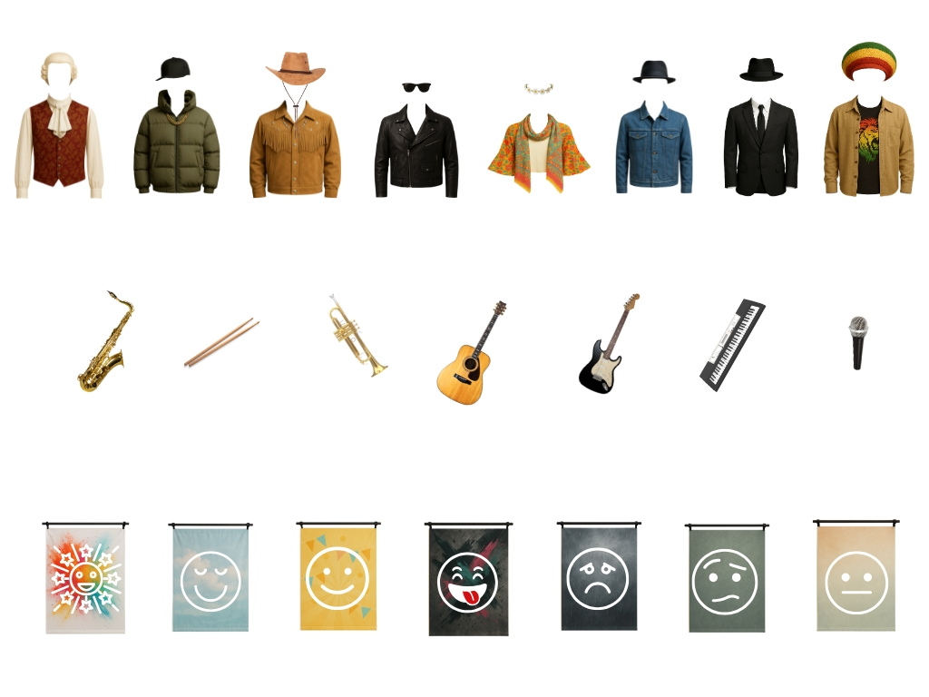

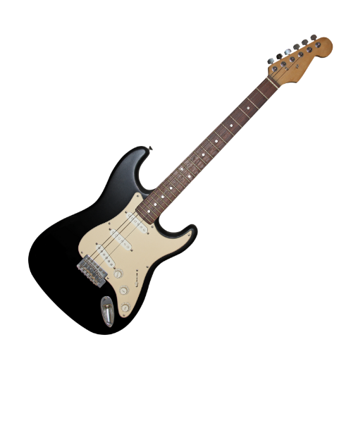

Instrumentation, Style and Mood

Slide 9


Musical Elements
Pitch
Rhythm
Tempo
Texture
Dynamics
Timbre
Structure

Slide 10
Pitch
Pitch tells us how high or low the notes are.

Slide 11

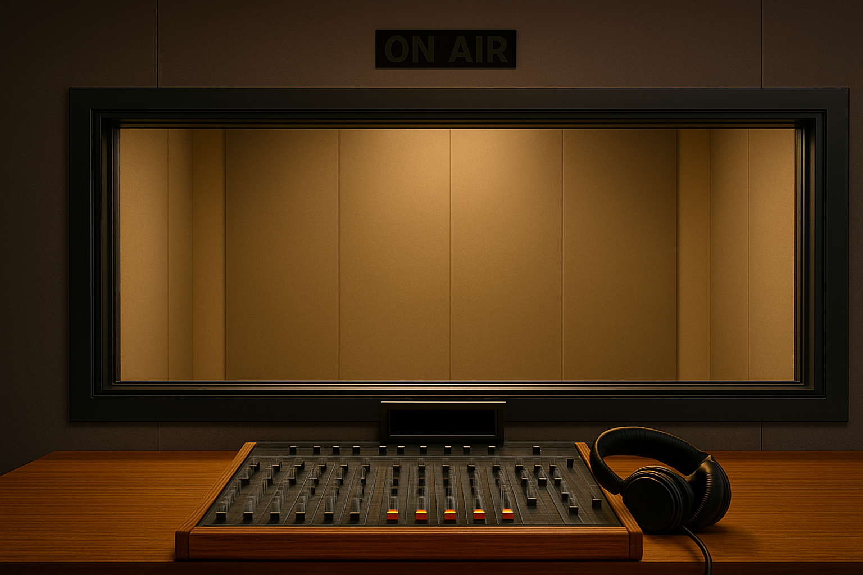
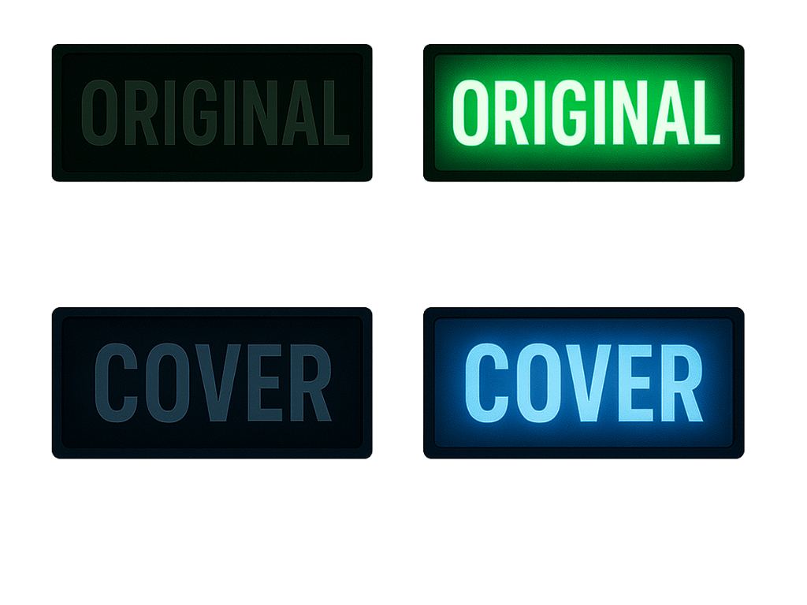
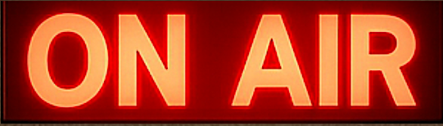

Pitch

Slide 12
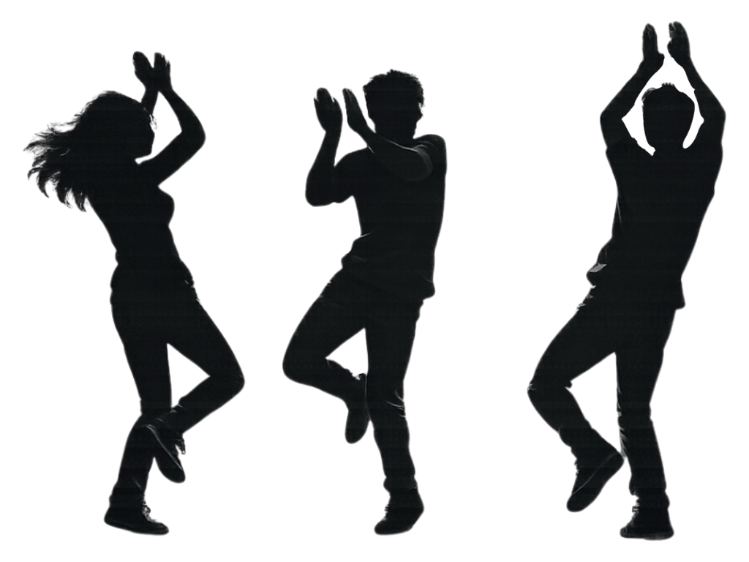
Rhythm and Tempo
Tempo, or speed, tells us how fast or slow the music is.
Rhythms are patterns of longer and shorter sounds or notes.

Slide 13
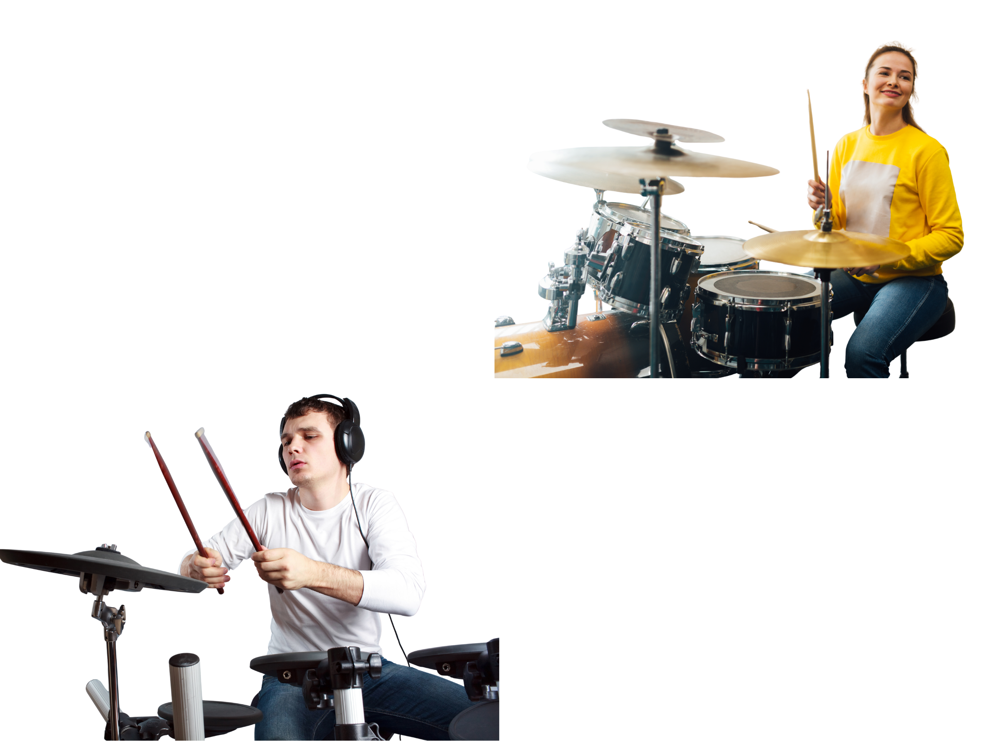
Rhythm and Tempo

Slide 14

Dynamics
Dynamics tells us how loud or soft the music is. It is another word for volume.

Slide 15


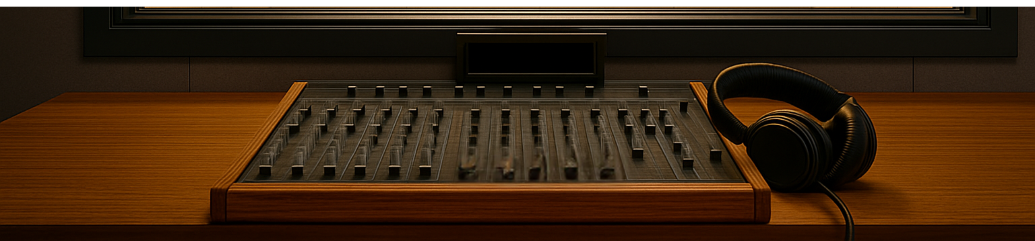

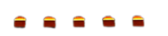
Dynamics

Slide 16
Timbre
Timbre tells us about the quality of the sound, such as bright or dark.

Slide 17

Timbre

Slide 18
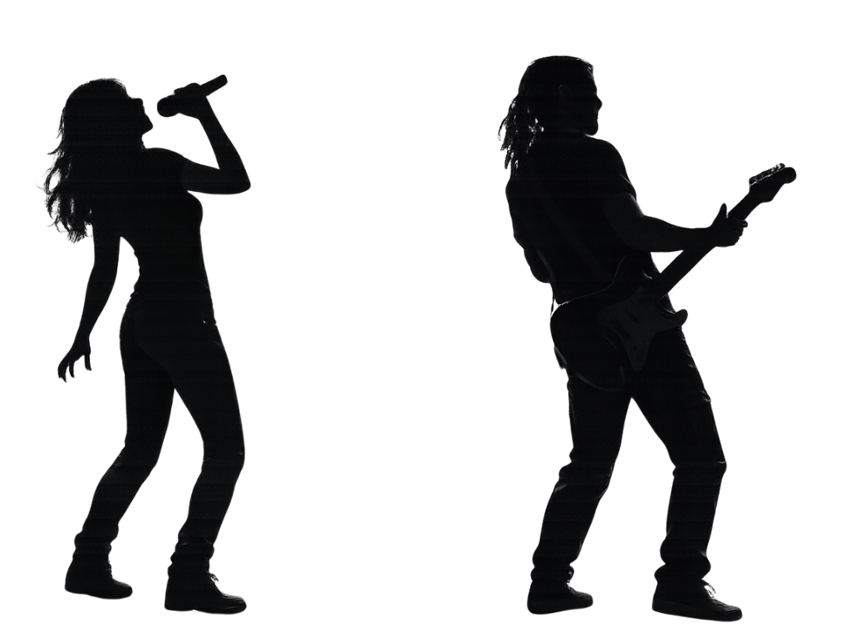
Texture
Texture tells us how many layers there are in the music.

Slide 19

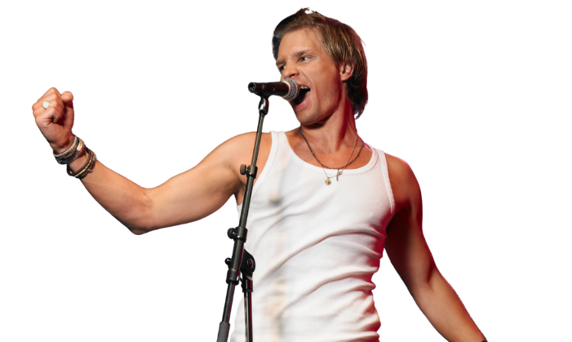
Texture

Slide 20
Structure
Structure tells us how the music is built or put together.
Verse
Chorus
Verse
Verse
Chorus

Slide 21
Structure
Structure

Slide 22
Musical Elements
Questions
Pitch
Structure
Timbre
Dynamics
Texture
Rhythm
Does it repeat?
Describe the overall sound
Loud or soft?
Many or few instruments?
Fast or slow?
High or low?

Slide 23
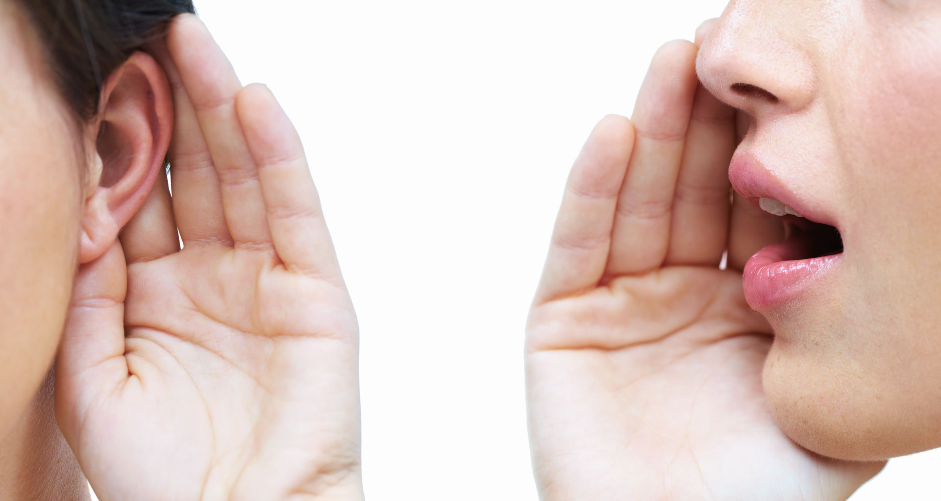
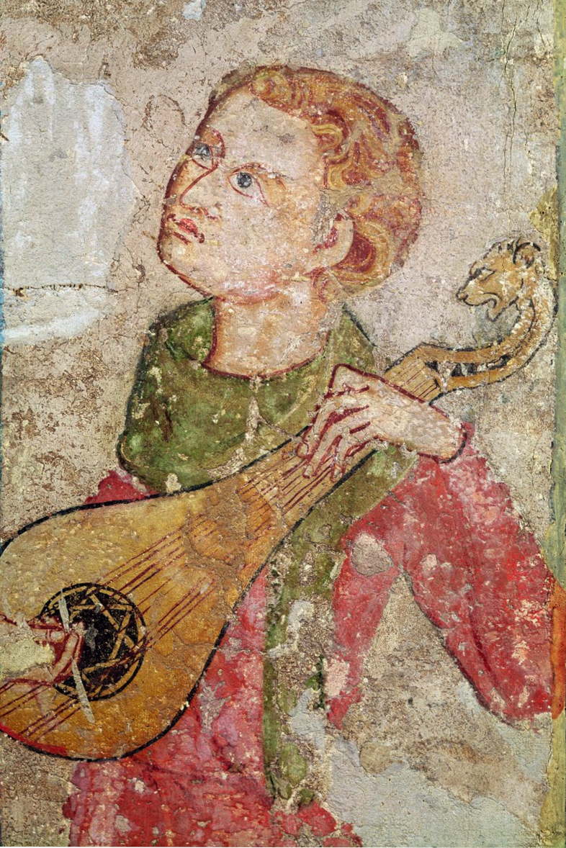
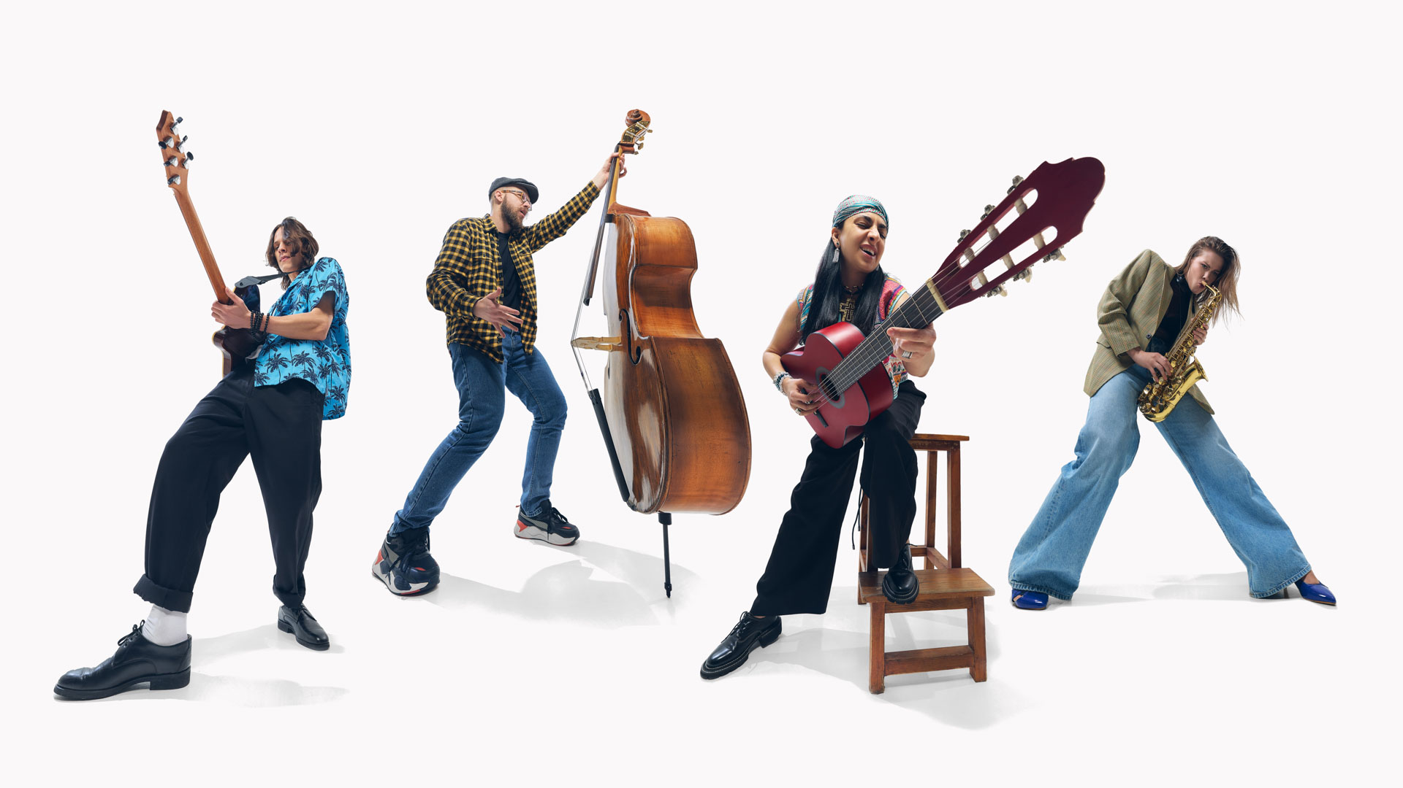
Scarborough Fair

Slide 24
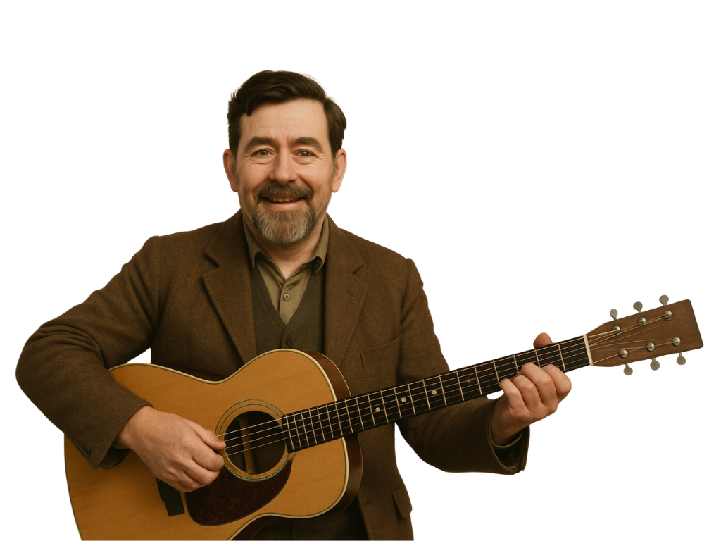


Slide 25
Pitch
Rhythm
Dynamics
Timbre
Texture
Structure
Narrow range
Slow and steady
Gentle
Warm and natural
Thin texture
Melody repeats
High or low?
Fast or slow?
Loud or soft?
Describe the overall sound
Many or few instruments?
Does it repeat?

Slide 26
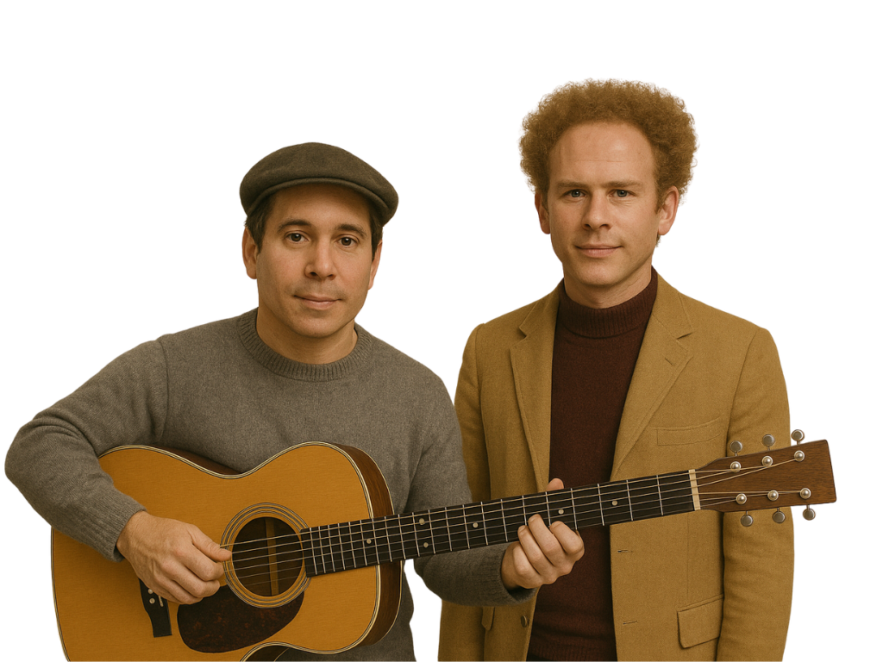
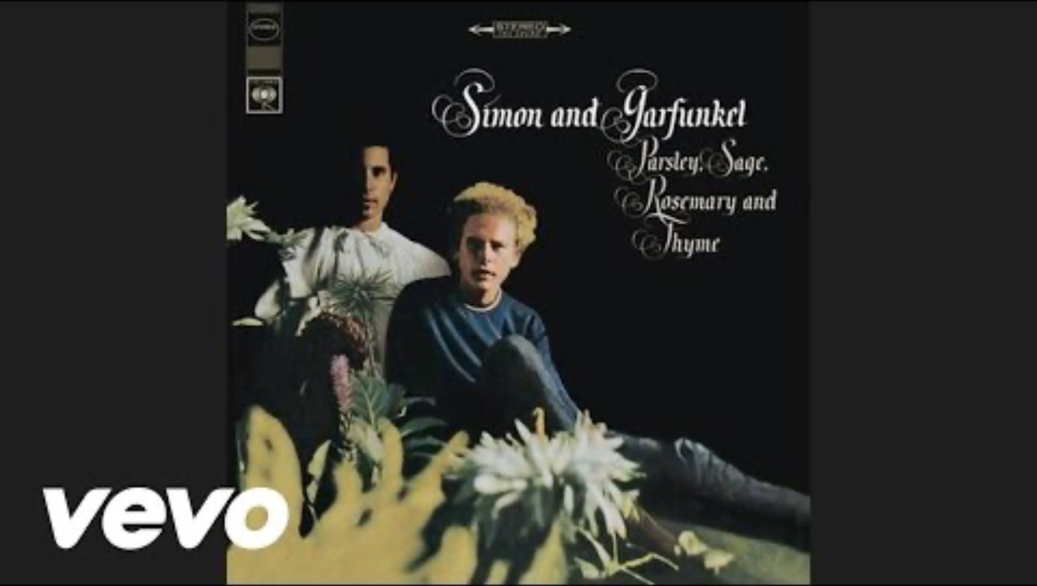

Slide 27
Pitch
Rhythm
Dynamics
Timbre
Texture
Structure
Two voices,
high and low
Steady rhythm
Smooth swells
Bright
Thick and full
High or low?
Fast or slow?
Loud or soft?
Describe the overall sound
Many or few instruments?
Does it repeat?
Same pattern

Slide 28
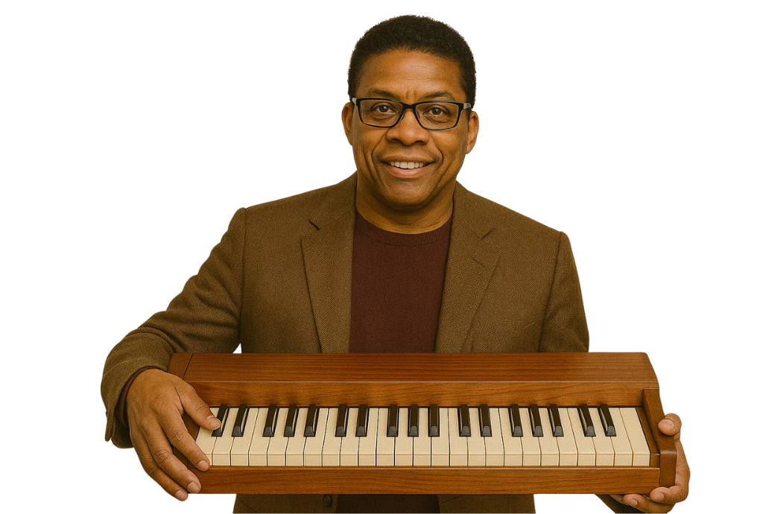


Slide 29
Texture
Timbre
Dynamics
Rhythm
Pitch
Structure
Free with solos
Thick
Smooth and colourful
Loud and soft
Quicker, jazzy swing
Played in a new way
High or low?
Fast or slow?
Loud or soft?
Describe the overall sound
Many or few instruments?
Does it repeat?

Slide 30
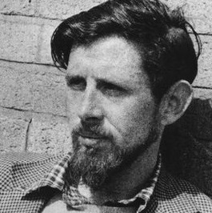
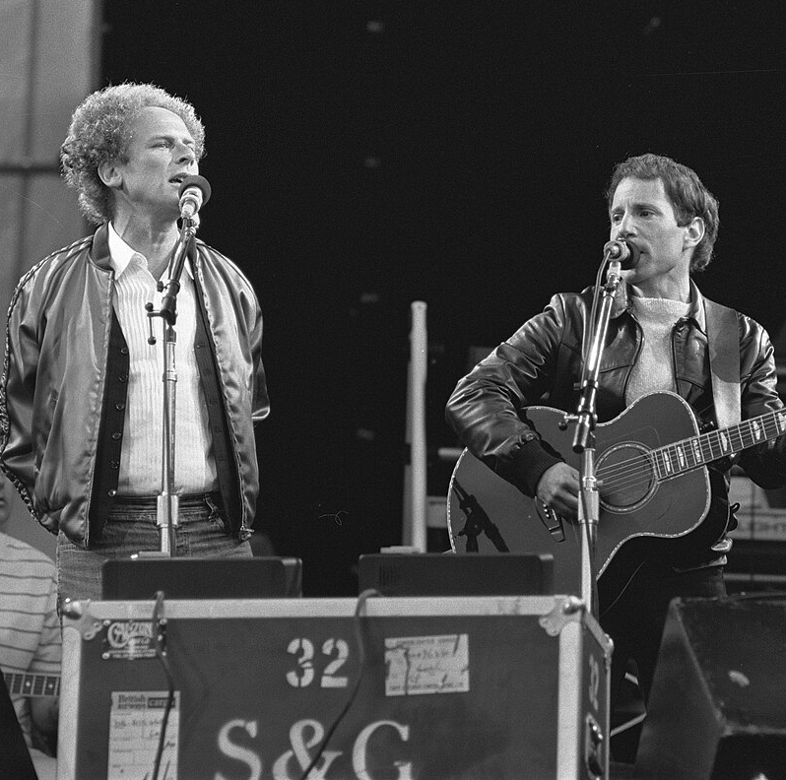
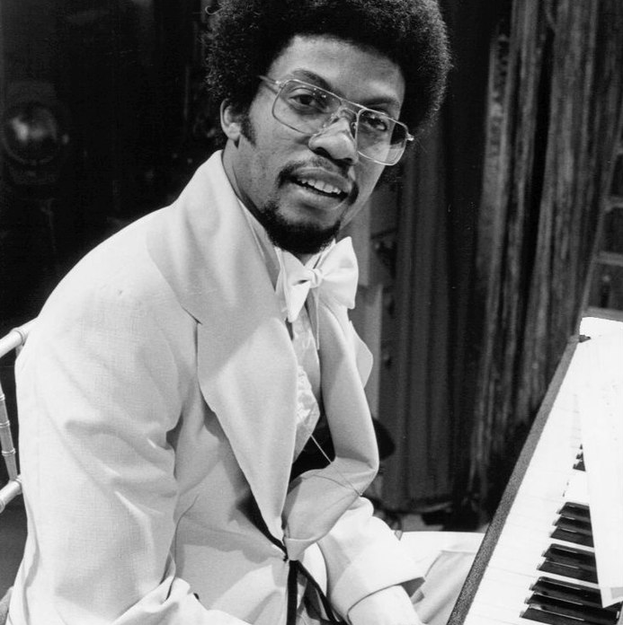
Pitch in ‘Scarborough Fair’
Ewan MacColl
Simon & Garfunkel
Herbie Hancock
narrow range
two voices in harmony
improvisation
calm and even
high and low
changes to melody

Slide 31
Rhythm in ‘Scarborough Fair’
Ewan MacColl
Simon & Garfunkel
Herbie Hancock
slow and steady
steady
quicker tempo
free like speech
guitar pattern keeping time
jazzy swing rhythms

Slide 32
Dynamics in ‘Scarborough Fair’
Ewan MacColl
Simon & Garfunkel
Herbie Hancock
gentle
gentle swells
louder passages
no big changes
smooth rises and falls
and softer ones

Slide 33
Musical Elements
The musical elements are pitch, rhythm, dynamics, texture, timbre and form and structure.
Music is built from different elements that work together to create what we hear.

Slide 34
Musical Elements
Musicians change musical elements to make their covers sound different from the original.
When we hear a cover version of a song, the use of the musical elements is what makes it unique.

Slide 35


Exit Ticket
Date: _________
Lesson 2
elements
Music is built from different __________ that work together to create what we hear.
.
Musicians change musical elements to make their covers sound:
the same as the original
different from the original
better than the original
worse than the original
The use of musical elements is what makes a cover song u______.
decorations
feelings
elements
nique
3
I know _____ out of 3 answers.

Slide 36
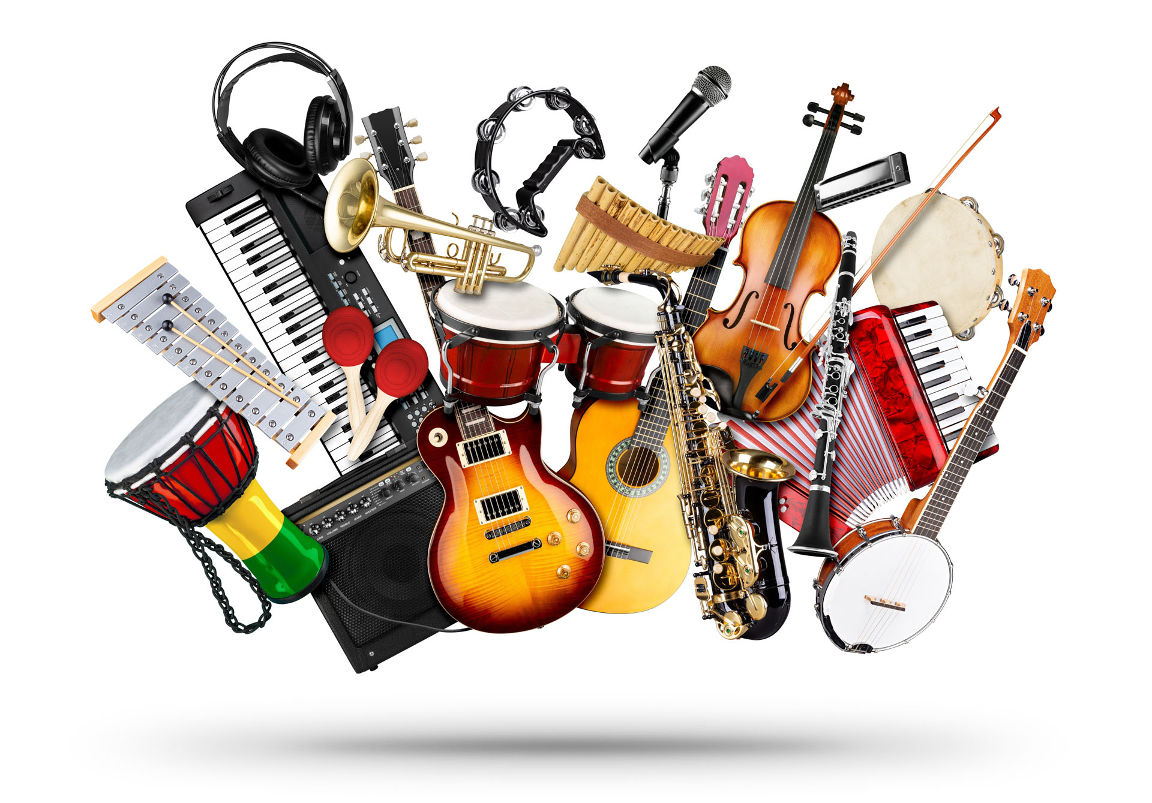
In the next lesson, we will explore how instrumentation changes the sound of a song.

Slide 37
Attributions
Slide 7 (second, left) Photo: Joni Mitchell 1983 by Capannelle, from Wikimedia Commons, CC BY 2.0, https://commons.wikimedia.org/wiki/File:Joni_Mitchell_1983.jpg#/media/File:Joni_Mitchell_1983.jpg
Slide 7 (second, right) Photo: Counting Crows by Shannon McGee from Wikimedia Commons, CC BY-SA 2.0, 7-24 Counting Crows (933365372) - File:7-24 Counting Crows (933365372).jpg - Wikimedia Commons
Slide 13 (first clip) Rock drum beats, various by bigjoedrummer, https://freesound.org/s/209455/, License: Attribution 4.0
Slide 19 (first clip) When Its Over 02.mp3 by mushino, https://freesound.org/s/432191/ -- License: Attribution 4.0
Slides 30, 31 and 32 (left) Photo: Portrait photograph of Ewan MacColl, Unknown author, from Wikimedia Commons, Fair use, https://en.wikipedia.org/wiki/File:Portrait_photograph_of_Ewan_MacColl.jpg

