Slide 1
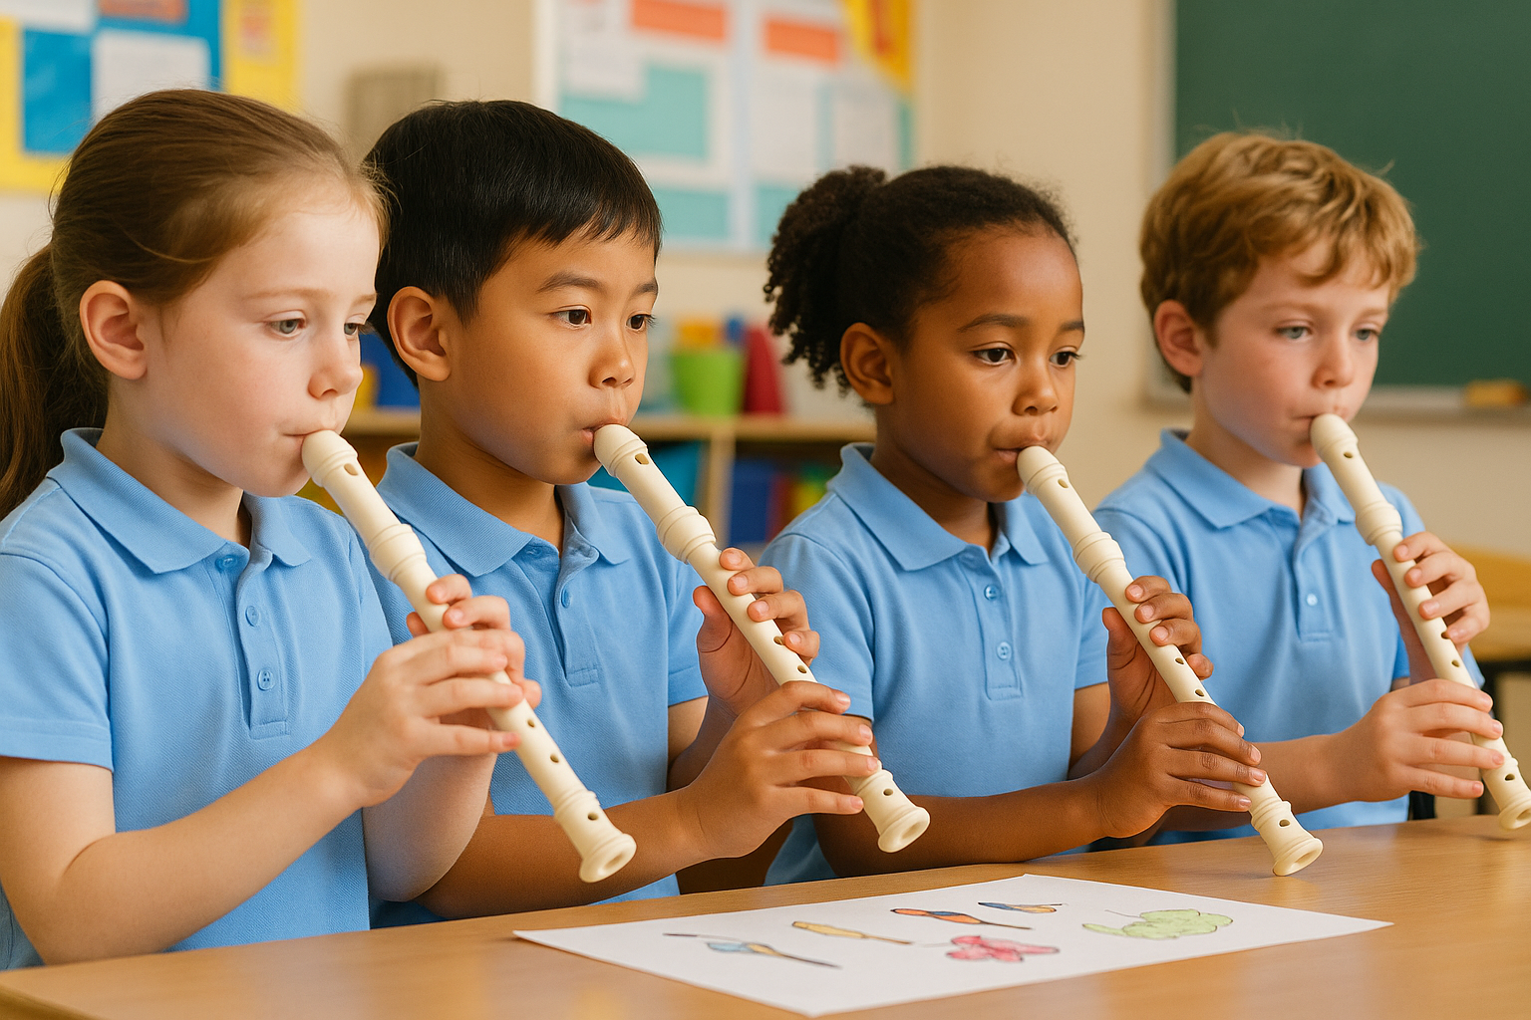
Exploring Instrument Families
Lesson 2
Play the Recorder
Unit 3 Version 3

Slide 2
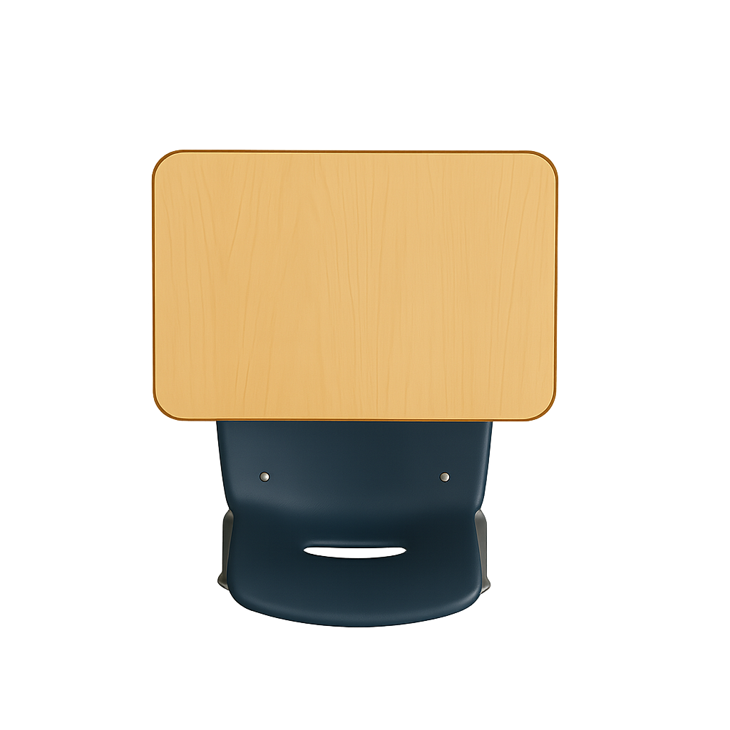




What We Learnt
Exit Ticket
Lesson 1
People make sounds on woodwind instruments by _________ air into or across them.
These instruments are held out to the side while they are played:
Oboe and bassoon.
Flute and piccolo.
Clarinet and saxophone.
Some woodwind instruments have a thin r_____ that vibrates with air to make sound.
blowing
tapping
shaking
blowing
eed

Slide 3
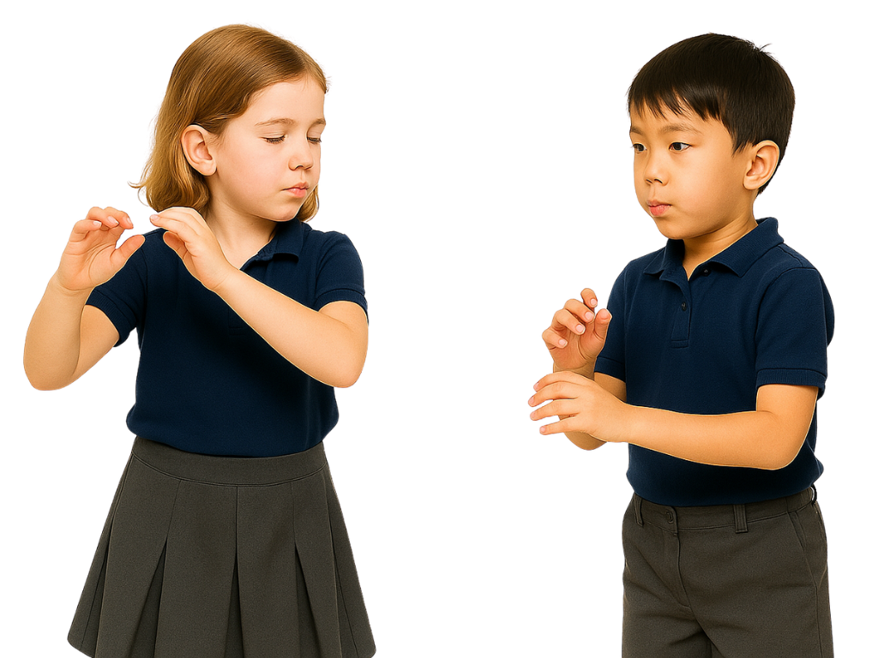
Some woodwind instruments have reeds that vibrate to make sound.
Yes
No

Slide 4
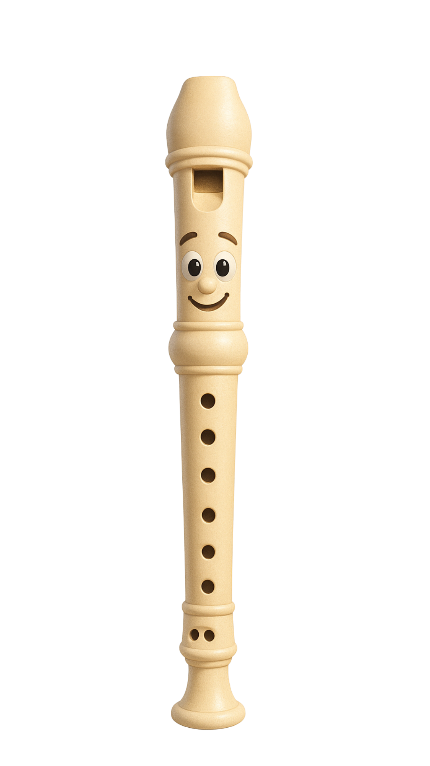
In this lesson, we will play music on the recorder.

Slide 5
You will be able to: ​
make sounds on the recorder with gentle breathing
play a song on the recorder.​
Make means to cause something to happen.
Play means to make a musical sound on your instrument.

Slide 6


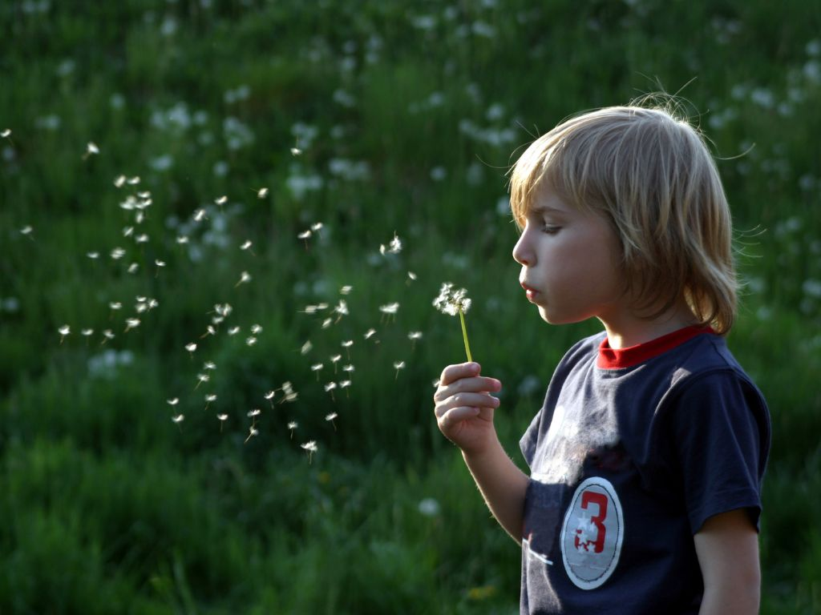


Slide 7
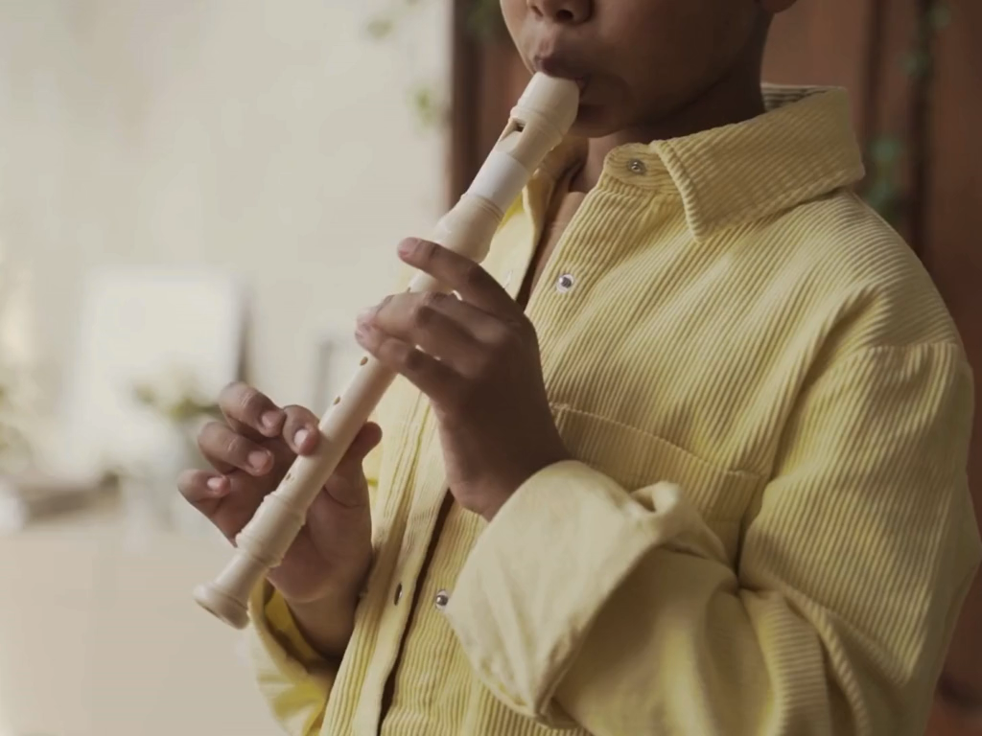
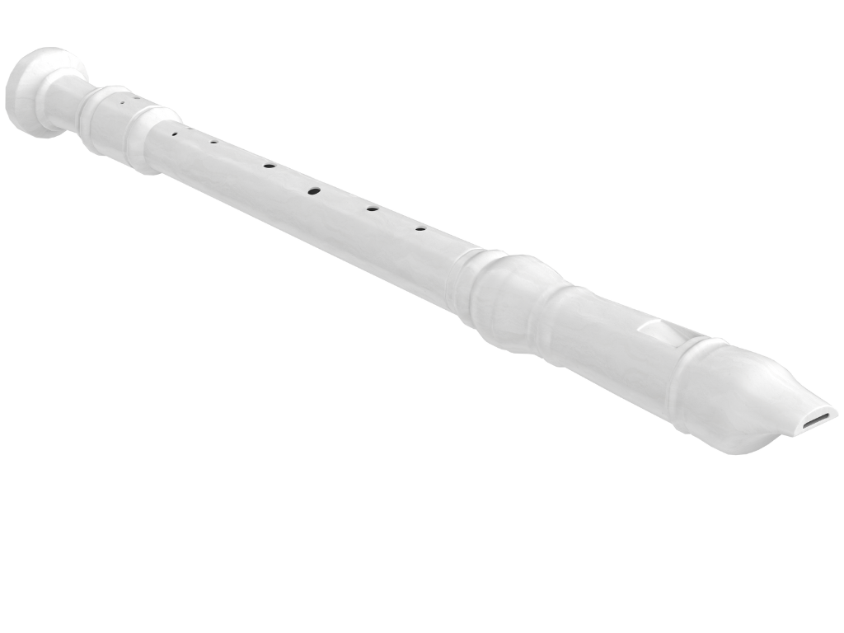
The Recorder
The recorder is part of the woodwind family because it makes sound with air.

Slide 8


Gentle Blowing

Slide 9

Gentle Blowing

Slide 10
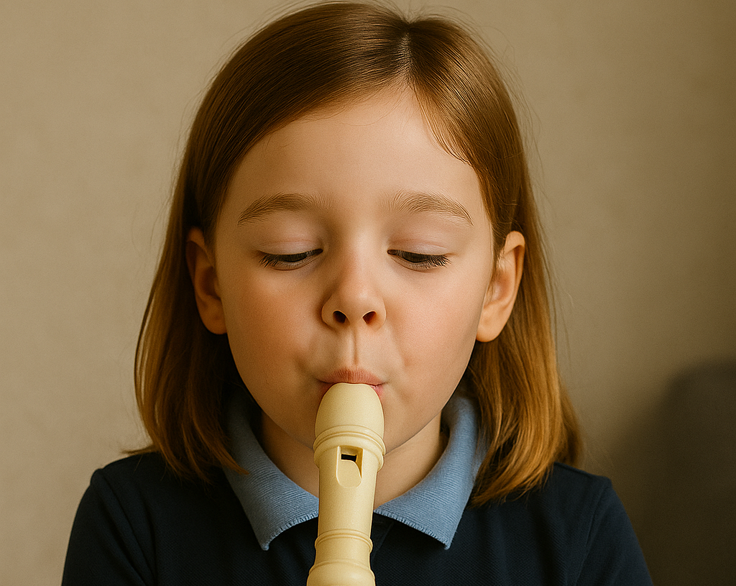
Gentle Blowing into Recorders

Slide 11


Playing the Recorder
We blow as hard as we can when we play the recorder.
Yes
No

Slide 12
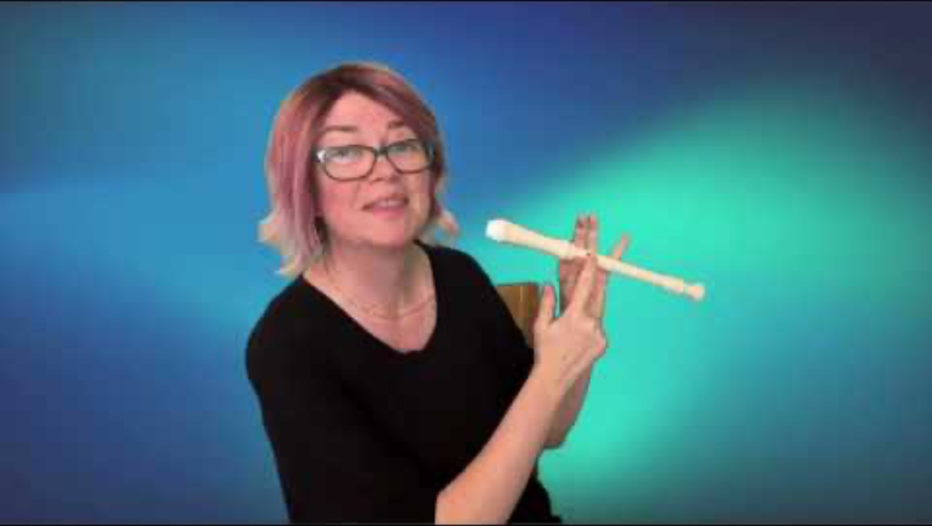
Play B on the Recorder

Slide 13

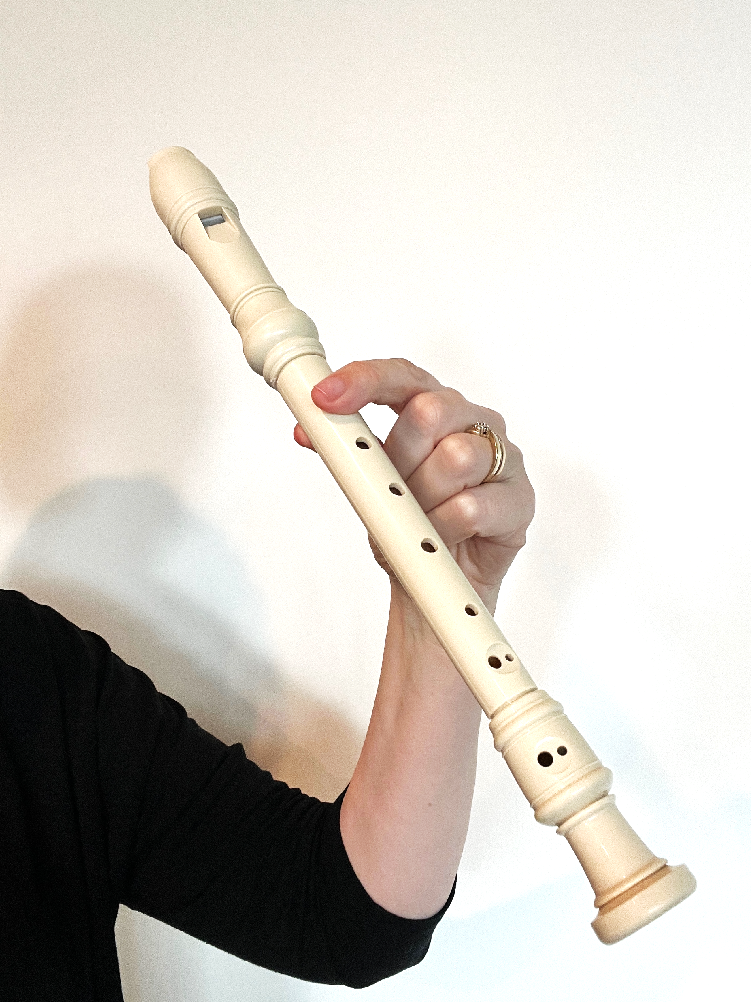
Play B on the Recorder
B

Slide 14
Play B on the Recorder
We cover the back hole and the top front hole to play B.
B

Slide 15
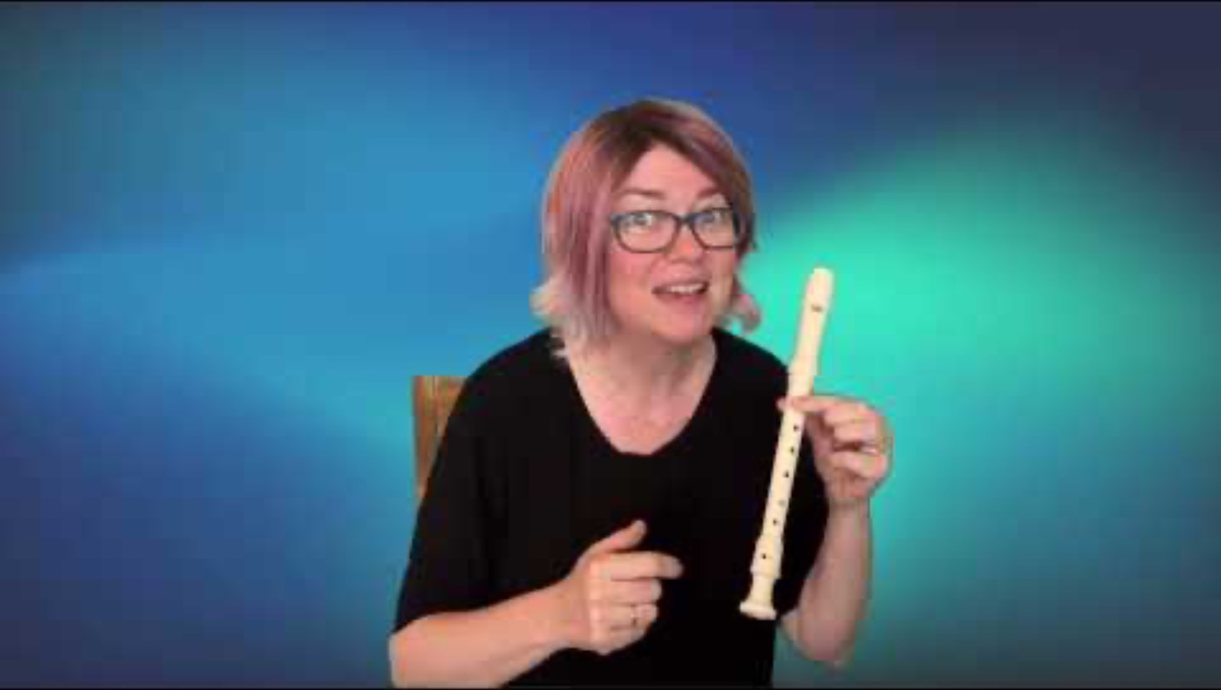
Play A on the Recorder

Slide 16
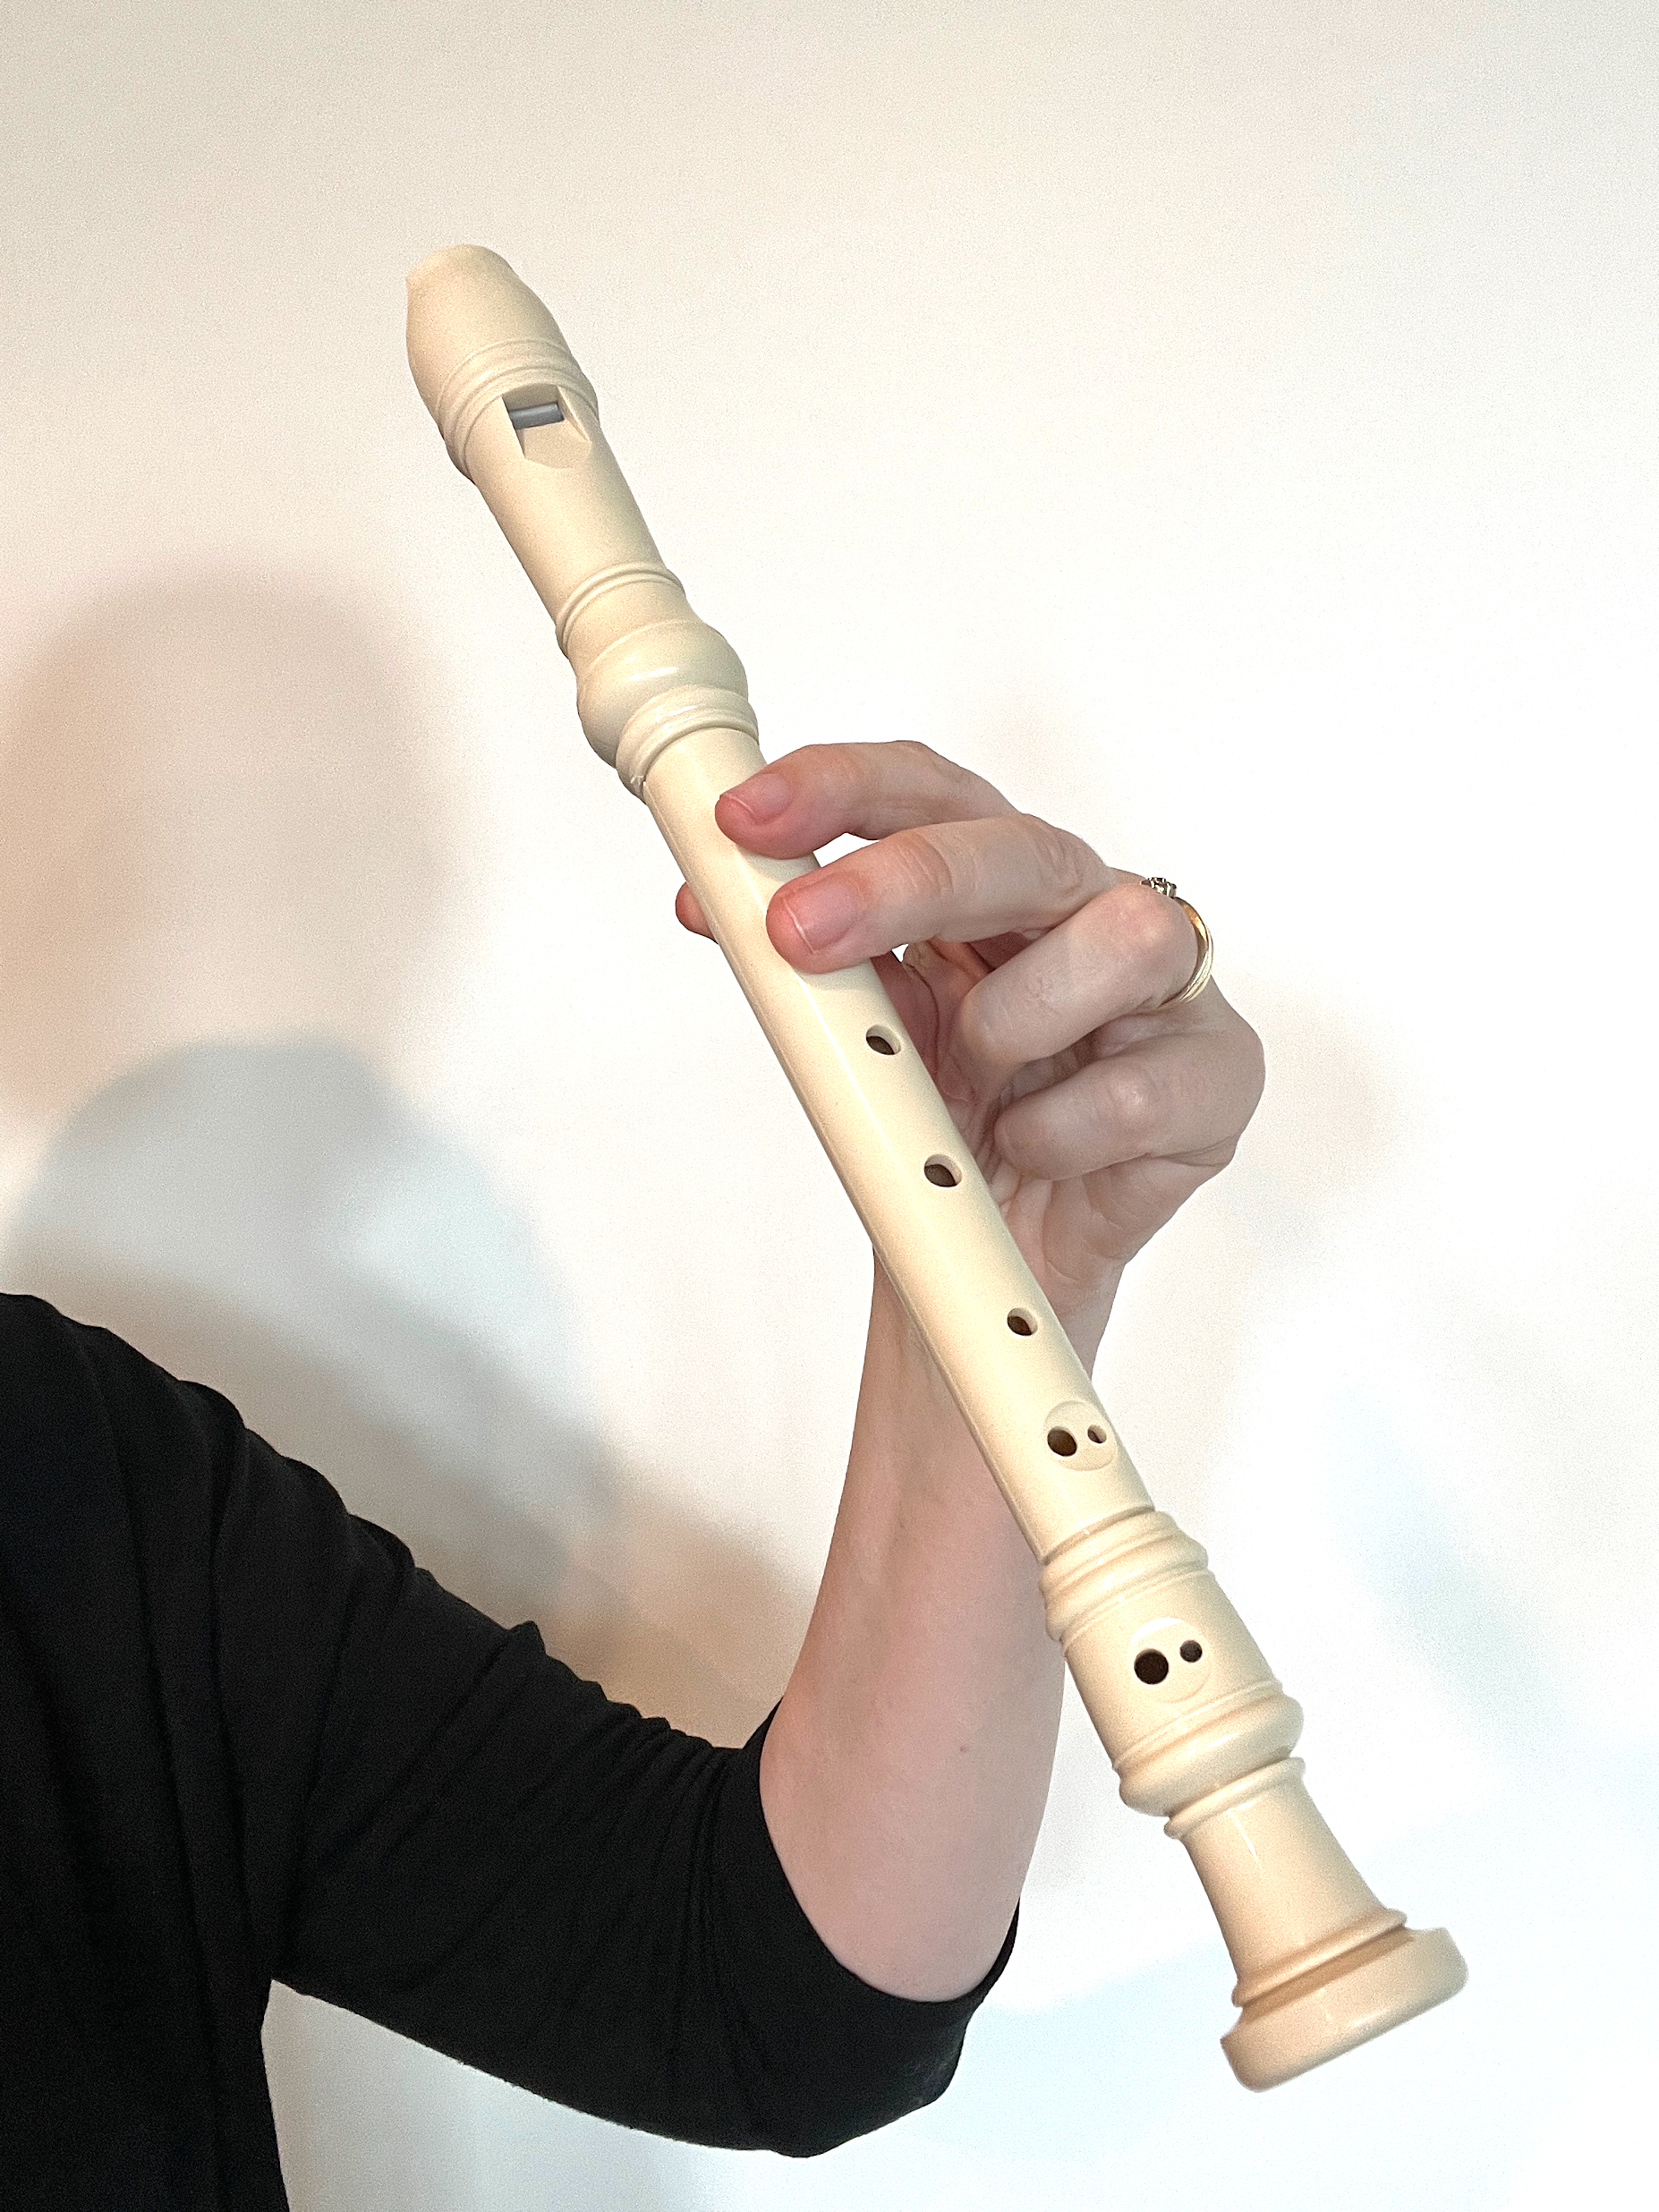
Play A on the Recorder
A

Slide 17
Play A on the Recorder
We cover the back hole and the top two front holes to play A.
A

Slide 18
Practise B and A
B
A

Slide 19
Which Sound Is Higher?
B
A

Slide 20
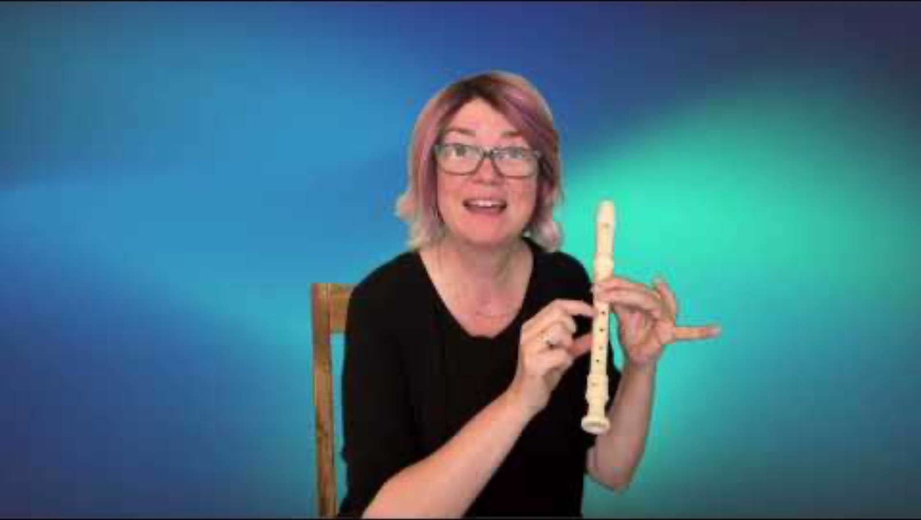
Play G on the Recorder

Slide 21
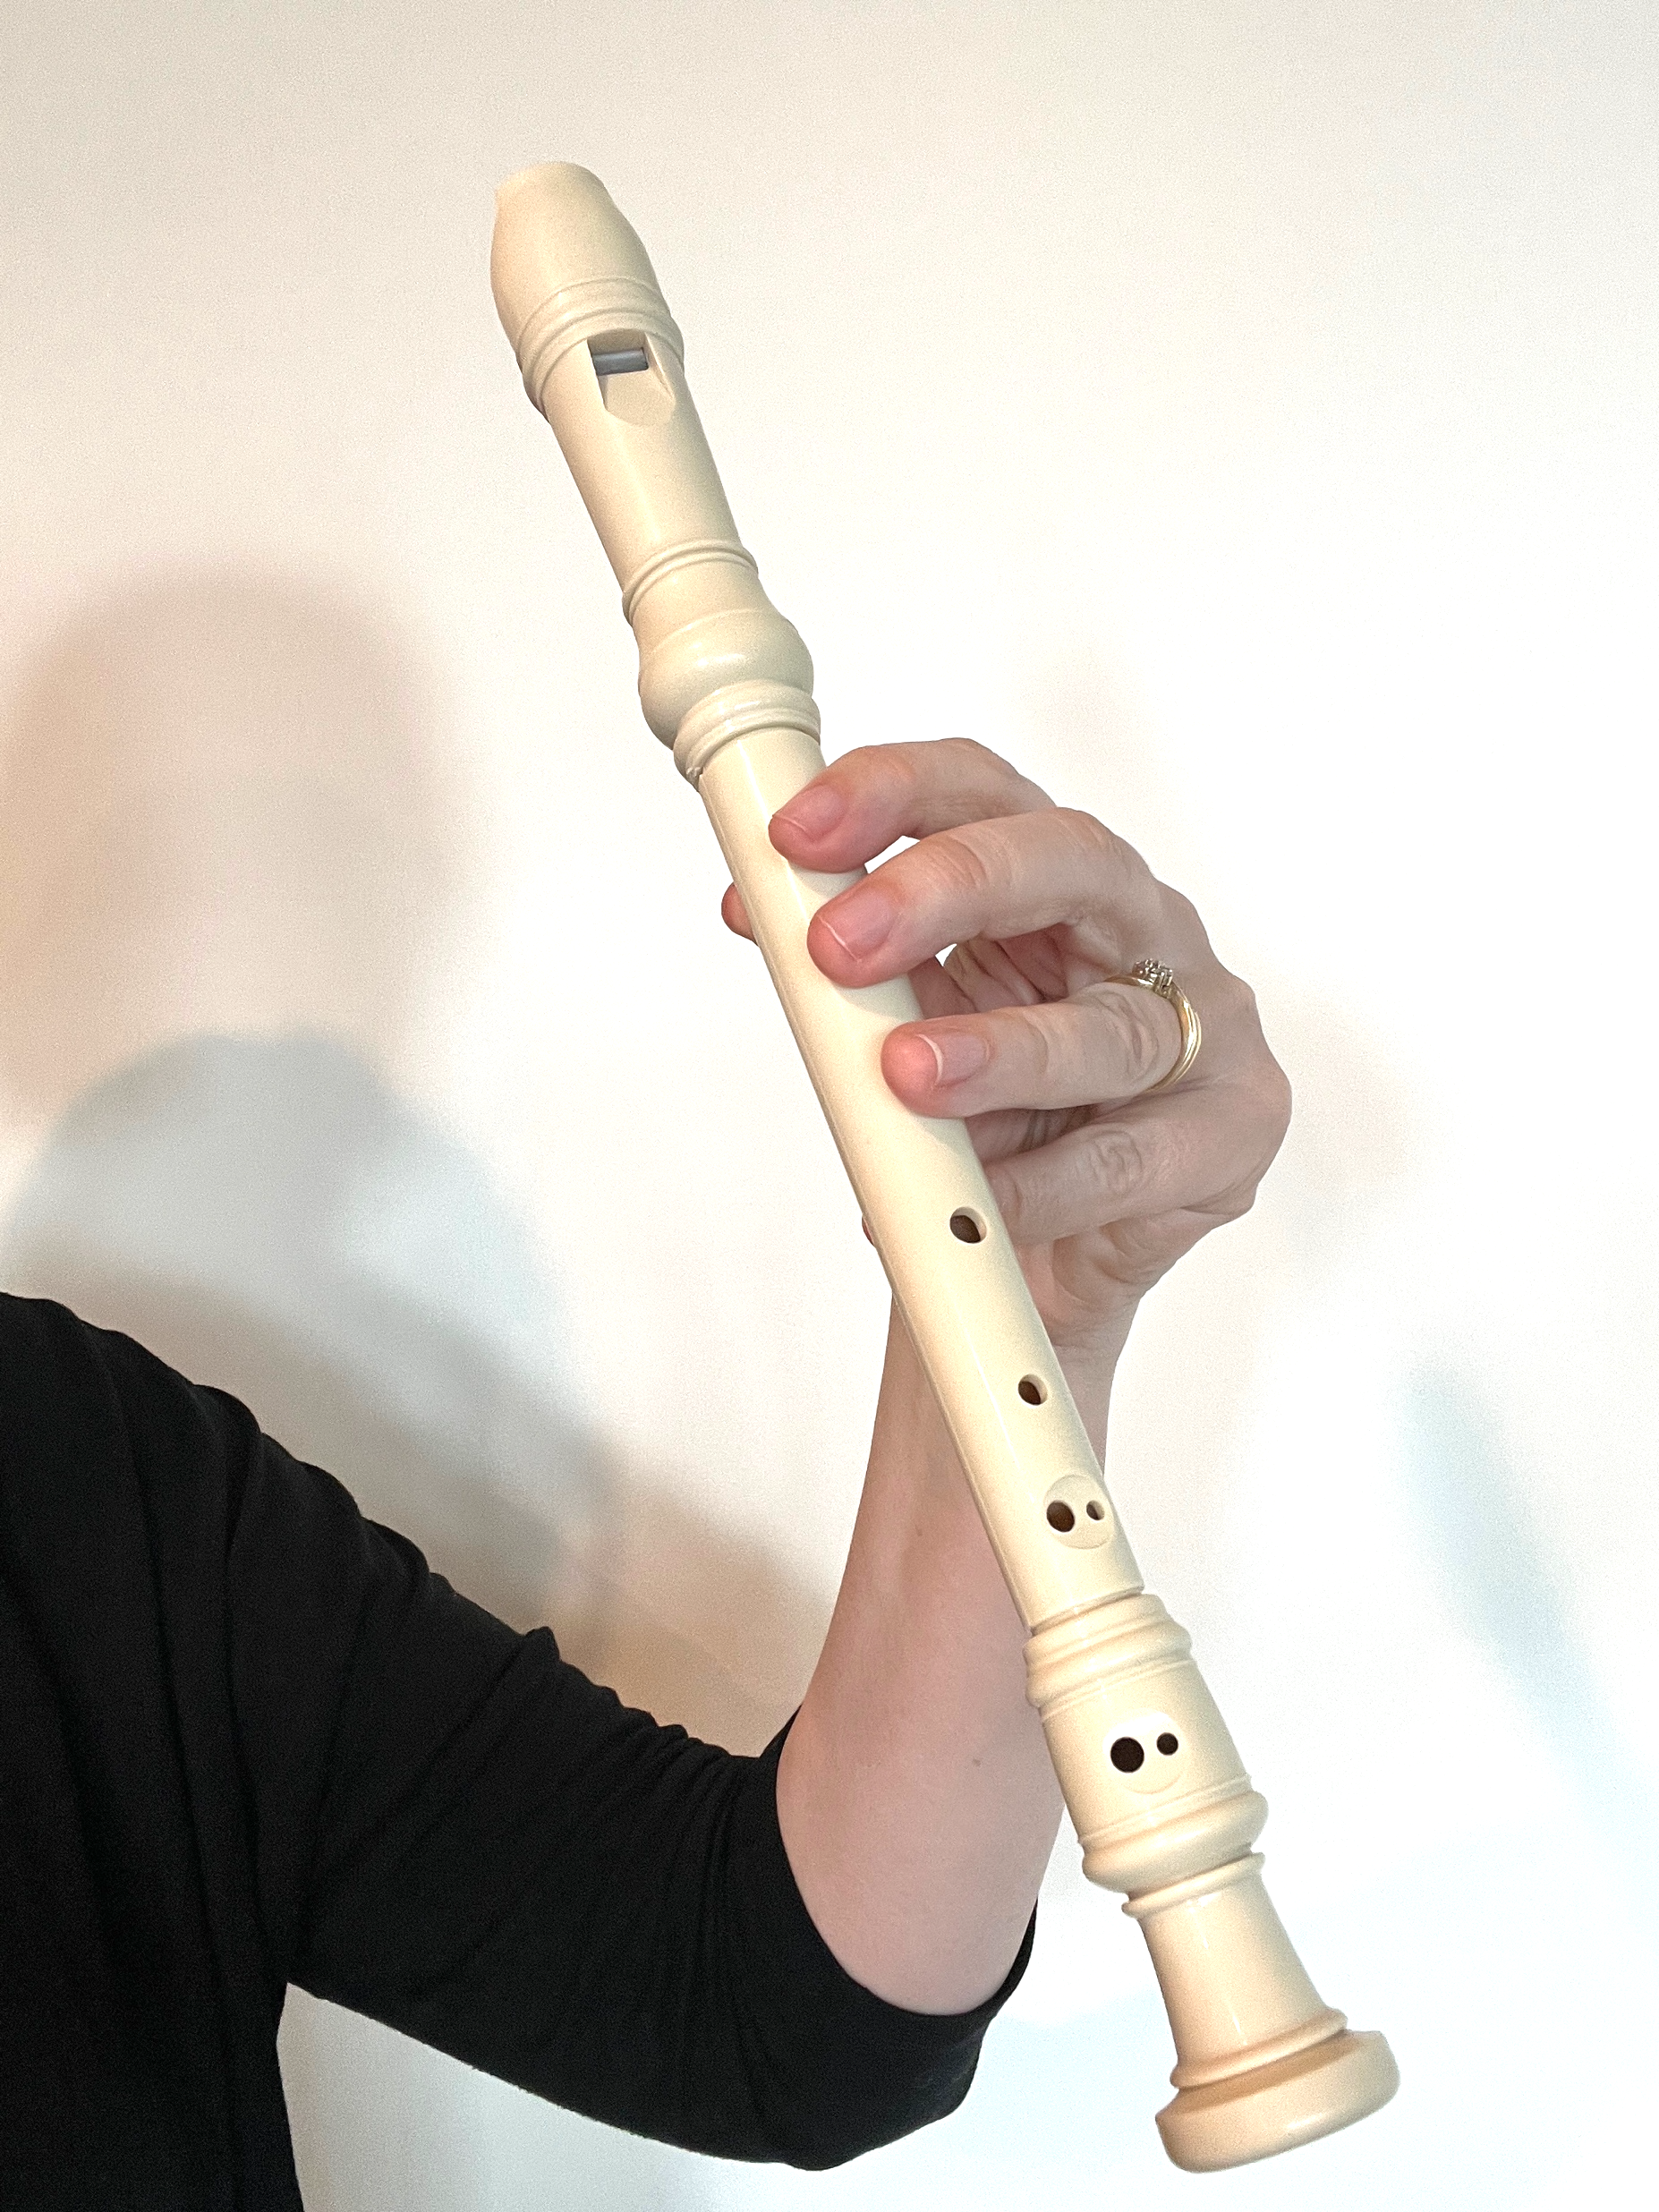
Play G on the Recorder
G

Slide 22

Play G on the Recorder
We cover the back hole and the top three front holes to play G.
G

Slide 23
Practise B, A and G
B
A
G

Slide 24
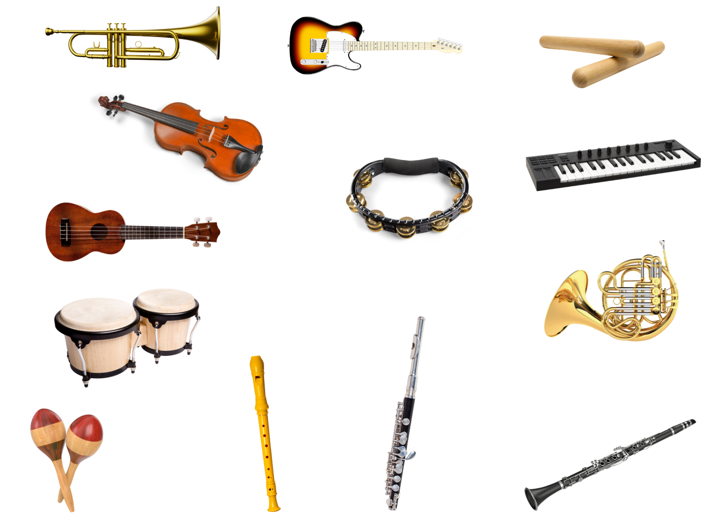
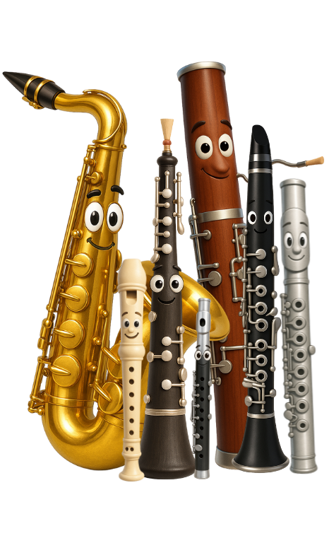
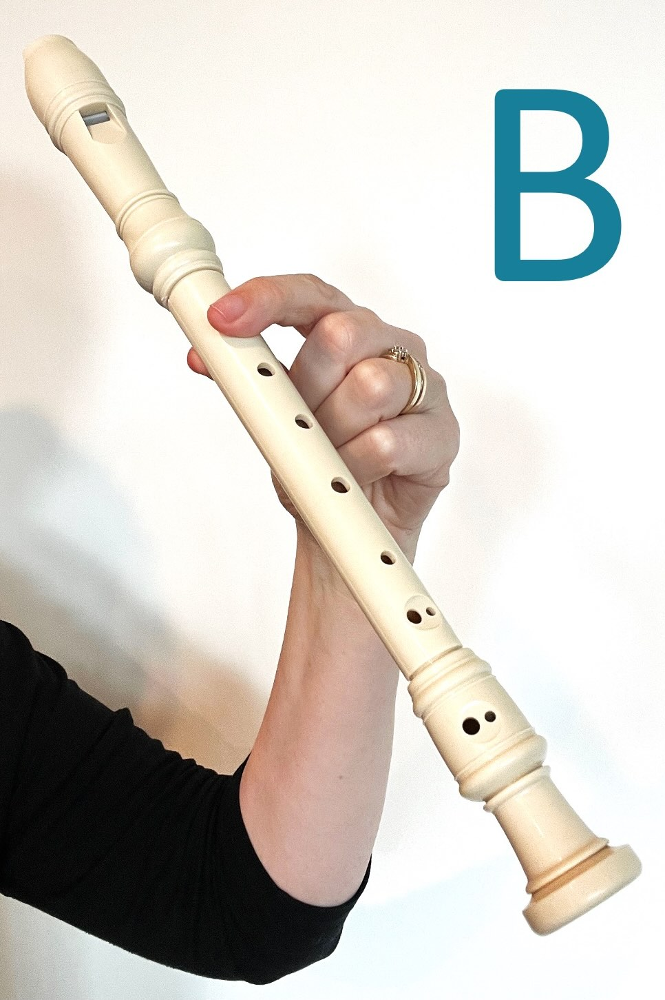
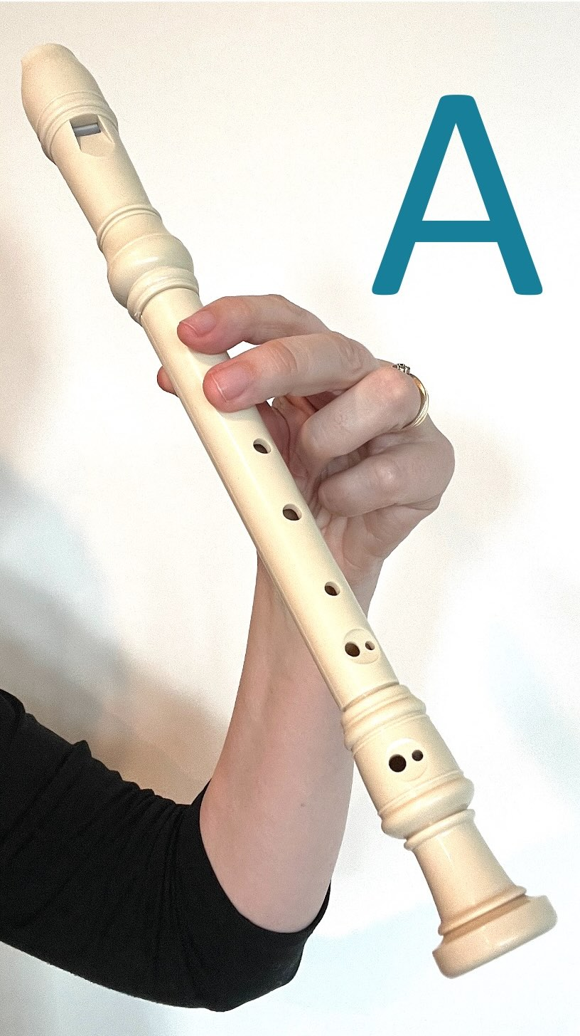
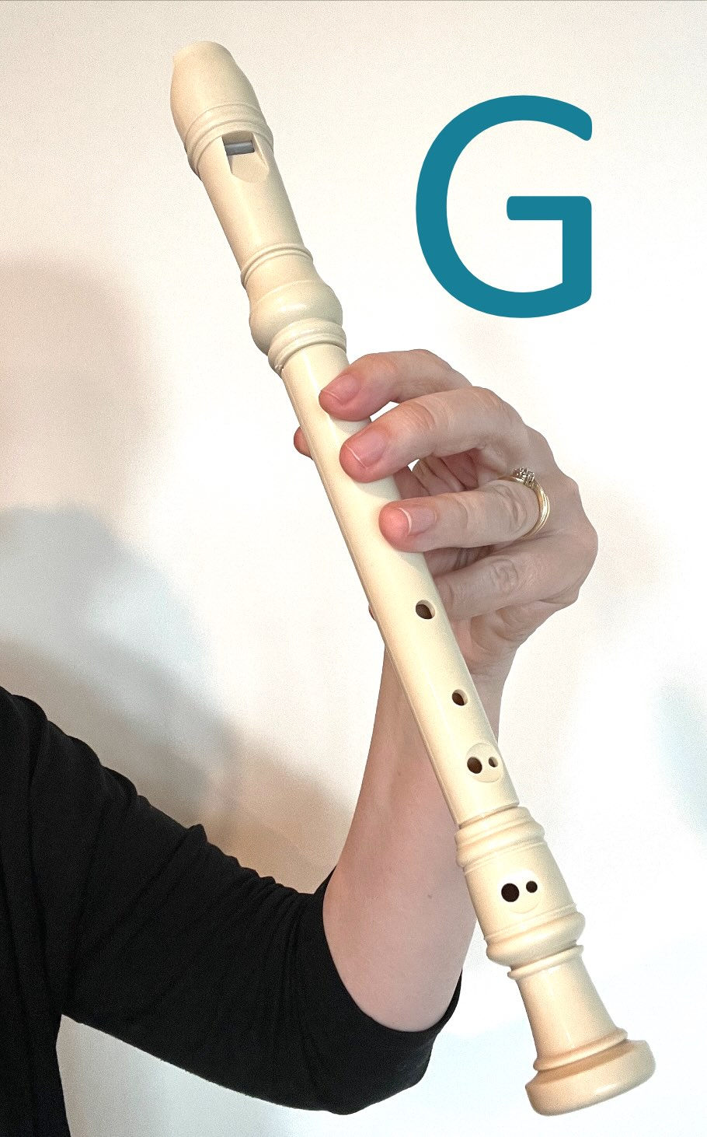
The Instruments Song
B
A
G
Instruments
Instruments
All in different families, they’re
instruments.
B
A
G
G G G G
A A A A
B
A
G

Slide 25
Practise the Instruments Song
B
A
G
Instruments
Instruments
All in different families, they’re
instruments.
B
A
G
G G G G
A A A A
B
A
G

Slide 26
Play the Instruments Song
B
A
G
Instruments
Instruments
All in different families, they’re
instruments.
B
A
G
G G G G
A A A A
B
A
G

Slide 27
Practise the Instruments Song
B
A
G
Instruments
Instruments
All in different families, they’re
instruments.
B
A
G
G G G G
A A A A
B
A
G

Slide 28
Play the Instruments Song
B
A
G
Instruments
Instruments
All in different families, they’re
instruments.
B
A
G
G G G G
A A A A
B
A
G

Slide 29
Play the Instruments Song
B
A
G
Instruments
Instruments
All in different families, they’re
instruments.
B
A
G
G G G G
A A A A
B
A
G

Slide 30
Musicians play the recorder to make music.
The recorder can make different sounds.
We can play B, A and G.

Slide 31


Exit Ticket
Date: _________
Lesson 2
recorder
The _________ is a woodwind instrument that we blow into to make sound.
We make the G note by covering the back hole and:
the top front hole
the top two front holes
the top three front holes
On the recorder, we cover the back hole with our t________.
recorder
guitar
drum
humb
3
I know _____ out of 3 answers.

Slide 32
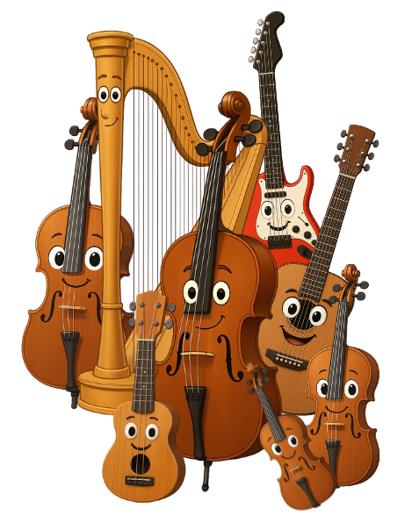
In the next lesson, we will explore the string instrument family.

