Slide 1
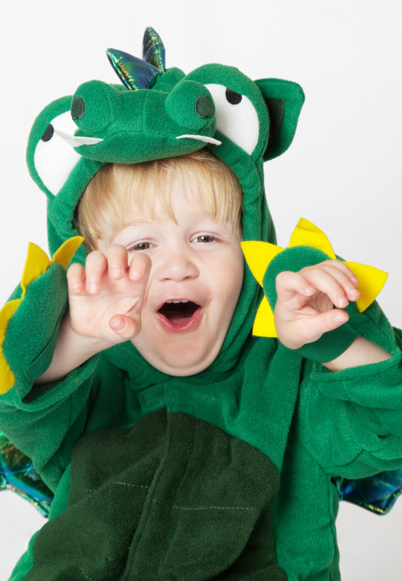
Magical Creatures
Lesson 1
Big and Tiny
Unit 3 Version 3

Slide 2
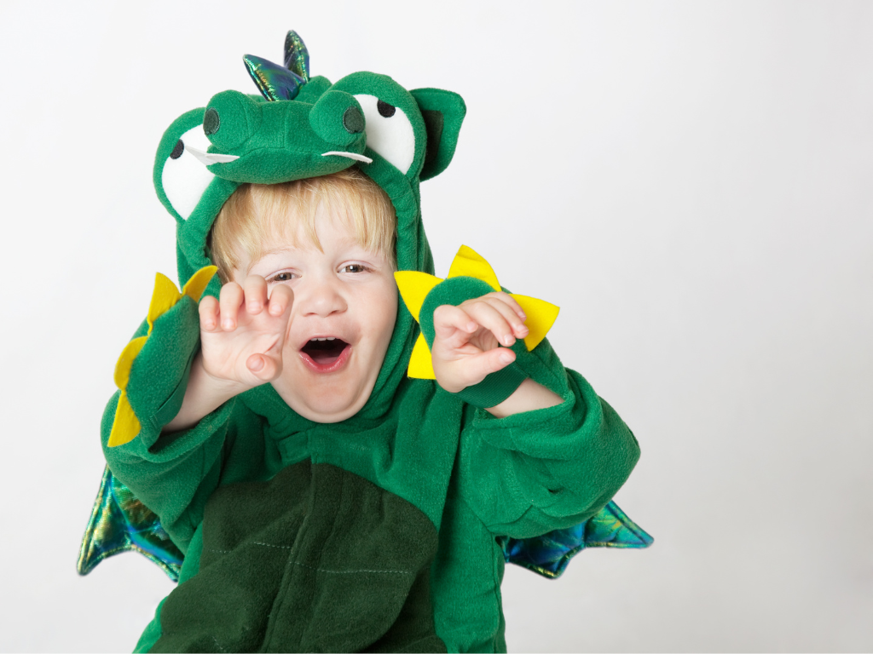
In this lesson, we will learn how music can tell stories about magical creatures.

Slide 3
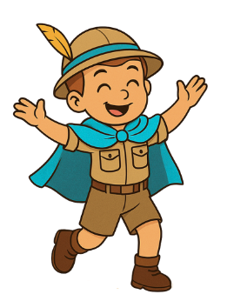
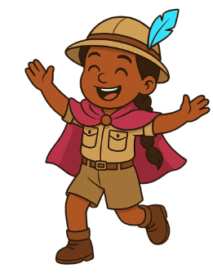
You will be able to: ​
use your voice to make high and low sounds
move to music that is loud and soft.​
Use means to take something and apply it for a purpose.
Move means to change your body position.

Slide 4
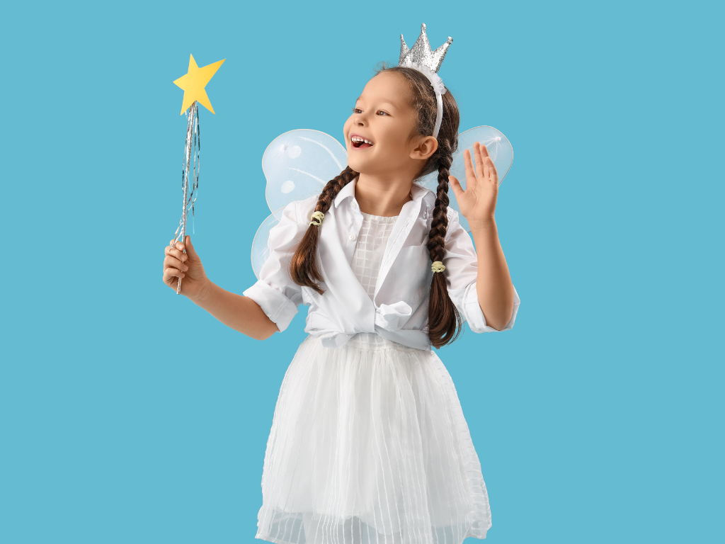
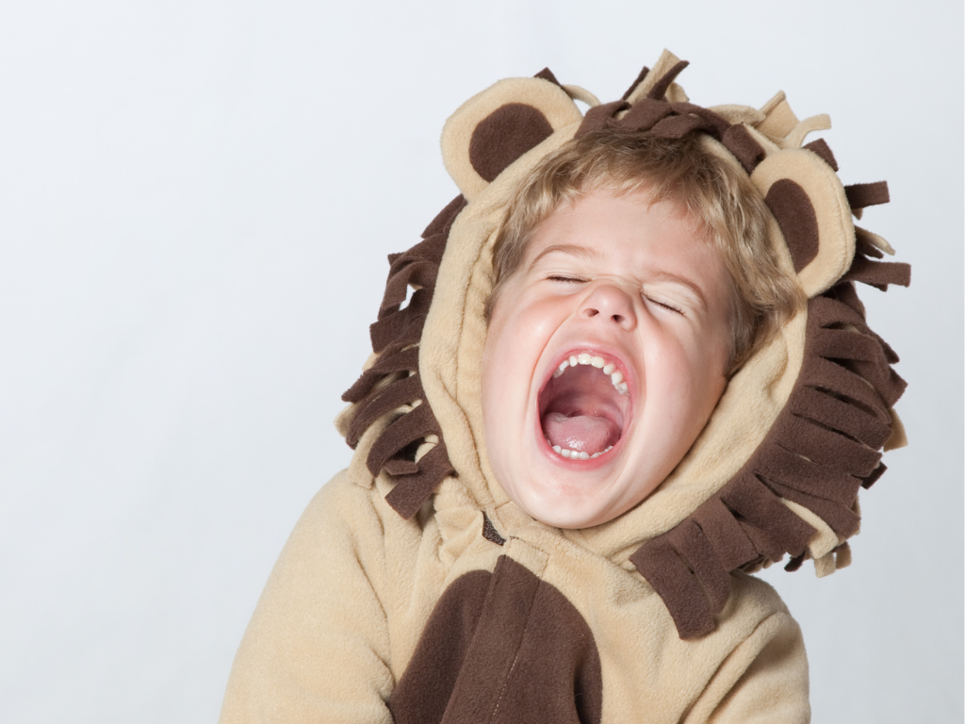
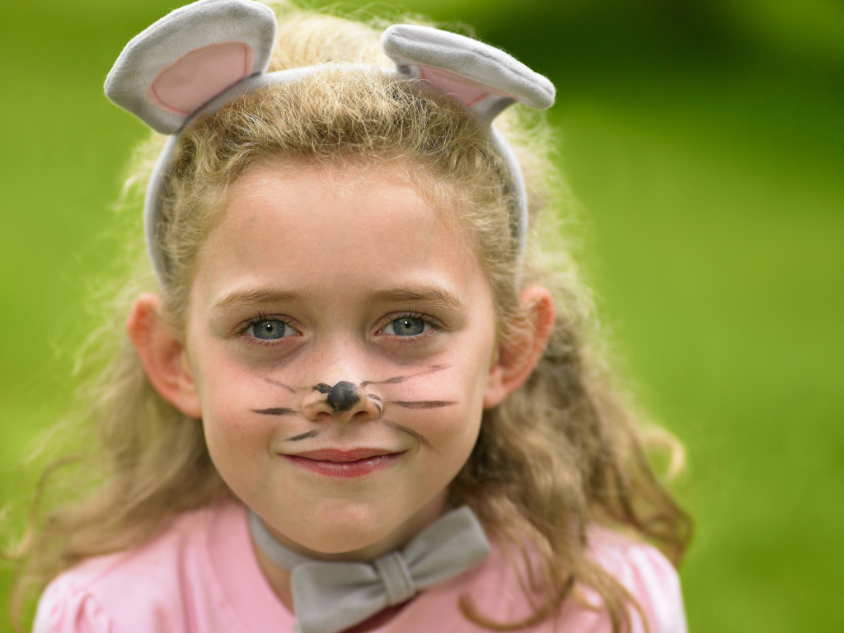

Slide 5

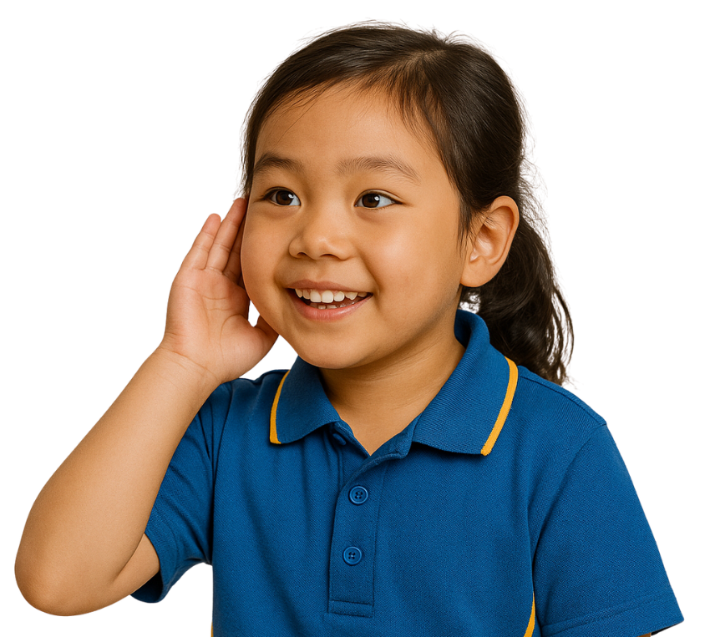




Music Gives Us Clues
The sound of music gives clues for what it is about.

Slide 6

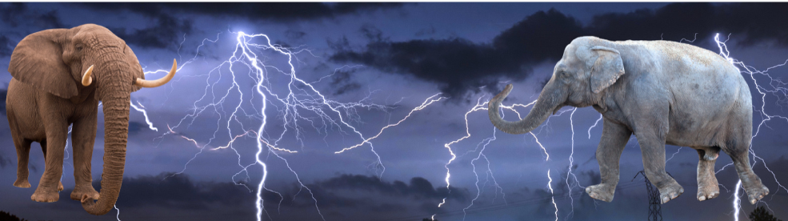
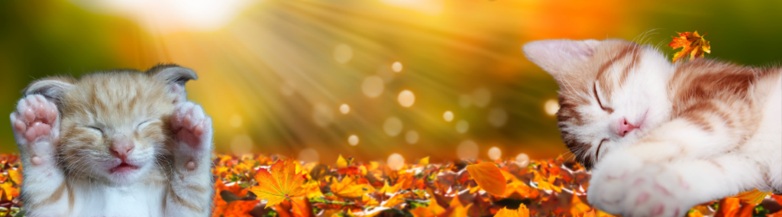
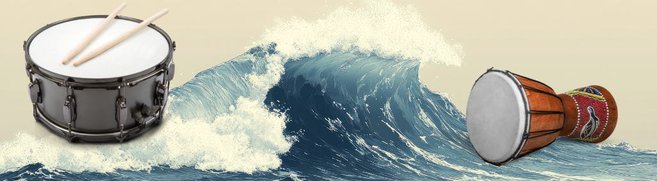

Music Gives Us Clues

Slide 7
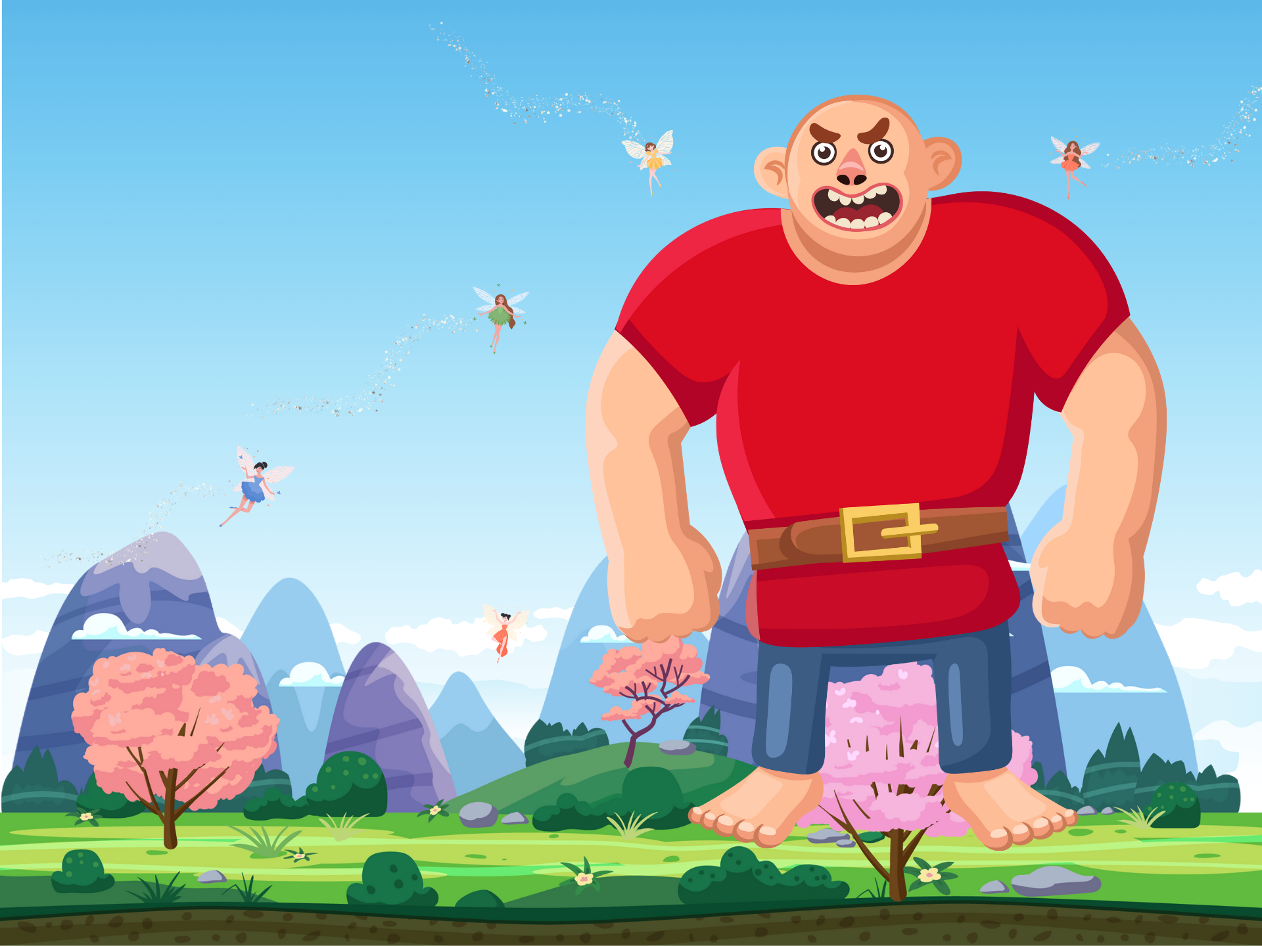




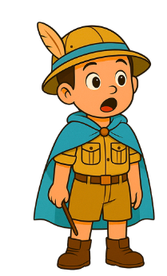
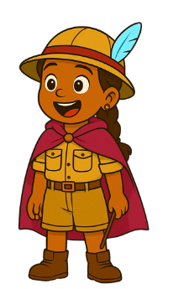
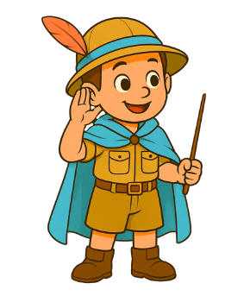
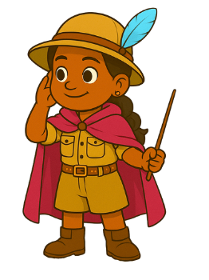

Slide 9


High and Low Sounds
Music can have high and low sounds.
Yes
No

Slide 10
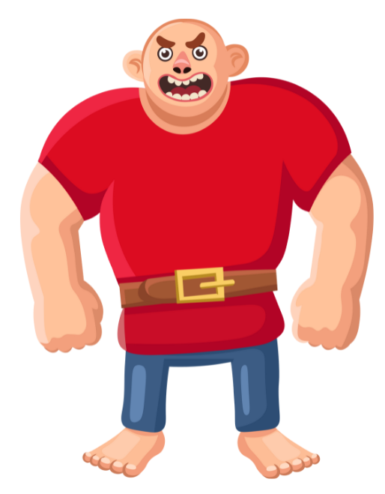
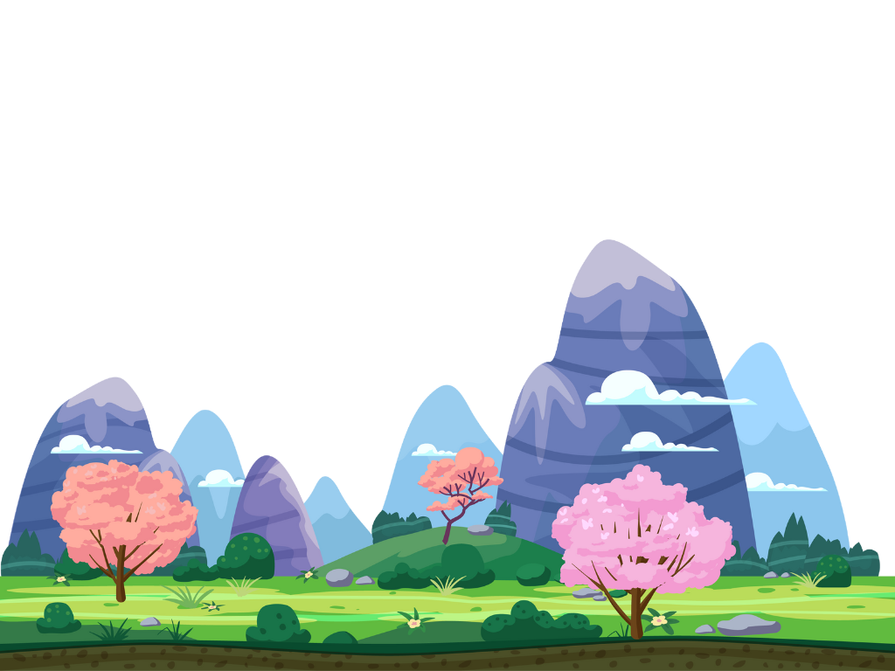
Giants
Fee Fi Fo Fum!
I am a giant,
Big and strong!

Slide 11



Giant Sounds

Slide 12

Giant Sounds

Slide 13
Giant Song
Fee Fi Fo Fum!
I am a giant,
Big and strong!

Slide 14
Giant Song
Fee Fi Fo Fum!
I am a giant,
Big and strong!

Slide 15

Music can be high and low, loud and soft.
The sound of music gives clues for what it is about.
Giants make low and
loud sounds.

Slide 16





Exit Ticket
Date: _________
Lesson 1
high
Music can be _____ and low.
The sound of music gives us:
  clues for what it is about
  snacks to eat
  shoes to wear
Giants make low and l____ sounds.
big
high
red
oud
3
I know _____ out of 3 answers.

Slide 17
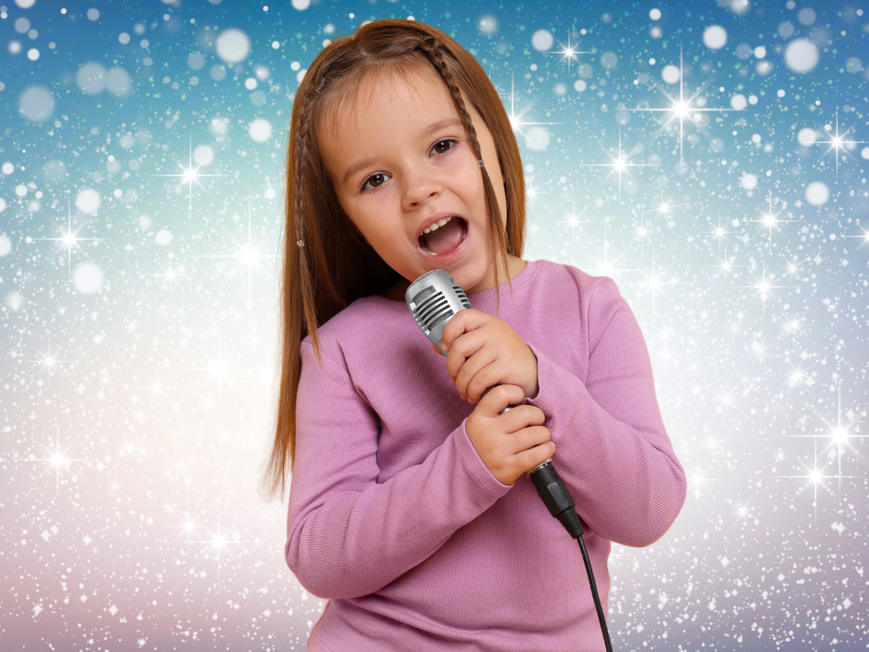
In the next lesson, we will learn how we can use our voices to make magical creature music.

