Slide 1
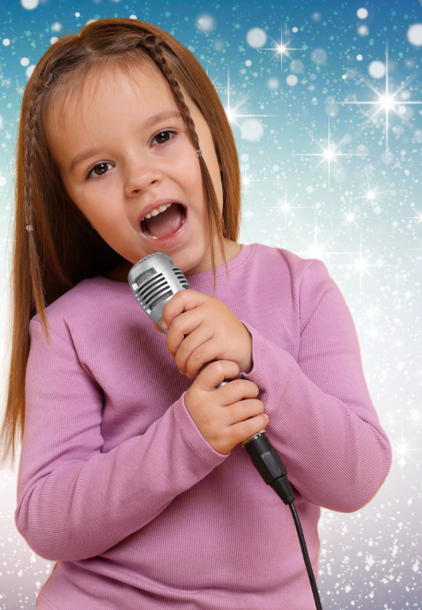
Magical Creatures
Lesson 2
High and Low
Unit 3 Version 3

Slide 2
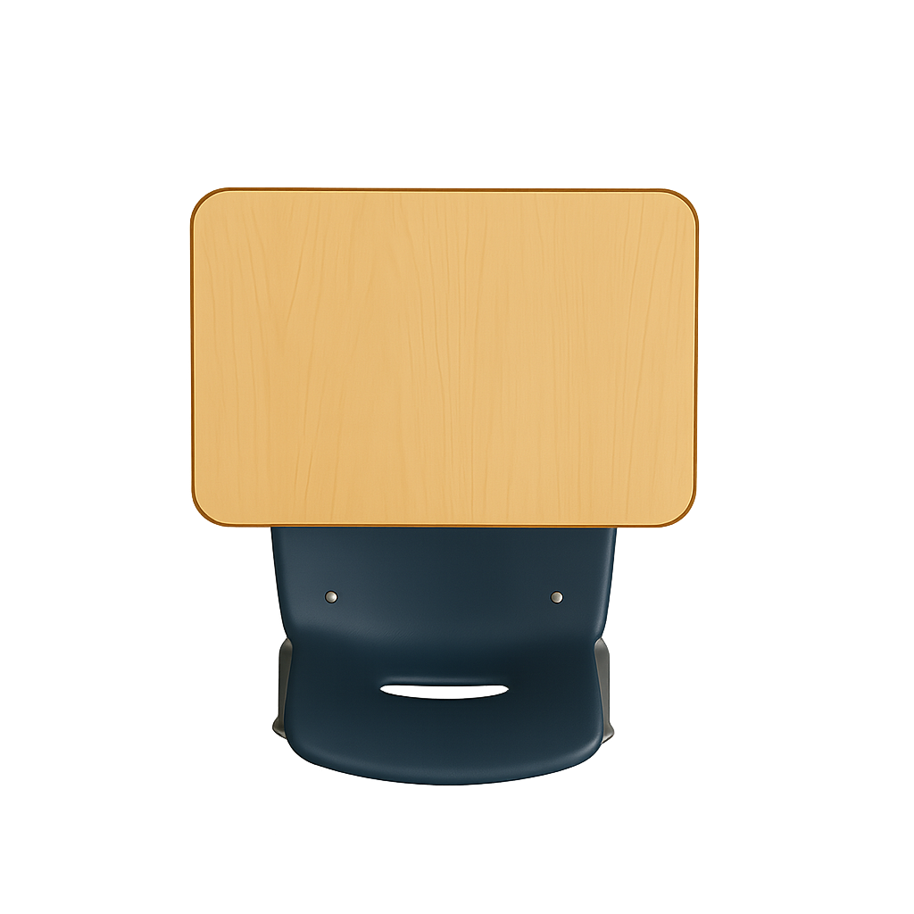
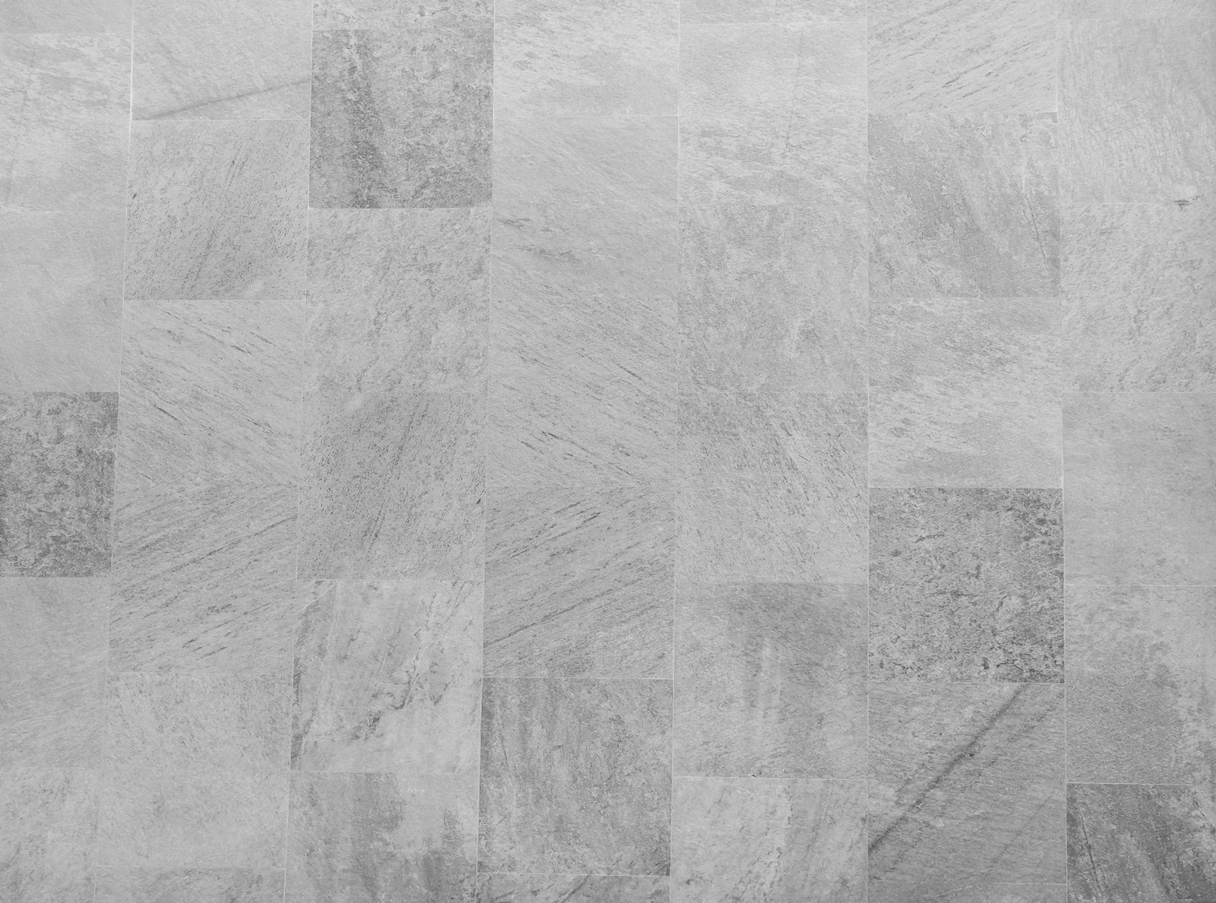
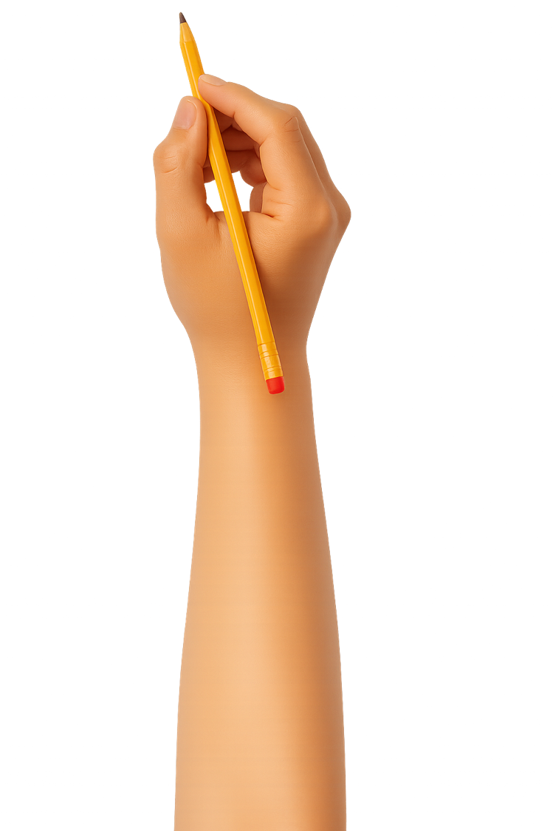

What We Learnt
Exit Ticket
Lesson 1
high
Music can be _____ and low.
The sound of music gives us:
clues for what it is about
snacks to eat
shoes to wear
Giants make low and l____ sounds.
big
high
red
oud

Slide 3
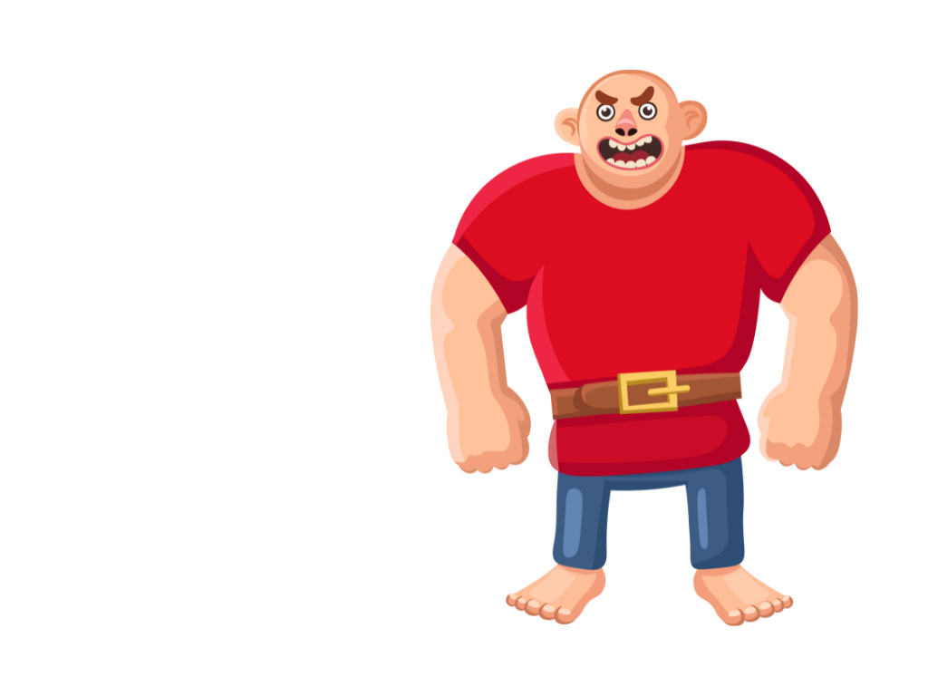
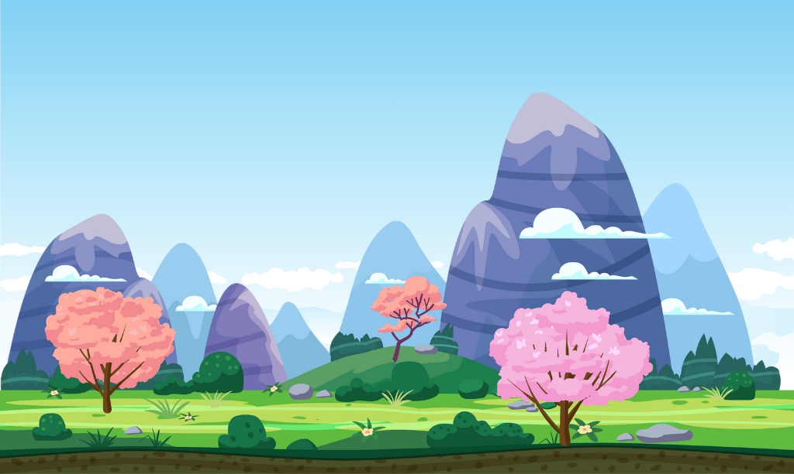

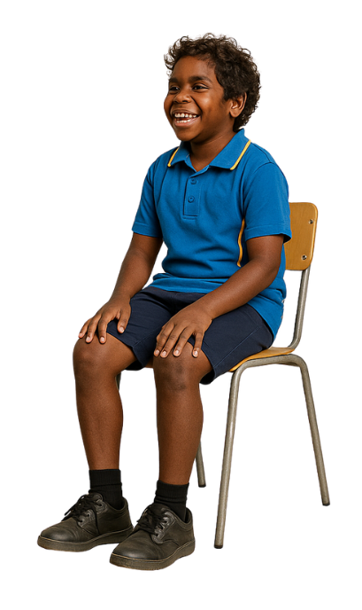


Slide 4
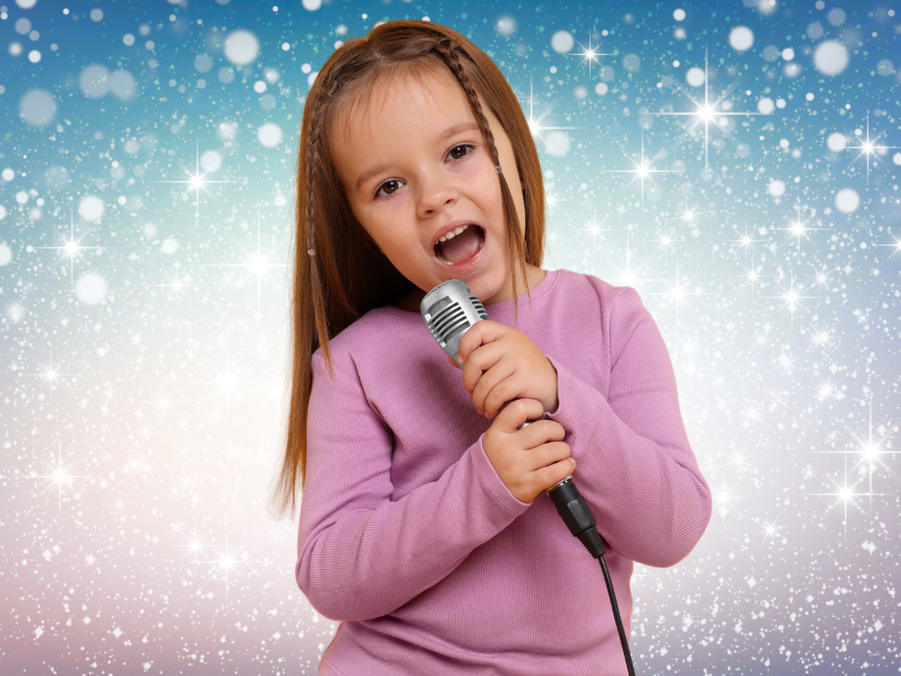
In this lesson, we will learn how we can use our voices to make magical creature music.

Slide 5
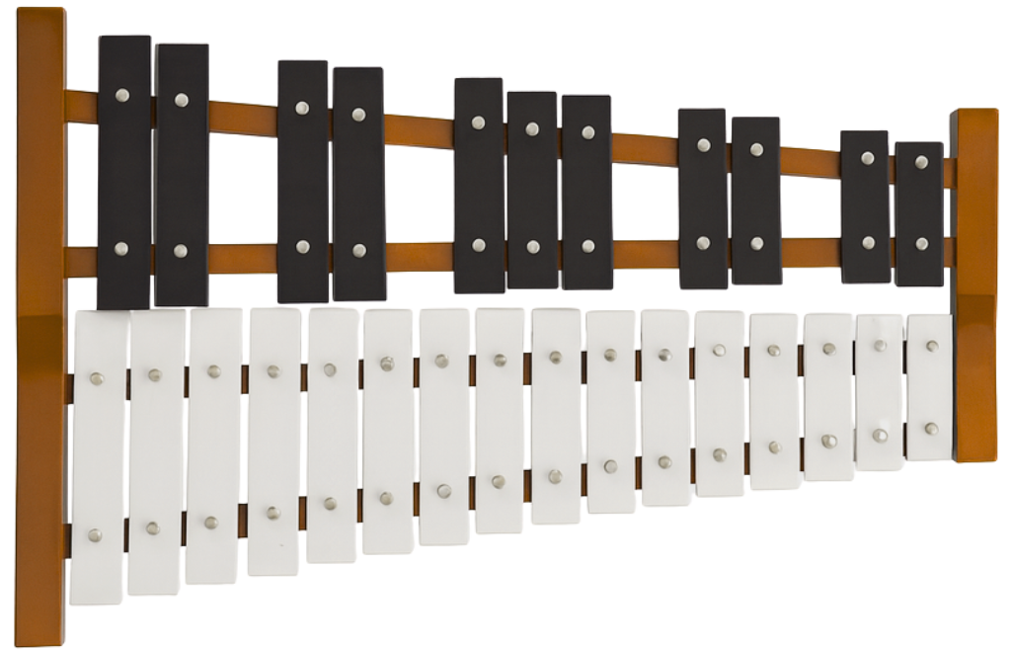
You will be able to: ​
use your voice to show a creature with high and low sounds
play high or low sounds on a keyboard or glockenspiel.
Use means to take something and apply it for a purpose.
Play means to make a musical sound on your instrument.

Slide 6
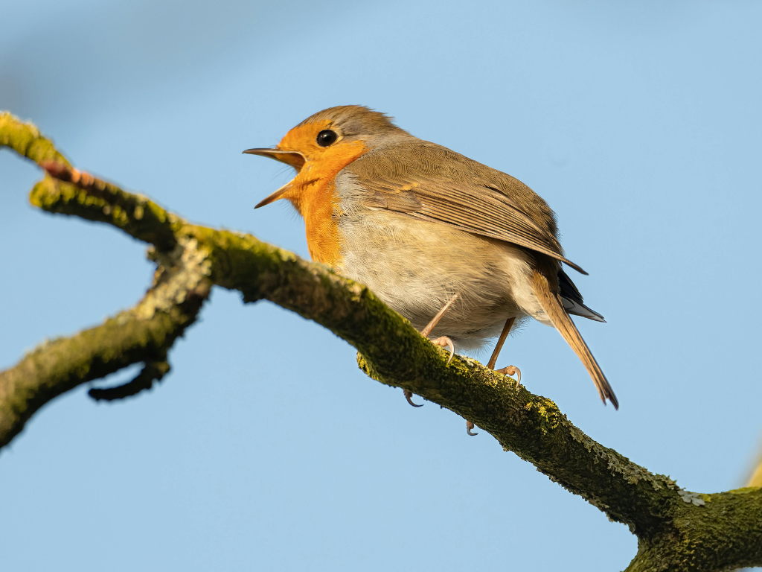
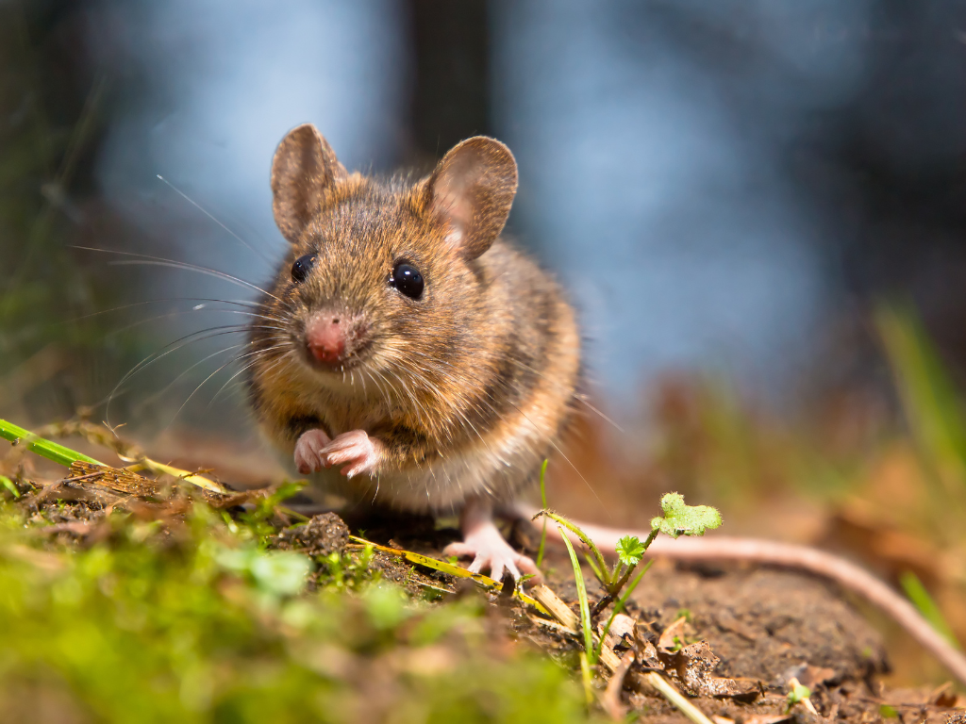


Slide 7
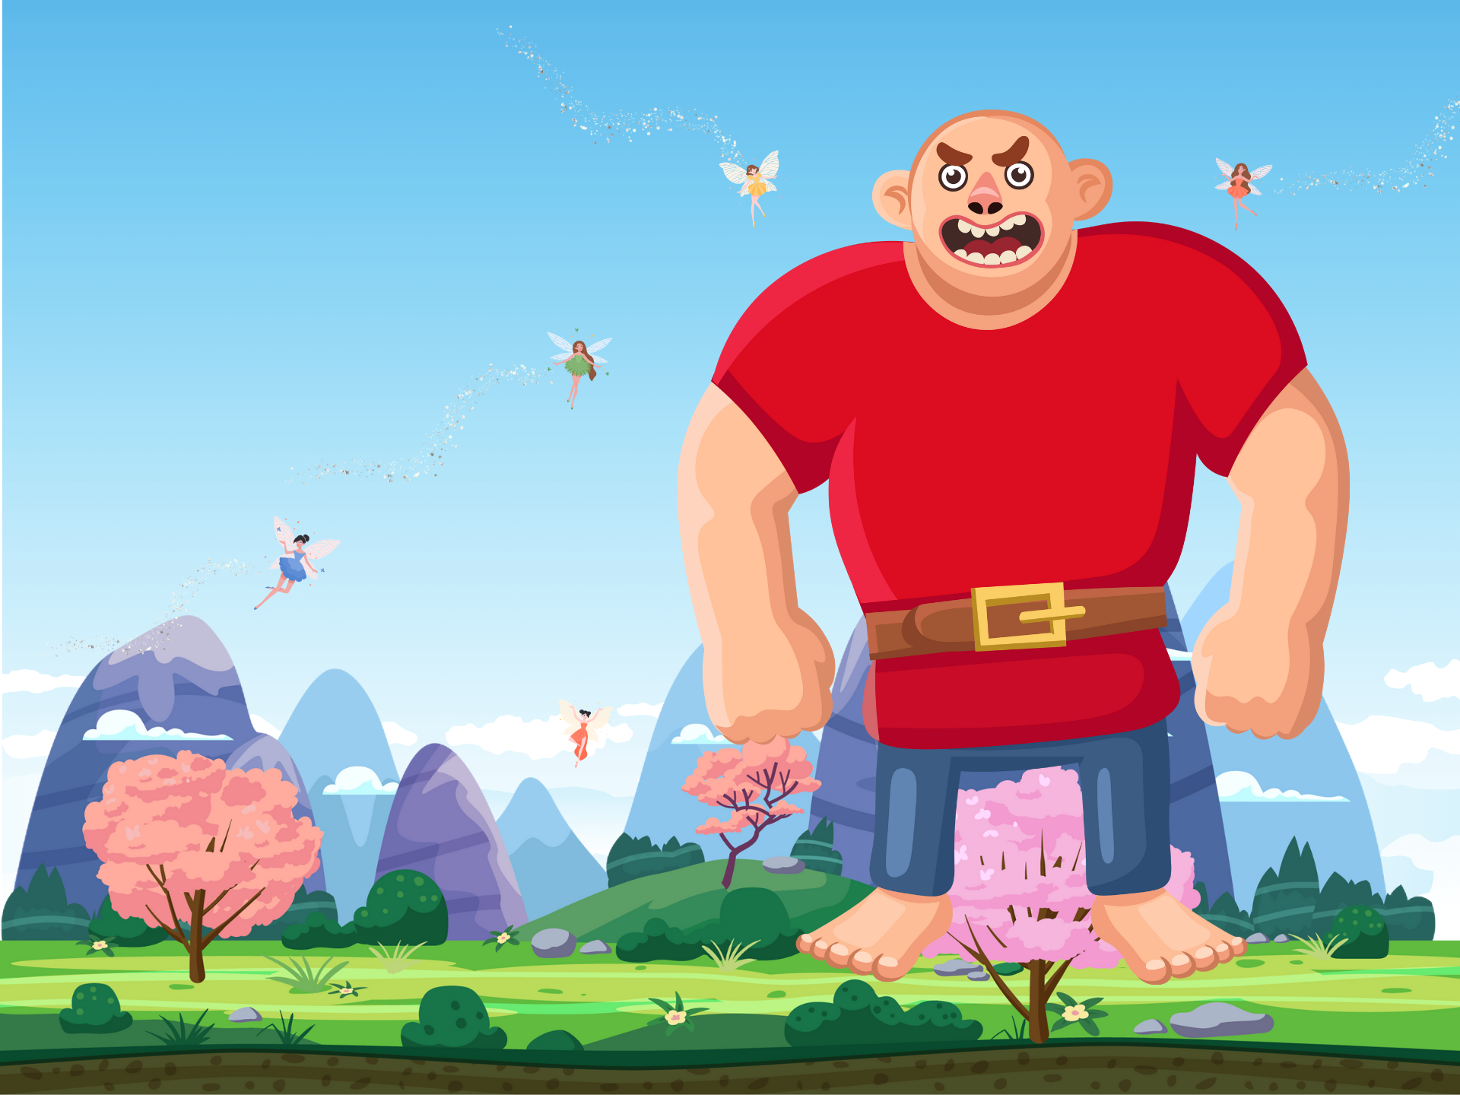
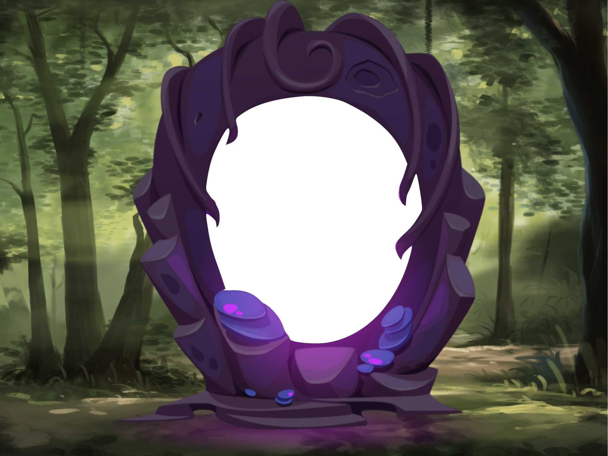
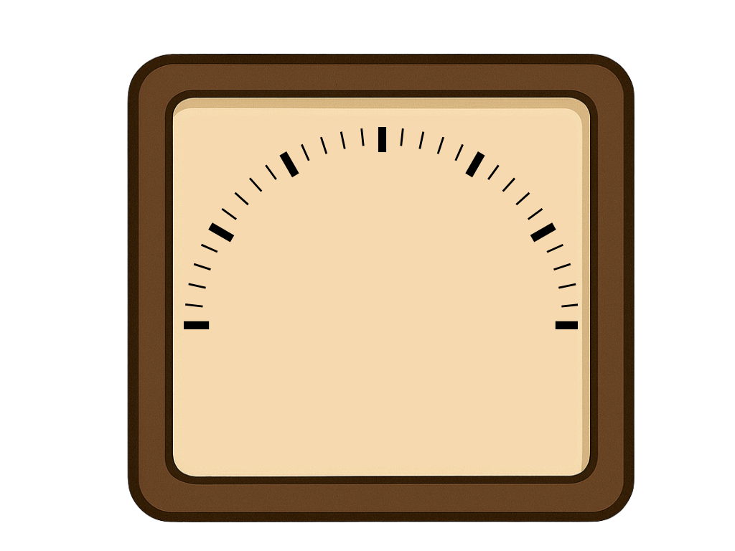

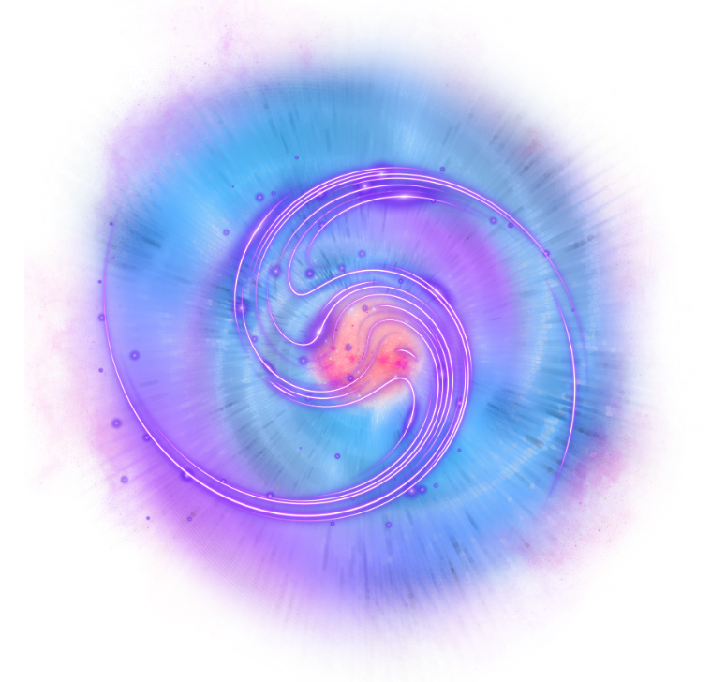


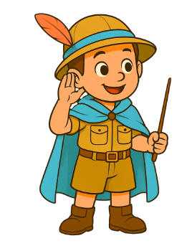
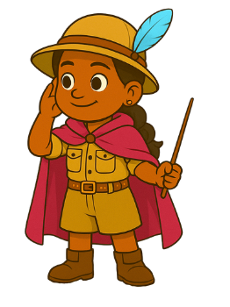

Slide 8
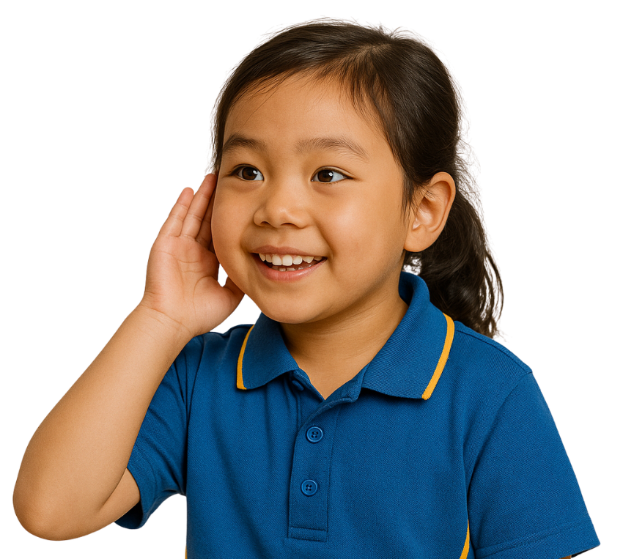


Music Gives Us Clues
The sound of music gives clues for what it is about.

Slide 9
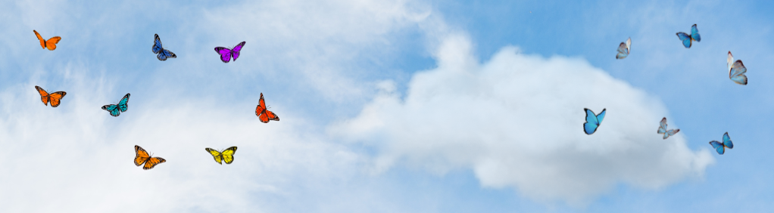
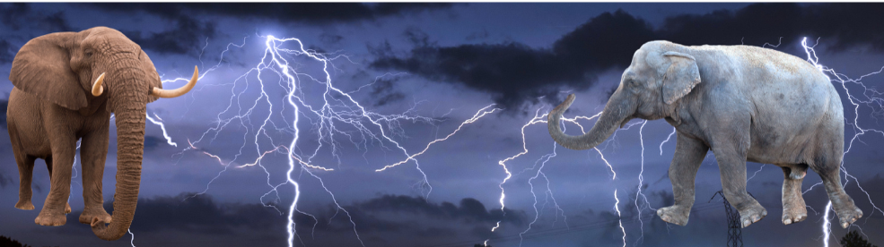
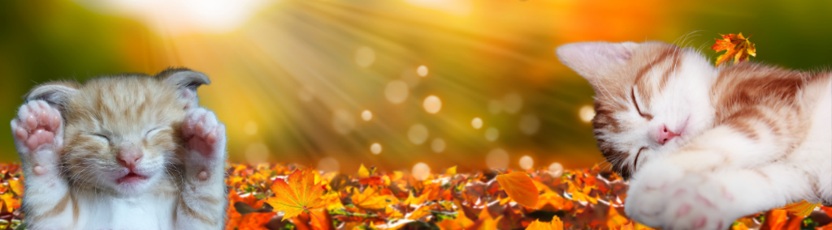
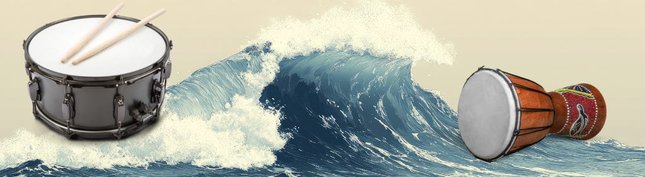

Music Gives Us Clues

Slide 10

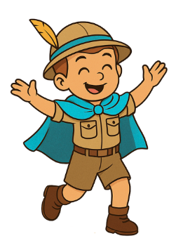
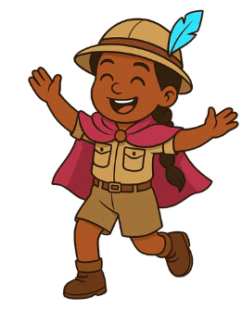

Slide 11
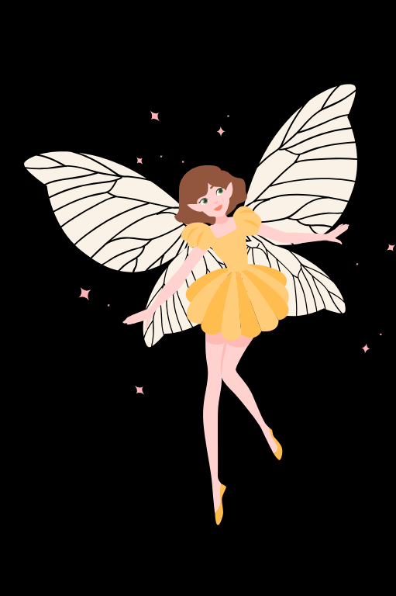


Music About Fairies
Music about fairies is:
high and soft
low and loud

Slide 12
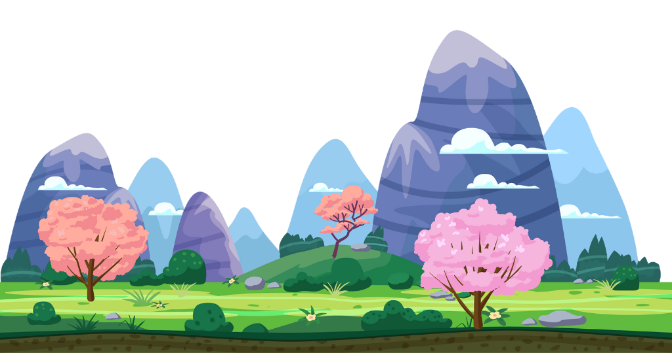
Giants
Fee Fi Fo Fum!
I am a giant,
Big and strong!

Slide 13

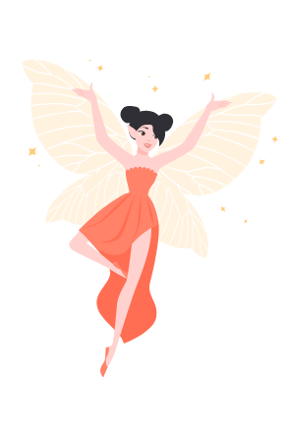
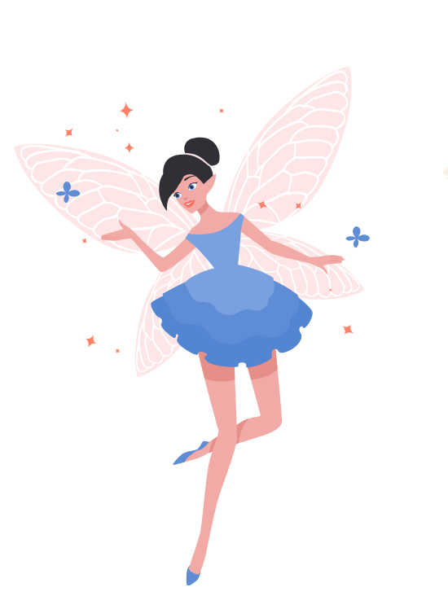
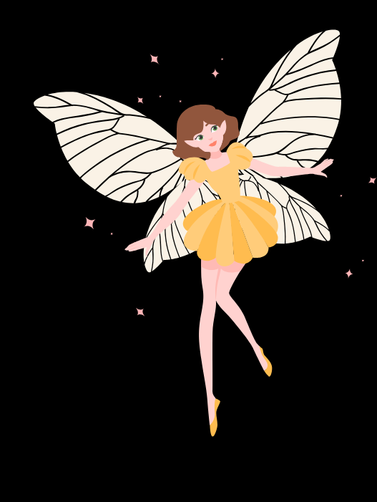
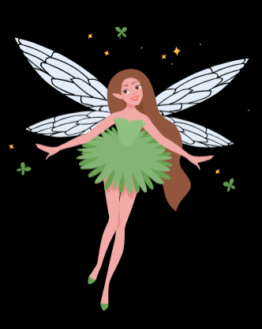
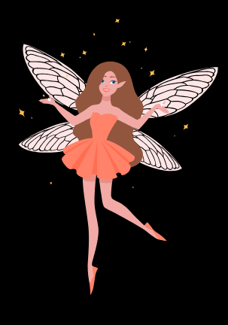
Fairies
Ting, ding, sing-a-ling.
I am a fairy
With clear wings.

Slide 14



























Fairy Sounds

Slide 15
Fairy Story in Sounds

Slide 16
Fairy Story in Sounds

Slide 17
Giant Sounds

Slide 18
Giant Story in Sounds

Slide 19
Giant Sounds

Slide 20
Fairy and Giant Story

Slide 21
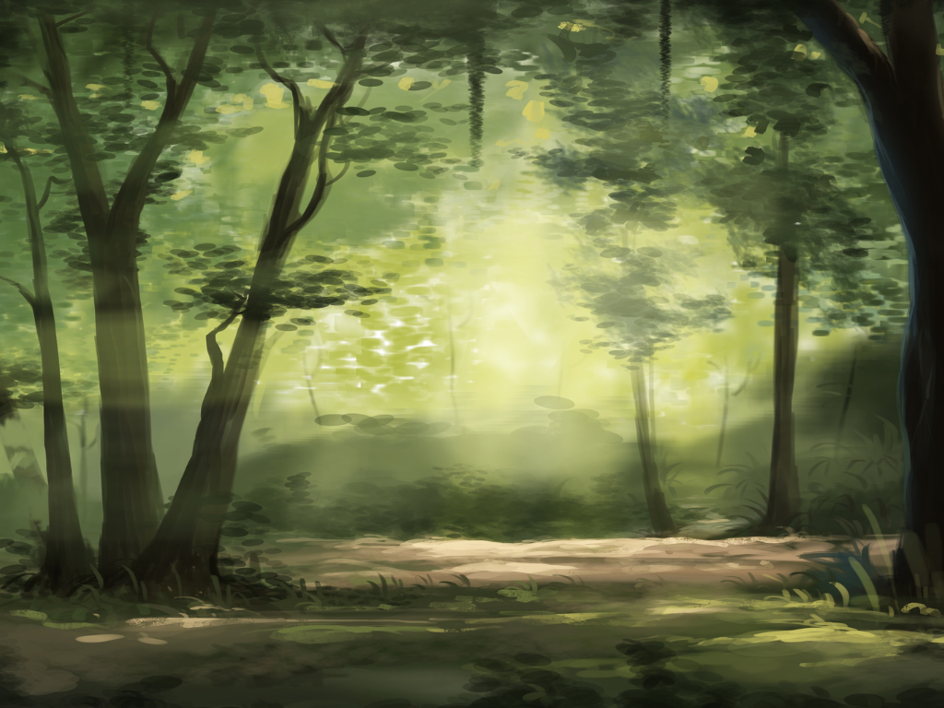
Fairy and Giant Story

Slide 22
Fairy Song
Ting, ding, sing-a-ling.
I am a fairy
With clear wings.

Slide 23
Fairy Song
Ting, ding, sing-a-ling.
I am a fairy
With clear wings.

Slide 24
Music can be high and low, loud and soft.
Keyboards and glockenspiels can make music tunes.
Fairies make high and soft sounds.

Slide 25


Exit Ticket
Date: _________
Lesson 2
soft
Music can be loud and _____.
Keyboards and glockenspiels can:
dance like fairies
run fast
make music tunes
Fairies make h____ and soft sounds.
ball
giant
soft
igh
3
I know _____ out of 3 answers.

Slide 26
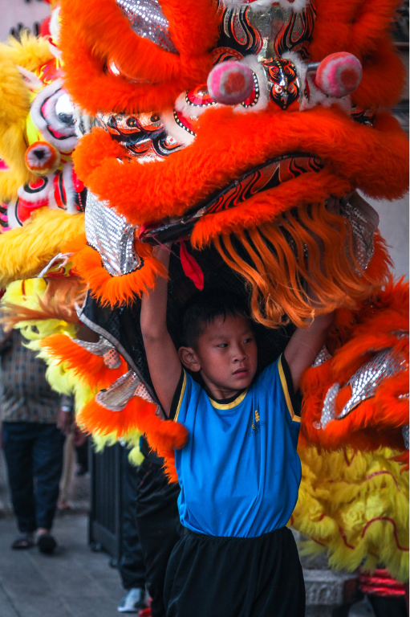
In the next lesson, we will learn how music can show movement.

Slide 27
Slide 10: Dance Of The Sugar Plum Fairies performed by Kevin MacLeod (incompetech.com) Licensed under Creative Commons: By Attribution 3.0 License, http://creativecommons.org/licenses/by/3.0/

