Slide 1
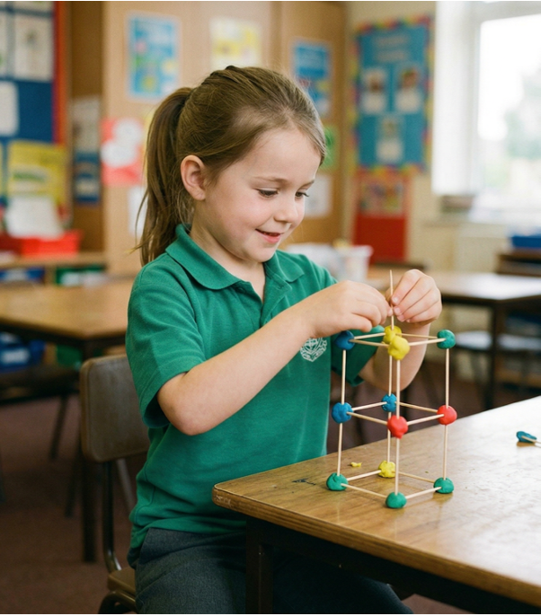
Training Mode
Unit 3: Achieving Goals
Lesson 2

Slide 2
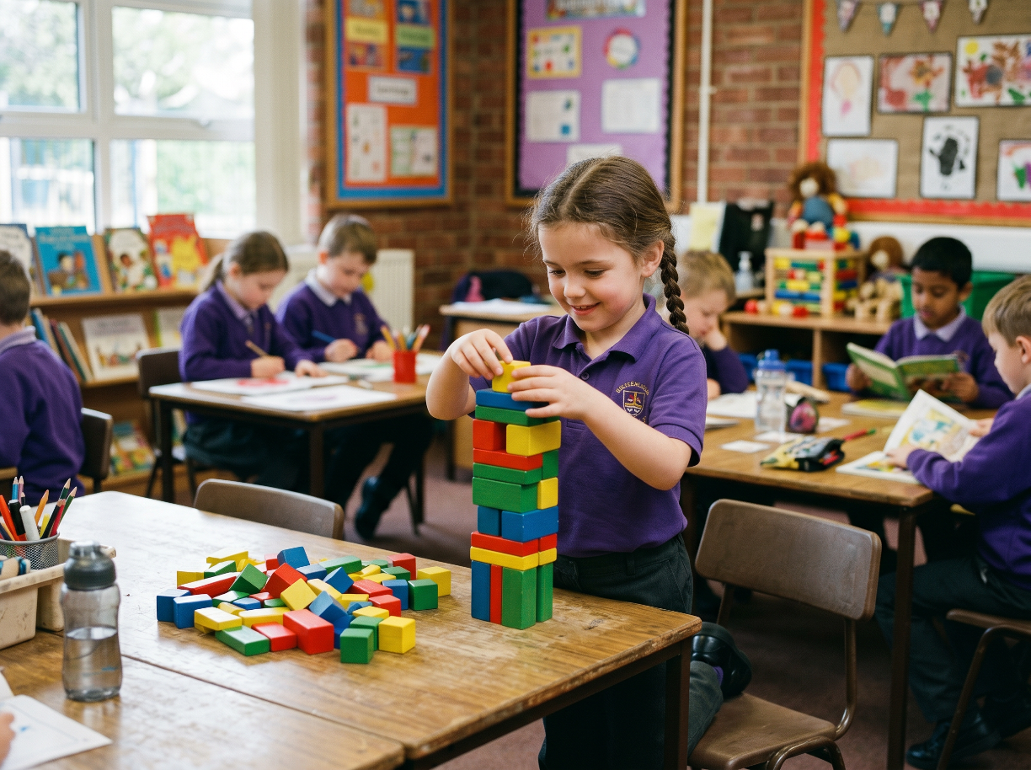
Belief means thinking, ‘I can try,’ even when something is new or tricky.

Slide 3
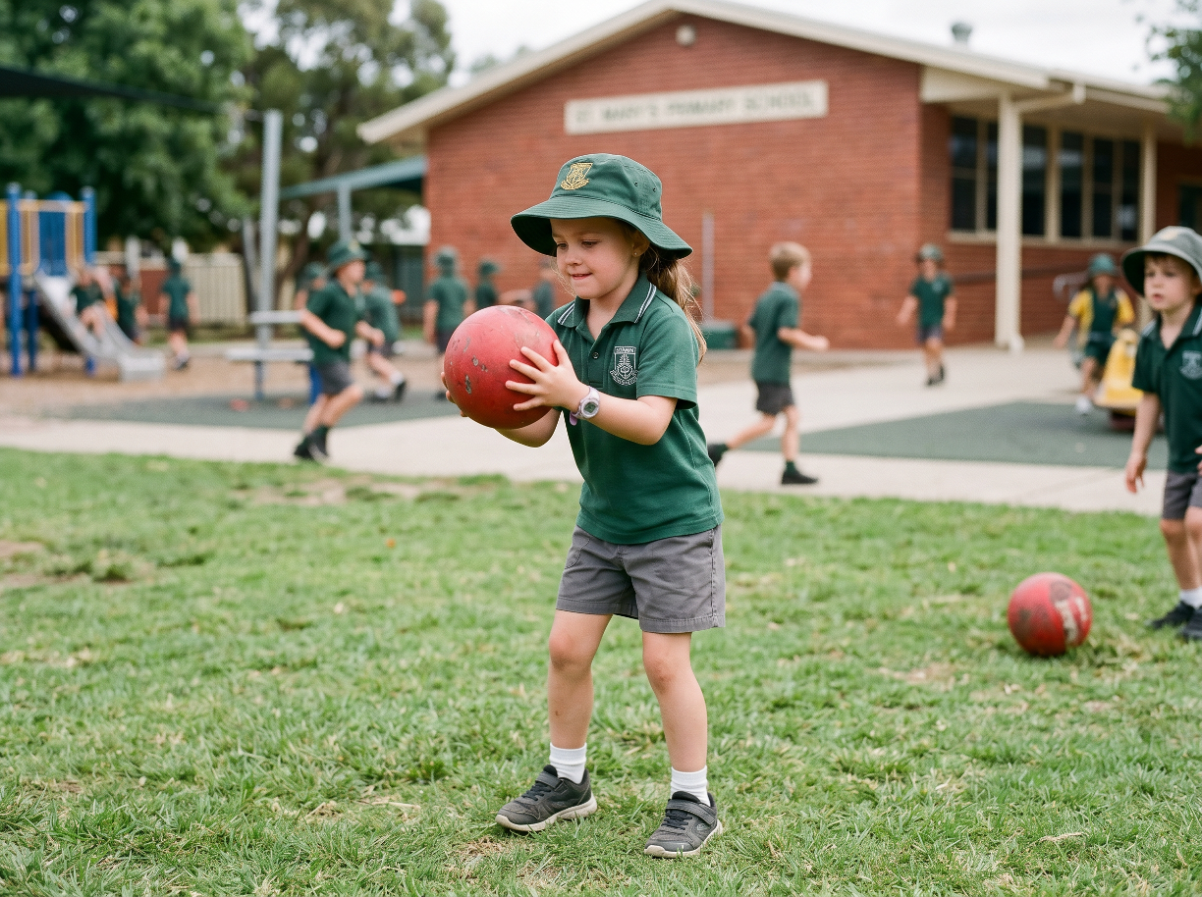
Telling yourself ‘I can try’ shows belief because you think you can improve if you choose to try.

Slide 4
Belief grows when you try, ______ and see yourself getting better.
practise
give up
stop
practise

Slide 5
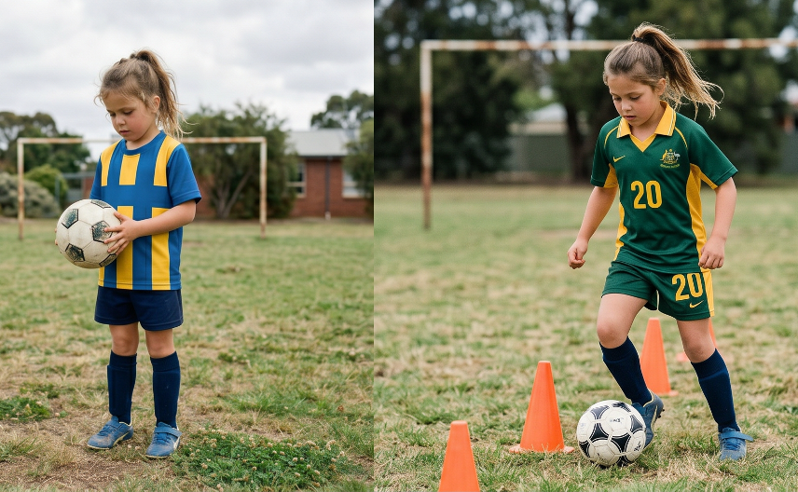
In this lesson, we will learn that practising and trying again helps us improve.

Slide 6
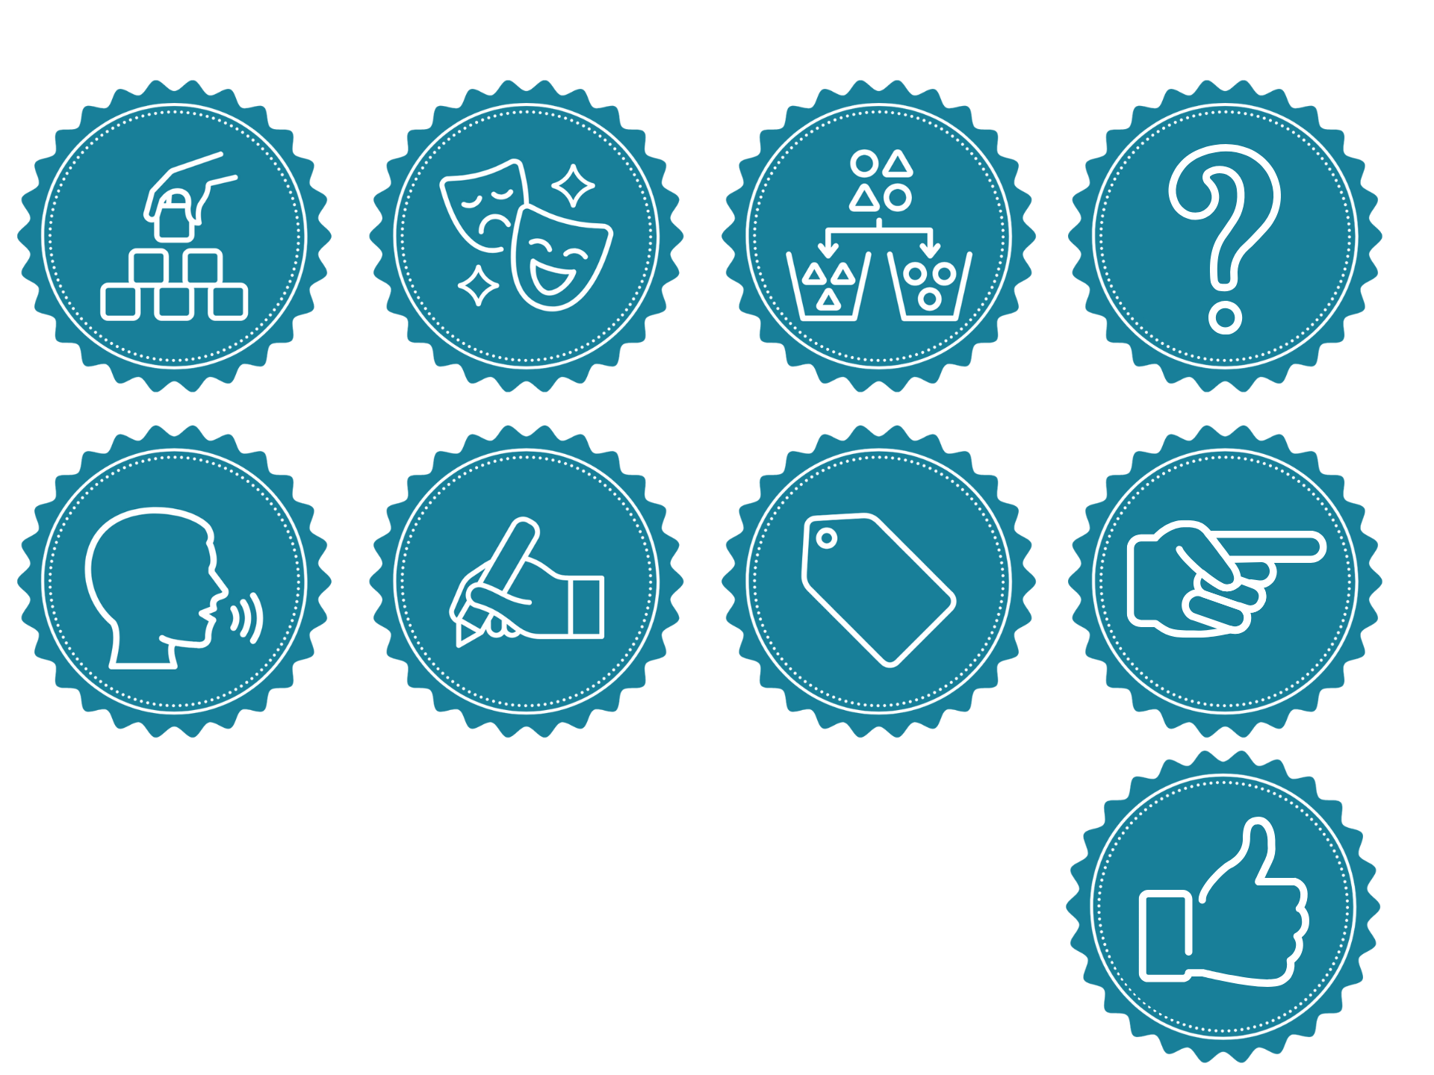
You will be successful when you can:
show effort
explain how trying again leads to improvement.

Slide 7
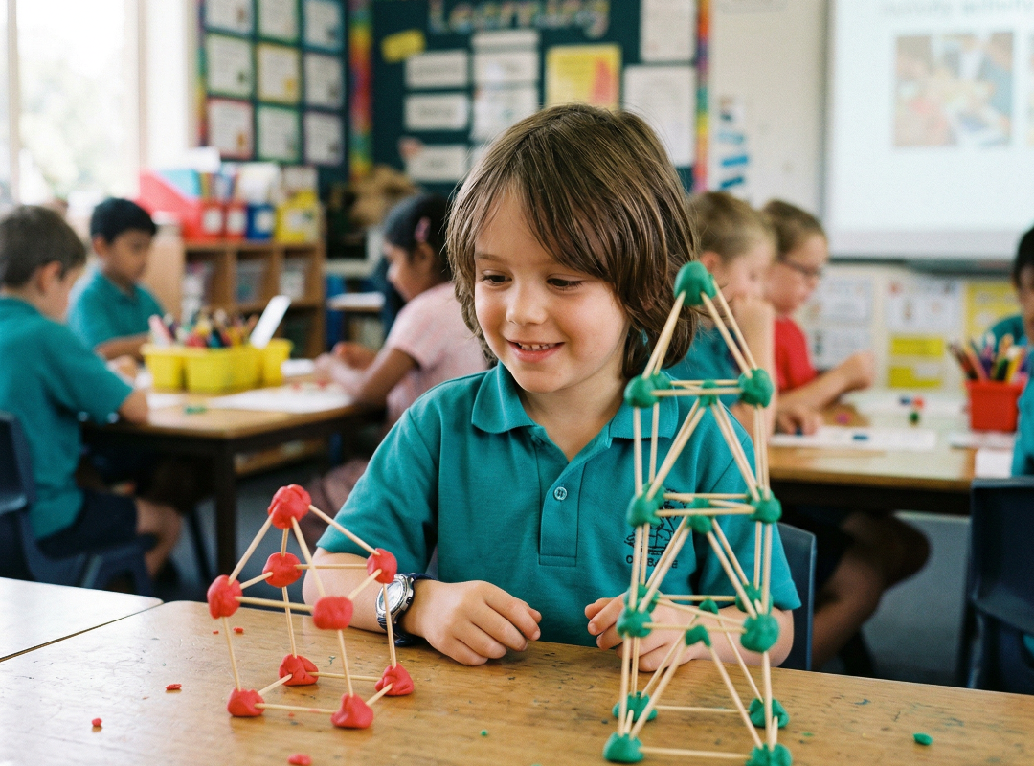
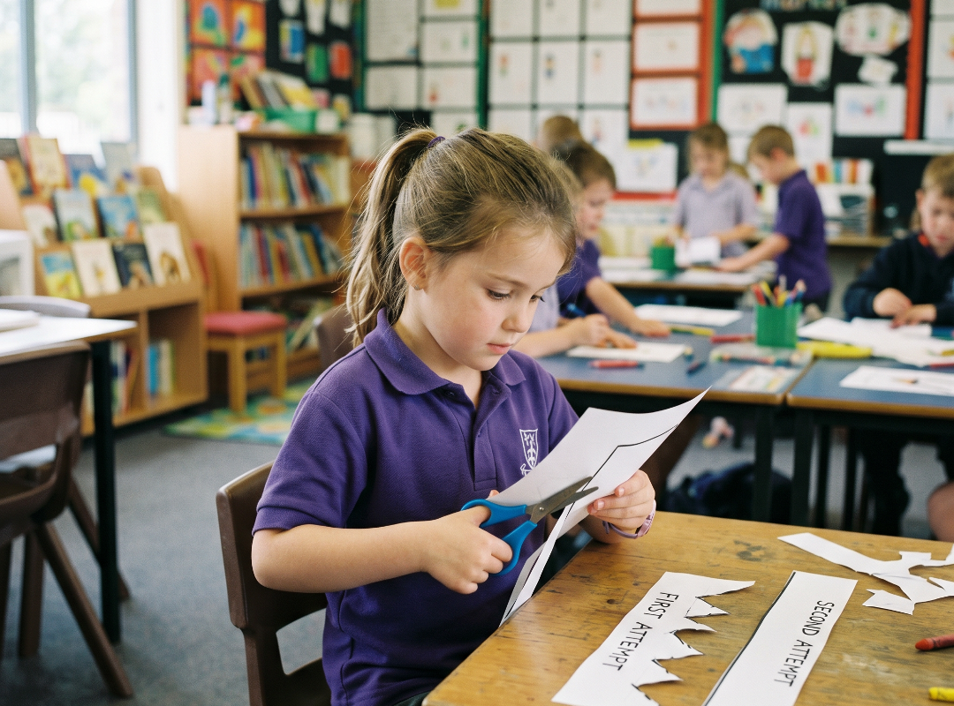
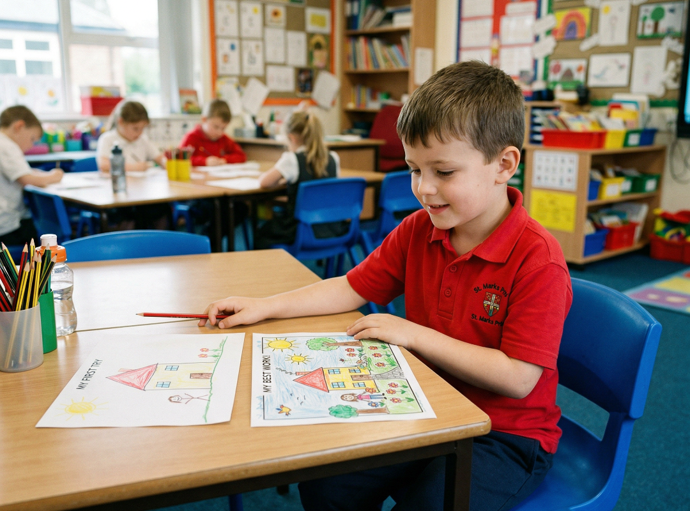

Slide 8
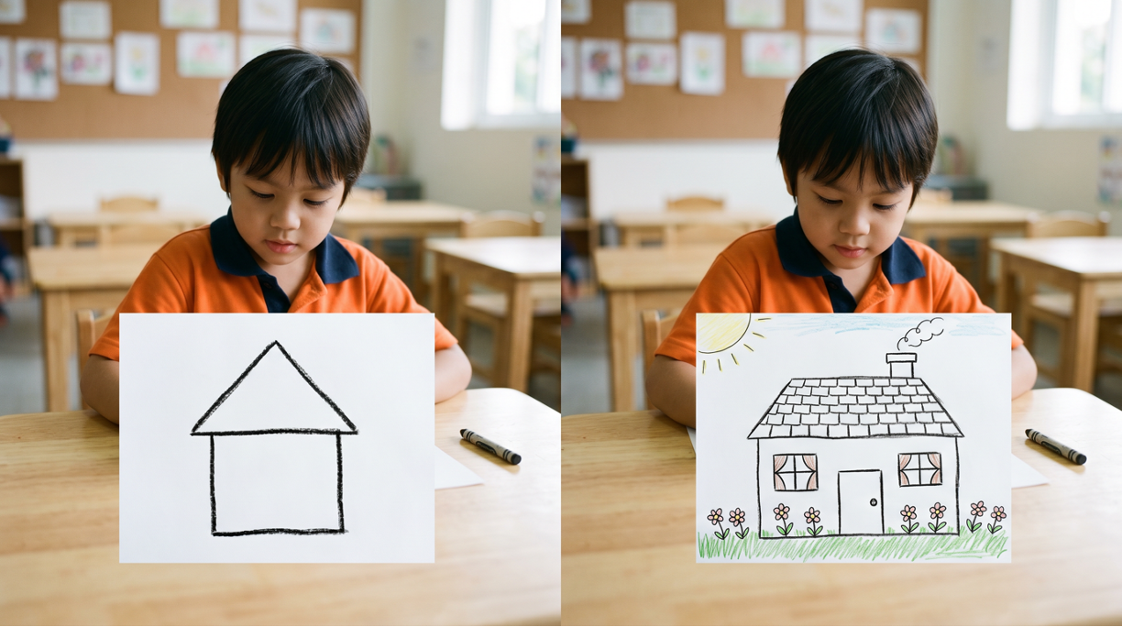
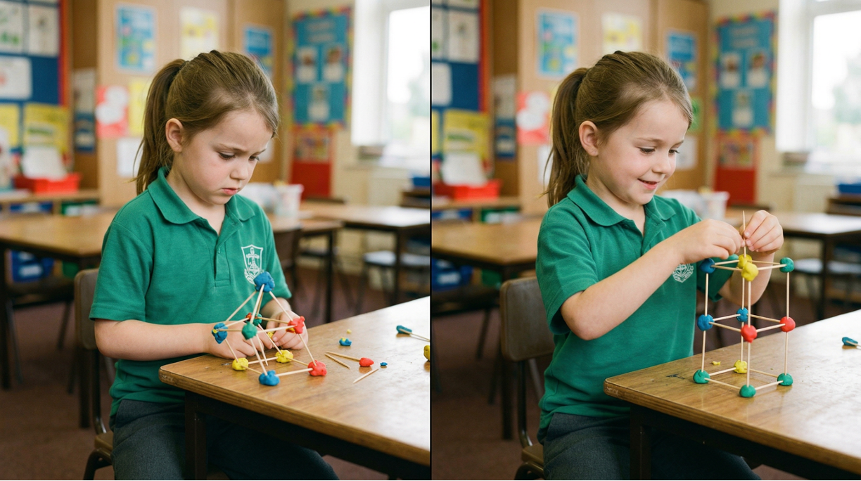
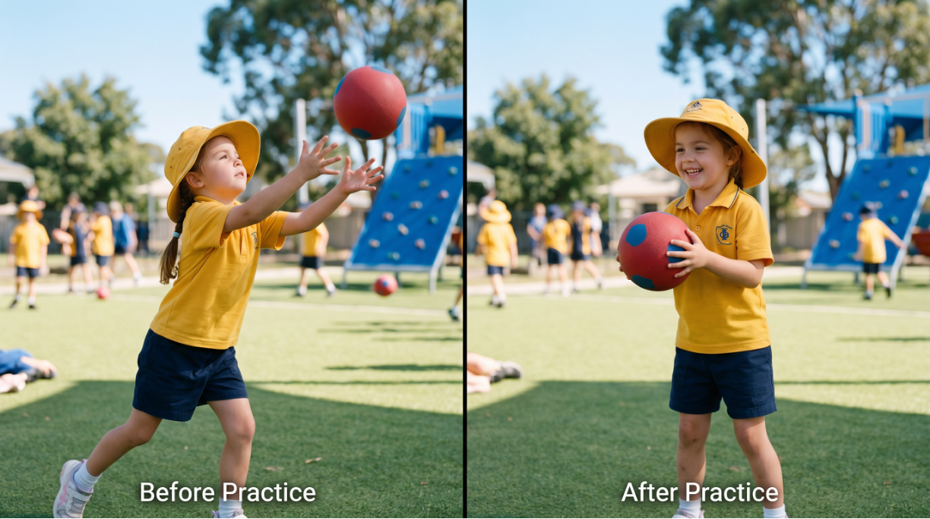
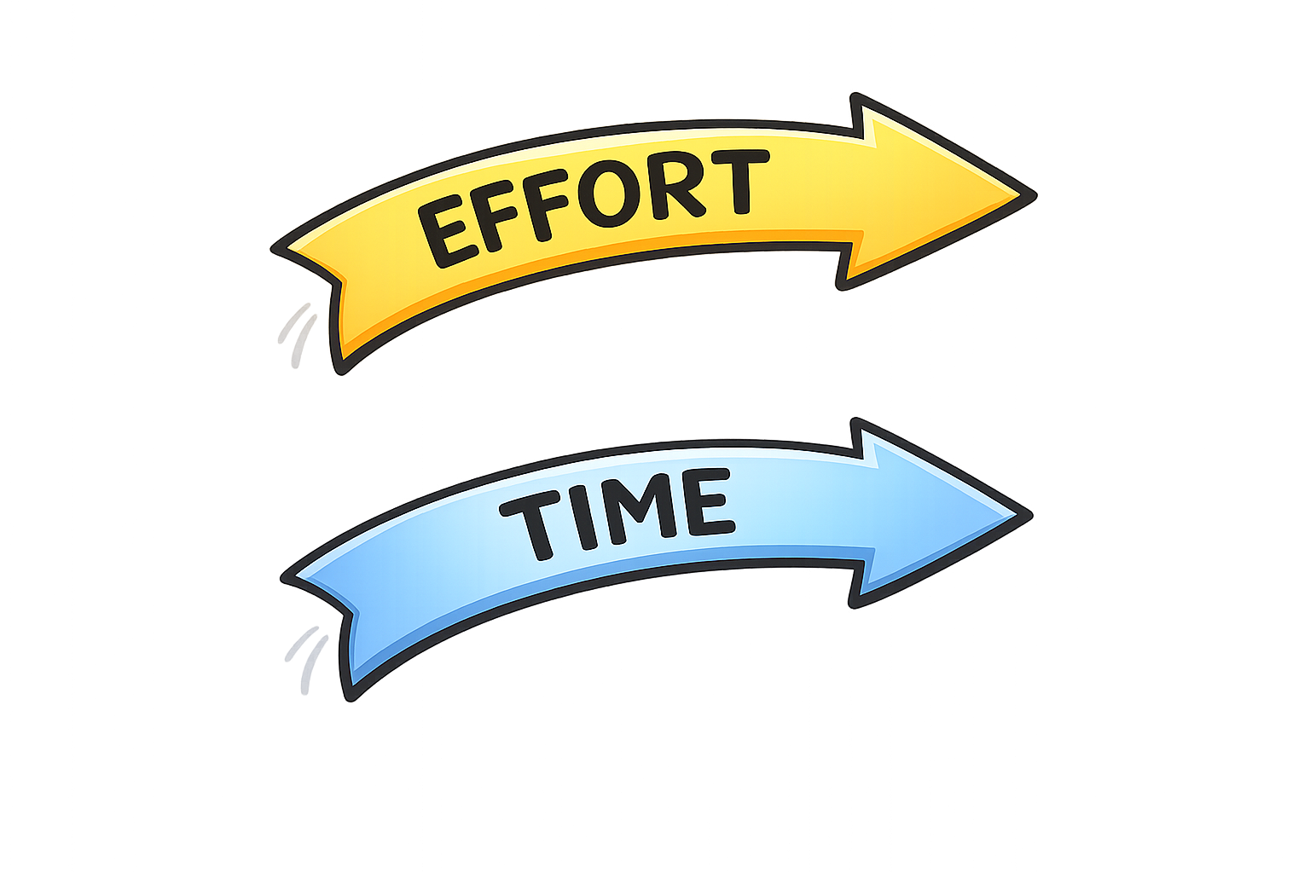
Effort and Time
Effort and time mean trying again and spending time to get better.

Slide 9
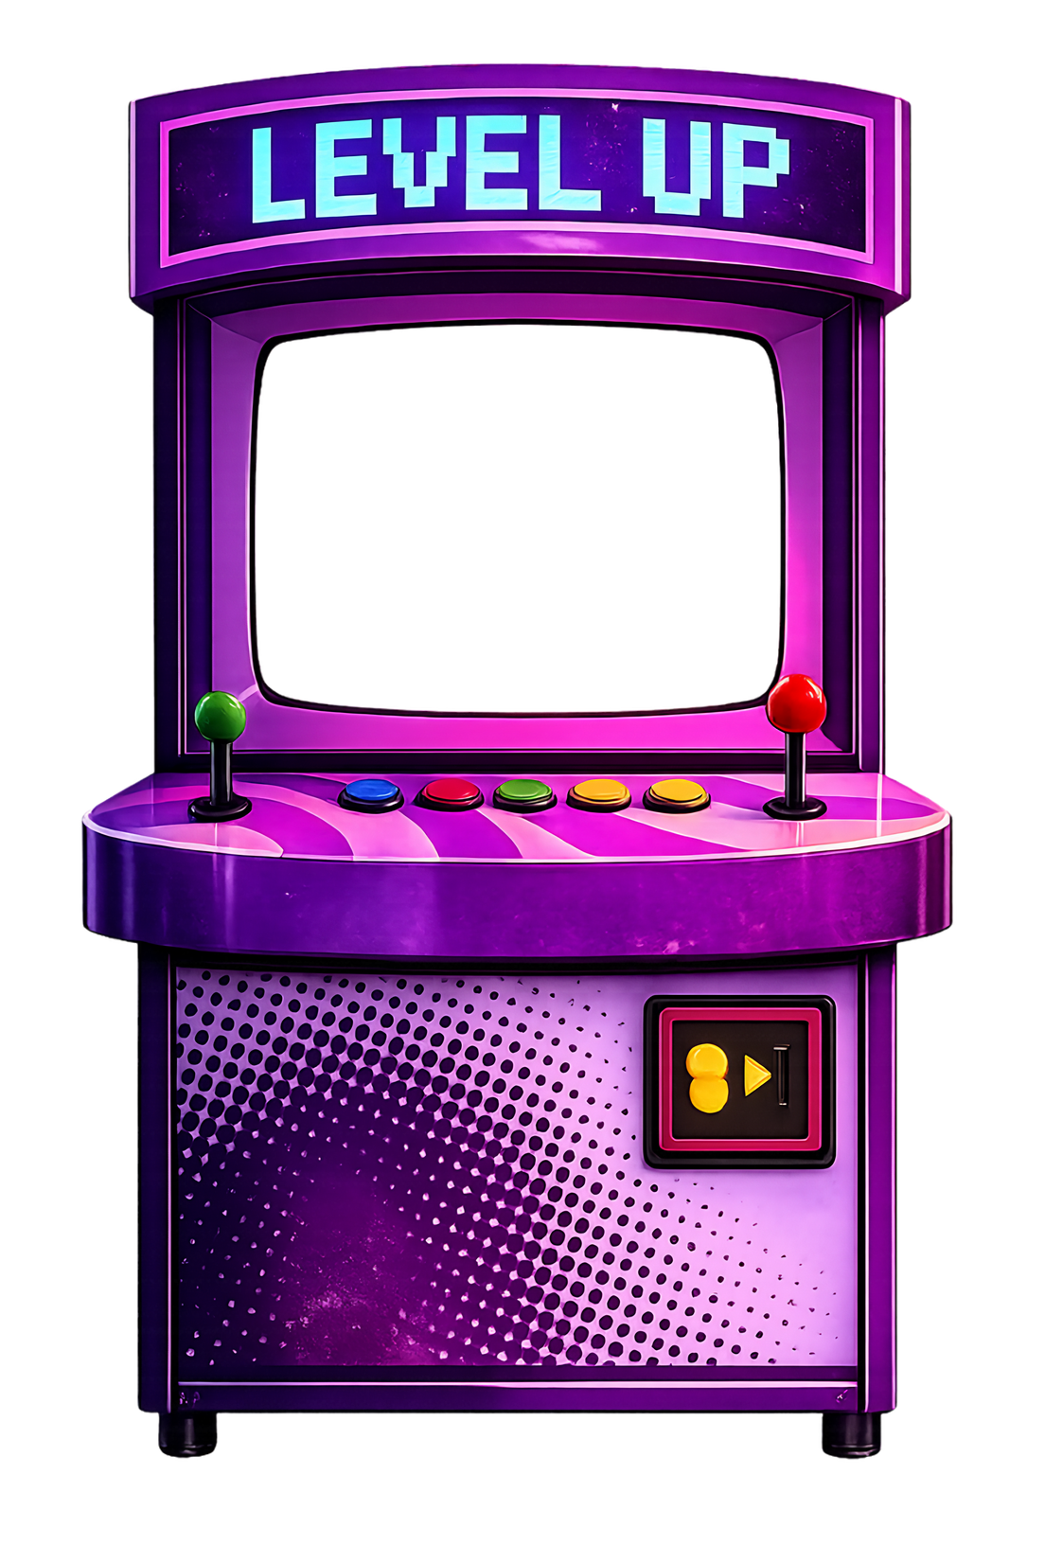
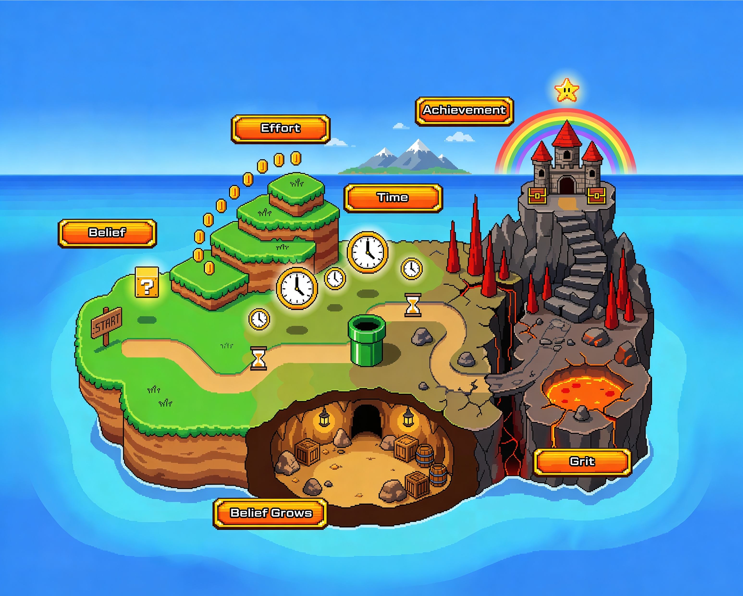
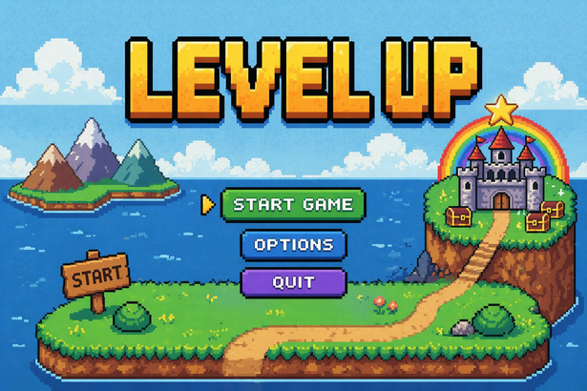


Slide 12


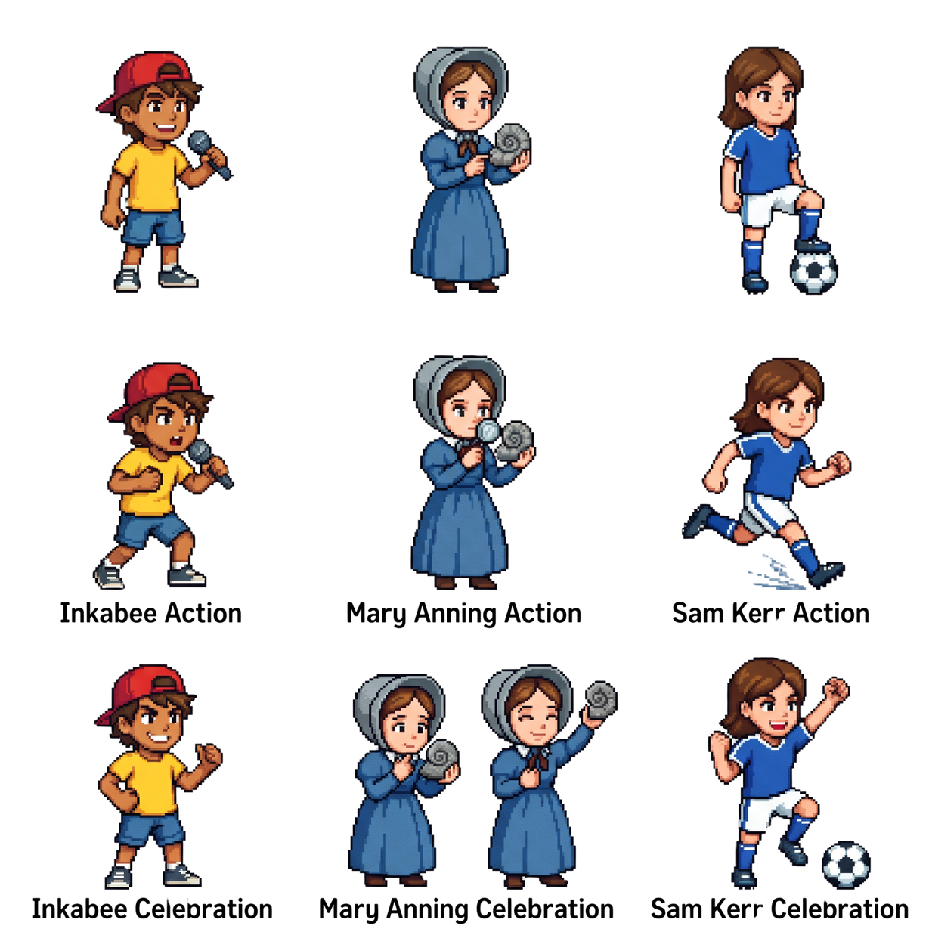

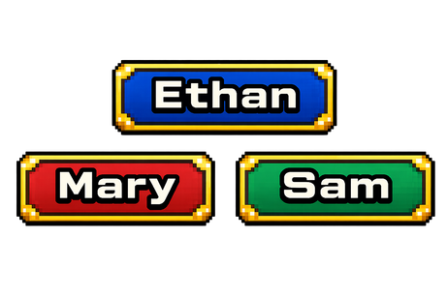

Slide 13



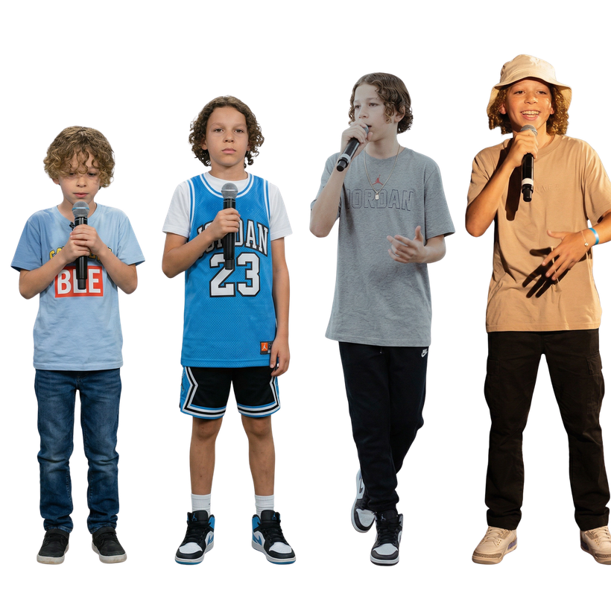

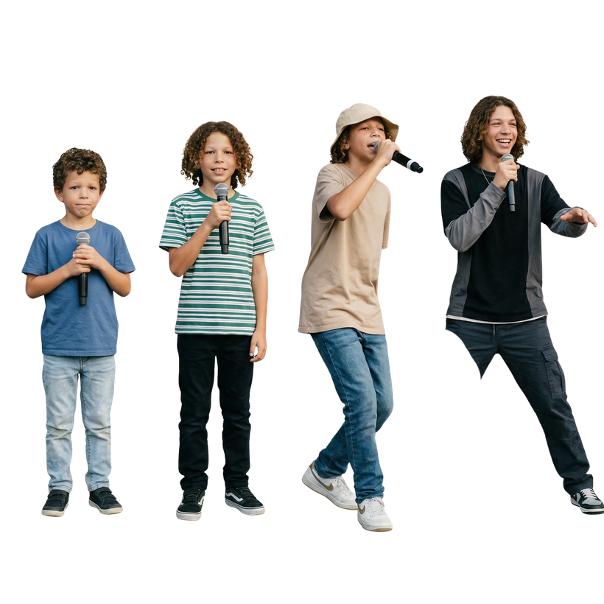

Slide 14
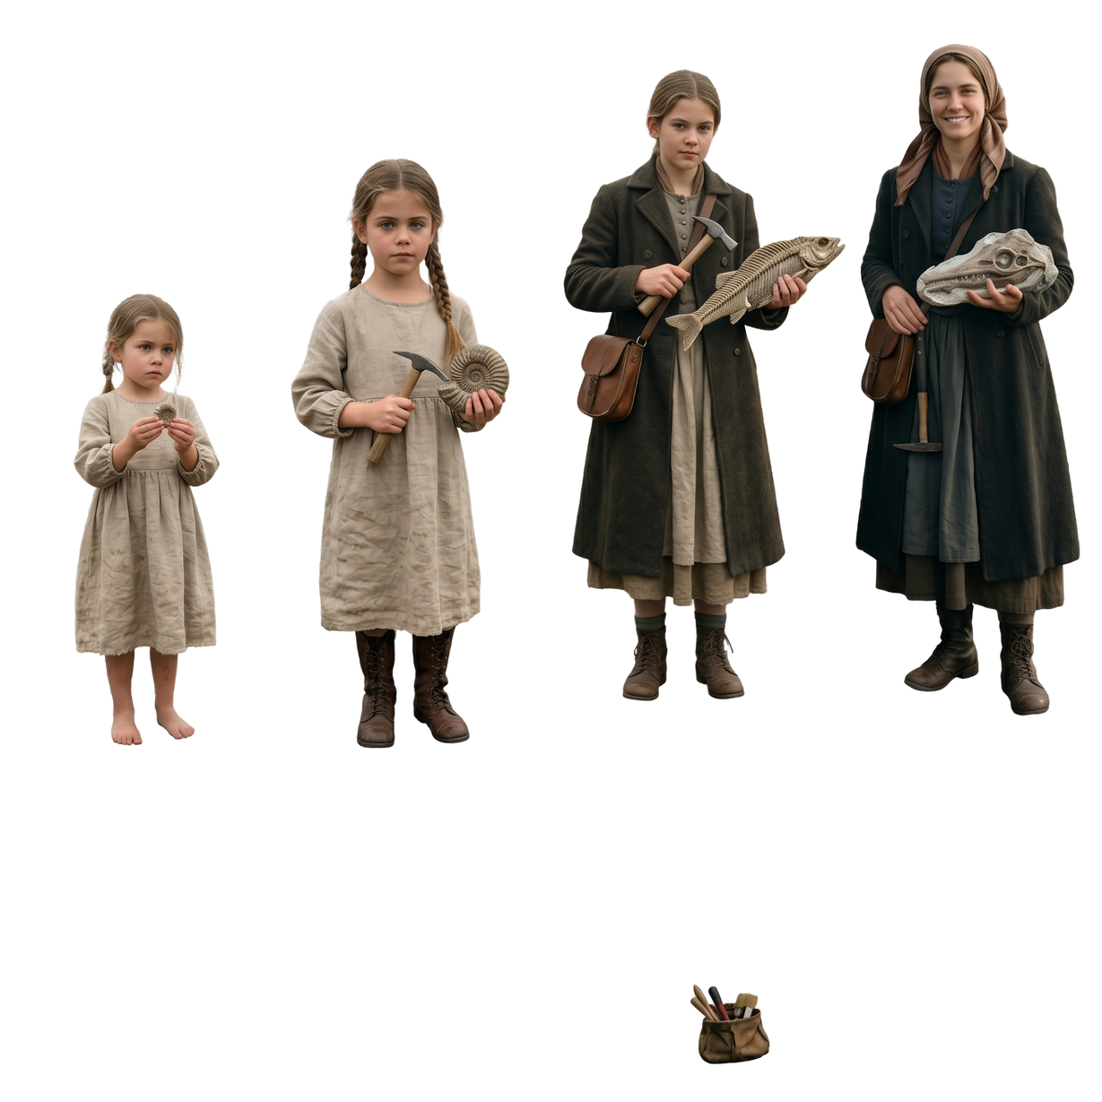

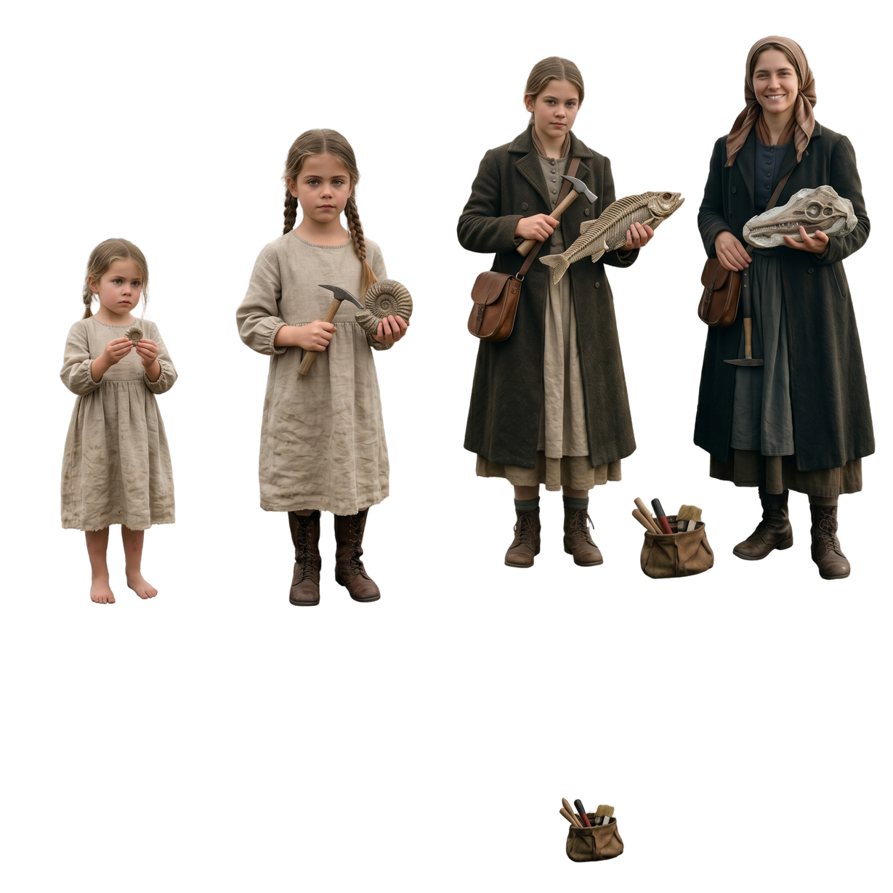

Slide 15

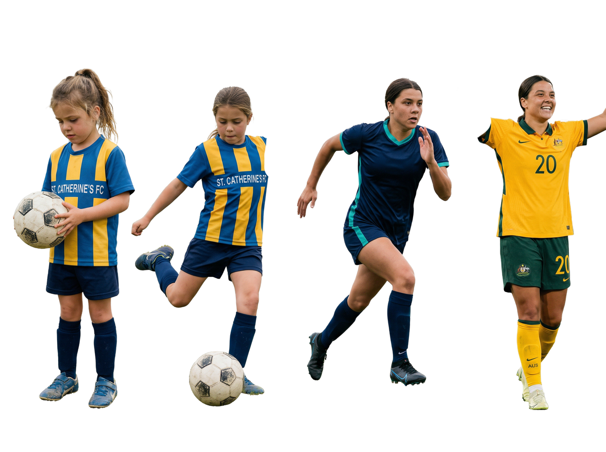


Slide 16

Effort and Time
Effort and time mean trying something new only one time.
yes
no

Slide 17
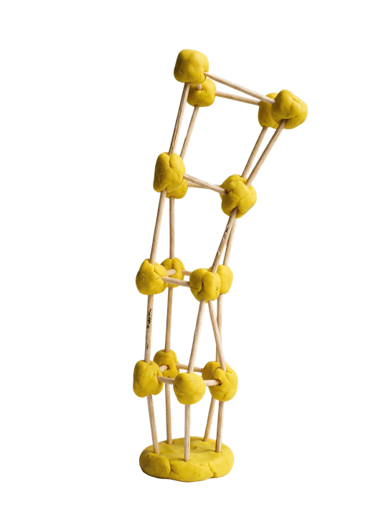

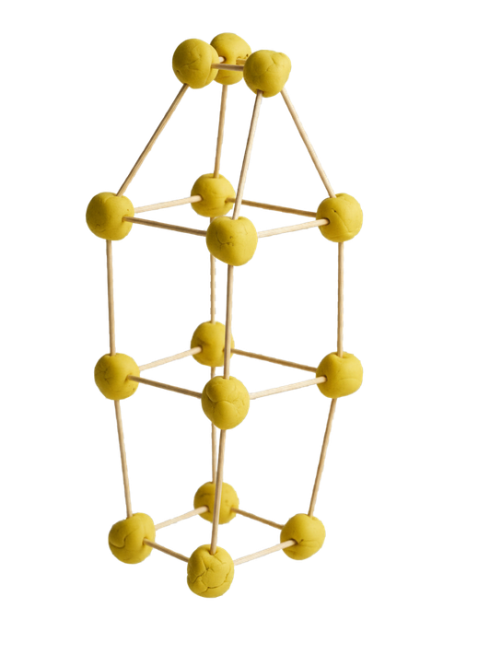
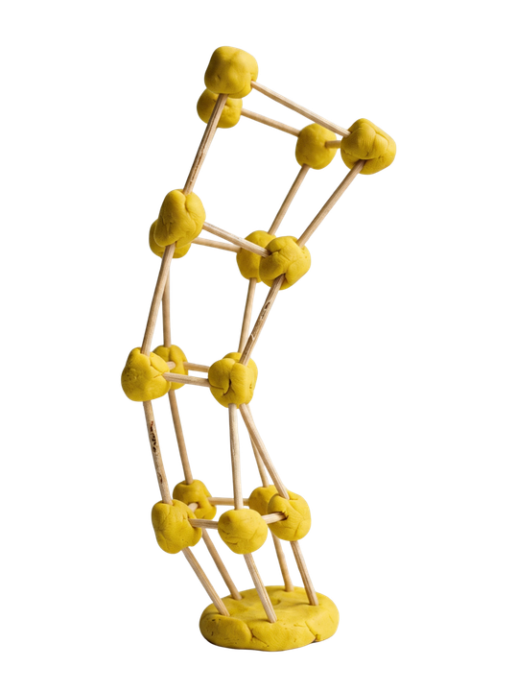
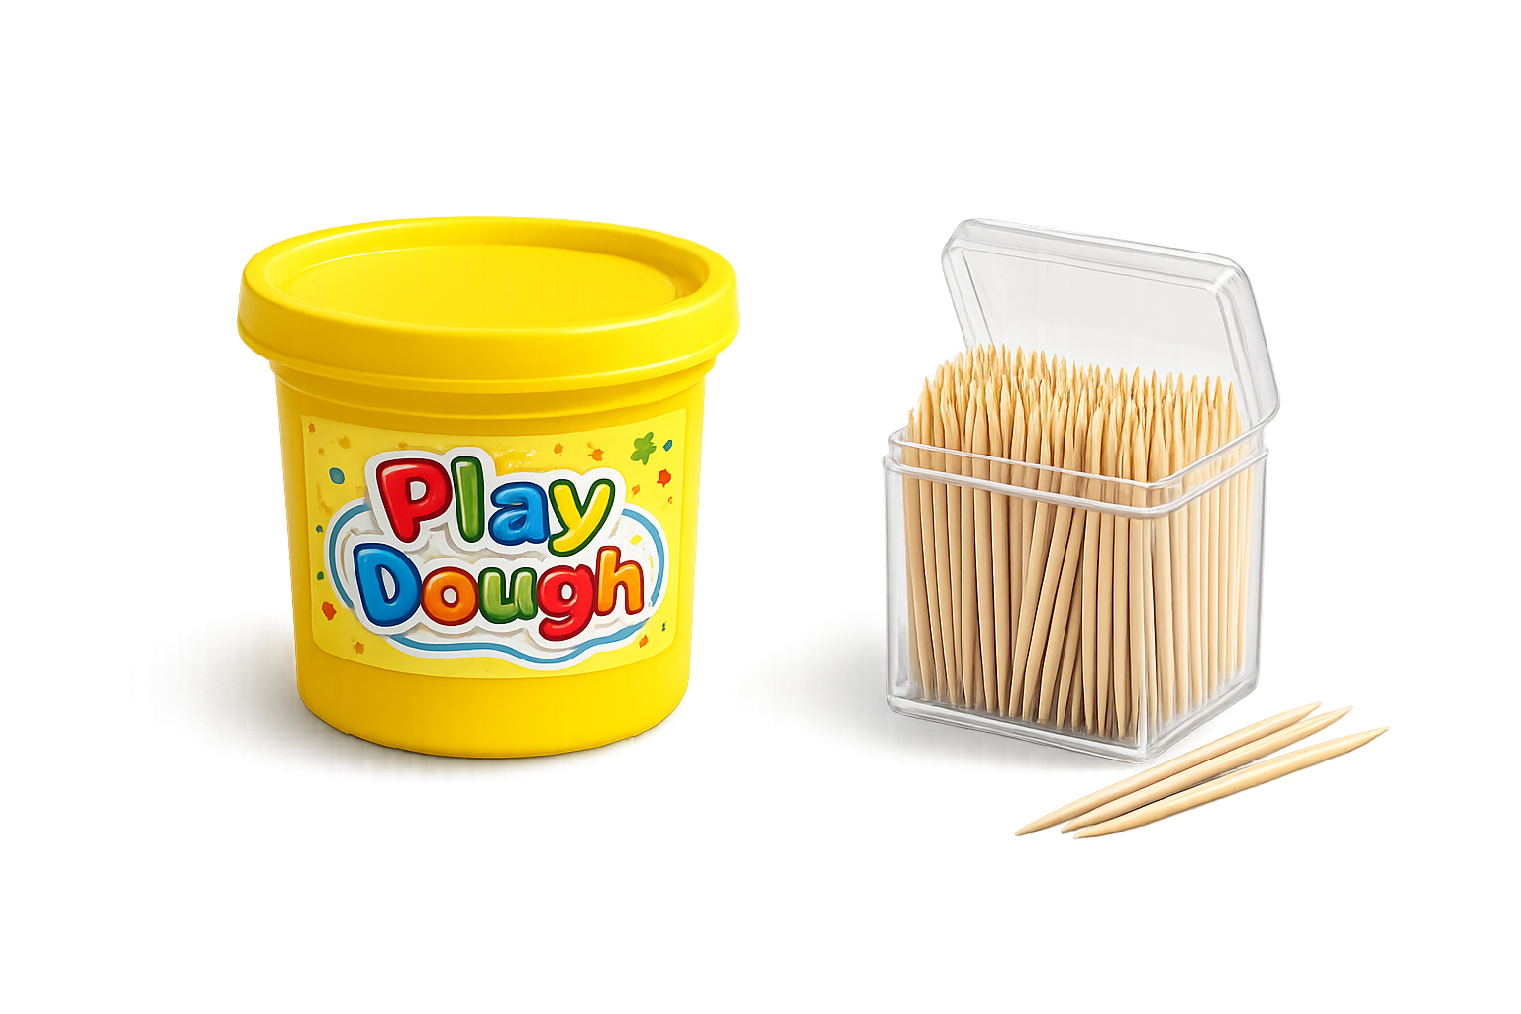

Slide 18
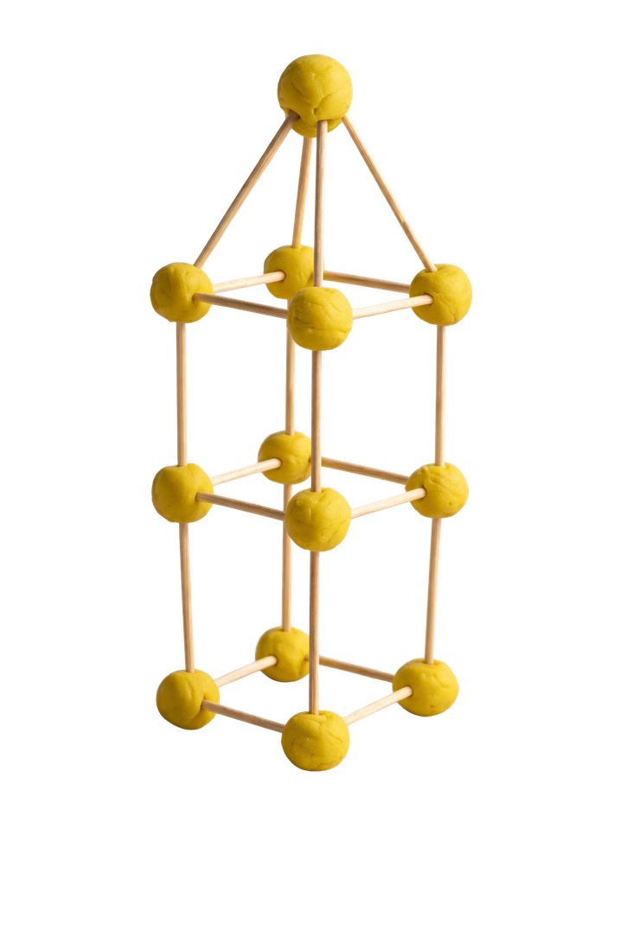
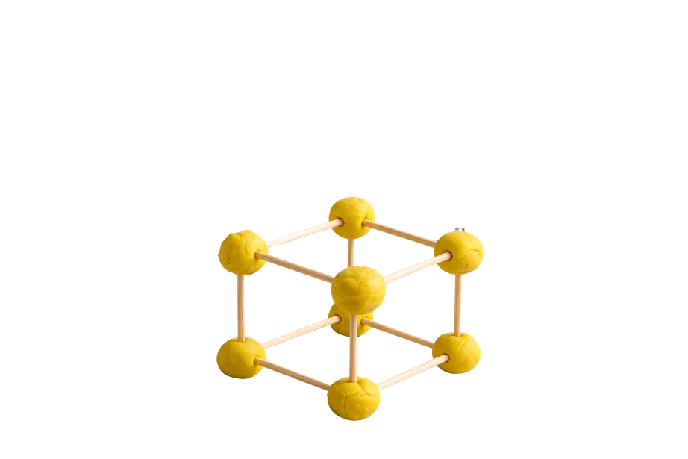
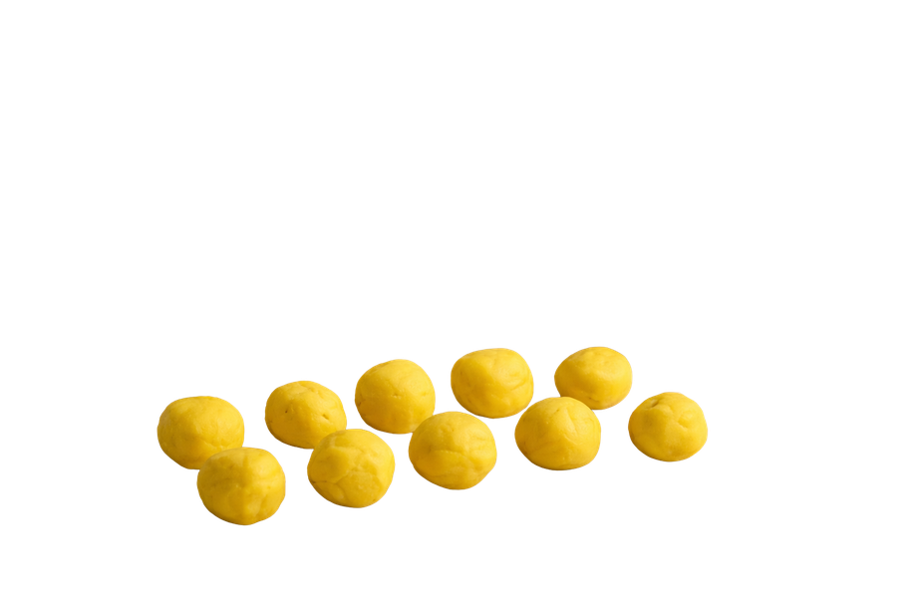
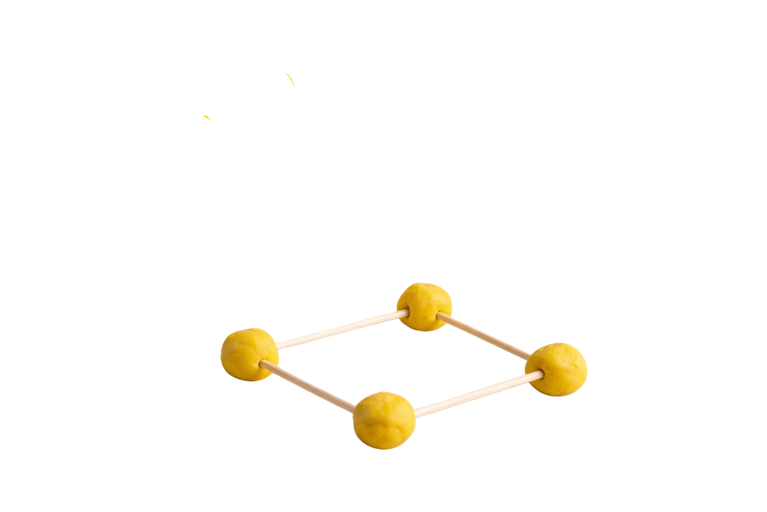

Slide 19

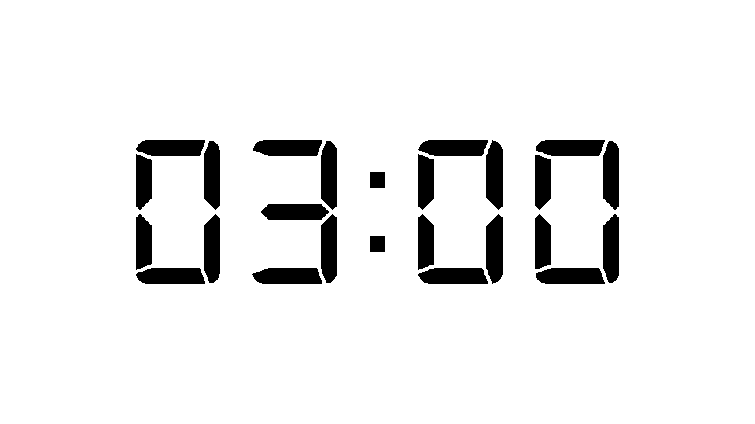
Effort and Time Task Trial 1

Slide 20

How does trying again lead to improvement?

Slide 21
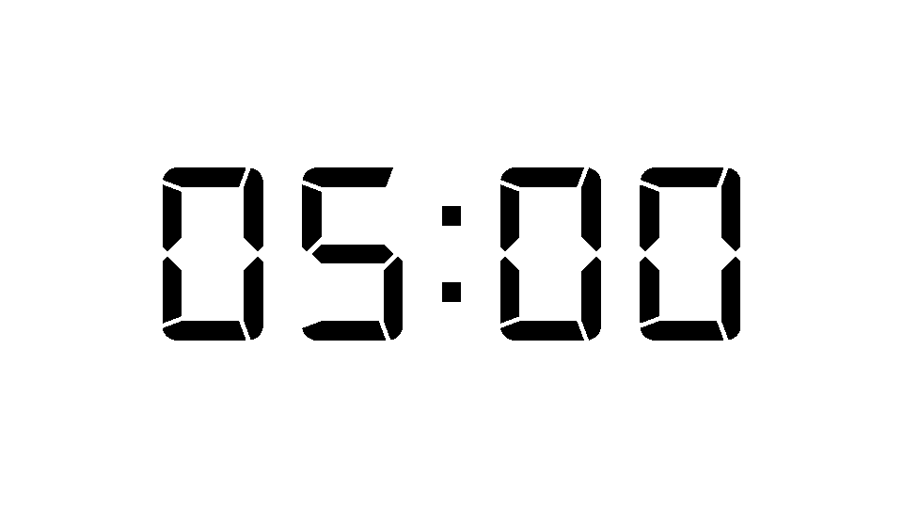
Effort and Time Task Trial 2

Slide 22
Effort and time mean trying again and spending time to get better.
Effort is the energy you put in when you keep trying.
Time is giving yourself enough time to practise and improve.

Slide 23


How well did you:
show effort
explain how trying again leads to improvement?

Slide 24
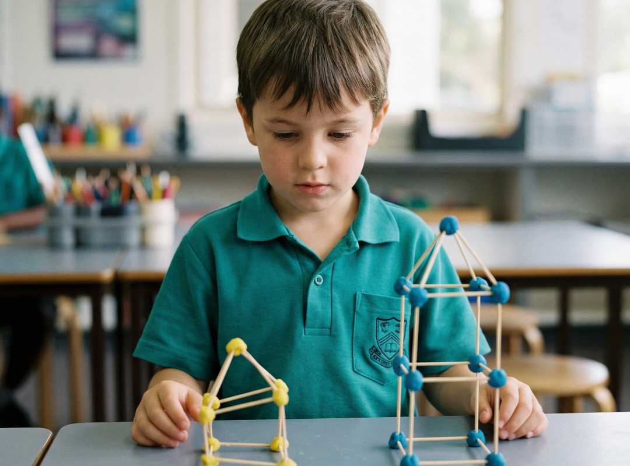
In the next lesson, we will learn that improvement helps us believe we can succeed.

