Slide 1
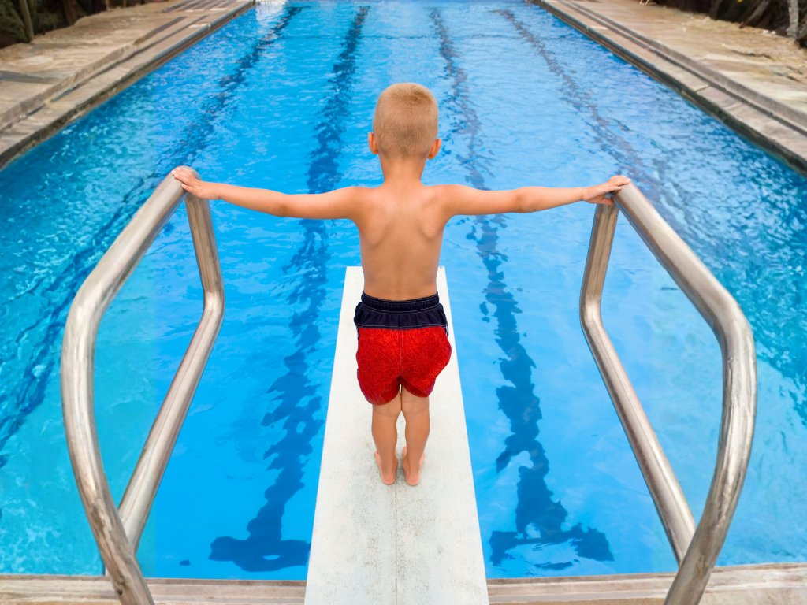
The Goal is Possible
Unit 3 Achieving Goals
Lesson 1

Slide 2

In this lesson, we will learn that belief helps people start something new even when it feels difficult.

Slide 3

You will be successful when you can:
select a thought that shows belief about starting
complete sentences to show what people believed and what that made them start doing.

Slide 4

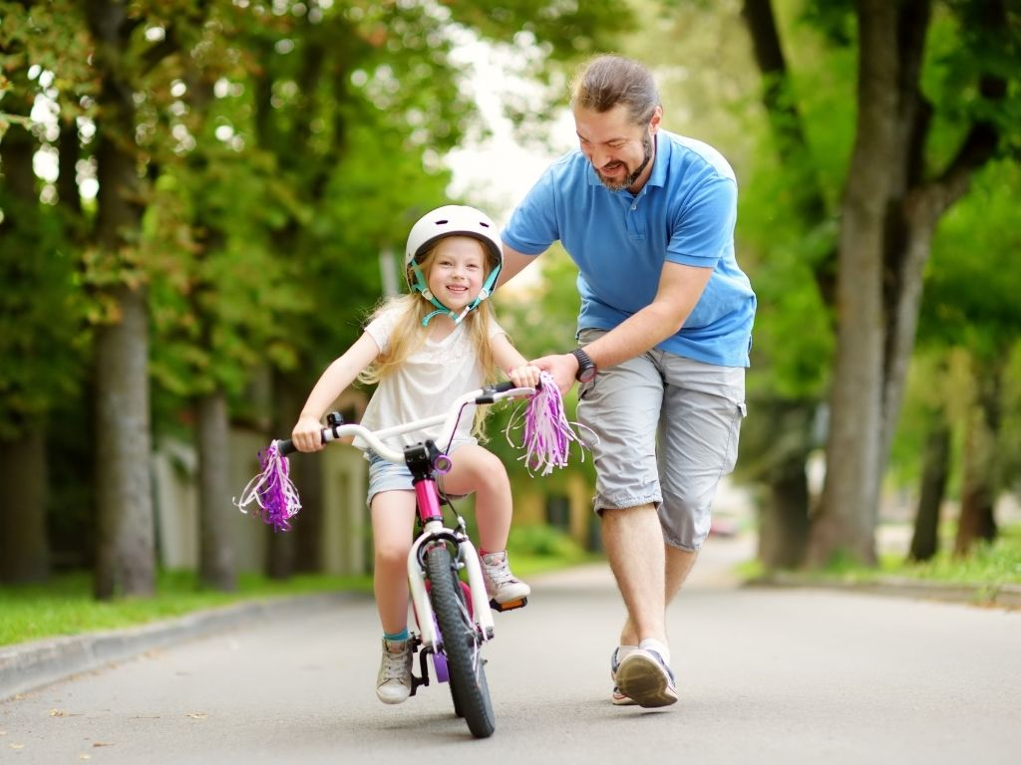


Slide 5
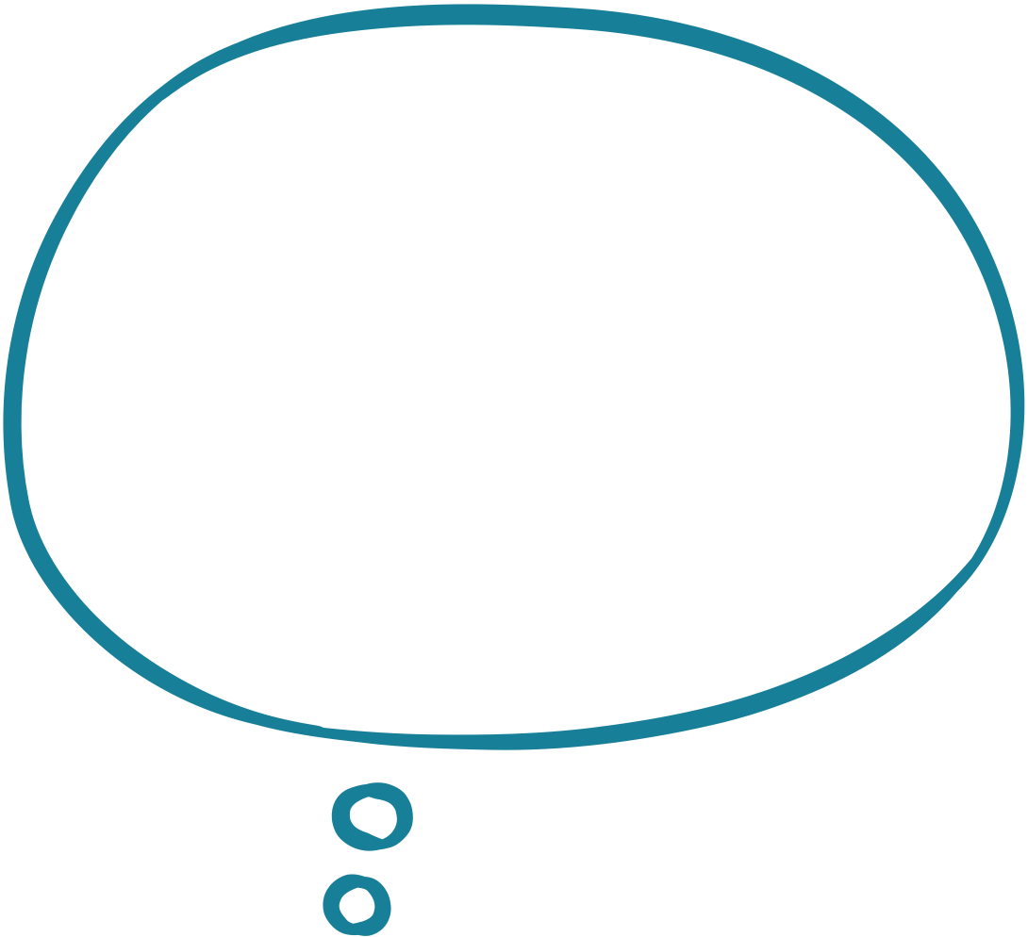
Belief is deciding that a goal is possible and choosing to start.
I can do this if I keep at it.
It’s hard now but I will learn.
If I put the work in, I will succeed.

Slide 6
Belief
Which of these thoughts shows belief?
I will wait until someone shows me exactly what to do.
I will try, even though I am not very good at it yet.
I will never be able to do this.

Slide 7
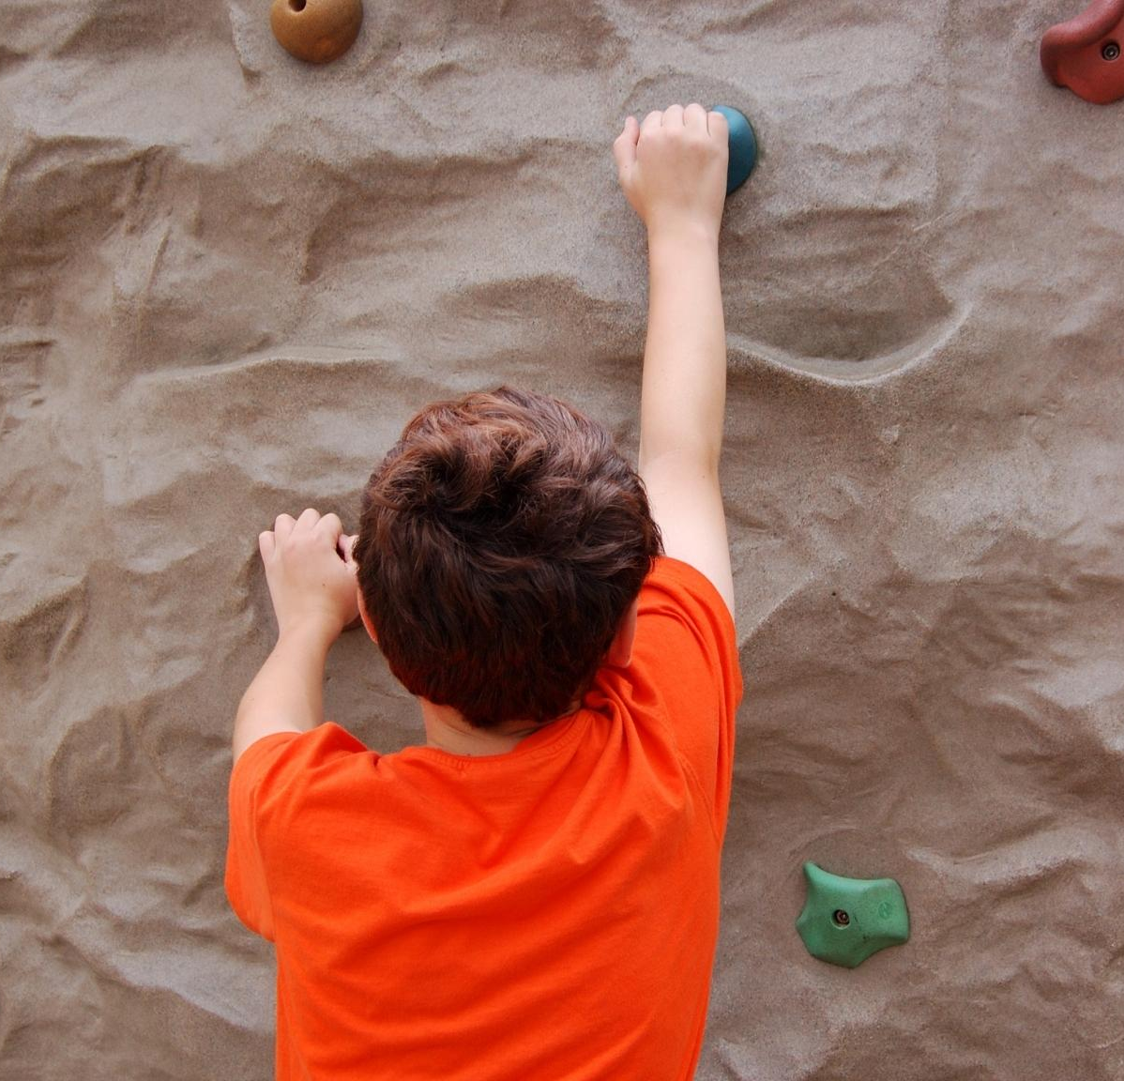
Belief
Which of these thoughts shows belief?
I might not get it right, but I will start.
I will only try if I know I can do it perfectly.
I will wait until it feels easy.

Slide 8

Belief
Belief means:
waiting until something feels easy
deciding something is possible and choosing to start
already knowing how to do something.

Slide 9

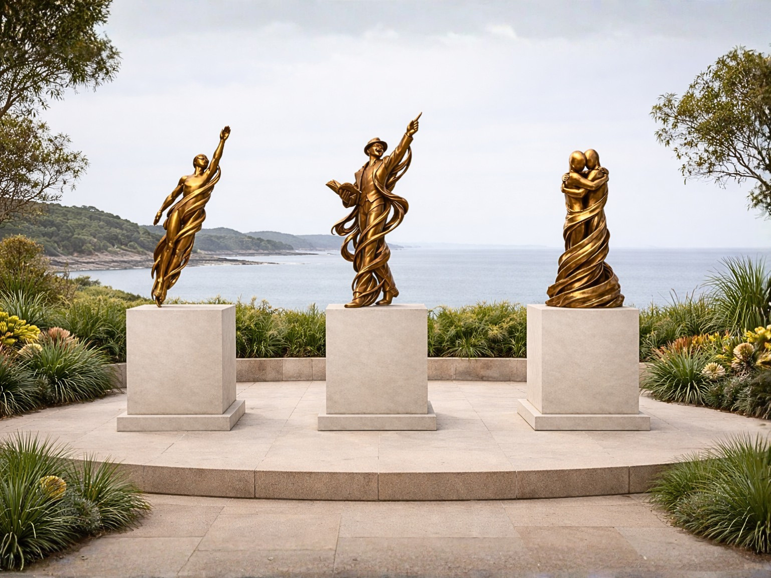


Slide 10

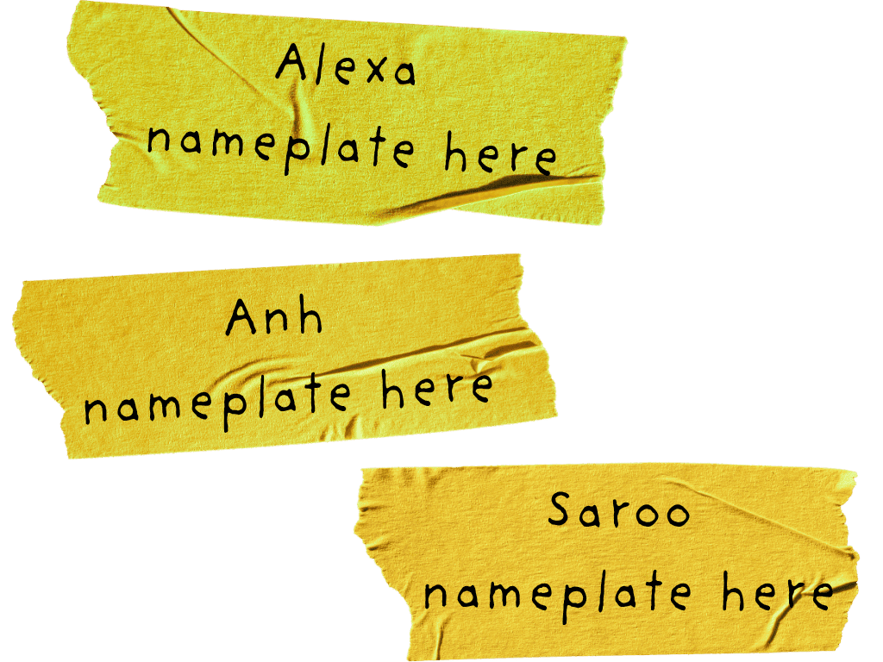



Slide 12
Alexa believed she could _________ even though __________. This made her start __________.

Slide 14
Anh believed he could _________ even though __________.
This made him start __________.

Slide 16
Saroo believed he could _________ even though __________.
This made him start __________.

Slide 18

My Belief
I believed I could _________ even though __________.
This made me start __________.
I can learn the times tables. I just need to spend time memorising them.

Slide 19

Our Belief
I believed I could _________ even though __________.
This made me start __________.

Slide 20
Your Belief
I believed I could _________ even though __________.
This made me start __________.

Slide 21
Belief is deciding that a goal is possible and choosing to start working towards it.
People start before they are good at something.
Starting is the first step in learning and improving.

Slide 22



How well did you:
select a thought that shows belief about starting
complete sentences to show what people believed and what that made them start doing?

Slide 23
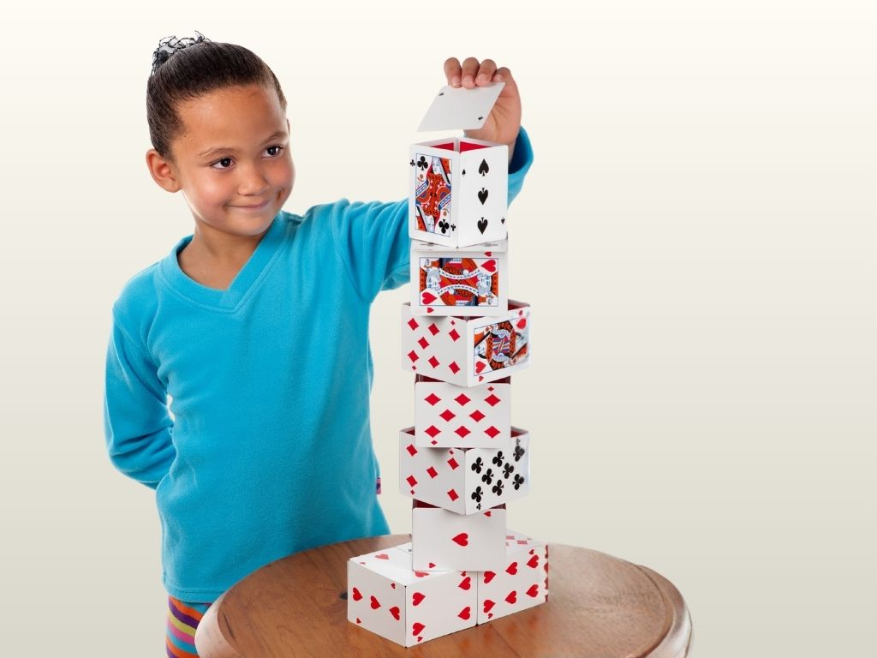
In the next lesson we will learn that effort over time helps people improve.

