Slide 1

Small Steps Repeated
Unit 3 Achieving Goals
Lesson 2

Slide 2

Belief is deciding that a goal is possible and choosing to start working towards it.
I will try, even though I am not very good at it yet.

Slide 3

People start before they are good at something.
I can learn the times tables. I just need to spend time memorising them.

Slide 4

I believed I could _________ even though __________.
This made me start __________.

Slide 5
In this lesson, we will learn that effort over time helps people improve.

Slide 6
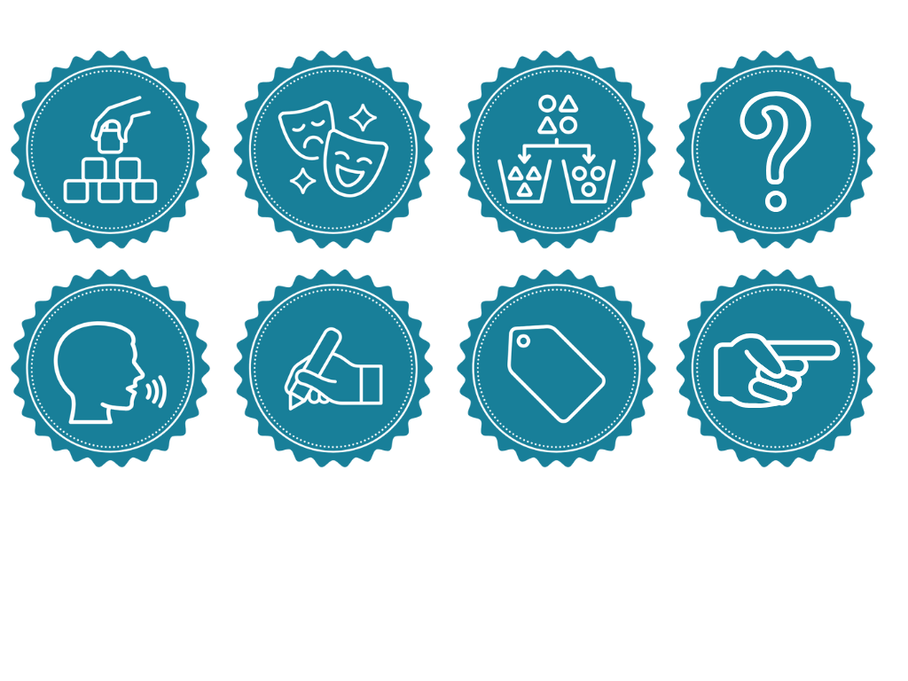
You will be successful when you can:
identify when an action is repeated over time
repeat a difficult action to practise it.

Slide 7
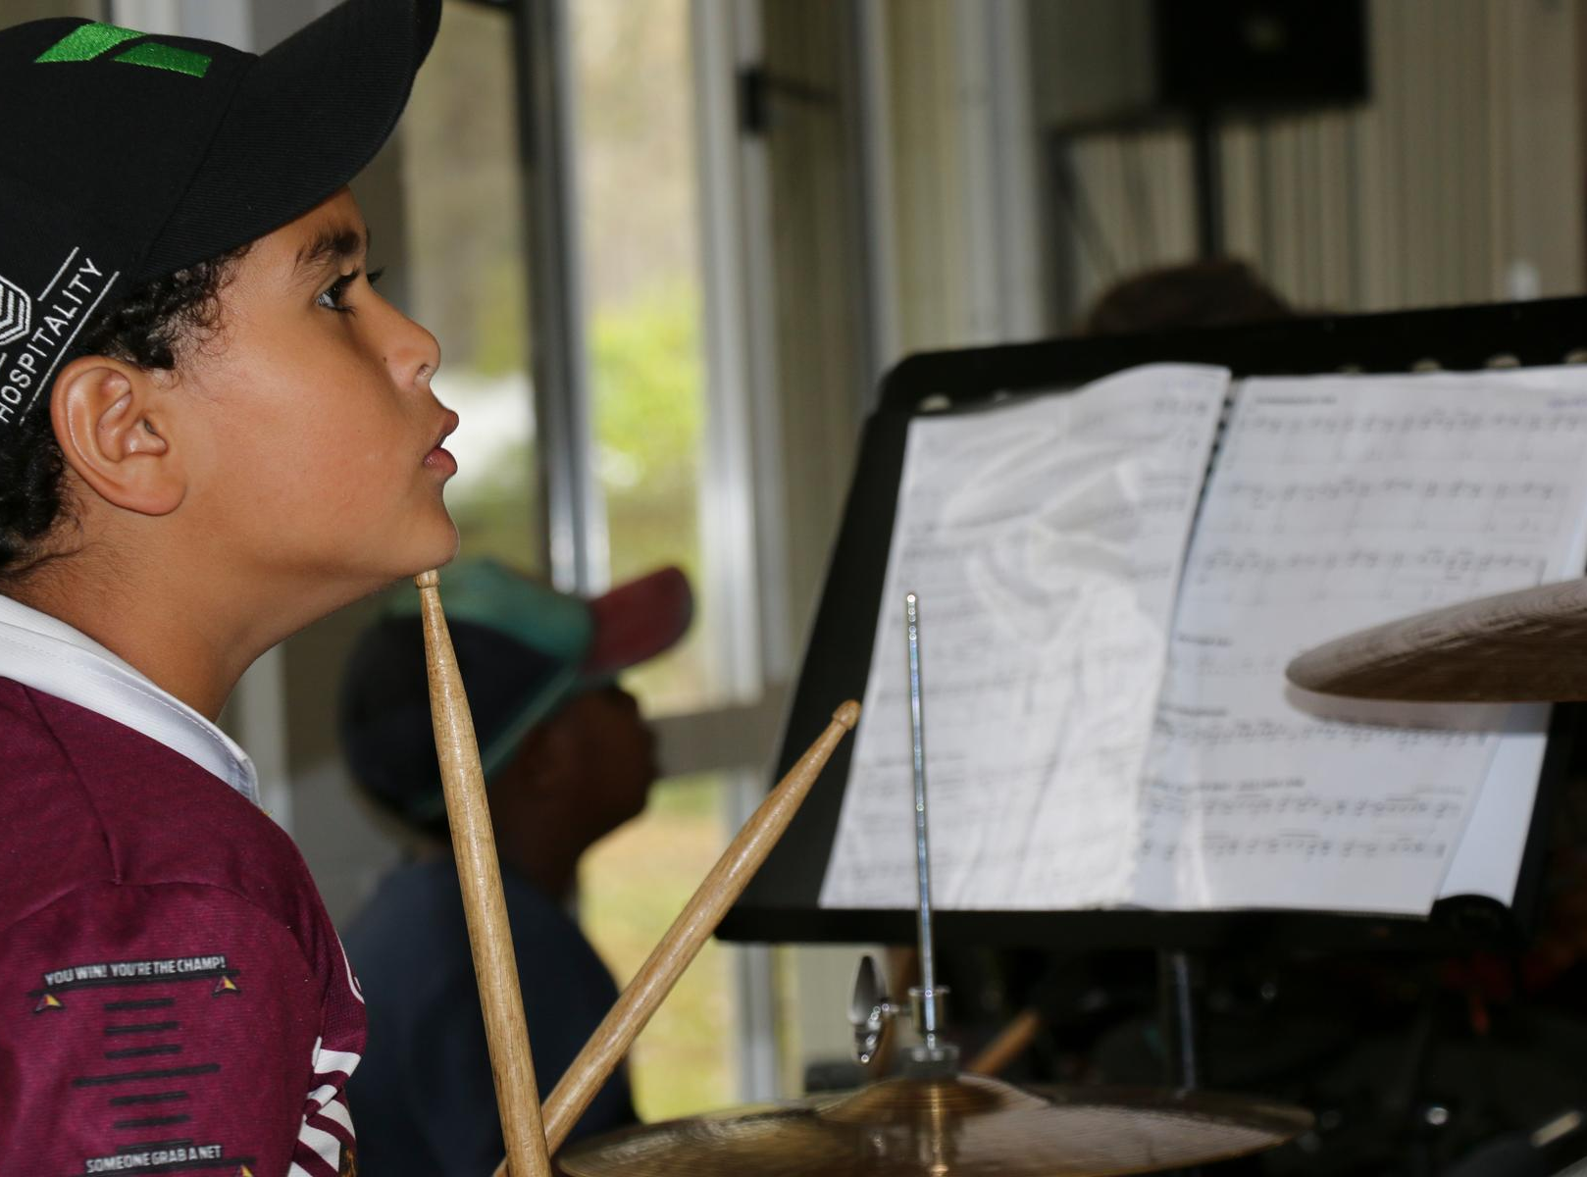
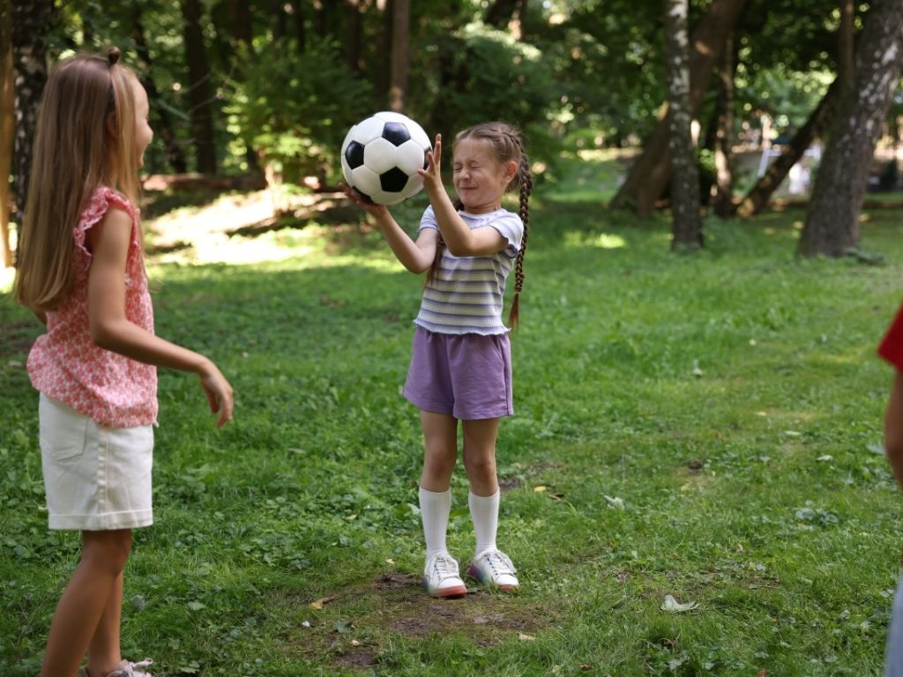

Slide 8

Time
Time means choosing how to spend your moments wisely.

Slide 9
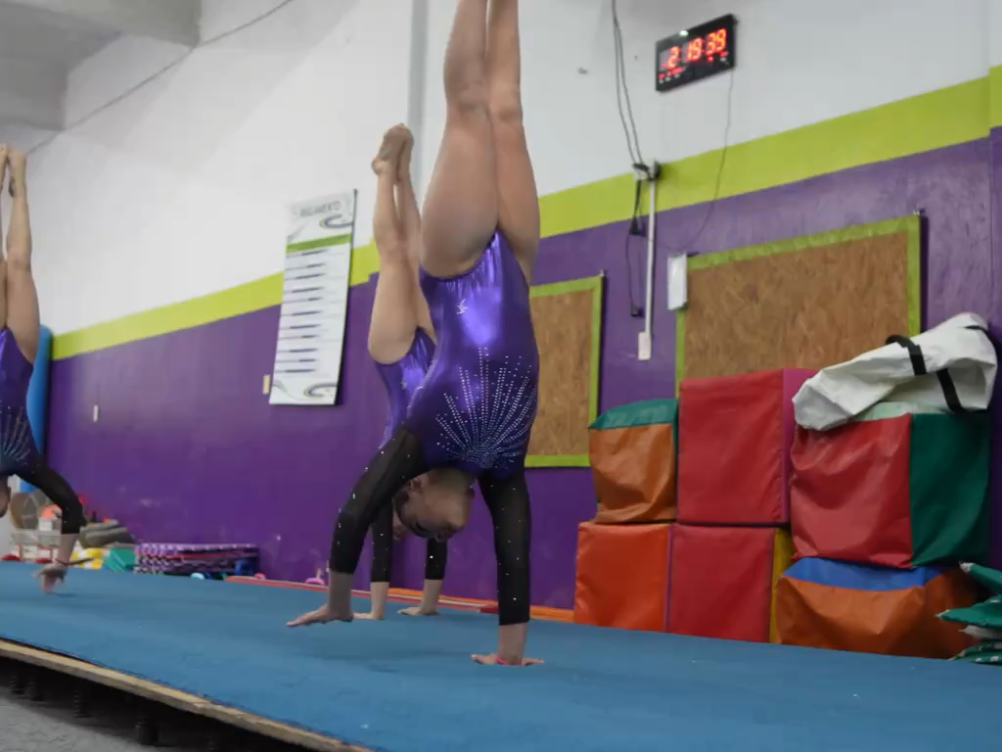
Effort
Effort is the energy and hard work you put into learning or improving something.

Slide 10
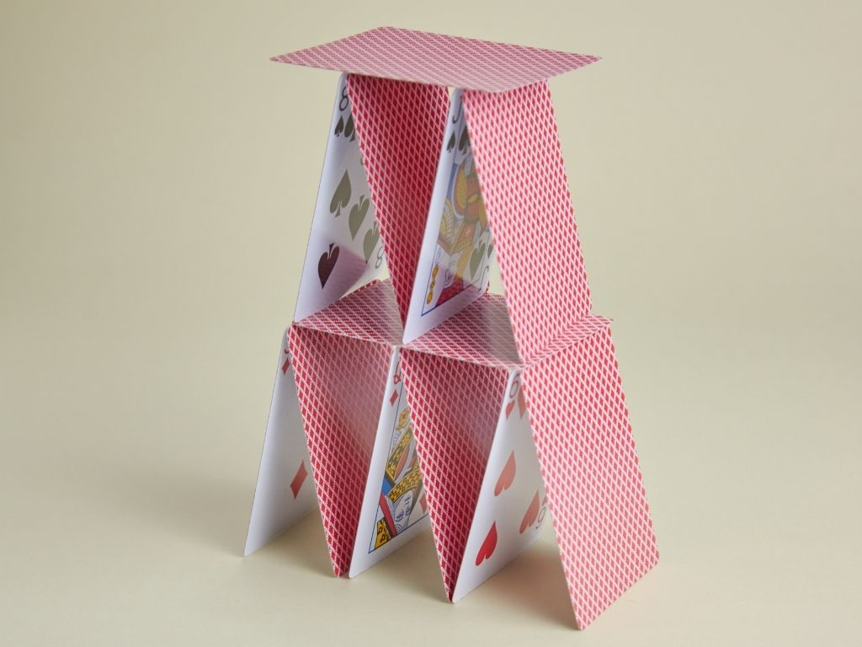
Time and Effort

Slide 11

Time and Effort
Time: What would you do again and again when building the tower?
Effort: What would you do when the tower keeps falling, and you feel frustrated?

Slide 12

Belief
When someone improves over time, they are:
waiting until something feels easy
repeating an action and trying again when it is difficult.
doing something once and stopping

Slide 13
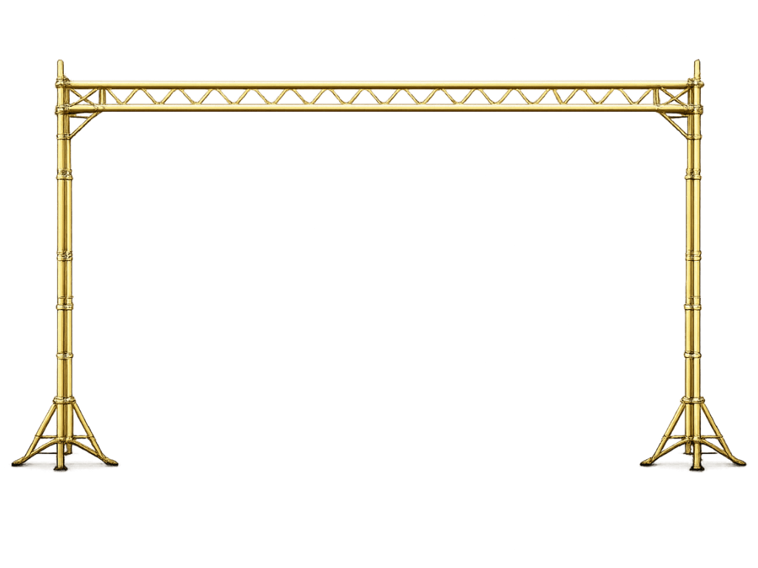
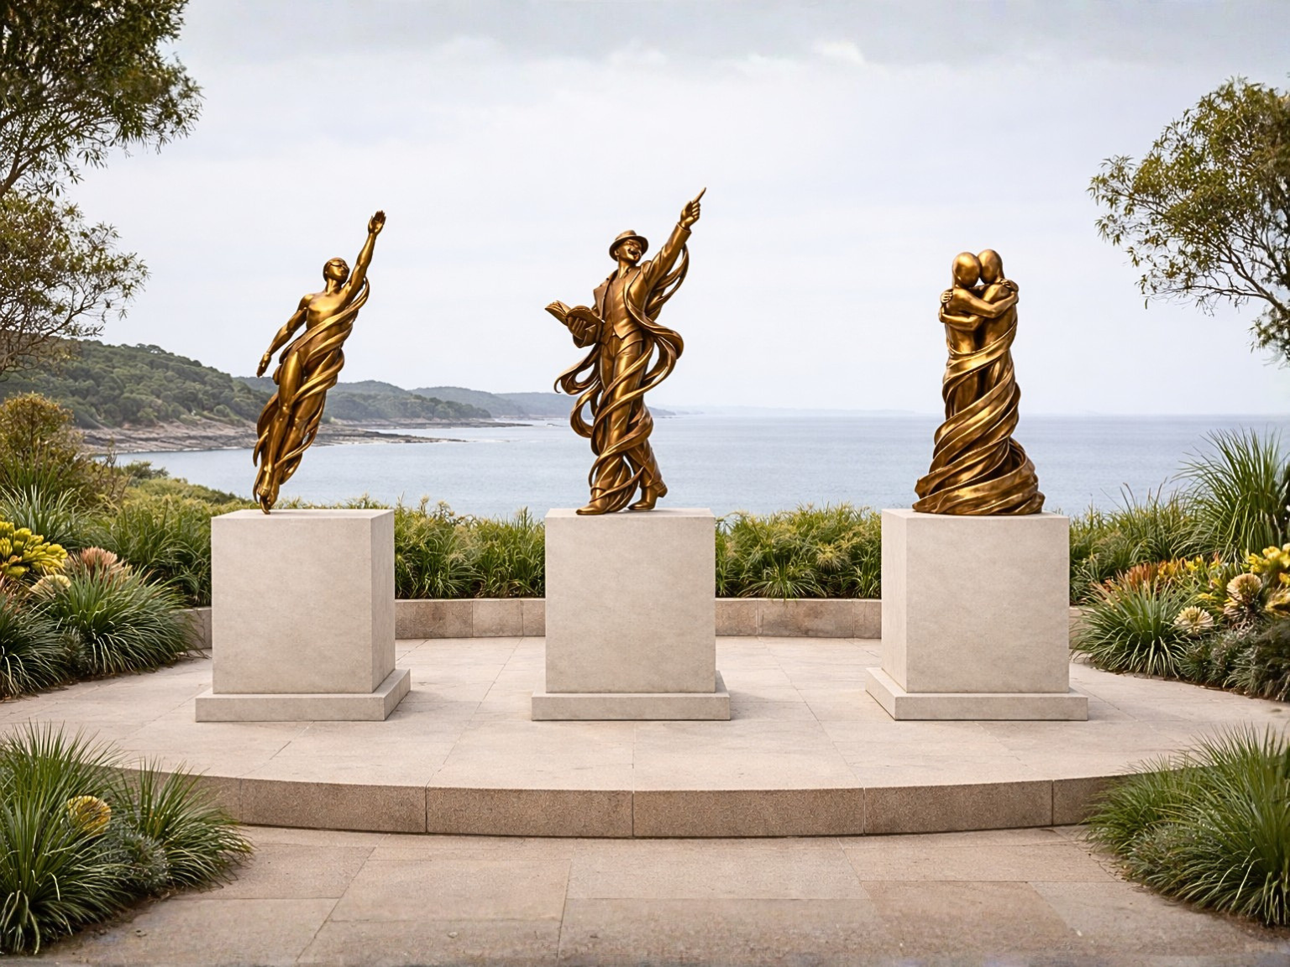

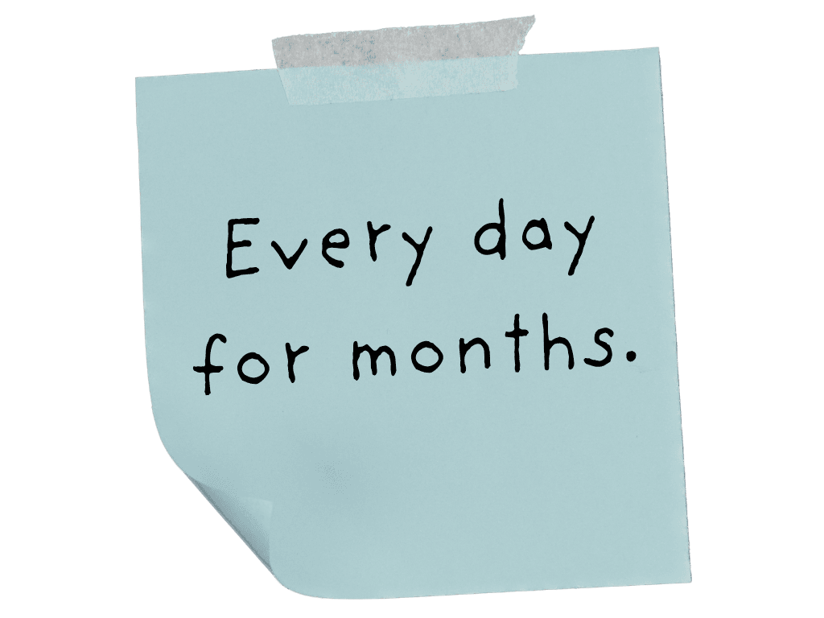
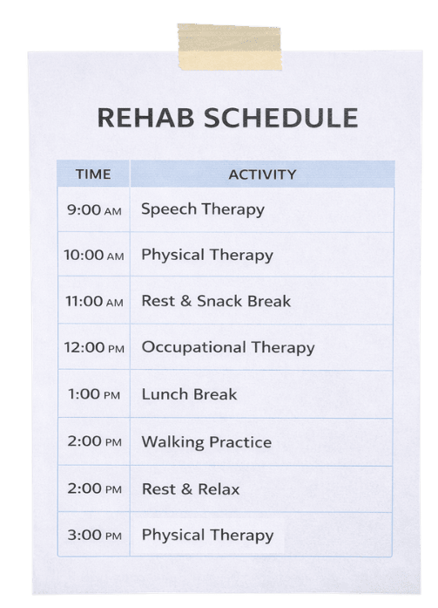
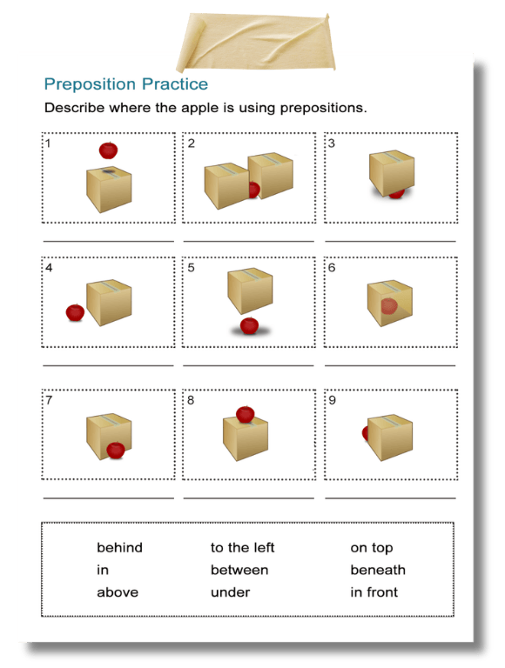
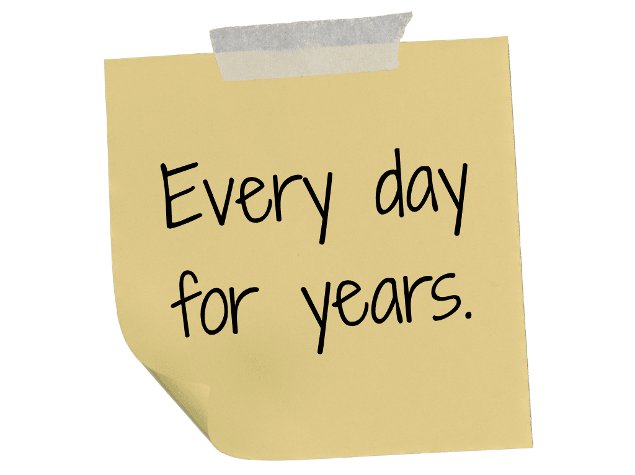
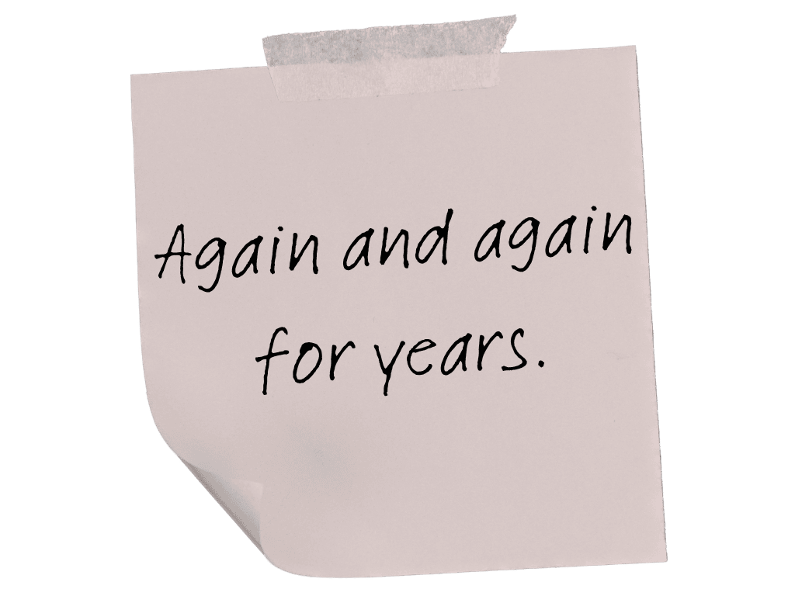


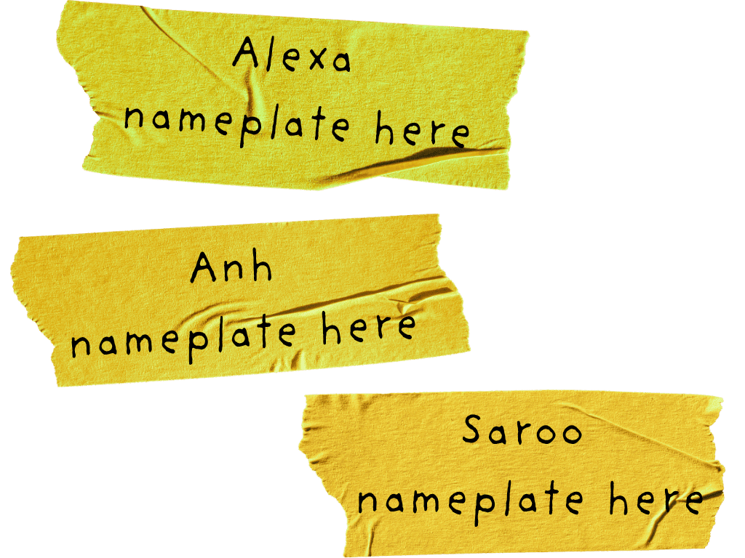

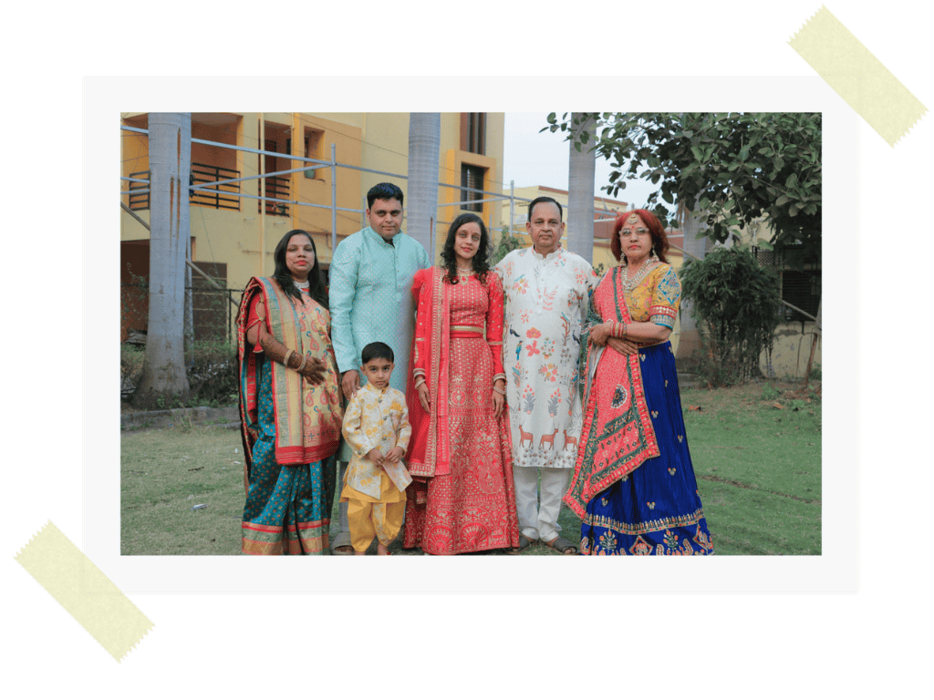

Slide 15
Which action did Alexa repeat over time?
What might she have done when it was difficult?

Slide 17
Which action did Anh repeat over time?
What might he have done when it was difficult?

Slide 19
Which action did Saroo repeat over time?
What might he have done when it was difficult?

Slide 21
My Time and Effort

Slide 22
Our Time and Effort
What are we doing again and again?
What are we doing when our tower falls?

Slide 23

Repeating an action again and again over time helps people improve.
Using effort means continuing, even when something is difficult.
Using time and effort helps people get closer to their goals.

Slide 24

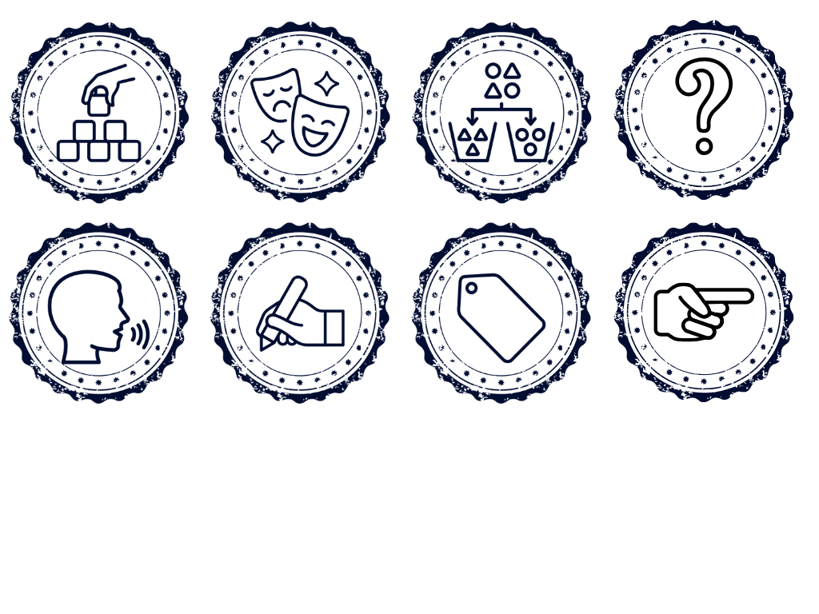

How well did you:
identify when an action is repeated over time
repeat a difficult action to practise it?

Slide 25
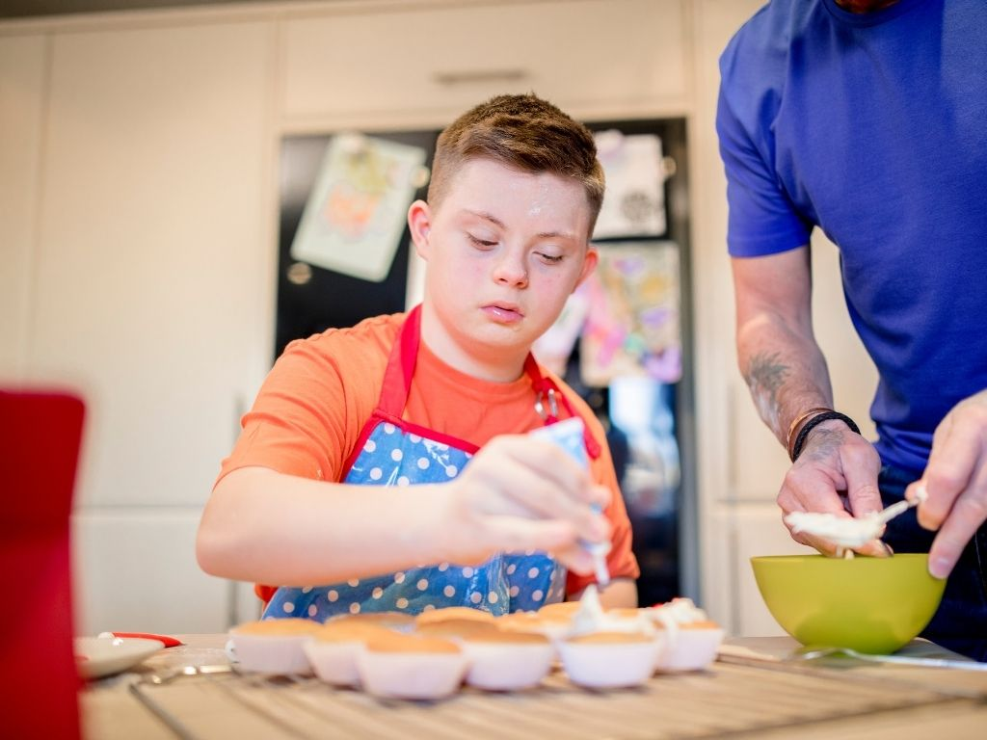
In the next lesson we will learn that effort leads to progress and builds stronger belief.

