Slide 1

Belief: The Decision to Start
Unit 3 Achieving Goals
Lesson 1

Slide 2
In this lesson, we will learn that belief helps people decide something is possible and choose to start, even when unsure.

Slide 3

You will be successful when you can:
explain what each nominee chose to believe was possible
identify what happens in the brain when someone decides to start something new.

Slide 4
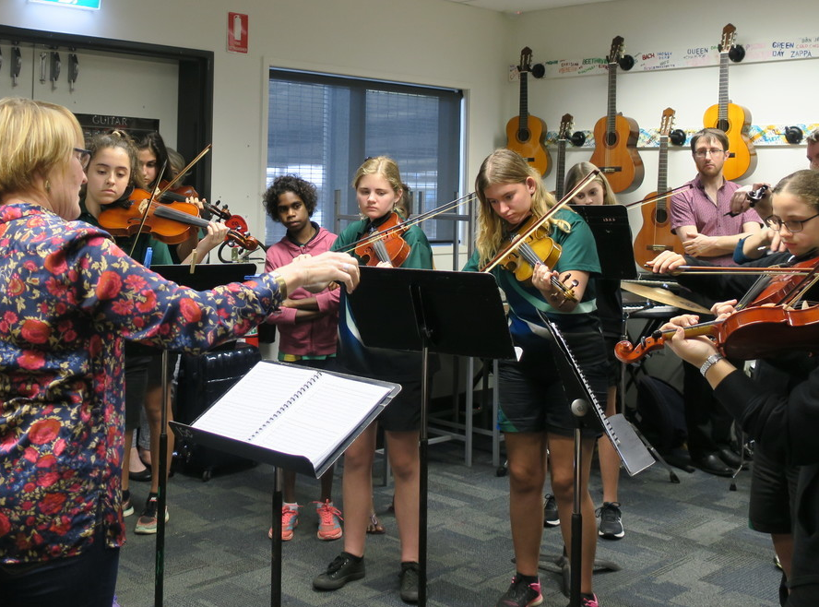
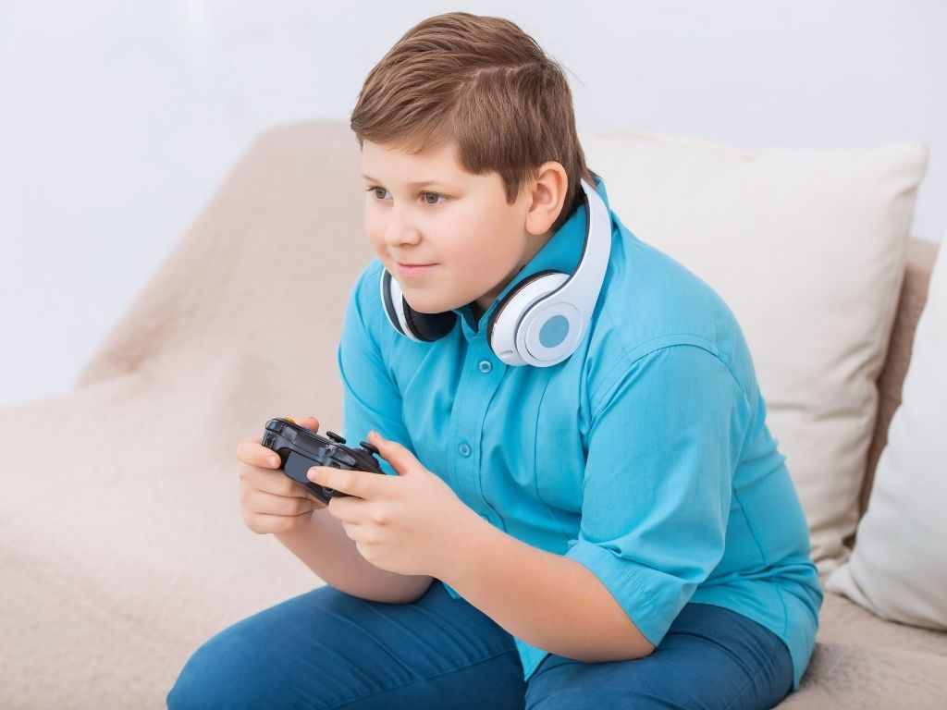
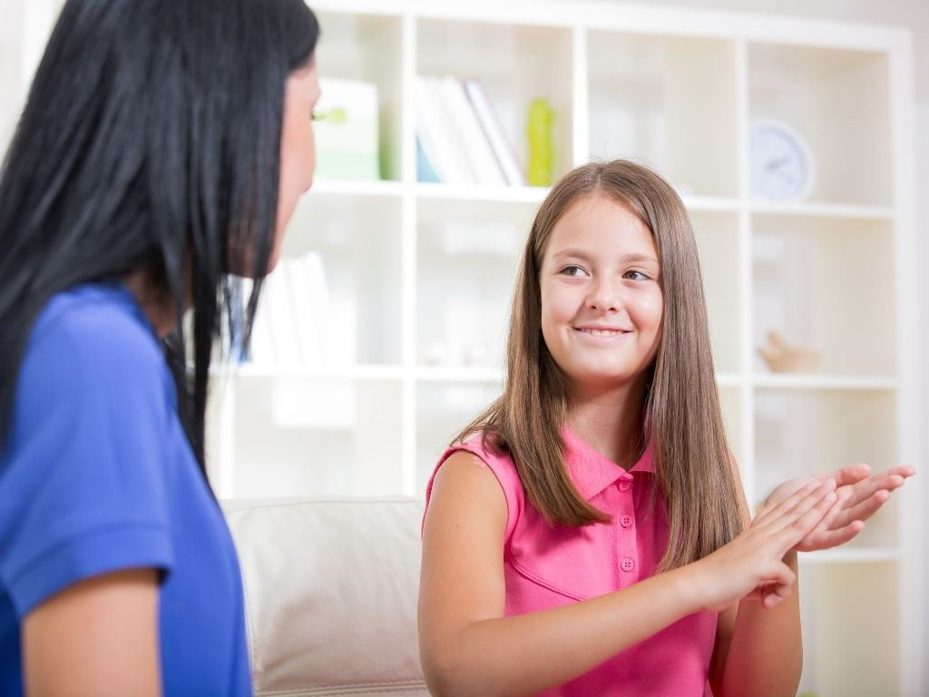

Slide 5
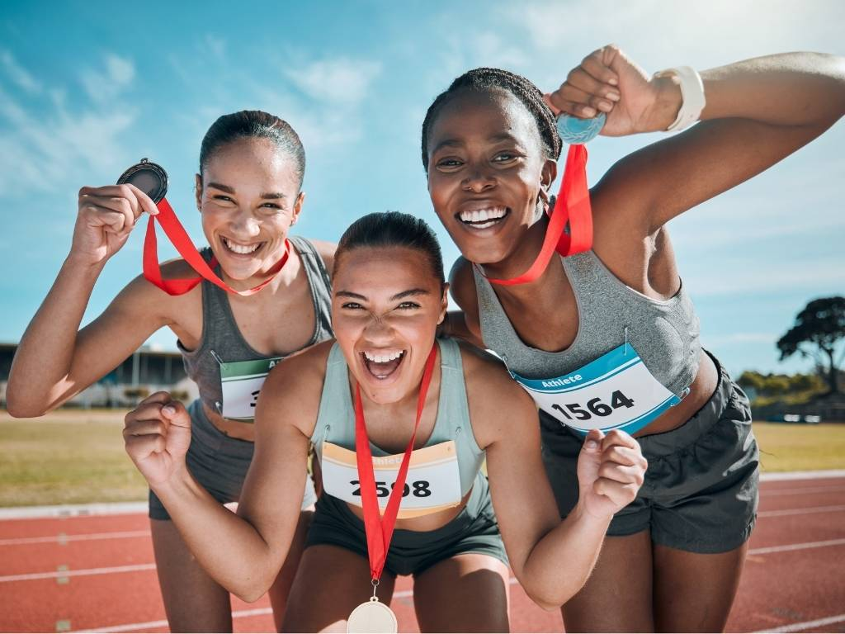

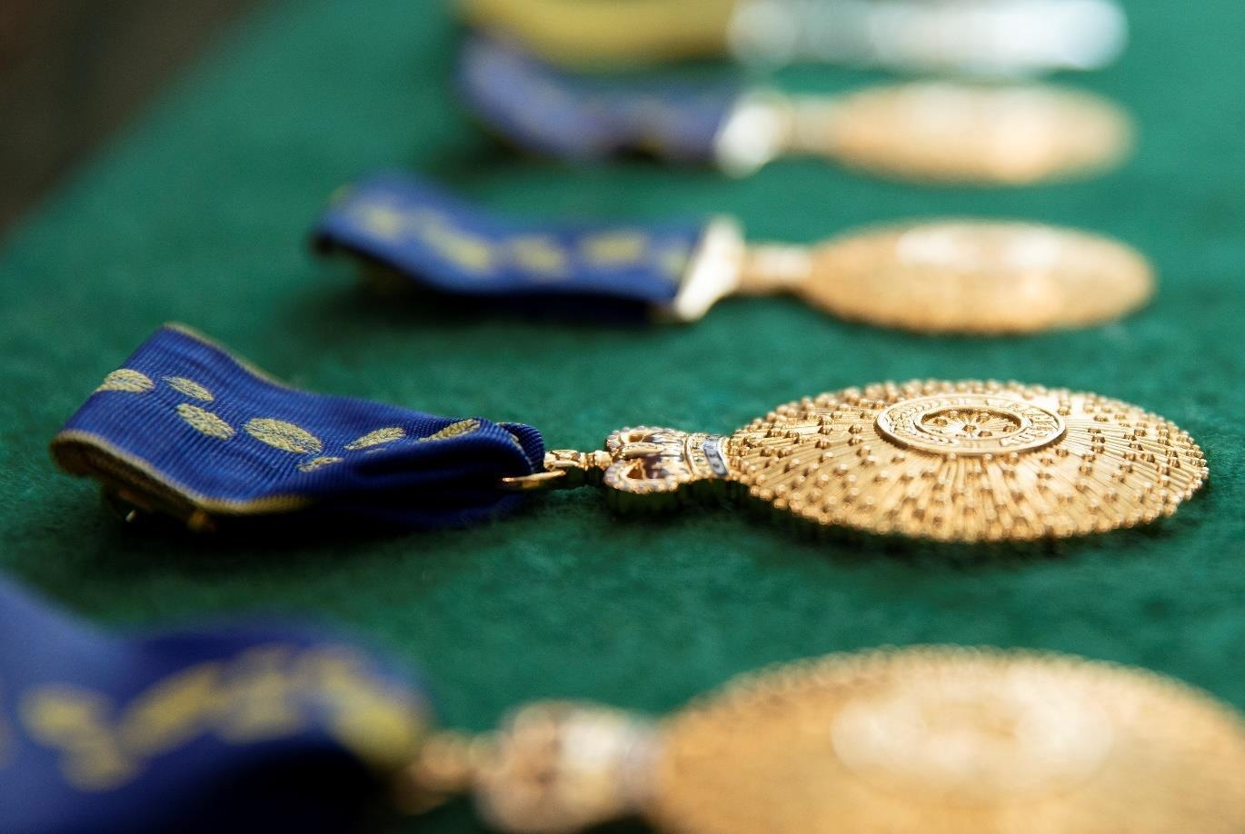
Special Awards

Slide 6

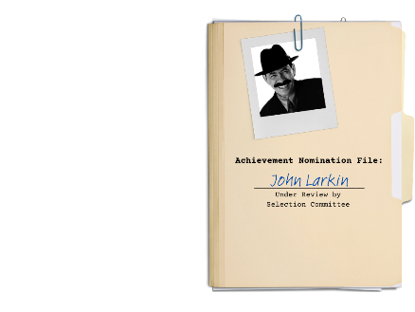



Slide 7

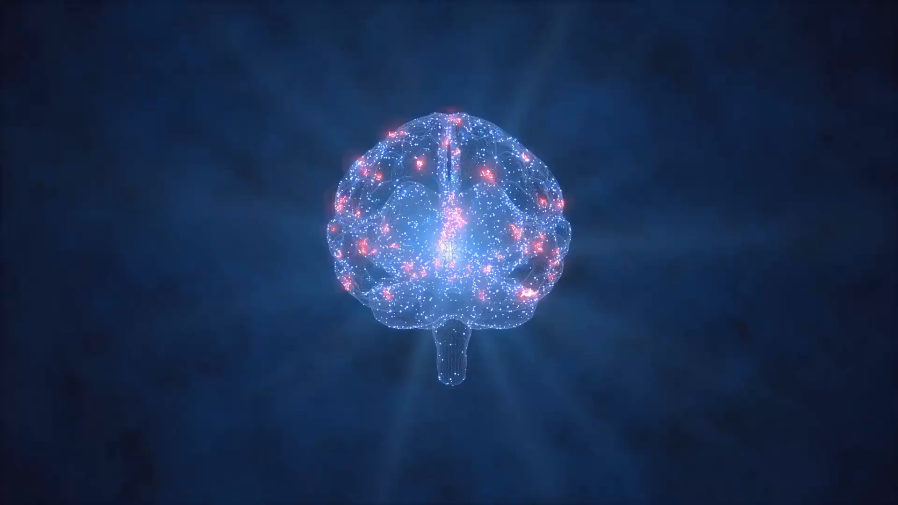
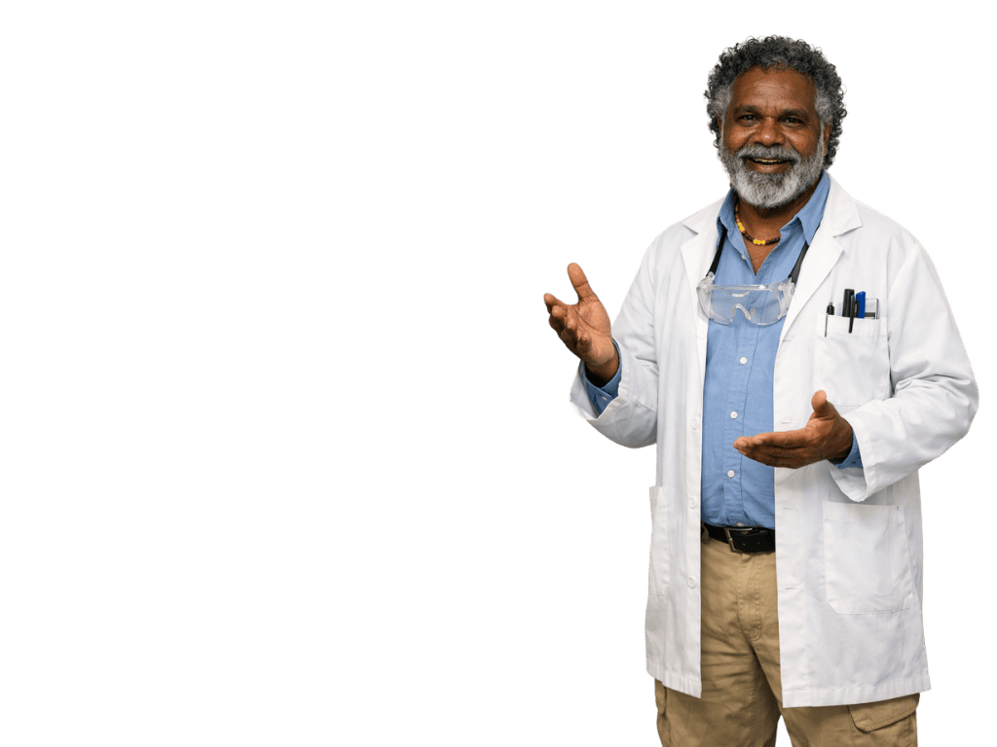
Belief is deciding that a goal is possible and choosing to start working towards it.
When we try something new, the brain begins building a new pathway.
Neuroplasticity: the brain can grow and change.

Slide 8

Belief
Belief means:
waiting until something feels easy
deciding something is possible and choosing to start
already knowing how to do something.

Slide 10
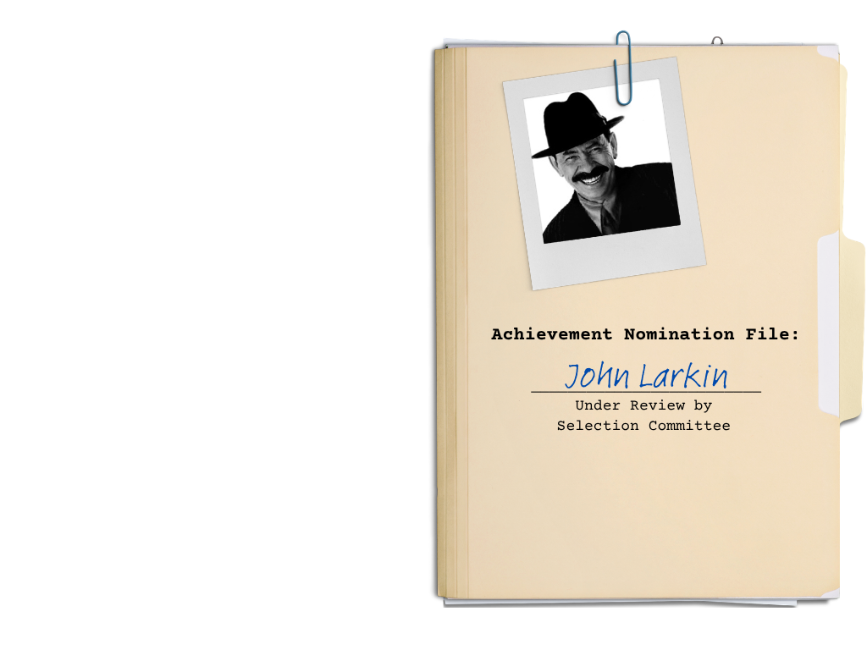



Slide 12


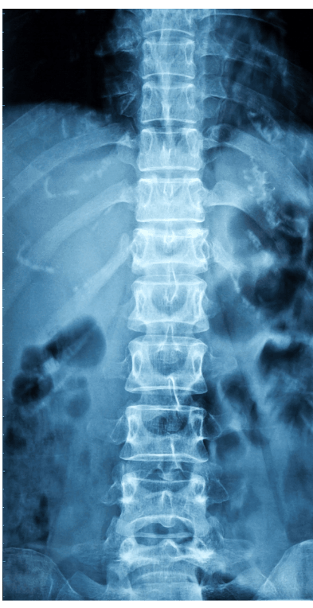
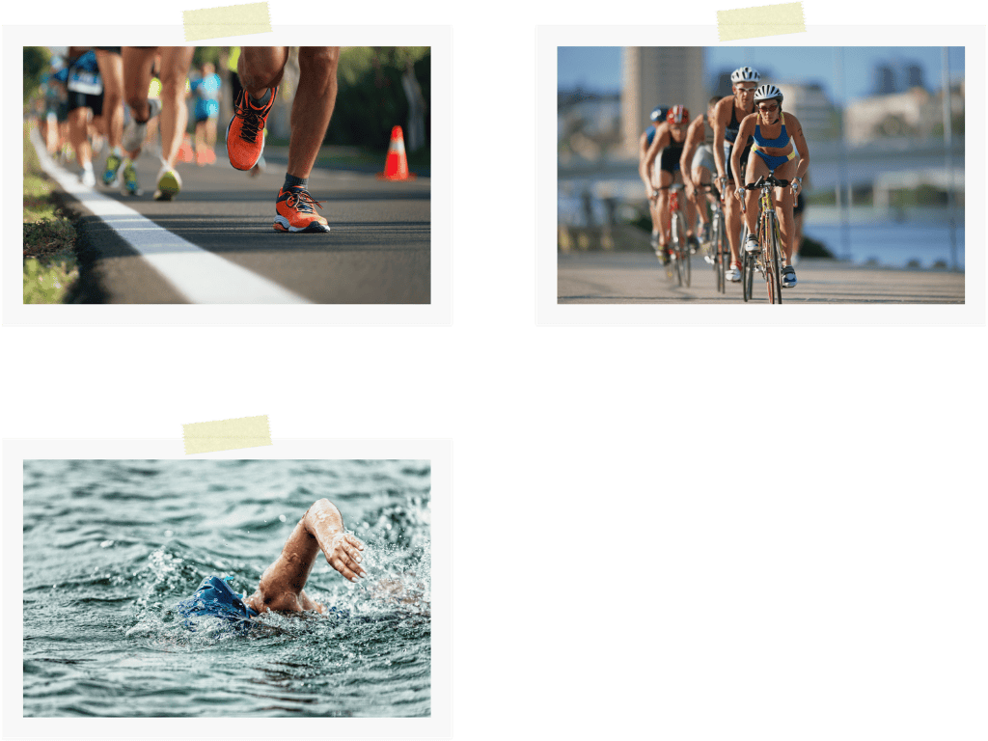
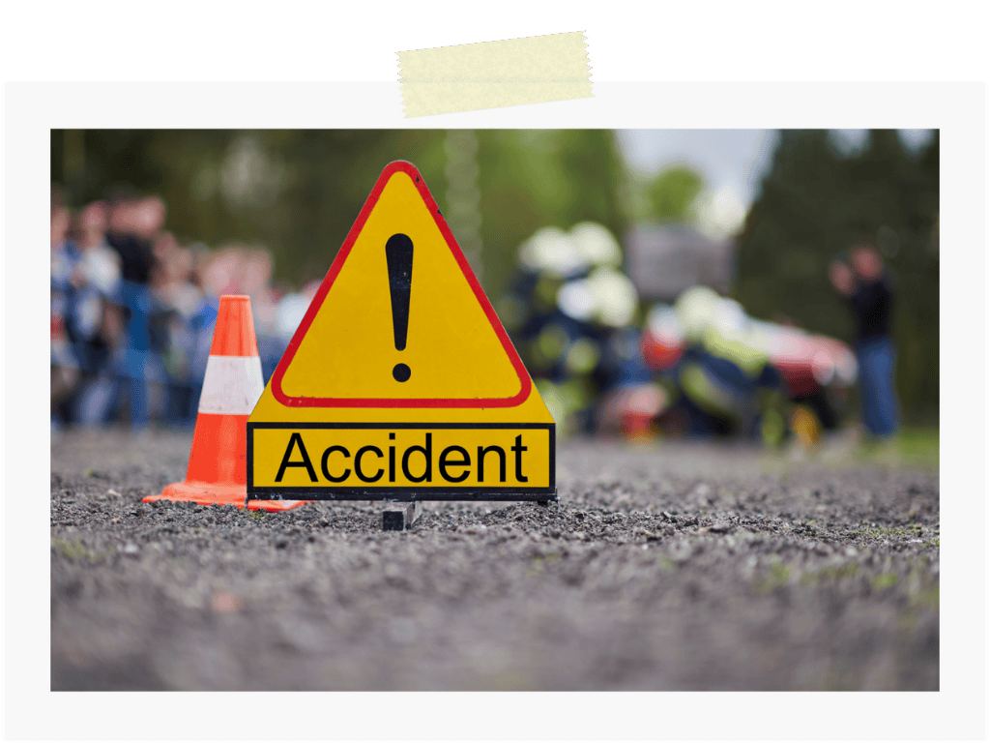

Slide 15
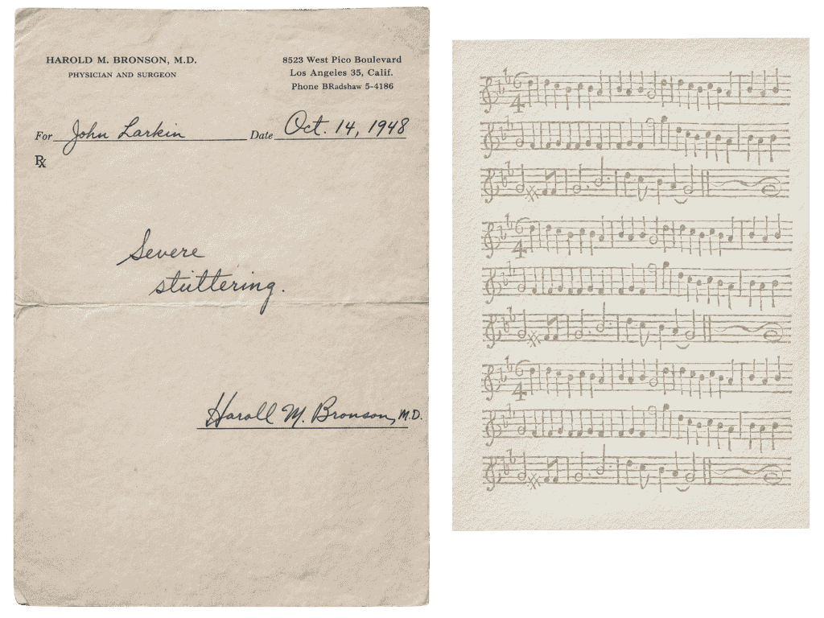

Slide 18
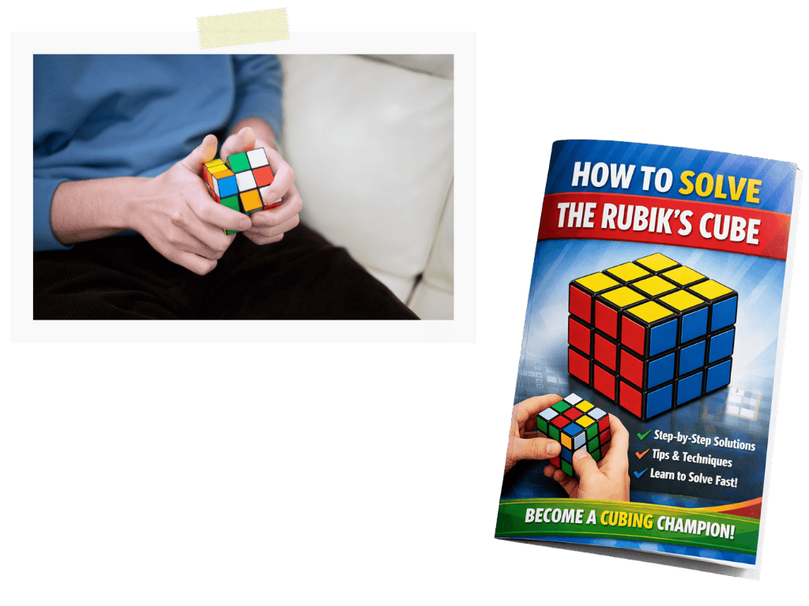

Slide 22
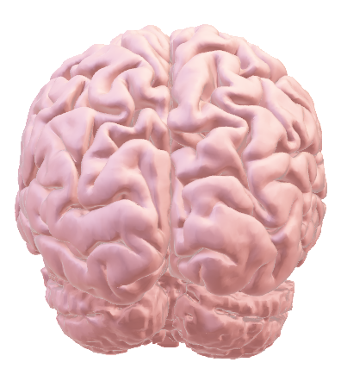
Belief is deciding that a goal is possible and choosing to start working towards it.
People often start when they are unsure or find something difficult.
The brain can grow and change. This is called neuroplasticity.
Trying something new builds new pathways in the brain.
Choosing to start something new allows the brain to begin building new pathways.

Slide 23
Belief is deciding that a goal is possible and choosing to start working towards it.
What is a goal you once decided was possible for you?
What happened in your brain when you chose to start working towards it?

Slide 24
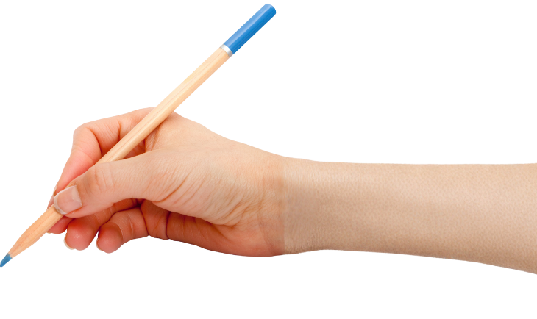


How well did you:
explain what each nominee chose to believe was possible
identify what happens in the brain when someone decides to start something new?

Slide 25
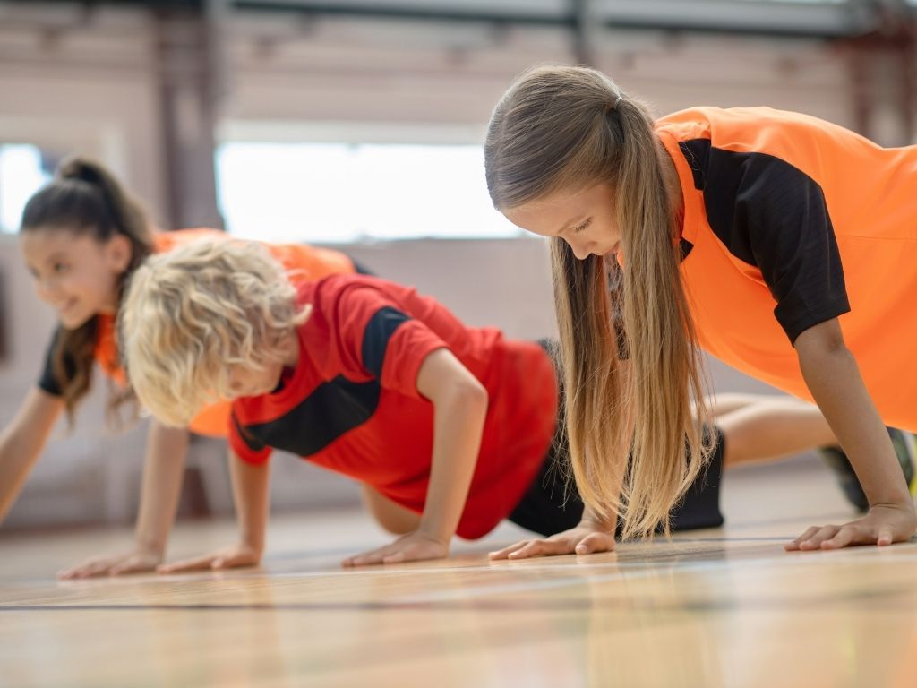
In the next lesson, we will learn that time and effort involve repeated and deliberate practise over time.

Slide 26
Attributions
Slide 5 Photo: Photo: Orders of Australia on a table by Office of the Official Secretary to the Governor-General, from Wikimedia Commons, CC BY 3.0, https://commons.wikimedia.org/wiki/File:Orders_of_Australia_on_a_table.jpg
Slides 6, 9, 10, 11, 13, 14, 16, 20, 21 Photo 1: Lauren Parker by Australian Paralympic Committee, from Wikimedia Commons, CC BY-SA 3.0, https://commons.wikimedia.org/wiki/File:Parker_Lauren_01_CC.jpg
Slides 6, 9, 10, 14, 16, 20, 21 Photo 2: Scatman John by RCA Records, from Wikimedia Commons, Fair use, https://en.wikipedia.org/wiki/File:Scatmanjohn.jpg
Slides 6, 9, 10, 20, 21 Photo 3 and Slides 17, 19 Photo: Feliks Zemdegs at the World Championships Oct 2011 by Lembasts at English Wikipedia, from Wikimedia Commons, CC BY-SA 3.0, https://commons.wikimedia.org/wiki/File:Feliks_Zemdegs_at_the_World_Championships_Oct_2011.jpg

