Slide 1
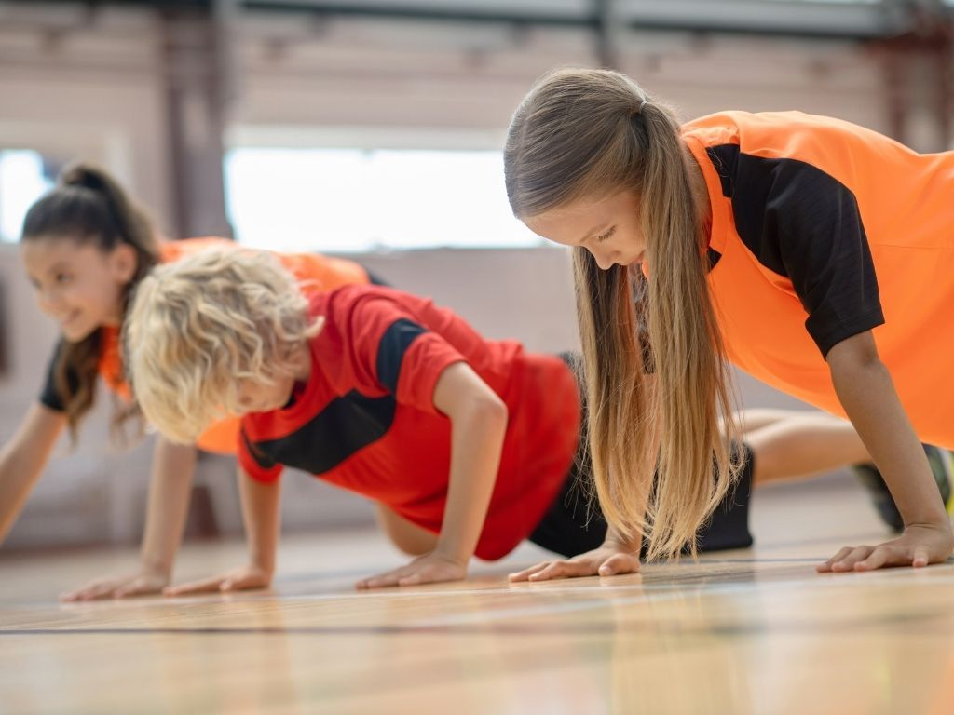
Building Strength Through Effort
Unit 3 Achieving Goals
Lesson 2

Slide 2
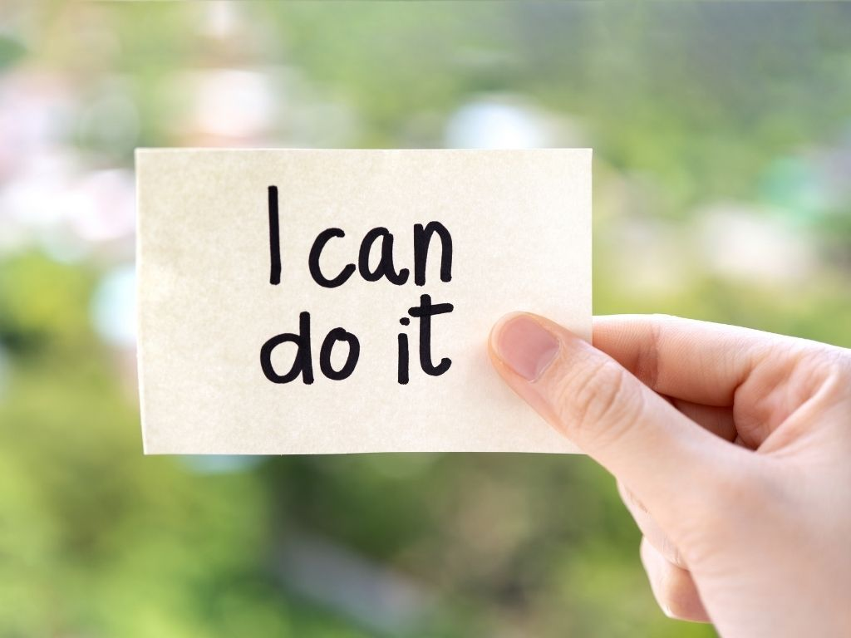
Belief is deciding that a goal is possible and choosing to start working towards it.

Slide 3
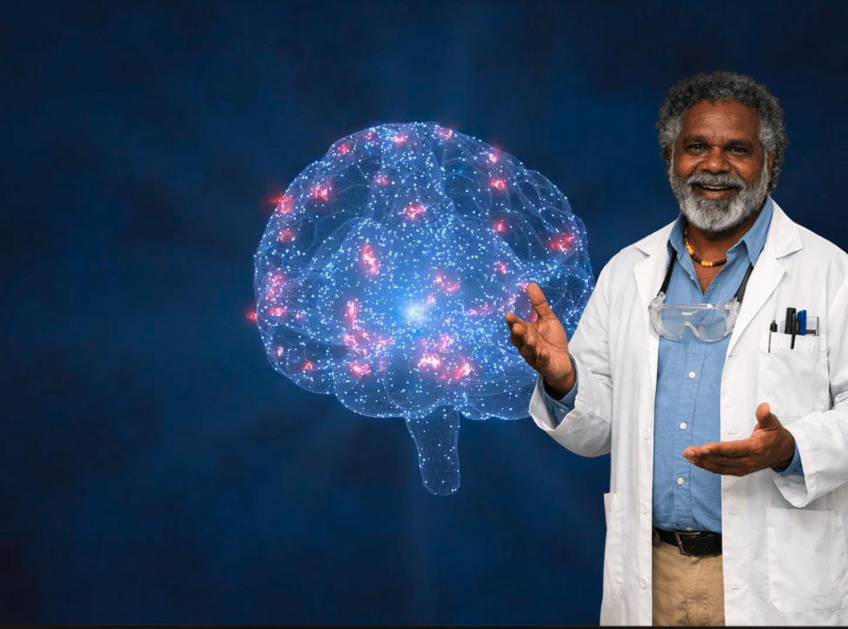
The brain can grow and change. This is called neuroplasticity.

Slide 4

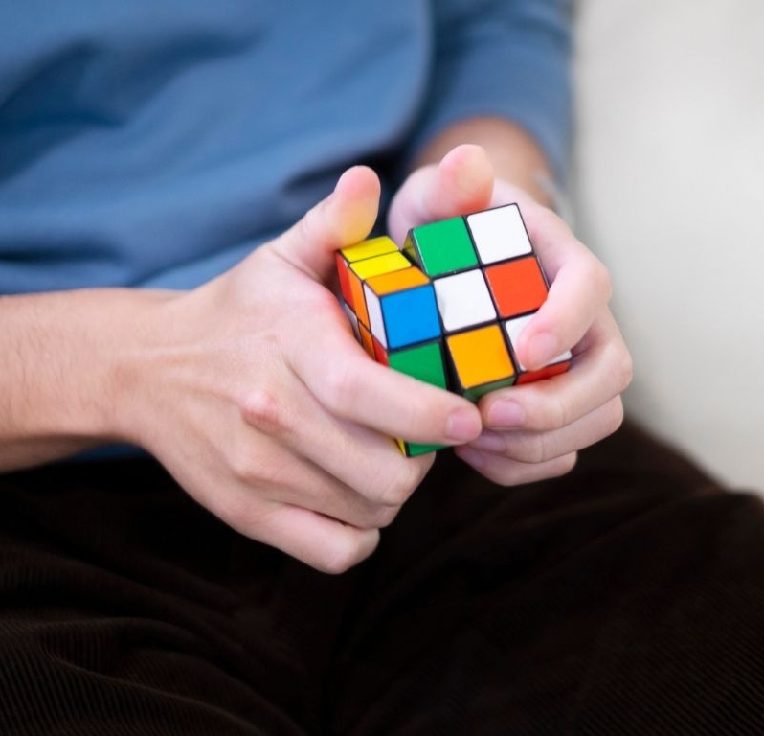
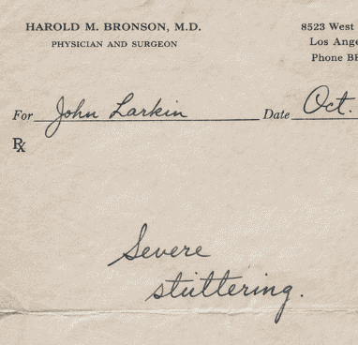
In the last lesson, what was one of the things someone believed?

Slide 5
In this lesson, we will learn that time and effort involve repeated and deliberate practise over time.

Slide 6

You will be successful when you can:
explain how each nominee used repeated effort over time
describe what happens in the brain when something is practised repeatedly.

Slide 7
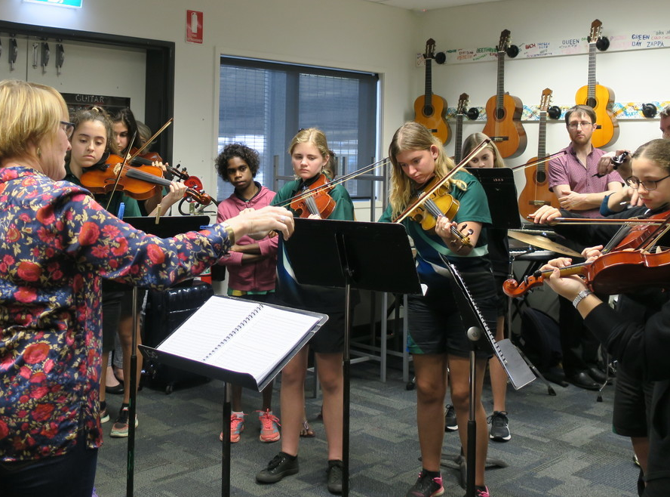
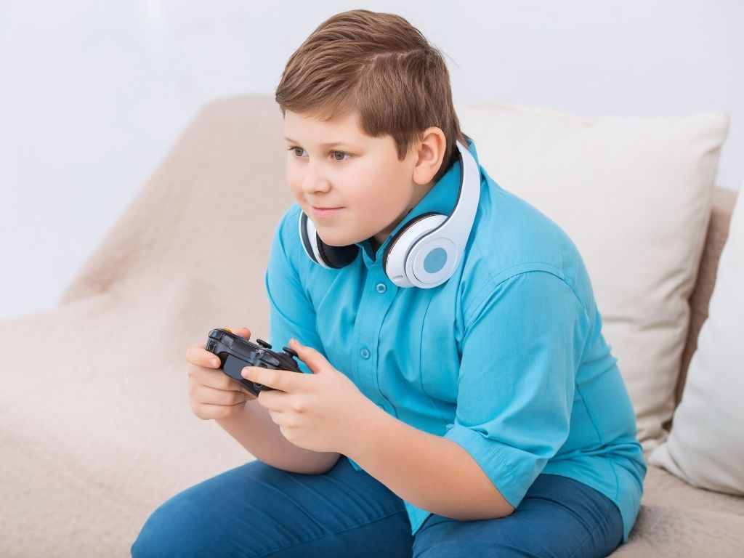
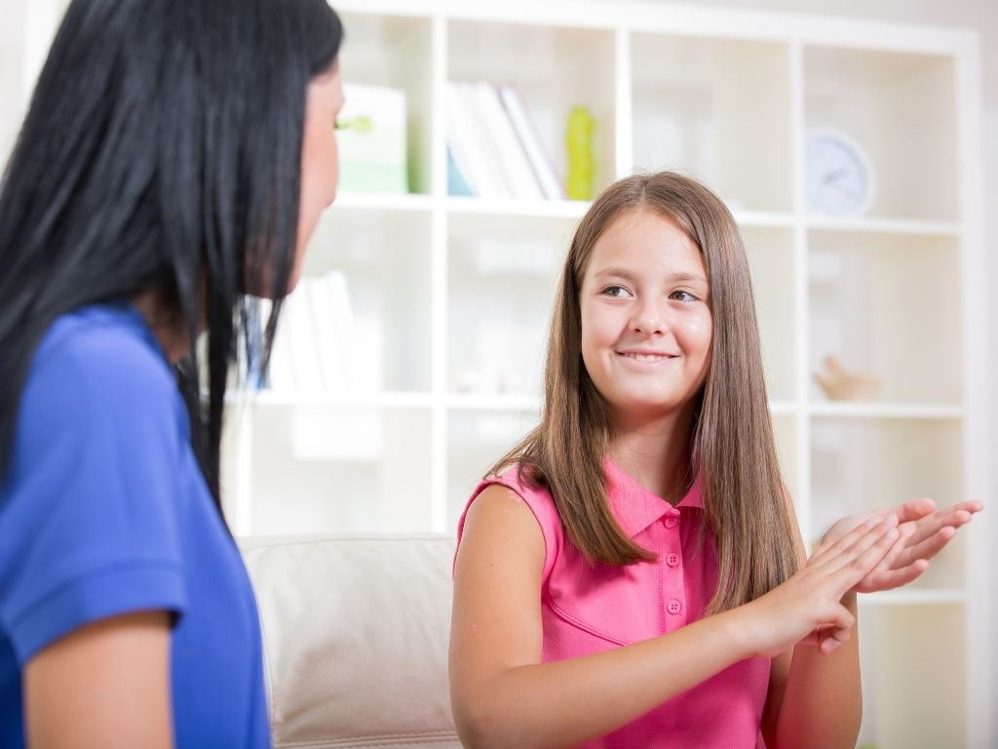

Slide 8
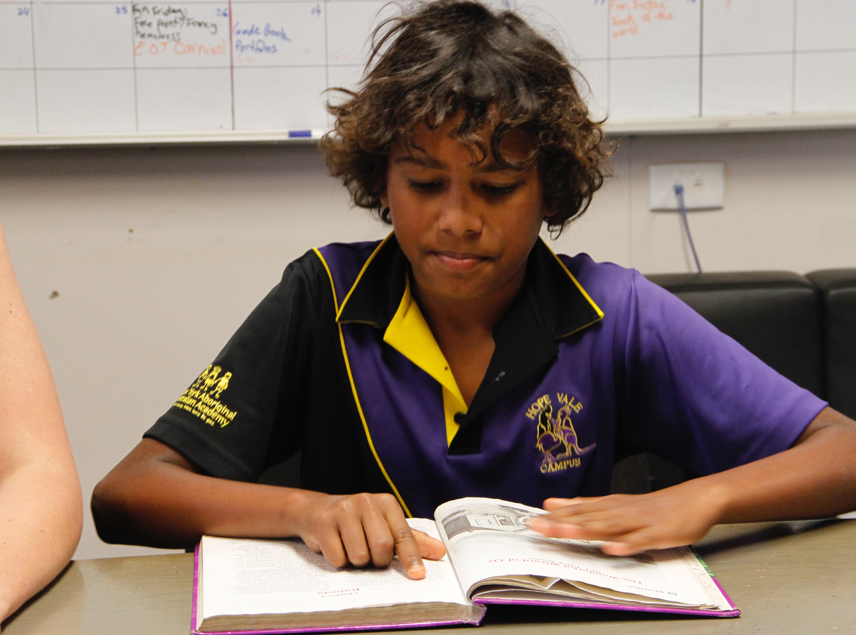
Time
Time means choosing how to spend your moments wisely.

Slide 9
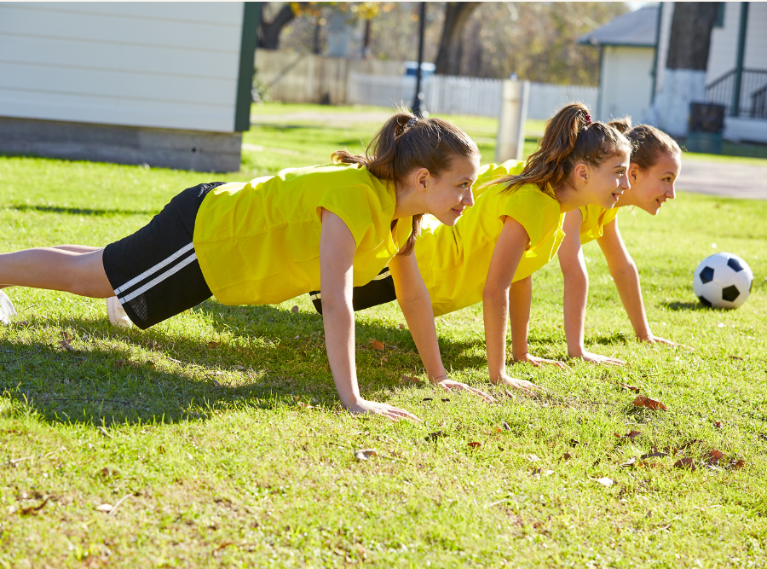
Effort
Effort is the energy and hard work you put into learning or improving something.

Slide 10

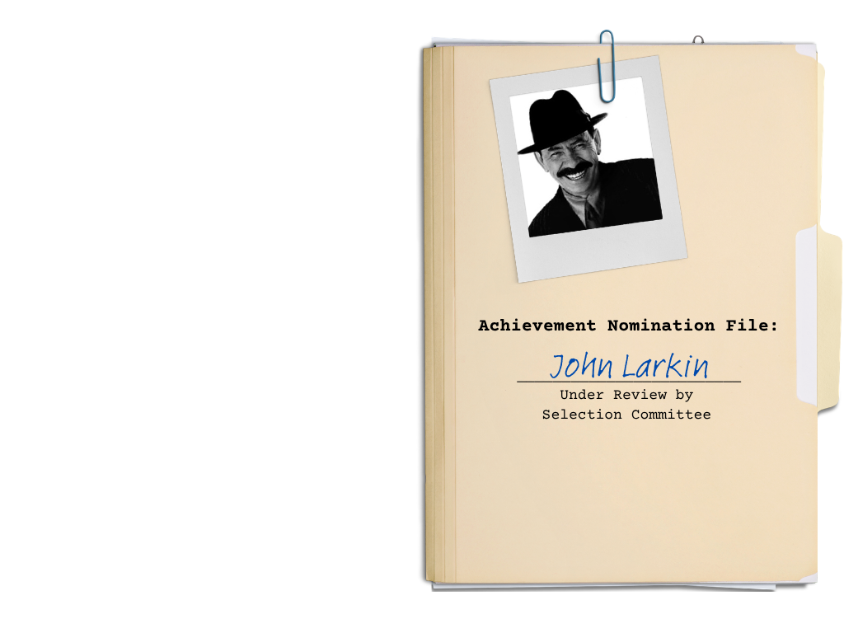
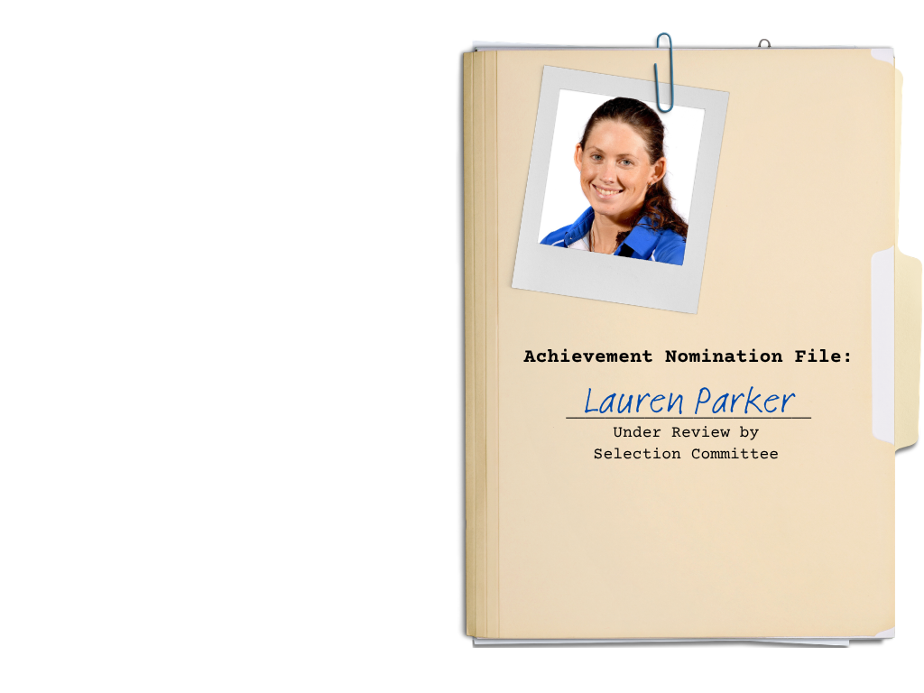


Slide 11

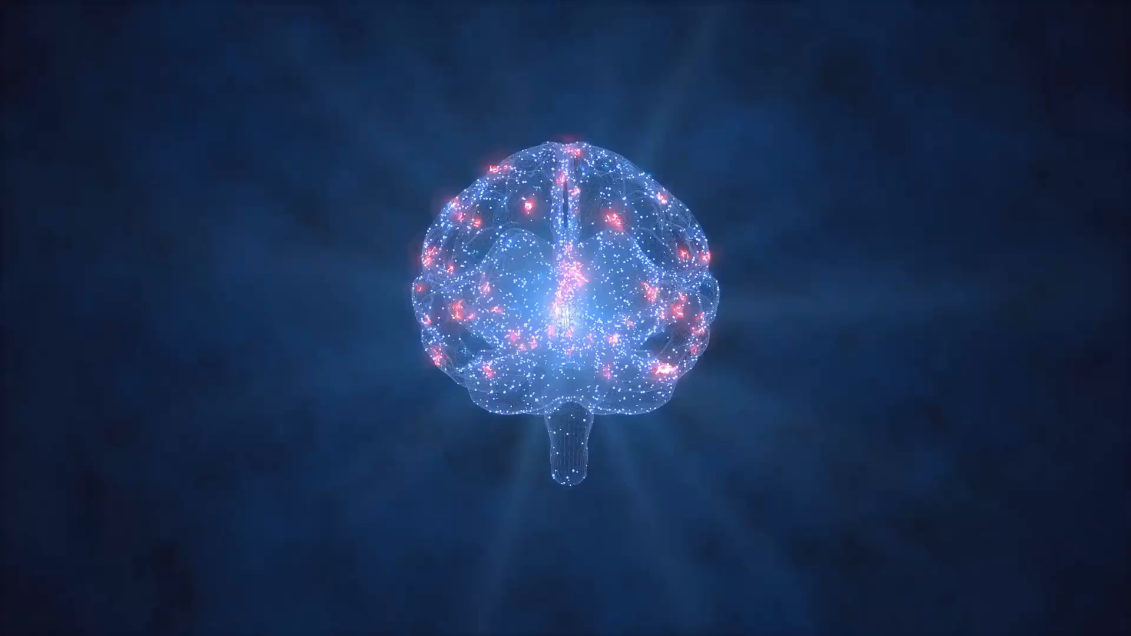
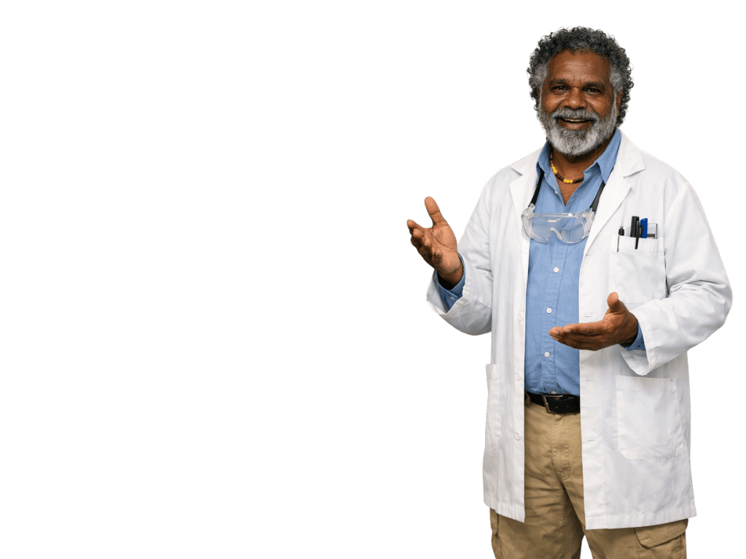
Repeated effort over time strengthens brain pathways.
When we try something new, the brain begins building a new pathway.
Neuroplasticity: the brain can grow and change.

Slide 12

Practise Over Time
When a person practices something over time, the brain:
stays the same
forgets what to do
strengthens the pathway

Slide 16




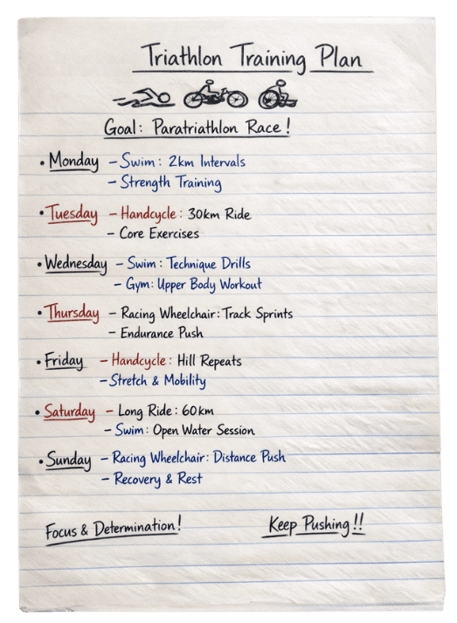

Slide 19

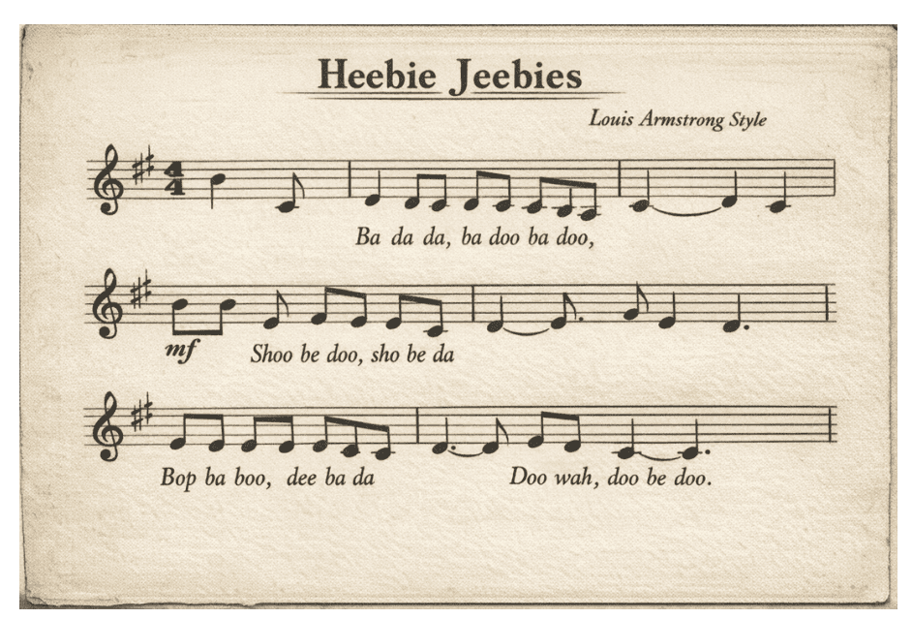

Slide 22
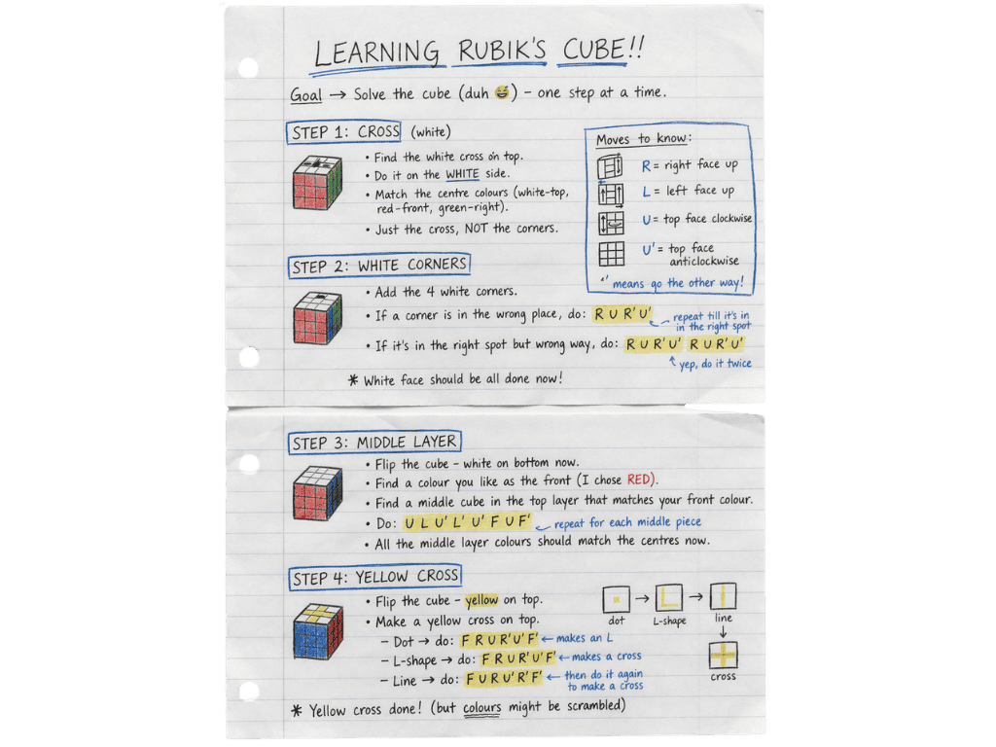

Slide 26
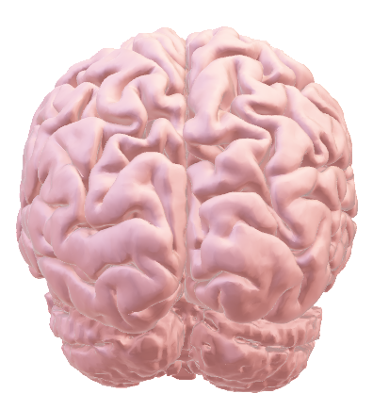
Repeated effort over time helps people improve.
Practising something again and again strengthens the pathway in the brain.
Stronger pathways make actions faster and easier.
Achieving goals happens through
repeated effort, not just starting.

Slide 27

Repeated effort over time helps people improve.
Practising something again and again strengthens the pathway in the brain.
What is a goal you worked
towards over time?
How did you practice or train?
What happened in your brain
as you did this?

Slide 28
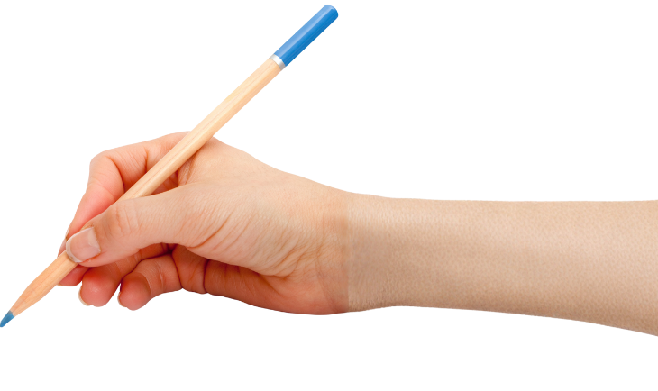


How well did you:
explain how each nominee used repeated effort over time
describe what happens in the brain when something is practised repeatedly?

Slide 29
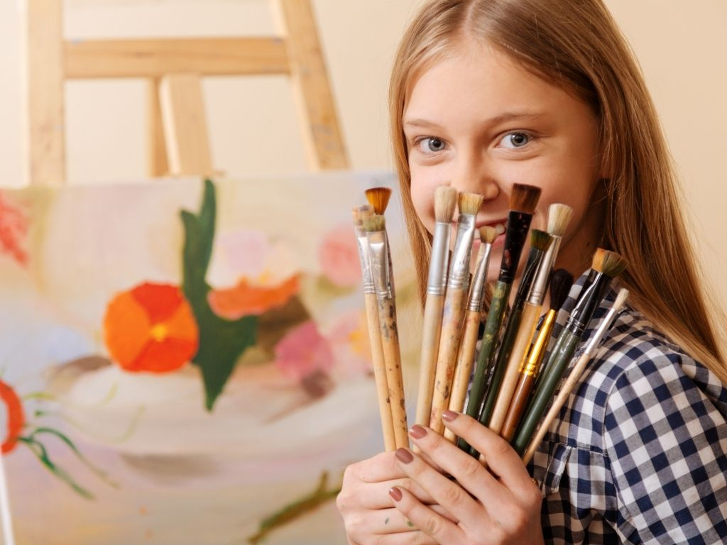
In the next lesson, we will learn that progress provides evidence that builds stronger belief.

Slide 30
Attributions
Slide 5 Photo: Photo: Orders of Australia on a table by Office of the Official Secretary to the Governor-General, from Wikimedia Commons, CC BY 3.0, https://commons.wikimedia.org/wiki/File:Orders_of_Australia_on_a_table.jpg
Slides 10, 13, 14, 15, 17, 18, 20, 24, 25 Photo 1: Lauren Parker by Australian Paralympic Committee, from Wikimedia Commons, CC BY-SA 3.0, https://commons.wikimedia.org/wiki/File:Parker_Lauren_01_CC.jpg
Slides 10, 13, 14, 18, 20, 24, 25 Photo 2: Scatman John by RCA Records, from Wikimedia Commons, Fair use, https://en.wikipedia.org/wiki/File:Scatmanjohn.jpg
Slides 10, 13, 14, 24, 25 Photo 3 and Slides 21, 23 Photo: Feliks Zemdegs at the World Championships Oct 2011 by Lembasts at English Wikipedia, from Wikimedia Commons, CC BY-SA 3.0, https://commons.wikimedia.org/wiki/File:Feliks_Zemdegs_at_the_World_Championships_Oct_2011.jpg

