Slide 1
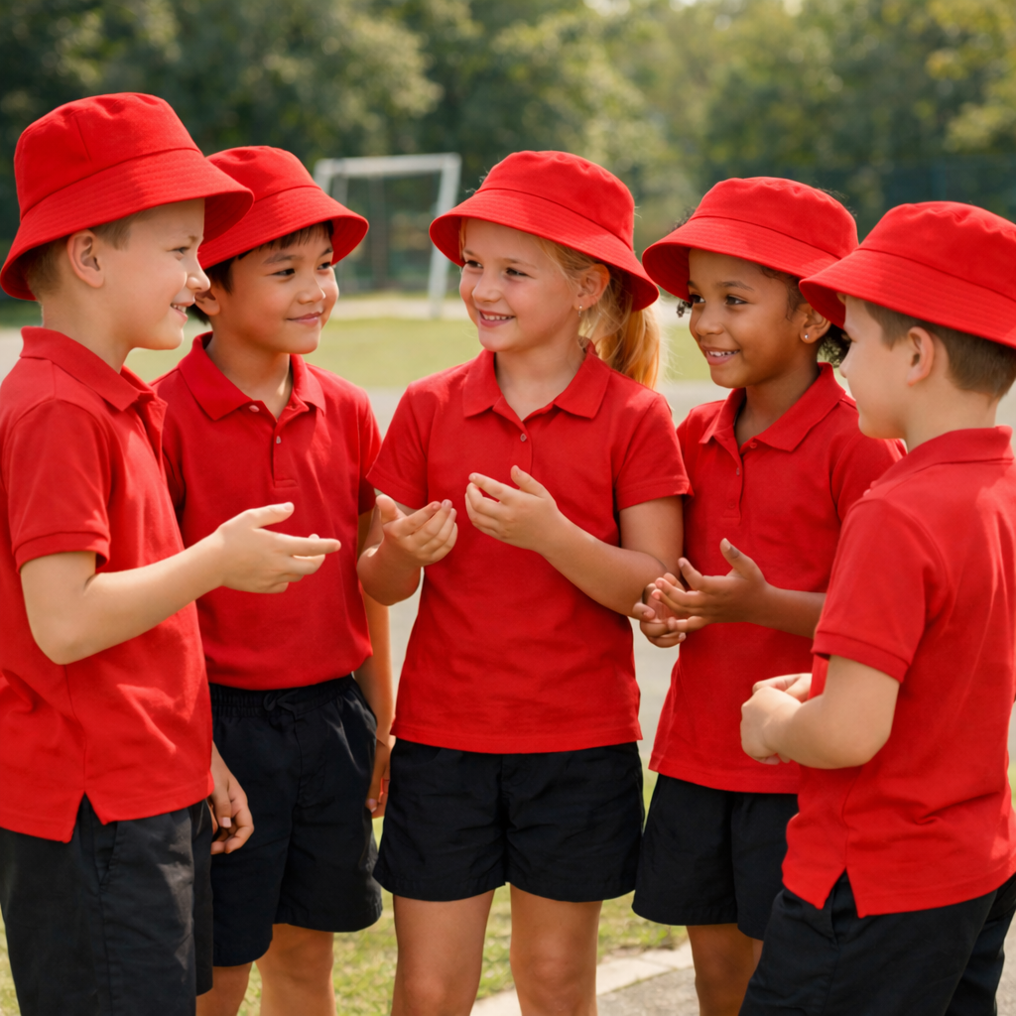
Mission Relay
Unit 3: Better Together
Lesson 1,
Lesson 2 (Extension)

Slide 2
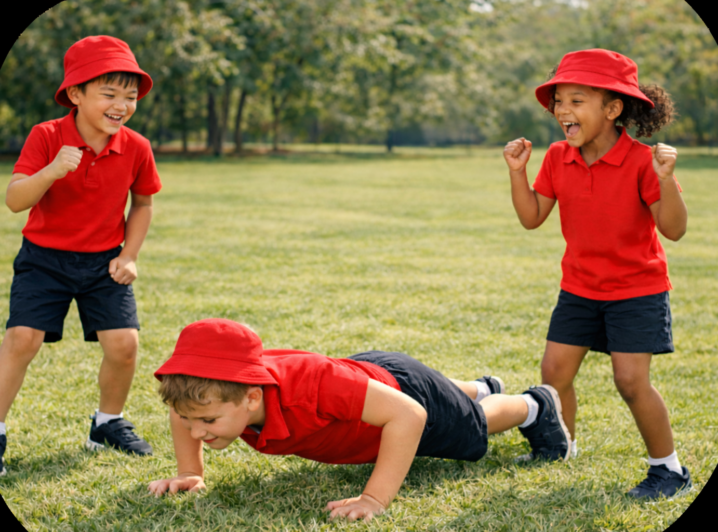
Lesson 1

Slide 3
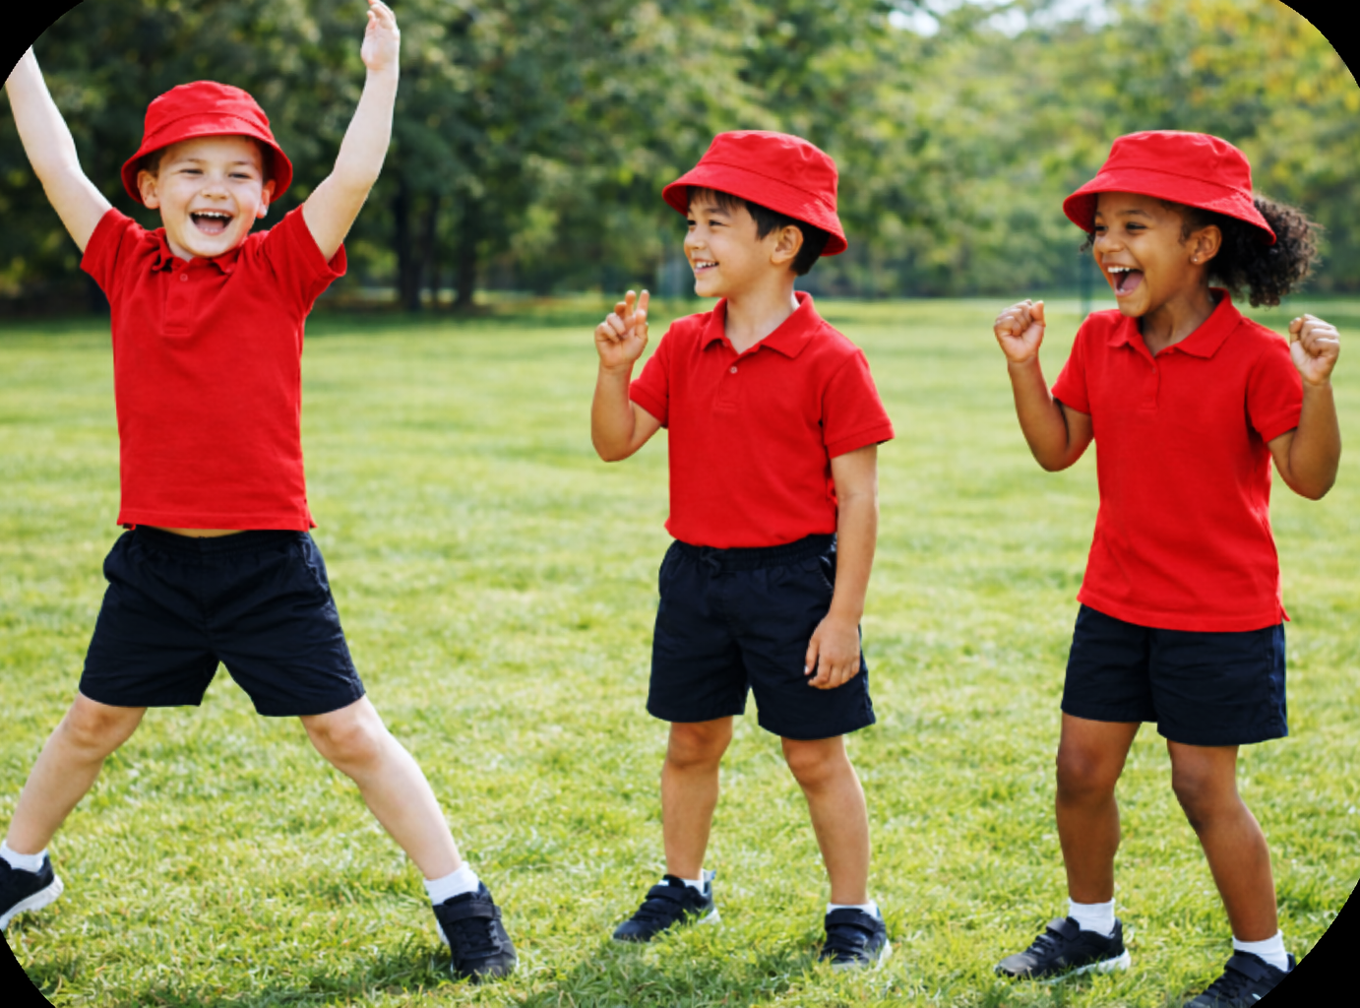
You will learn what fairness means and how to include others equally.

Slide 4
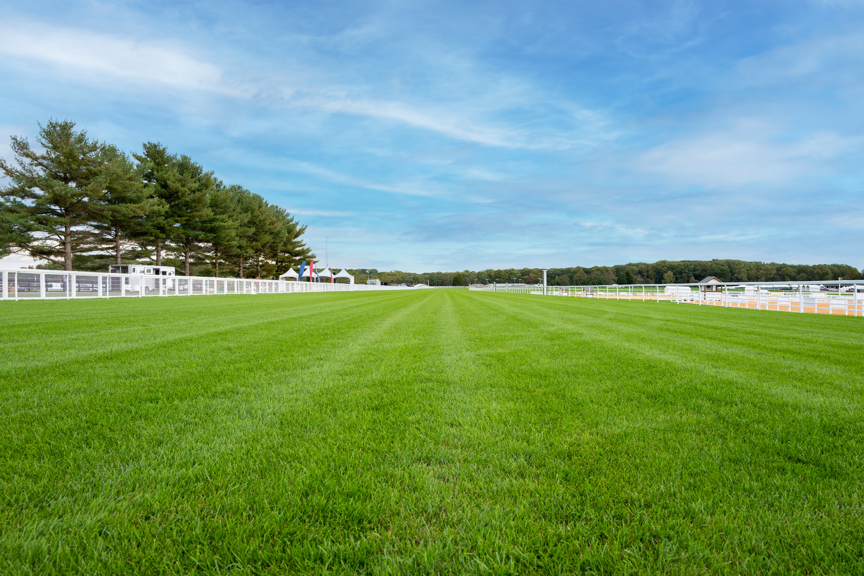






Slide 5


Slide 7
Lesson 2

Slide 8
You will practise taking turns and sharing during group play.

