Slide 1
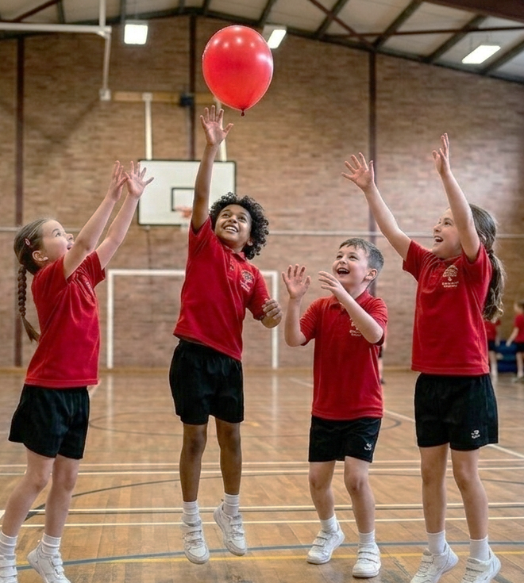
Balloon Keep-Up
Unit 3: Better Together
Lesson 3,
Lesson 8 (Extension 1)

Slide 2
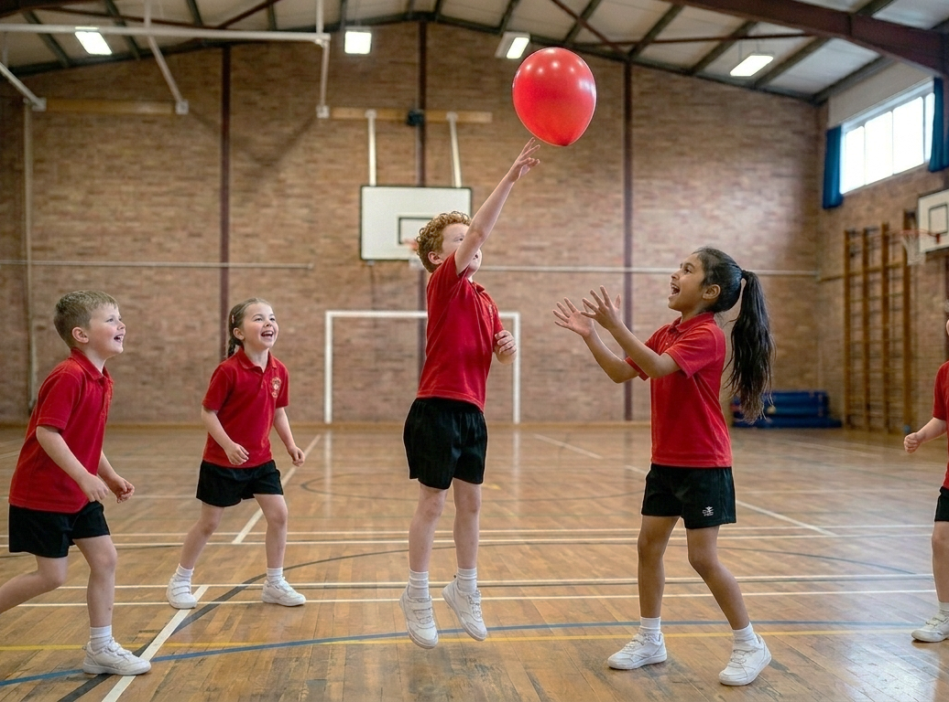
Lesson 3

Slide 3
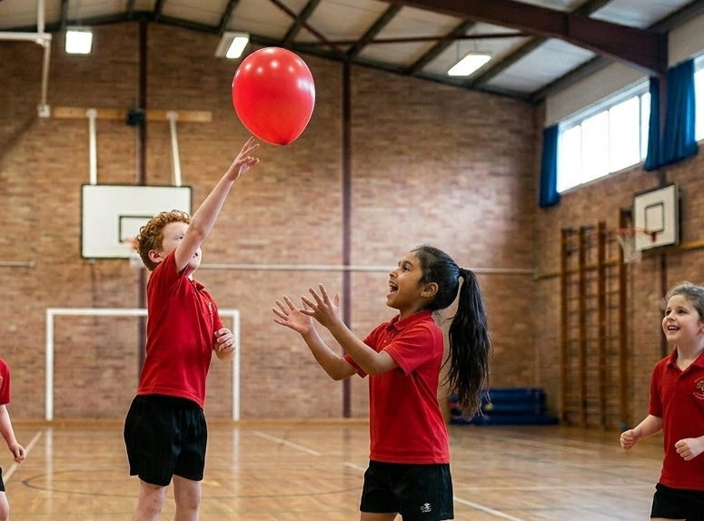
You will explore what good teammates do to help their team.

Slide 4






Slide 7
Lesson 8

Slide 8
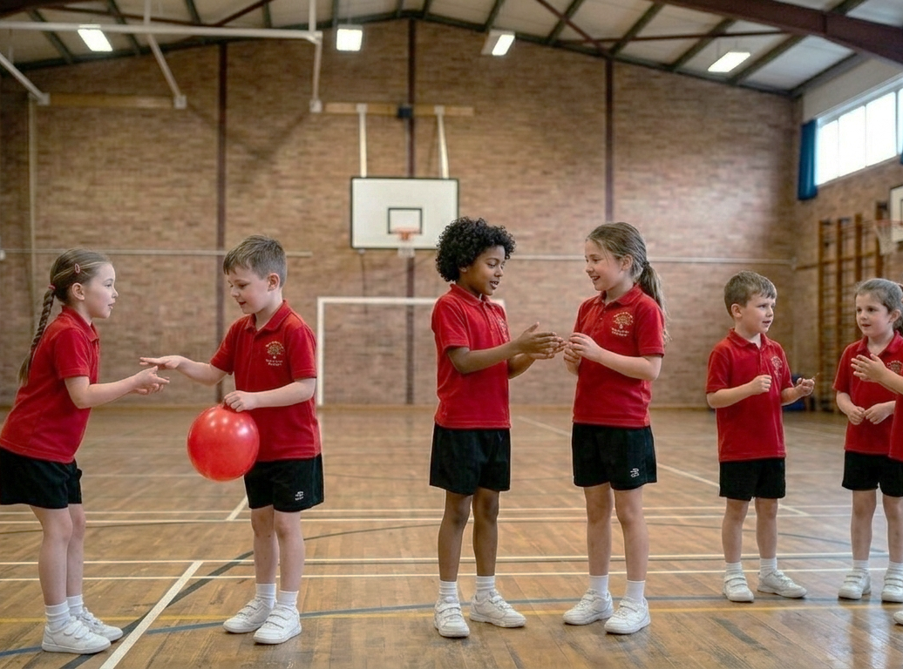
You will practise being a good friend through words and action.

