Slide 1
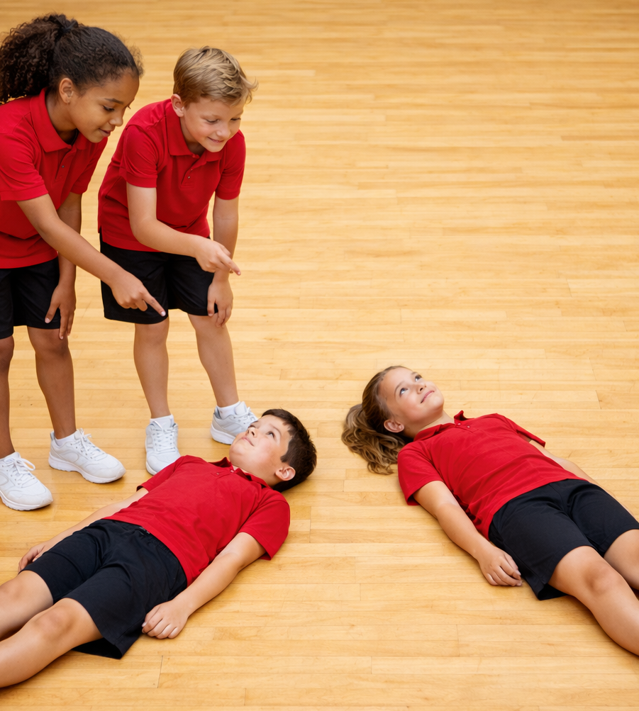
Human Shapes
Unit 3: Better Together
Lesson 1,
Lesson 2 (Extension 1)

Slide 2
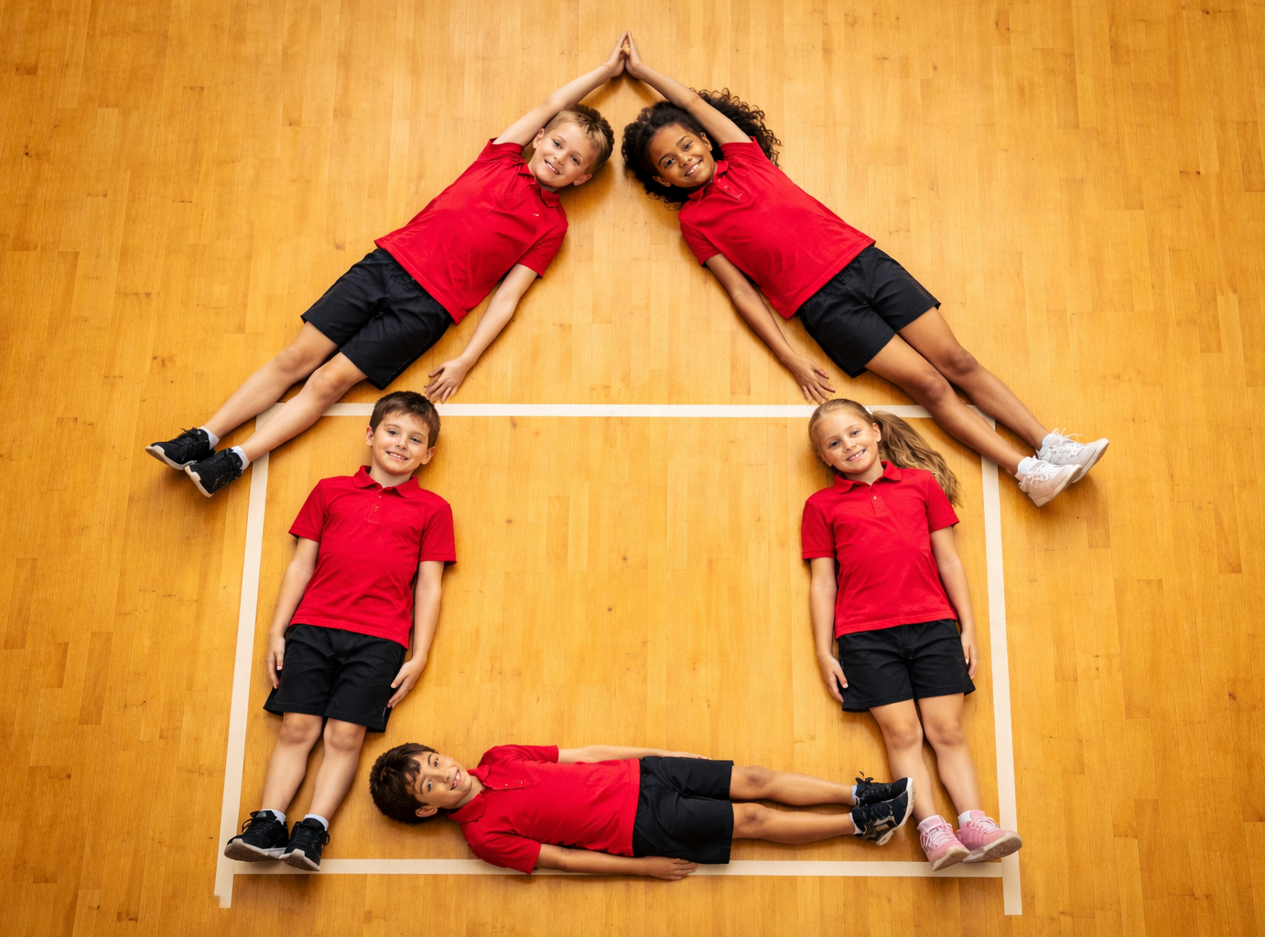
Lesson 1

Slide 3
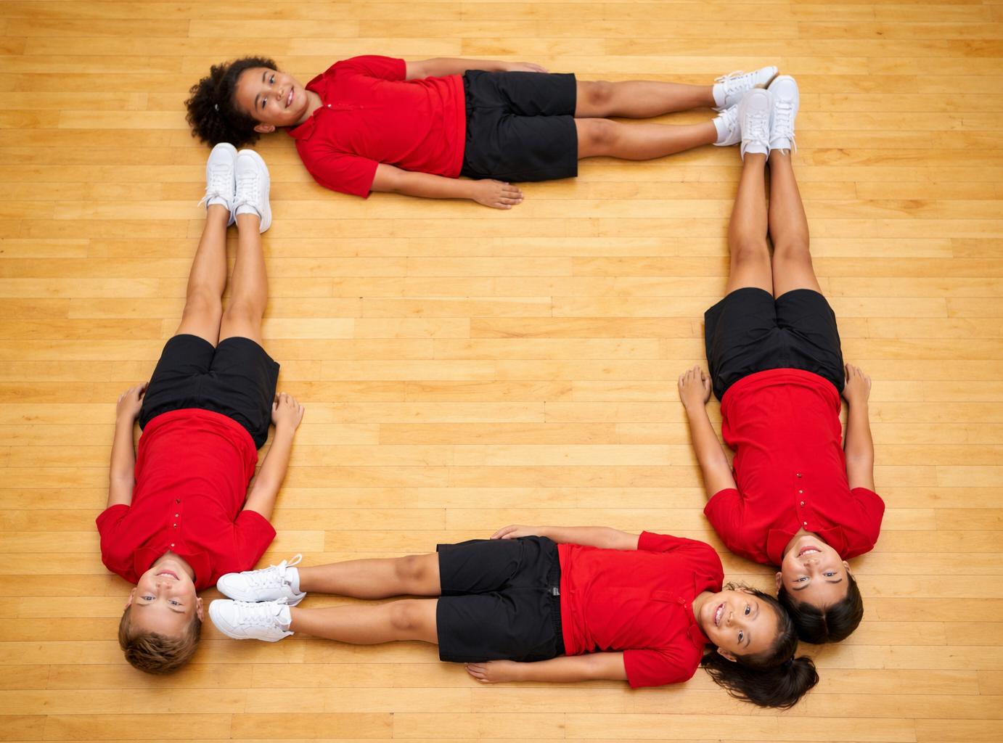
You will identify what fairness looks and sounds like in a game setting.
Notes:
.

Slide 4

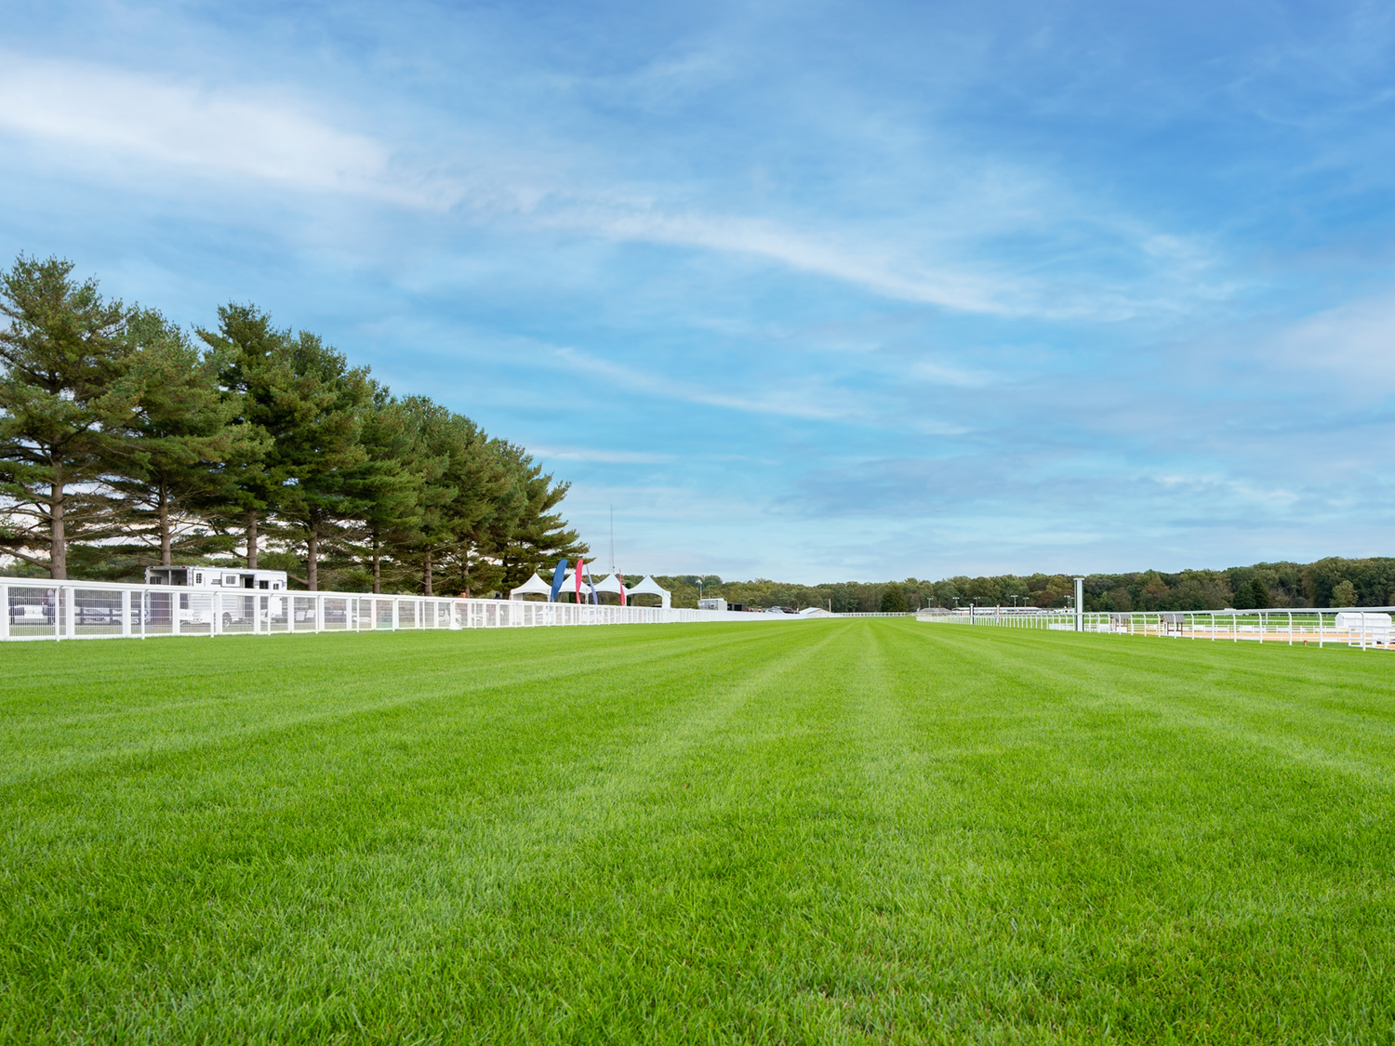




Slide 5




Slide 6









Slide 7
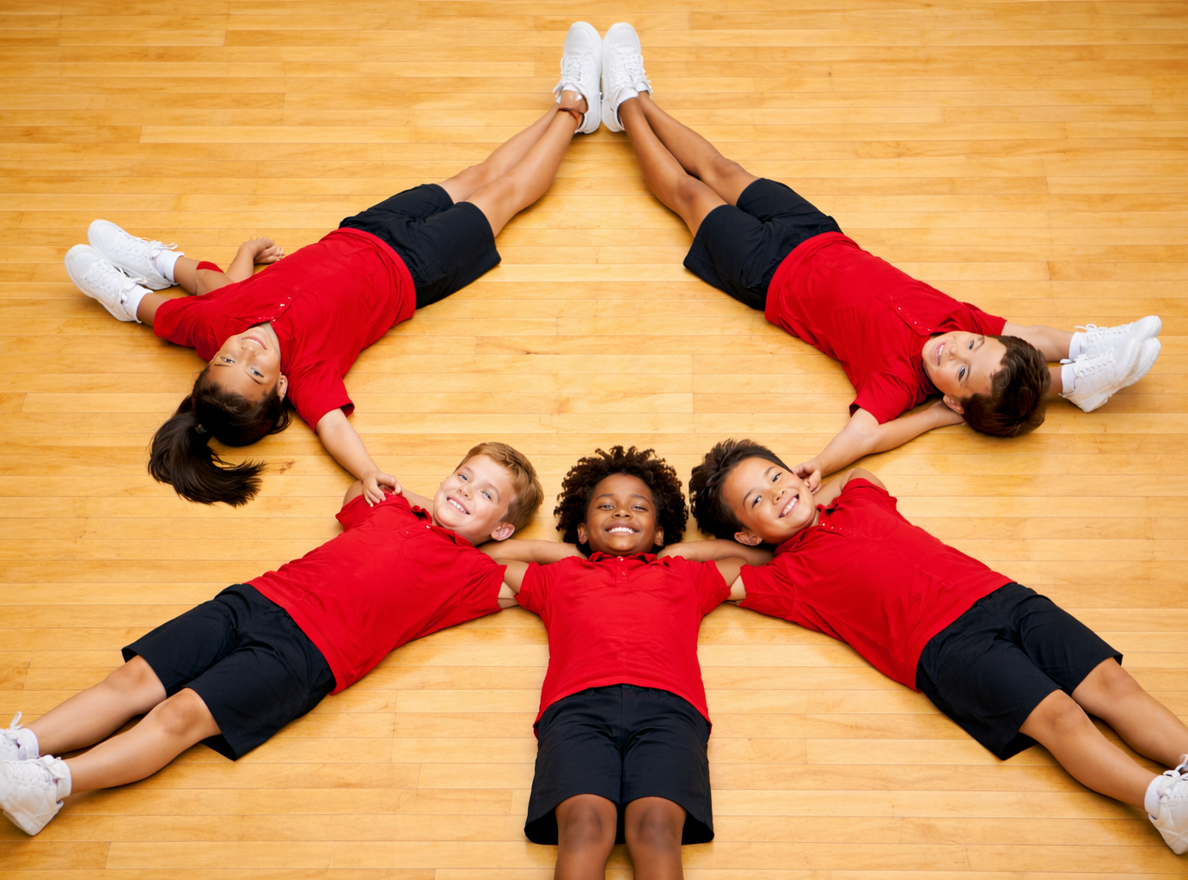
Lesson 2 (Extension)

Slide 8
You will learn what good teamwork really means and how each member can play a role.

Slide 10

Good!

Slide 11


