Slide 1
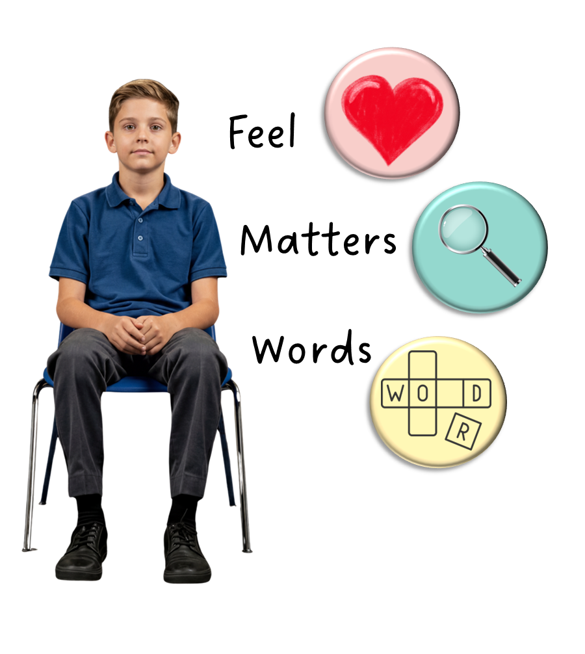
How to Listen and Respond
Unit 3 Better Together
Lesson 4

Slide 2
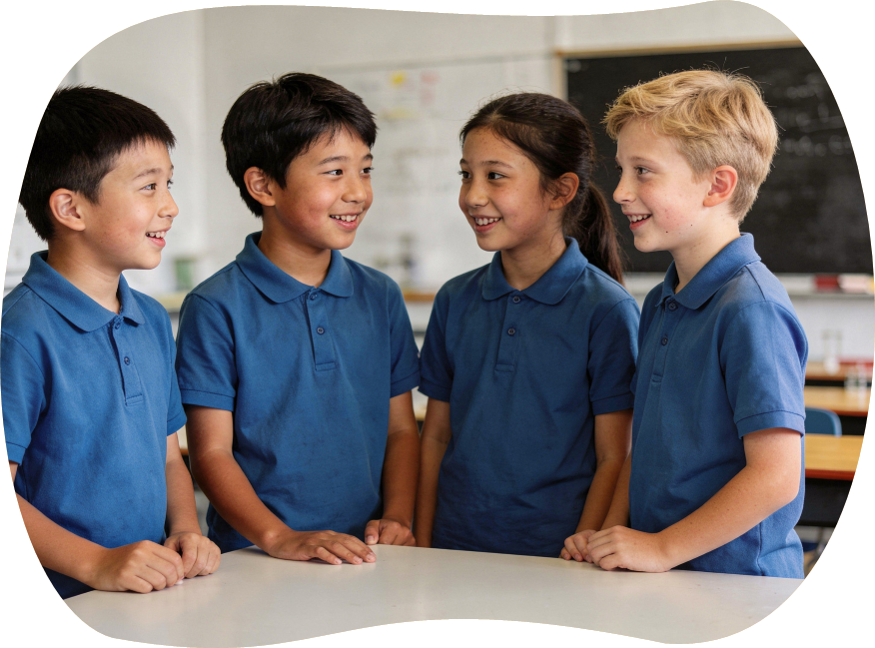
Conversations are like playing catch. When we play catch, we throw a ball back and forth. When we take turns to talk and listen, it helps everyone feel respected and like they belong.

Slide 3
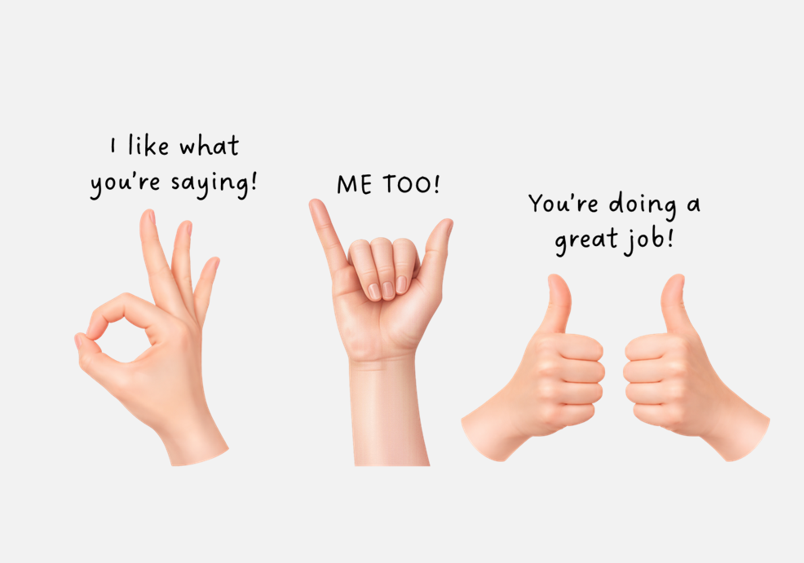
When someone is talking, we listen by facing them, making eye contact with them and using three hand signals.

Slide 4

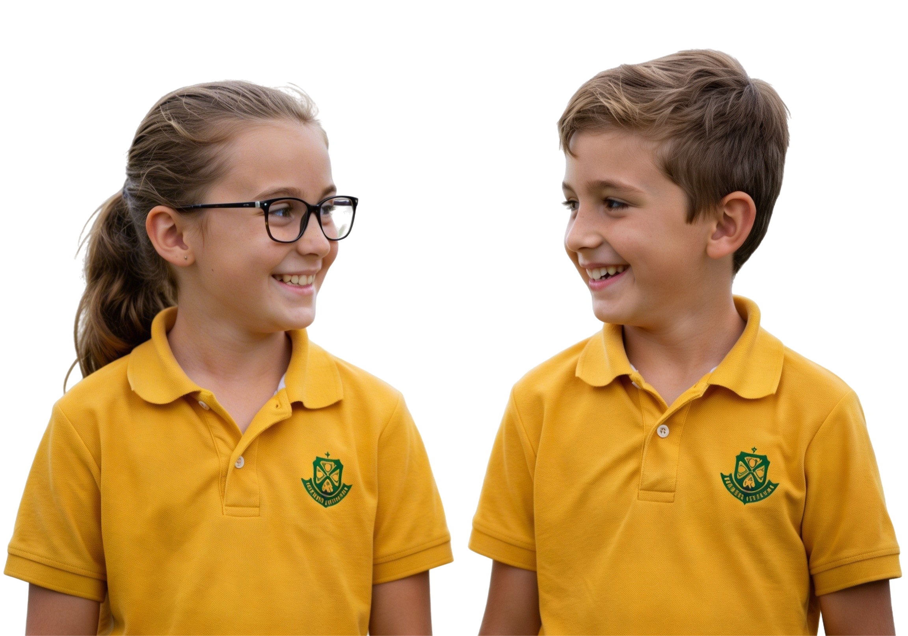
How does it make you feel when someone invites you to join in the conversation with a talk signal?
Pair/share
What do you think?
Do you want to share next?
I’d like to hear your idea.
What would you like to add?

Slide 5
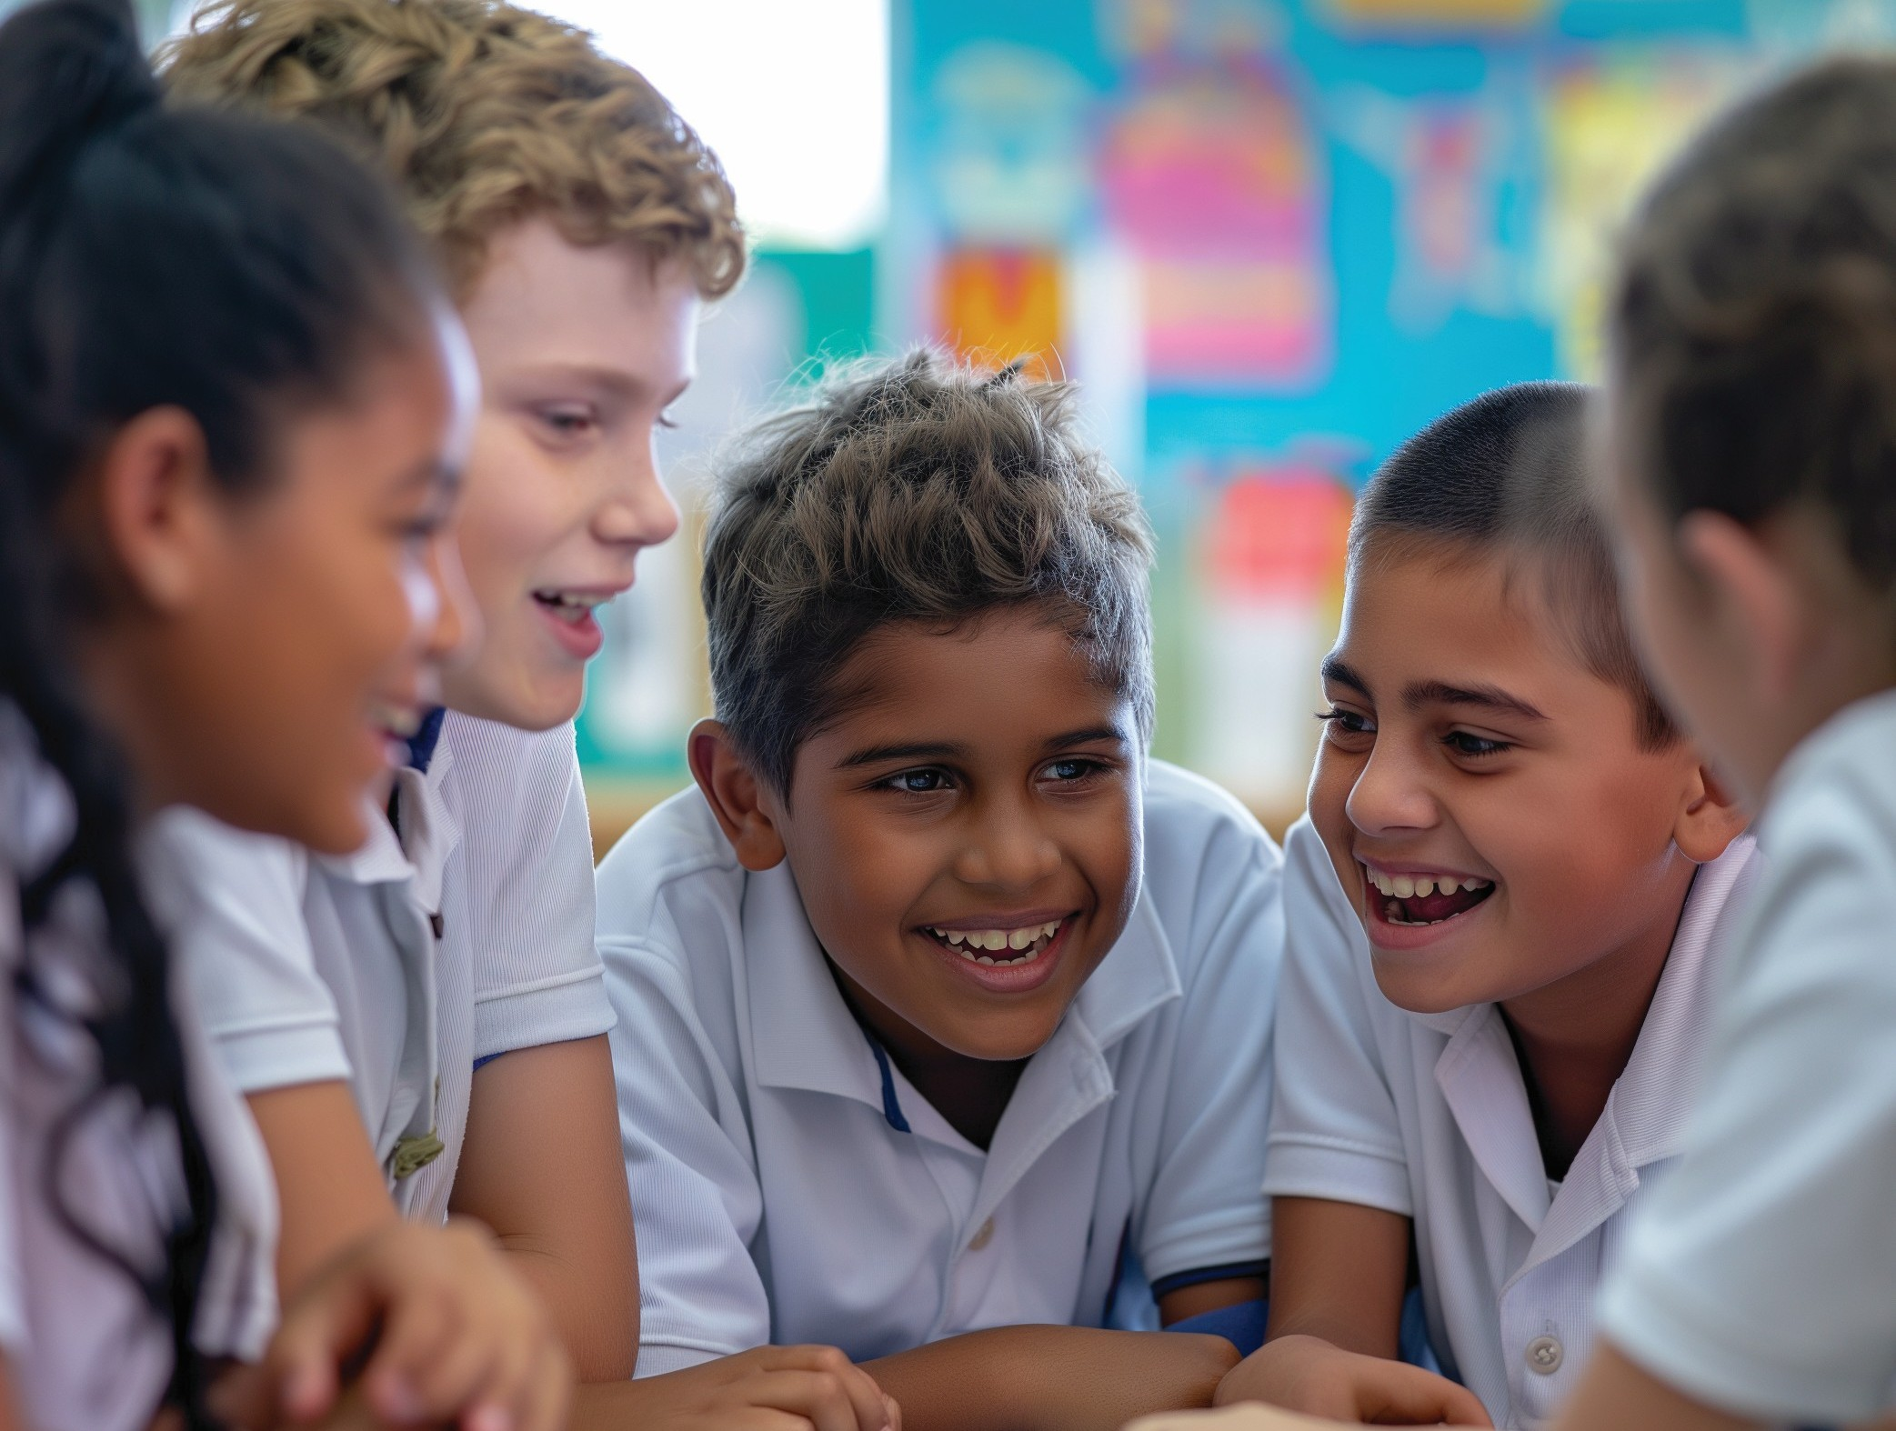
In this lesson, you will learn how to listen carefully and respond in a way that shows care.

Slide 6
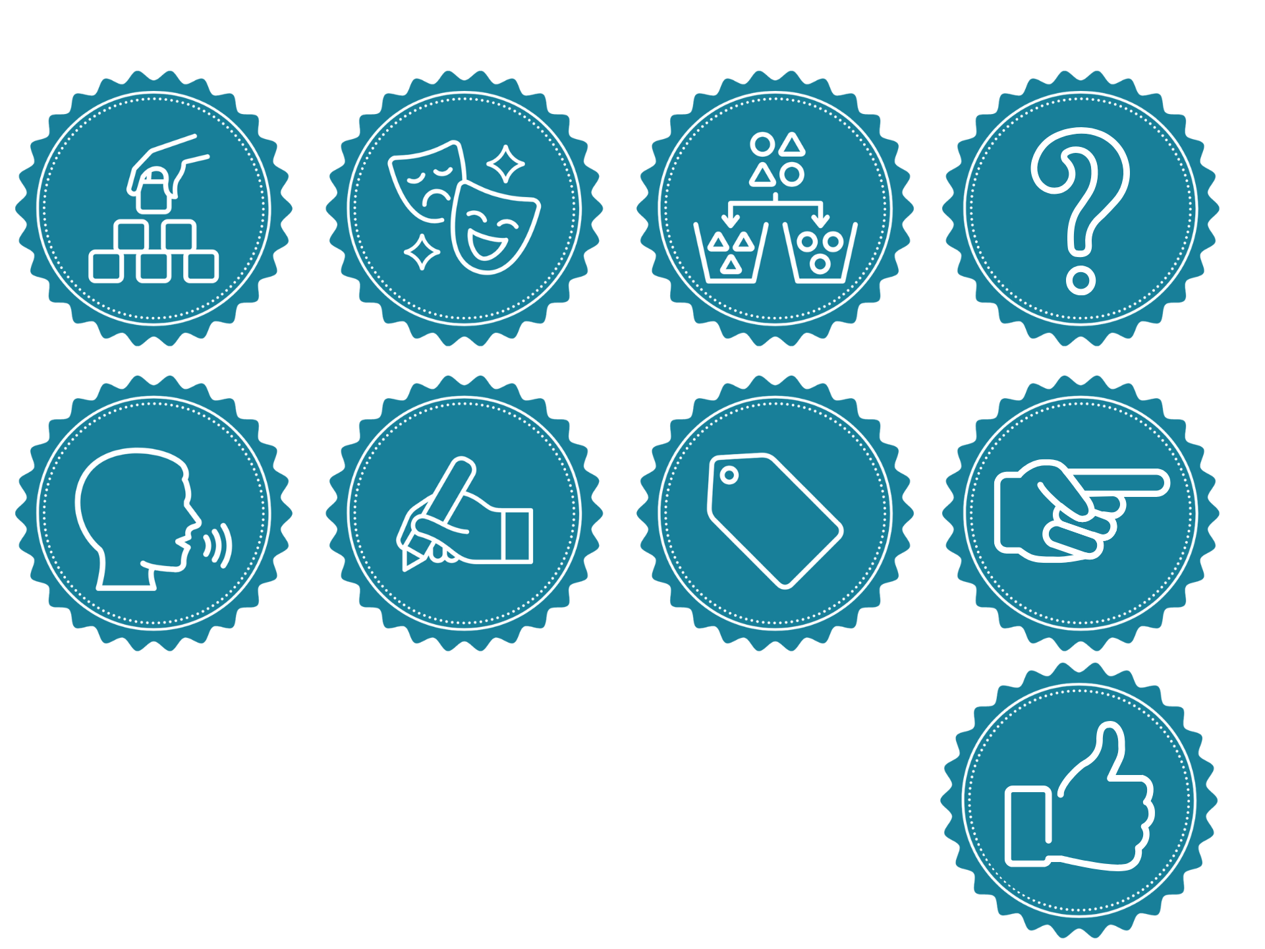
You will be successful when you can:
show listening with your body
say something thoughtful in response.

Slide 7
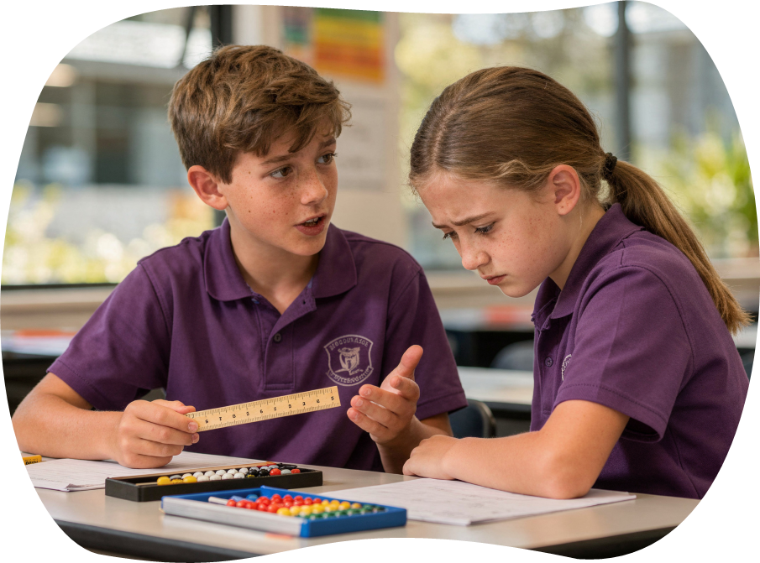

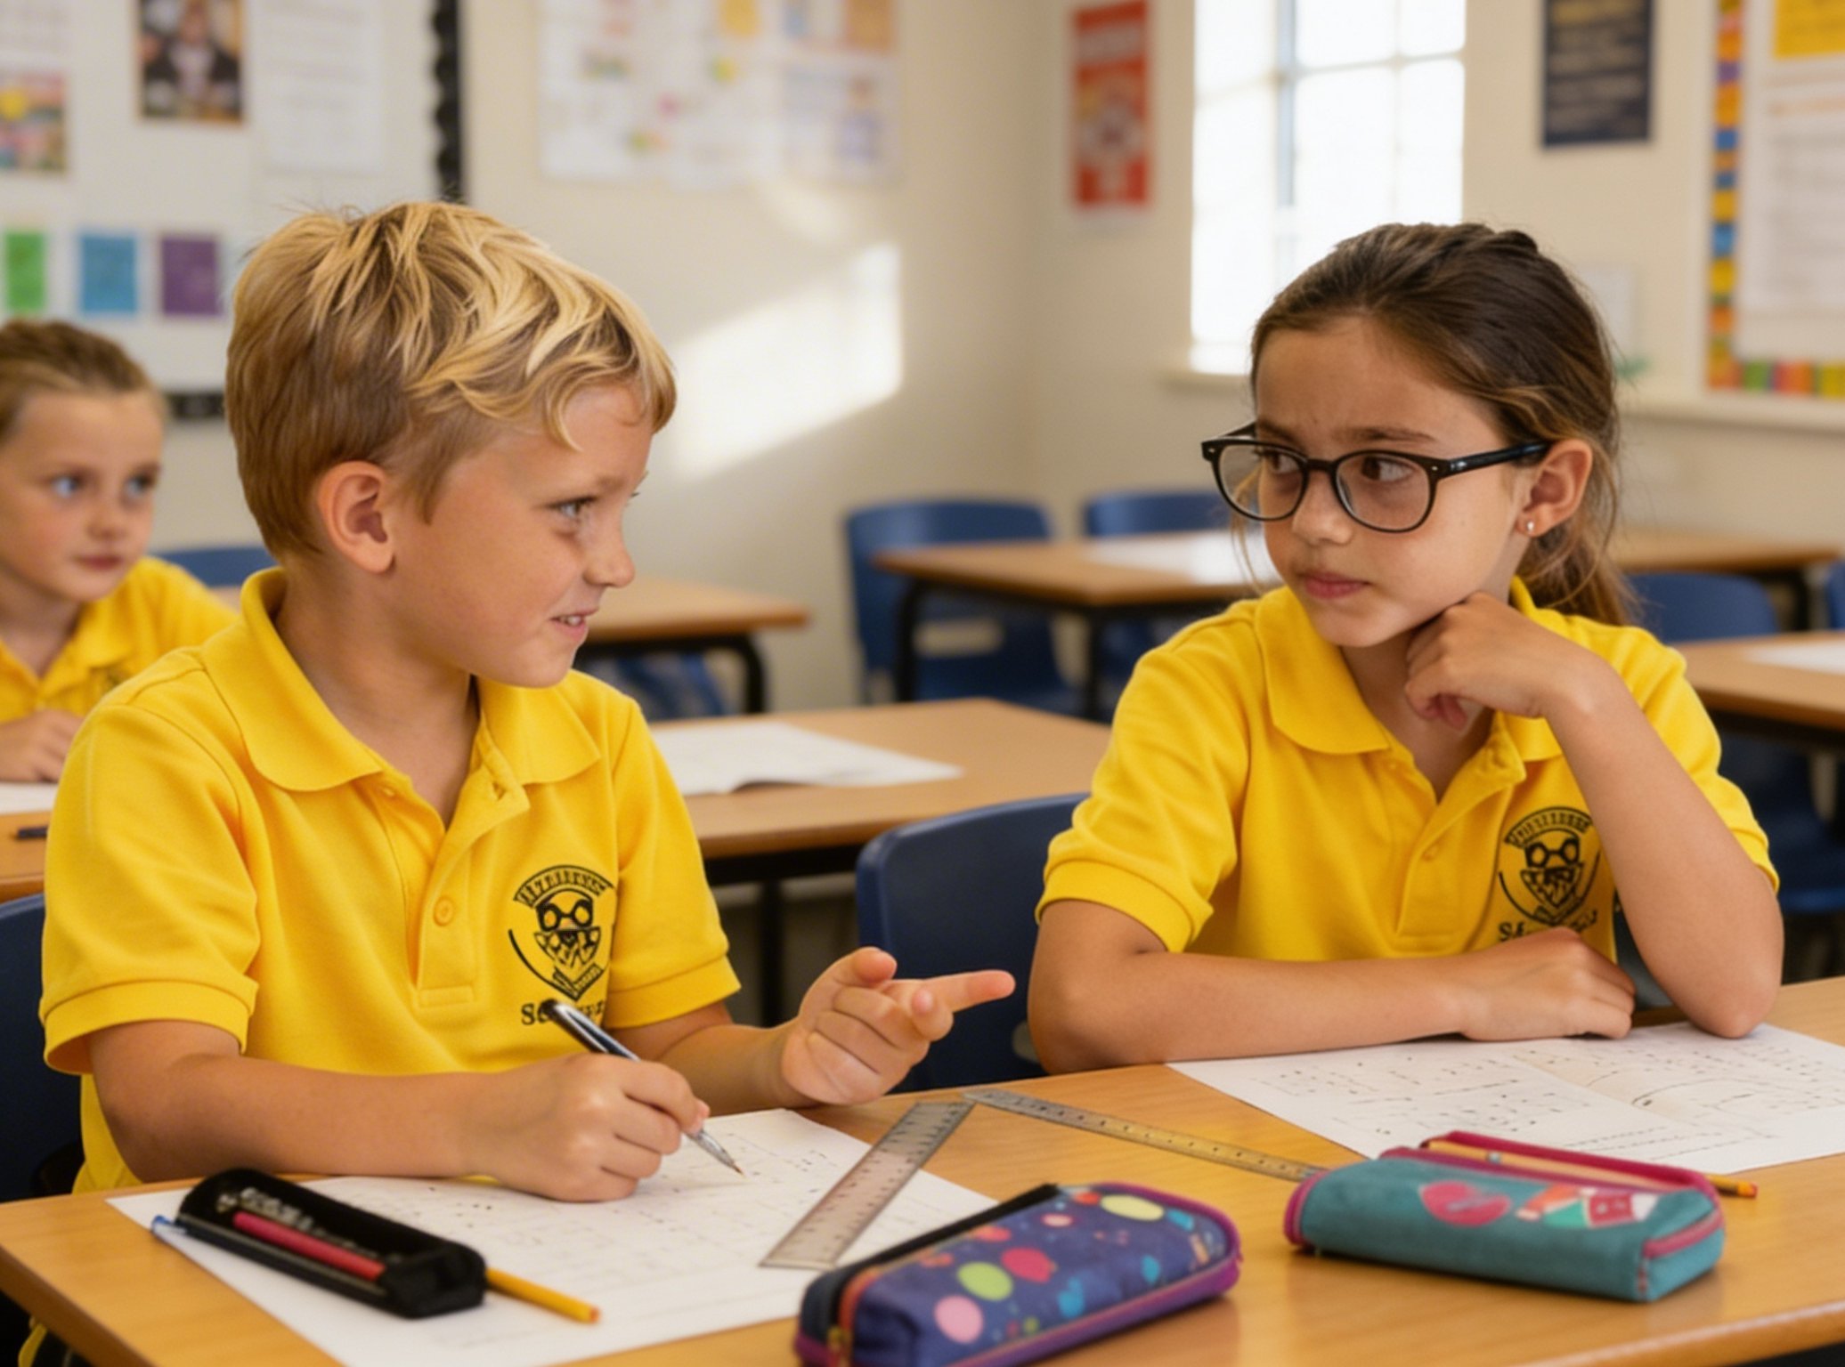

Slide 8
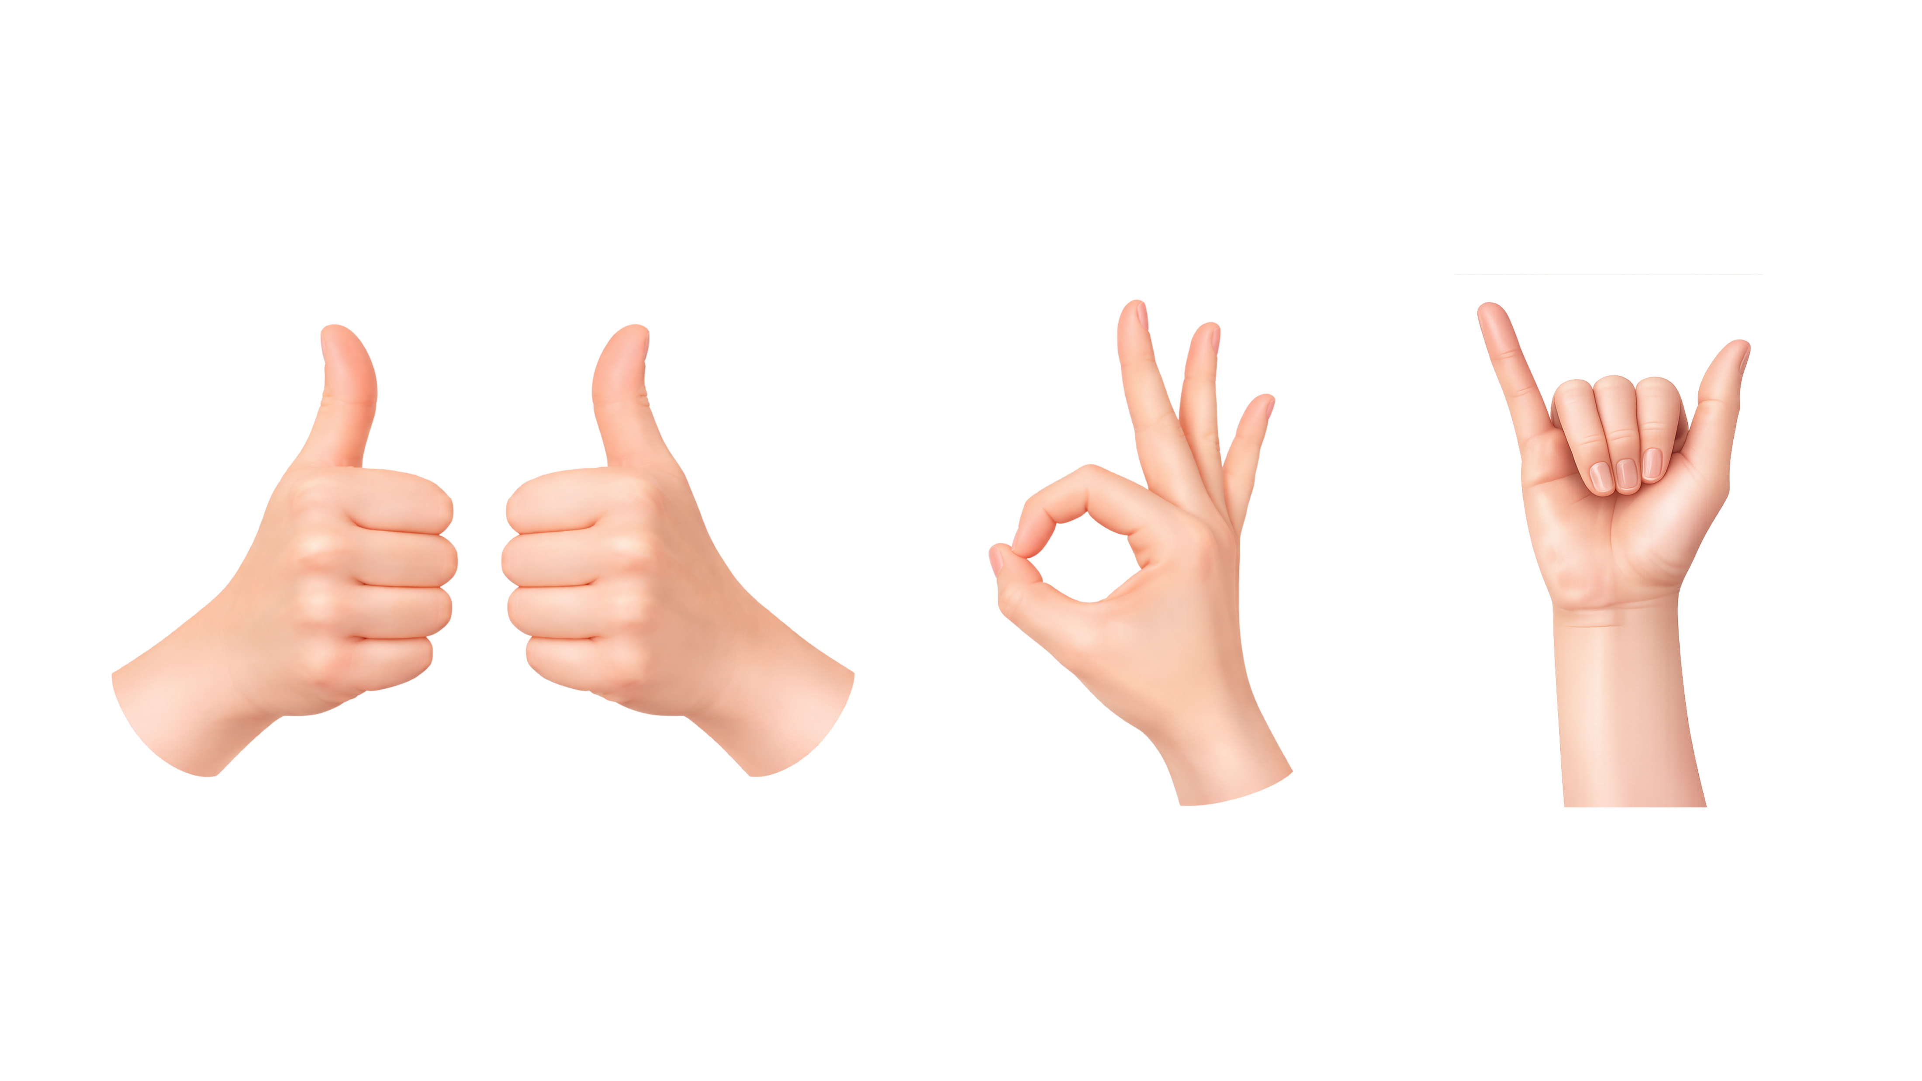
Body Clues
When someone is talking, we need to show we are listening to what they have to say. We do this by facing them and making eye contact with them.
I like what you’re saying!
ME TOO!
You’re doing a great job!

Slide 9
Body Clues
I like what you’re saying!
You’re doing a great job!
ME TOO!

Slide 10
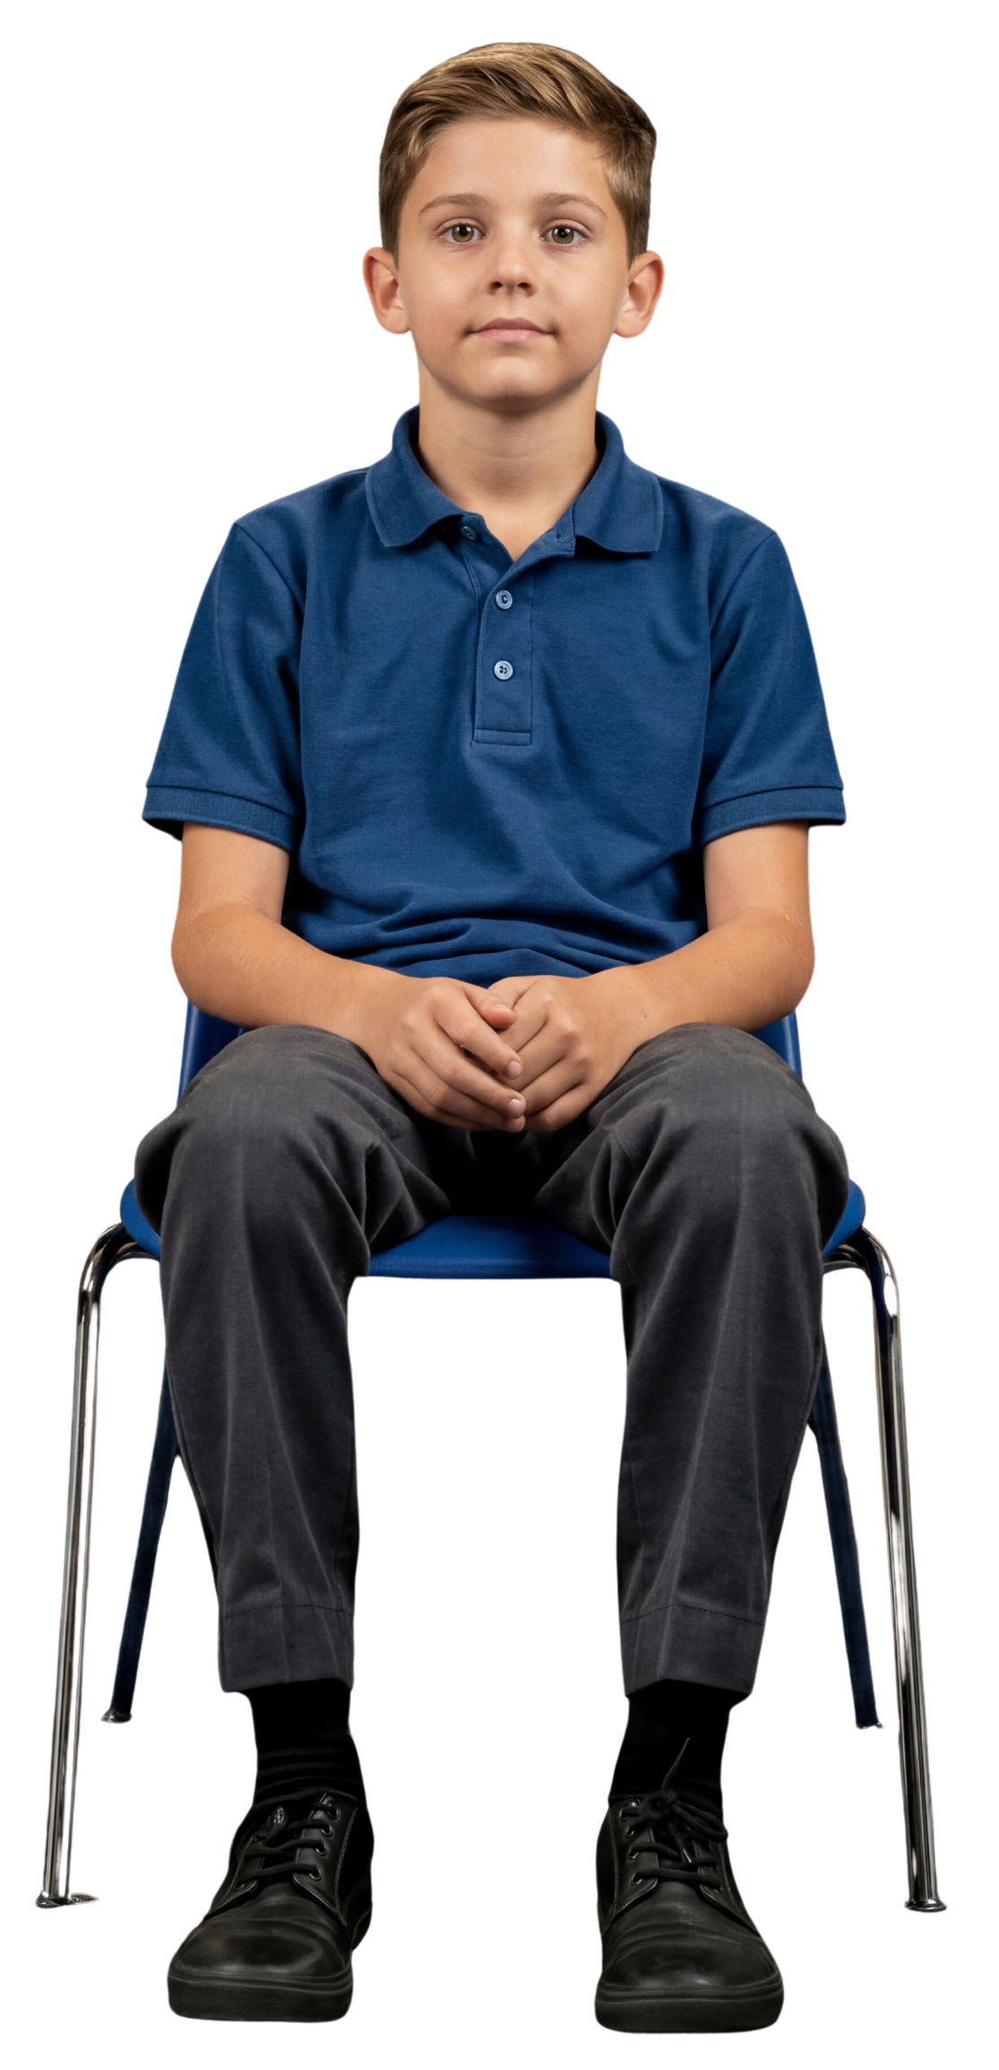
Using Whole Body Listening Clues
Brain thinks about what is being said.
Eyes look at the speaker.
Ears are ready to listen to the words.
Mouth is quiet while they speak.
Heart is ready to care about their words.
Hands are still and relaxed.
Body faces the speaker.
Feet face the speaker and quiet on the floor.

Slide 11
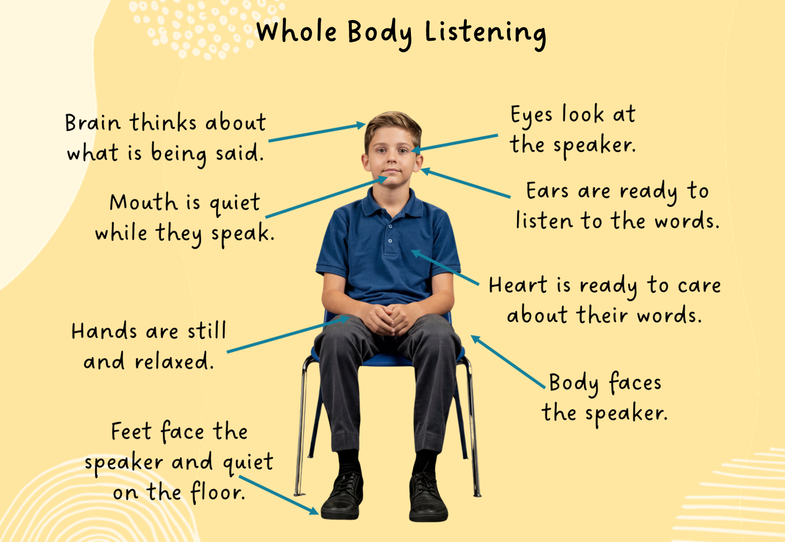
Using Whole Body Listening Clues

Slide 12


Caring Clues: What Do I Feel?
That sounds really fun.
Feel
I’d like to try that too!
I like what you said.
I’m glad you told me that.
That sounds a bit scary...
That’s a good idea.
That’s really interesting.

Slide 13


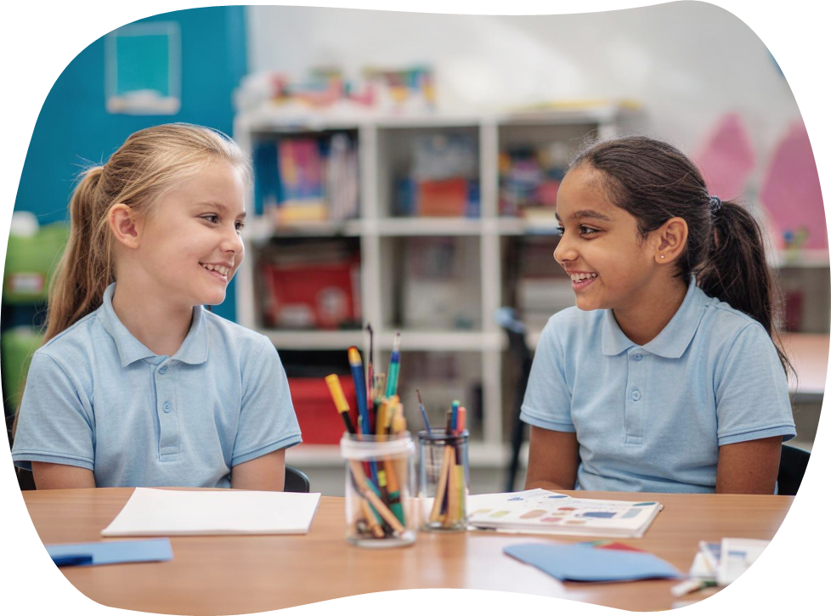
Caring Clues: What Matters?
Matters
I think that was important to you because …
I can tell that was important to you because …
I think that mattered to you because…
I can tell that mattered to you because…
I think that meant a lot to you because...
I can tell that meant a lot to you because…
It sounds like that…

Slide 14


Caring Clues: What Words?
Words
I think it was interesting when you said everyone started laughing when that happened.
I can notice something interesting.
You said you were nervous at first, but then you felt proud when you’d finished.
I can link two details.
It sounds like the whole day was fun, and the best part was when you all played footie together.
I can show I heard the main points.

Slide 15

Caring Clues
When someone has finished talking, we show we listened with our whole body by using Caring Clues. The Caring Clues are:
Think. Talk. Words.
Feel.
Share.
Think.
Feel.
Matters.
Words.

Slide 16
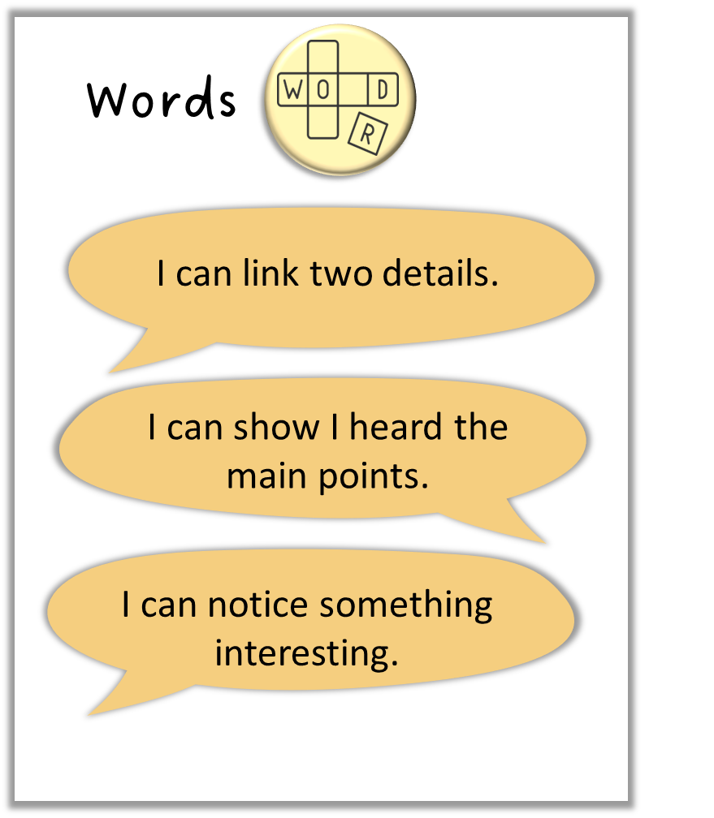
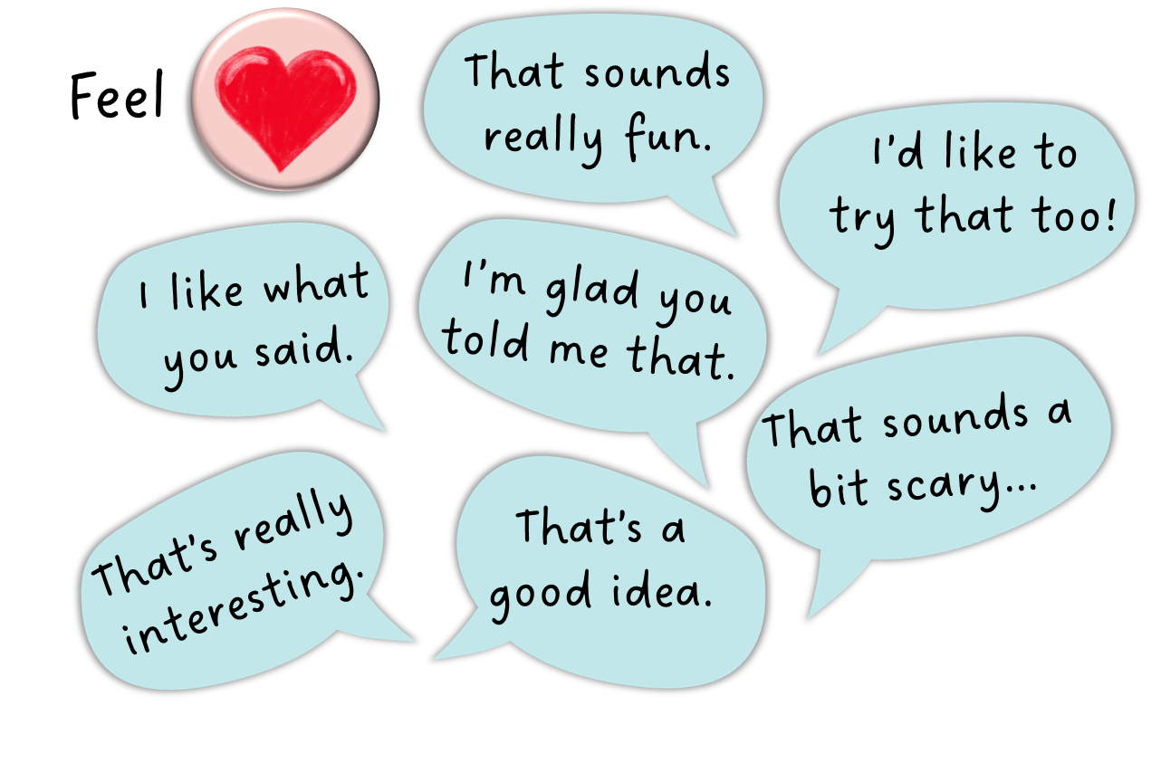
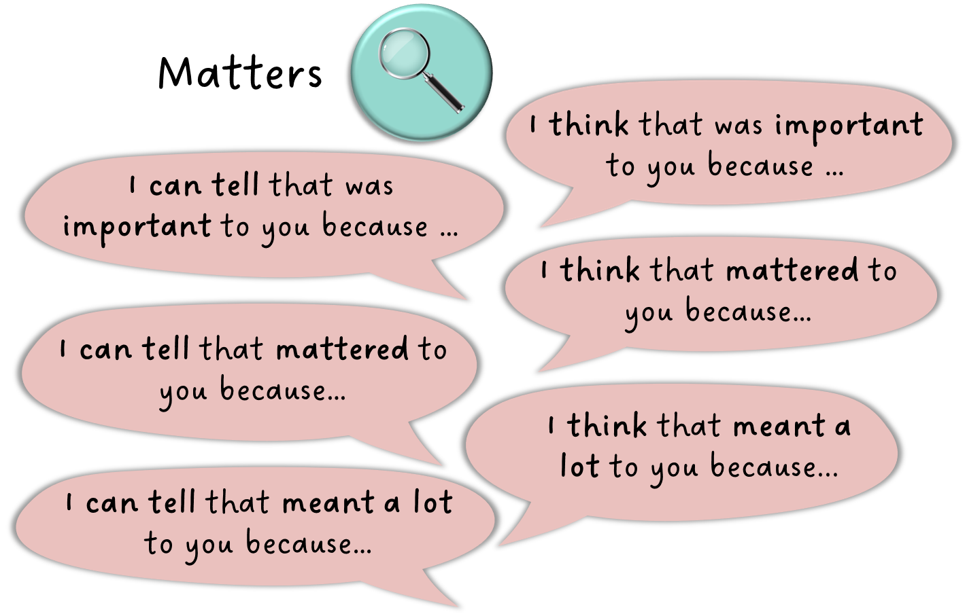
Caring Clues
Feel
Matters
Words

Slide 17
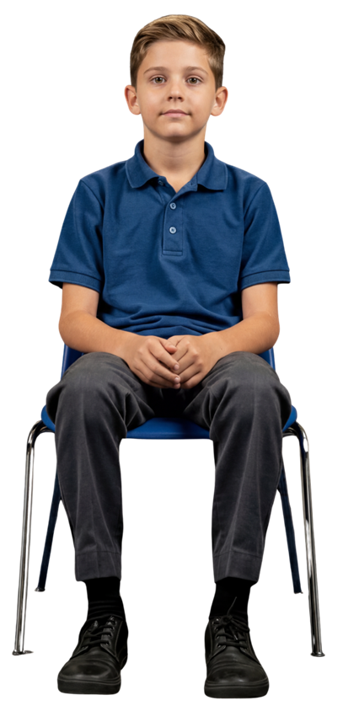
Using Caring Clues

Slide 18
While someone is talking, we use Whole Body Listening Clues.
When someone has finished talking, we show we listened with our whole body by using Caring Clues, so they feel respected and like they belong.
The Caring Clues are: Feel. Matters. Words.
Feel: How did we feel about what they said?
Matters: What do we know matters to them?
Words: What did we notice from the words they said?

Slide 19
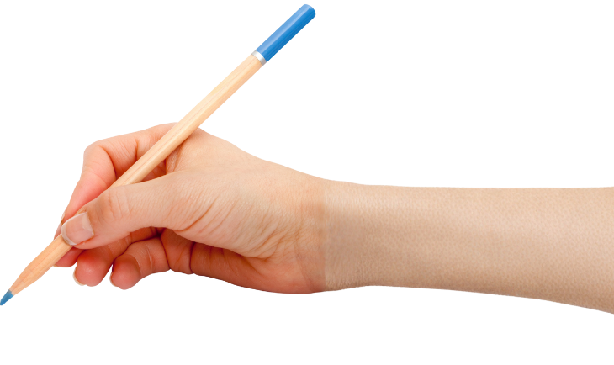


How well did you:
show listening with your body
say something thoughtful in response?

Slide 20
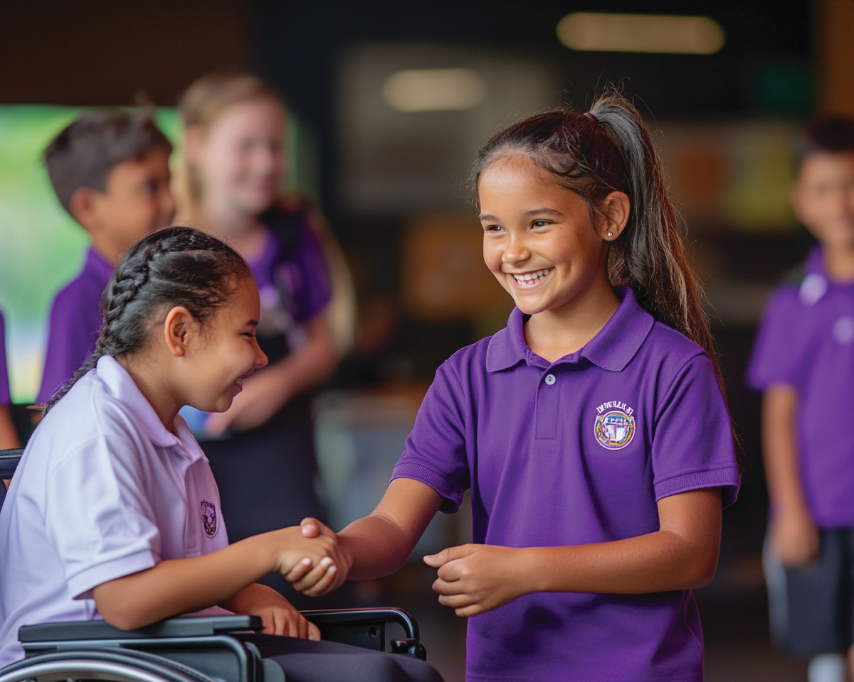
In the next lesson, we will explore how people can be different and why it’s important to respect those differences.

