Slide 1
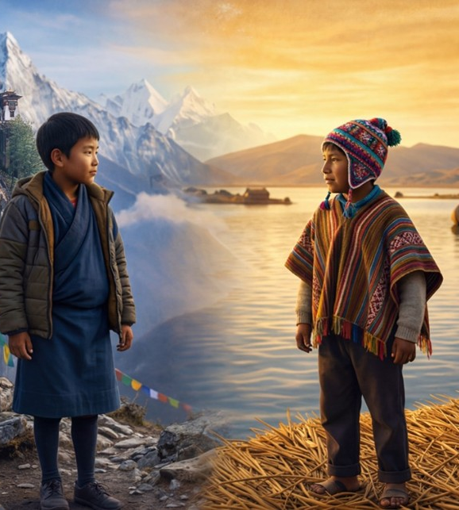
Respecting Different Opinions
Unit 3 Better Together
Lesson 2

Slide 2

Friendships are like smoothies. If we put in the right ingredients, we get something really good.

Slide 3
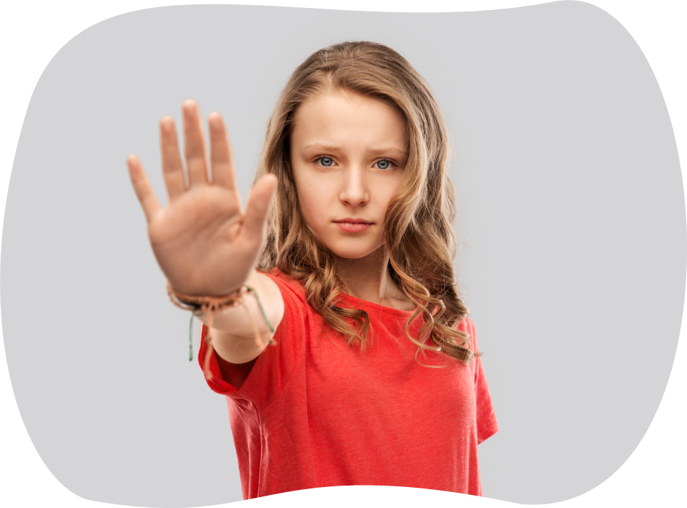
Setting a boundary is a big part of a healthy friendship because we need to say when something doesn’t feel right.

Slide 4
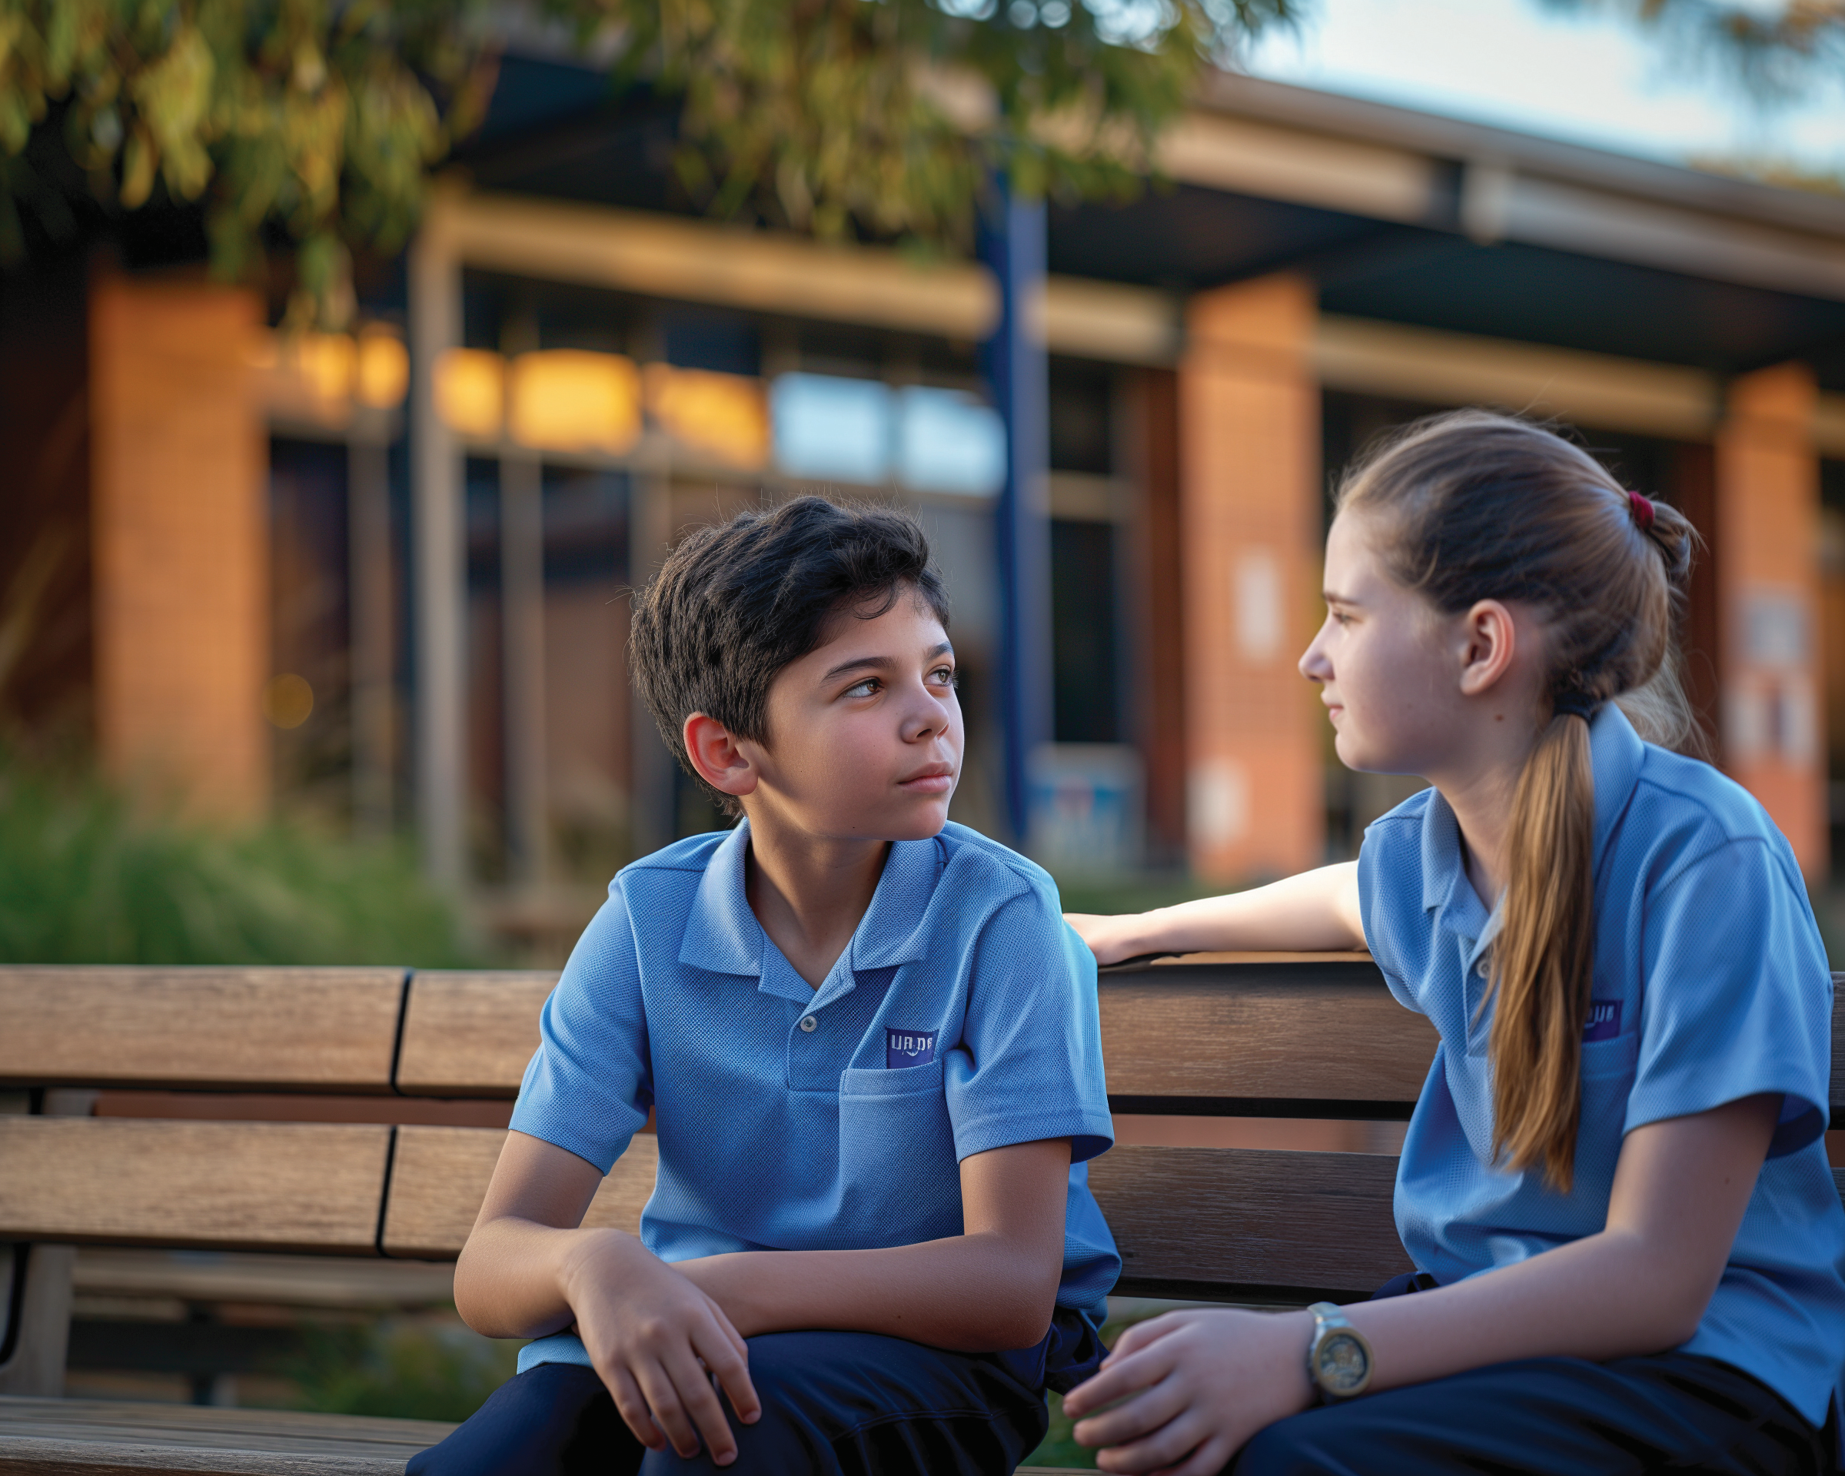
Boundaries are like the lid on a smoothie blender. They keep everything safe and working well just like the smoothie blender lid keeps the smoothie from spilling and making a mess.
Why is it important to set boundaries in our friendships?
Pair/share.

Slide 5
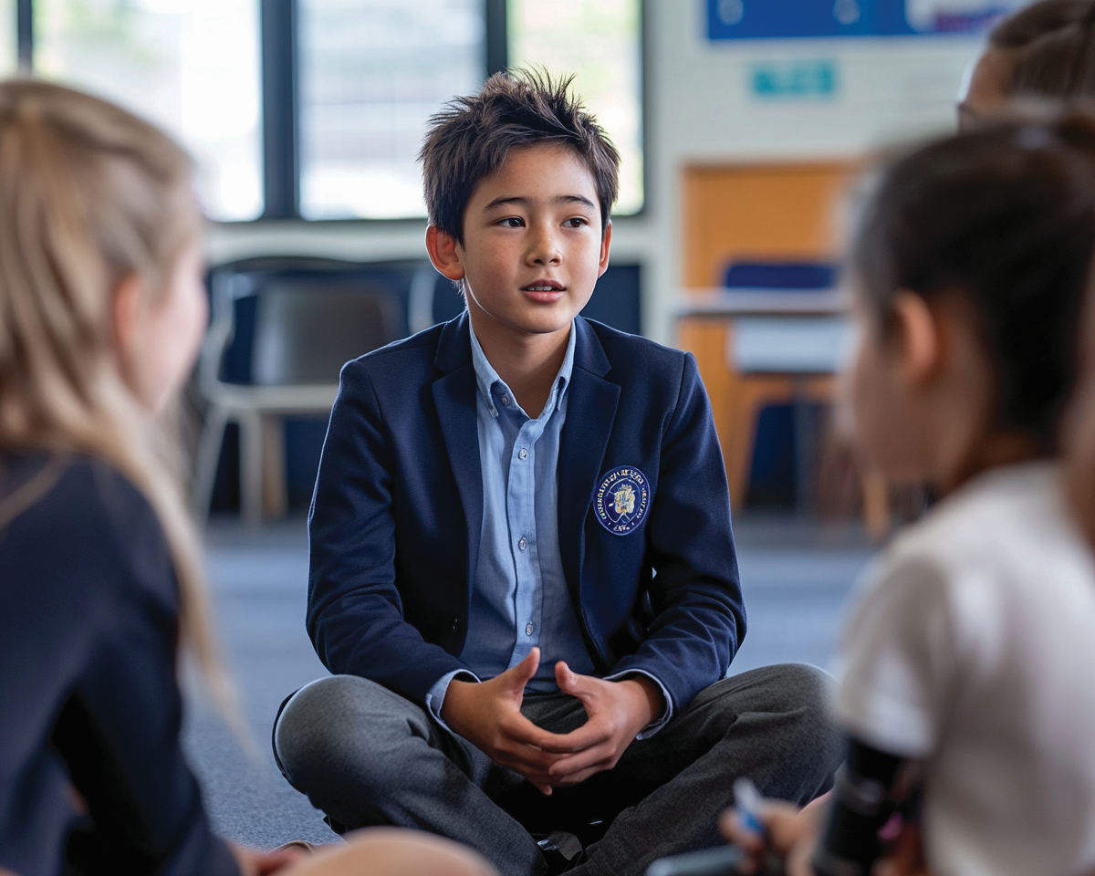
In this lesson, you will practice listening to and respecting opinions that are different from your own.

Slide 6

You will be successful when you can:
explain why people might think differently
respond to different opinions respectfully.

Slide 7
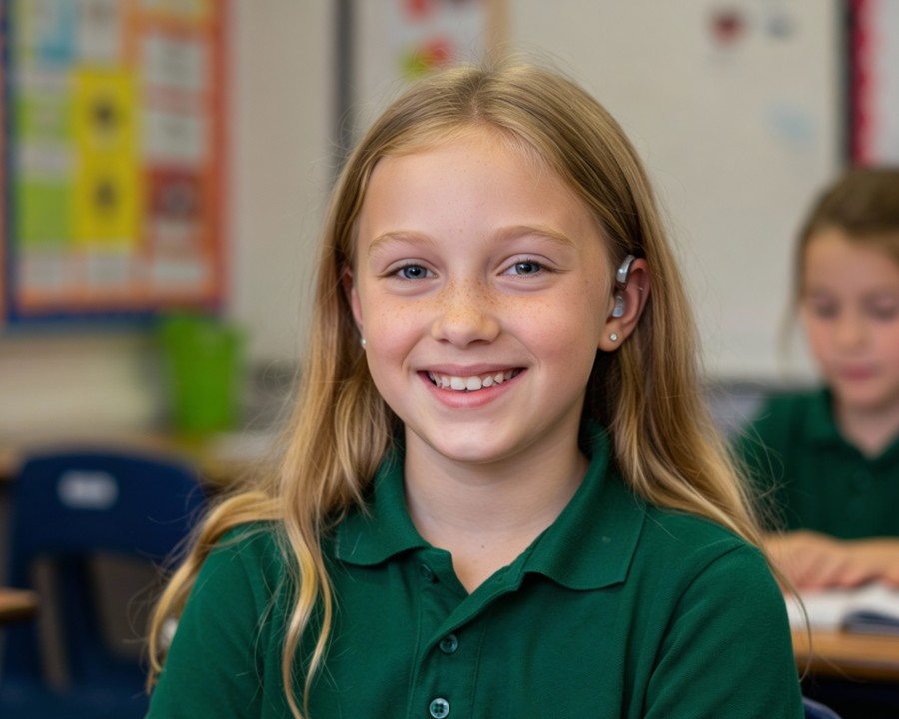
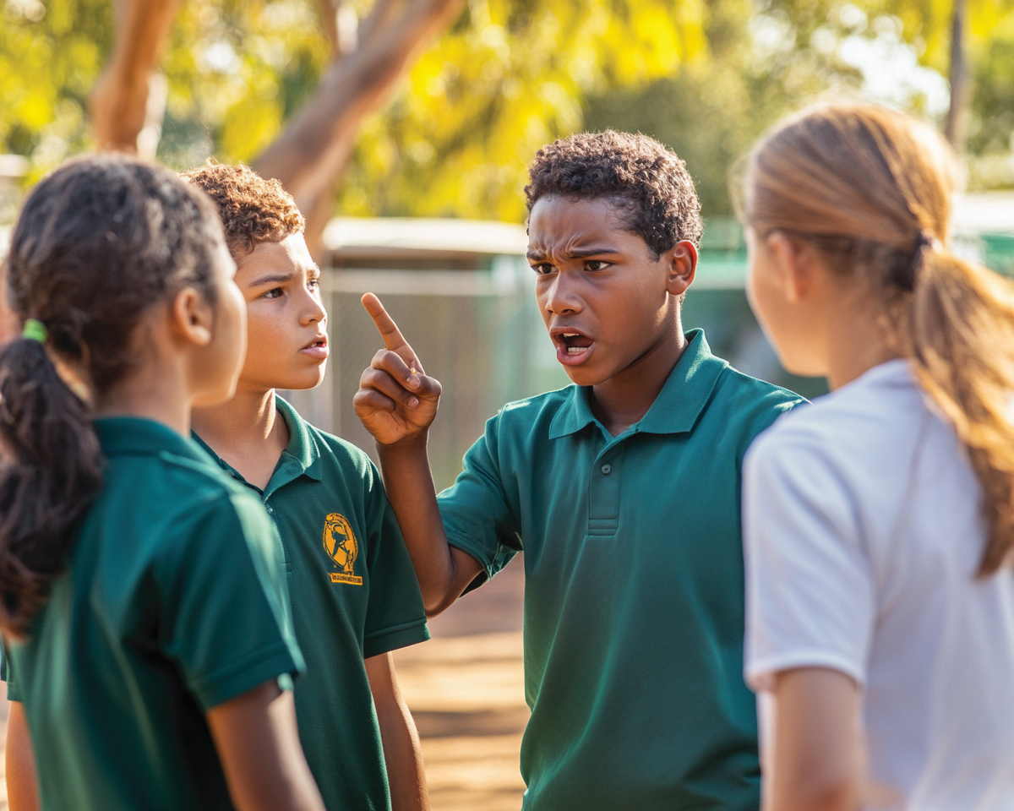
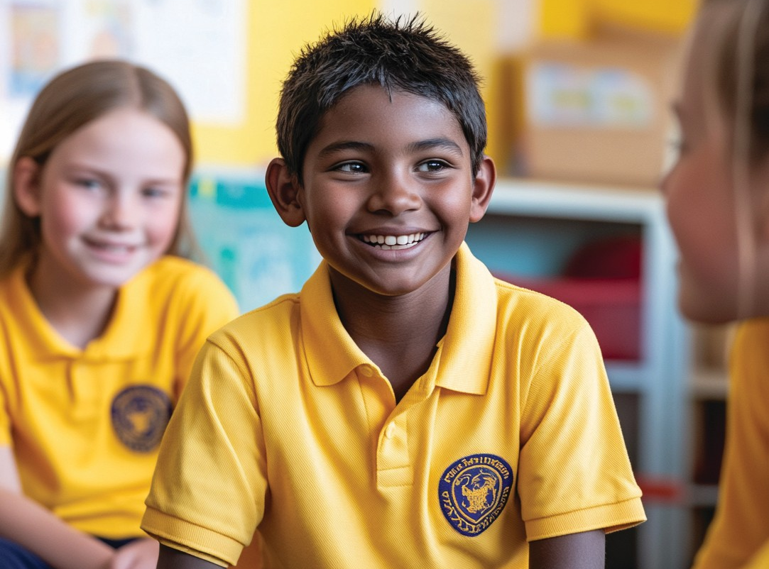

Slide 8
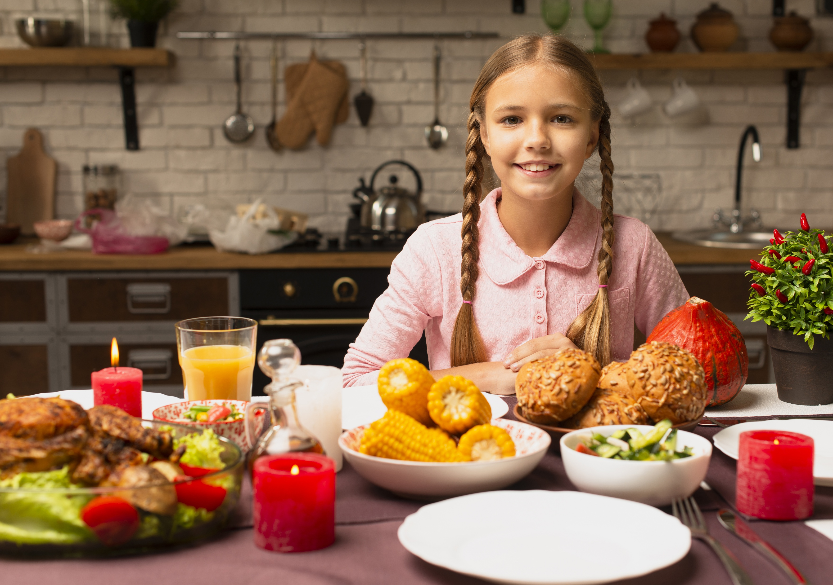
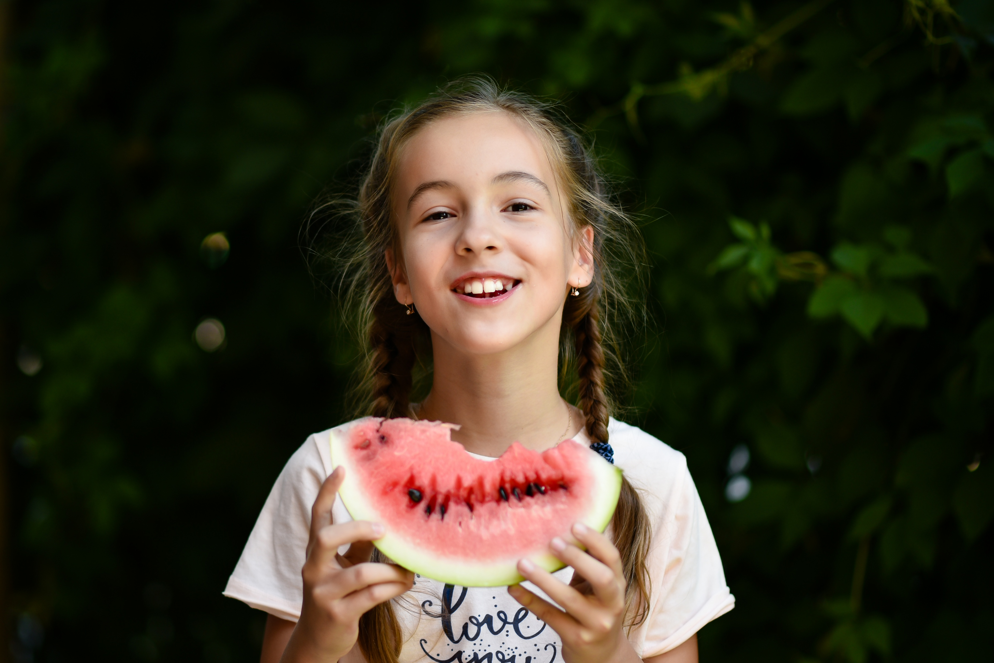
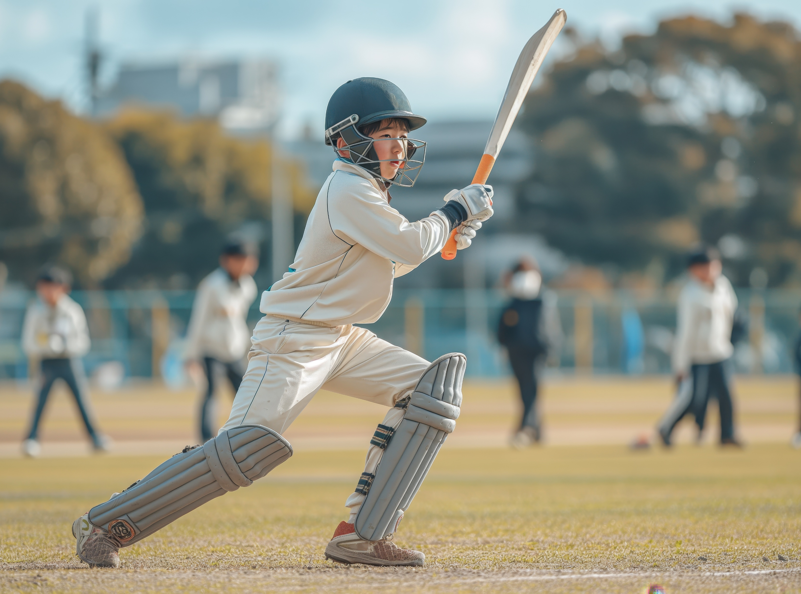
Different Opinions

Slide 9
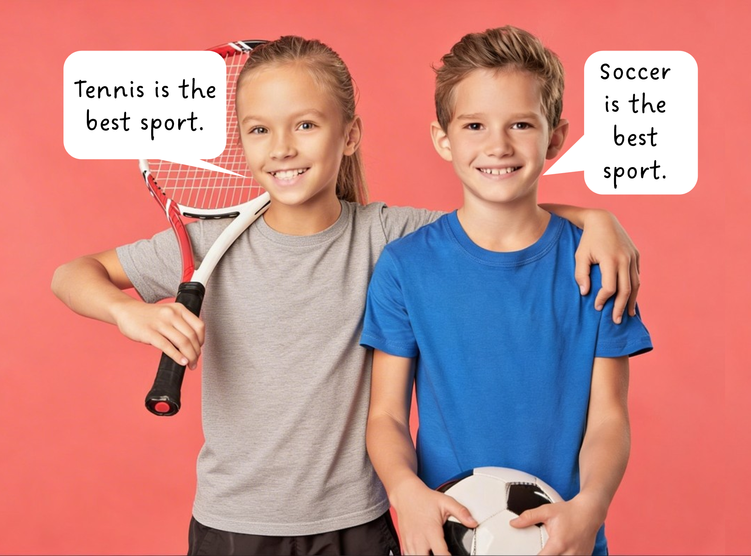
An opinion is a view we make about something or someone that isn’t necessarily based on facts. An opinion is a personal judgement, thought or belief.

Slide 10
Different Opinions
An opinion is a personal judgement, thought, or belief.
Is breakfast the most important meal of the day?
Is football the best sport?
Are strawberries the tastiest fruit?

Slide 11


Different Opinions
Is strawberry ice cream better than vanilla ice cream?
Agree
Disagree
Notes:
.

Slide 12


Slide 13
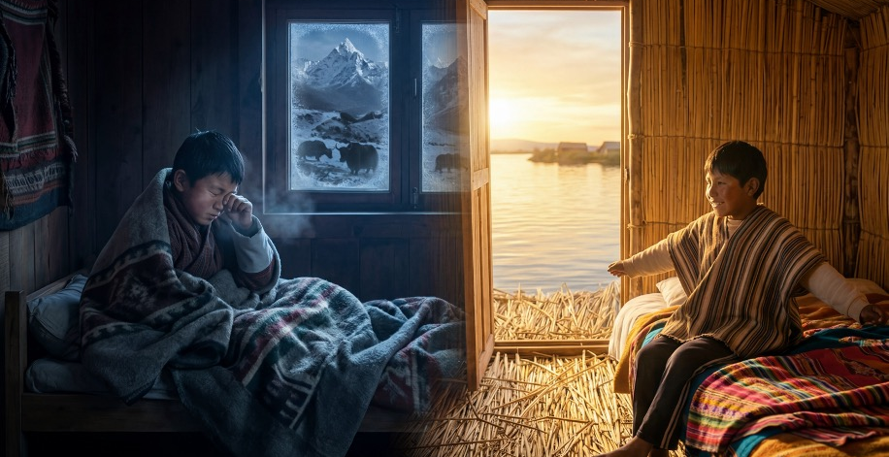
The sun hadn’t risen yet in the mountains of Bhutan when Tenzin stirred under his thick blanket, but he could already feel the cold air nibbling at his nose and hear the grunts of the yaks. His village sat high up in the Himalayas, where the air was cool and fresh. The sky outside his wooden window was still dark blue.
Far across the world in South America, the first light of dawn shimmered across Lake Titicaca as Amaru woke up on his floating reed island. He woke to the soft sloshing sound of the water beneath their home, which moved ever so slightly, rocking like a cradle. Even though the boys lived on opposite sides of the Earth, both were ten years old and were just beginning their day.

Slide 14
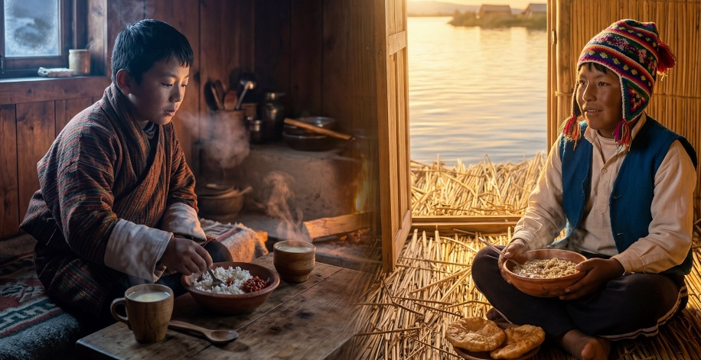
Tenzin stretched and quickly dressed in his gho, a traditional robe tied neatly at the waist. His mother was already in the kitchen, pouring him a warm bowl of butter tea and rice with a little chilli paste. Steam curled into the cold air as he ate.
Meanwhile, Amaru pulled on his woolly hat and his school uniform. They were warm clothes because even though the sun was rising, the lake air was chilly. He sat cross-legged on the soft, springy floor of his island home, made from layers of totora reeds. He ate his breakfast of quinoa porridge, and a piece of fried bread called tawa tawa.
Both boys ate quickly – they both had school to get to.

Slide 15
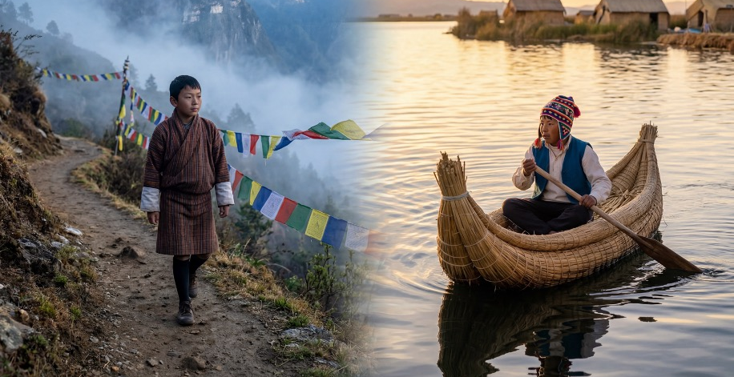
Tenzin’s school was perched high on a hillside, sometimes called a ‘school in the clouds’ because mist often drifted through the playground. He walked along a narrow dirt path, prayer flags fluttering in the wind as he passed.
Amaru’s journey was very different. He climbed into a small reed canoe, gently pushing off into the calm water. The lake shimmered around him as he paddled towards a nearby island where his school stood.
Even though their journeys were different – one on foot through mountains, the other by boat across water – both boys watched the world wake up around them.

Slide 16
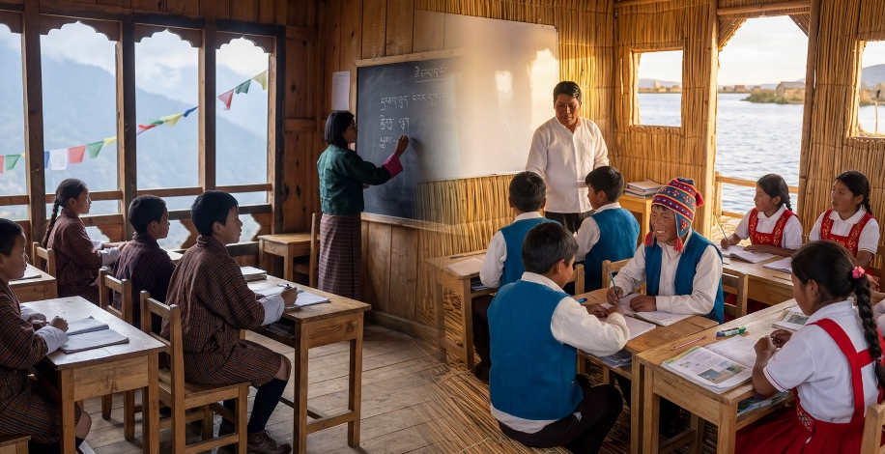
Tenzin’s classroom had wooden walls and large windows looking out over the mountains. Inside, students sat at desks, learning maths, reading, and Dzongkha (their national language). Sometimes, their teacher also told stories about Bhutanese culture, and she even wrote English words on the board. The windows rattled whenever the wind pushed against them.
Amaru’s school was simpler and floated just like his home island. It swayed gently during lessons, and he could hear the water bubbling below the soft floor. His class learnt Spanish, maths and science, and about the traditions of the Uros people who live on the floating islands.
Both boys worked hard and felt proud. Both boys laughed with their friends at break time.

Slide 17
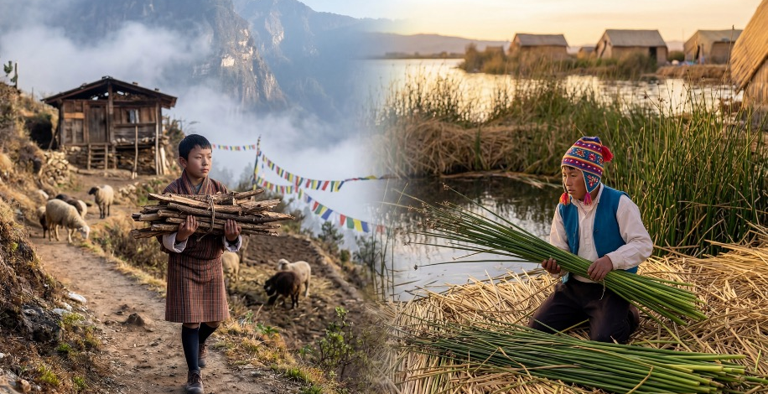
When the school day ended, Tenzin walked home under the bright afternoon sun. Chores waited for him. As soon as he arrived home, he collected the firewood, fed the sheep and carried water to the house from the well.
Meanwhile, Amaru paddled back across the lake, where he helped his family by trimming the fresh totora reeds for repairing the floating island and feeding their fish.
Their chores were different, but both boys worked hard to help their families.

Slide 18
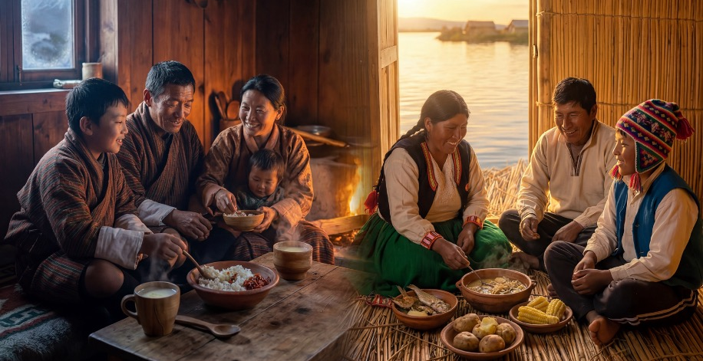
Dinner came as the sky darkened. Tenzin’s family gathered inside, and they shared ema datshi, a spicy cheese and chilli dish with vegetables, while they talked about their day.
On the floating island, Amaru’s family sat together as the sky turned orange over the lake. They ate fish soup, potatoes and corn, food that his family had grown nearby or caught fresh.
Both families shared stories and laughter as they ate.

Slide 19
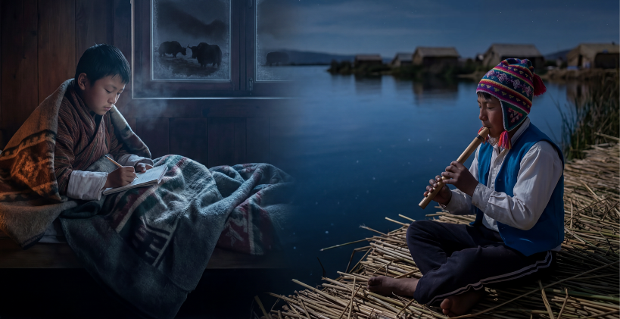
After dinner, Tenzin practised writing in his school notebook by the fire before listening to his grandparents tell stories. Soon, the mountain air grew cold again, and he climbed into bed under heavy blankets, listening to the yaks snorting outside.
On the Uros Islands, on the other side of the world, Amaru watched the stars reflect on the waters of Lake Titicaca. His family welcomed the visitors who came daily to see their amazing life on the floating islands as he played the small wooden flute his grandfather had taught him. Finally, he snuggled into his reed-walled bedroom, hearing waves lap gently beneath him.

Slide 20
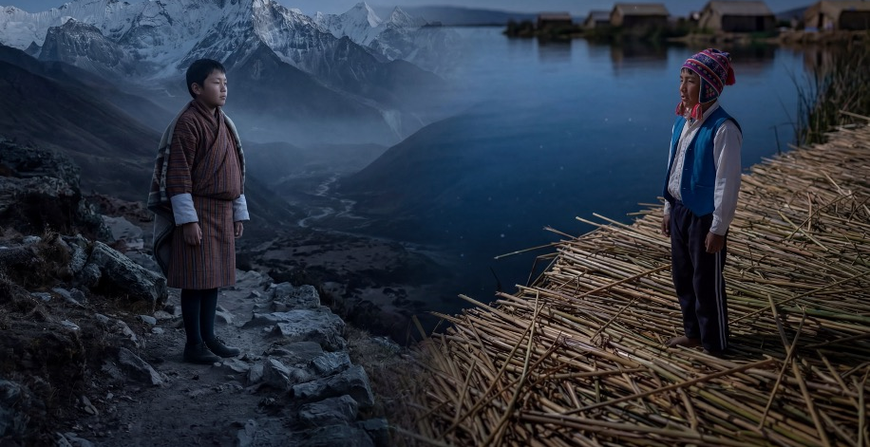
Two boys in two worlds – one among the mountains, one on floating islands – living different days in different ways, but they ended their day in much the same way: tired, warm, and dreaming of tomorrow.

Slide 21
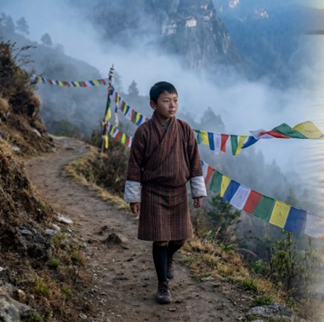
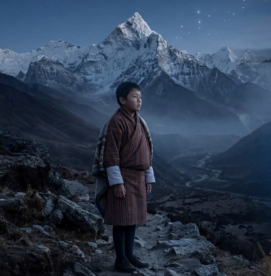
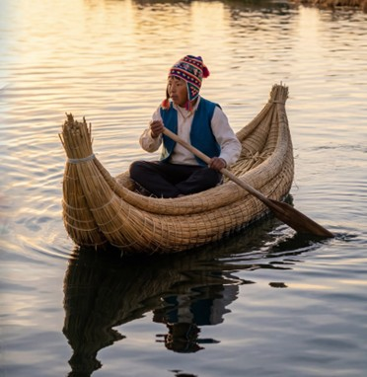


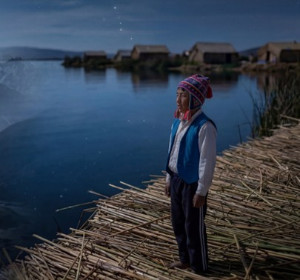
Tenzin and Amaru’s Life Experiences
What is the same about Tenzin’s and Amaru’s lives?
What is different about Tenzin’s and Amaru’s lives?
What is the same? | What is different?
They live in houses with their family. | Tenzin lives in the mountains and Amaru lives on an island.
They go to school.
Tenzin walks to school and
Amaru goes by boat.

Slide 22
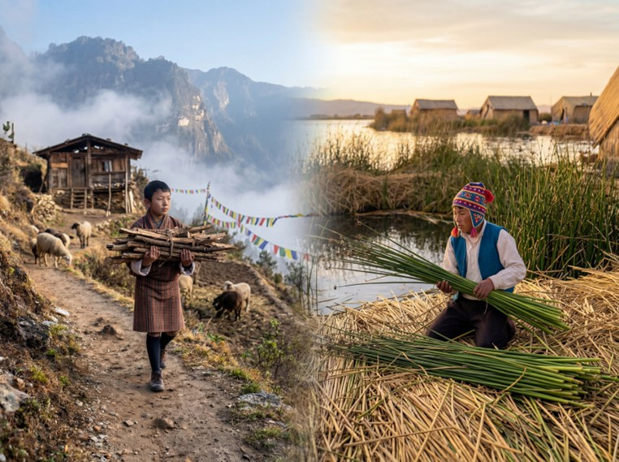

Tenzin and Amaru’s Life Experiences
What is the same about Tenzin’s and Amaru’s lives?
What is different about Tenzin’s and Amaru’s lives?
Pair/share.
What is the same? | What is different?
They live in houses with their family. | Tenzin lives in the mountains and Amaru lives on an island.
They go to school.
Tenzin walks to school and
Amaru goes by boat.

Slide 23


Life Experiences Influence Us
People’s life experiences influence how they see the world and what they believe.
What they eat influences what they prefer to eat.
How they travel influences what feels normal to them.
What they learn influences what they think and believe.

Slide 24

Responding Respectfully in 3 Steps
We show we have listened to them.
We share our opinion respectfully.
We stay open-minded by showing we are willing to think about other’s opinions.
Notes:
.

Slide 25
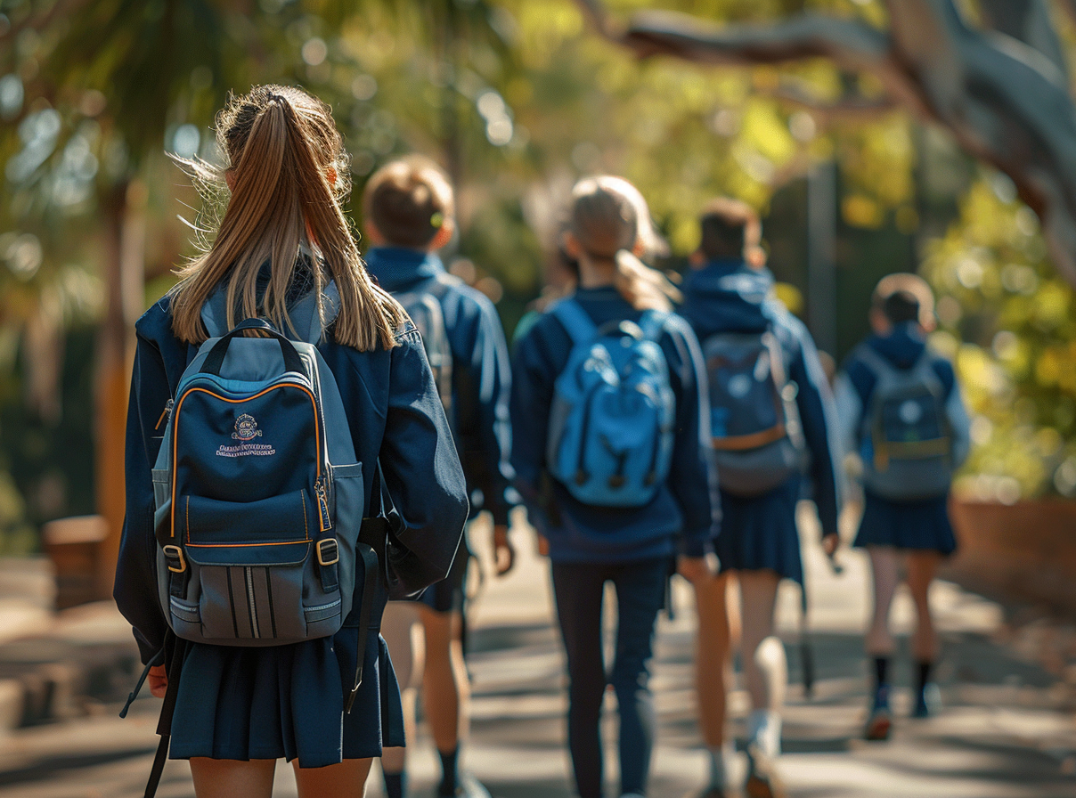
Responding Respectfully in 3 Steps
1. Listen
I think walking to school is better.
2. Share
3. Open-minded
1. I understand why you think that.
2. I see it a bit differently because I think travelling by bike is more exciting.
3. I’ll try walking tomorrow instead.

Slide 26
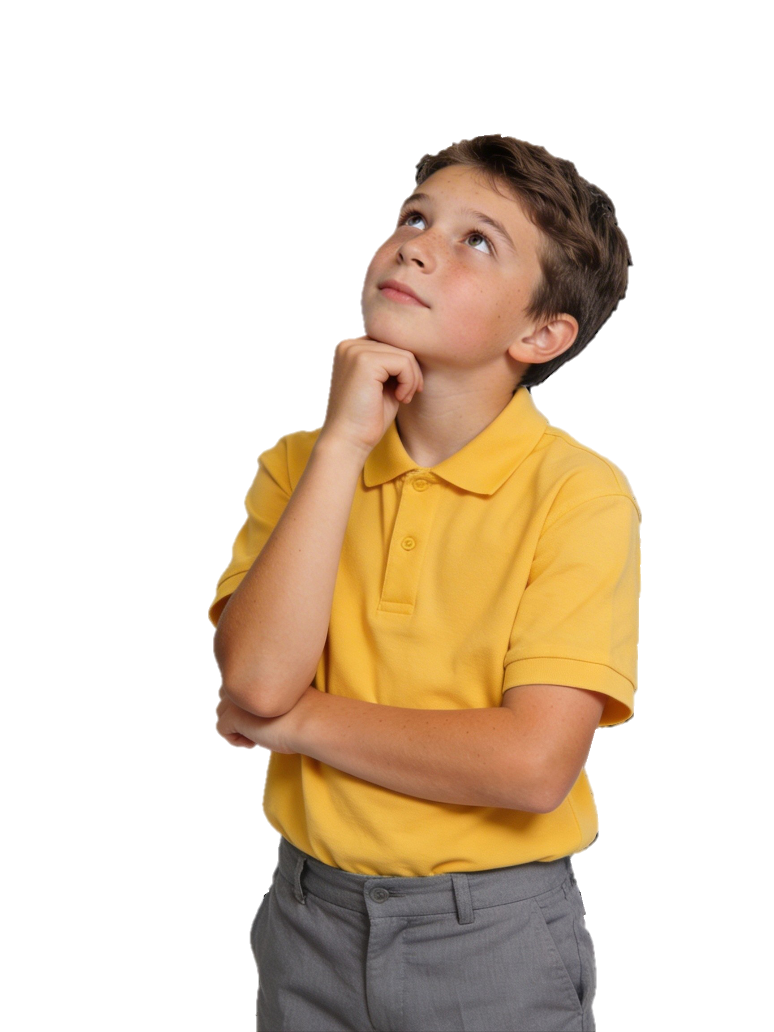
Responding Respectfully in 3 Steps
Listen. Share. Open-minded.
Everyone should speak one universal language.
Are movies better than books?
Maths is the most important subject to learn at school.
What’s
Your
Opinion?
Is social media a good idea?
What’s
Your
Opinion?
1. Listen
2. Share
3. Open-minded

Slide 27
Responding Respectfully in 3 Steps
Give a reason why people think differently to each other.
Explain one respectful thing you can say when someone gives a different opinion to you.

Slide 28
An opinion is a view we make about something or someone that isn’t necessarily based on facts. An opinion is a personal judgement, thought, or belief.
Our life experiences influence how we see the world and what we believe.
When we have a different opinion to someone else, we use three steps to respond respectfully: listen, share, be open-minded.

Slide 29



How well did you:
explain why people might think differently
respond to different opinions respectfully?

Slide 30
In the next lesson, we will learn how to resolve conflict in a mature and respectful way.

