Slide 1
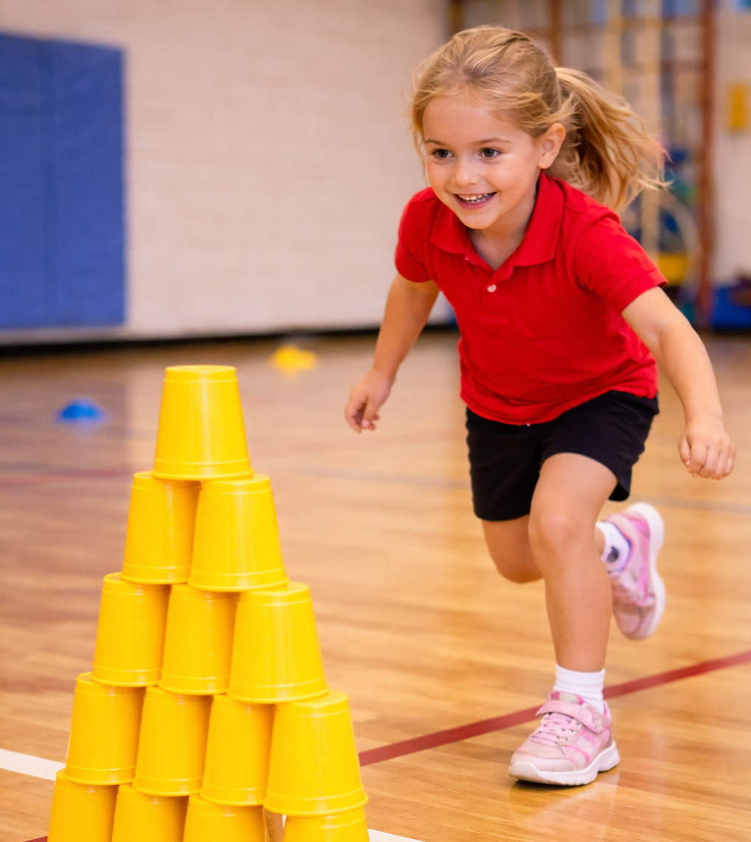
Ready, Set, Stack!
Unit 3: Better Together
Lesson 2
Lesson 6 (Extension 1)

Slide 2
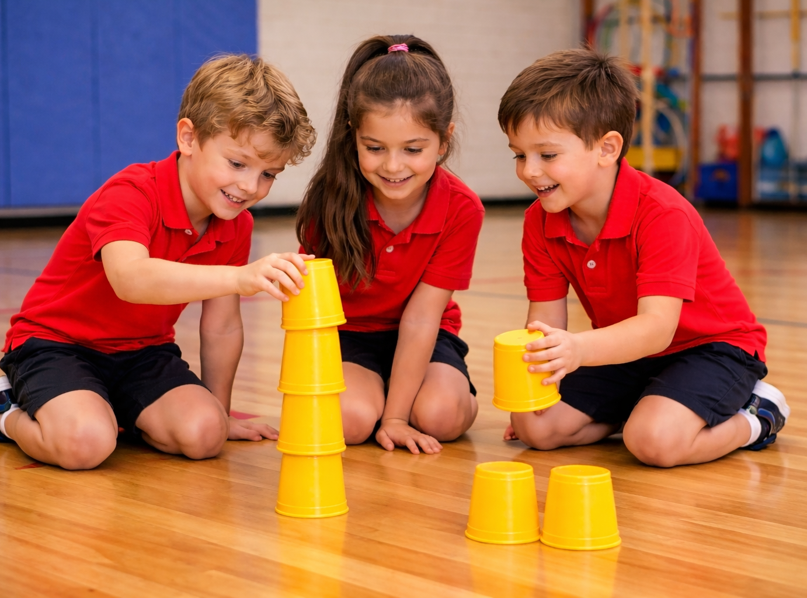
Lesson 2

Slide 3
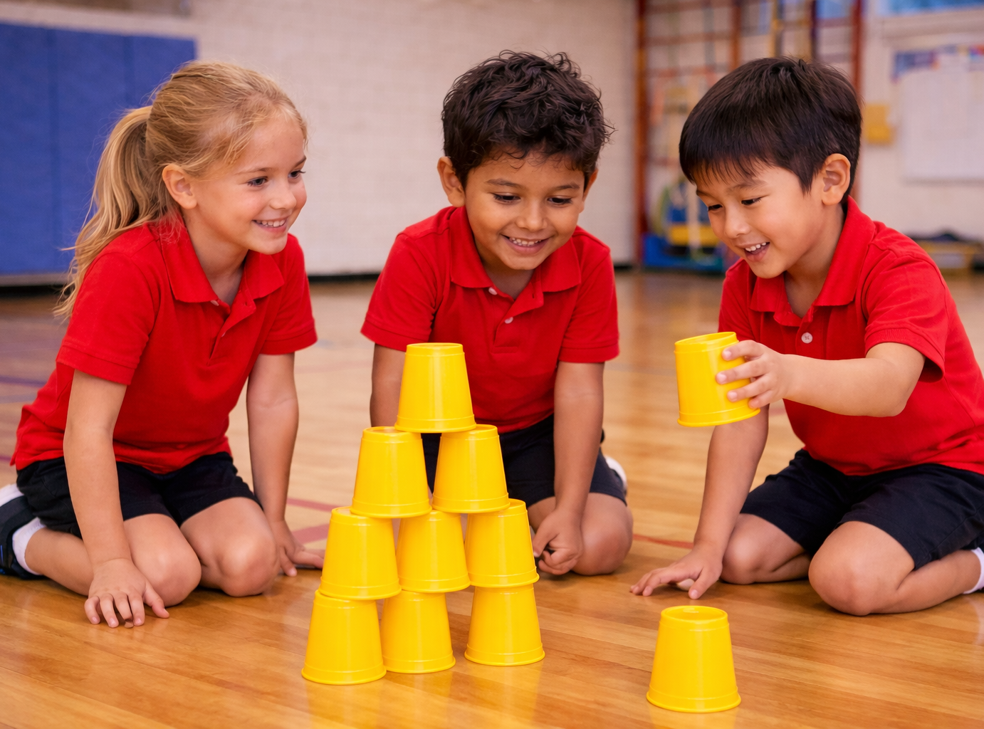
You will practise taking turns and waiting without interrupting.

Slide 4





Slide 5



Slide 6


Slide 7
Lesson 6 (Extension)

Slide 8
You will learn that offering help and working together make it easier to finish a task or game.

Slide 10

Fetcher
Stacker
Coach
Spotter
Holder

Slide 11
Fetchers
Stackers
Coaches
Spotters
Holders

