Slide 1
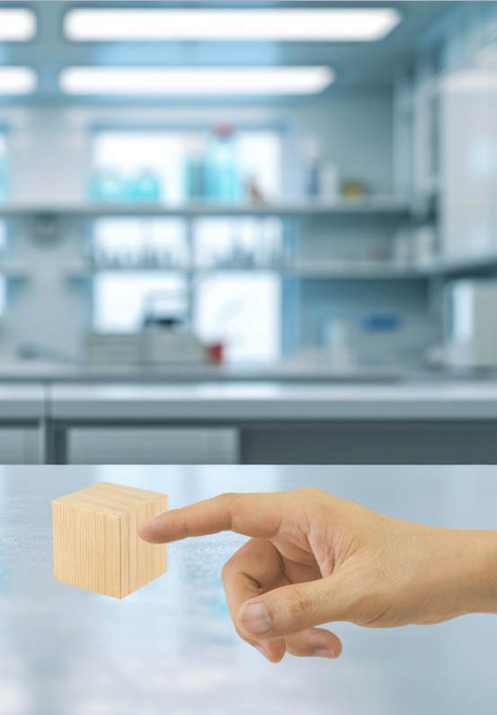
Science
Chemistry
Lesson 1 Part A
What is Matter?
Version 2

Slide 2

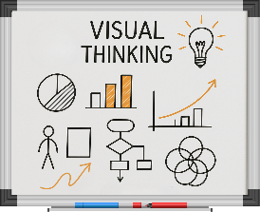
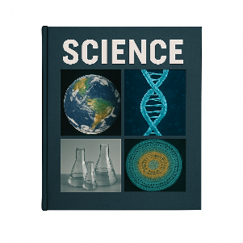








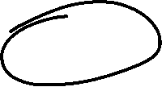
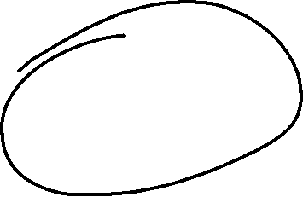
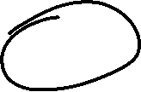





Remember what we’ve learned
Organise ideas
Helps put information IN
Show thinking
Purpose
Visualise thoughts
Helps take information OUT
Concept maps help us organise information and show how different concepts fit together.
You can see:
Last levels: details or subconcepts
Read information
Radiate outwards
Pictures
Centre circle: key idea
Words
Next level: main concepts

Slide 3
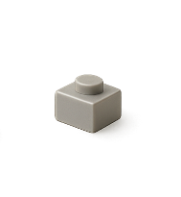
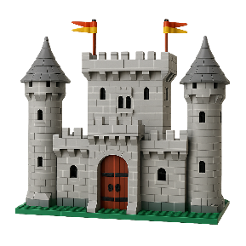
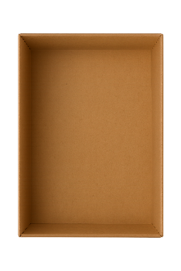



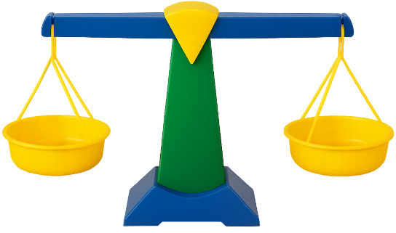
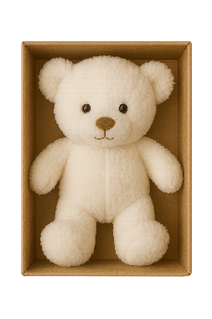




Takes up no space
Building blocks of matter
Too small to see
Nonmatter
Matter is made of tiny particles.
Particles
No mass
No particles
Matter
Mass
Takes up space
How much stuff something has

Slide 4
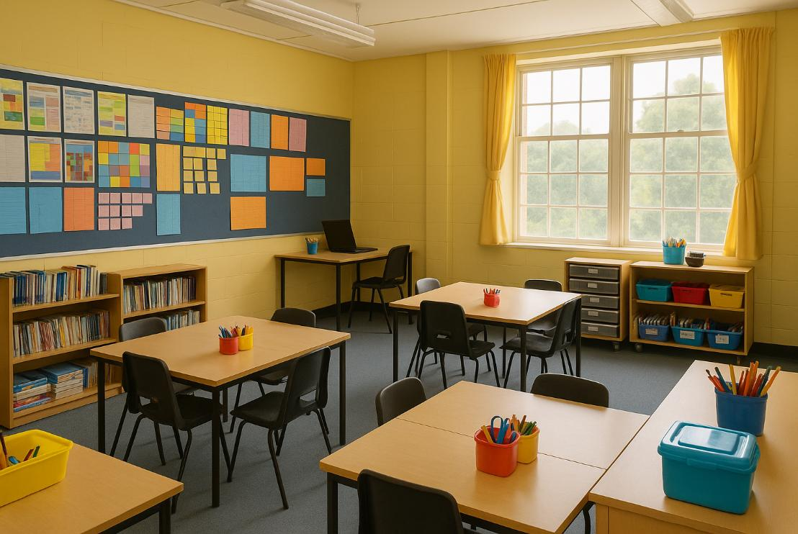
In this lesson, we will learn about matter.

Slide 5

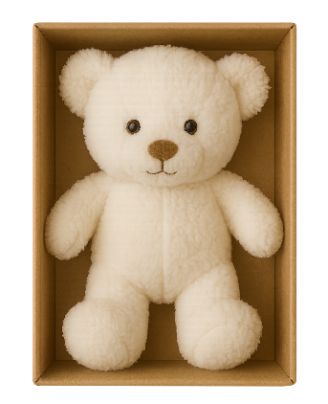
You will be able to: ​
test for mass and taking up space
record observations in a table
classify an example as matter or nonmatter.
Test: To find out how something works, behaves or how well it works.
Record: To write, draw or mark what you observe or measure.
Classify: To sort things into groups based on their properties.

Slide 6
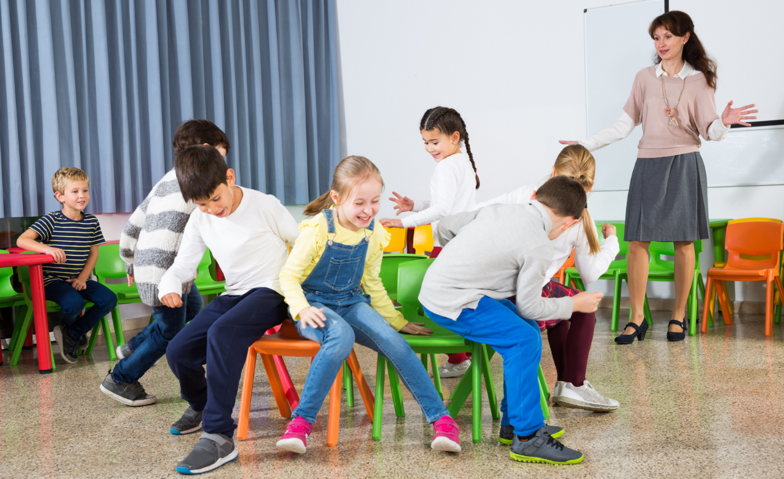
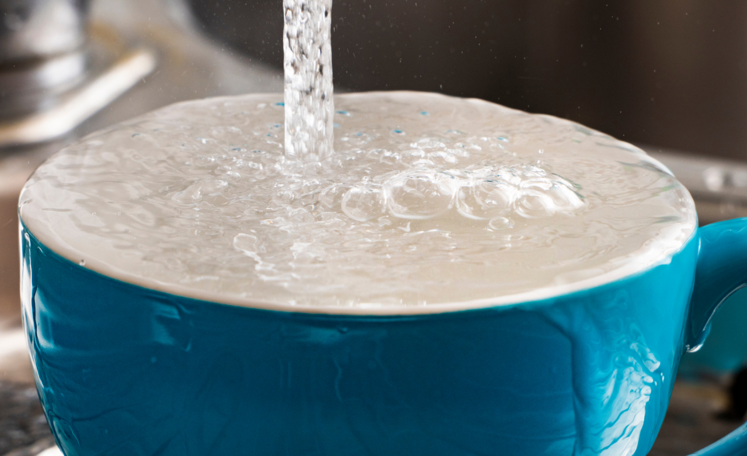

Slide 7

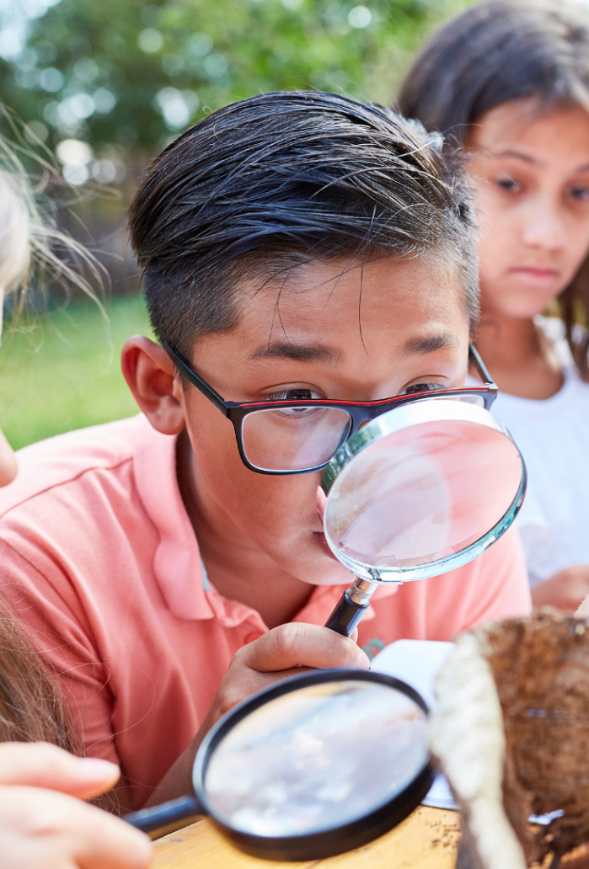




Slide 8
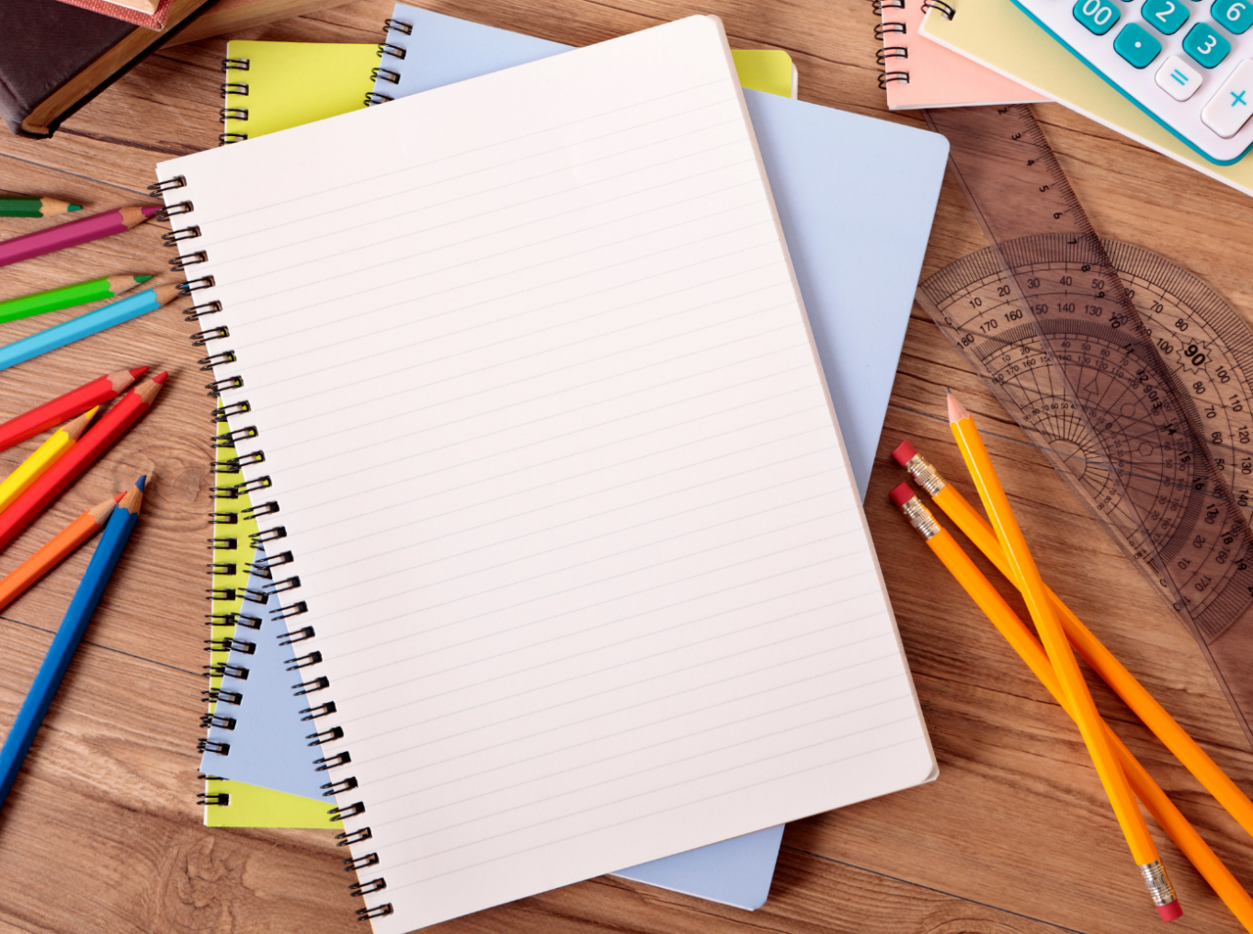
Look around. Everything takes up space – the pencil on your desk, the book in your bag, the water in your cup. Scientists have a word for this stuff. They call it matter.
Matter is anything that has mass and takes up space. If an object fills space so that nothing else can fit there, and if it has mass, it is matter.

Slide 9

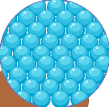



More mass
Less mass

Slide 10
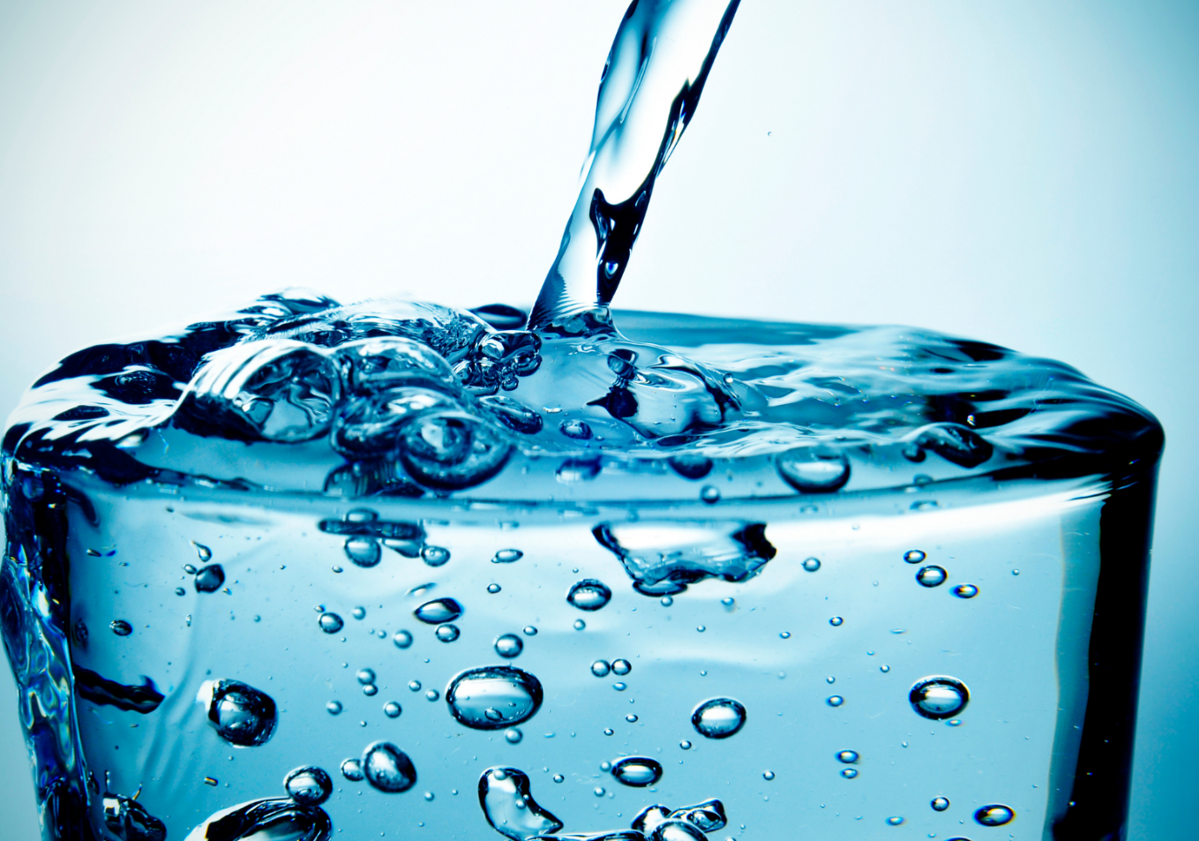
Takes up space

Slide 11
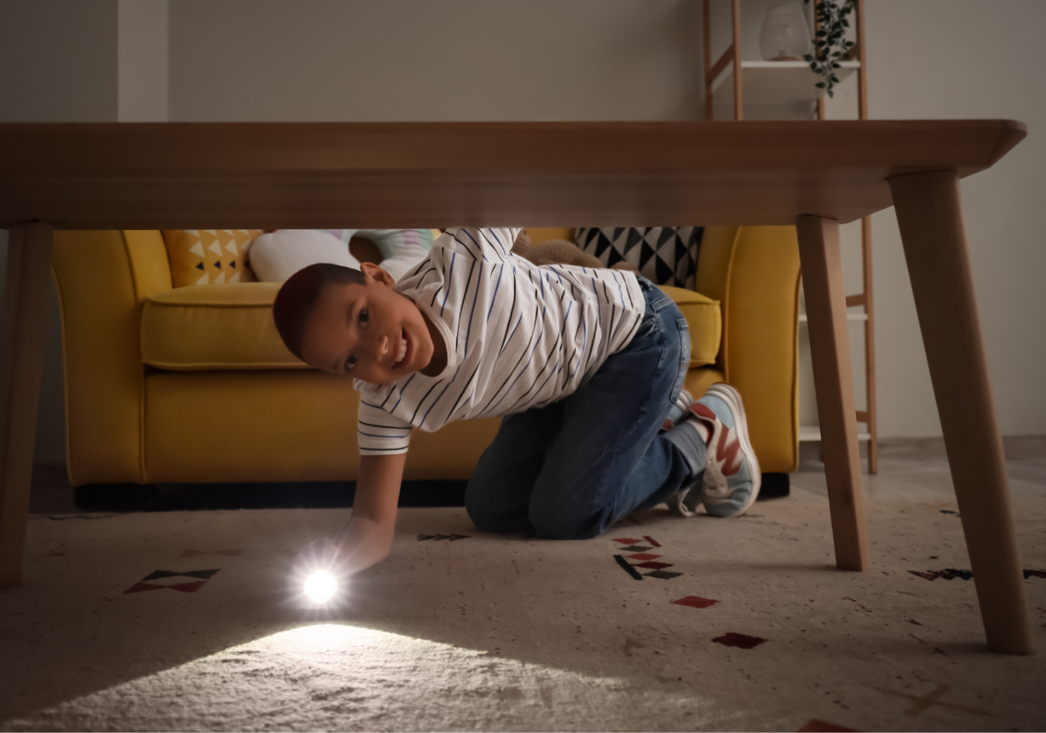

No mass

Slide 12
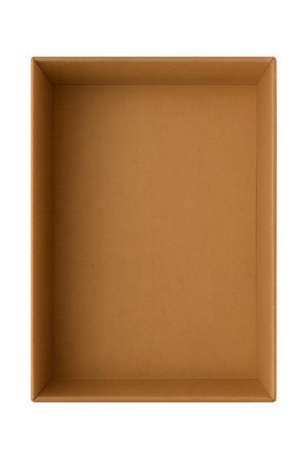
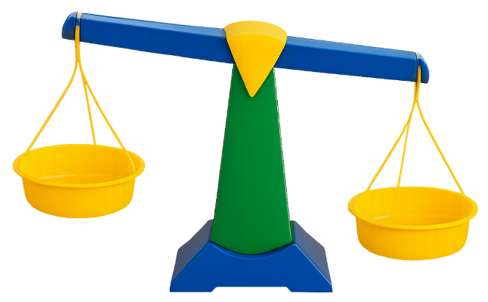
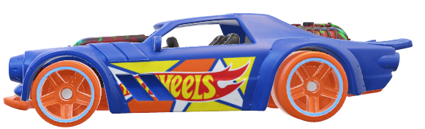


Does the object have mass?
Does the object take up space?

Slide 13
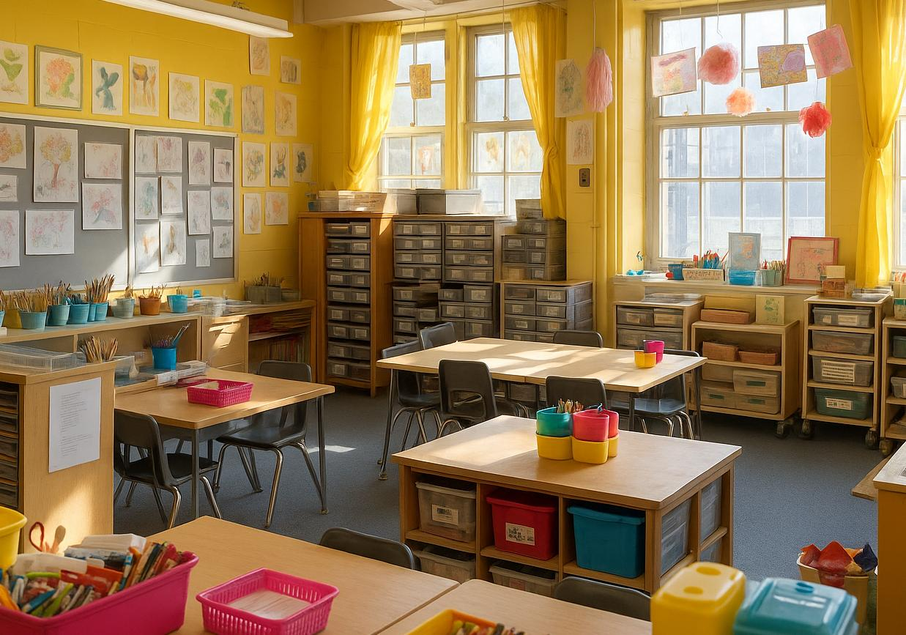


Slide 14

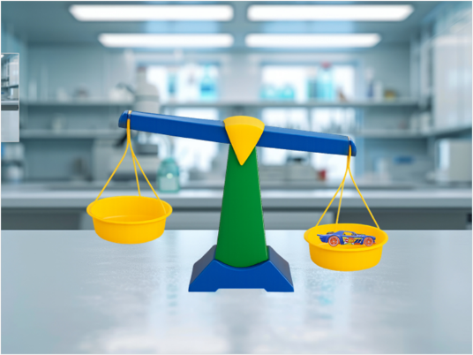
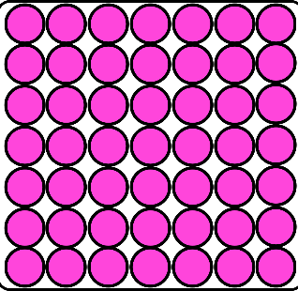
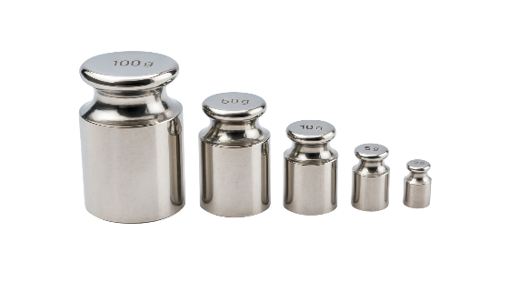
mass – The measure of how much matter is in an object. All objects and materials that are matter have mass.
matter – Anything that has mass and takes up space. It is made up of tiny parts called particles.
particle – A part of matter too small to see.

Slide 15
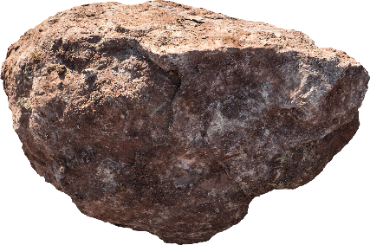
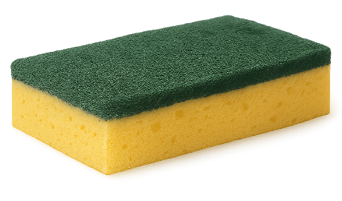
Mass and Matter
Two objects are the same size: a rock and a sponge.
Which statement best explains their mass?
They have the same mass because they are the same size.
The rock has more mass because it has more matter packed inside.
The sponge has more mass because it feels softer.

Slide 16
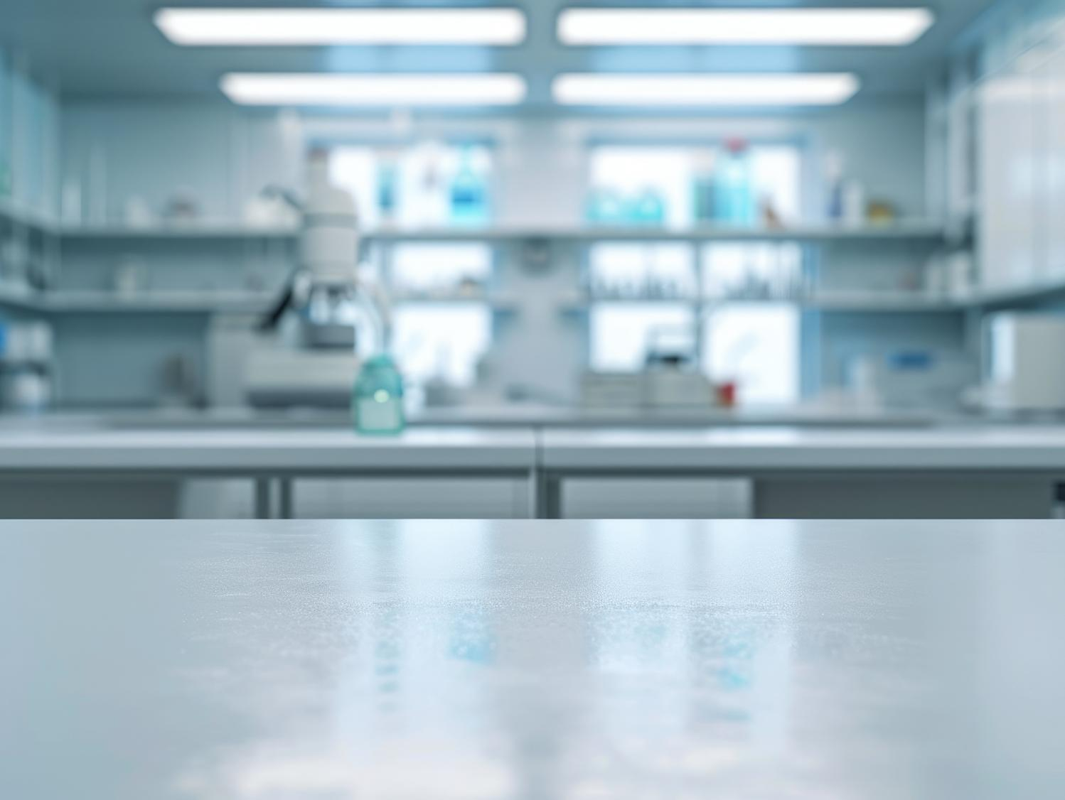
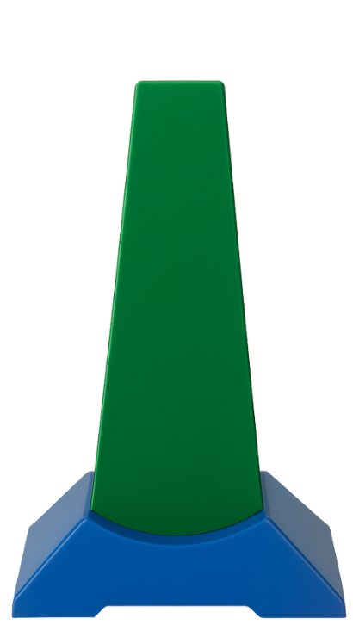
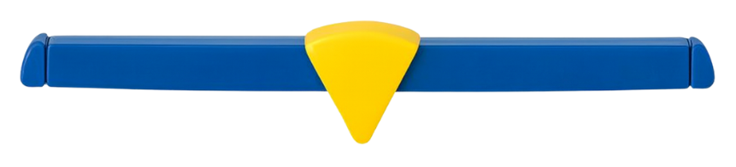
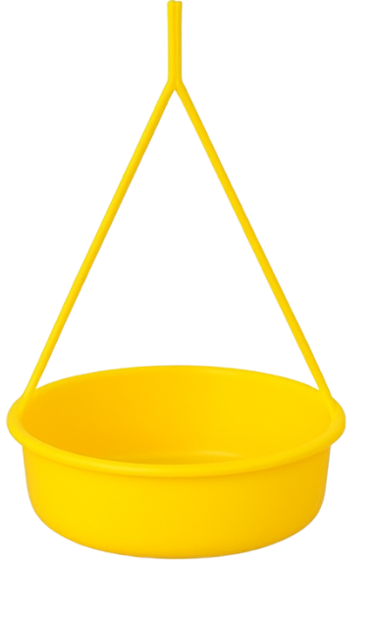
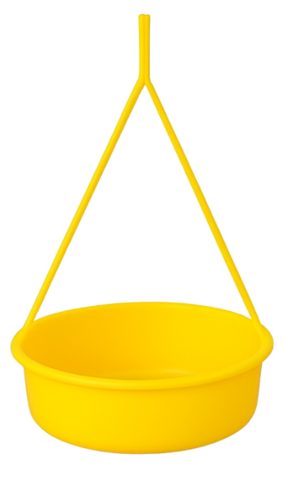
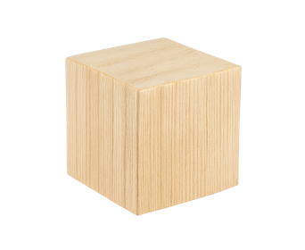
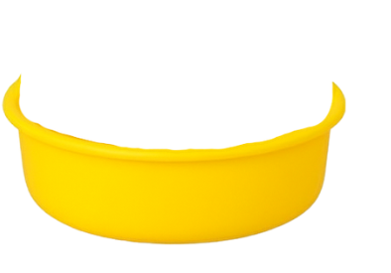
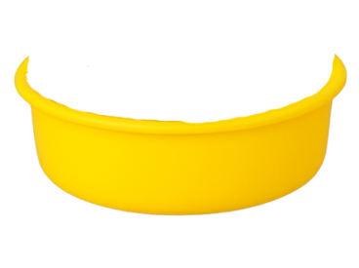

Slide 18
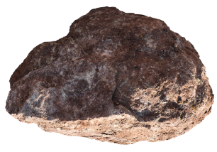

Slide 19
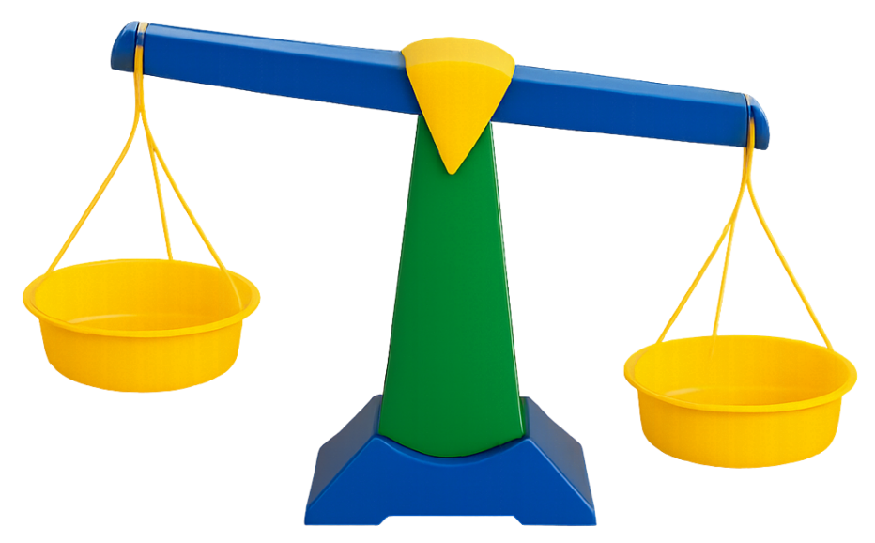

Evidence of Mass
Thumbs up if this shows that the eraser has more mass than the pencil.
Yes
No

Slide 20



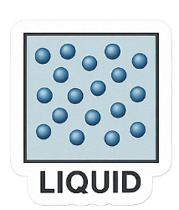

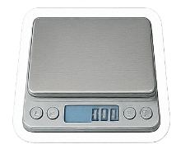
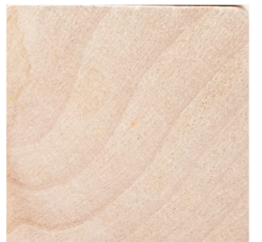
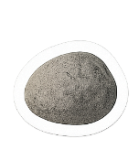
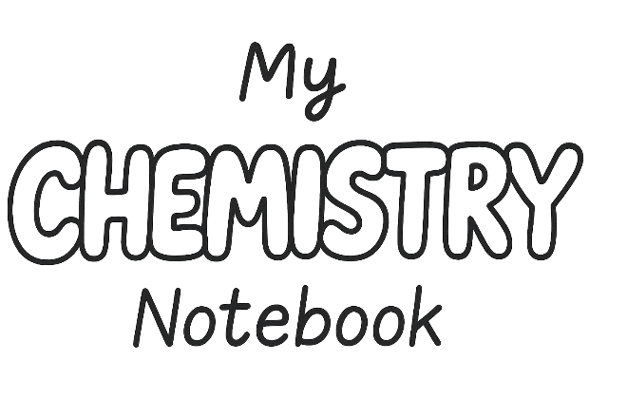

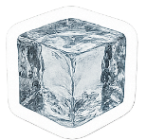
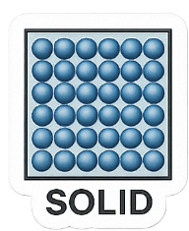
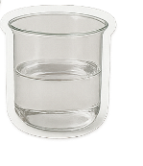
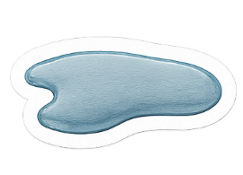


Slide 21
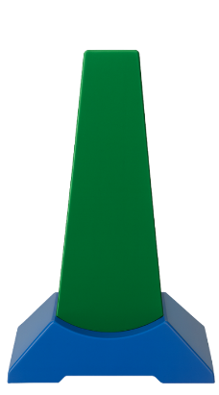
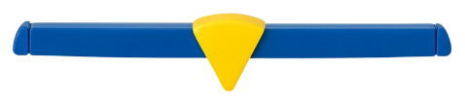





Matter
I Do: Wooden Block Mass Test
Matter Observations: Wooden Block
Example
Mass Observation
Space Observation
Is it Matter?
Wooden Block
Block side went down.

Slide 22

Matter
We Do: Rock Mass Text
Matter Observations: Rock
Example
Mass Observation
Space Observation
Is it Matter?
Rock
Rock side went down.

Slide 23



We tested a sponge, and the balance only went down a little. What could you write about the mass of the sponge in the table?
Sponge Mass Observation
Sponge
Example
Mass Observation

Slide 24



All Matter Takes Up Space
All matter has mass and takes up space.

Slide 25


Slide 26


Matter
I Do: Wooden Block Space Test
Matter Observations: Wooden Block
Example
Mass Observation
Space Observation
Is it Matter?
Wooden Block
Block side went down.
Finger cannot fit where the block is.

Slide 27


Slide 28

Matter
We Do: Rock Space Text
Matter Observations: Rock
Example
Mass Observation
Space Observation
Is it Matter?
Rock
Rock side went down.
Finger cannot fit where the rock is.

Slide 29


Evidence of Mass
Thumbs up if this picture shows that the sponge takes up space.
Yes
No

Slide 30




All Matter Takes Up Space
All matter has mass and takes up space.

Slide 31

Matter
I Do: Wooden Block Mass Test
A wooden block is matter.
Matter Observations: Wooden Block
Example
Mass Observation
Space Observation
Is it Matter?
Wooden Block
Block side went down.
Finger cannot fit where the block is.
Yes

Slide 32

Matter
We Do: Rock
A rock is matter.
Matter Observations: Rock
Example
Mass Observation
Space Observation
Is it Matter?
Rock
Rock side went down.
Finger cannot fit where the rock is.
Yes

Slide 33
Mass and Matter
Mass Test: The balance scale went down when the sponge was put on it.
Space Test: My finger could not fit in the same spot as the sponge.
Is the sponge matter?
Yes, the sponge is matter.
No, the sponge is not matter.

Slide 34



Slide 35


Matter
We Do: Light Mass Test
Matter Observations: Light
Example
Mass Observation
Space Observation
Is it Matter?
Light
Light side did not go down

Slide 36


Slide 37

Matter
We Do: Light Space Test
Matter Observations: Light
Example
Mass Observation
Space Observation
Is it Matter?
Light
Light side did not go down
Finger can go in the light

Slide 38
Matter
We Do: Light Space Test
Light is not matter.
Matter Observations: Light
Example
Mass Observation
Space Observation
Is it Matter?
Light
Light side did not go down
Finger can go in the light
No

Slide 39


What evidence would you need if you wanted to call light matter?

Slide 40

Matter
You Do: Pencil
A pencil is matter.
Matter Observations: Pencil
Example
Mass Observation
Space Observation
Is it Matter?
Pencil
Pencil side went down
Finger cannot fit where the pencil is
Yes

Slide 41

Matter
You Do: Paper Cup
A paper cup is matter.
Matter Observations: Paper Cup
Example
Mass Observation
Space Observation
Is it Matter?
Paper Cup
Paper cup side went down
Finger cannot fit where the paper cup is
Yes

Slide 42

Matter
You Do: Water
Water is matter.
Matter Observations: Water
Example
Mass Observation
Space Observation
Is it Matter?
Water
Water side went down
Finger cannot fit where the water is
Yes

Slide 43





Learn more
Teach someone
I understand
Challenging

Slide 44











Exit Ticket
Date: _________
Lesson 1A
Lesson 1A
You will be successful when you can:
describe properties of objects
sort objects into property groups.
Matter is anything that has _____ and takes up space.
A student tries to put a finger where a rock is on the desk, but the rock pushes it away. What does this show?
  The rock takes up space.
  The rock has mass.
  The rock is heavy.
A sponge is m______, because the balance scale went down and my finger could not fit in the same space.
mass
Describe means to tell what something looks like, sounds like, feels like or what it is.
volume
evidence
mass
Sort to put things that are the same together.
red
round
atter
crunchy
3
I know _____ out of 3 answers.

Slide 45


In the next lesson, we will learn about the particles in matter.

