Slide 1
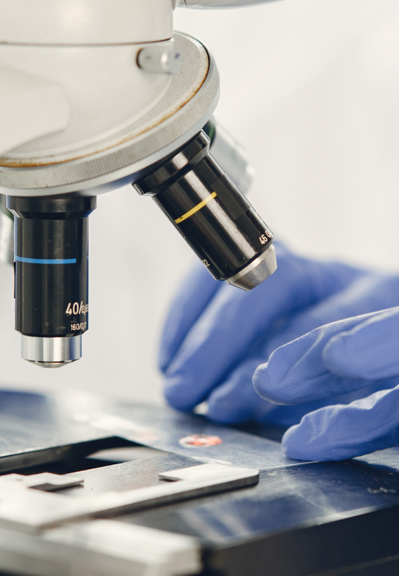
Science
Chemistry
Lesson 1 Part B
Particles of Matter
Version 2

Slide 2


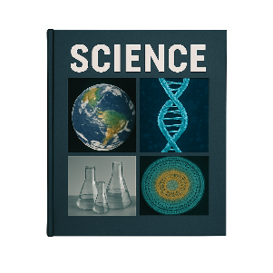








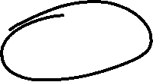
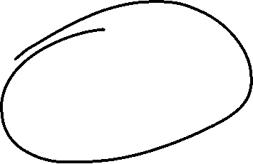






Remember what we’ve learned
Organise ideas
Helps put information IN
Show thinking
Purpose
Visualise thoughts
Helps take information OUT
Concept maps help us organise information and show how different concepts fit together.
You can see:
Last levels: details or subconcepts
Read information
Radiate outwards
Pictures
Centre circle: key idea
Words
Next level: main concepts

Slide 3
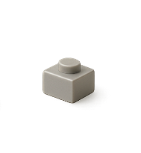
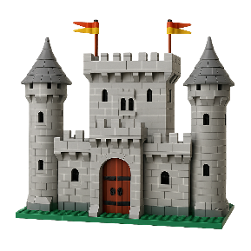
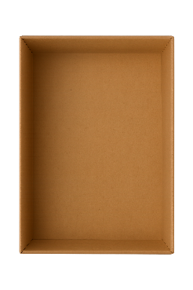



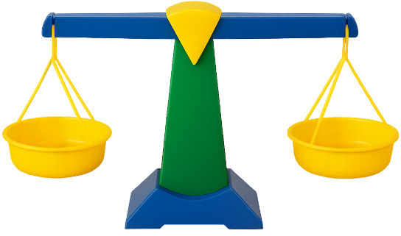
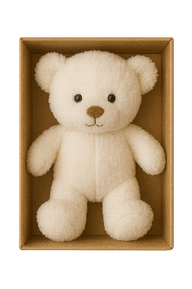




Takes up no space
Building blocks of matter
Too small to see
Nonmatter
Matter is made of tiny particles.
Particles
No mass
No particles
Matter
Mass
Takes up space
How much stuff something has

Slide 4
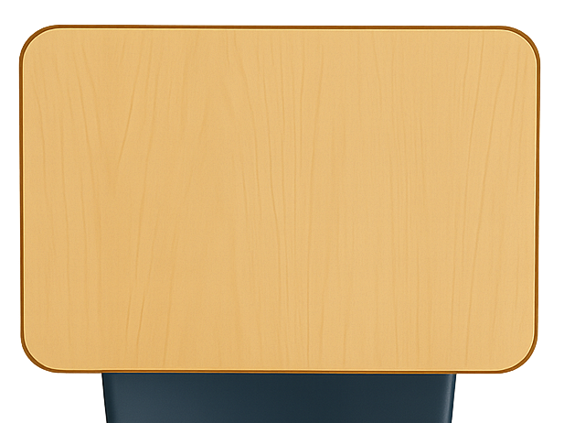


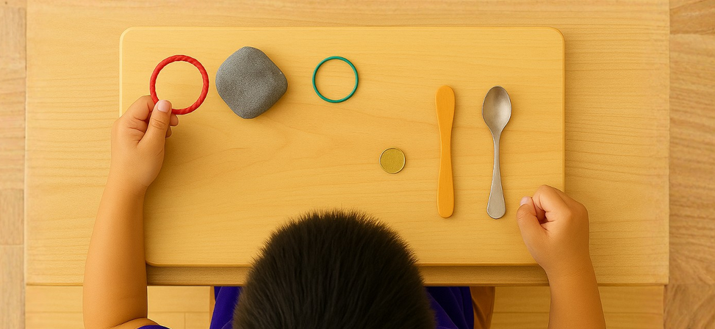
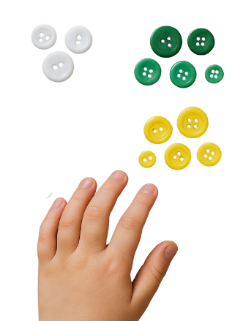
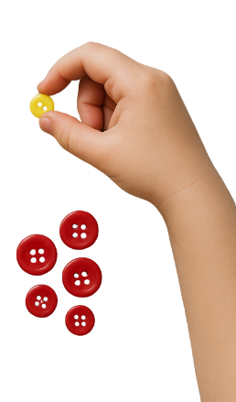
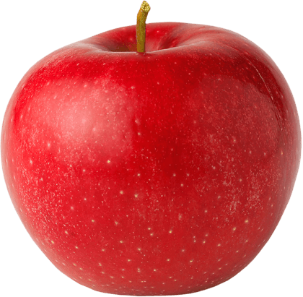




Revise
Exit Ticket
Date: _________
Lesson 1A
Lesson 1A
You will be successful when you can:
describe properties of objects
sort objects into property groups.
Matter is anything that has _____ and takes up space.
A student tries to put a finger where a rock is on the desk, but the rock pushes it away. What does this show?
  The rock takes up space.
  The rock has mass.
  The rock is heavy.
A sponge is m______, because the balance scale went down and my finger could not fit in the same space.
mass
Describe means to tell what something looks like, sounds like, feels like or what it is.
volume
evidence
mass
Sort to put things that are the same together.
red
round
atter
crunchy

Slide 5
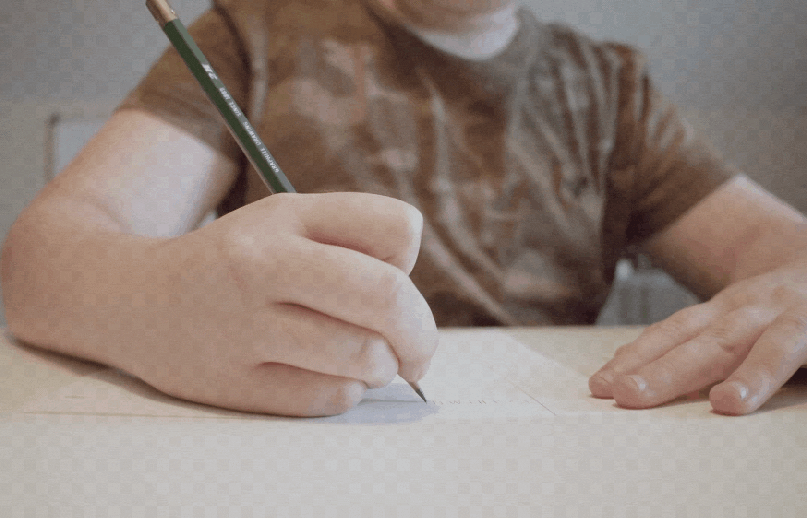
While writing on paper with a pencil, you hear a sound.
Which of those things are matter?
The pencil is matter.
The sound is matter.
Neither are matter.

Slide 6
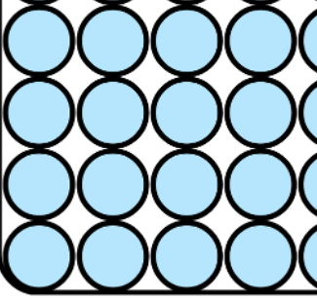
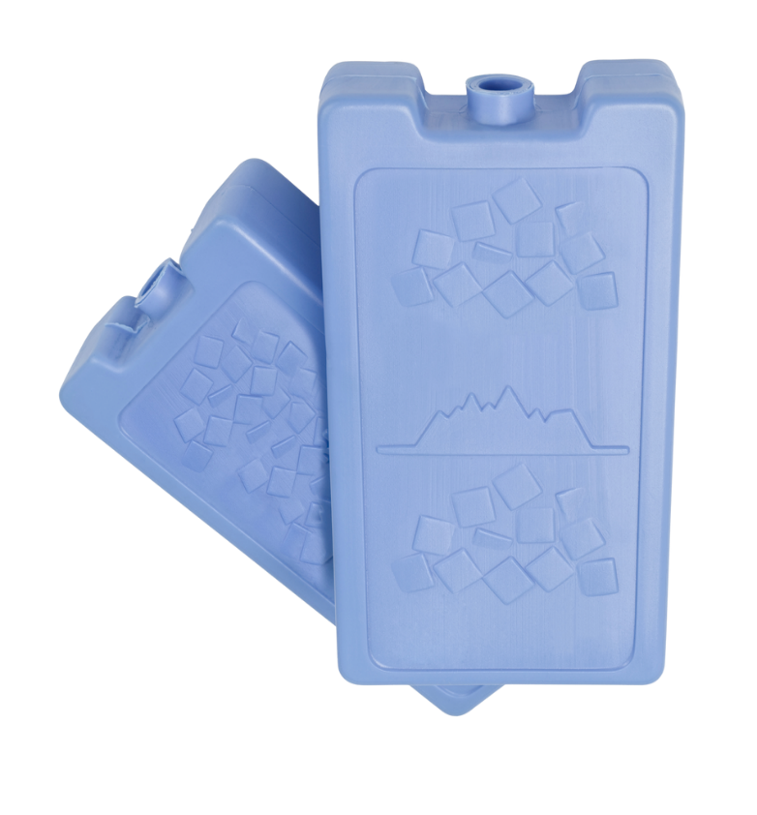
In this lesson, we will learn about the particles in matter.

Slide 7
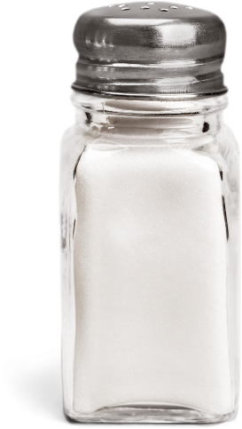
You will be able to: ​
interpret what a particle diagram means
model the particles for examples of matter.
Interpret: to explain what data, observations or models show.
Model: to create or use something to represent and explain.

Slide 8
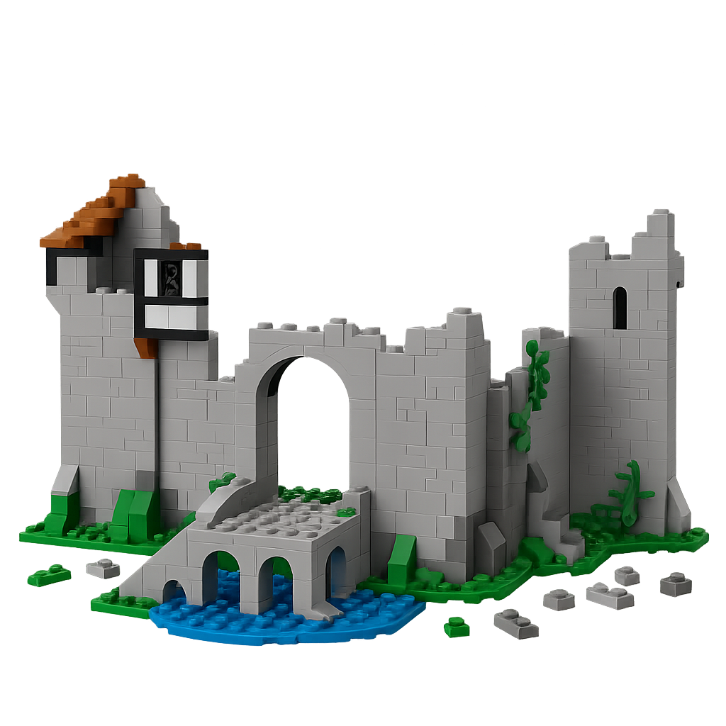
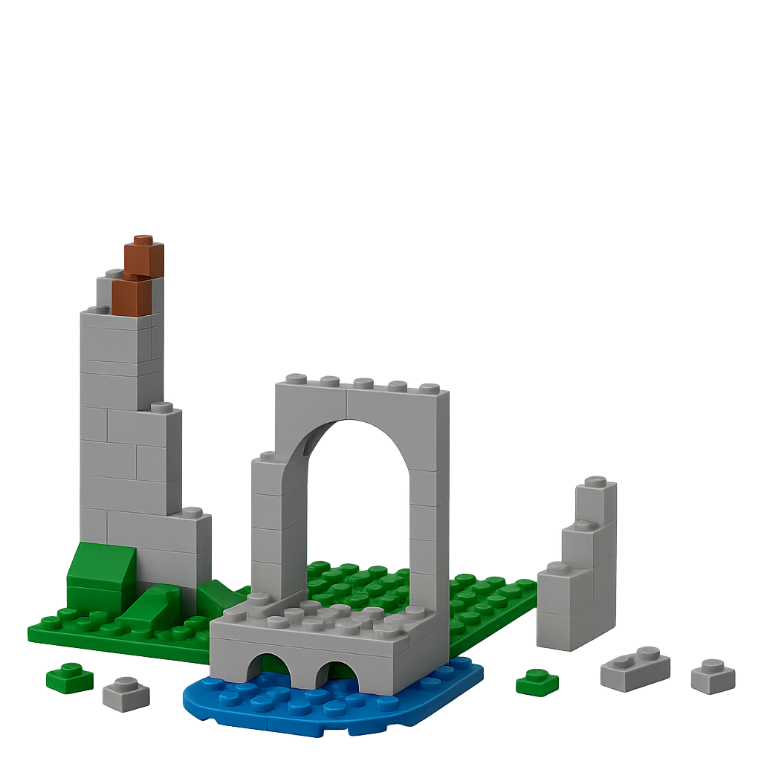
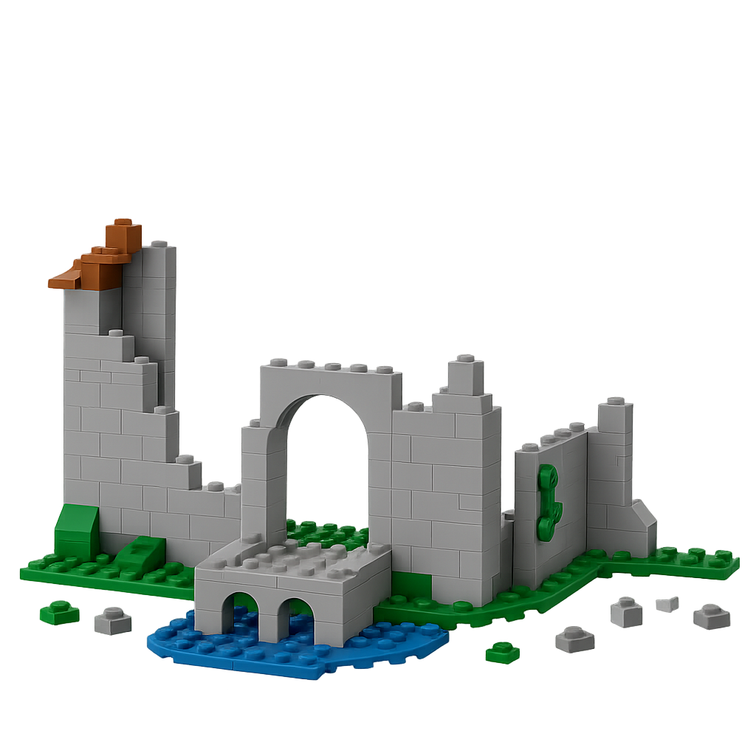
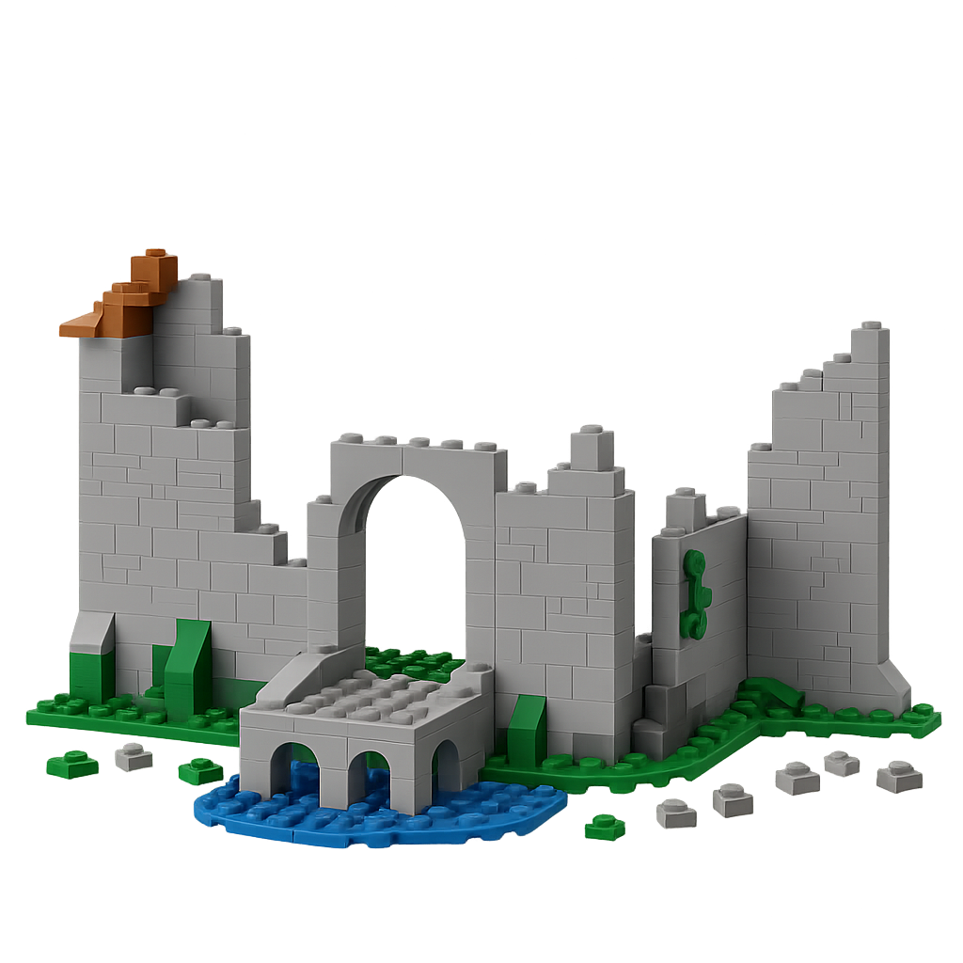

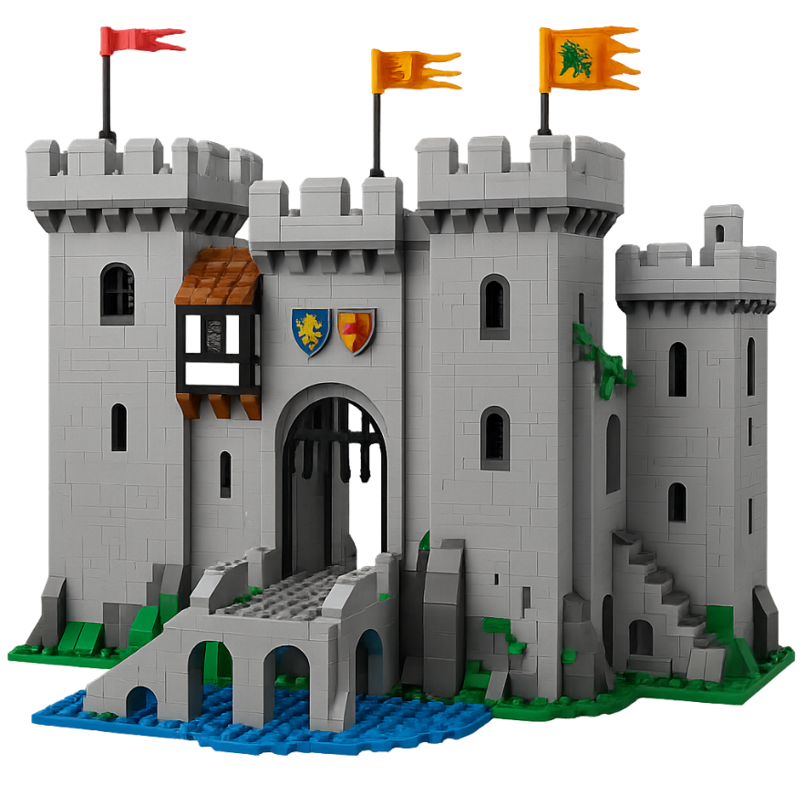
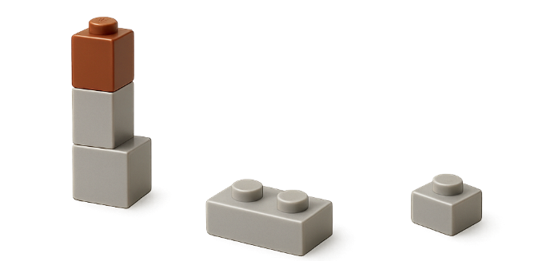


Slide 9
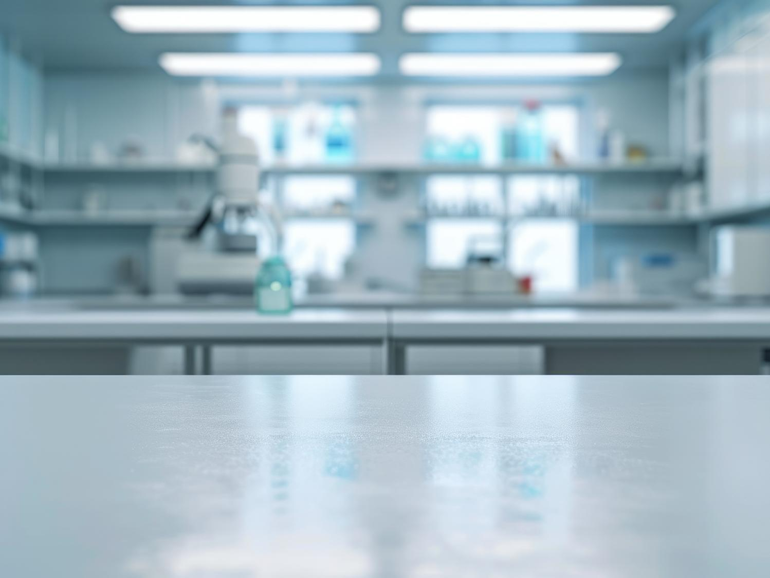
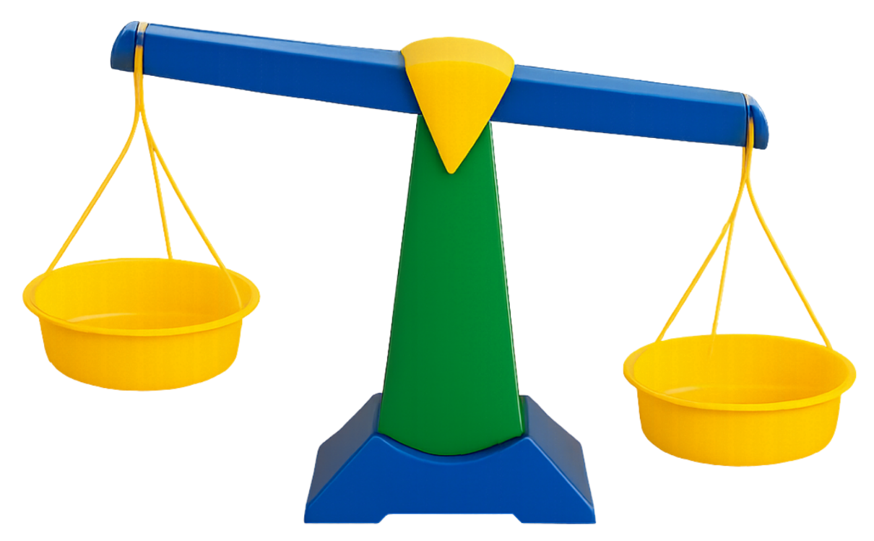
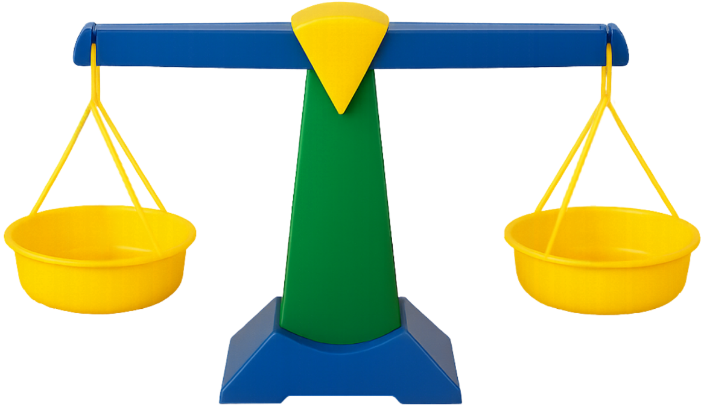

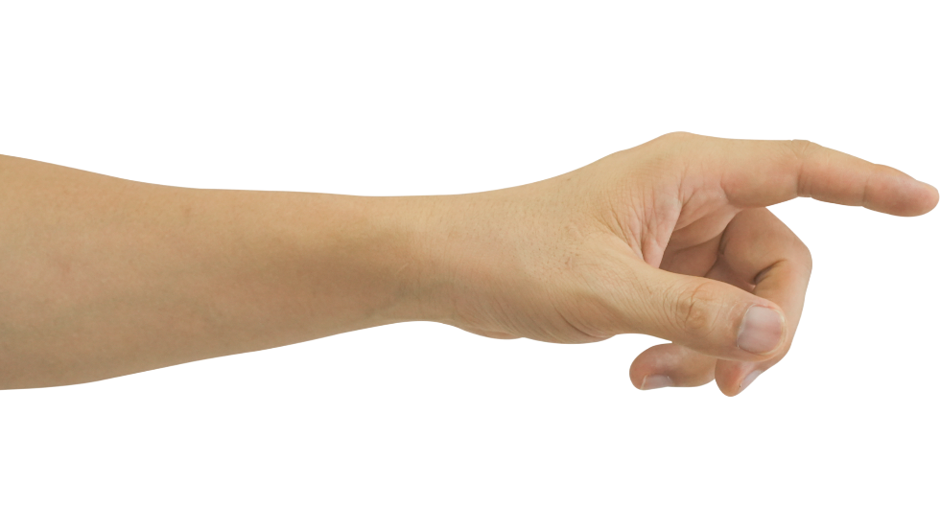
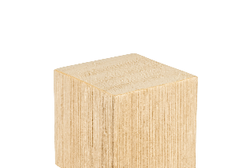
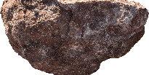
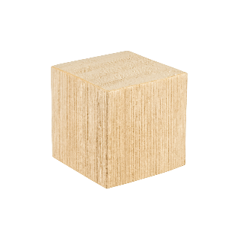
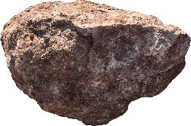
Matter Has Mass and Takes Up Space

Slide 10

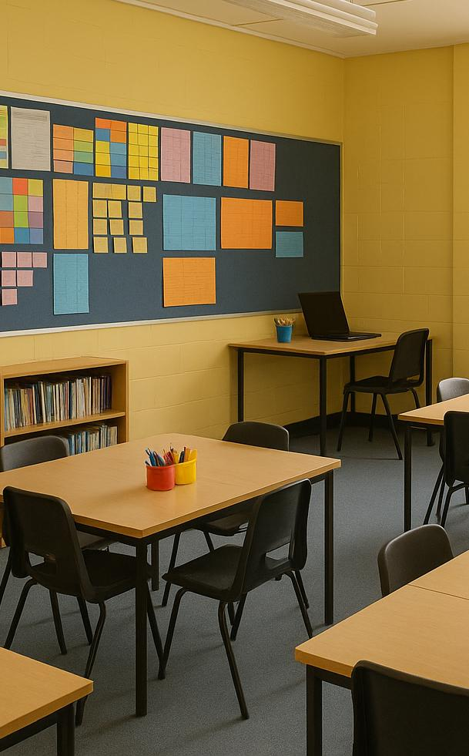




Slide 11
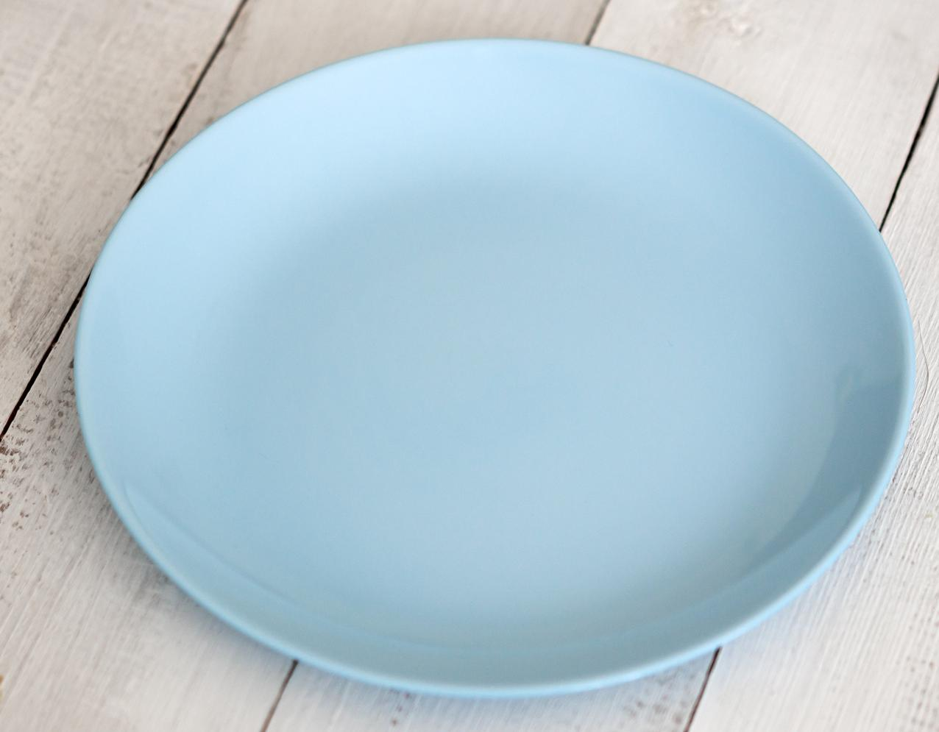
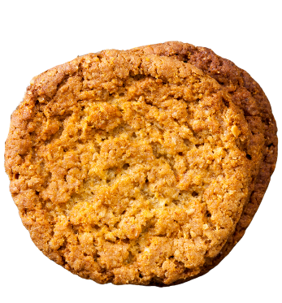
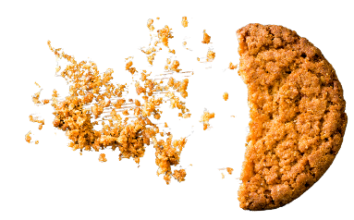
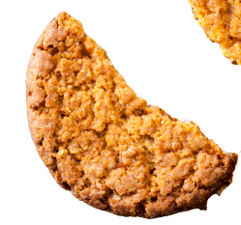
A biscuit is matter because it has mass and takes up space. When broken into smaller and smaller pieces, each piece is still a biscuit.
If it could be broken even smaller, it would reach pieces too tiny to see. Those smallest invisible pieces are what scientists call particles.

Slide 12
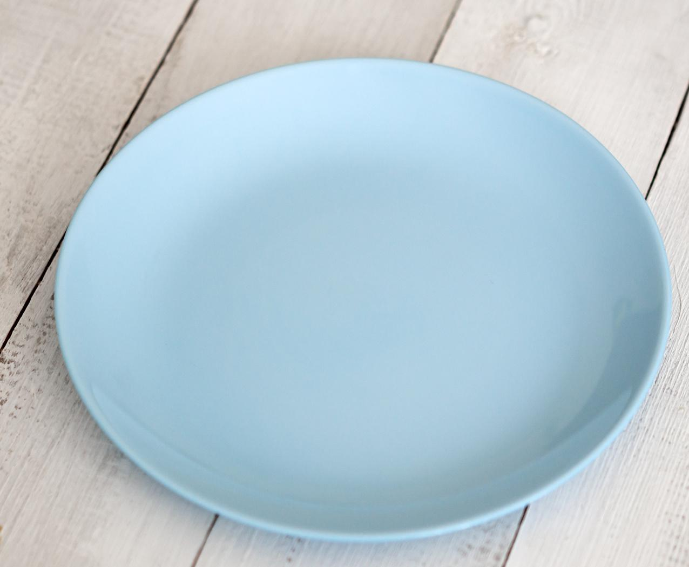

Particles are the tiny building blocks of all matter.

Slide 13
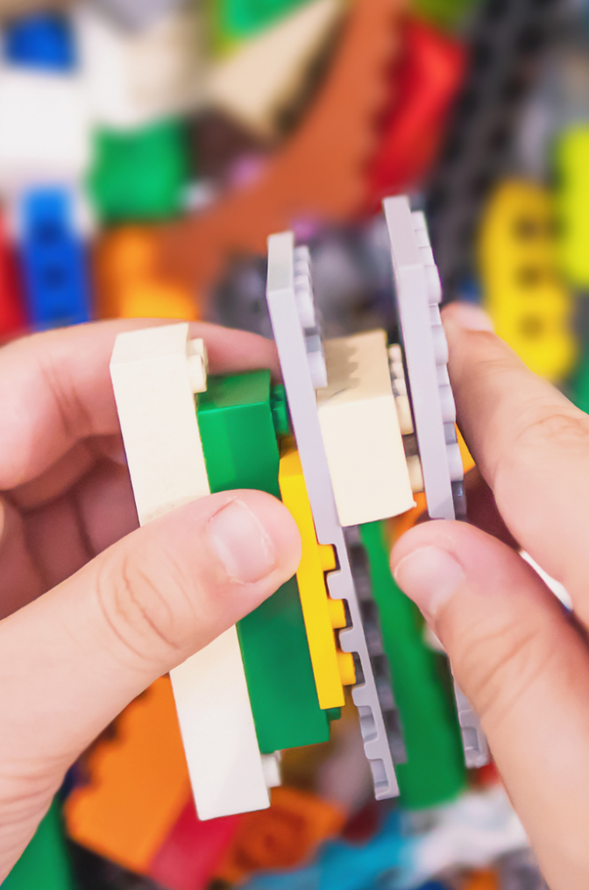
Particles join together like LEGO pieces to make larger objects.
When many particles connect, they form solids like wood and rock.
When particles move freely, they form liquids like water.

Slide 14
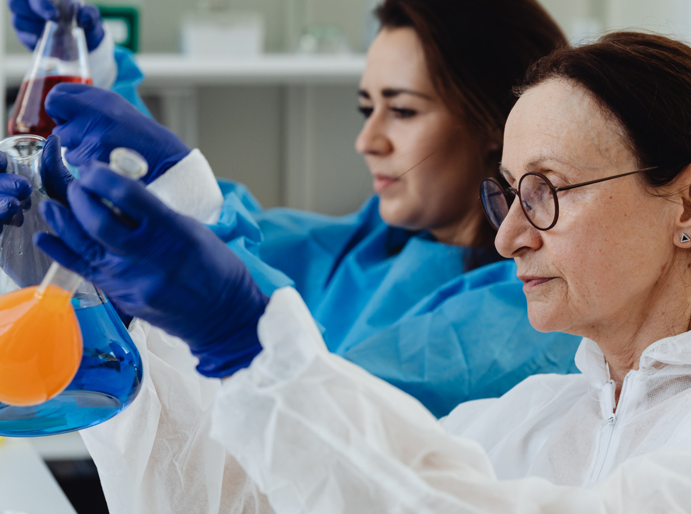
All matter is made of particles. Particles are tiny, invisible pieces that join together to make everything we see.
Because all matter is made of particles, we can study how it behaves and changes.

Slide 15

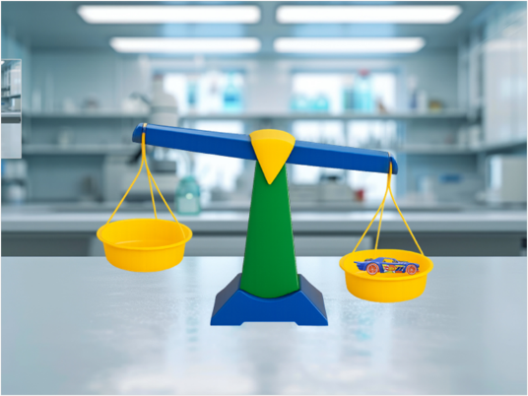
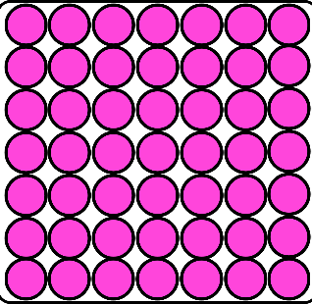
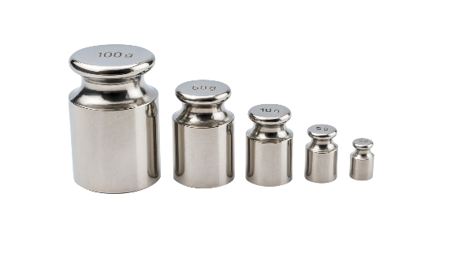
mass – The measure of how much matter is in an object. All objects and materials that are matter have mass.
matter – Anything that has mass and takes up space. It is made up of tiny parts called particles.
particle – A part of matter too small to see.

Slide 16
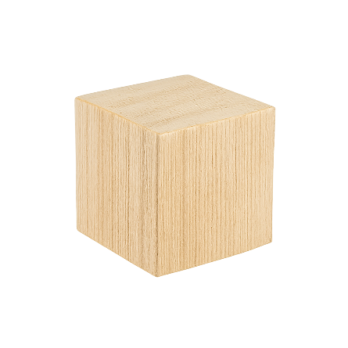


Particles
Which of these does not have particles?
A rock
Light
A wooden block

Slide 17
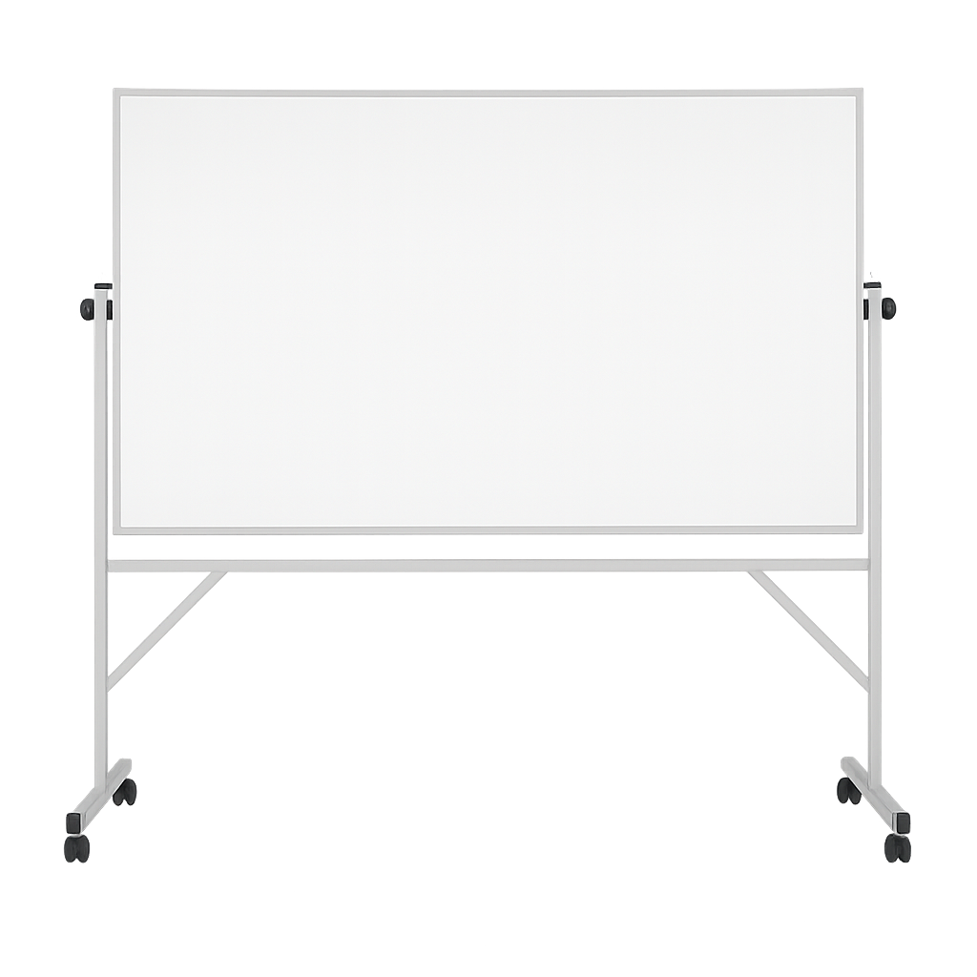



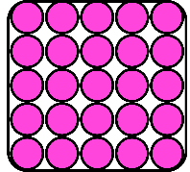
Interpreting a Particle Diagram
Particle

Slide 18




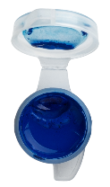
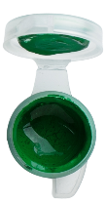
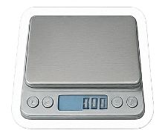
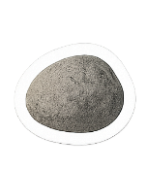









Slide 19

Particles
Question:
Each circle in the diagram represents a ________.
I Do: Interpret Particle Diagram
particle
Question:
There are ____ particles shown, but in real life there would be ___________.
30
many more
Question:
This diagram shows that matter ______________.
Particle
takes up space

Slide 20
Particles
Question:
Each circle in the diagram represents a ________.
We Do: Interpret Particle Diagram
particle
Question:
There are ____ particles shown, but in real life there would be ___________.
24
many more
Question:
This diagram shows that matter ______________.
Particle
takes up space

Slide 21




This diagram shows about 50 circles.
Does that mean the object only has about 50 particles? Why?
Particle

Slide 22
Particles
Question:
Each circle in the diagram represents a ________.
You Do: Interpret Particle Diagram
particle
Question:
There are ____ particles shown, but in real life there would be ___________.
28
many more
Question:
This diagram shows that matter ______________.
Particle
takes up space

Slide 23





Particles
Wooden Block Particle Diagram
I Do: Modelling the Particles in Matter
Particle
A wooden block is made of many _________, so it is matter.
particles

Slide 24

Particles
Light Particle Diagram
I Do: Modelling the Particles in Matter
Light does not have any particles, so it is not _______.
matter

Slide 25










Key Idea
We Do: Key Diagram
We Do: Key Idea
Matter is made of tiny particles.
Matter and Nonmatter
Matter is Made of Particles
No Particles
Particles
Nonmatter
Torch
Light
Matter

Slide 26



Particle Diagrams and Real Life
Which of these is the best model to show particles in matter?

Slide 27

Particles
Particles
Rock Particle Diagram
We Do: Modelling the Particles in Matter
Particle
A rock is made of many _________, so it is matter.
particles

Slide 28



Particles
You Do: Modelling the Particles in Matter
You Do: Modelling the Particles in Matter
All matter is made of _________.
particles

Slide 29





Learn more
Teach someone
I understand
Challenging

Slide 30


Exit Ticket
Date: _________
Lesson 1A
Lesson 1B
You will be successful when you can:
describe properties of objects
sort objects into property groups.
All _______ is made of particles.
In a particle diagram what do the dots represent?
  Atoms
  Particles in matter
  Holes in the object
In a model of light, we leave the bubble empty because light has no p________.
matter
nonmatter
matter
mass
Describe means to tell what something looks like, sounds like, feels like or what it is.
Sort to put things that are the same together.
red
round
crunchy
articles
3
I know _____ out of 3 answers.

Slide 31



In the next lesson, we will learn about liquids.

