Slide 1
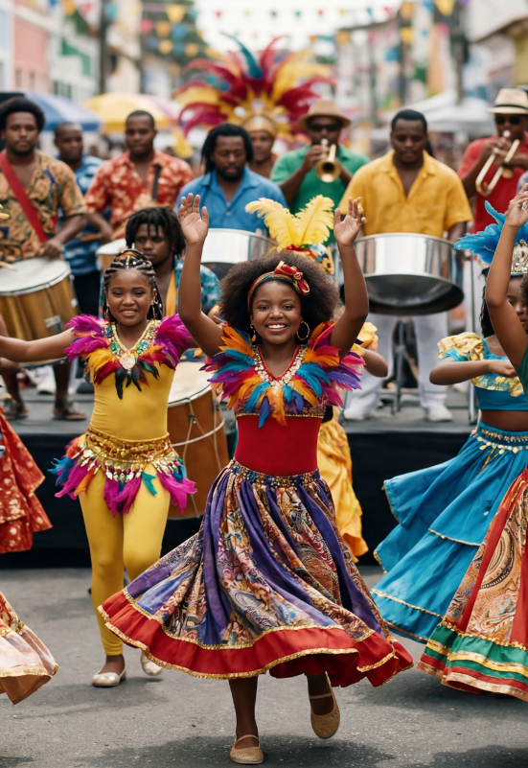
Music in Celebrations
Lesson 1
The Sound of Celebration
Unit 4 Version 3

Slide 2
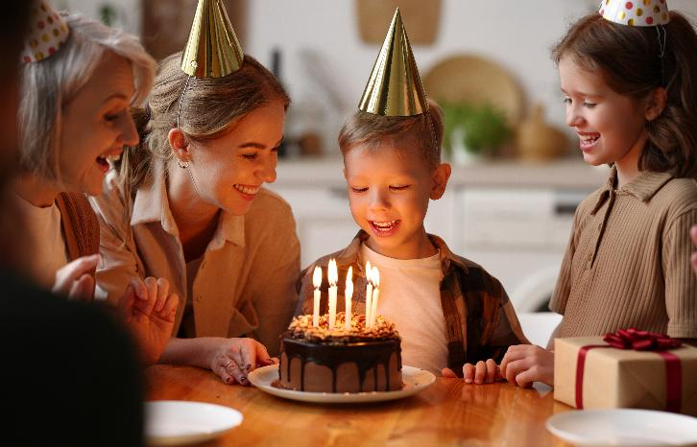
In this lesson, we will explore how music is used in different celebrations.

Slide 3
You will be able to: ​
what a celebration is
different celebrations
music used in celebrations.
define
Define means to tell the exact meaning of a word or idea so others understand what it means.
name
Name means to say what something is called.
hear
Hear means to notice sounds using your ears.

Slide 4
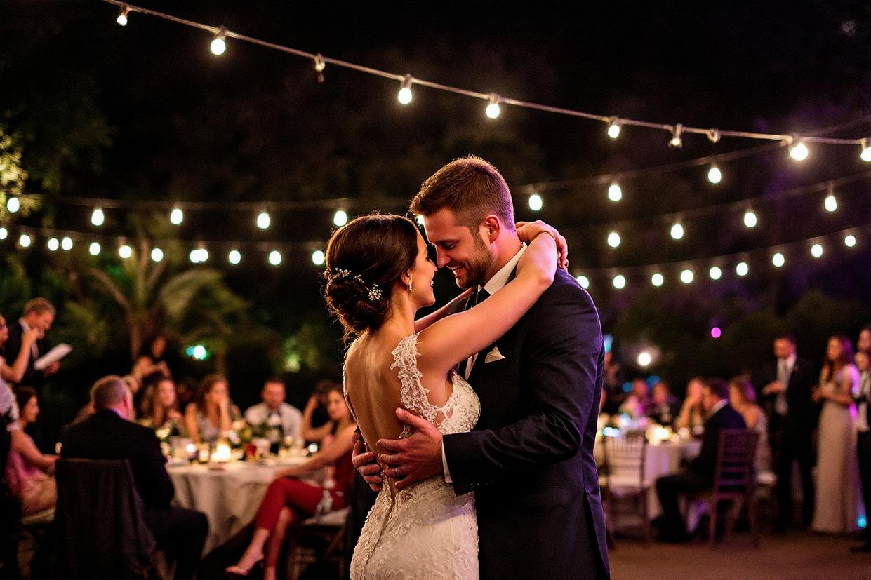
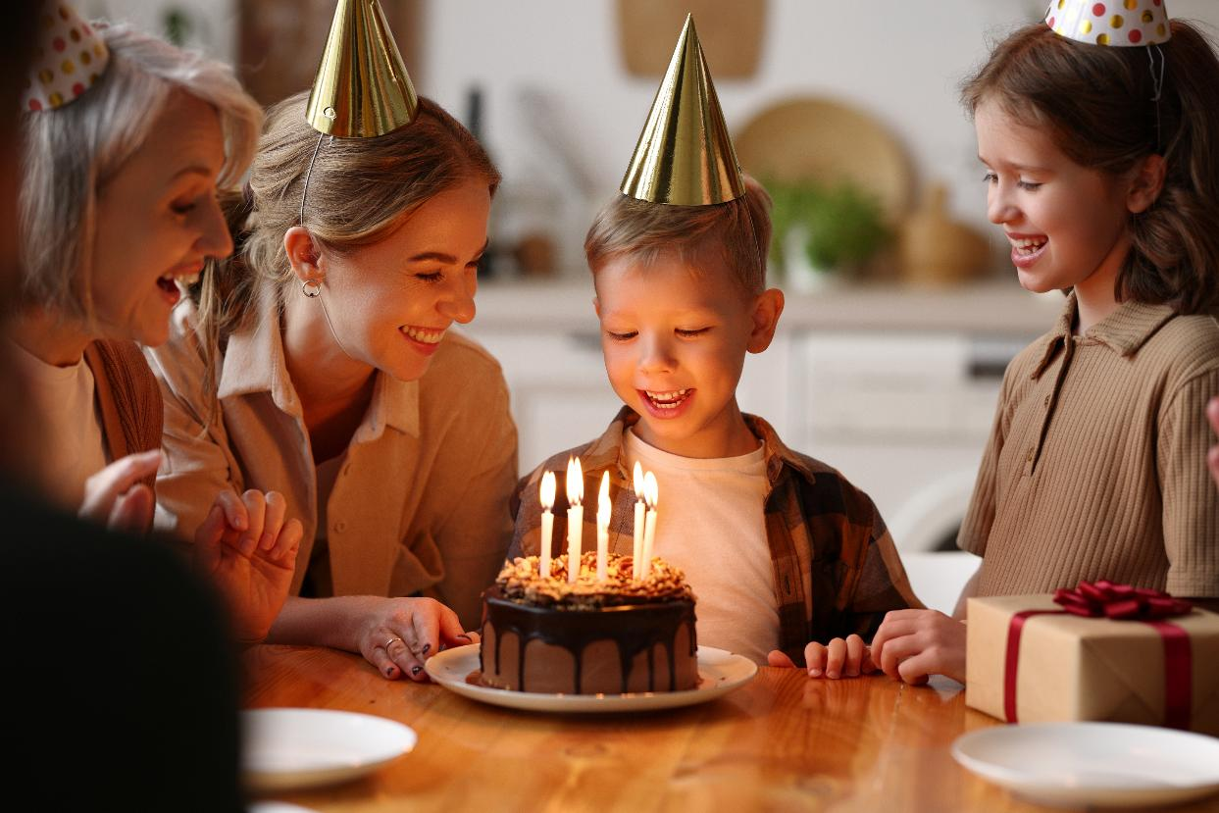
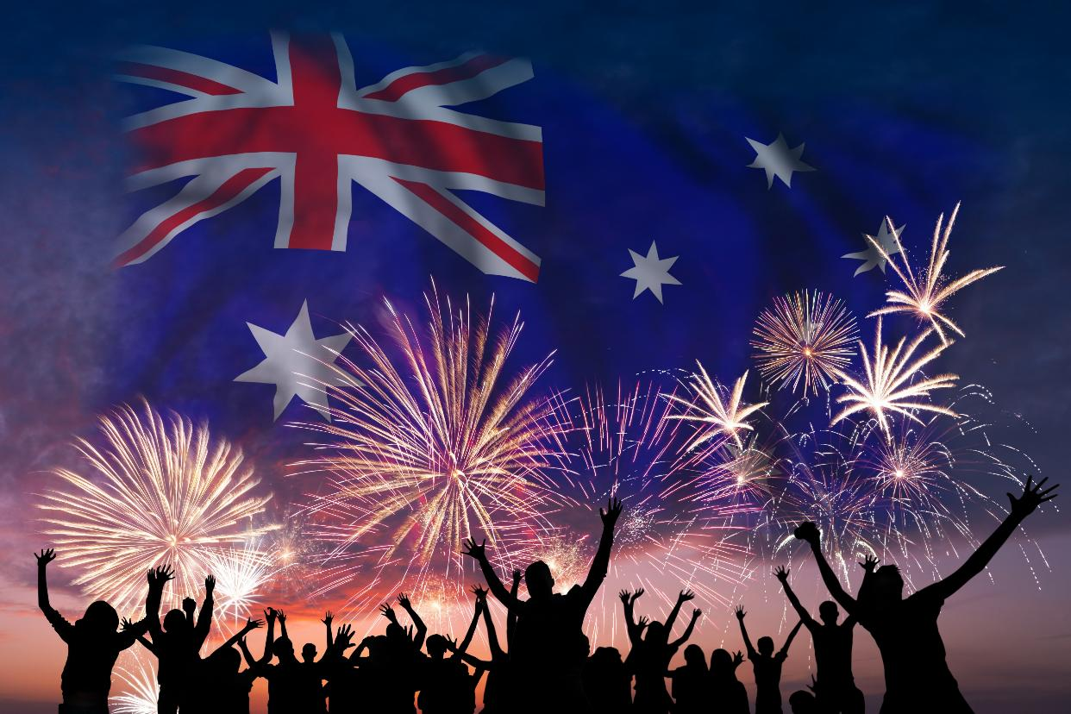

Slide 5
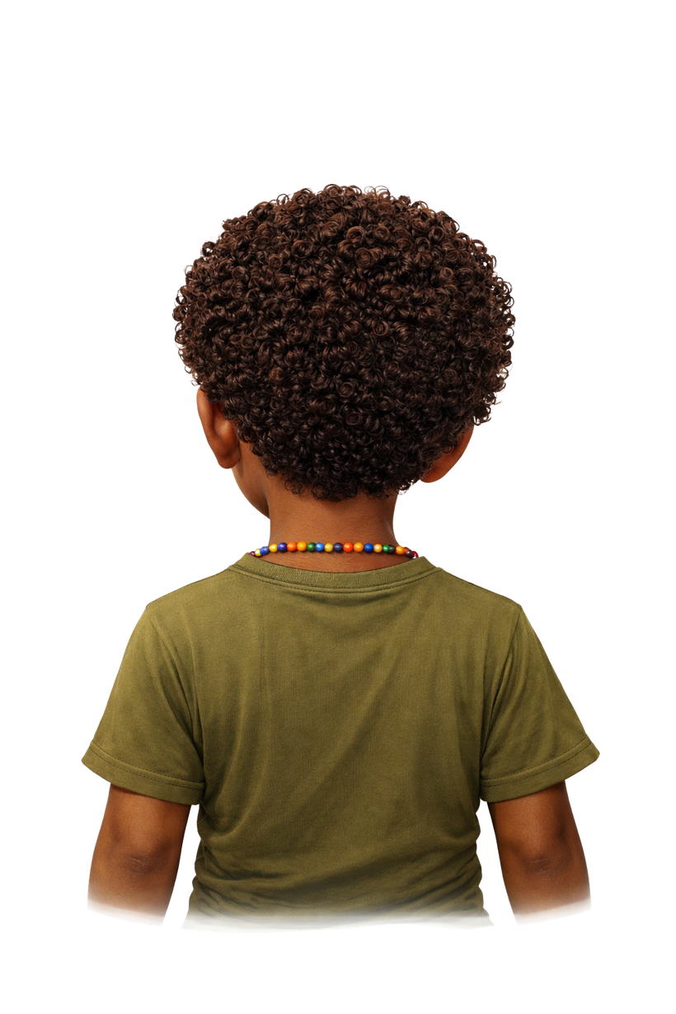
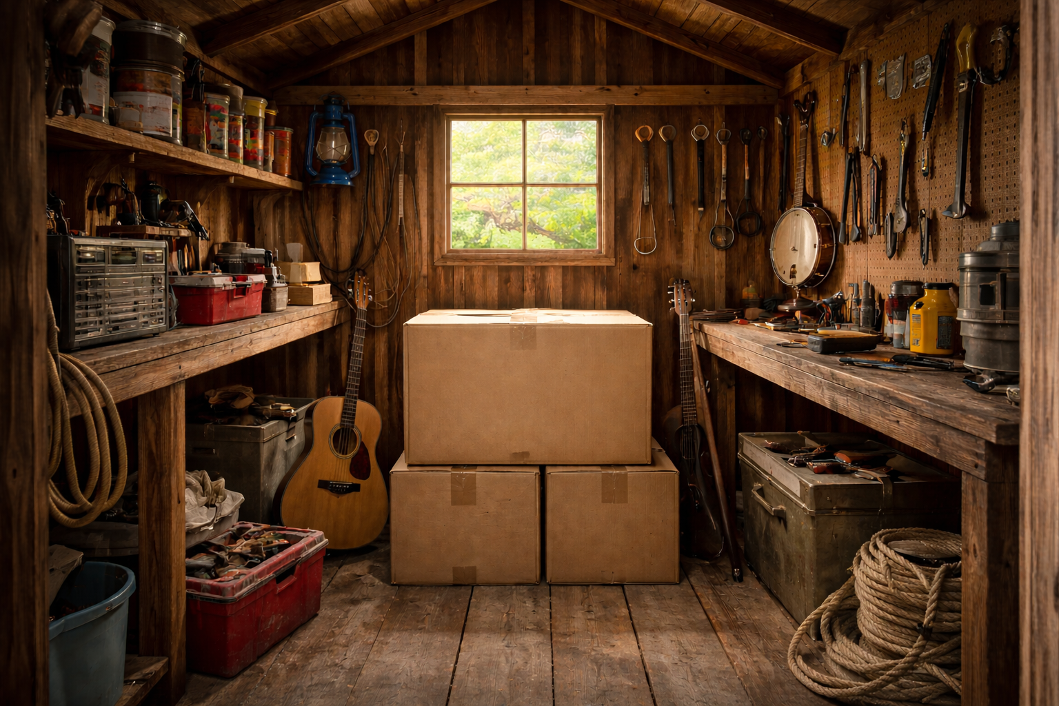

Slide 6
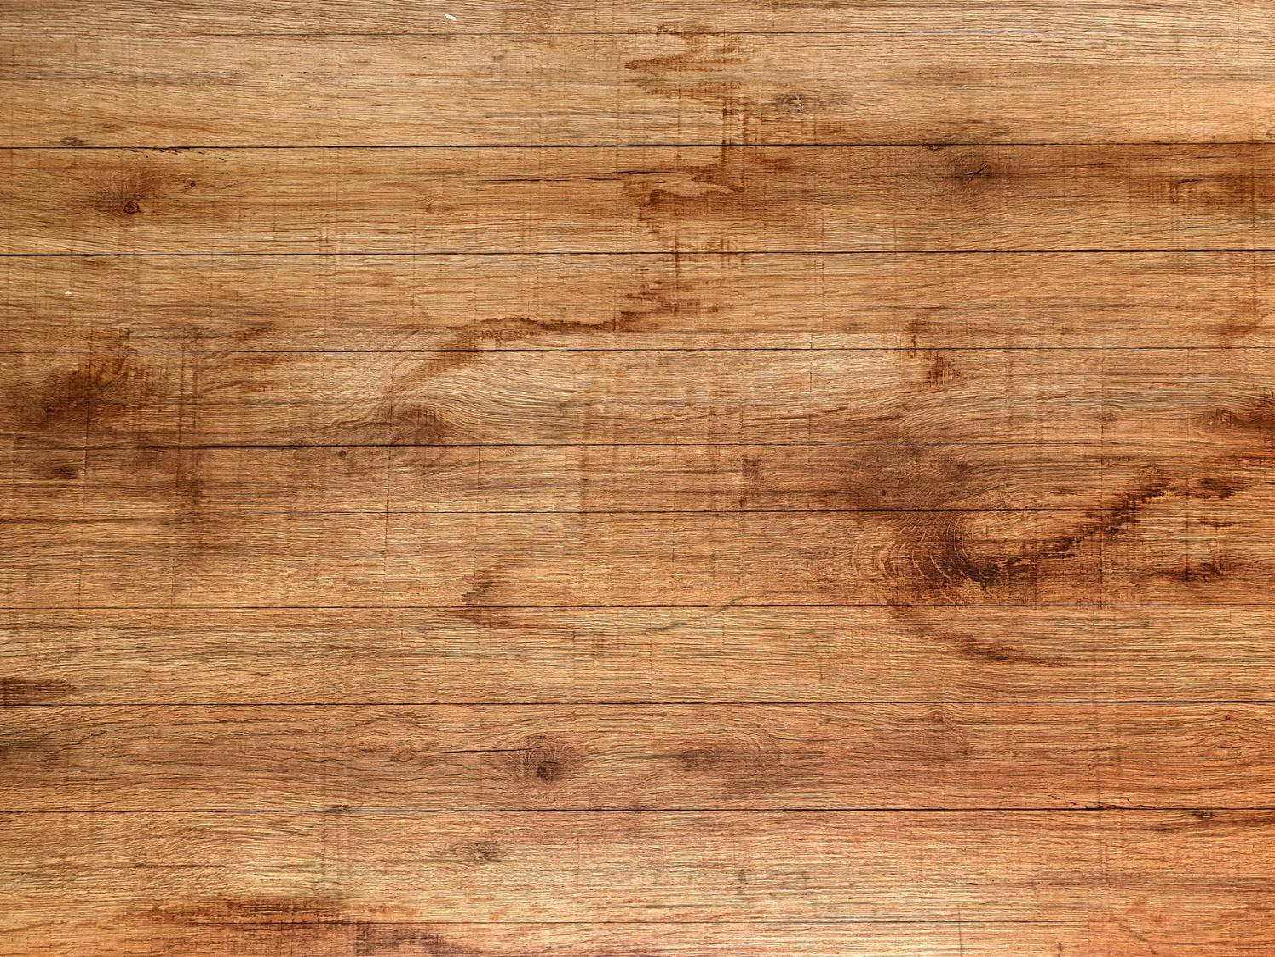
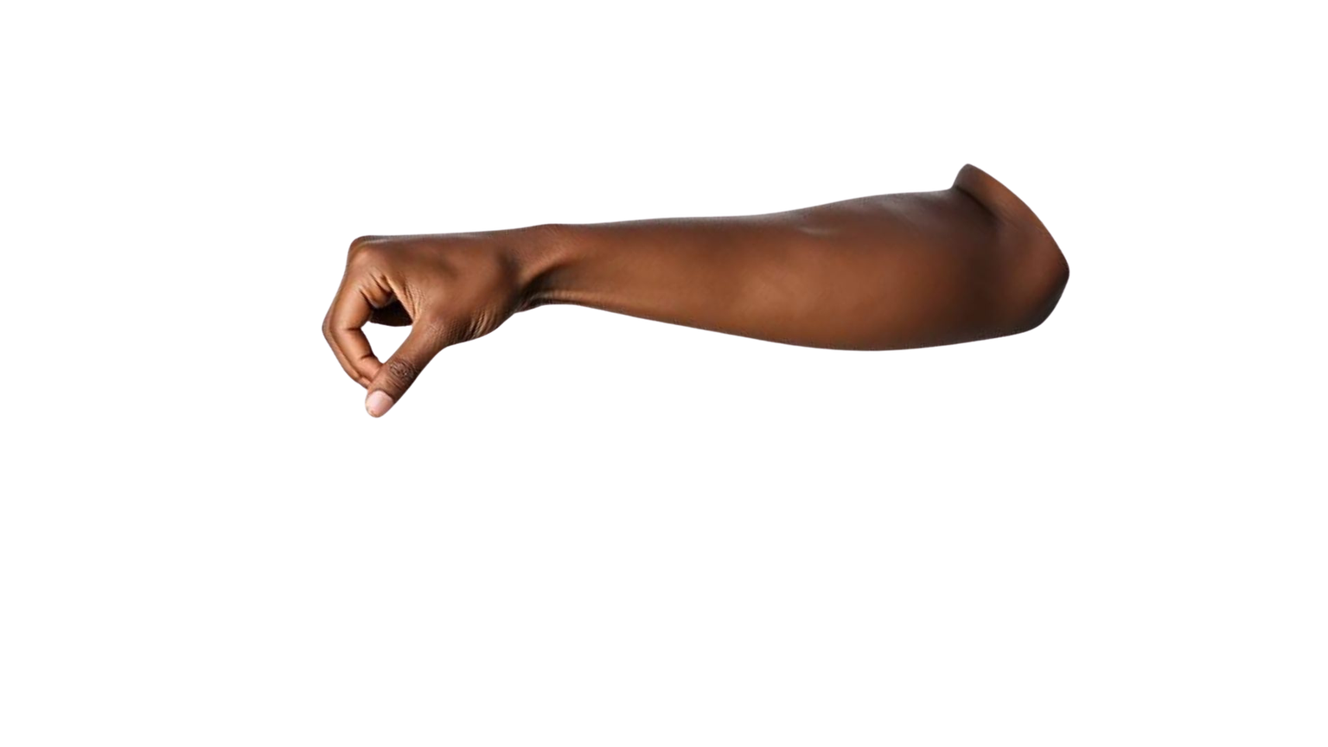


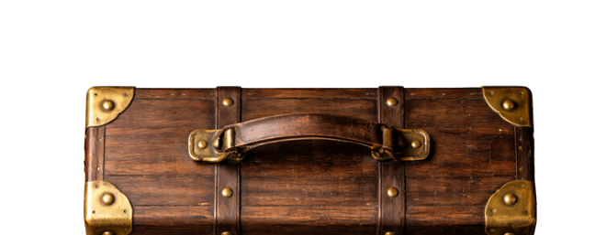
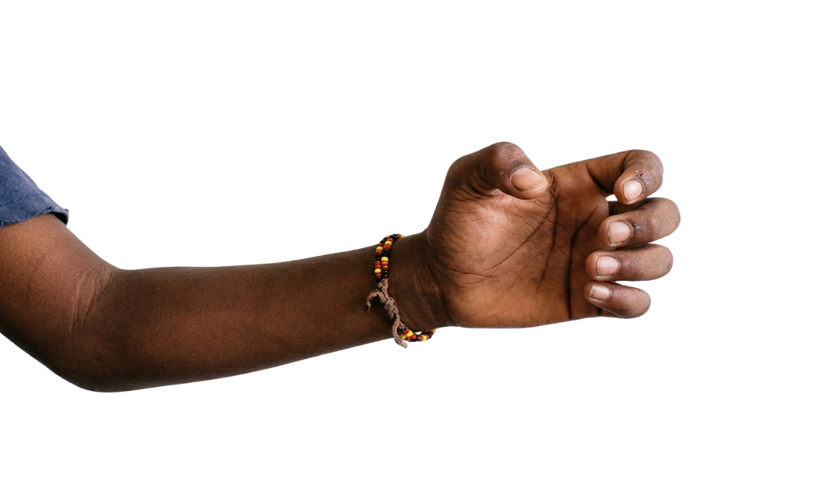
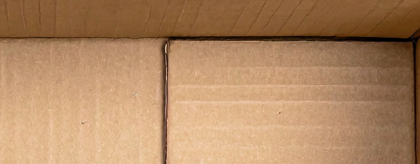
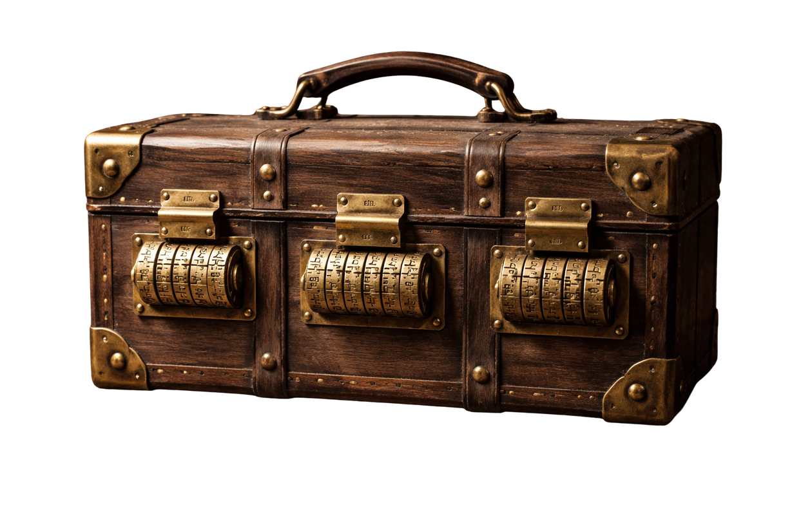
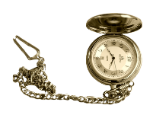
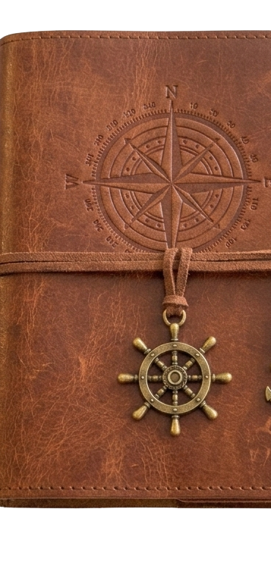

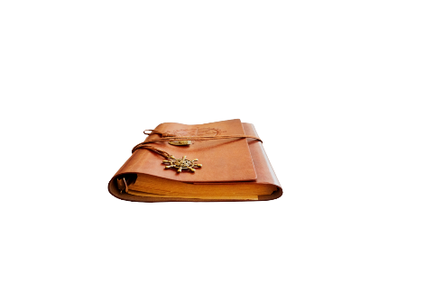

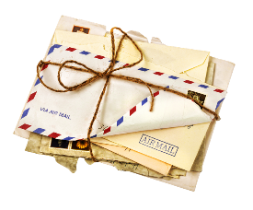
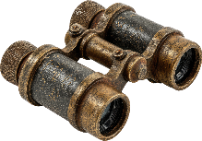

Slide 7
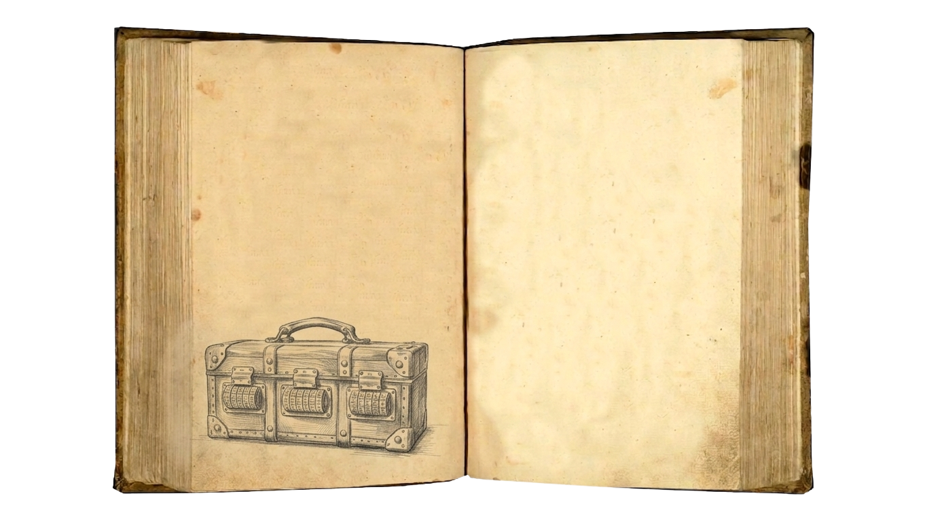
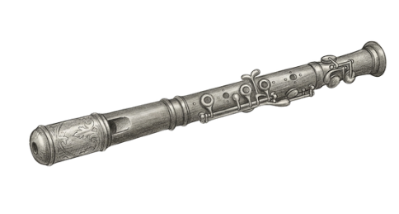
Song of the Four Lands
Broken?
Need code words to unlock box

Slide 8
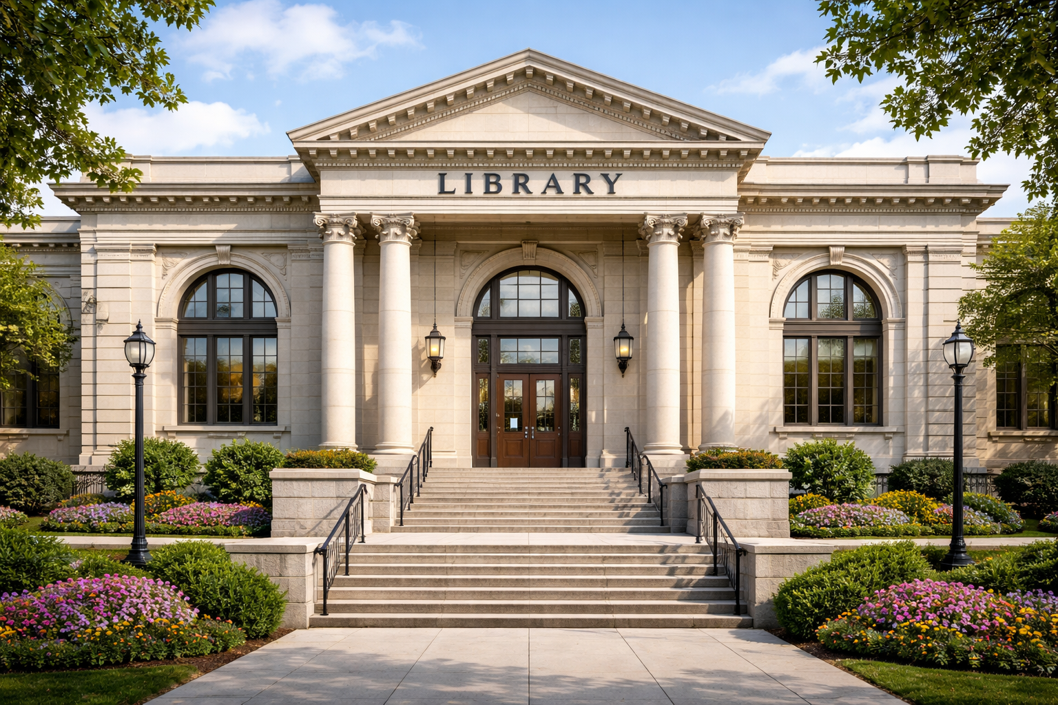

Slide 9
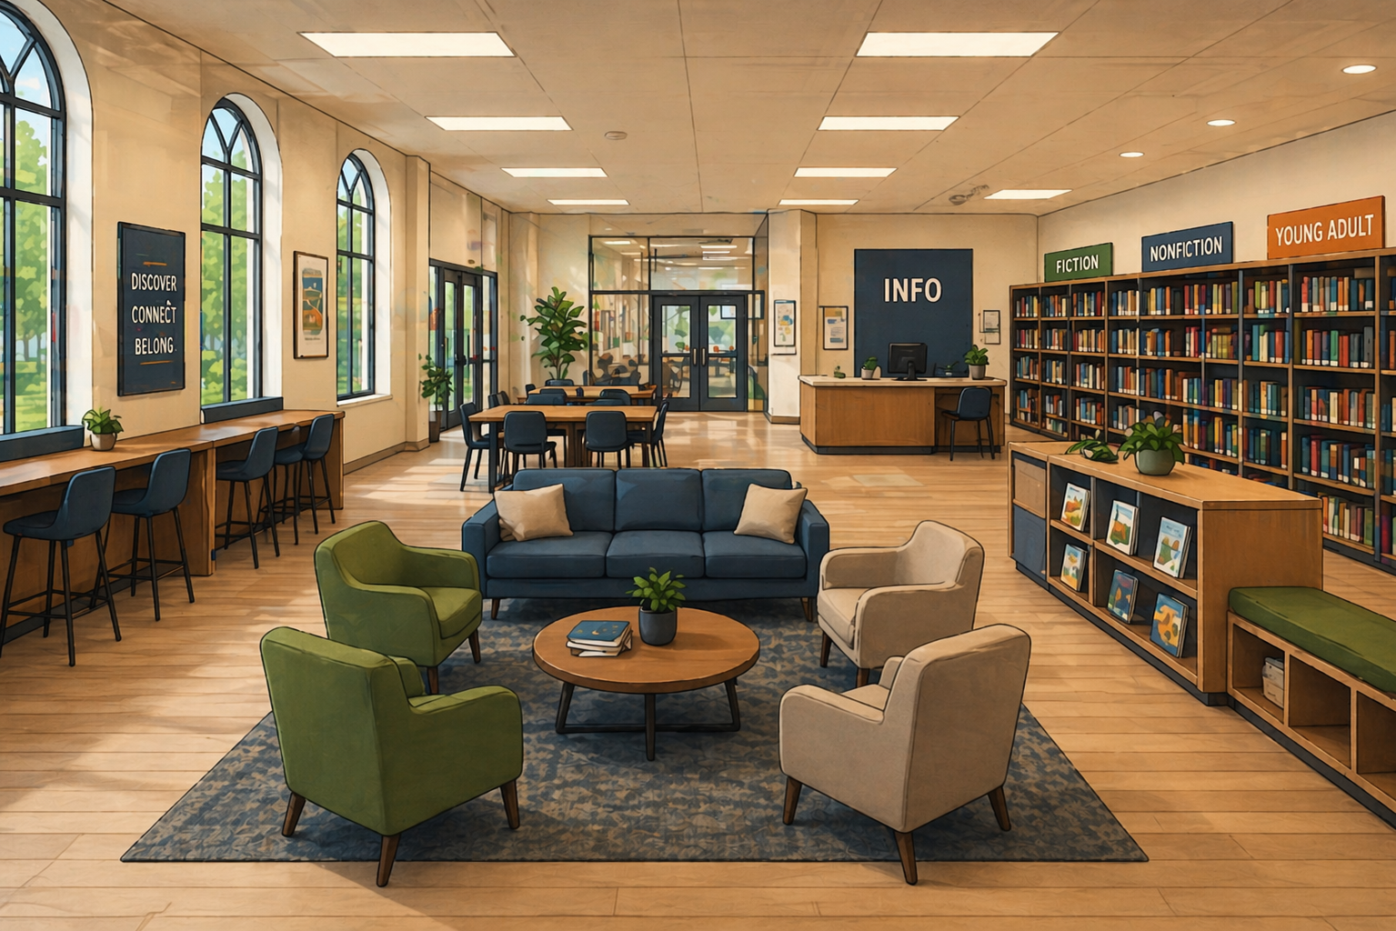
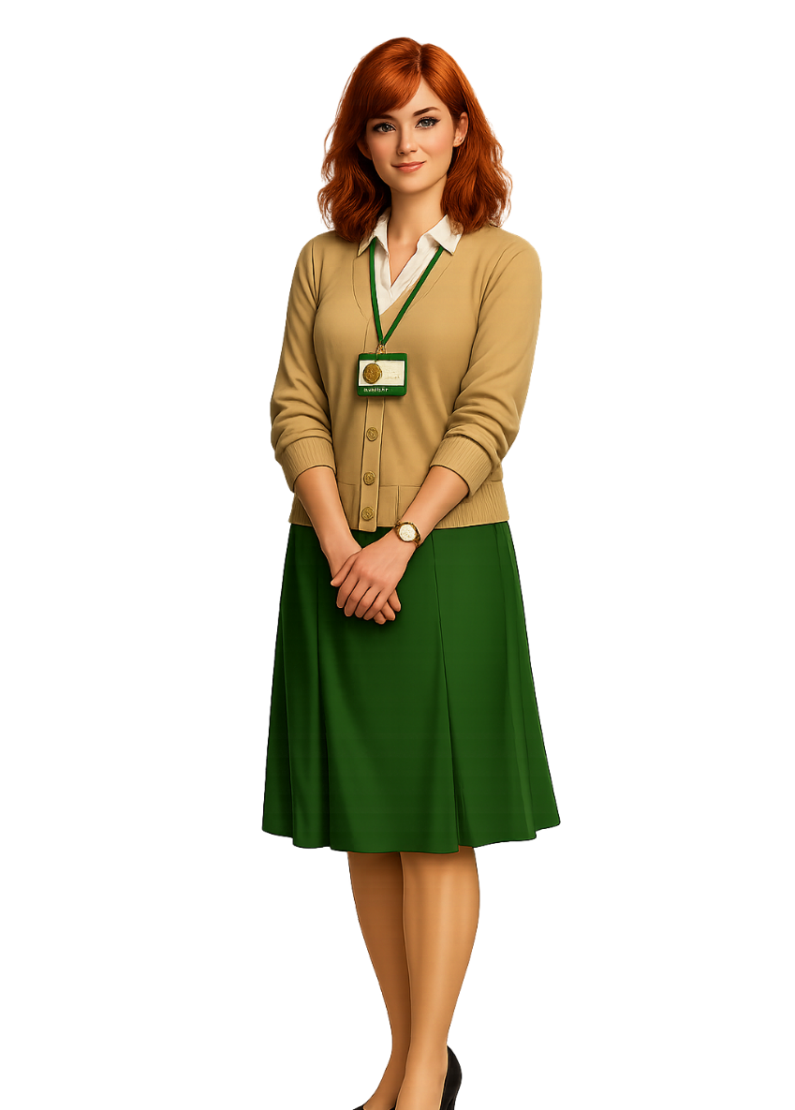

Slide 10

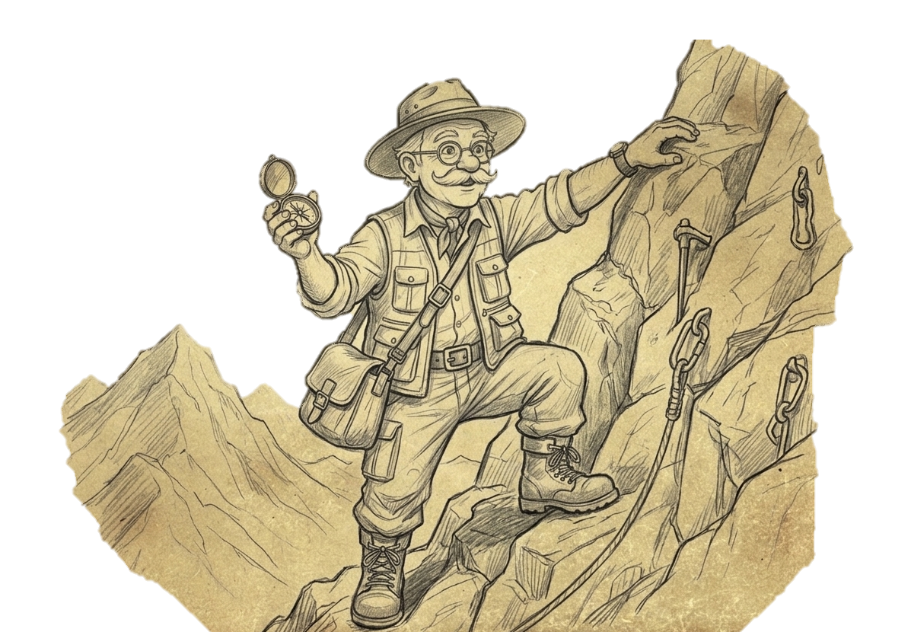
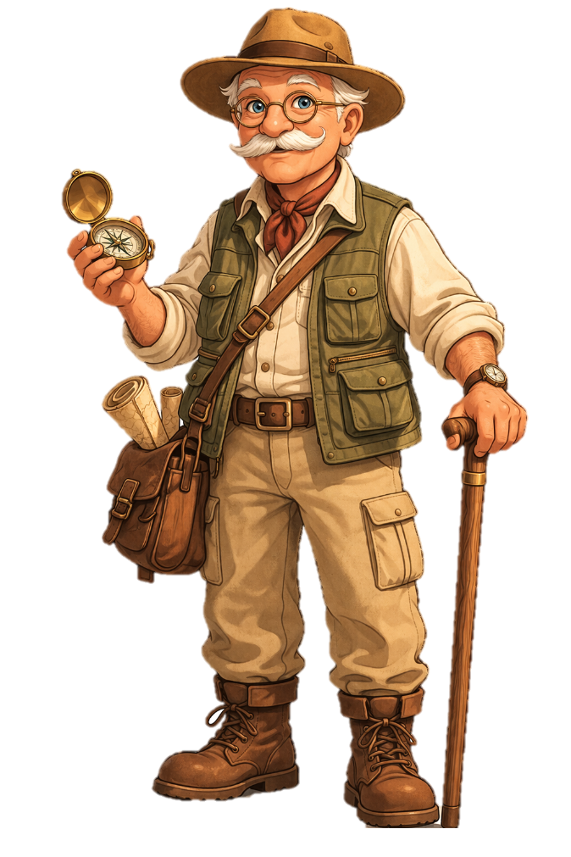
Song of the
Four Lands

Slide 11
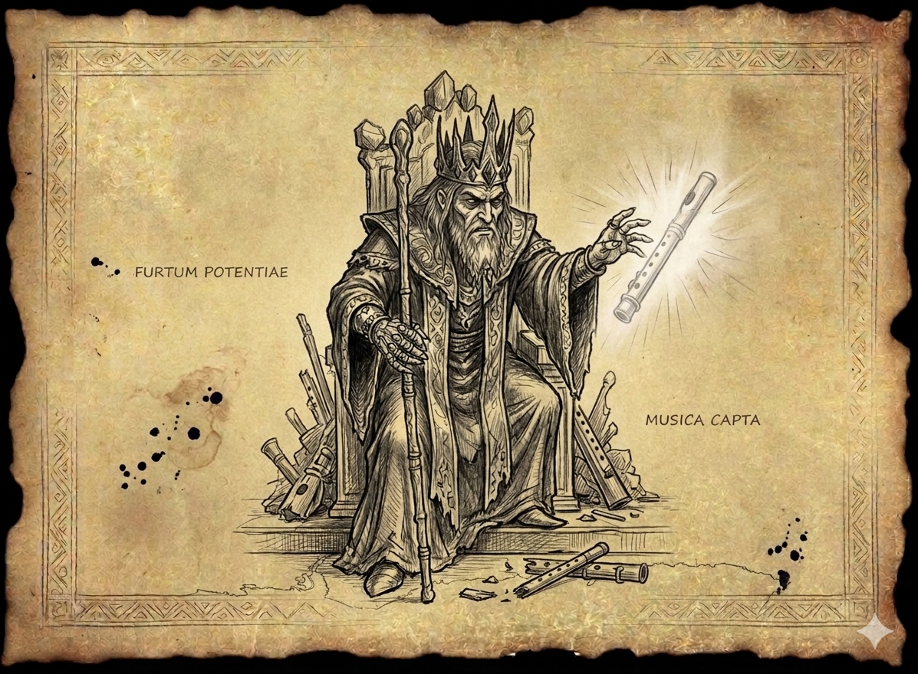
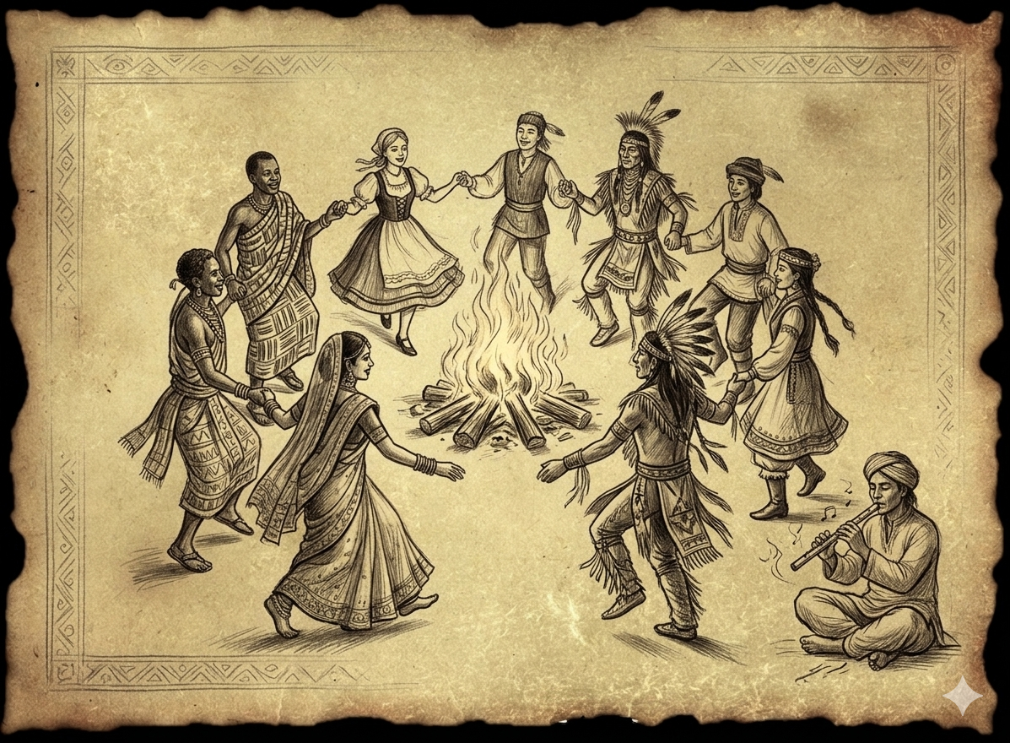
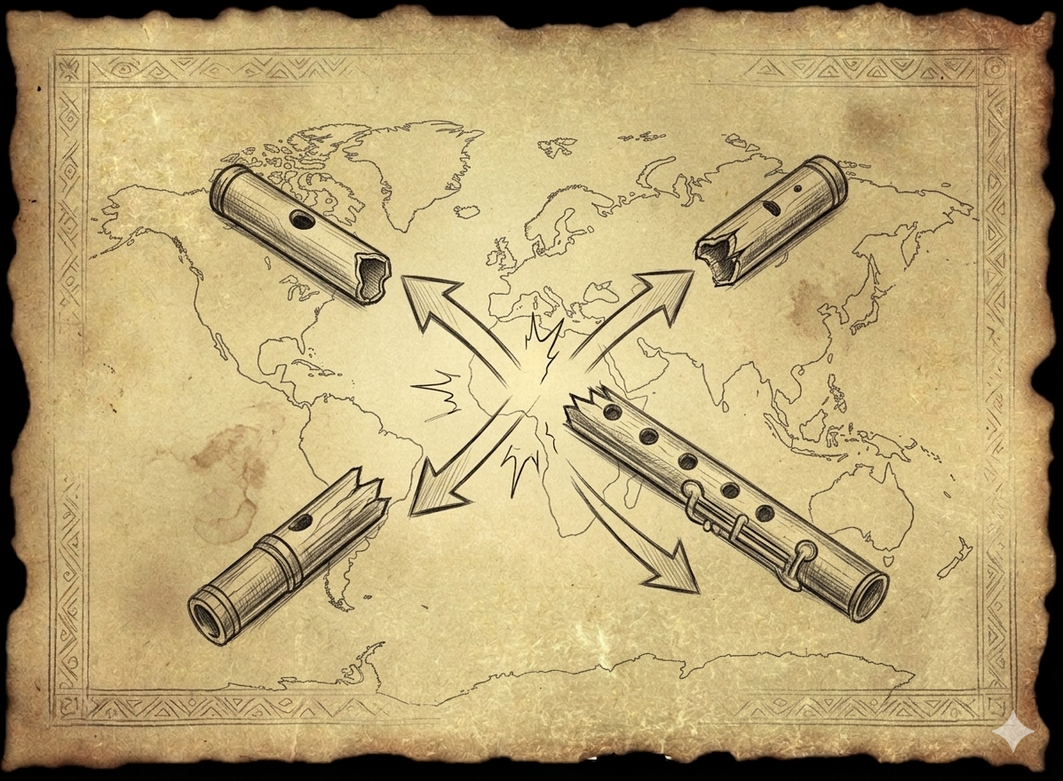

Slide 12
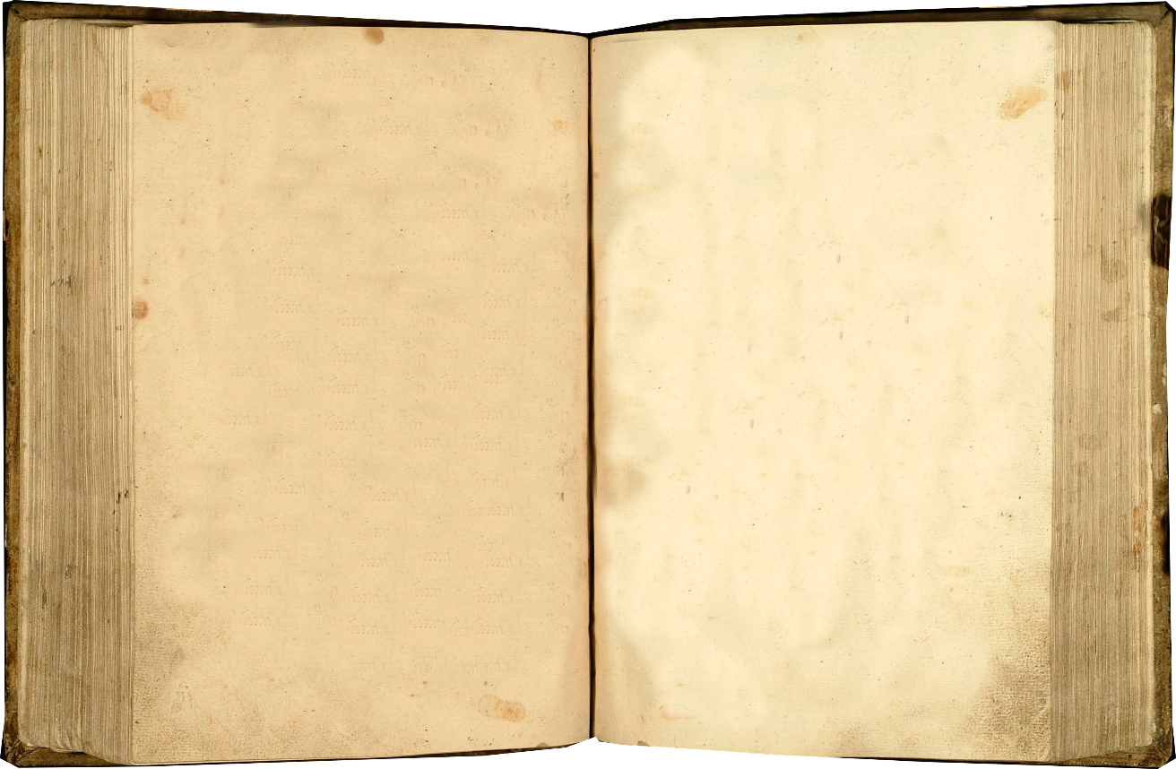
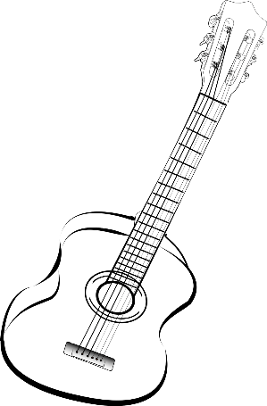
Clue 1: I’m not a person. I’m not a thing you can hold. But go to a celebration and you’ll find me.

Slide 13
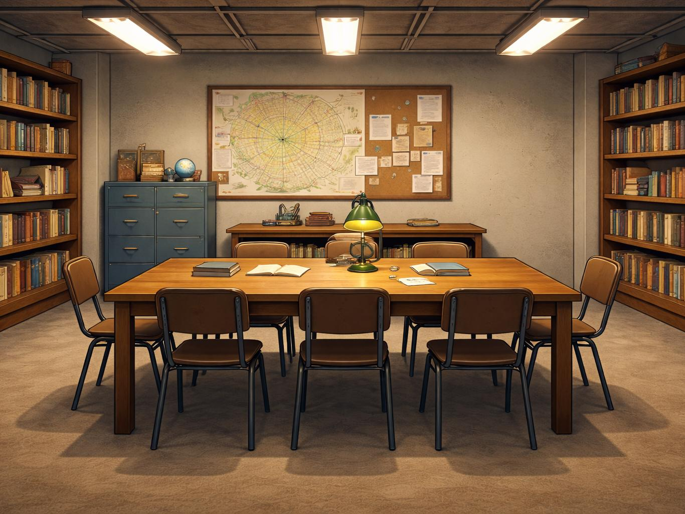

Slide 14

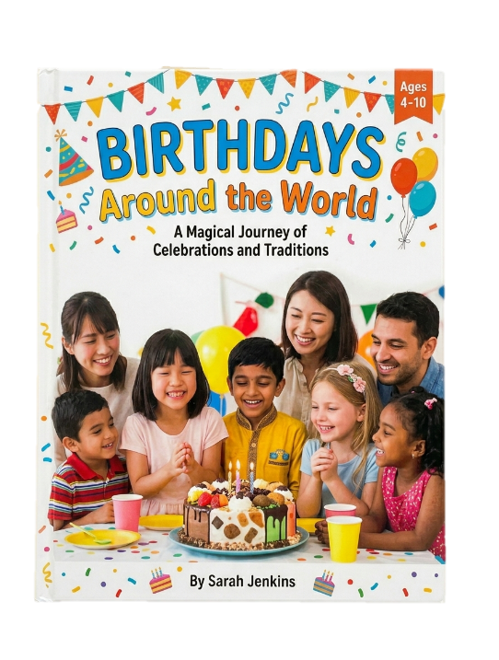
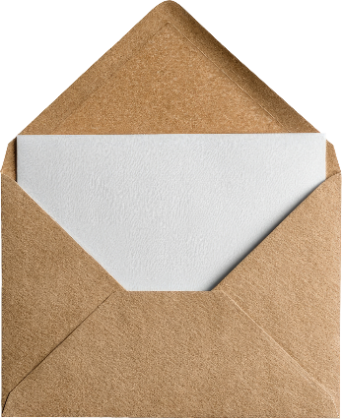
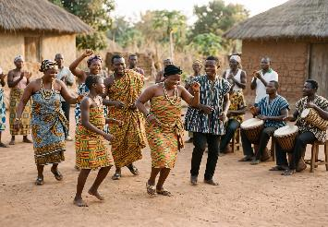
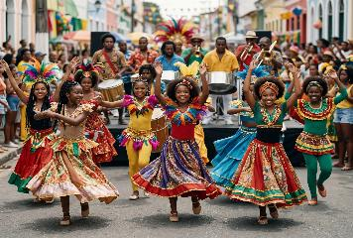

Slide 15

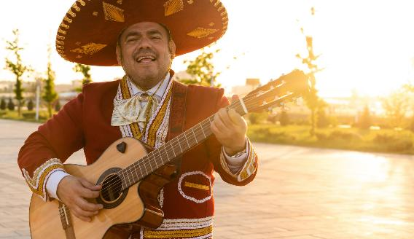
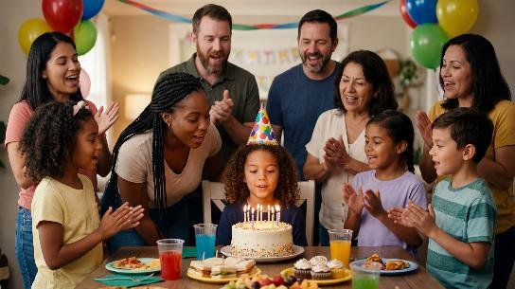
Birthdays are celebrated all around the world, but not everyone celebrates in the same way. Many times, there is cake and other good food.
Birthdays are a time for people to get together with family. Music is a big part of these celebrations.
In countries like Australia and the United States, people often sing ‘Happy Birthday’.
But in Mexico, families often sing ‘Las Mañanitas’ early in the morning to wake up the birthday person.

Slide 16


Dear Sam,
Guess what? Hanukkah has started! Every night, my family lights the menorah and we add one more candle. It gets brighter each night.
One of my favorite parts is singing songs together. We sang songs while we lit the candles and it made everything feel warm and happy. Everyone joined in. Even when I didn’t know all the words, I still tried my best.
I wish you could come celebrate with me one year.
From,
Alex

Slide 17
Clue 1: I’m not a person. I’m not a thing you can hold. But go to a celebration and you’ll find me.
Dear Sam,
Guess what? Hanukkah has started! Every night, my family lights the menorah and we add one more candle. It gets brighter each night.
One of my favorite parts is singing songs together. We sang songs while we lit the candles and it made everything feel warm and happy. Everyone joined in. Even when I didn’t know all the words, I still tried my best.
I wish you could come celebrate with me one year.
From,
Alex

Slide 18
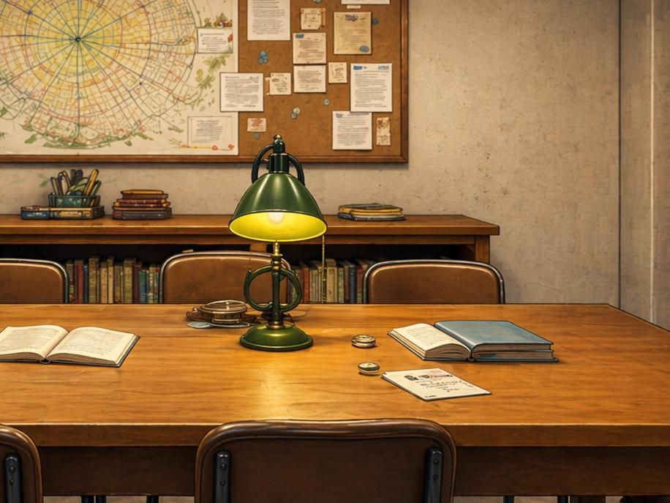
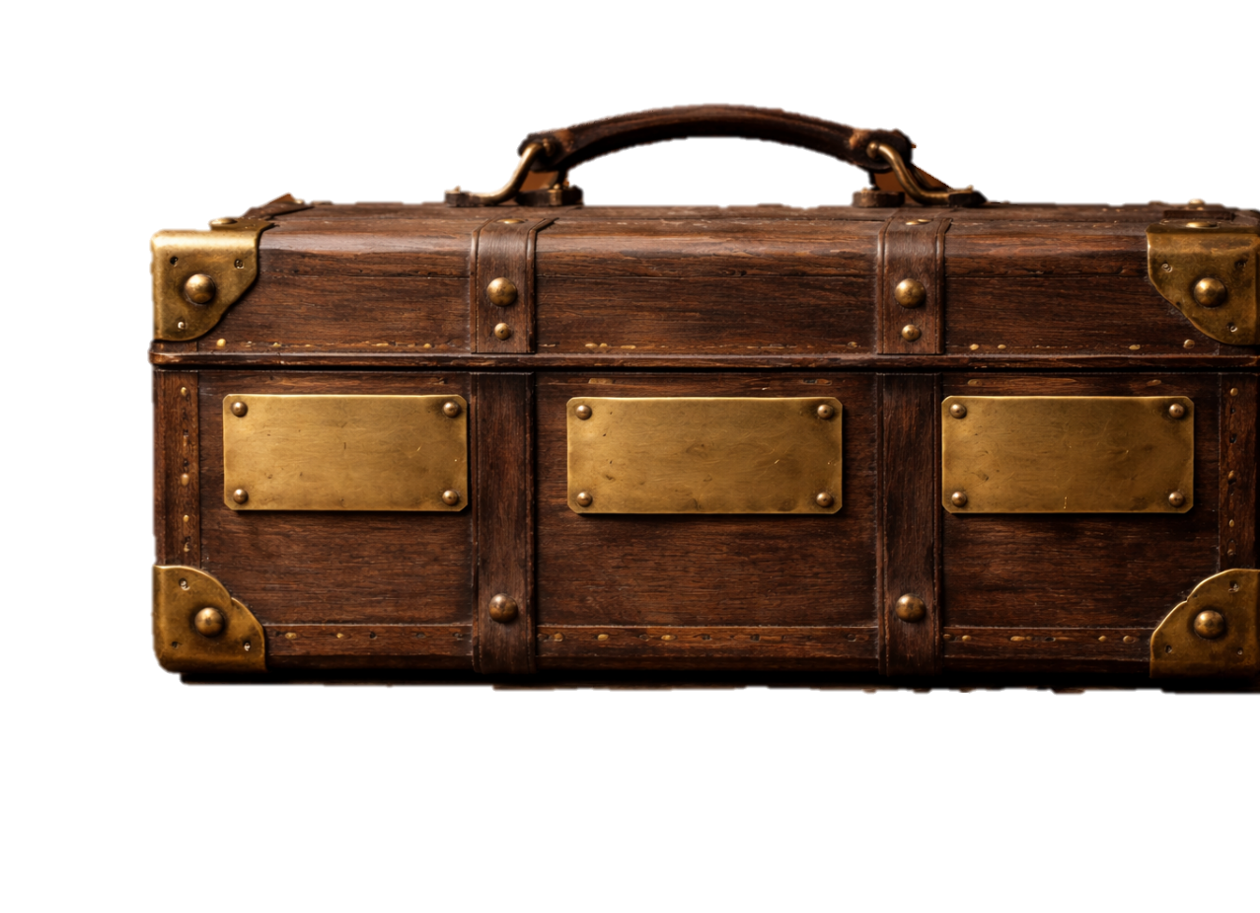














Slide 19
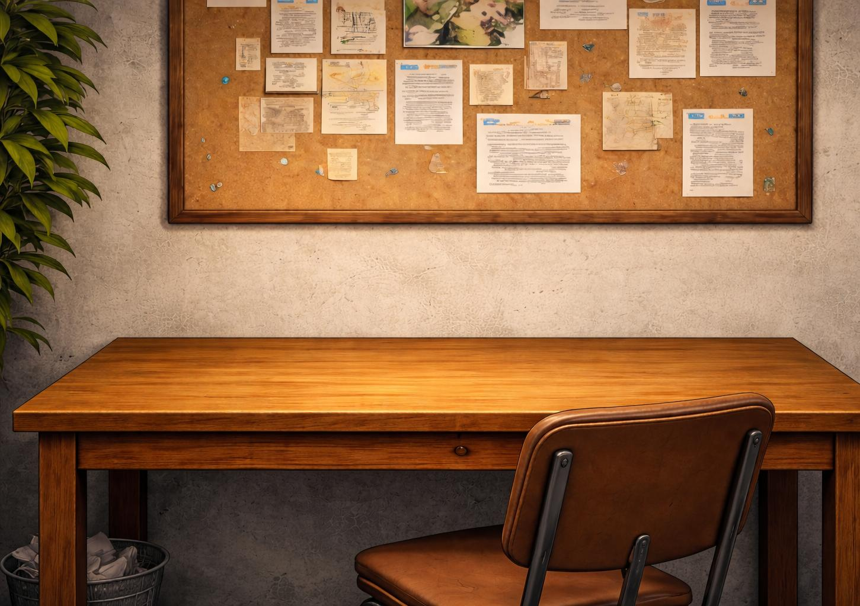

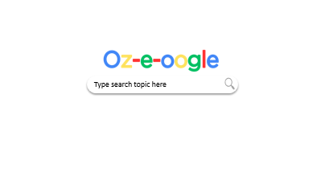

Slide 20


Birthday songs around the world

Slide 21

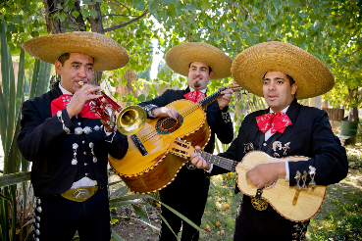
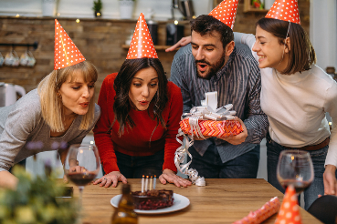
The Dreaming
Birthday songs around the world
All
Images
News
Videos
More
Traditional birthday song in Mexico
‘Las Mañanitas’ is a very special birthday song from Mexico and many countries in Latin America.
Sto Lat: Poland’s Birthday Song
The traditional celebration song in Poland is ‘Sto lat’. It is sung to wish someone a long life, happiness and good health.

Slide 22
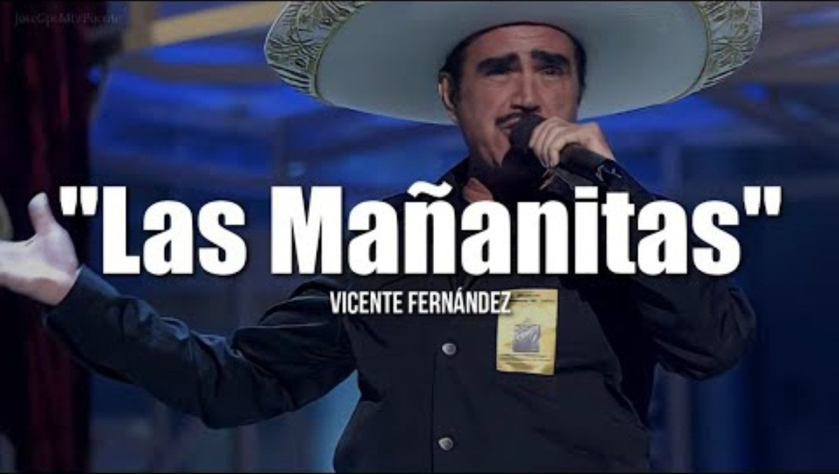
The Dreaming
Birthday songs around the world
All
Images
News
Videos
More

Slide 23
The Dreaming
Birthday songs around the world
All
Images
News
Videos
More
Traditional birthday song in Mexico
‘Las Mañanitas’ is a very special birthday song from Mexico and many countries in Latin America.
Sto Lat: Poland’s Birthday Song
The traditional celebration song in Poland is ‘Sto lat’. It is sung to wish someone a long life, happiness and good health.

Slide 24
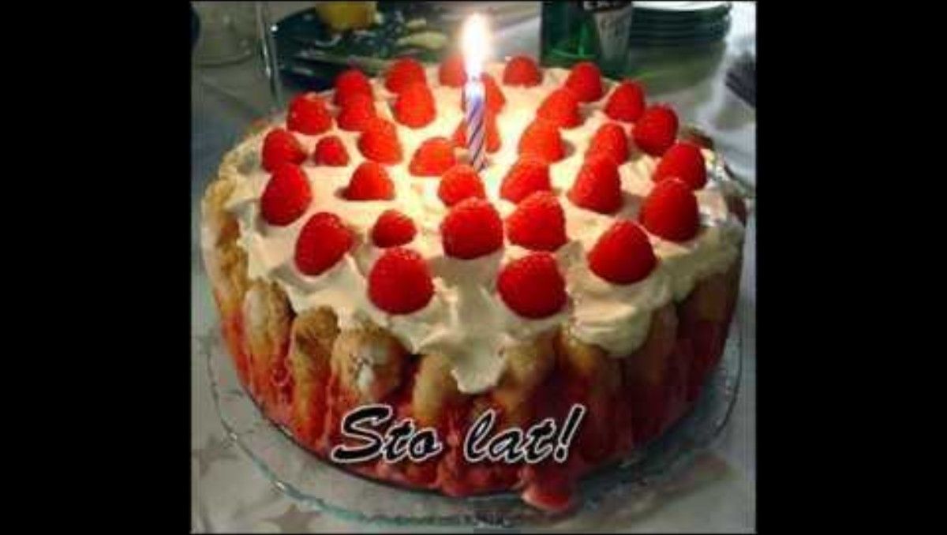
The Dreaming
Birthday songs around the world
All
Images
News
Videos
More

Slide 25
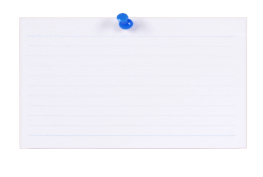


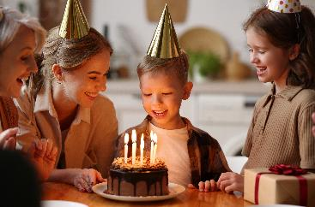
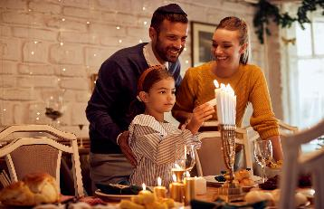

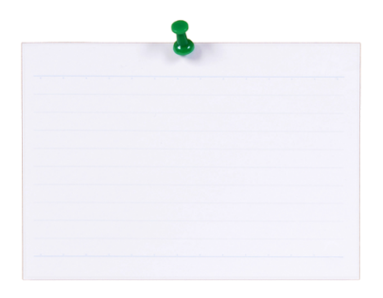


Personal
Religious
Community
Carnival
Birthday
Traditional Ceremony
Hanukkah

Slide 26
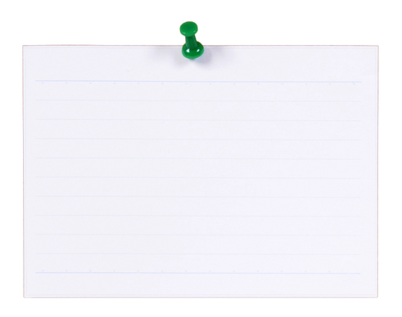


Personal
Religious
Community
Trip to Melbourne
School
Australia
Day
Christmas

Slide 27



Lesson 1
You Do: Types of Celebrations
Name a celebration that you enjoy. Draw a picture to show how you celebrate it.
I like to celebrate _______________________.

Slide 28



A celebration is a special event used to mark something important.
There are personal, religious and community celebrations.

Slide 29

Music is used in many celebrations.

Slide 30


Exit Ticket
Date: _________
Lesson 1
event
A celebration is a special ______ used to mark something important.
An example of a celebration is:
a birthday
a puppy
a trip to the zoo.
M____ is an important part of many celebrations.
event
food
song
usic
3
I know _____ out of 3 answers.

Slide 31

In the next lesson, we will look at how music helps bring people together during celebrations.

