Slide 1
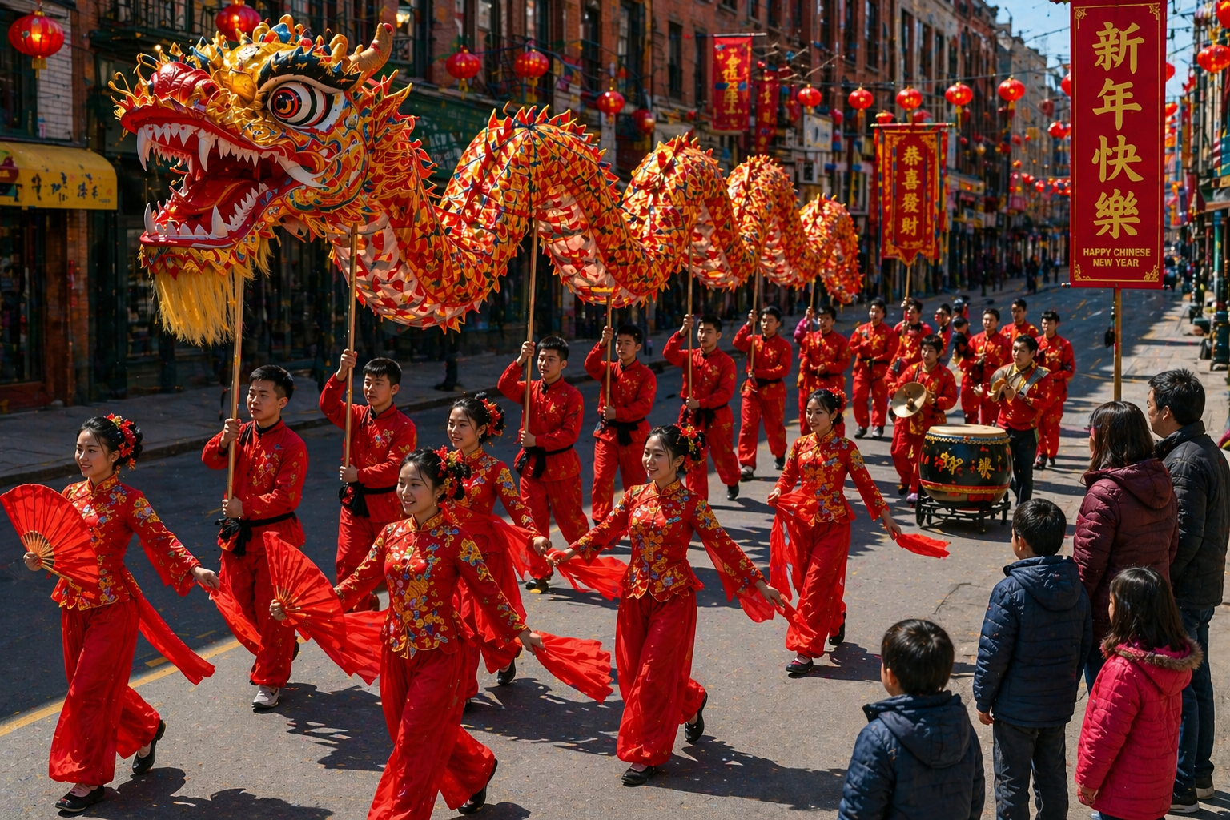
Music in Celebrations
Lesson 2
Music That Connects Us
Unit 4 Version 3

Slide 2
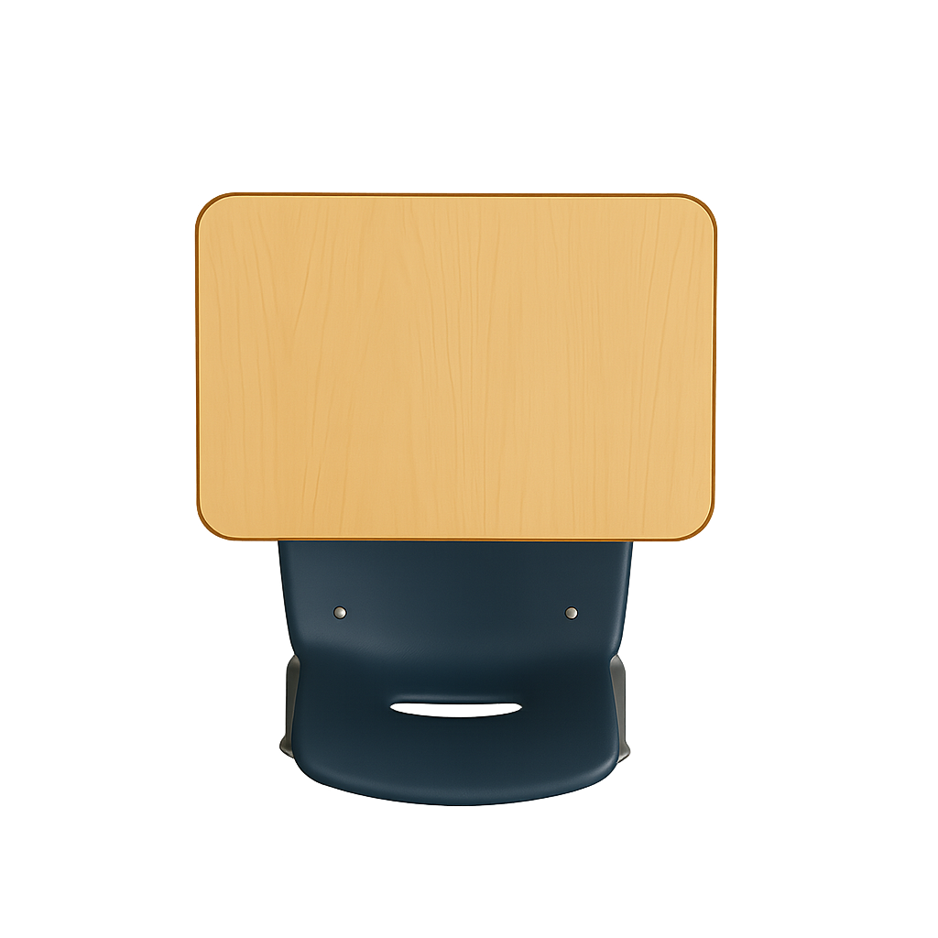

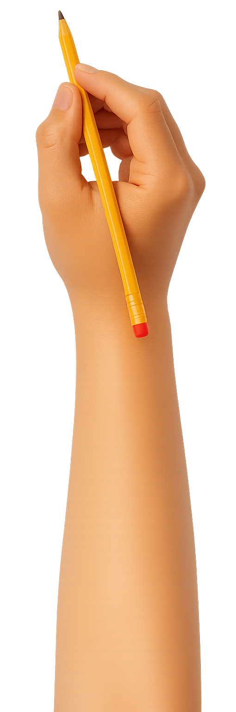


What We Learnt
Exit Ticket
Lesson 1
event
A celebration is a special ______ used to mark something important.
An example of a celebration is:
a birthday
a puppy
a trip to the zoo.
M____ is an important part of many celebrations.
event
food
song
usic

Slide 3
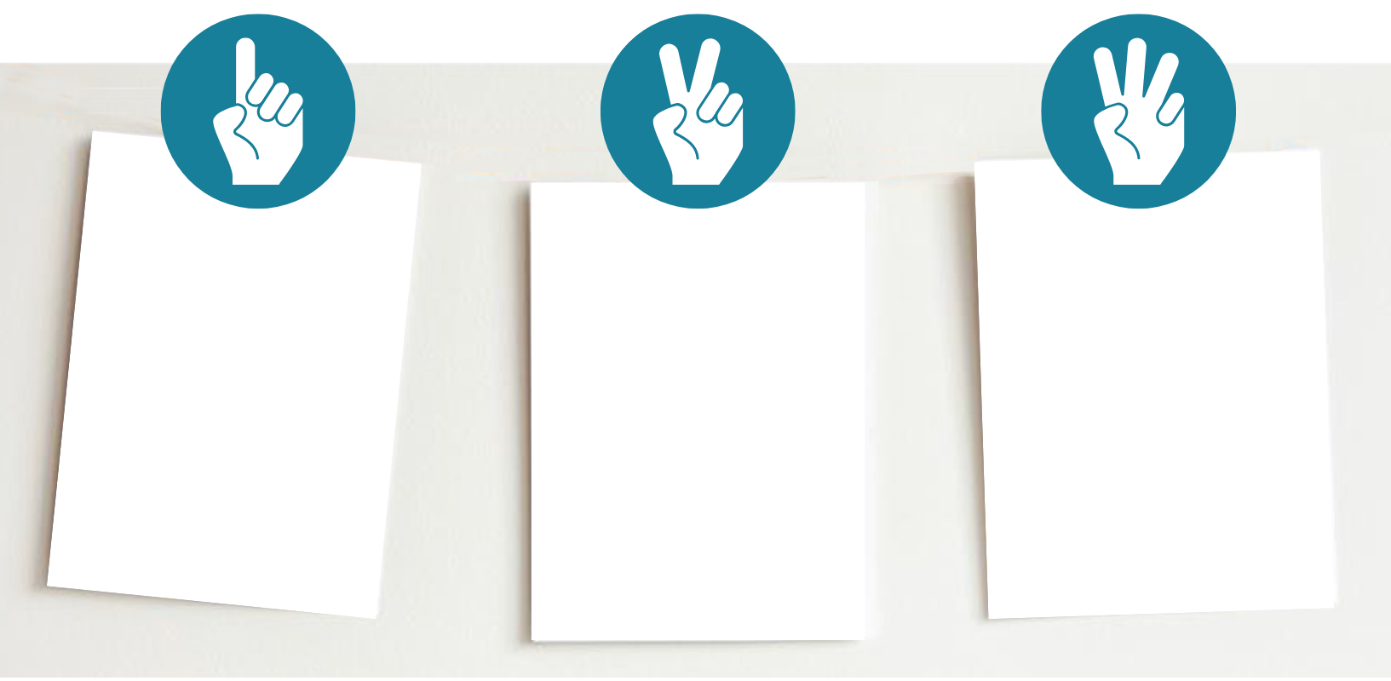
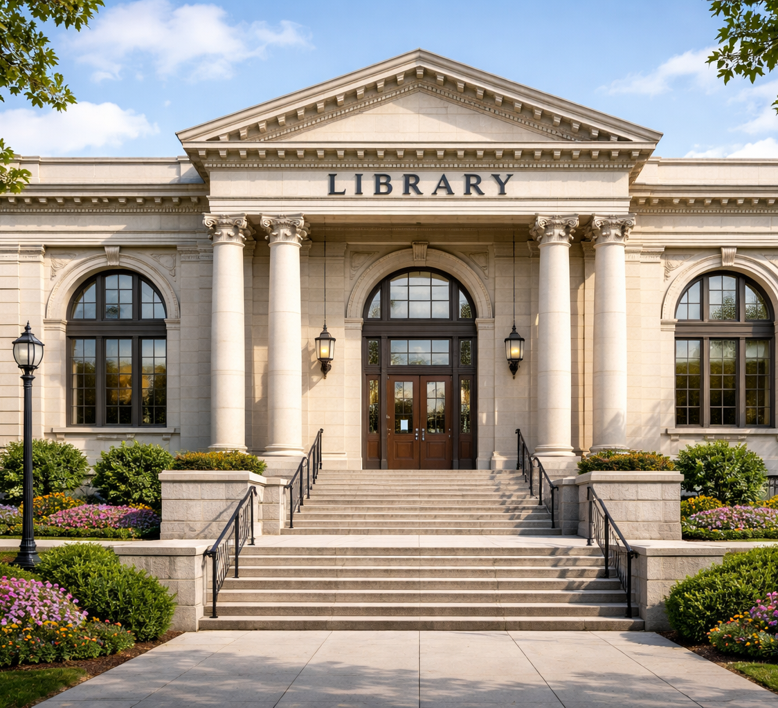
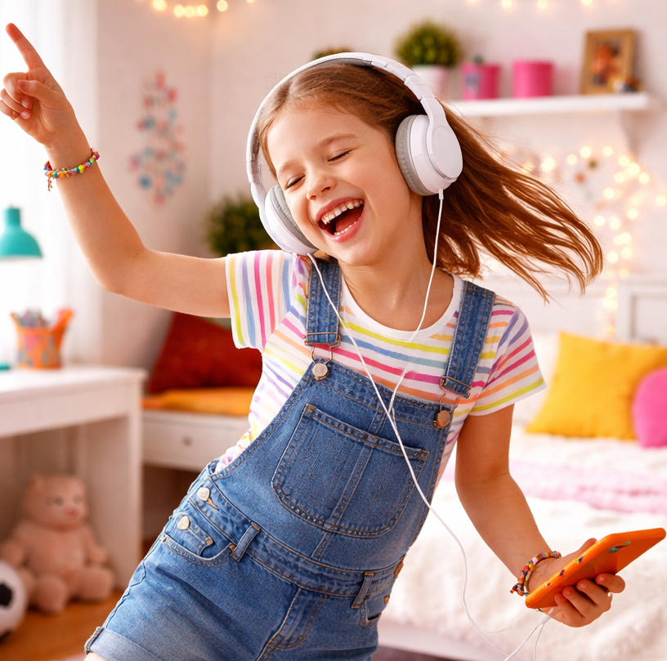
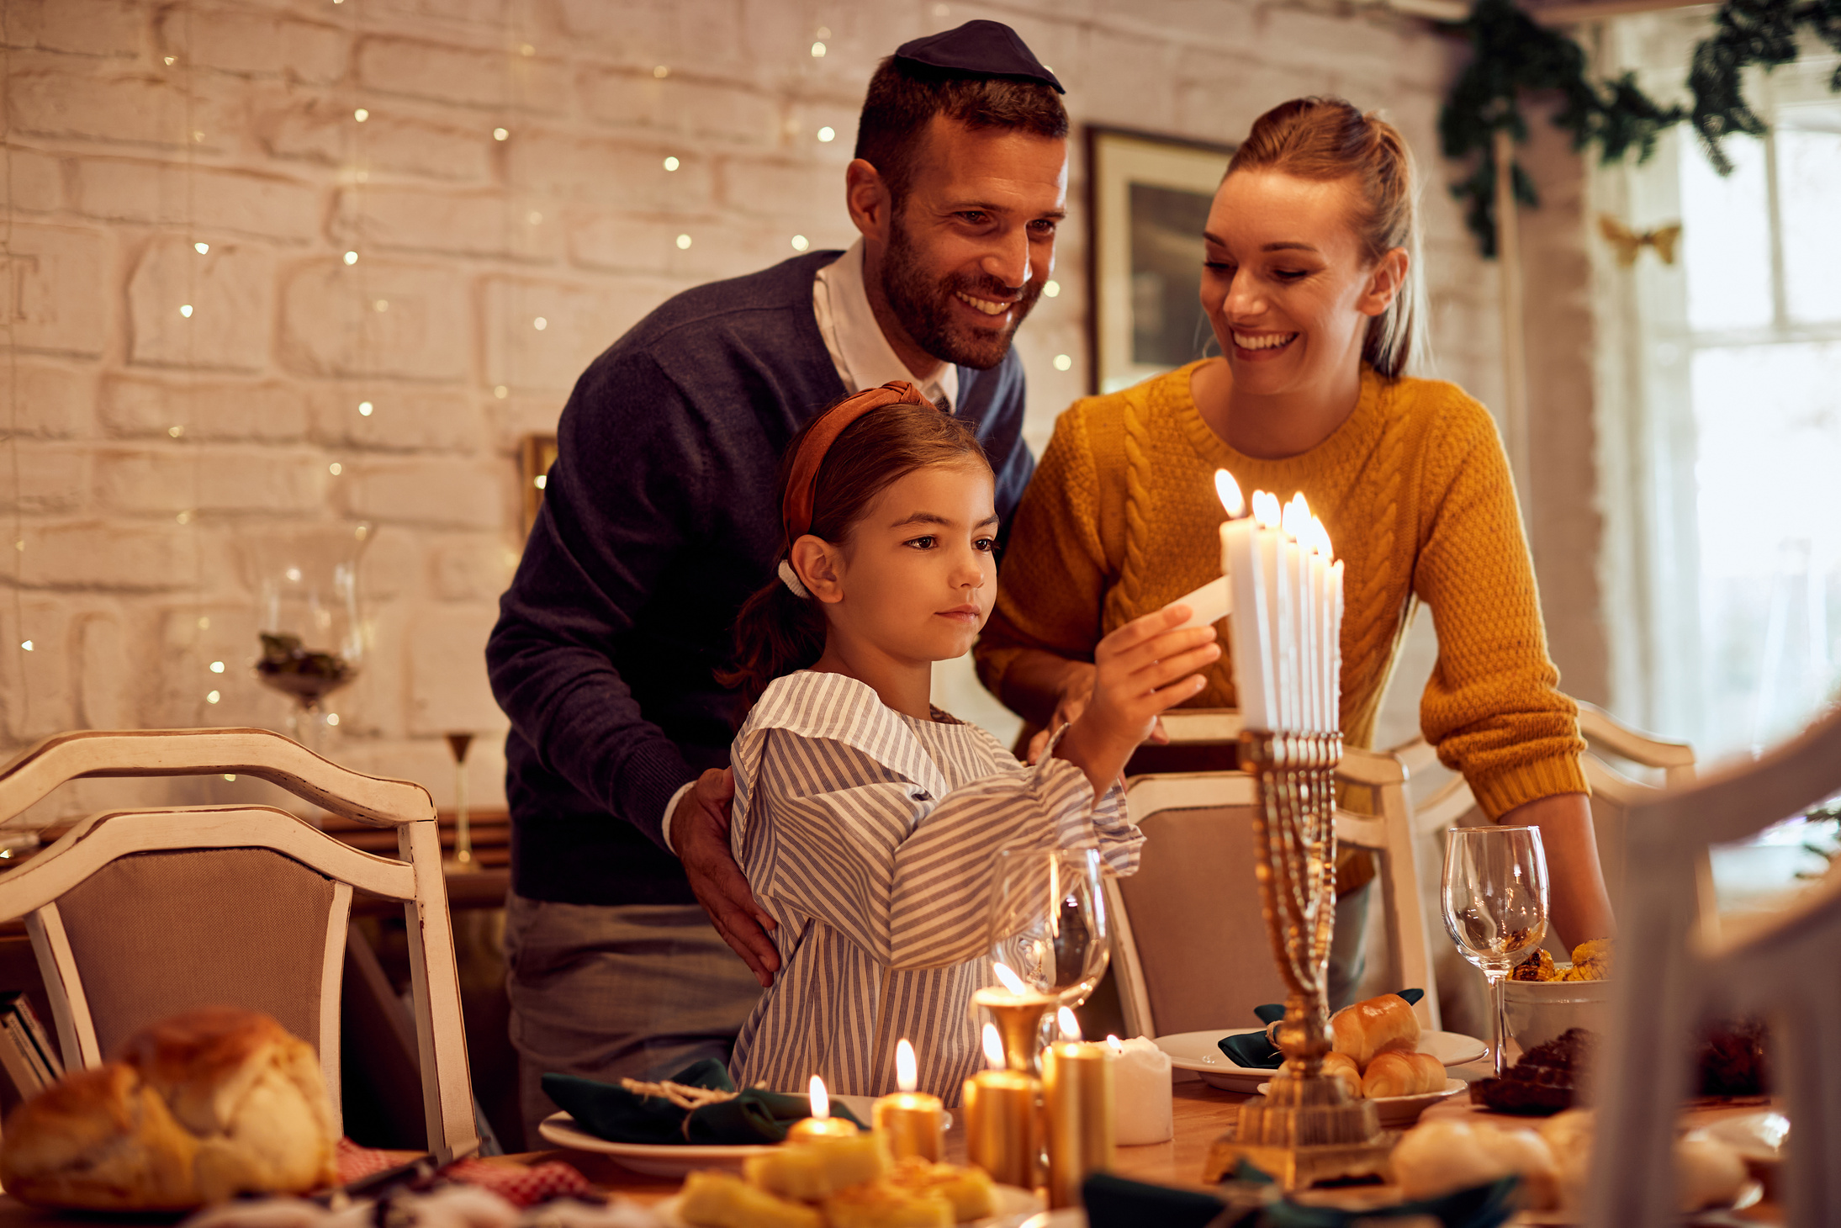
Which is an example of a celebration?

Slide 4
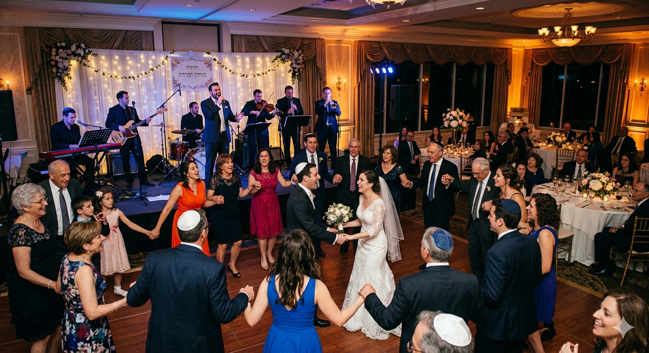
In this lesson, we will look at how music helps bring people together during celebrations.

Slide 5
You will be able to: ​
about how music brings people together with singing and dancing
to music from different celebrations.
talk
Talk means to tell someone something using words.
move
Move means to change your body position.

Slide 6
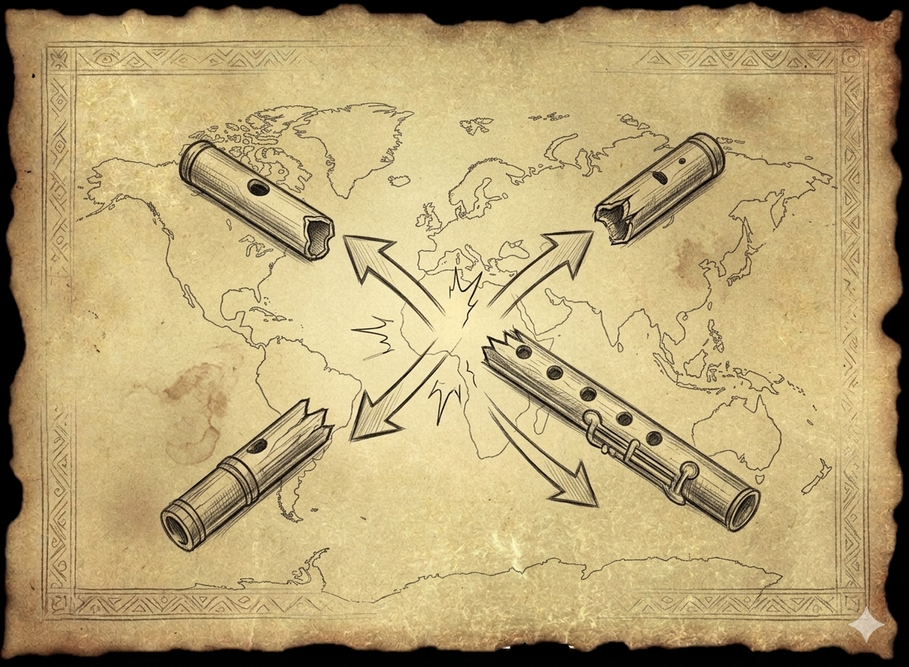
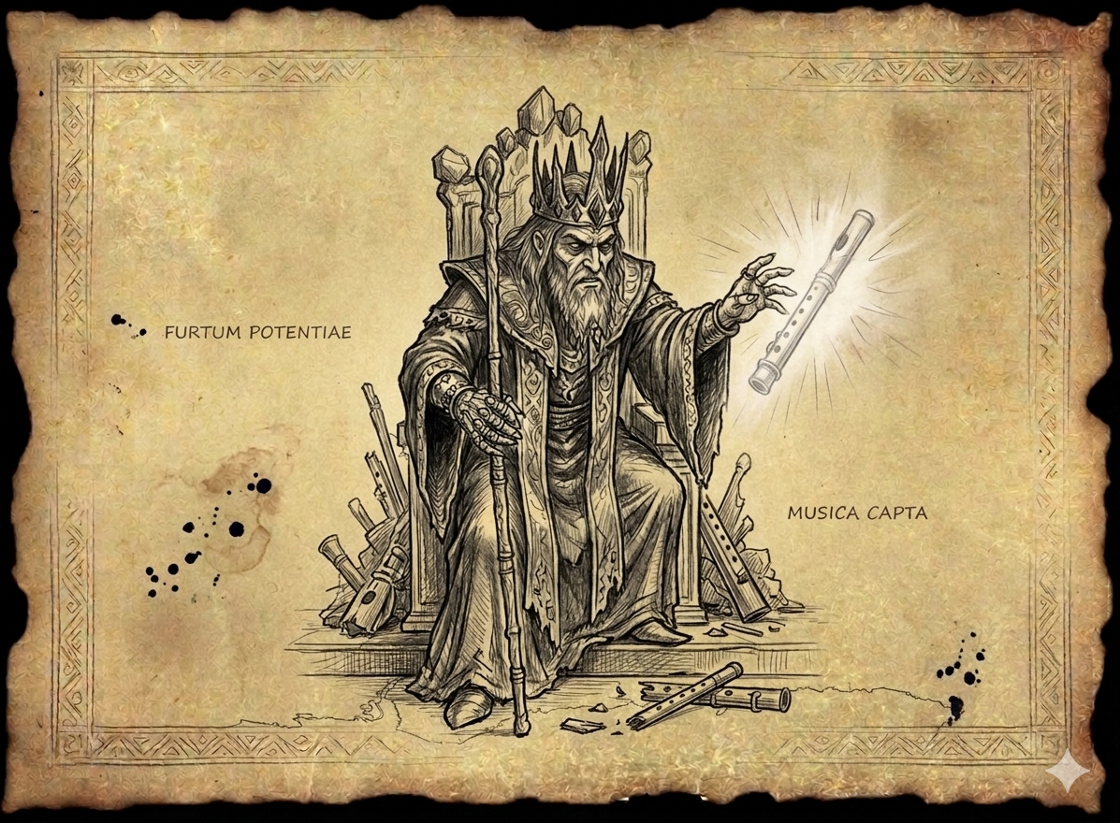
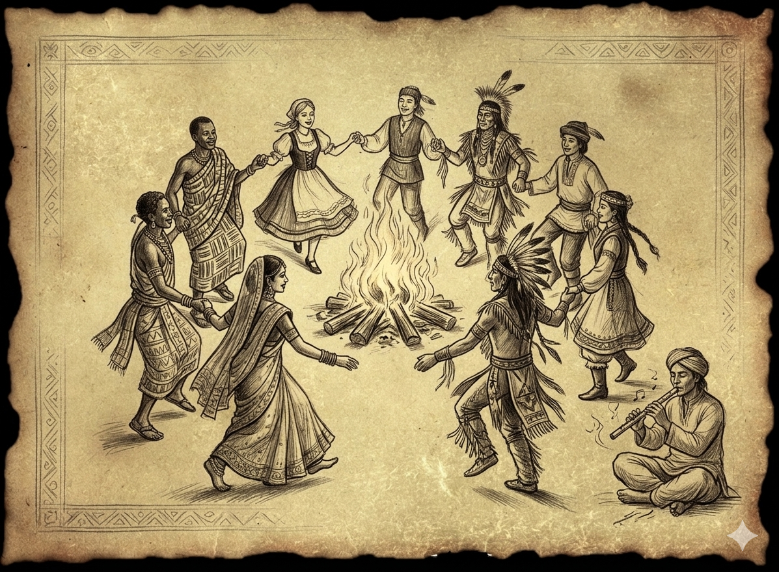

Slide 7

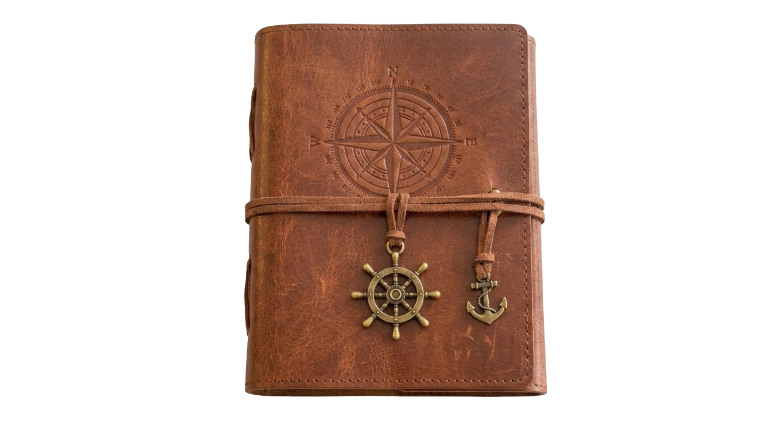
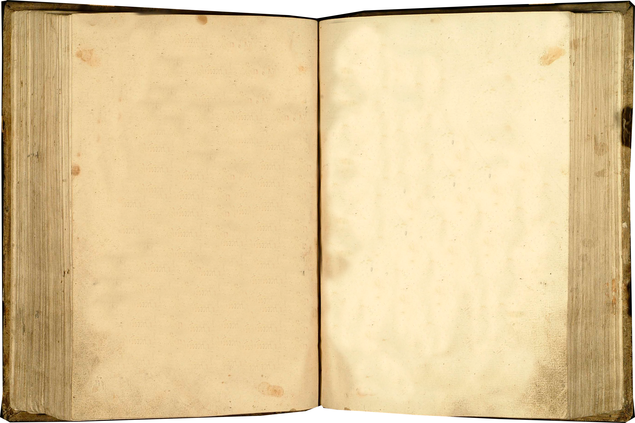
Clue 2: In many celebrations, people laugh, play music and dance.
They are not alone. They are doing something as one.
What word tells how they are all celebrating?

Slide 8
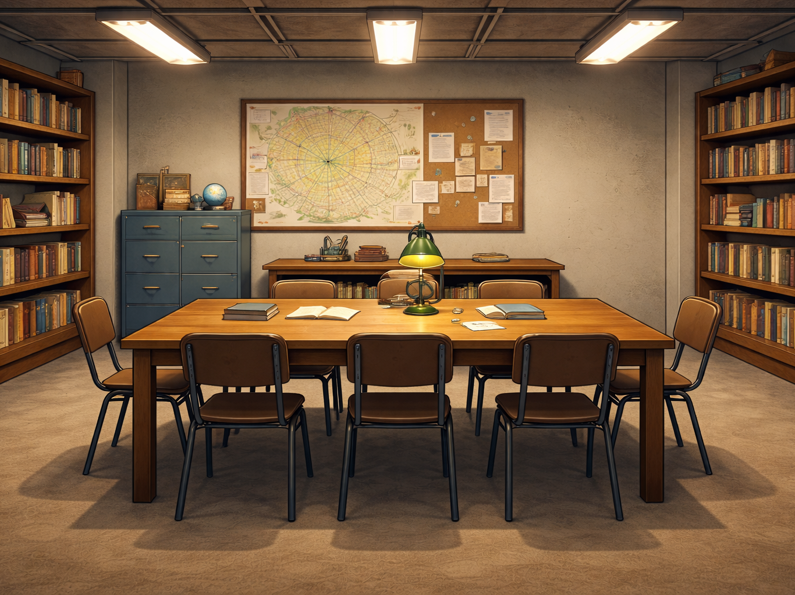
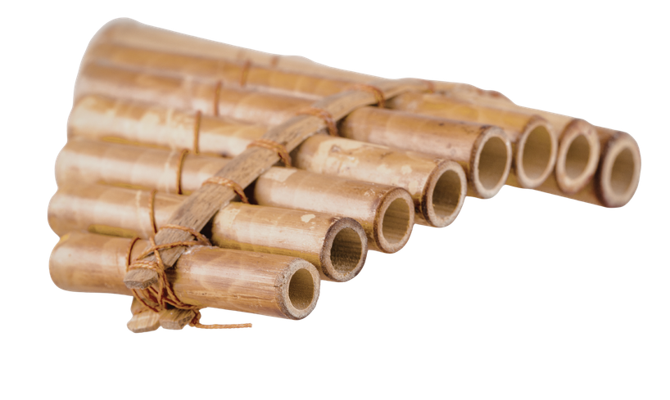
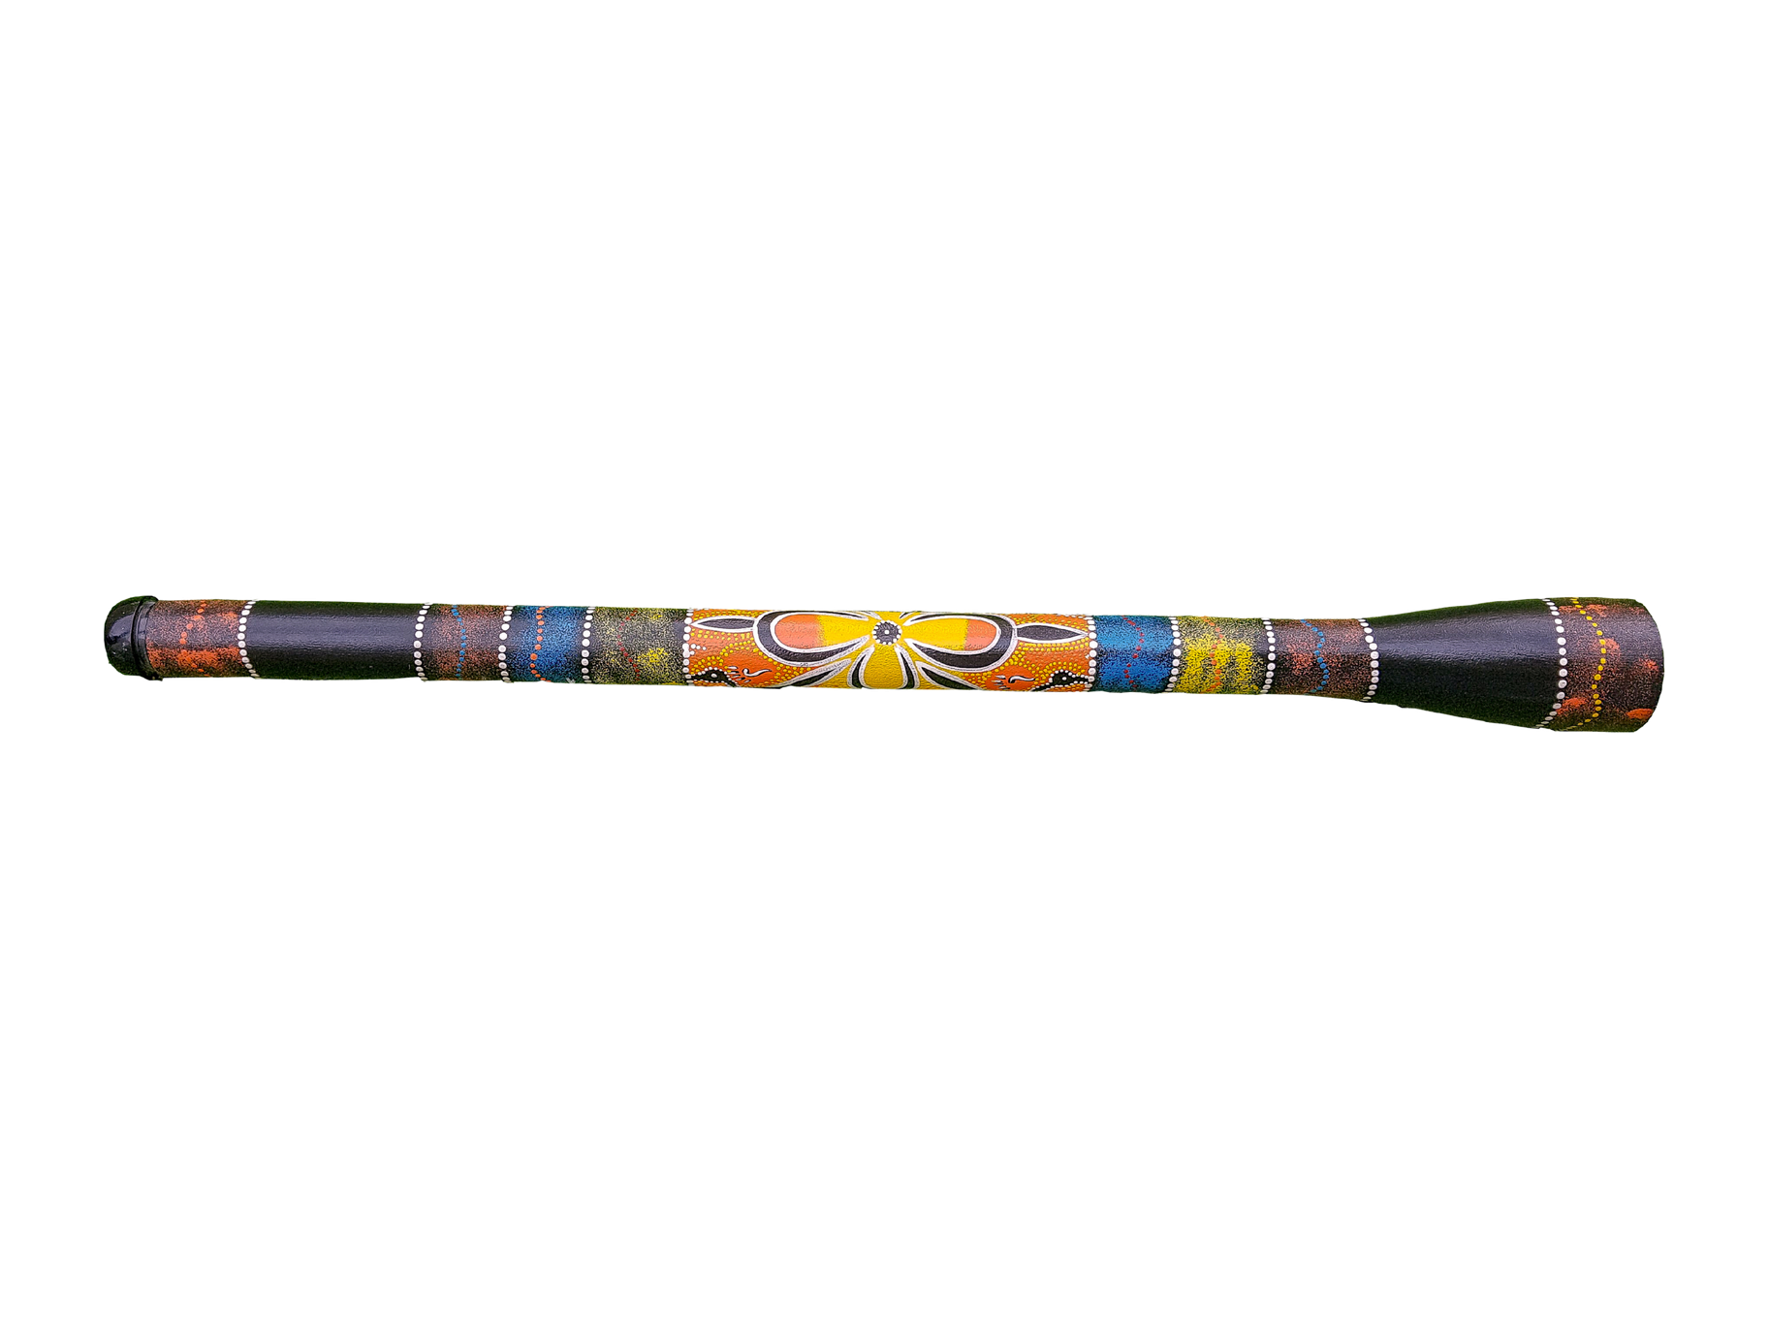

Slide 9
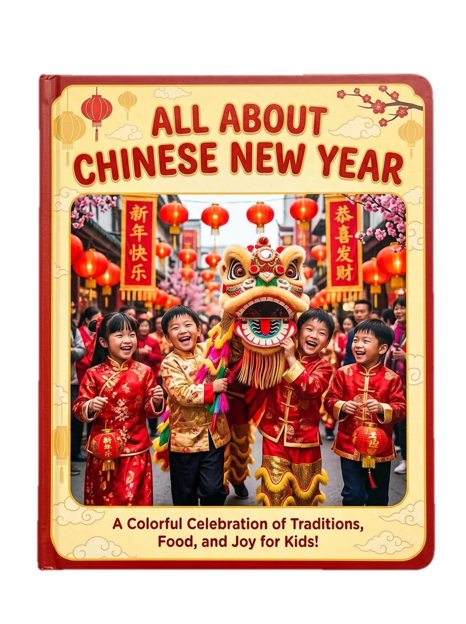
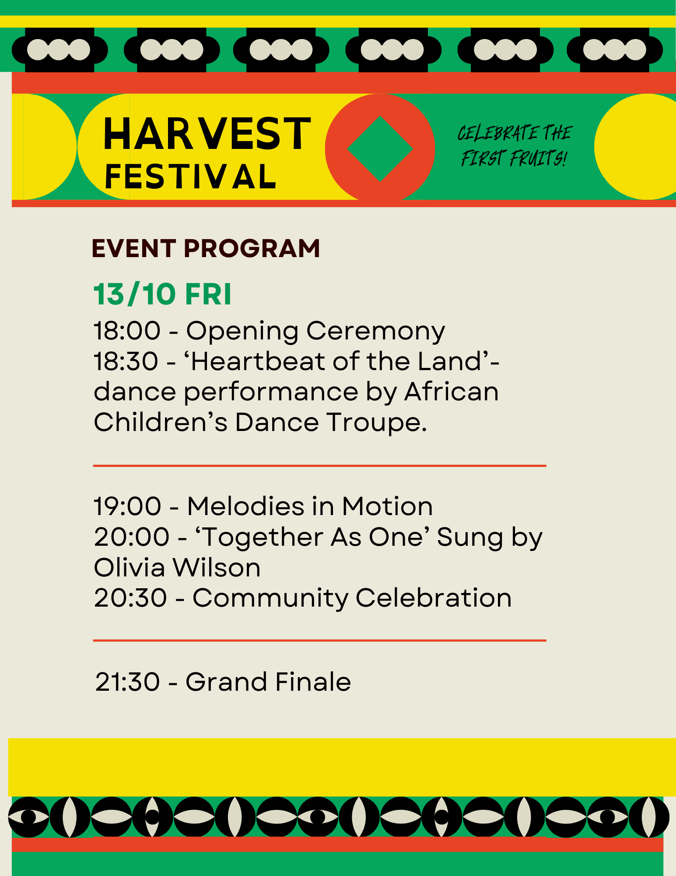
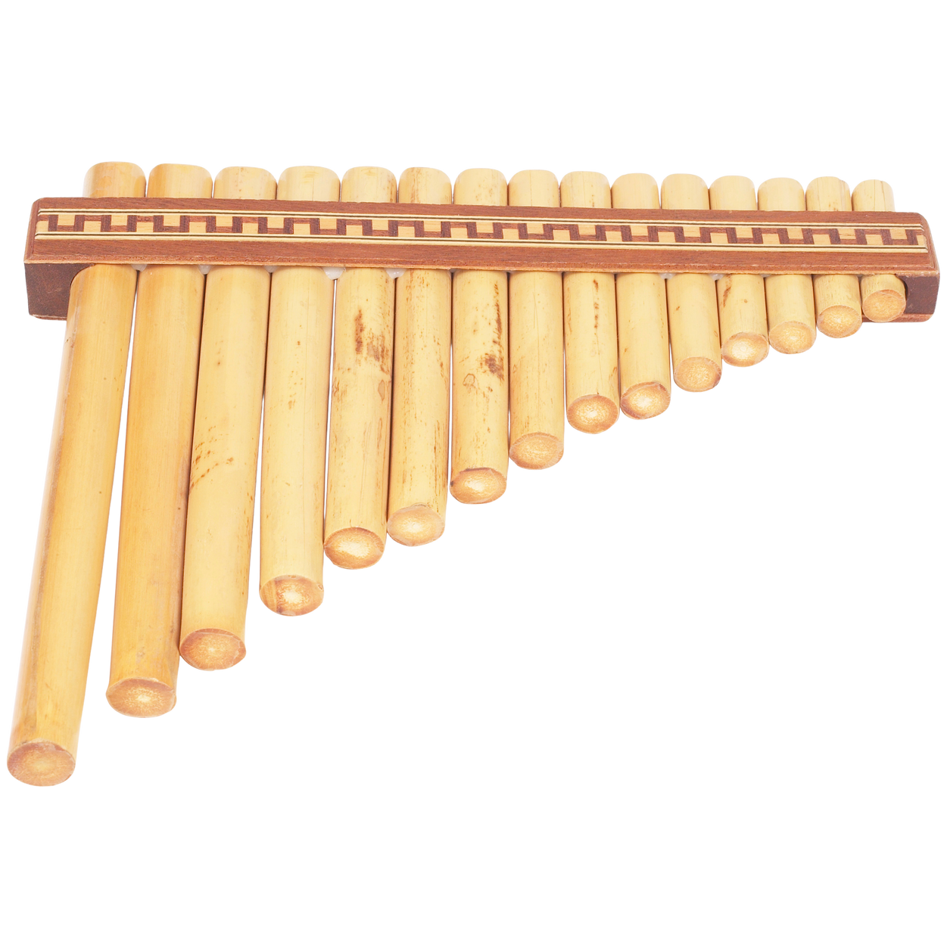

Slide 10

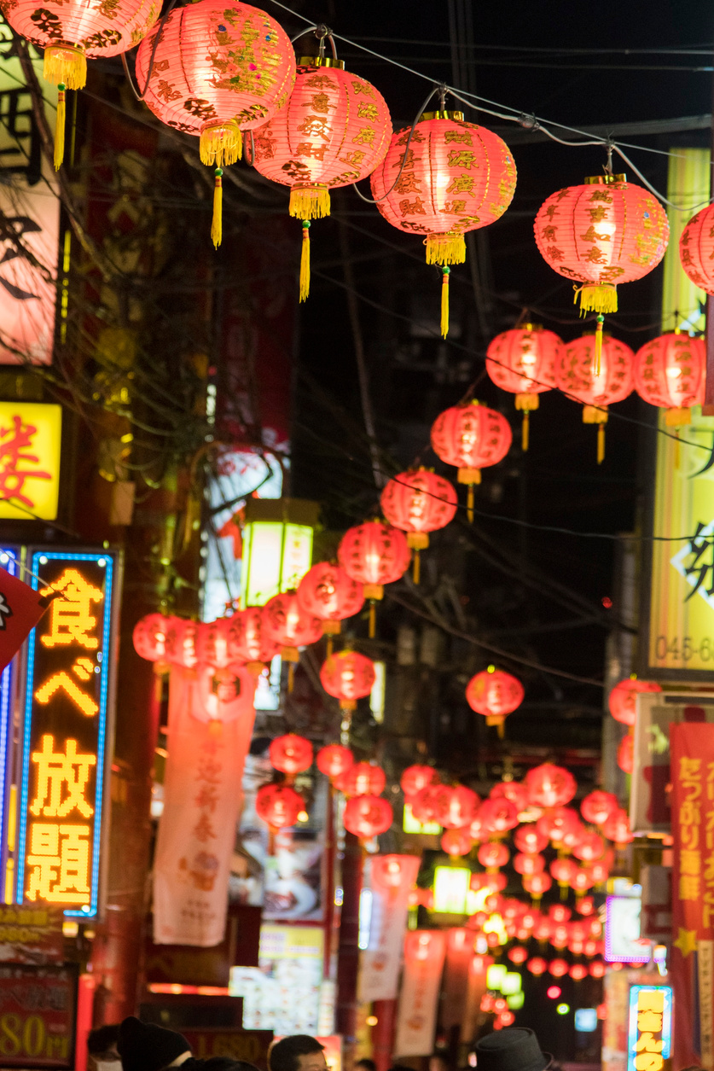
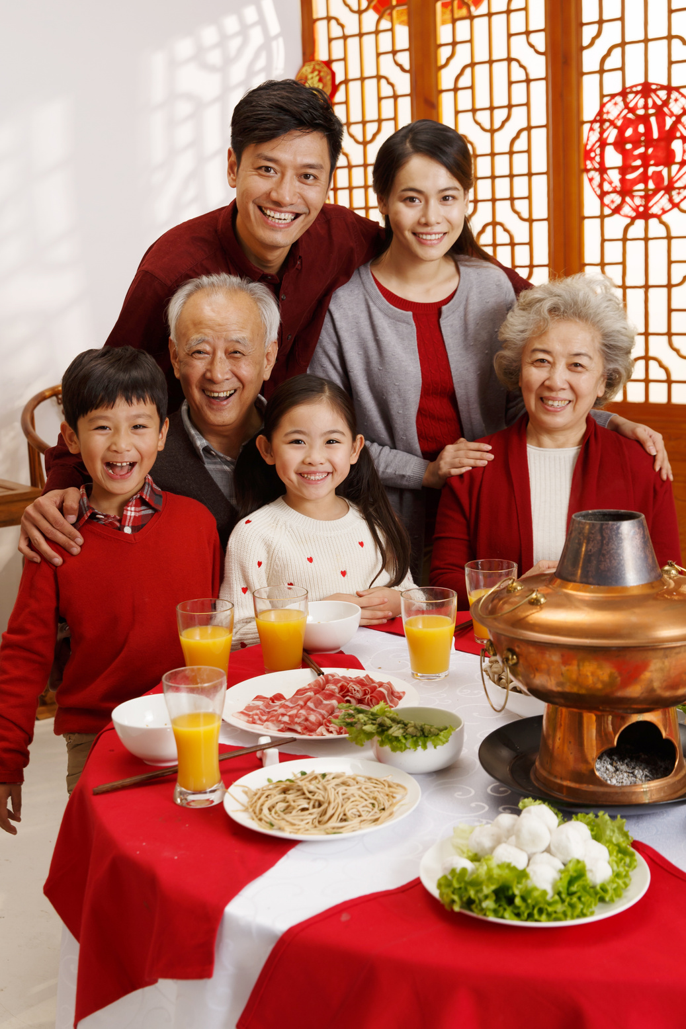
Chinese New Year celebrates the start of a new year. Families get together and eat special food. People decorate with red and gold colours.

Slide 11
People dance through the streets. Music is a big part of the celebration. It is loud and exciting. Music helps the dragon and lion dances come alive.
There are parades with big dragons and lions.

Slide 12
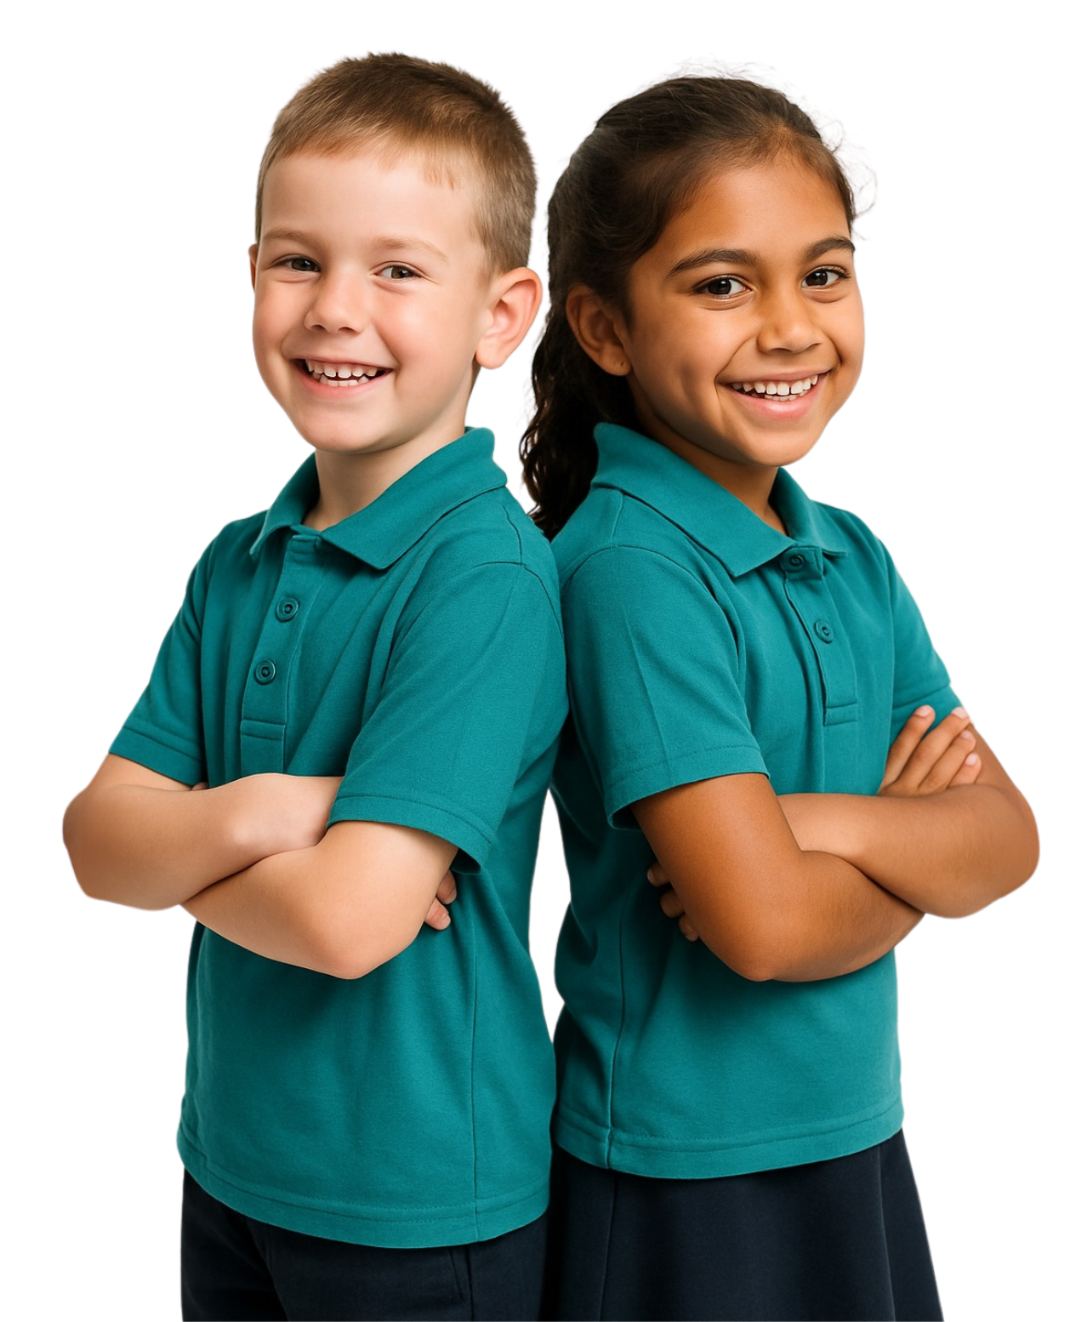
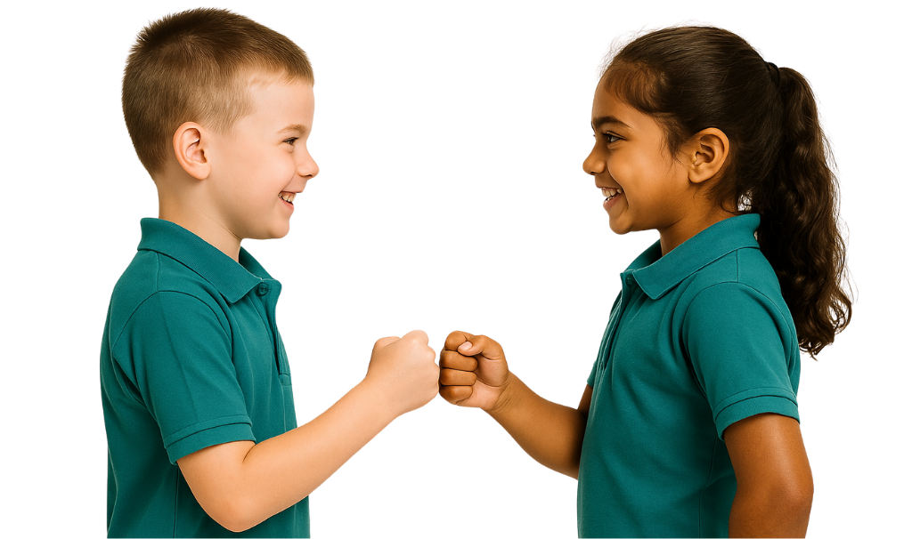
Chinese New Year Parades
Which animal is often part of
Chinese New Year parades?
Dragon
Cat
Elephant
When I say, ‘Reveal,’ hold up the symbol for the answer you agree with and turn to face your partner.

Slide 15

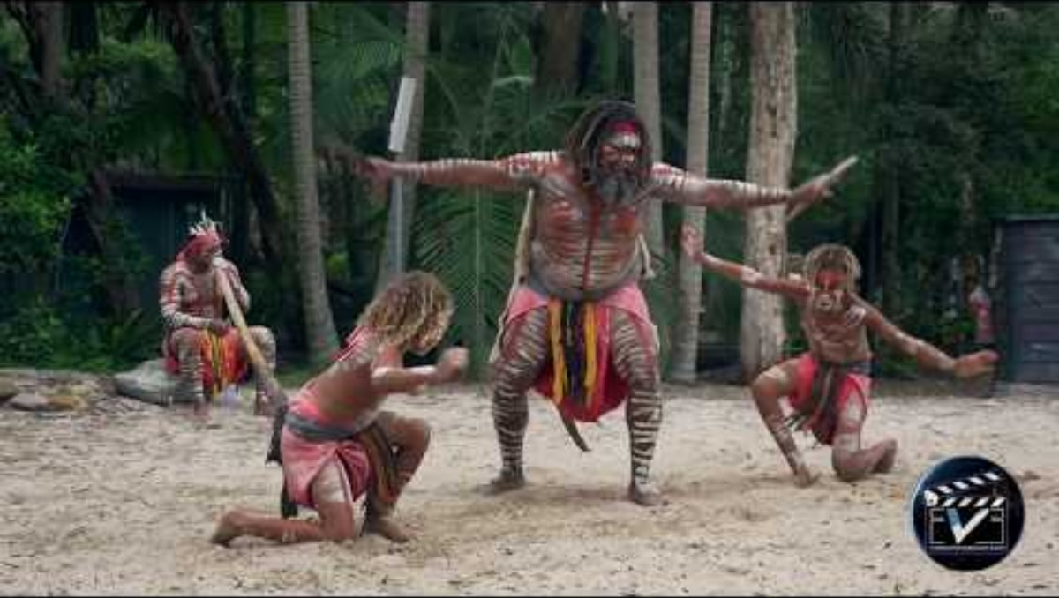
First Nation Australian Dance

Slide 16
Clue 2: In many celebrations, people laugh, play music and dance.
They are not alone. They are doing something as one.
What word tells how they are all celebrating?

Slide 17
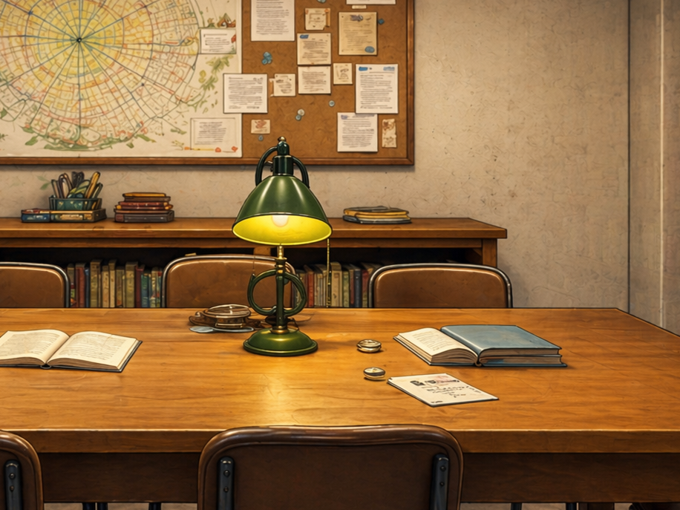
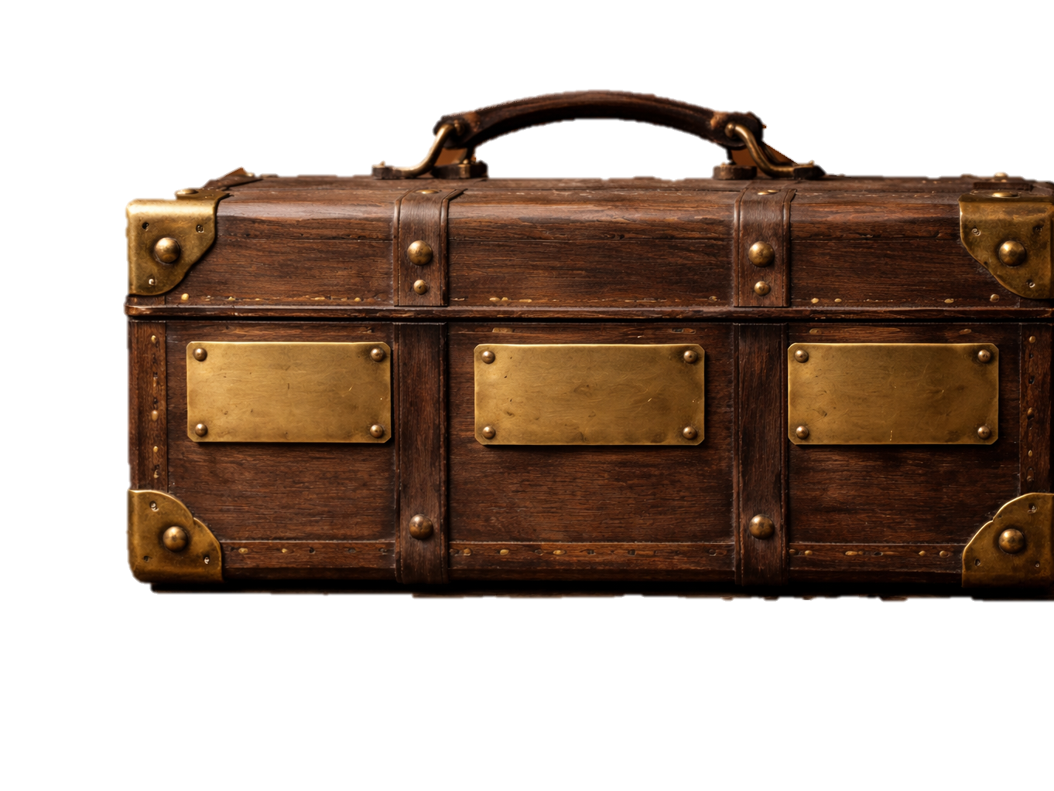
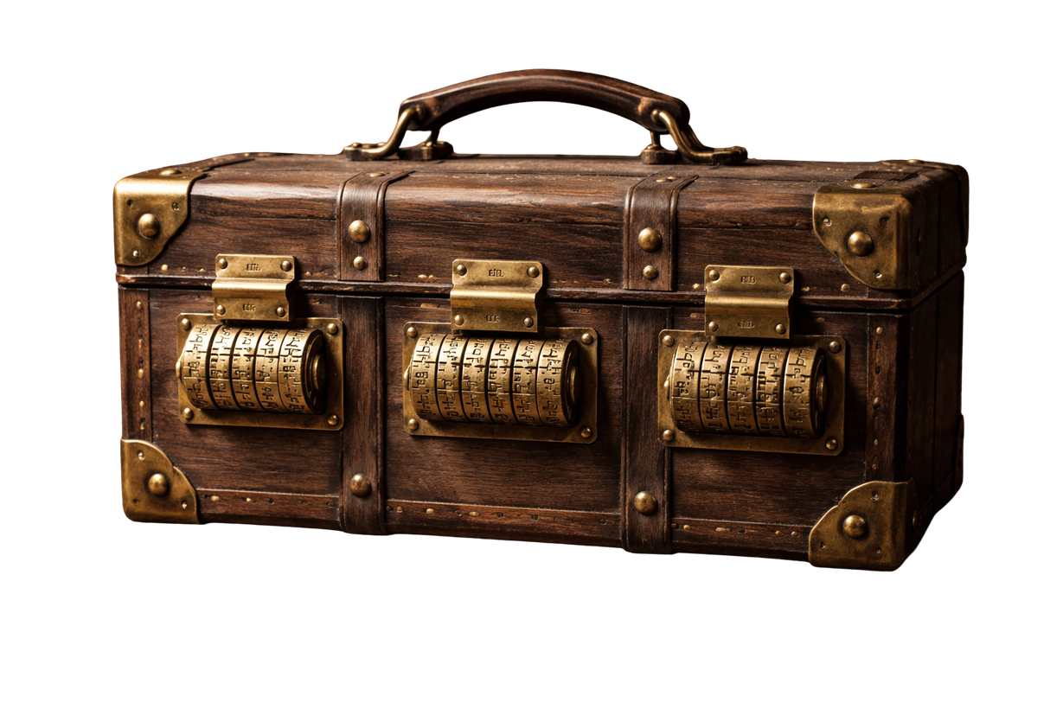








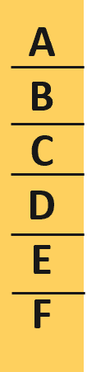

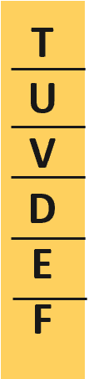

RST
U
V
D
F

Slide 18
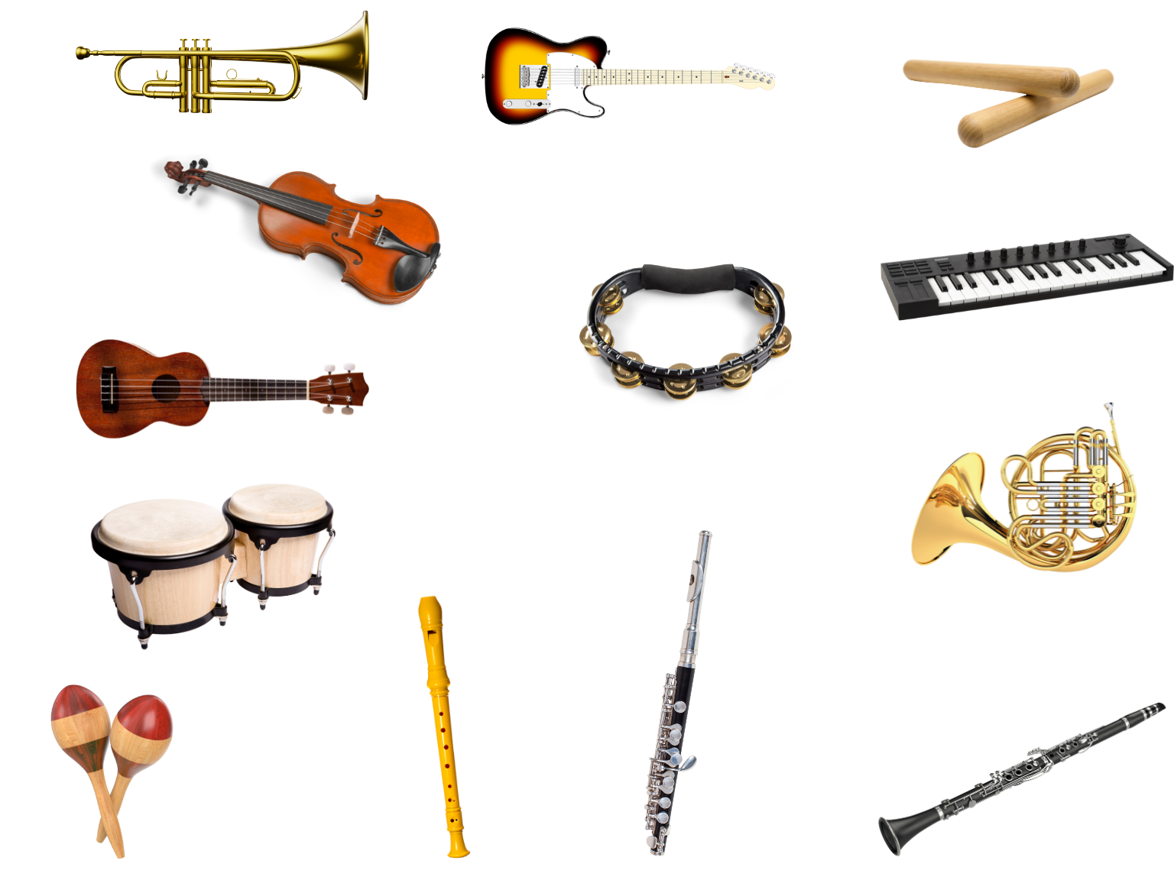
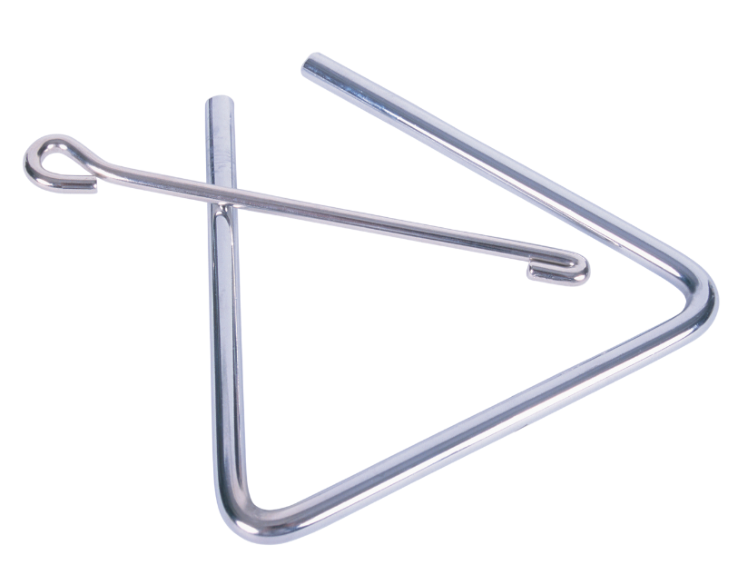
Instruments have Families
Instrument families are sorted by the way they make sound.

Slide 19
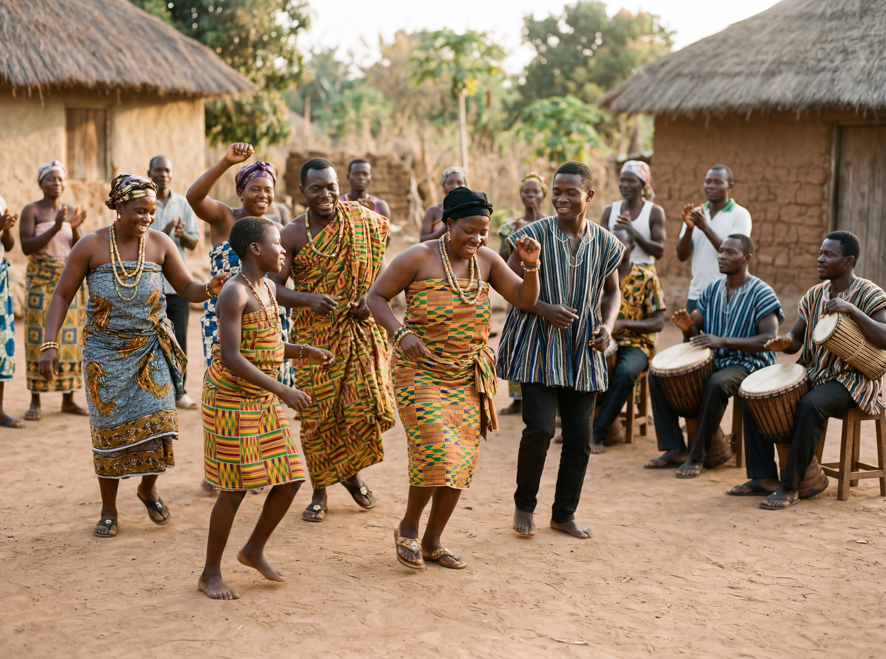
Identifying Instruments

Slide 20
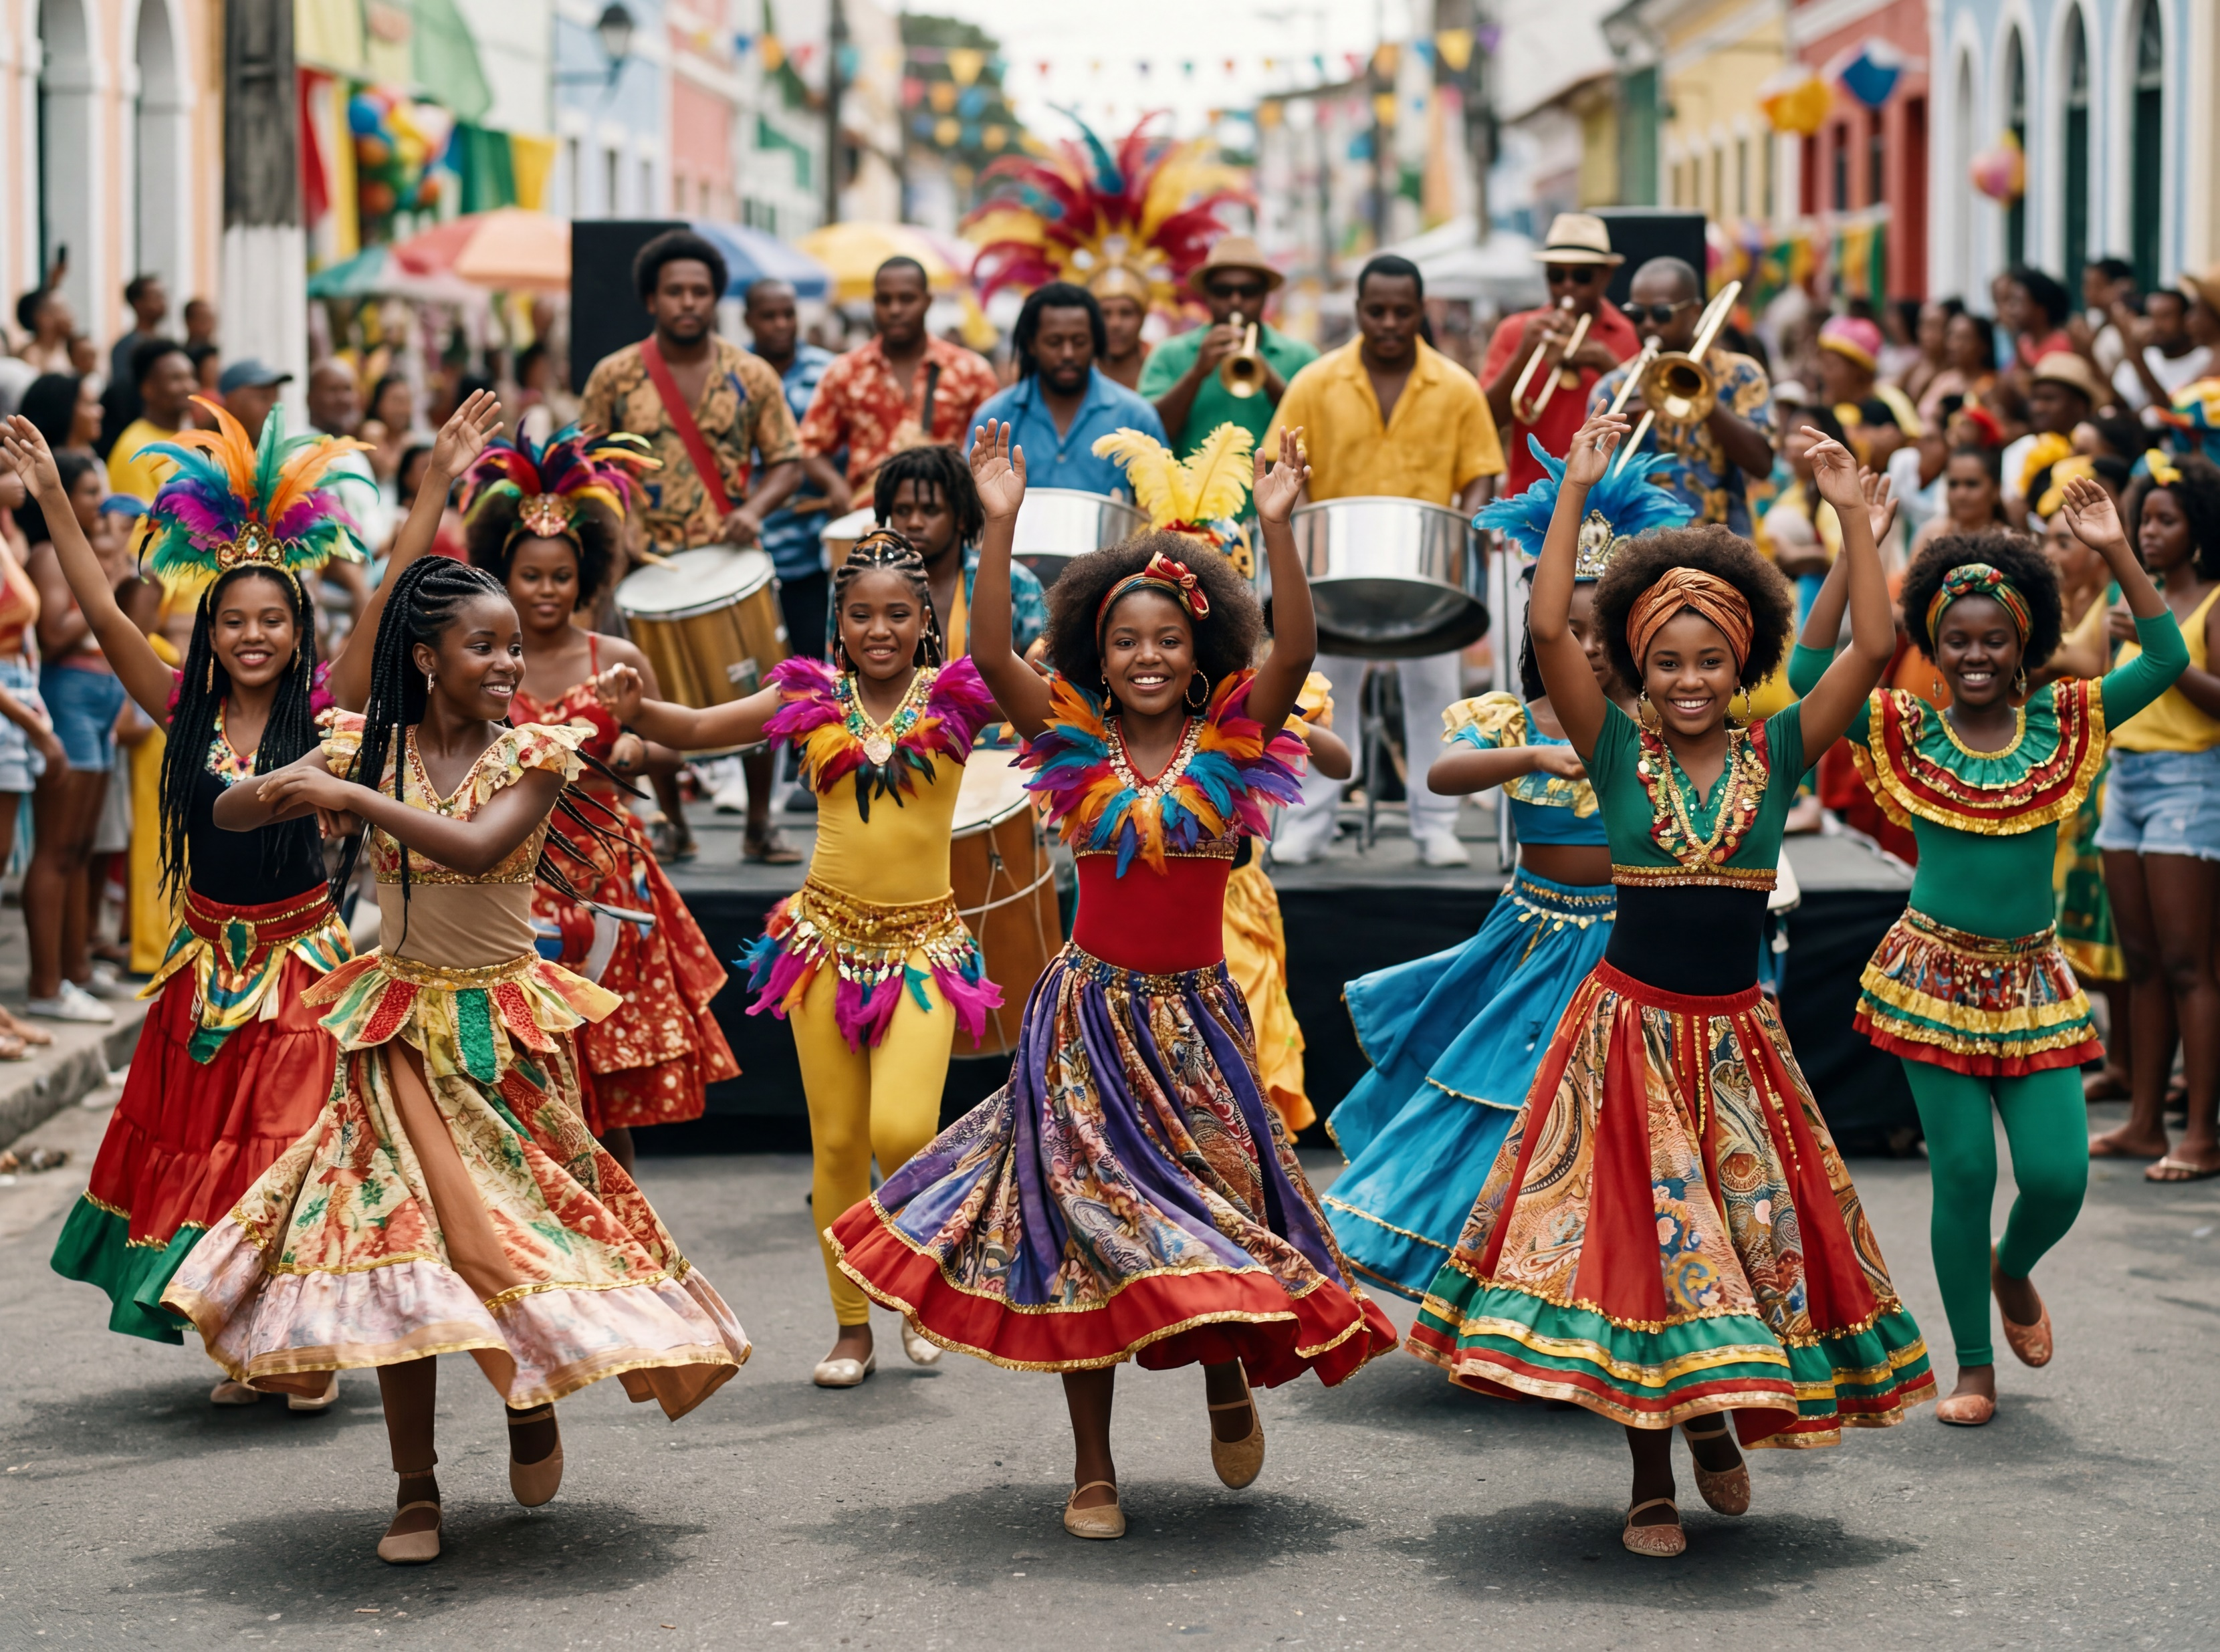
Identifying Instruments

Slide 21
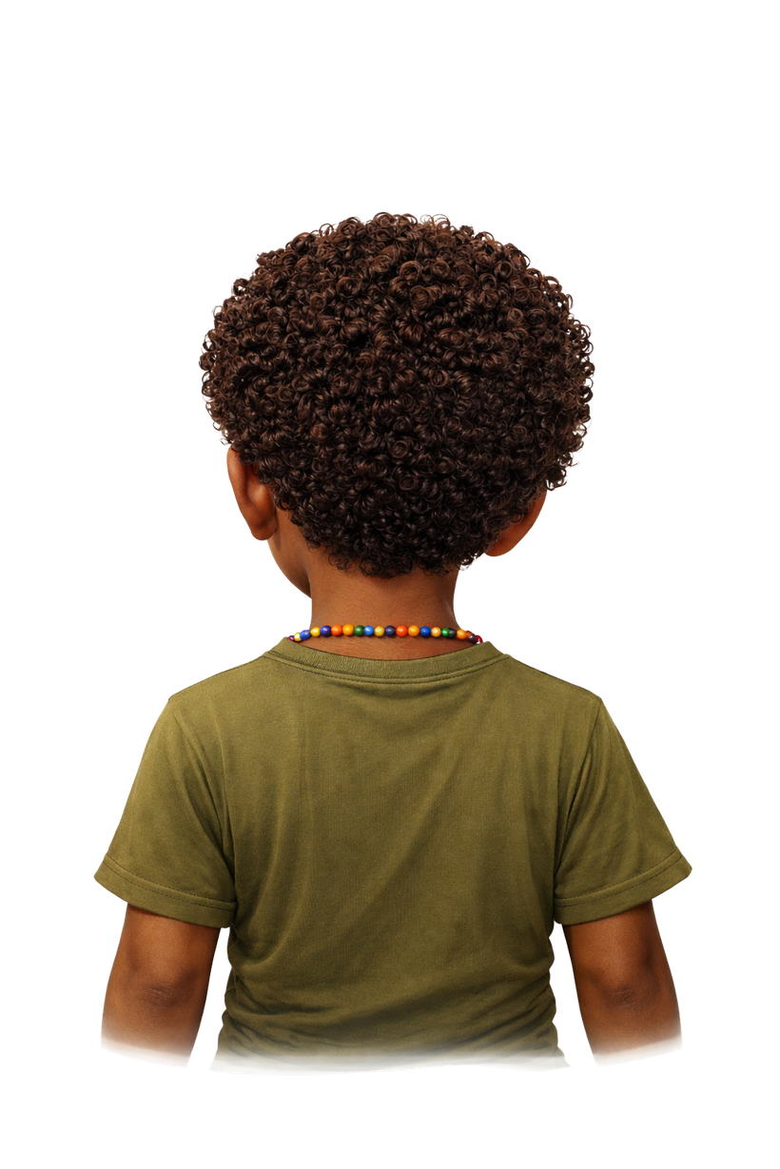


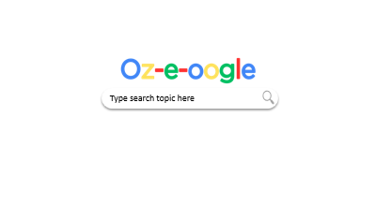

Slide 22

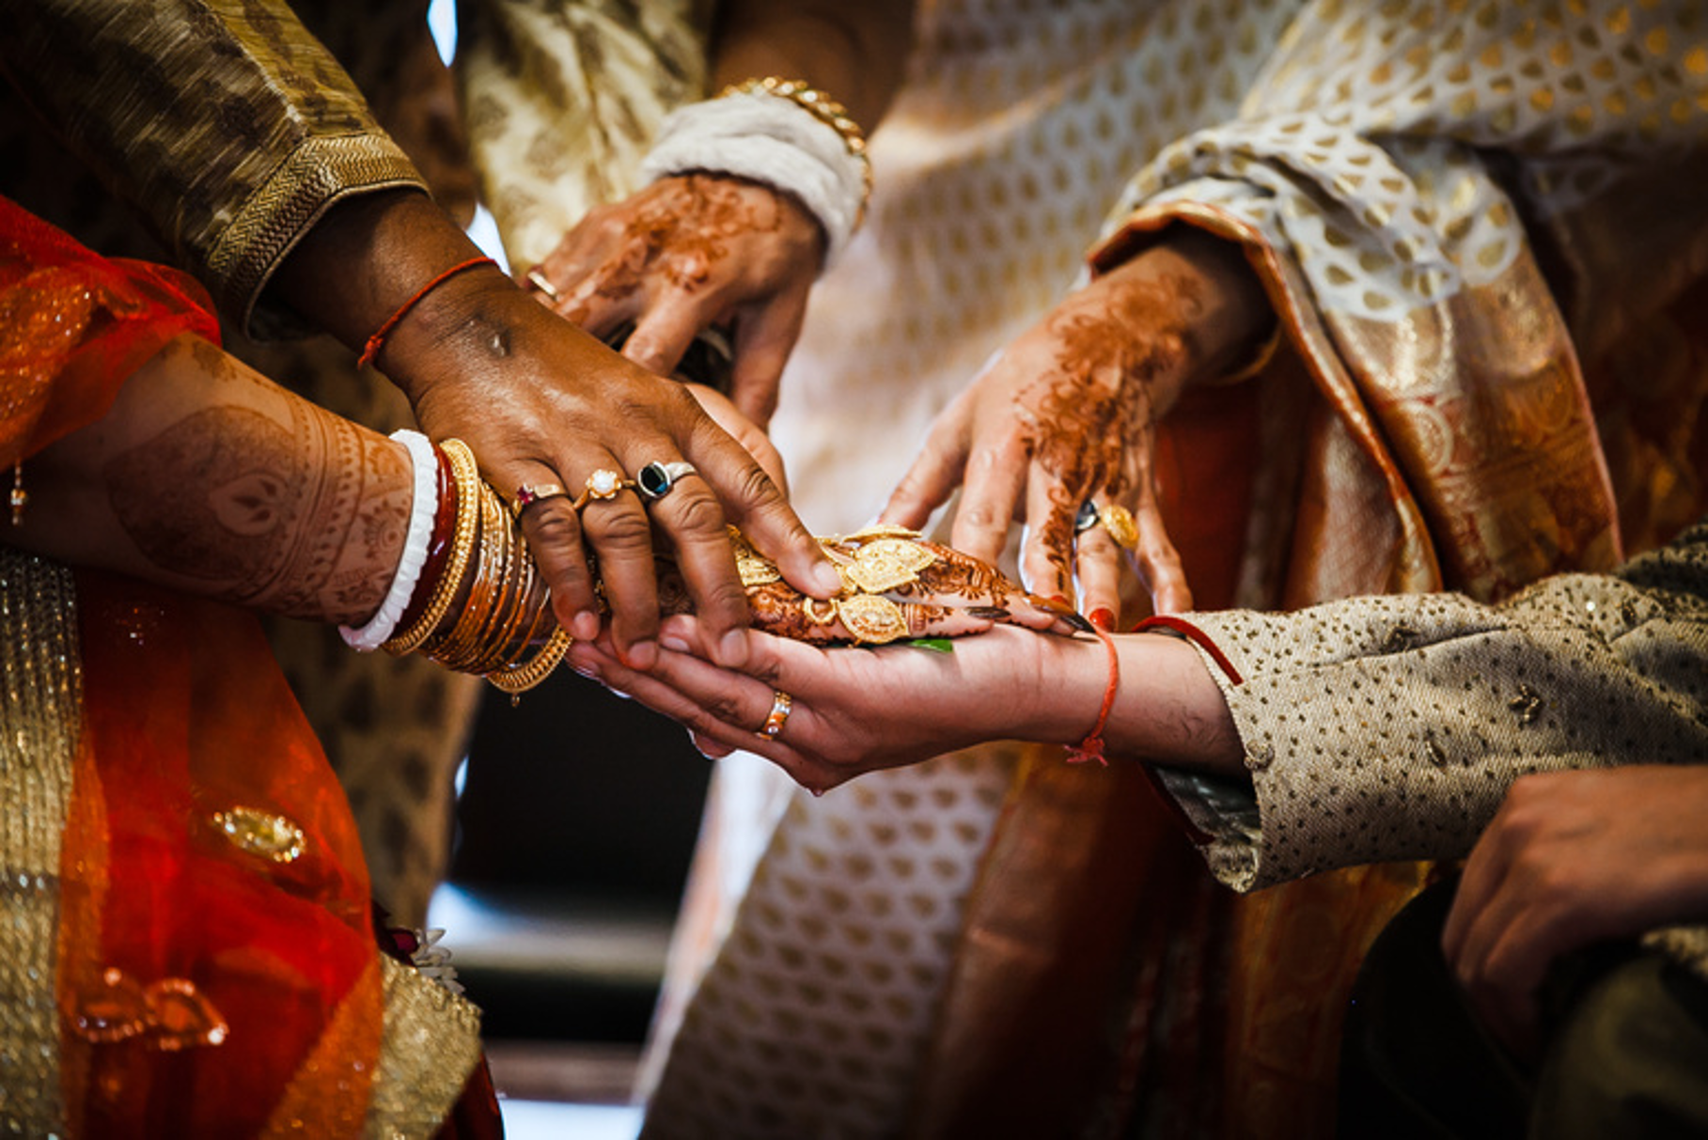
The Dreaming
Celebration dances
All
Images
News
Videos
More
Indigenous Tribal Round Dance
A traditional ‘friendship dance’ that shows unity and connection. It involves moving in a circle, often in a clockwise direction.
Jewish Horah
The horah is a traditional dance performed at Jewish weddings. Guests circle up and dance around while holding hands.

Slide 23
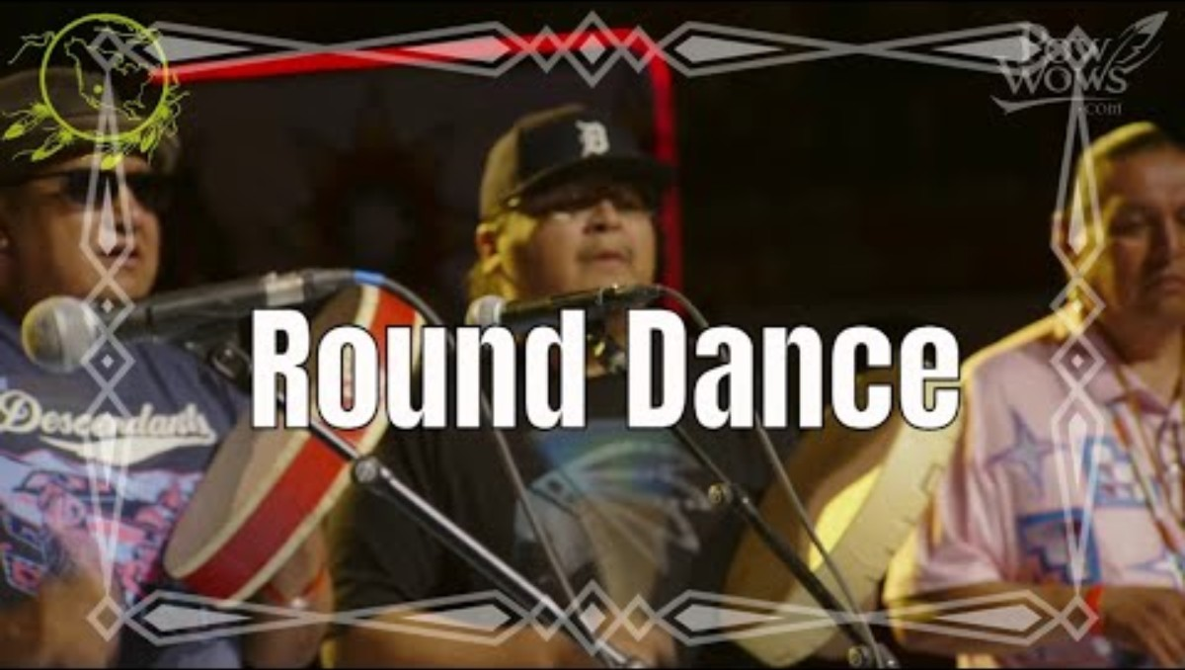
The Dreaming
Round dance
All
Images
News
Videos
More

Slide 24
The Dreaming
Birthday songs around the world
All
Images
News
Videos
More
Indigenous Tribal Round Dance
A traditional ‘friendship dance’ that shows unity and connection. It involves moving in a circle, often in a clockwise direction.
Jewish Horah
The horah is a traditional dance performed at Jewish weddings. Guests circle up and dance around while holding hands.

Slide 25
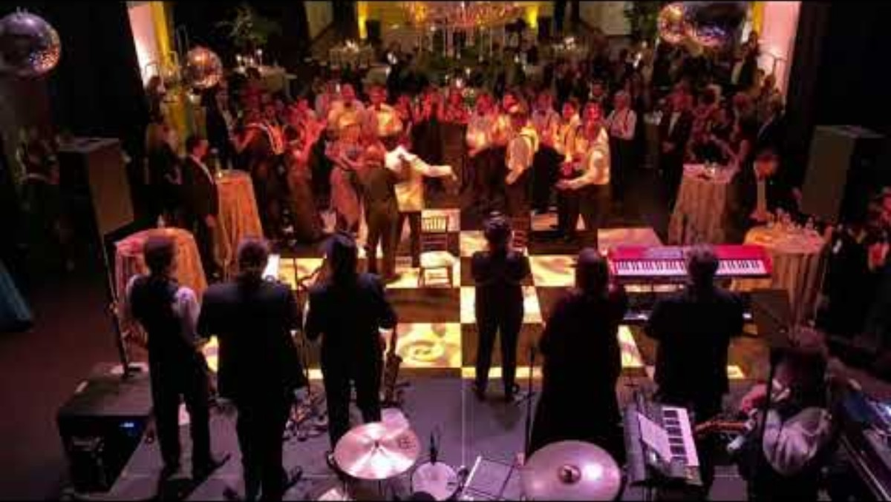
The Dreaming
Jewish wedding dance
All
Images
News
Videos
More

Slide 26
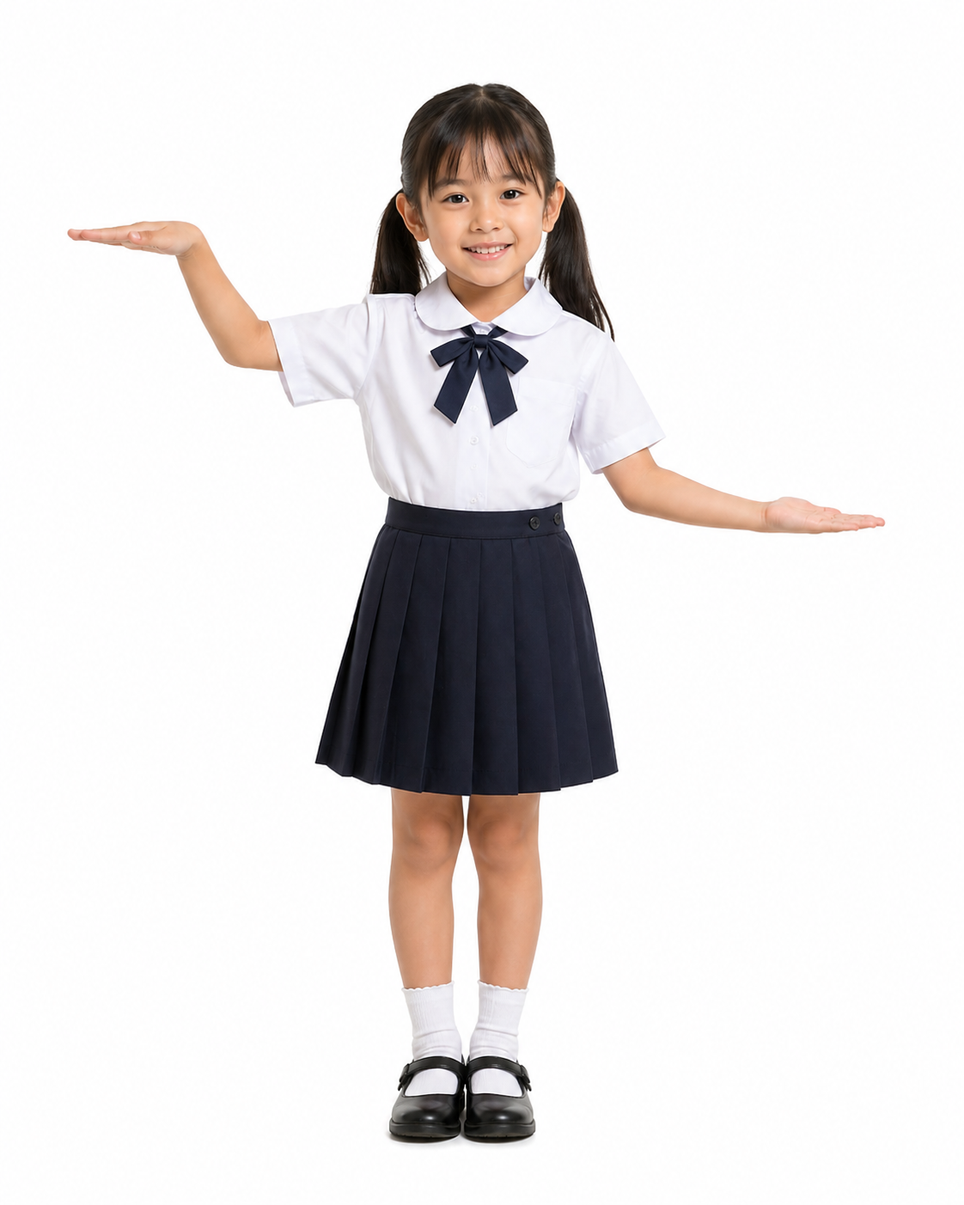
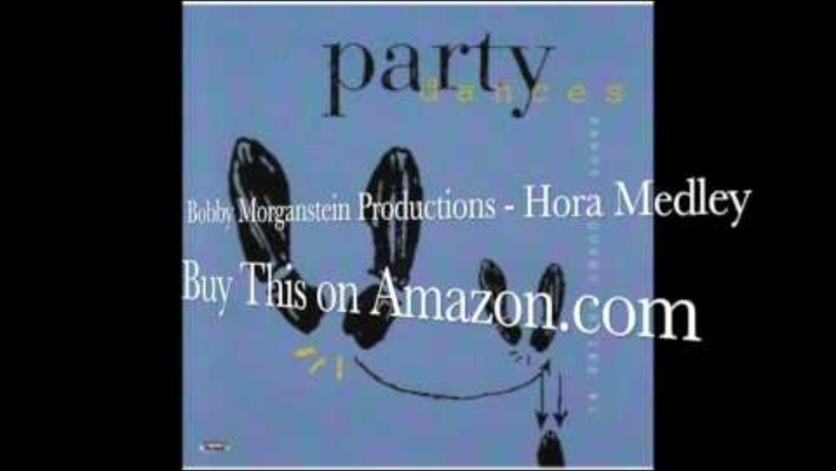
Horah Dance

Slide 27
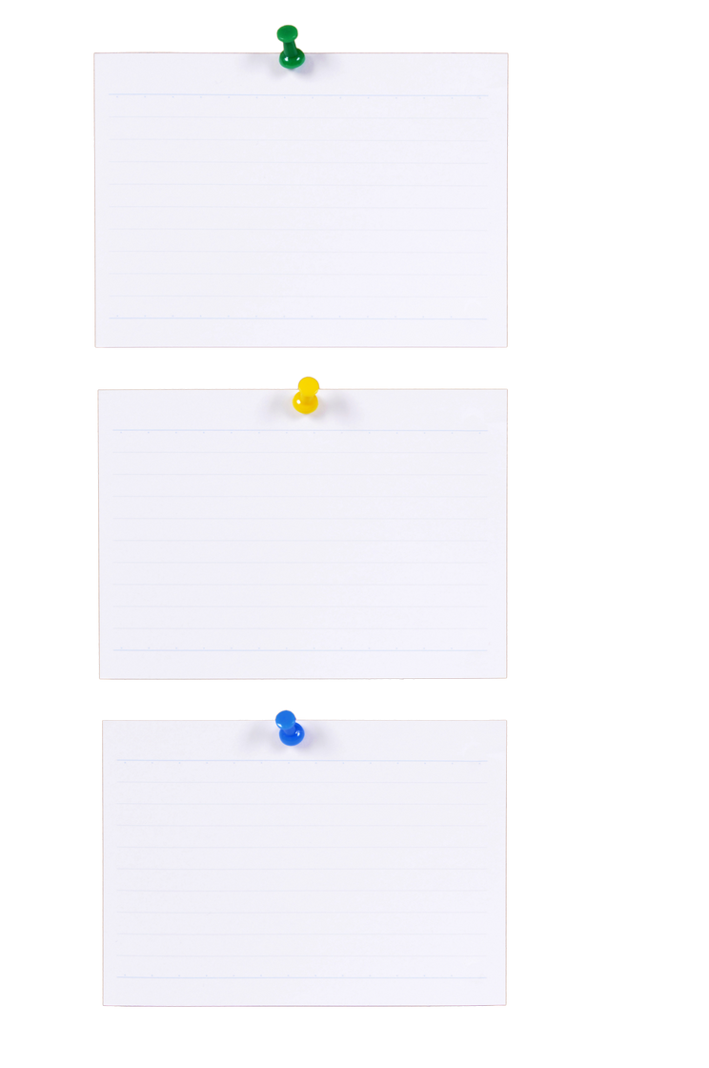
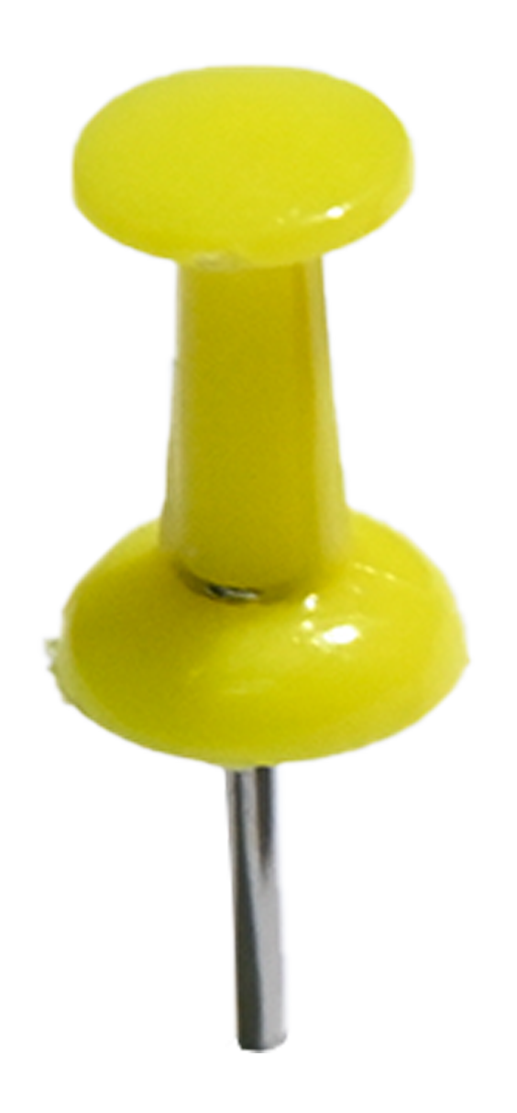
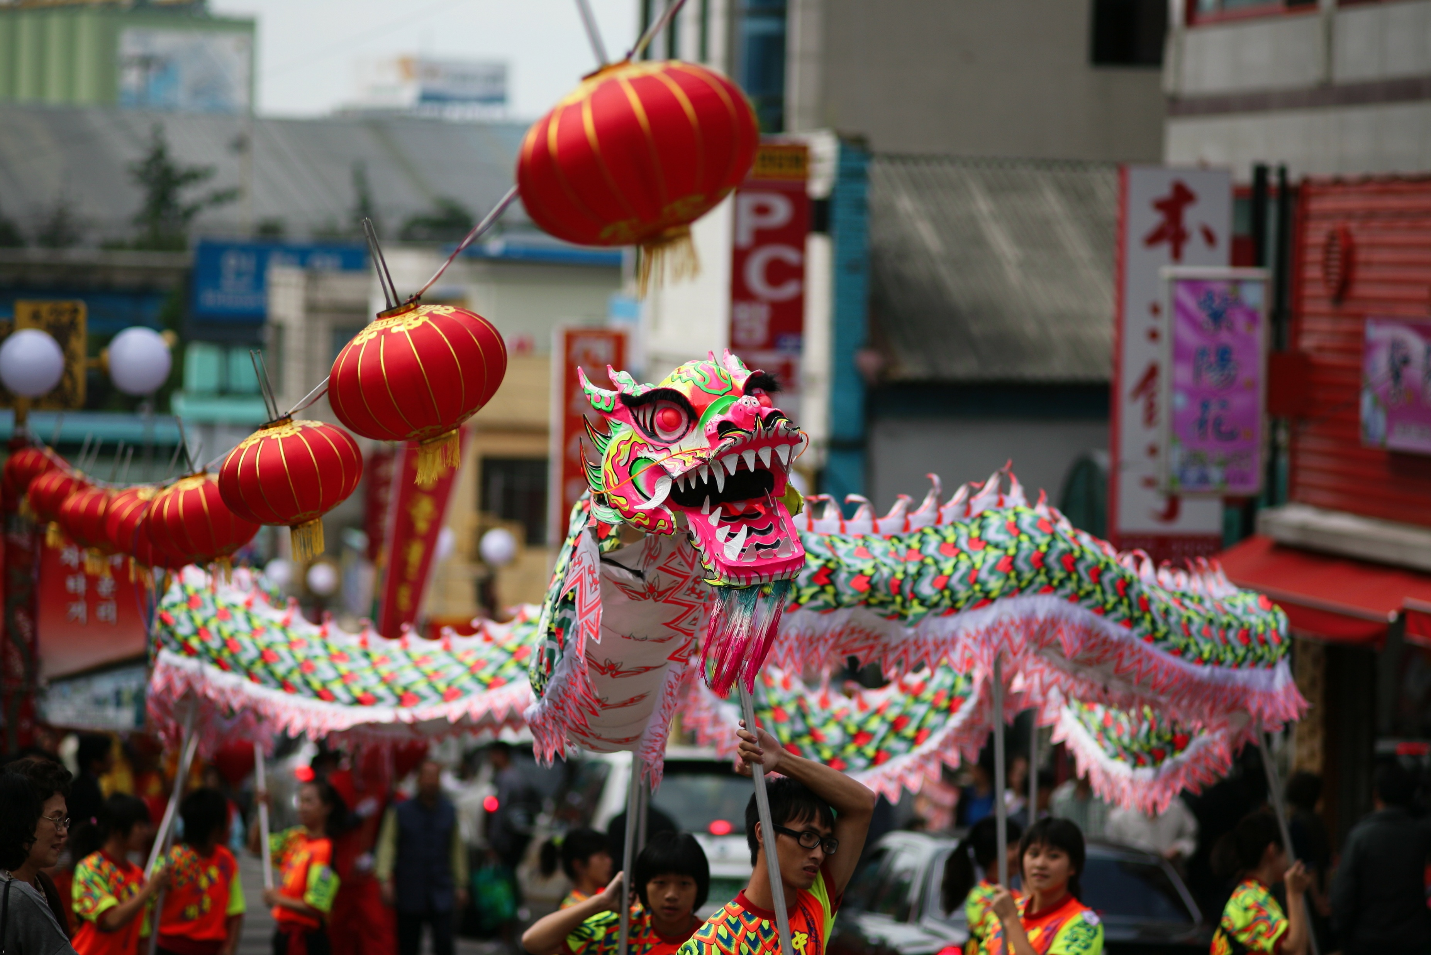
Personal
Religious
Community
Birthday
Hanukkah
Carnival
Traditional Ceremony
Wedding
Chinese New Year

Slide 28
Music brings people together with singing and dancing.
Instruments help us stay together when we clap and dance.

Slide 29
The round dance is a dance used to join different cultures together.
At Jewish weddings they
dance the horah.

Slide 30

Exit Ticket
Date: _________
Lesson 2
Music brings people together with singing and __________.
Dancers are able to stay together by listening to:
a bird
words
instruments.
The r______ dance is a dance that brings many cultures together.
dancing
reading
listening
dancing
ound
3
I know _____ out of 3 answers.

Slide 31
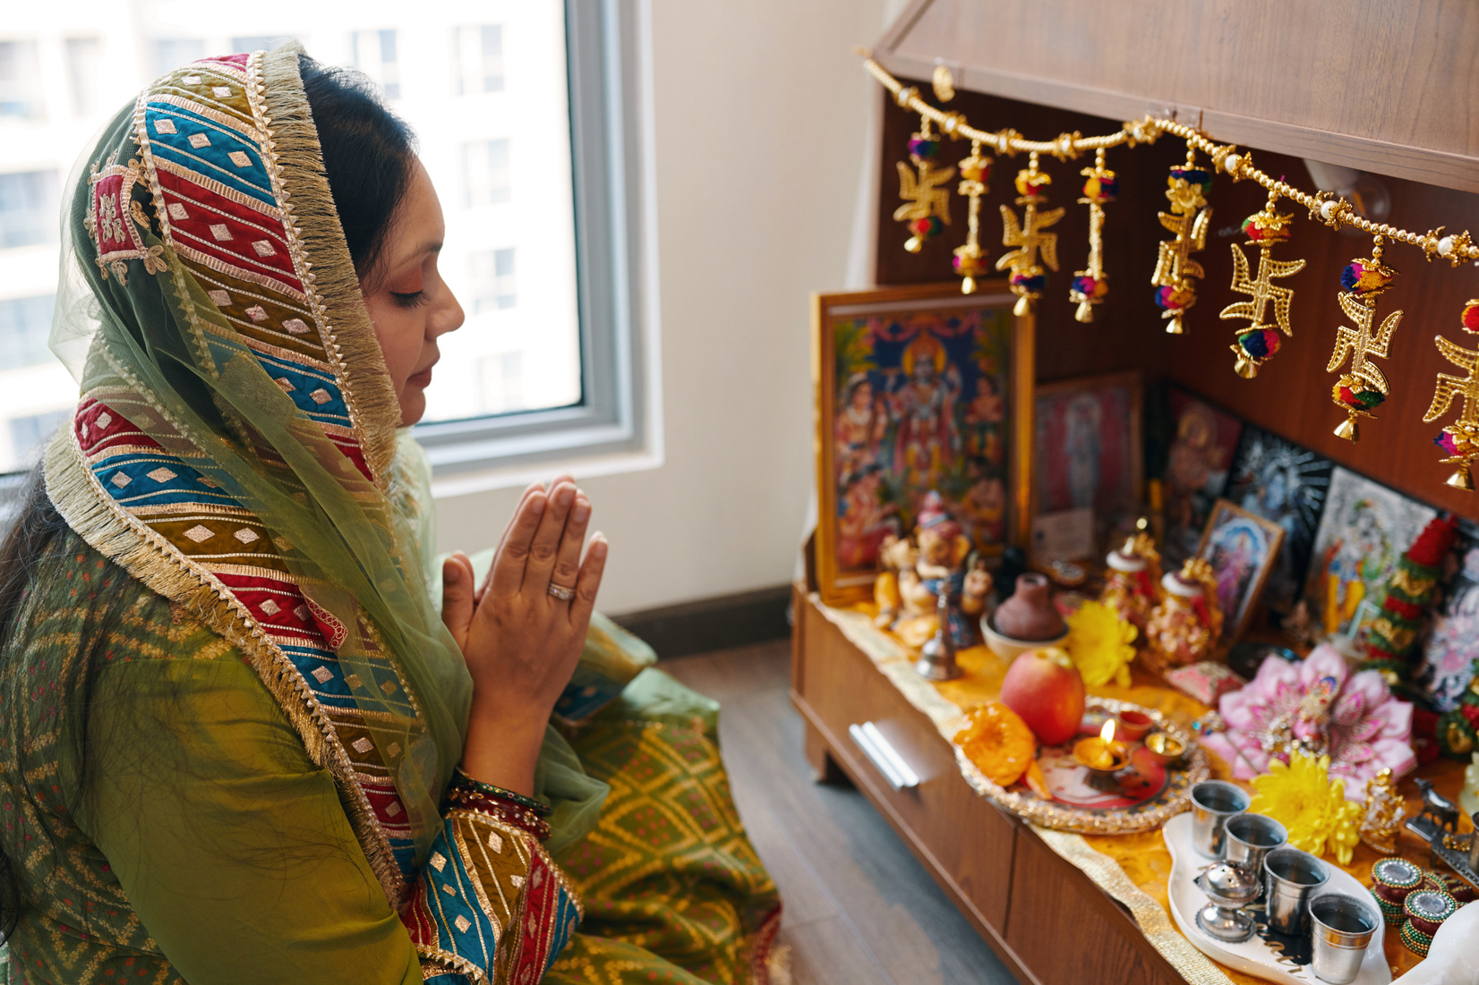
In the next lesson, we will explore how different music makes us feel.

