Slide 1
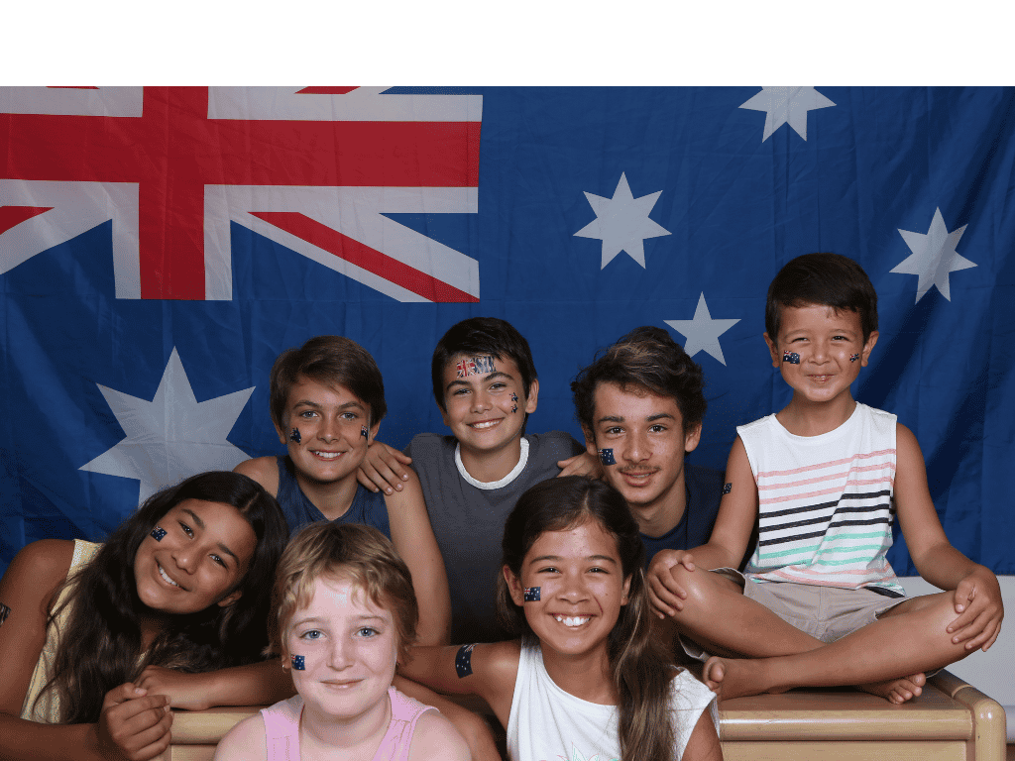
Music in Culture
Lesson 1
Music Around the World
Unit 4 Version 3

Slide 2


In this lesson, we will learn how music reflects culture around the world. ​

Slide 3

You will be successful when you can:
explain what culture means
describe what music might be used for.
Explain: To tell how or why something happens so others can understand it clearly.
Describe: To tell what something is like using words.

Slide 4
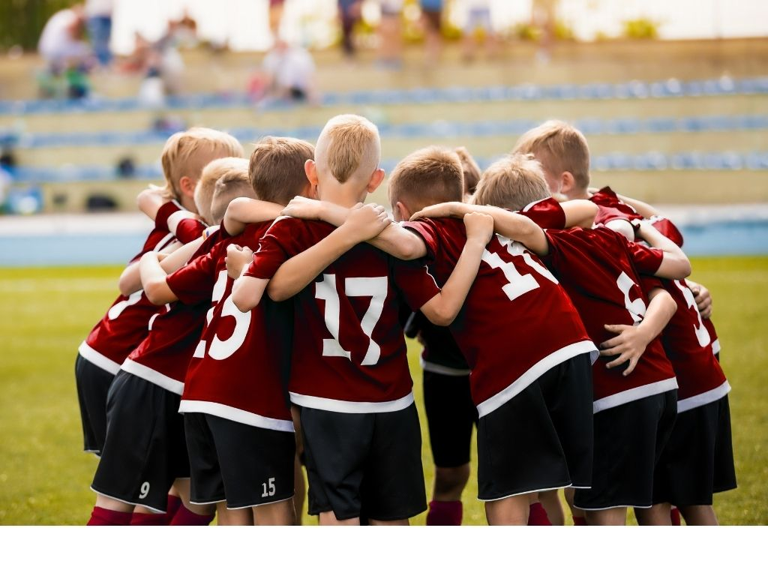
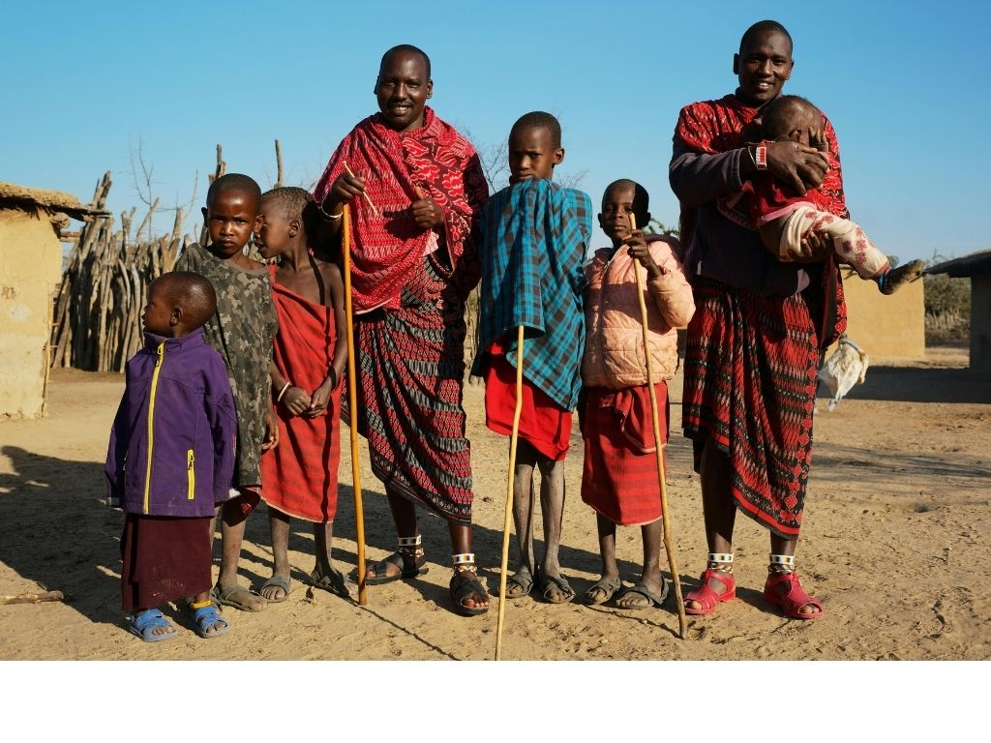
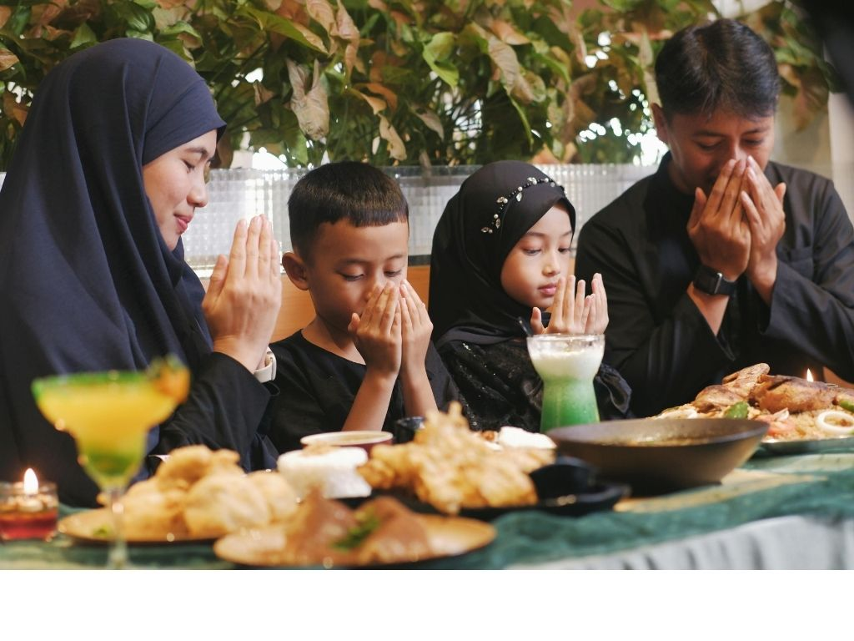

Slide 5


Culture
Culture is a shared set of traditions, values, beliefs and ways of life.

Slide 6
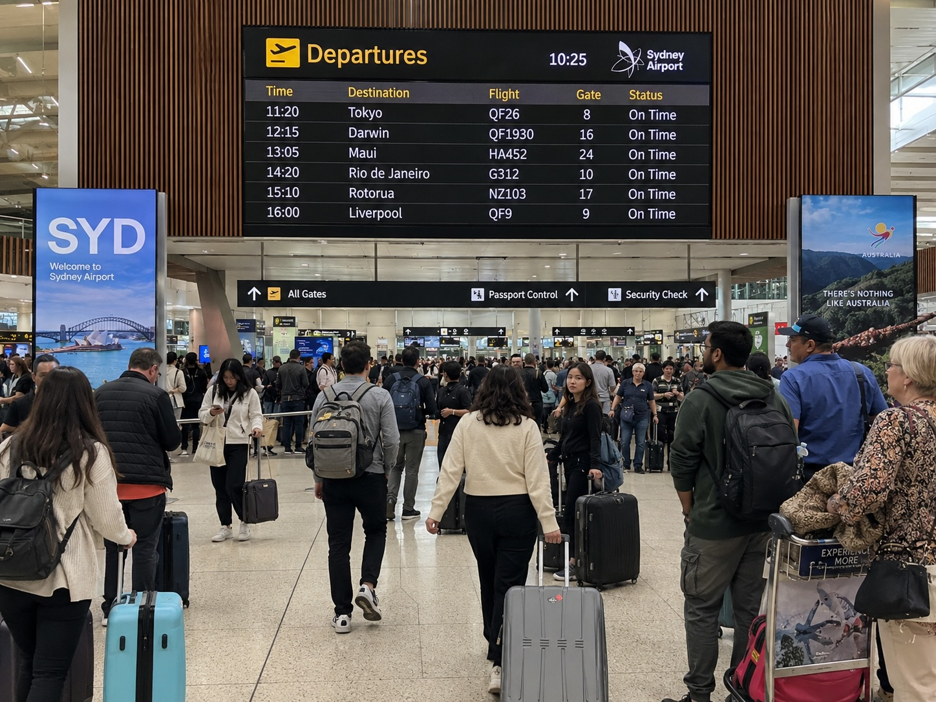


Slide 7
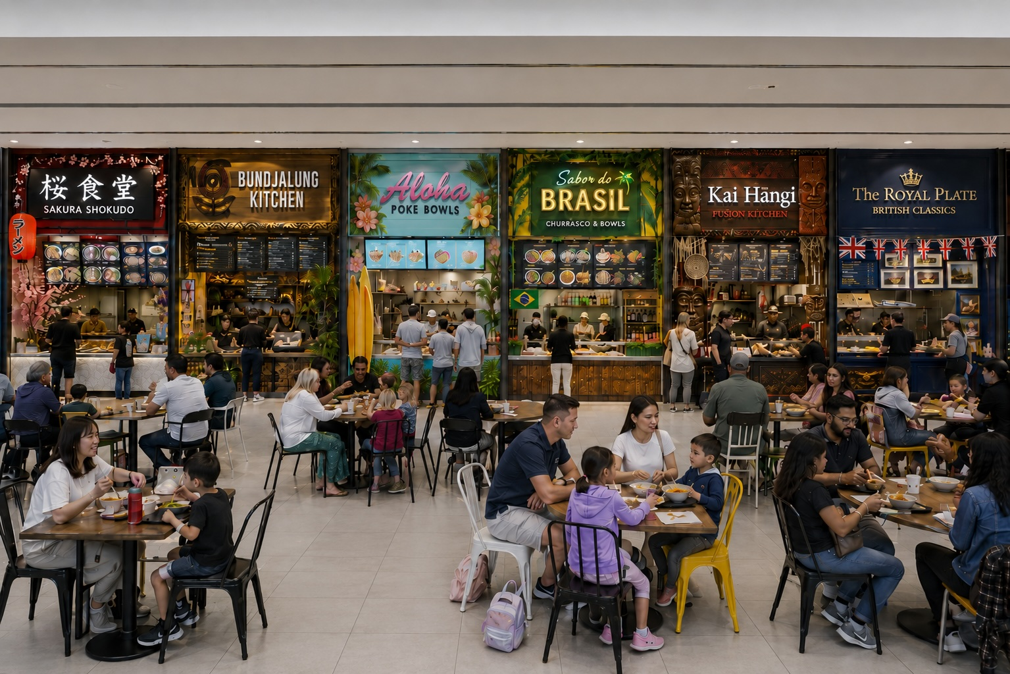

Slide 8
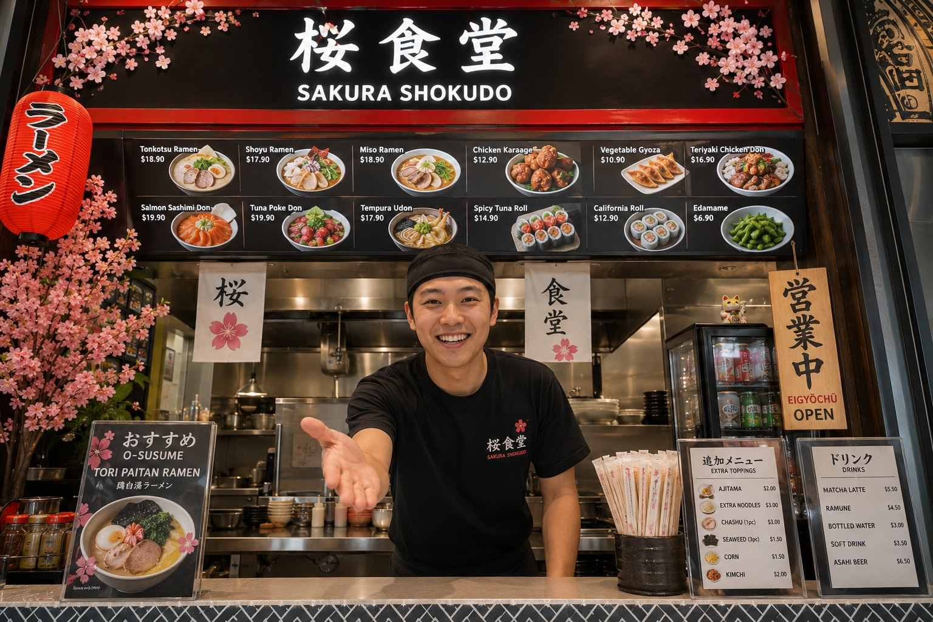


Slide 9
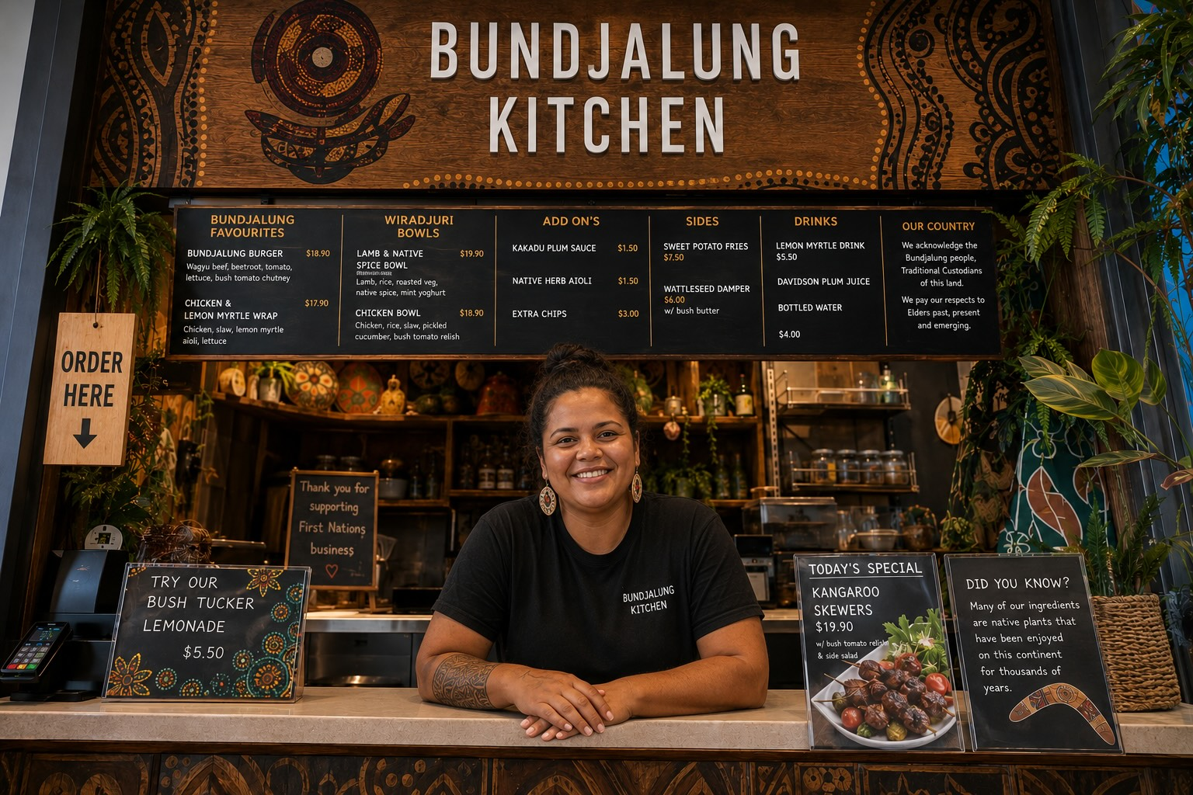
What do you notice about this music?
How is this music different to the others?
What does this music make you think about?
Does this music sound calm, energetic, emotional, serious, peaceful or something else?
What sounds in the music stood out to you?

Slide 10

What do you notice about this music?
How is this music different to the others?
What does this music make you think about?
Does this music sound calm, energetic, emotional, serious, peaceful or something else?
What sounds in the music stood out to you?

Slide 11

What do you notice about this music?
How is this music different to the others?
What does this music make you think about?
Does this music sound calm, energetic, emotional, serious, peaceful or something else?
What sounds in the music stood out to you?

Slide 12

What do you notice about this music?
How is this music different to the others?
What does this music make you think about?
Does this music sound calm, energetic, emotional, serious, peaceful or something else?
What sounds in the music stood out to you?

Slide 13

What do you notice about this music?
How is this music different to the others?
What does this music make you think about?
Does this music sound calm, energetic, emotional, serious, peaceful or something else?
What sounds in the music stood out to you?

Slide 14



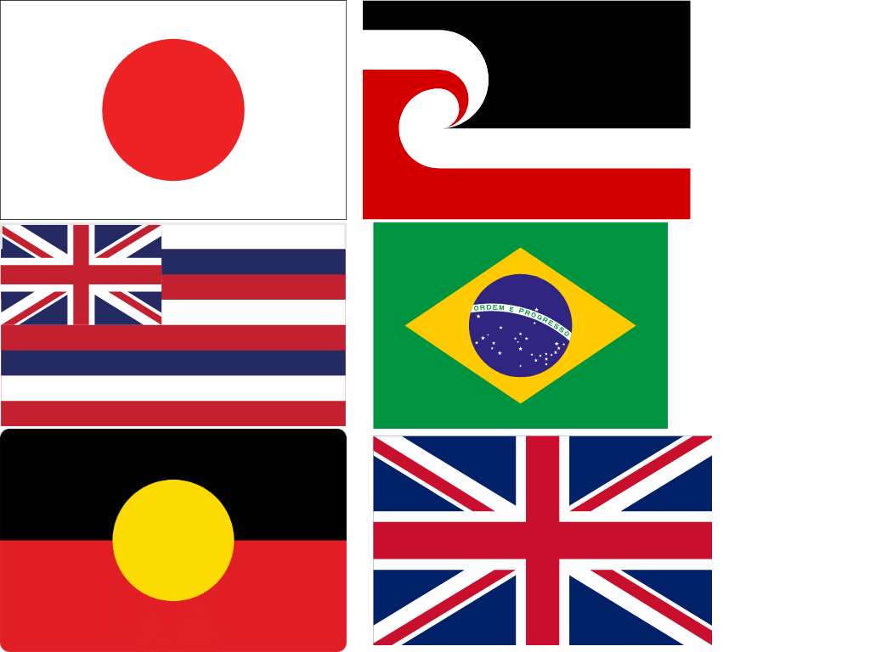

Music in Different Cultures
Bring people together.
Celebrate special events.
Tell stories.
Show what is important to people.

Slide 15
Music Around the World
Music from different cultures:
all sounds the same
has different sounds and
different purposes
is all used for the same purposes.

Slide 16




Slide 17
Final Call Game
Japanese
First Australians
Brazilian
Hawaiian
Māori in New Zealand
United Kingdom

Slide 18
My Culture

Slide 19
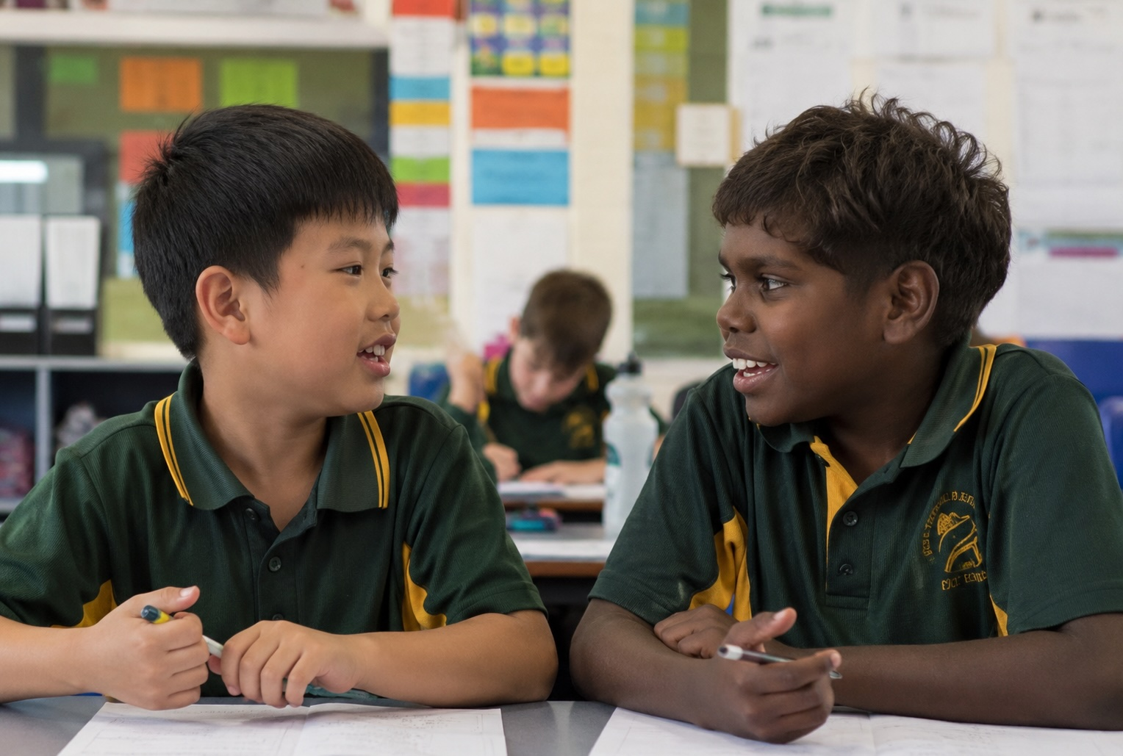
Our Cultures

Slide 20

Your Culture

Slide 21
Culture is a shared set of traditions, beliefs and ways of life.
Music can reflect culture.
Different cultures create music for different purposes.
Some music helps:
communities celebrate
groups work together
people connect to nature
cultures stay connected over time.

Slide 22





Exit Ticket
Date: _________
Lesson 1
Different cultures can use music for different __________.
Music can help bring people together, celebrate important events and:
cook food
tell stories
board planes.
Different cultures can use music to bring people together, tell stories and show what is i____________ to people.
purposes
stories
airports
purposes
mportant
3
I know _____ out of 3 answers.

Slide 23
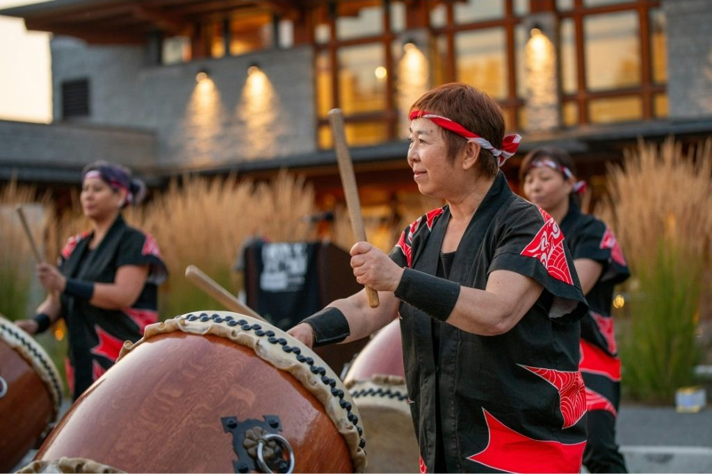
In the next lesson, we will explore how music can reflect cultural values, traditions and beliefs.

