Slide 1
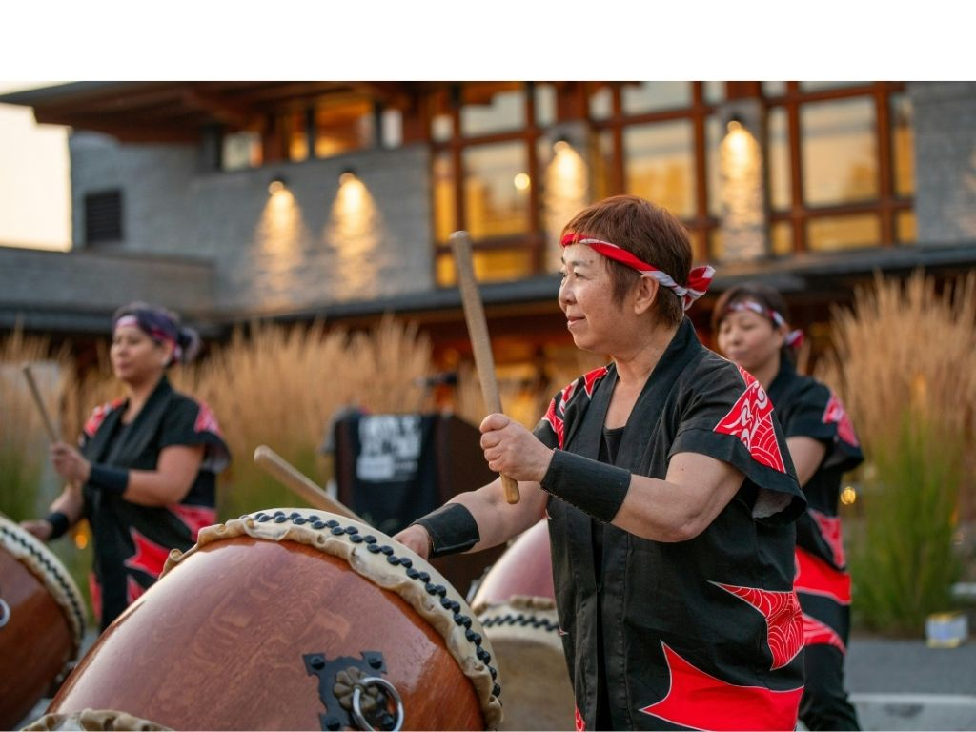
Music in Culture
Lesson 2
Shared Values
Unit 4 Version 3

Slide 2





Revise
Exit Ticket
Lesson 1
Different cultures can use music for different __________.
Music can help bring people together, celebrate important events and:
cook food
tell stories
board planes.
Different cultures can use music to bring people together, tell stories and show what is i___________ to people.
purposes
stories
airports
purposes
mportant

Slide 3
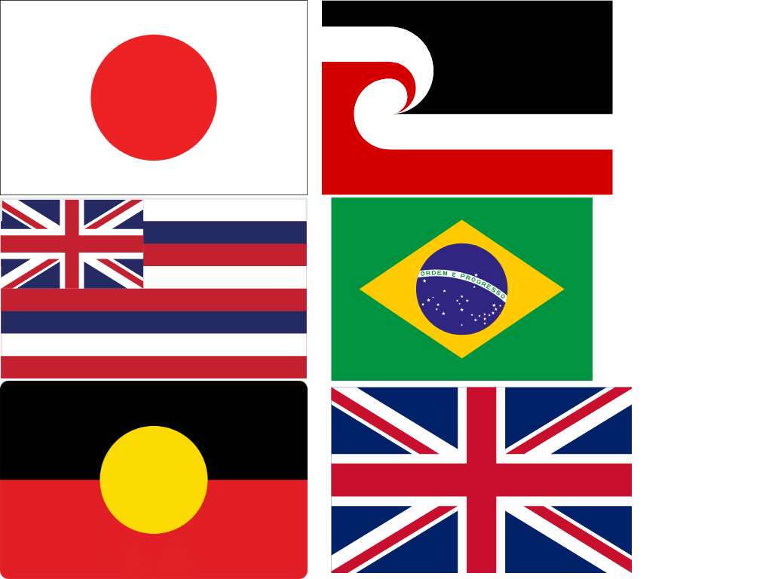
What do you remember about the music you heard from these cultures?
Japan
First Australians
Brazil
Hawaii
Māori in New Zealand
United Kingdom

Slide 4
In this lesson, we will explore how music can reflect cultural values, traditions and beliefs.

Slide 5
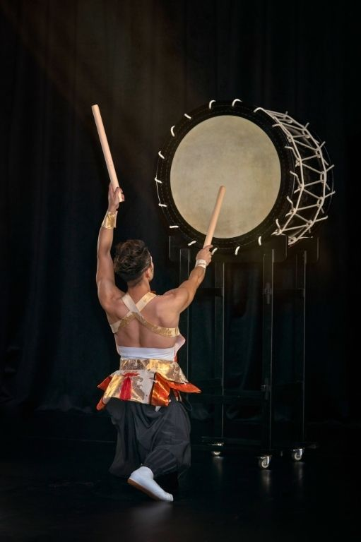
You will be successful when you can:
describe how movement and
timing can reflect cultural values,
traditions and beliefs in Japanese
music
play a Taiko drum pattern.
Describe: To tell what something is like using words.
Play: To make a musical sound on your instrument.

Slide 6
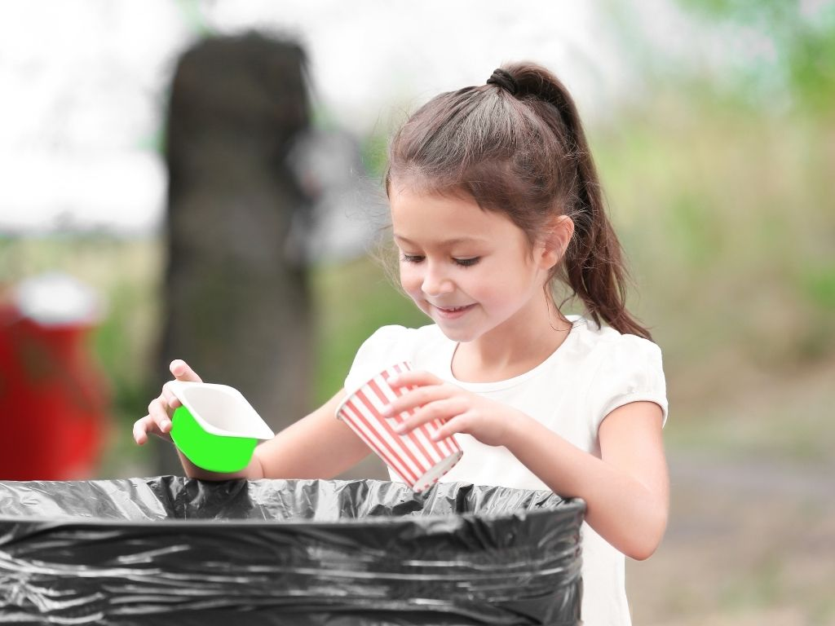
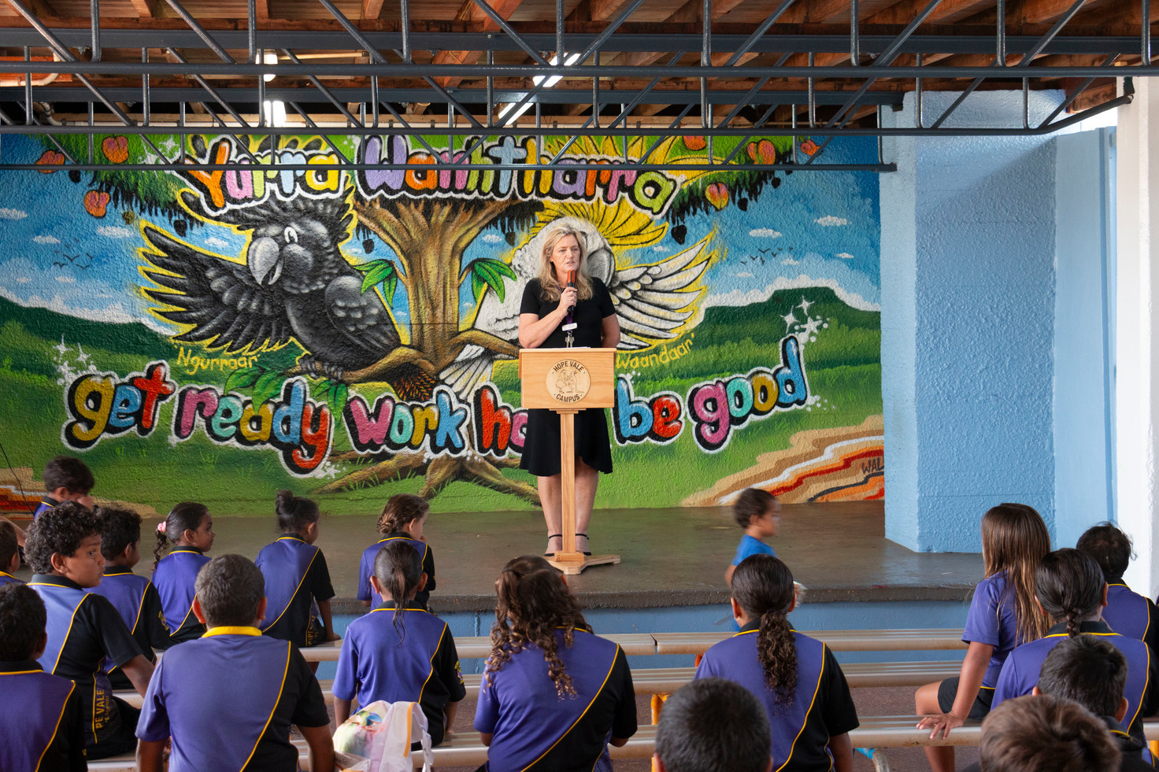
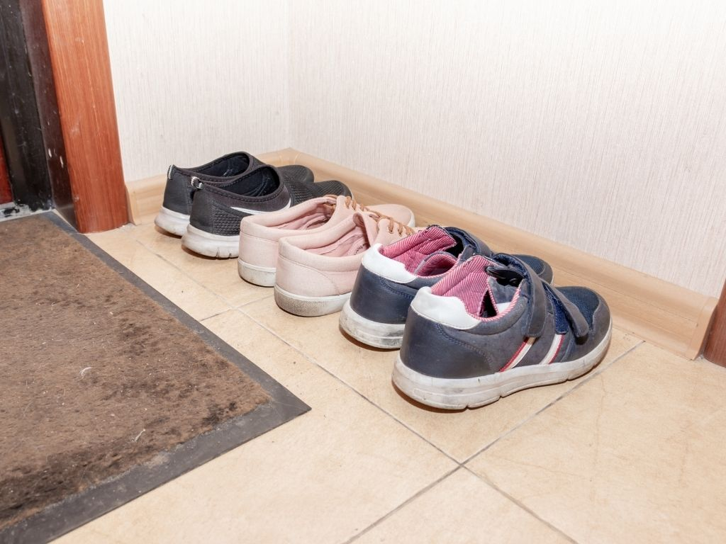


Slide 7


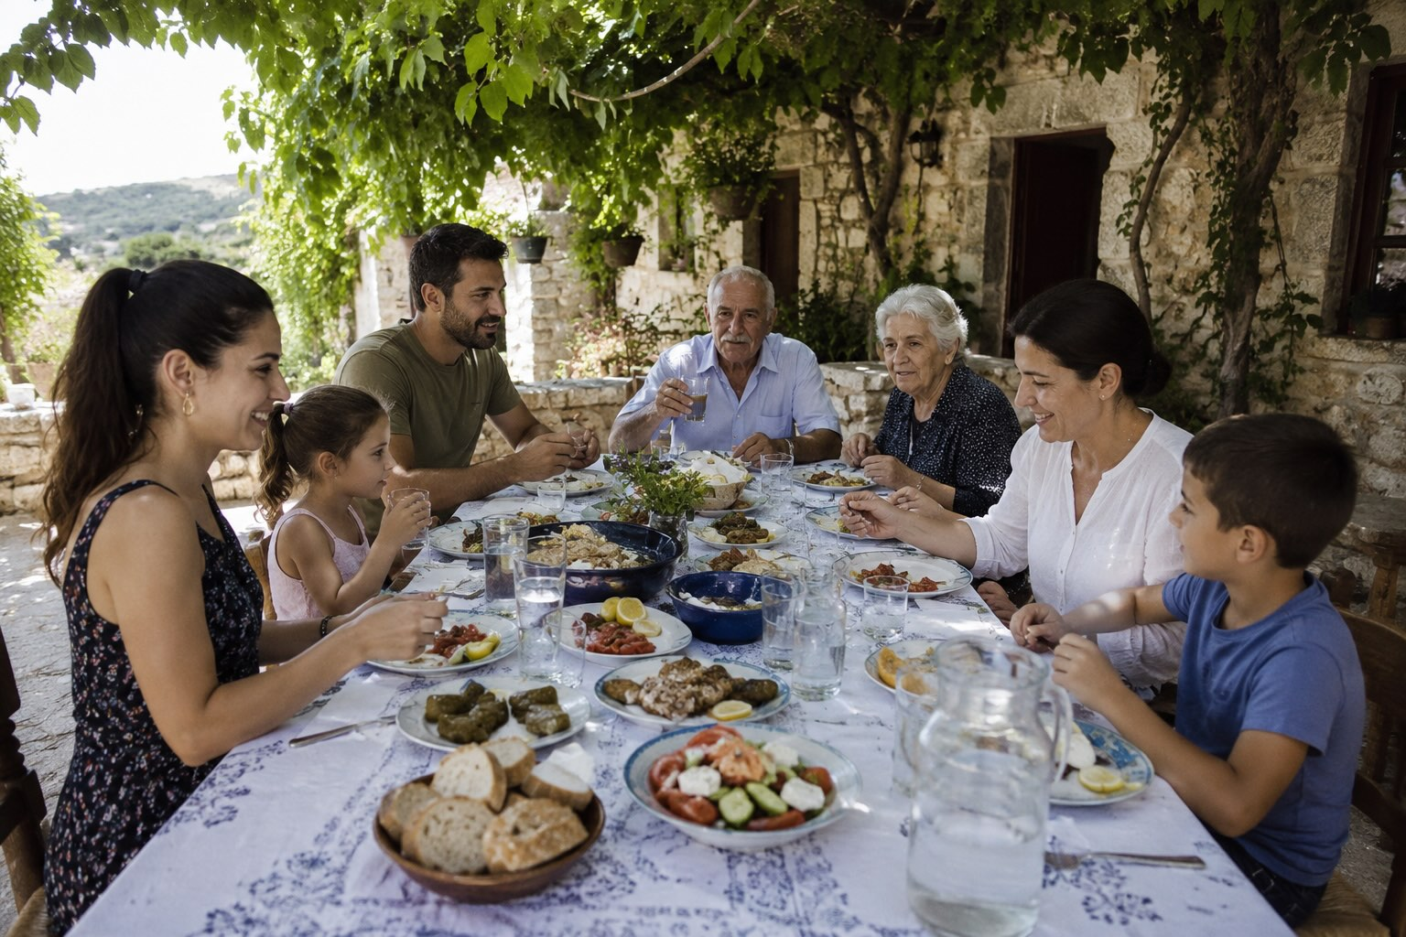

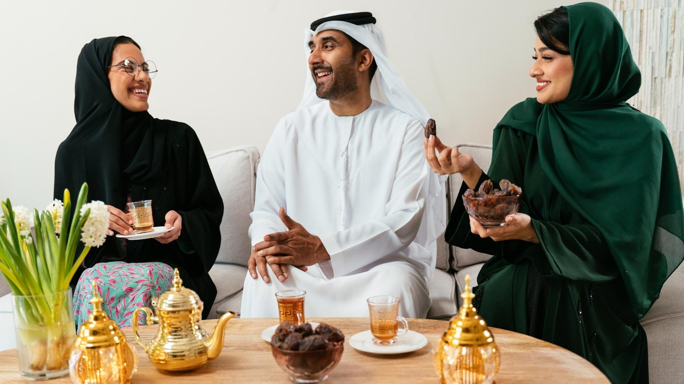
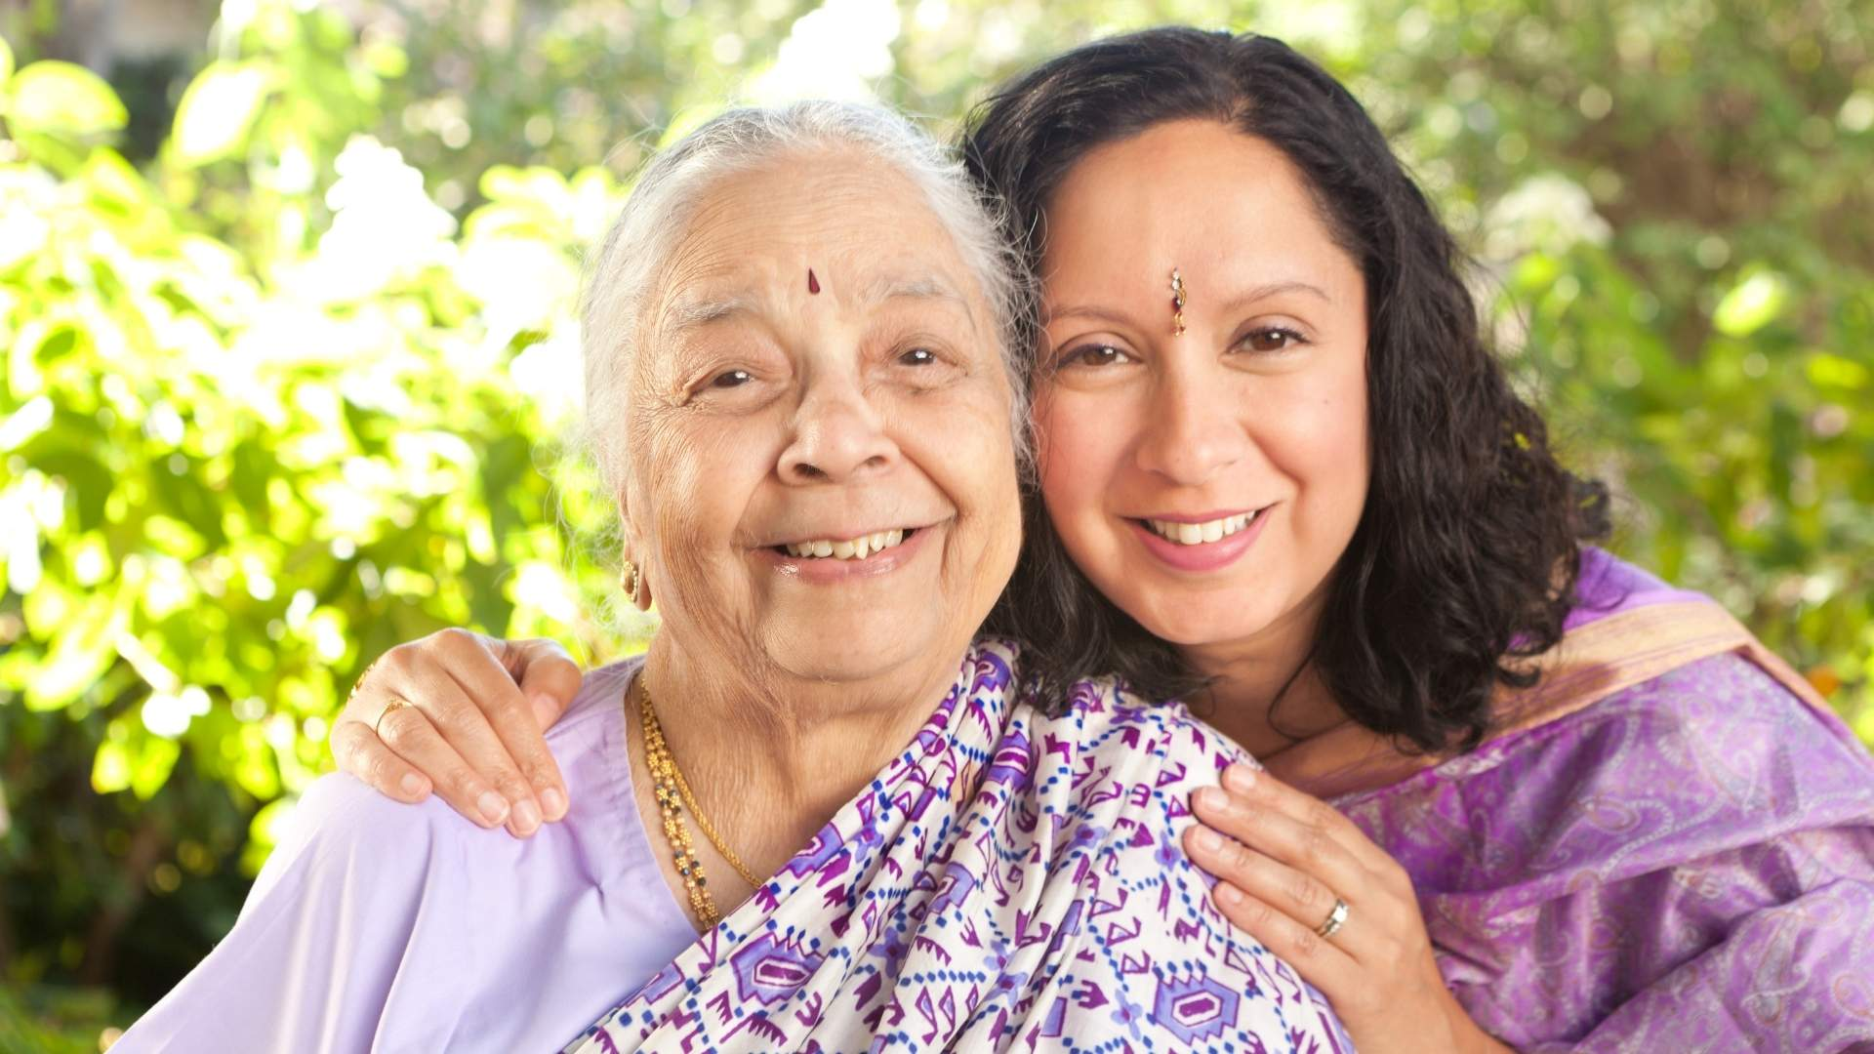
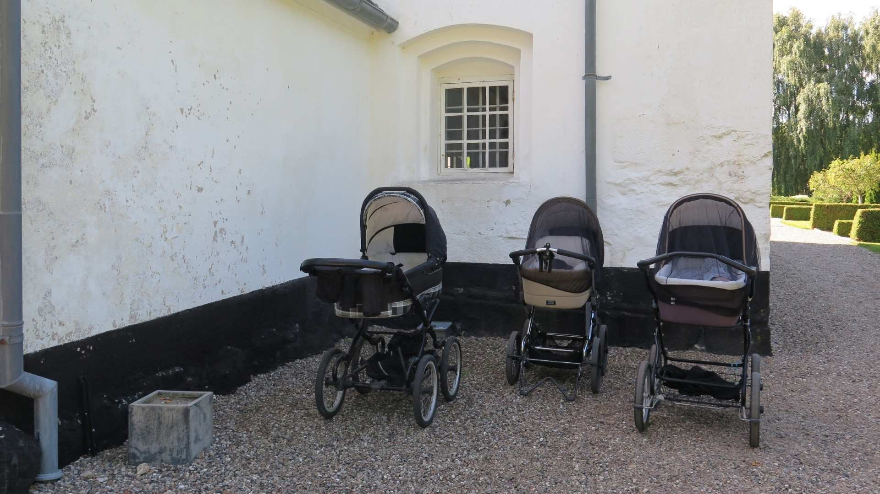
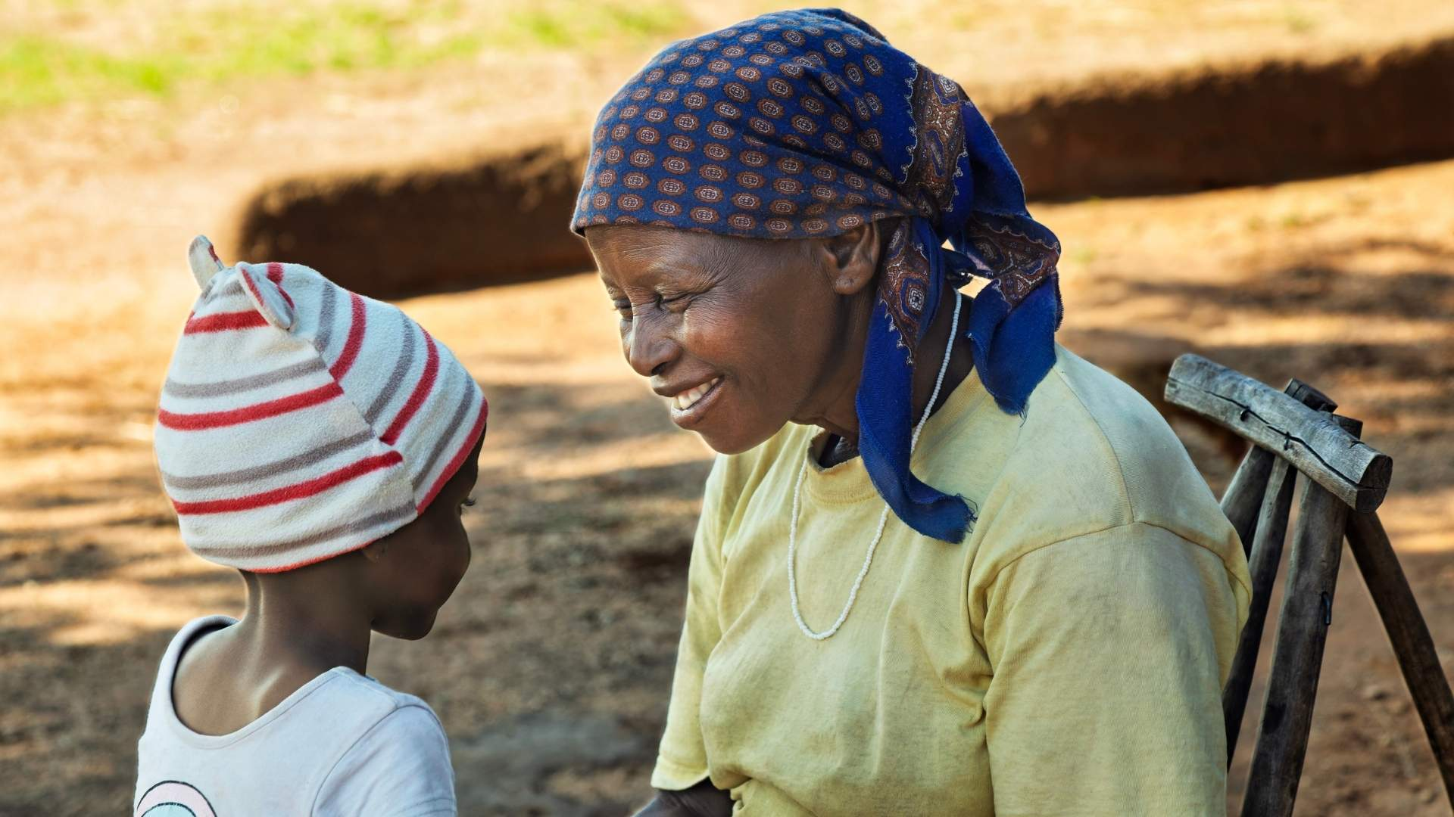
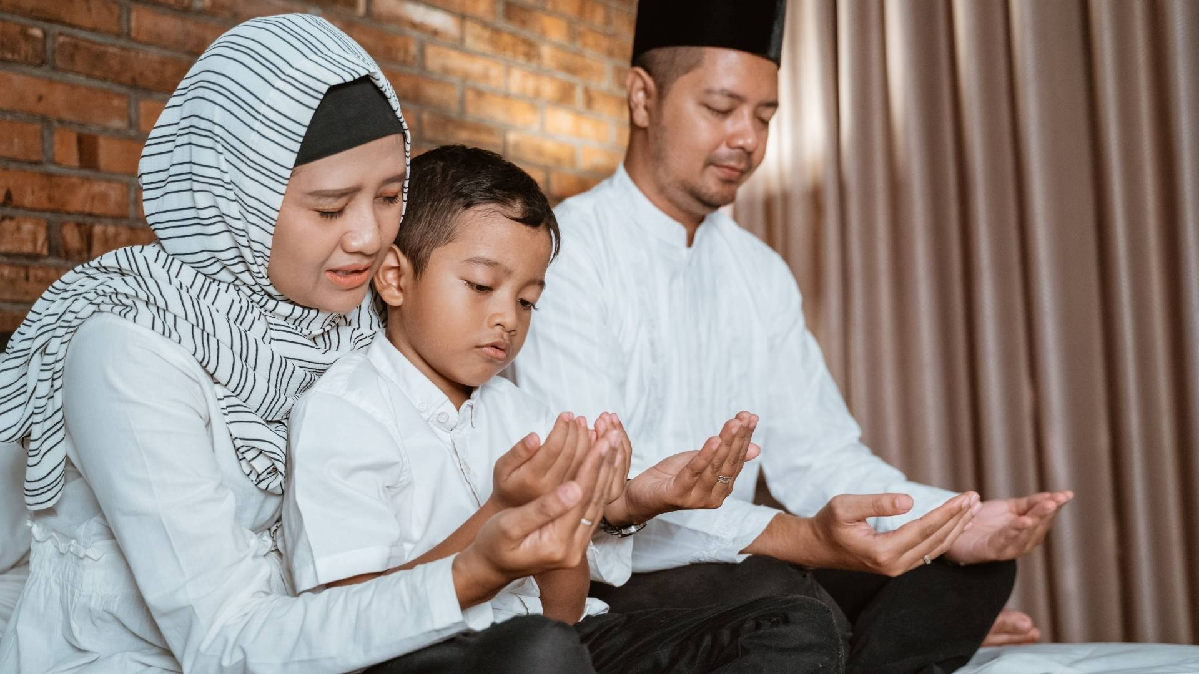
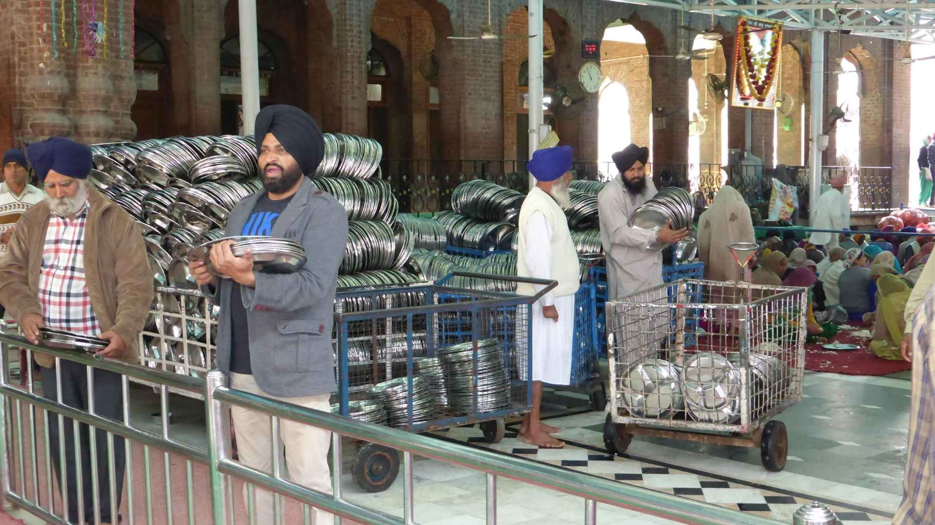

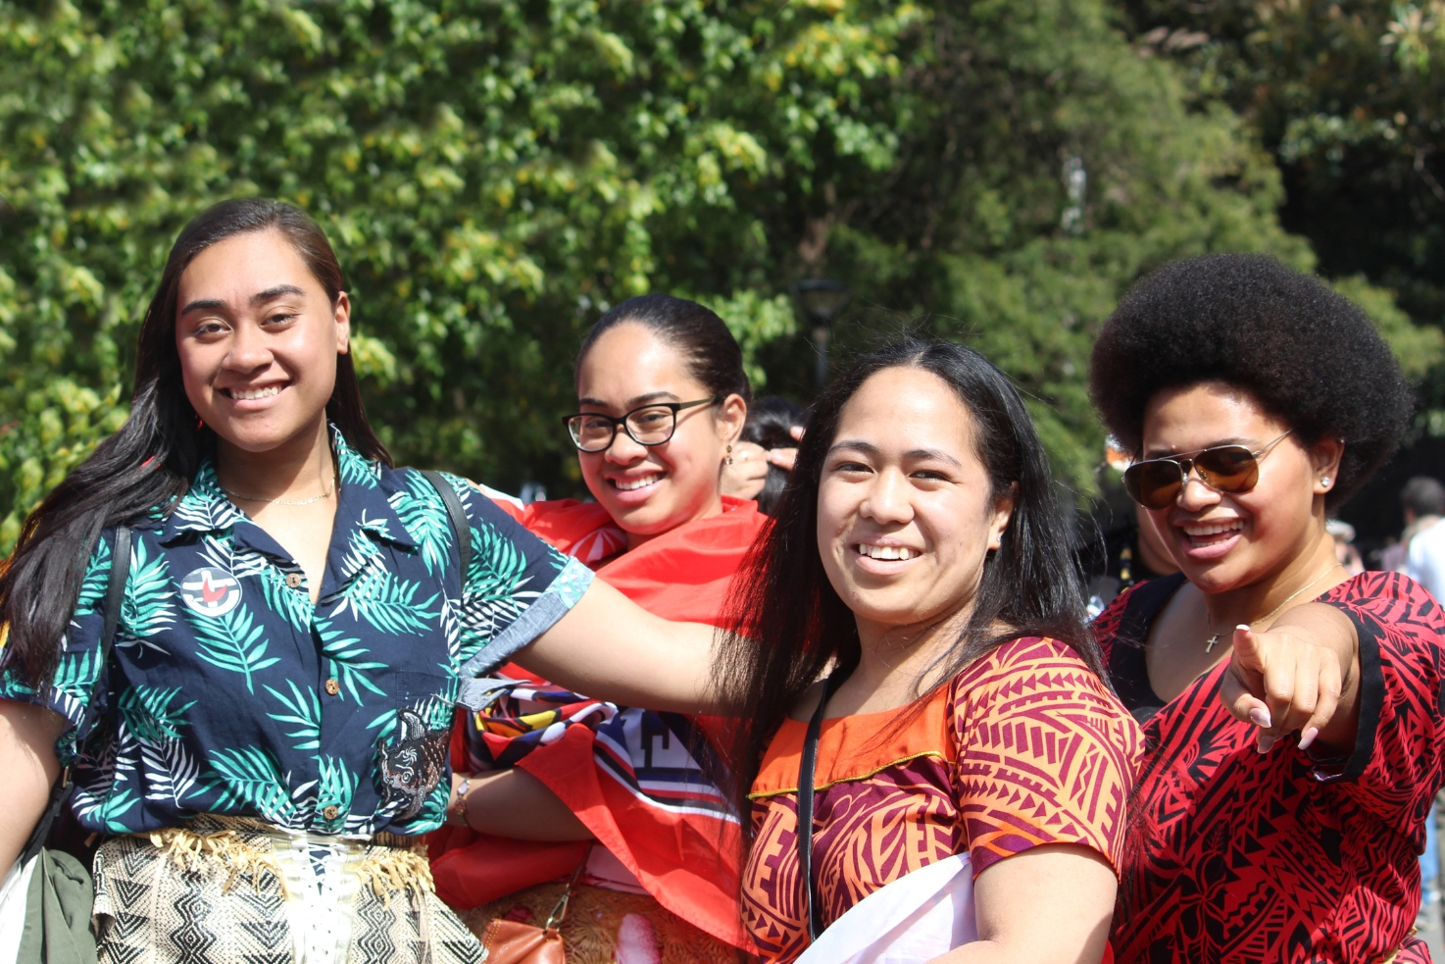
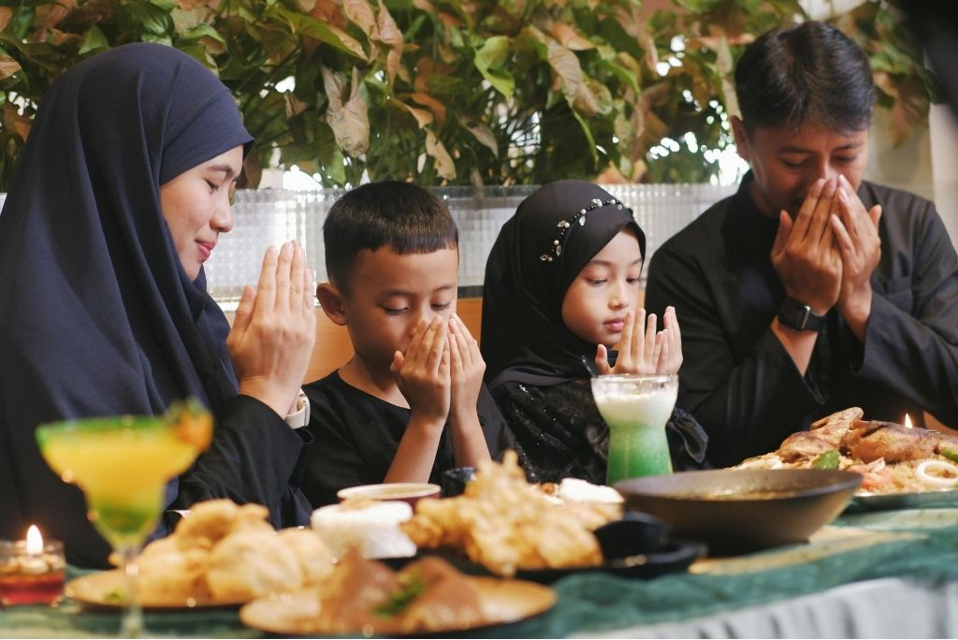
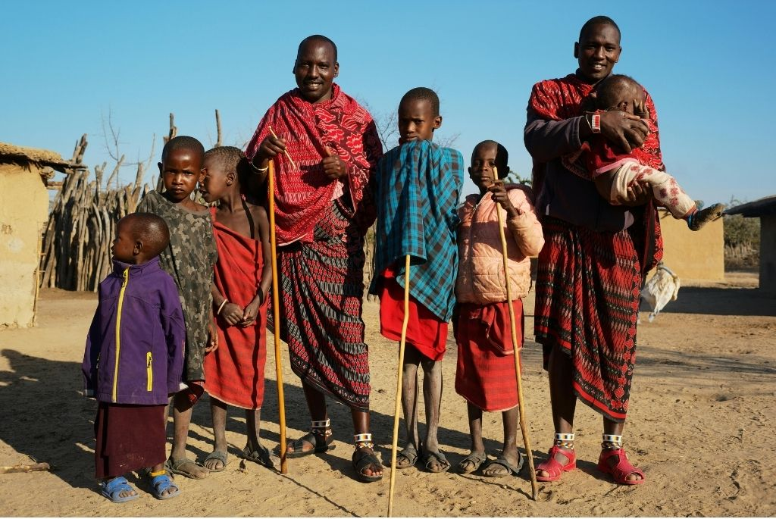
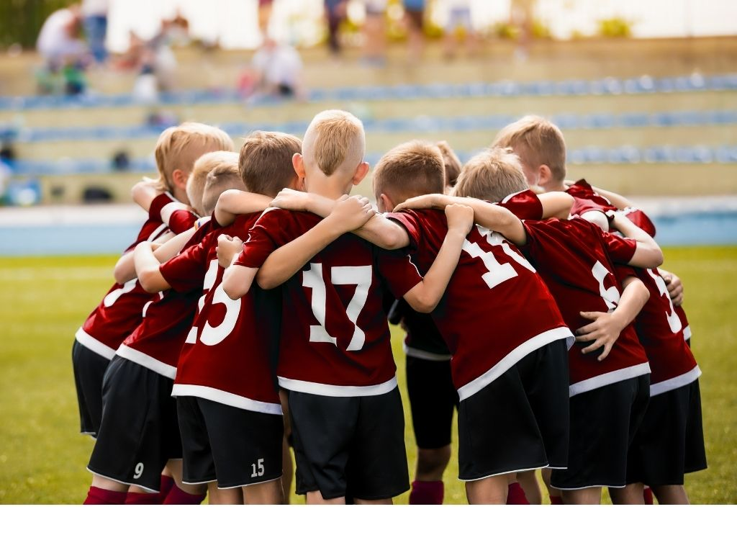
Culture
Culture is a shared set of traditions, values, beliefs and ways of life.

Slide 8
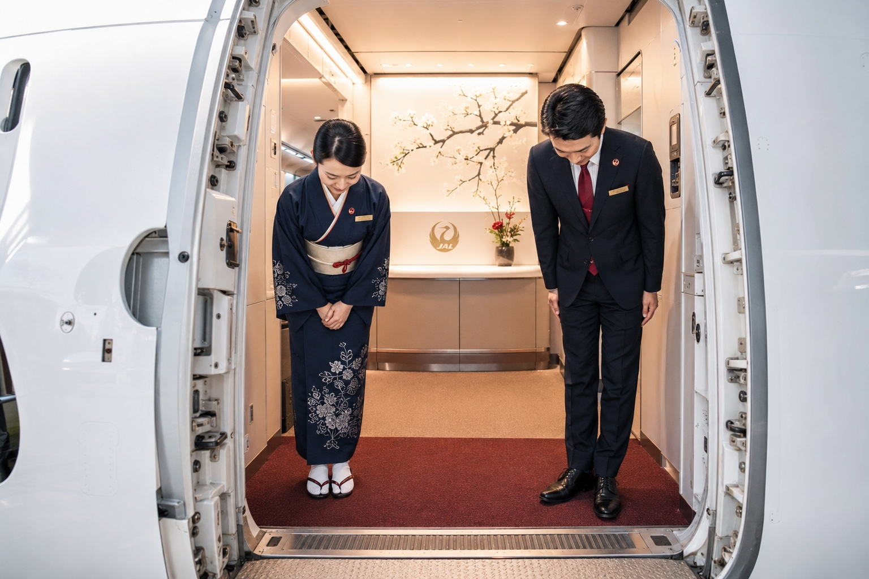


Slide 9
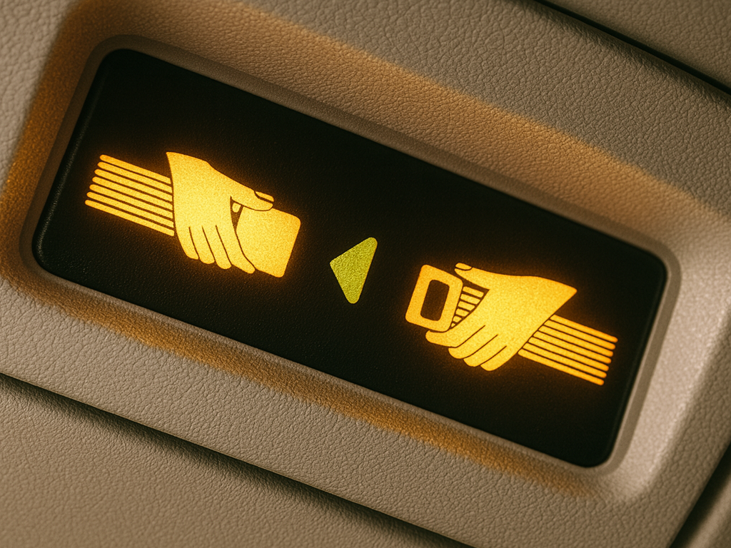

Slide 10

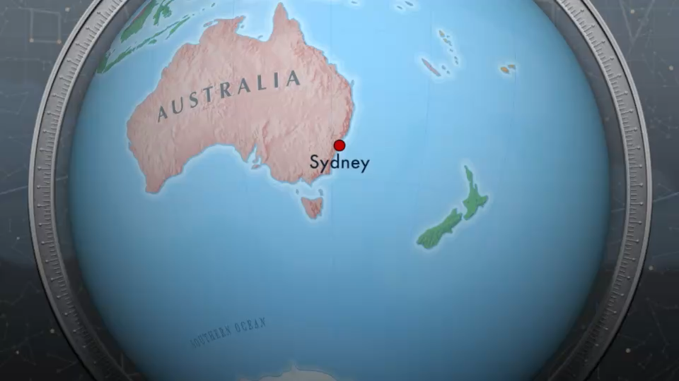

Slide 11
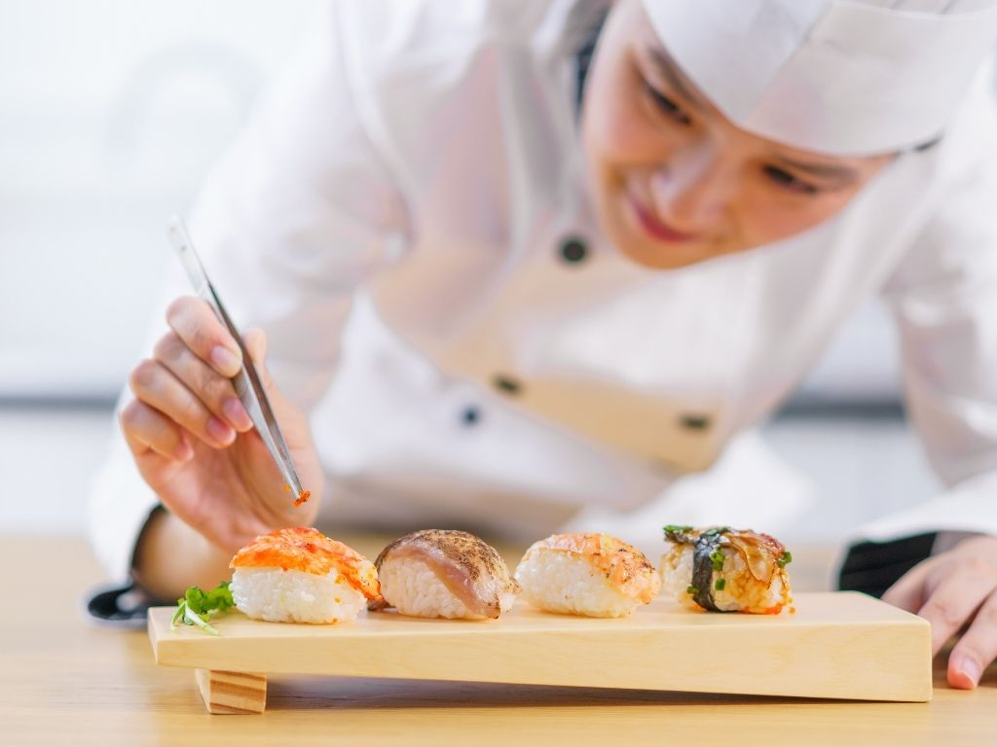
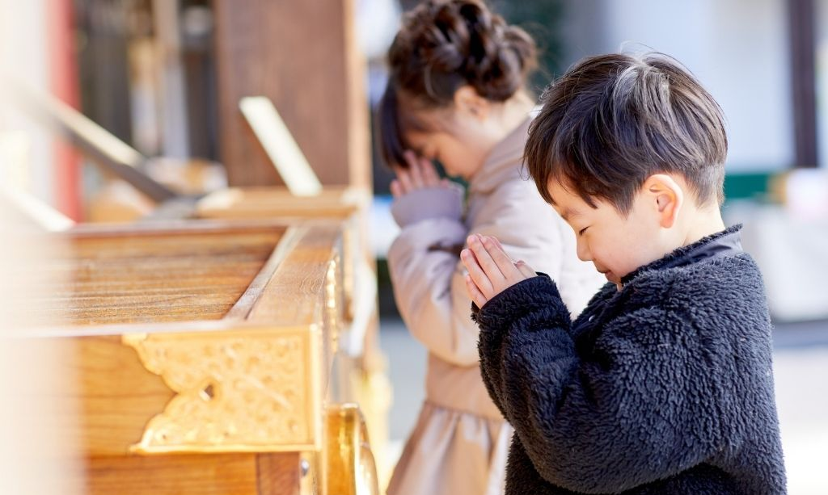
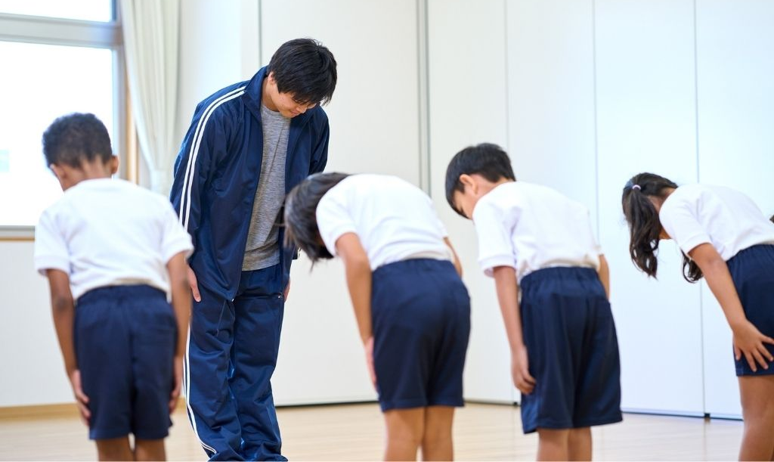
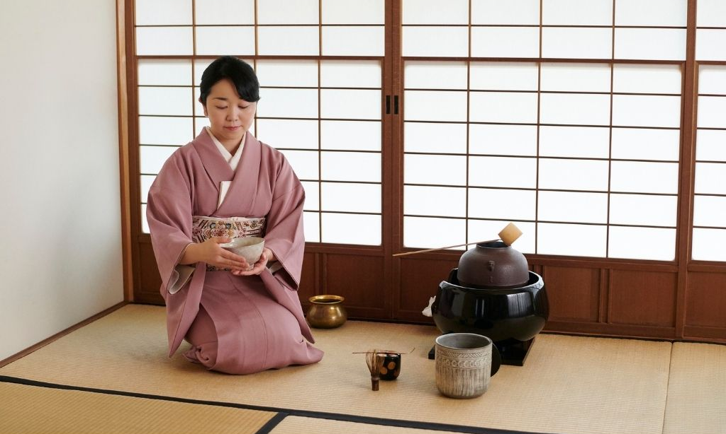
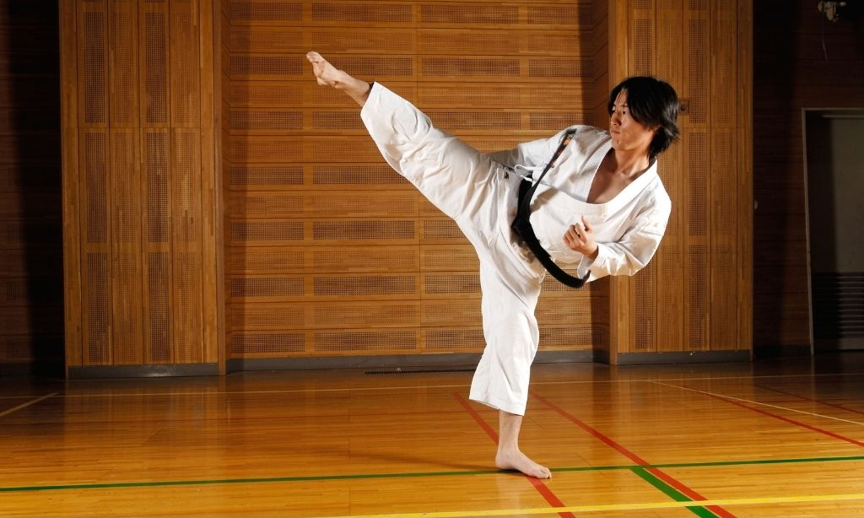
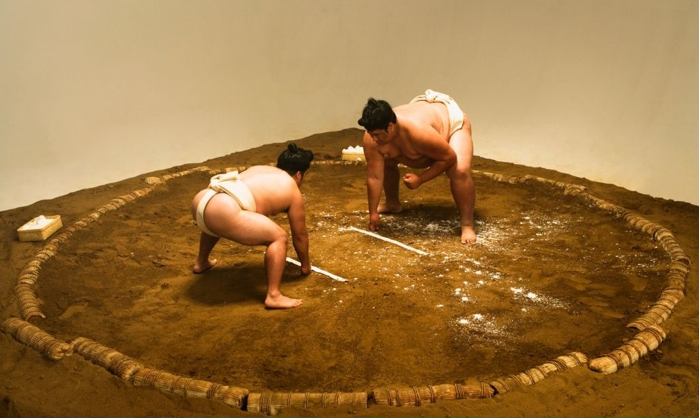
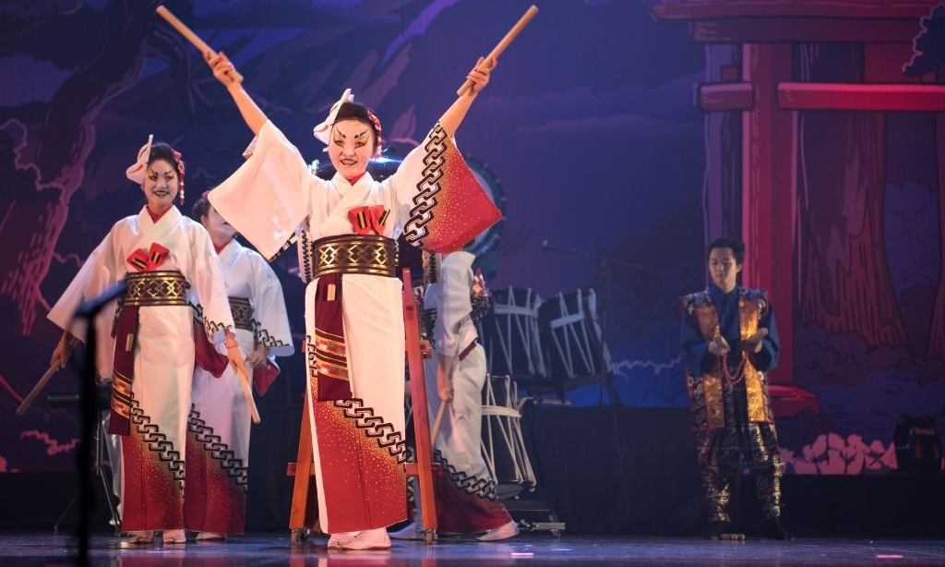


Slide 12
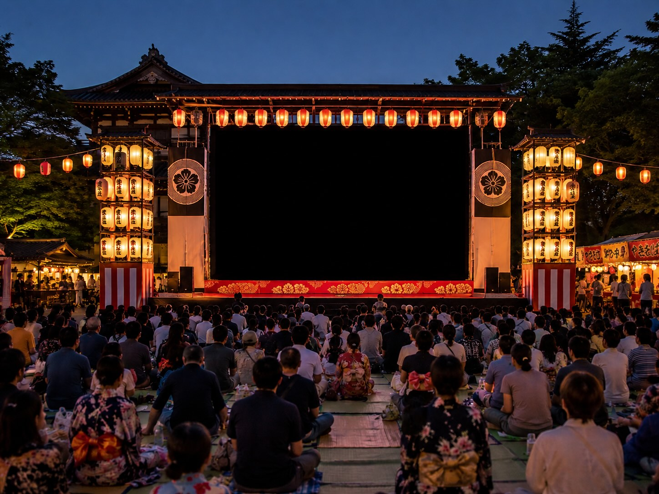

Slide 13
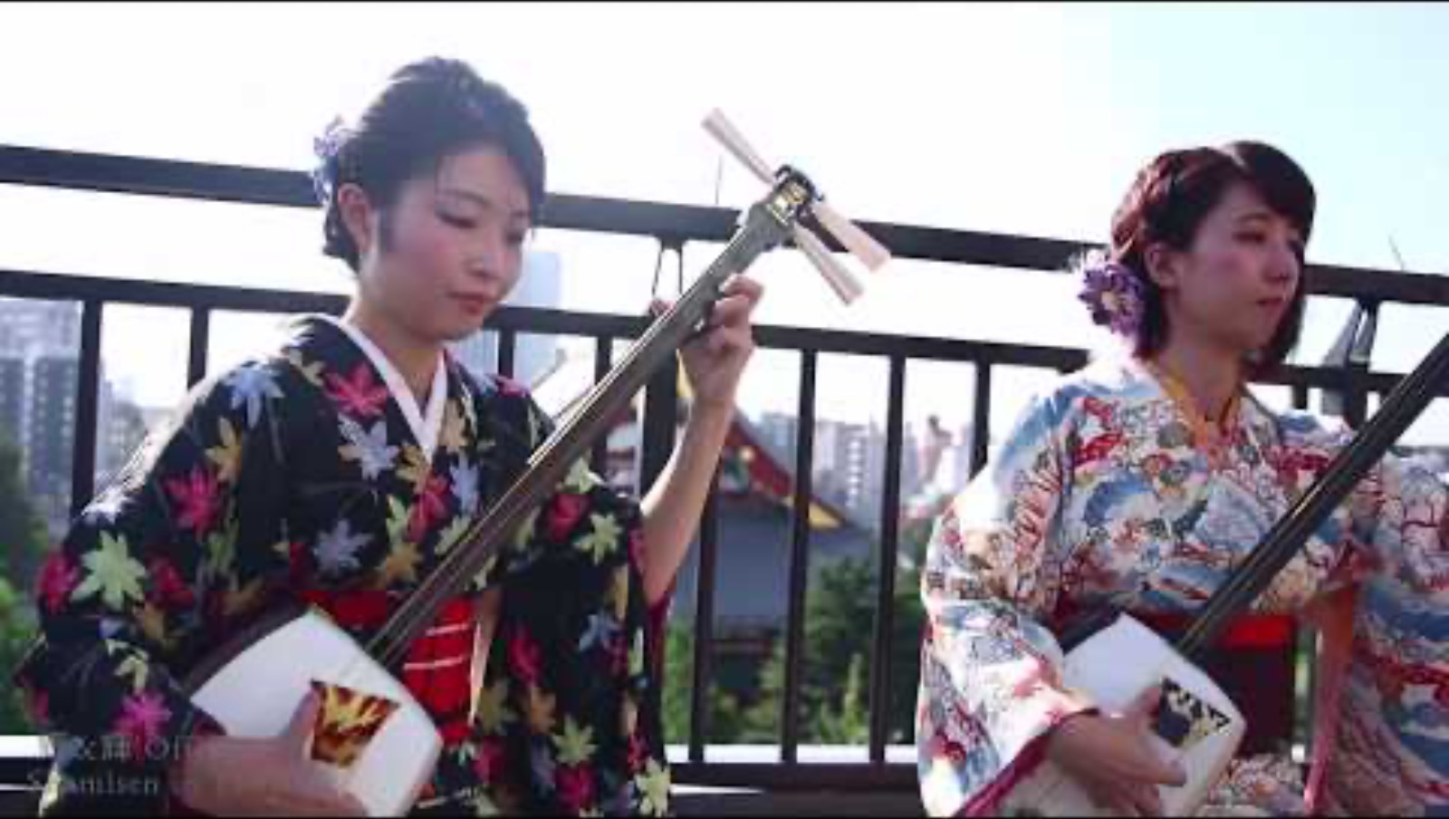

Slide 14
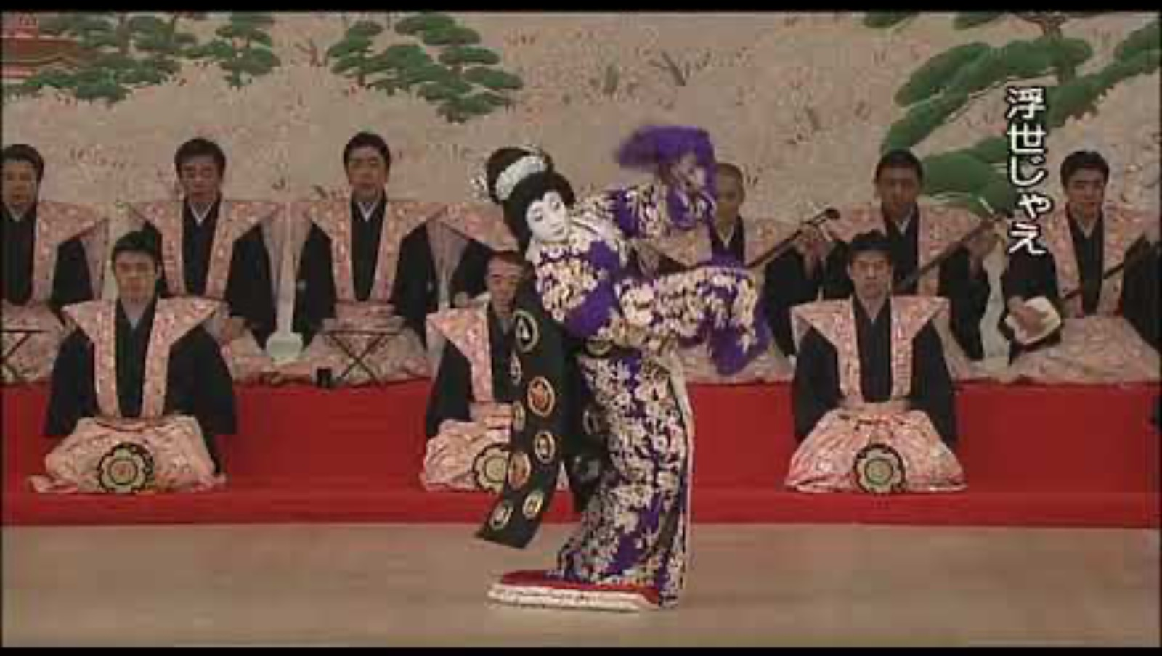

Slide 15
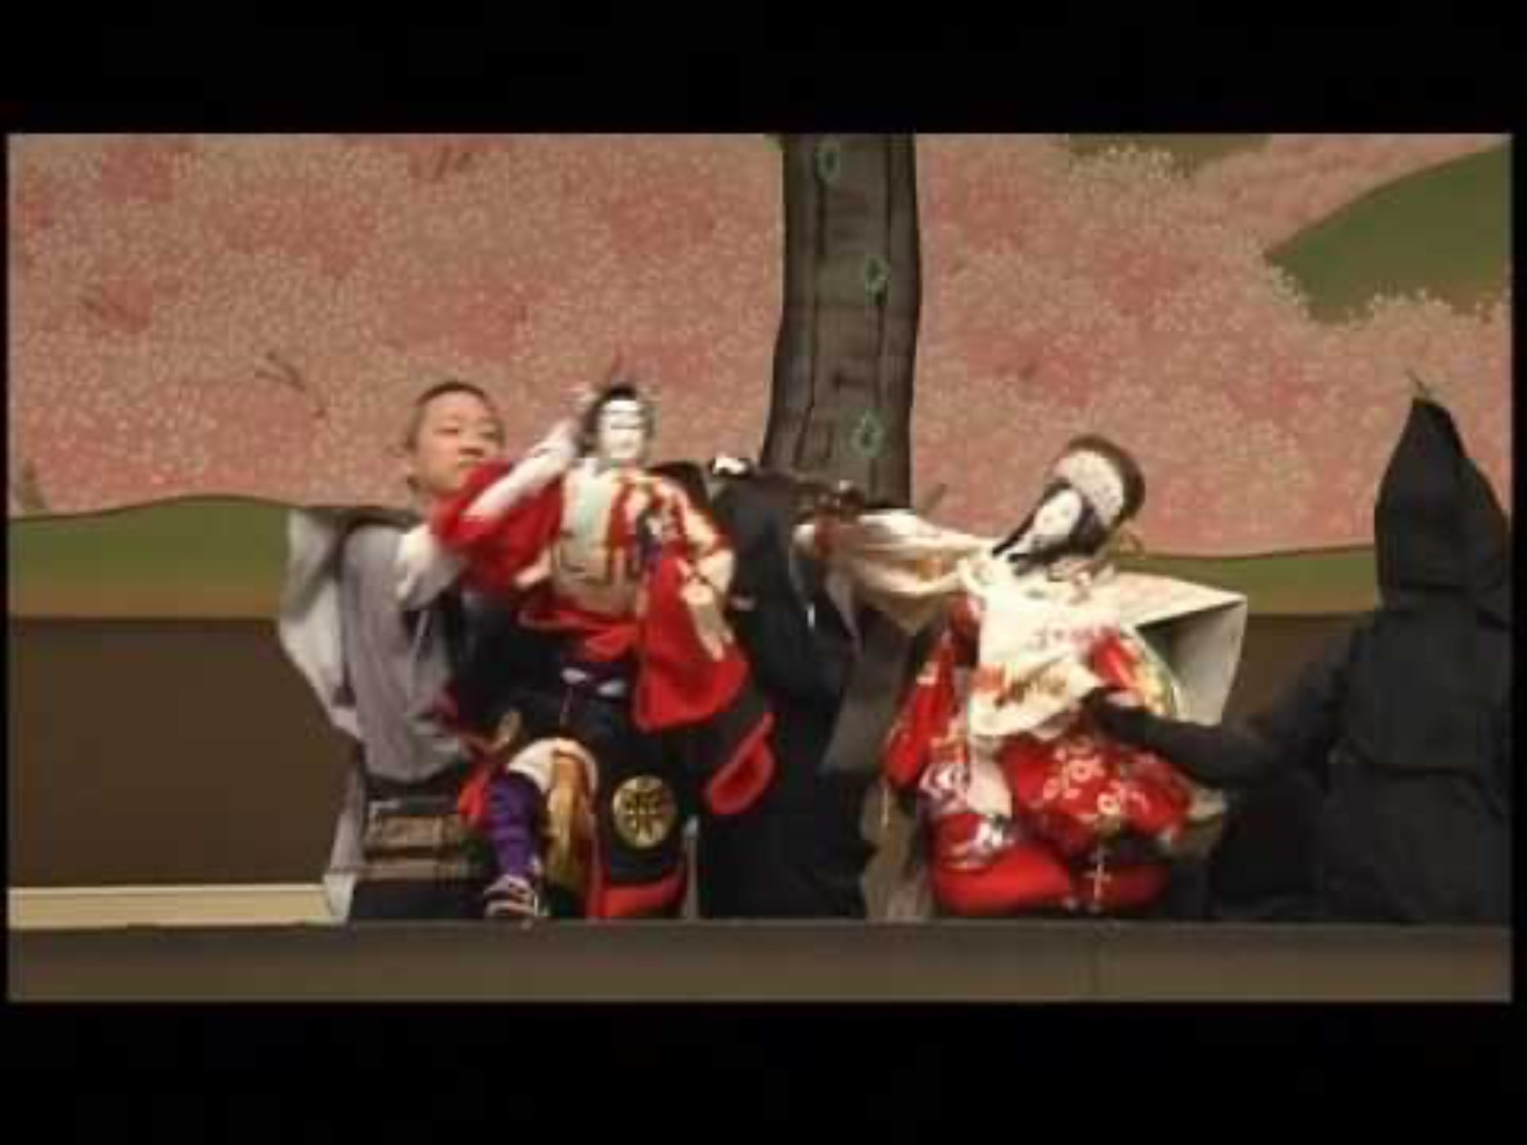

Slide 16
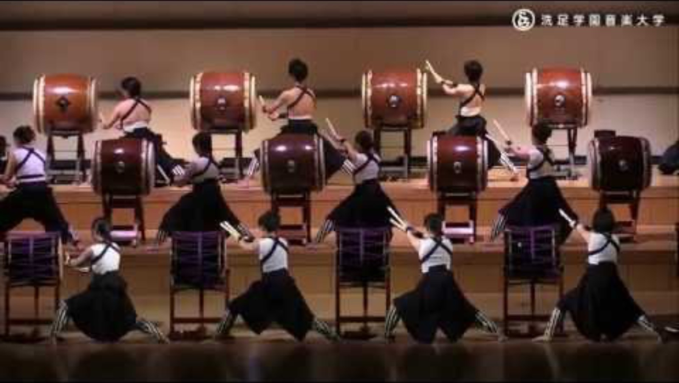

Slide 17
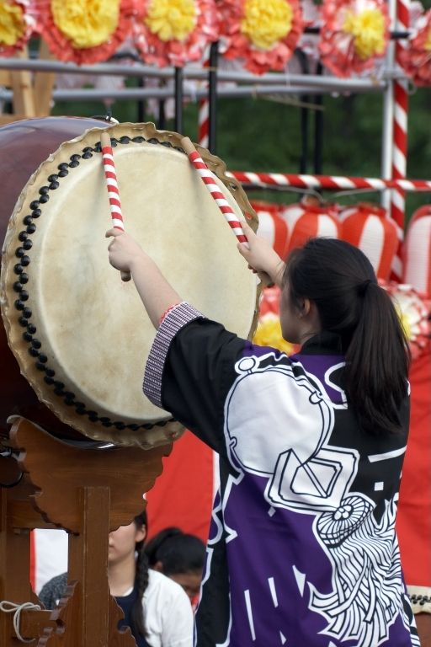
Music From Japan
Which cultural values does a lot of Japanese music reflect?
Respect, focus and care.
Celebration, dancing and
community gatherings.
Adventure, travel and exploration.

Slide 18
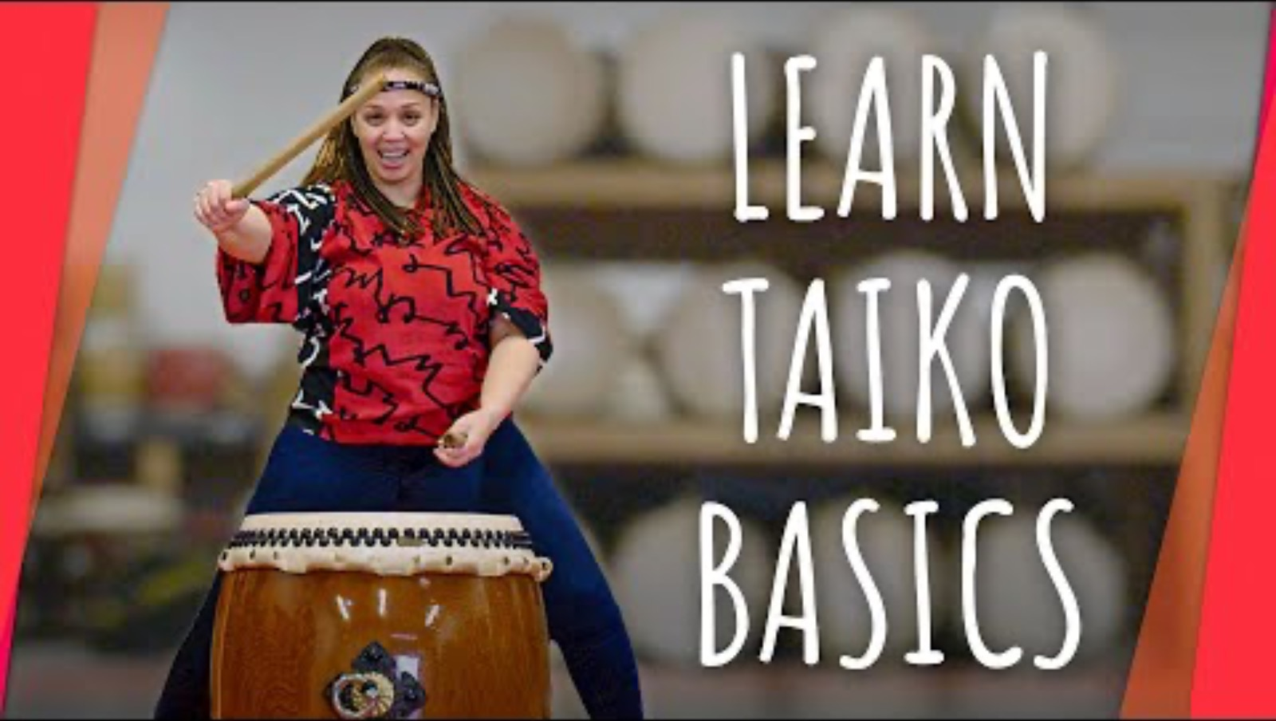
Taiko Drumming

Slide 19
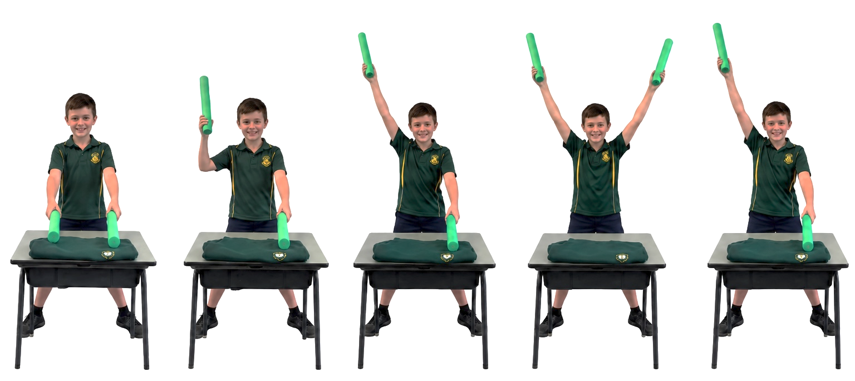
Respectful Taiko Performance
Ichi, Ni, Sore!
Suku
Doko
Don
Move
Don
1-2-3-4
1-2-3-4
1-2-3-haa!
move, move
1-2-3-saa!

Slide 20
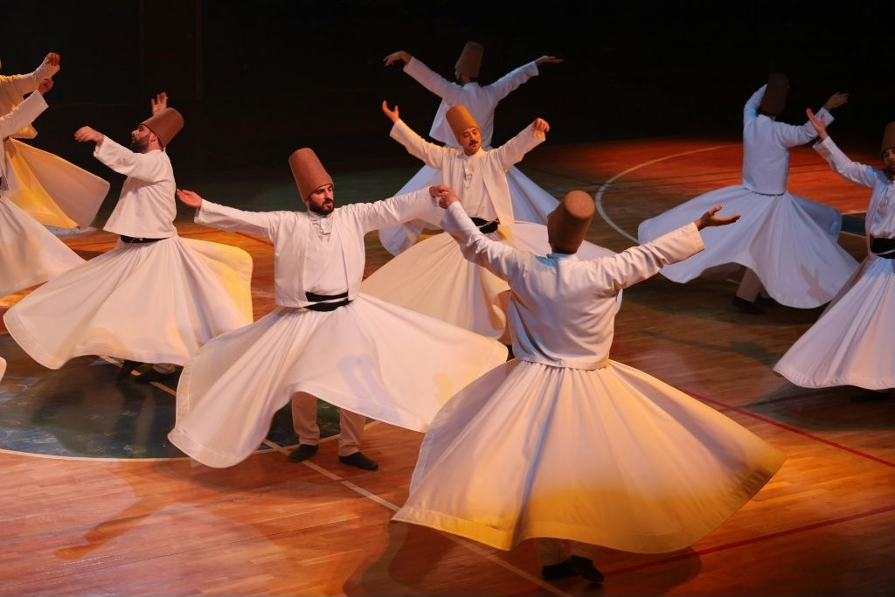
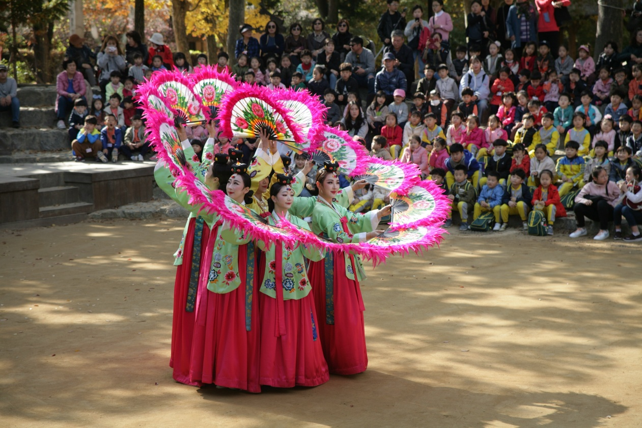
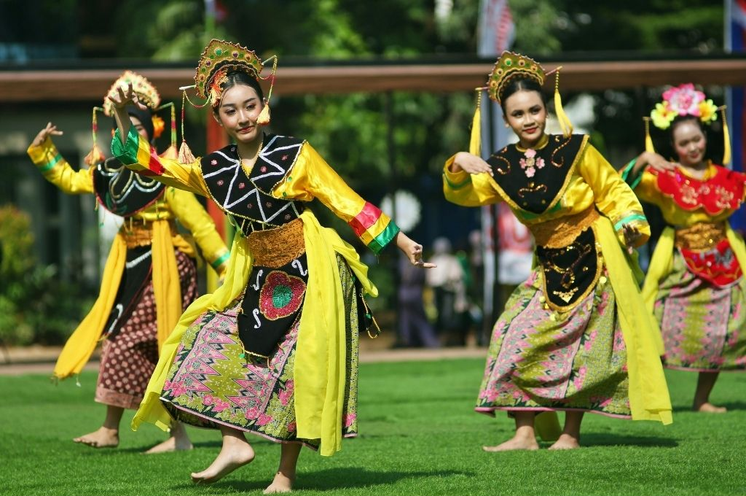
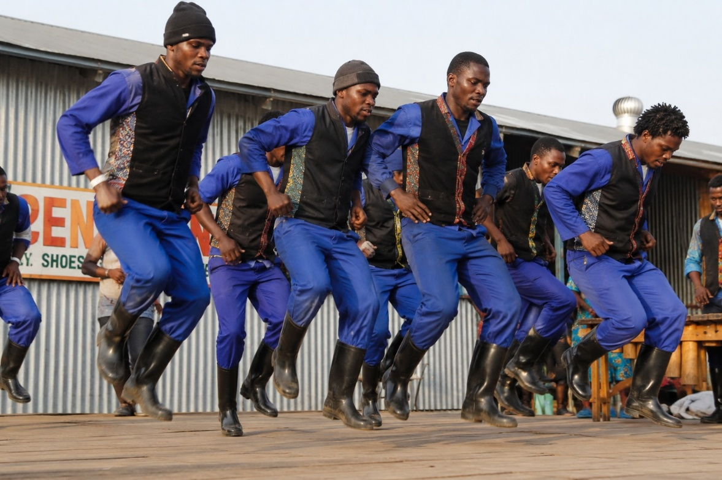

Slide 21
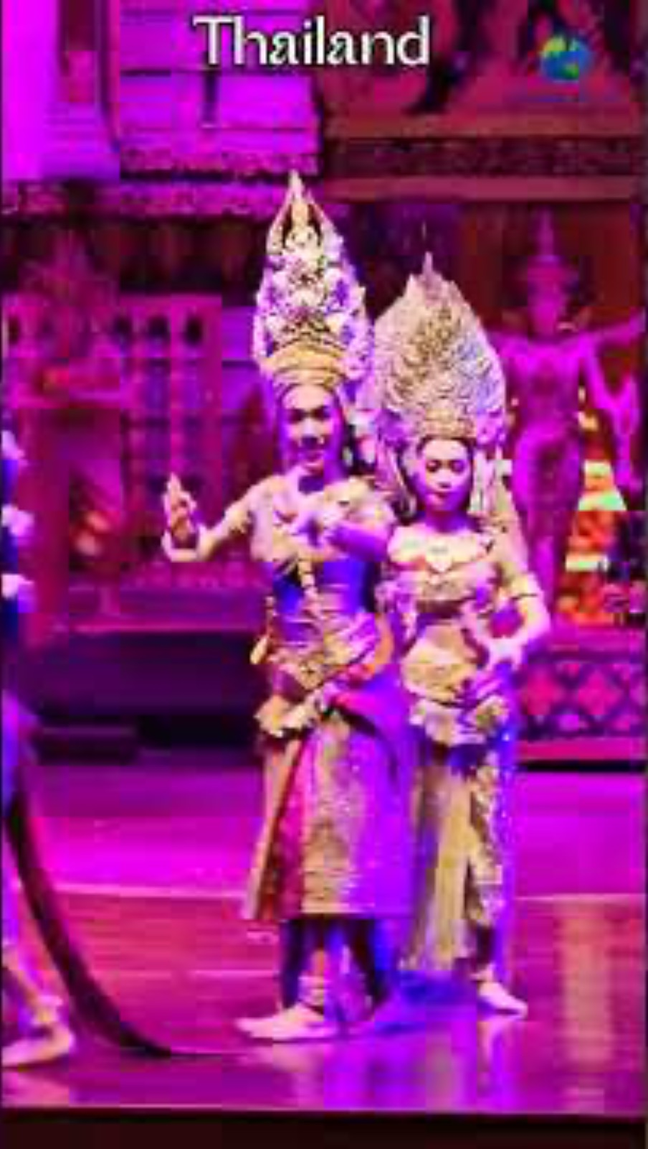
Cultural Values in Music
remember history
support each other
pray and connect spiritually
respect important people

Slide 22
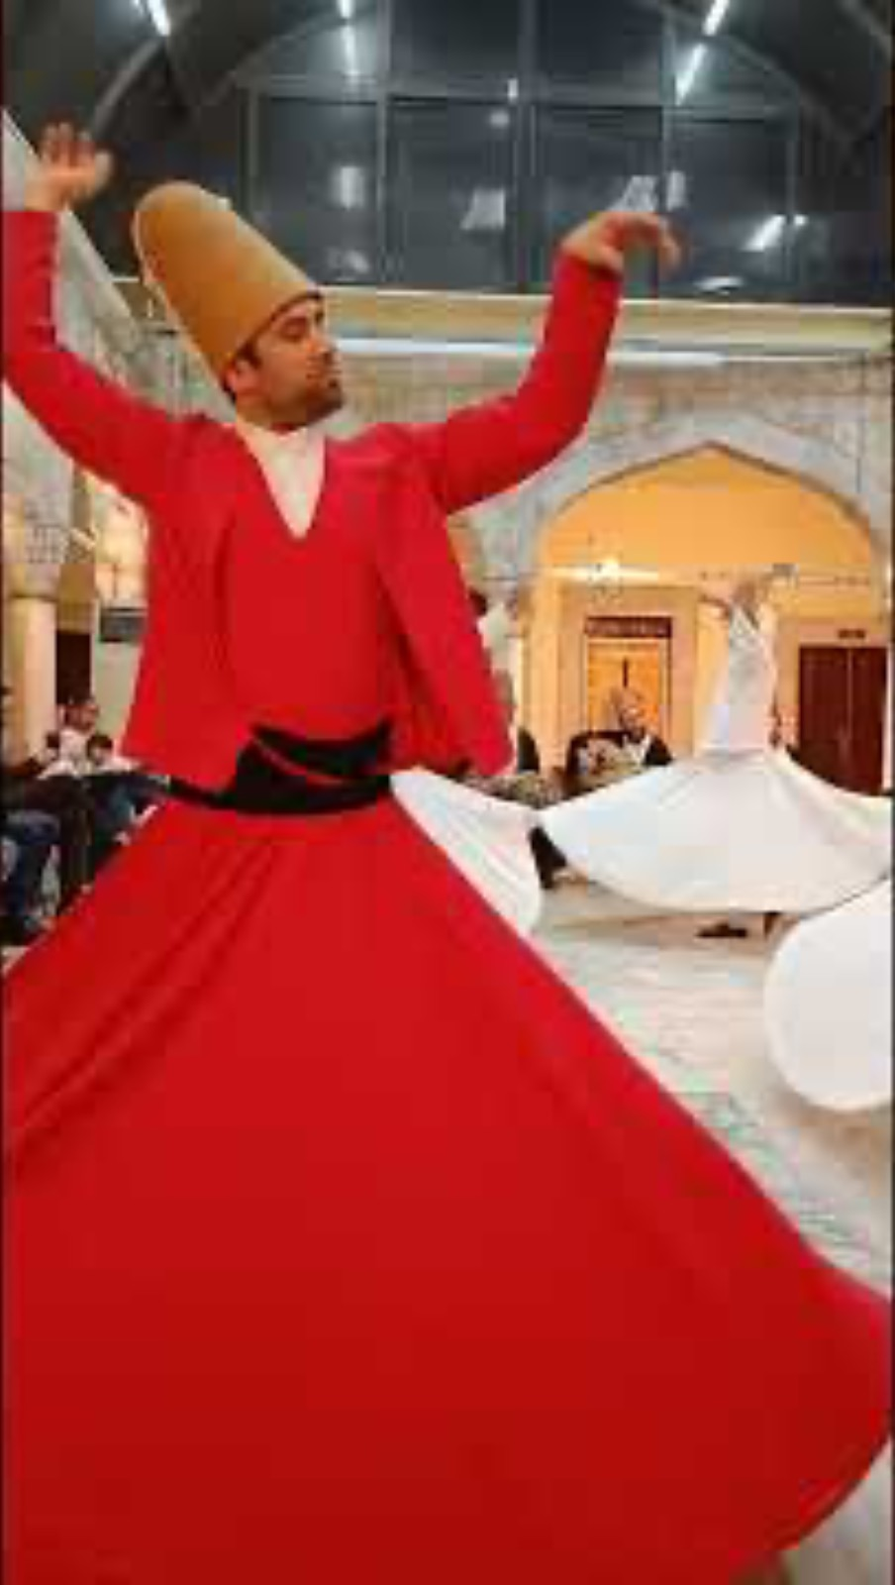
Cultural Values in Music
remember history
support each other
pray and connect spiritually
respect important people

Slide 23
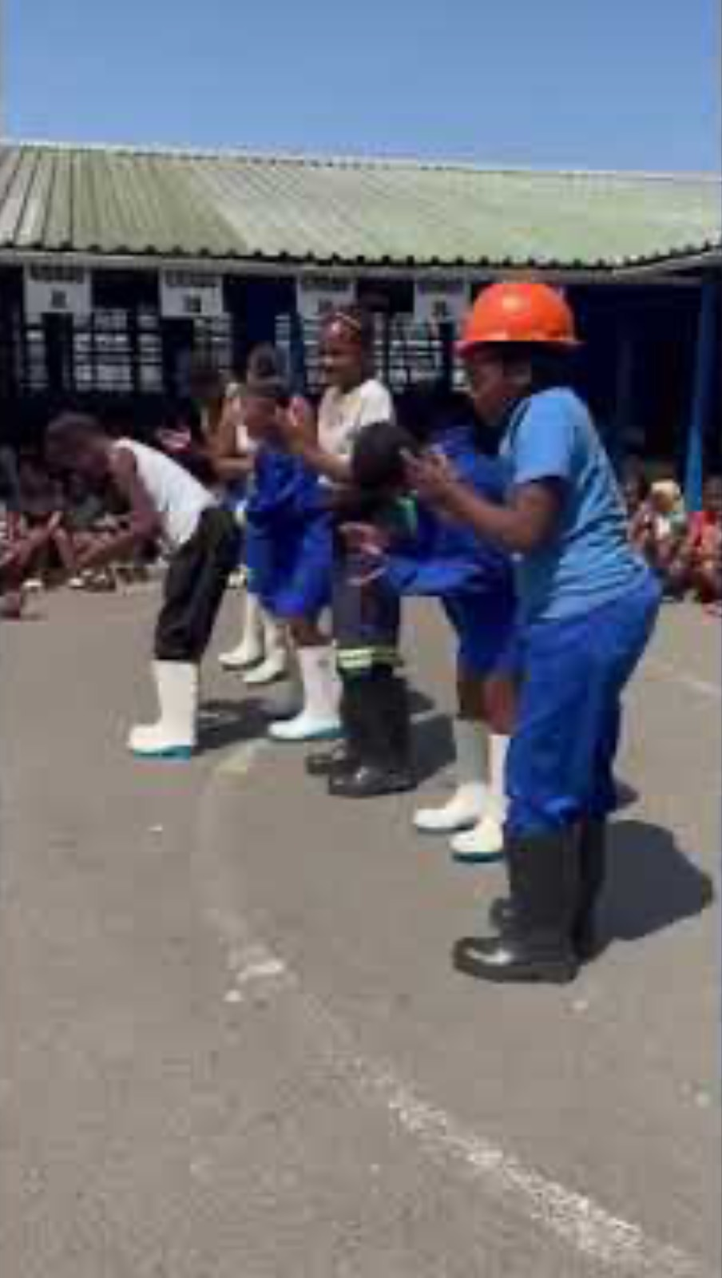
Cultural Values in Music
remember history
support each other
pray and connect spiritually
respect important people

Slide 24
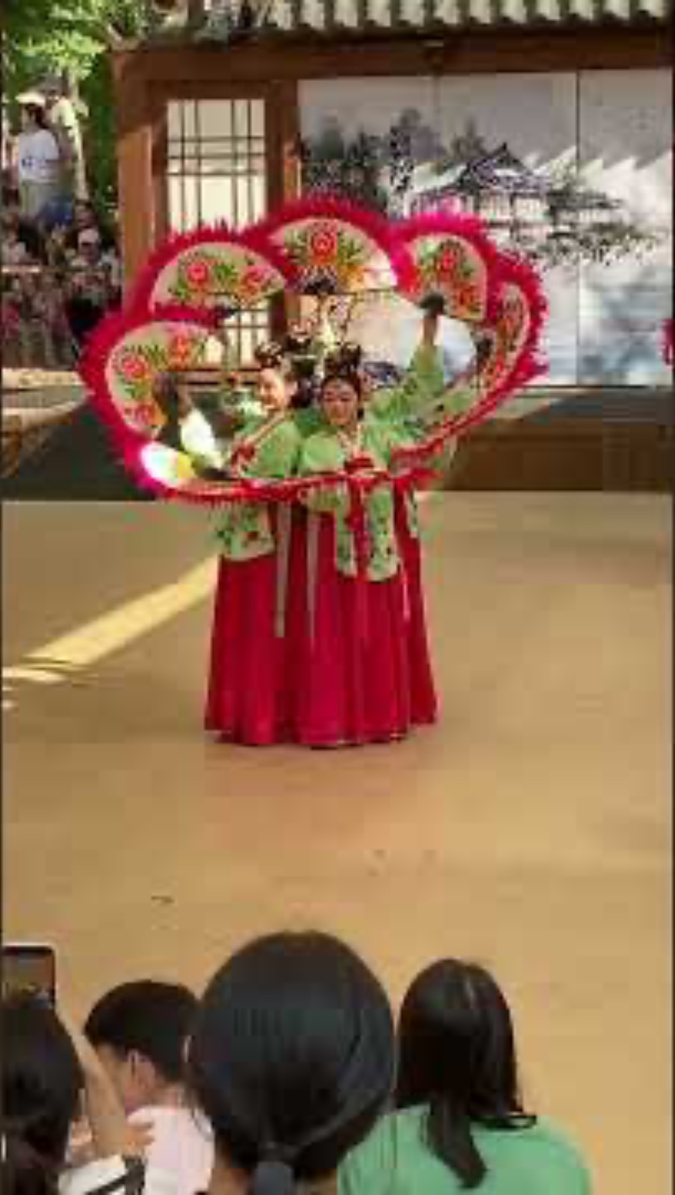
Cultural Values in Music
remember history
support each other
pray and connect spiritually
respect important people

Slide 25
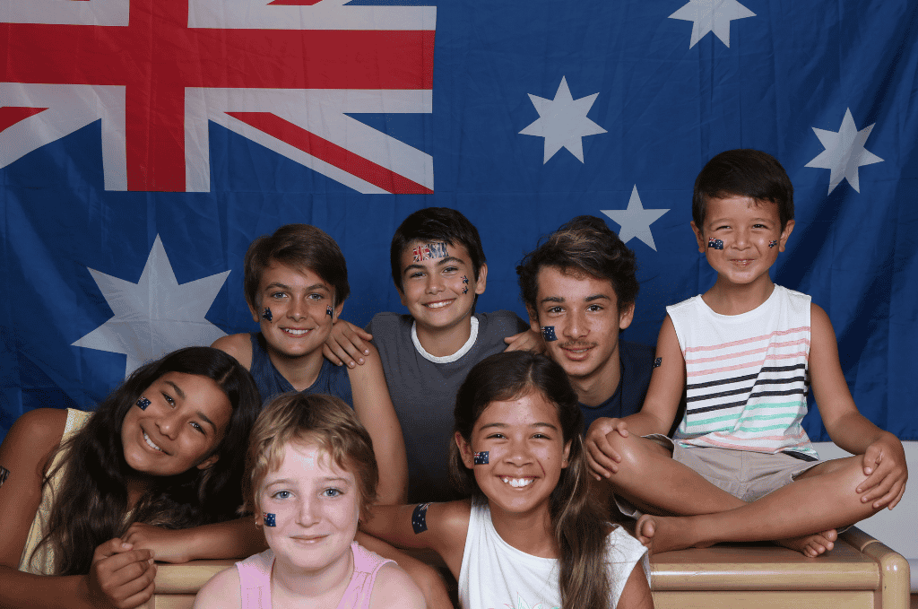
My Culture

Slide 26
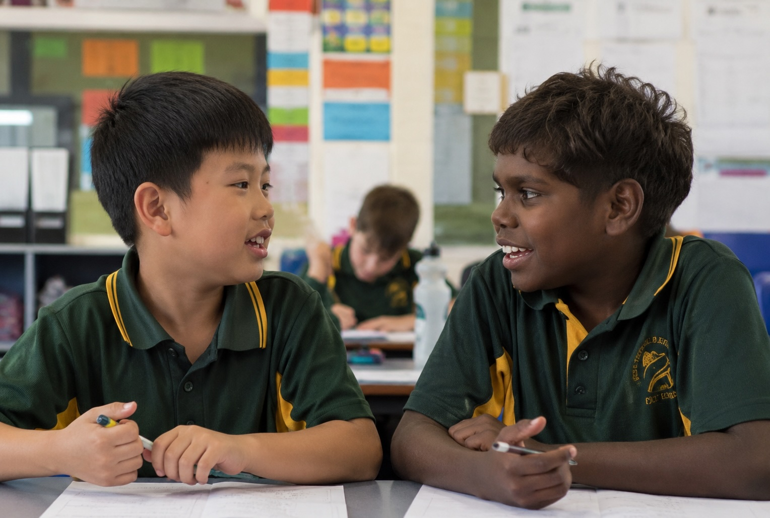
Our Cultures

Slide 27

Your Culture

Slide 28
Music can reflect cultural traditions and religious beliefs.
Some Japanese performances use careful movement, timing and precision.
Deliberate movement can help
communicate respect, focus and care.
Different cultures can use music and
movement to show the values most
important to them.

Slide 29


Exit Ticket
Date: _________
Lesson 2
Music and movement can reflect what different cultures ______.
Some Japanese music uses:
careful movement, timing and precision
many small instruments
sounds of nature all around them.
Being careful and making deliberate movements helps to show the value of r_______.
value
buy
value
have
espect
3
I know _____ out of 3 answers.

Slide 30
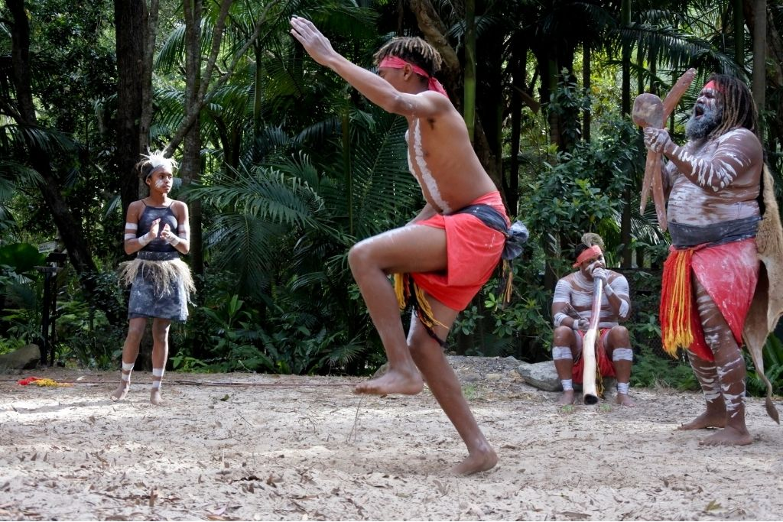
In the next lesson, we will explore how music can reflect connection to Country.

