Slide 1
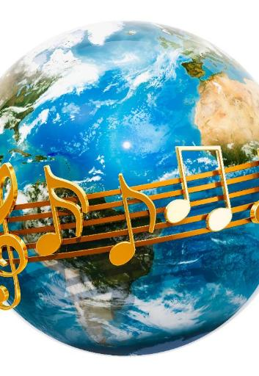
Around the World
Lesson 1
Music Around the World
Unit 2 Version 3

Slide 2
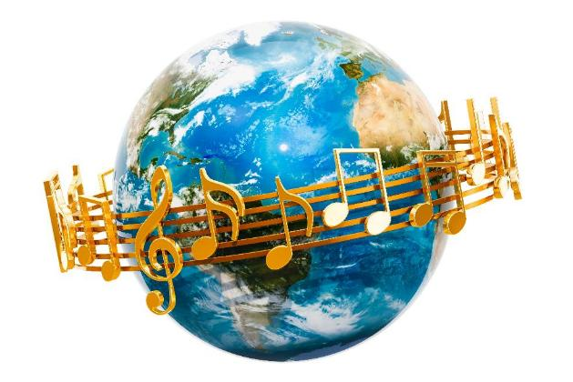
In this lesson, we will listen to music from around the world.

Slide 3
You will be able to: ​
music from different places
and cultures
to music from different
cultures
musical instruments with the
play they come from.
hear
Hear means to notice sounds using your ears.
move
Move means to change your body position.
Match means to find things that are the same or alike.
match

Slide 4
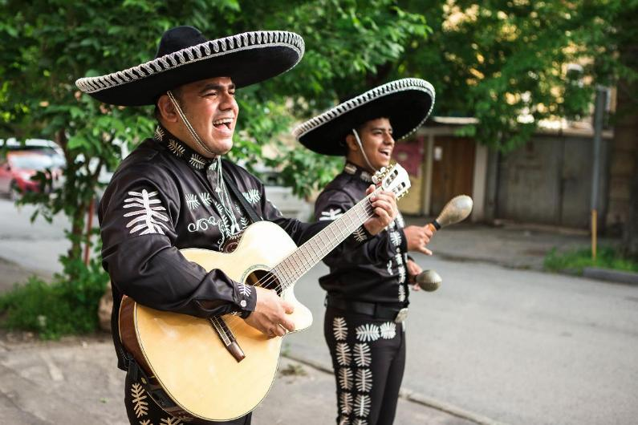
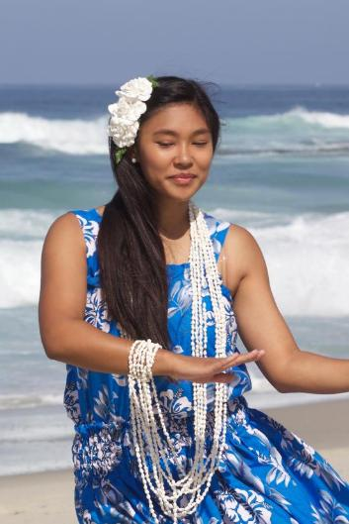
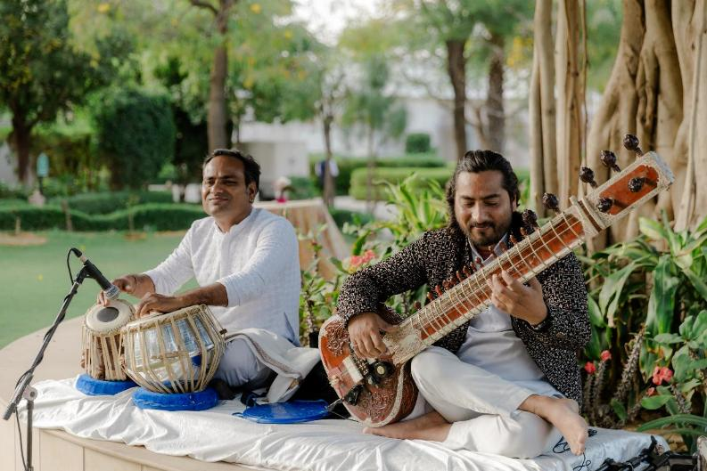
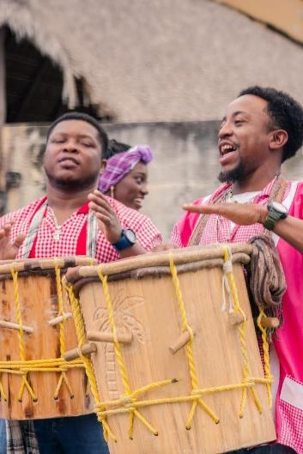
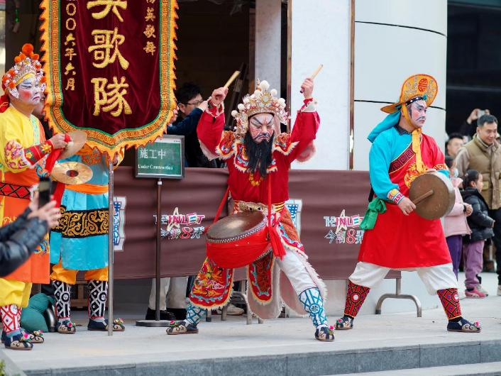

Slide 5
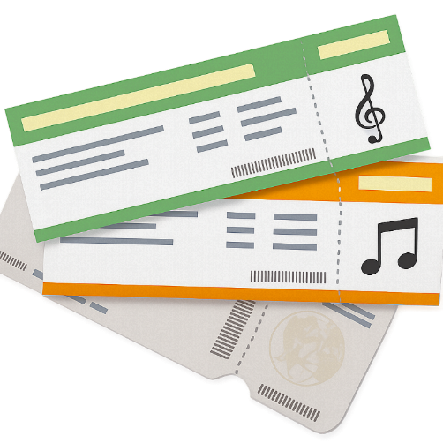



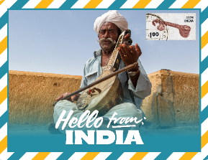



Slide 6


First Name
________________
Last Name
________________
Birthday
________________
Chris
I am from
________________
Willis
Australia
September 3

Slide 7
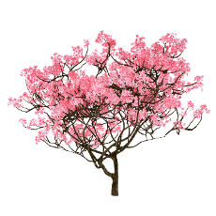



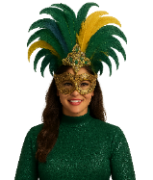

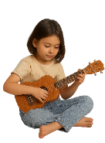
India
Japan
Hawaii
Ghana
Brazil

Slide 8
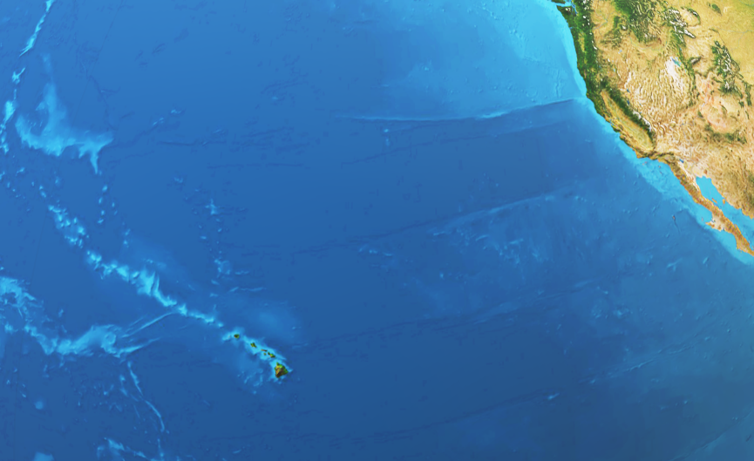
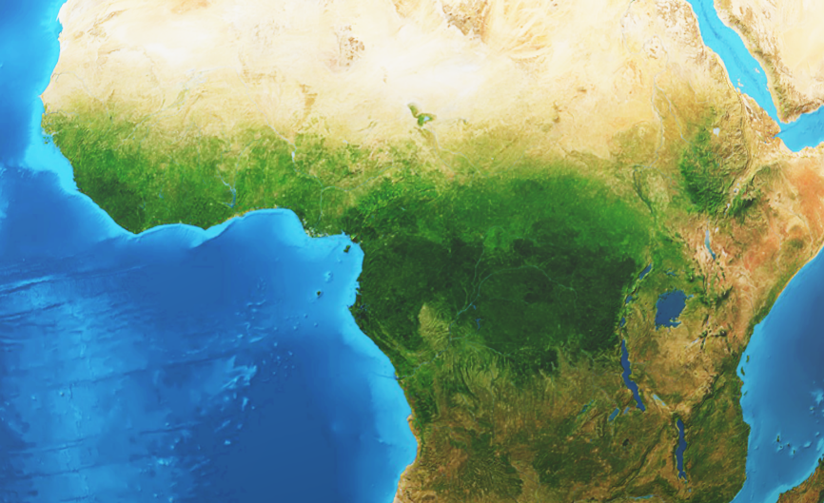
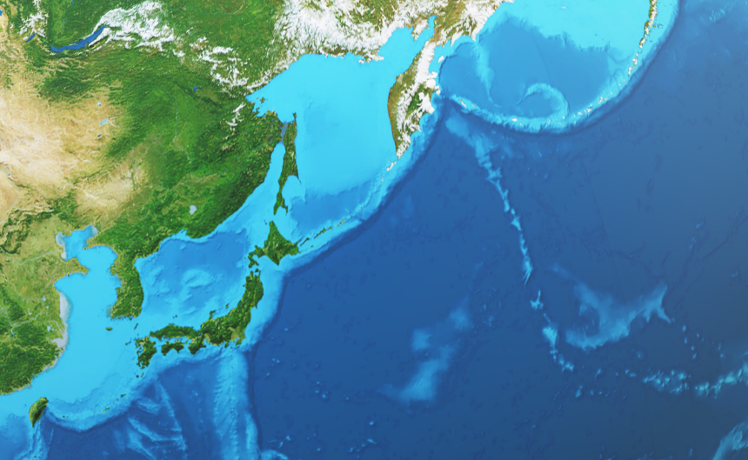
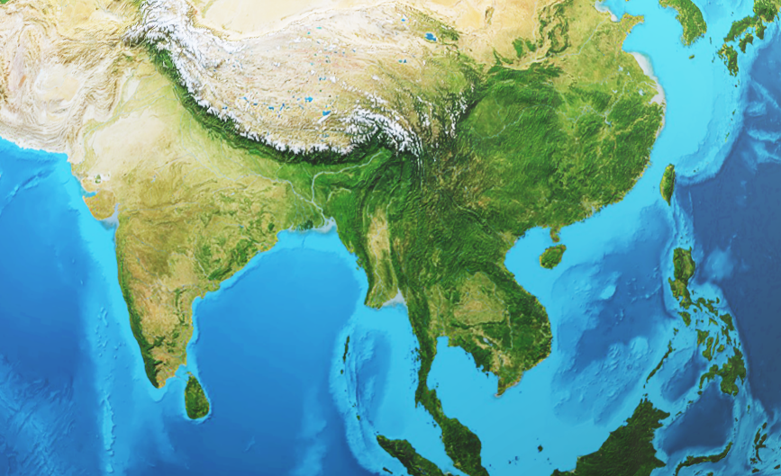


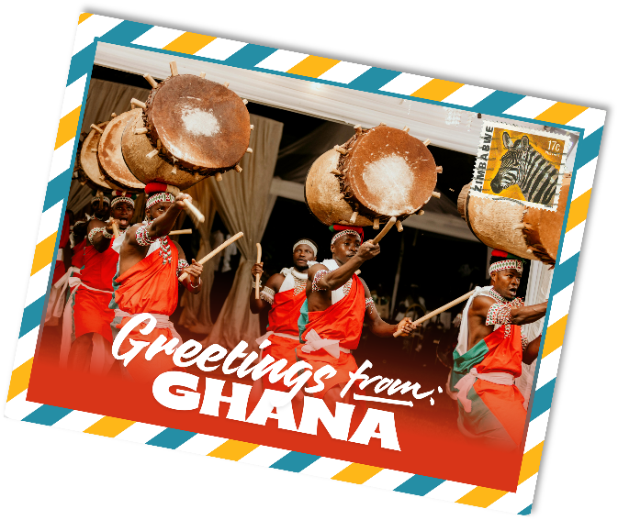

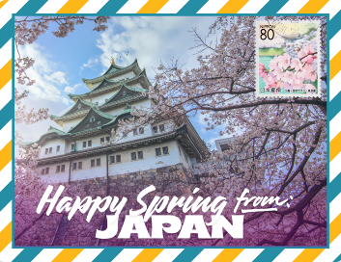
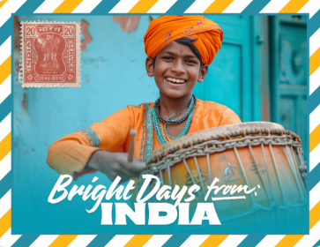
Around the World
Ghana
Japan
India
Hawaii

Slide 9

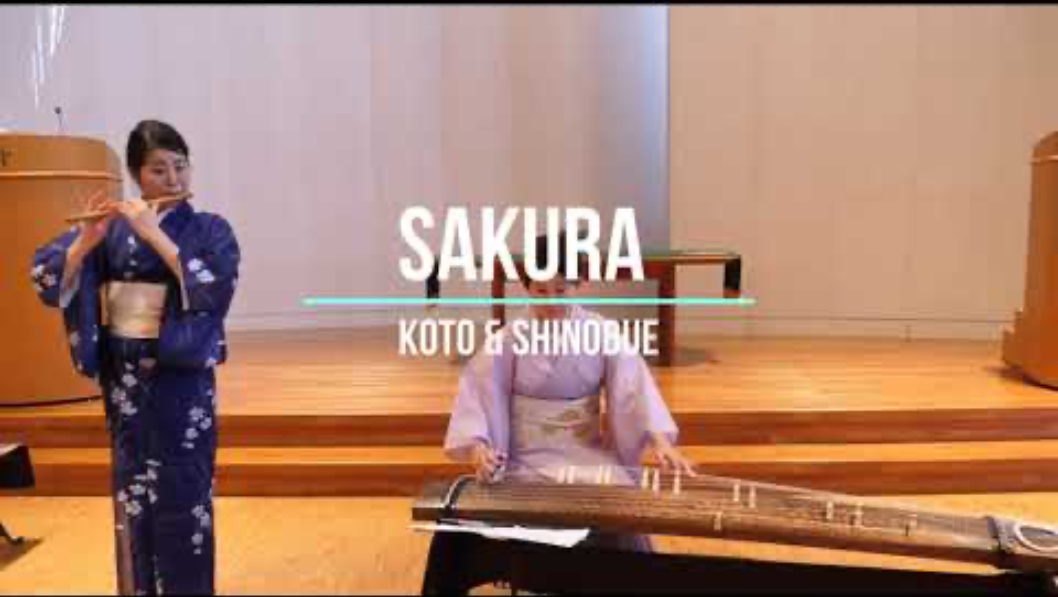
The Dreaming
Music from Japan
All
Images
News
Videos
More
Japanese Instruments
Insert Video Here
Music from Japan
Play
Videos may be subject to copyright

Slide 10
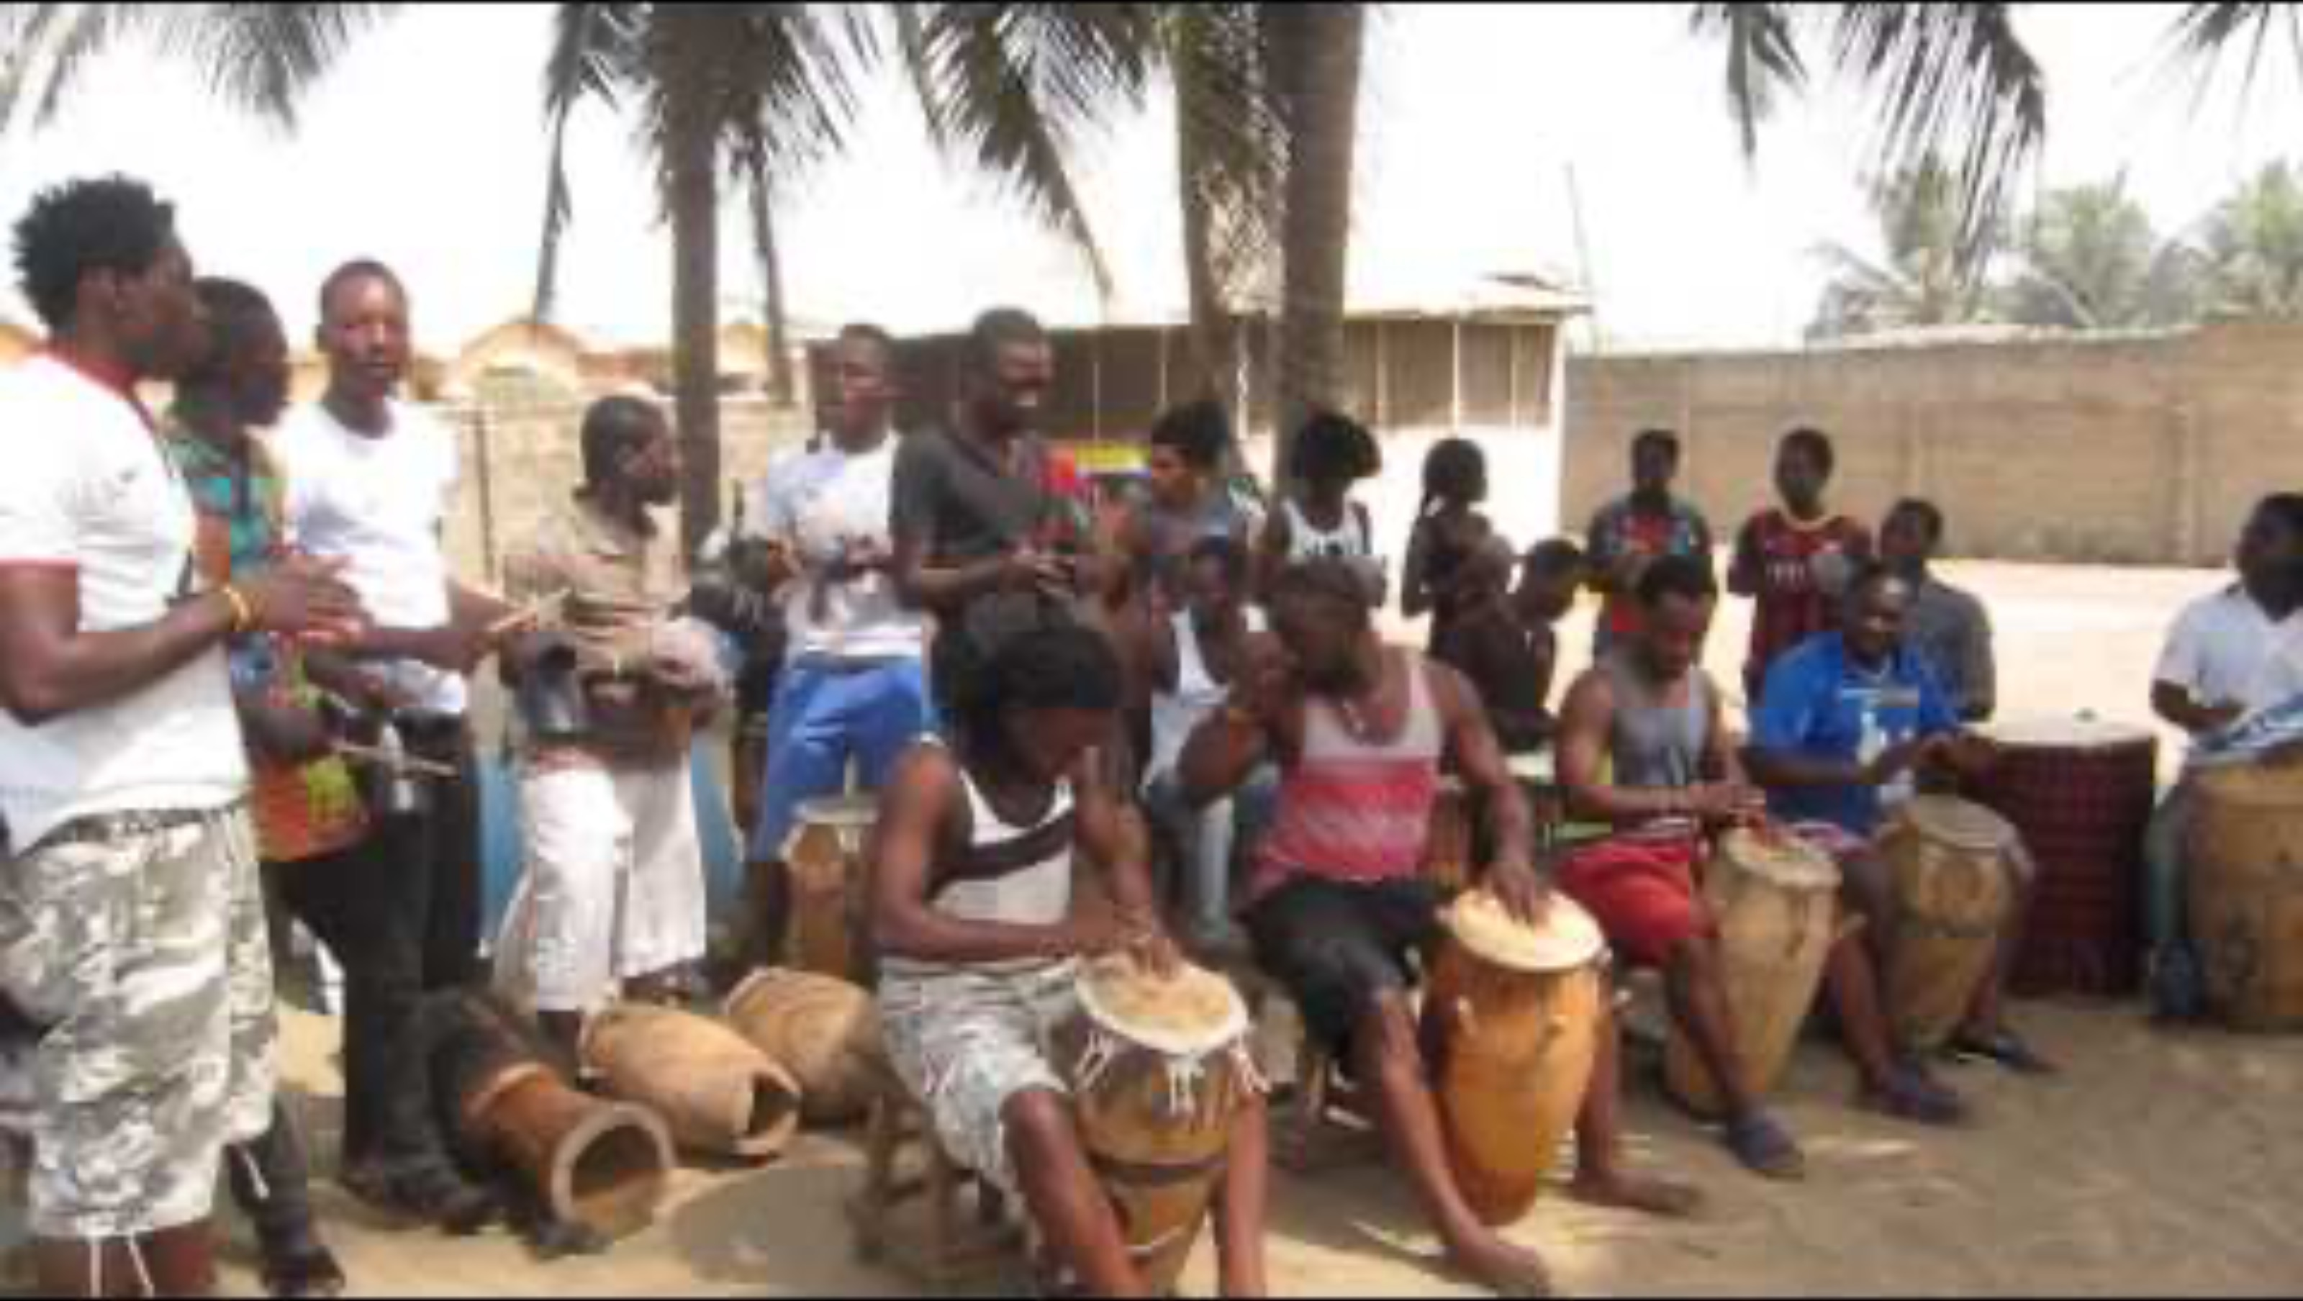
The Dreaming
Music from Ghana
All
Images
News
Videos
More
About the Djembe
Insert Video Here
Music from Africa
Play
Videos may be subject to copyright

Slide 11
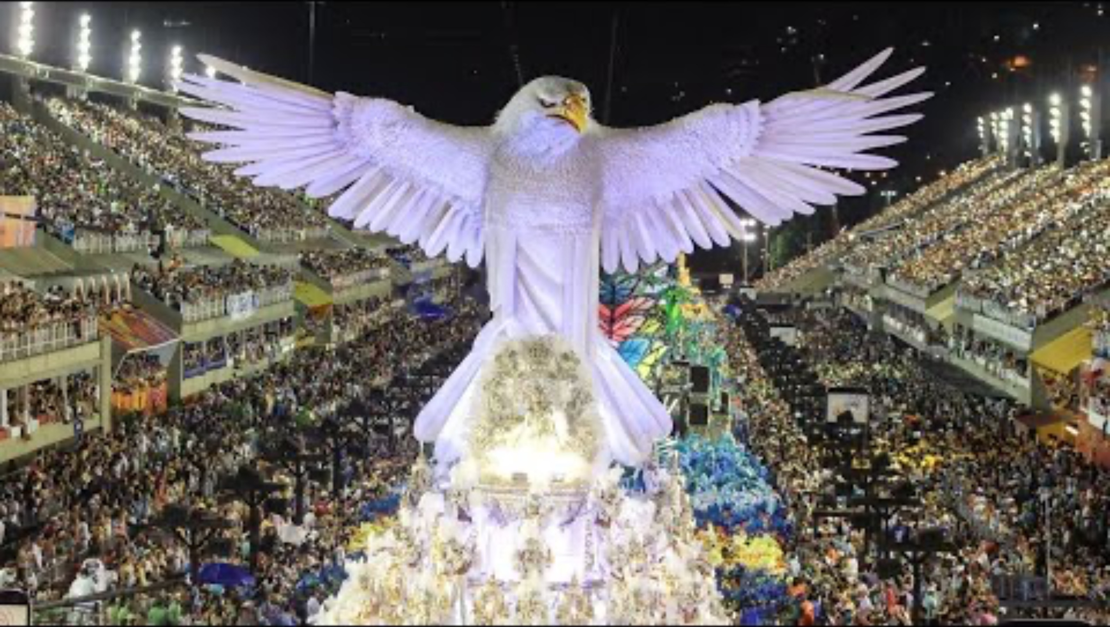
The Dreaming
Music from Brazil
All
Images
News
Videos
More
Brazilian Carnival Drums
Insert Video Here
Music from Brazil
Play
Videos may be subject to copyright

Slide 12

The Dreaming
Music from Hawaii
All
Images
News
Videos
More
Hawaiian Ukulele
Insert Video Here
Music from Hawaii
Play
Videos may be subject to copyright

Slide 13

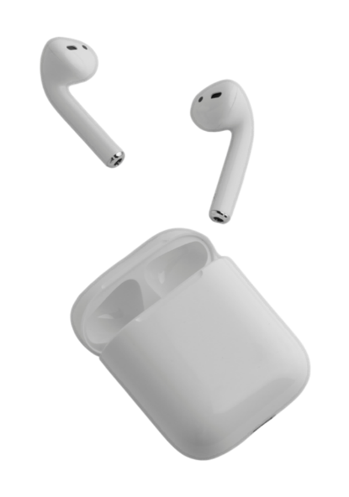


Japan
Hawaii
Ghana

Slide 14
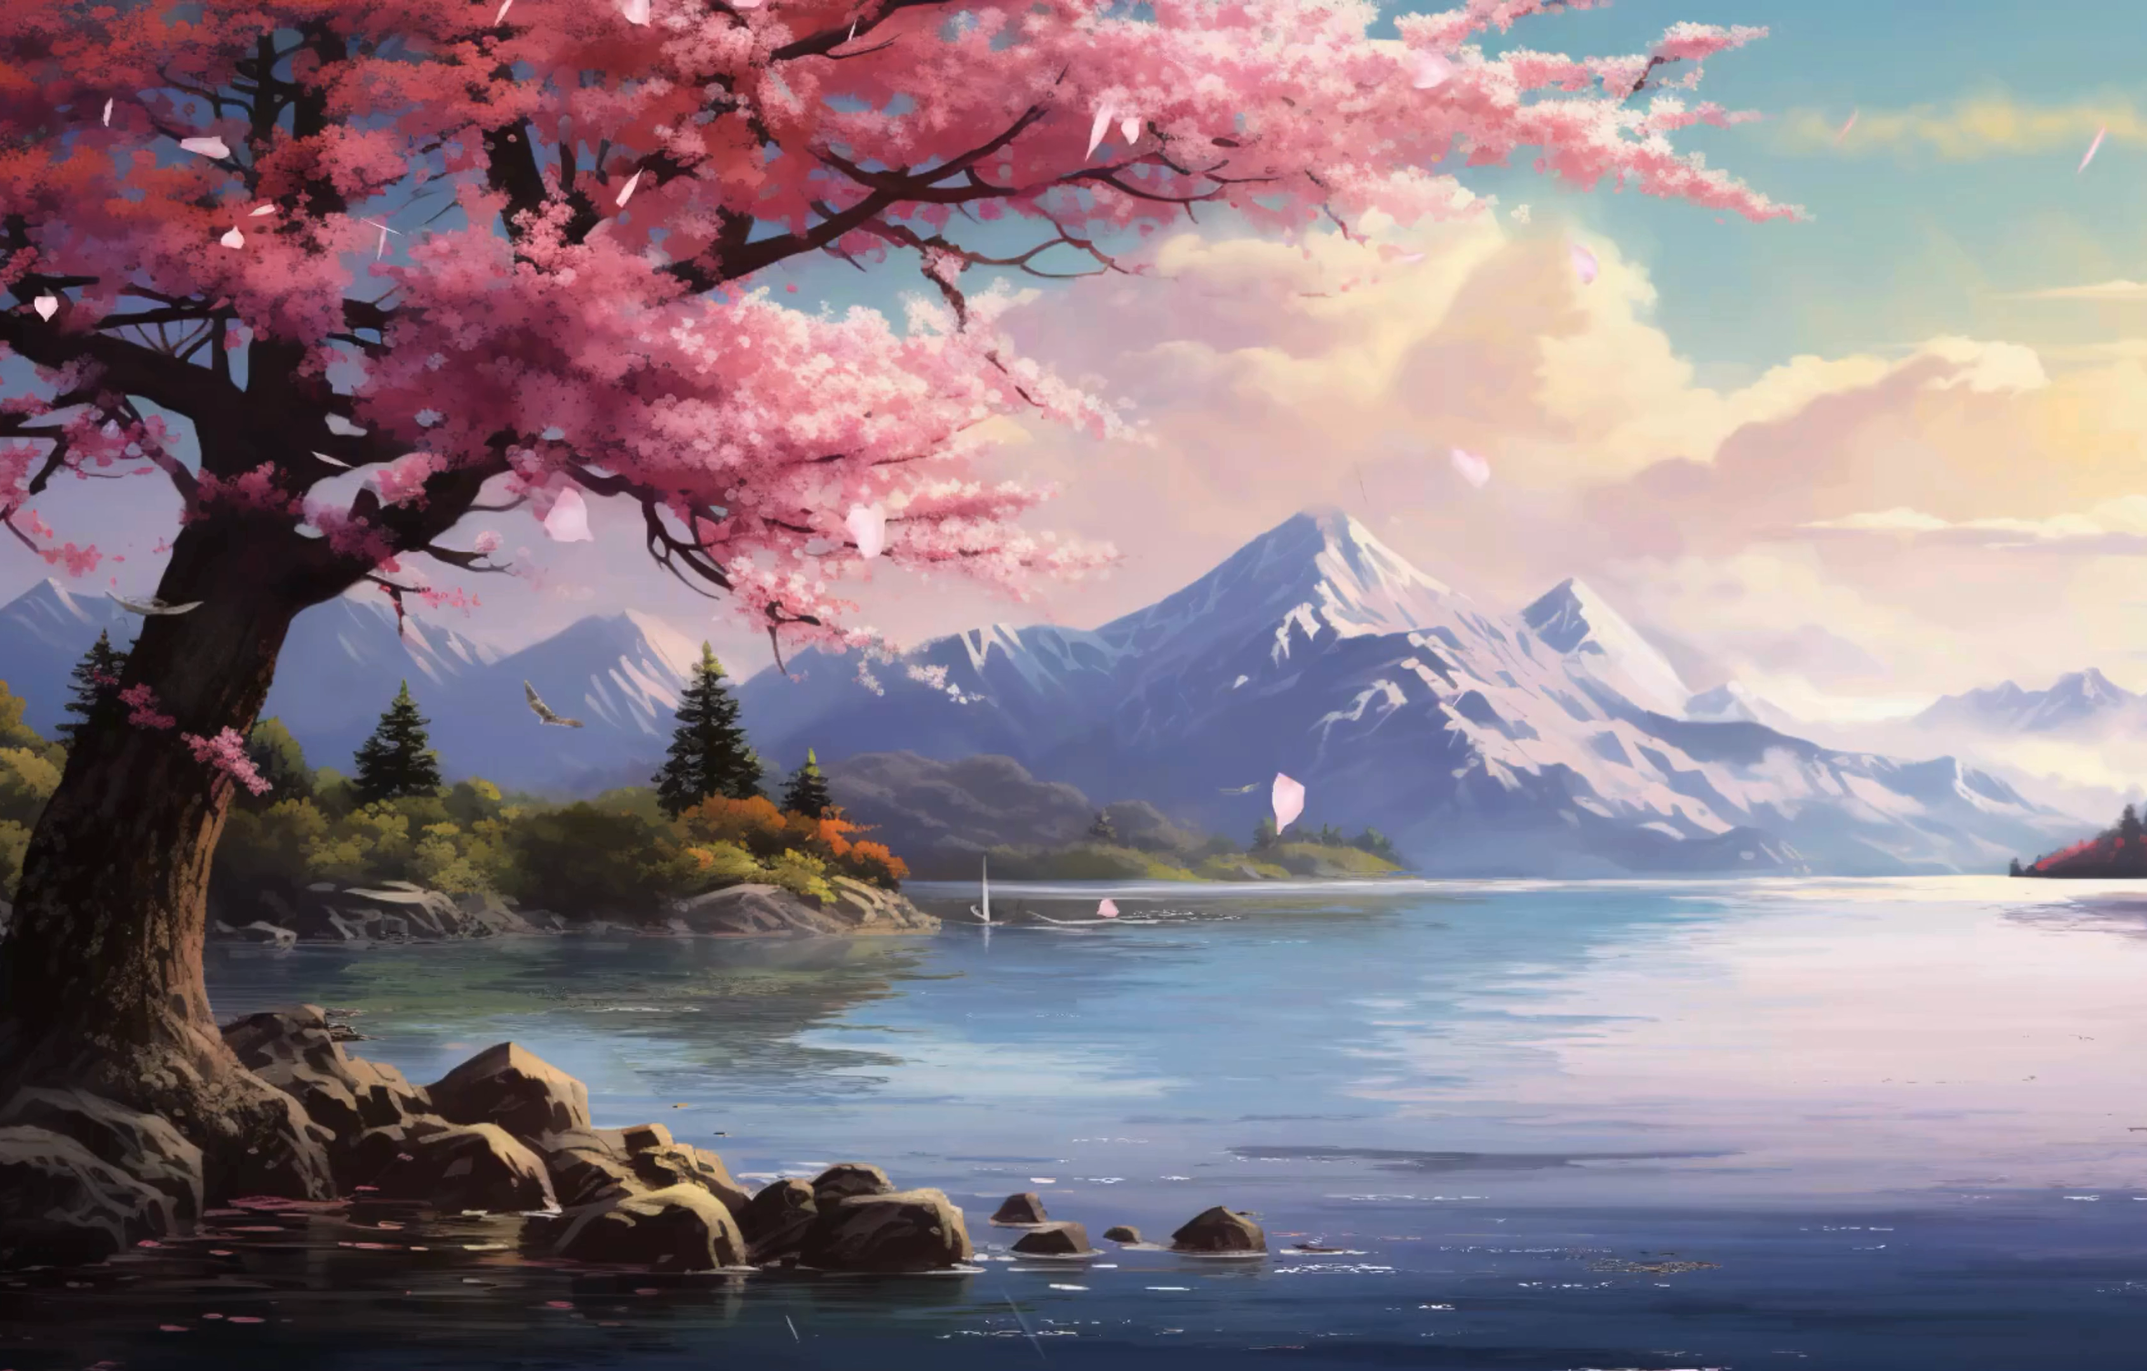
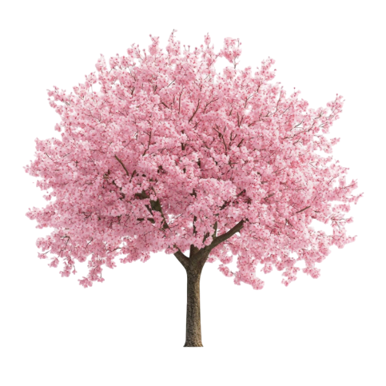

Moving to Music from Japan

Slide 15
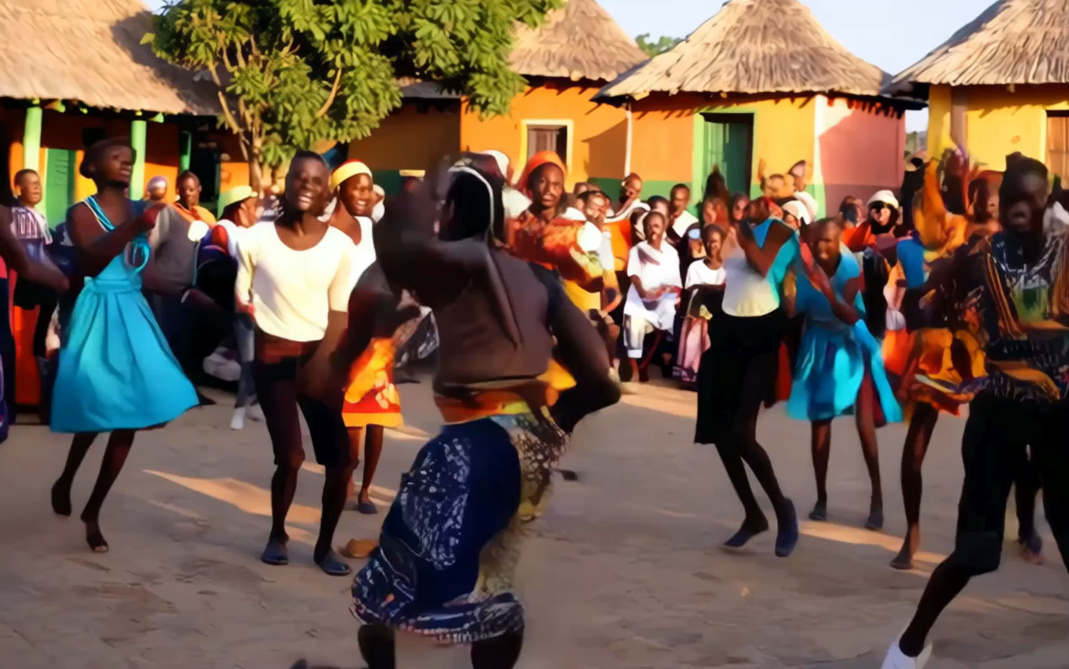
Moving to Music from Ghana

Slide 16
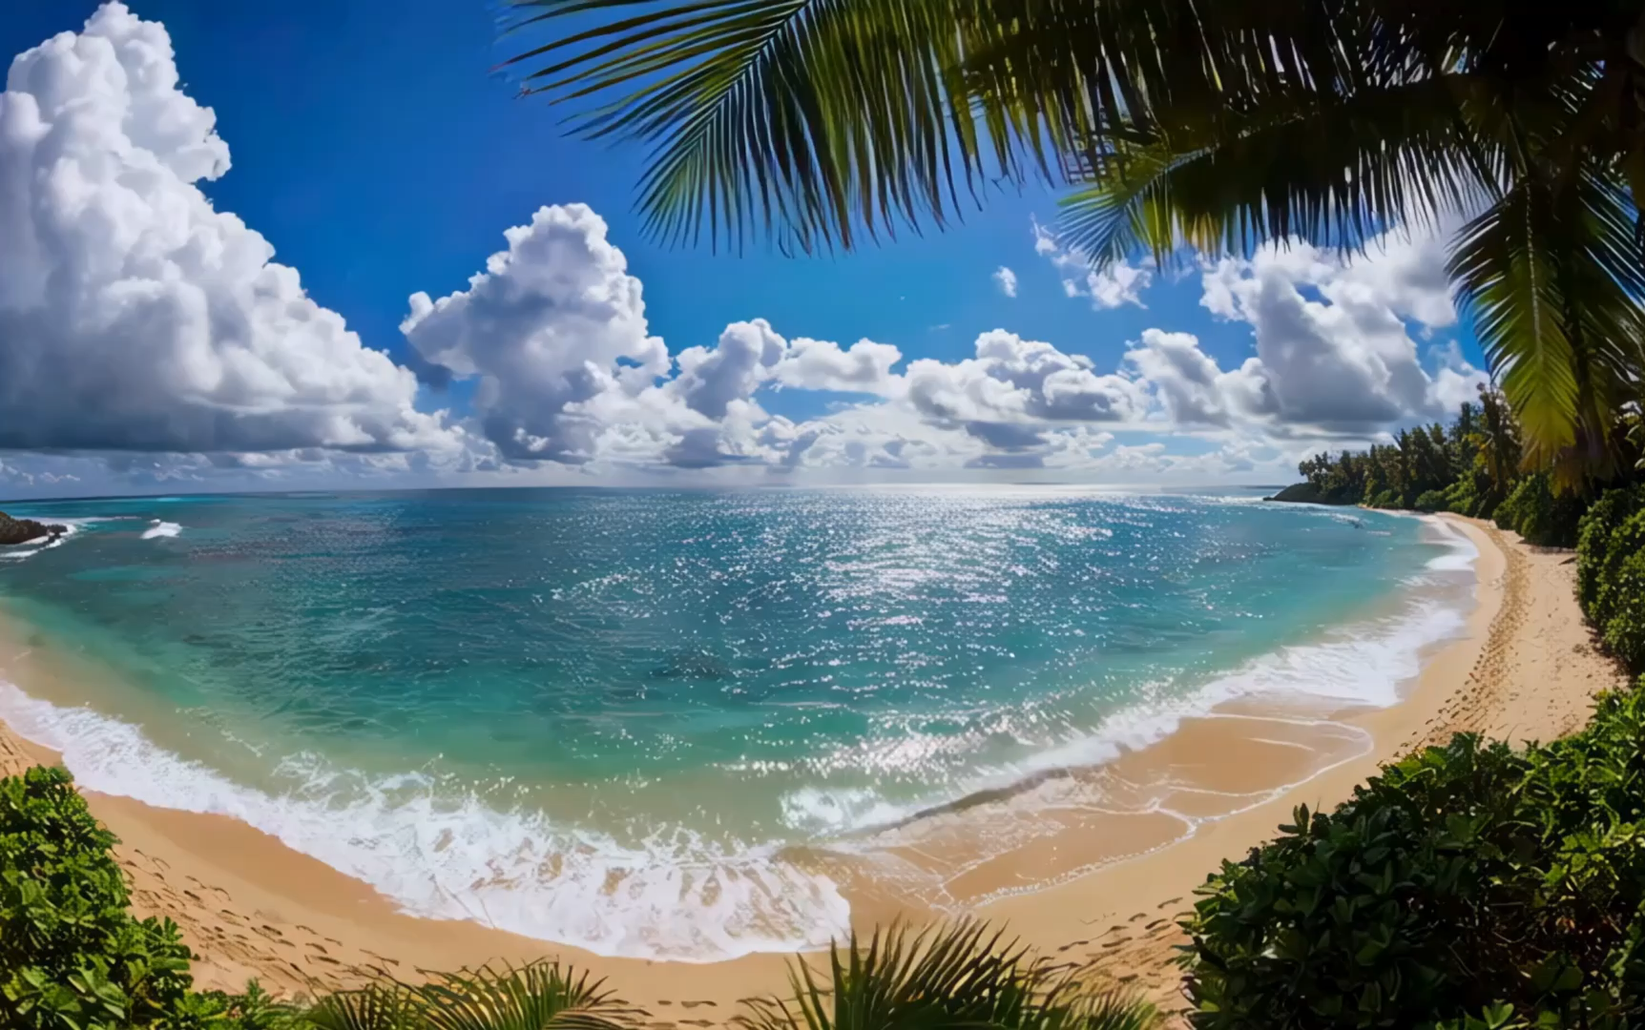
Moving to Music from Hawaii

Slide 17
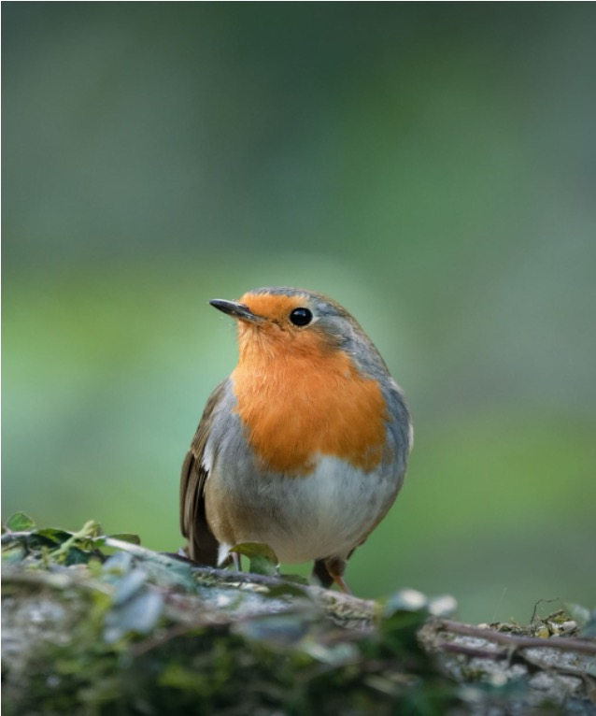
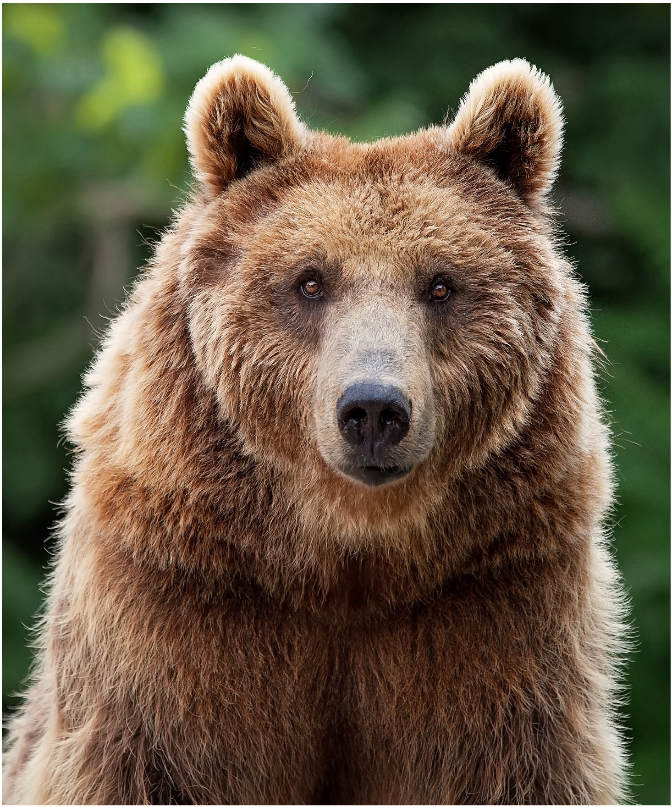
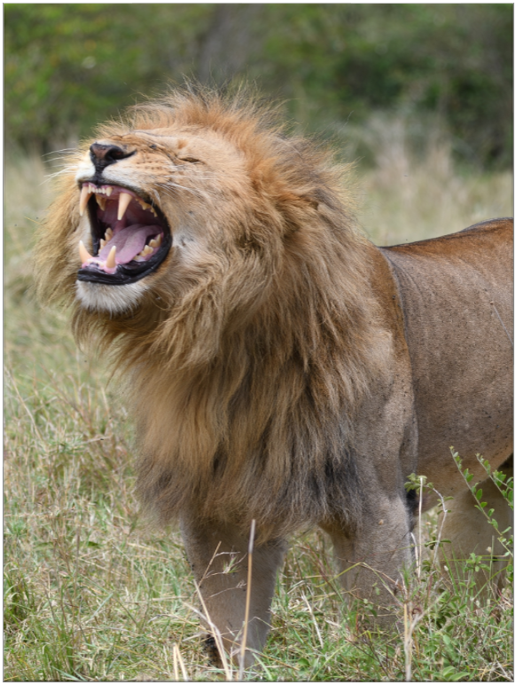
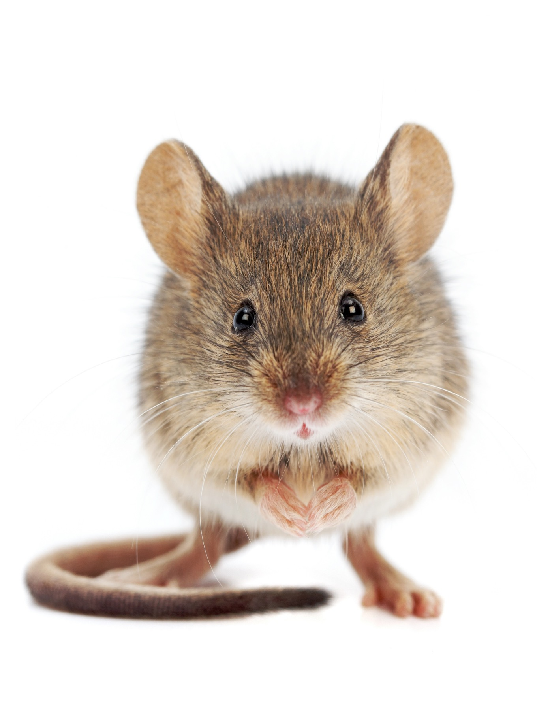

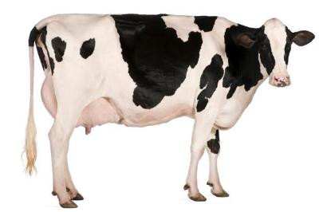


Music Is Made Up of Different Sounds

Slide 18
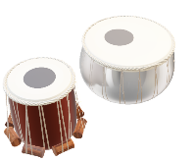
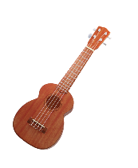
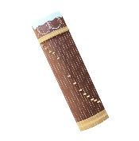

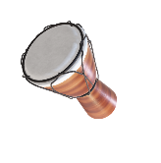
India
Tabla
Japan
Koto
Ghana
Djembe
Hawaii
Ukulele
Brazil
Shakers

Slide 19

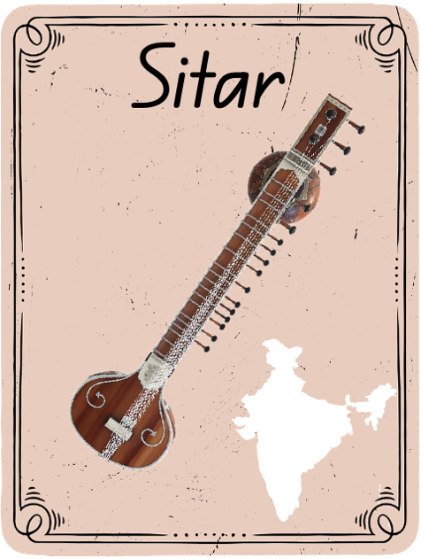
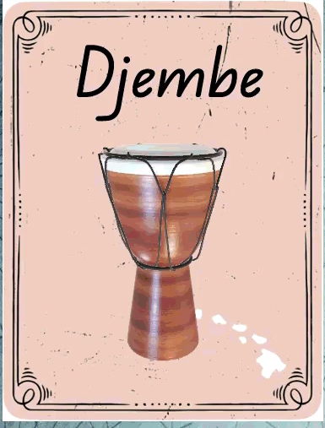
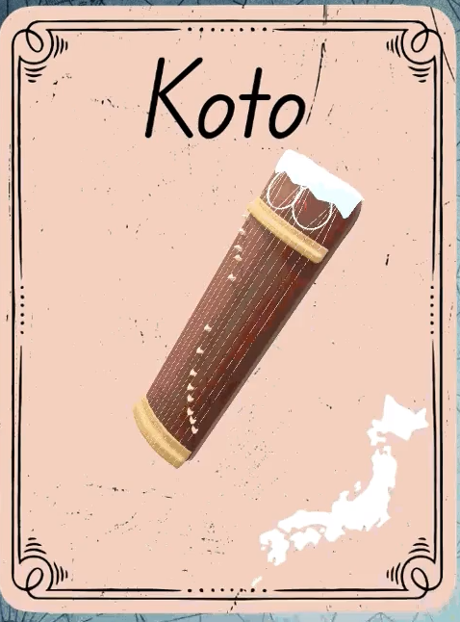
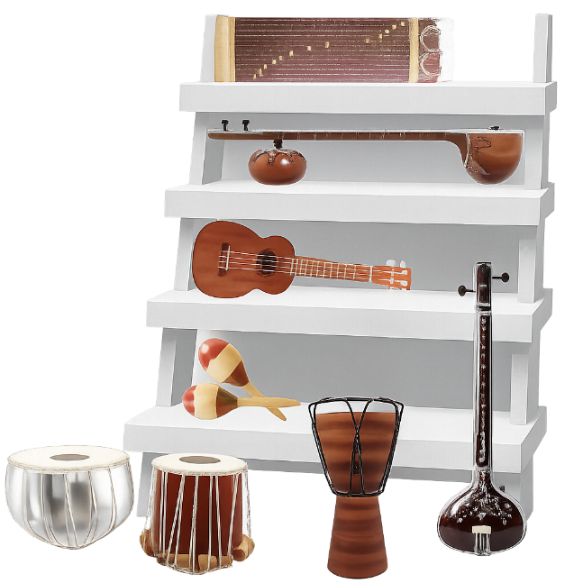


Slide 20
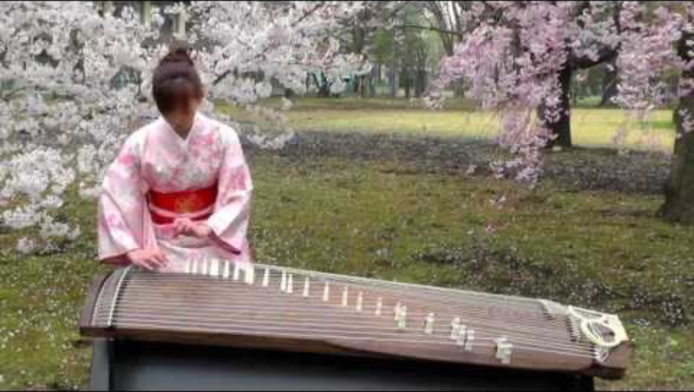
Koto (Japan)

Slide 21
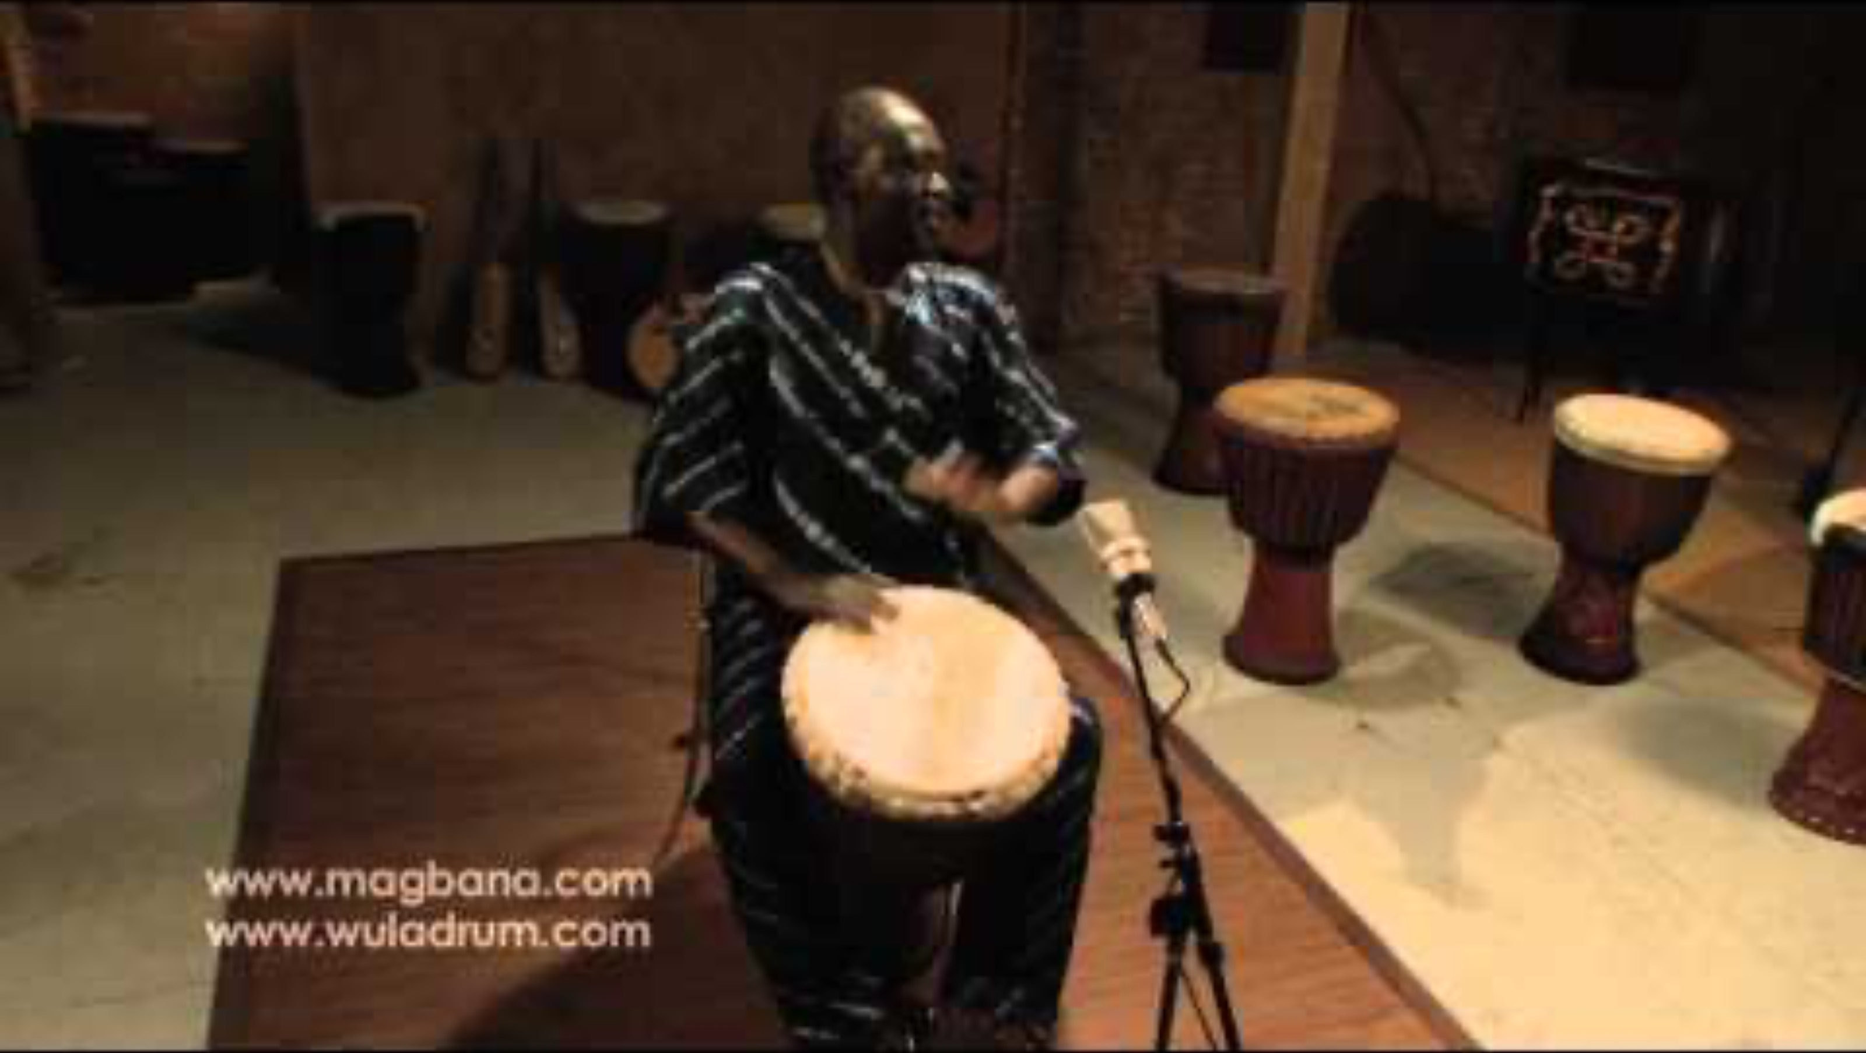
Djembe (Ghana)

Slide 22
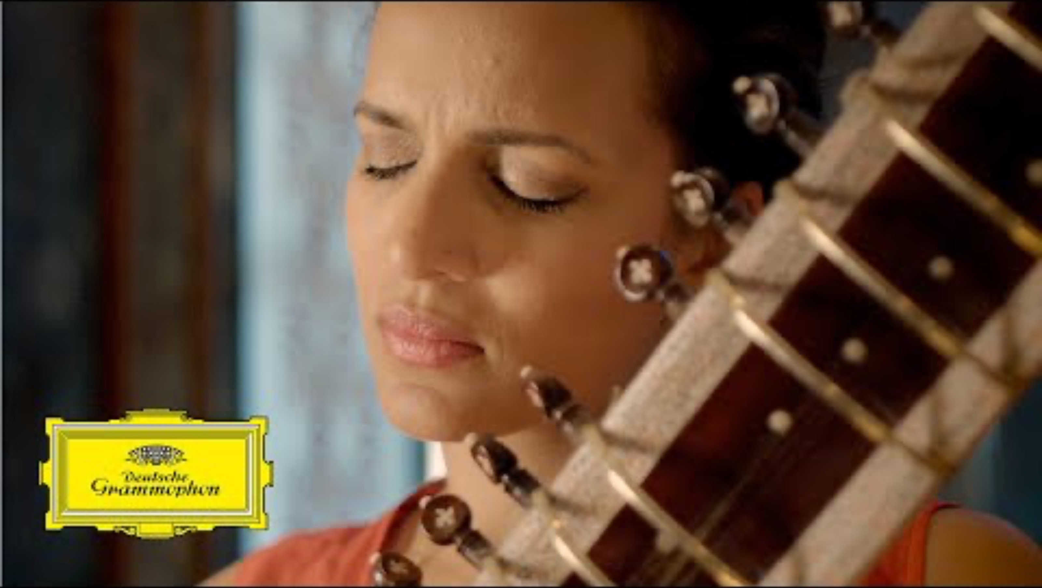
Sitar (India)

Slide 23
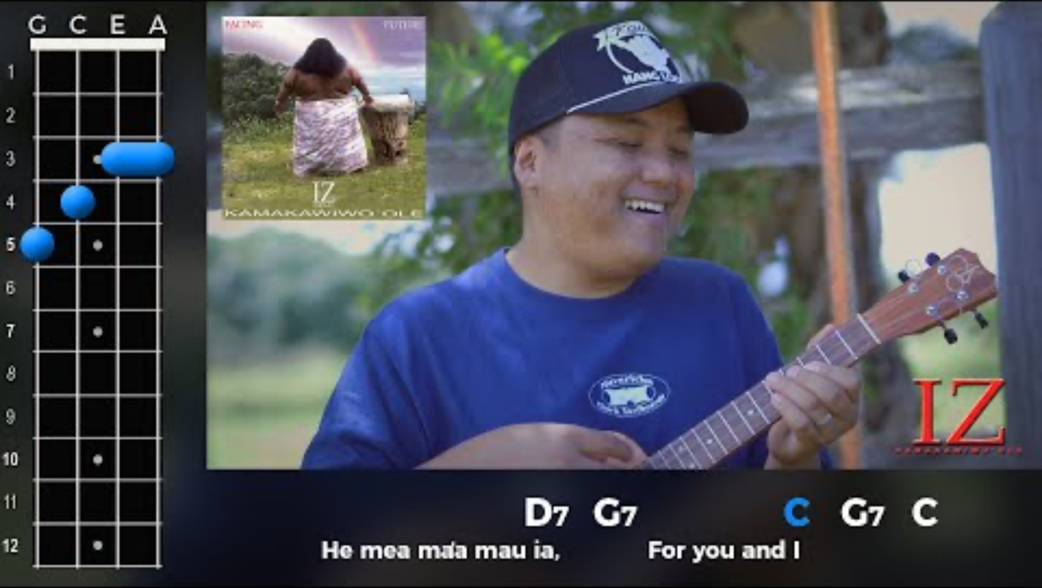
Ukulele (Hawaii)

Slide 24




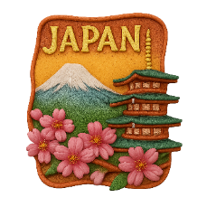
Souvenir Matching

Slide 25





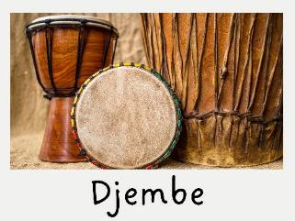
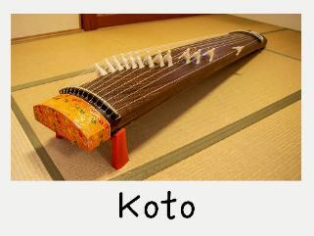

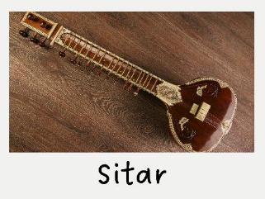
Souvenir Matching

Slide 26





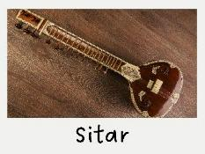

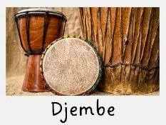

Souvenir Magnet Matching

Slide 27









Souvenir Matching

Slide 28
Music sounds different in places and cultures around the world.
People around the world use different instruments to make music.

Slide 29





Exit Ticket
Date: _________
Lesson 1A
Lesson 1
different
Music sounds __________ in places and cultures around the world.
People around the world:
  play instruments like koto and sitar to make music
  gather to sing and play together
  make music about the cherry blossom
  all of the above.
Instruments from around the ______ make different sounds.
the same
happy
different
world
3
I know _____ out of 3 answers.

Slide 30

In the next lesson, we will explore music from India.

Slide 31
Slide 20, 3D Module, Ukelele (https://skfb.ly/ouVtF) by Lucia Criscuolo is licensed under Creative Commons Attribution (http://creativecommons.org/licenses/by/4.0/).
Alide 20, 3D Module, Tabla (Bayan) (https://skfb.ly/oNAWR) by 868nabeel is licensed under Creative Commons Attribution (http://creativecommons.org/licenses/by/4.0/).
Slide 20, 3D Module, Koto (https://skfb.ly/6Zn98) by Thanasis Ioranidis is licensed under Creative Commons Attribution (http://creativecommons.org/licenses/by/4.0/).
Slide 20, 3D Module, Sitar (https://skfb.ly/KNVL) by Kai Jolly is licensed under Creative Commons Attribution (http://creativecommons.org/licenses/by/4.0/).

